Slide 1
Muon Accelerators: R&D Towards Future Neutrino Factory &
Lepton Collider Capabilities
Mark Palmer
Director, US Muon Accelerator Program
May 8, 2015

Slide 2
Muon Accelerators for HEP
μ – an elementary charged lepton:
  200 times heavier than the electron
  2.2 μs lifetime at rest
Physics potential for the HEP community using muon beams
  Tests of Lepton Flavor Violation
  Anomalous magnetic moment a hints of new physics (g-2)
  Can provide equal fractions of electron
  and muon neutrinos at high intensity for
  studies of neutrino oscillations –
  the Neutrino Factory concept
  Offers a large coupling to the “Higgs mechanism”
  As with an e⁺e⁻ collider, a μ⁺μ⁻ collider would offer a precision leptonic probe of fundamental interactions

Slide 3
Outline
Why Neutrino Factories?
Neutrino Factory Concepts
  Short baseline a νSTORM
  Long Baseline a IDS-NF and NuMAX
Going Beyond a Neutrino Factory Facility
  Possibilities for a future Muon Collider Capability
  Higgs Factory to >5 TeV
  The MAP R&D Effort
Conclusion

Slide 4
Why Neutrino Factories?

Slide 5
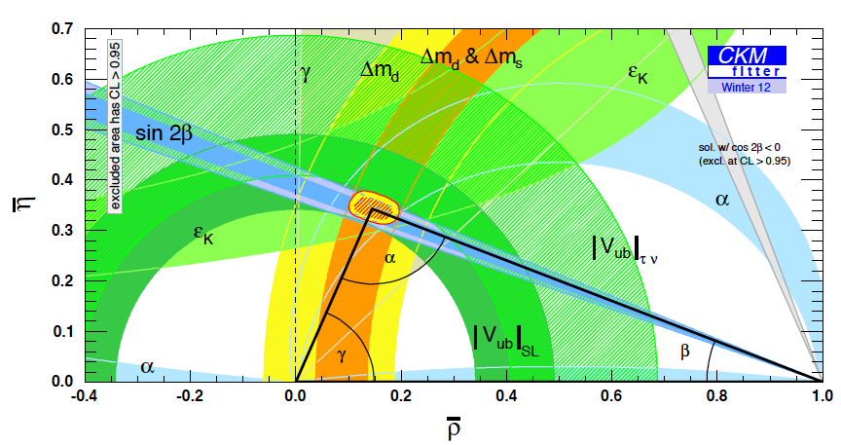
The Key Issues
What things must we understand in the neutrino sector?
  δ_{CP}: Can this be
  done with the same
  precision as the quark
  sector???
  The mass hierarchy
  The value of θ₂₃-π/4:
  +, - or zero?
  Resolve the LSND and other short baseline experimental anomalies
  And enable the search for new physics

Slide 6
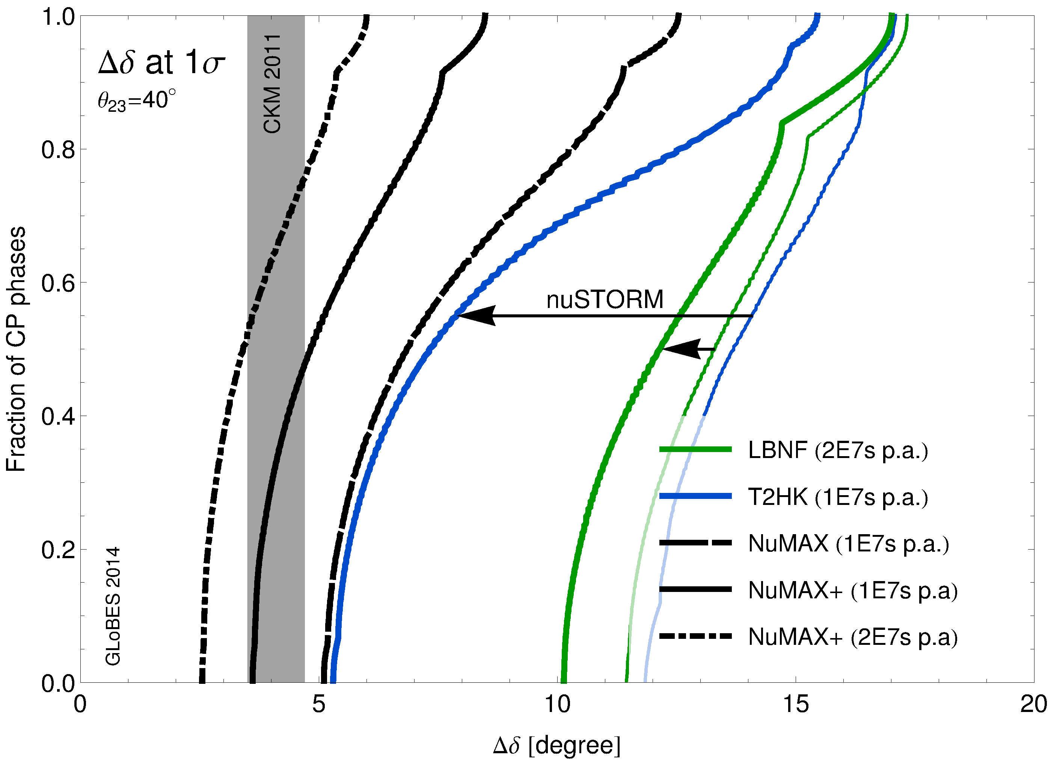
Performance Benefits from Precision ν Sources
GLoBES Comparison of Potential
Performance of the Various
Advanced Concepts (courtesy P. Huber)

Slide 7
Microscopes for the ν Sector
Superbeam technology will continue to drive initial observations in the coming years
However, anomalies and new discoveries will drive our need for precision studies to develop a complete physical understanding
Neutrino Factory capabilities (both long- and short-baseline) offer a route to controlled systematics and precision measurements to fully elucidate the relevant physics principles
a Precision Microscopes for the ν sector

Slide 8
Neutrino FactorY Concepts

Slide 9
Neutrino Factory Overview
Short Baseline NF
  nuSTORM
    Definitive measurement of sterile neutrinos
    Precision ν_{e} cross-section measurements (systematics issue for long baseline SuperBeam experiments)
    Would serve as an HEP muon accelerator proving ground…
Long Baseline NF with a Magnetized Detector
  IDS-NF (International Design Study for a Neutrino Factory)
    10 GeV muon storage ring optimized for 1500-2500km baselines
    “Generic” design (ie, not site-specific)
  NuMAX (Neutrinos from a Muon Accelerator CompleX)
    Site-specific: FNAL a SURF (1300km baseline)
    4-6 GeV beam energy optimized for CP studies
      Flexibility to allow for other operating energies
    Can provide an ongoing short baseline measurement option
    Detector options
      Magnetized LAr is the goal
      Magnetized iron provides equivalent CP sensitivities using ~3x the mass

Slide 10
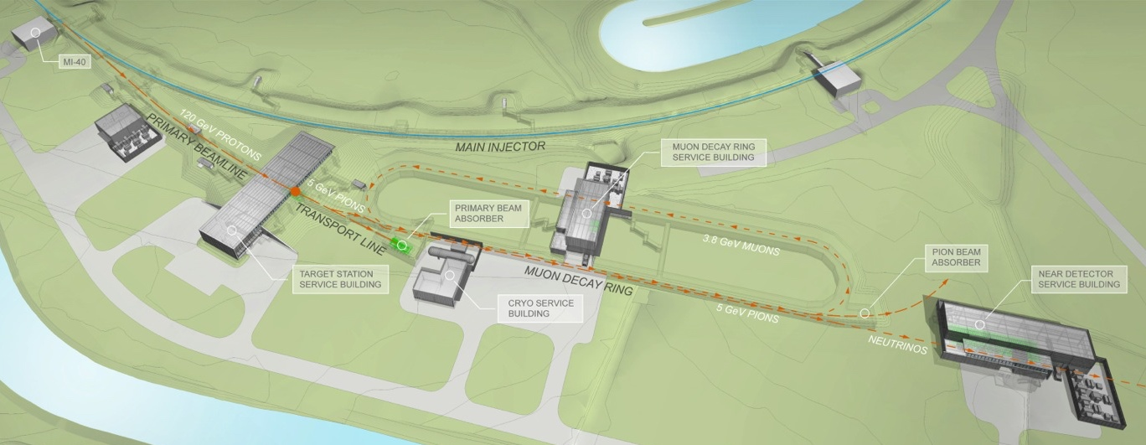
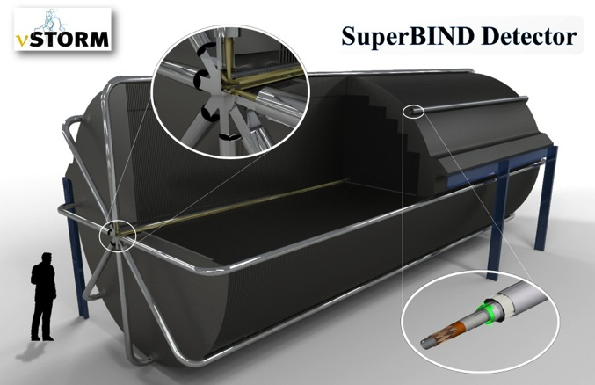
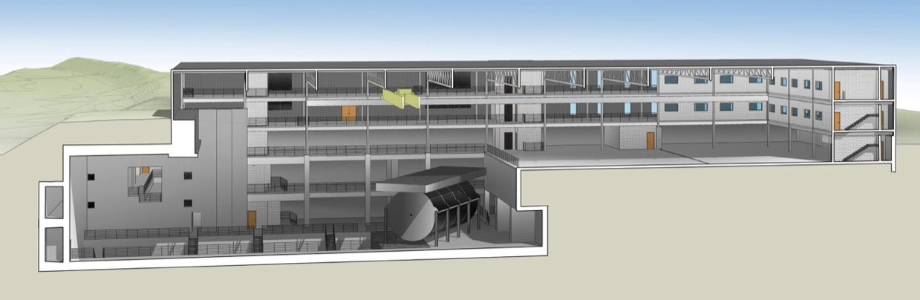
νSTORM
μ decay ring: P = 3.8 GeV/c ± 10%
  No new technologies required!
  Could be deployed now!
To Far
Hall
Near Hall
Far Hall @1.9km
Far Detector

Slide 11
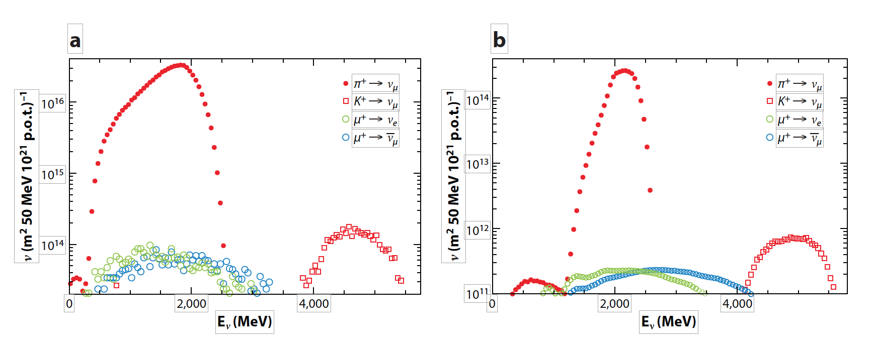
ν Beams at nuSTORM π⁺ ➔ μ⁺ + ν_{μ}
ν beams from π⁺ decay at nuSTORM
  a: at 50 m from end of production straight
  b: at 2000 m
Flavor pure with flux known to better than 1%

Slide 12
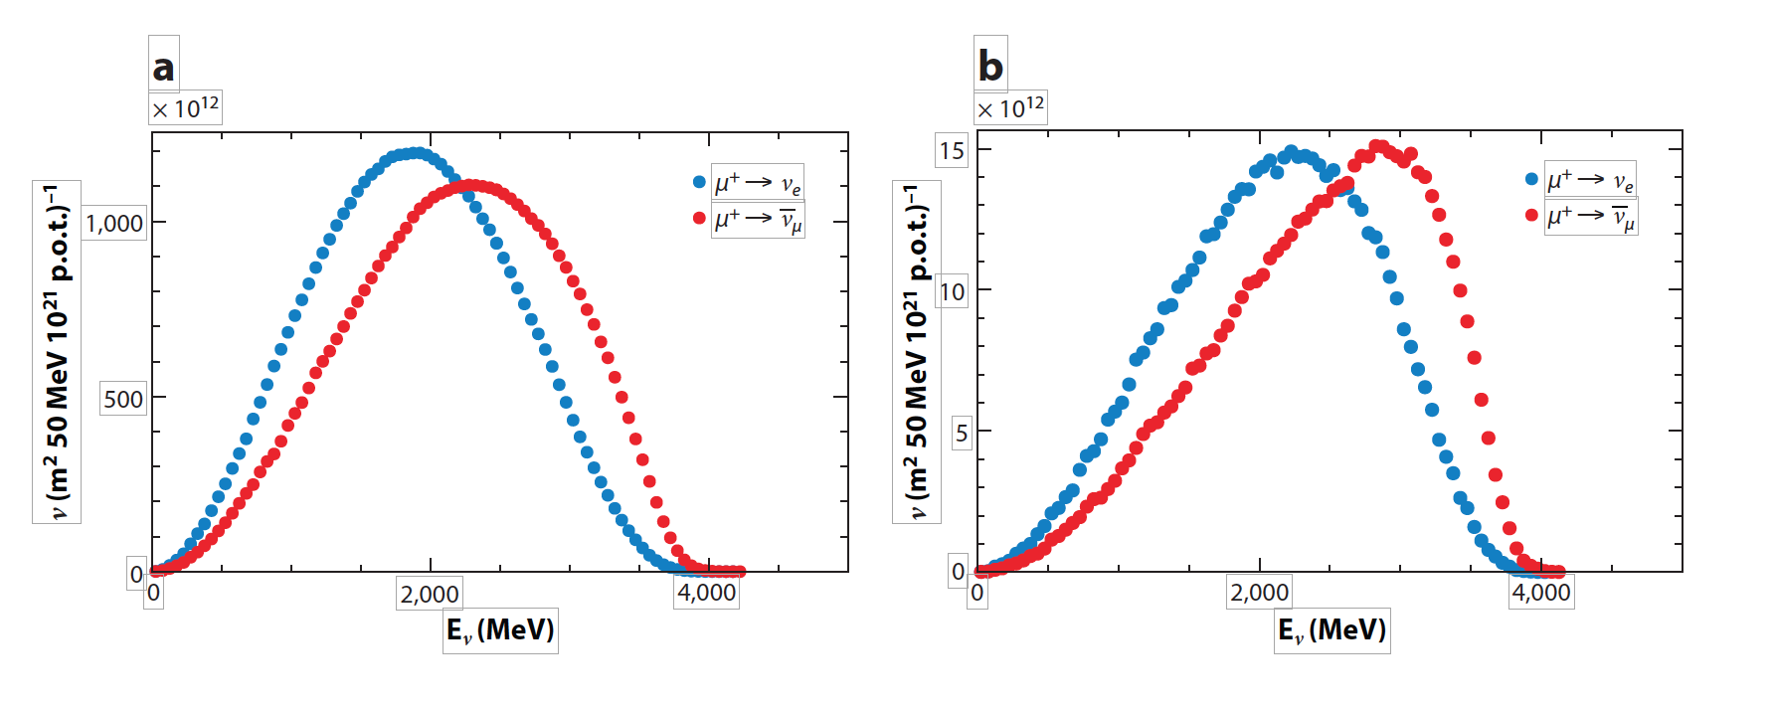
ν Beams at nuSTORM μ⁺ ➔ e⁺ + ν_{e} + ν_{μ}-bar
ν beams from μ decay at nuSTORM
  a: at 50 m from end of production straight
  b: at 2000 m
Absolute flavor purity with flux known to better than 1%

Slide 13
nuSTORM and δ_{cp} coverage @ DUNE
75% coverage of δ_{cp} in a LBL ν oscillation experiment (P5 requirement) in a reasonable exposure time
a Systematic uncertainties at the 1% level are required.
Degradation of systematic uncertainties to the ~5% level
a exposure increase of 200-300% (very non-linear).
We have yet to achieve 2% uncertainty in ν experiments.

Slide 14
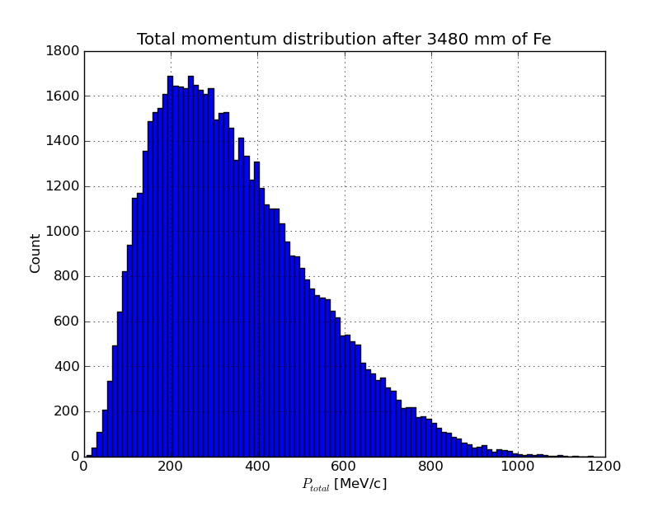
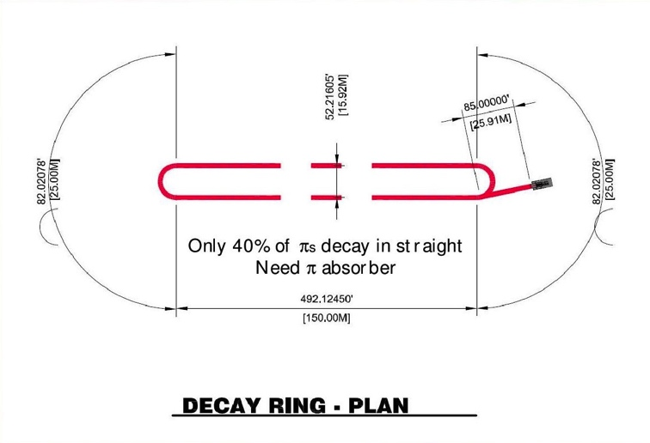
νStorm as an R&D platform
A high-intensity pulsed muon source
100<p_{μ}<300 MeV/c muons
  Using extracted beam from ring
  10¹⁰ muons per 1 μsec pulse
Beam available simultaneously with physics operation
νSTORM also provides the opportunity to design, build and test decay ring instrumentation (BCT, momentum spectrometer, polarimeter) to measure and characterize the circulating muon beam

Slide 15
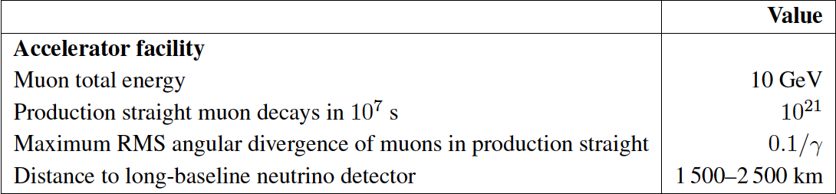
The Long Baseline Neutrino Factory
IDS-NF: the ideal NF
  Supported by MAP
MASS working group:
A staged approach -
NuMAX@5 GeVaSURF

Slide 16
The MAP Muon Accelerator Staging Study a NuMAX
5 GeV Storage Ring optimized for Fermilab-to-SURF baseline
NuMAX Staging:
Commissioning
  1MW Target
  No Muon Cooling
  10kT Detector
NuMAX+
  2.75 MW Target
  6D Muon Cooling
  34kT Detector

Slide 17
MASS NF Parameters
6D

Slide 18
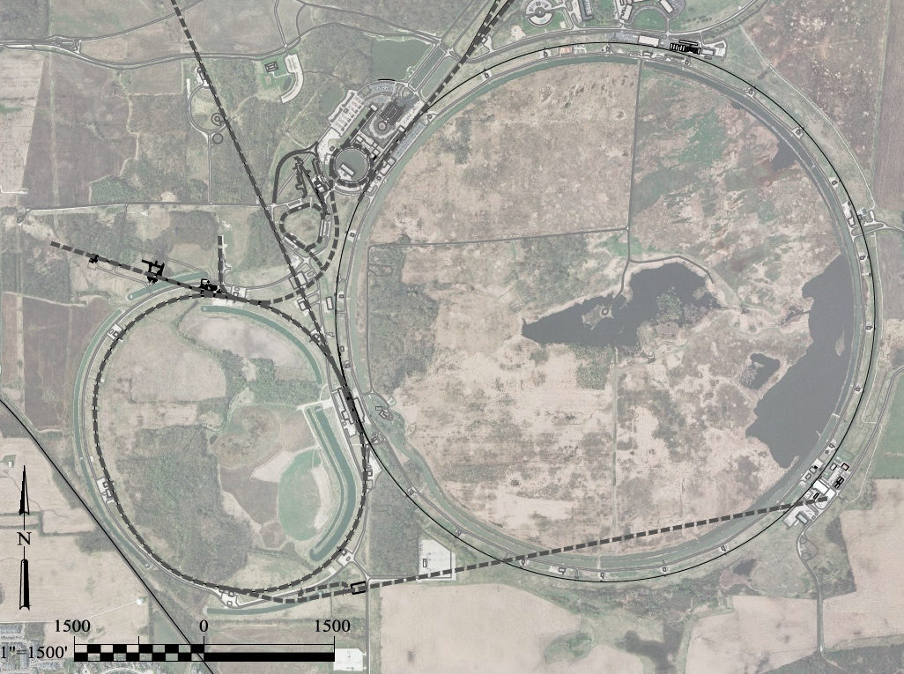
Possibilities for NF Capabilities at Fermilab:
νSTORM ➔ NuMAX
0.8 GeV Proton
Linac (PIP-II)
DUNE
Superbeam
Accumulator,
Buncher,
Combiner
Front
End
0.8-3 GeV Proton
Linac (PIP-III)
Remains fully compatible with the PIP-II a III staging option
To
SURF
Target
Final
Cool
NuMAX:
νs to SURF
6D
Cool
Initial
Cool
1 GeV Muon
Linac (325MHz)
3-7 GeV Proton &
1-5 GeV Muon
Dual Species Linac
To Near Detector(s) for
Short Baseline
Studies
Muon Beam
R&D Facility
Possible to deploy subsequent muon collider capabilities
ft
νSTORM
ft

Slide 19
Going Beyond Neutrino Factory Capabilities

Slide 20
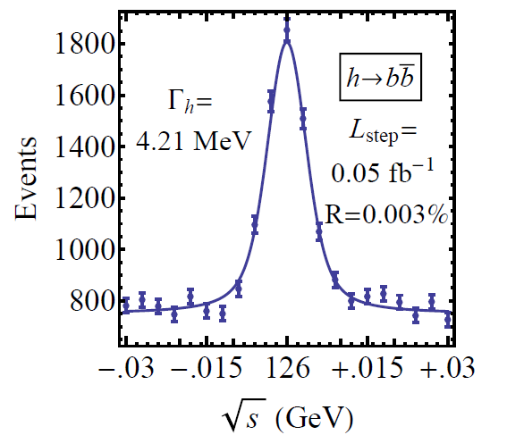
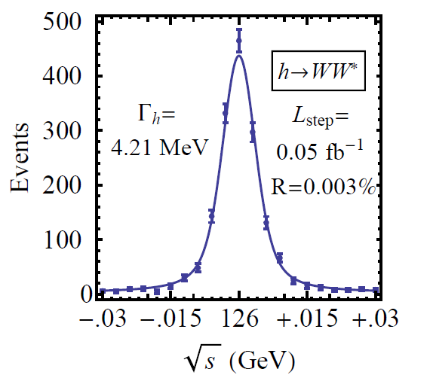

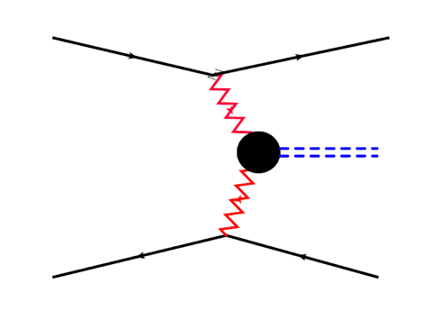



Features of the Muon Collider
Superb Energy Resolution
  SM Thresholds and s-channel Higgs Factory operation
Multi-TeV Capability (≤ 10TeV):
  Compact & energy efficient machine
  Luminosity > 10³⁴ cm⁻² s⁻¹
  Option for 2 detectors in the ring
  For √s > 1 TeV: Fusion processes dominate
  a an Electroweak Boson Collider
  a a discovery machine complementary to a
  very high energy pp collider
  At >5TeV: Higgs self-coupling resolutions of <10%
What are our accelerator options if new LHC
data shows evidence for a multi-TeV particle spectrum?

Slide 21
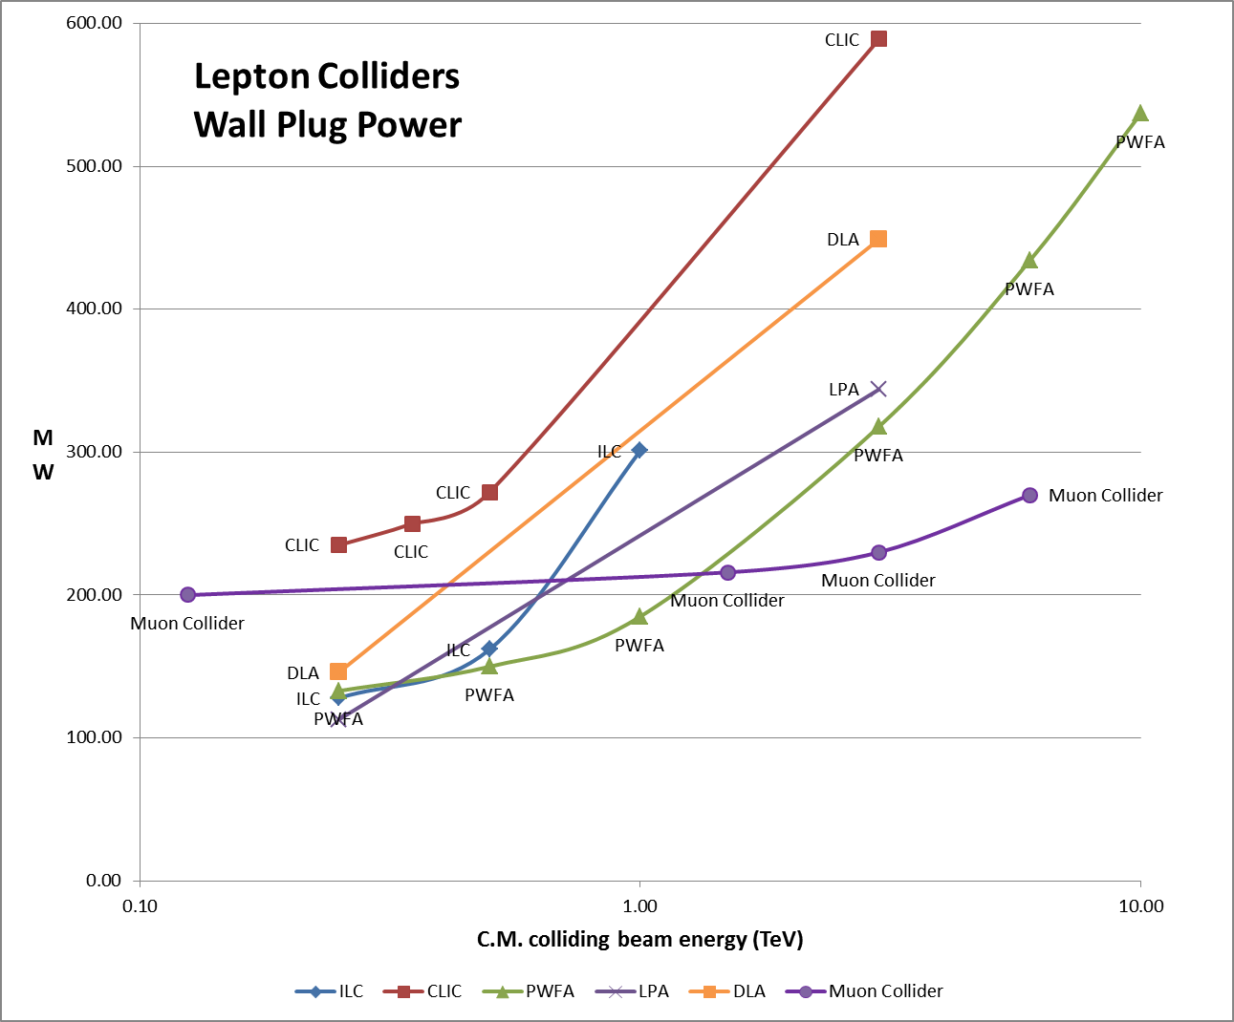
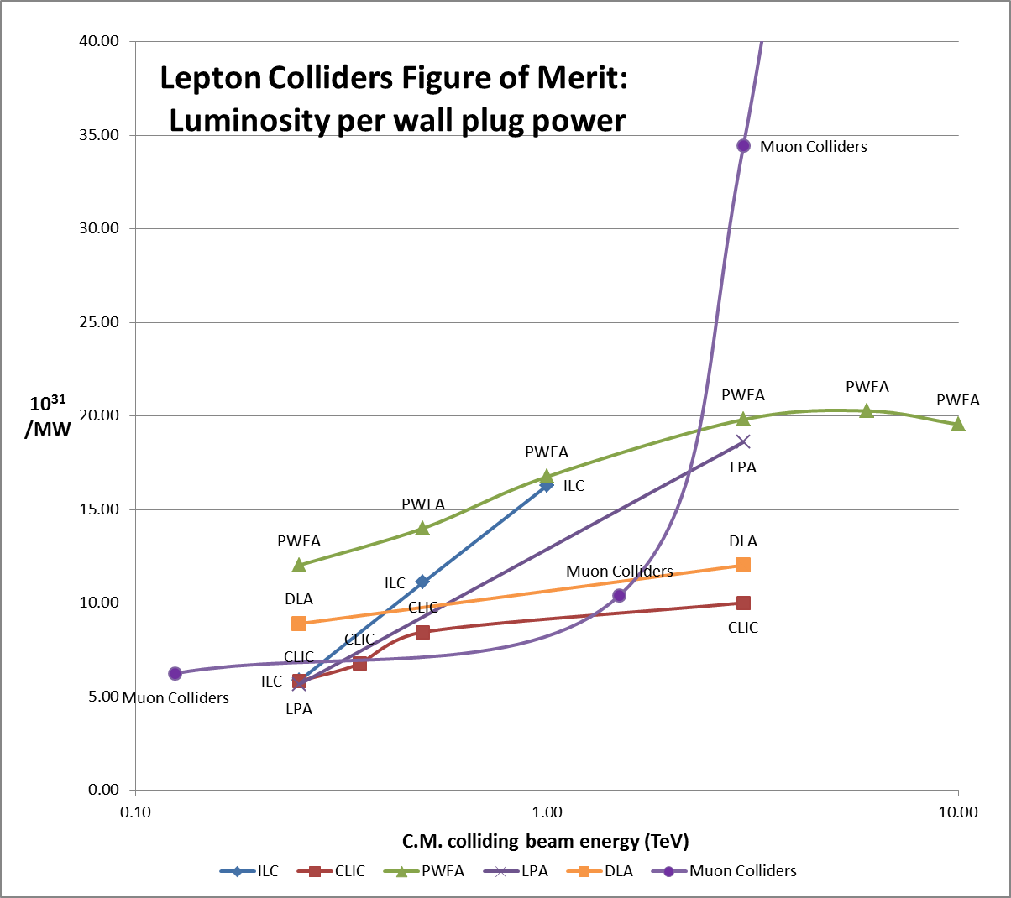
Muon Colliders extending high energy frontier with potential of considerable power savings
J.-P. Delahaye

Slide 22
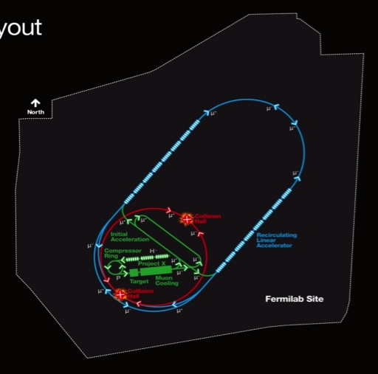
Muon Collider Parameters
Exquisite Energy Resolution
Allows Direct Measurement
of Higgs Width
Success of advanced cooling
concepts a several × 10³²
Site Radiation mitigation with depth and lattice design: ≤ 10 TeV

Slide 23
The MAP R&D effort

Slide 24
NF/MC Synergies

Slide 25
Accelerator R&D Effort (U.S. MAP)
Design Studies
  Proton Driver
  Front End
  Cooling
  Acceleration and Storage
  Collider
  Machine-Detector Interface
  Work closely with physics and detector efforts
Technology R&D
  RF in magnetic fields
  SCRF for acceleration chain (Nb on Cu technology)
  High field magnets
    Utilizing HTS technologies
  Targets & Absorbers
  MuCool Test Area (MTA)
Major System Demonstration
  The Muon Ionization Cooling Experiment – MICE
    Major U.S. effort to provide key hardware: RF Cavities and couplers, Spectrometer Solenoids, Coupling Coil(s), Partial Return Yoke
    Experimental and Operations Support

Slide 26
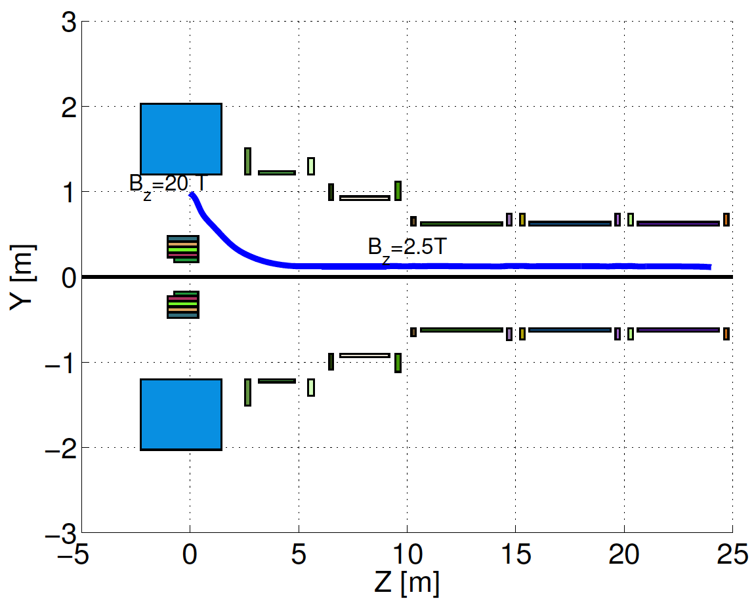
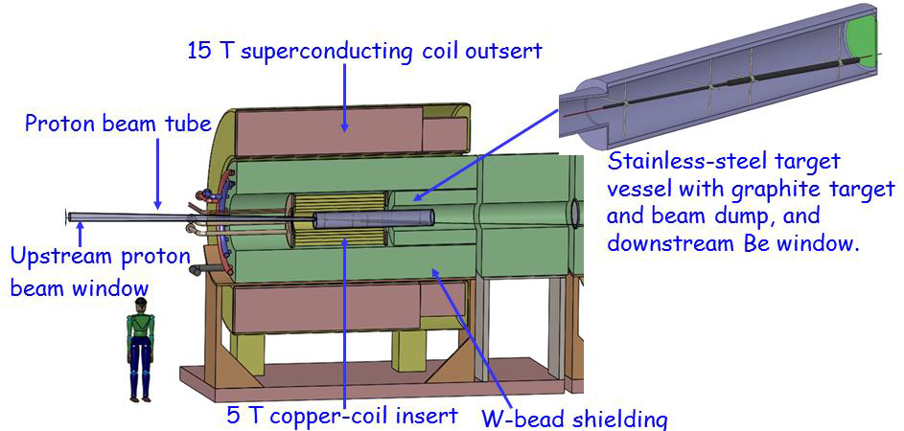
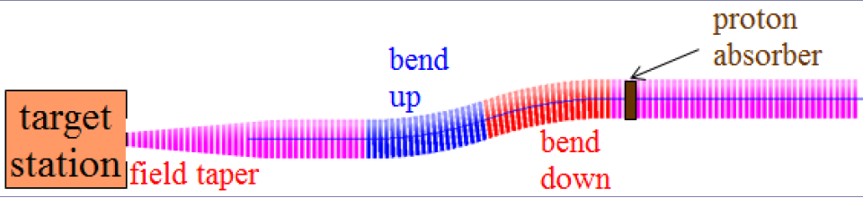
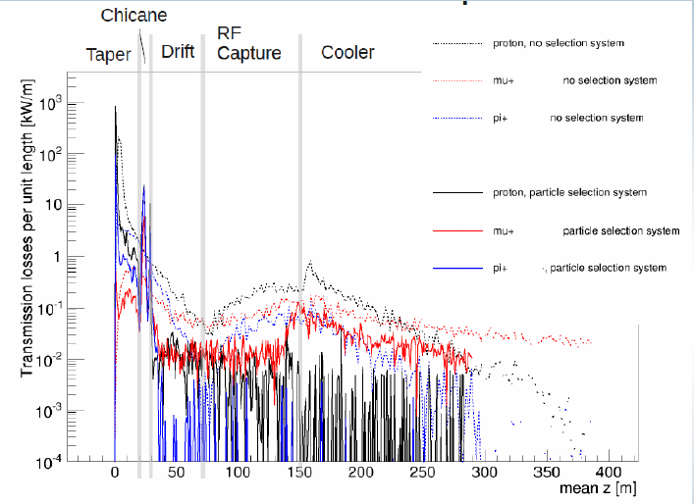
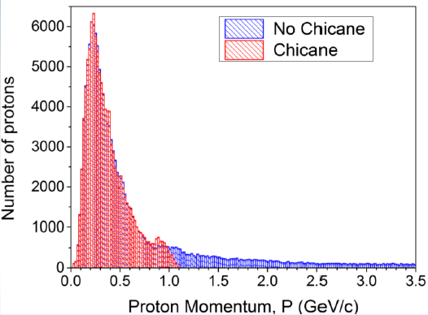
Target & Front End Progress
Compact
Taper Design
C Target
Control of FE Energy Deposition
FE Energy
Deposition

Slide 27
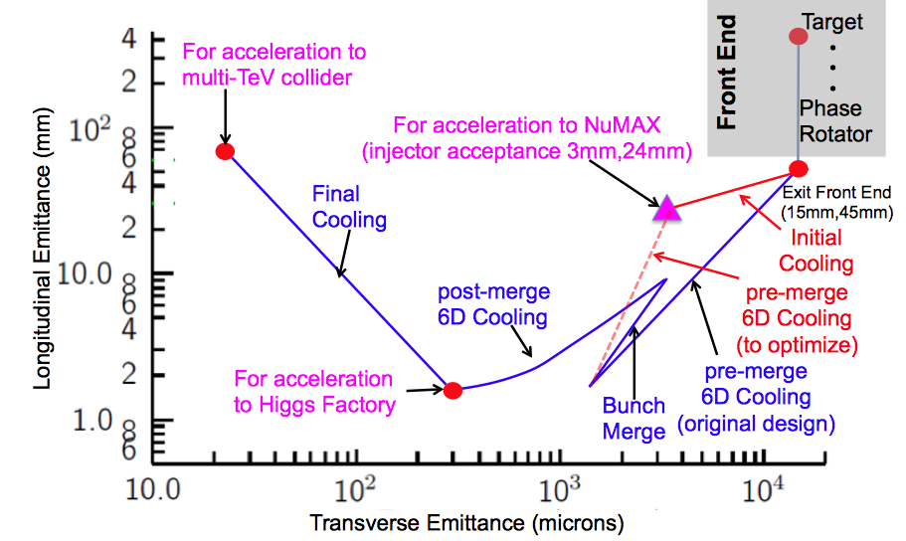
Muon Ionization Cooling

Slide 28
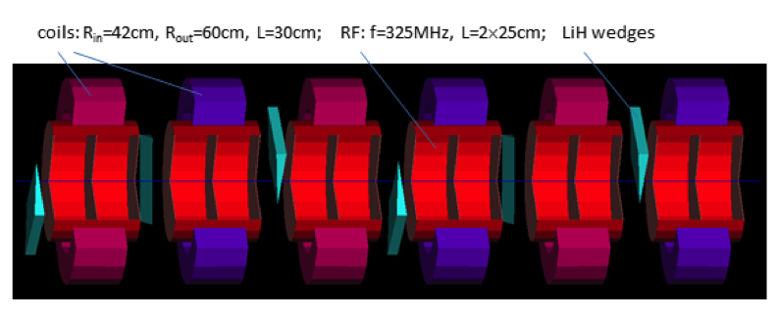
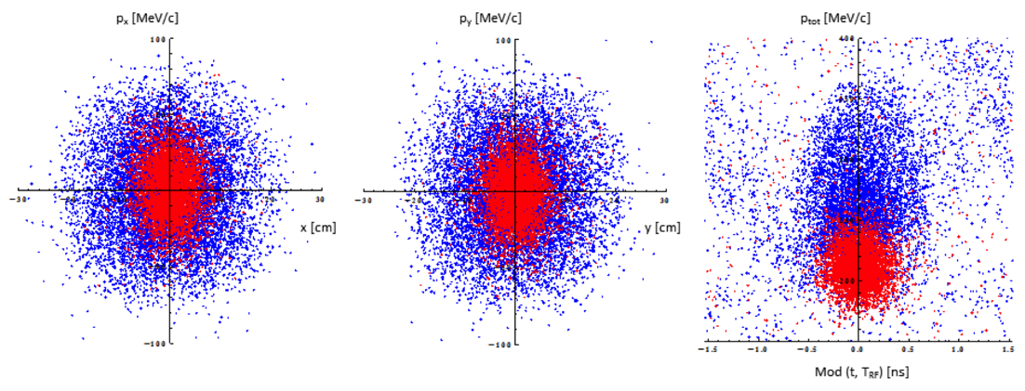
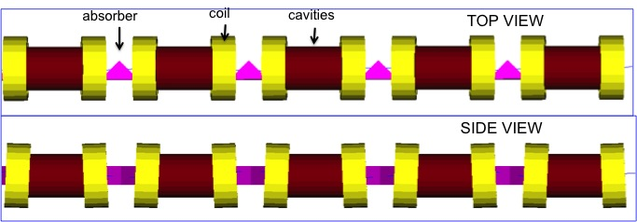
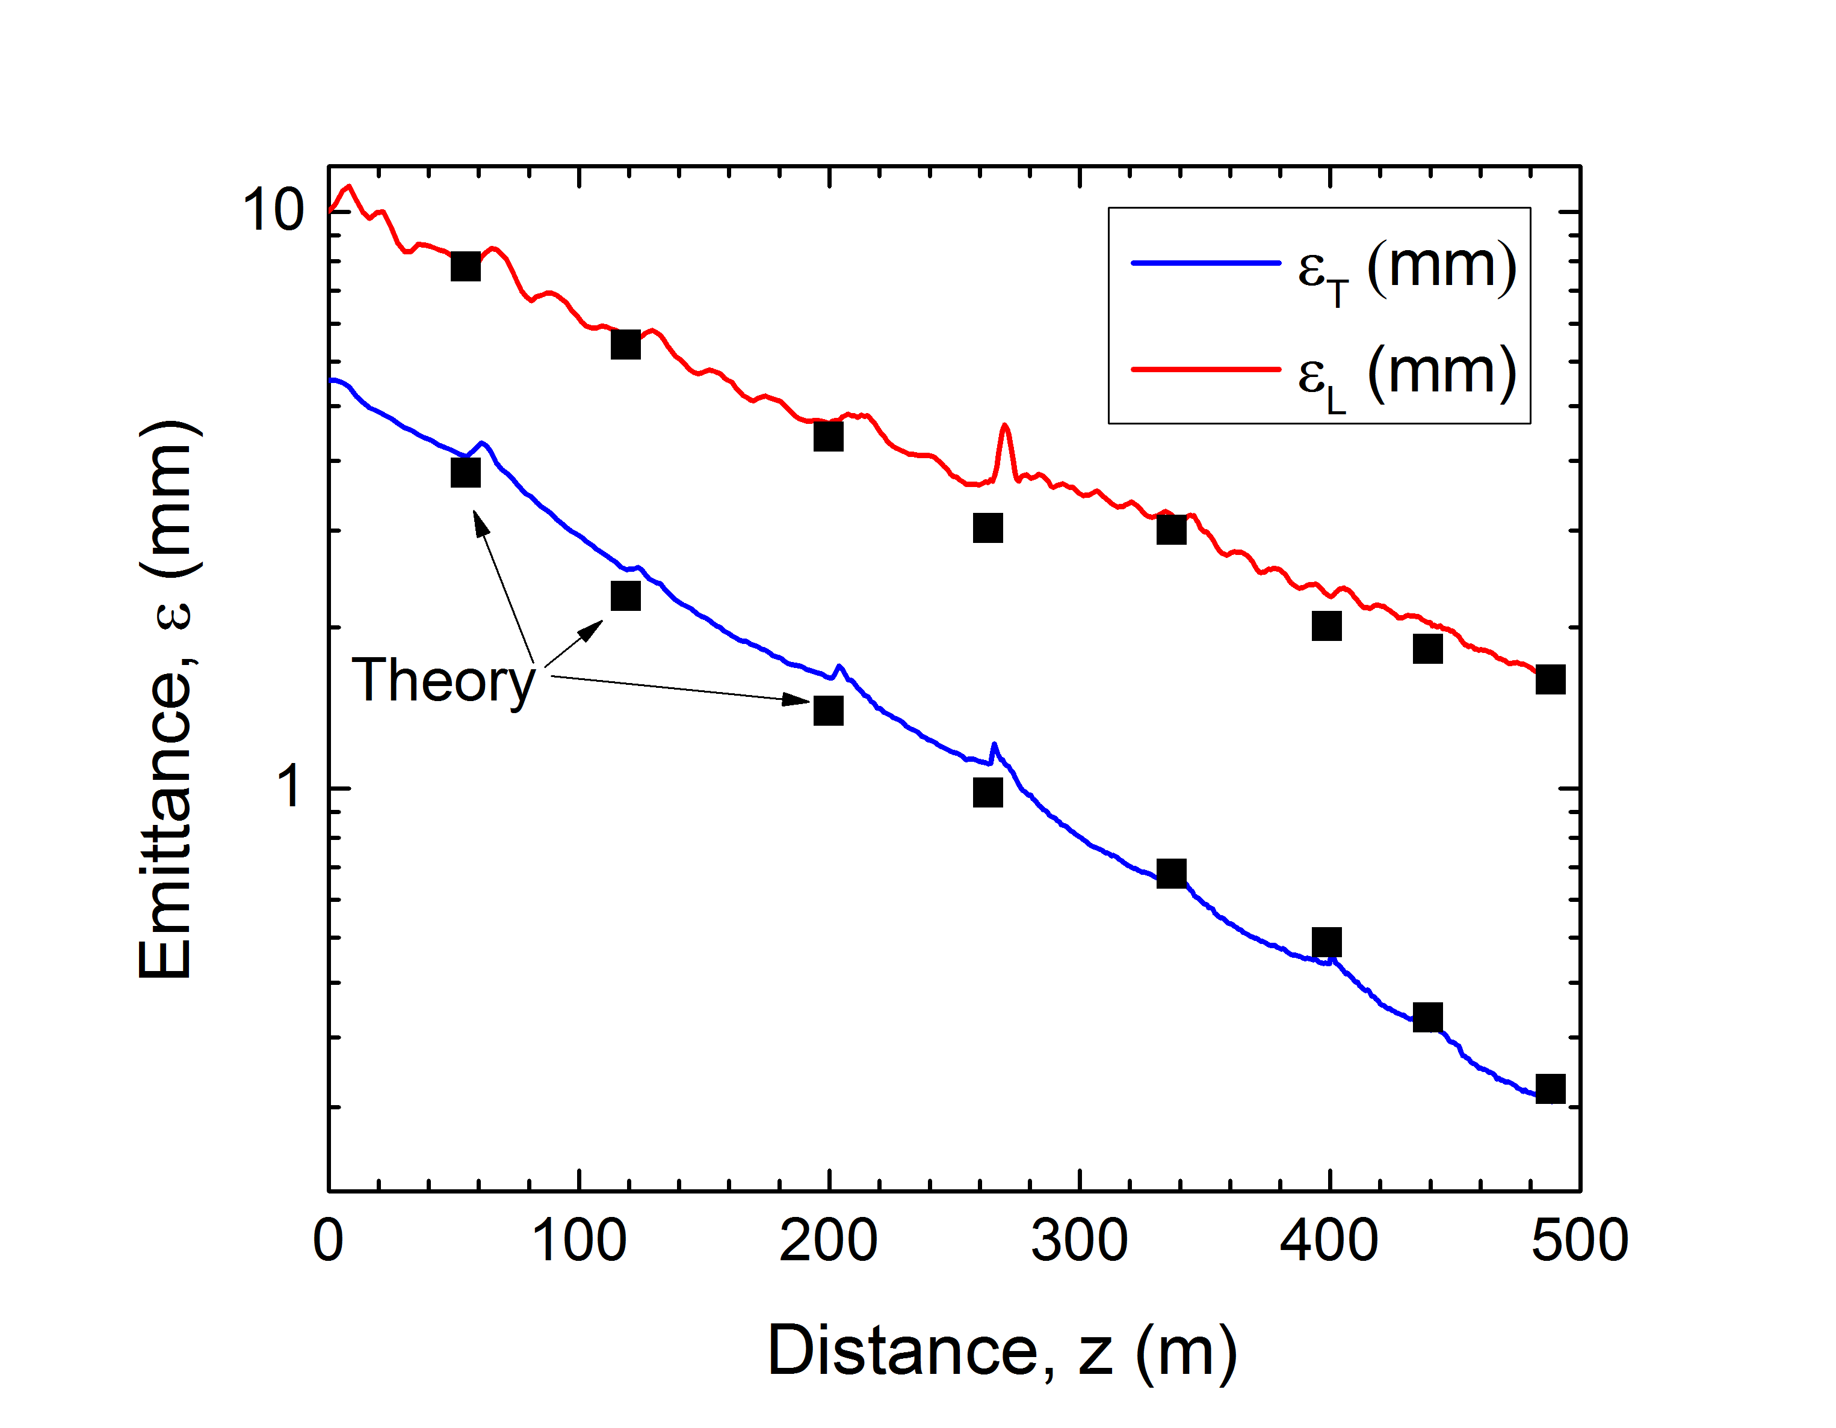
Muon Ionization Cooling (Design)
Initial Cooling: ε_{6D} 60 cm³ a ~50 mm³; Trans = 67%
Rectilinear Vacuum Cooling Channel (Guggenheim successor):
Trans = 55%(40%) without(with) bunch recombination

Slide 29
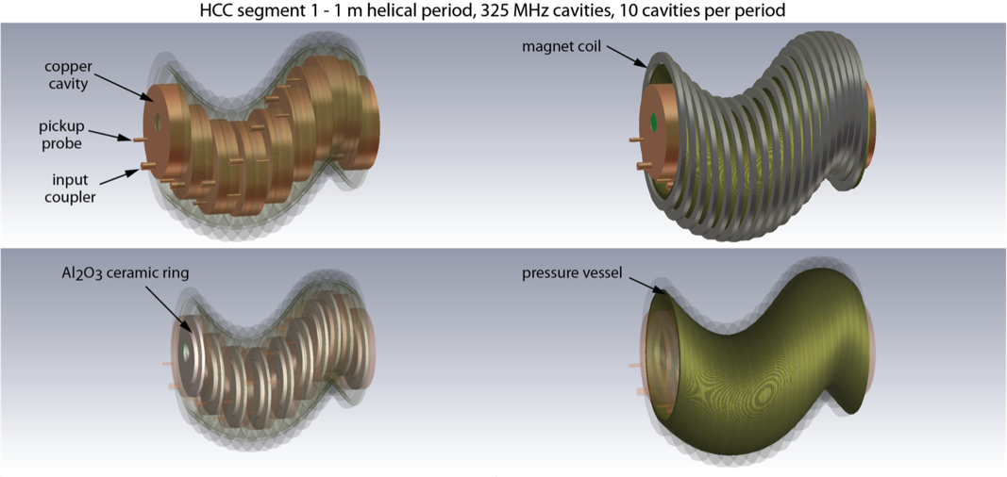
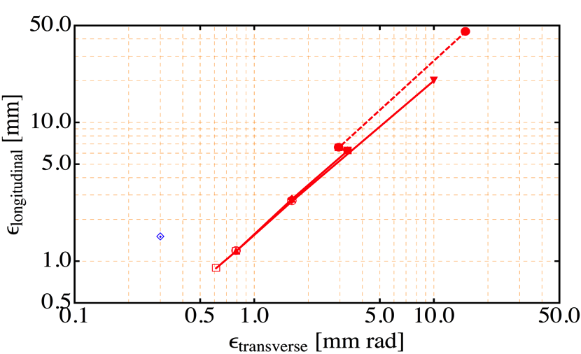
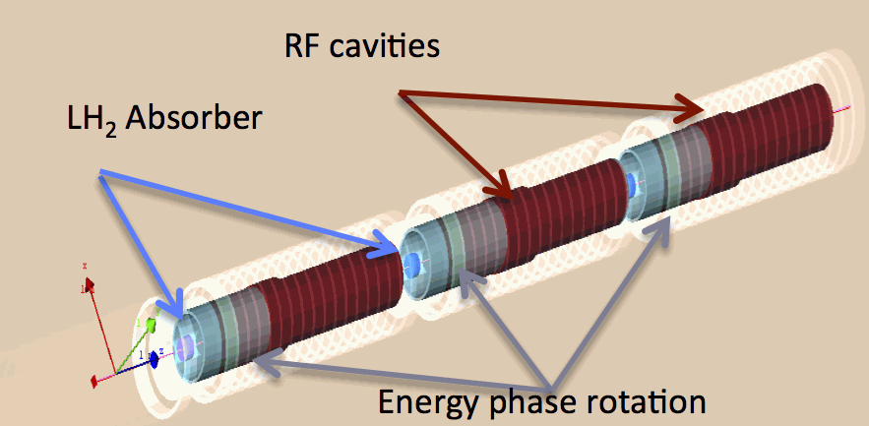
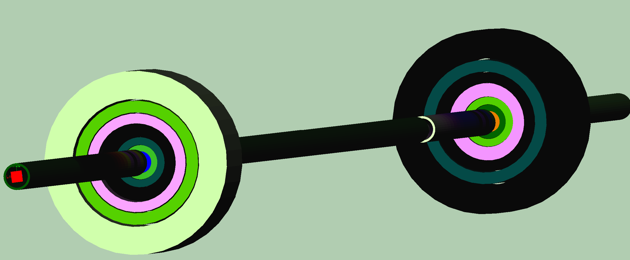
Muon Ionization Cooling (Design)
Initial 6D cooling
Matching
325 MHz cooling
650 MHz
Helical Cooling Channel (Gas-filled):
ε_{T} = 0.6mm, ε_{L} = 0.3mm
Late Stage w/ Induction Linac
Final Cooling with 25-30T solenoids (emittance exchange):
ε_{T} = 55μm, ε_{L} = 75mm

Slide 30
Muon Ionization Cooling
Alternative and Advanced Concepts
  Hybrid rectilinear channel with gas-filled structures
  Parametric Ionization Cooling (Morozov, et al)
  Partial Final Cooling a Round-to-flat beam transform a Transverse Bunch Slicing a Longitudinal Coalescing (Neuffer, et al)
  a Considerable promise to exceed our original target parameters
MASS identified extension of 6D cooling concepts and modification of Final Cooling scheme to be one of most likely areas of performance improvement
Also now have demonstrated technology solutions (RF) to the cooling problem

Slide 31
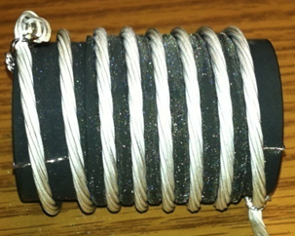
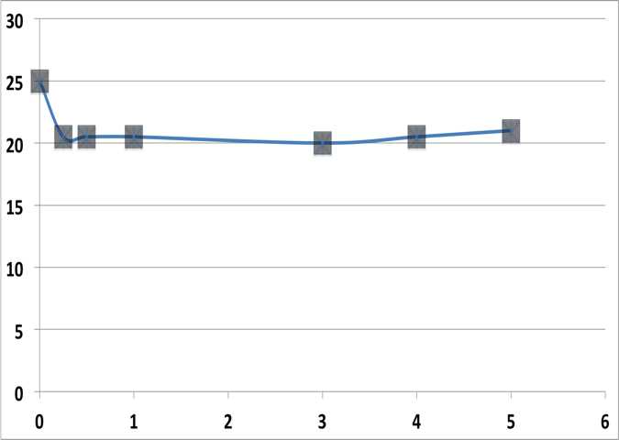
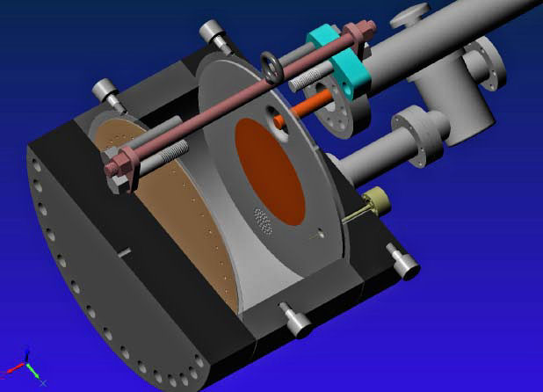
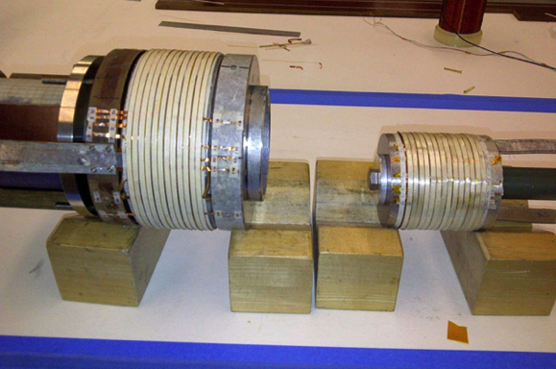
Cooling Technology R&D
>20MV/m operation
in up to 5 T B-field
Successful Operation of 805 MHz “All Seasons” Cavity in 5T Magnetic Field under Vacuum
MuCool Test Area/Muons Inc
World Record
HTS-only Coil
15T on-axis field
16T on coil
PBL/BNL
Demonstration of High Pressure RF Cavity in 3T Magnetic Field with Beam
Extrapolates to
μ-Collider Parameters
MuCool Test Area
Breakthrough in HTS Cable Performance with Cables Matching Strand Performance
FNAL-Tech Div
T. Shen-Early Career Award
The Path to a Viable
Muon Ionization
Cooling Channel
1% Dry Air (0.2% O2) in GH2
Pure GH2
1% Dry Air
(0.2 % O2)
in GH2 at
B = 3T
~50X reduction in
RF power dissipation
E₀ = 25 MV/m

Slide 32
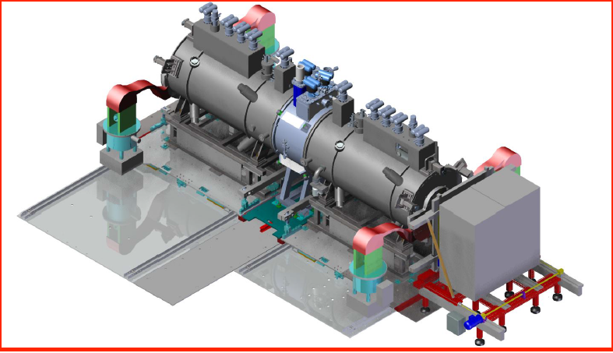
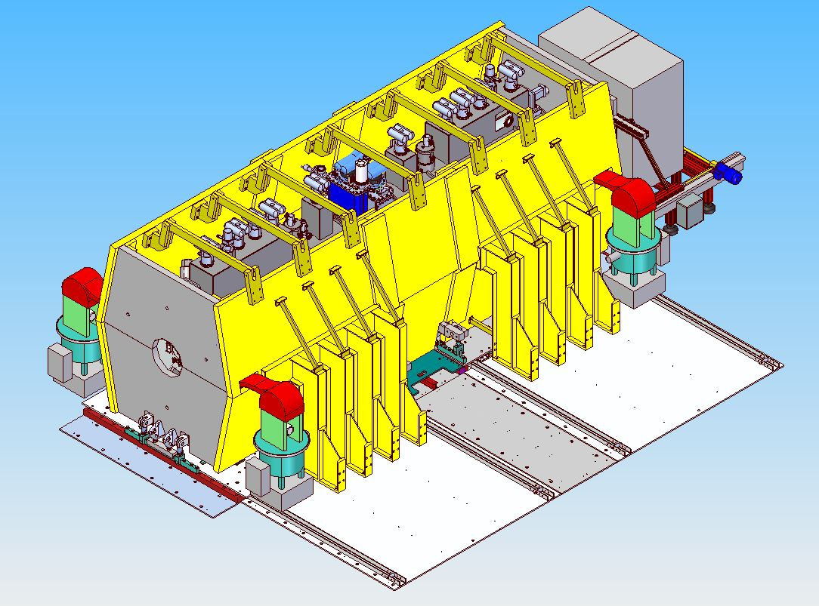
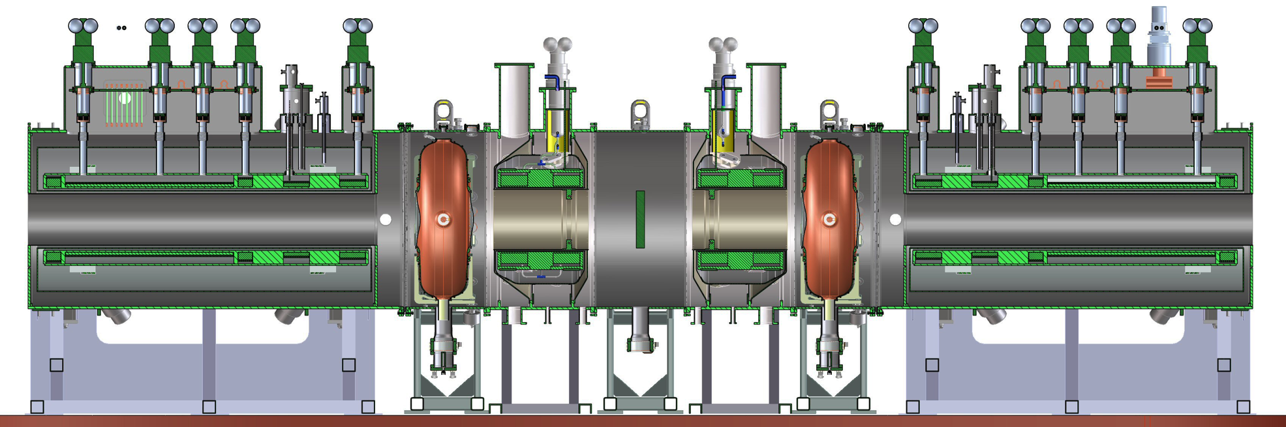
MICE Demonstration @ RAL
2015 Data
MICE Step IV:
Study of Absorber
Materials
US
US
US-UK
2017 Data
UK
UK
US
US
Demonstration of Muon Ionization Cooling (Re-baseline)

Slide 33
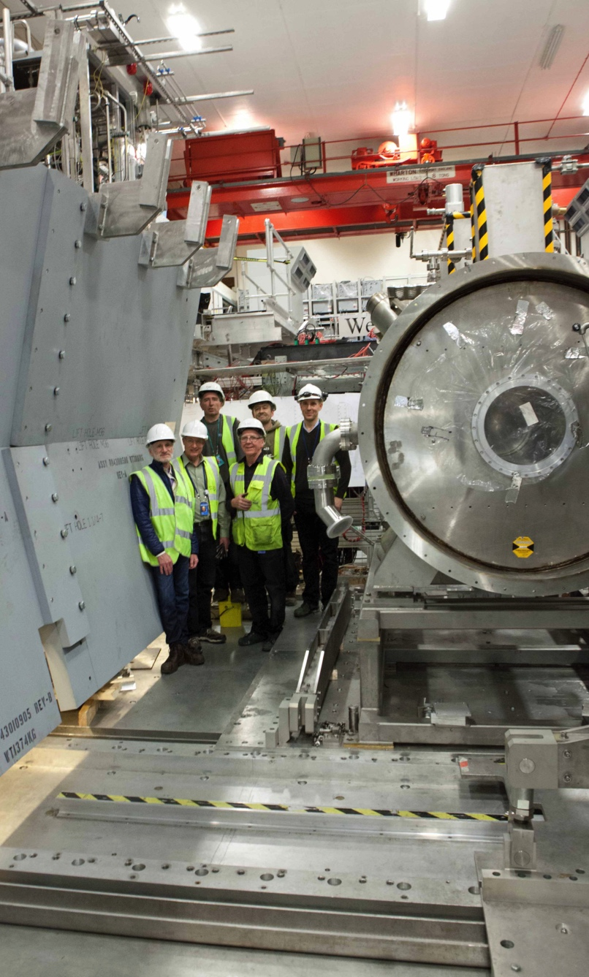
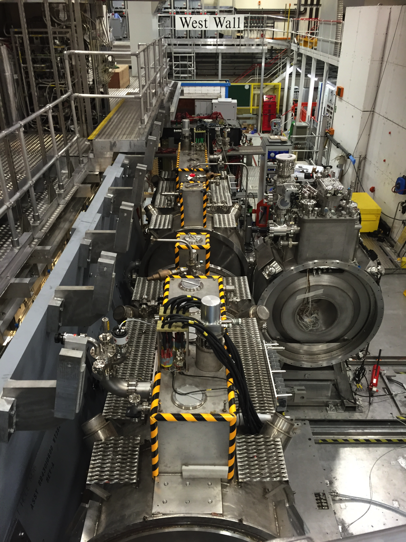
MICE Installation/Commissioning
Integration
and Commissioning Underway
Formal start of
operations in
June

Slide 34
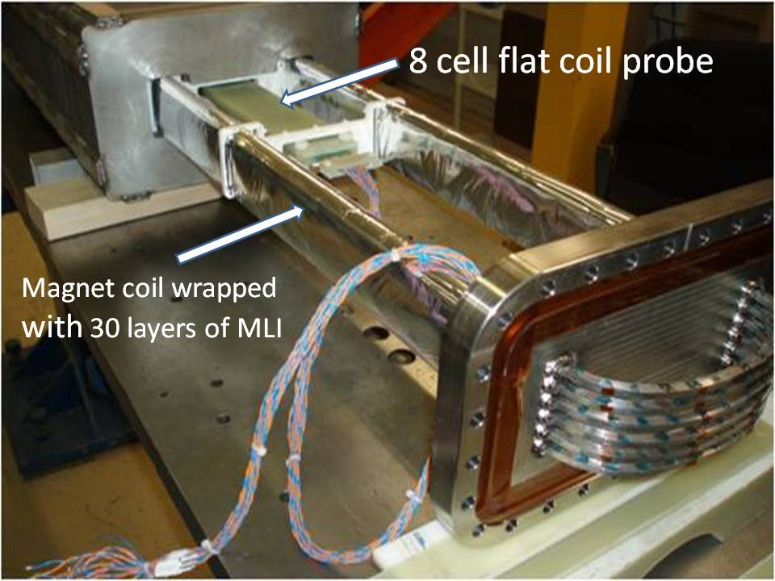
Acceleration Chain
Muons require an ultrafast accelerator chain
a A particular challenge for this unstable species
Solutions include:
  Superconducting Linacs (NuMAX choice)
  Recirculating Linear Accelerators (RLAs)
  Fixed-Field Alternating-Gradient (FFAG) Machines
  Rapid Cycling Synchrotrons (RCS)
  RCS requires
  2 T p-p magnets
  at f = 400 Hz
  (U Miss & FNAL)
EMMA – FFAG
JEMMRLA Proposal:
JLAB Electron Model of
Muon RLA with Multi-pass
Arcs

Slide 35
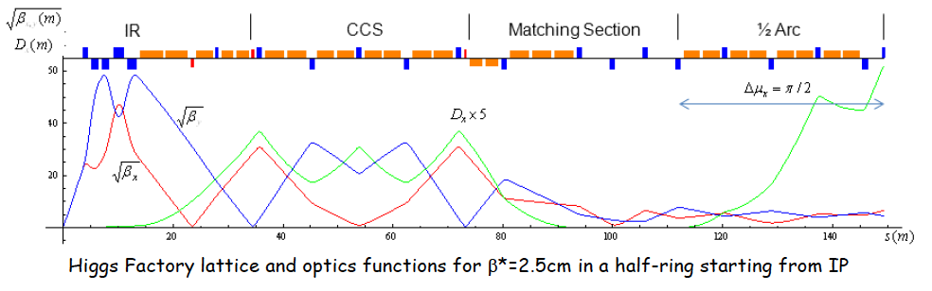
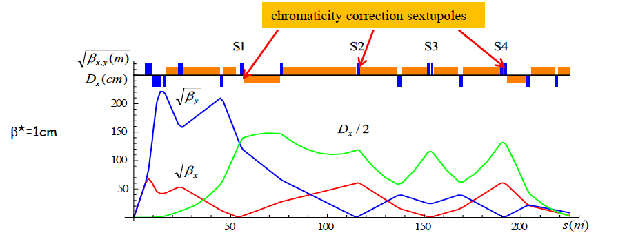
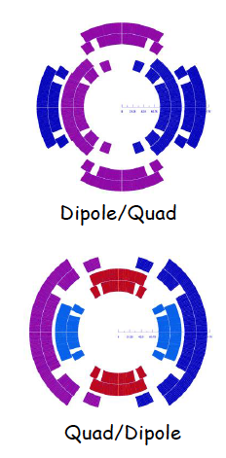
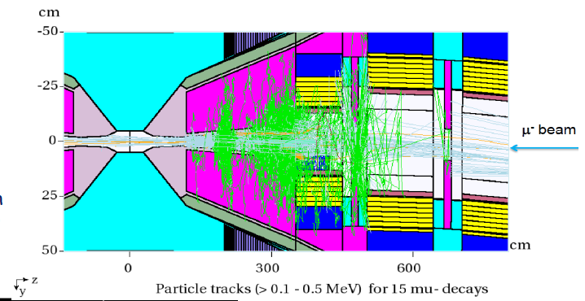
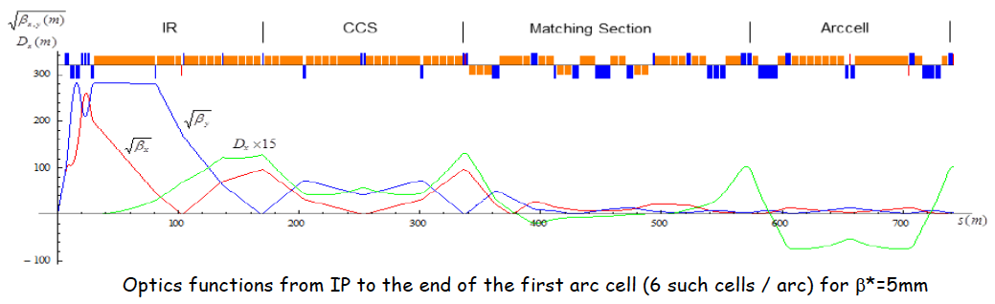
Muon Rings
NF: nuSTORM and NuMAX designs
Collider: Detailed optics studies for Higgs, 1.5 TeV,
3 TeV and now 6 TeV
  With supporting magnet designs
  and background studies
  Detector occupancy
  similar to that seen in
  LHC Lumi Upgrade

Slide 36
Conclusion

Slide 37
Concluding Remarks
Neutrino Factory capabilities offer a precision microscope
that will likely be needed to fully probe the physics of the neutrino sector
A multi-TeV muon collider may be the only cost-effective route to lepton collider capabilities at energies > 5 TeV
For the last 3 years US Muon Accelerator Program has pursued options to deploy muon accelerator capabilities
  Near term (νSTORM)
  Long term (NuMAX)
  A muon collider capability that would build on a NF complex
In light of the recent P5 recommendations that this directed facility effort no longer fits within the budget-constrained US research portfolio, the US effort is entering a ramp-down phase
Nevertheless, muon accelerator capabilities offer unique potential for the future of high energy physics research

