Slide 1
PIP-II at Fermilab
Nigel Lockyer
DOE Independent Project Review of PIP-II
16 June 2015

Slide 2
The context
The Fermilab accelerator injector complex is 40 years old
The recent P5 report charts out a path of ever increasing power needed to perform a world leading neutrino accelerator program referred to as LBNF/DUNE
The report has the support of the US community and DOE
Fermilab has followed report closely
The world community has come together quickly to form a new neutrino collaboration DUNE that is planning an 40 kton liquid argon TPC detector deep underground assuming a 1.2 MW primary beam to generate neutrinos
P5 also recommended that Fermilab plan for 2.4 MW

Slide 3
Priority
PIP-II is the highest priority project for Fermilab in the accelerator complex once 700 kW achieved.

Slide 4
SRF Staffing
Lab policy over the last year with DOE encouragement has been to build up the SRF team in Technical division under leadership of Hasan Padamsee
Significant impact on SRF technology with Q0 program
Critical new hires are taking ownership of the program
Aimed at LCLS-II and PIP-II
Cryogenics group at Fermilab is led by Arkadiy Klebaner has had several recent hires and is very strong
Management team led by Steve Holmes, Paul Derwent and Shekhar Mishra is experienced

Slide 5
Technology
Over the last decade Fermilab invested heavily in the SRF technology because of world wide interest in ILC
Fermilab is one of the leading SRF laboratories in the world
Fermilab is presently building 20 SRF cryomodules for LCLS-II project at SLAC and is thus developing SRF cryomodule assembly and test infrastructure
Lab infrastructure & know how well matched to build PIP-II

Slide 6
India Collaboration
The DOE has signed a major SRF agreement with India to co-develop an ~1 GeV CW SRF proton accelerator…..
This initial phase R&D partnership is well along and substantial devices are being jointly designed, built, and tested along with exchanged personnel
This partnership meshes extremely well with the PIP-II plans

Slide 7
PIP-II accelerator upgrade at Fermilab
P5 Recommendation 14:
“Upgrade the Fermilab proton accelerator complex to produce higher intensity beams. R&D for the Proton Improvement Plan II (PIP-II) should proceed immediately, followed by construction, to provide proton beams of > 1 MW by the time of first operation of LBNF”
PIP-II will allow Fermilab to maintain it’s lead with the most powerful neutrino beam in the world

Slide 8
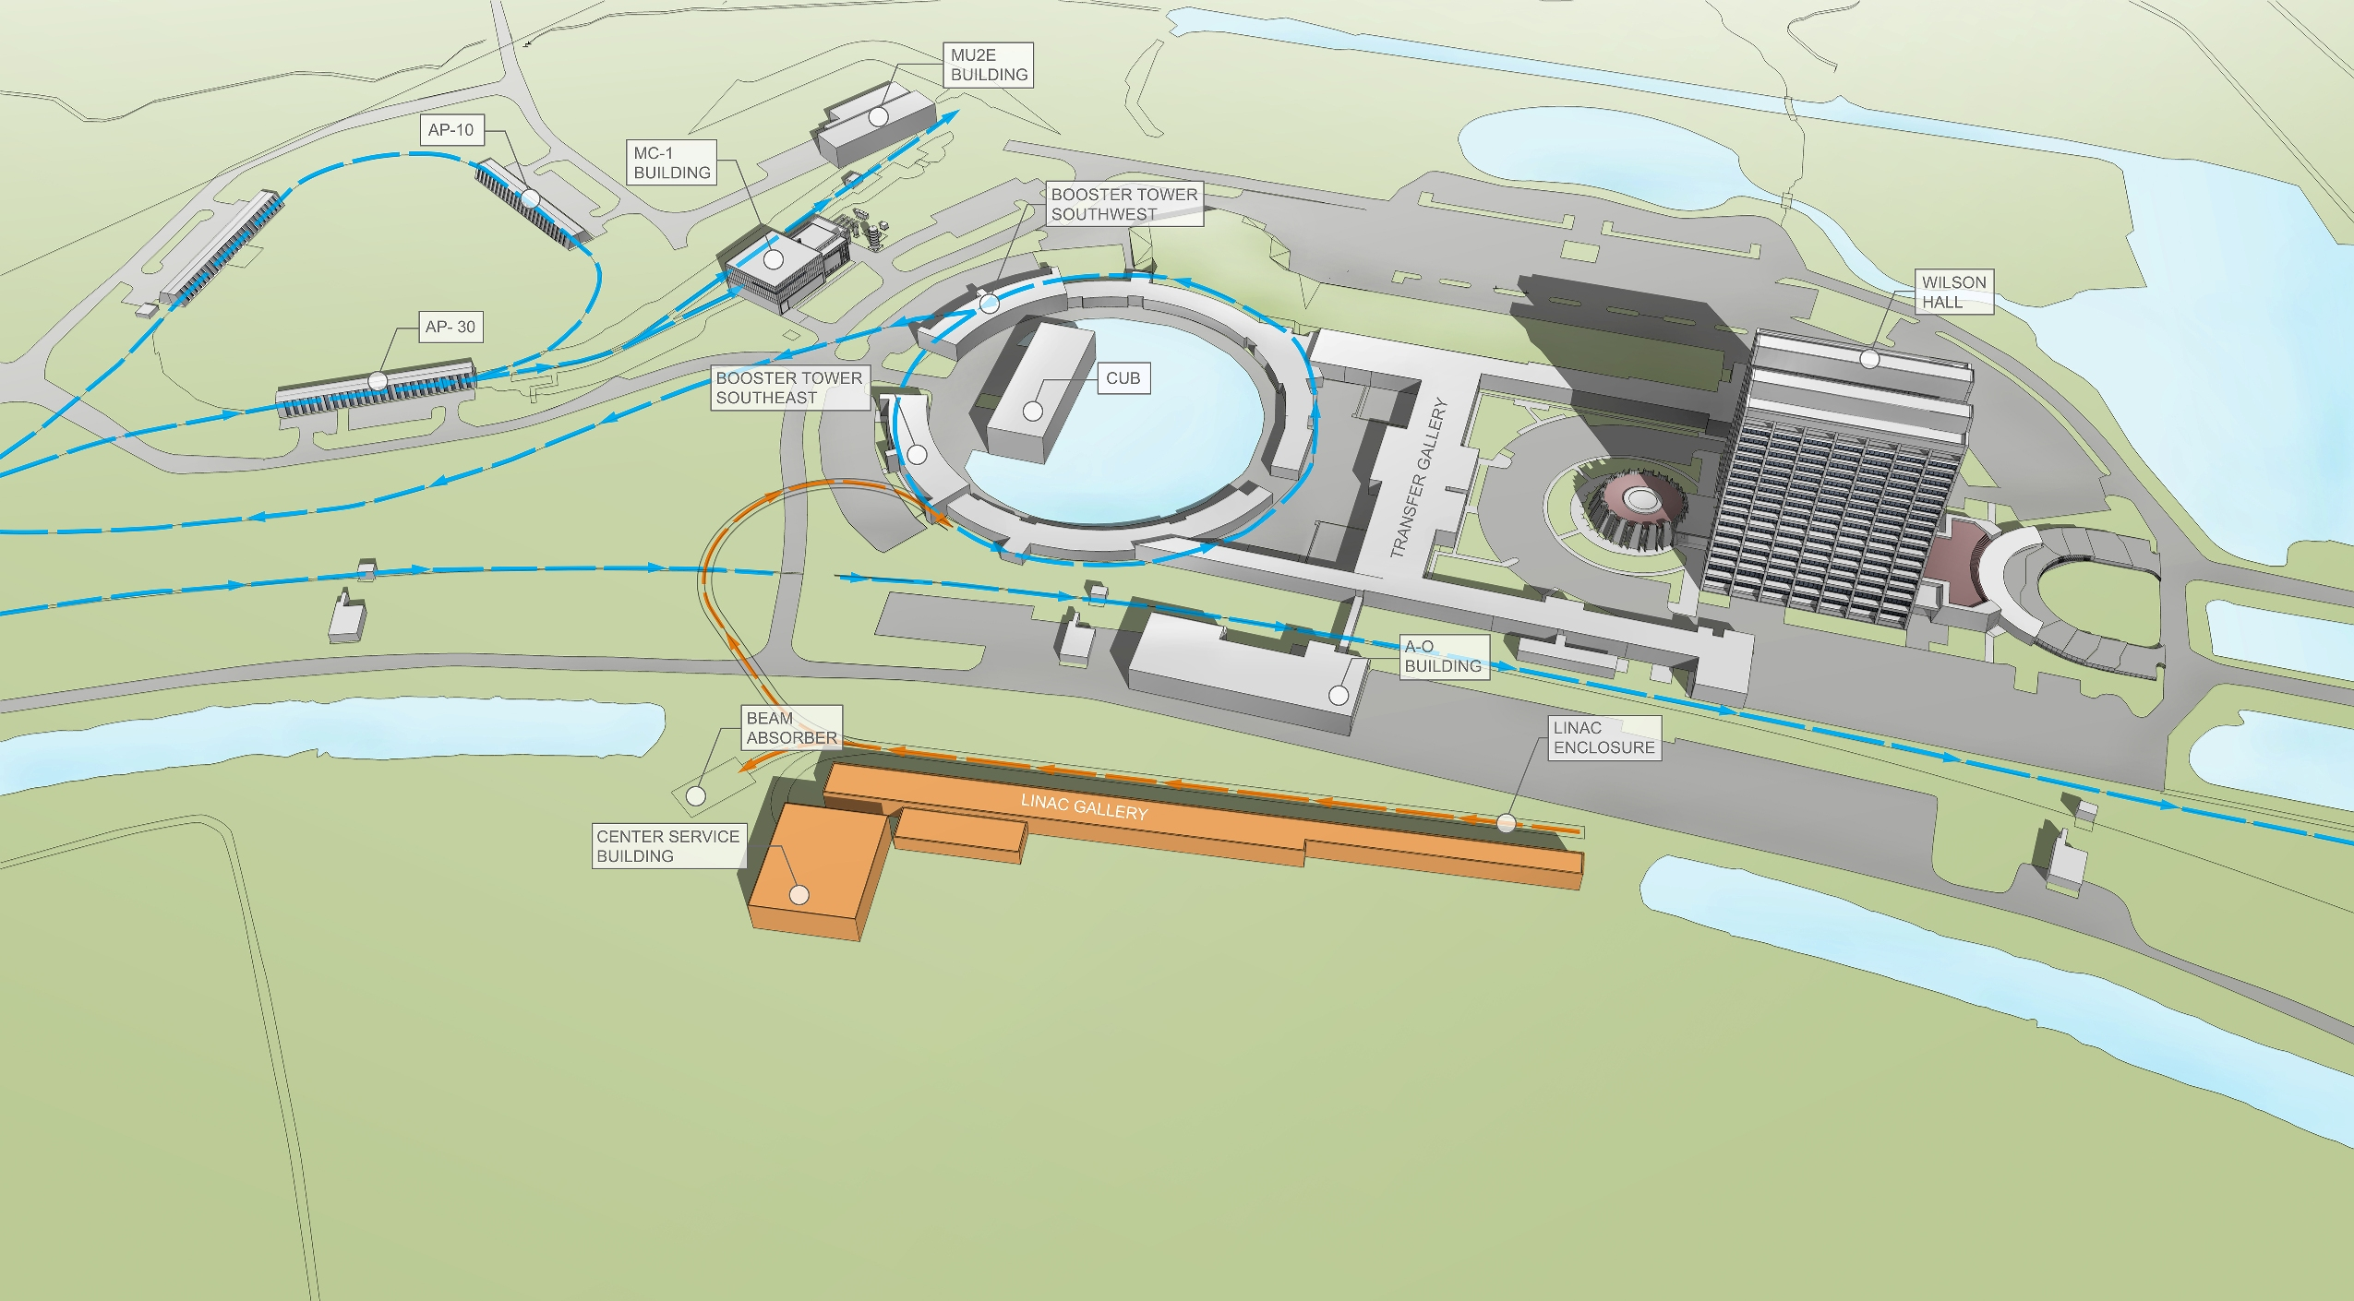
PIP-II Site Layout

Slide 9
Main Peripheral Issues
The choice of CW is not driven by neutrino physics
P5 recognized the other physics opportunities from PIP-II
For example, the potential future physics program of Mu2e could expand its reach by an order of magnitude greatly from direct injection from PIP-II in CW mode
It is influenced greatly by the India collaboration desire to build a CW machine and this partnership makes the SRF linac cheaper to DOE than a copper linac
PIP-III (booster replacement that allows multi-MW beams) is an essential part of the upgrade to 2.4 MW… the recent HEPAP subpanel report “Accelerating Discovery” supported R&D for PIP-III to help with SRF linac versus RCS choice

Slide 10
Conclusion
Strong Management team in place
Strong technical team being assembled
Scope of project defined by 1.2 MW beam for LBNF/DUNE
Technical design has years of effort behind it
Risk mitigation strategy progressing well with PXIE
Major partner India is highly engaged
We are focused and moving forward

Slide 11
Thank you

