Slide 1
PIP-II Technical Description
Valeri Lebedev
DOE Independent Project Review of PIP-II
16 June 2015

Slide 2
Outline
PIP-II Performance Goals
Design Concept and Design Choices
  Linac
  Transfer line
  Booster
  Recycler and MI
Primary technical risks
Summary

Slide 3
PIP-II Performance Goals
Increase MI power
from 700 kW (NOvA) to >1 MW (LBNF)
in the energy range 60 – 120 GeV
Increase Booster power from 80 to 160 kW
  8 GeV program: SBNE, …
Future upgrades
  Mu2e at 0.8 GeV and ~100 kW
  Beam power to LBNF to >2 MW
  Provide a platform supporting a high duty factor/CW operation for future intensity frontier experiments

Slide 4
PIP/PIP-II Performance Goals
Performance Parameter | PIP | PIP-II
Linac Beam Energy | 400 | 800 | MeV
Linac Beam Current | 25 | 2 | mA
Linac Beam Pulse Length | 0.03 | 0.5 | ms
Linac Pulse Repetition Rate | 15 | 20 | Hz
Linac Beam Power to Booster | 4 | 18 | kW
Linac Beam Power Capability (@>10% Duty Factor) | 4 | ~200 | kW
Mu2e Upgrade Potential (800 MeV) | NA | >100 | kW
Booster Protons per Pulse | 4.2×10¹² | 6.5×10¹²
Booster Pulse Repetition Rate | 15 | 20 | Hz
Booster Beam Power @ 8 GeV | 80 | 160 | kW
Beam Power to 8 GeV Program (max) | 32 | 80 | kW
Main Injector Protons per Pulse | 4.9×10¹³ | 7.6×10¹³
Main Injector Cycle Time @ 60-120 GeV | 1.33* | 0.7-1.2 | s
LBNF Beam Power @ 60-120 GeV | 0.7* | 1.0-1.2 | MW
LBNF Upgrade Potential @ 60-120 GeV | NA | >2 | MW
*NOvA operates exclusively at 120 GeV

Slide 5
Approach to the PIP-II Accelerator Physics Design
New SC Linac (800 MeV)
  Design compatible with CW operation
  => 2 mA beam current (comparatively small, actually an advantage)
  MEBT bunch-by-bunch chopper chops out bunches at boundaries of Booster RF buckets and from the extraction gap
  Emittance less than 0.3 mm mrad (rms, norm)
    to minimize injection loss and support of tailless transverse painting
  Energy stability of ~10⁻⁴ to support longitudinal painting
Booster upgrade
  Rep. rate: 15 -> 20 Hz (leaves more power at 8 GeV)
  Injection energy: 400 -> 800 MeV => intensity×1.5, reduction ΔQ_{SC}
  Transverse and longitudinal painting: small I_{beam} helps
    Reduces tails and, consequently, ΔQ_{SC} (KV-like distribution)
Recycler (intensity ×1.5 times)
  Booster repetition rate increase
  => larger momentum separation in slip-stacking => smaller loss
MI (τ_{cycle}: 1.33 -> 1.2 s, I_{beam} & RF power ×1.5 times, P>1 MW @ 60 GeV)

Slide 6
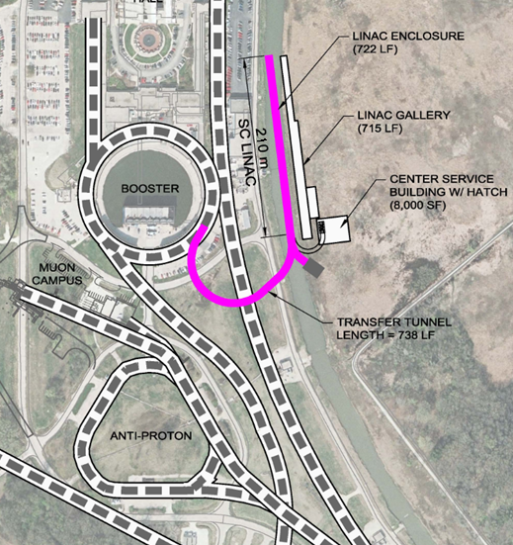
Major PIP-II Components
New 0.8 GeV linac
  L≈210 m
    Includes 4 empty slots at the linac end, L≈40 m
      Beam energy stabilization
      Possible energy upgrade
New Linac-to-Booster transfer line
  L≈280 m
Upgraded Booster
  20 Hz, 800 MeV injection
    New injection girder
    More RF cavities (18 -> 22)
Upgraded Recycler & MI
  RF and collimation

Slide 7
SC Linac

Slide 8
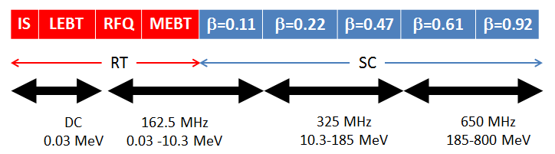
Linac Major Components
H⁻ ion source: 30 kV, 10 mA
LEBT – differential pumping, optics match, beam switch for MPS
RFQ – 2.1 MeV, CW
MEBT – bunch-by-bunch chopper with 20 kW beam dump,
optics match, differential pumping, prevent micro-particle migration
SC linac – 800 MeV, 2 mA, CW compatible operation

Slide 9
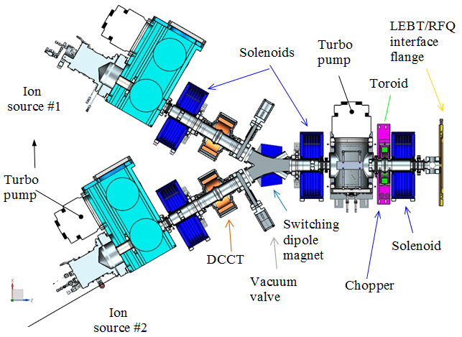
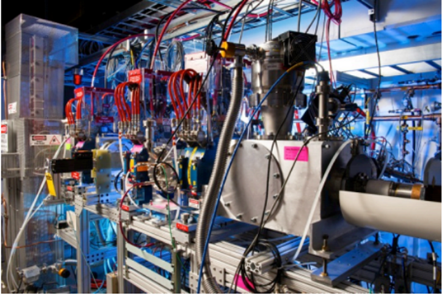
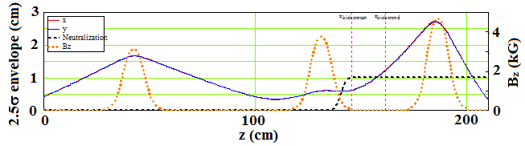
Ion Source and LEBT
Ion source lifetime is limited
  2 ion sources
  => only short interruptions for switching, offline repairs
3 solenoids
  Optics match
LEBT chopper
  ~0.1 μs rise & fall times

Slide 10
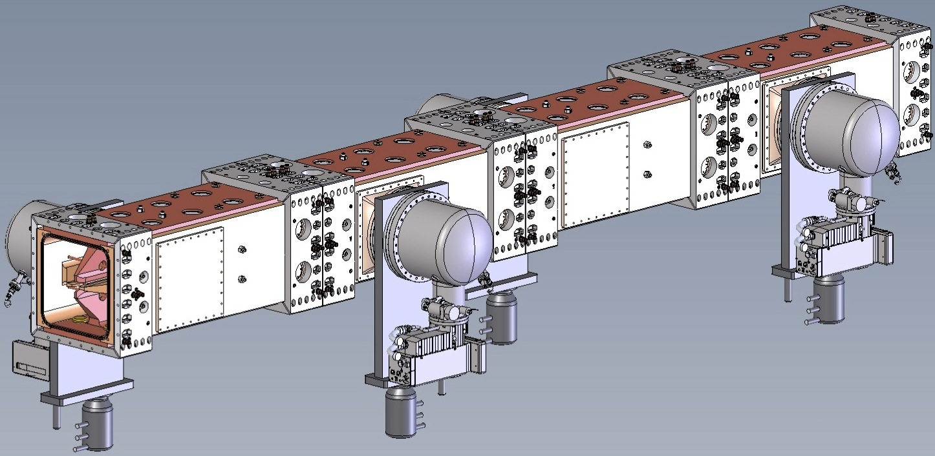
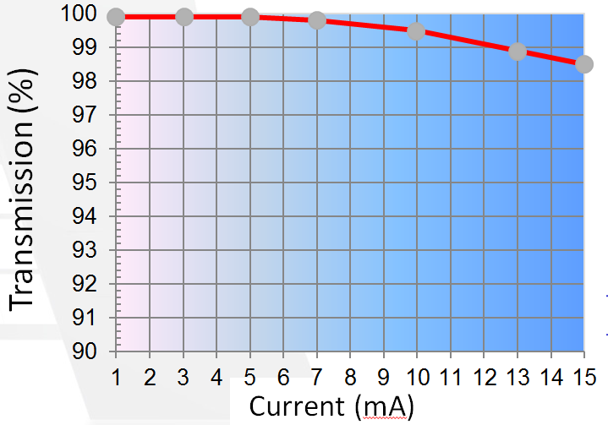
CW RFQ
Optimized for 5-10 mA beam current
Long adiabatic buncher
=> small L. emittance.
Input energy | 30 kV
Output energy | 2.1 MeV
Frequency | 162.5 MHz
Beam current | 1 – 10 mA
Output rms ⊥ emit. | 0.15 μm
Output rms L. emit. | 0.7 keV∙ns

Slide 11

MEBT
Optimize conditions for chopping (2 kickers, 180º phase advance)
20 kW internal beam dump
  Differential pumping to prevent residual gas flux to SC part
Triplet based transverse focusing (compensates strong SC force)
3 rebunching cavities to control longitudinal phase space

Slide 12
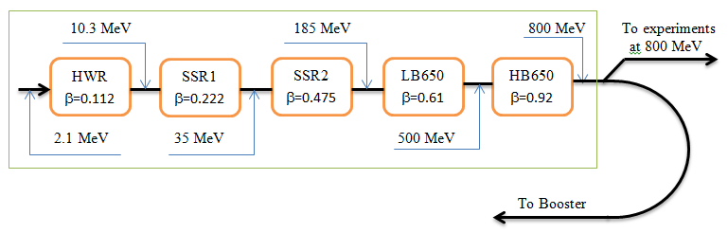
SC part of PIP-II linac
Transition points are chosen to minimize number of cavities/cryomodules (i.e. cost)
Altogether - 25 cryomodules
Type | N CM | Cav/CM
HWR | 1 | 8
SSR1 | 2 | 8
SSR2 | 7 | 5
LB650 | 11 | 3
HB650 | 4 | 6

Slide 13
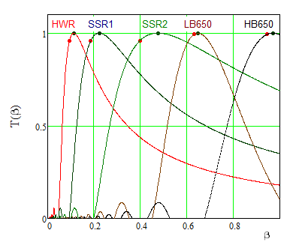
SC Cryomodules
  5 types of SC cavities
  required to cover
  required energy range
  Adiabatic damping makes
  reasonable frequency
  increase with increasing
  energy
  HWR – 162.5 MHz
  SSR1 & 2 - 325 MHz
  LB650 & HB650 – 650 MHz
  All subharmonics of ILC frequency
Transient time factors;
Black dots mark optimal betas
Red dots mark geometric betas

Slide 14
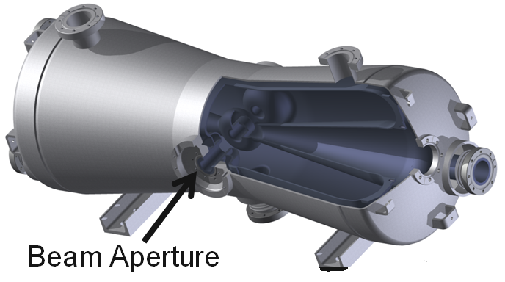
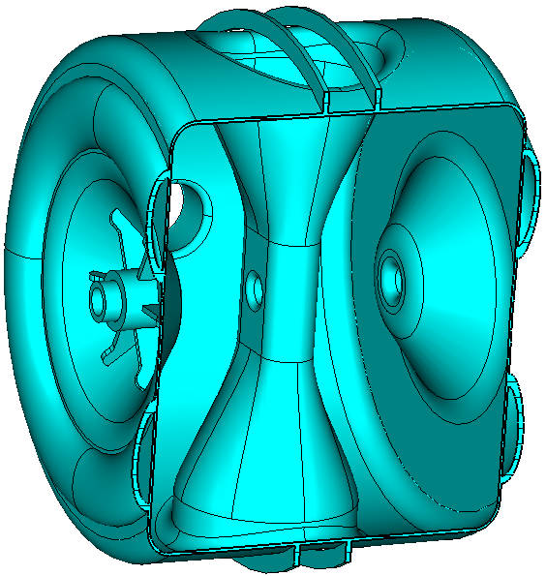
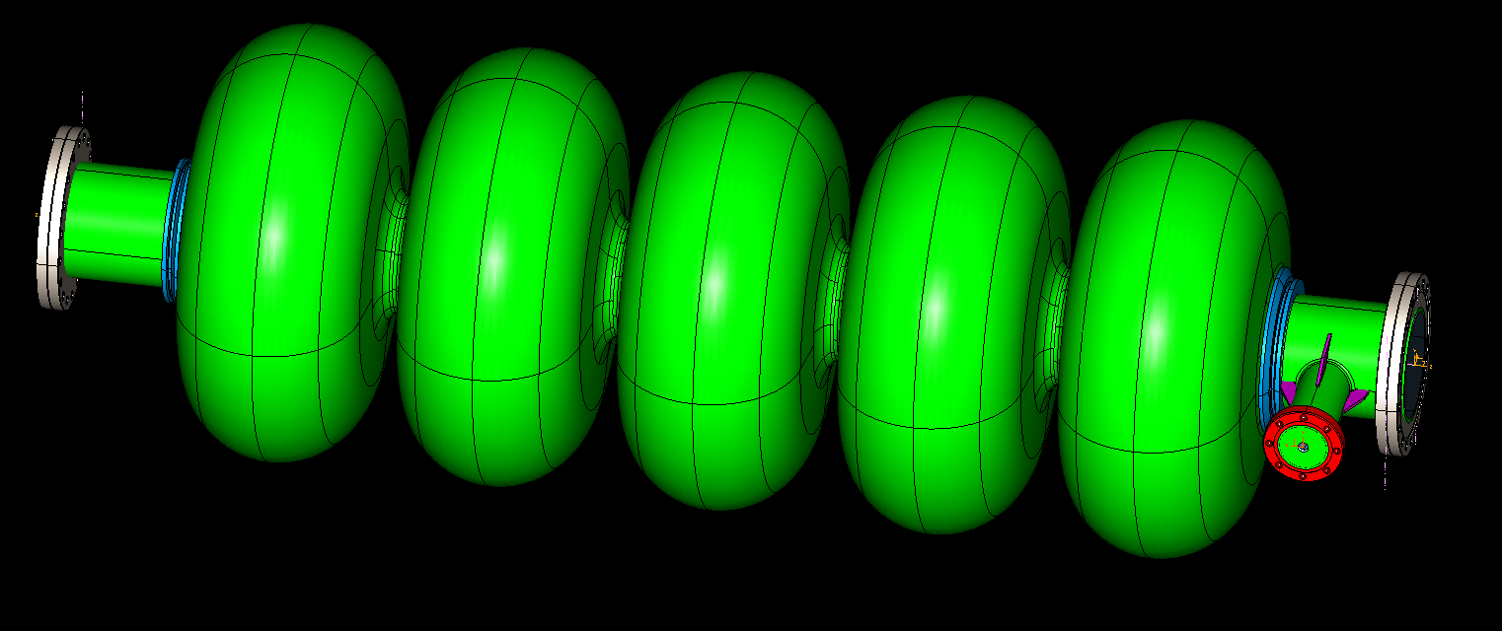
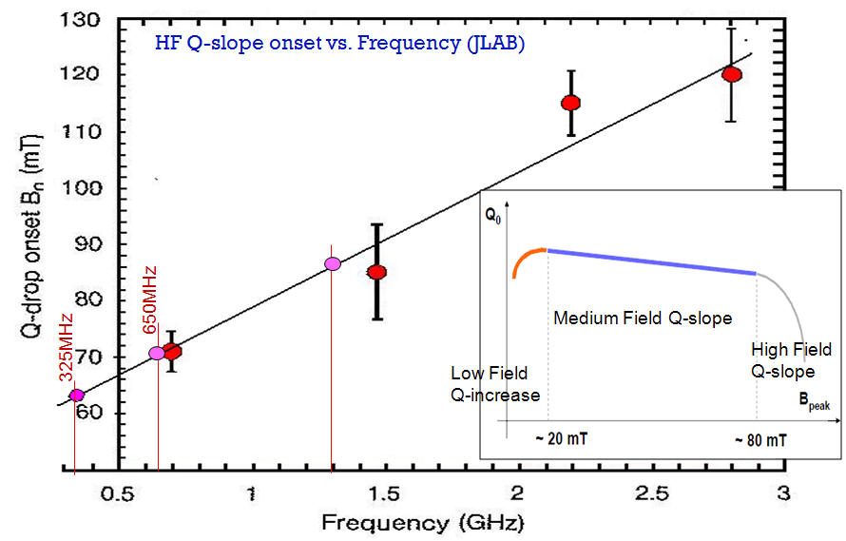
Main parameters of SC cavities
HWR SSR1&2 Elliptic (LB & HB650)
B_{peak} is set by the high field Q slope
It grows with frequency
Cavity type | Aperture (diameter) (mm) | Energy gain (MV) | Accelerating gradient (MV/m) | E_{peak} (MV/m) | B_{peak} (mT)
HWR | 33 | 2 | 9.7 | 45 | 48
SSR1 | 30 | 2.05 | 10 | 38 | 58
SSR2 | 40 | 5 | 11.4 | 40 | 65
LB650 | 83 | 11.9 | 15.9 | 38.5 | 72
HB650 | 118 | 19.9 | 17.8 | 38.3 | 72

Slide 15
SC Linac Design Choices
  Separate SC cryomodules
    Collimators between cryomodules to minimize beam loss inside them
    Solenoidal focusing for HWR, SSR1&2
      SC solenoids inside cryomodules (with attached BPMs and built-in trims)
  Doublet focusing between cryomodules for LB650 and HB650
    Warm correctors and BPMs
  Energy stability of ≈10⁻⁴ is supported by the beam based feedback
    Cavities of the last cryomodule are used for correction
    4 empty slots at the linac end are used for time-of-flight energy measurements
  All beam instrumentation with exception of BPMs in HWR and SSR1&2 cryomodules is located between cryomodules
  RF power is set by 2 mA beam current (SC linac can support up to 5 mA)

Slide 16
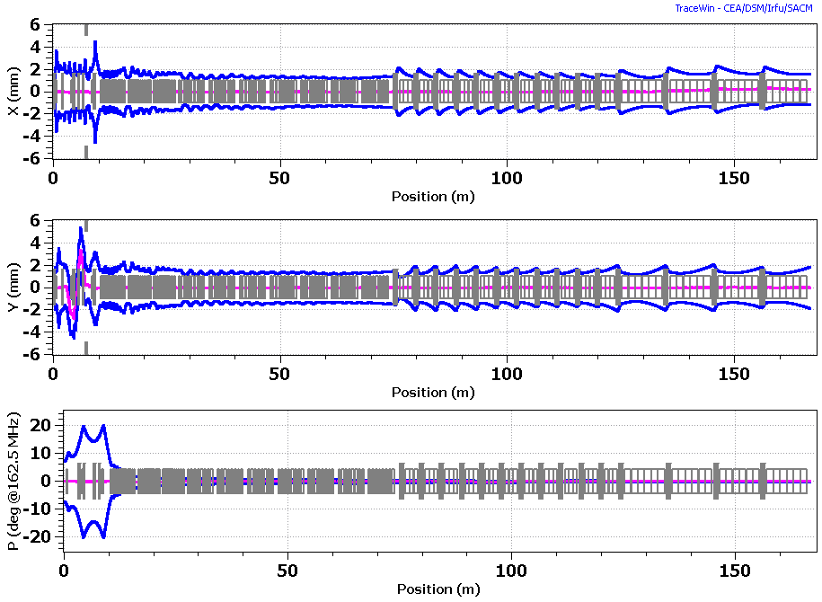
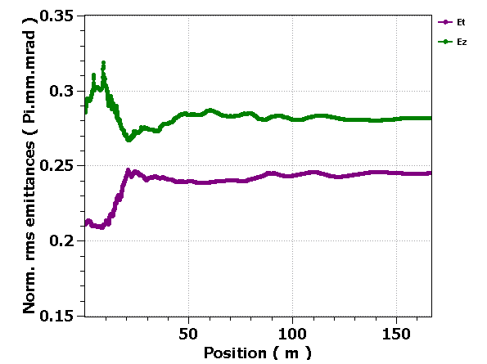
Beam Optics in MEBT and SC Linac
Beam is close to equipartitioning (ε_{x}≈ ε_{y}≈ ε_{s})
  Helps to prevent uncontrolled emittance growth
  L to ⊥ emittance exchange is found in simulations
Strong ⊥ defocusing
due to cavity fields
=> Strong machine
focusing
1σ envelopes

Slide 17
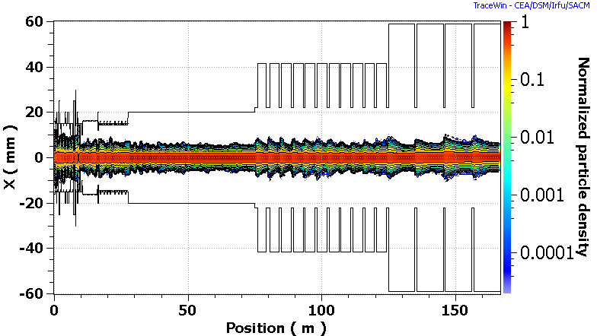
Beam Optics in SC Part (continue)
Simulations do not show dangerous halo growth
  Verified by SNS experience at ~twice larger value of N_{b}/ε⊥
  Ratio of beam size to aperture stays approximately the same downstream of HWR

Slide 18
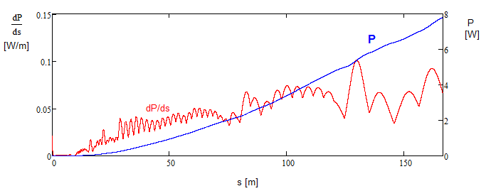
Beam Loss
Intrabeam stripping is the main source of particle loss in the SC linac
  The loss value (<0.1 W/m) for CW beam (2 mA, with 5 mA RFQ) is well within requirements
    Not an issue for PIP-II operating at ~1% duty factor

Slide 19
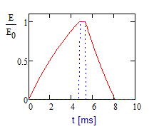
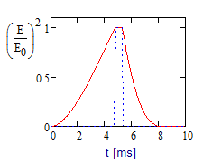
Cryogenic Requirements
New cryo-plant is planned to be built
  LBNF support requires an operation only in the pulsed regime
  Cost minimization => low power => low duty factor operation
=>
  Beam duty factor – 1.1%
  Fast cavity discharge using RF power with inverted phase
    Cryogenic duty factor ~ 5%
    RF duty factor ~12%
    4 times peak power increase in RF couplers at phase flip is supported by coupler design
  Fast tuner is required for pulsed operation
HWR can operate only in CW (no fast tuner)

Slide 20
Cryogenic Requirements
Dynamic and static loads are approximately equal
  Solenoids and couplers are included in the static load
  Conservative values for Q₀ – details in V. Yakovlev presentation
Cryo-plant power has sufficient operating margins at all temp.
  T[K] Cryo-plant(W) ΣCryomodules(W)
  70 4000 2830
  5 1500 715
  2 550 276
Rms pressure
fluctuations have
to be <0.1 mbar
  Passive
  microphonics
  suppression
Cryo-loads per CM at 2K
for accelerated cavity discharge
CM Type | Static cryo-load (W) | Cryo-duty factor, % | Dynamic cryo-load (W)
HWR | 14 | 100 | 23.3
SSR1 | 12 | 3.8 | 0.88
SSR2 | 9 | 5.3 | 2.8
LB650 | 3 | 5.2 | 4.0
HB650 | 5 | 5.2 | 10.3
Total | 146 | N/A | 130

Slide 21
RF Power Requirements
RF power requirements include
  Up to 20 Hz microphonics driven detuning
  1 dB allowance for regulation
  Power transfer inefficiency:
    0.5dB - HWR&SSR (coaxial);
    0.25 dB – LB&HB (wave guide)
CM type | Power trans-ferred to beam per cav. (kW) | Cavity half-bandwidth, f / 2Q_{L}, (Hz) | Peak RF power per cavity (kW) | Power of RF Amplifier (kW)
HWR | 4 | 33 | 6.5 | 7
SSR1 | 4.1 | 43 | 6.1 | 7
SSR2 | 10 | 28 | 17 | 20
LB 650 | 23.8 | 29 | 38 | 40
HB 650 | 39.8 | 29 | 64 | 70

Slide 22
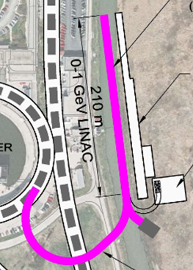
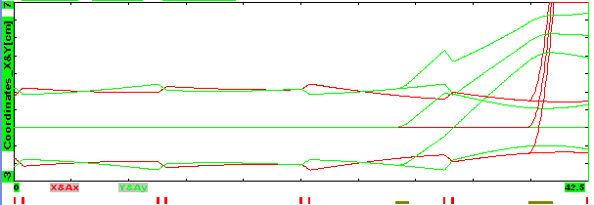
Beam Based Energy Stabilization
Local cavity feedback should stabilize its voltage and phase to better than 0.1% and 0.1º rms
Beam based stabilization
  Beam is sent to the beam dump for 10 - 30 μs
  Time of flight energy measurement is used
  to stabilize energy to 0.01% rms
    4 empty slots are reserved at the linac end,~40m
    Fast kicker and septum switch the beam
    from the beam dump to the Booster
Beam trajectories with 10σ envelopes in the beam switching

Slide 23
Microphonics and LFD
High accelerating gradient and the comparatively small beam current
=> small cavity bandwidth
=> high sensitivity to microphonics and LFD
The major sources of cavity detuning are:
  Variations in He pressure
  Mechanical vibrations driven by external sources
  Lorentz Force Detuning (LFD)
    Pulsed operation greatly complicates LFD compensation
Passive means
  Reduction of sensitivity to He pressure and LFD
  Engineering aimed at noise reduction in the tunnel
Active means
  Piezo tuners

Slide 24
Linac-to-Booster Transfer line

Slide 25
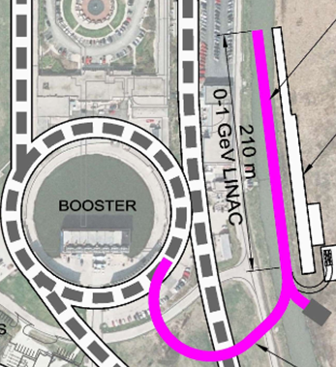
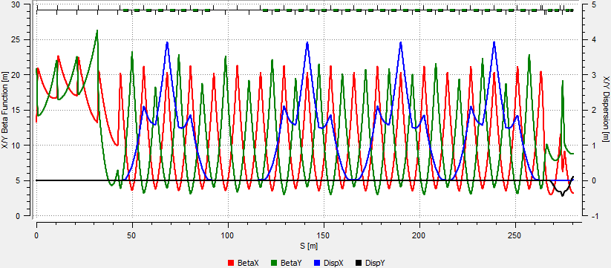
Linac to Booster Transfer Line
H⁻ Lorentz stripping (<10⁻⁸ m⁻¹) limits dipole field to 2.77 kG
for 1 GeV beam => the bending radius of dipoles to 20.7 m
Simple optics: all dipoles and most of quads have the same strength
Two arcs and a short straight between them
Sufficient place for collimators and possible debunching cavities

Slide 26
Booster

Slide 27
Performance Requirements for Linac Beam
Support Booster operation with increased beam power
  20 Hz repetition rate
  Beam pulse duration, 0.55 ms =290 turns (1.1% duty factor)
  Control bunch structure at single bunch level for injection
    Not harmonically related RFs: f_{Booster_Inj}=44.7 MHz; f_{Linac}=162.5 MHz
    84 RF buckets; 81 bunches; Extraction gap of 3 RF buckets
  2 mA average beam current (~4 mA peak)
  Transverse emittance: <0.3 mm mrad (norm.)
    To minimizes uncontrolled loss at injection
    To paint KV-like distribution
  Momentum spread: <3∙10⁻⁴
    To paint longitudinal distribution without tails and with minimum peak longitudinal density
  Rms relative energy stability: <10⁻⁴ (required for L. painting)
Be compatible with upgrade to high duty factor (CW) operat.

Slide 28
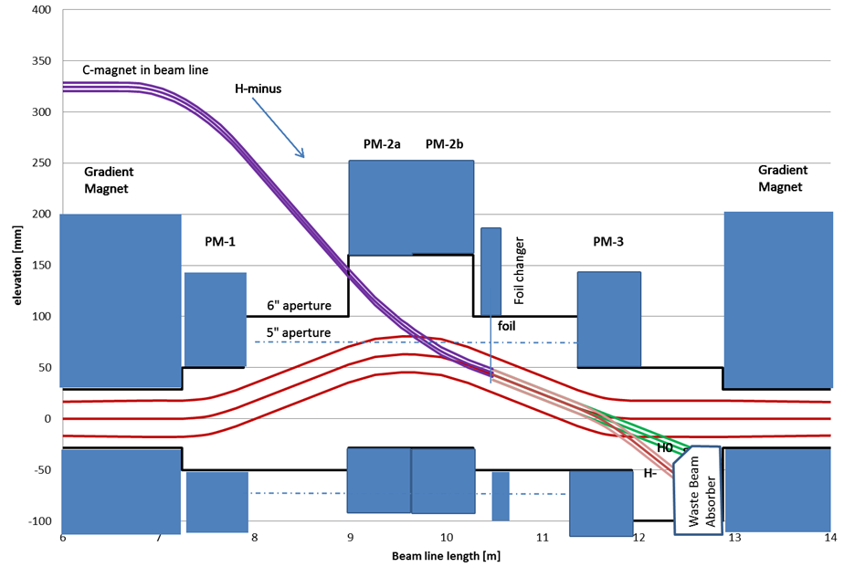
Booster Injection
H⁻ strip injection occurs through vertical dogleg allowing simple suppression of vertical dispersion
Vertical painting is done by changing dogleg dipoles and fast correctors in the beam line or by the correctors only
  linac beam stays
  at the same point
  of the foil
Booster correctors
are used for
horizontal
painting
Foil – 600 μg/cm²

Slide 29
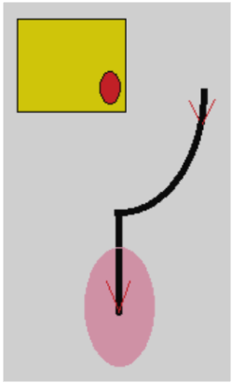
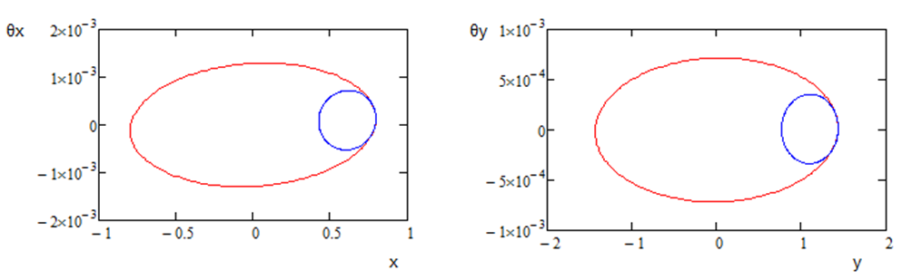
Transverse Painting
H⁻ strip injection (x-y correlated painting)
  Linac beam comes to the foil corner
    Like in the SNS but much smaller charge per cycle
  Reduced beta-functions for linac beam to reduce secondary heats of stripping foil
Zero dispersion of linac beam
Non-zero Booster dispersion and non-zero momentum offset reduce secondary hits

Slide 30
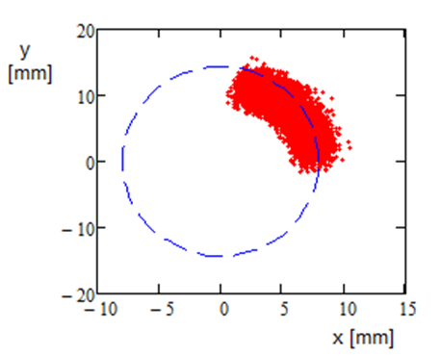
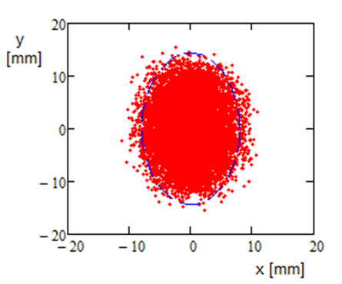
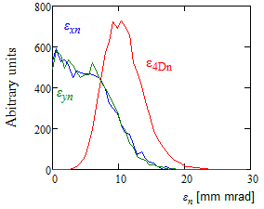
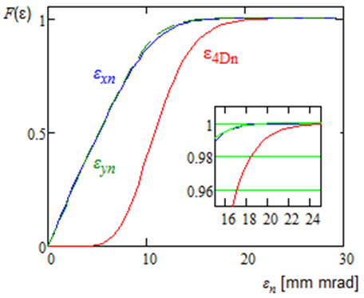
Transverse Painting (continue)
X and Y coordinates of injected particles relative to the current orbit position for particles incoming to the Booster (left) and at the end of injection process (right).
Left - the particle distribution over transverse CS invariant.
Right– the integrals of particle distributions (normalized to unity) presented in the left pane; ε_{95%n}=17 mm mrad

Slide 31
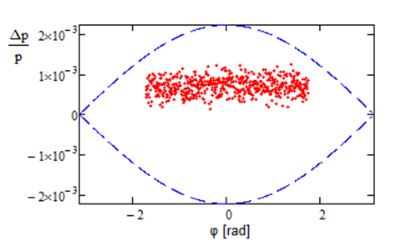
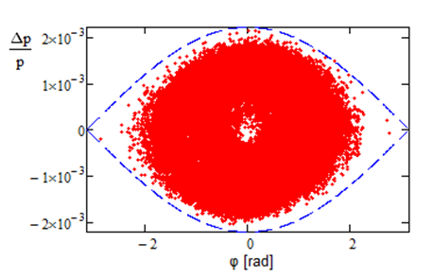
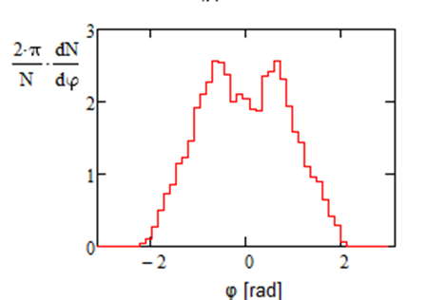
Longitudinal Painting in the Course of Booster Injection
Linac current | 2 mA
Duration of injection | 0.55 ms
- || - | 290 turns
- || - | 7 synchr. periods
Linac rms mom. spread | 2∙10⁻⁴
Booster bucket height | 2.2∙10⁻³
Momentum offset | +7∙10⁻⁴
Small tails in L. distribution
=> 10⁻⁴ energy stability

Slide 32
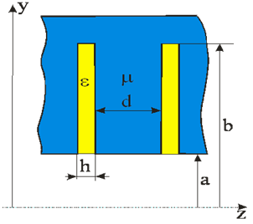
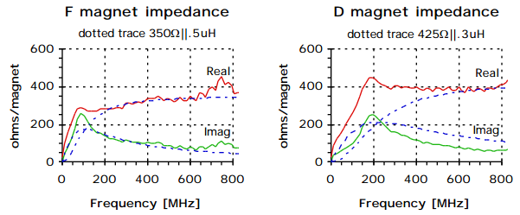
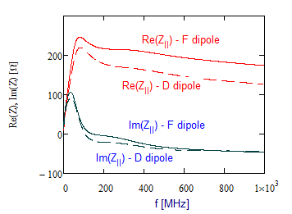
Booster Longitudinal Impedance
Beam aperture in Booster is formed by
poles of laminated dipoles (F & D)
  That greatly amplifies Booster impedance
Theoretical model yields results close to
the wire measurements (J. Crisp, 2001)
  But there is a discrepancy between
  measurements of F and D dipoles
=> Beam based measurements => final correction (~30%)

Slide 33
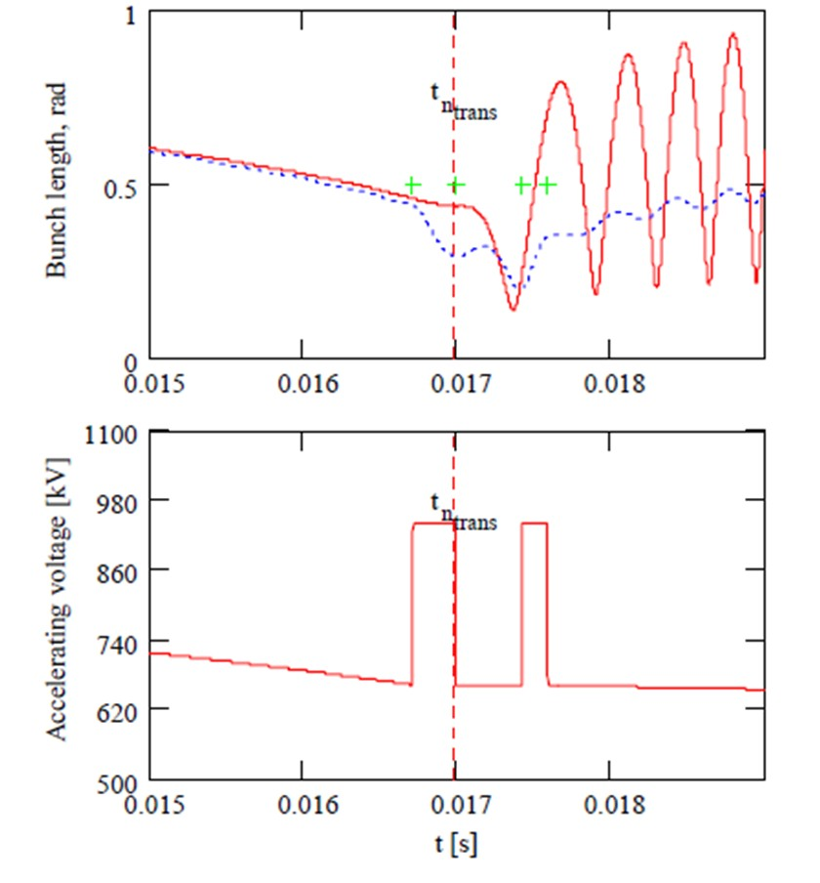
Booster Transition Crossing
150 kV decelerating voltage at transition + strong space charge
1.5 times larger bunch charge in the same long. emittance
RF voltage jump technique looks as a most promising method for transition crossing
Requires additional RF volts~300 kV
  150 kV due to impedance
  deceleration
  And 150 kV for voltage jump
Total required RF voltage ~ 1.1 MV
  Planned to be achieved with PIP
Simulations and experimental
studies were initiated
Most of work will be complete
in the course of PIP

Slide 34
Recycler and Main injector

Slide 35
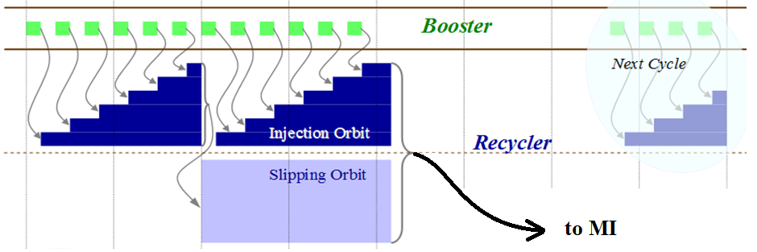
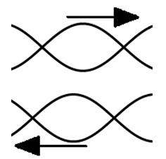
Slip Stacking in Recycler
Twelve Booster batches are slip-stacked in Recycler
An increase of Booster rep. rate from 15 to 20 Hz => faster slipping => larger momentum separation
  Δp/p=(1.26→1.68)∙10⁻³ (supported by Recycler accept.)
  => larger RF bucket size
  => smaller loss at slip stacking
New RF cavity
  Higher voltage
  Support for increased rep. rate at 60 GeV operation

Slide 36
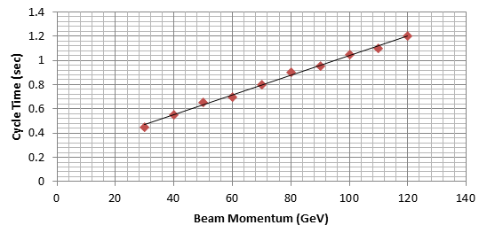
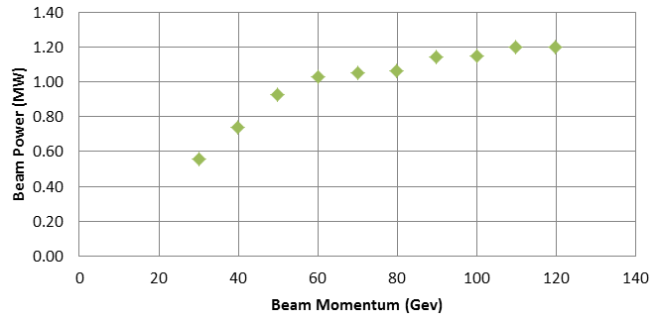
Beam Acceleration in MI
The accelerating rate in MI is determined by maximum slue rate of magnetic field and RF voltage
  That determines the dependences of
  (1) cycle time duration &
  (2) beam power
  on the final beam energy
MI RF power upgrade is required to support the beam intensity increase
γ_{t}-jump to be used for transition crossing
  Additional pulsed quads (8*3)

Slide 37
Primary Risks and Required R&D

Slide 38
Primary Risks and Required R&D
PXIE should mitigate most risks related to the frontend
Design and testing of SC cryomodules is time consuming process
  5 new types of SC cavities
    Doing good for HWR and SSR1
    vigorous design work for SSR2, LB650 and HB650 has to be initiated
Microphonics and LFD detuning suppression in SC linac
  Major challenge − reliable operation in pulsed regime
Longitudinal emittance growth at transition crossing in Booster can increase beam loss at slip stacking in Recycler
  It can limit the beam intensity and, consequently, the beam power
Suppression of fast beam instabilities at slip stacking in Recycler can be a challenging enterprise

Slide 39
Summary
The PIP-II proposal meets the performance goals established in the P5 report.
The PIP-II concept is described in detail in the Reference Design Report (released at the end of May)
  The concept does not differ significantly from what was developed 18 months ago
  This design concept and accompanying R&D program were reviewed by the P2MAC in March
The primary technical risks are understood and are being addressed in the PIP-II R&D program

Slide 40
Backup Slides

Slide 41
General Parameters of SC cryomodules
Conservative choice for Q₀ is based on the results obtained in real cryomodules
CM type | Cavities per CM | Number of CMs | CM configu-ration* | CM length (m) | Q₀ at 2K (10¹⁰) | Surface resis-tance, (nW) | Loaded Q (10⁶)
HWR | 8 | 1 | 8 × (sc) | 5.93 | 0.5 | 9.6 (2.75♠ ) | 2.7
SSR1 | 8 | 2 | 4 × (csc) | 5.2 | 0.6 | 14 (10#) | 3.7
SSR2 | 5 | 7 | sccsccsc | 6.5♦ | 0.8 | 14.4 | 5.8
LB650 | 3 | 11 | ccc | 3.9♦ | 1.5 | 12.7 | 11.3
HB650 | 6 | 4 | cccccc | 9.5♦ | 2 | 13 | 11.5
* “c” - denotes accelerating cavity; “s” - focusing solenoid.
♦ This number represents the present estimate of cryomodule length. It will be finalized with advances in the cryomodule design.
♠ Based on recent measurements of two HWR cavities at 2 MV accelerating voltage.
# Based on recent measurements of SSR1 cavities made of CABOT niobium.

Slide 42
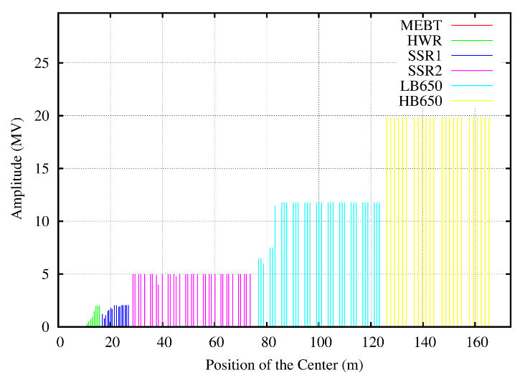
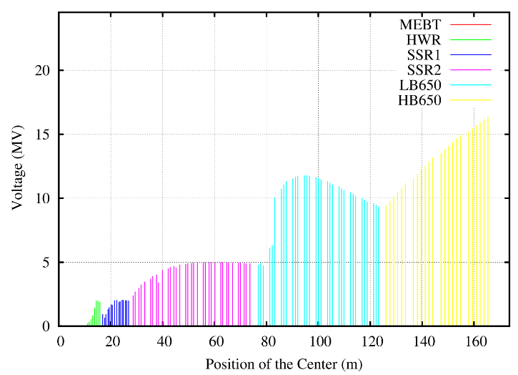
Accelerating Voltage
First HWR cavity has about half of nominal voltage to prevent longitudinal overfocusing
  Slow voltage increase in downstream cavities
Voltage is adjusted at the boundaries between different types of cryomodules
Accelerating voltage per cavity along SC Linac; optics is tuned to 5 mA RFQ beam current;
left – the voltage amplitude at the optimal beta,
right – the voltage amplitude with the transit-time factors accounted

Slide 43
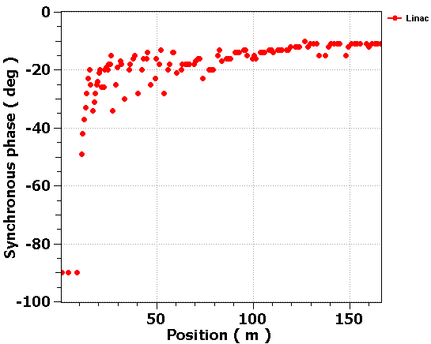
Phases of RF Cavities
Cavity phases are adjusted to control longitudinal beam envelope
MEBT cavities do not accelerate

Slide 44
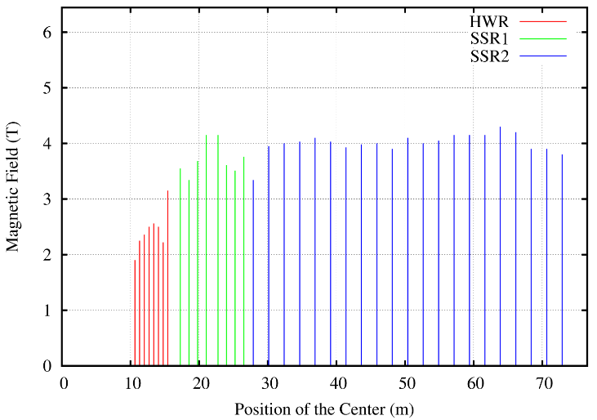
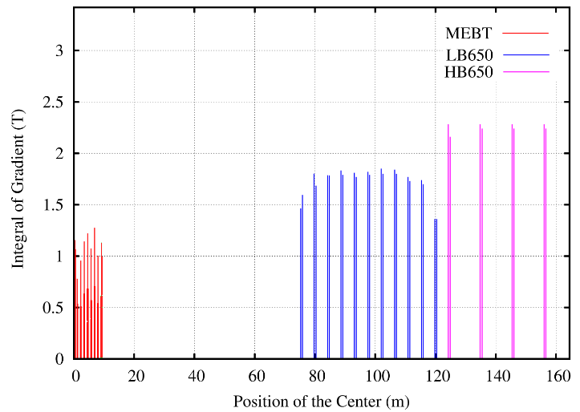
Transverse Focusing Strength
Comparatively small variation of focusing strength along the linac
  Magnets of the same design will be used
Magnetic field of focusing solenoids (left) and integral strength of quadrupoles (right) along the linac (MEBT quads are included). Optics is tuned to 5 mA RFQ beam current

Slide 45
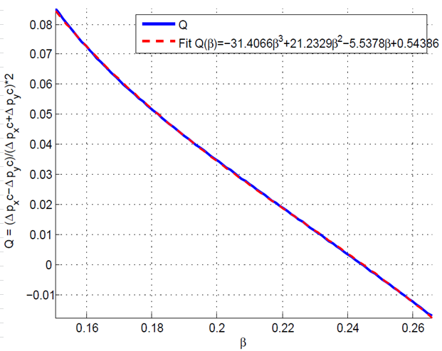
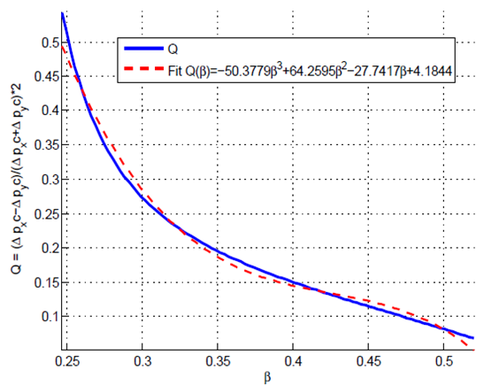
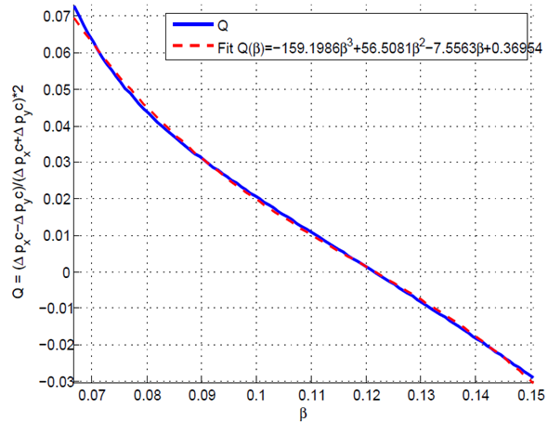
Quadrupole Fields of HWR and SSR cavities
Cavity asymmetry introduces velocity dependent quad fields
  Geometry is adjusted to nullify them in the range center
SSR1 & SSR2 cavities are rolled by 45º to adapt couplers
  Quad -> skew quad
  Skew quad correctors are located inside solenoids (part of dipole correctors package)
HWR SSR1 SSR2
Ratio of quadrupole focusing to axial symmetric focusing versus the particle velocity β in the operating domain

Slide 46
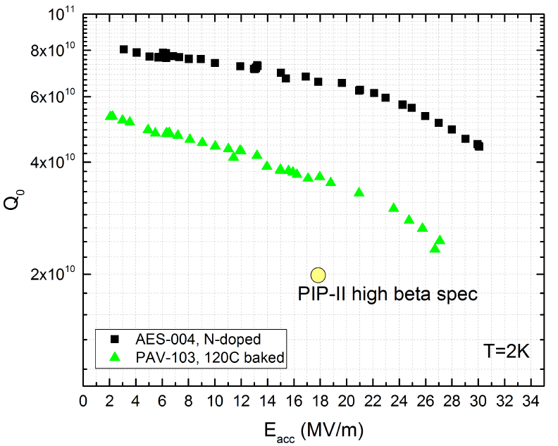

High Q₀ Studies
3 times increase of Q₀ was demonstrated in the vertical tests
  If this increase is transferred to the cryomodule
    10 times increase of beam duty factor from 1% to 10% (for the same cryo-plant)
      Corresponding cryo duty factor changes from 5% to 15%
Dependence of Q₀ on accelerating voltage for (1) 120C baked cavity and (2) N doped cavity; 2K, 650 MHz
Dependence of Q₀ on acc. voltage for N doped 650 MHz cavity for fast and slow cool downs.

Slide 47
Suppression of Microphonics and LFD
Tested HWR & SSR1 demonstrated better than specified df/dP
df/dE² for SSR1 results in Δf_{E} ~5 times larger than the cavity bandwidth
  Cannot operate in pulsed regime without fast (piezo) tuner
Mechanical design of HB650 is initiated
  Aimed at reduction of df/dP and df/dE²
CM type | HWR | SSR1 | SSR2 | LB650 | HB650
Sensitivity to He pressure (FRS), df/dP , Hz/Torr | <25 | <25 | <25 | <25 | <25
… (measurements), df/dP , Hz/Torr | 13 | 4.0 | - | - | -
Estimated LFD sensitivity, df/dE², Hz/(MV/m)² | - | -5.0 | - | -0.8 | -0.5
… (measurements), df/dE², Hz/(MV/m)² | -1.5 | -4.4 | - | - | -
Estimated LFD at nominal voltage (FRS), Hz | - | -500 | - | -192 | -136
… (measurements ) at nominal voltage, Hz | -122.4 | -440 | - | - | -

Slide 48
Suppression of Microphonics and LFD
Passive compensation
  Cavity to be designed to minimize sensitivity He pressure variat.
  Cryogenic system design has to limit ΔP below
    0.1 mbar rms
    1 mbar for maximum pressure deviation;
  Cryomodule design has to minimize transmission of external vibrations to the cavities;
  Civil engineering has to minimize vibrations in the tunnel and the transfer of these vibrations to cryomodules.
    Large compressors have to be well isolated from ground and be located far enough from the tunnel
Active compensation
  Resonant frequency correction with fast (piezo) tuner
    Feedforward for LFD + feedback
      First tests with SSR1 showed promising results
  Excessive RF power is required to support LLRF.

Slide 49



Foil Heating in the Course of Transverse Painting
Secondary foil heats make major contribution to the foil heating
Foil thickness - 600 μg/cm² => ~100% stripping efficiency
  Negligible effect on emittance growth
  0.1% single scattering loss
  Total beam loss <2% (mostly particles missing the foil)
Foil temperature is below 650Cº => long lifetime

Slide 50



Acceleration in Booster
Transition from 15 to 20 Hz rep. rate does not require additional RF voltage if beam current is not changed
  Due to smaller slip factor at injection
Increase of beam current (planned for PIP-II) requires additional voltage
  Deceleration due to RW impedance
  Suppression of quadrupole oscillations after transition
15 Hz 20 Hz

Slide 51

Coulomb Tune Shifts
Increased injection energy and KV-like transverse distribution reduce tune shifts due to beam space charge by more than factor of 2 relative to the present operation
Betatron tune shifts due to beam space for horizontal and vertical planes within accelerating cycle. The reduction of tune shifts due to non-Gaussian shape of the particle distribution is taken into account

Slide 52


Beam Based Calibration of Booster Longitudinal Impedance
Measurements are based on dependence of the accelerating phase with beam intensity
  That resulted in minor correction of parameters used in the model
Deceleration achieves its maximum at the transition (shortest bunch)
  ~150 kV/turn in the bunch center for PIP-II parameters

Slide 53

Booster Beam Stability Studies
A study of transverse instabilities in Booster is going on
  A. Burov, T. Zolkin and A. Macridin
Good coincidence between analytical model and computer simulations is obtained for:
  shape and frequencies of
  head-tail modes in the
  presence of strong space
  charge,
  Landau damping rates.
Reliable simulations of
stability boundaries for
Booster will follow
Curtesy of A. Macridin

Slide 54


MI Transition Crossing
Increased beam intensity and larger longitudinal emittance complicate transition crossing
γ_{t} jump is preferred method for transition crossing in MI
ESME simulations do not show significant increase of L. emittance and longitudinal tails
Additional hardware for fast tune change is required
Phase space distribution after transition in MI. The hole in the center is a result of slip stacking

Slide 55
Beam Stability in Recycler and MI
A study shows that instabilities related to beam interaction with vacuum chamber do not present outstanding problem
However a strong transverse instability has been observed in Recycler
  The only credible explanation is related with electron multipacting which results in the ep instability
    Studies are going on
    An instability threshold is increasing with time
      Vacuum chamber conditioning is the most probable reason
  A number of actions is planned to mitigate the problem for NOvA
Better understanding of instability is required to make reliable prediction of beam stability for PIP-II parameters

Slide 56
High Duty Factor Experiments
PIP-II design is compatible with CW operation
The only exception is the cooling power of cryo-plant
  It is set by requirement to support >1 MW MI operation
    Corresponding to 1% beam duty factor and 5% cryo duty factor
Success of high Q₀ program will allow operation with ~15% cryo duty factor
=> beam duty factor 1% -> 10%
  Such duty factor can be acceptable for Mu2e upgrade
  Further increase of duty factor will require an upgrade of the cryo-plant

