Slide 1
Accelerator Division View
Sergei Nagaitsev
DOE Independent Project Review of PIP-II
16 June 2015

Slide 2
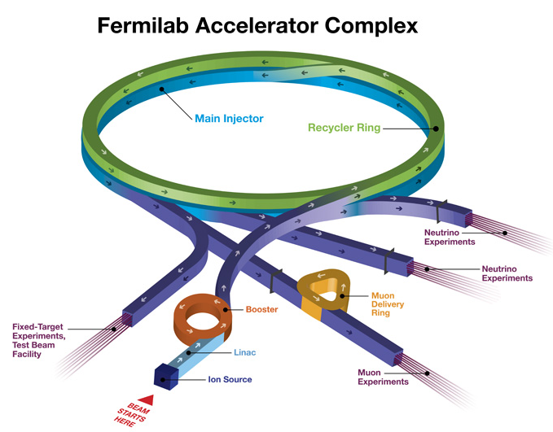
Fermilab Accelerator Complex
Linac: MTA
BNB: MicroBooNE
NuMI: MINOS+, MINERvA, NOvA
Fixed Target: SeaQuest, Test Beam Facility, M-Center
Muon: g-2, Mu2e (future)
Fabrication, Test and R&D facilities.
~16 km of accelerators and beamlines, second largest accelerator
complex in the world. About 700 FTE accelerator-related workforce.

Slide 3
Accelerator and Technical Divisions
AD: 450 FTEs, of which 115 FTEs are working on various projects (including 24 FTEs on PIP-II) in various stages of completion.
TD: 230 FTEs (highly project-oriented)
Two core technology competencies: SCRF and Magnets (sc and warm)
Several projects end starting in FY17 and we are planning to redirect the workforce to PIP-II.

Slide 4
Adapting the division organization
Muon department replaced Tevatron and Pbar departments
New PIP-II department
Accelerator Physics Center:
Missions: PIP-III R&D (>2 MW), Modeling, MAP, Education and Training
New Target Systems department
Responsibility for NuMI, BNB, g-2, Mu2e target stations
LBNF target design
R&D in high-power targets and radiation damage in target environments (Multi
We are preparing the organization for high-power neutrino projects (LBNF and PIP-II)

Slide 5
Priorities
Priorities help us decide what to work on
Importance x Criticality = Priority
(strategy) x (time)
Importance is the overall strategic value
Criticality is a time issue…must this be done now based on schedule, external commitment, or a window of opportunity?
Common sense, good judgment, emergency response, … always needed of course (employees & supervisors)

Slide 6
May 2015
Importance rankings for lab-wide Priorities
LBNF + DUNE
LCLS-II (we must deliver….and we are)
PIP-II
LHC Upgrades (CMS, LARP, …)
Muon g-2 (go go go) (high criticality here)
Mu2e (go go go) and associated AIPs
Operations in order:
NOvA
MicroBoone
Everything else
SBN (small but fast track)
Cosmic projects and ops (small but leveraged)
R&D (a core competency) accelerators & detectors

Slide 7
Proton Improvement Plan Goals and Scope (Established in 2011)
Increase the Booster beam repetition rate from the present ~7.5 Hz to 15 Hz
Need at least 9 Hz for NOvA 12-batch slip-stacking
Requires refurbishment of Booster RF cavities
Eliminate major reliability vulnerabilities and maintain reliability at present levels (>85%) at the full repetition rate
Eliminate major obsolescence issues
Increase the proton source throughput, with a goal of reaching >2E17 protons/hour
Presently operating at <1E17 protons/hour
Ensure a useful operating life of the proton source through at least 2025 (now extended to 2030 to accommodate PIP-II schedule)

Slide 8
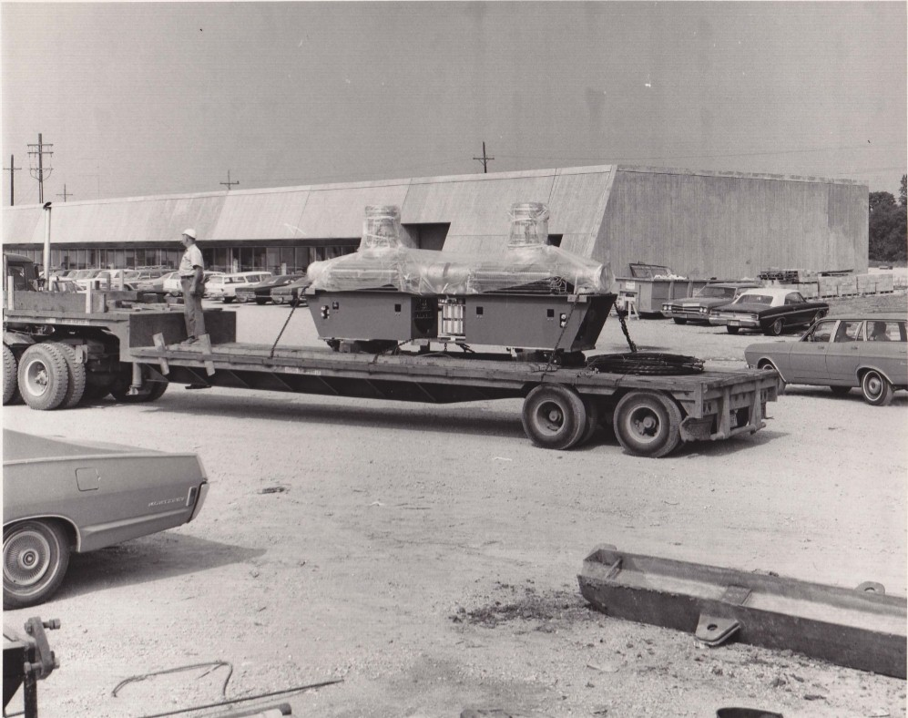
Booster RF cavities
July 1970 Flatbed semi delivering Booster RF cavity pair
Cavities built by GE

Slide 9
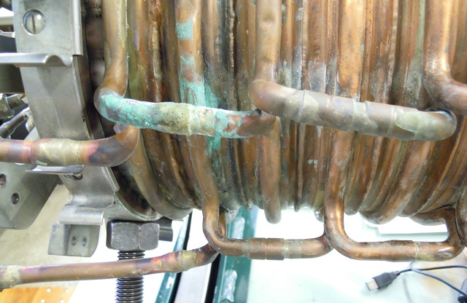
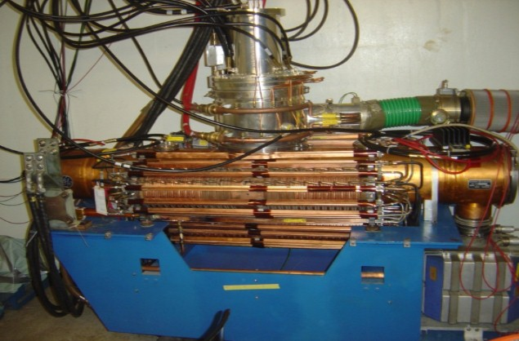
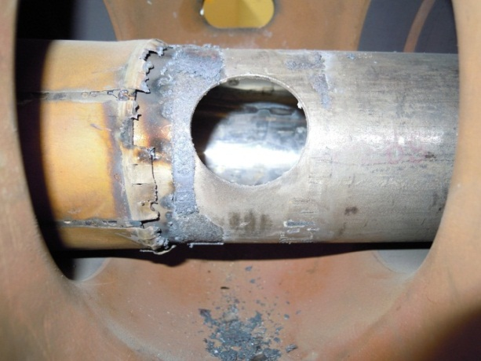
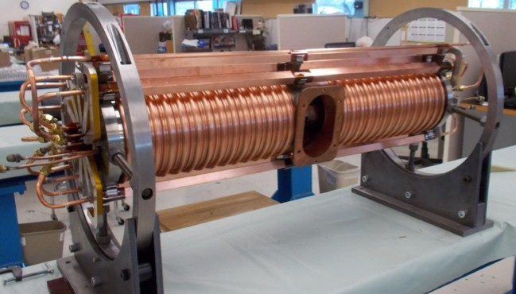
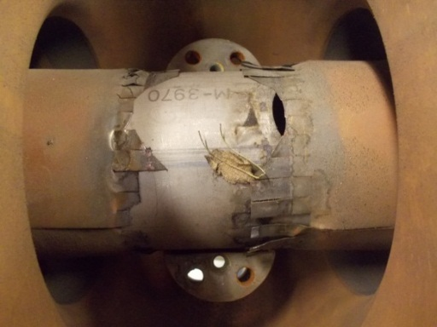
PIP – Booster Cavity Refurbishment
Has been a challenge but now almost complete (17th of 22 stations this month)
East gallery complete and running 15 Hz tests
Additional 20th cavity being tested 15 Hz (salvaged original cavity – major rebuild)
After 2+ years vendor able to produce suitable ferrite for new tuners
Old cavities had many problems - especially the tuners:
Water Leaks
Burnt RF Fingers
Connection Flange
First new tuner – built & tested

Slide 10
Goals for the next couple of years
Ramp up beam power to 700 kW for NOvA (FY16)
Achieve 15 Hz Booster beam pulse repetition rate as soon as possible by carrying out Proton Improvement Plan (FY16)
Complete Muon Campus construction on budget and on schedule and commission g-2 experiment in FY17
Finish PIP in FY19 and move on to PIP-II

Slide 11
Once PIP Completed
Only remaining original hardware in Booster will be the magnet system and some small fraction of utilities
All other systems will either be relatively new (<10 years) or significantly upgraded
Linac upgrades will allow reliable delivery (>85 % uptime) of beam till 2023
Plans for longer lifetime operations, 2025 and beyond, will not be pursued such as the replacement of high power 7835 triode

Slide 12
We are fully committed to make the jump!
700 kW PIP II
1.2 MW

Slide 13
R&D toward multi-MW beams and targets at Fermilab
Beyond PIP-II (mid-term)
Strategy after PIP-II depends on the technical feasibility of each option and the analysis of costs/kiloton versus costs/MW
R&D on cost-effective SRF, control of beam losses in proton machines with significantly higher currents (Q_{SC}) and on multi-MW targets
Establishing IOTA facility to explore novel approaches to rings
PIP-II

Slide 14
Summary
Fermilab delivers the highest-power proton beam for neutrinos now.
We are fully committed to maintain our leadership in the future.
We are fully capable of executing complex accelerator projects.
We will make what is necessary to make PIP-II project executed on budget and on schedule.

