Slide 1
Mission Need for PIP-II
Regina Rameika
DOE Independent Project Review of PIP-II
16 June 2015

Slide 2
Outline
Mission Need : P5 + DOE Strategic Plan
Physics goals and requirements for beams and detectors
Present capability of accelerator complex ➔ capability gap
Proposed solution : a new/upgraded facility
Notes:
After looking through the entire talk I would suggest reorganizing so that it more directly aligned with the structure of the Mission Needs Statement, and is more directly tied to the P5 report. This would mean starting with the mission need description (physics goals and how this translates into performance requirements on the accelerator and detector) followed by a comparison with present capabilities, and then culminating in the design criteria for a new/upgraded facility. I would suggest that the design criteria should be your last slide before the summary and that the summary be a bulletized form of the MNS. This will feed directly into my talk

Slide 3
P5 Science Drivers
Use the Higgs Boson as a New Tool for Discovery
Pursue the Physics Associated with Neutrino Mass
Identify the New Physics of Dark Matter
Understand Cosmic Acceleration : Dark Energy and Inflation
Explore the Unknown : New Particles, Interactions, and Physical Principles

Slide 4
Recommendations from May 2014 P5 Report
Recommendation 12: In collaboration with international partners, develop a coherent short- and long-baseline neutrino program hosted at Fermilab.
Recommendation 13: Form a new international collaboration to design and execute a highly capable Long-Baseline Neutrino Facility (LBNF) hosted by the U.S. To proceed, a project plan and identified resources must exist to meet the minimum requirements in the text. LBNF is the highest-priority large project in its timeframe.
Recommendation14: Upgrade the Fermilab proton accelerator complex to produce higher intensity beams. R&D for the Proton Improvement Plan II (PIP- II) should proceed immediately, followed by construction, to provide proton beams of >1 MW by the time of first operation of the new long-baseline neutrino facility.

Slide 5
Mission Need : DOE Strategic Plan 2014 - 2018
Strategic Objective 3 : Deliver the scientific discoveries and major scientific tools that transform our understanding of nature and strengthen the connection between advances in fundamental science and technology innovation.
Strategies to achieve this objective :
  Conduct discovery-focused research to increase our understanding of matter, materials and their properties through partnerships with universities, national laboratories, and industry;
  Provide the nation’s researchers with world-class scientific user facilities that enable mission-focused research and advance scientific discovery;
  Use the national laboratory system and leverage partnerships with universities and industry to conduct mission-focused research.
PIP-II at Fermilab will deliver science + technology

Slide 6
Mission Need : Understanding Neutrinos
Neutrinos are the most ubiquitous and puzzling of known particles
Menu of a discovery program :
  Determine if neutrinos violate leptonic CP and by how much
  Extract multiple detailed properties of neutrinos in a single experiment to test the current 3-flavor paradigm
  Look for surprises
  Search for nucleon decay (because we need very large detectors)
  Detect thousands of neutrinos from galactic supernova explosions
  And more

Slide 7
Mission Need : Understanding Neutrinos
FNAL currently operating two neutrino beams : NuMI and BNB
  NuMI : 120GeV, 3e20 POT/yr ➔ >6e20 POT/yr (@700kW)
  BNB : 8 GeV, ~1 – 2 e20 POT/yr (depends on rate to NuMI)
Collecting DATA from NOvA, Minerva, MINOS+ and soon MicroBooNE!
PHYSICS
  neutrino mass and mixing, mass hierarchy
  cross-sections
  sterile neutrinos
  resolve anomalies
At this time, the U.S. has a unique opportunity to host a flagship global program : LBNF/DUNE to study and possibly discover CP violation in the leptonic sector
  LBNF is a natural progression from NUMI/MINOS and NOvA, and the expertise exists at Fermilab to host this facility
  DUNE is a highly motivated, experienced and well organized international team that has assembled quickly and is anxious to begin

Slide 8
Next Generation Long Baseline Neutrino Experiment : DUNE
DUNE will be a world-class accelerator-based neutrino experiment for CP violation searches and more!
  Baseline of 1300 km
    For the determination of the mass hierarchy AND measuring the CP violating phase
  Wide-band neutrino beam of 0.5 – 5GeV
    Enough statistics to fit event spectra for both neutrinos AND anti-neutrinos
  Underground Liquid Argon Detector of ~40kT mass
    Excellent signal efficiency and background rejection
  High Resolution Near Detector
The combination of these components make LBNE a very effective way to get to neutrino CP-violation physics
Underground leads to extended physics capabilities (supernova, proton decay, ….)
Full scope may need to be achieved in stages

Slide 9
From P5 report
For a long-baseline oscillation experiment, based on the science drivers and what is practically achievable in a major step forward, we set as the goal a mean sensitivity to CP violation of better than 3σ (corresponding to 99.8% confidence level for a detected signal) over more than 75% of the range of possible values of the unknown CP-violating phase δCP.
  By current estimates, this corresponds to an exposure of 600kt*MW*y assuming systematic uncertainties of 1% and 5% for the signal and background, respectively. With a wideband neutrino beam produced by a proton beam with power of 1.2 MW, this implies a far detector with fiducal mass of more than 40 kilotons (kt) of liquid argon (LAr) and a suitable near detector.
The minimum requirements to proceed are the identified capability to reach an exposure of at least 120 kt*MW*yr by the 2035 timeframe, the far detector situated underground with cavern space for expansion to at least 40 kt LAr fiducial volume, and 1.2 MW beam power upgradable to multi-megawatt power.
Neutrino Experiments Need : Mass * Power * Time

Slide 10
From DUNE CDR – May 2015

Slide 11
STATISTICS in Neutrino Experiments
Neutrino Events/Unit Time =
Neutrino Flux x
Neutrino Cross-section/Nucleon x
Number of Nucleons
BEAM = Protons/year +
Target/horns, Beam Energy
PHYSICS!
Detector = Mass +
Efficiency
Neutrino Experiments Need : Mass * Power * Time
We want to achieve our physics goals in a timely manner!
Notes:
You might point out that the neutrino flux is pretty much proportional to protons/time x proton energy = beam power

Slide 12
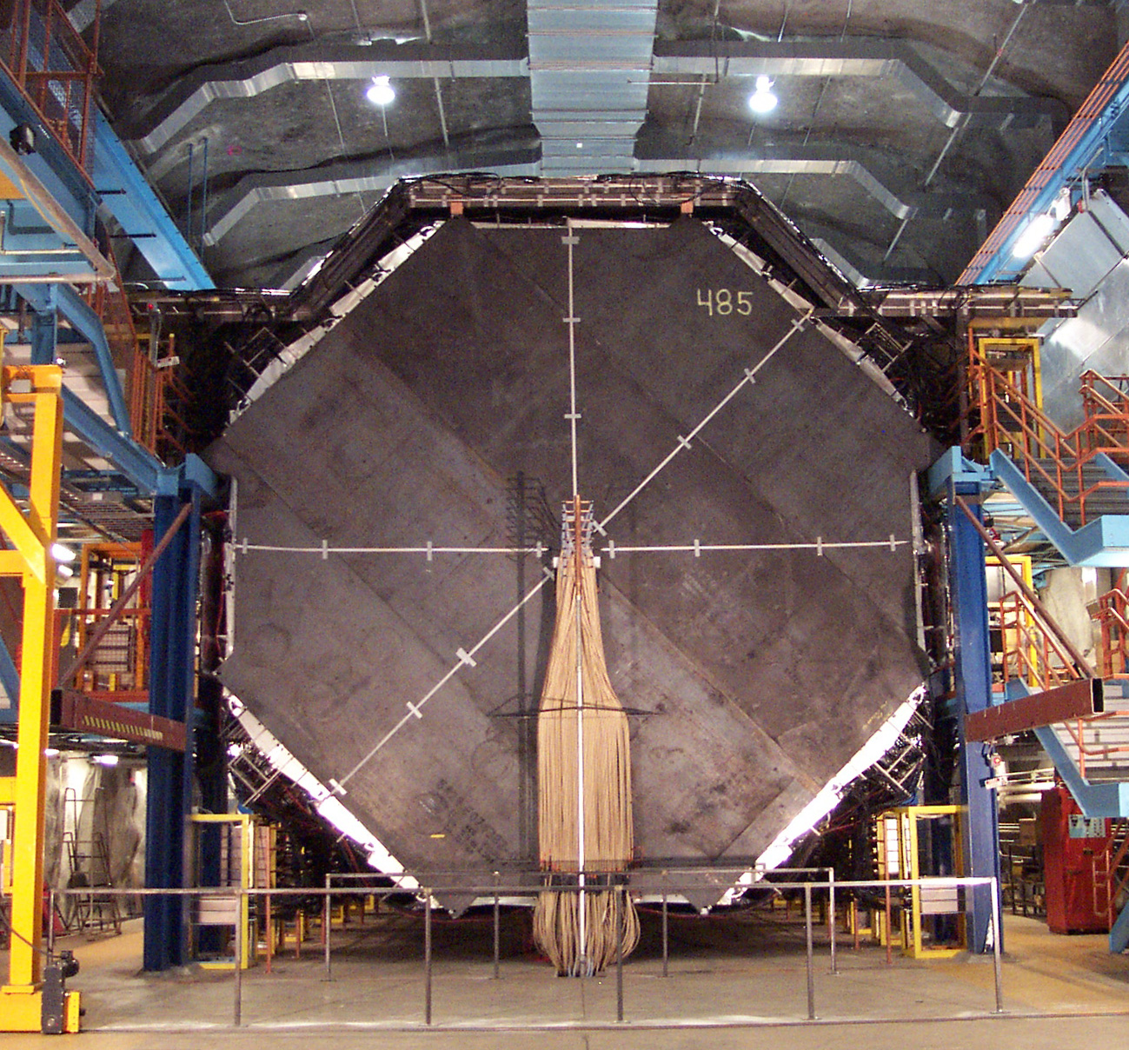
Mass : Neutrino Detectors are large!
MINOS Far Detector :
5kTon Fe-Scintillator
(NuMI on-axis @ 735km)

Slide 13
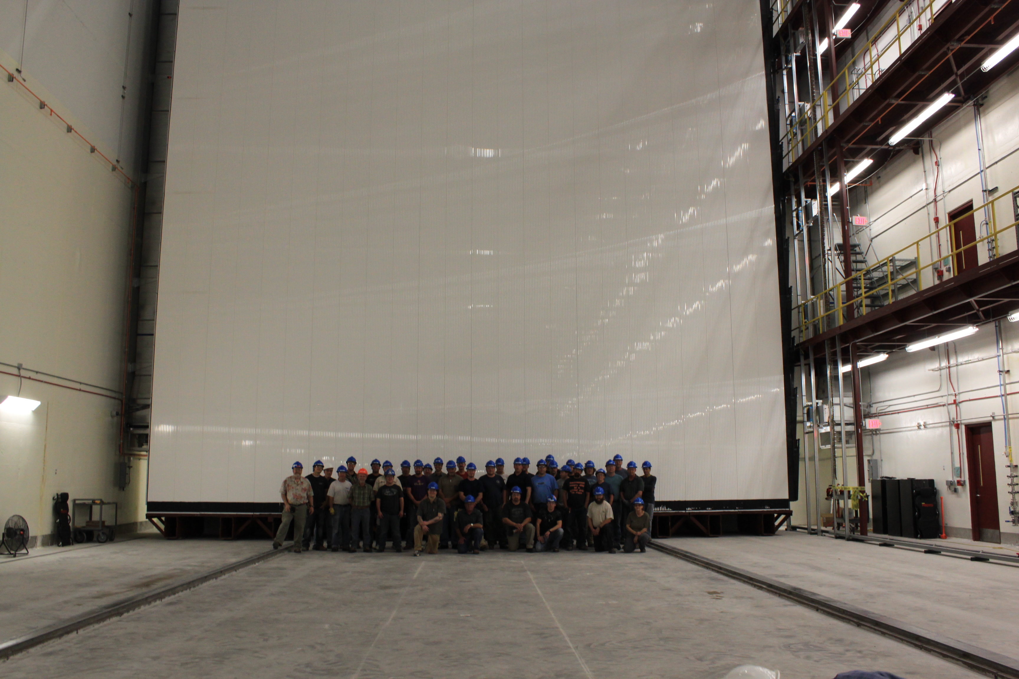
And getting larger ….
NOvA 14 kTon Liquid Scintillator Far Detector
(810km – NuMI off-axis)

Slide 14
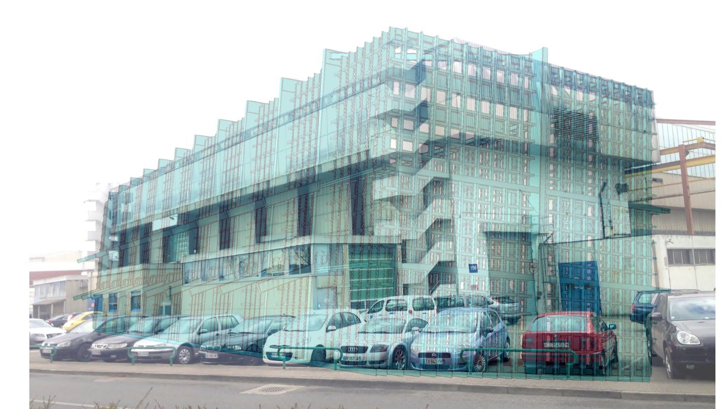
A 10kT fiducial mass detector
Size of a single 10kT detector

Slide 15

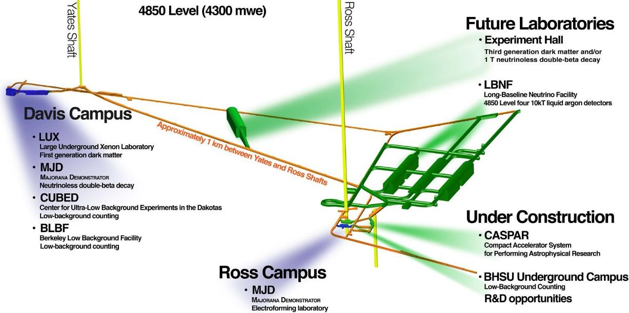
Plan is to build 4 of them 1 mile underground
Reference design:
Rectangular caverns
4 caverns, each to hold a 10 kt fiducial mass detector
Central utility cavern to house cryogenic equipment and common utilities
Potential interleaved excavation, outfitting, cryogenics and cryostat and detector installation is envisioned.

Slide 16
Power : Current high power operation and plans for NuMI
The MI has been delivering 2.4E13 ppp every 1.333 sec by using the Recycler as a proton stacker (6 batches, no slip stacking).
  350 KW beam power (315 KW with SY120)
On March 5th, 2015 it switched to 2+6 operation, currently delivering ~420 KW of beam power.
  453 KW new MI Beam Power record (running without SY120) achieved on March 25th, 2015.
Plan to demonstrate 4+6 operation in June 2015, before the summer shutdown.
Achieve 575 KW with 4+6 operation-November 2015 (19 re-furbished Booster RF stations, 7.5 Hz operation).
Achieve 700 KW with 6+6 operation-Feb. 2016 (20 re-furbished Booster RF stations, 9 Hz operation).

Slide 17
Time : Neutrino experiments take time
Consider several options for how one could reach the P5 goals
We see that the existing 700kW capability, even when paired with the full detector mass leads to an unrealistic time line for achieving the physics goals
Given the size and complexity – it is difficult to imagine more mass (at least at this time)
Notes:
It would make more sense if the left column of this table was 120 kT-MW-years since that is the P5 recommendation.
This table is basically the statement of need for LBNF based on the P5 report. This needs to feed directly into PIP-II design criteria.

Slide 18
Time : Neutrino experiments take time
Consider several options for how one could reach the P5 goals
We see that the existing 700kW capability, even when paired with the full detector mass leads to an unrealistic time line for achieving the physics goals
Given the size and complexity – it is difficult to imagine more mass (at least at this time) 40kT with 1.2 MW is a 20 year program
Notes:
It would make more sense if the left column of this table was 120 kT-MW-years since that is the P5 recommendation.
This table is basically the statement of need for LBNF based on the P5 report. This needs to feed directly into PIP-II design criteria.

Slide 19
Protons ➔ Neutrino Flux
Conventional Neutrino Beam = target + focusing horns + decay volume
  Design choices made to optimize the flux and provide reliable operation
  Lot’s of design effort, not an additional factor of two to be found

Slide 20
LBNF/ DUNE Schedule Summary Overview
SCHEDULE CONTINGENCY:
24 months on CD-4a
31 months on CD-4b
Dec-19
CD-2/3c Project
Baseline/ Construction
Approval
Jul-15
CD-1 Refresh
Review
Feb-23
CD-4a (early completion)
Sep-27
CD-4b (early completion)
Jan-16
CD-3a
May-18
CD-3b
Feb-25
DOE CD-4a
Apr-30
DOE CD-4b
24 months
31 months
CFFS Preliminary & Final Design
FSCF Excavation and Caverns
Cryostat and Cryogenics Construction
FD Detector Design and Prototyping
FD Detector 1-4 Procurement assembly, installation, filling, commissioning
CFNS Preliminary & Final Design
Near Detector & Beamline Design
Near Detector Procurement and Assembly
Beamline Conventional Facilities and Component Installation
N.D. Hall & Install of Near
Detector in Hall
ND Commissioning
FY15
FY16
FY17
FY18
FY19
FY20
FY21
FY22
FY23
FY24
FY25
FY26
FY27
Beamline Installation
LBNF at the Far Site Complete
Near Detector Installation
Detector #1 Commissioned
NSCF Installation
LBNF at the Near Site Complete – Beamline Components Installed

Slide 21
Timeliness is important

Slide 22
Strategic Risk of Not Filling the Capability Gap
The Fermilab complex, when fully operational at 700kW does not allow for a timely execution of the neutrino science program that is proposed (LBNF/DUNE)
  Additionally, by 2021 the accelerator complex will be 50 years old
The proposed Hyper-K experiment in Japan is complimentary to the DUNE experiment, and execution of both would provide an outstanding attack on the open neutrino questions.
If a timely solution to the proton power problem is not realized, the DUNE experiment risks missing the opportunity for significant scientific discovery

Slide 23
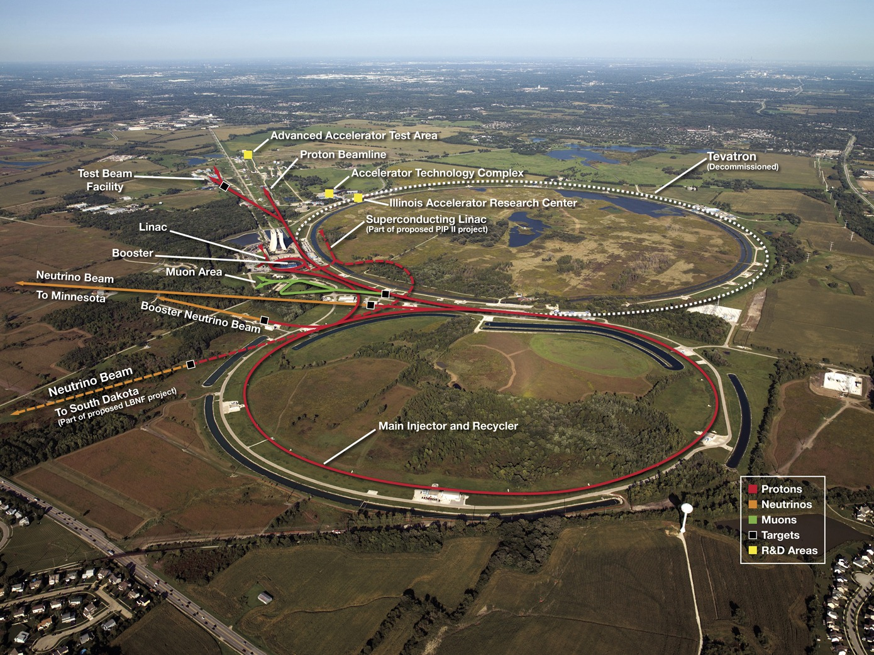
The accelerator complex supports a diverse program
Neutrinos
  NuMI
  BNB
Muons
  g-2
  Mu2e
Test beams
Fixed Target

Slide 24
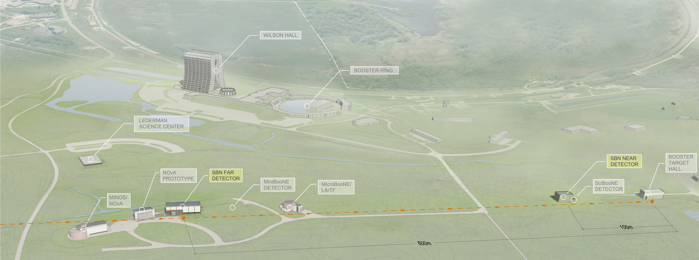
Short-baseline Neutrino Program
P5 Recommendation 12: In collaboration with international partners, develop a coherent short- and long-baseline neutrino program hosted at Fermilab.
3 detector LArTPC program using the Booster Neutrino Beam
Just getting underway in 2018

Slide 25
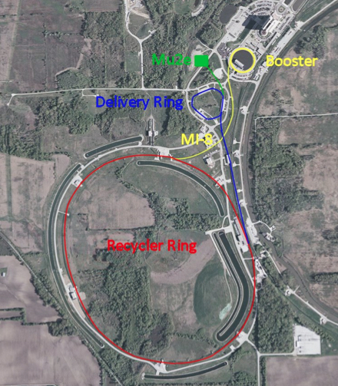
G-2 and Mu2e beamlines
g-2 and Mu2e will use
  8 GeV protons from the Booster
  Re-bunched in the Recycler
  Slow-spill from Delivery Ring
Do not run simultaneously
Each can run simultaneously with BNB and NuMI
g-2 would benefit from more protons
Mu2e will benefit in long term with CW at 800MeV

Slide 26
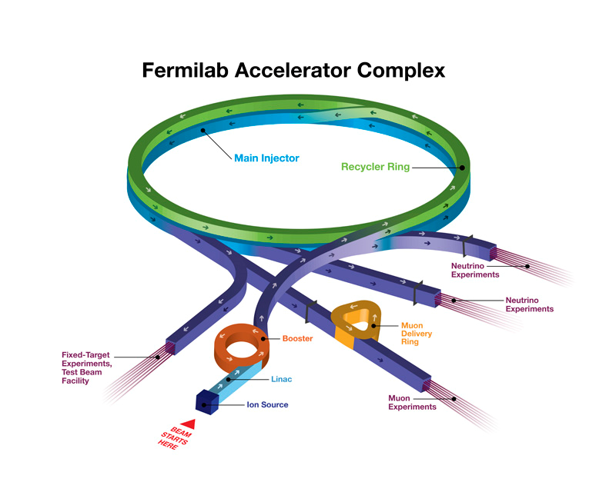
PIP Improvement
The Fermilab complex will be capable (in 2016) of delivering protons at both 8 and 120 GeV, in support of the neutrino and muon programs:
  Booster: 4.3×10¹² protons @ 8 GeV @ 15 Hz = 80 kW
  MI: 4.9×10¹³ protons @ 120 GeV @ 0.75 Hz = 700 kW
Limitations
  Booster pulses per second (15 Hz)
    Total power available to 8 GeV
    program limited by the repetition rate
  Booster protons per pulse
    Limited by space-charge forces at
    Booster injection, i.e. the linac energy,
    and total beam loss
  Reliability
    Linac/Booster represent a non-negligible operational risk

Slide 27
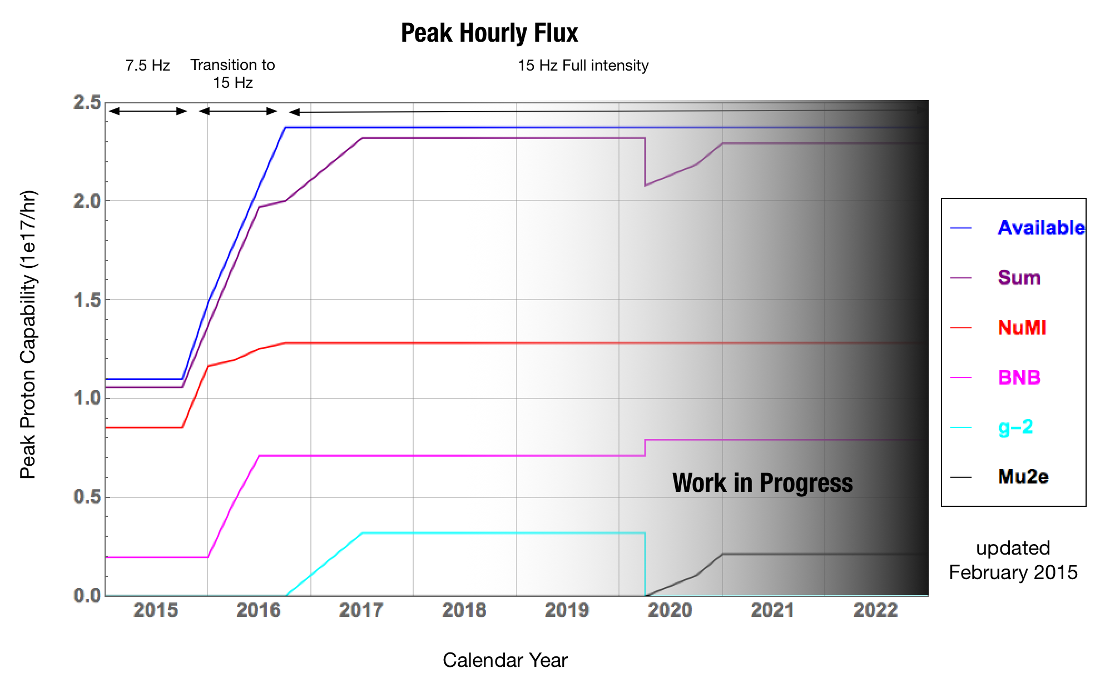
Proton Economics in the complex

Slide 28
Main Injector Energy for LBNF/DUNE
Notes:
What’s the point of this slide? That we need to retain flexibility to run down to 60 Gev? Or that it doesn’t matter?

Slide 29
Main Injector Energy for LBNF/DUNE
What can we conclude from the sensitivity vs. energy study?
  Two possible answers :
    We should be sure to have the flexibility to lower the primary proton energy to 60 GeV
    The energy dependence is small and therefore doesn’t matter
We recognize that the choice of primary beam energy for LBNF will has both technical and programmatic impacts

Slide 30
15 ➔ 20 Hz in Booster Rep Rate
Provides the capability to run the long- and short-baseline programs simultaneously

Slide 31
P5 Looking forward
Looking farther into the future, progress in precision physics and rare processes will be shaped partly by what particle physicists learn in the coming decade. Upgrades to the accelerator complex at Fermilab (PIP-II and additional improvements) will offer opportunities to further this program.
For example, combined with modest upgrades to Mu2e, improvements in the Fermilab accelerator complex potentially could provide increased sensitivity (by a factor of ten) to muon-to-electron conversion and allow one to search for this very rare process in different nuclei. This will provide crucial clues on the nature of the new physics revealed in the event of an observation in the next-generation experiments.

Slide 32
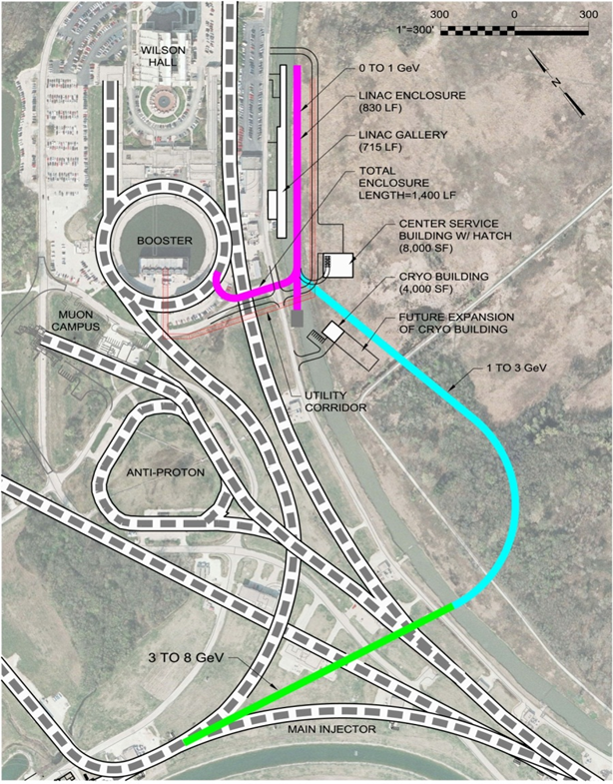
Flexible Platform for the Future (PIP-III)
0.8 GeV CW
3 GeV
New SC linacs
I
8 GeV into MI
Notes:
ma to mA in 2nd capability bullet

Slide 33
Addressing the capability gap : the PIP-II Program
Deliver >1 MW of proton beam power from the Main Injector over the energy range 60 – 120 GeV, at the start of LBNF operations;
Support the current 8 GeV program at Fermilab including Mu2e, g-2, and short-baseline neutrinos;
Provide an upgrade path for Mu2e;
Provide a platform for extension of beam power to LBNF to >2 MW;
Provide a platform for extension of capability to high duty factor/higher beam power operations.
Notes:
These design criteria should match those in my talk. This should be the last slide of your talk prior to the Summary

Slide 34
Summary
Mission Need : Science and Technology
  Fermilab’s current and future science program includes experiments that require high intensity protons from the accelerator complex
  Increasing the number of protons and reliability of the complex will be critical to the success of these experiments
Capability Gap : Limited protons and reliability
  Injection energy + intensity lead to space charge effects
  15 Hz operation limits the diversity of the physics program
  Failures in the aging complex puts the physics program at risk
Proposed Solution : PIP-II Program
  PIP-II offers the opportunity for the future long-baseline neutrino program get to physics results as quickly as possible after construction completion (>1MW)
  20 Hz operation of the complex will allow diversity in the physics program
  A new linac plus upgrades to the existing complex will increase reliability of operations
  PIP-II builds a platform on which to expand the capability to > 2MW. (ultimate physics reach for LBNF/DUNE)

Slide 35
Backup

Slide 36
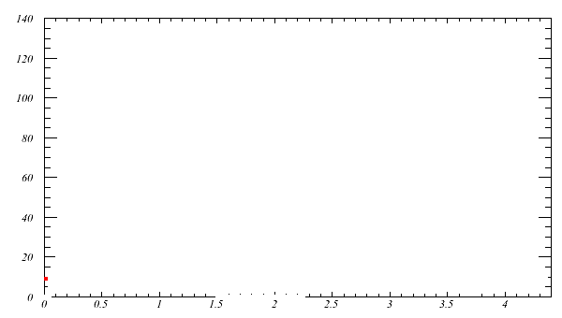
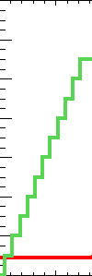
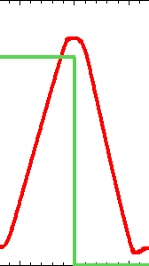
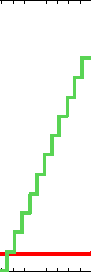
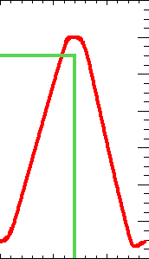
Power : the NuMI beam is powerful
Operation for MINOS (2004 – 2014) : 400 kW
  11 batches in Main Injector
    Slip Stacking in Main Injector
  2.2 sec cycle
    0.67 for injection
Recycler
Main Injector
Notes:
green is the beam intensity (arbitrary scale), red is the MI momentum ramp from 8 to 120 GeV

Slide 37
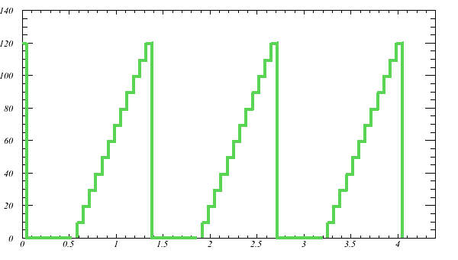
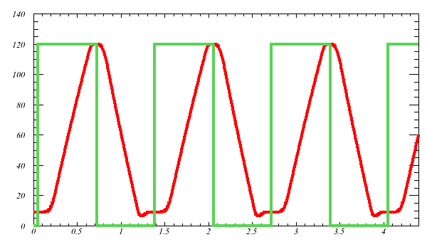
And getting more powerful: from 400 kW to 700 kW for NOvA
Move slip-stacking to recycler
  11 batch -> 12 batch
Increase Main Injector ramp rate (204 GeV/s -> 240 GeV/s)
  1.33 second cycle
Increase power with only ~10% increase in pulse intensity
Recycler
Main Injector

Slide 38
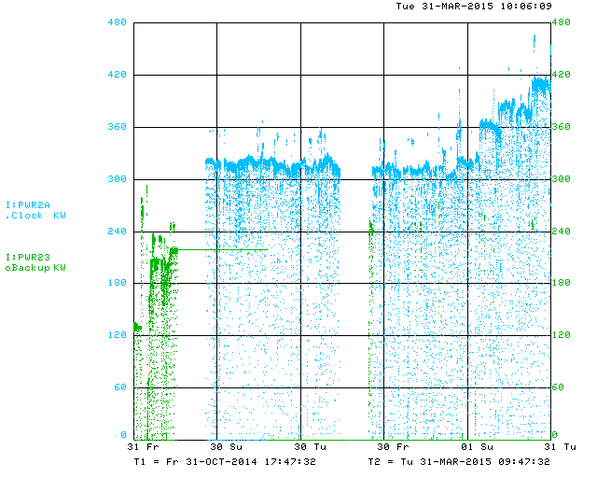
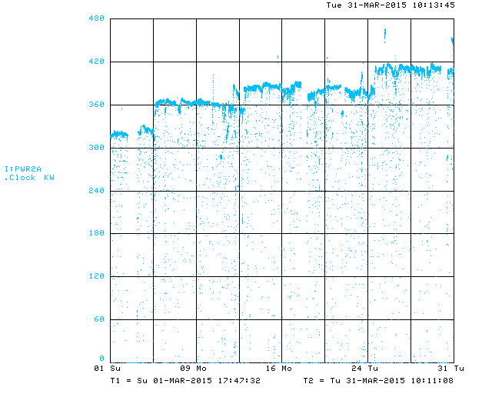
MI Beam Power since long shutdown and during March 2015
453 KW Beam Power
Beam Power (kw)
Switched to 2+6 operation
RR as stacker
480
MI Only
180
300
0
0

Slide 39
From the P5 report
The PIP-II project at Fermilab is a necessary investment in physics capability, enabling the world’s most intense neutrino beam, providing the wideband capability for LBNF, as well as high proton intensities for other opportunities, and it is also an investment in national accelerator laboratory infrastructure The project has already attracted interest from several potential international partners.
  Recommendation 14 : Upgrade the Fermilab proton accelerator complex to produce higher intensity beams. R&D for the Proton Improvement Plan II (PIP- II) should proceed immediately, followed by construction, to provide proton beams of >1 MW by the time of first operation of the new long-baseline neutrino facility.

Slide 40
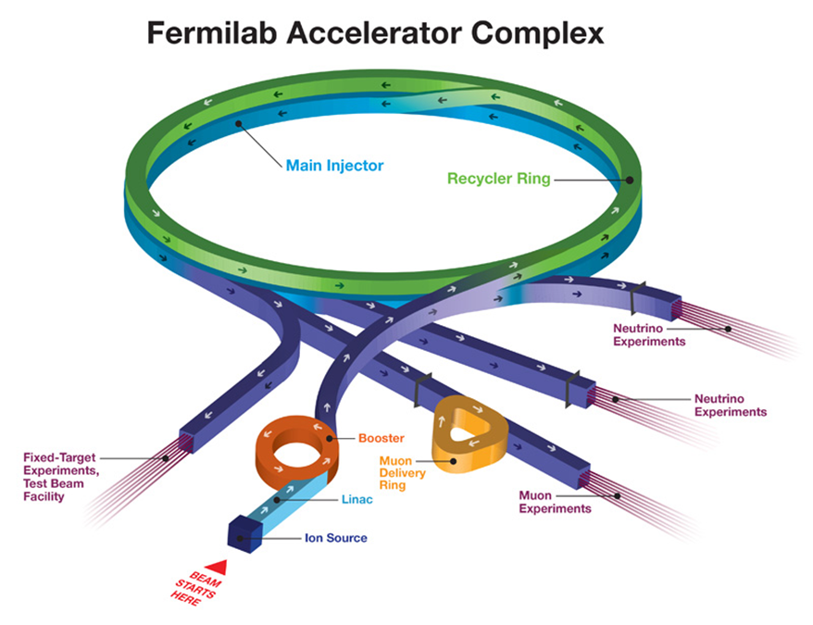
Present capability for delivered beam power
In its current configuration, the Fermilab complex currently delivers protons for neutrino production at both 8 and 120 GeV, with a present capability :
  Booster: 4.2×10¹² protons @ 8 GeV @ 7.5 Hz = 40 kW
  MI: 3.5×10¹³ protons @ 120 GeV @ 0.75 Hz = 500 kW
Fundamental limitations
  Booster pulses per second
    The Booster magnet/power supply
    system operates at 15 Hz
    RF system limited to 7.5 Hz
  Booster protons per pulse
    Limited by space-charge forces at the Booster injection energy, i.e. the linac energy
Notes:
In terms of the MNS you are now entering capabilities gap

Slide 41
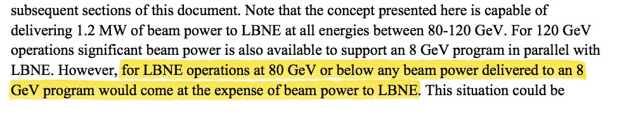
8 GeV program in LBNE era
From PIP-II report, June 2014

Slide 42
STATISTICS in Neutrino Experiments
Neutrino Events/Unit Time =
Neutrino Flux x
Neutrino Cross-section/Nucleon x
Number of Nucleons

Slide 43
STATISTICS in Neutrino Experiments
Neutrino Events/Unit Time =
Neutrino Flux x
Neutrino Cross-section/Nucleon x
Number of Nucleons
A really big number
A really small number
A really big number

Slide 44
P5 Science Drivers
Use the Higgs Boson as a New Tool for Discovery
Pursue the Physics Associated with Neutrino Mass
Identify the New Physics of Dark Matter
Understand Cosmic Acceleration : Dark Energy and Inflation
Explore the Unknown : New Particles, Interactions, and Physical Principles

Slide 45
Research Opportunities Afforded by PIP-II Beyond DUNE, SBN, and Mu2e-II
Next generation μg3e:
Enabling technology is CW operation
Next generation μ⁺e⁻ge⁺μ⁻:
Enabling technology is high frequency pulsed beam, macro-CW operation
Proton edm experiment:
Enabling technology is low emittance 236 MeV (T) polarized proton beam
PIP-II can also drive other research opportunities that would require major facility enhancements such as a high-power spallation target for particle physics applications.

Slide 46
Mu2e-II : Next generation Mu2e experiment
Mu2e Signal?
A next-generation Mu2e experiment makes sense in all scenarios
  Push sensitivity (x10) or
  Study underlying NP
  Modest upgrade
  Will require more protons
  (narrow pulses w/ 1-2 μs spacing, high duty factor, extinction <10⁻¹¹)
  Snowmass White Paper, arXiv:1307.1168
Yes
No
Precision Measurement if necessary
Higher Sensitivity search
Measure conversion rate as a function of stopping-target Z
Organizing to explore pressing issues
  - Targeting 800 MeV p, accidental detector rates, radiation tolerance of Production Solenoid
Notes:
Mu2e-II would have about x10 better sensitivity than Mu2e baseline – so it would explore conversion rates down to 1e-18. We restricted ourselves to things we could do while reusing as much of planned Mu2e baseline as possible. More ambitious concepts also exist, but would require very new schemes.
NB. Mu2e is NOT enabled by PIP-II; requires PIP-III in order to deliver proton beam that meets our requirements

Slide 47
Program Planning
Mu2e and g-2 will not run together
Booster Neutrino Beam CAN run with either
BNB and Muons can run with NuMI and later LBNF, but limited by proton economics
Schedules matter in trying to understand the proton economics issues in the short term
Issues of beam structure, timing, etc. may be more important than just the # of POTs

Slide 48
Short Baseline Program in the Booster Neutrino Beam
Two ways to increase neutrino flux :
  Improve pion focusing efficiency : new target/horn configuration
  Increase number of delivered protons
Present BNB designed to handle maximum of 5 hz, limited by the horn power supply, and the horn structure itself
  Typical operations over the
During the past year we have done studies to see how we can improve the beam via new focusing with new target and new horns
Notes:
Note: The PIP-II plan is to upgrade the Booster to 20 Hz. This allows either maintaining full beam power down to 60 GeV, or generating 2.5 x the beam power to BNB is operating MI at 120 GeV.

Slide 49
Next generation Muon (g-2)
Current Muon (g-2) uses μ⁺
  For 8 GeV protons, production π⁺: π⁻ ~ 2.5 : 1
PIP-II would provide x2 protons to the Booster
  Would enable a μ⁻ run over a reasonable timescale
  Experimental sensitivity on a_{μ} would be comparable for μ⁺ & μ⁻
  Uses baseline Muon (g-2) apparatus and detectors
  Allows a sensitive test of CPT
Instrumenting all calorimeters with trackers would additionally enable another x10 improvement in muon EDM
Notes:
This is enabled with PIP-II as is assuming the accelerator timeline can be made to work for LBNF and g-2, both of which would use the Booster and Recycler (if I understand correctly).

