Slide 1
Muon Accelerators: R&D Towards Future Neutrino Factory &
Lepton Collider Capabilities
Mark Palmer
Director, US Muon Accelerator Program
for the MAP Collaboration
May 8, 2015

Slide 2
Muon Accelerators for HEP
μ – an elementary charged lepton:
  200 times heavier than the electron
  2.2 μs lifetime at rest
Physics potential for the HEP community using muon beams
  Tests of Lepton Flavor Violation
  Anomalous magnetic moment a hints of new physics (g-2)
  Can provide equal fractions of electron
  and muon neutrinos at high intensity for
  studies of neutrino oscillations –
  the Neutrino Factory concept
  Offers a large coupling to the “Higgs mechanism”
  As with an e⁺e⁻ collider, a μ⁺μ⁻ collider would offer a precision leptonic probe of fundamental interactions

Slide 3
Outline
The U.S. Muon Accelerator Program
Why Neutrino Factories?
  Neutrino Factory Concepts
    Short baseline a νSTORM
    Long Baseline a IDS-NF and NuMAX
Going Beyond a Neutrino Factory Facility
  Possibilities for a future Muon Collider Capability
  Higgs Factory to >5 TeV
  Key Accomplishments of the MAP R&D Effort
Conclusion
Will show highlights from ~50 MAP-related contributions to this conference

Slide 4
The U.S. Muon Accelerator Program I
The US Muon Accelerator Program was approved by DOE-OHEP in in 2011, in response to the 2008 P5 Panel Report Recommendation:
  The panel also recommends R&D for alternative accelerator technologies, to permit an informed choice when the lepton collider energy is established.
That report specifically noted:
  Finally, a muon collider may be an effective means to reach multi-TeV energies... Recent studies using a jet of mercury in a strong magnetic field have demonstrated that such a target is capable of surviving a four-megawatt proton beam. This first step toward providing muons is very encouraging. The next step is the demonstration of cooling using a combination of ionization energy loss and dispersion in a low-energy, low-frequency acceleration system. Support for R&D for this program has been very limited. Demonstrating its feasibility or understanding its limitations will require a higher level of support.
In 2012, DOE-OHEP requested development of a detailed plan for a ~6-year program to establish muon accelerator feasibility
  A detailed Feasibility Assessment Execution Plan was delivered to DOE-OHEP and endorsed by an OHEP-convened review panel in February 2014.

Slide 5
The U.S. Muon Accelerator Program II
Long Baseline NF
The program also targeted a short-baseline NF design for precision studies of σ_{ν} and the short baseline ν anomalies

Slide 6
Why Neutrino Factories?

Slide 7
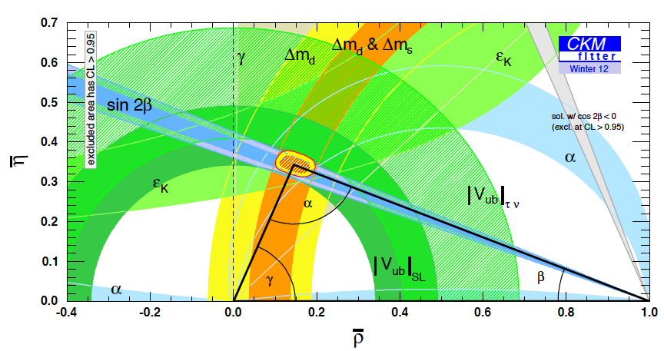
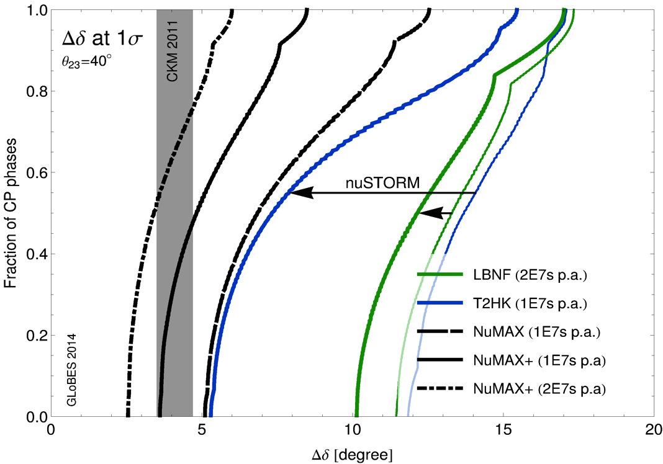
The Critical Issues
What must we understand in the neutrino sector?
  δ_{CP}: Can this be done with the same
  precision as the quark sector???
  The mass hierarchy
  The value of θ₂₃-π/4: +, - or zero?
  Resolve the LSND and other short
  baseline experimental anomalies
  And enable the search for new
  physics
Impact of precision short-baseline NF capabilities
Impact of precision long-baseline NF capabilities
GLoBES Comparison of Potential
Performance of the Various
Advanced Concepts (courtesy P. Huber)

Slide 8
Microscopes for the ν Sector
Superbeam technology will continue to drive initial observations in the coming years
However, anomalies and new discoveries will drive our need for precision studies to develop a complete physical understanding
Neutrino Factory capabilities (both long- and short-baseline) offer the route to controlled systematics and precision measurements, which are required to fully elucidate the relevant physics processes
a Precision Microscopes for the ν sector

Slide 9
Neutrino Factory Development Under MAP
Short Baseline NF
  nuSTORM
    Definitive measurement of sterile neutrinos
    Precision ν_{e} cross-section measurements (systematics issue for long baseline SuperBeam experiments)
    Would serve as an HEP muon accelerator proving ground…
Long Baseline NF with a Magnetized Detector
  IDS-NF (International Design Study for a Neutrino Factory)
    10 GeV muon storage ring optimized for 1500-2500km baselines
    “Generic” design (ie, not site-specific)
  NuMAX (Neutrinos from a Muon Accelerator CompleX)
    Site-specific: FNAL a SURF (1300km baseline)
    4-6 GeV beam energy optimized for CP studies
      Flexibility to allow for other operating energies
    Can provide an ongoing short baseline measurement option
    Detector options
      Magnetized LAr is the goal
      Magnetized iron provides equivalent CP sensitivities using ~3x the mass

Slide 10
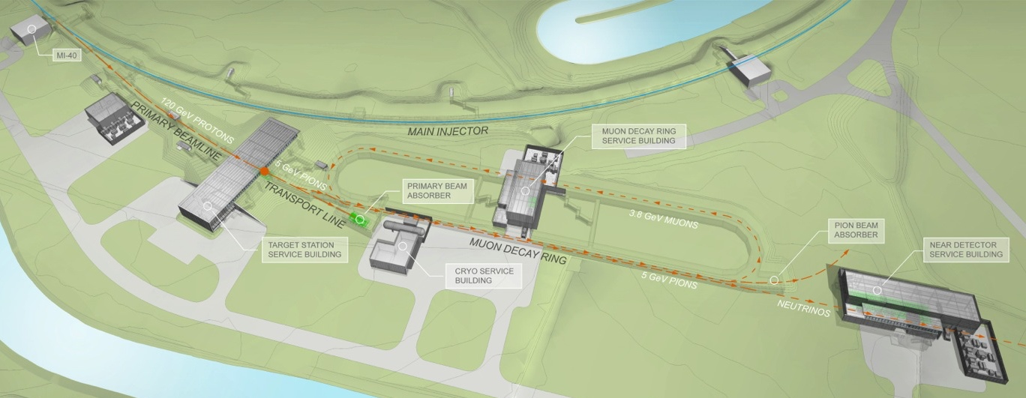
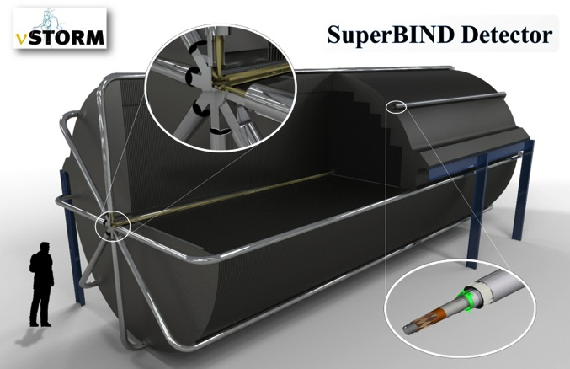
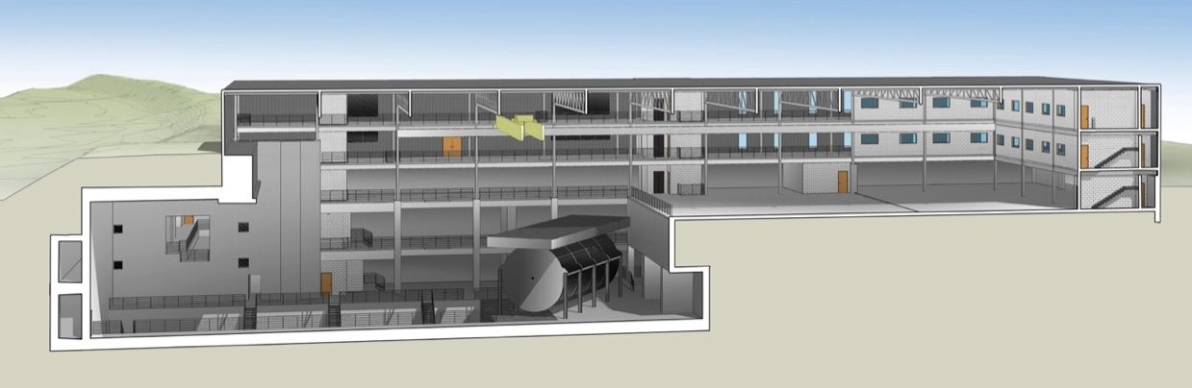
νSTORM – the First NF?
μ decay ring: P = 3.8 GeV/c ± 10%
  No new technologies required!
  Could be deployed now!
To Far
Hall
Near Hall
Far Hall @1.9km
Far Detector

Slide 11
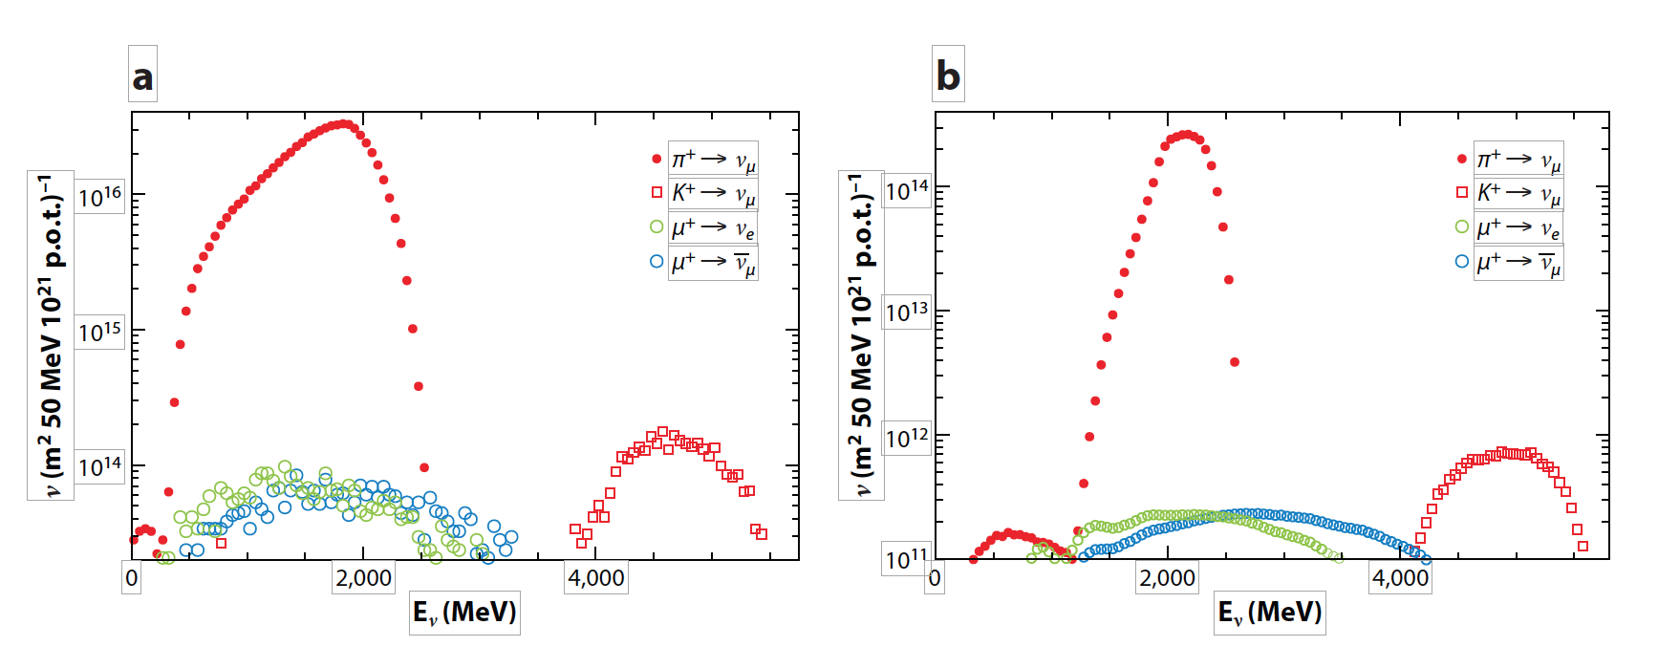
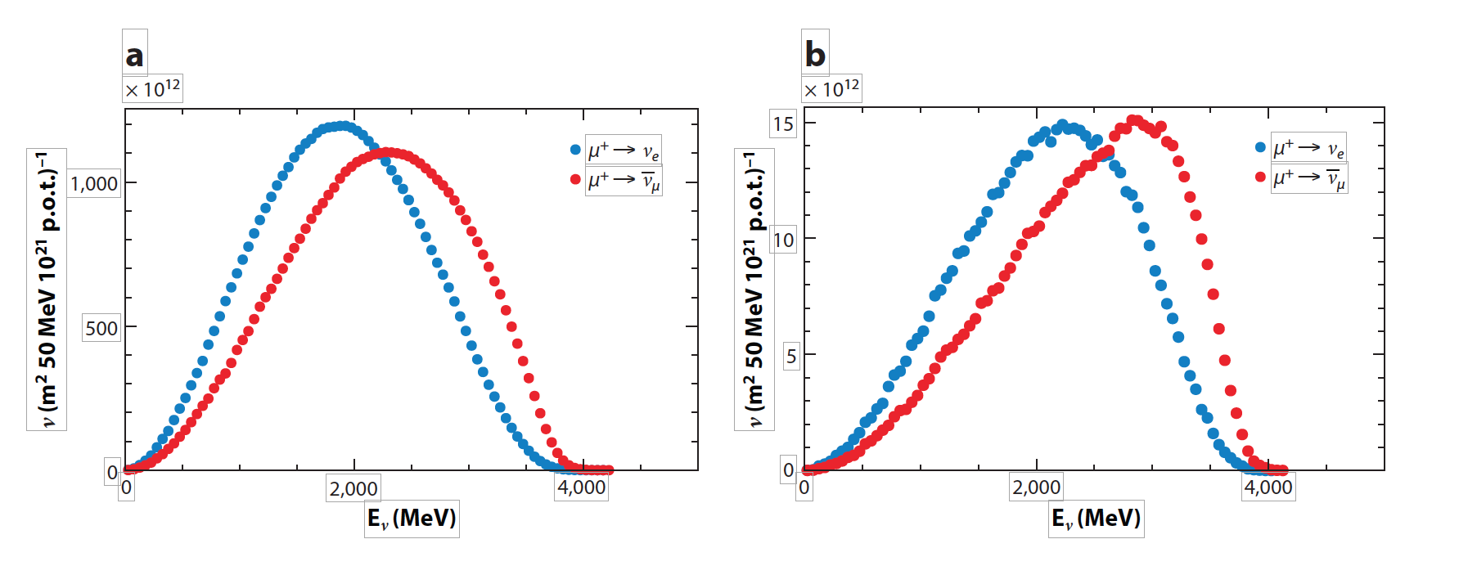
ν Beams at nuSTORM
ν beams from π⁺ decay at nuSTORM
  a: at 50 m from end of production straight
  b: at 2000 m
Flavor pure with flux known to <1%
ν beams from μ decay at nuSTORM
  a: at 50 m from end of production straight
  b: at 2000 m
Absolute flavor purity with flux known to <1%
π⁺ ➔ μ⁺ + ν_{μ}, π decays in injection straight
μ⁺ ➔ e⁺ + ν_{e} + ν_{μ}-bar, decays from stored muons

Slide 12
nuSTORM and δ_{cp} Coverage @ DUNE
75% coverage of δ_{cp} in a LBL ν oscillation experiment (P5 requirement) in a reasonable exposure time
a Systematic uncertainties at the 1% level are required.
Degradation of systematic uncertainties to the ~5% level
a exposure increase of 200-300% (very non-linear).
We have yet to achieve 2% uncertainty in ν experiments.

Slide 13
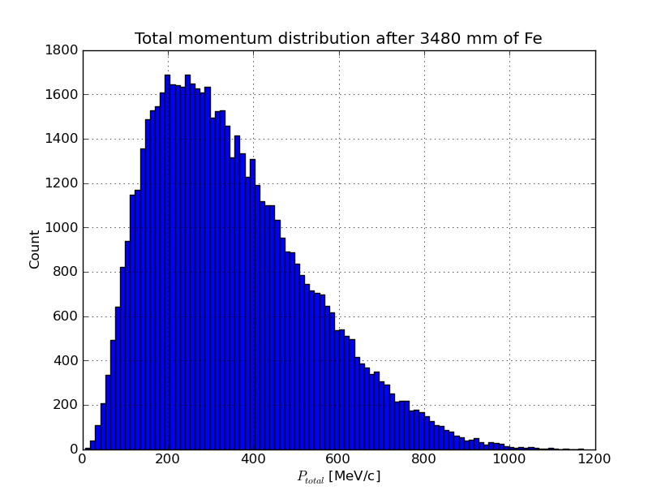
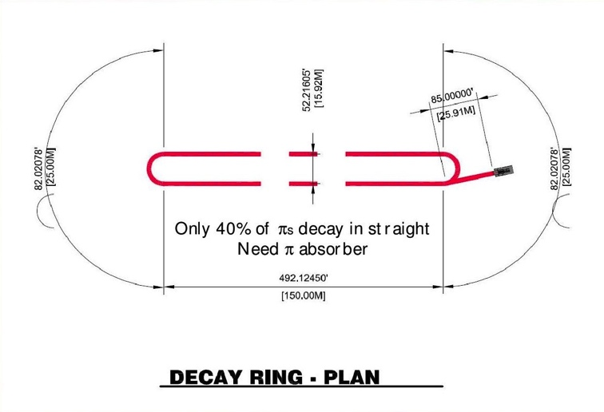
νStorm as an R&D platform
A high-intensity pulsed muon source
100<p_{μ}<300 MeV/c muons
  Using extracted beam from ring
  10¹⁰ muons per 1 μsec pulse
Beam available simultaneously with physics operation
νSTORM also provides the opportunity to design, build and test decay ring instrumentation (BCT, momentum spectrometer, polarimeter) to measure and characterize the circulating muon beam

Slide 14
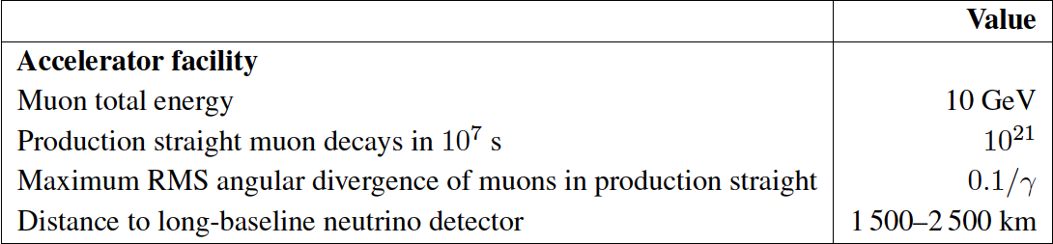
The Long Baseline Neutrino Factory
IDS-NF: the ideal NF
  Supported by MAP
MASS working group:
A staged approach -
NuMAX@5 GeVaSURF

Slide 15
The MAP Muon Accelerator Staging Study a NuMAX
5 GeV Storage Ring optimized for Fermilab-to-SURF baseline
NuMAX Staging:
Commissioning
  1MW Target
  No Muon Cooling
  10kT Detector
NuMAX+
  2.75 MW Target
  6D Muon Cooling
  34kT Detector

Slide 16
MASS NF Parameters

Slide 17
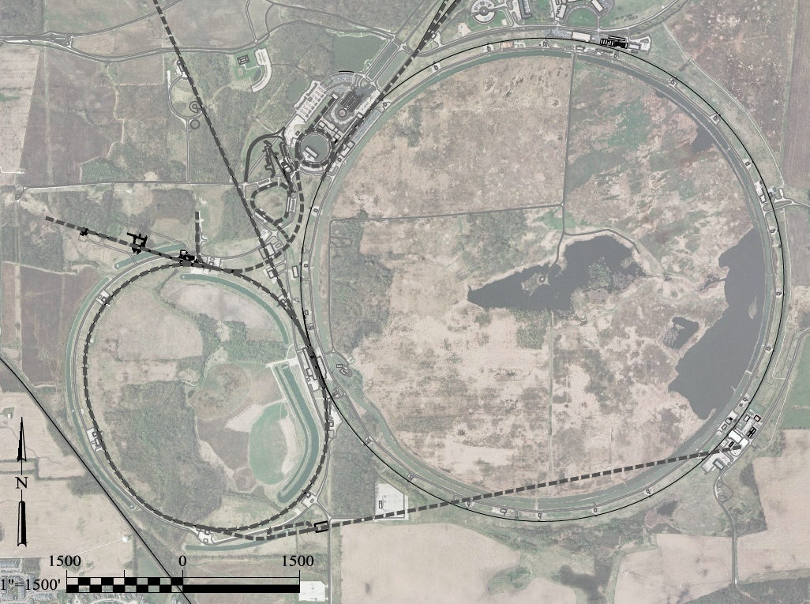
Possibilities for NF Capabilities at Fermilab:
νSTORM ➔ NuMAX
0.8 GeV Proton
Linac (PIP-II)
SURF
Superbeam
Accumulator,
Buncher,
Combiner
Front
End
0.8-3 GeV Proton
Linac (PIP-III)
Remains fully compatible with the PIP-II a III staging option
To
SURF
Target
Final
Cool
NuMAX:
νs to SURF
6D
Cool
Initial
Cool
1 GeV Muon
Linac (325MHz)
3-7 GeV Proton &
1-5 GeV Muon
Dual Species Linac
To Near Detector(s) for
Short Baseline
Studies
Muon Beam
R&D Facility
Possible to deploy subsequent muon collider capabilities
ft
νSTORM
ft

Slide 18
Going Beyond Neutrino Factory Capabilities

Slide 19
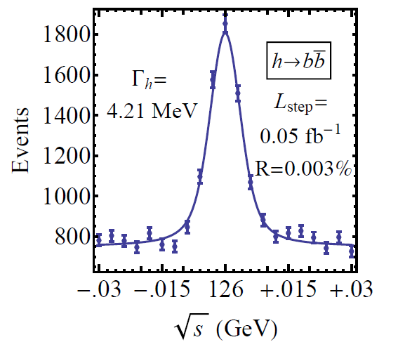
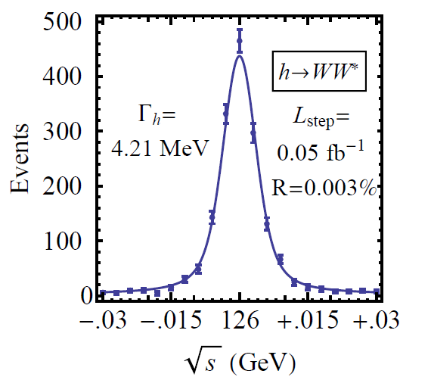

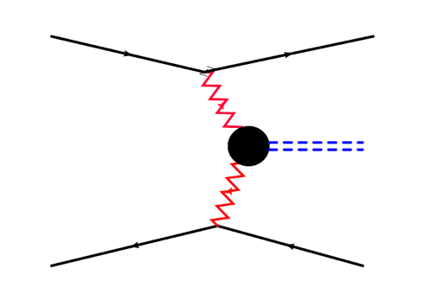



Features of the Muon Collider
Superb Energy Resolution
  SM Thresholds and s-channel Higgs Factory operation
Multi-TeV Capability (≤ 10TeV):
  Compact & energy efficient machine
  Luminosity > 10³⁴ cm⁻² s⁻¹
  Option for 2 detectors in the ring
  For √s > 1 TeV: Fusion processes dominate
  a an Electroweak Boson Collider
  a a discovery machine complementary to a
  very high energy pp collider
  >5TeV: Higgs self-coupling resolution <10%
What is our most efficient accelerator option if
new LHC data shows evidence for a multi-TeV particle spectrum?

Slide 20
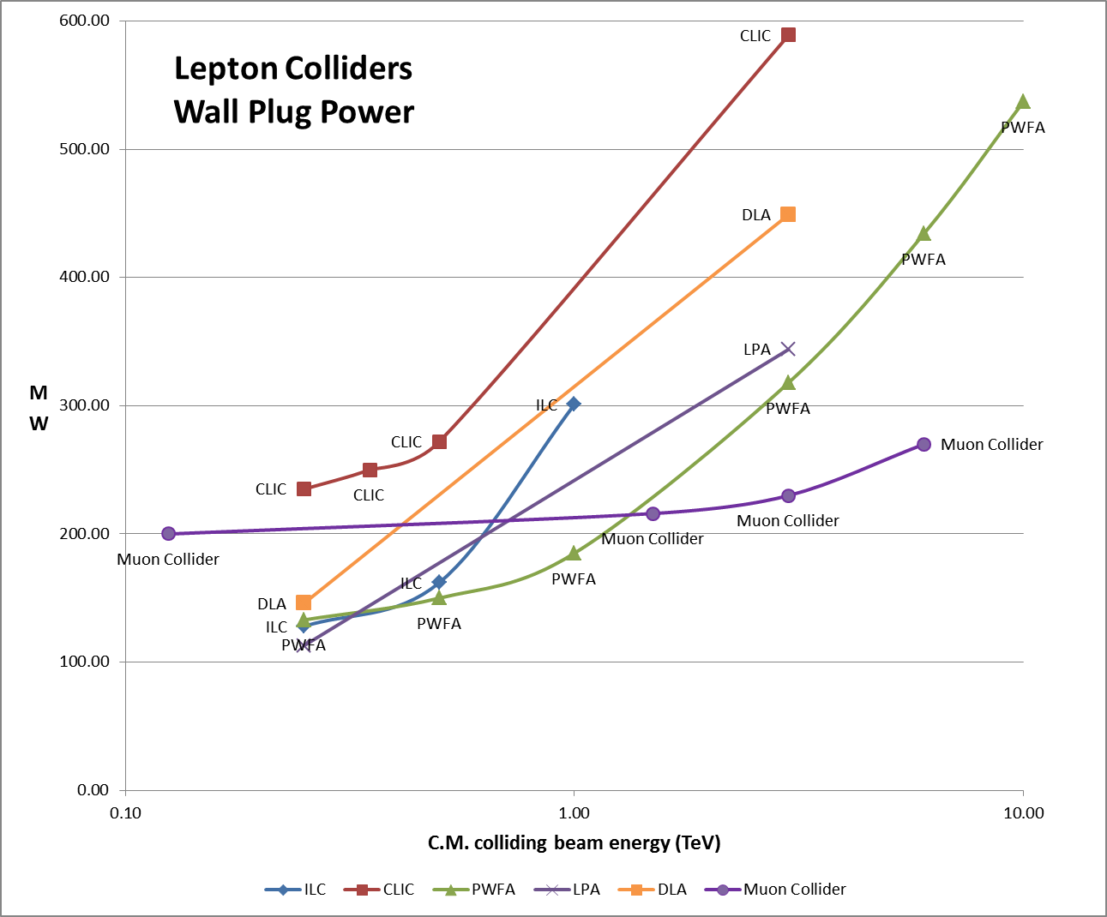
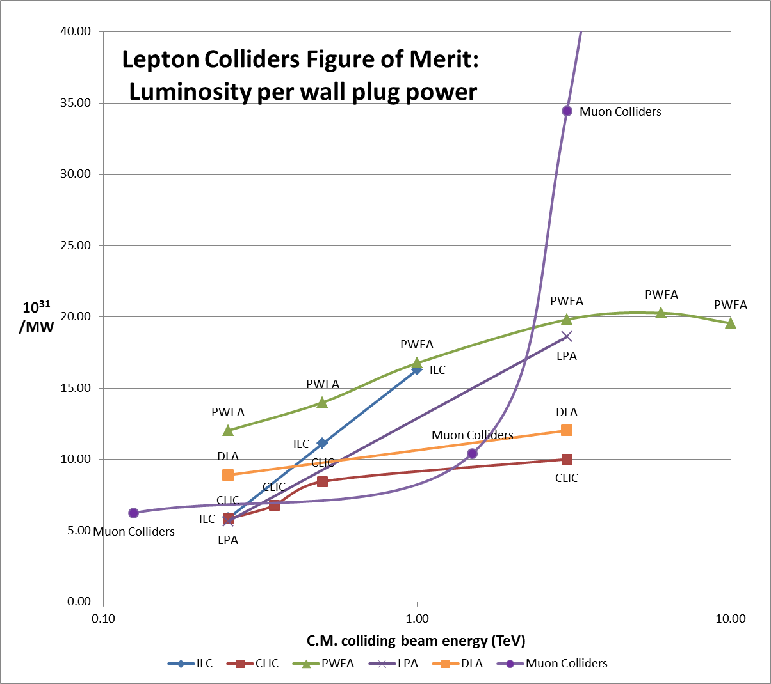
Muon Colliders – Efficiency at the multi-TeV scale
Efficiency of multi-pass acceleration

Slide 21
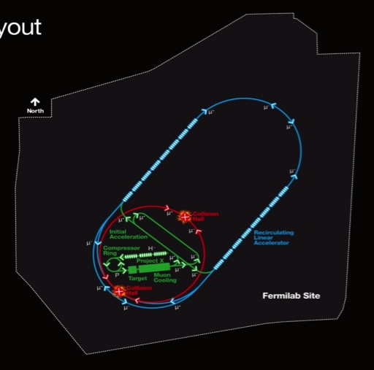
Muon Collider Parameters
Exquisite Energy Resolution
Allows Direct Measurement
of Higgs Width
Success of advanced cooling
concepts a several × 10³²

Slide 22
The MAP R&D effort

Slide 23
Accelerator R&D Effort (U.S. MAP)
Design Studies
  Proton Driver
  Front End
  Cooling
  Acceleration and Storage
  Collider
  Machine-Detector Interface
  Work closely with physics and detector efforts
Technology R&D
  RF in magnetic fields
  SCRF for acceleration chain (Nb on Cu technology)
  High field magnets
    Utilizing HTS technologies
  Targets & Absorbers
  MuCool Test Area (MTA)
Major System Demonstration
  The Muon Ionization Cooling Experiment – MICE
    Major U.S. effort to provide key hardware: RF Cavities and couplers, Spectrometer Solenoids, Coupling Coil(s), Partial Return Yoke
    Experimental and Operations Support

Slide 24
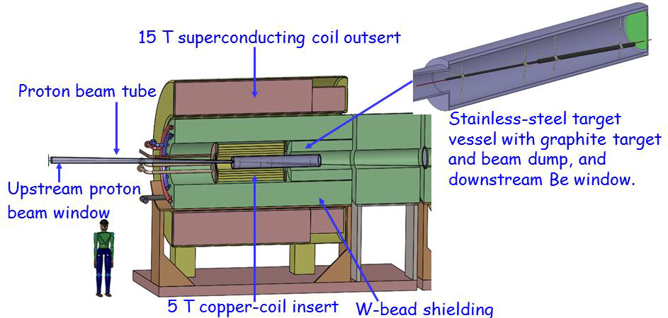
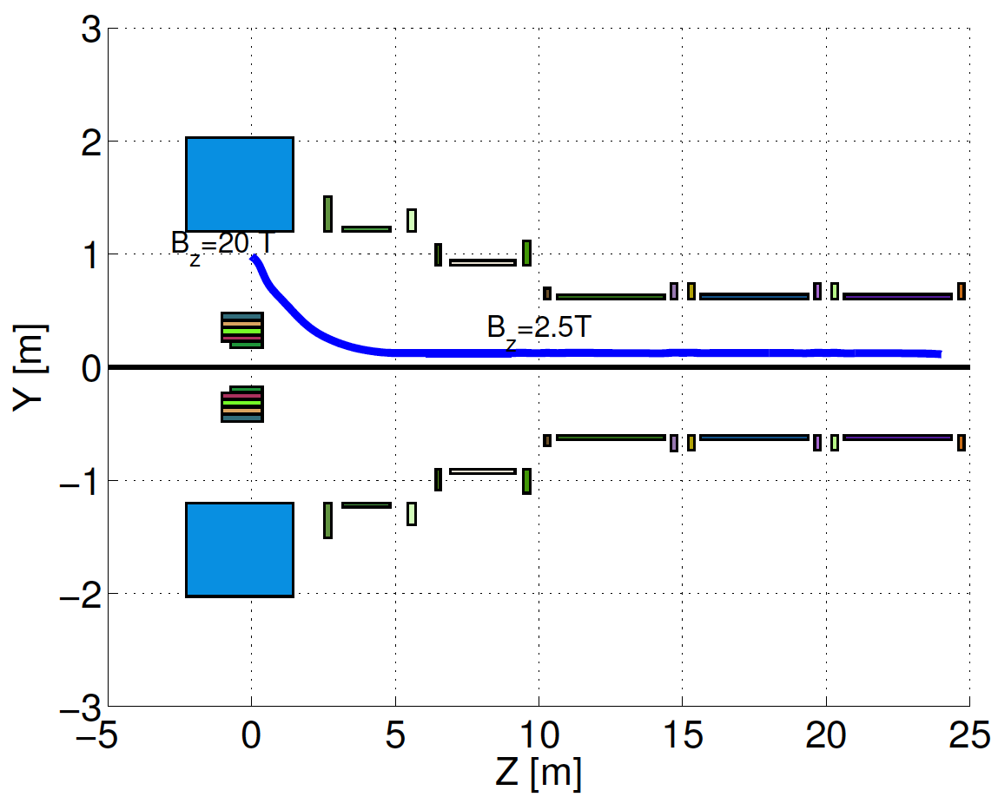
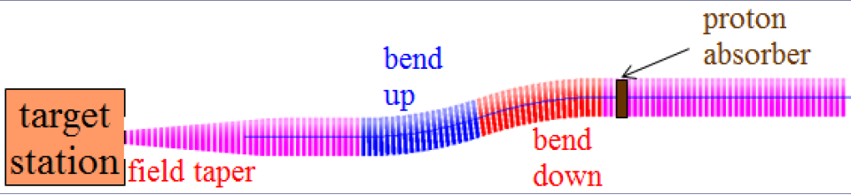
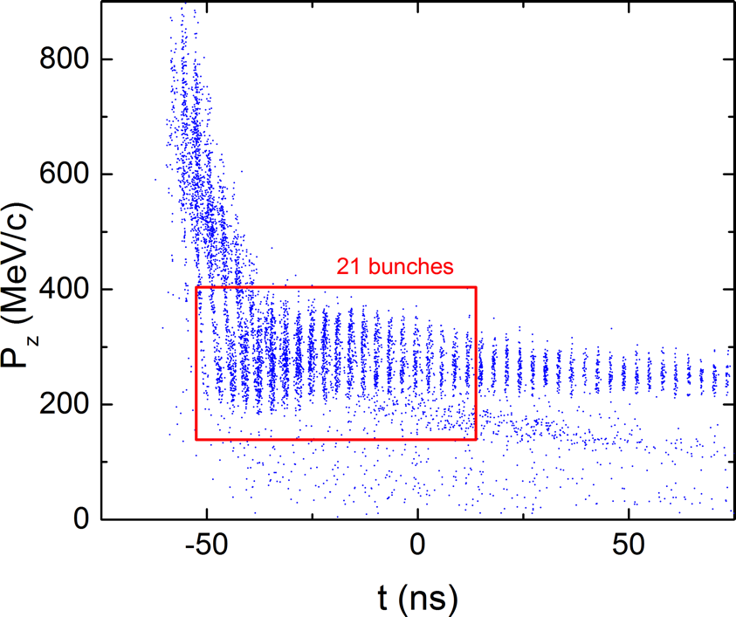
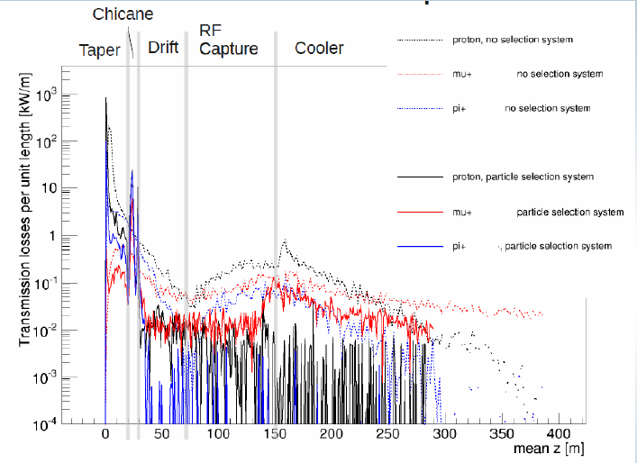
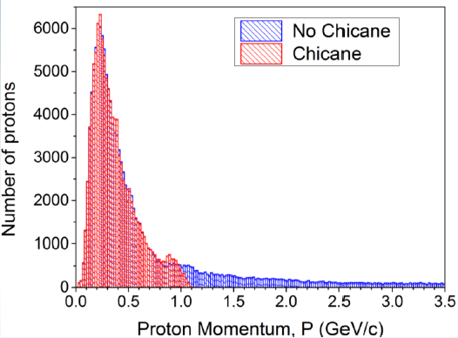
Target & Front End Progress
Compact
Taper Design
C Target
Control of FE Energy Deposition
Buncher and Phase
Rotator Matched to a
325 MHz Initial Cooling
Channel
FE Energy
Deposition

Slide 25
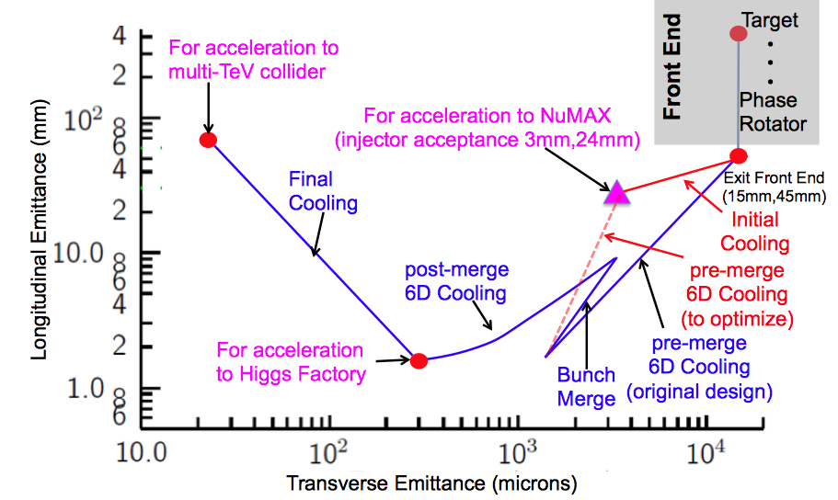
Muon Ionization Cooling
Advanced techniques a
Improved HF Luminosity
Simplified Final Cooling requirements
PIC?

Slide 26
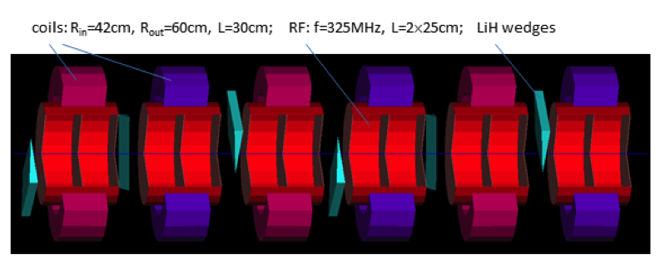
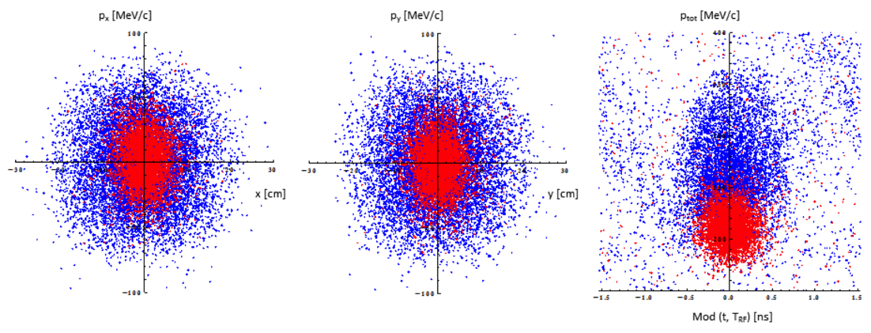
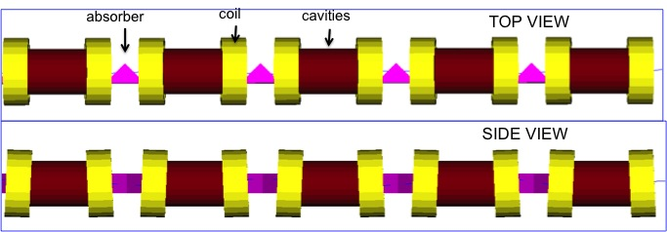
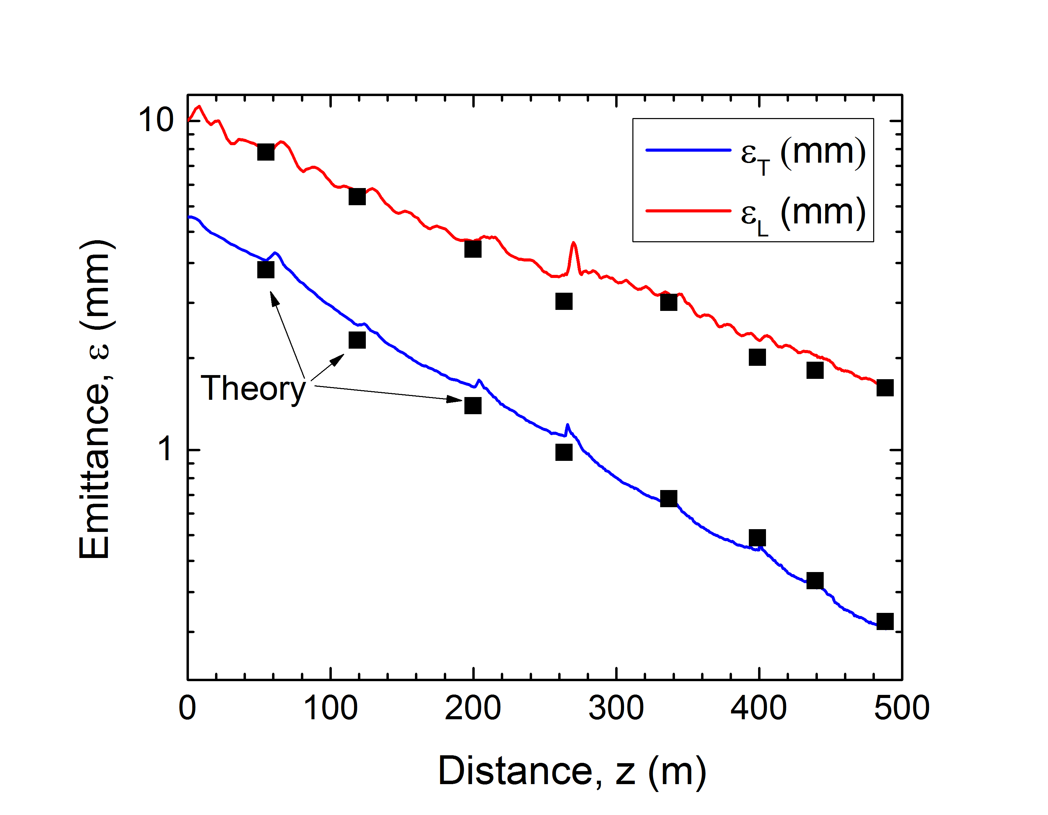
Muon Ionization Cooling (Design)
Initial 6D Cooling: ε_{6D} 60 cm³ a ~50 mm³; Trans = 67%
6D Rectilinear Vacuum Cooling Channel (replaces Guggenheim concept):
Trans = 55%(40%) without(with) bunch recombination

Slide 27
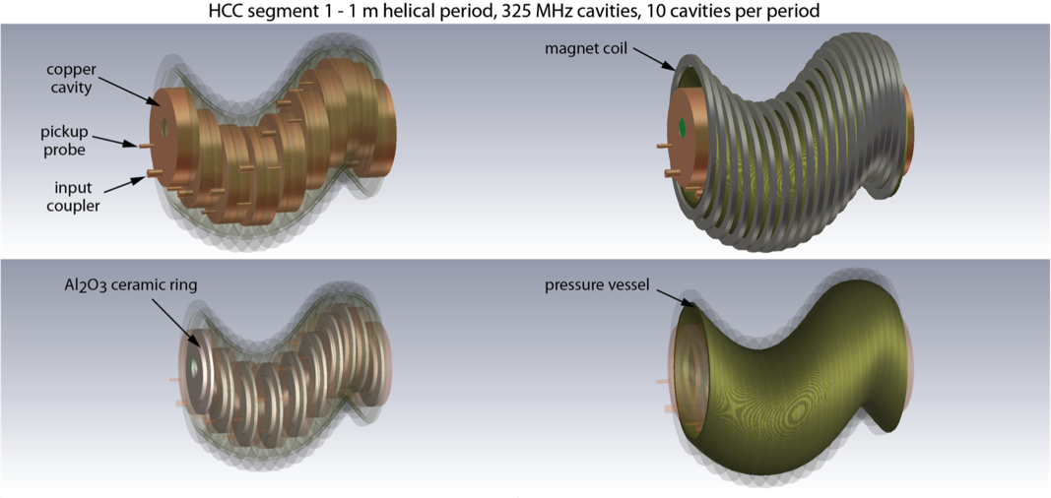
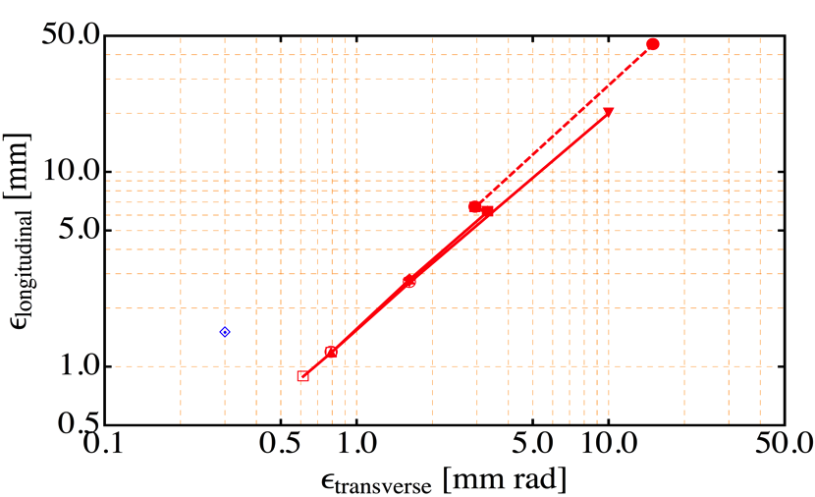
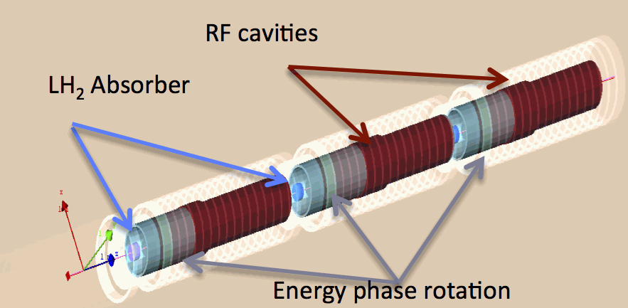
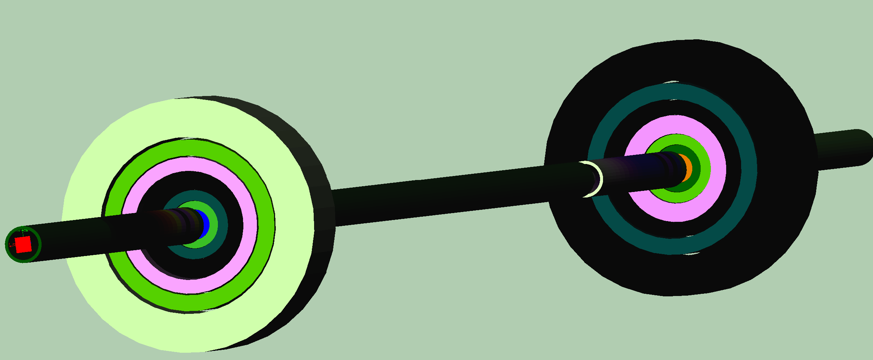
Muon Ionization Cooling (Design)
Initial 6D cooling
Matching
325 MHz cooling
650 MHz
Helical Cooling Channel (Gas-filled RF Cavities): ε_{T} = 0.6mm, ε_{L} = 0.3mm
Late Stage w/ Induction Linac
Final Cooling with 25-30T solenoids (emittance exchange):
ε_{T} = 55μm, ε_{L} = 75mm

Slide 28
Muon Ionization Cooling (Design)
Longitudinal Merge
Bunch Merge
MAP Baseline Designs offer
  Factor >10⁵ in emittance reduction
Alternative and Advanced Concepts
  Hybrid Rectilinear Channel
  (gas-filled structures)
  Parametric Ionization Cooling
  Alternative Final Cooling
  a Early stages of existing scheme
  a Round-to-flat Beam Transform
  a Transverse Bunch Slicing
  a Longitudinal Coalescing
  (at ~10s of GeV)
  a Considerable promise to exceed our original target parameters
Bunch
Merge
Transverse Merge
ε_{T}
Trans
σ_{t}
MASS identified extension of the 6D cooling concepts
and modification of Final Cooling scheme to be one of
most likely areas of performance improvement

Slide 29
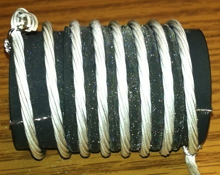
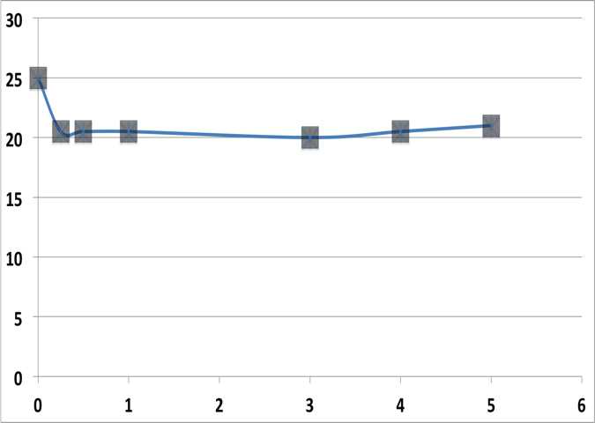
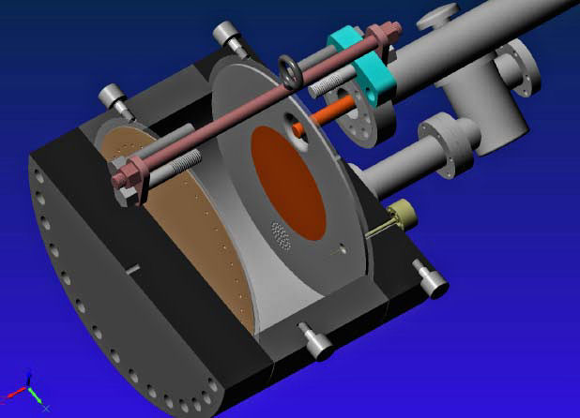
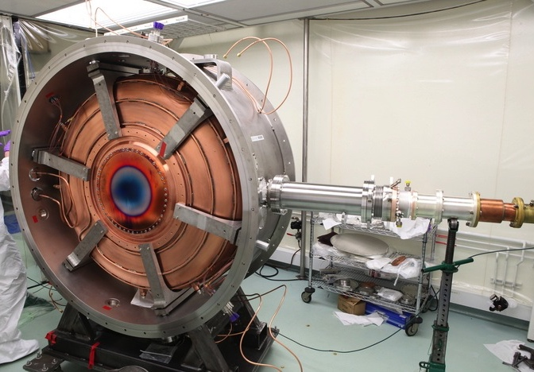
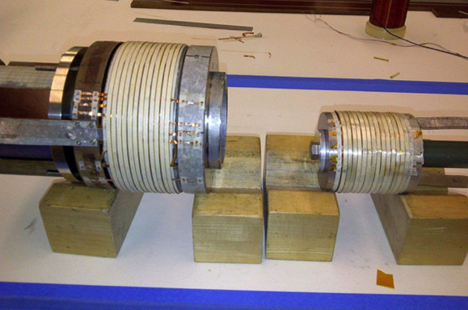
Cooling Technology R&D
>20MV/m operation
in up to 5 T B-field
Successful Operation of 805 MHz “All Seasons” Cavity in 5T Magnetic Field under Vacuum
MuCool Test Area/Muons Inc
Demonstration of High Pressure RF Cavity in 3T Magnetic Field with Beam
Extrapolates to required
μ-Collider Parameters
MuCool Test Area
Breakthrough in HTS Cable Performance with Cables Matching Strand Performance
FNAL-Tech Div
T. Shen-Early Career Award
World Record HTS-only Coil
15T on-axis field (16T on coil)
R. Gupta
PBL/BNL
MICE 201 MHz RF Module –
MTA Acceptance Test in B-field Complete
11MV/m in Fringe of 5T Lab-G Solenoid
<4×10⁻⁷ Spark Rate (0 observed)
1% Dry Air (0.2% O₂) in GH₂
Pure GH₂
1% Dry Air
(0.2 % O₂)
in GH₂ at
B = 3T
~50X reduction in
RF power dissipation
E₀ = 25 MV/m

Slide 30

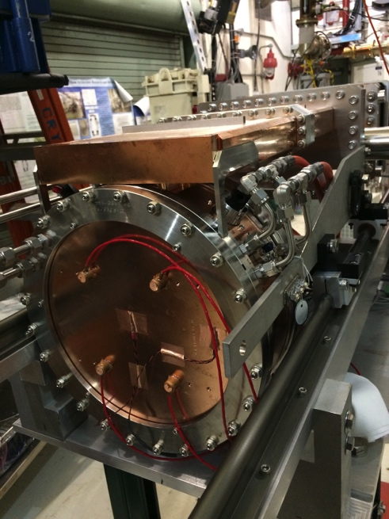
Cooling Technology R&D
Cooling Technology Status
  Magnets
    MAP Initial Baseline Selection process has yielded 6D cooling baselines that do not require HTS magnets
    HTS Solenoids may be required as part of a higher performance 6D Cooling Channel and for parts of the Final Cooling Channel
  RF Cavities
    The successful test in magnetic field of the MICE RF Module Prototype demonstrates
      The importance of surface preparation
      The importance of detailed simulation in magnetic field as part of the design process
    High Pressure Gas-Filled RF Cavities provide a demonstrated route to the required gradients with high intensity muon beams
    Recent results with vacuum RF cavities
    in magnetic field have shown results
    consistent with our physical models
      805 MHz “Modular” Cavity:
      A test vehicle to characterize breakdown
      effects in vacuum cavities
        SCRF-style surface preparation
        Design optimized for use in magnetic field
        Data-taking has begun
The MAP Feasibility Assessment aimed to provide a full 6D
cell prototype for testing at high beam intensity in the MTA

Slide 31
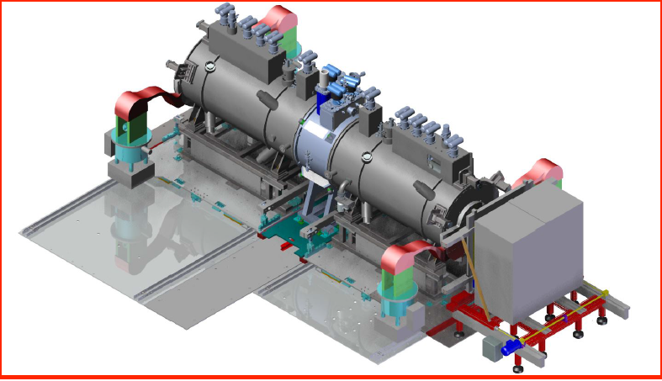
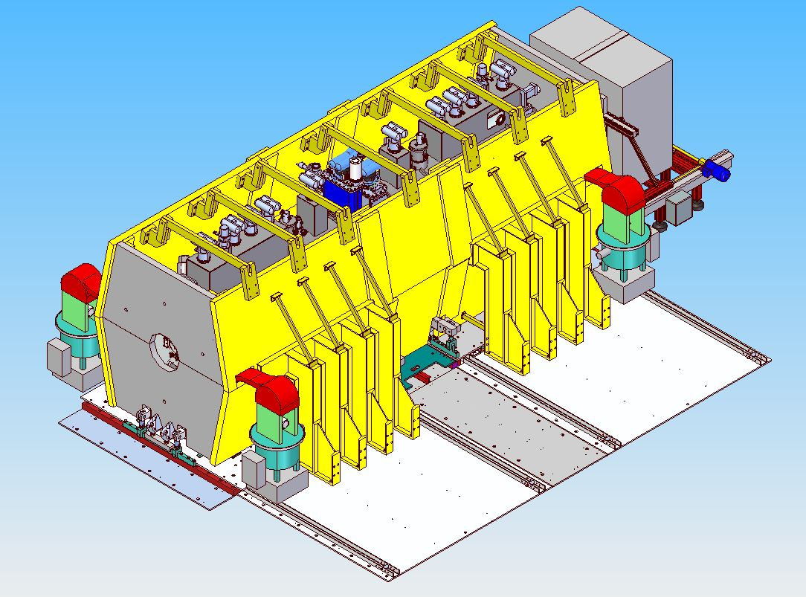
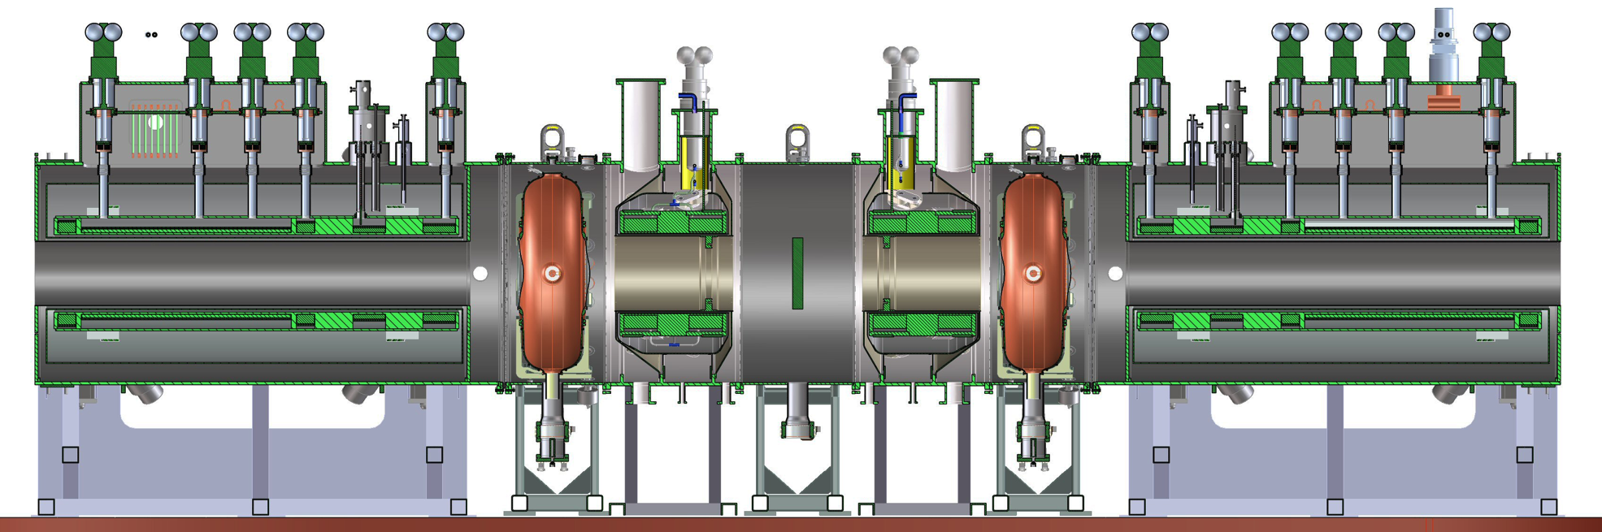
MICE Demonstration @ RAL
2015 Data
MICE Step IV:
Study of Absorber
Materials
US
US
US-UK
2017 Data
UK
UK
US
US
Demonstration of Muon Ionization Cooling (Re-baseline)

Slide 32
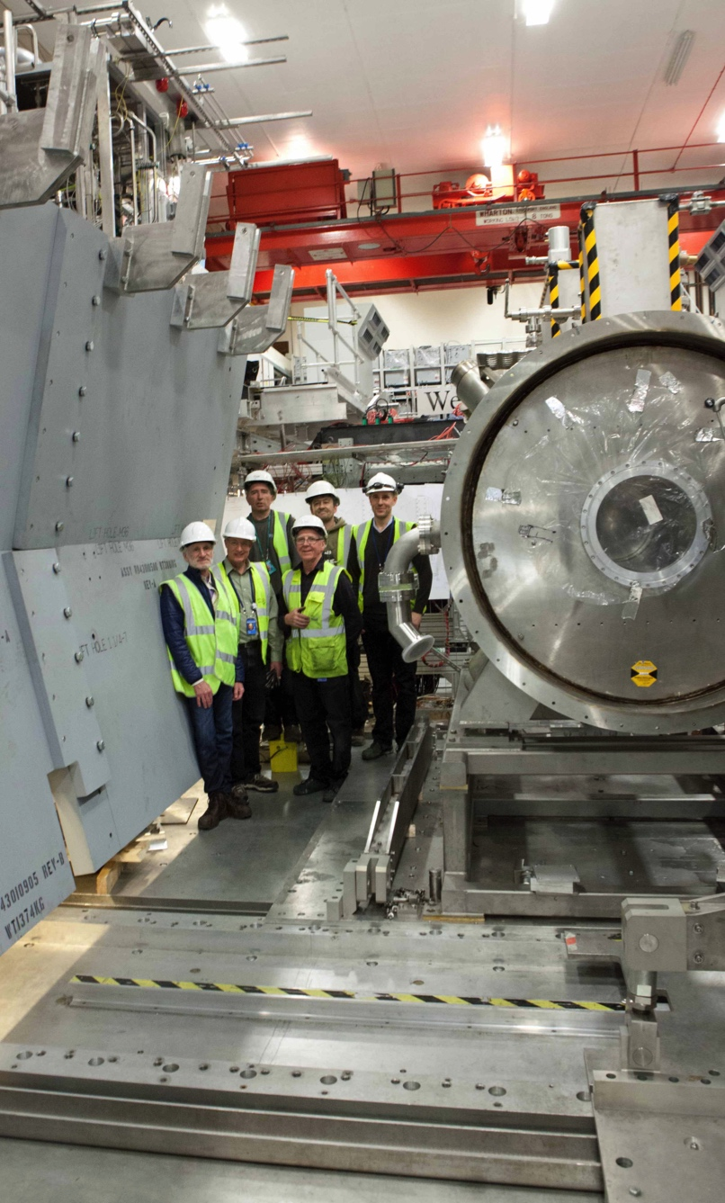
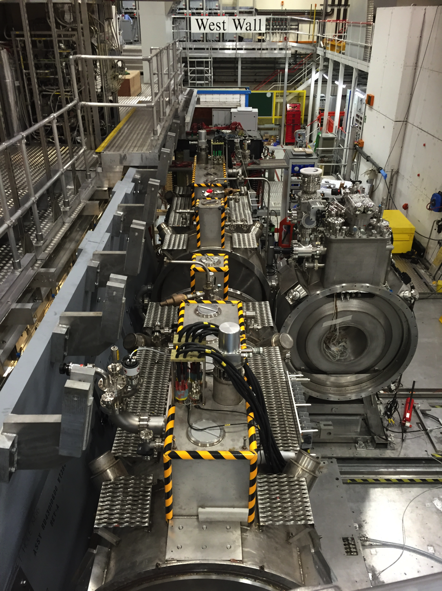
MICE Installation/Commissioning
Integration
and Preliminary Commissioning Underway
Formal start
of Channel Commissioning
in June

Slide 33
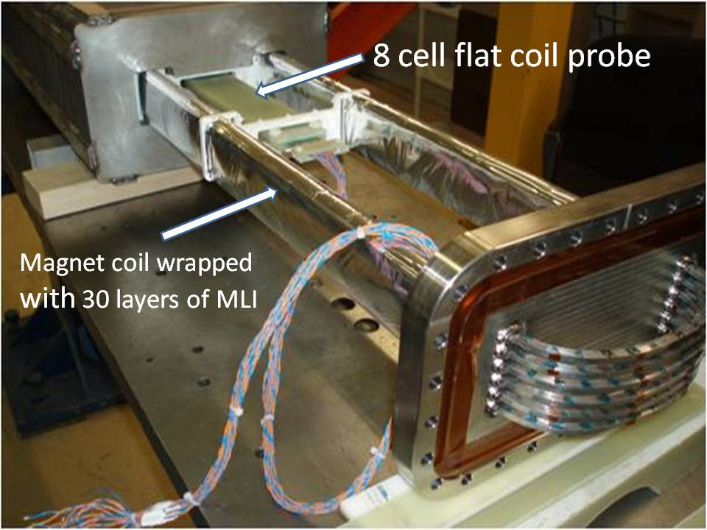
Technology Challenges - Acceleration
Muons require an ultrafast accelerator chain
a Beyond the capability of “standard designs”
Solutions include:
  Superconducting Linacs (NuMAX choice)
  Recirculating Linear Accelerators (RLAs)
  Fixed-Field Alternating-Gradient (FFAG) Rings
  Rapid Cycling Synchrotrons (RCS)
  RCS requires
  2 T p-p magnets
  at f = 400 Hz
  (U Miss & FNAL)
EMMA – FFAG
JEMMRLA Proposal:
JLAB Electron Model of
Muon RLA with Multi-pass
Arcs

Slide 34
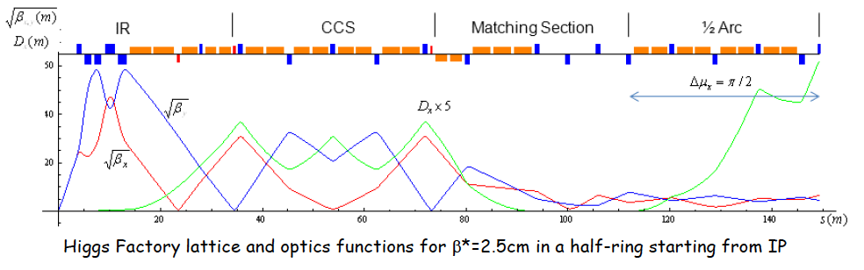
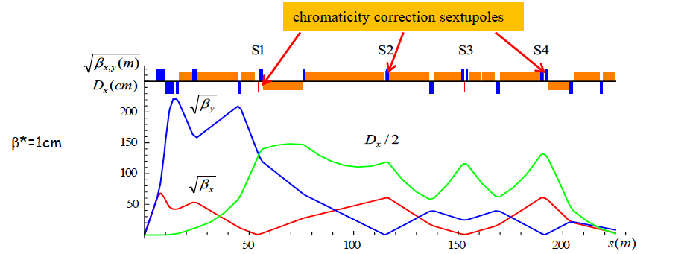
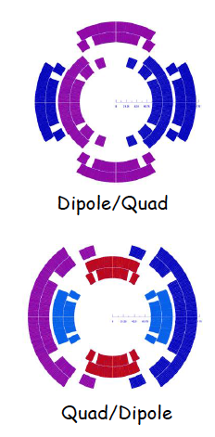
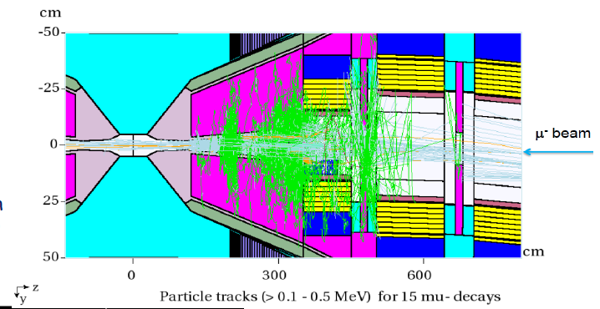
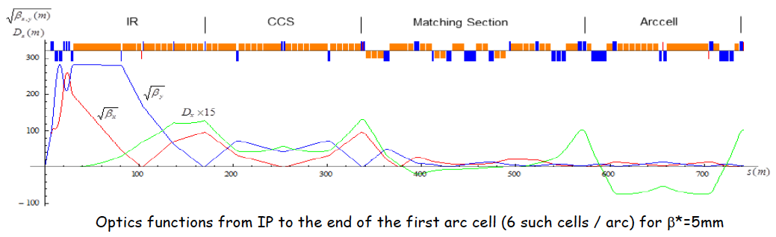
Muon Rings
NF: nuSTORM and NuMAX designs
Collider: Detailed optics studies for Higgs, 1.5 TeV,
3 TeV and now 6 TeV CoM
  With supporting magnet designs
  and background studies
  Detector occupancy similar to
  that seen in the LHC
  Luminoisty Upgrade

Slide 35
Conclusion

Slide 36
Concluding Remarks
Neutrino Factory capabilities offer a precision microscope
that will likely be needed to fully probe the physics of the neutrino sector
A multi-TeV muon collider may be the only cost-effective route to lepton collider capabilities at energies > 5 TeV
For the last 3 years US Muon Accelerator Program has pursued options to deploy muon accelerator capabilities
  Near-term (νSTORM)
  Mid-term (NuMAX)
  Long-term: a muon collider capability that would build on the NF complex
  and key technical hurdles have been addressed.
In light of the 2014 P5 recommendations that this directed facility effort no longer fits within the budget-constrained US research portfolio, the US effort is entering a ramp-down phase
Nevertheless, muon accelerator capabilities offer unique potential for the future of high energy physics research

