Slide 1


WIN 2017 Summary
Boris Kayser
UCI
June 24, 2017

Slide 2
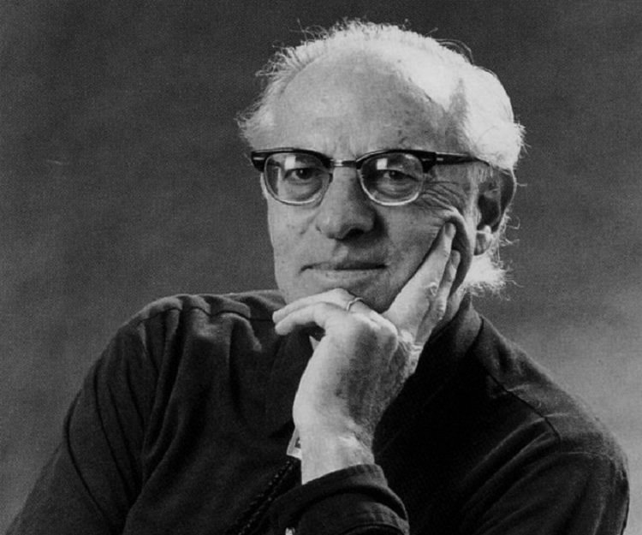
The University of California at Irvine (UCI)
has contributed a great deal to our field.
Fred Reines and Clyde Cowan were the first to detect neutrinos, proving that
they are real.
We thank the Local Organizing Committee, especially Mu-Chun Chen and Michael Smy, its Co-Chairs, for the latest UCI contribution, a very interesting workshop.
We also thank the working group organizers for their
key role, and the speakers for some very fine talks.

Slide 3
The plan: A partial picture of where we stand, and where we are going.
I did not find a way to be complete,
especially since 4 working groups
have been meeting simultaneously.
Apologies!

Slide 4
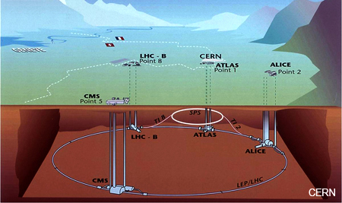
The Higgs h(125 GeV)

Slide 5
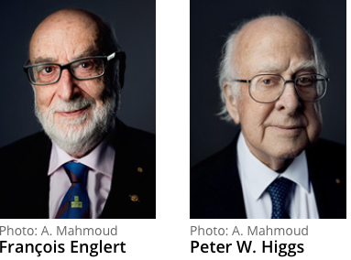
Is the Standard Model of the Electroweak Interactions Now Complete With the Discovery of the Higgs h(125 GeV)?
Nobel Prize
2013

Slide 6
Studies to see if the properties of h(125 GeV) deviate from those of the SM Higgs continue.
So far, this particle looks like
a very pure SM Higgs.

Slide 7
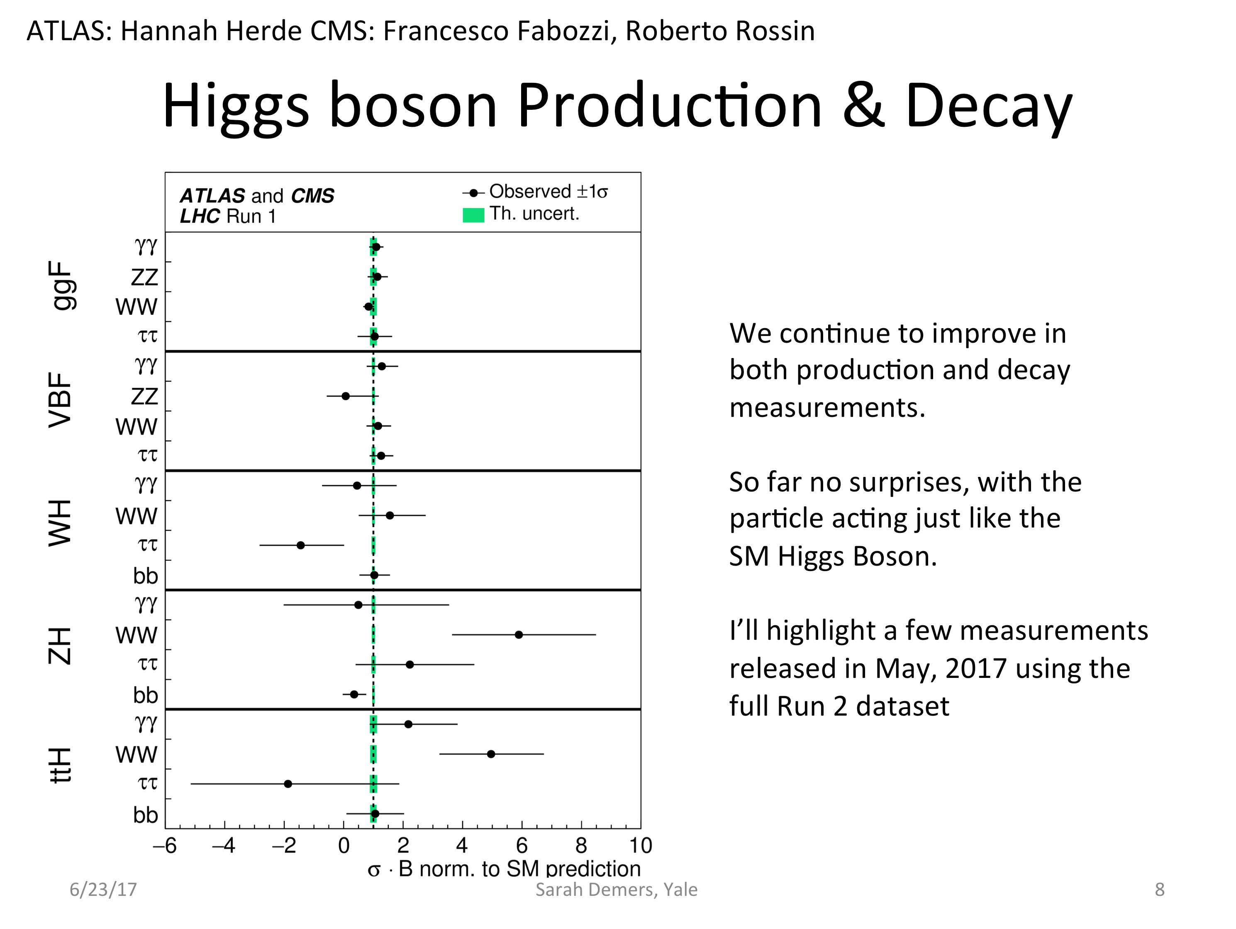
Sarah Demers
at 95% CL
Dhiman Chakraborty,
ATLAS

Slide 8
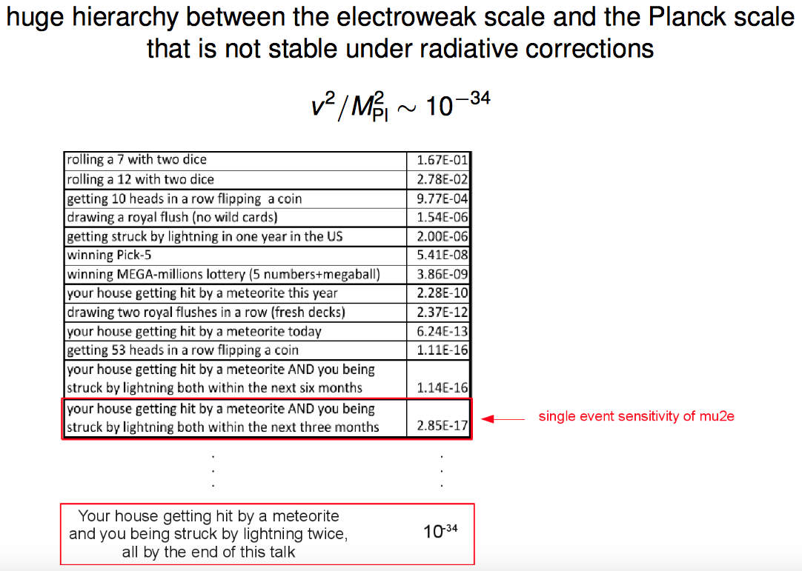
Wolfgang Altmannshofer

Slide 9
Where is the New Physics
that comes to the rescue?
Or, as Sarah Demers put it —
(or whatever it is that comes to the rescue)
Hard-to-see signals?
Higher mass?
Do we have to change our way of thinking?
JiJi Fan

Slide 10
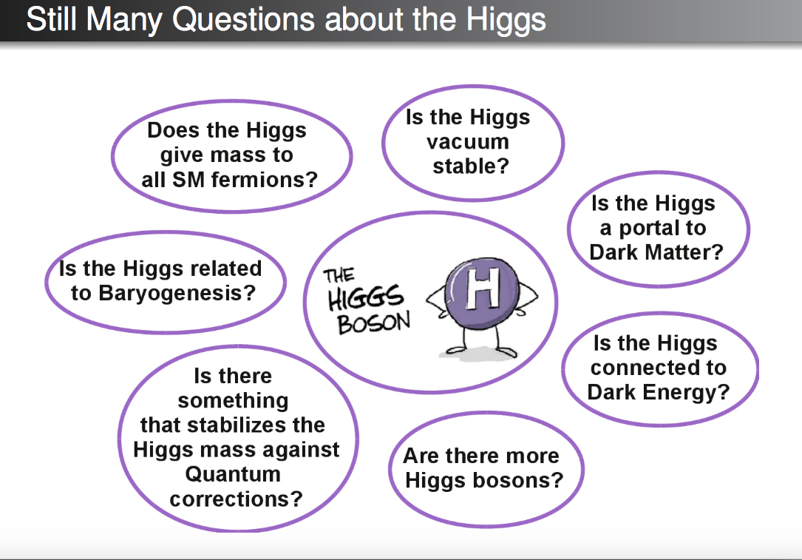
Wolfgang Altmannshofer

Slide 11
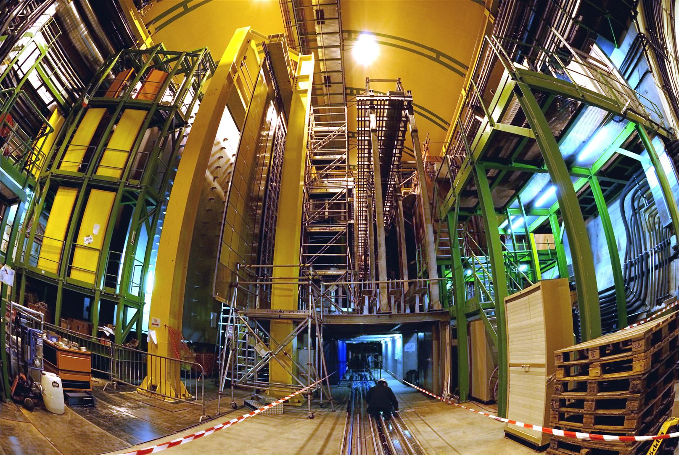
Anomalies

Slide 12
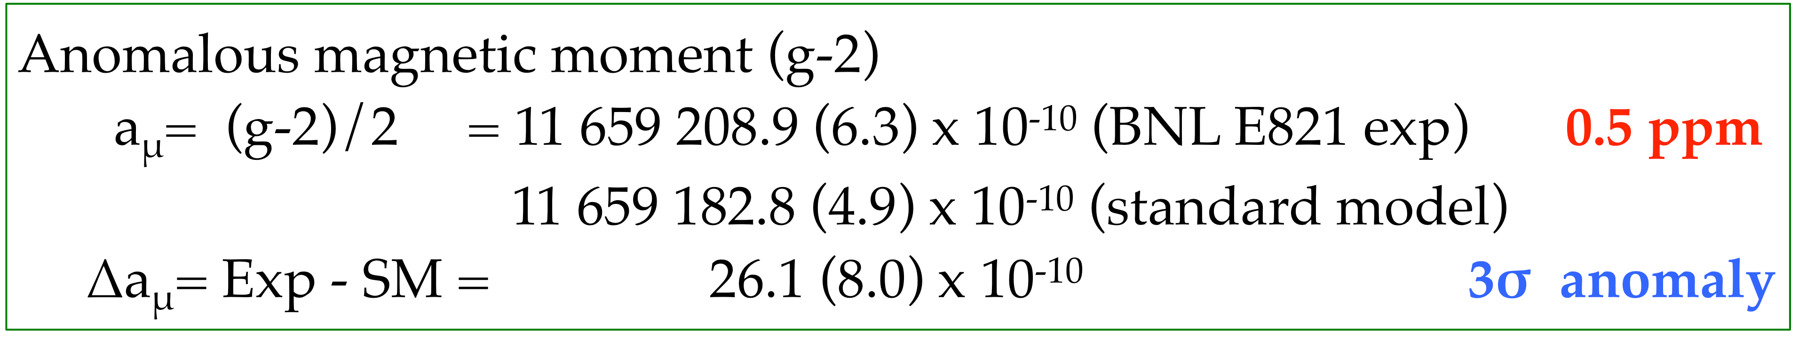
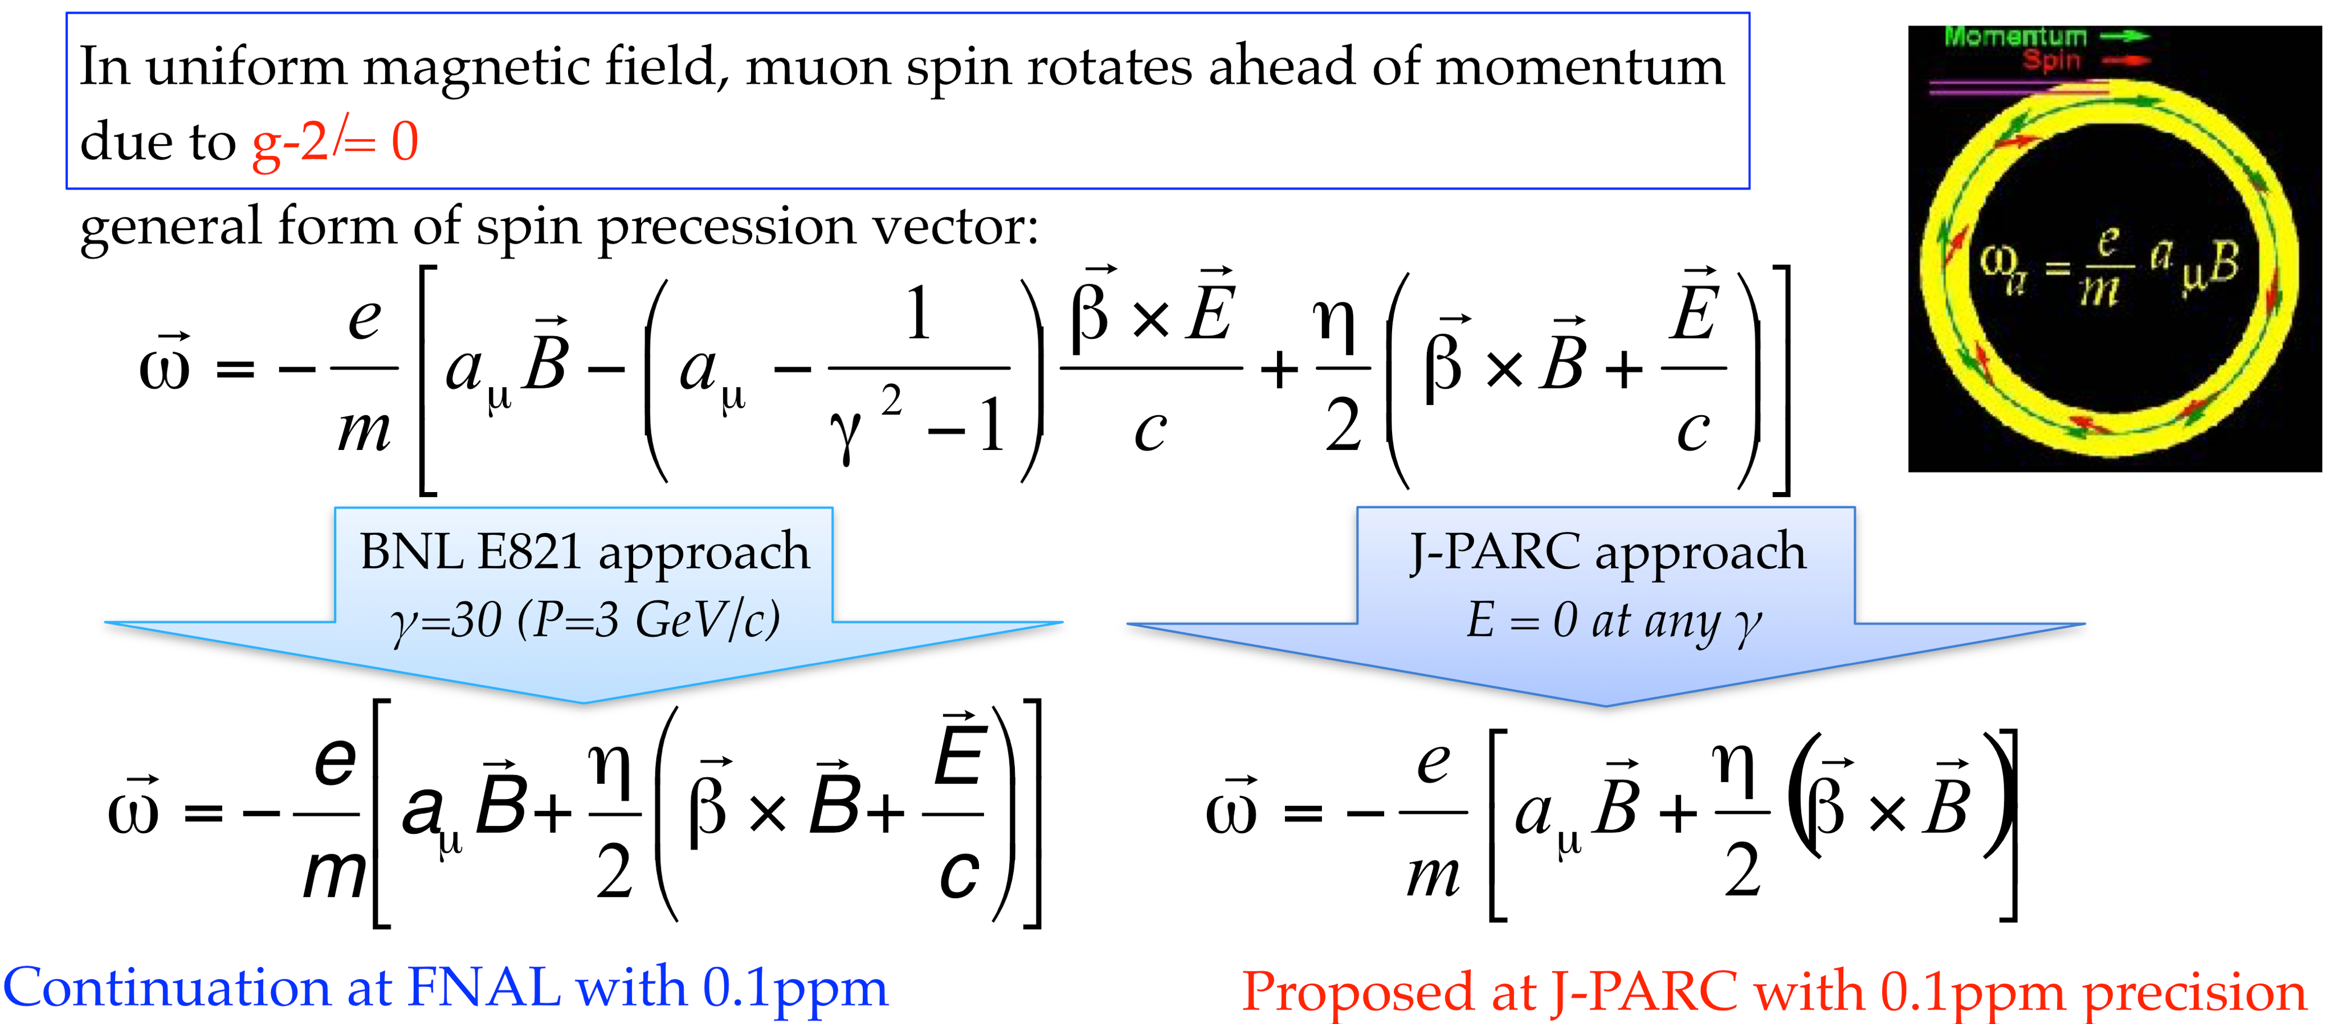
Satoshi Mihara
A variety of anomalous results hint at physics beyond the SM.
μ
EDM
EDM
precision

Slide 13
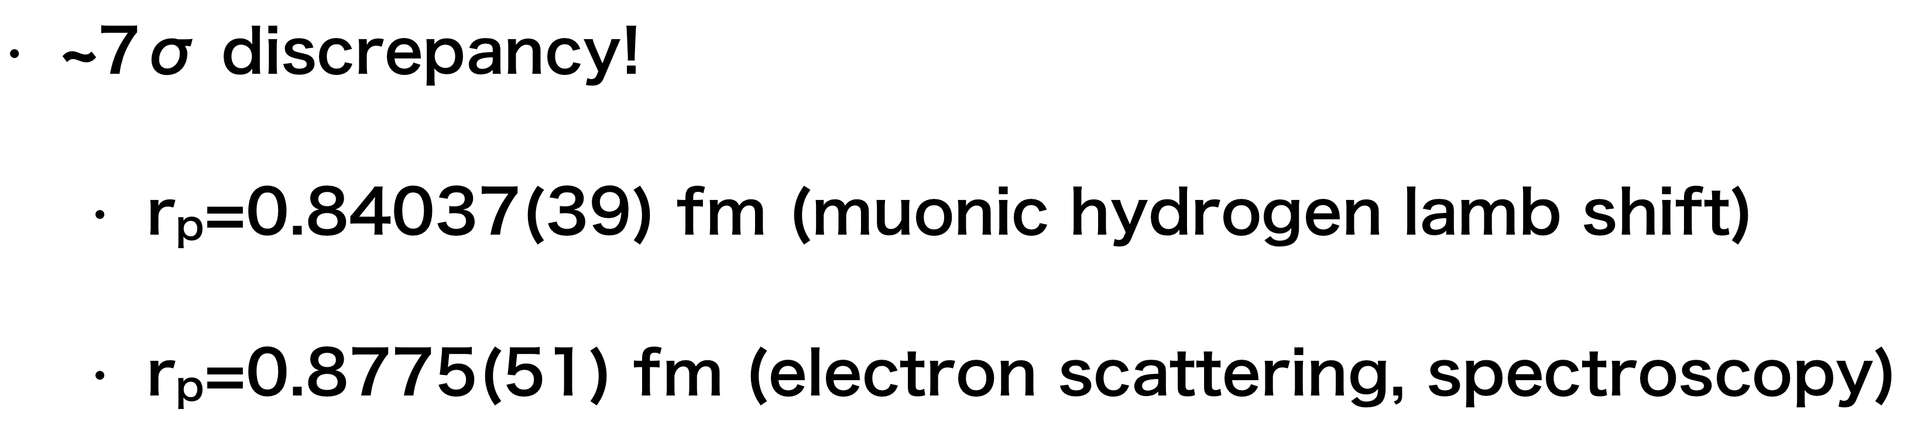
μ to e conversion in a nuclear field will be sought at J-PARC and FNAL.
The Shrinking Proton
Satoshi Mihara
Does either the muon or the electron know something that the other lepton doesn’t?

Slide 14
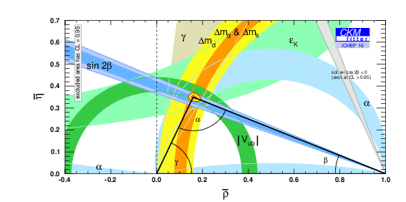
B Decay SM Success
SM quark mixing and CP violation describes many aspects of B physics with spectacular success!

Slide 15
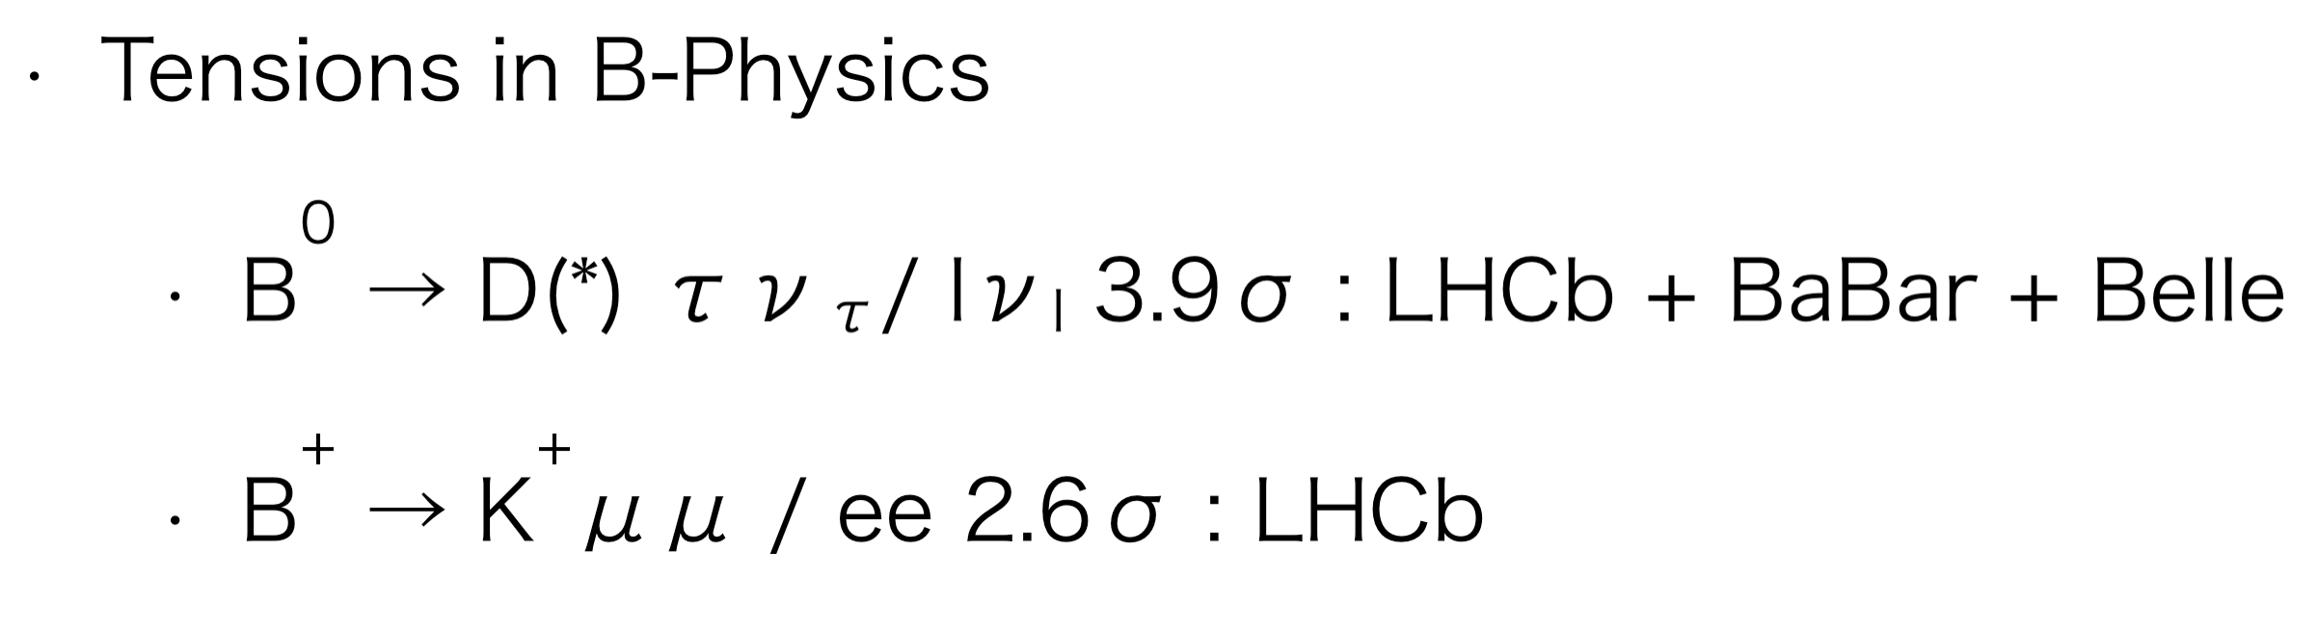
B Physics Anomalies
New physics?

Slide 16
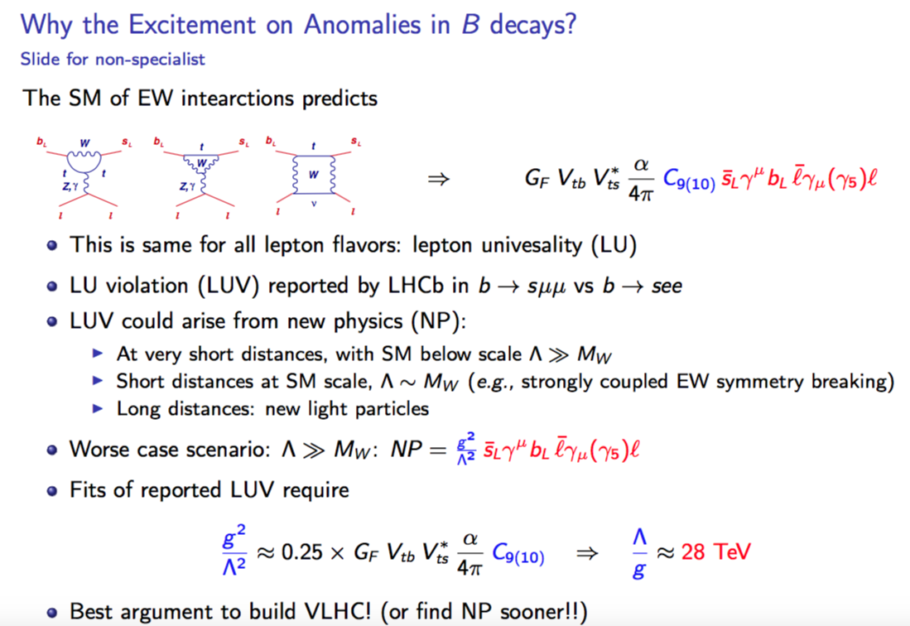
Ben Grinstein

Slide 17
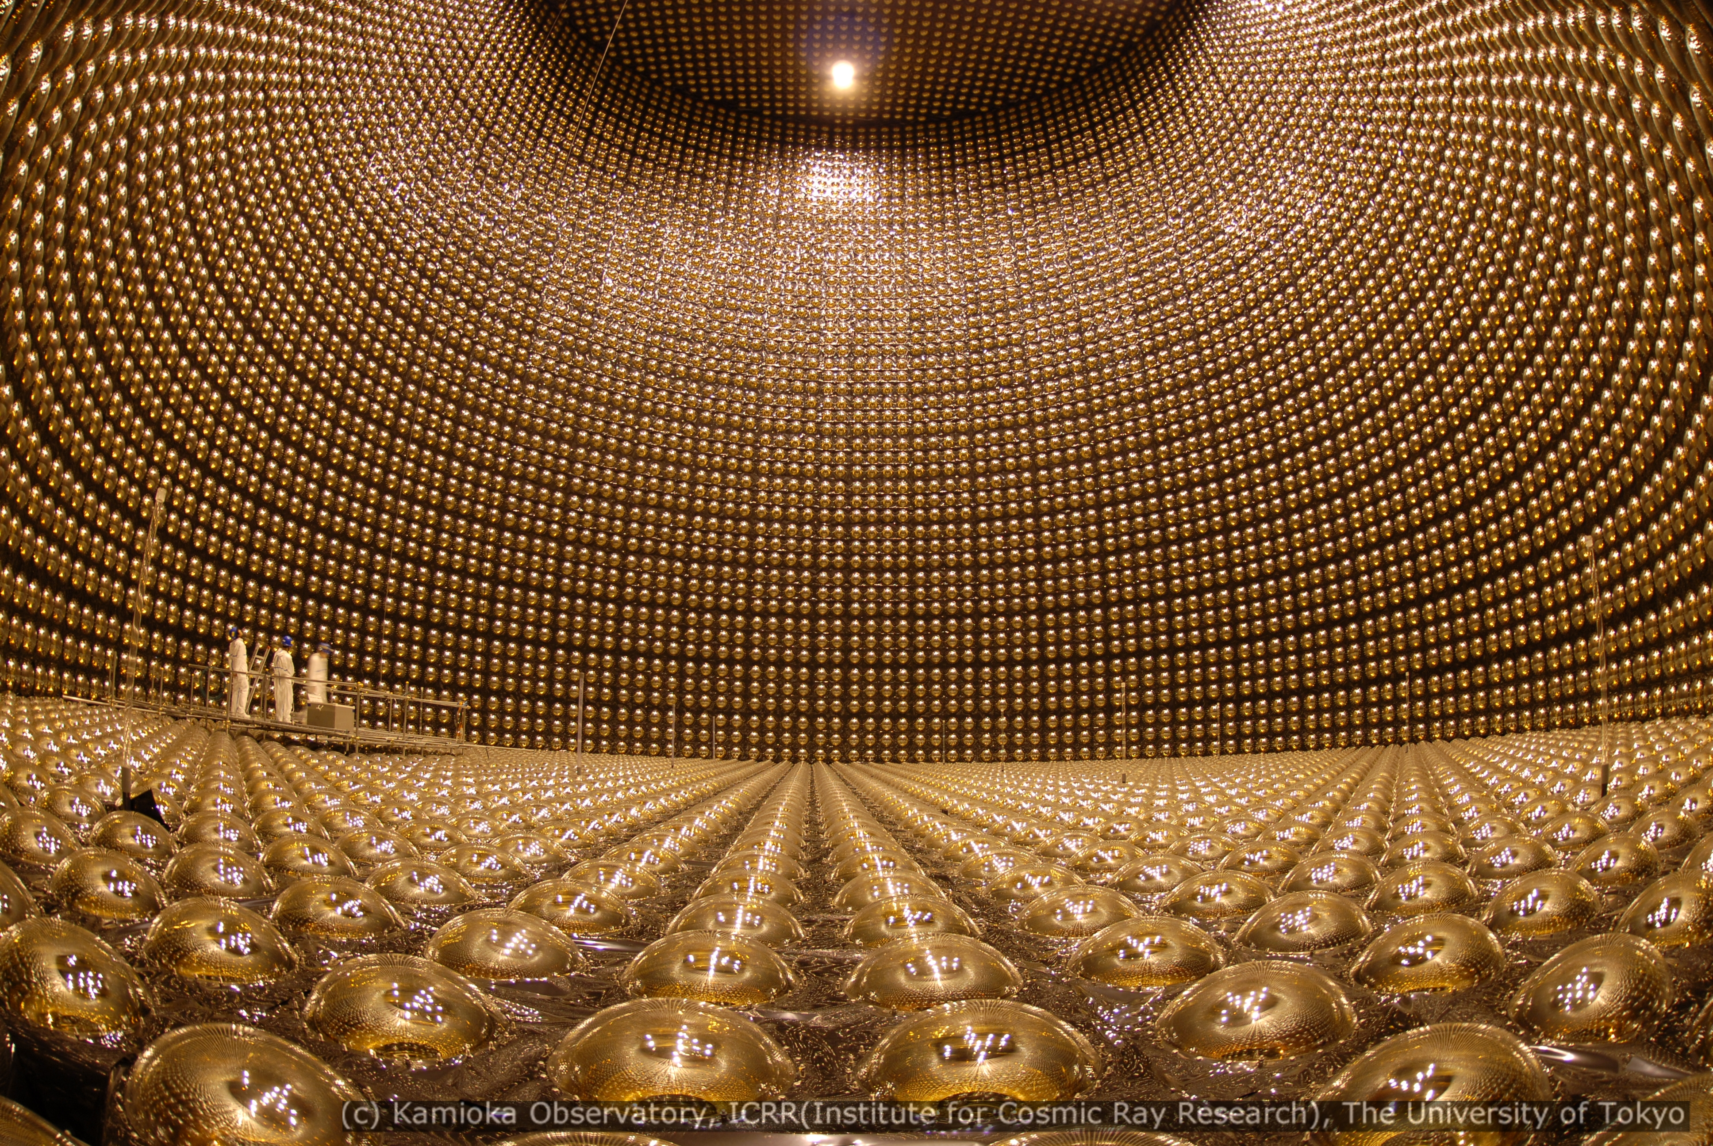
  Neutrino Physics

Slide 18
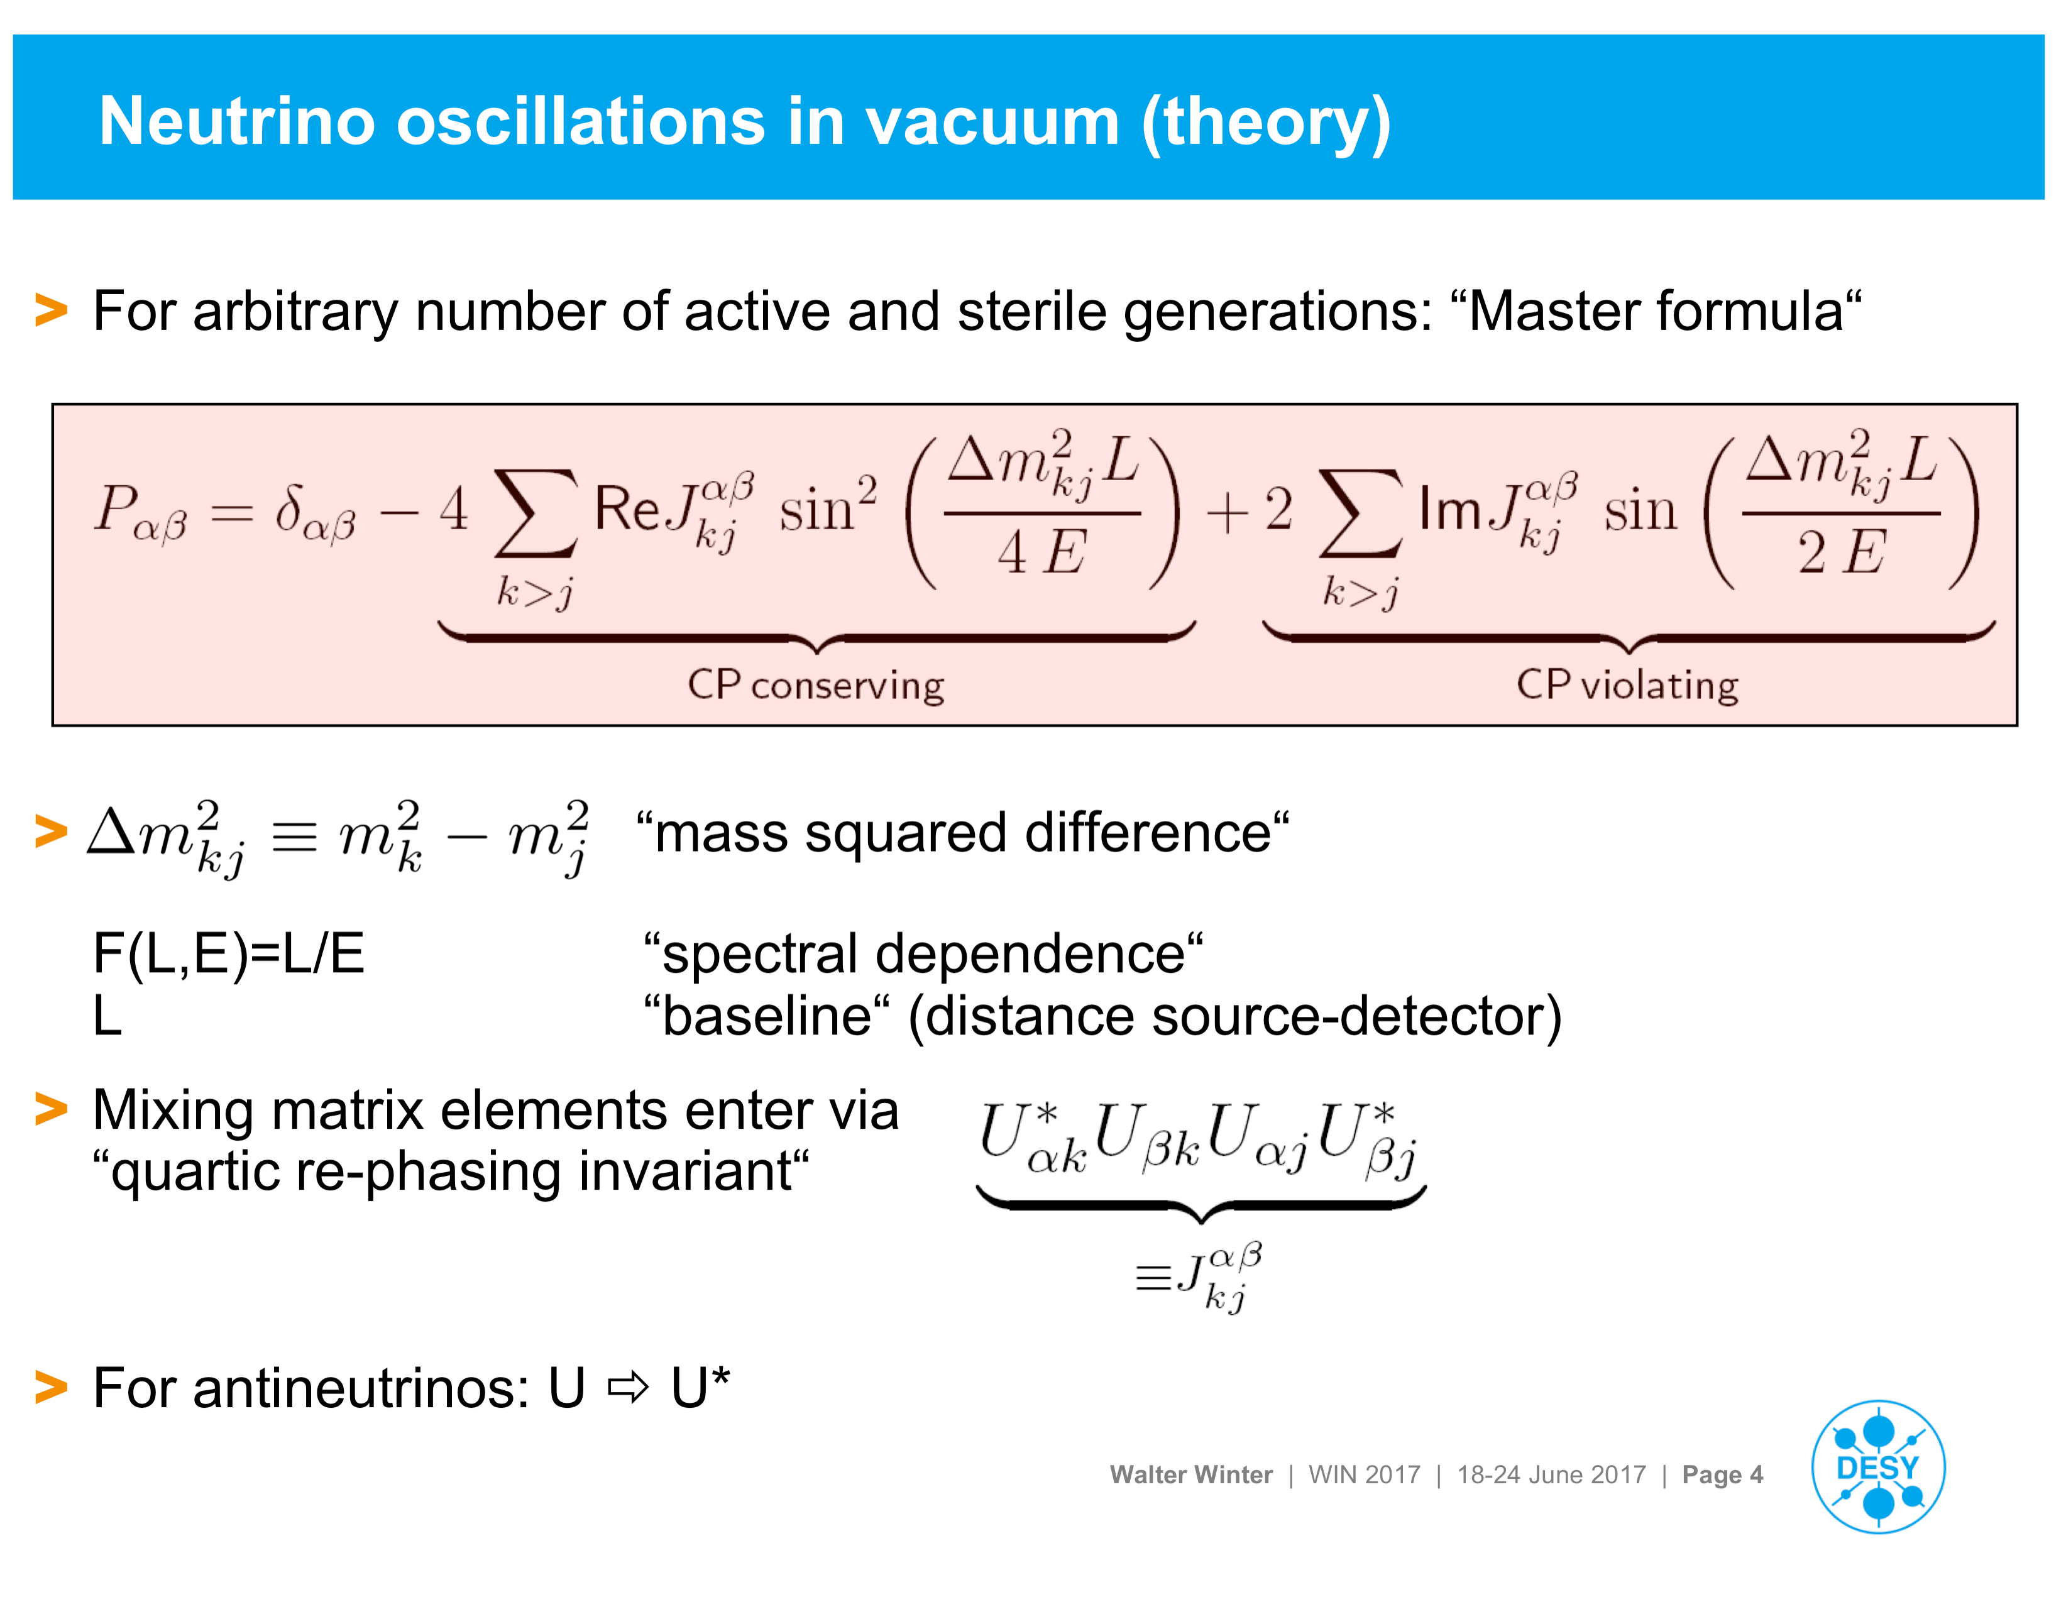
Neutrino flavor change (oscillation)
implies neutrino mass.
Walter Winter

Slide 19
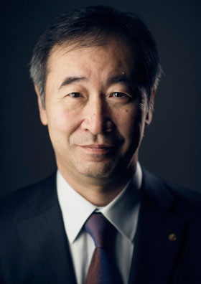
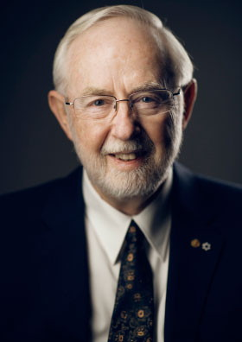
The 2015 Nobel Prize in Physics went to Takaaki Kajita and Art McDonald
for the experiments that proved flavor change.
Sudbury Neutrino Observatory,Canada
Super–
Kamiokande,
Japan
The 2016 Breakthrough Prize
in Fundamental Physics went to these
two experiments and four subsequent ones.

Slide 20
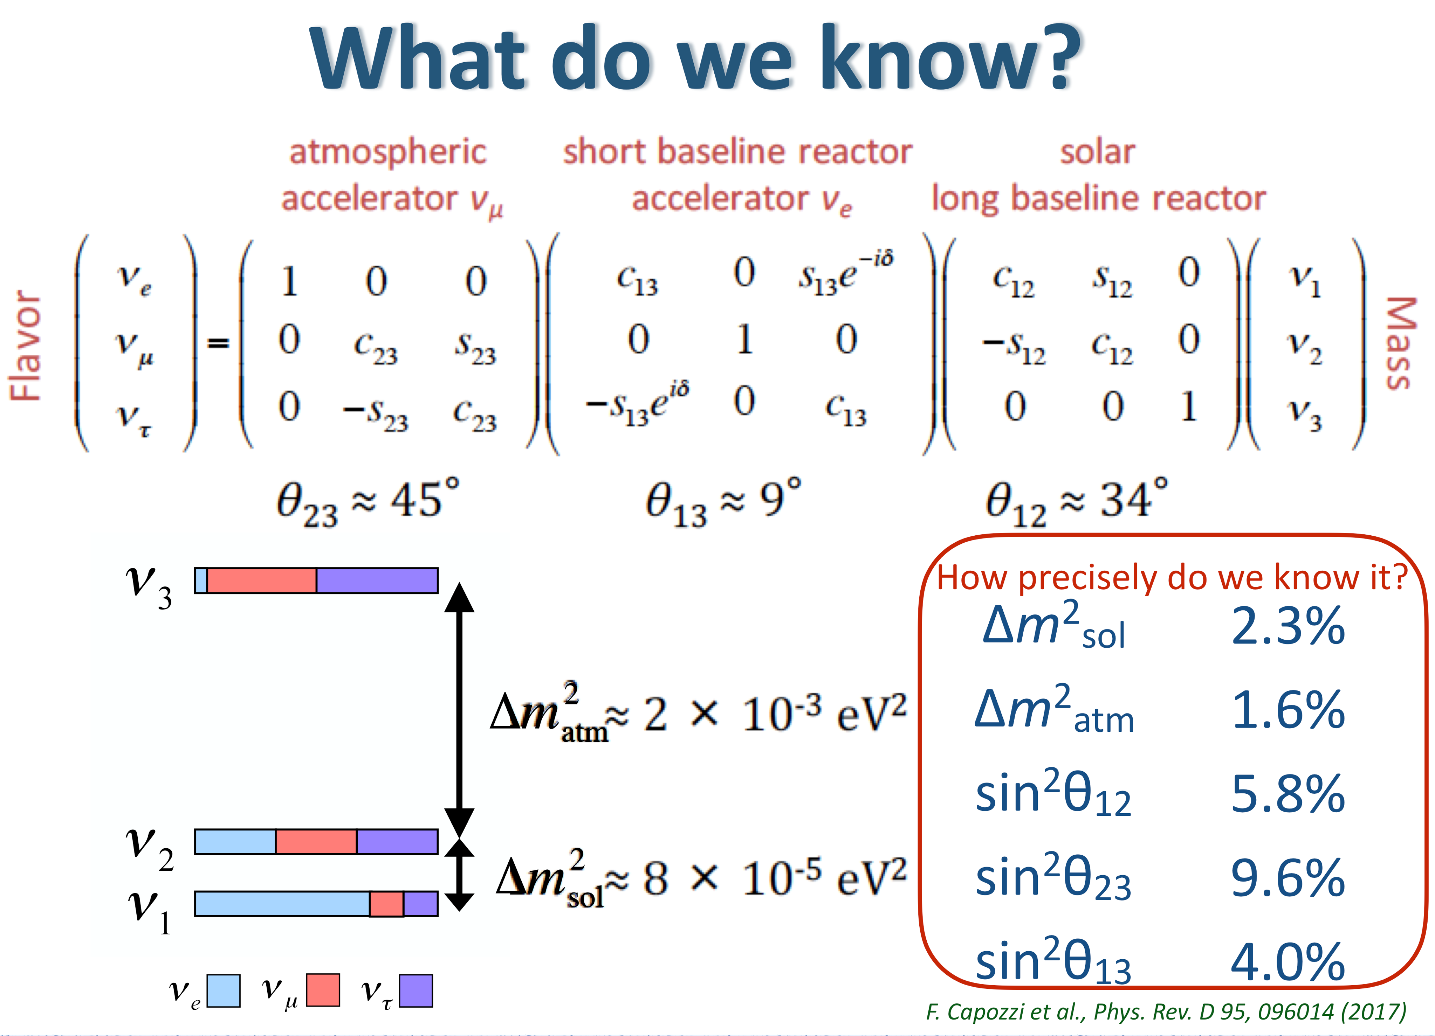
Alex Sousa
U

Slide 21
What We Would Like To Find Out

Slide 22
Is the physics behind the masses of neutrinos
different from that behind the masses
of all other known particles?
Are neutrinos their own antiparticles?
What is the absolute scale
of neutrino mass?
Is the spectrum like or ?

Slide 23
Is θ₂₃ maximal?
Do neutrino interactions
violate CP?
Is P(ν_{α} → ν_{β}) ≠ P(ν_{α} → ν_{β}) ?
Is CP violation involving neutrinos
the key to understanding the matter – antimatter asymmetry of the universe?

Slide 24
What can neutrinos and the universe
tell us about one another?
Are there more than 3 mass eigenstates?
Are there “sterile” neutrinos
that don’t couple to the W or Z?
Do neutrinos have Non-Standard-Model interactions?

Slide 25
Do neutrinos break the rules?
Violation of Lorentz invariance?
Violation of CPT invariance?
Departures from quantum mechanics?

Slide 26
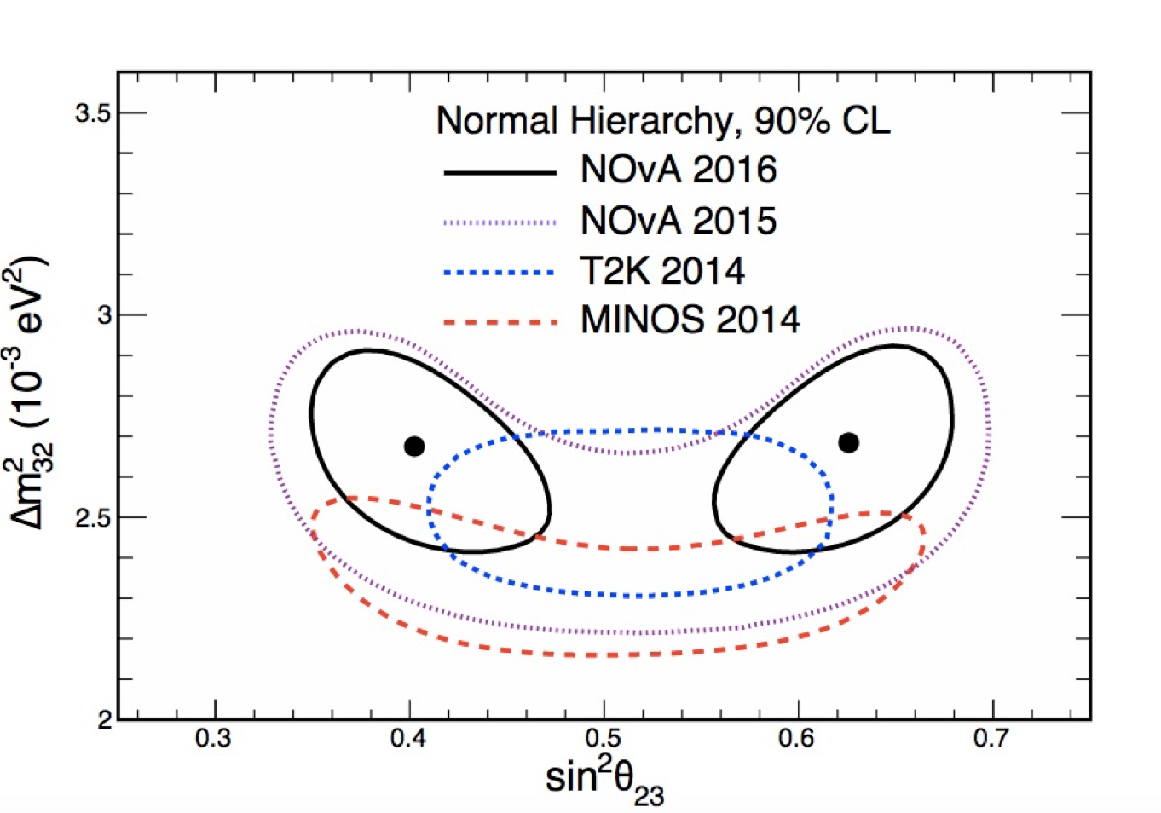
Current Issues
Is θ₂₃ maximal (45º)?
If so, there may well be a symmetry behind that.
Norm
Buchanan

Slide 27
Is the mass ordering normal or inverted?
(Mass)²
or

Slide 28
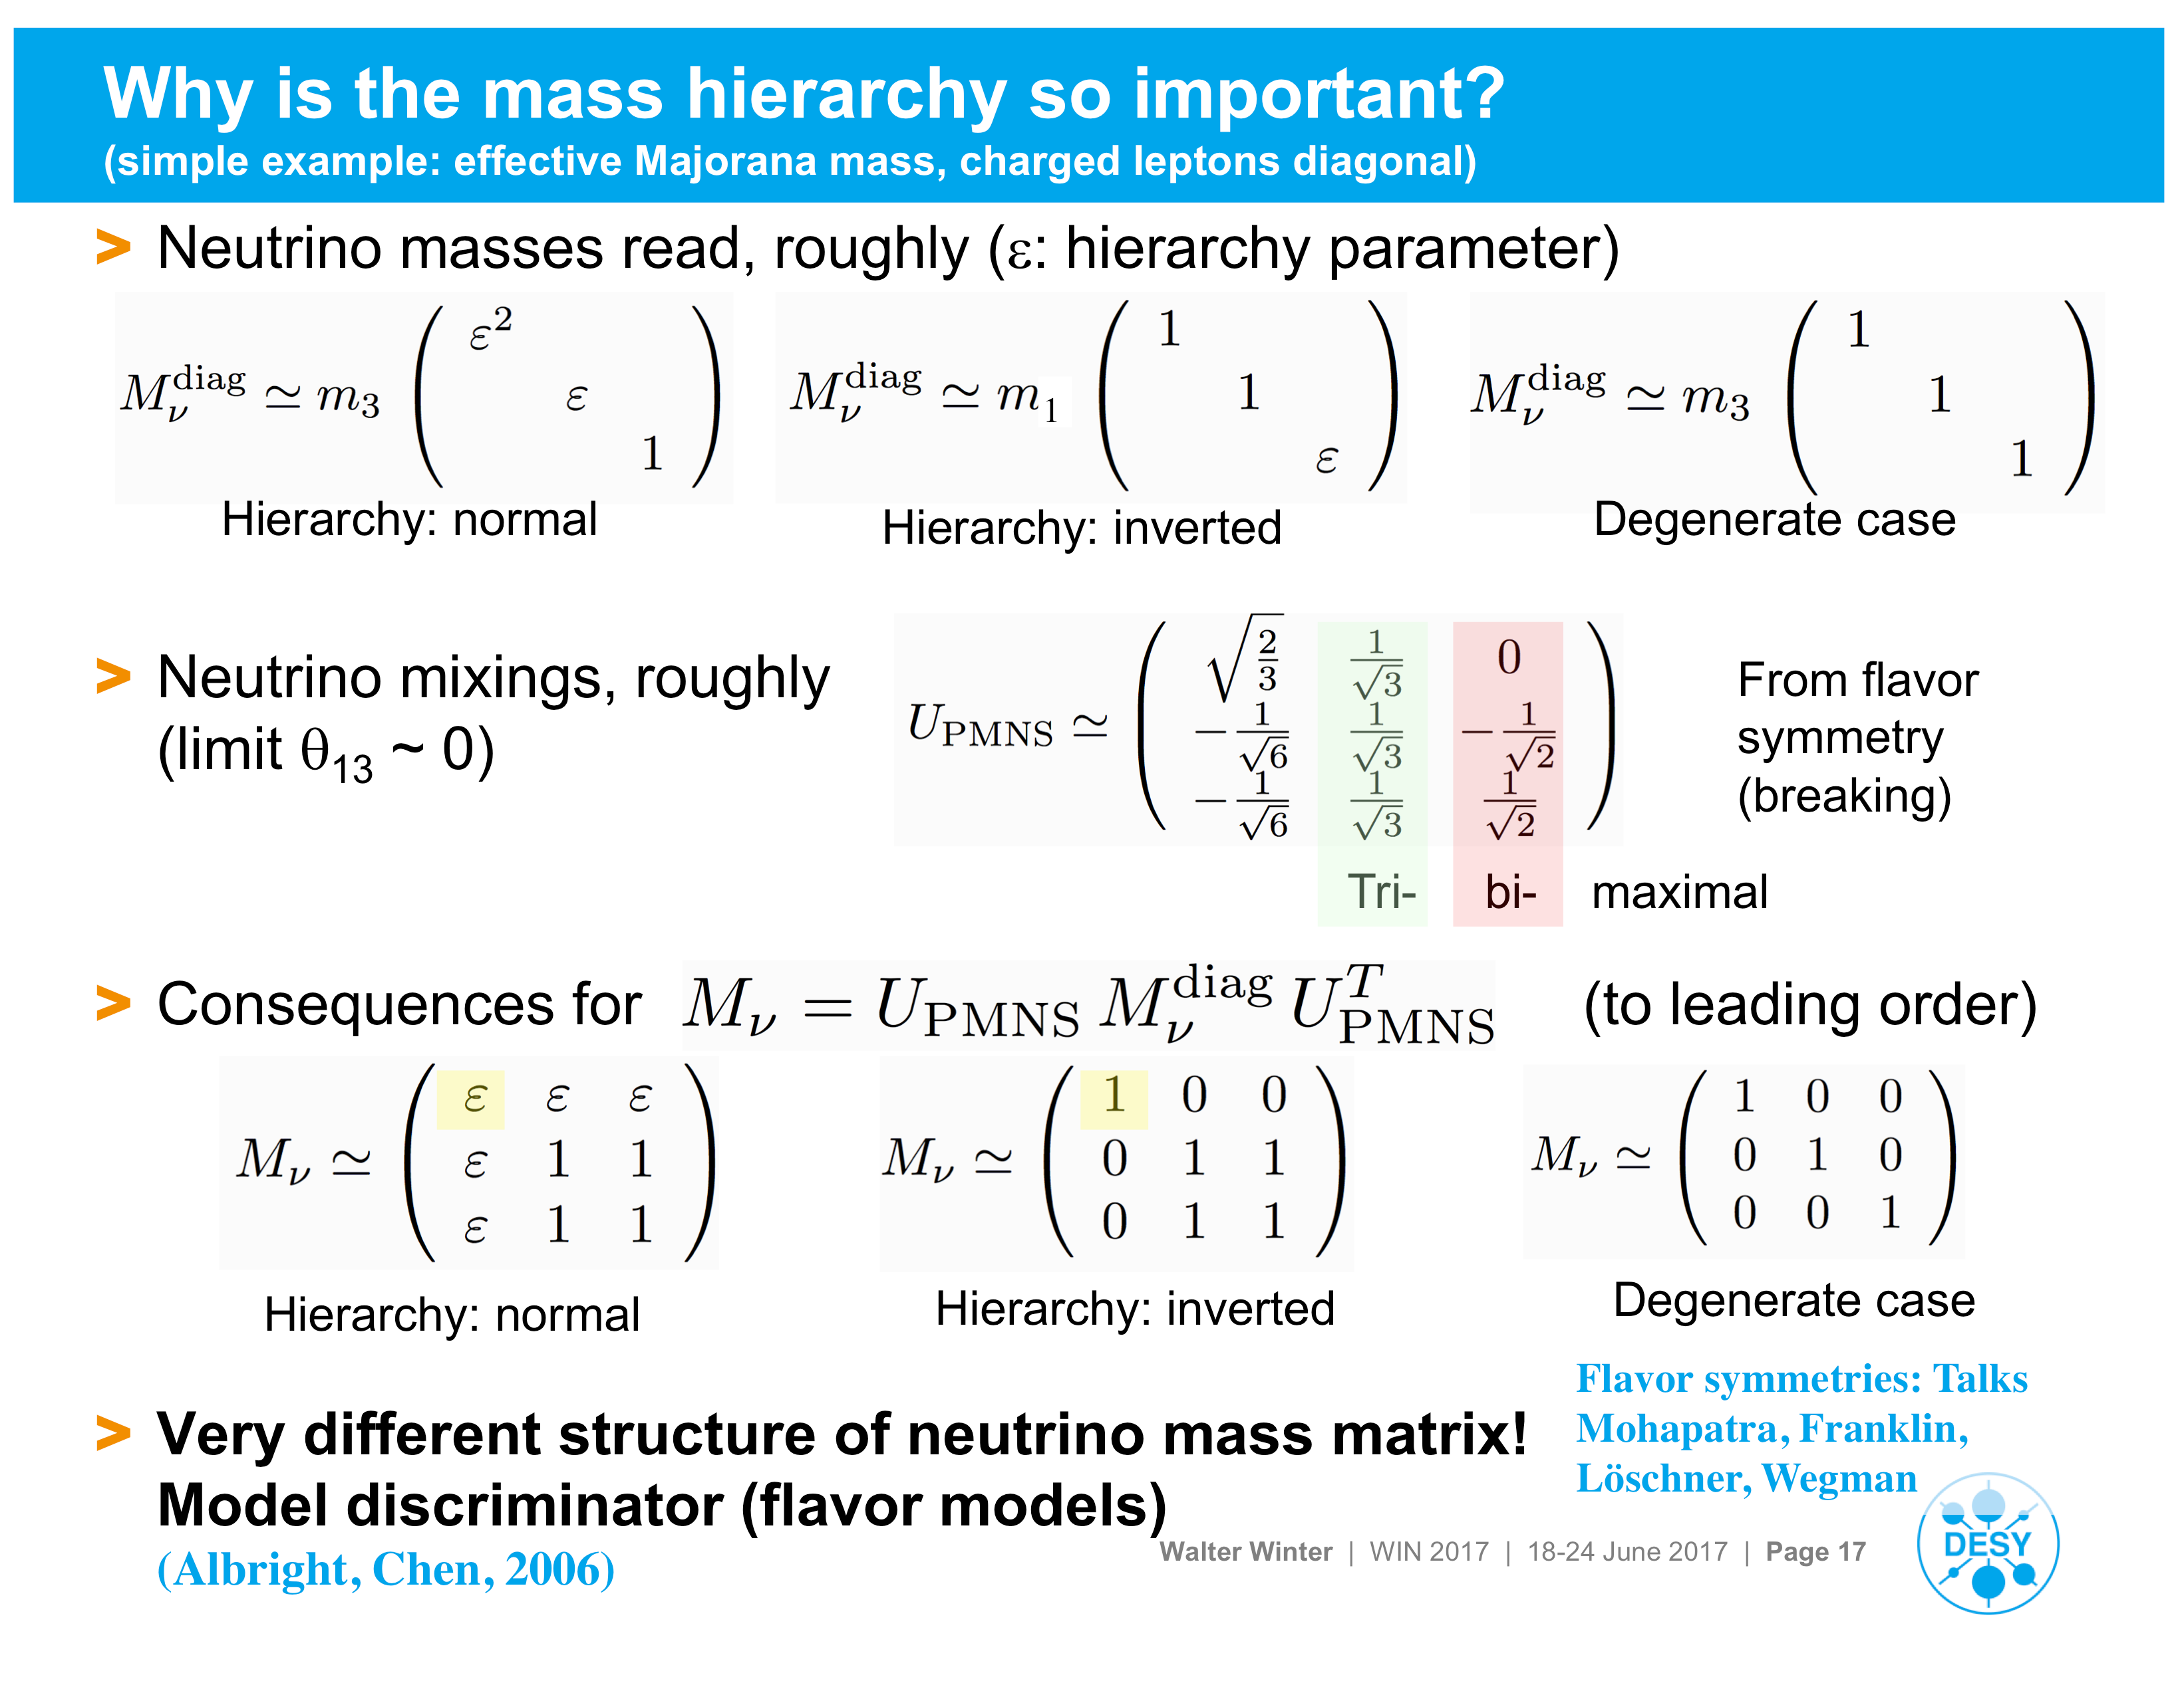
Walter Winter

Slide 29
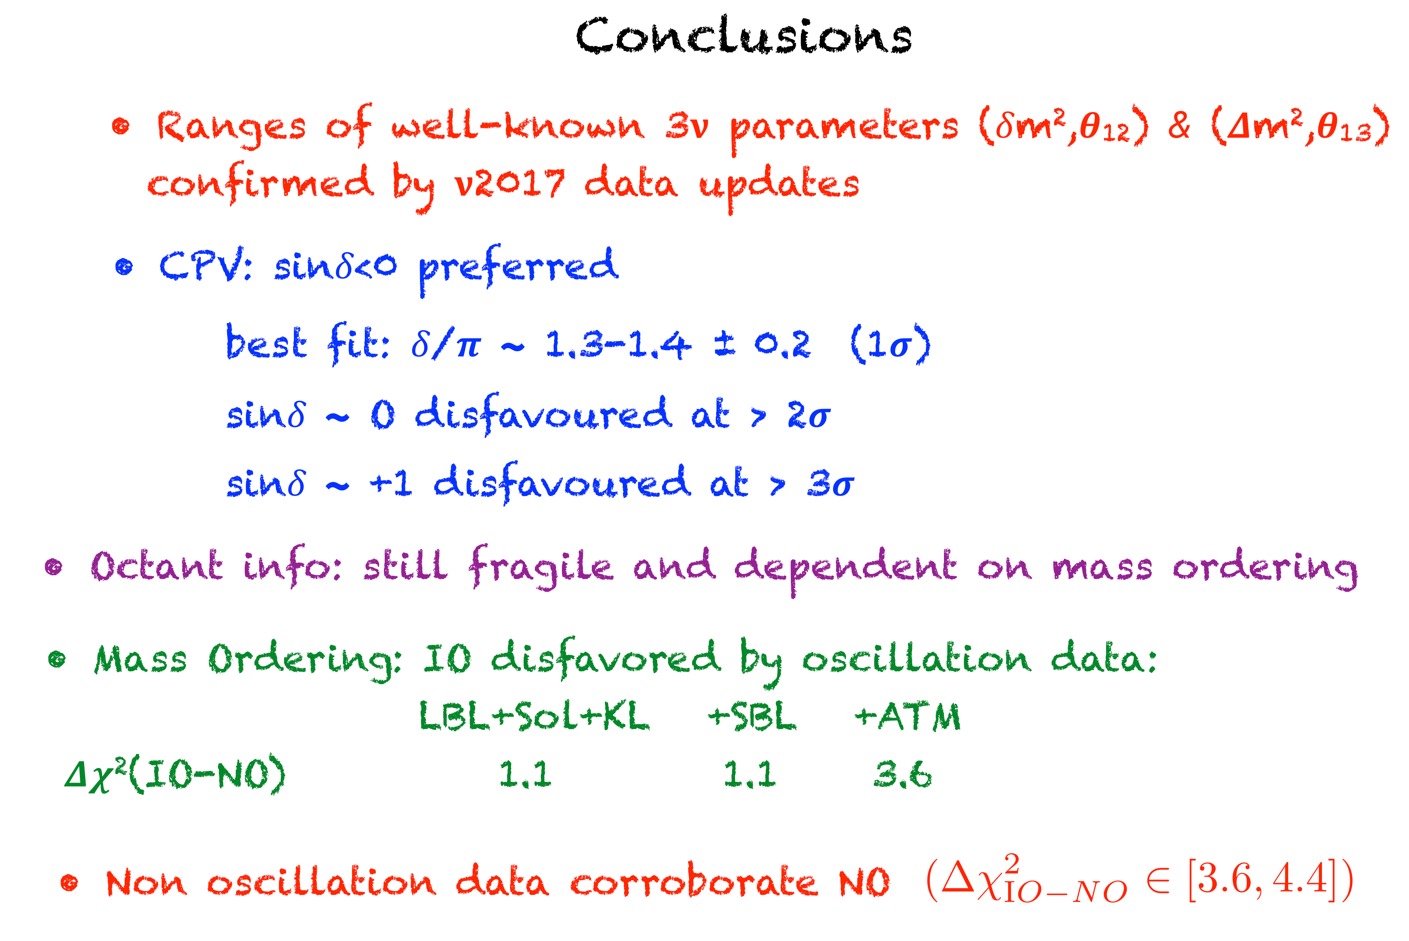
Antonio Marrone

Slide 30
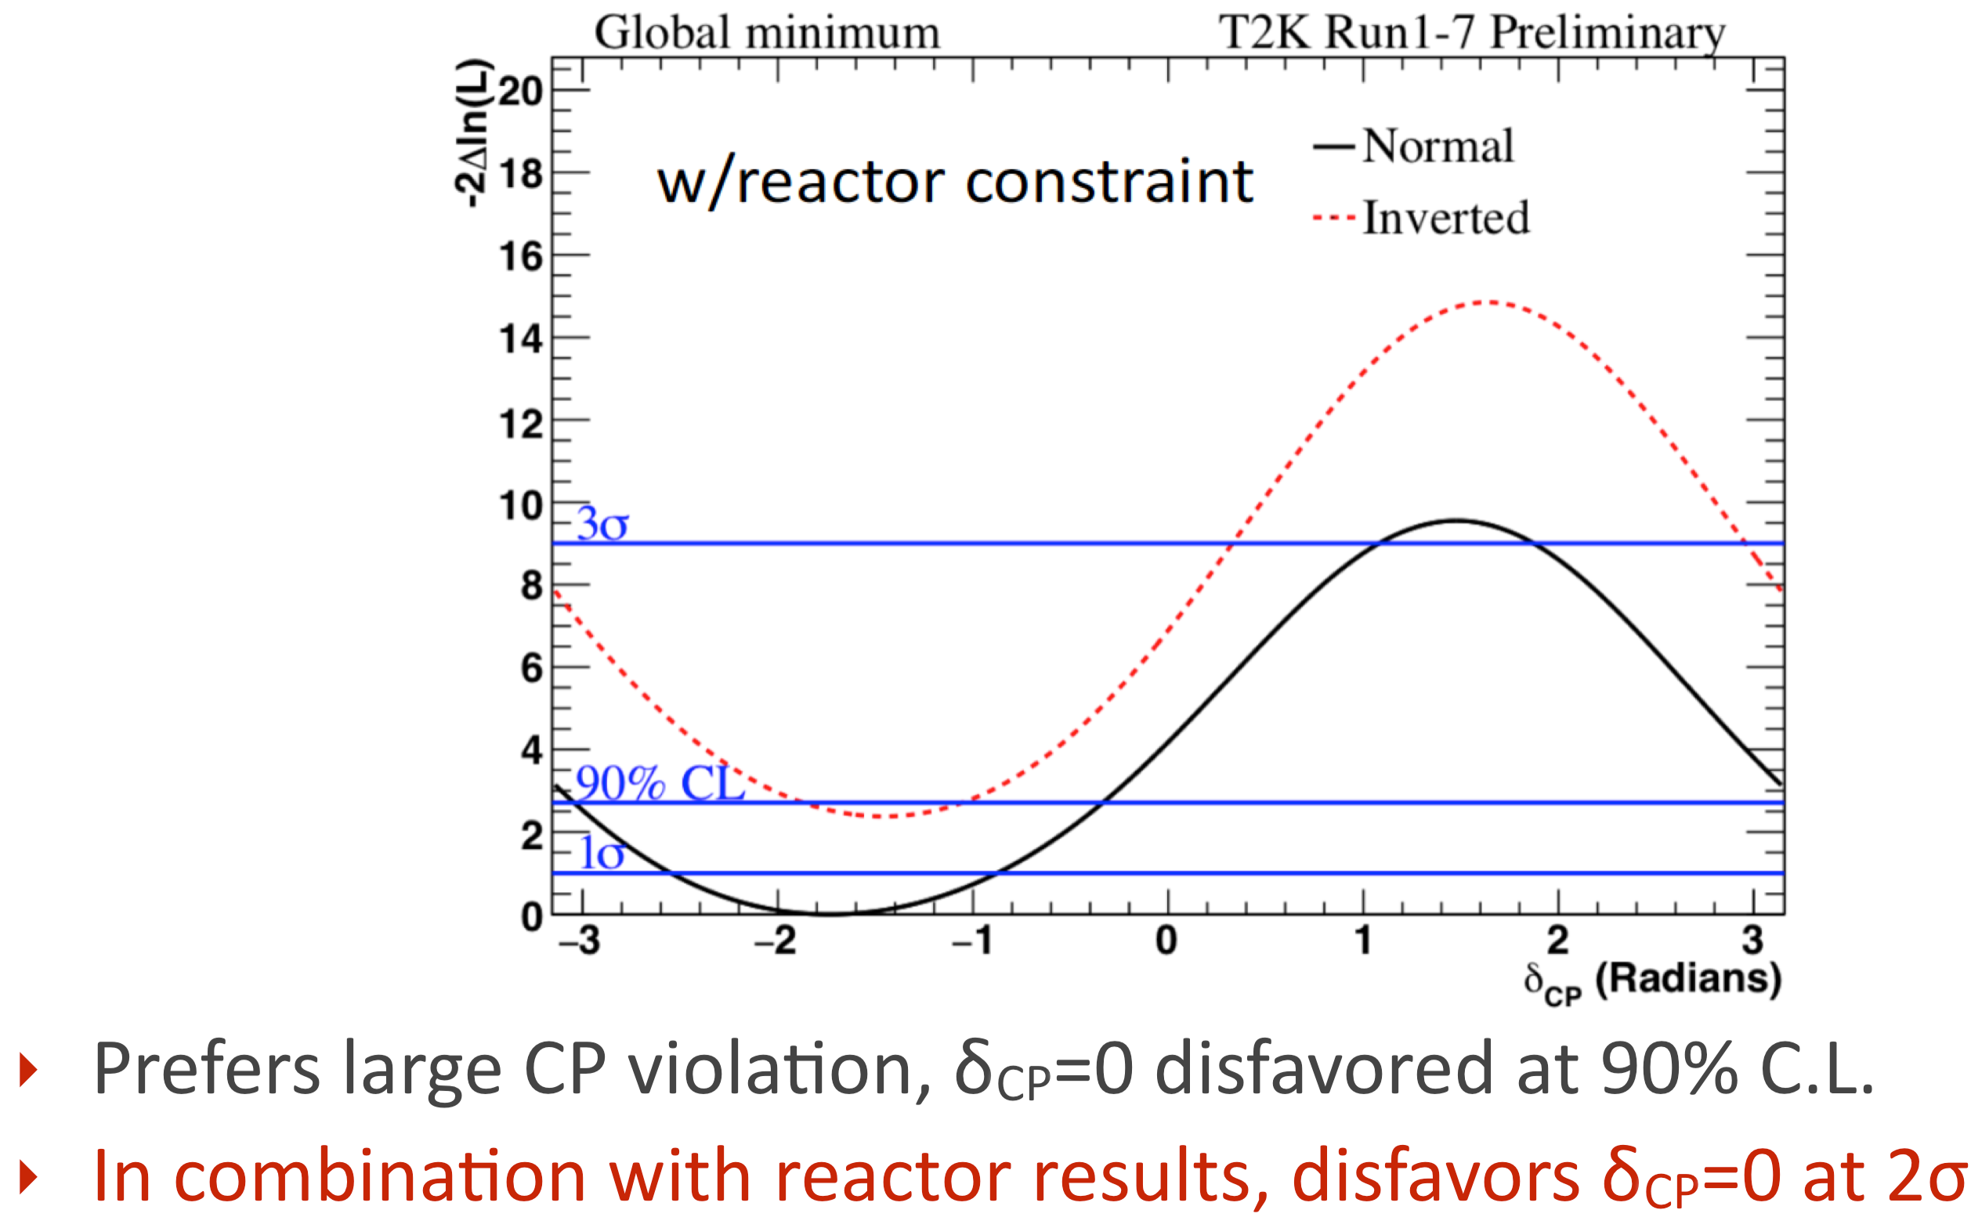
Has leptonic CP violation already been seen?
From T2K

Slide 31
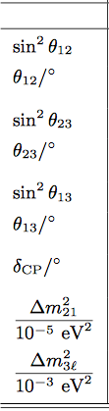
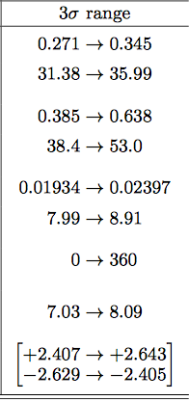
But —
Global fit of Esteban, et al.

Slide 32
Are There ∼ 1eV Sterile Neutrinos?
There are several hints of oscillation with L(m)/E(MeV) ∼ 1:
These a Δm² ∼ 1 eV², bigger
than the two established splittings.
 1eV²
At least 4 mass eigenstates
Firm
At least 4 flavors
Then
At least 1 sterile neutrino

Slide 33
The Hints of eV²-Scale Δm²
Experiment
Possible Oscillation
Comment
LSND
Interesting
MiniBooNE
Low energy excess?
Not consistent with LSND (Carlo Giunti)
MiniBooNE
Low energy excess?
Flux uncertain and time dependent (Daya Bay)
Reactor Exps.
⁵¹Cr and ³⁷Ar
Source Exps.
Detection efficiency?

Slide 34
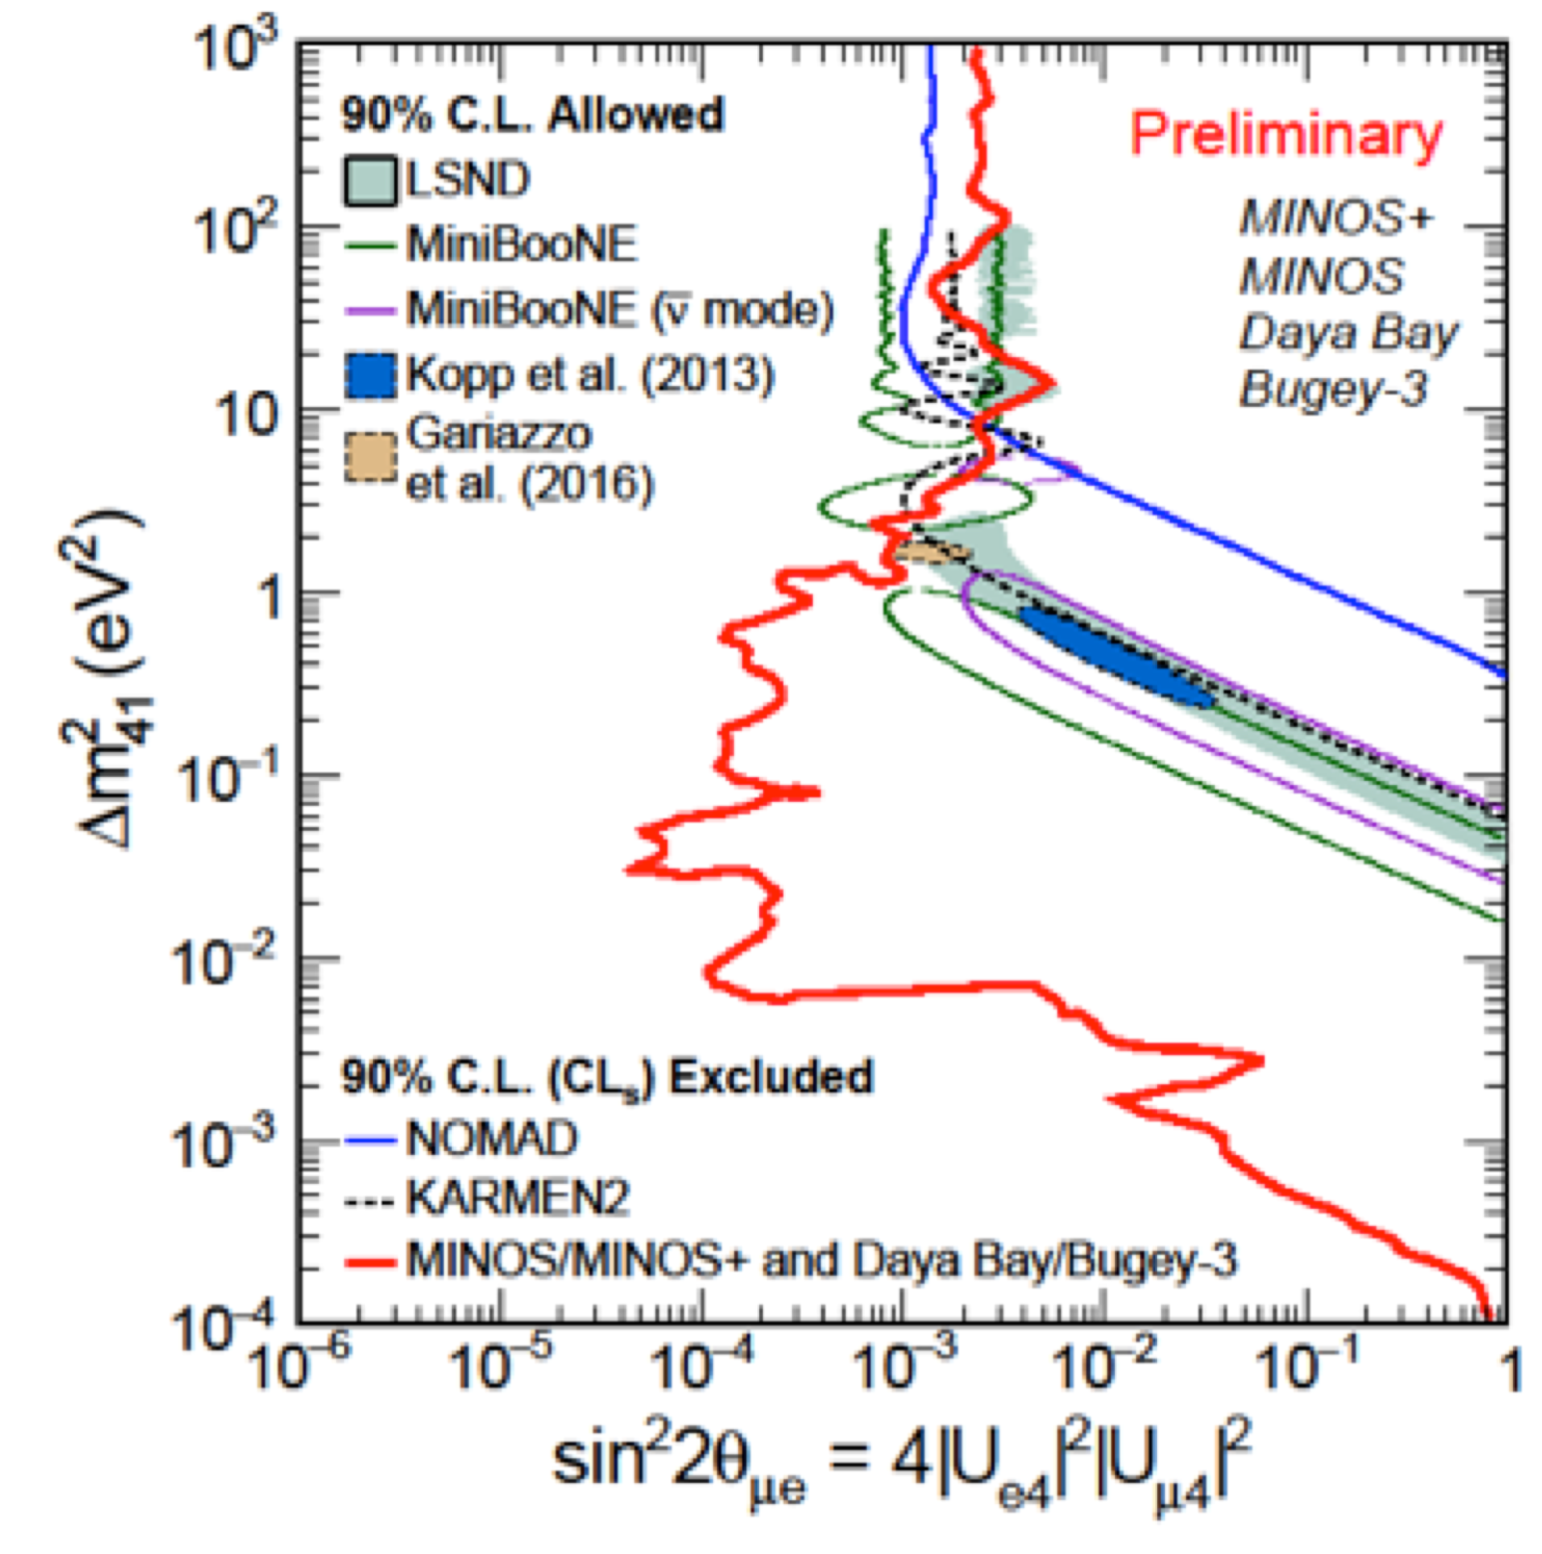
Negative experimental results are tightening the constraints on possible 1eV scale sterile neutrinos.
Milind Diwan
Stay tuned
Additional constraints
from DANSS, IceCube, NEOS.

Slide 35
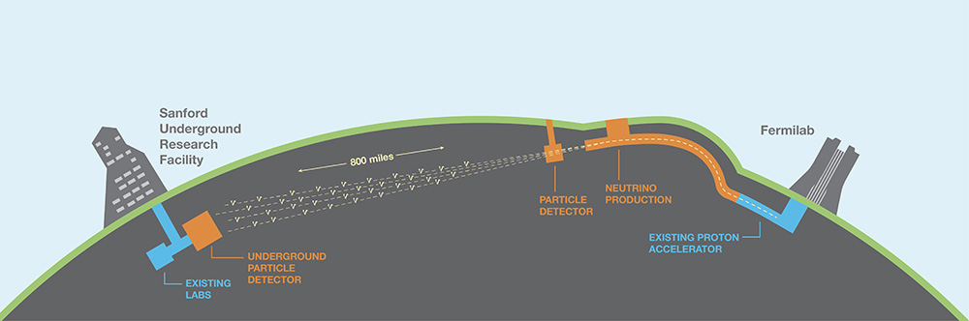
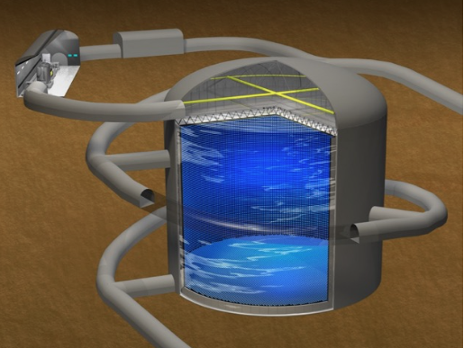
The Future
DUNE
HyperKamiokande

Slide 36
DUNE and T2HK will seek CP violation in neutrino oscillation, proton decay, and other phenomena.
Various approaches to determining the mass ordering will be pursued.
Numerous searches for neutrinoless double beta decay, employing quite different techniques, will seek to show that the origin of neutrino mass is not the same as the origin of the masses of everything else,
and that neutrinos are their own antiparticles.
Lindley Winslow
Tritium beta decay and other experiments will try
to determine the absolute scale of neutrino mass.
Joe Formaggio

Slide 37
The Short Baseline Neutrino program at Fermilab,
a number of reactor experiments, radioactive source experiments, and other experiments will attempt to determine whether ∼ 1eV sterile neutrinos are real.
Experiments will try to observe coherent neutrino –nucleus scattering, confirming the SM prediction
or finding evidence for NSI. klklklkklkkl
James Dent
Neutrino cross section measurements will be crucial to the neutrino oscillation experiments.
We must be alert to the unexpected, such as Non Standard neutrino Interactions Irina Mocioiu
and sterile neutrinos.

Slide 38
  Grand Unified Theories
  and Proton Decay

Slide 39
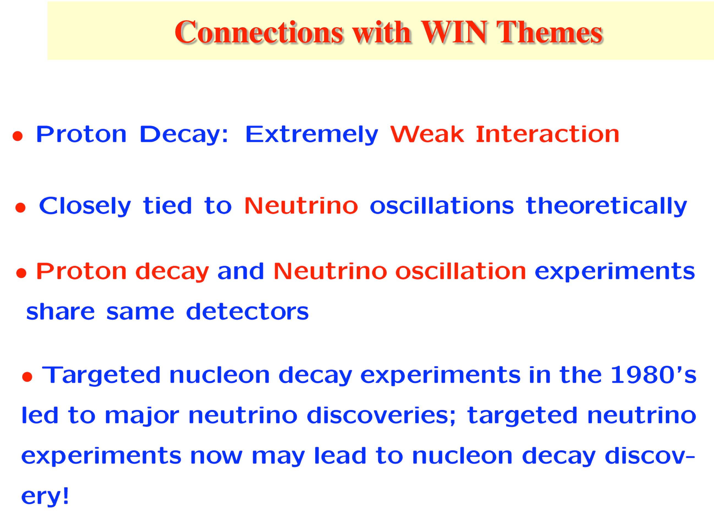
Kaladi Babu

Slide 40
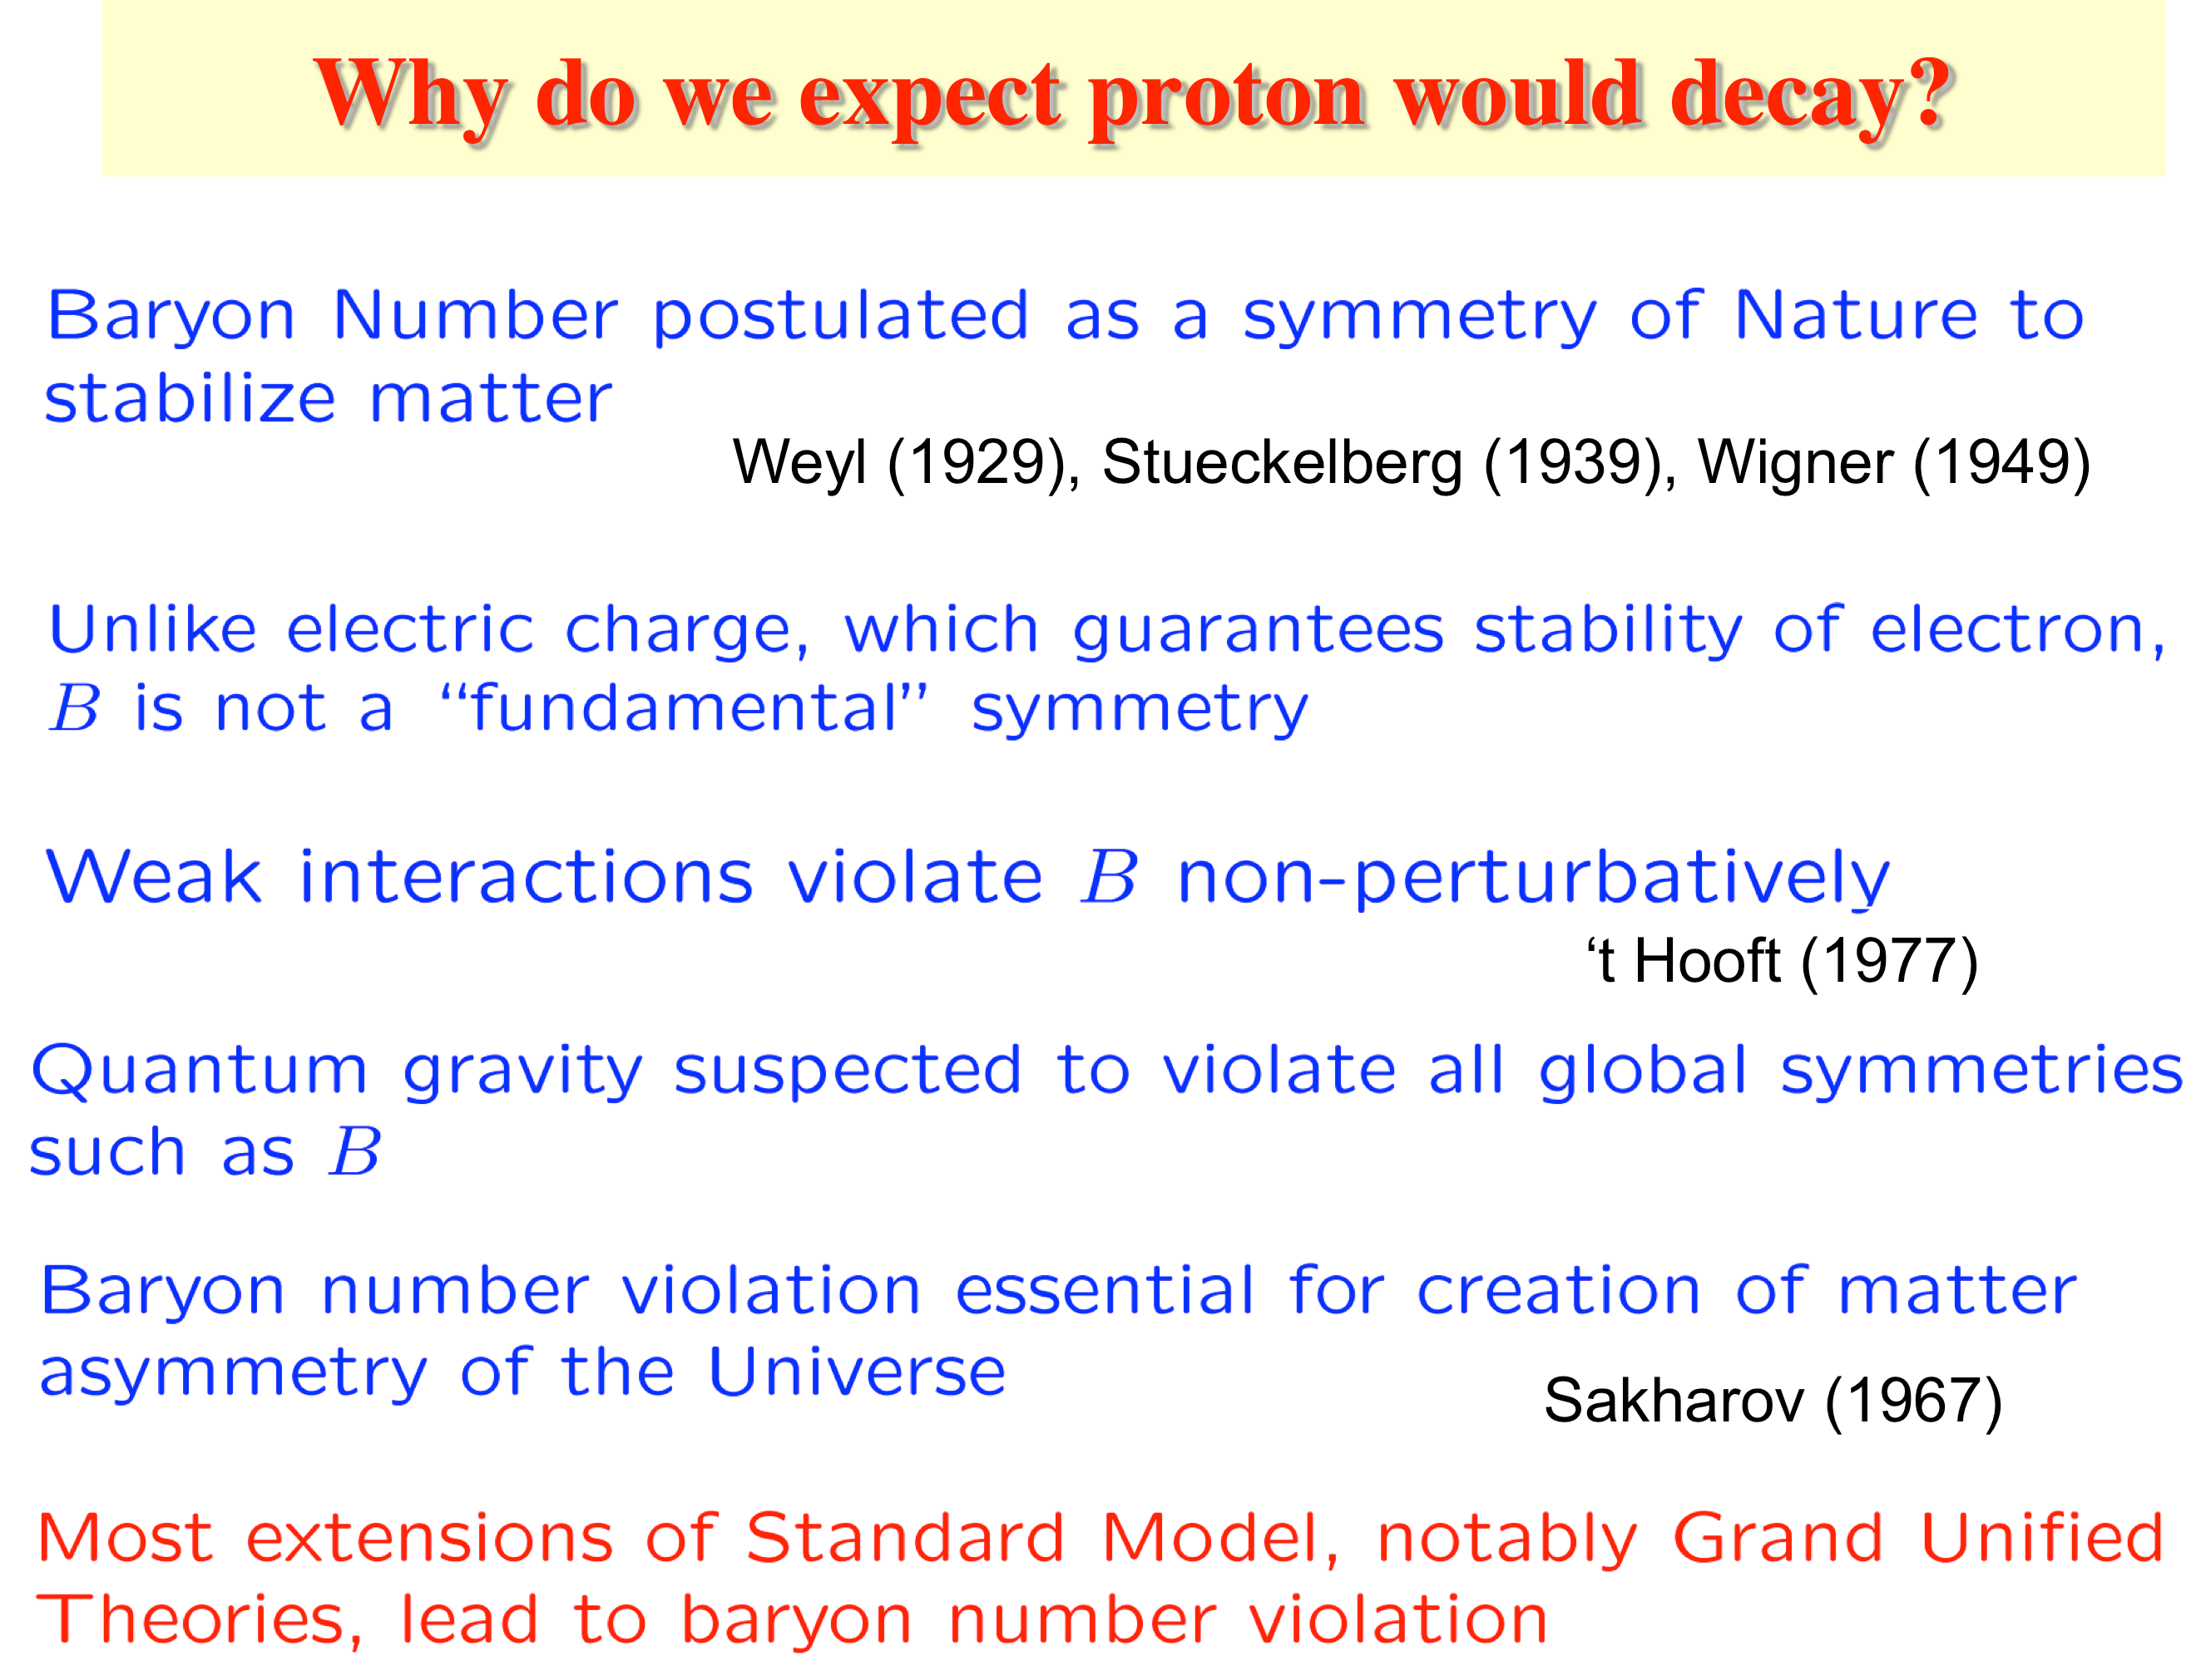

Slide 41
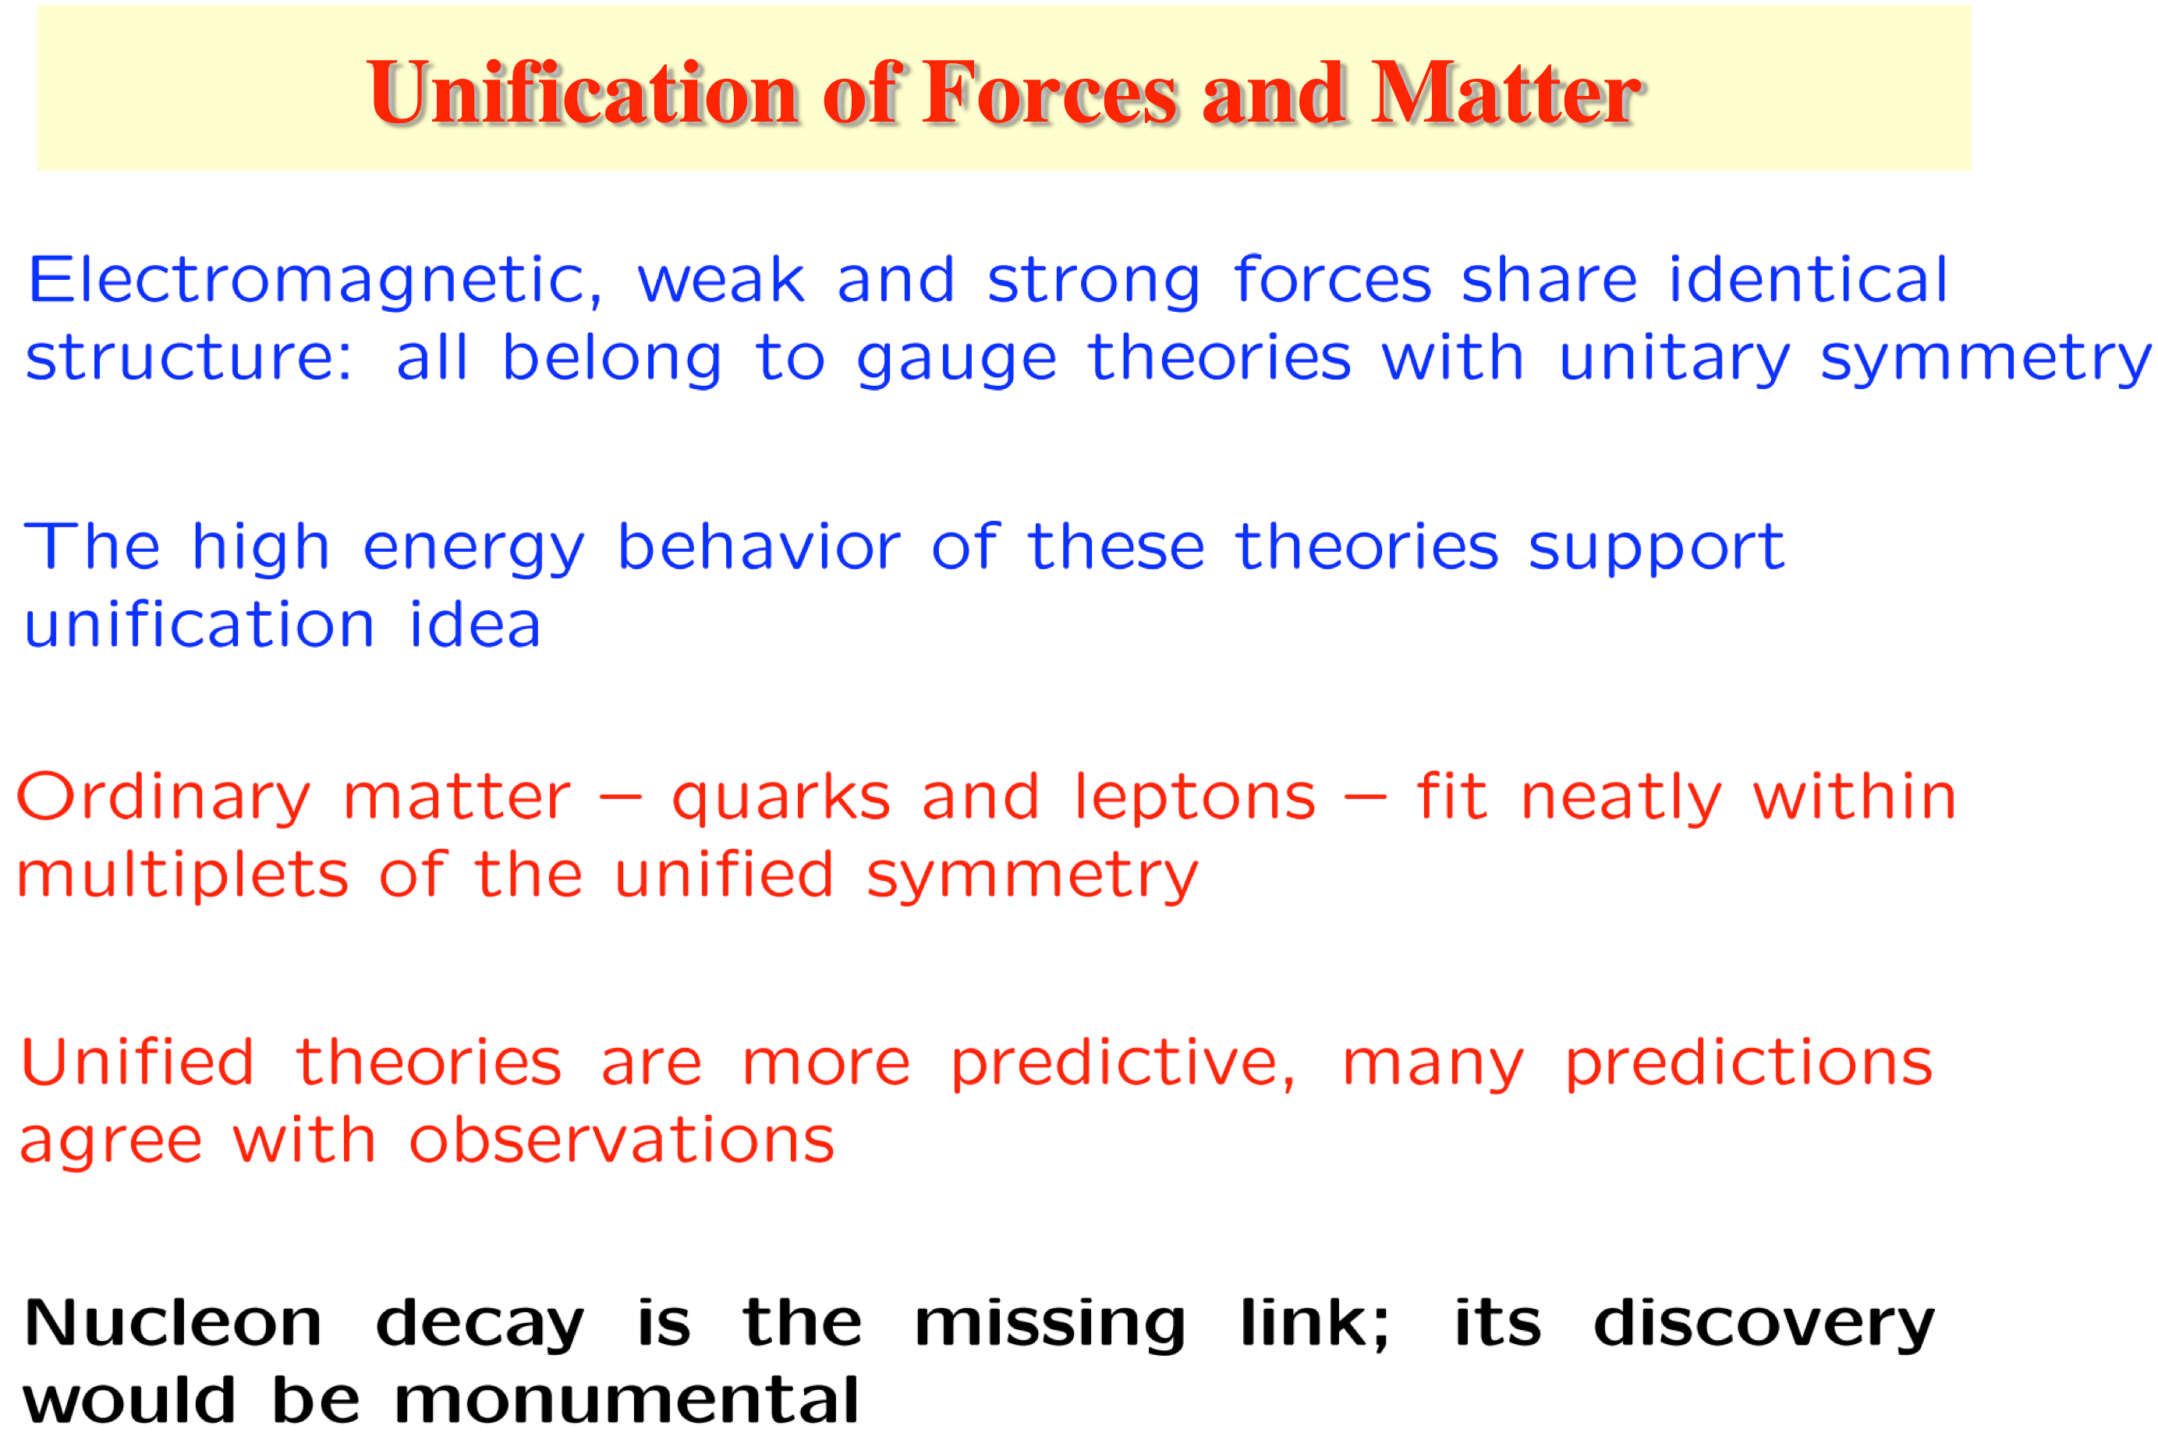

Slide 42
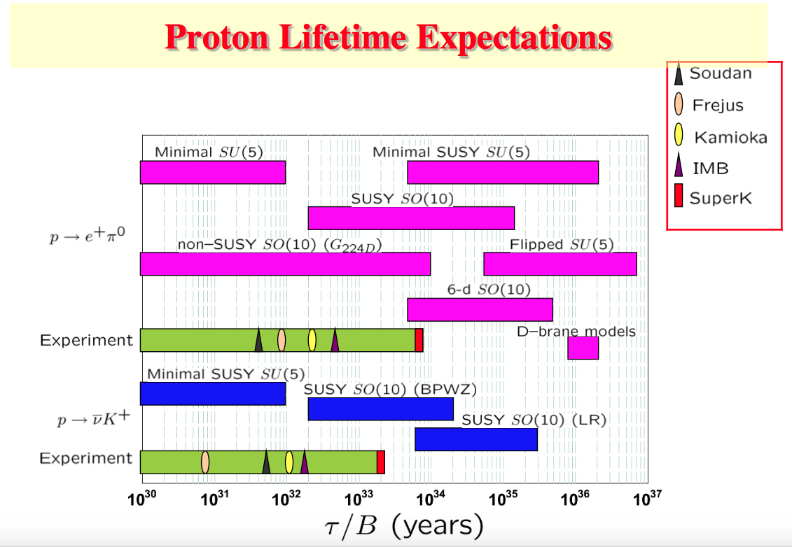

Slide 43
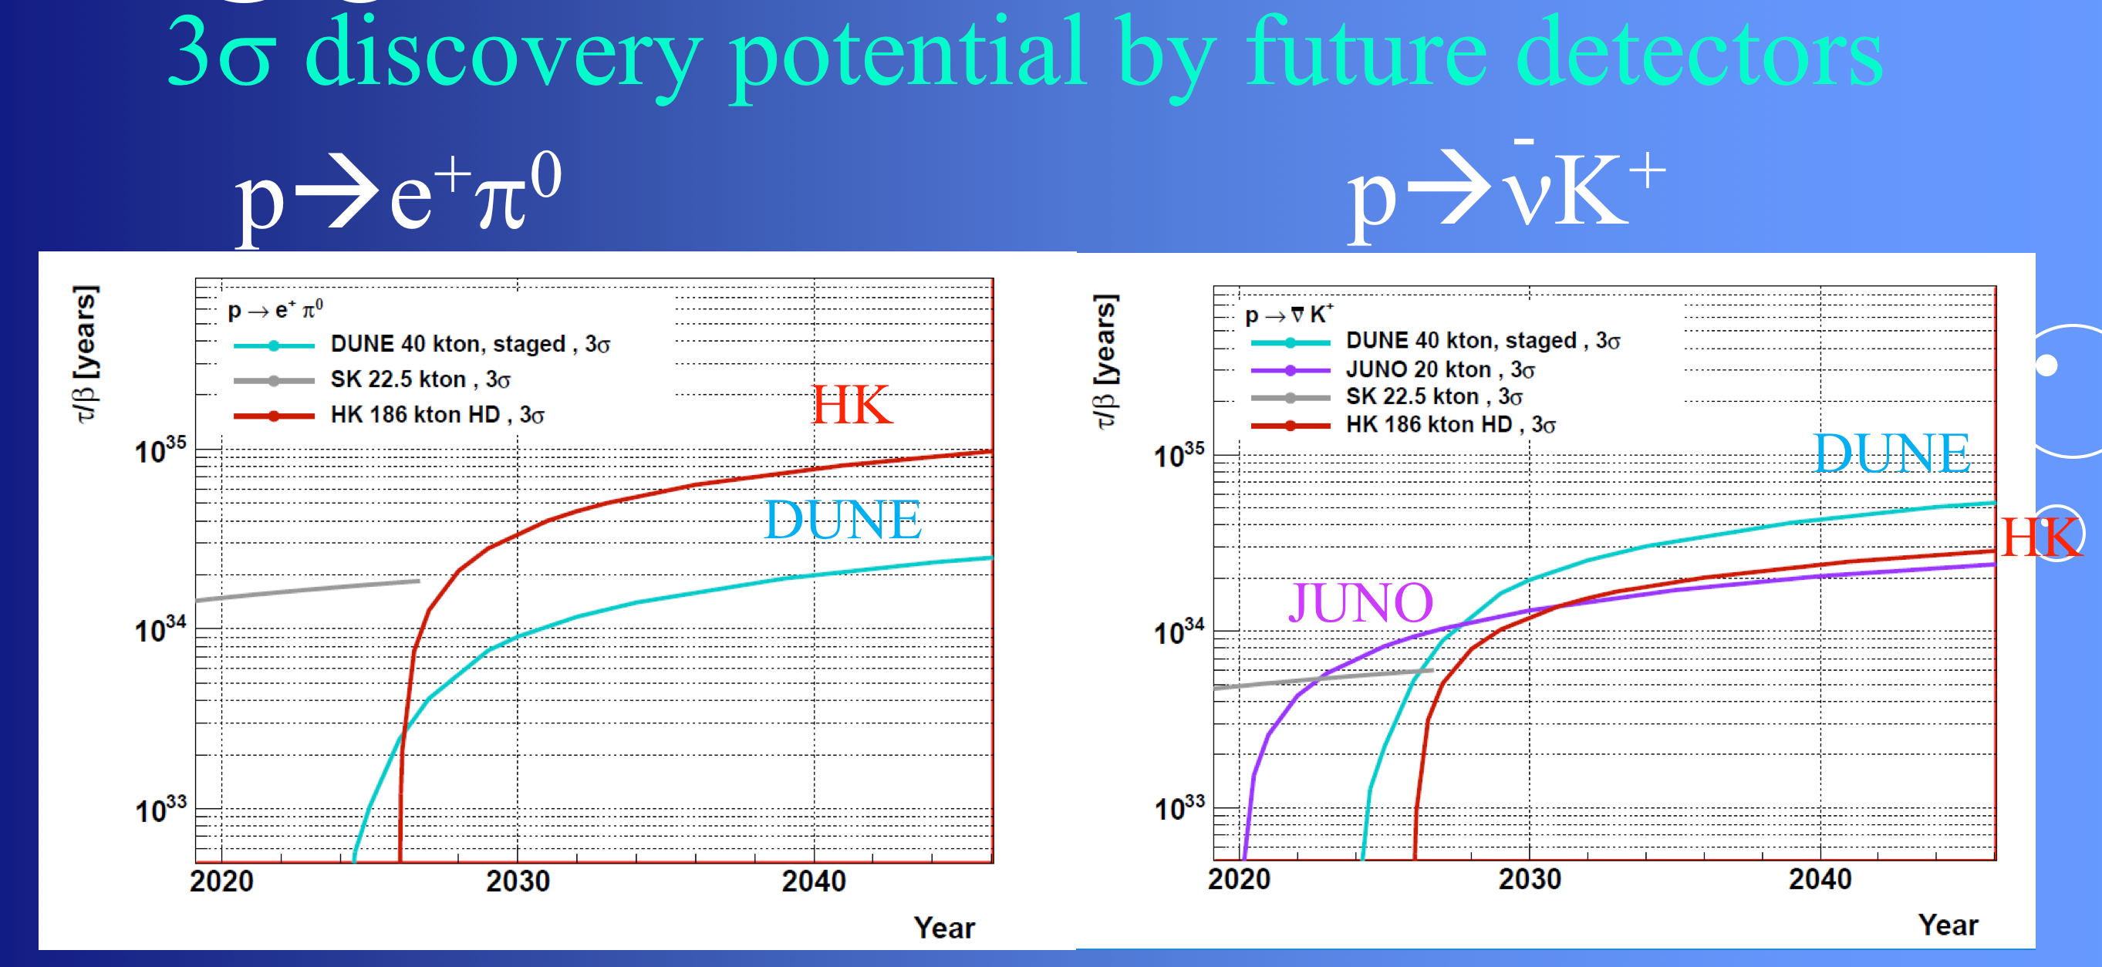
Reach of Future Detectors
Makoto Miura

Slide 44
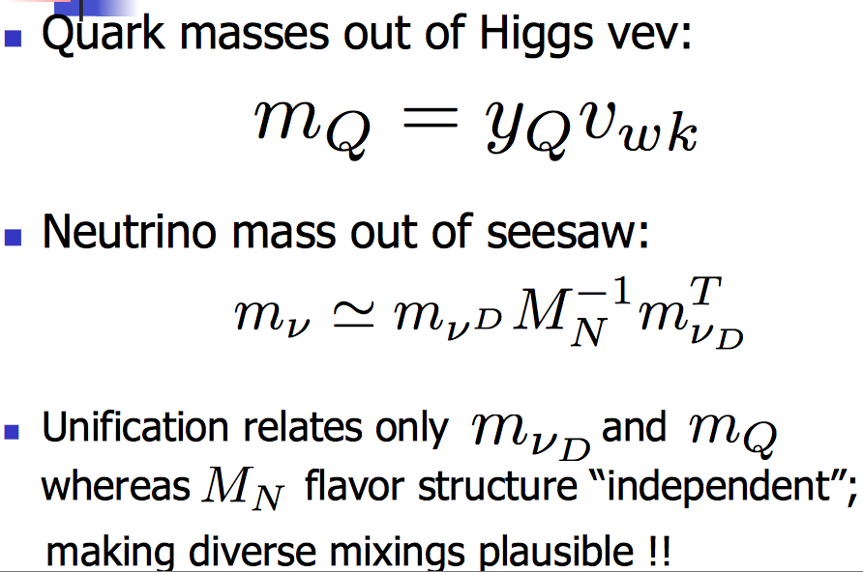
Grand Unified Theories (GUTS) unify quarks and leptons.
A challenge for GUTS: Quarks and leptons have very different mixings. The largest quark mixing angle is 13º. The largest lepton mixing angle is
∼ 45º. The smallest lepton mixing angle is 9º.
The See-Saw can help.
Rabi Mohapatra

Slide 45
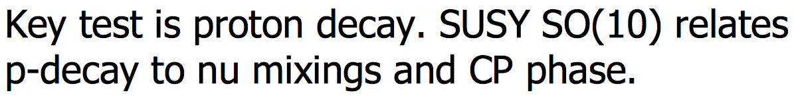
SUSY (which so far has not shown up), is not essential for coupling unification in SO(10) GUTS.
Kaladi Babu
and
Rabi Mohapatra
And there are other tests.

Slide 46
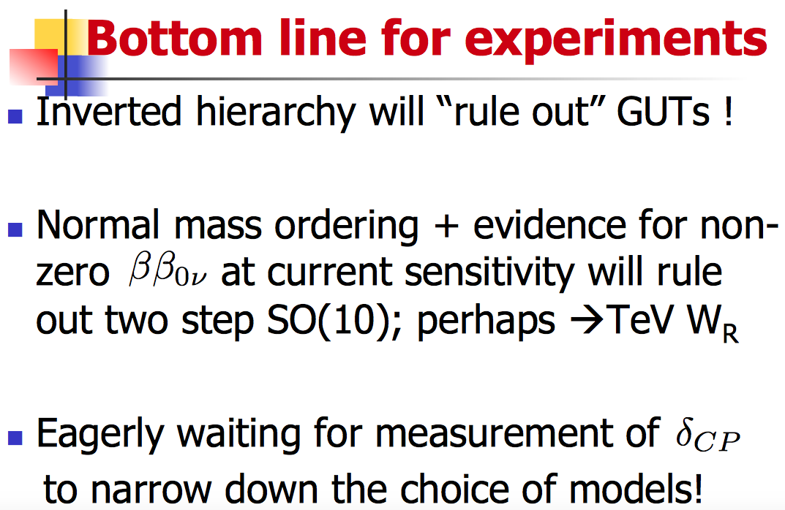
Rabi Mohapatra

Slide 47
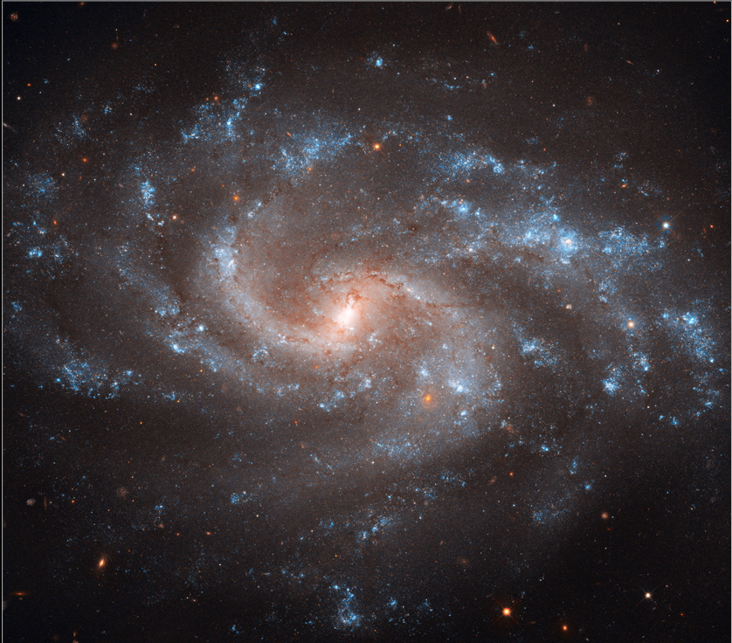
Astroparticle Physics
and Cosmology

Slide 48
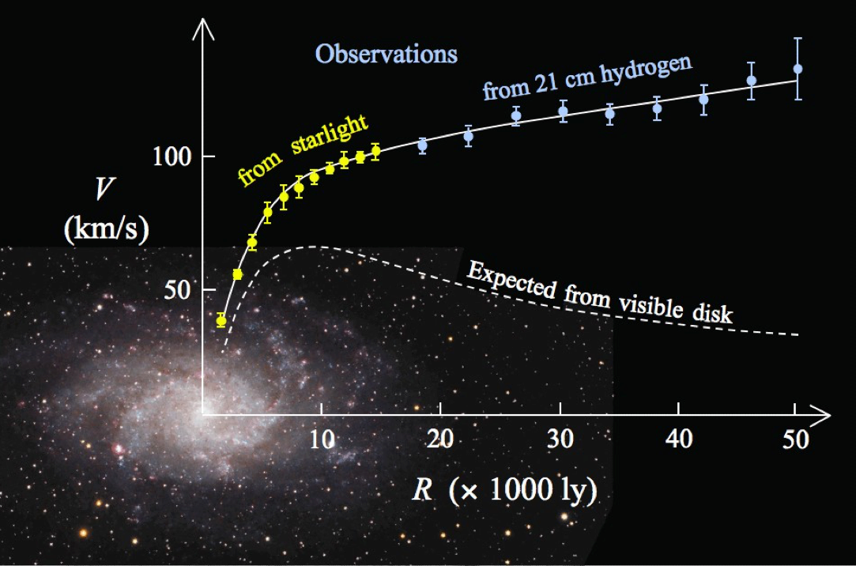
Rotation curve evidence for Dark Matter
Yvonne Wong

Slide 49
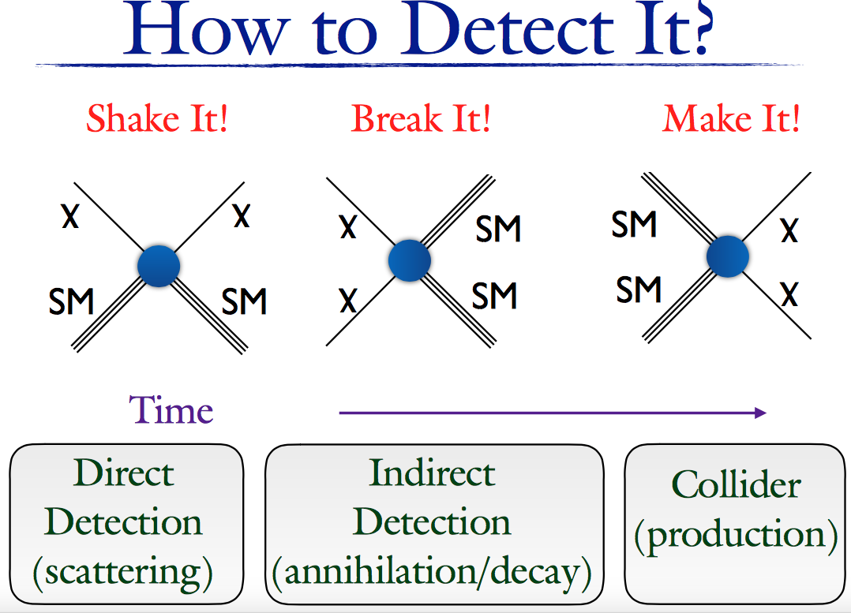

Slide 50
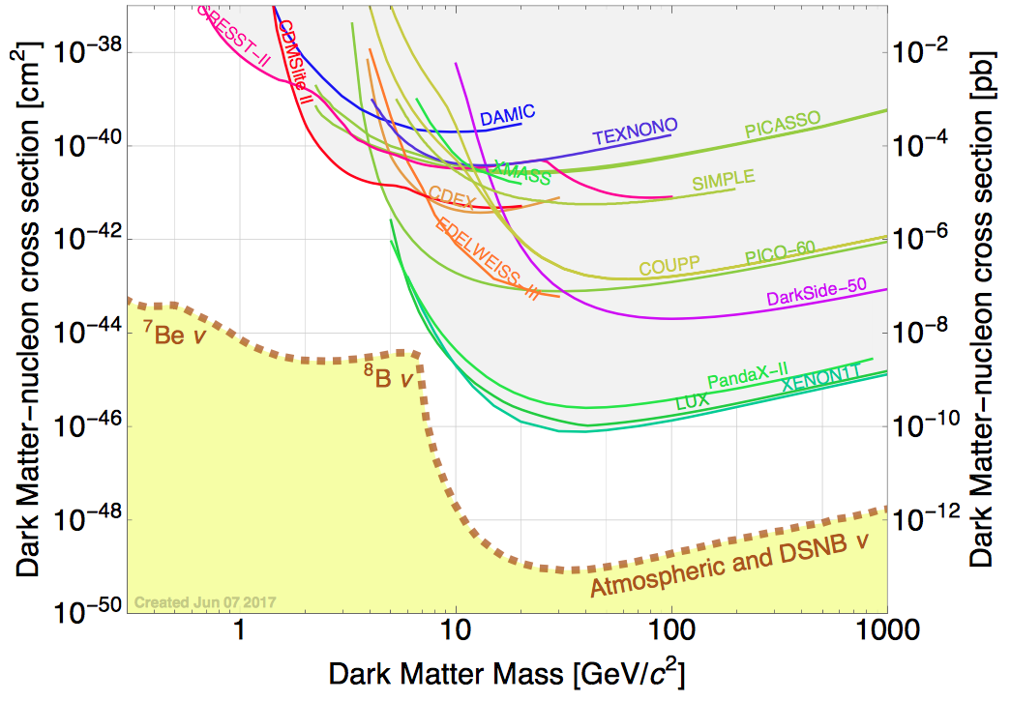
Spin-independent
Jodi Cooley

Slide 51
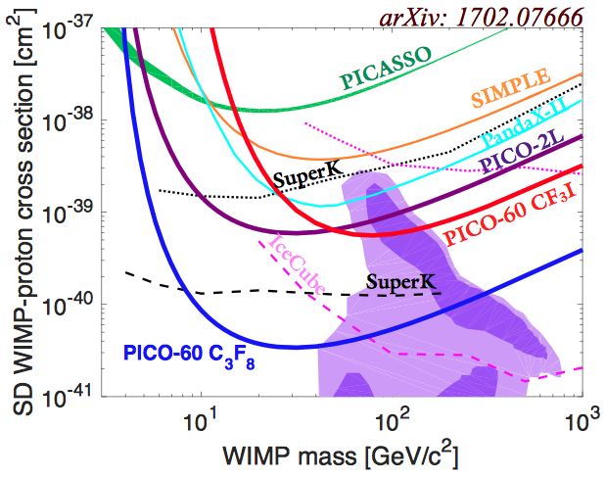
Spin Dependent

Slide 52
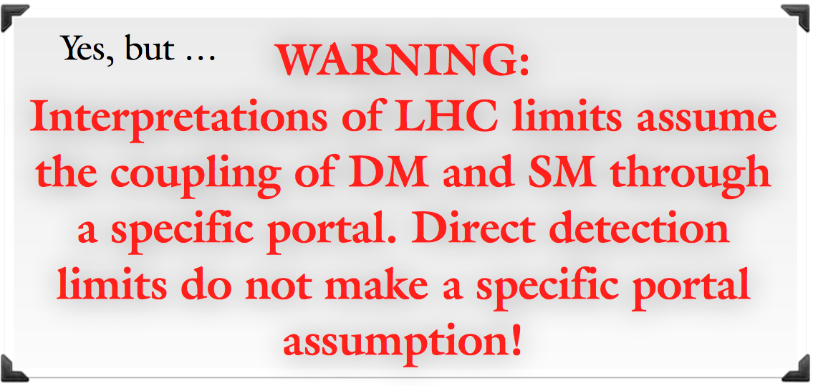
Collider Searches for DM
Somewhat related to direct detection experiments.
Jodi Cooley

Slide 53
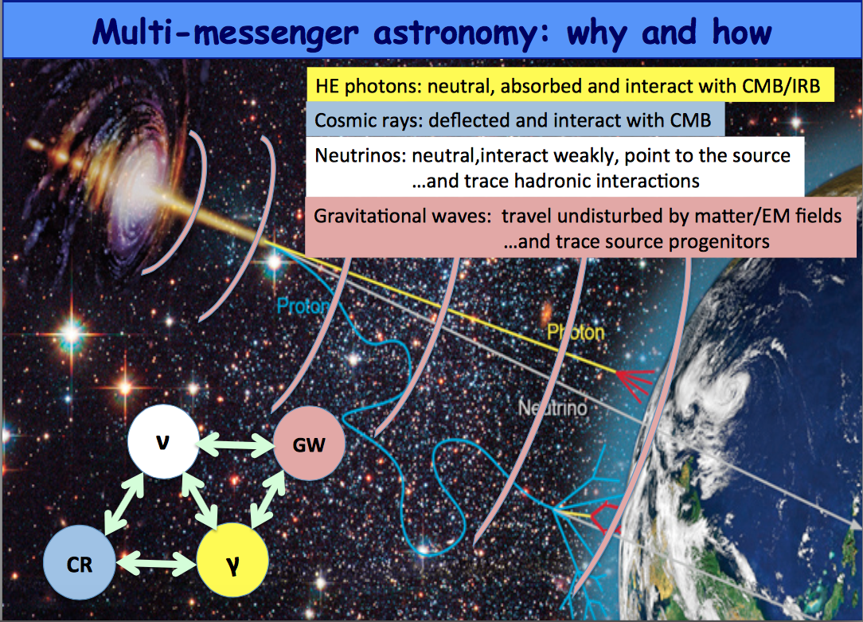
Veronique
Van Elewyck

Slide 54
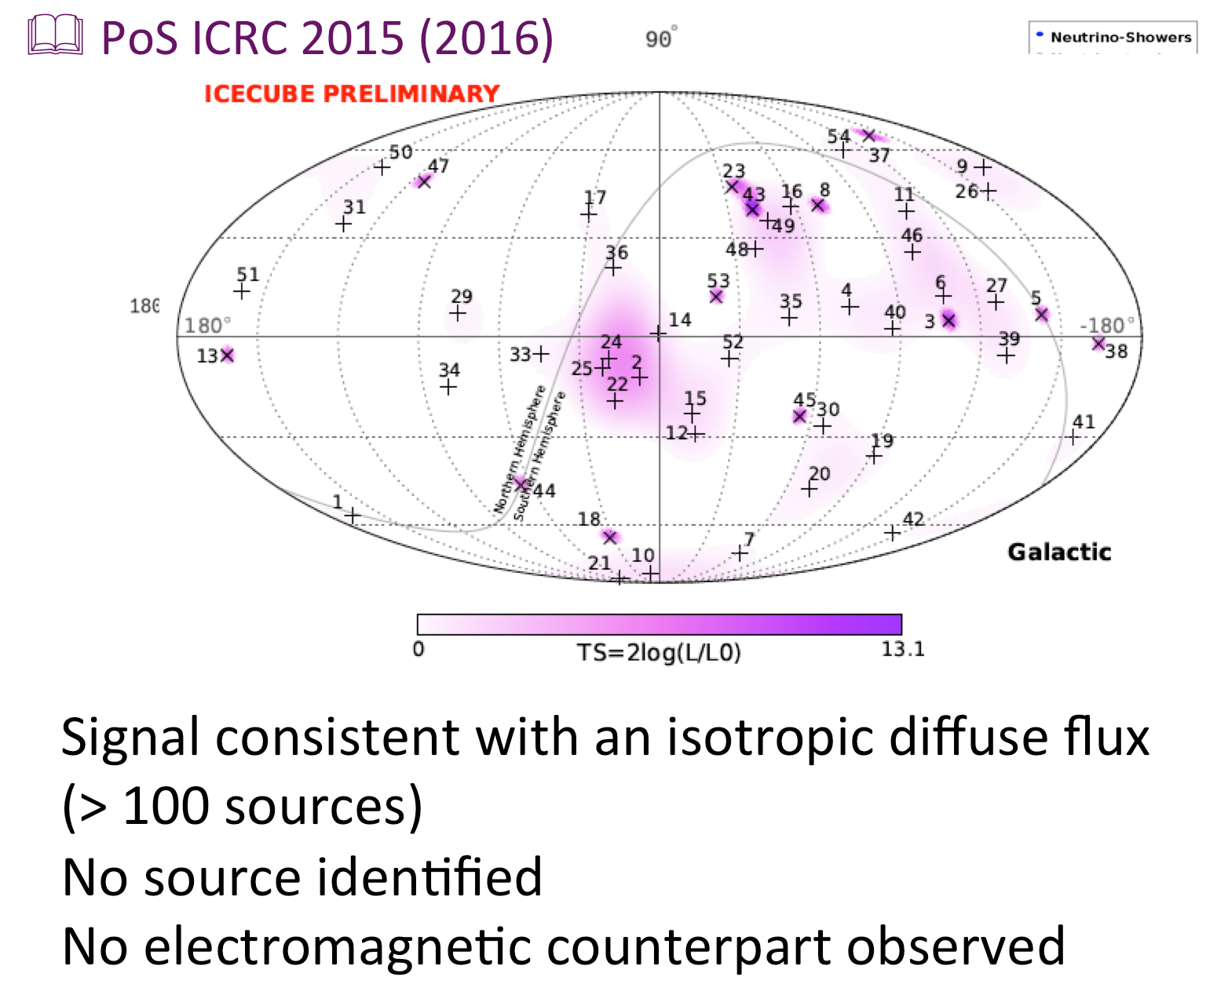
Veronique Van Elewyck

Slide 55
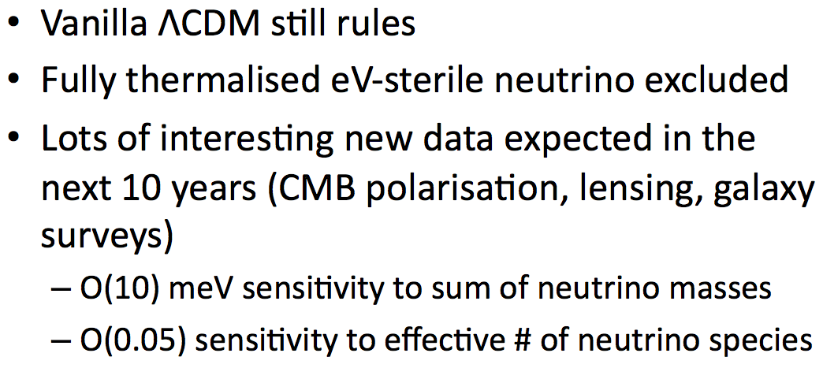
Cosmology Conclusions of Astroparticle Physics and Cosmology Working Group
Jan Hamaan

Slide 56
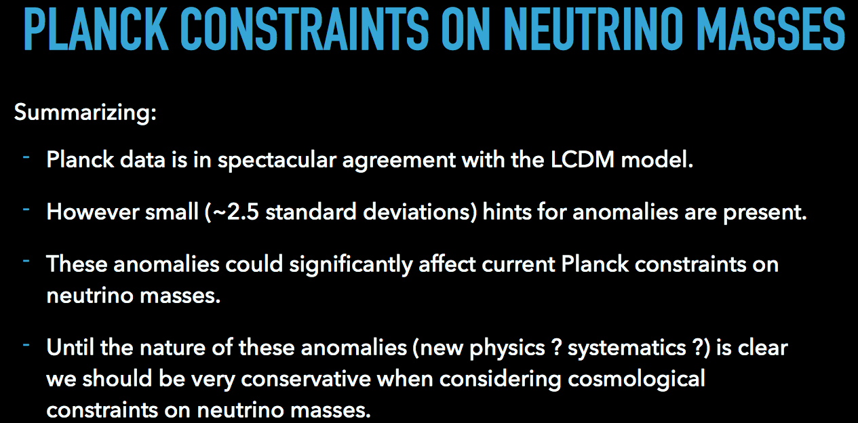
However —
Alessandro Melchiorri

Slide 57
This has been a very interesting
and illuminating workshop,
focused on an exciting
and lively field.

