Slide 1
Neutrinos In Large Extra Dimensions and the LSND/MiniBooNE anomalies
WIN2017
In collaboration with
Marcela Carena, Camila S.Machado, Pedro A.N.Machado and Carlos E.M.Wagner
Ying-Ying Li
Hong Kong University of Science and Technology

Slide 2
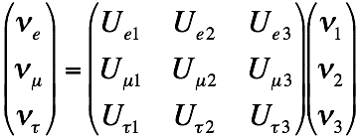
Neutrino Oscillation
Neutrino mass states:
propagate as states of
definite mass
PMNS matrix
Flavor state: participate in weak interaction, created or destroyed in definite flavour
Neutrino mass and its mixing observed in Experiments:
1,Solar neutrino
2,Atmospheric neutrino
3,reactor
…

Slide 3
Unknown about neutrinos
See Walter Winter’s talk
Neutrino mass:origin?
3-flavor?
Beta decay&0 decay &Cosmology: Very light!
See Alexandre Sousa’s talk
Majorana fermion: seesaw mechanism
Dirac fermion: natural way to get light neutrino-large extra dimension
Right-handed neutrinos in the bulk, Yukawa
coupling could be suppressed by the volume

Slide 4
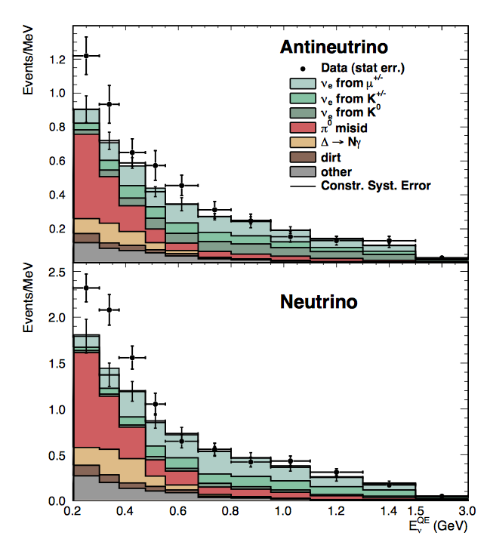
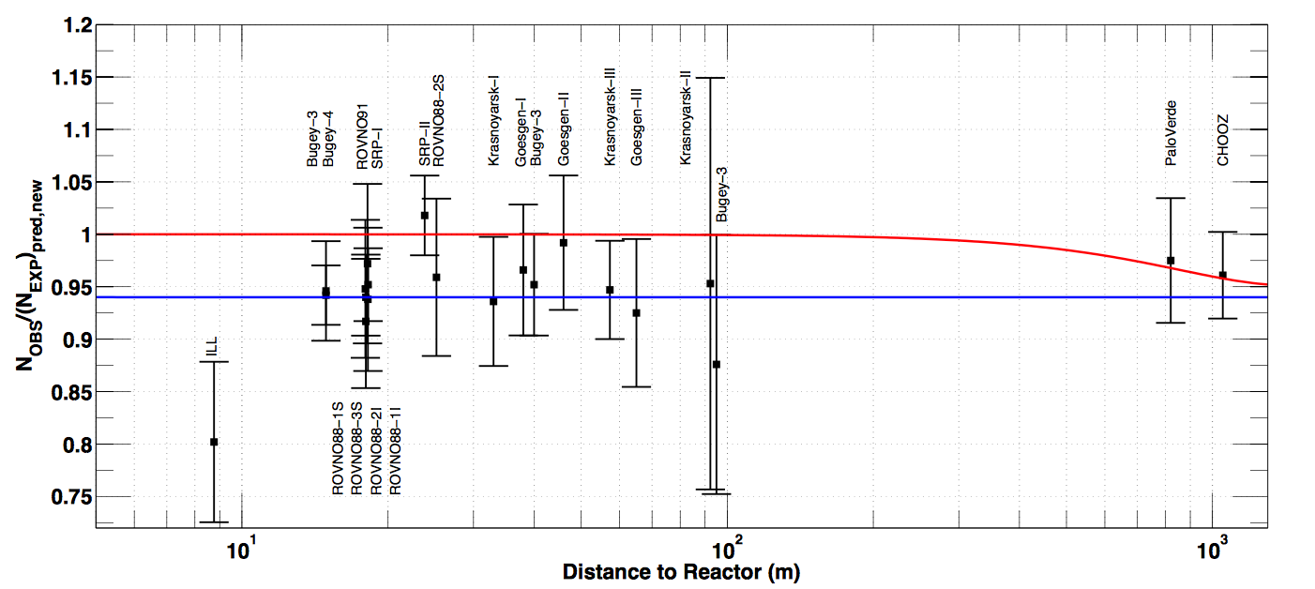
LSND/MiniBooNE
Reactor/Gallium
3-flavor in LED model?
arXiv:1303.2588
arXiv:1101.2755
Reactor: Isotope dependence of the flux reduction ? arXiv:1704.01082
KK Sterile Neutrino of eV scale

Slide 5
Large extra dimension (LED)
could not explain LSND/MinibooNE anomaly because of the cancellation between the degenerate KK towers of the three flavor.
break the degeneracy between KK towers and probably explain the LSND/MinibooNE anomaly
H.Davoudiasl, P.Langacker and M.Perelstein
(LED) + Bulk mass ?

Slide 6
LED model + bulk mass
PMNS matrix
Assume: alignment between the bulk mass matrix and Yukawa matrix

Slide 7
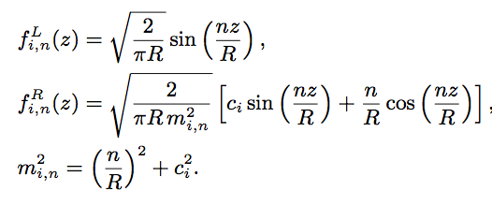
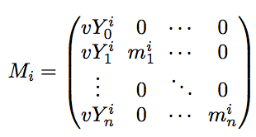
LED model + bulk mass
Dirichlet Boundary conditions for left-handed mode
Notation:

Slide 8
LED model + bulk mass
Generalize to models where neutrino propagate in
(d extra dimensions) with
Require additional boundary condition
to allow only one zero mode

Slide 9
LED model + bulk mass
Define the left rotation to diagonalize
The oscillation amplitude:

Slide 10
LED model + bulk mass
In the limit , we could approximate:
Suppression

Slide 11
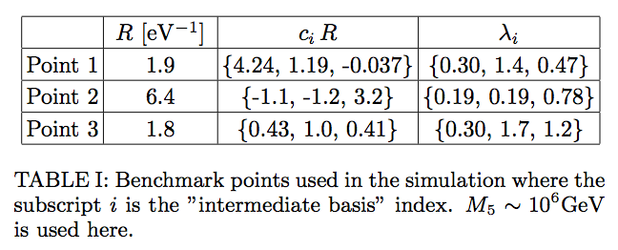
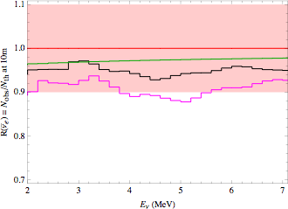
Neutrino Oscillation-Reactor and MiniBooNE
MiniBooNE excess:
Point1 53
Point2 5
Point3 148
R= 1.9/eV (0.37 )
6.4/eV(1.3 )
1.8/eV(0.36 )

Slide 12
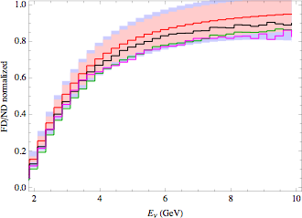
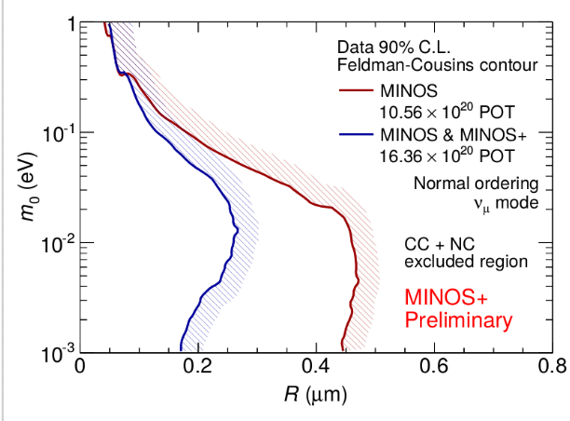
Neutrino Oscillation-Minos(+)
small effect on appearance due to the small mixing at long-baseline
R= 1.9/eV (0.37 )
6.4/eV(1.3 )
1.8/eV (0.36 )
Disappearance
http://www-numi.fnal.gov/PublicInfo/forscientists.html

Slide 13
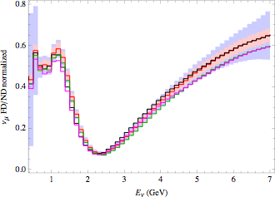
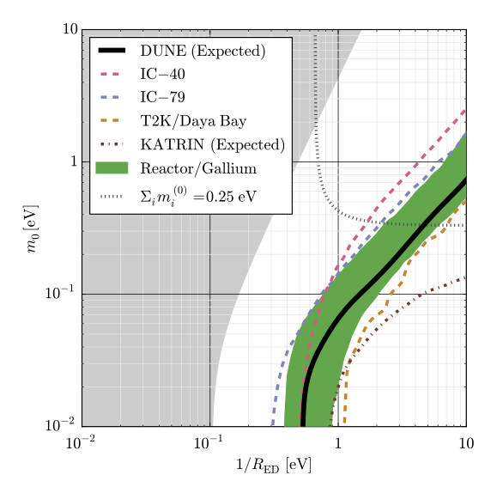
Neutrino Oscillation-DUNE
small effect on appearance due to the small mixing at long-baseline
R= 1.9/eV (0.37 )
6.4/eV(1.3 )
1.8/eV(0.36 )
Disappearance
Dune-CDR arXiv:1512.06148
Jeffrey M. Berryman. et al

Slide 14
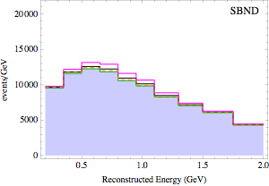
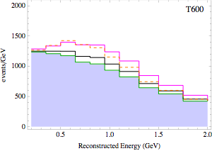
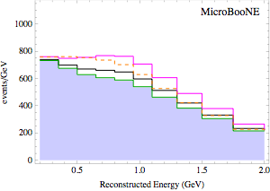
Neutrino Oscillation-SBN
NSBL+LSND best fit
M.Sorel. et al.
Appearance
R= 1.9/eV (0.37 )
6.4/eV(1.3 )
1.8/eV(0.36 )

Slide 15
Neutrino Oscillation-Cosmology
BBN and CMB: model dependent (in thermal equilibrium or not? very low reheating temperature scenario?)
Supernova: non linear effect? feedback effect?
KK gravition argument: , safe from graviton production
G. Cacciapaglia. et al.
Nima Arkani-Hamed. et al.

Slide 16
Conclusion
LED model + bulk mass
Right-handed neutrinos propagate in the bulk of the extra dimensions while SM fermions restricted to the 3-D brane— light Dirac neutrinos.
Kaluza-Klein(KK) sterile neutrinos arises— explain reactor anomaly/Gallium anomaly with
could explain LSND/MinibooNE anomaly
Loosen the constraints from future Minos+ and DUNE

Slide 17
Thank you for your attention!

Slide 18
Backup
For Point 2

Slide 19
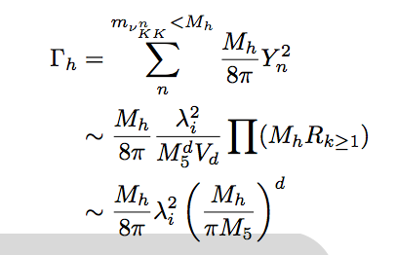
Backup
Higgs decay width

