Slide 1
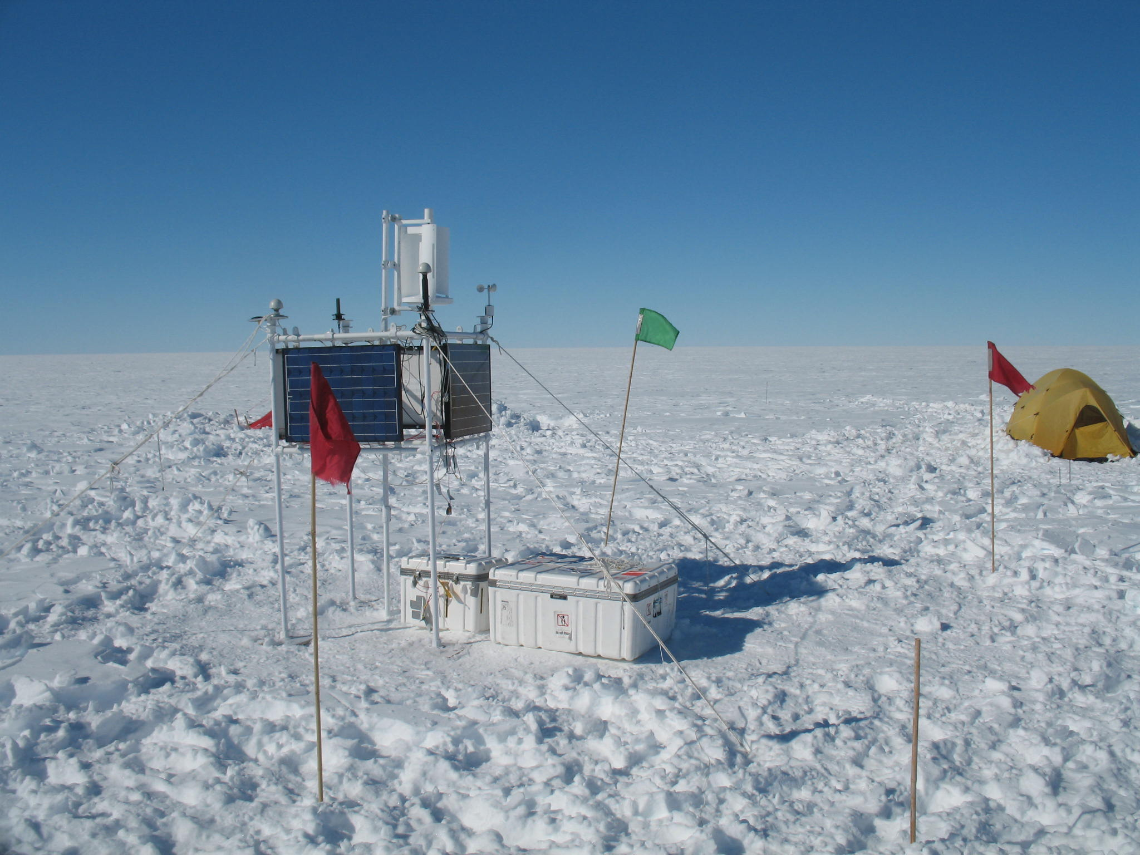
Radiodetection of ultra-high energy neutrinos
Spencer Klein, LBNL & UC Berkeley
GZK neutrinos & their physics
Radio signals from cosmic-ray air showers
Coherent Cherenkov radiation & the Askaryan effect
Existing experiments, from Moon to Antarctica
Looking ahead: ARA, ANITA, EVA…

Slide 2
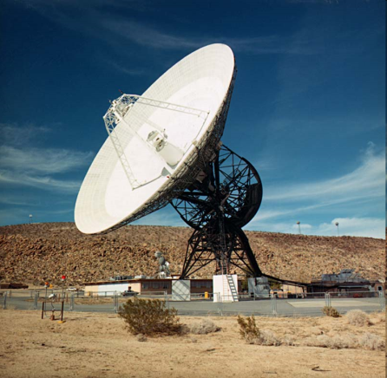
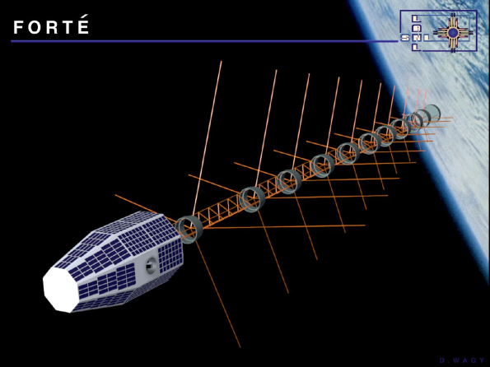
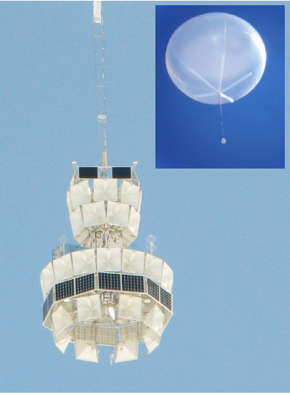
Different techniques for different ν energies
The Moon -> radiotelescopes
Greenland -> Satellite
FORTE
Antarctica -> high altitude balloon
ANITA
Antarctica/Greenland-> embedded antennas
RICE/ARA/ARIANNA
Embedded antennas w/ interferometric triggers
New Physics
Larger target- antenna separations
Higher E_{threshold}
Larger targets
GZK neutrinos
> PeV ν spectrum
Overall Energy Dynamic range > 10⁵

Slide 3
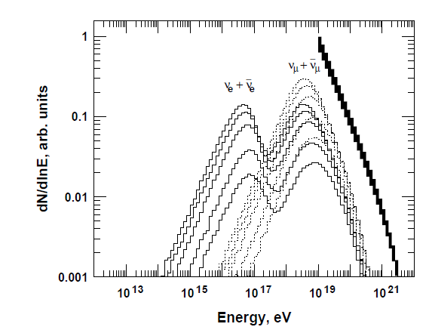
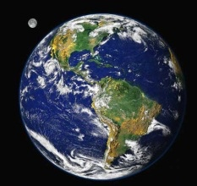
Greisen-Zatsepin-Kuzmin neutrinos
Neutron
β decay
π,K decay
At energies above 4*10¹⁹eV, protons interact with the 3⁰K microwave background radiation
p + γ_{3°K} -> Δ⁺ −> nπ⁺, π⁺−> νμ, μ−>eνν
Neutrino energy range:10¹⁷-10²⁰ eV
ν flux depends on CR flux & composition
ν don’t interact; distant sources contribute
Time evolution of sources matter; probe out to redshift of a few
“Guaranteed” (*composition restrictions apply)
Accelerator
p
γ (3⁰K)
2ν_{μ}:1ν_{e}
1ν_{μ}:1ν_{e}:1ν_{τ}
γ
Δ⁺
π⁺
μ⁺
e⁺e⁻
ν Oscillations

Slide 4
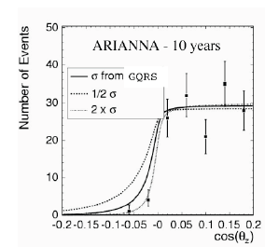
Detecting GZK ν
Cross-sections rise with energy
Standard model σ ~ 10⁻³³ to 10⁻³² cm²
Uncertainty from low-x (10⁻³ to 10⁻⁷) high-Q² parton distributions
ν are absorbed by the Earth
Horizontal or downgoing events
Zenith angle distribution probes σ_{νN}
Sensitive to new physics
Extra compact dimensions, leptoquarks, etc.
Most sensitive to ν_{e,}
80% of energy goes to EM shower from electron
LPM effect lengthens shower
Narrows Cherenkov radiation pattern
20% of energy transferred to target nucleon
Hadronic shower
For all flavors CC & NC interactions
~ 100 km³ needed to see 100 events in 3-5 years
Plot by Amy Connolly

Slide 5
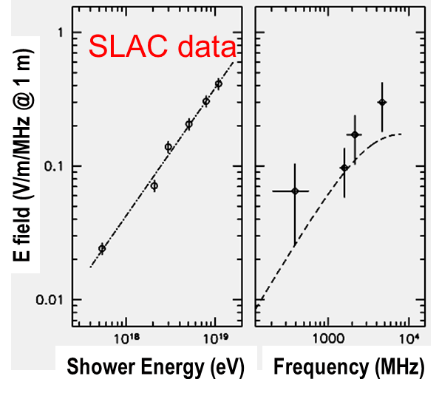
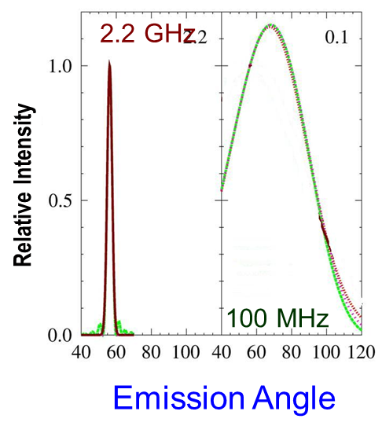
Radio-detection of ν
ν induced showers emit radio pulses
Showers contain ~ 20% more e⁻ than e⁺
Compton scattering of atomic e⁻
Shower e⁺ annihilate on atomic e⁻
For wavelengths > transverse size of the shower, the net charge emits coherent Cherenkov radiation
Peak electric field ~ E_{ν}²
Coherent at frequencies up to ~ 1 GHz in ice
Angular distribution depends on frequency
Extensive studies with SLAC test beams
SLAC data:D. Saltzberg et al., PRL 86, 2802 (2001)
Angles: O. Scholten et al. J.Phys.Conf.Ser. 81, 012004 (2007)

Slide 6
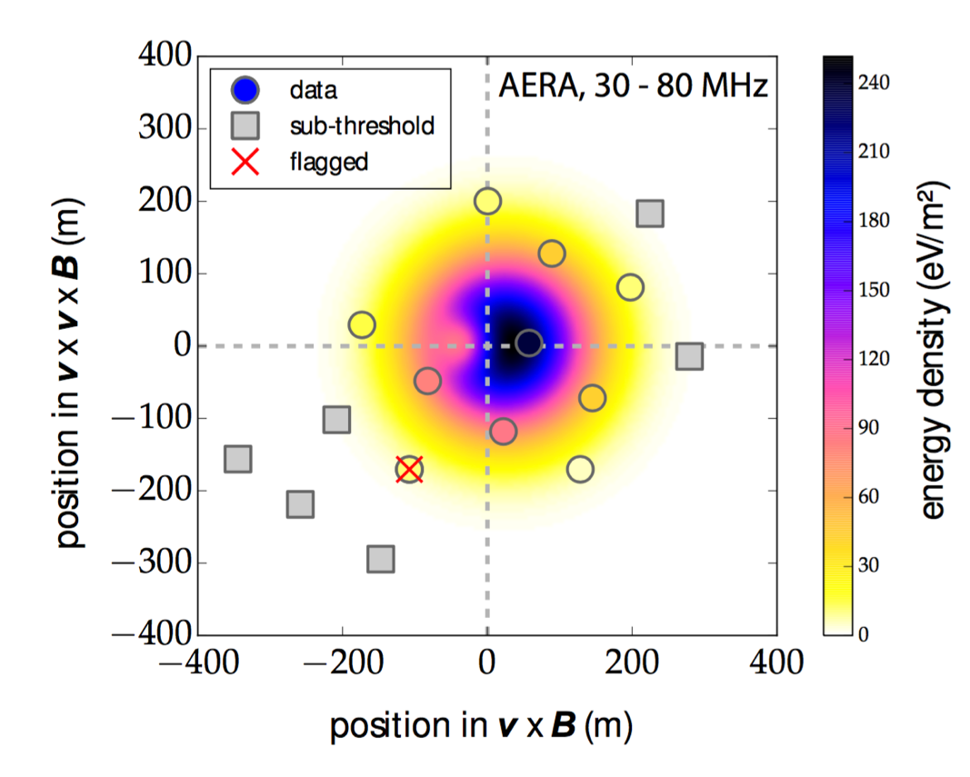
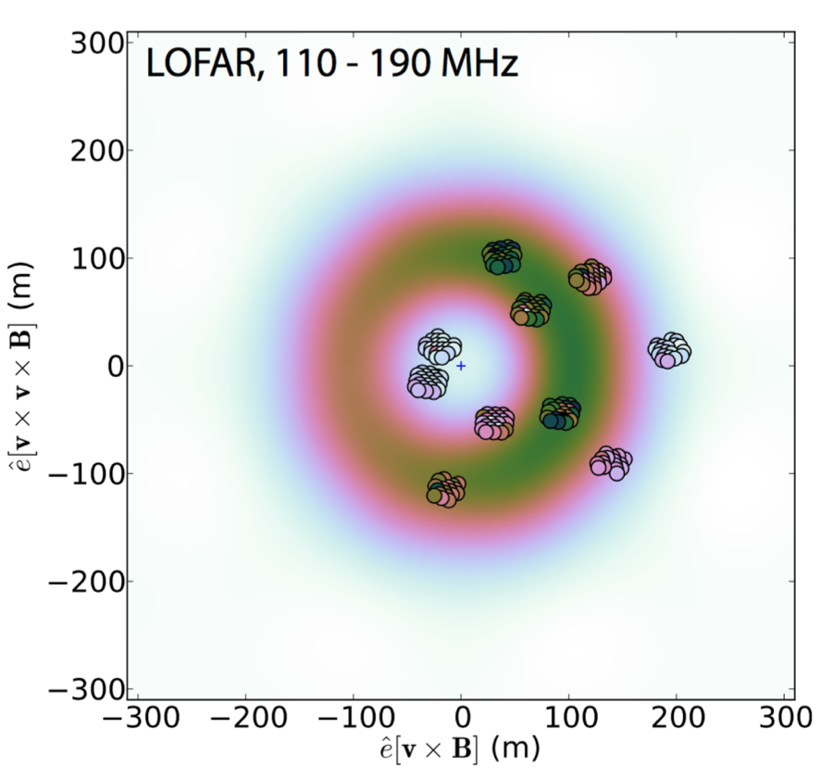
Radio signals from air showers
Geomagnetic deflection of e⁺ and e⁻ in opposite direction in Earths B field
Coherent Cherenkov radiation contributes subdominantly
Interference between 2 components leads to asymmetric signals on ground
Signal depends on shower orientation with respect to Earth’s magnetic field
Larger distance scales
Cherenkov angle is small, but altitudes are high
Lower frequencies except exactly on Cherenkov cone
F. G. Schroeder, arXiv:1701.0596

Slide 7
Air Shower studies
Useful signals for E> ~~ 10¹⁶ eV
Recent codes show good agreement with data
COREAS & ZHAires
<20% energy resolution; could reach < 10%
Better than surface arrays
Radio samples well-understood EM component
1⁰ angular resolution achievable
Many applications
Energy calibration source for Auger
Composition studies via measurement of X_{max}
Radio arrays, especially LOFAR & TUNKA
σ(X_{max}) ~ 20 g/cm² for LOFAR
Calibrations for ν detectors
Proposed air shower veto (RASTA for IceCube)

Slide 8
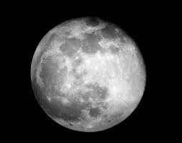
Radio signals from the Moon
Sensitive volume depends on frequency
Radio absorption length ~ 9 m/f(GHz) limits sensitive depth
High frequency searches see radio waves near the Cherenkov cone - near edge (limb) of moon
Lower frequency searches see a broader angular range
Larger active volume
But… there is more radio energy at high frequencies
Backgrounds from cosmic-ray moon showers
Not always distinguishable
ν
ν
On Cherenkov cone: Limited geometry,
high f_{max}, more energy, lower E_{ν} threshold
Off Cherenkov cone: open geometry,
lower f_{max}, less energy, higher E_{ν} threshold
T. R. Jaeger et al., arXiv:0910.595

Slide 9
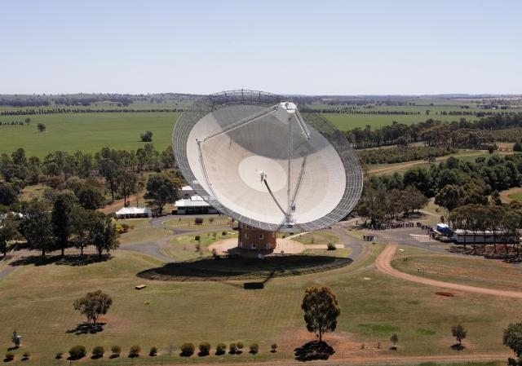
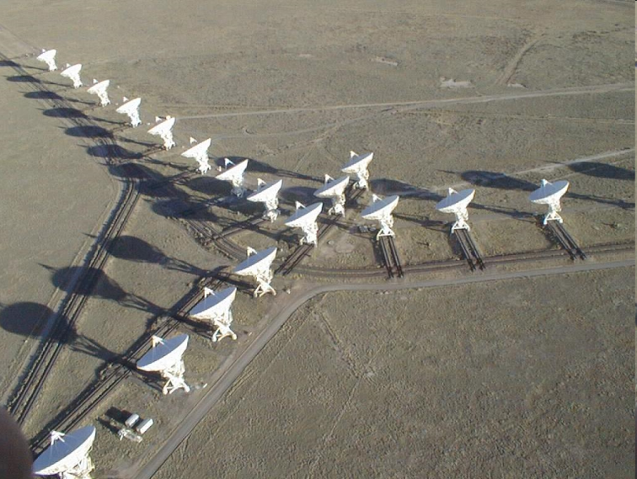
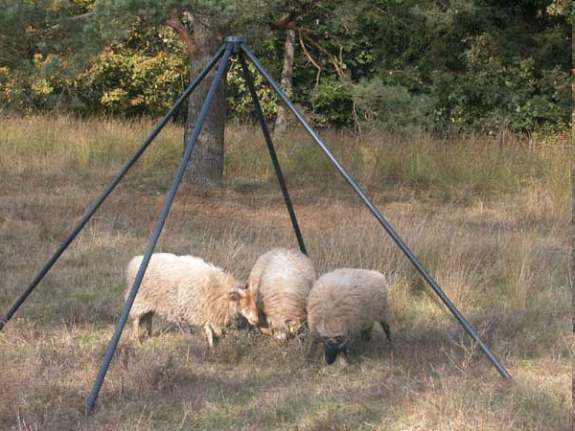
Radio detection
NuMoon @ Westerbork 64 m dish
Lunaska @ Australia Telescope Compact Array
6 dishes
Wide bandwidth: de-dispersion filter
Resun: 4 dishes of VLA array
Low frequency array for radio astronomy (LOFAR)
36 stations in Northwest Europe
Square Kilometer Array - low
Proposed radio telescope array with 1 km² collecting area
131,072 low-frequency antennas
Extensive beam forming in trigger
C. W. James et al., arXiv:1704.05336

Slide 10
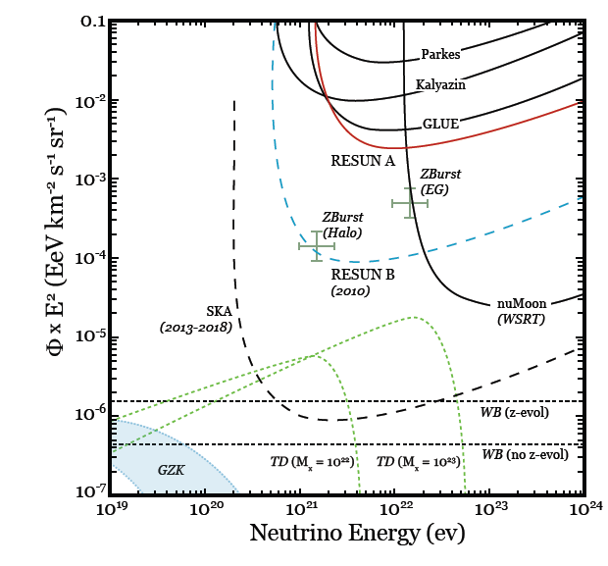
Lunar results
Larger arrays
Higher frequencies
Thresholds >> 10²⁰ eV
Small fraction of GZK spectrum
Probes exotic models, like topological defects
Multi-dish apparatus reach lower thresholds
SKA- will reach down to 10²⁰ eV
Lunaska (ATCA) presented two limits for different models of lunar surface roughness
E² Φ(E) (EeV km⁻² s⁻¹ sr⁻¹)
More observing time
Lower frequencies
GZK
Log₁₀ E_{ν} (eV)
O. Scholten et al., PRL 103, 191301 (2009).

Slide 11
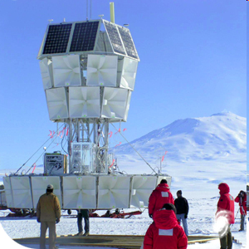
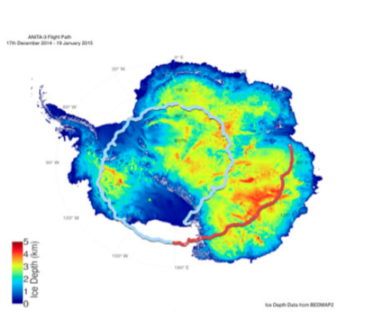
A balloon over Antarctica: ANITA
Circled Antarctica, looking for radio pulses coming from the ice
Typical altitude ~ 35 km
Distance to horizon ~ 650 km
4 flights, from 2006/7 to 2016/2017
22-35 days
At the mercy of the winds; flew over varying quality of ice
5th flight requested
Results from 1st 2 flights released
ANITA-3 flight path

Slide 12
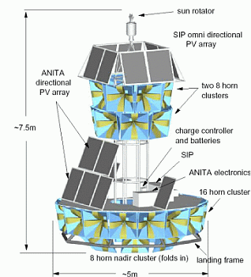
ANITA instrumentation
32/40/48 horn antennas
Separate channels for vertical (VPOL) and horizontal polarization (HPOL)
ν events should be VPOL
Frequency range roughly 200-1300 MHz
Read out with 2.6 GS/s switched capacitor array ADCs
Sophisticated trigger
Tunnel-diode square law detectors
1/channel
ANITA-IV includes notch filters
FPGA combines channels
Calibrations from buried transmitters measure signal propagation through ice, firn and snow-air interface.

Slide 13
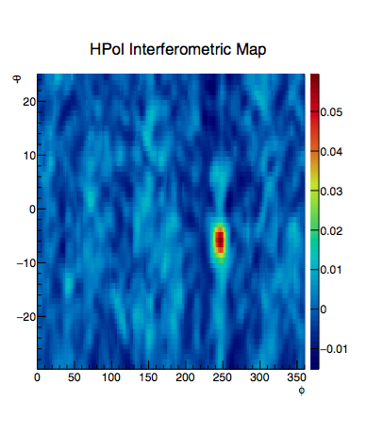
ANITA reconstruction & analysis
Precise timing allows use of interferometry to reconstruct events
Like a phased-array radar
Multiple antennas act like a single larger one
Precise angular resolution
Improved signal:noise ratio
Cuts remove thermal, payload & anthropogenic noise, and misreconstructions
Anthropogenic noise cuts are stringent
Mostly vertical polarization
1 events remains after all cuts
Consistent with backgrounds
Upper limit constrains ‘interesting’ GZK models

Slide 14
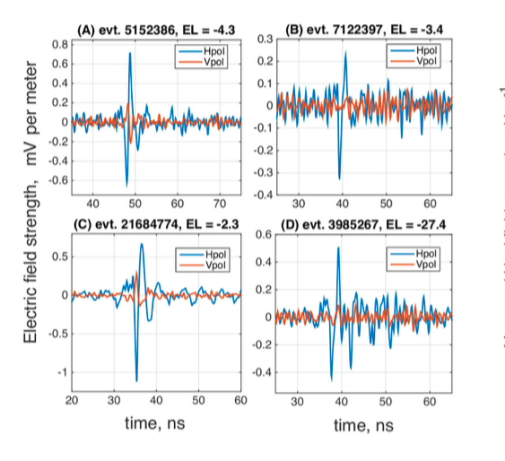
Cosmic-rays in ANITA
Cuts similar to ν search
Mostly HPOL
Earth’s magnetic field is ~ vertical
16 events found in blind search
3 background
13 pulses from air showers which reflected off the ice surface
Later found 4 more events
3 events likely Earth-skimming cosmic-ray air showers
1 event is consistent with an air shower coming from the Earth
τ or ν_{τ} event?
Unusual snow configuration?
Transition radiation?
Time (ns)
Waveforms from 3 (4?) air-shower candidates, with mostly horizontal polarization. The bottom left event appears to ceme from the Earth.
ANITA, PRL 117, 071010 (2016)

Slide 15
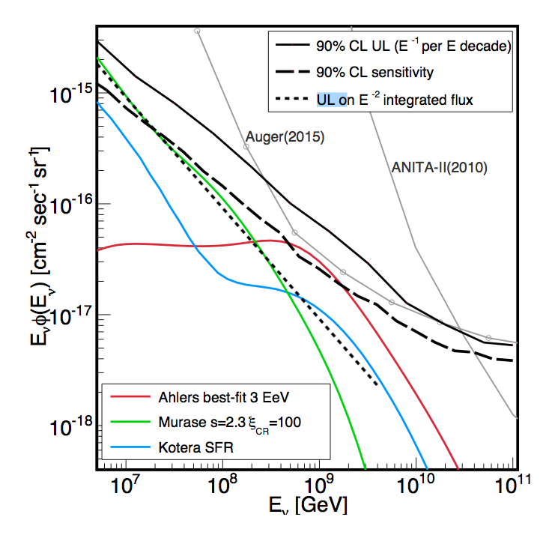
Current limits
ANITA (2 flights)
IceCube
Tracks or cascades with very high light output
Auger
Showers emerging from the Earth
Near-vertical & deeply interacting high-angle
Current Limits touch on some GZK predictions
All protons
Favorable evolution
M. G. Aartsen et al., PRL117, 241101 (2016);
Aab et al., Phys. Rev. D91, 092008 (2015);
P. W. Gorham et al., Phys. Rev. D85, 049901 (2012)

Slide 16
Looking ahead
Most effort is focused on deploying antennas in Antarctic ice to reach ~ ~< 10¹⁷ eV thresholds to probe GZK ν and test IceCube spectral measurements at higher energies
No sharp threshold – turn-on is gradual
Pioneered by the RICE Collaboration, which deployed antennas in AMANDA bore holes
ARA & ARIANNA collaborations have deployed prototype arrays & published test limits
Both achieve few-degree angular resolution
Monte Carlo cross-checks show agreement there
Planned volume ~~ `100 km³
Other ideas : EVA balloon & tau-induced radio showers emerging from the Earth

Slide 17
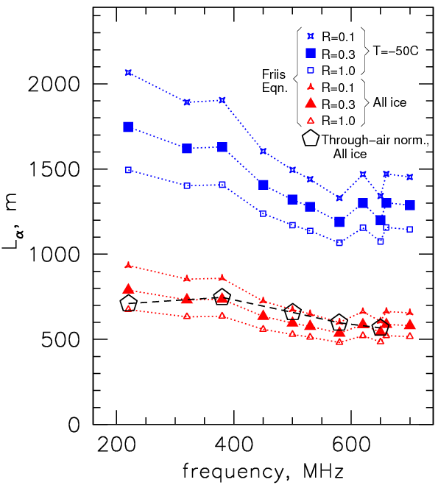
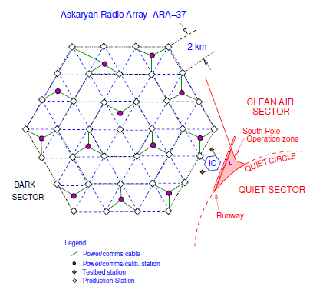
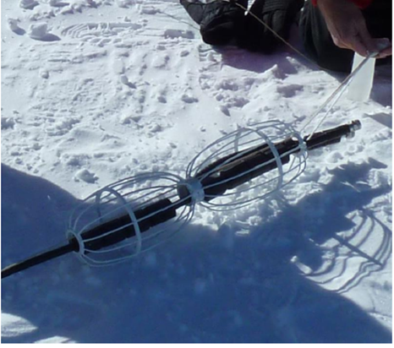
ARA at the South Pole
Clusters of radio antennas in 200 m deep holes
On a ~1-1.5 km triangular grid
VPOL + some HPOL
Radio Attenuation length 500-1500 m
Buried pulsers
Frequency & temperature dependent
Surface detectors as monitors…
ARA-37 proposal submitted
ARA Collaboration: Astropart Phys. 35, 457 (2012)

Slide 18
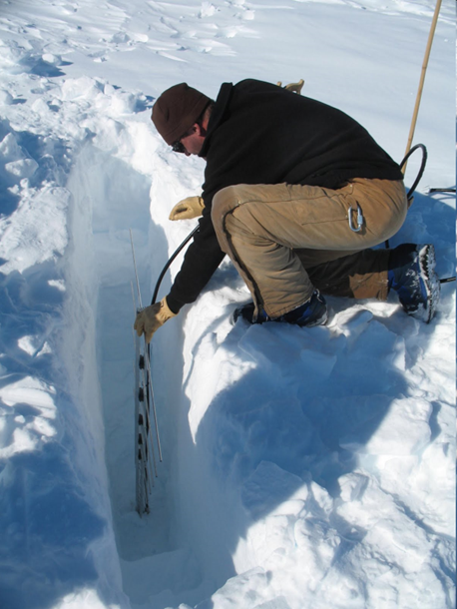
ARIANNA in Moore’s Bay
570 m of ice floating atop seawater
The smooth ice-water interface reflects radio waves like a mirror
Reflection increases solid angle
Sensitive to downward-going neutrinos
Latitude also increases sky coverage
Surface stations avoid drilling costs & allows flexibility in antennas
~ 8 antennas/station allow single-station reconstruction
Clean radio environment – almost no anthropogenic noise
Proposed 1300 stations array
An ARIANNA
LPDA
ν
Ice
Water
S. Barwick, tomorrow; SK ft. ARIANNA Collaboration: arXiv:1207.3846

Slide 19
ARA and ARIANNA
Factor | ARA | ARIANNA
Site | South Pole | Ross Ice Shelf
Ice Temperature | Colder | Warmer
Radio Atten. Length | 820 m (avg.) | 400 m (avg.)
Antenna Deployment | 200 m deep narrow borehole | Surface
Acceptance | Horizontal | Horizontal + Downgoing
Anthropogenic Noise | South Pole Station | Little
Logistics Surface Temperature | South Pole Station, 2800 m elevation Winter power -20 to -40⁰C | Green Field Site Near sea level Winter wind (maybe) Surface temp ~0 ⁰C

Slide 20
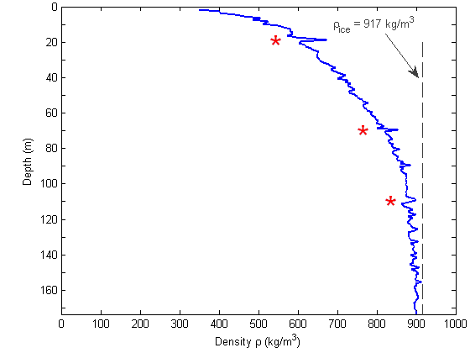
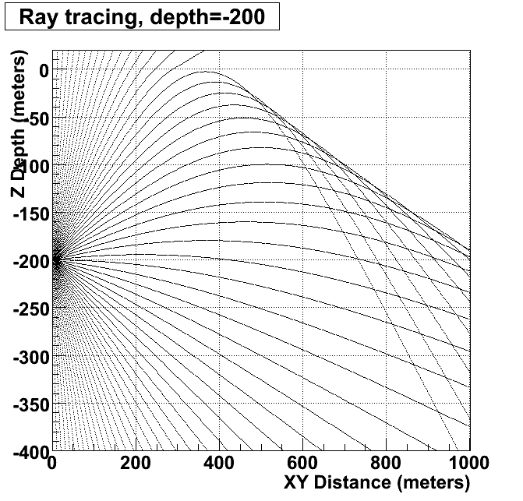
Radio propagation in ice
Ice density varies with depth
Solid at depths below ~ 100 m
Packed snow at surface; gradual increase in density with depth
Recent studies find non-uniform variation with depth
Layering, as seen in optical studies
Index of refraction depends on density
Waves bend downward
Surface detectors have a limited field of view in smoothly varying firn
Density variations may produce channels which capture waves and transport them horizontally
How efficient is horizontal capture?
Depth (m)
* = Melt zones
Density (kg/km³)
Density vs depth
DYE-3 core (Greenland)
http://www.iceandclimate.nbi.ku.dk/research/flowofice/densification/

Slide 21
Horizontal propagation
A
B
ARIANNA test (Ross Ice Shelf)
Signals from a 20 m deep VPOL dipole pulser seen up to 1.5 km away
Impossible in smoothly varying firn
Timing shows direct propagation
South Pole study (D. Besson)
Older data from RICE
Attenuation length ~ 500 m
CR 1
G
F
1 km
C
E
CR 2
D
VPOL Dipole pulser buried at 20 m
A
B
S. Pole/
RICE/
D. Besson
C
D
X
L_{atten}=508±114 m

Slide 22
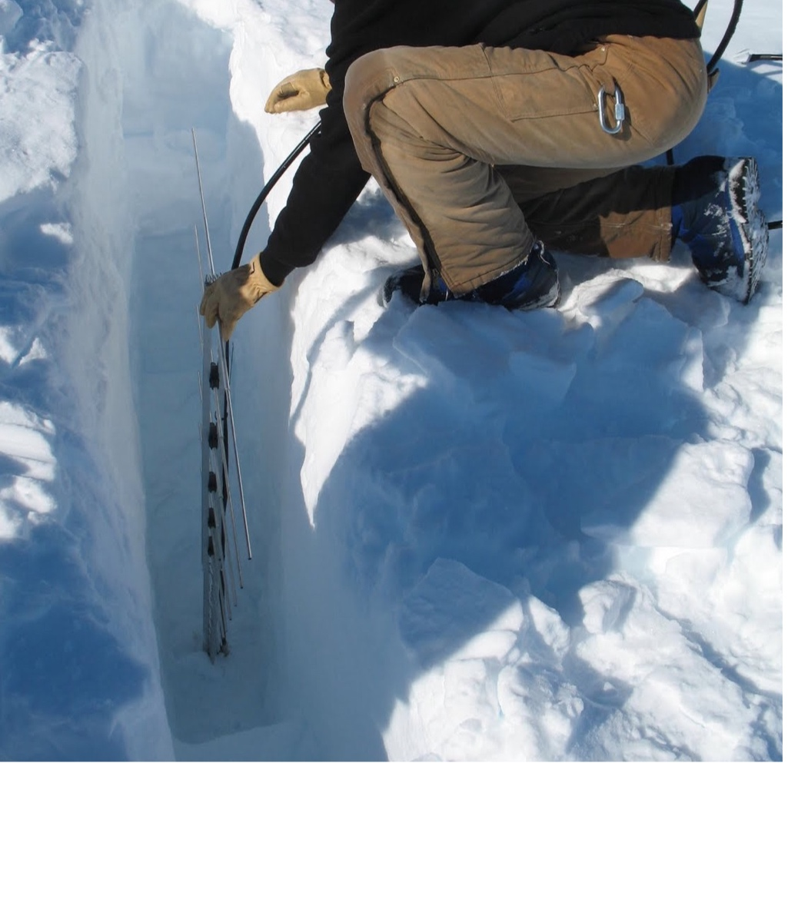
Antenna Tradeoffs
Surface
VPOL+HPOL
Many choices, including with gain
Simpler design
Limited field of view, unless channeling is highly efficient
Buried
Mostly VPOL
Must fit in small hole
Full field of view

Slide 23
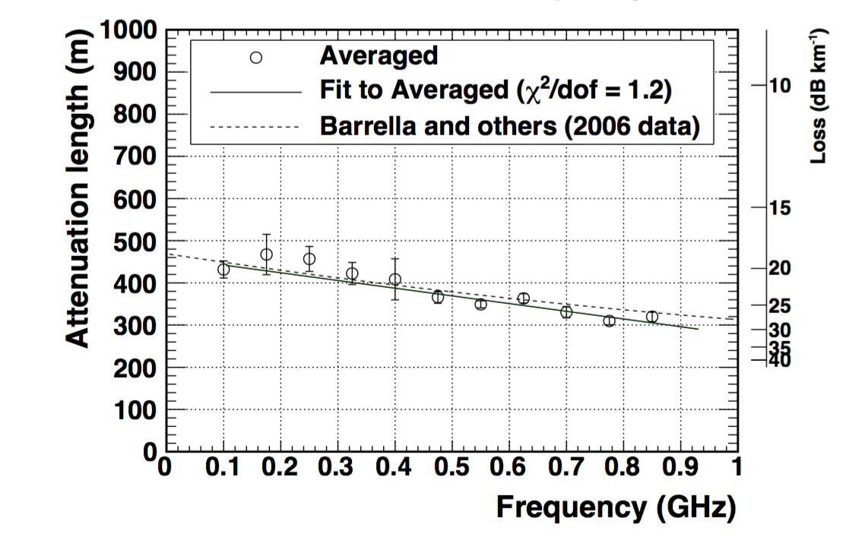
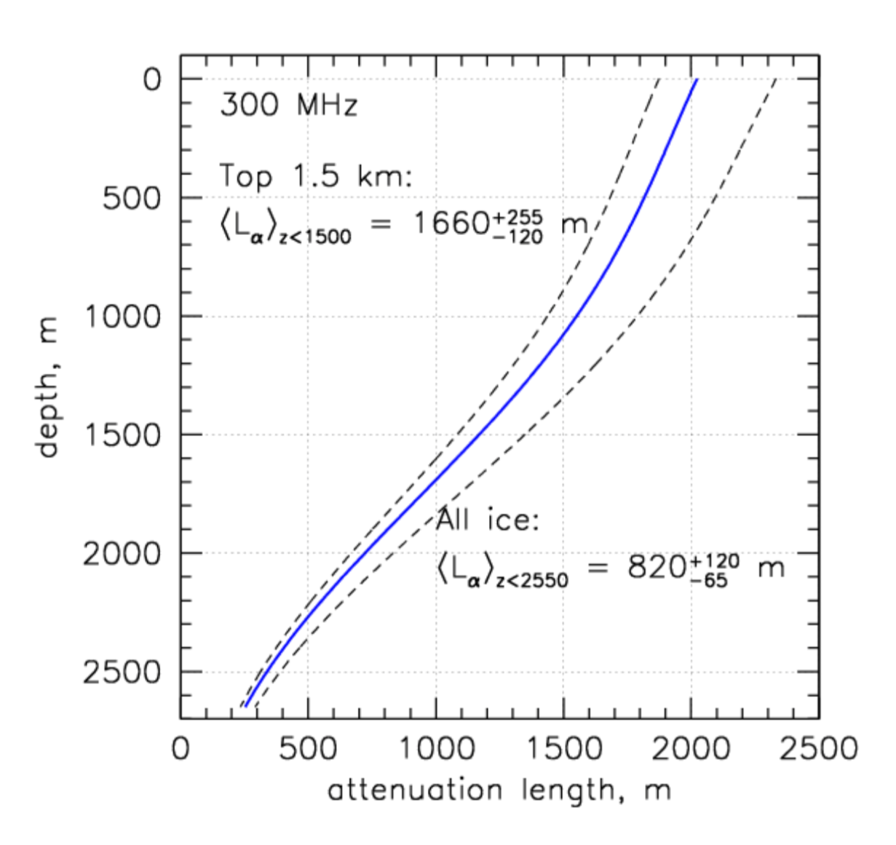
Ice Comparison
Moore’s Bay
Ice is warmer
Measured by reflecting signals off bottom
<Λ> ~ 400 m
South Pole
Ice is colder
Measured w/ buried transmitter
<Λ> ~ 820 m
Better near surface
Big advantage for higher E_{ν}
Moore’s Bay
ARIANNA: S Barwick et al., J. Glaciol. 61, 227 (2015)
ARA: P. Allison et al., Astropart. Phys. 35, 457 (2012)

Slide 24
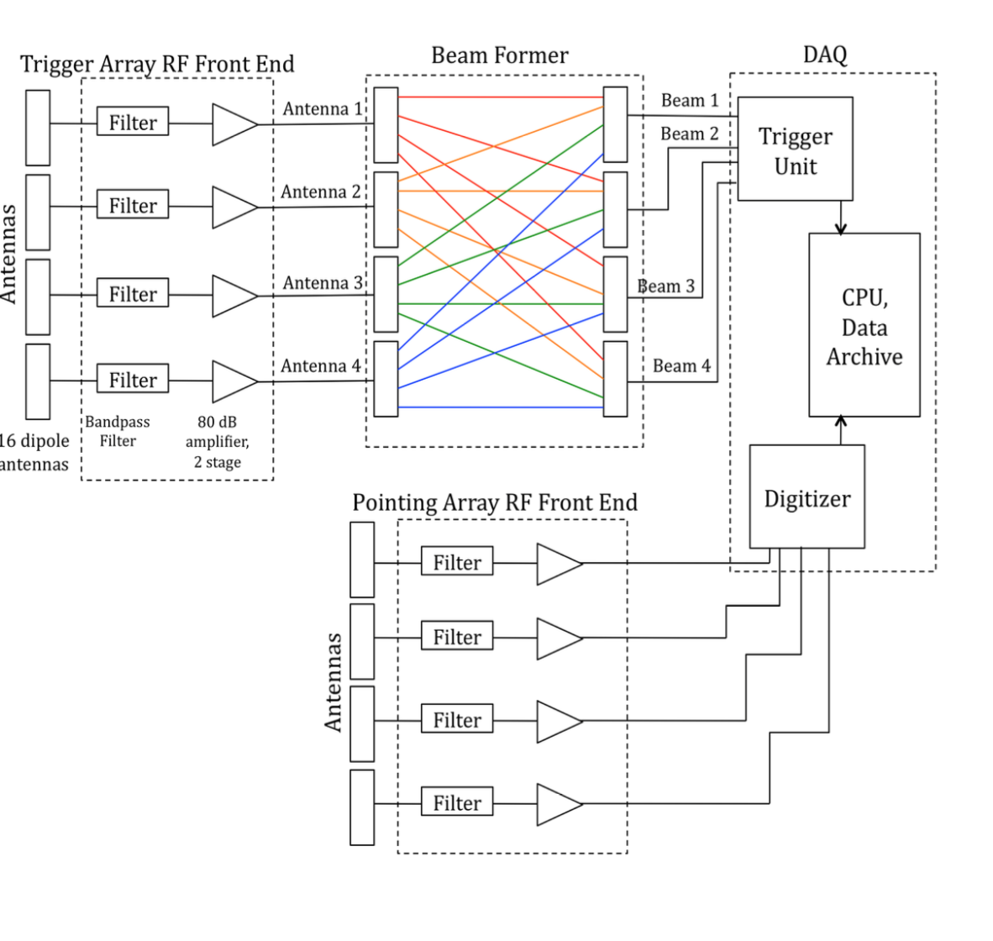
Interferometric detection
With interferometric techniques
Signal ~N_{ant.}
Noise ~ √N_{ant.}
Threshold scales ~ 1/√N_{ant.}
Beam-former needs N_{ant.}² elements to cover all directions
Complicates trigger
Power
4-antenna system tested in Greenland
ARA tests planned this Austral summer
‘Factor of several’ threshold reduction
Attractive for studies of Icecube ν flux
A. Vieregg

Slide 25
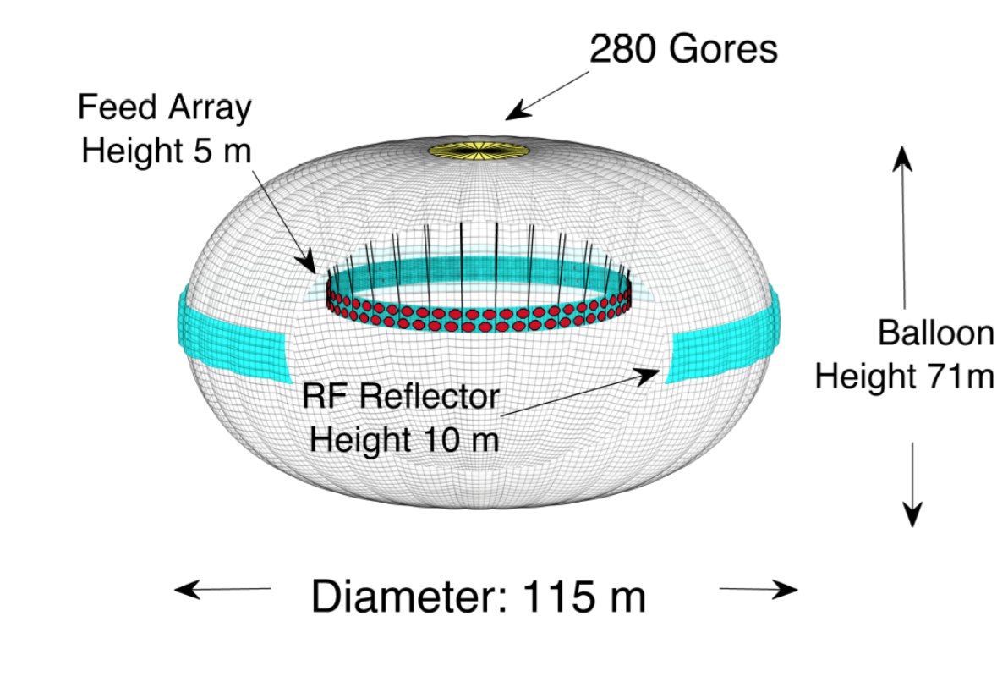
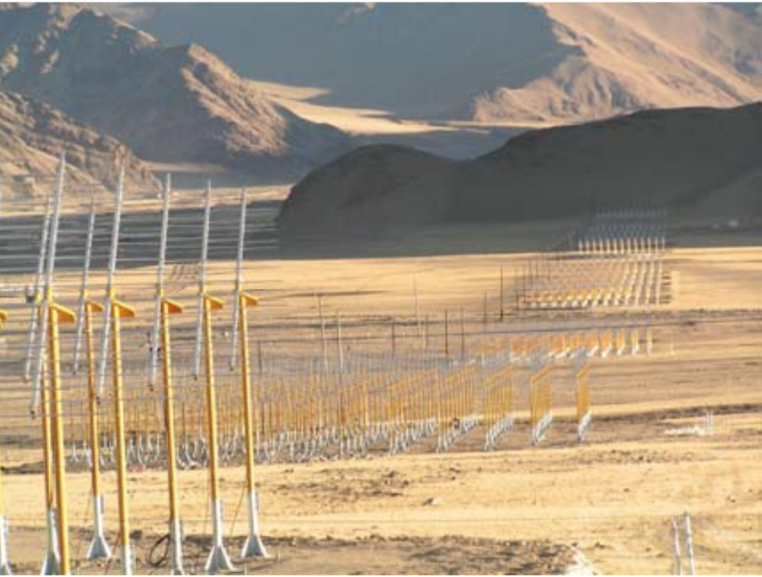
Other ideas
In EVA (Exavolt antenna), part of the surface of an 115 m diameter balloon would serve as a radio reflector
Large area -> 10¹⁷ eV threshold
1/20 scale model built & being tested
Multiple groups are considering experiments to look for ν_{τ} interactions in mountains (or shallow Earth)
The τ emerges and then decays.
Optical methods for 10¹⁵⁻¹⁷ eV
Radio at higher energy
Chinese 21 cm array (right)
TAROGEE (Taiwan)

Slide 26
Whither radio?
There is a strong physics case and much interest in a large radio array. One should be built.
Non-detection of GZK ν would also be very interesting.
Both ARA and ARIANNA are modular. Performance scales fairly directly with $$$
So, no performance projection comparisons
We want to maximize physics/cost
Logistics are a main component of cost
I don’t know which has a better overall ratio
ARA and ARIANNA have many differences. We should mix & match to use the best site & design ideas.
This future radio effort might be part of IceCube Gen2
A large array might cost in the $10-25 M range

Slide 27
Conclusions
GZK neutrinos are a guaranteed* (if UHECR are mostly protons), but as-yet unseen source of UHE neutrinos. A ~ 100 km³ detector should observe GZK ν
Over the past ~ decade, radio-detection of neutrinos has become an accepted technique.
Radio-telescopes searching for ν interactions in the Moon have set limits on ν flux for E > (>>) 10²⁰ eV.
The ANITA balloon experiment has put limits on ν with energies above ~ 10¹⁹ eV.
Next-generation experiments are focusing on arrays of embedded antennas, leading to a threshold of order 10¹⁷ eV.
These experiments will either see GZK neutrinos, or rule out models with significant UHECR proton content. They will also probe the IceCube ν flux at higher energies.

Slide 28
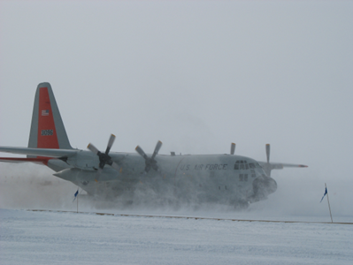
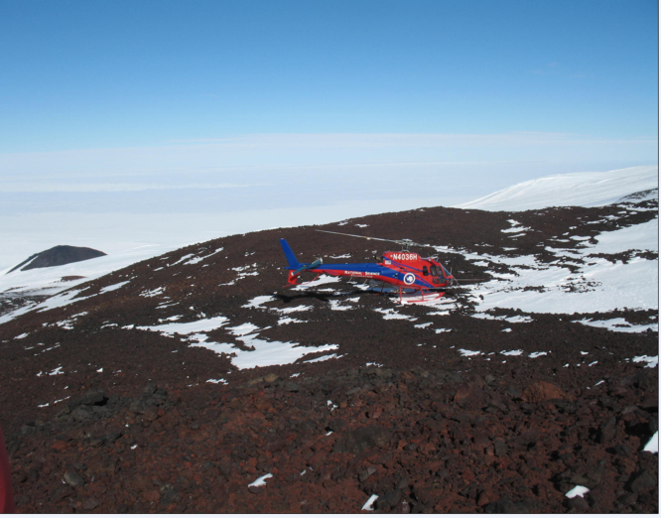
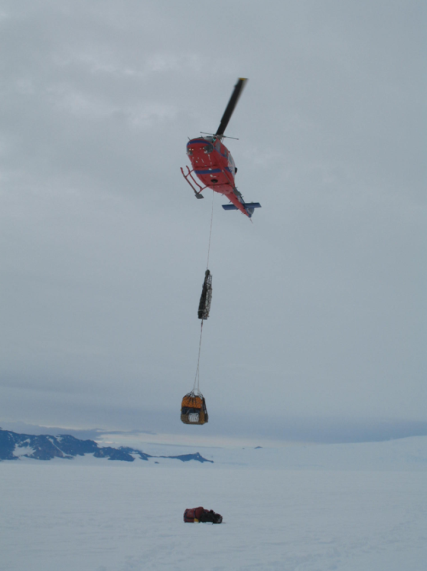
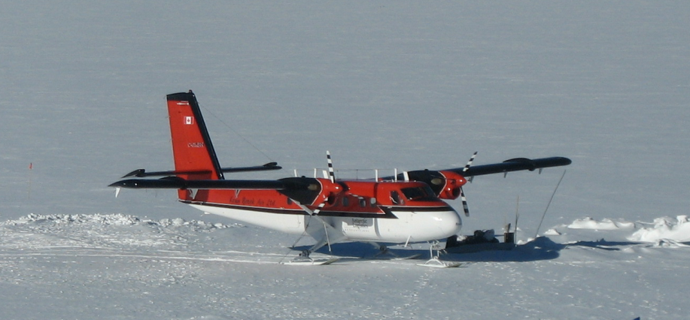
Thank you
Any questions?

Slide 29
Backup Slides

Slide 30
Measuring σ_{νN}
# Events
Measure the neutrino flux as a function of energy and zenith angle
Absorption increases with zenith angle
Self-normalizing
At >10¹⁷eV, the Earth is opaque to neutrinos, so all of the action is at the horizon
Proposed detectors can measure σ_{νN} at ~ 10¹⁸ eV to a factor of ~ 2 in 10 years
Can’t tell what type of interaction (charged or neutral current) caused the absorption
Measure σ as a multiple of the standard model
Not an issue for extra-dimension studies
Tau regeneration is also a complication
IceCube has measured neutrino absorption in the Earth &, with it σ_{νN} !
Cos(θ_{z})
Plot by Amy Connolly
Gary Binder
Next talk

Slide 31
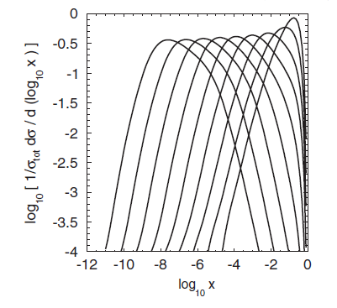
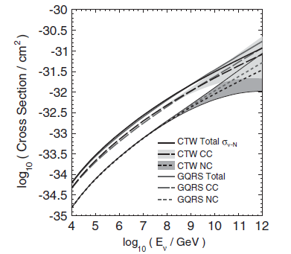
Theoretical issues, and the competition
σ_{SM} has ~ 50% uncertainties at 10¹⁹ eV, mostly from the poorly known low-x gluon distributions
MSTW 2008 PDFs
For E_{ν} = 10¹⁹ eV, x_{typ.} ~ 10⁻⁶.
Uncertainty not dissimilar to the expected statistical errors.
The LHC can do similar studies, but GZK ν reach higher energies. A 10¹⁹ eV ν has a νp center of mass energy of 140 TeV - 10 times that at the LHC
N.b. ν energy should be compared to parton energy
Bjorken x values of the target,
For E_{ν} = 10⁴…10¹² GeV
Connoly, R. S. Thorne & David Waters,
PRD 83, 113009 (2011)

Slide 32
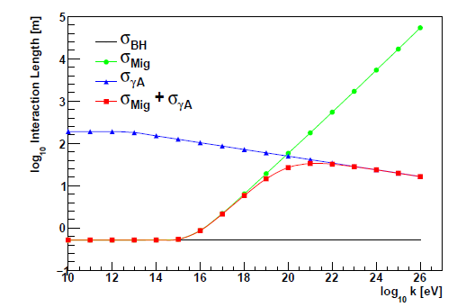
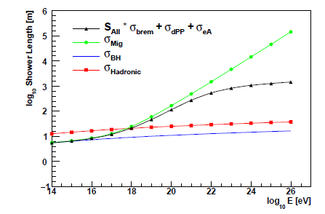
Neutrino Induced Showers
Focus on ν_{e}, since that is most detectable
20% of E_{ν} goes into a hadronic shower
80% of E_{ν} goes into an electromagnetic shower
EM showers are elongated by LPM effect
Many higher energy (>10²⁰ eV) experiments ignore ν_{e} showers
For E_{ν} > 10²⁰ eV, e & γ interact hadronically, limiting growth in shower length
Muons in showers
LPM
Log₁₀ Λ (m)
Photonuclear
Log₁₀ E_{ν} (eV)
LPM
Full
Log₁₀ Shower Length (m)
Hadronic
Bethe-Heitler
L. Gerhardt & SK, 2010
Log₁₀ E_{ν} (eV)

Slide 33
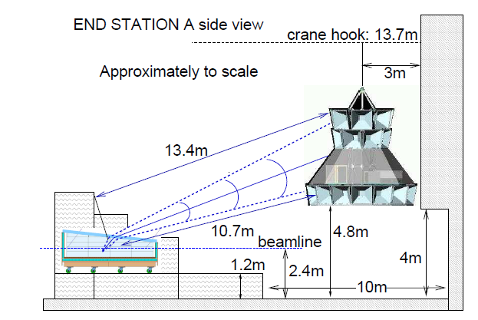
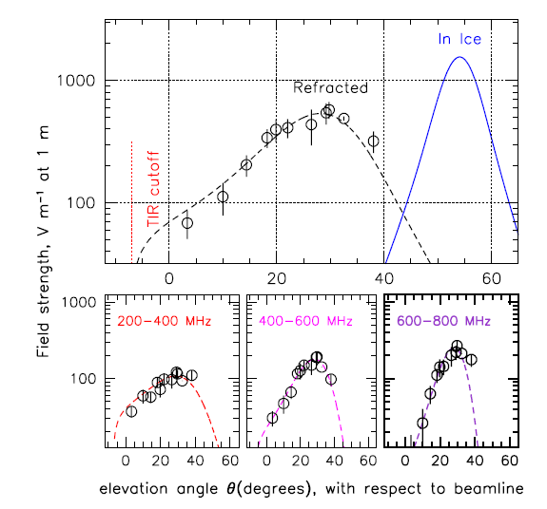
Shower Studies @ SLAC
Pulses of 10¹⁰ 25 GeV e- were directed into a large cube of ice
Radiation studied by ANITA detector
Frequency & angular distributions matched theory
Refraction affects angular dist.
Previous expts. with salt and sand targets
ANITA Collab., 2007

Slide 34
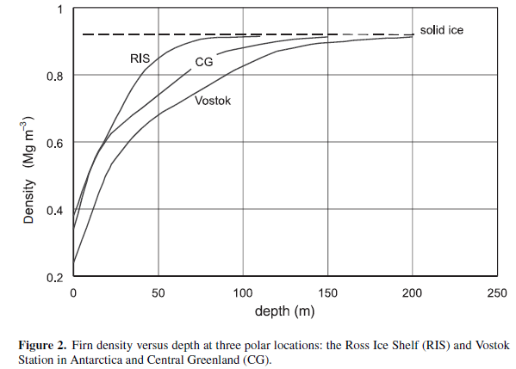
Ray Tracing in Antarctic Ice
The varying density near the surface causes radio waves to refract
Density profile measured with boreholes.
Slowest transition to pure ice in central Antarctica
Density (Mg/m³)
Depth (m)

Slide 35
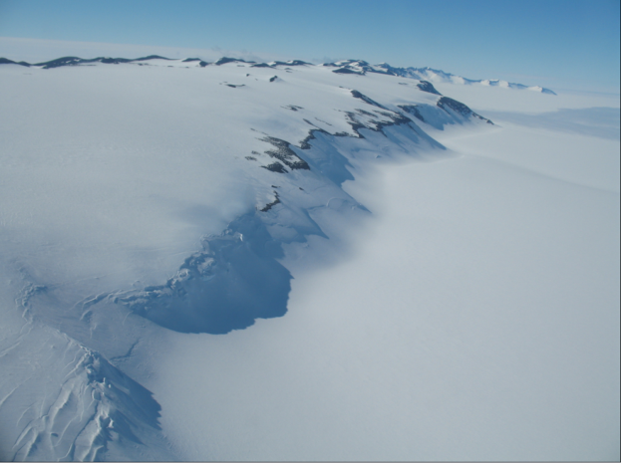
The ARIANNA proposal
Each station is autonomous
Local trigger & intelligence
Spacing is a tradeoff between maximum volume/cost vs. seeing events with multiple stations
Stations with 8 antennas
Antennas are in shallow trenches
Autonomous data acquisition
Site is 110 km from McMurdo station, shielded by Minna bluff from anthropogenic noise
Wide angular range allows measurement of neutrino-nucleon cross-section, independent of flux
# Events
Cos(θ_{z})
Plot by Amy Connolly

Slide 36
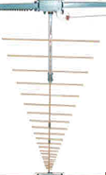
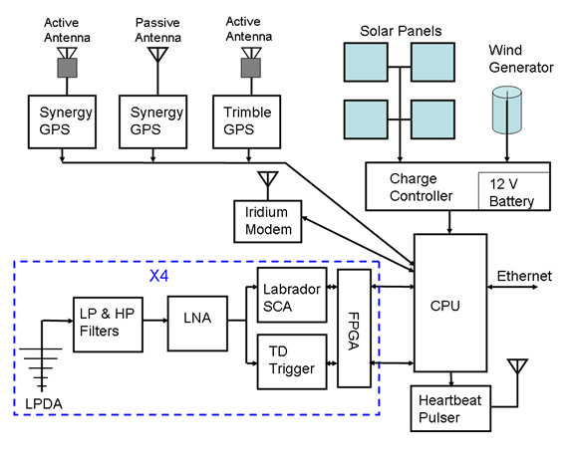
The ARIANNA detector
900 stations on a 1 km grid
Stations trigger independently
8 log—periodic dipole antennas/station
Response in ice from 80 MHz – 1 GHz
All pointed downward
Separation 2-4 m
Δt from opposing pairs gives zenith angle
Amplitudes from 45⁰ pairs gives polarization (azimuthal angle)
Trigger on 2-3 antenna above threshold
Digitize signals at 2 GS/s with a switched capacitor array
Irridium modem & internet communication
Solar + wind/wired power

Slide 37
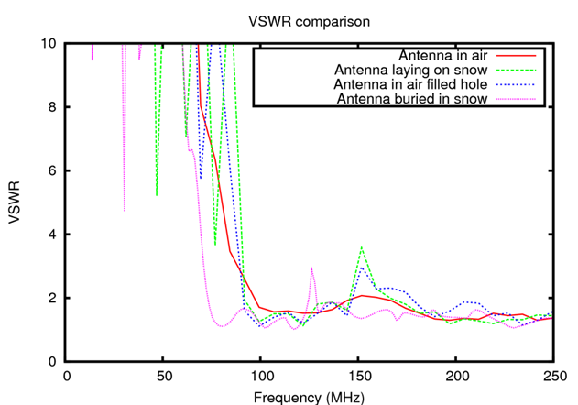
Signal Detection Hardware
Log Periodic Dipole Antenna
Good directionality & polarization sensitivity
105-1300 MHz in air
In ice, index of refraction n> 1
Wavelength Λ = c/nf is shorter
Antenna impedance is altered, shifted to slightly lower frequencies
Low noise pre-amp & switch capacitor array ADC + trigger system
GPS for timing
Solar power (summer)
Wind generators under investigation for winter
Not much wind at site
Central power station + cables possible
VSWR
In Air
Buried in Snow
Stuart Kleinfelder will discuss the ARIANNA DAQ system on Thurs. morning

Slide 38
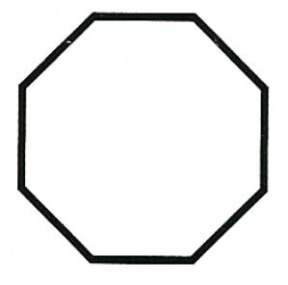
Directional determination
~ 6 m
Δt
The octagonal antenna arrangement allows us to determine ν direction from a single station.
The direction from the station to the ν (D) interaction is found from the paired time differences from opposing antennas
Two angles
Two angles determine ν arrival direction
The RF signal is linearly polarized in the plane containing the n direction and D
The frequency spectrum tells how far D is off the Cherenkov cone.
4-fold ambiguity in direction (2/angle)
(8-fold w/ only 4 antennas)

Slide 39
ARA hardware
Receivers are deployed in ~ 200 m deep 4 inch diameter boreholes
4 receiver + 1 calibration string/cluster
150-850 MHz bicone antennas for vertical polarization
200-850 MHz quad-slotted cylinders for horizontal polarization.
Single string trigger
Waveform digitization at 2GS/s
Some reflection observed from surface

Slide 40
ARA stations and antenna clusters
4 receiver strings + 1 buried calibration transmitter/cluster
Prototype Development in progress
Multiple antennas for up/down discrimination

