Slide 1
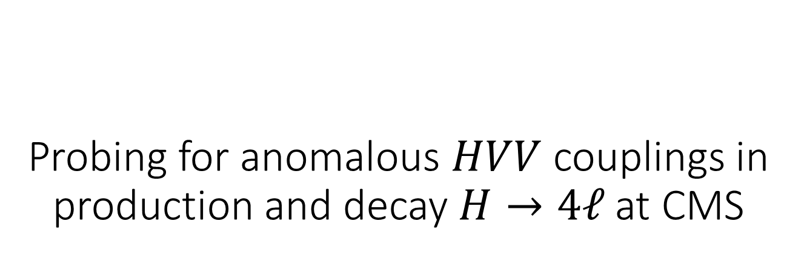
Probing for anomalous $HVV$ couplings in production and decay $H→4ℓ$at CMS
Animated gifs on some slides.
See ppt version or separate indico attachment.
Heshy Roskes (Johns Hopkins University)
for the CMS collaboration
The 26th International Workshop on Weak Interactions and Neutrinos (WIN2017)
UC Irvine
June 20, 2017

Slide 2
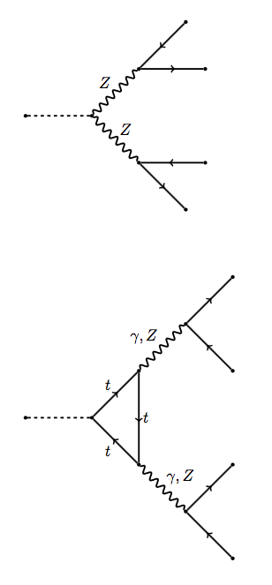
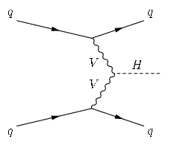
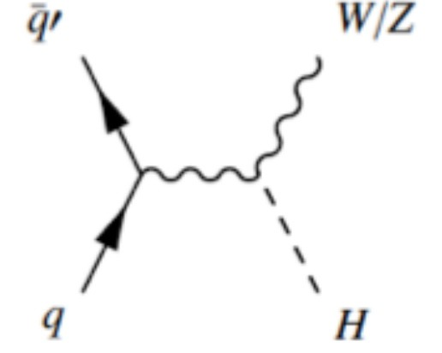
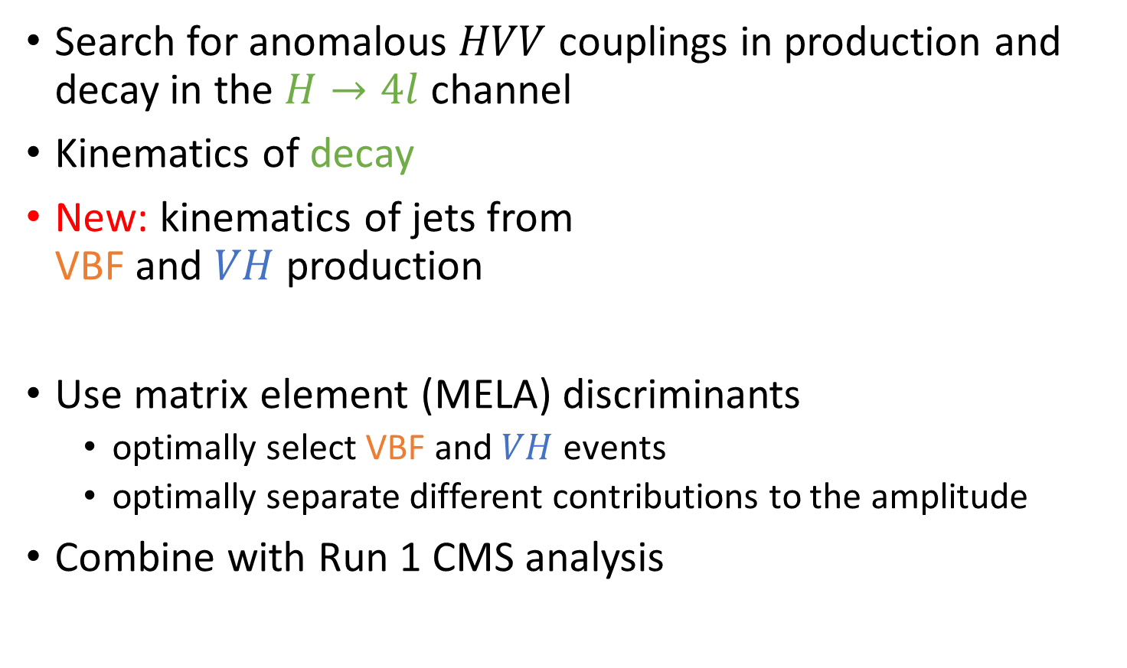
Anomalous couplings
Search for anomalous $HVV$ couplings in production and decay in the $H→4l$ channel
Kinematics of decay
New: kinematics of jets from
VBF and $VH$ production
Use matrix element (MELA) discriminants
  optimally select VBF and $VH$ events
  optimally separate different contributions to the amplitude
Combine with Run 1 CMS analysis

Slide 3
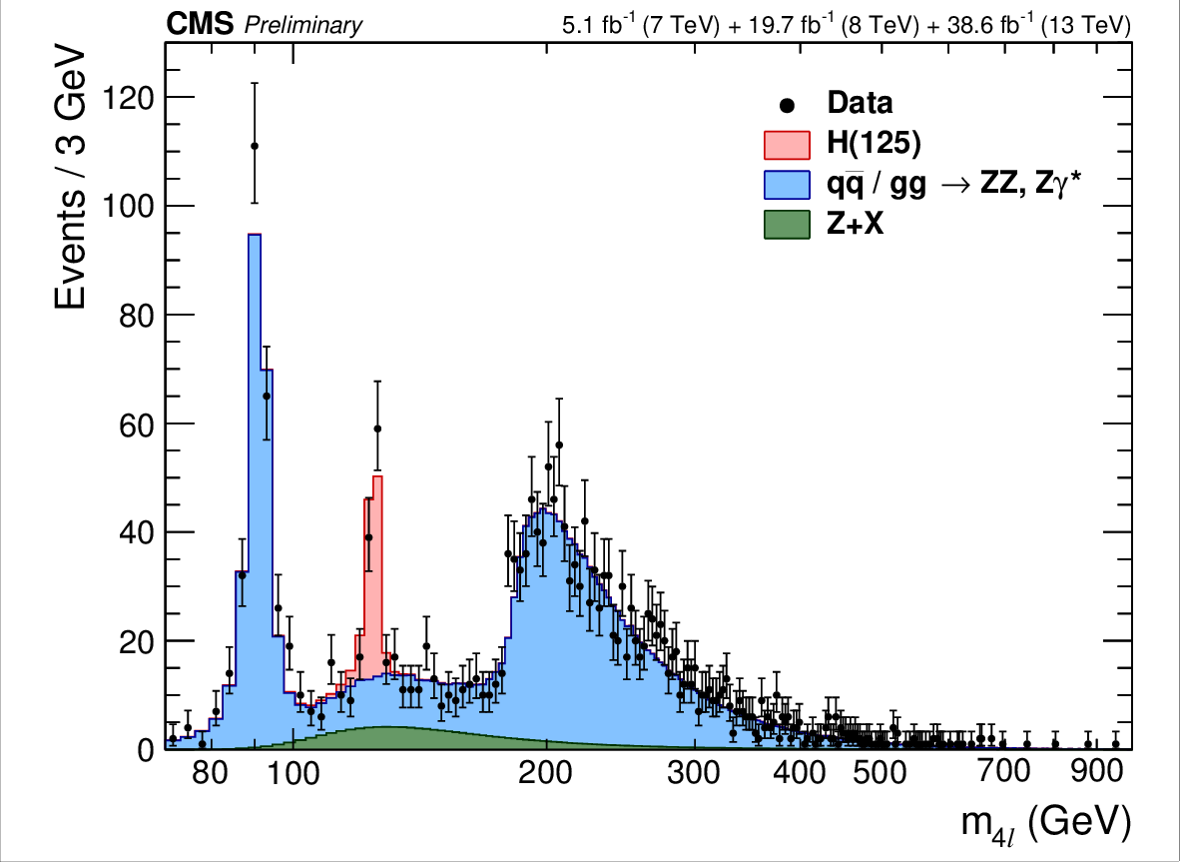

$$H\left(125\right)→4ℓ$$
References:
Run 1:
CMS-HIG-14-018
  spin
  anomalous couplings
Run 2:
CMS-PAS-HIG-16-041
  properties
CMS-PAS-HIG-17-011
  anomalous couplings
What is it?
How does it interact with other particles?

Slide 4
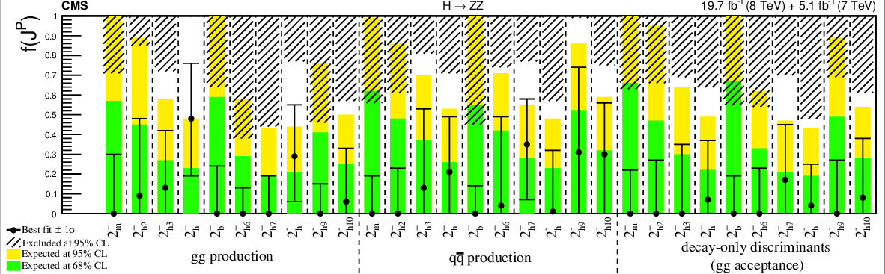

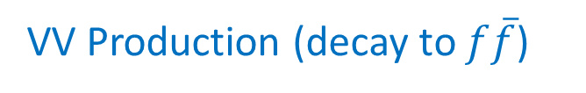
CMS&ATLAS results
Run 1: exclude spin 1 and 2
Set limits on spin 0 anomalous couplings
CMS
ATLAS
Study of the mass and spin-parity of the Higgs boson candidate via its decays to Z boson pairs CMS-HIG-12-041, arXiv:1212.6639
Measurement of the properties of a Higgs boson in the four-lepton final state arXiv:1312.5353, CMS-HIG-13-002
Constraints on the spin-parity and anomalous HVV couplings of the Higgs boson in proton collisions at 7 and 8 TeV arXiv:1411.3441, CMS-HIG-14-018
Limits on the Higgs boson lifetime and width from its decay to four charged leptons arXiv:1507.06656, CMS-HIG-14-036
Combined search for anomalous pseudoscalar HVV couplings in VH production and H to VV decay arXiv:1602.04305, CMS-HIG-14-035
Measurements of properties of the Higgs boson and search for an additional resonance in the four-lepton final state at √s = 13 TeV, CMS-PAS-HIG-16-033
Constraints on anomalous Higgs boson couplings in production and decay H→4ℓ, CMS-PAS-HIG-17-011
Evidence for the spin-0 nature of the Higgs boson using ATLAS data ATLAS arXiv:1307.1432
Study of the spin and parity of the Higgs boson in diboson decays with the ATLAS detector ATLAS arXiv:1506.05669
Test of CP Invariance in vector-boson fusion production of the Higgs boson using the Optimal Observable method in the ditau decay channel with the ATLAS detector ATLAS arXiv:1602.04516
Measurement of inclusive and differential cross sections in the H → ZZ∗ → 4l decay channel at 13 TeV with the ATLAS detector ATLAS-CONF-2017-032
$$f_{ΛQ}$$
VV Production (decay to $f\overline{f}$)
Run 2 results
This analysis

Slide 5
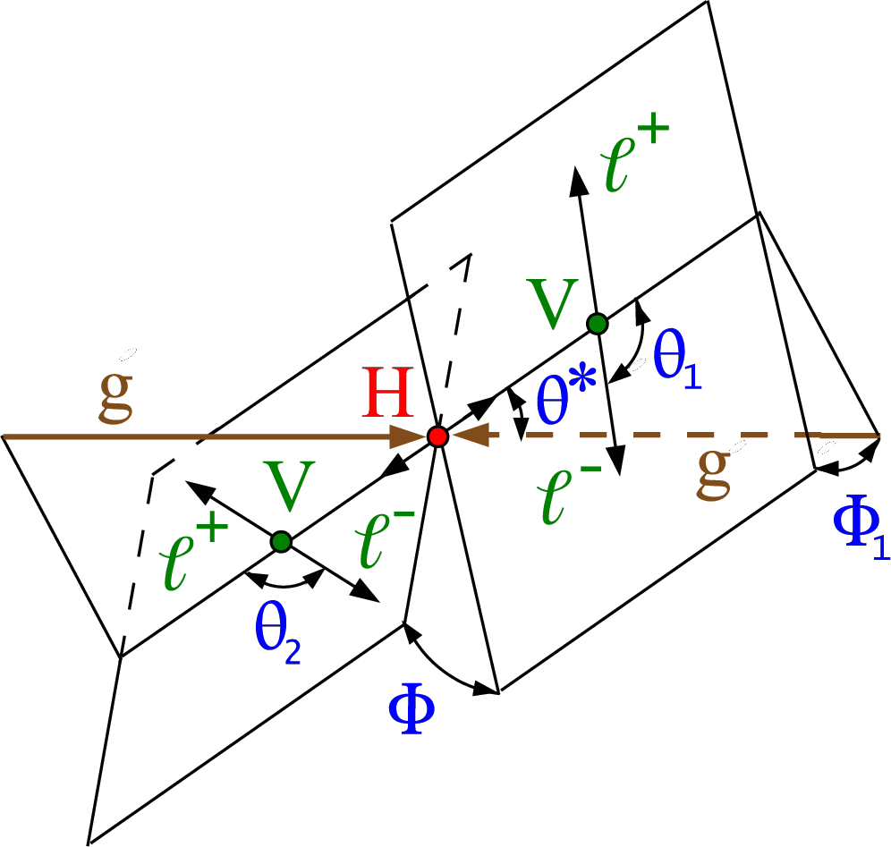
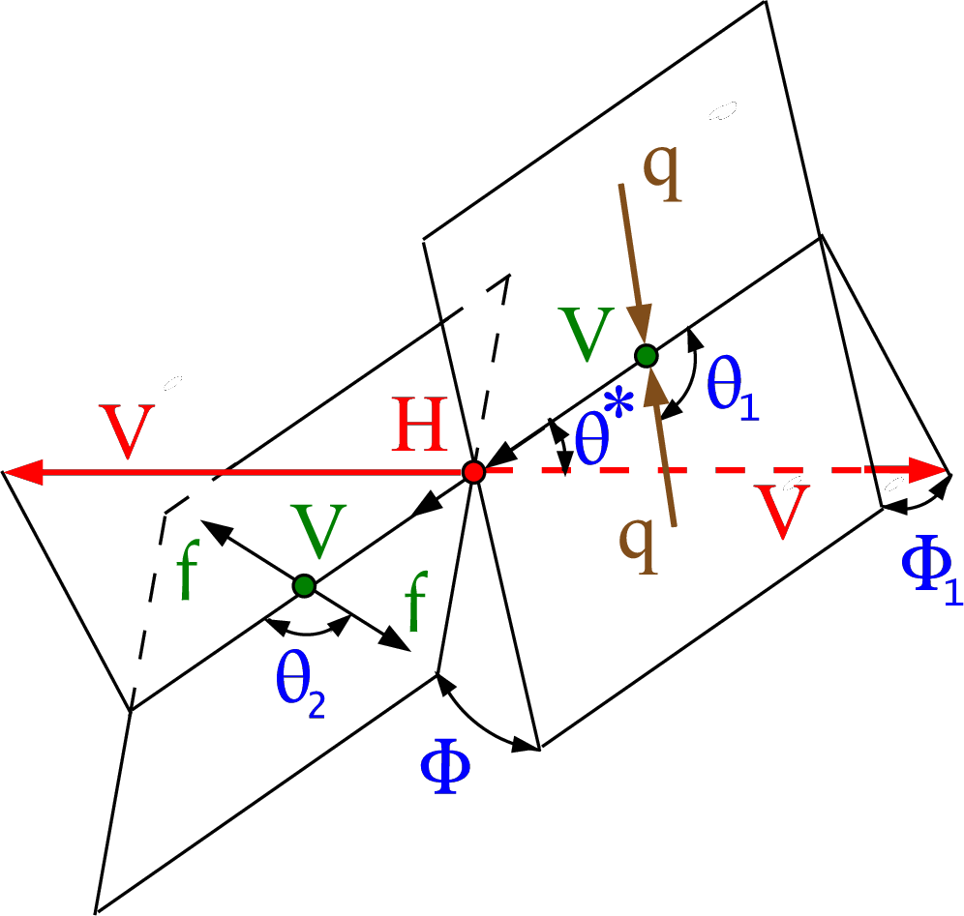
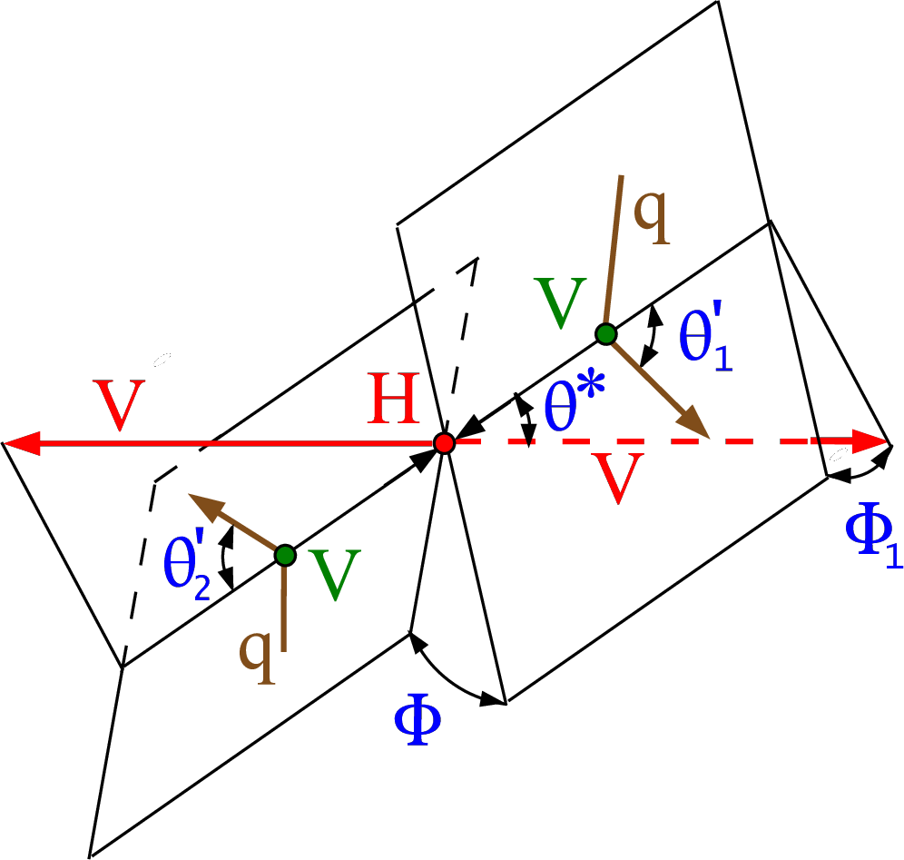
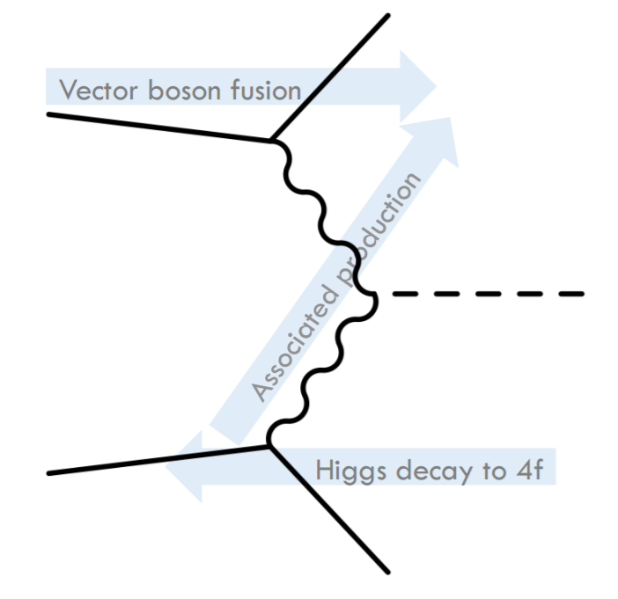

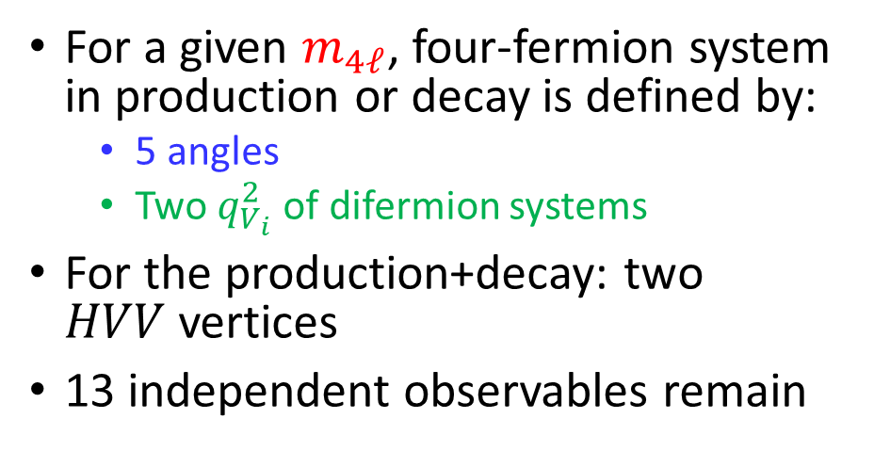

Kinematics
$$H→ZZ→4ℓ$$
$$VH$$
VBF
For a given $m_{4ℓ}$, four-fermion system in production or decay is defined by:
  5 angles
  Two $q_{V_{i}}^{2}$ of difermion systems
For the production+decay: two
$HVV$ vertices
13 independent observables remain

Slide 6
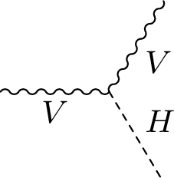
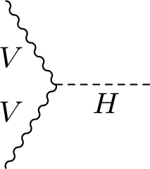
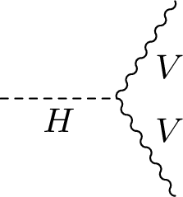
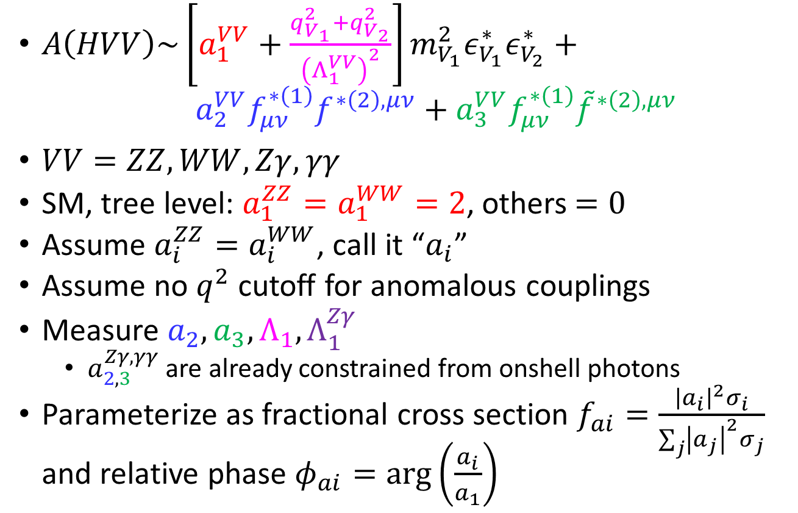
HVV amplitude
$A\left(HVV\right)\sim \left[a_{1}^{VV}+\frac{q_{V_{1}}^{2}+q_{V_{2}}^{2}}{{\left(Λ_{1}^{VV}\right)}^{2}}\right]m_{V_{1}}^{2}ε_{V_{1}}^{∗}ε_{V_{2}}^{∗}+ a_{2}^{VV}f_{μν}^{∗\left(1\right)}f^{∗\left(2\right),μν}+a_{3}^{VV}f_{μν}^{∗\left(1\right)}{\tilde{f}}^{∗\left(2\right),μν}$
$VV=ZZ, WW, Zγ, γγ$
SM, tree level: $a_{1}^{ZZ}=a_{1}^{WW}=2$, others$=0$
Assume $a_{i}^{ZZ}=a_{i}^{WW}$, call it “$a_{i}$”
Assume no $q^{2}$ cutoff for anomalous couplings
Measure $a_{2}, a_{3}, Λ_{1}, Λ_{1}^{Zγ}$
  $a_{2,3}^{Zγ,γγ}$ are already constrained from onshell photons
Parameterize as fractional cross section $f_{ai}=\frac{{\left|a_{i}\right|}^{2}σ_{i}}{\sum_{j}{{\left|a_{j}\right|}^{2}σ_{j}}}$ and relative phase $φ_{ai}=\arg\left(\frac{a_{i}}{a_{1}}\right)$

Slide 7
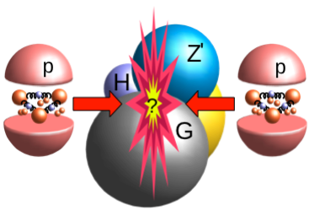
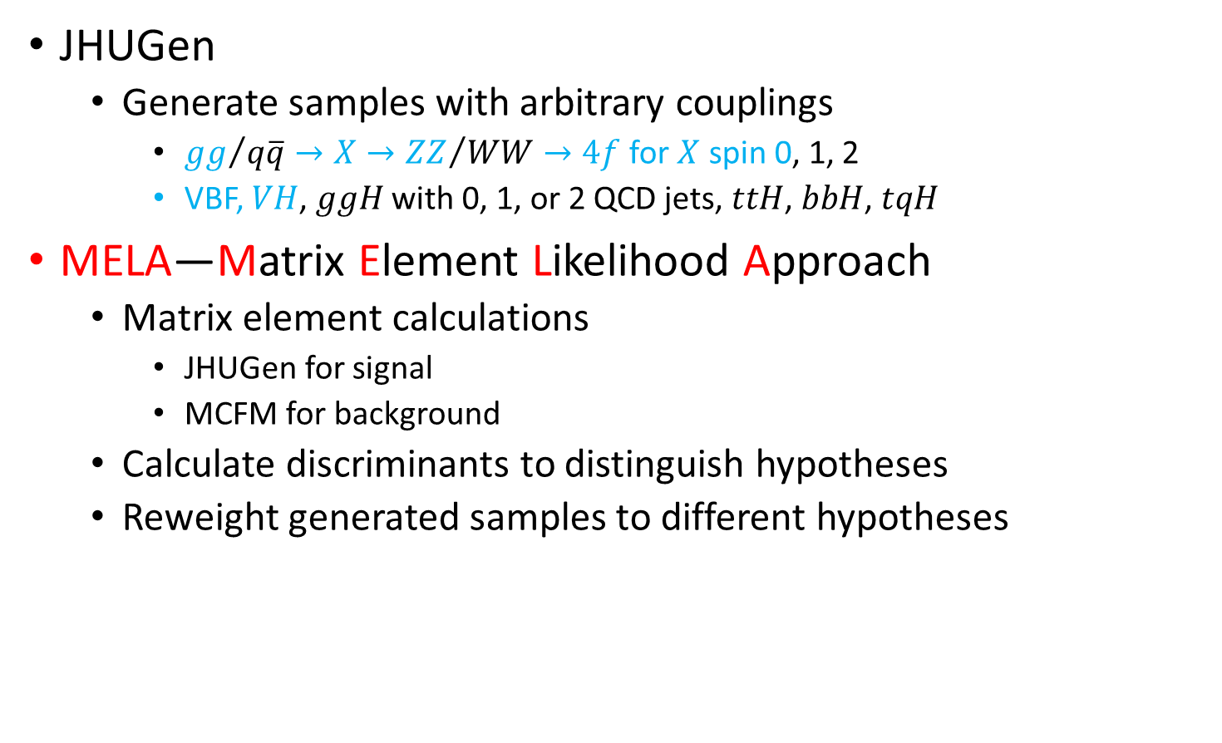
Tools
JHUGen
  Generate samples with arbitrary couplings
    ${gg}/{q\overline{q}}→X→{ZZ}/{WW}→4f$ for $X$ spin 0, 1, 2
    VBF, $VH$, $ggH$ with 0, 1, or 2 QCD jets, $ttH$, $bbH$, $tqH$
MELA—Matrix Element Likelihood Approach
  Matrix element calculations
    JHUGen for signal
    MCFM for background
  Calculate discriminants to distinguish hypotheses
  Reweight generated samples to different hypotheses

Slide 8
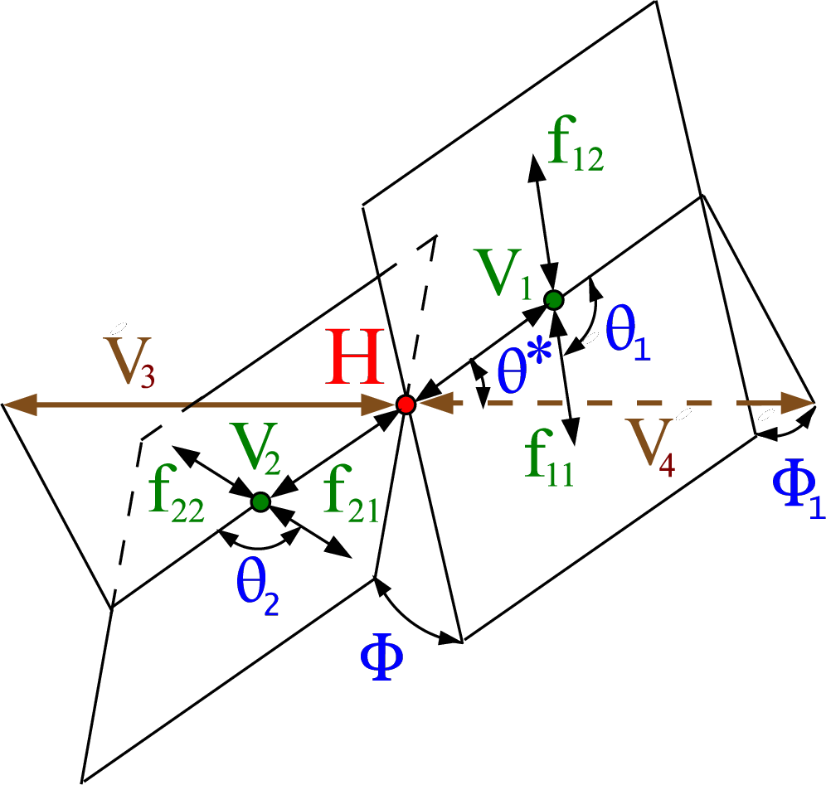
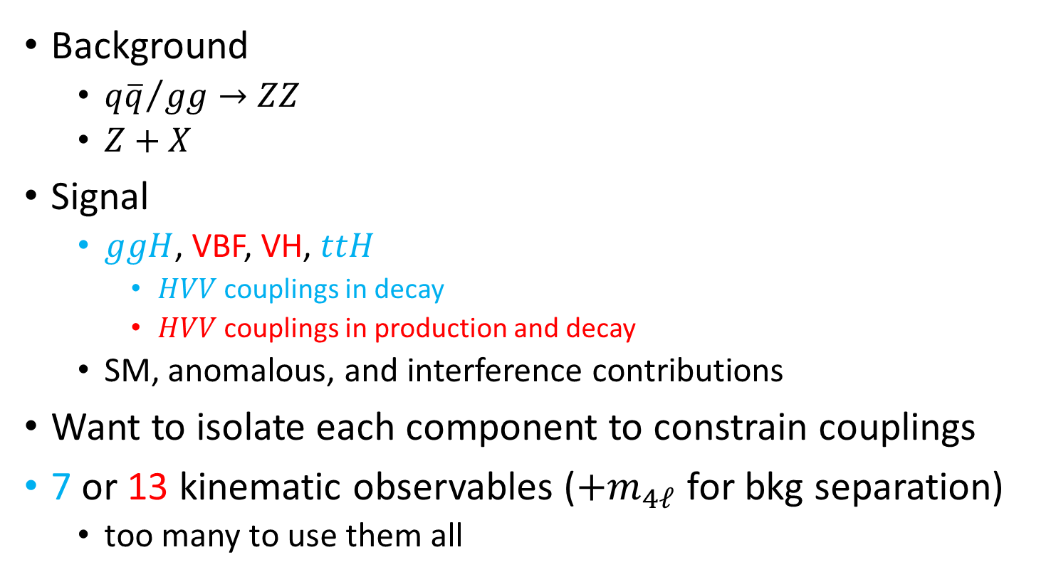
Contributions
Background
  ${q\overline{q}}/{gg}→ZZ$
  $Z+X$
Signal
  $ggH$, VBF, VH, $ttH$
    $HVV$ couplings in decay
    $HVV$ couplings in production and decay
  SM, anomalous, and interference contributions
Want to isolate each component to constrain couplings
7 or 13 kinematic observables ($+m_{4ℓ}$ for bkg separation)
  too many to use them all

Slide 9
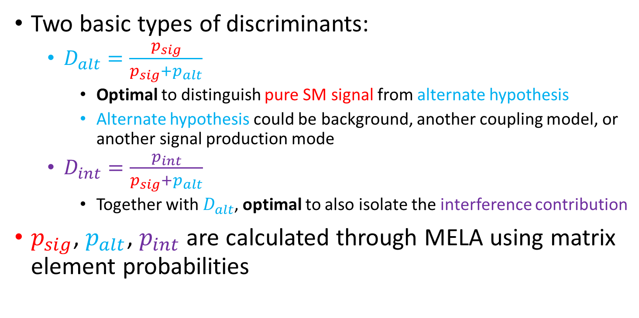
Discriminants
Two basic types of discriminants:
  $D_{alt}=\frac{p_{sig}}{p_{sig}+p_{alt}}$
    Optimal to distinguish pure SM signal from alternate hypothesis
    Alternate hypothesis could be background, another coupling model, or another signal production mode
  $D_{int}=\frac{p_{int}}{p_{sig}+p_{alt}}$
    Together with $D_{alt}$, optimal to also isolate the interference contribution
$p_{sig}$, $p_{alt}$, $p_{int}$ are calculated through MELA using matrix element probabilities

Slide 10
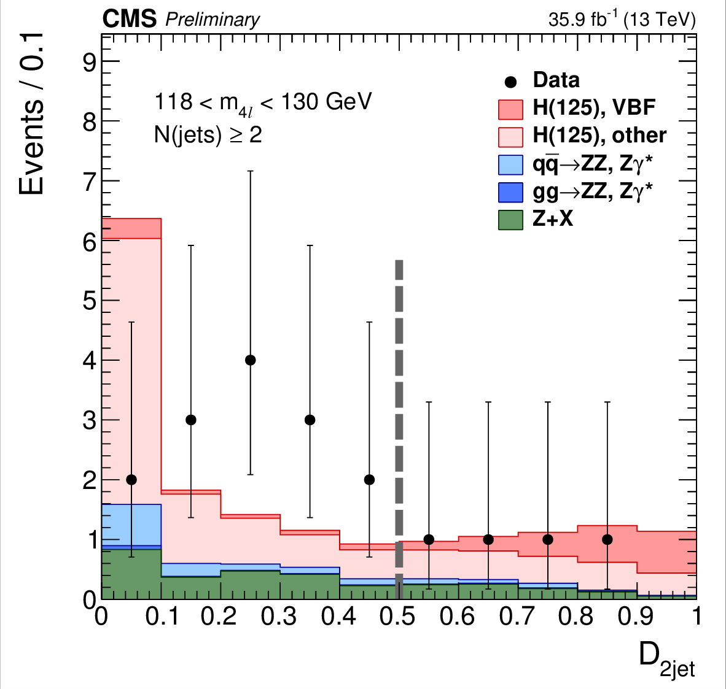
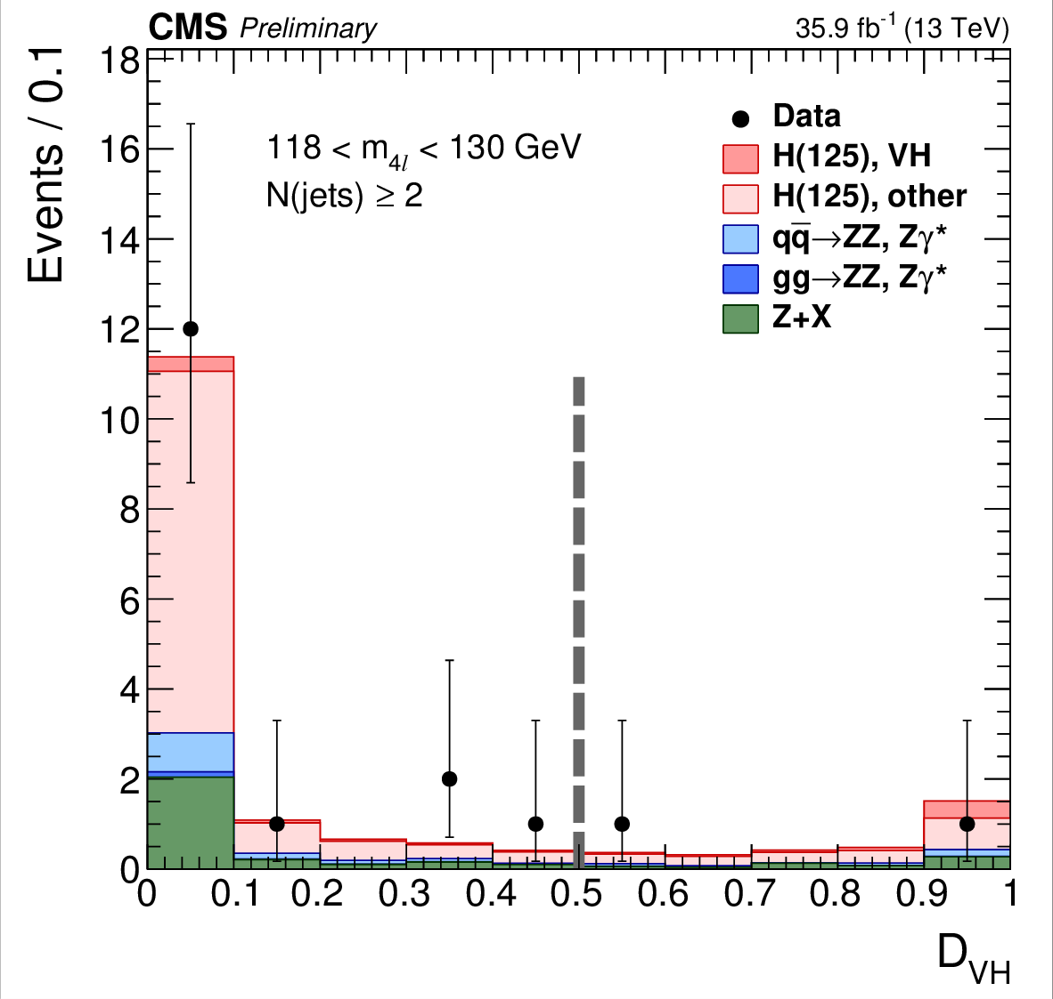


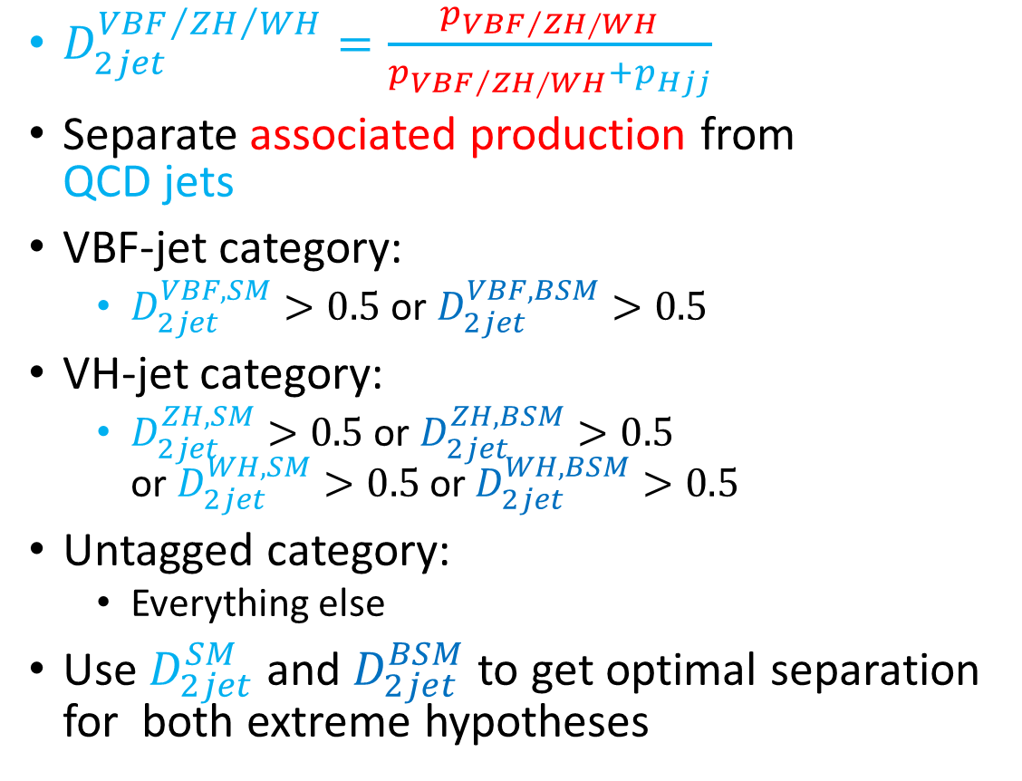
Discriminants 1
$D_{2jet}^{{{VBF}/{ZH}}/{WH}}=\frac{p_{{VBF}/{ZH}∕WH}}{p_{{VBF}/{ZH}∕WH}+p_{Hjj}}$
Separate associated production from
QCD jets
VBF-jet category:
  $D_{2jet}^{VBF,SM}>0.5$ or $D_{2jet}^{VBF,BSM}>0.5$
VH-jet category:
  $D_{2jet}^{ZH,SM}>0.5$ or $D_{2jet}^{ZH,BSM}>0.5$
  or $D_{2jet}^{WH,SM}>0.5$ or $D_{2jet}^{WH,BSM}>0.5$
Untagged category:
  Everything else
Use $D_{2jet}^{SM}$ and $D_{2jet}^{BSM}$ to get optimal separation for both extreme hypotheses
$$D_{2jet}^{VBF,SM}$$
$$\max\left(D_{2jet}^{ZH,SM},D_{2jet}^{WH,SM}\right)$$

Slide 11
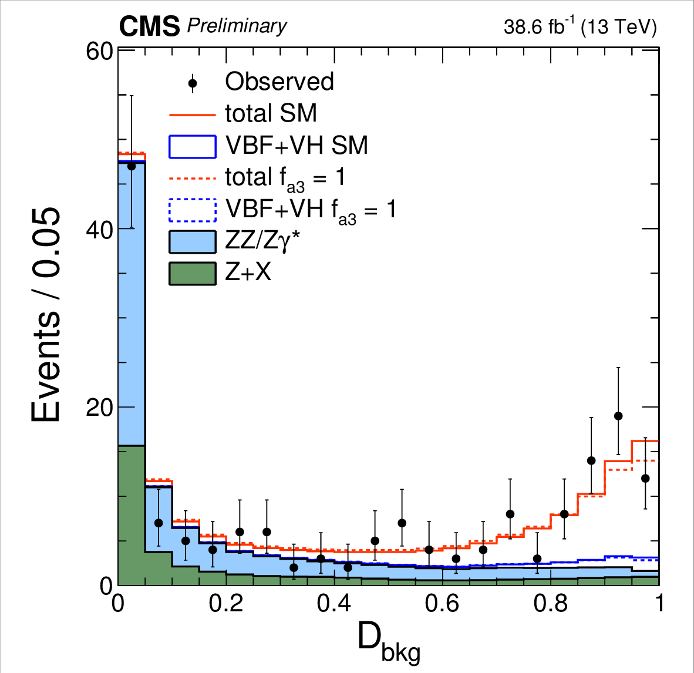

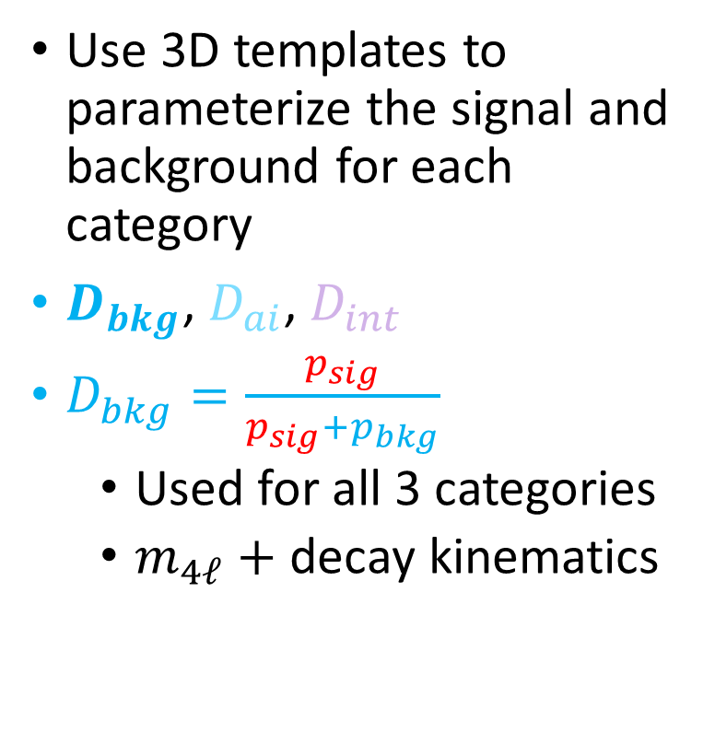
Discriminants 2
Use 3D templates to parameterize the signal and background for each category
$D_{bkg}$, $D_{ai}$, $D_{int}$
$D_{bkg}=\frac{p_{sig}}{p_{sig}+p_{bkg}}$
  Used for all 3 categories
  $m_{4ℓ}+$ decay kinematics
$$105 \text{GeV}<m_{4ℓ}<140 \text{GeV}$$

Slide 12
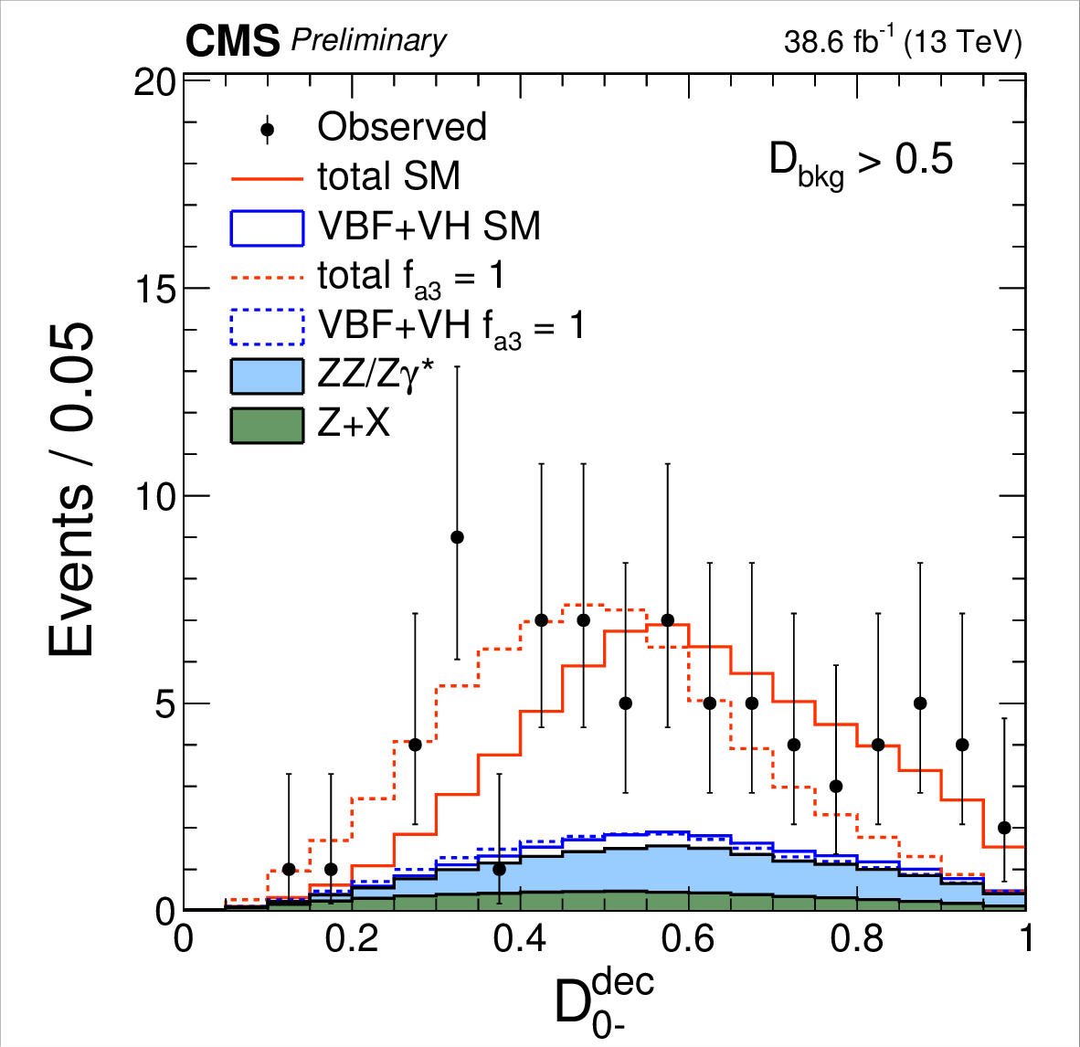
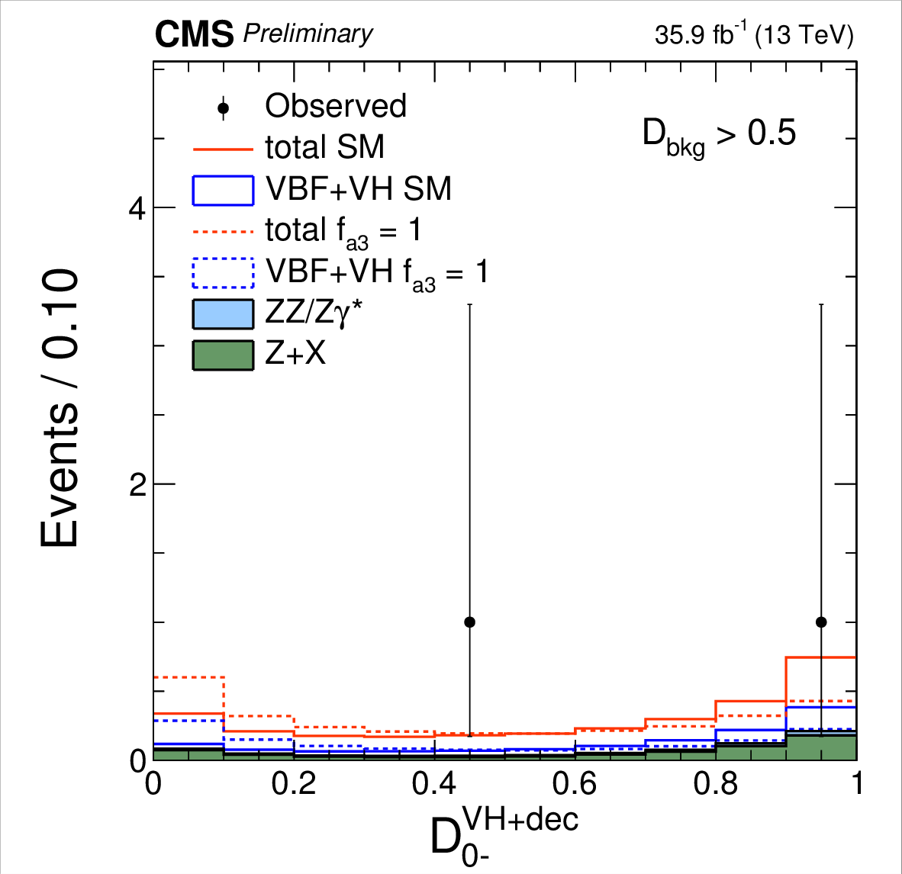
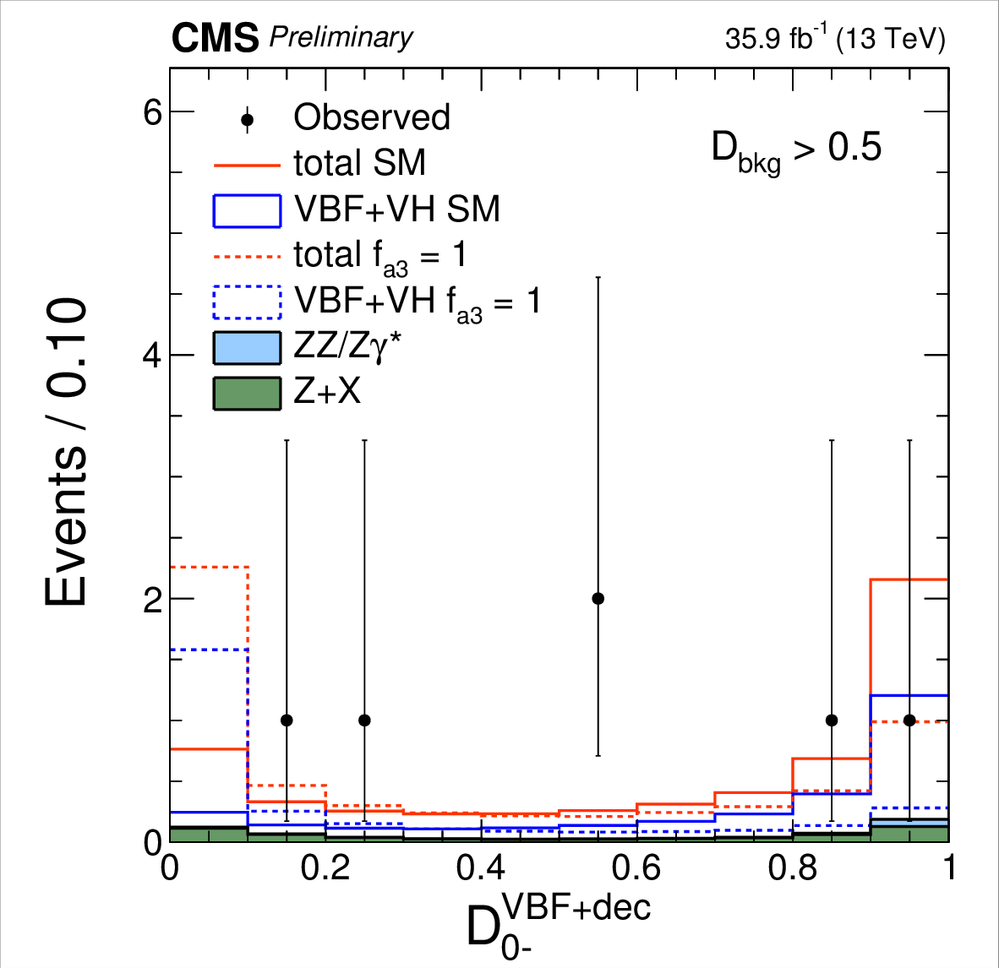

Discriminants 3
$D_{bkg}$, $D_{ai}$, $D_{int}$
$D_{ai}=\frac{p_{sig}}{p_{sig}+p_{ai}}$
Tagged categories: use production$×$decay probabilities
Untagged: use decay probabilities only
Example: $D_{0−}$ for the $f_{a3}$ analysis

Slide 13
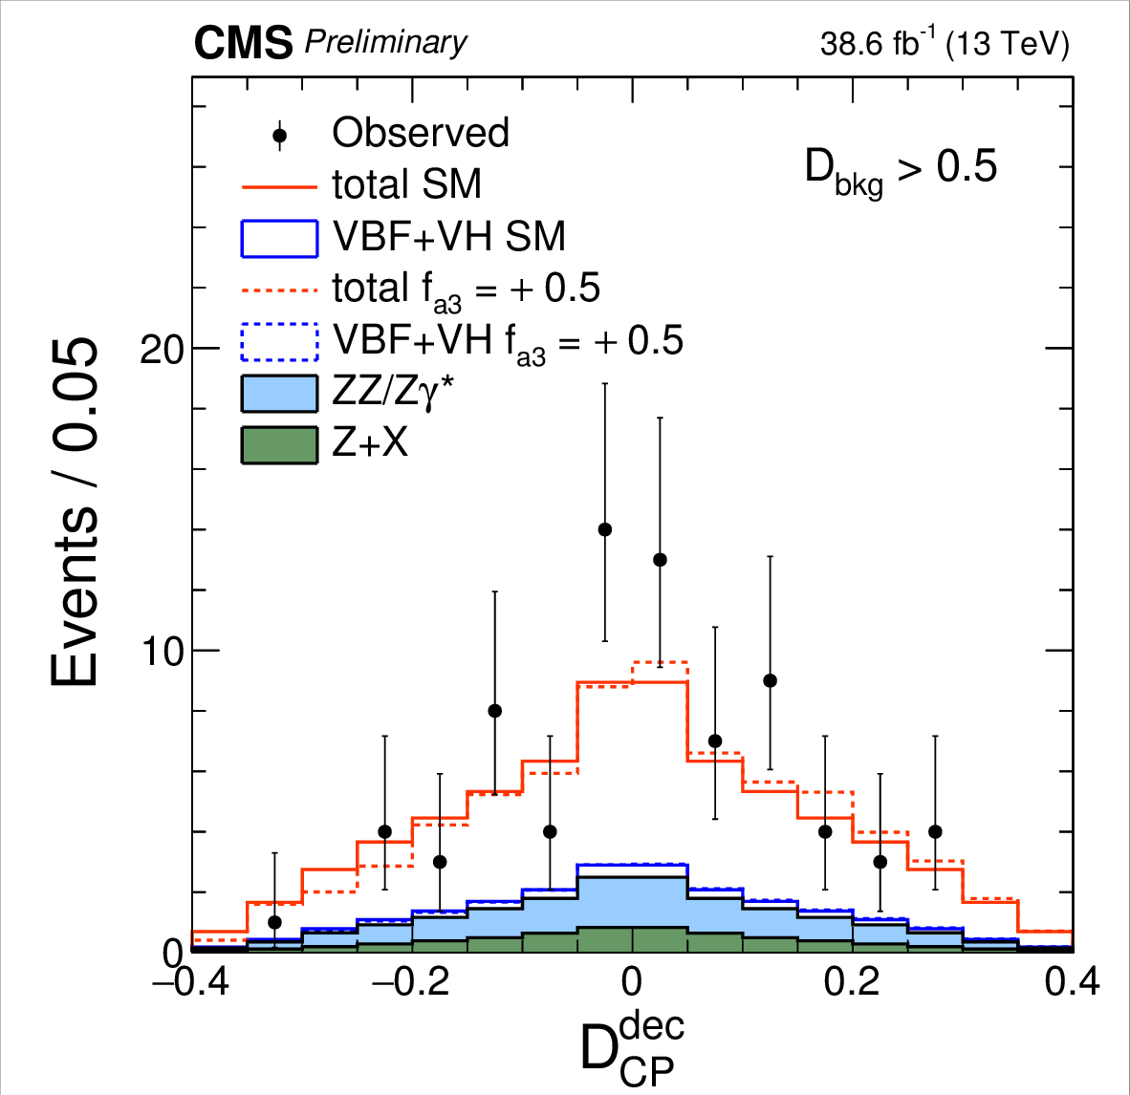
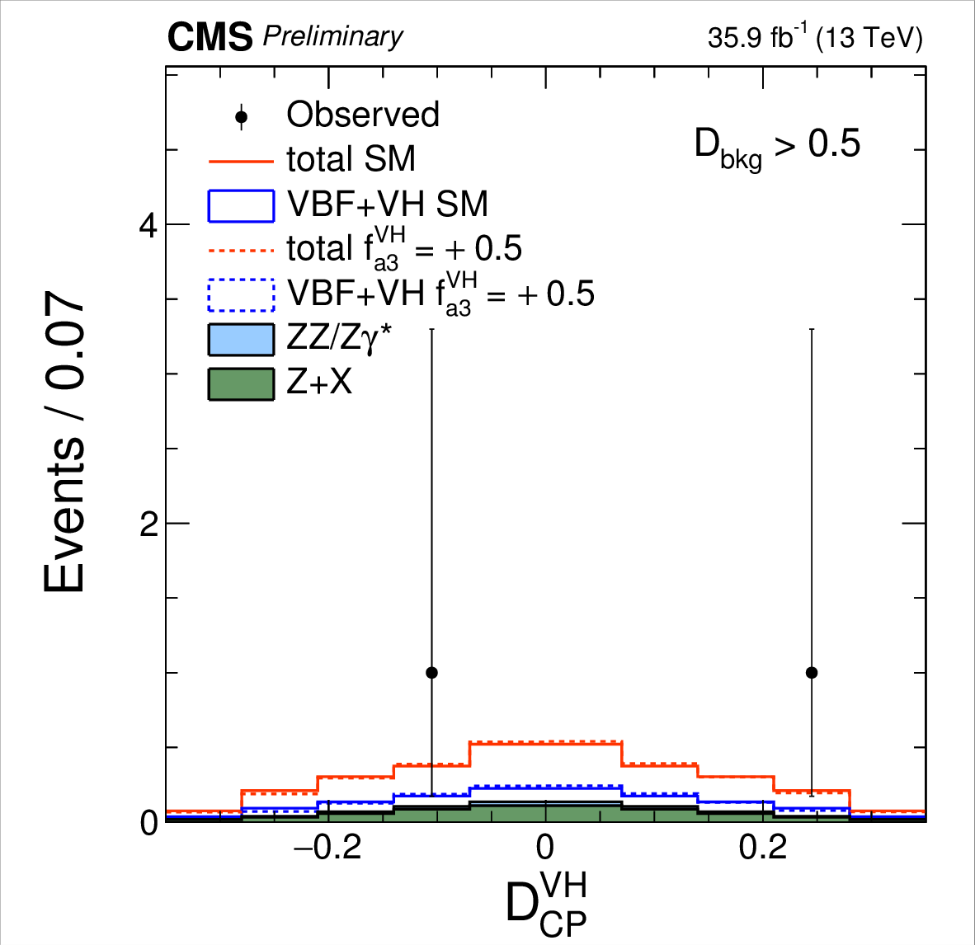
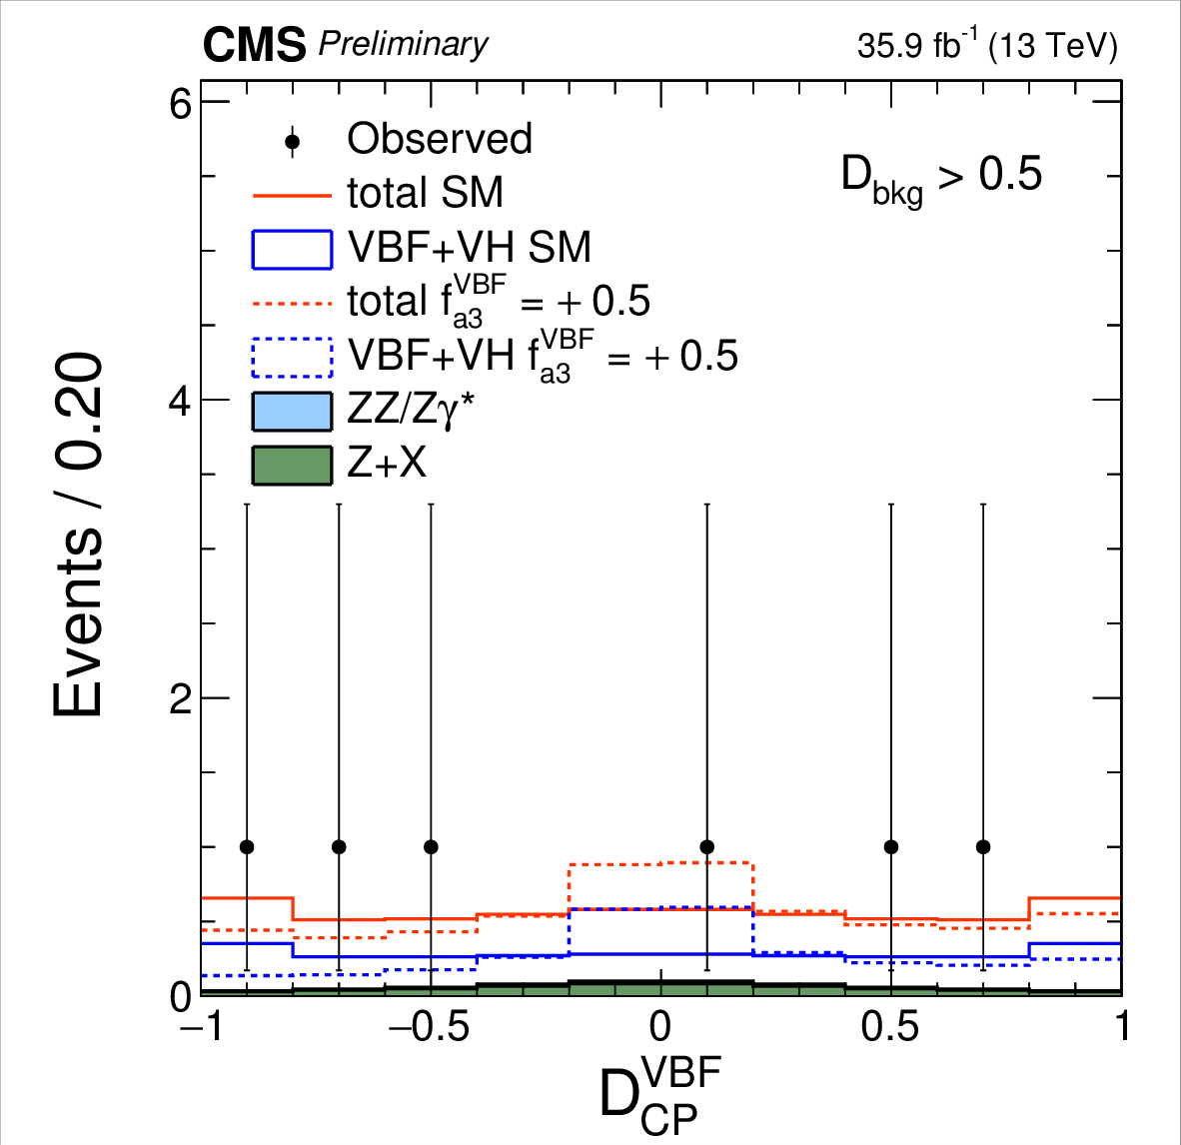

Discriminants 4
$D_{bkg}$, $D_{ai}$, $D_{int}$
$D_{int}=\frac{p_{int}}{p_{sig}+p_{alt}}$
Tagged categories: use production probabilities
Untagged: use decay probabilities

Slide 14
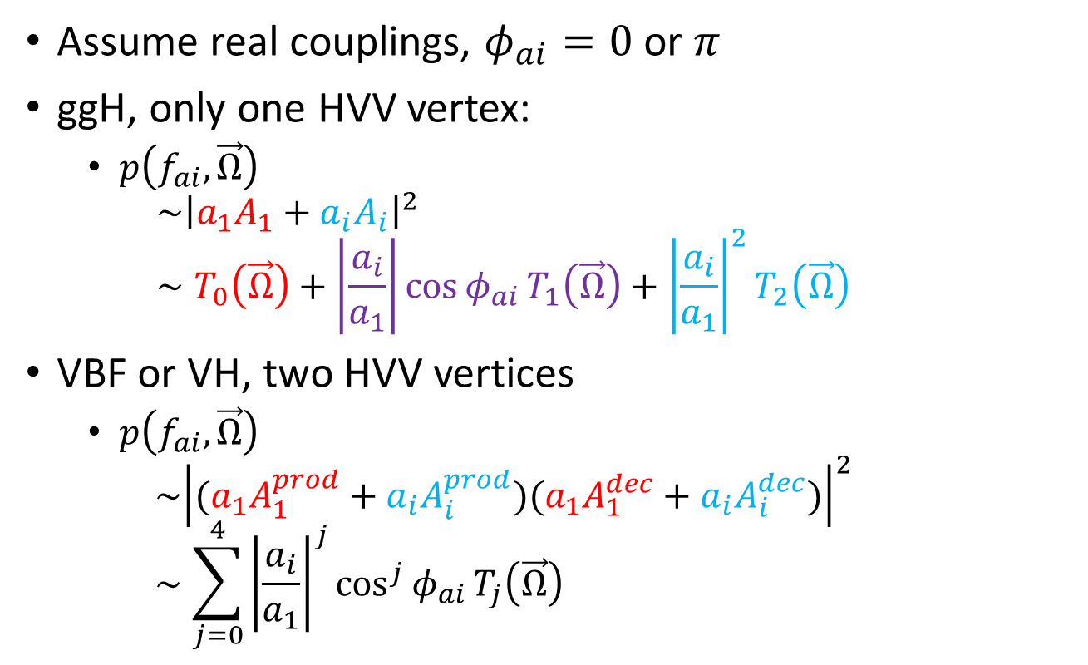
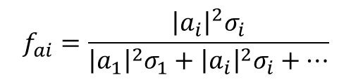

Likelihood fit
$$f_{ai}=\frac{{\left|a_{i}\right|}^{2}σ_{i}}{{\left|a_{1}\right|}^{2}σ_{1}+{\left|a_{i}\right|}^{2}σ_{i}+…}$$
Assume real couplings, $φ_{ai}=0$ or $π$
ggH, only one HVV vertex:
  $p\left(f_{ai},\vec{Ω}\right)$
  $\sim {\left|a_{1}A_{1}+a_{i}A_{i}\right|}^{2}$
  $∼T_{0}\left(\vec{Ω}\right)+\left|\frac{a_{i}}{a_{1}}\right|\cos{φ_{ai}}T_{1}\left(\vec{Ω}\right)+{\left|\frac{a_{i}}{a_{1}}\right|}^{2}T_{2}\left(\vec{Ω}\right)$
VBF or VH, two HVV vertices
  $p\left(f_{ai},\vec{Ω}\right)$
  $\sim {\left|(a_{1}A_{1}^{prod}+a_{i}A_{i}^{prod})(a_{1}A_{1}^{dec}+a_{i}A_{i}^{dec})\right|}^{2}$
  $∼\sum_{j=0}^{4}{{\left|\frac{a_{i}}{a_{1}}\right|}^{j}\cos^{j}{φ_{ai}}T_{j}\left(\vec{Ω}\right)}$
$$\left|\frac{a_{i}}{a_{1}}\right|=\sqrt{\frac{f_{ai}}{f_{a1}}\frac{σ_{1}}{σ_{i}}}$$

Slide 15
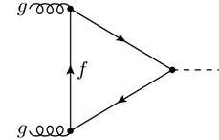
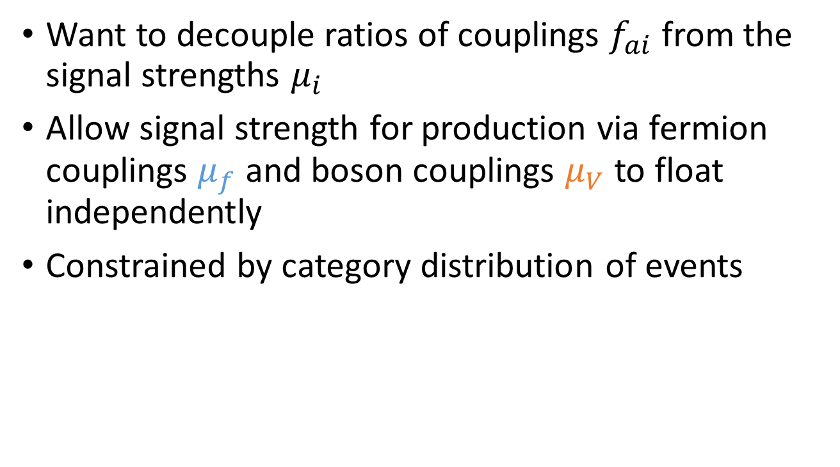
Signal strength
Want to decouple ratios of couplings $f_{ai}$ from the signal strengths $μ_{i}$
Allow signal strength for production via fermion couplings $μ_{f}$ and boson couplings $μ_{V}$ to float independently
Constrained by category distribution of events

Slide 16
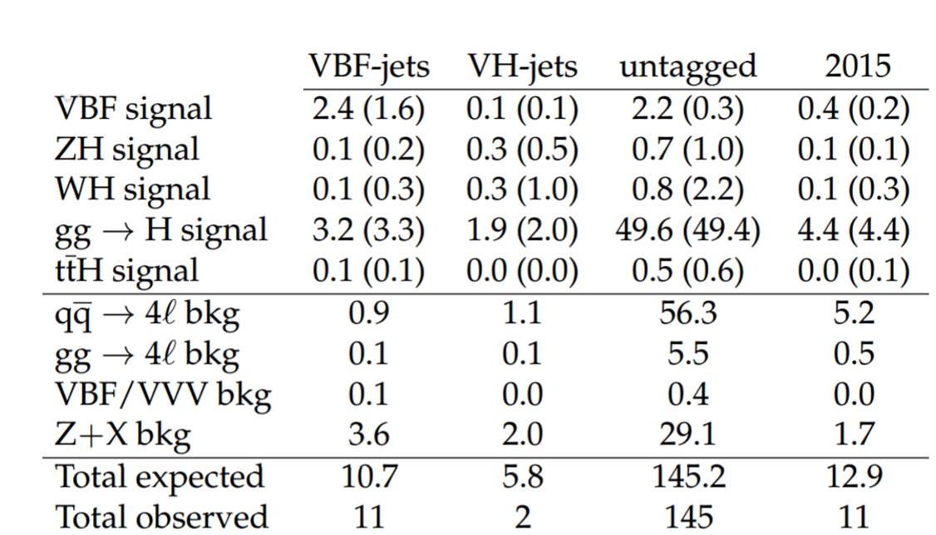
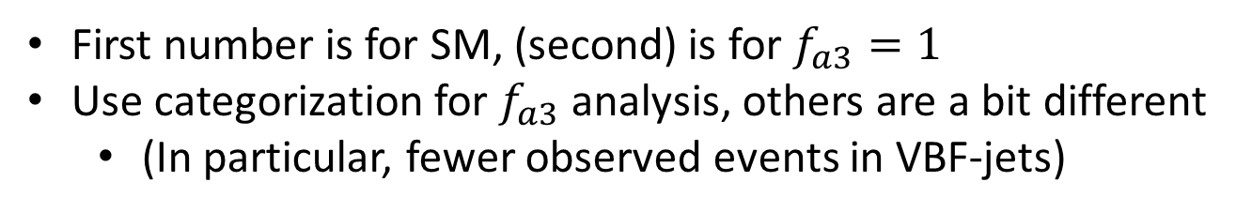
Event distribution
First number is for SM, (second) is for $f_{a3}=1$
Use categorization for $f_{a3}$ analysis, others are a bit different
  (In particular, fewer observed events in VBF-jets)

Slide 17
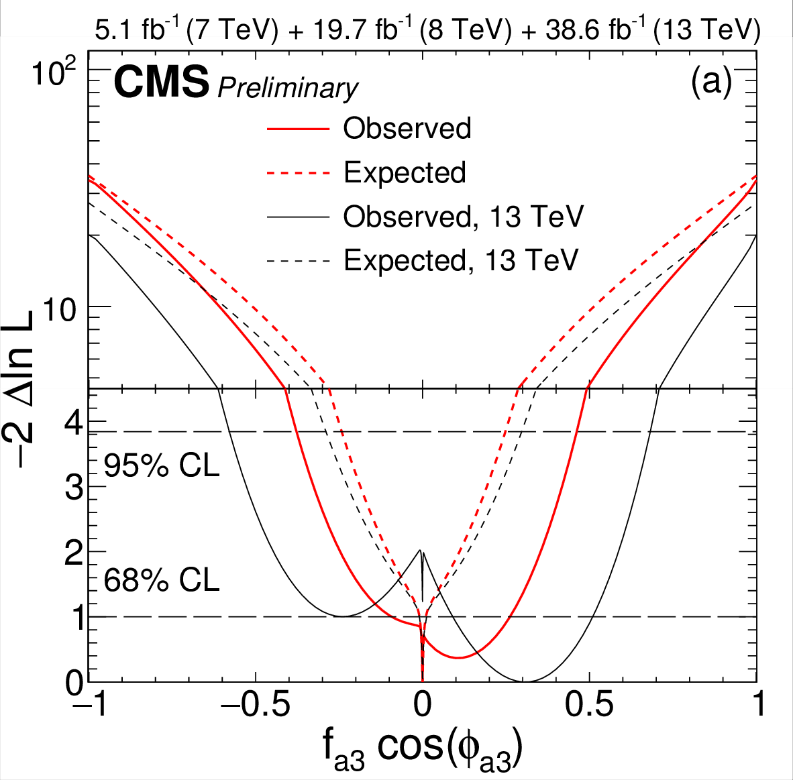
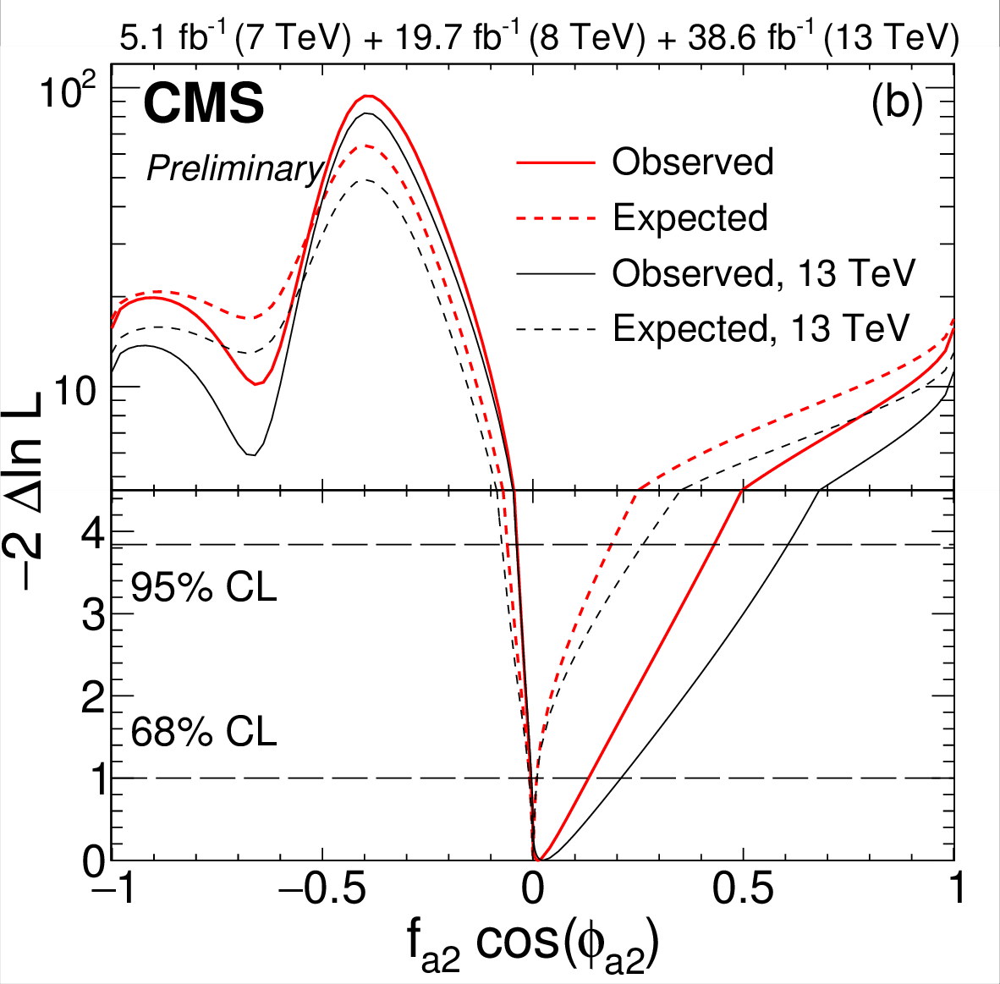
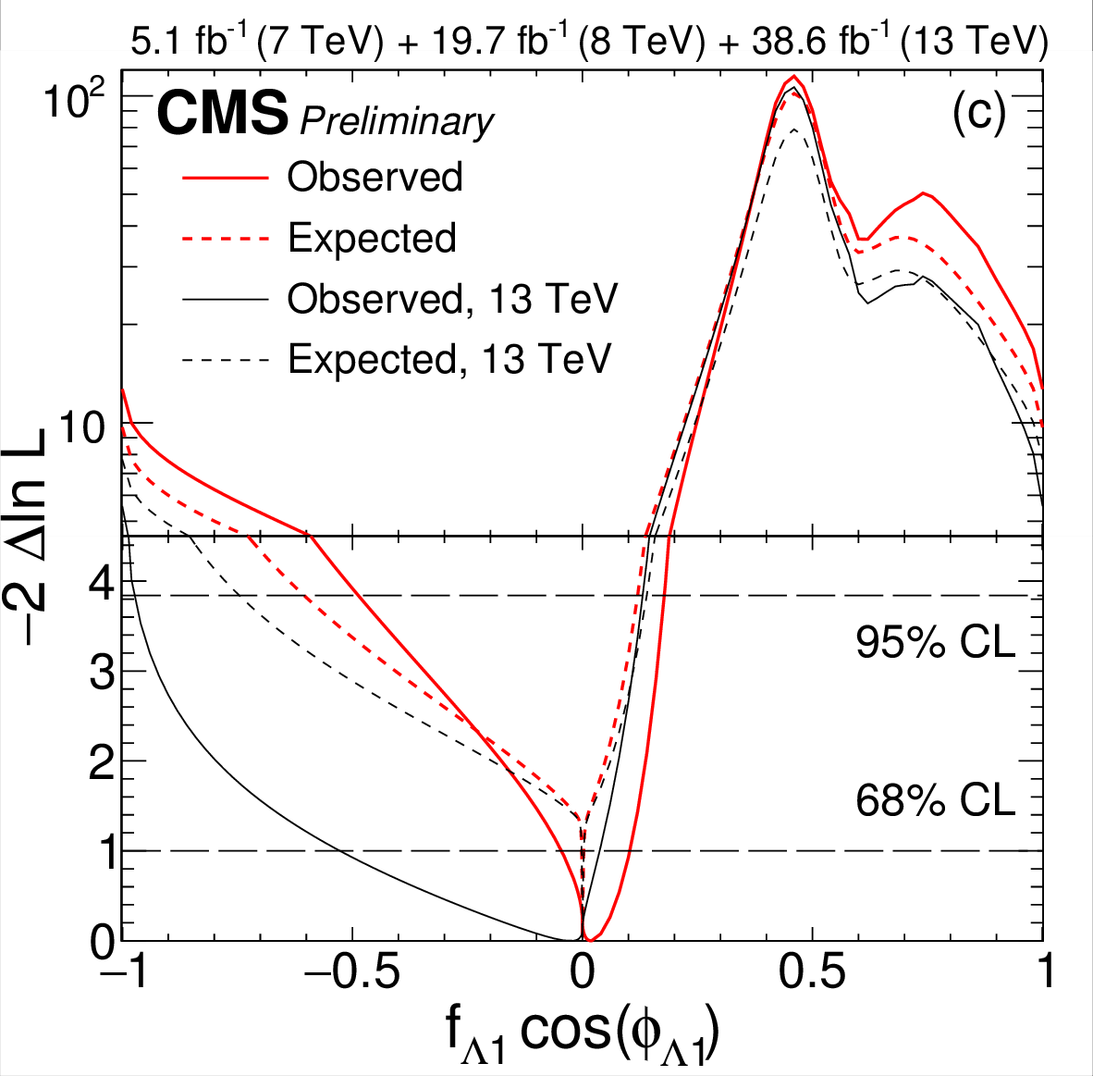
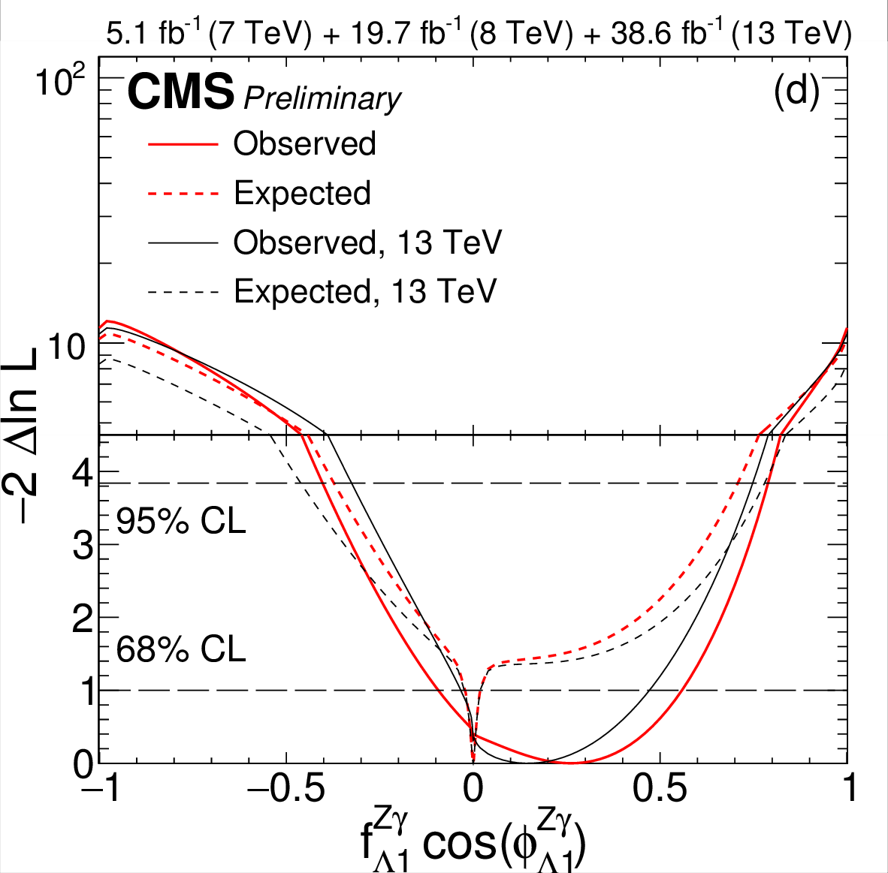
Results
Scans for each parameter
13 TeV only, and combination with Run 1 result

Slide 18

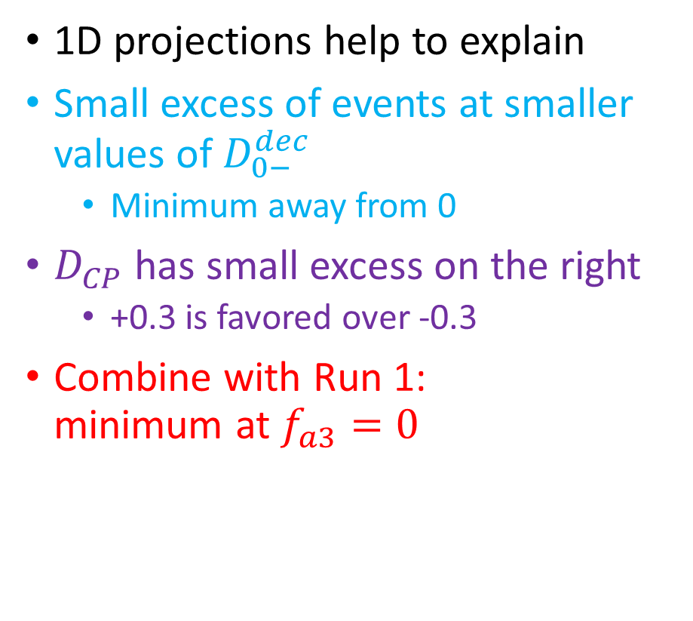
More details: $f_{a3}$
1D projections help to explain
Small excess of events at smaller values of $D_{0−}^{dec}$
  Minimum away from 0
$D_{CP}$ has small excess on the right
  +0.3 is favored over -0.3
Combine with Run 1:
minimum at $f_{a3}=0$

Slide 19
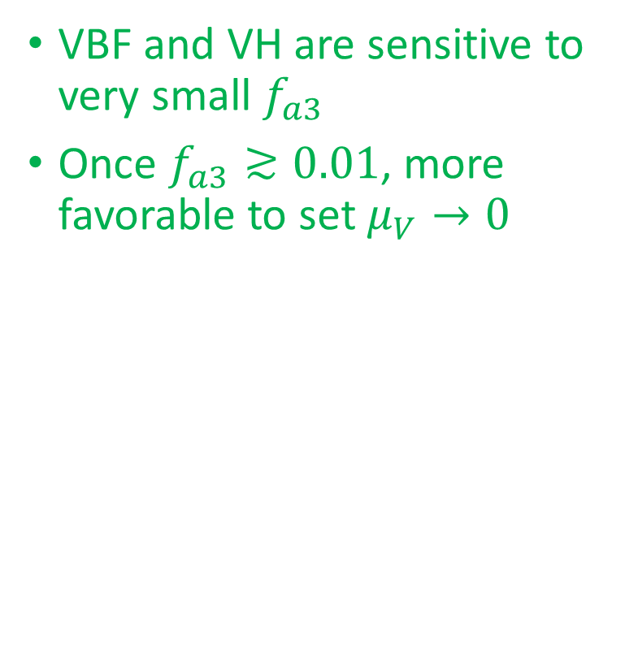
More details: $f_{a3}$
VBF and VH are sensitive to very small $f_{a3}$
Once $f_{a3}≳0.01$, more favorable to set $μ_{V}→0$

Slide 20
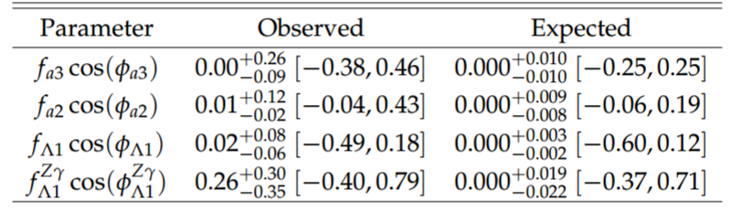
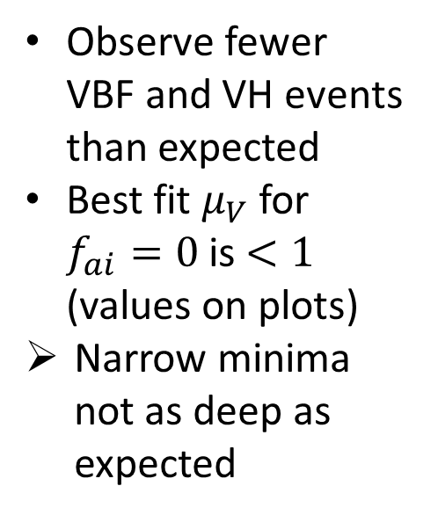





$μ_{V}$
$$μ_{V}=0.76$$
$$μ_{V}=0.03$$
Observe fewer VBF and VH events than expected
Best fit $μ_{V}$ for $f_{ai}=0$ is $<1$ (values on plots)
Narrow minima not as deep as expected
$$μ_{V}=0.20$$
$$μ_{V}=0.24$$

Slide 21






More details: $f_{a3}$
Animations: each frame uses the best fit $μ_{V}$ and $μ_{f}$
$f_{a3}^{VBF∕VH}$ are the cross section fractions for those processes
Watch what happens when $f_{a3}≲0.01$
See ppt version for animations
or separate indico attachment

Slide 22


Summary
Constrain anomalous HVV couplings
Decay information: $4×$ more data
than in Run 1
Production information: expected $1σ$ exclusion of small $f_{ai}$ values, observation falls a little short
By the end of Run 2: expect production information to give narrow $2σ$ limits

Slide 23
Backup

Slide 24

Categorization
$D_{2jet}^{{{VBF}/{ZH}}/{WH}}=\frac{p_{{VBF}/{ZH}∕WH}}{p_{{VBF}/{ZH}∕WH}+p_{Hjj}}$
Separate associated production from QCD jets
VBF-jet category:
  exactly 4 leptons
  2 or 3 jets with at most one btag, or $≥4$ jets with no btag
  $D_{2jet}^{VBF,SM}>0.5$ or $D_{2jet}^{VBF,BSM}>0.5$
VH-jet category:
  exactly 4 leptons
  2 or 3 jets with at most one btag, or $≥4$ jets with no btag
  $D_{2jet}^{ZH,SM}>0.5$ or $D_{2jet}^{ZH,BSM}>0.5$ or $D_{2jet}^{WH,SM}>0.5$ or $D_{2jet}^{WH,BSM}>0.5$
Untagged category:
  Everything else
Use $D_{2jet}^{SM}$ and $D_{2jet}^{BSM}$ to get optimal separation for both extreme hypotheses

Slide 25

Discriminants table

Slide 26




$$Λ_{Q}$$
CMS-HIG-14-036
$Λ_{Q}$ gives same kinematics, different mass shape
Search from offshell region
Limits assume $Γ_{H}=4.1$ MeV

