Slide 1
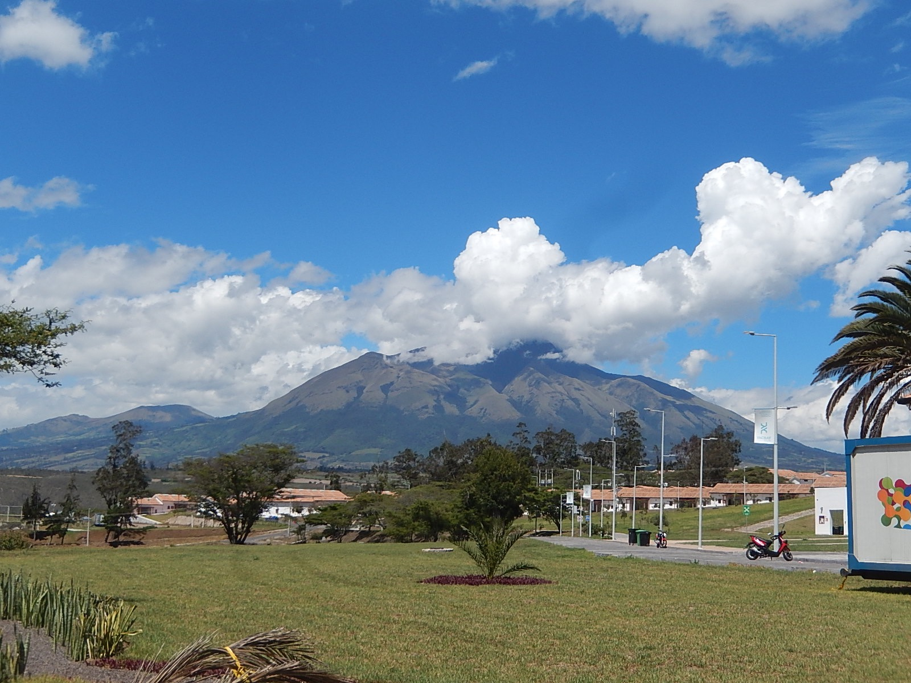
Low-Energy vs. High-Energy Leptonic Unitarity Violation
WIN2017@ UC Irvine
Hisakazu Minakata Yachay Tech, Ecuador

Slide 2
What is next?
After so many years struggle and pioneered by SK discovery of neutrino oscillation, a bunch of experiments identified/confirmed neutrino masses and lepton flavor mixing
Then, the question is “what is next?”
Of course, CP phase not known, neither mass ordering
But, probably now is the right time to start thinking about the next step Paradigm Test !

Slide 3
Unitarity test: 2 ways
Introduce models with unitarity violation
Example #1: Demand that NP at high energy can be written at low energy a limited set of higher-D operators
Example #2: Introduce sterile nu’s to extend 3 active nu sector
Closing unitarity triangle (like CKM triangle)
Model-independent, but hard to measure the side of triangle
Obviously non-unitary case
High-E unitarity violation
e.g., if sterile nu is discovered, one must go to a different direction, i.e., identify its masses, how many etc.
Low-E unitarity violation

Slide 4
New Physics at high or low energies?

Slide 5
High- vs low-energy unitarity violation
Low-energy UV
High-energy UV
lepton flavor universality: YES
zero distance neutrino flavor transition: NO
Kinematical effect of sterile nu emission: YES
lepton flavor universality: NO
zero distance neutrino flavor transition: YES
Kinematical effect of sterile nu emission: YES (if kinematically allowed)
Chee Sheng Fong, HM, Hiroshi Nunokawa, JHEP 2017

Slide 6
High-energy unitarity violation
Antusch et al JHEP 2006
When high mass sector integrated out we have effective Lagrangian of light neutrinos and leptons but with unitarity violation
Flavor nu states NOT orthogonal with each other

Slide 7
Low energy unitarity violation
Model is simple and obviously well-defined
3 active + N sterile nu’s
Unitary in (3+N) space, but non-unitary in 3 active subspace
Question: Does this model allow us active nu oscillation probability in a manner independent of details of the N sterile sector?
Purpose of this work: answer the question
YES!
Chee Sheng Fong, HM, Hiroshi Nunokawa, JHEP 2017

Slide 8
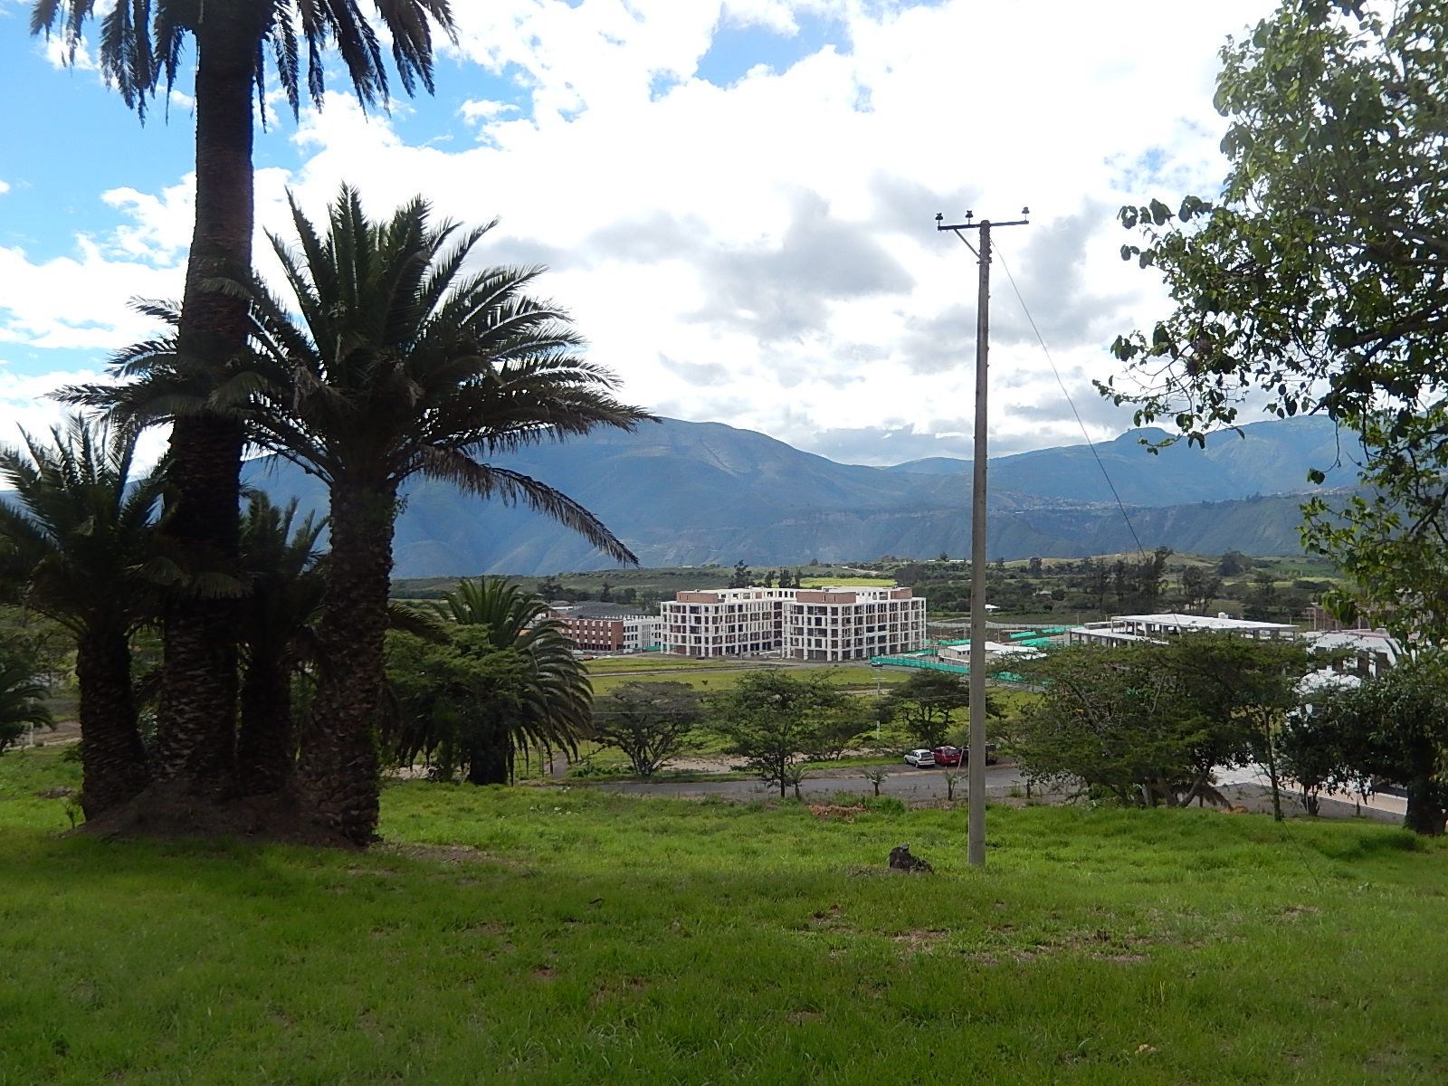
New term in the oscillation probability !

Slide 9
There is a new term in oscillation Prob.
Probability leakage term exists !
Appearance
U = non-unitary “MNS”
Disappearance

Slide 10
P-leaking term: It must be obvious from the beginning, right?
There is a N sterile sector which can communicate with active nu sector
So the probability leaks to sterile sector
Yet, not emphasized before…

Slide 11
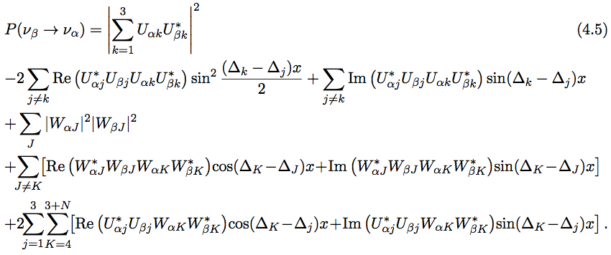
Not a whole story for “almost unitary-like” form
Under assumption of sterile mass and energy-baseline so that “fast oscillation” due to active-sterile and sterile-sterile Δm² averaged out (>> active-active Δm² ) m_{J}² > 0.1 eV²

Slide 12
There exists sterile-sector model independent P formula
Disappearance
A constant leaking term C_{αβ} (= distinguishes between low-E vs high-E unitarity violation !!)
Unitary MNS → non-unitarty “U”

Slide 13
Can one detect C_{ee}? (=P leaking term): JUNO!

Slide 14
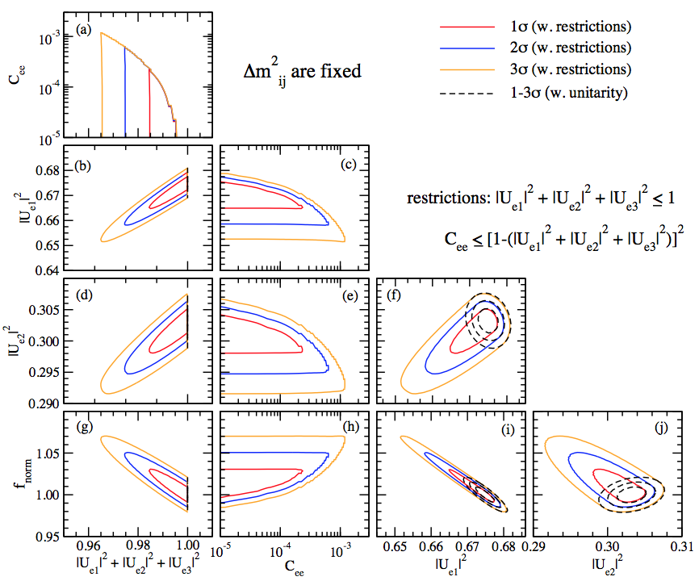
Sensitivity to C_{ee} and 1-Σ|U_{ei}|² from JUNO 5 years
3% flux uncertainty assumed
C_{ee} ~ 10⁻⁴ (1 σ)
1-Σ|U_{ei}|² ~ 0.01

Slide 15
Sterile model-independent P: Prevail in matter ?

Slide 16
The answer seems YES!
Up to now, based on the analysis using 1st order in matter perturbation theory
If W ~ 0.1, P formula OK if Δm²_{Jk} >~ 0.1 eV²
If W ~ 0.01, P formula OK if Δm²_{Jk} >~ 10 eV²
OK means “sterile sector model independent”

Slide 17
Conclusion
General structure of nu oscillation in active nu sector of (3+N) unitary system is analyzed in the context of low-E unitarity violation
A new term, the “probability leaking term” found (of course, leaking to sterile sector)
Distinguishes between Low-E vs High-E unitarity violation
Conditions for sterile sector model-independent P are elucidated m_{J}² > 0.1 eV²
JUNO analysis shows
C_{ee} ~ 10⁻⁴ (1 σ), 1-Σ|U_{ei}|² ~ 0.01

