Slide 1
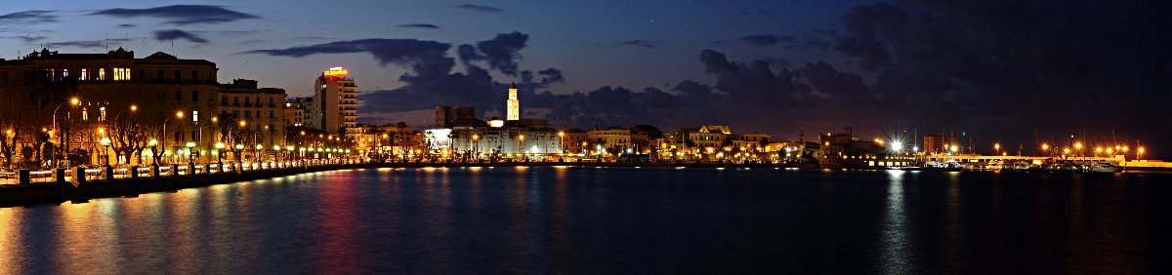


The 27th International Workshop on Weak Interactions and Neutrinos (WIN2019)
Welcome to Bari
(On behalf of Maria Gabriella Catanesi, Chair of WIN 2019)

Slide 2
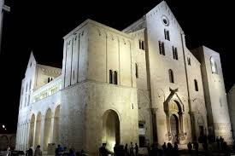
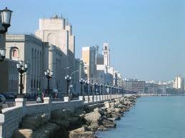
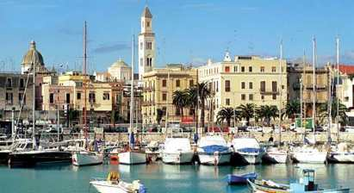
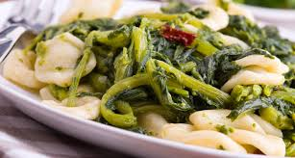
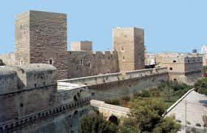
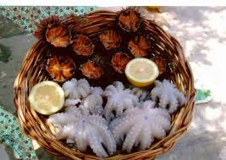
Bari in a nutshell
Bari is the second main city of the southern mainland of Italy after Naples. It is located on the lower Adriatic sea
In the medieval part of the city you will find the ”Basilica di San Nicola" which houses the relics of Saint Nicholas
Bari is famous for its monuments, its beautiful location on the Mediterranean coast and its culinary delights

Slide 3
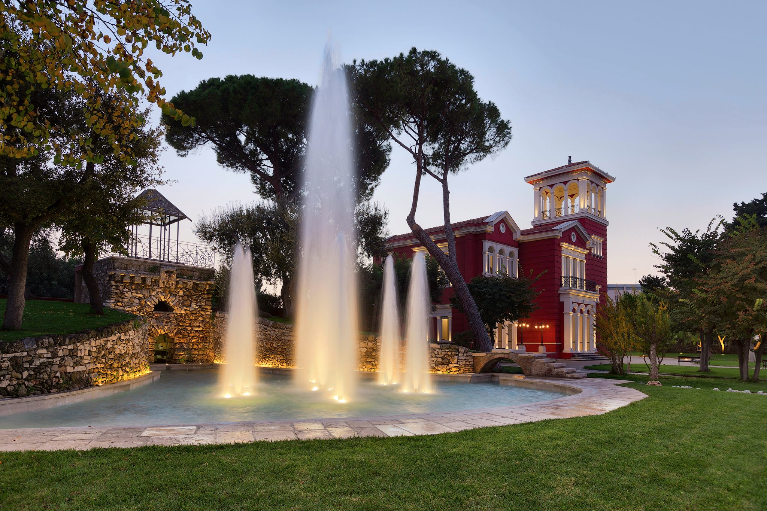
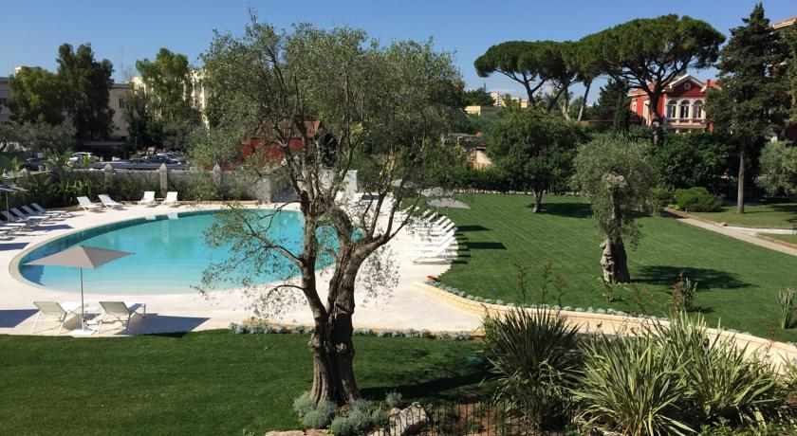
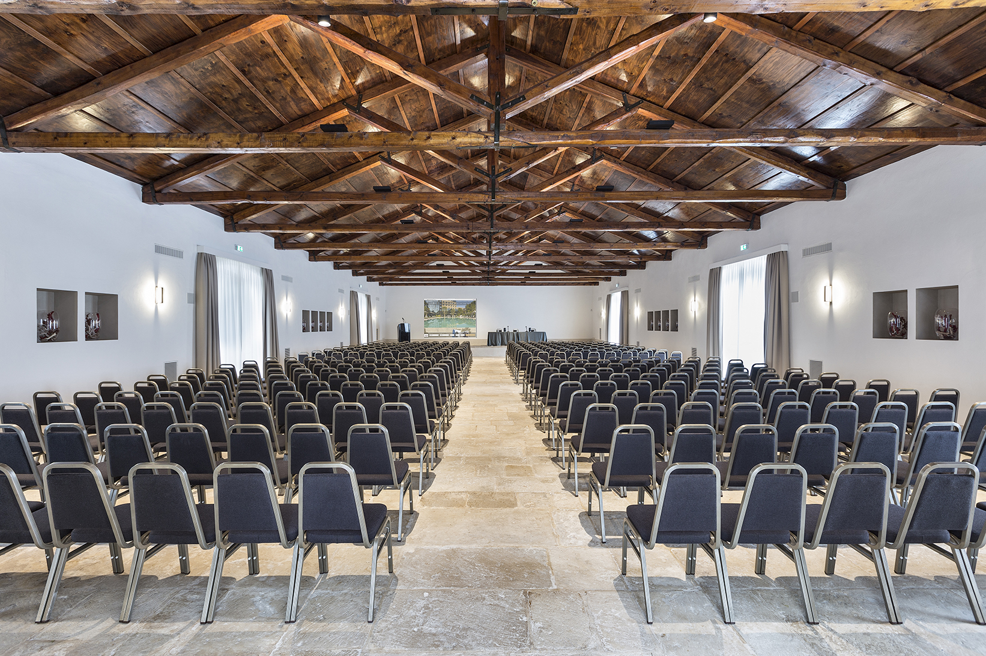
Conference Venue
The Conference will be held in the historical “Villa Romanazzi Carducci” conveniently located at walking distance from the Central Train Station

Slide 4
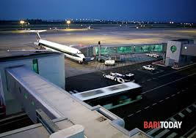
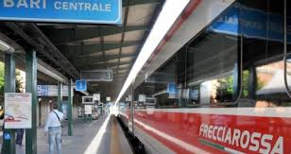
How to get to Bari
Bari can be conveniently reached by train, bus, car or plane.
Reaching Bari by train or bus.
The Italian Railways Company, Trenitalia, offers a fast service (slightly less than 4 hours) from Rome to Bari. Several bus companies also
connect Bari to major Italian cities.
Reaching Bari by car (from north).
Bari is directly located on the Adriatic
A14 toll highway,
Reaching Bari by plane.
The International Airport of Bari-Palese, named after Pope Karol Wojtyla, is well
connected with major European airports.
The city center is easily reachable by shuttle or train from the airport.

Slide 5

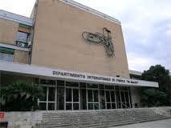
See you in Bari !
The Local Organizing Committee:
Maria Gabriella Catanesi (Chair)
Vincenzo Berardi
Francesco Cafagna
Mauro de Palma
Nicola Giglietto
Eligio Lisi
Antonio Marrone
Alexis Pompili
Emilio Radicioni
Bari INFN section & Dept. of Physics
http://www.ba.infn.it/
http://www.uniba.it/english-version
http://www.poliba.it/

