Slide 1


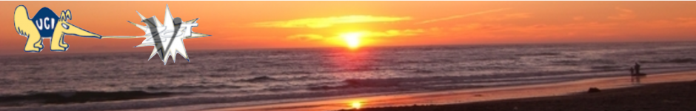
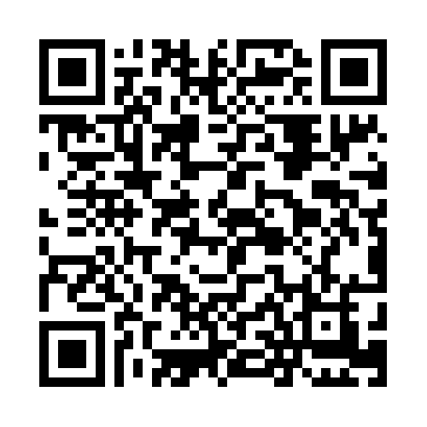
Recent results from the ANTARES High Energy Neutrino Telescope.
KM3NeT-ARCA status report.
Antonio Capone, University "La Sapienza" and I.N.F.N. Roma, Italy
at the
26th International Workshop
on
Weak Interactions and Neutrinos (WIN2017)
University of California, Irvine

Slide 2
Talk outline
ANTARES: the 1st undersea Cherenkov detector for High Energy Astrophysical neutrino detection
The ANTARES main physics goal: search for astrophysical neutrinos
  Search for a diffuse flux
  Search for point-like sources
  Search for “enhanced” diffuse flux
Indirect search for Dark Matter
  from the SUN, the Galactic Plane, the Earth
Transient/multi-messenger studies
Perspectives for the future
Conclusions & Summary

Slide 3
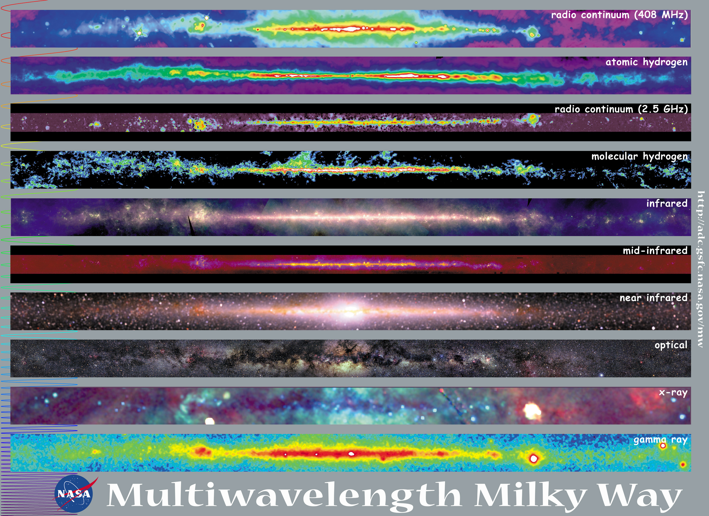
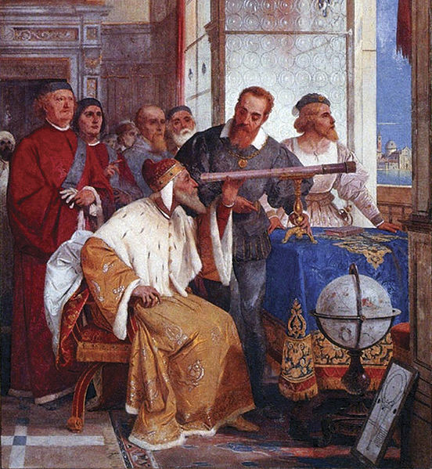
The evolution of astronomy
From Traditional Astronomy (Optics) to Multi-Wavelength Astronomy:
  observations of light in
  the visible band are
  complemented by radio,
  X-ray and γ astronomy
http://mwmw.gsfc.nasa.gov/
Galileo Galilei showing the Doge of Venice how to use the telescope (1858), fresco by Giuseppe Bertini (1825–1898)
… and to Multi-Messengers Astronomy:
HE-CR, photons, neutrinos, GW …
Notes:
The picture is built up collecting results from several observations, obtained with different experimental techniques

Slide 4
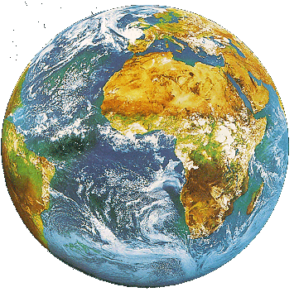
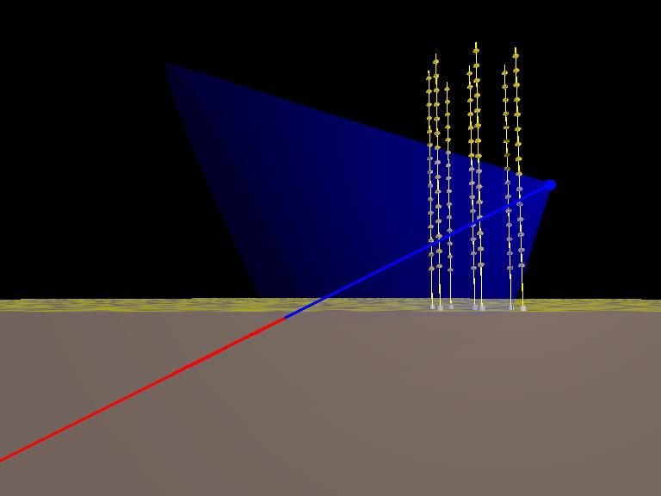
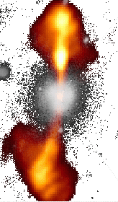
Cherenkov ν Telescope: Detection principle
Search for neutrino induced events, mainly , deep underwater
Atmospheric neutrino flux ~ E_{ν}⁻³
Neutrino flux from cosmic sources ~ E_{ν}⁻²
  Search for neutrinos with E_{ν}>1÷10 TeV
~TeV muons propagate in water for several km
before being stopped
  go deep to reduce down-going atmospheric µ backg.
  long µ tracks allow good angular reconstruction
Down-going µ from atm. showers
S/N ~ 10⁻⁶ at 3500m w.e. depth
p, nuclei
µ direction reconstructed from the arrival time of Cherenkov photons on the Optical Modules: needed good measurement of PMT hits, σ(t)~1ns, and good knowledge of PMT positions: (σ ~10cm)
Neutrinos from cosmic sources
induce 1-100 muon evts/y
in a km³ Neutrino Telescope
Cherenkov
Neutrino
Telescope
p, nuclei
Up-going µ from neutrinos
generated in atm. showers
S/N ~ 10⁻⁴
charge current
interactions
43°
µ
water/ice
up-going neutrino
rock
Picture from ANTARES

Slide 5
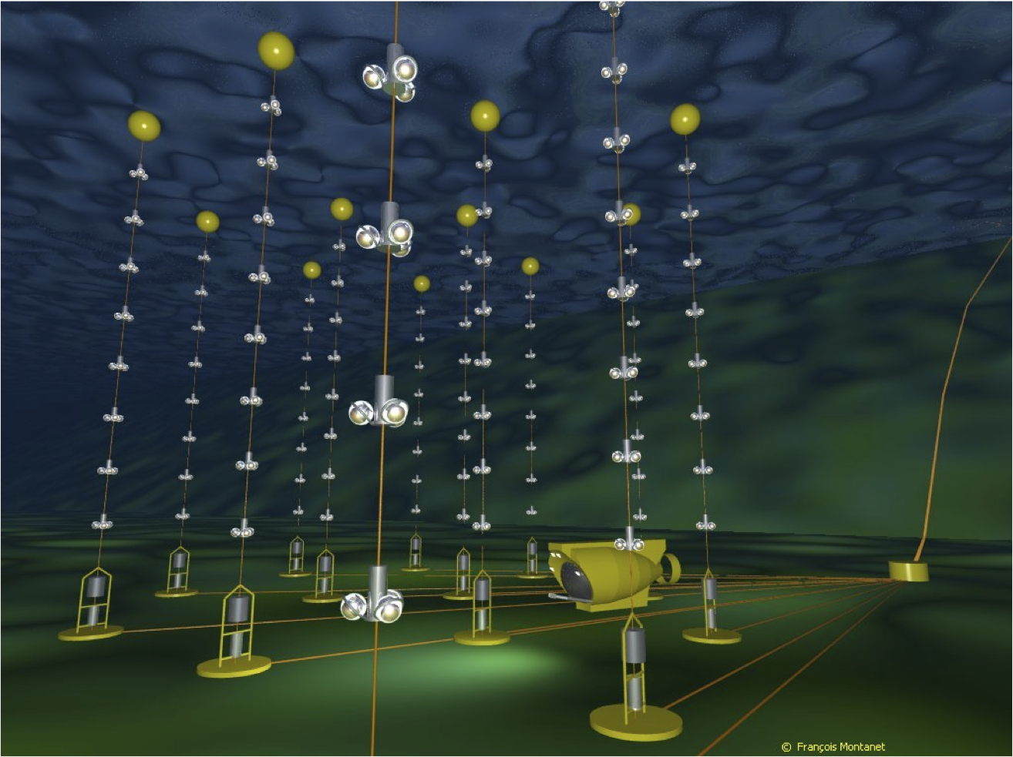
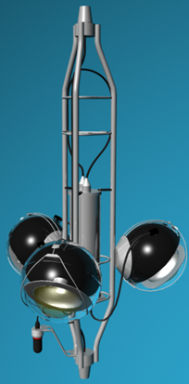
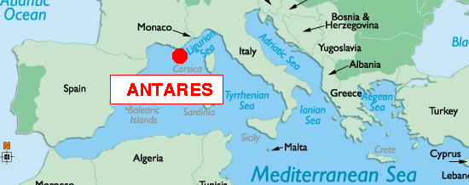
ANTARES: Astronomy with Neutrino Telescope and Abyss environm. RESearch
Nucl. Instr. and Meth.A 656 (2011) 11-38
The Largest Neutrino Detector in the Northern Hemisphere
Total Instrum. Volume ~ 10⁻² km³
25 storeys
350 m
MULTISDISCIPLINARITY
→ associated sciences (oceanography, marine biology, geology …)
14.5 m
40 km to
shore
Junction
Box
String-based detector
Downward-looking PMTs
axis at 45º to vertical
100 m
~70 m
~2500 m
depth
12 detection lines
25 storeys / line
3 PMTs / storey
~900 PMTs

Slide 6
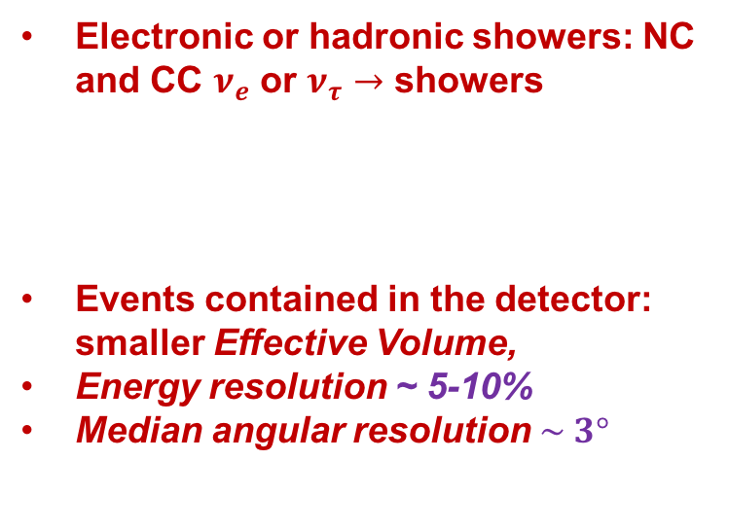
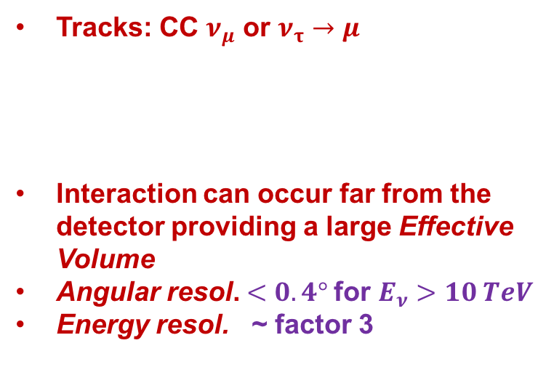
The ANTARES search for point-like ν sources based on two kind of events
Tracks: CC $ν_{μ}$ or $ν_{τ}→μ$
Interaction can occur far from the detector providing a large Effective Volume
Angular resol. $<0.4°$for $E_{ν}>10 TeV$
Energy resol. ~ factor 3
Electronic or hadronic showers: NC and CC $ν_{e}$ or $ν_{τ}→$ showers
Events contained in the detector: smaller Effective Volume,
Energy resolution ~ 5-10%
Median angular resolution $\sim 3°$
tracks
showers

Slide 7
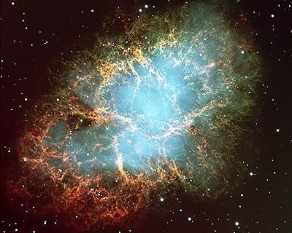
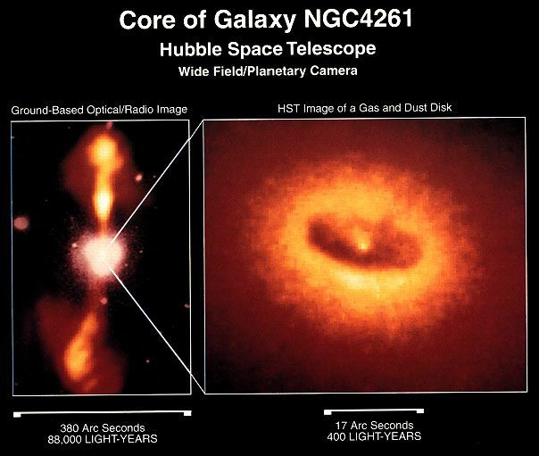
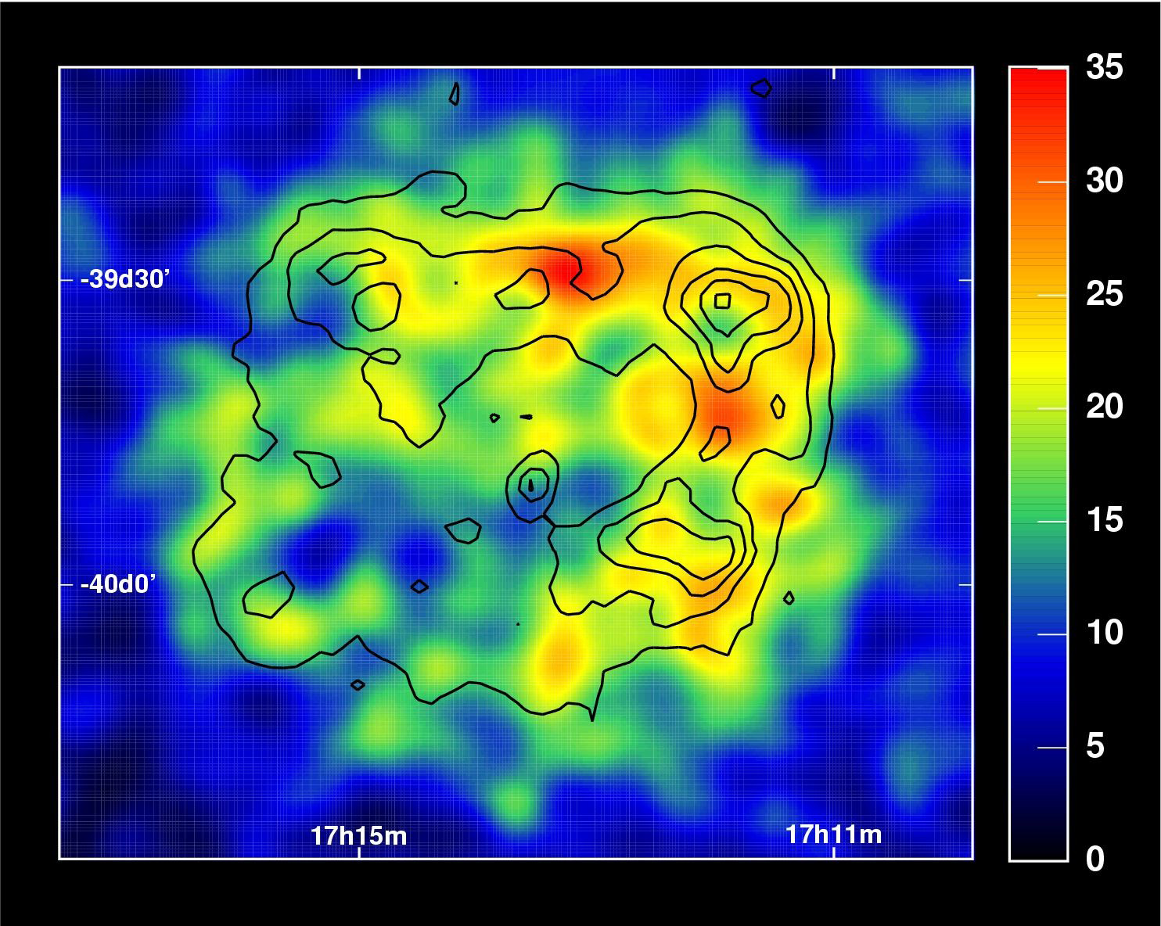
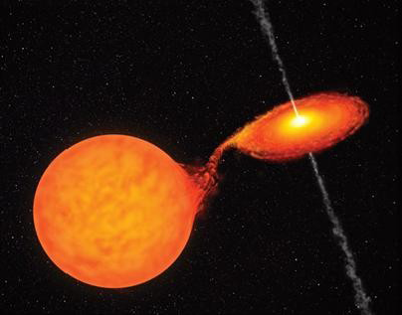
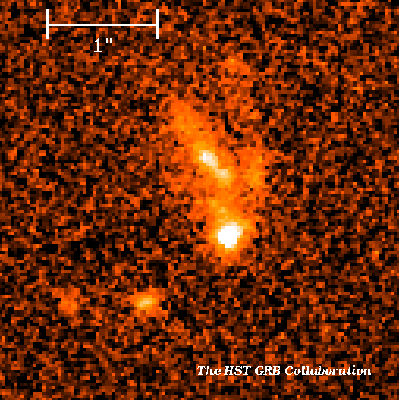
ANTARES physic’s goals
Search for point-like cosmic Neutrino Sources
Galactic
Extragalactic
Pulsar Wind Nebulae
Supernova Remnants
Microquasars
Active Galactic Nuclei
RX J1713.73946HESS
GRB 990123
Their identification requires a detector with accurate angular reconstruction
For transient sources the time meas.
improves the signal detection
Experimental signal : statistical evidence of an excess of events coming from the same direction

Slide 8
ANTARES Search for point-like cosmic ν Sources
9 years of ANTARES data searching for all neutrino flavours:
7629 “tracks” + 180 “shower” events passed the selection criteria
$${logℒ}_{sig+bkg}=\sum_{S=tr. ,sh.}{\sum_{τ=S}{log{[μ}_{sig}^{τ}∙{ℱ_{sig}^{τ}(δ)∙𝓟}_{sig,i}^{τ} (E_{i})+𝓝^{τ}∙𝓑_{i}^{τ}∙𝓟_{bkg,i}^{τ} (E_{i})]}−μ_{sig}}$$
ANTARES arXiv:1706.01857v1, 6 June 2017
Candidate
Sources
IC HESE tracks
Blue: Tracks
Red: Cascades
GC region
equatorial coordinates
so far …. no significant excess has been found

Slide 9
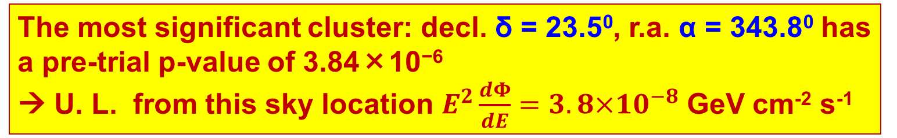
ANTARES results: “full sky search” of ν sources
The visible sky of ANTARES divided on a $1^{0}×1^{0}$ (r.a x decl.) boxes.
Maximum Likelihood analysis searching for clusters
ANTARES arXiv:1706.01857v1, 6 June 2017
equatorial coordinates
The most significant cluster: decl. δ = 23.5⁰, r.a. α = 343.8⁰ has a pre-trial p-value of 3.84×10⁻⁶
→ U. L. from this sky location $E^{2}\frac{dΦ}{dE}=3.8×10^{−8}$ GeV cm⁻² s⁻¹

Slide 10
ANTARES results: “full sky search” of ν sources
90% U.L.
9 years of ANTARES data :
7629 “tracks” + 180 “shower”
ANTARES arXiv:1706.01857v1, 6 June 2017

Slide 11
Joint IceCube + ANTARES search for ν sources
Skymap of pre-trial p-values for the combined
ANTARES 2007/12 and IceCube 40, 59, 79
point-source analyses.
The red circle indicates the location of the most significant cluster:
(0.7σ post-trial significance)
The Astrophysical Journal, 823:65 (12pp), 2016 May 20

Slide 12
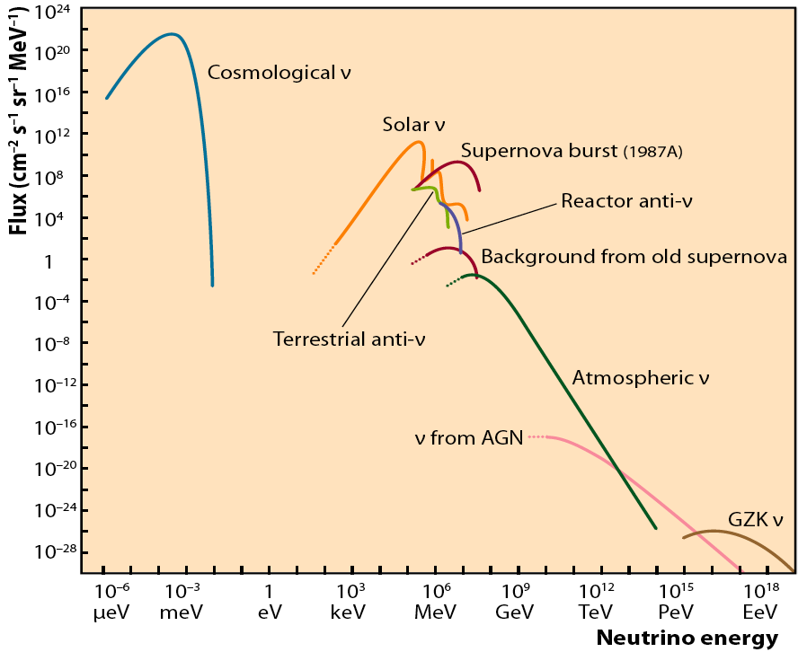
ANTARES Search for Diffuse flux of Cosmic Neutrinos
Neutrinos from:
  Unresolved AGN
  "Z-bursts"
  "GZK like" proton-CMB interactions
Top-Down models Neutrinos
….
Search here !!!
Their identification out of the more intense background of atmospheric neutrinos (and μ) is possible at very high energies (E_{μ} >> TeV) and requires good energy reconstruction.
arXiv:1703.02432v1
Found 8 “shower events” for
10 TeV<E_{SH}<100 TeV
when 5 expected.
Compatible with IceCube signal
ANTARES, 6 years

Slide 13
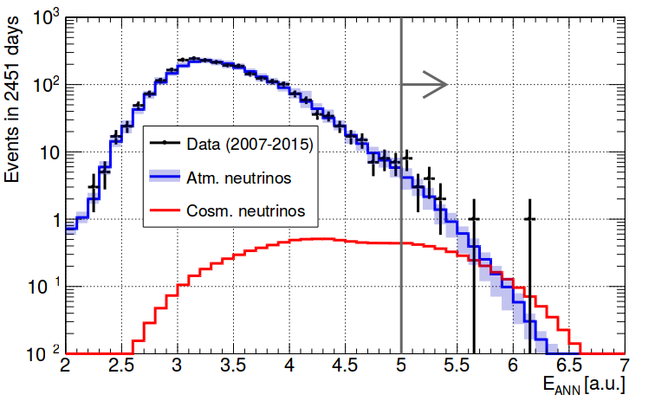
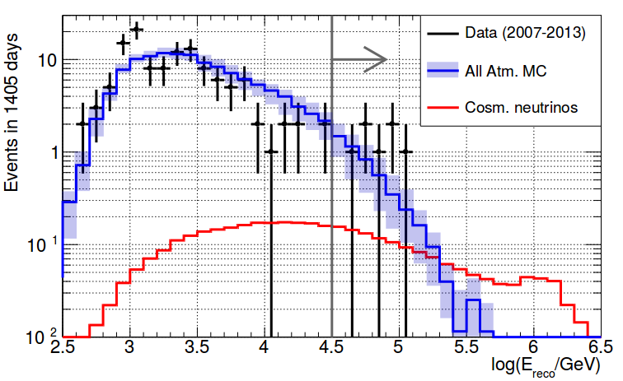
Latest ANTARES results on the search for diffuse ν flux
Tracks
Data: 2007-2015 (2451 live-days)
Above E_{cut}: Bkg: 13.5 ± 3 evts, IC-like signal: 3 evts
Observed: 19 evts
Cascades
Data: 2007-2013 (1405 live-days)
Above E_{cut}: Bkg: 5 ± 2 evts, IC-like signal: 1.5 evts
Observed: 7 evts
PRELIMINARY
PRELIMINARY
Energy Estimator
Reconstructed Energy
ANTARES
combined upper limits and sensitivities for 9 years data sample (2007-2015) tracks + cascades
PRELIMINARY

Slide 14
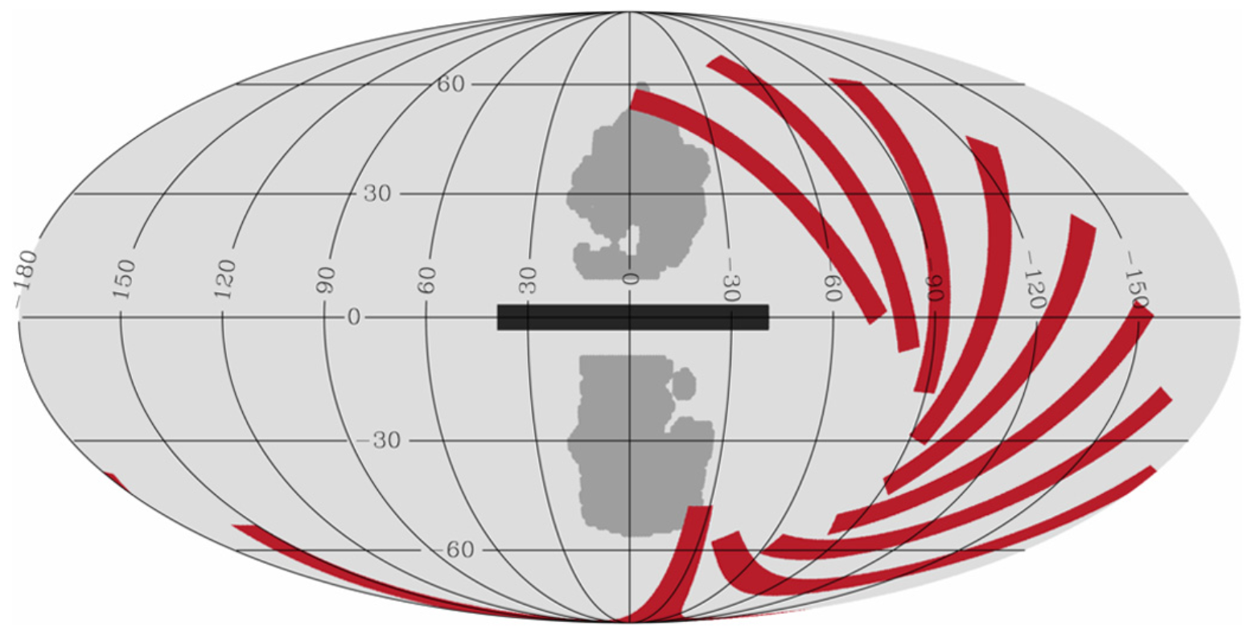
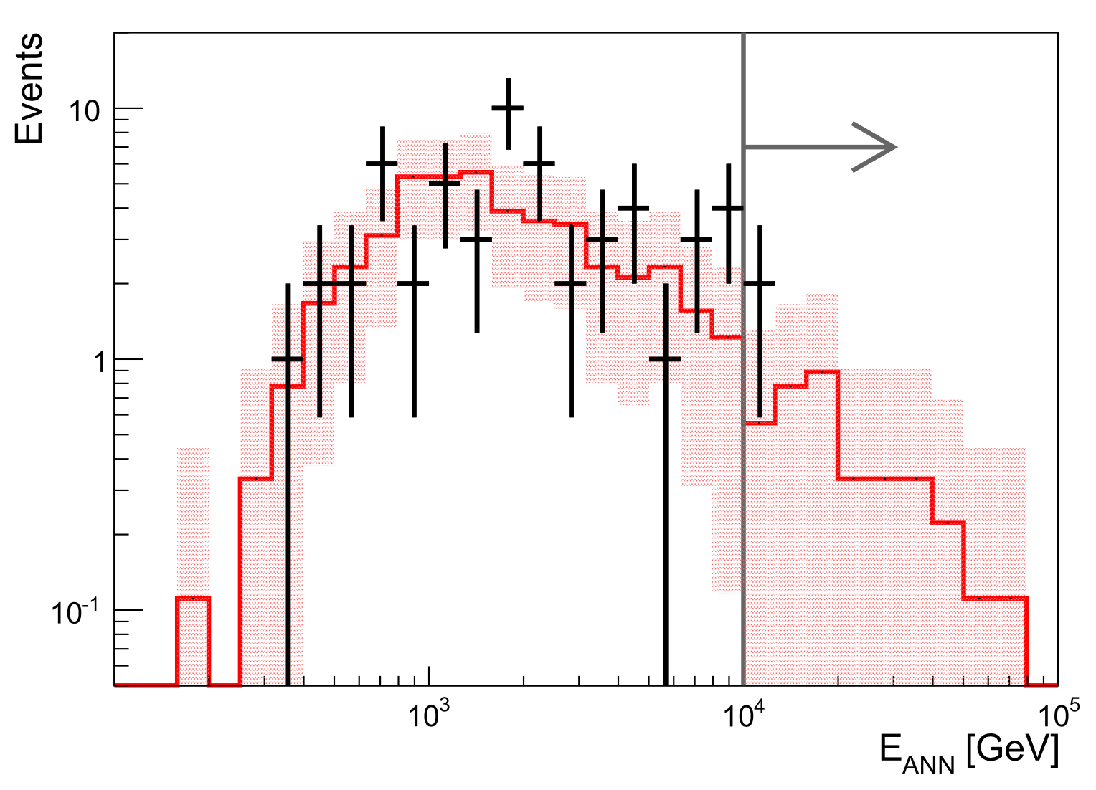
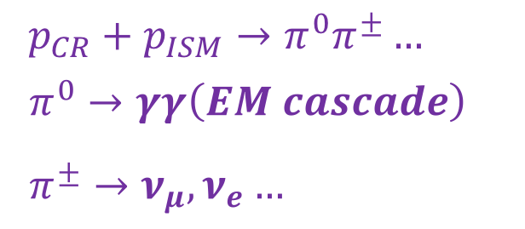
Search for neutrinos from the Galactic ridge - 1
ν’s and γ-rays produced by CR propagation
$$p_{CR}+p_{ISM}→π^{0}π^{±}…$$
$$π^{0}→γγ\left(EM cascade\right)$$
$$π^{±}→ν_{μ},ν_{e}…$$
Search for ν_{μ} , data 2007-2013
Search region |l|<30° , |b|<4°
Cuts optimized for neutrino energy spectrum ~E^{-γ} (γ=2.4-2.5)
Counts in the signal/off zones
No excess in the HE neutrinos
90% C.L. upper limits: 3<E_{ν}<300 TeV
Physics Letters B 760 (2016) 143–148
E_{μ} cut applied
Distribution of the reconstructed E_{μ} of up-going muons in the Galactic Plane (black crosses) and average of the off-zone regions (red histogram).

Slide 15
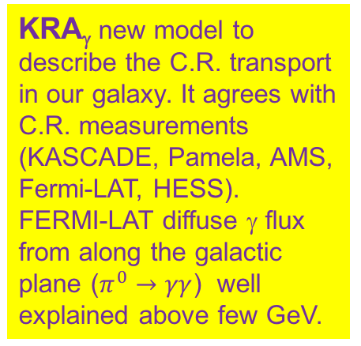
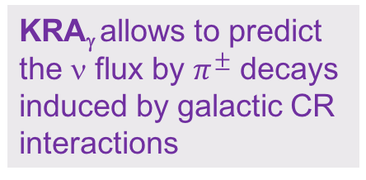
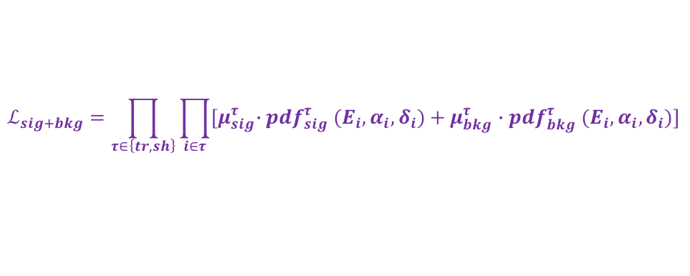
Search for neutrinos from the Galactic plane - 2
New analysis on tracks and showers, based on Max. Lik.
$$ℒ_{sig+bkg}=\prod_{τ∈\left\{tr,sh\right\}}{\prod_{i∈τ}{{[μ}_{sig}^{τ}∙{pdf}_{sig}^{τ} (E_{i},α_{i},δ_{i})+μ_{bkg}^{τ}∙{pdf}_{bkg}^{τ} (E_{i},α_{i},δ_{i})]}}$$
KRA_{γ} new model to describe the C.R. transport in our galaxy. It agrees with C.R. measurements (KASCADE, Pamela, AMS, Fermi-LAT, HESS).
FERMI-LAT diffuse γ flux from along the galactic plane ($π^{0}→γγ$) well explained above few GeV.
Fermi-LAT γ
IceCube ν
KRA_{γ} allows to predict the ν flux by $π^{±}$ decays induced by galactic CR interactions
New ANTARES 90% UL, 50 PeV cutoff
ANTARES 90% UL 2016
ANTARES arXiv:1705.00497v1
1 May 2017
KRA_{γ} 50PeV cut-off for CR
KRA_{γ} 5PeV cut-off for CR
KRA_{γ} assuming a neutrino flux ∝ E^{-2.5} and a CR spectrum with 50 PeV cut-off can explain ~20% of the IceCube observed HESE.
ANTARES, with an good visibility of the Galactic Plane well suited to observe these fluxes or to put competitive limits: no signal found → set 90%C.L. upper limits.

Slide 16
… not only neutrino astrophysics…
… also open problems in particle physics …
  Dark Matter searches:
    Neutralino annihilation in Sun, Earth, Galactic Center
  Magnetic Monopoles
  Particle acceleration mechanisms
  Multi-messenger searches
  Neutrino Oscillations
  Search for Sterile Neutrinos
  …
Neutralino search: χχ → ν+…

Slide 17
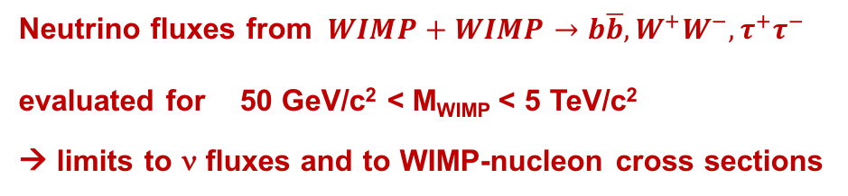
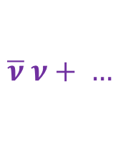
Indirect search for Dark Matter in the Sun
6 years of ANTARES data: 2007-2012
Distribution of the angular distance between reconstructed the track direction of events and the Sun position for two different track reconstruction algorithms in order to maximize the event reconstruction for single line and multi-lines events.
No excess observed over the expected backg.
μ
Ψ
Neutralino search: χχ → ν+…
Neutrino spectrum
  from WIMPSIM (M. Blennow, J. Edsjö, T. Ohlsson, J. Cosmol. Astropart. Phys. 0801 (2008) 021. )
Background
  estimated from time-scrambled data.
Neutrino fluxes from $WIMP+WIMP→b\overline{b}, W^{+}W^{−},τ^{+}τ^{−}$
evaluated for 50 GeV/c² < M_{WIMP} < 5 TeV/c²
→ limits to ν fluxes and to WIMP-nucleon cross sections
$$\overline{ν} ν+ …$$

Slide 18
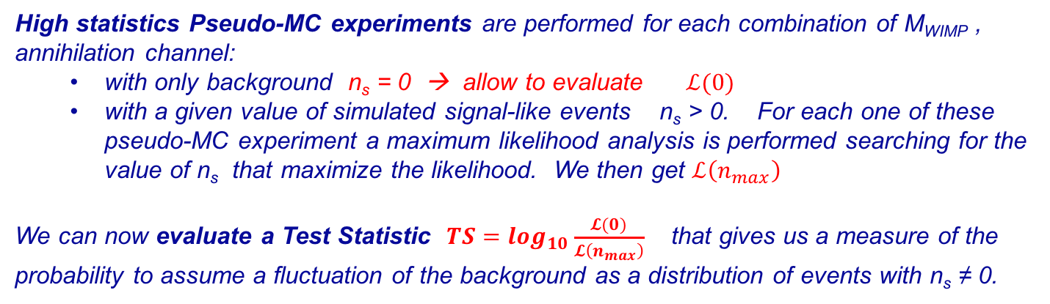
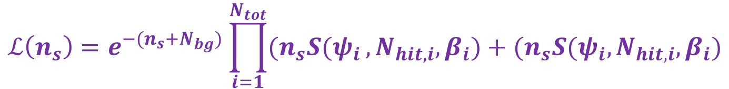
The analysis strategy
Maximization of a likelihood function based on the knowledge of the probability density functions, for the contribution of a background event, B(Ψ, N_{hit}, β), or a signal event, S(Ψ, N_{hit}, β), to the observed distribution.
$$ℒ\left(n_{s}\right)=e^{−(n_{s}+N_{bg})}\prod_{i=1}^{N_{tot}}{(n_{s}S(ψ_{i}},N_{hit,i},β_{i})+(n_{s}S(ψ_{i},N_{hit,i},β_{i})$$
N_{hit} = number of hit used for the track reconstruction
β = the angular error estimate for the reconstructed track
N_{tot} = tot. Number of reconstructed events
n_{s} and N_{bg} are the number of signal and background events in the maximization procedure
B(Ψ, N_{hit}, β) obtained by the collected data randomising the right ascension of the event
S(Ψ, N_{hit}, β) obtained from MC simulation using the ν energy spectra given by WIMPSIM
High statistics Pseudo-MC experiments are performed for each combination of M_{WIMP} , annihilation channel:
  with only background n_{s} = 0 → allow to evaluate $ℒ(0)$
  with a given value of simulated signal-like events n_{s} > 0. For each one of these pseudo-MC experiment a maximum likelihood analysis is performed searching for the value of n_{s} that maximize the likelihood. We then get $ℒ\left(n_{max}\right)$
We can now evaluate a Test Statistic $TS=\log_{10}\frac{𝓛(0)}{𝓛\left(n_{max}\right)}$ that gives us a measure of the probability to assume a fluctuation of the background as a distribution of events with n_{s} ≠ 0.

Slide 19
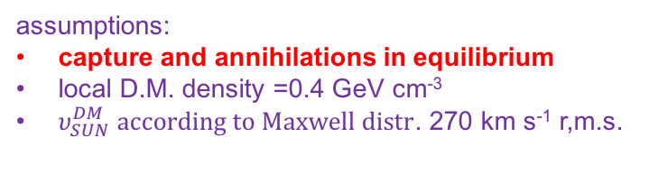
Indirect search for Dark Matter in the Sun
No excess observed over the expected background: evaluate 90% C.L. upper limits for expected signal
Limits on the spin-dependent WIMP-nucleon scattering cross-section as a function of WIMP mass for the bb ̄, τ+τ− and W+W− channels.
assumptions:
capture and annihilations in equilibrium
local D.M. density =0.4 GeV cm⁻³
$υ_{SUN}^{DM} according to Maxwell distr$. 270 km s⁻¹ r,m.s.
Limits on the spin-independent WIMP-nucleon scattering cross-section as a function of WIMP mass for the different channels considered.
Physics Letters B 759 (2016) 69–74
Limits on a neutrino flux
coming from the Sun as a function of the WIMP masses for the different channels considered.

Slide 20
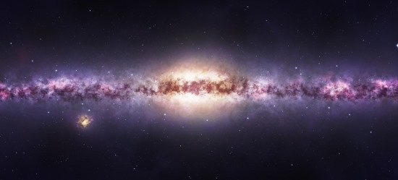

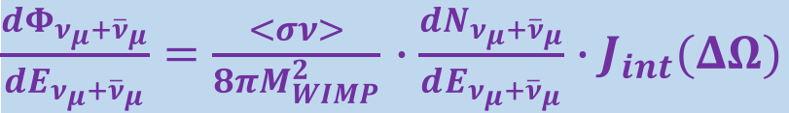
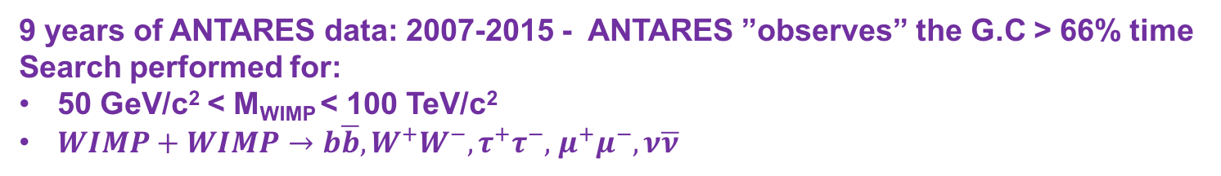
Indirect search for Dark Matter in the Galactic Centre
9 years of ANTARES data: 2007-2015 - ANTARES ”observes” the G.C > 66% time
Search performed for:
50 GeV/c² < M_{WIMP} < 100 TeV/c²
$WIMP+WIMP→b\overline{b}, W^{+}W^{−},τ^{+}τ^{−},$ $μ^{+}μ^{−},ν\overline{ν}$
$\frac{dΦ_{ν_{μ}+{\overline{ν}}_{μ}}}{dE_{ν_{μ}+{\overline{ν}}_{μ}}}=\frac{<σν>}{8πM_{WIMP}^{2}}$ $∙\frac{dN_{ν_{μ}+{\overline{ν}}_{μ}}}{dE_{ν_{μ}+{\overline{ν}}_{μ}}}∙J_{int}(ΔΩ)$
The expected ν flux depends on the DM distribution around the GC.
3 halo models have been considered
μ
Ψ
Physics Letters B 769 (2017) 249–254
No excess found over the expected backg. → limits to $<συ>$
Distribution of measured angles between reconstructed tracks and the Galactic Centre (crosses). The red line describes what is expected from background event.
The integrated J-Factor, J_{int} , for a cone-shaped region centred on the G.C. with an opening angle Ψ

Slide 21
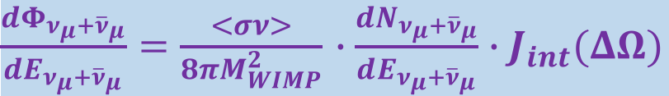
Indirect search for Dark Matter in the Galactic Centre
No excess found over the expected background
➟ limits to
$\frac{dΦ_{ν_{μ}+{\overline{ν}}_{μ}}}{dE_{ν_{μ}+{\overline{ν}}_{μ}}}=\frac{<σν>}{8πM_{WIMP}^{2}}$ $∙\frac{dN_{ν_{μ}+{\overline{ν}}_{μ}}}{dE_{ν_{μ}+{\overline{ν}}_{μ}}}∙J_{int}(ΔΩ)$
DM density profile from NFW
90% C.L. limits on the thermally averaged annihilation cross-section ⟨σv⟩ from WIMP annihil. in the Milky Way
DM density profile from NFW
90% C.L. limits on the thermally averaged annihilation cross-section, ⟨σ v⟩, as a function of M_{WIMP}. The results from IceCube and ANTARES were obtained with the NFW profile.
90% C.L. upper limits on the neutrino flux from WIMP annihilations in the Milky Way.
Notes:
E’ sbagliata la curva di HESS che invece dovrebbe essere di CTA arxiv:1508.06128

Slide 22
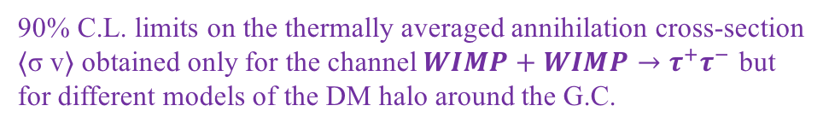
Indirect search for Dark Matter in the Galactic Centre
90% C.L. limits on the thermally averaged annihilation cross-section ⟨σ v⟩ obtained only for the channel $WIMP+WIMP→τ^{+}τ^{−}$ but for different models of the DM halo around the G.C.

Slide 23


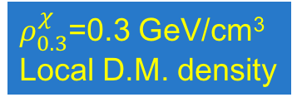
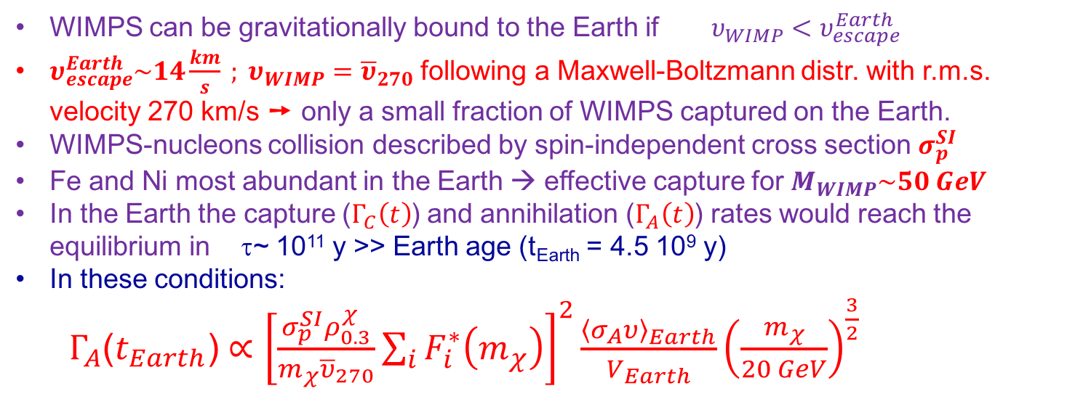
Indirect search for Dark Matter in the Earth
WIMPS can be gravitationally bound to the Earth if $υ_{WIMP}<υ_{escape}^{Earth}$
$υ_{escape}^{Earth}\sim 14\frac{km}{s} ; υ_{WIMP}={\overline{υ}}_{270}$ following a Maxwell-Boltzmann distr. with r.m.s. velocity 270 km/s ➙ only a small fraction of WIMPS captured on the Earth.
WIMPS-nucleons collision described by spin-independent cross section $σ_{p}^{SI}$.
Fe and Ni most abundant in the Earth → effective capture for $M_{WIMP}\sim 50 GeV$.
In the Earth the capture ($Γ_{C}\left(t\right)$) and annihilation ($Γ_{A}\left(t\right)$) rates would reach the equilibrium in τ~ 10¹¹ y >> Earth age (t_{Earth} = 4.5 10⁹ y)
In these conditions:
$Γ_{A}\text{(}t_{Earth}\text{)}∝{\left[\frac{σ_{p}^{SI}ρ_{0.3}^{χ}}{m_{χ}{\overline{υ}}_{270}}\sum_{i}{F_{i}^{∗}\left(m_{χ}\right)}\right]}^{2}\frac{{\left\langle σ_{A}υ\right\rangle }_{Earth}}{V_{Earth}}{\left(\frac{m_{χ}}{20 GeV}\right)}^{\frac{3}{2}}$
Needed to estimate the ν fluxes with WimpSim
$C_{C}^{2}$ capture factor
C_{A} annih. factor
Conversion factor =
$\frac{ρ_{0.3}^{χ}}{{2m}_{χ}{\overline{υ}}_{270}}\sum_{i}{F_{i}^{∗}\left(m_{χ}\right)}$
$ρ_{0.3}^{χ}$=0.3 GeV/cm³
Local D.M. density
the capture is very
effective when
m_{WIMP} ~ m_{target}
Fe, Ni ~ 55-60 GeV
ANTARES, Physics of the Dark Universe 16 (2017) 41–48

Slide 24
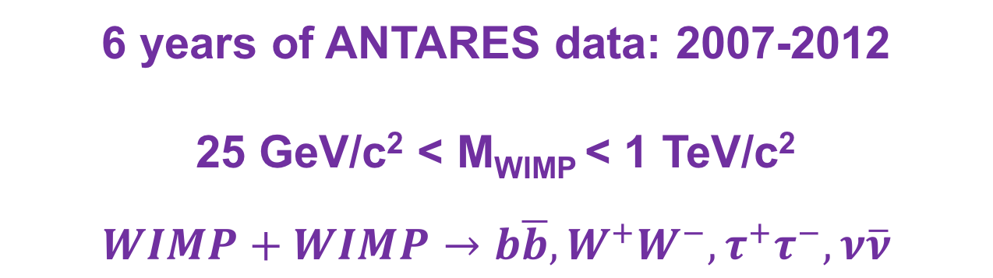
Indirect search for Dark Matter in the Earth
6 years of ANTARES data: 2007-2012
25 GeV/c² < M_{WIMP} < 1 TeV/c²
$$WIMP+WIMP→b\overline{b}, W^{+}W^{−},τ^{+}τ^{−},ν\overline{ν}$$
No excess found over the expected background
Limits on the WIMP-WIMP annihilation rate in the Earth
Limits on the spin independent WIMP-nucleon cross-section
ANTARES, Physics of the Dark Universe 16 (2017) 41–48

Slide 25
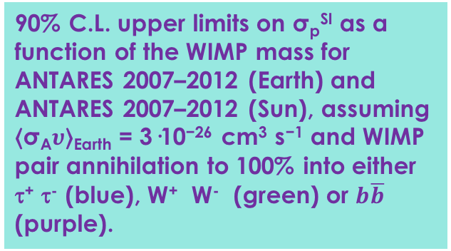
Indirect search for Dark Matter in the Earth
90% C.L. upper limits on σ_{p}^{SI} as a function of ⟨σ_{A}ν⟩_{Earth} for m_{WIMP} =52.5 GeV
90% C.L. upper limits on Γ_{A} as a function of the WIMP mass.
ANTARES, Physics of the Dark Universe 16 (2017) 41–48
90% C.L. upper limits on σ_{p}^{SI} as a function of the WIMP mass for ANTARES 2007–2012 (Earth) and ANTARES 2007–2012 (Sun), assuming ⟨σ_{A}$υ$⟩_{Earth} = 3·10⁻²⁶ cm³ s⁻¹ and WIMP pair annihilation to 100% into either τ⁺ τ⁻ (blue), W⁺ W⁻ (green) or $b\overline{b}$ (purple).
25 Gev/c² < M_{WIMP} < 1 Tev/c²

Slide 26
ANTARES Multi-messenger program
A “common observation” of the same source will allow to better understand the “acceleration mechanisms”, the physics inside the source
A “common observation will increase the detector sensitivities
A long list of activities:
  Real-time (follow-up of the selected neutrino events):
  optical telescopes [TAROT, ROTSE, ZADKO, MASTER]
  X-ray telescope [Swift/XRT]
  GeV-TeV γ-ray telescopes [HESS, HAWC]
  radio telescope [MWA]
  Online search of fast transient sources [GCN, Parkes]
  Multi-messenger correlation with:
  Gravitational wave [Virgo/Ligo]
  UHE events [Auger]
  Time-dependent searches:
  GRB [Swift, Fermi, IPN]
  Micro-quasar and X-ray binaries [Fermi/LAT, Swift, RXTE]
  Gamma-ray binaries [Fermi/LAT, IACT]
  Blazars [Fermi/LAT, IACT, TANAMI…]
  Crab [Fermi/LAT]
  Supernovae Ib,c [Optical telescopes]
  Fast radio burst [radio telescopes]

Slide 27
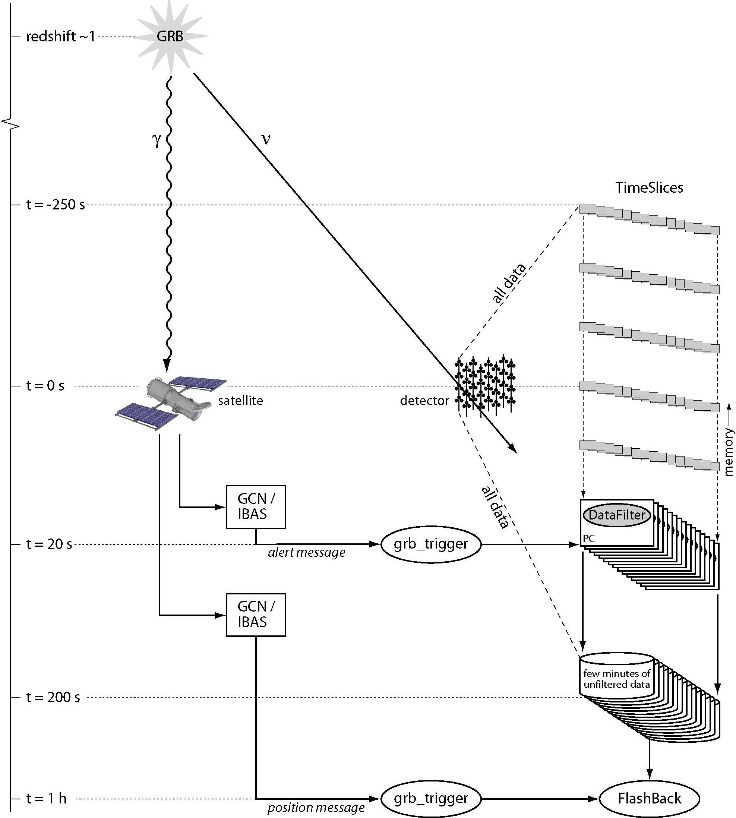
ANTARES Multi-Messenger program: search for ν from GRB
Search for neutrino-like tracks coming in time coincidence with an observed GRB.
The knowledge of the time and the source position:
reduces the background
improves the sensitivity
GCN alerts trigger the recording of all the low level triggers. A continuous buffer ensures the availability of the data before the alert
t =-250 s
GCN=Gamma Ray Burst Coordination Network
t = 0 s
Data taking triggered by a satellite (FERMI; SWIFT, INTEGRAL)
t = 20 s
All data written to disk
t = 200 s
Specific data filtering and reconstruction by searching
for an excess of events in the GRB direction (offline)
t = 1 h

Slide 28
ANTARES Multi-messenger program: some example search for ν from GRB sources
2007-2011 data:
alerts and data from FERMI – SWIFT - GCN
analysis of 296 long GRBs (total prompt emission 6.6 hours)
Simulation of neutrino fluxes from GRB:
NeuCosmA (Hümmer et al 2010) → expected 0.061 events
Guetta (Guetta et al. 2004) → expected 0.48 events
Expected background 0.051 events
No events found in stacked GRB search within 10° window:
Astronomy & Astrophysics 559, A9 (2013)
A&A 559, A9 (2013)
Previous ANTARES result, 40 GRBs
JCAP 1303 (2013) 006
A&A 559, A9 (2013)
ANTARES upper limits 90% C.L. for
Guetta fluxes
NeuCosmA fluxes
IceCube upper limits 90% C.L.
IC40+59 for 215 GRBs

Slide 29
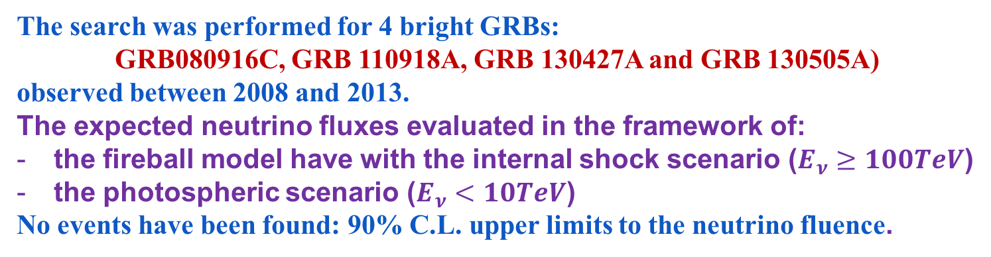
ANTARES Multi-messenger program: search for ν_{μ} from very bright GRB sources
The search was performed for 4 bright GRBs:
GRB080916C, GRB 110918A, GRB 130427A and GRB 130505A)
observed between 2008 and 2013.
The expected neutrino fluxes evaluated in the framework of:
the fireball model have with the internal shock scenario ($E_{ν}≥100TeV$)
the photospheric scenario ($E_{ν}<10TeV$)
No events have been found: 90% C.L. upper limits to the neutrino fluence.
Monthly Notices Royal Astronomical Society (2017) 469 (1): 906-915.
Internal Shock Scenario
Photospheric Scenario

Slide 30

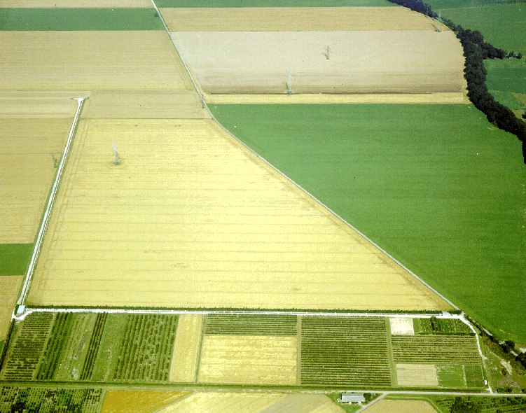
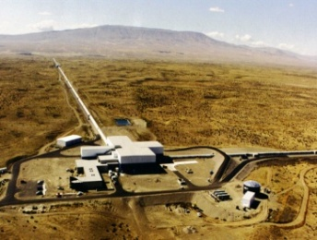
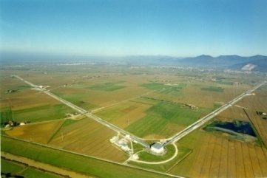
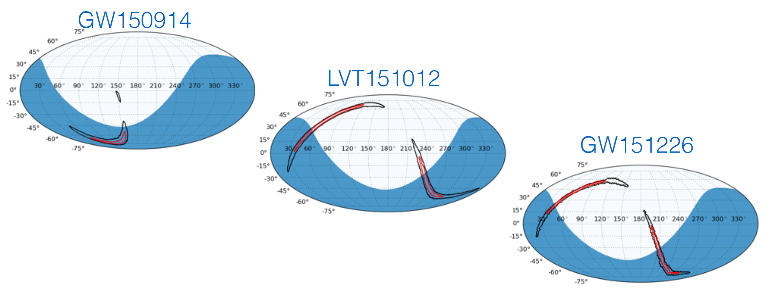
ANTARES Multi-messenger program ν follow-up of GW sources - 1
3 alerts sent by LIGO during the run 01 (2015/09 → 2016/01):
GW150914: merging of 2 BHs (M= 36/29 M_{s} - 410 Mpc - 5.1 σ)
LVT151012: merging of 2 BHs (M= 23/13 M_{s} - 1000 Mpc - 1.7 σ)
GW151226: merging of 2 BHs (M= 14/7 M_{s} - 440 Mpc - >5 σ)
ANTARES visibility

Slide 31
A joint ANTARES/IceCube/LigoSC/Virgo analysis
performed as “Neutrino follow-up” of GW150914
Phys.Rev. D93 (2016), 122010
No ANTARES events in ±500 s from the GW time (0.015 expected)
Limits from ANTARES dominates for Eν < 100 TeV
U.L. from IC dominated above 100 TeV
Size of GW150914 : 590 deg² ANTARES resolution: <0.5 deg²
Limits on total energy radiated in neutrinos: <10% GW
Future: Receive / send alerts in real time

Slide 32
ANTARES Multi-messenger program ν associated with GeV and TeV γ-ray flaring blazars and X-ray binaries
Search for ν’s (2008-2012) correlated with high activity state
Blazars monitored by FERMI-LAT and IACTs (JCAP 1512 (2015), 014)
33 X-ray binaries during flares observed by Swift-BAT, RXTE-ASM and MAXI. Transition states from telegram alerts
No significant excess (best post-trial 72% for GX 1+4), then → Upper limits on ν fluence and model parameters constrain
JCAP04(2017)019
X-ray binary 4U 1705-440
Swift/BAT (15 keV < E < 50 keV)
RXTE/ASM (2 keV < E < 10 keV)
MAXI (2 keV < E < 20 keV)
Neutrino Time-PDF

Slide 33
The future of Neutrino Astronomy in the Mediterranean Sea
ANTARES ➙ KM3NeT
3 Building Blocks on 2 Sites
3*115 lines, ~6210 OMs, ~ 192510 PMTs
12 Lines, 885 OM
Basic active element:
Digital Optical Module
31 x 3” PMTs
18 OMs/line

Slide 34
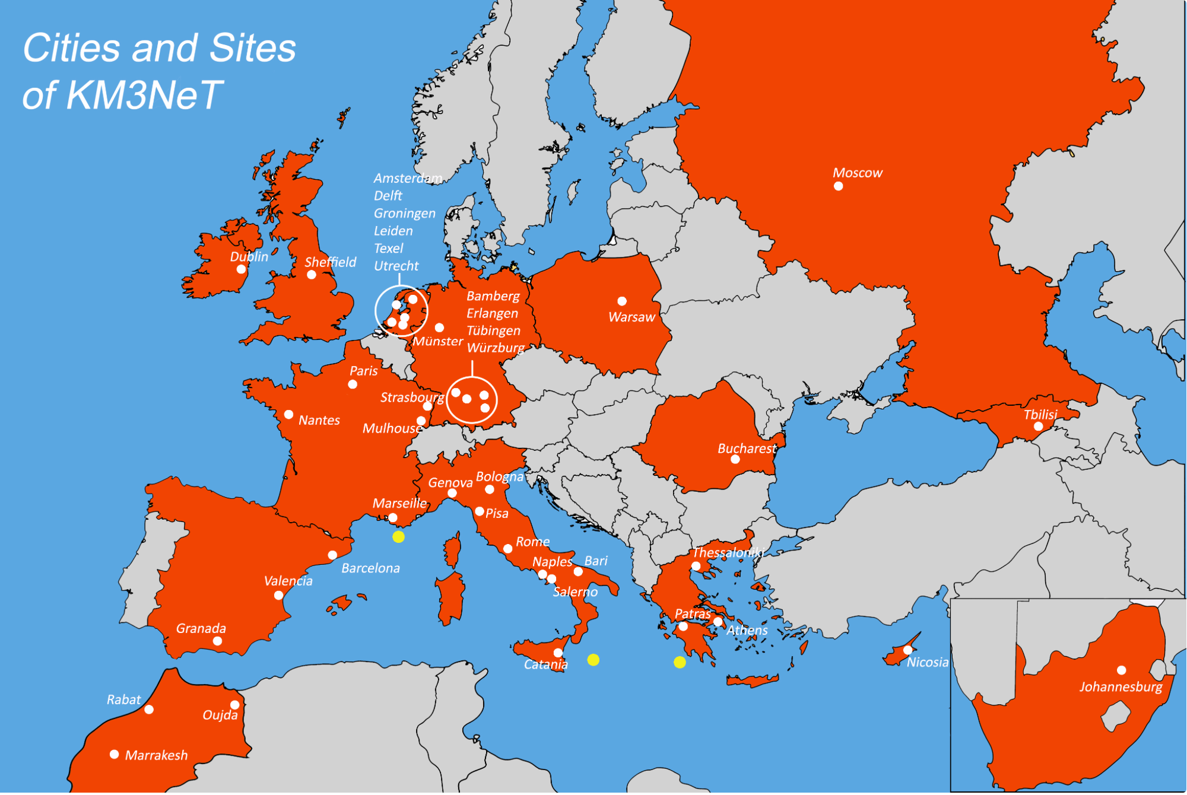
KM3NeT - Collaboration
240 people
45 institutes or universities
13 different countries

Slide 35
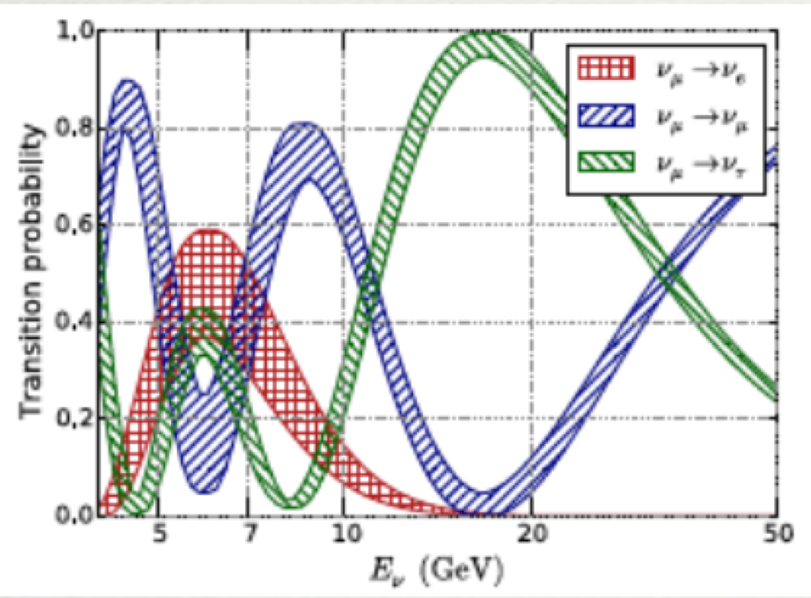


KM3NeT Neutrino Telescope science scopes
Composite View of the Crab Nebula
Low Energy Medium Energy High Energy
MeV < E_{ν} < 100 GeV M eV < E_{ν} < 100 GeV E_{ν} > 1 TeV
- Neutrino Oscillations
- Neut. Mass Hierarchy
- Sterile neutrinos
- Neut. From Supernovae
- Dark Matter search
- Monopoles
- Nuclearites
- Neutrinos from extra-terrestrial sources
- Origin and production mechanism of HE CR
KM3NeT-ORCA
ANTARES
KM3NeT-ARCA
… and synergies with Sea-Sciences: oceanography, biology, seismology, …

Slide 36


KM3NeT Building Blocks
ORCA
ARCA
 | ARCA | ORCA
Location | Italy – Capo Passero | France - Toulon
Detector Lines distance | 90m | 20m
DOM spacing | 36m | 9m
Instrumented mass | 500Mton | 5,7 Mton

Slide 37


KM3NeT phased implementation
L.O.I. KM3NeT ARCA and ORCA:
  J. Phys. G43 (2016) n. 8, 084001
  arXiv: 1601.07459

Slide 38

The future of Neutrino Astronomy in the Mediterranean Sea
See Simon BOURRET talk of Friday 23/06

Slide 39


KM3NeT-ARCA
ARCA detector
ARCA: 2 blocks
115 strings/block
90m horizontal spacing
18 Optical Modules/strings
36m vertical spacing
~1km³
Total Volume 1.2 km³

Slide 40
Summary
ANTARES studied the Southern sky with ν_{μ} competitive sensitivities and excellent angular resolution for both tracks and cascades;
  Upper limits on known GeV-TeV γ-ray sources <10⁻⁸ GeV/(cm² s)
  Sensitivity for a diffuse flux close to the level of the IC signal
Detailed study of extended regions (Galactic plane, Fermi Bubbles)
  no ν_{μ} excess from the Galactic ridge/IC hot spot;
A large multi-messenger effort
  EM radiation: radio (MWA), optical, X-ray, γ-rays (LAT,IACTs)
  Gravitational Wave observatories and IceCube
ANTARES contribute to the indirect searches for Dark Matter
  Most competitive limits for spin-dependent cross-section
  Competitive <σv> limits from the Galactic centre
KM3NeT-Arca Neutrino Telescope under construction will soon be able to observe the neutrino sky with unprecedented sensitivities.
Notes:
Help in identifying astrophysical sites that can be interpreted as (both galactic and extragalactic) CR sources

