Slide 1

WIN 2017
MAYDA M. VELASCO
NORTHWESTERN UNIVERSITY

Slide 2
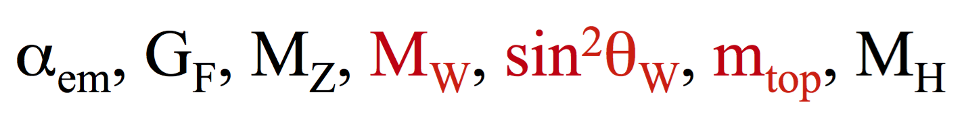

Standard Model Measurements at the LHC
➔ Focus on Electro Weak (EW) Interactions
SM precision measurements allow us to:
  test a wide range of EW and QCD predictions
  measure fundamental parameters
  to perform consistency tests of electroweak and the symmetry breaking mechanism
  understanding the backgrounds to rare/forbidden/new processes in order to
No direct observation of new
physics after Higgs boson discovery
→ Precision measurements are
more important than ever
  Vector Boson Fusion (VBF) and Scattering (VBS)
test lepton universality, search for anomalous couplings, etc.

Slide 3
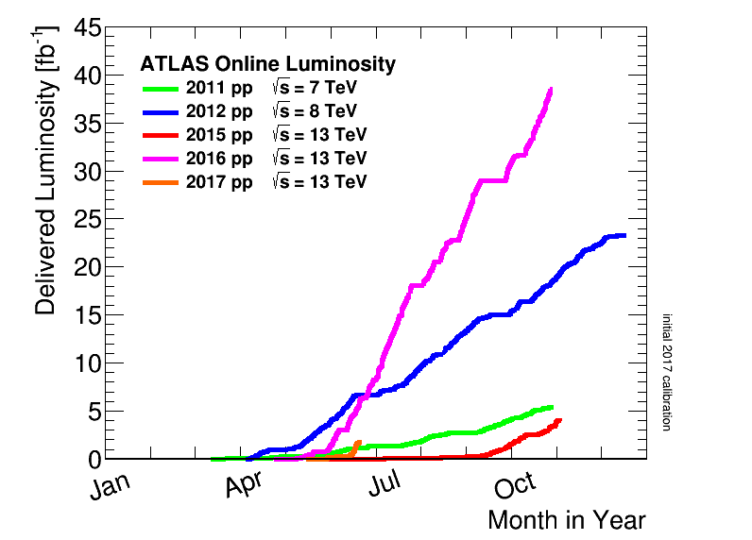
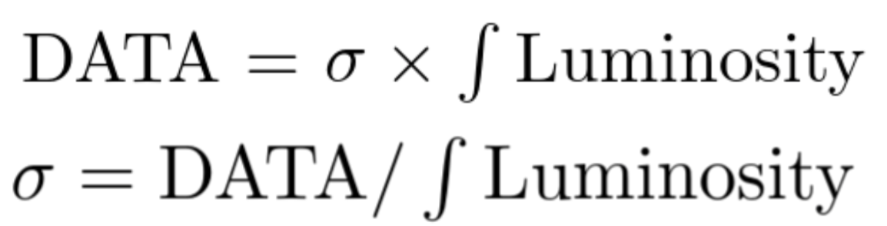
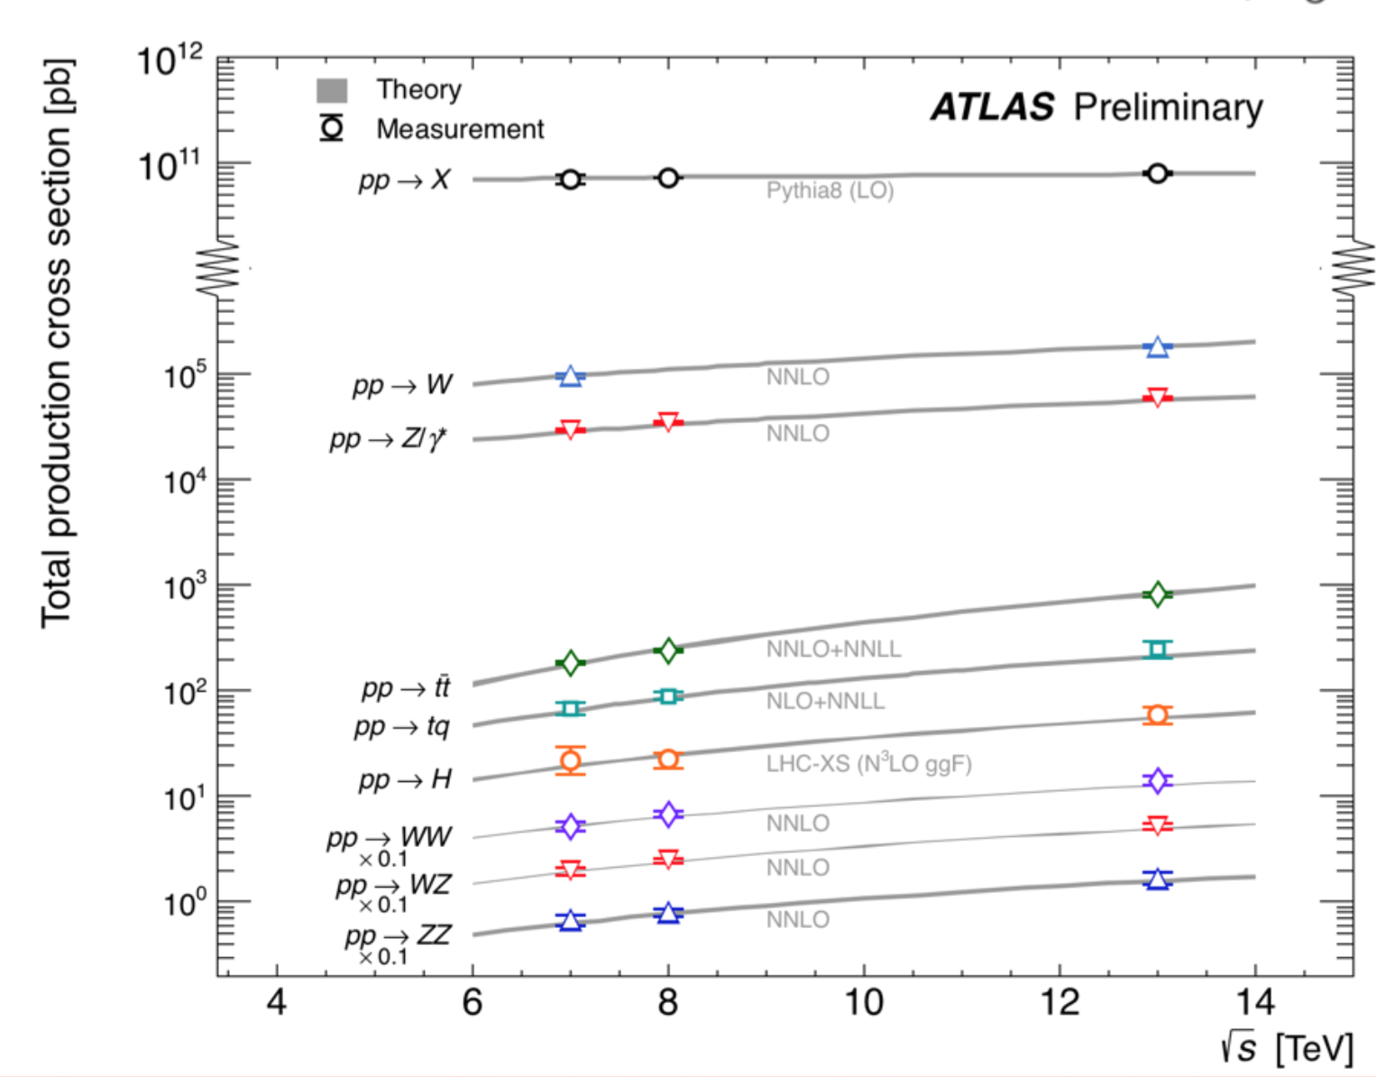
LHC 2017 run already started!
LHC performance giving us a HUGE amount of
information, including milestone discovery of
Higgs boson !

Slide 4
EW
Higgs
QCD
Top

Slide 5
Outline
Focusing on results
released in 2017
Vector Boson Fusion & Vector Boson Scattering
  Boson
  Dibosons
Other dibosons
Triboson
Information from precision W and Z bosons
  Lepton universality
  Strangeness and V_{cs}
  M_{W} and sin²θ_{W}
Top
  M_{top}
  V_{tb}
Higgs well represented at the parallel sections (> 10 talks and not covered in this review)
Anomalous
couplings
Measuring fundamental
parameters and searching for new physics using precision measurements

Slide 6
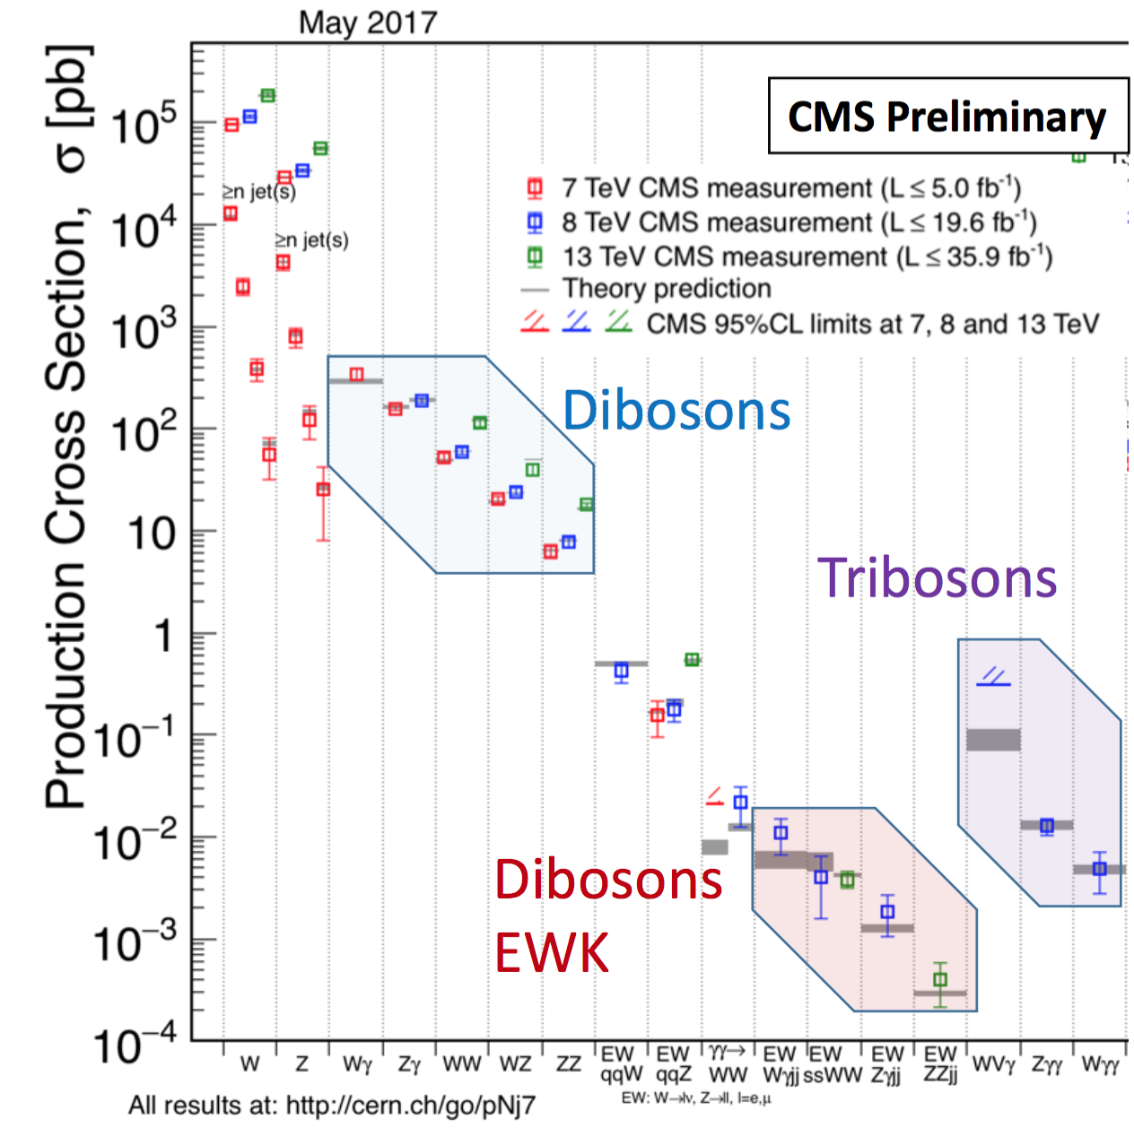
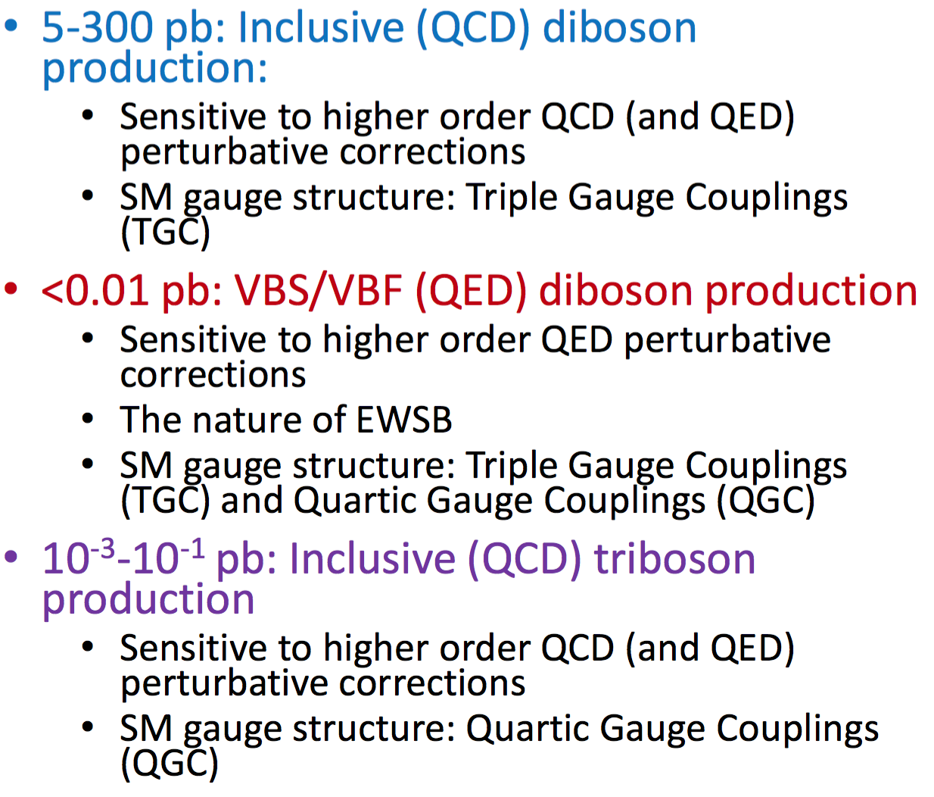
VBF/VBS & Multiboson
Huge range of production Cross Sections
Boson
EW
Dibosons
EW

Slide 7
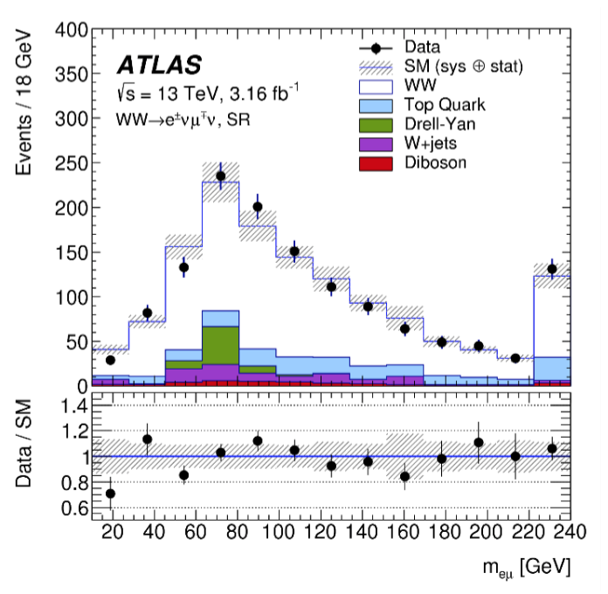
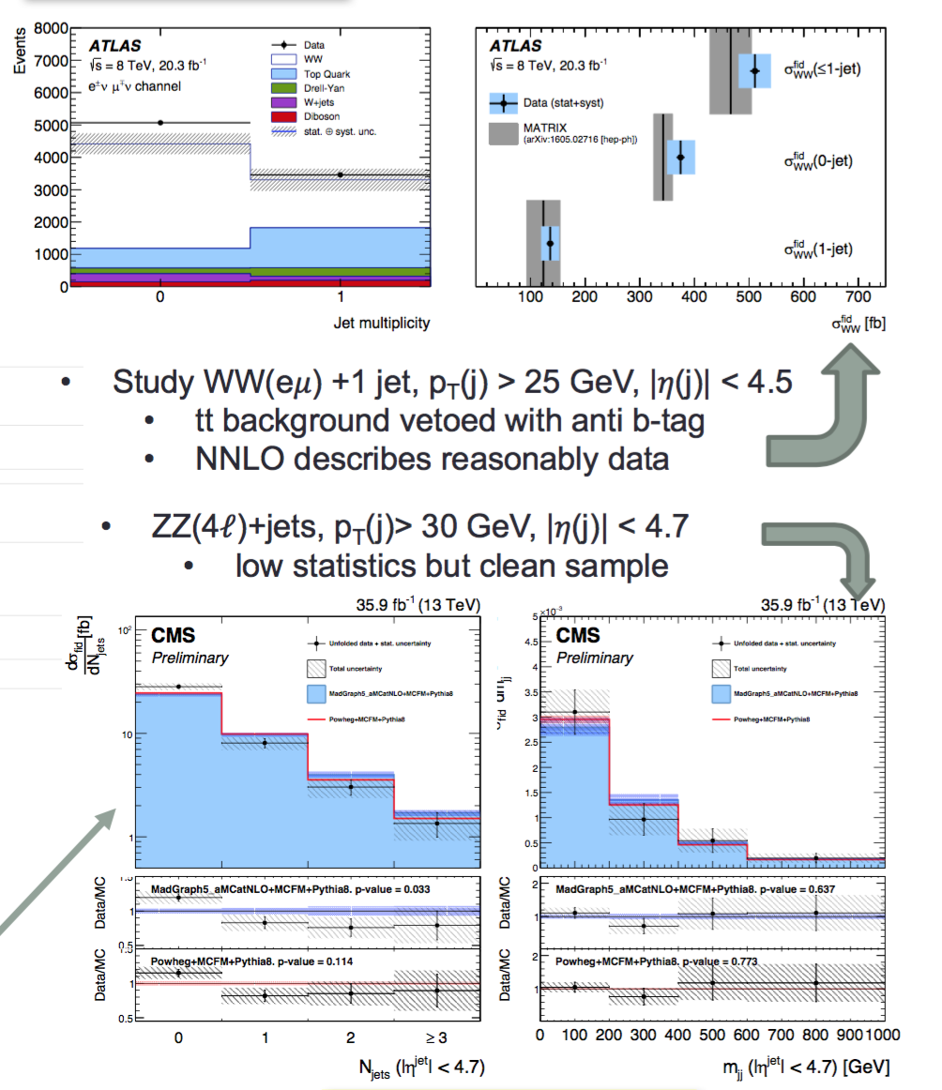
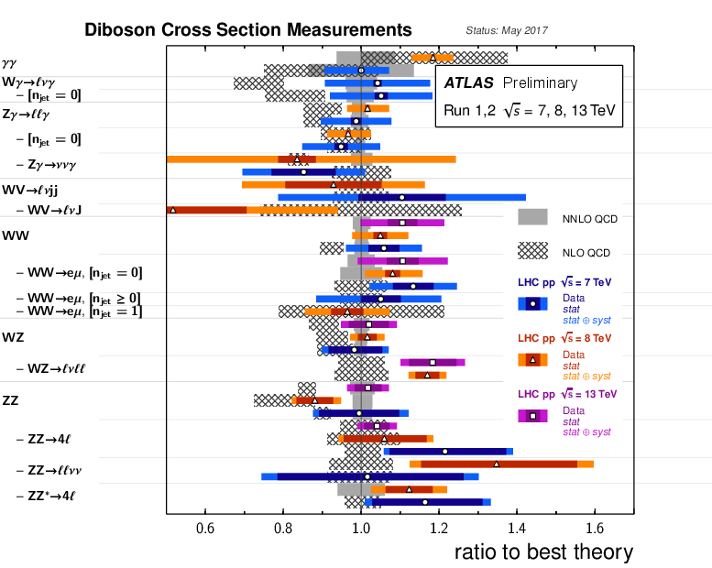
First: Dibosons and Jets
arXiv:1702.04519
PLB 763 (2016) 114
CMS-PAS-SMP-16-019
Initial tensions of Wγ & WW cross section with NLO calculations
showed need of NNLO to describe dibosons processes
(NEUMANN, FREYTSIS)
With Run2 VBF/VBS becoming statistically interesting
• understanding QCD jet production is crucial & strong EW probe

Slide 8
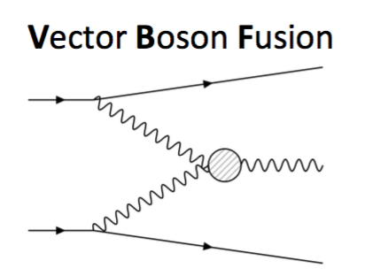
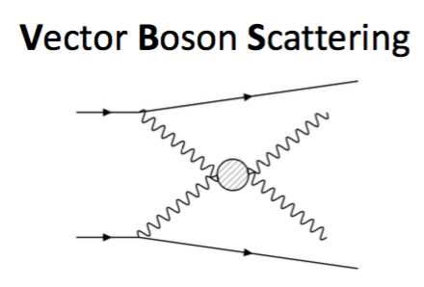
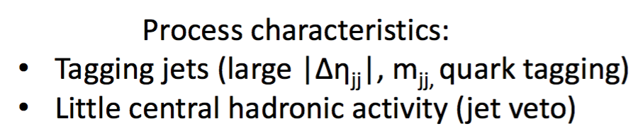
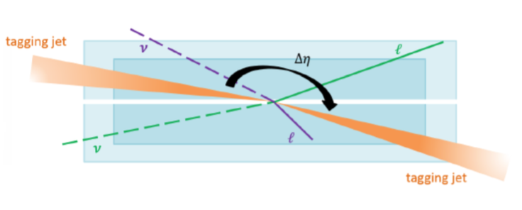
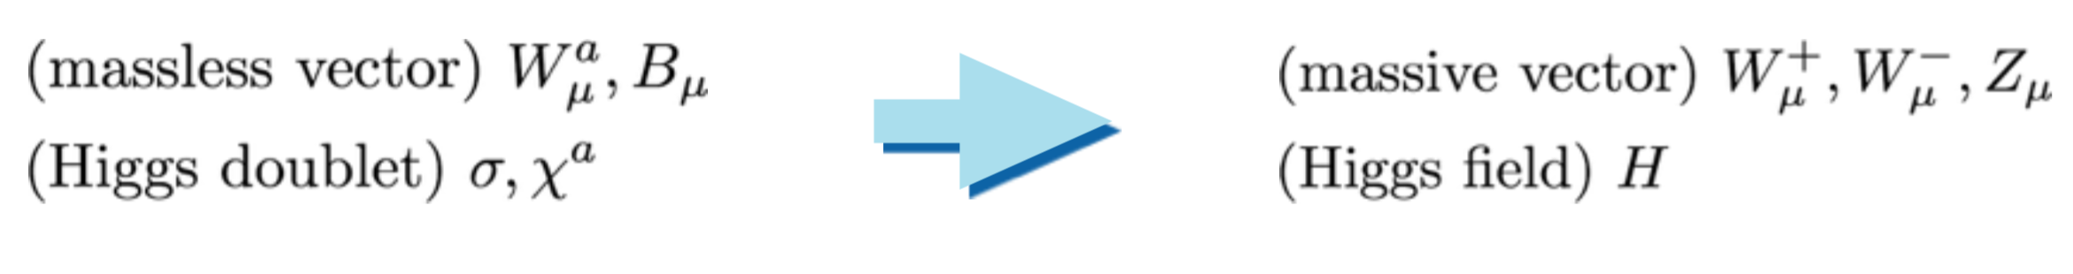
Motivation for VBS/VBF
V_{L} V_{L} scattering linked to the mechanism responsible for the EWSB which give us the particle content in the SM:
VBF Efficient way of producing resonances

Slide 9
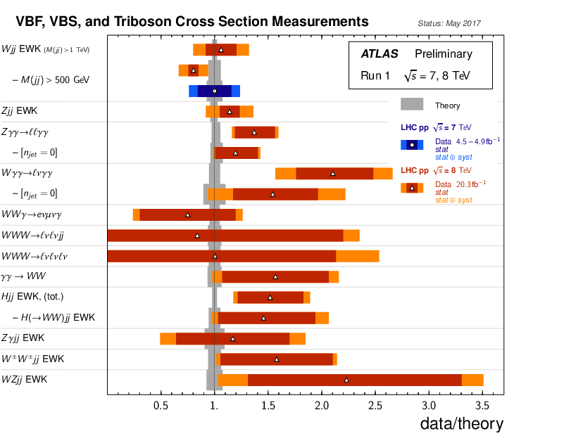
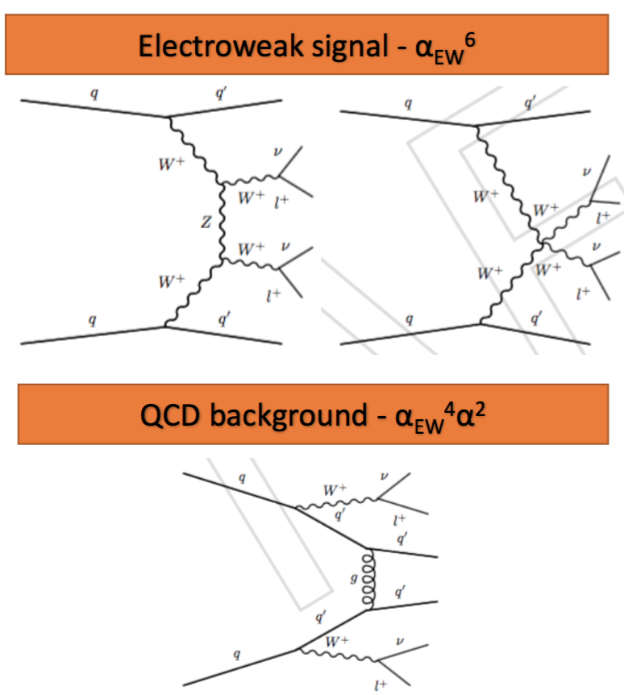
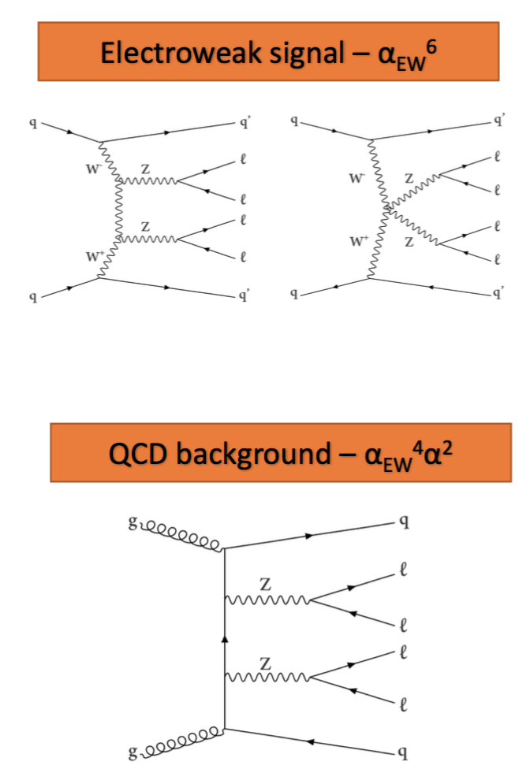
VBS example for pp→ W± W±
VBS example for pp→ Z Z
New
New
New CMS @13 TeV
New CMS @13 TeV

Slide 10
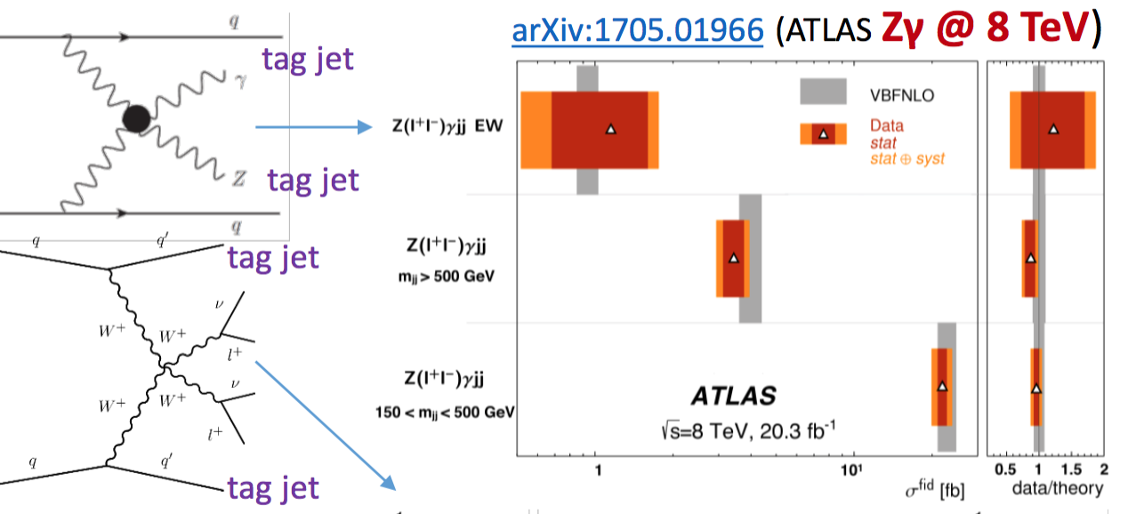
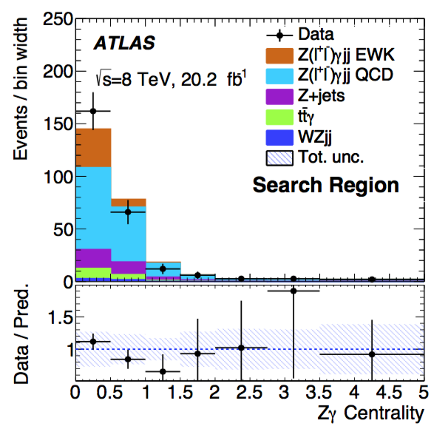
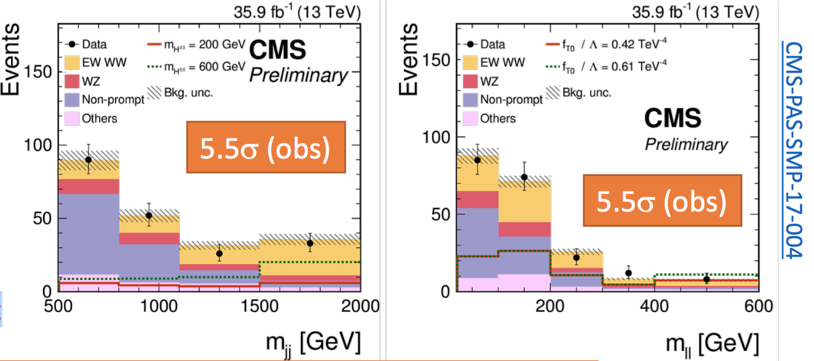
Vector
Boson
Scattering
M_{jj} > 500 GeV
Zγ and W±W± production in association with a high-mass dijet system @ 8 TeV (ATLAS)
ZZ and W±W± @ 13 TeV (CMS) with full 2016 data
→ 1st observation of EW--VV production at 13 TeV

Slide 11
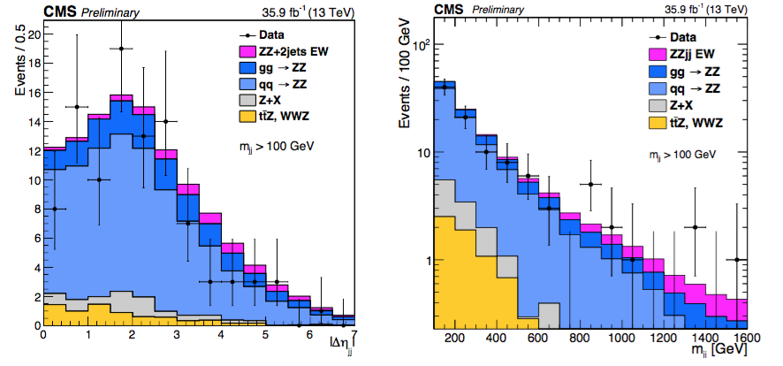
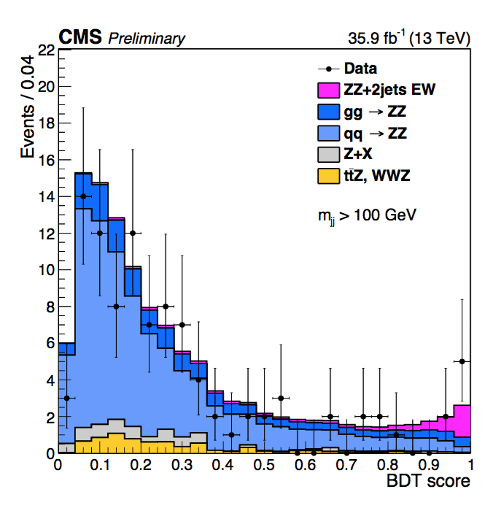
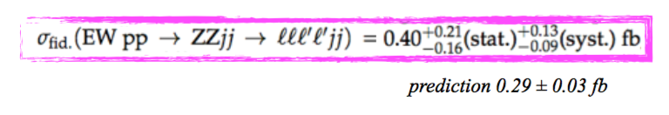
Search for VBS in the fully-leptonic ZZ channel
Little discrimination power on individual variables
SMP - 16 - 019
New results:
1st LHC result in this channel
Fully reconstructed final state gives access to scattering energy (m_{4l}) and boson polarizations via spin correlations of the leptons
S/B ~ 1/20 (Compared to W±W± where S/B ~ 1)
QCD 90%
EW 6%
Observed significance 2.7σ
BDT optimized to separate EW signal from QCD-induced production

Slide 12
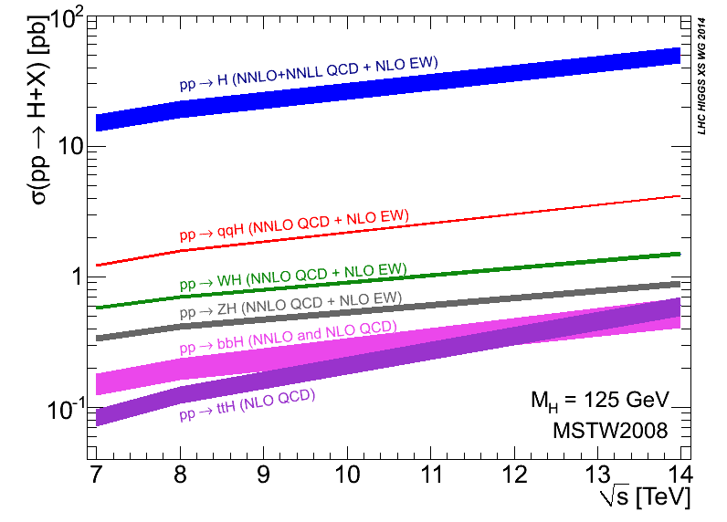
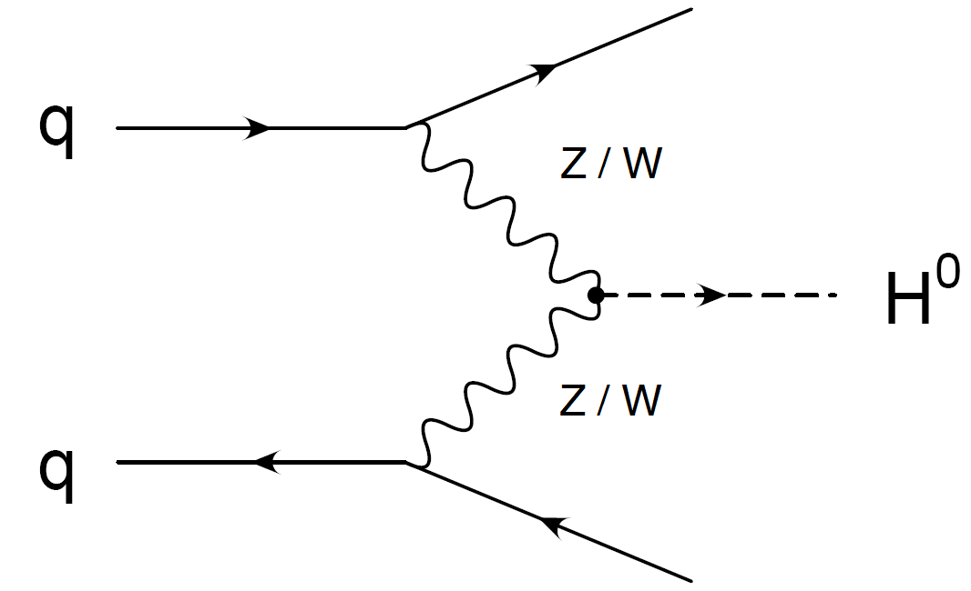
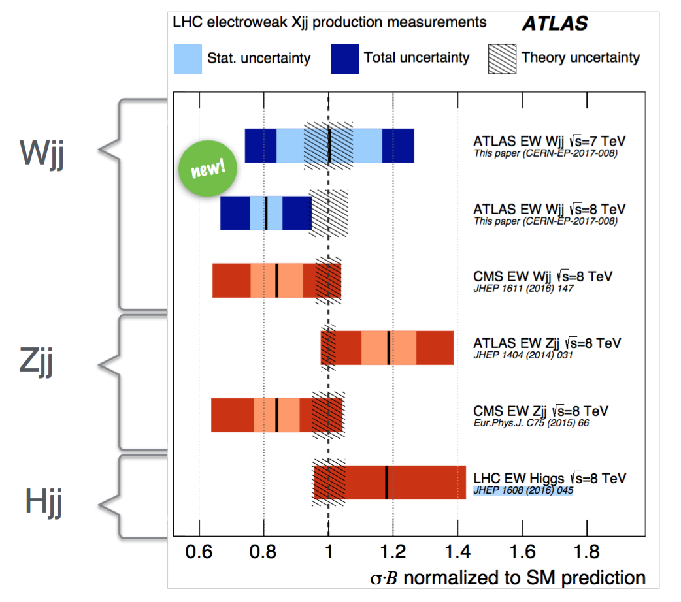
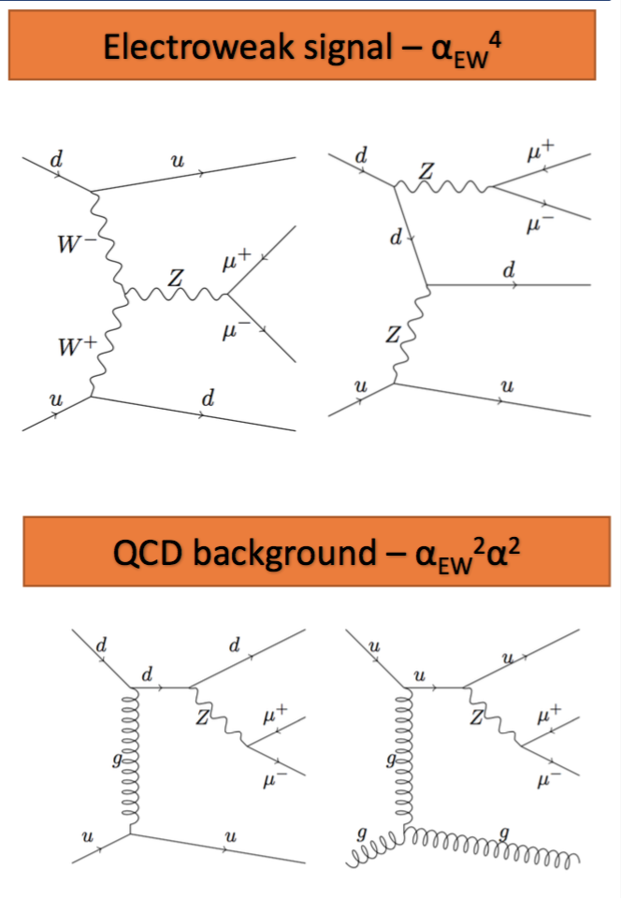
Vector boson Fusion to produce W, Z, H
VBF signal “large” for Higgs but not for W and Z
New
New
New
QCD background “small” for Higgs but not for W and Z

Slide 13
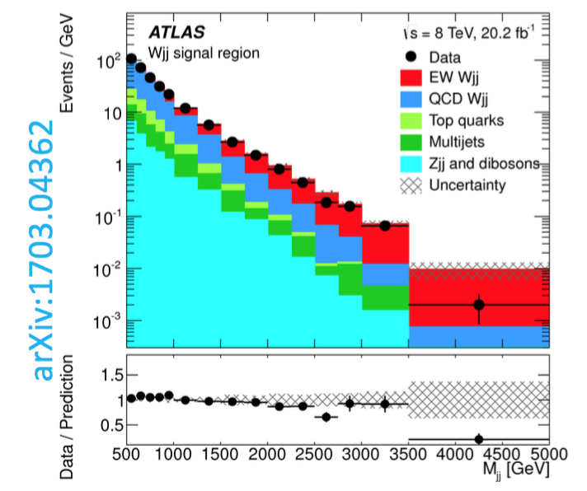
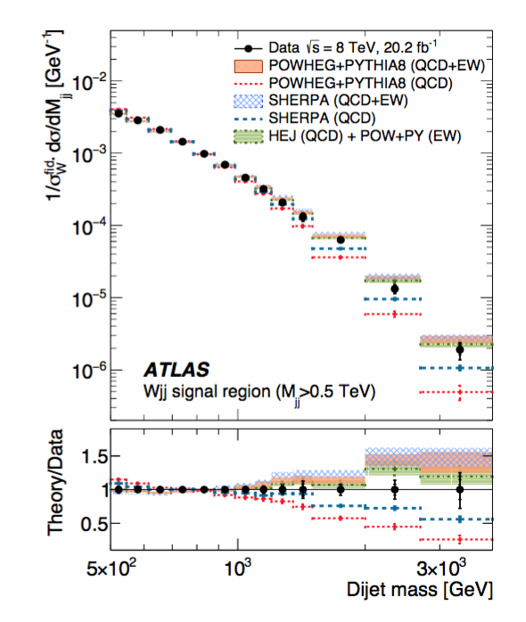
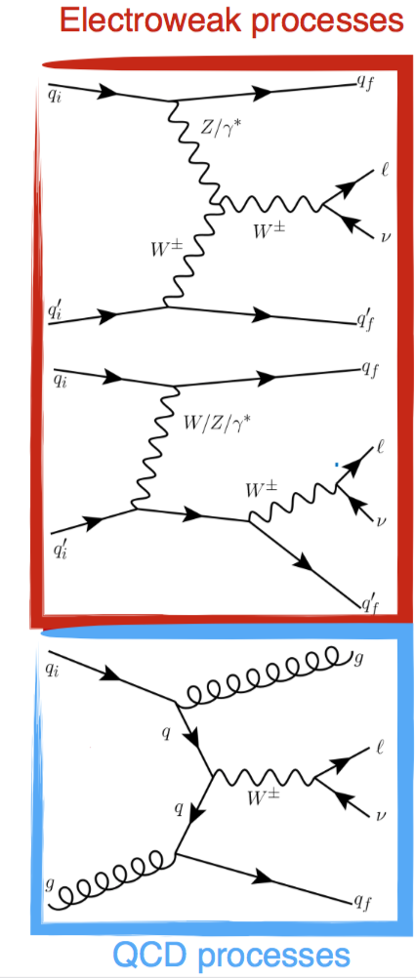
EW Production: Vector Boson Fusion pp→ jjW
Fiducial cross sections in agreement with NLO SM predictions.
Differential cross-sections well described in regions of different admixture of EW and QCD.

Slide 14
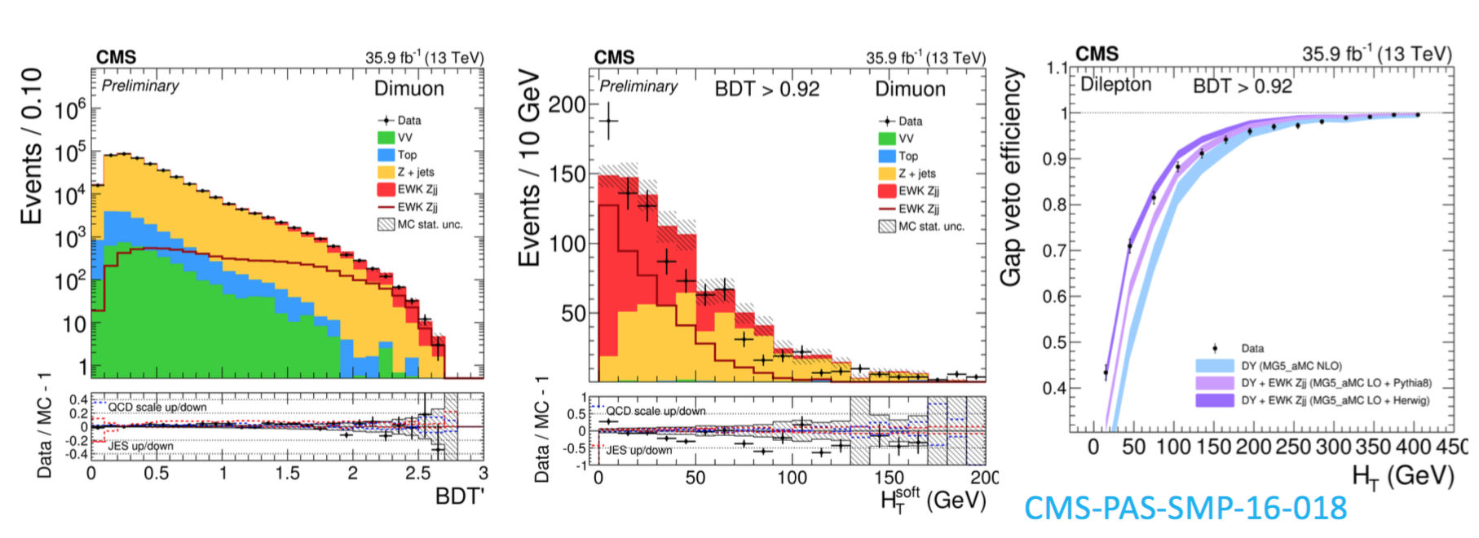
EW Production: Vector Boson Fusion pp→ jjZ
σ(EW lljj)=552±19(stat)±55(syst) fb agrees with LO SM predictions
Data favor a signal model with HERWIG (PYTHIA8) PS for low (larger) gap activity.
Similar measurement recently performed by ATLAS on 13 TeV (ATLAS-STDM-2016-09) also agrees with SM predictions

Slide 15
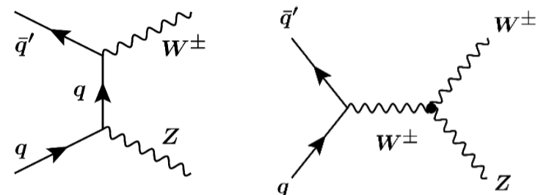
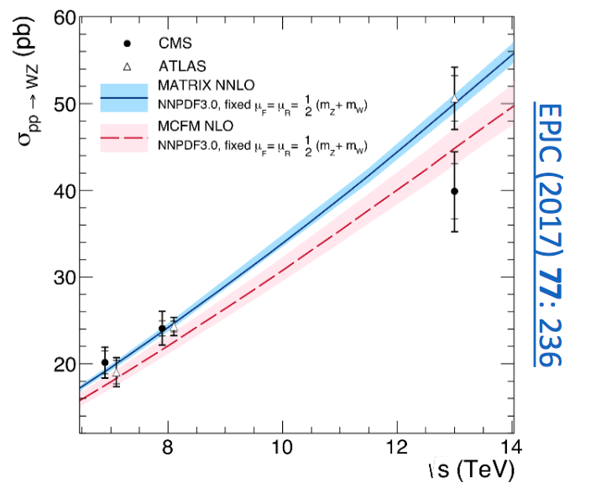
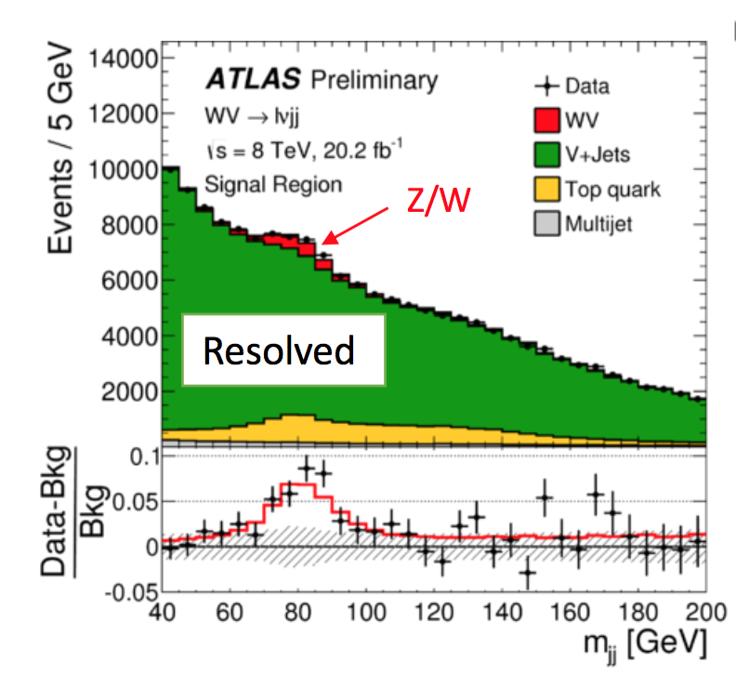
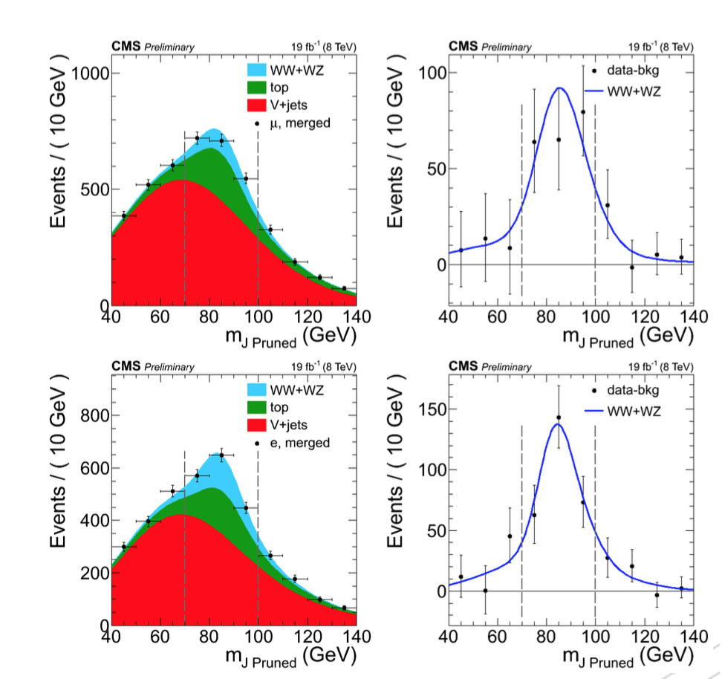
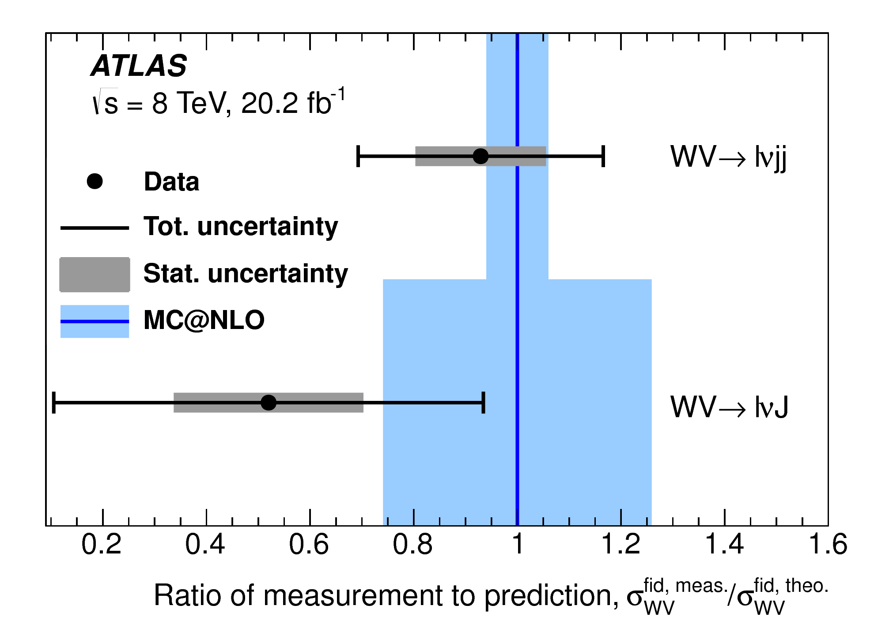
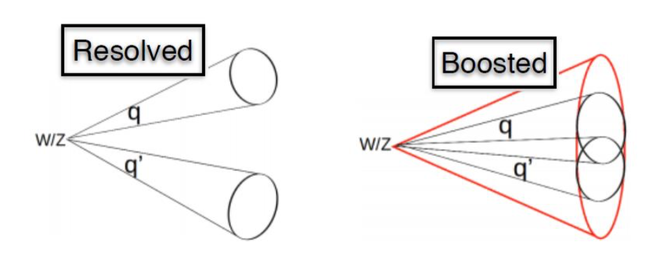
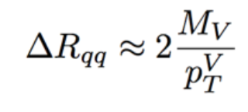
Other Dibosons: WZ
ATLAS and CMS measured @ 8TeV with full luminosity the combined cross section for WW +WZ with W → lν, W/Z → qq′:
Br 6 x higher compared to fully-leptonic
Probe higher 𝑃_{𝑉} → more sensitive to aTGC
arXiv:1703.06095
Leptonic channel
Boosted
STDM-2015-23

Slide 16
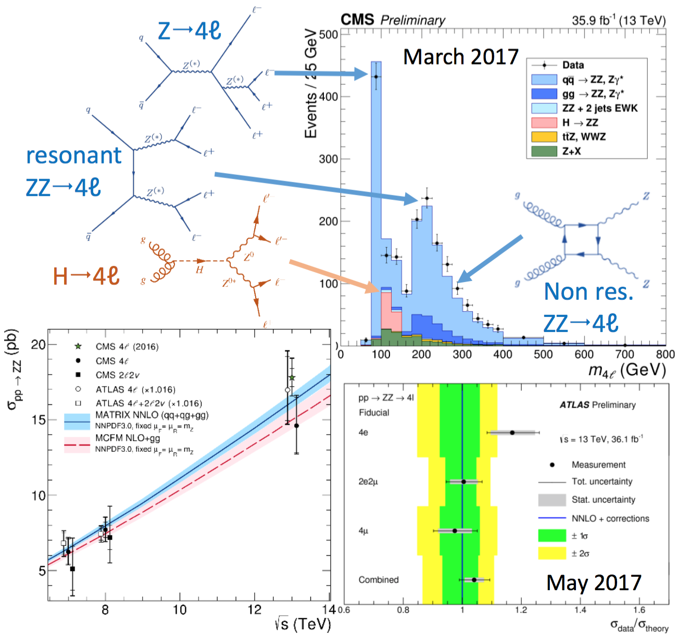
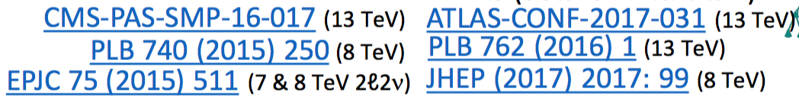
Other Dibosons: ZZ
Both CMS and ATLAS have measured the cross section
@ 13 TeV in the ZZ→4l channel:
Full final state reconstruction: Clean and good resolution
Good agreement with MATRIX NNLO prediction

Slide 17
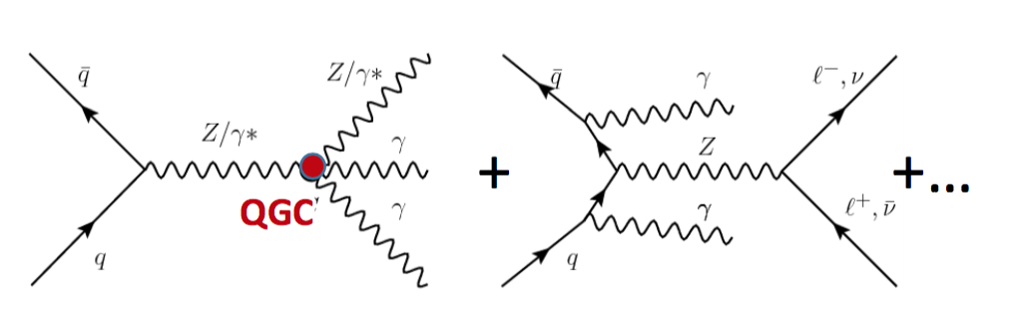
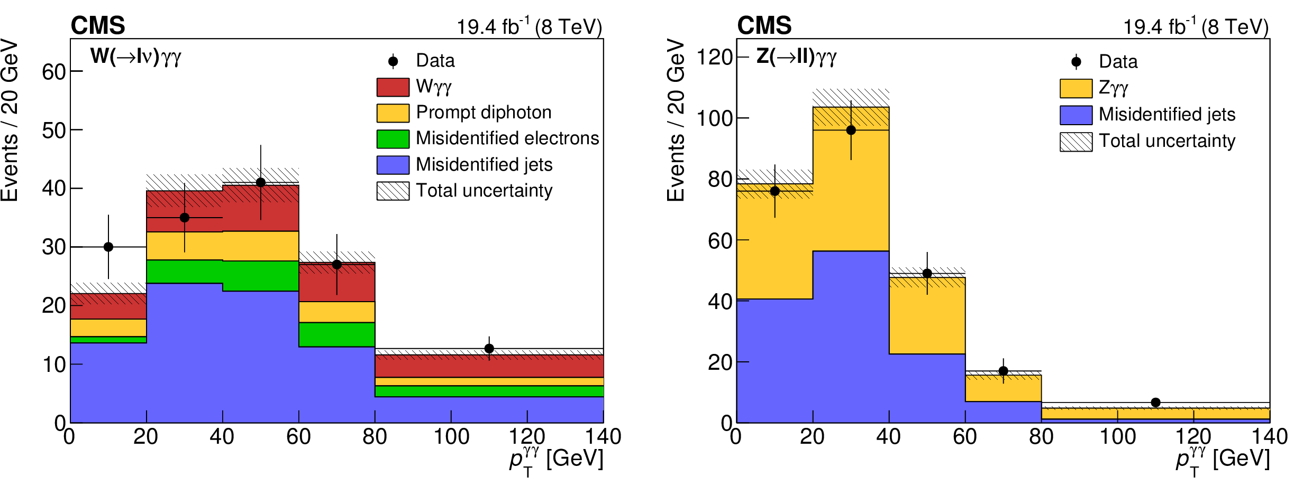
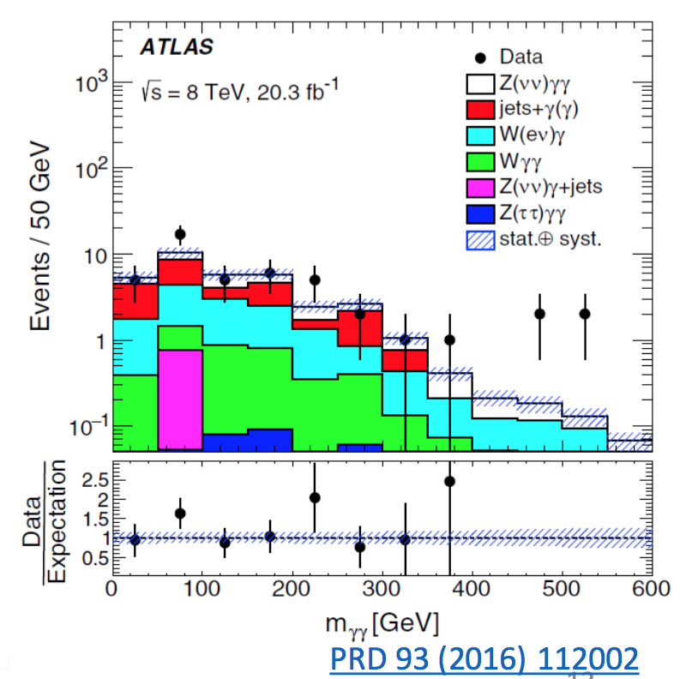
Tribosons
New results by CMS for
Wγγ & Zγγ @ 8 TeV
  • Dominated by background uncertainty
arXiv:1704.00366
Recall: ATLAS earlier disagreement due to
missing higher order (MCFM @NLO QCD)
Observation at 5.9 σ
2.6 σ

Slide 18
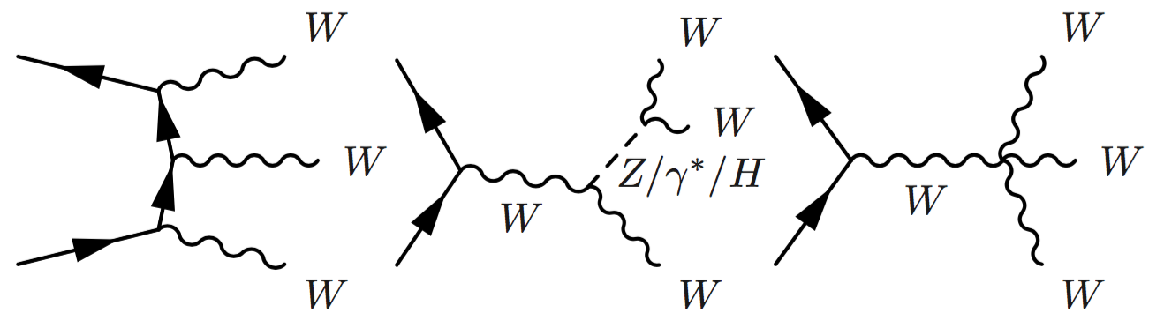
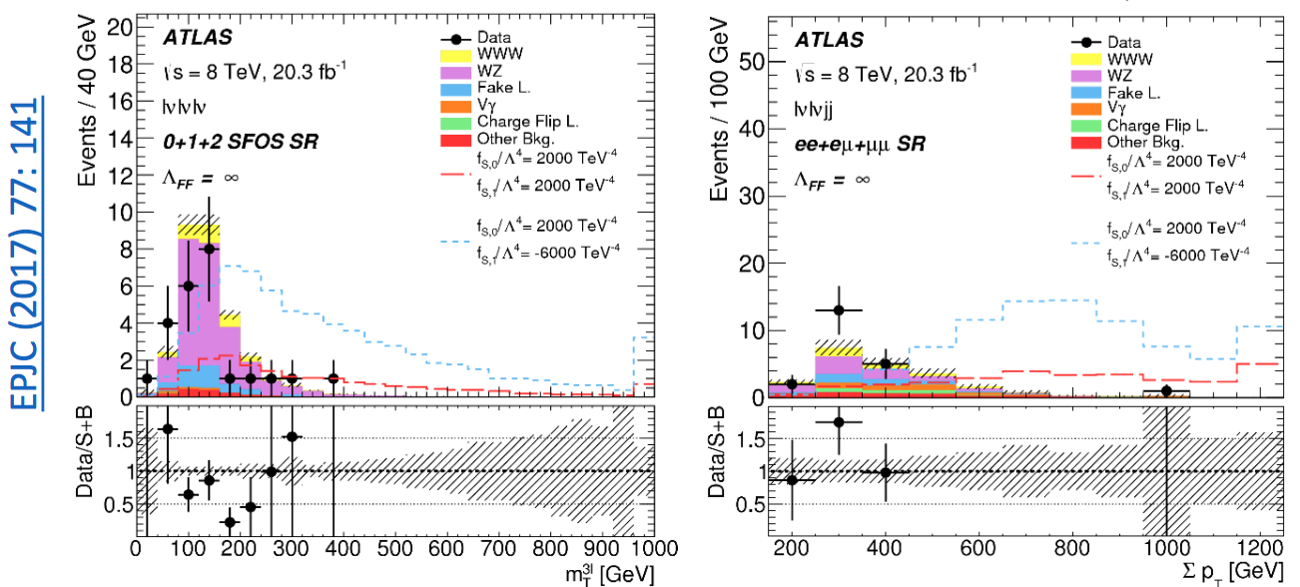
Tribosons
First study by ATLAS of W±W±W∓ to
l±𝜈 +l± 𝜈+l± 𝜈 and l±𝜈l± 𝜈𝑗𝑗
More statistics will come @13 TeV

Slide 19
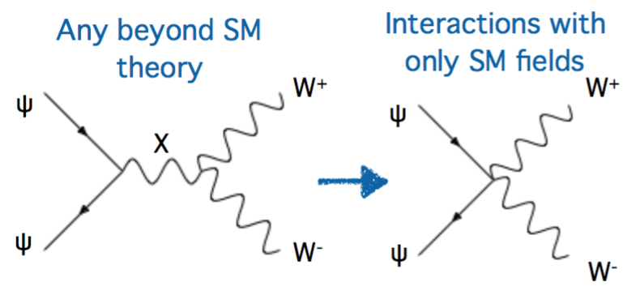
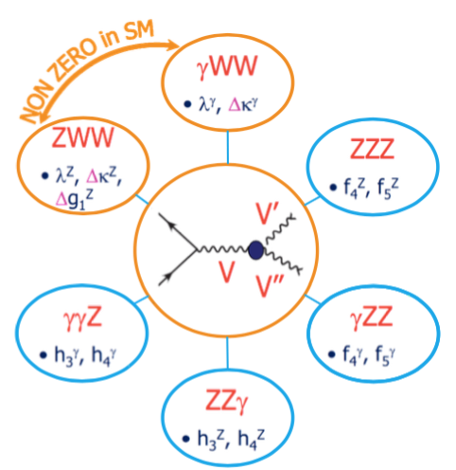
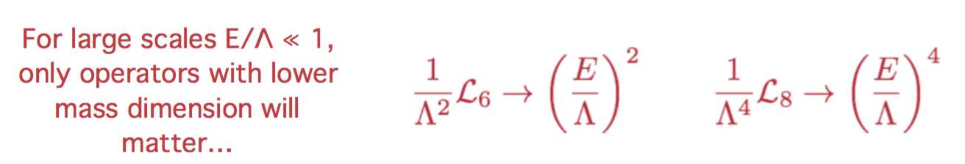
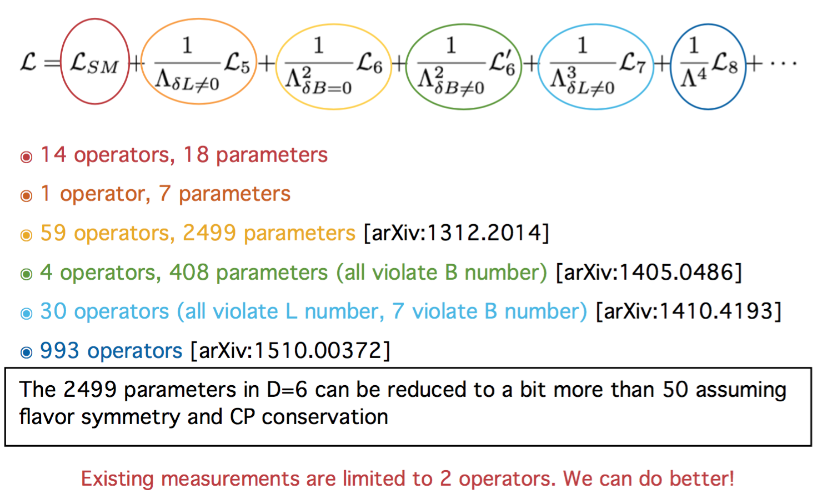
Multibosons and
VBF-Single boson are used to search for new physics via anomalous EW couplings
SHEPHERD ➔ EFT
ROSKES ➔ Anomalous-Higgs
If SM is a low-energy effective theory there should be new physics at a much larger scale Λ

Slide 20
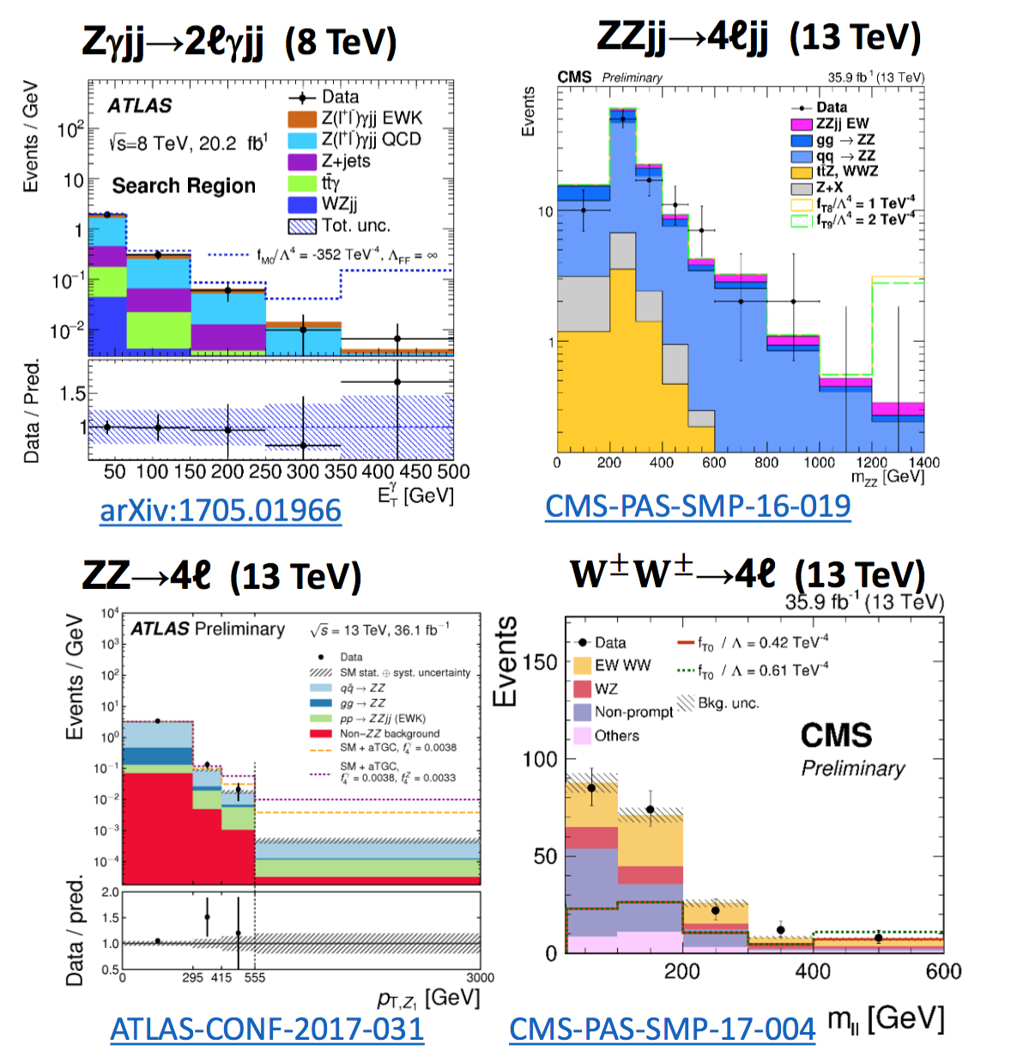

Anomalous couplings
Limiting factor: Observed statistics in the tail, systematics and statistical uncertainty on the S/B model ➔ Will improve as luminosity increases
Anomalous couplings result in an increase of cross sections at high energies
  Invariant mass of the diboson system and the boson p_{T} are particularly sensitive
YANG

Slide 21




aTGC couplings
ZZ only probe of ZZZ coupling ZZZ
ZZZ
CMS and ATLAS
WW +WZ
Out performing
LEP/TeVatron limits
WWZ

Slide 22

aQGC couplings: variety of measurements
VBS channels for WW and Vγ have better
sensitivity than triboson production.
Semileptonic channel WV shows best sensitivity

Slide 23




Precision measurements with W’s and Z bosons

Slide 24


Test of Lepton Universality
Next … include taus
➔ at least get the Br(W→τ ν)
τ BR ~2.7 σ larger than e/μ
Same as in
2005…
arXiV:1612.03016

Slide 25




Indication that assumed
PDF’s are not correct…
More specifically the
content of strange
quarks in the proton

Slide 26



Without
W/Z data
With
W/Z data

Slide 27




M_{H} measurements vs EW fits before and after Higgs discovery – conclusion work on the M_{W}

Slide 28



W mass
ATLAS-CONF-2016-113
W-boson mass measured with template fits to lepton p_{T} and W transverse mass

Slide 29



Other inputs to EW fits coming from the LHC
ERLER
PAPPADOPULO
New LHC results still to come…

Slide 30

Top Quark: 1 ttbar/sec (top mass, source of W’s)
Single top is an EW probe
Depends on
EW parameters

Slide 31


Single top ➔CKM V_{tb}
Single top cleaner… today’s uncertainty 4%
Best values are still from ttbar branching fractions B(t → Wb)/B(t → Wq) in top decays assuming three-generation unitary CKM matrix (uncertainty 1.6%)

Slide 32


Future top mass measurements could come from the boosted topology with W’s decaying hadronically
Boosted
resolved
CMS-PAS-TOP-16-013

Slide 33



LHC top mass measurements with σ ~0.5 GeV

Slide 34



Higgs Boson signals at 13 TeV already visible, even in challenging channels like ττ
4.9σ (4.7σ) --->>> OBSERVATION
HERDE, SEKULA, FABOZZI, ROSSIN, CHAKRABORTY

Slide 35

The next big challenge for the Higgs self interaction
Are (1)-(3) measured precise enough @ LHC to be sensitive the relevant PBSM?
(4) What is the exact shape of the Higgs potential?
ATLAS and CMS already developing the analysis strategies &
Hardware required for the High Luminosity runs
VAROL, MAKSIMOVIC

Slide 36

Looking forward: HL-LHC (starting 2023)

Slide 37
Conclusion
LHC giving us plenty of interesting EW results and more to come…

Slide 38
Backup

Slide 39


Slide 40


