Slide 1
Mechanical Design
1.3 GHz Cryomodule
Tom Peterson, Yuriy Orlov
22 May 2015

Slide 2
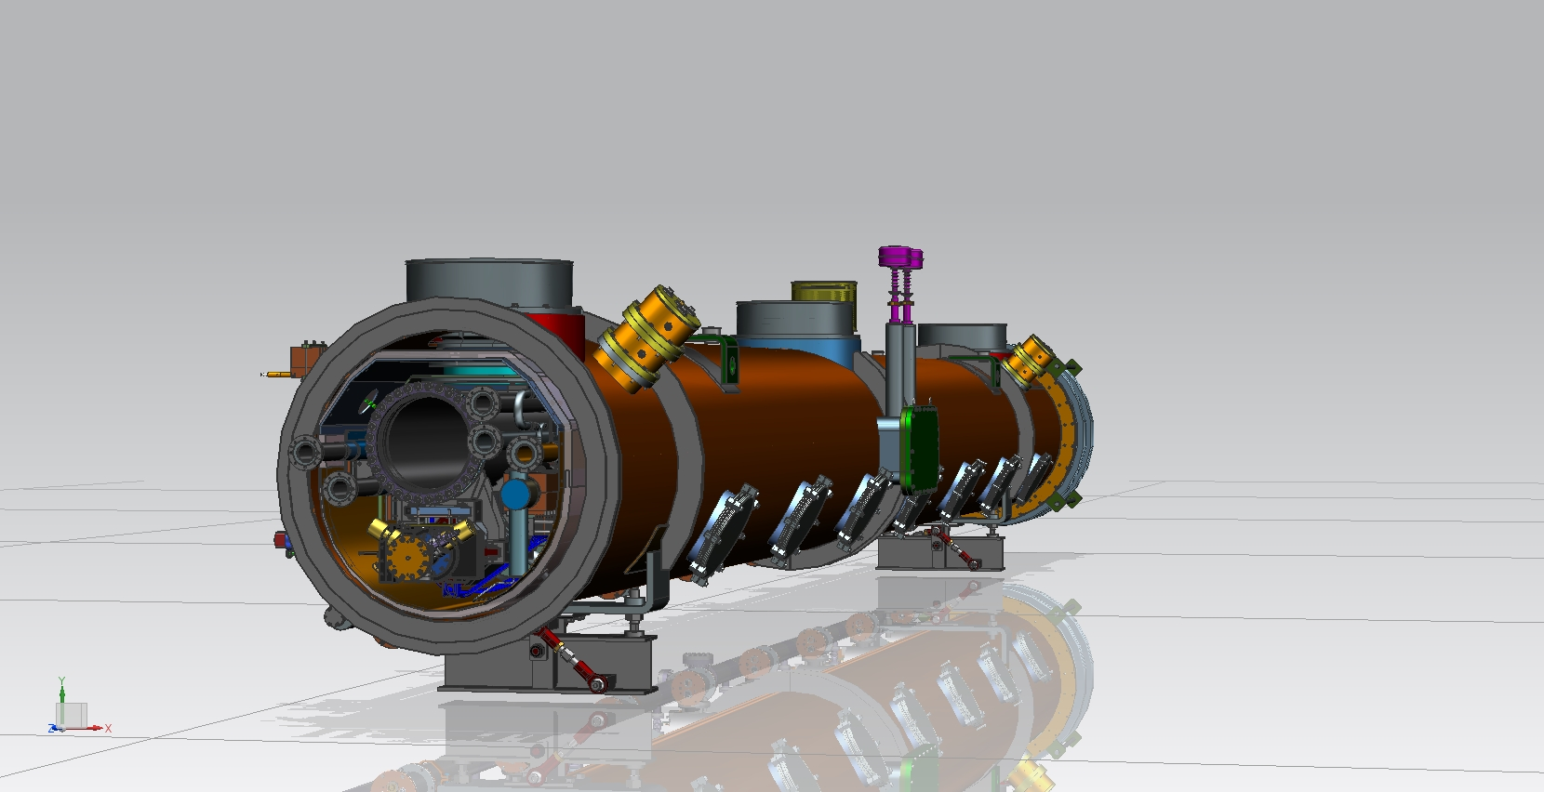
Mechanical design – images from the CAD model
(from Yuriy Orlov)

Slide 3
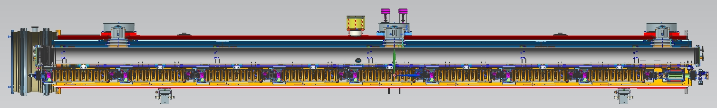
1.3GHz Production Cryomodule, Layout
Cryomodule length: ~12.3m
3 supports for cold mass (1-fix. and 2-sld.)
300 mm –ID, 12m long tube, as backbone for cavity string,
piping system and thermal shielding.
8- 9-cell dressed elliptical SRF cavities(with mag. Shielding) +
1-BPM +1- SC splittable quadrupole + 2 Gate valves. (one of the each
end of Cavity string)
Piping system of Cryomodule.
50K aluminum shielding with 30 layers of MLI insulation around cold mass.

Slide 4
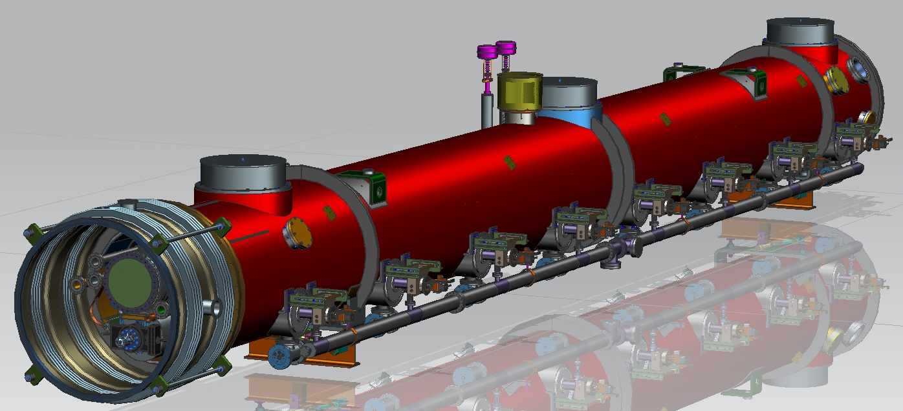
1.3GHz Production Cryomodule
38” vacuum vessel with 8” vacuum relieve valve.
2- cryomodule adjustment
supports
Sliding interconnection Bellow.
8- couplers ports with power couplers and vacuum manifold.
Instrumentations ports & magnet CL Flange.

Slide 5
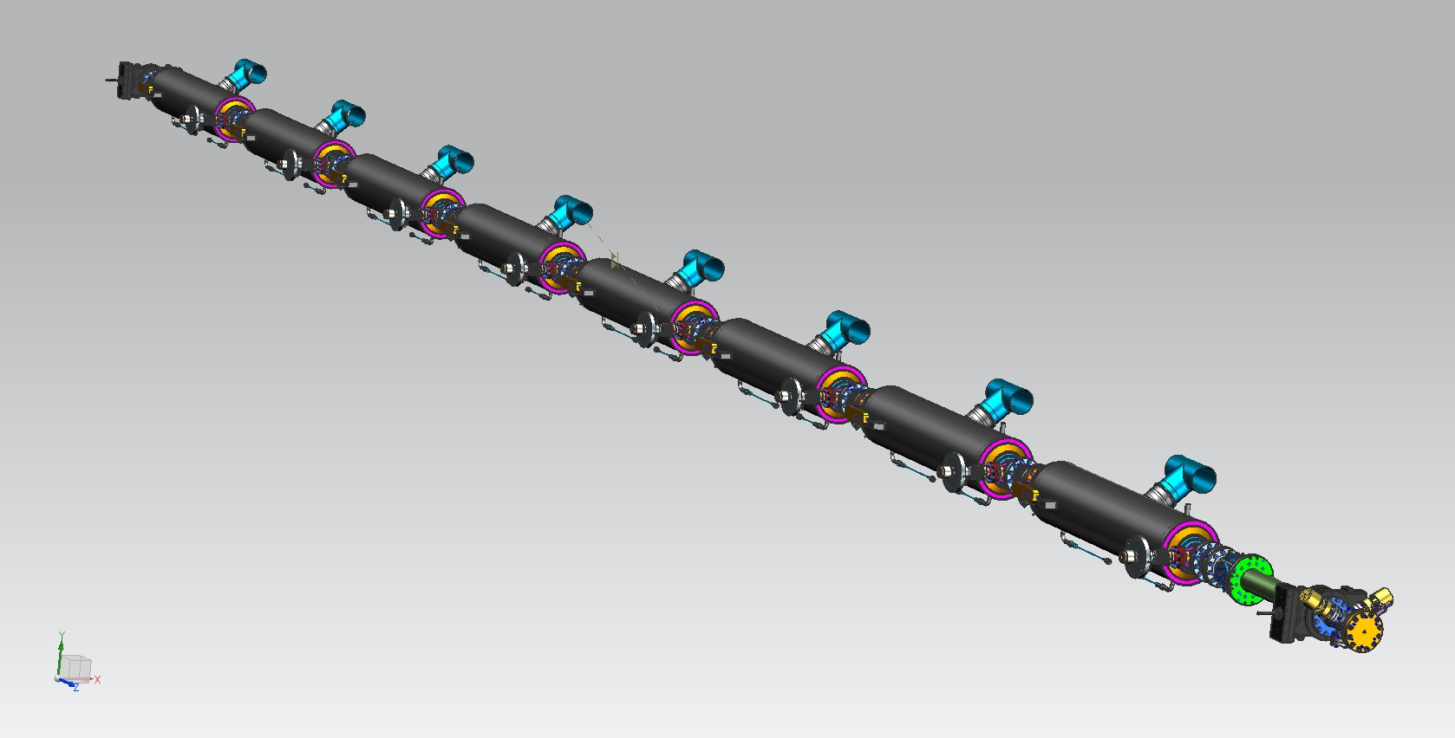

Slide 6
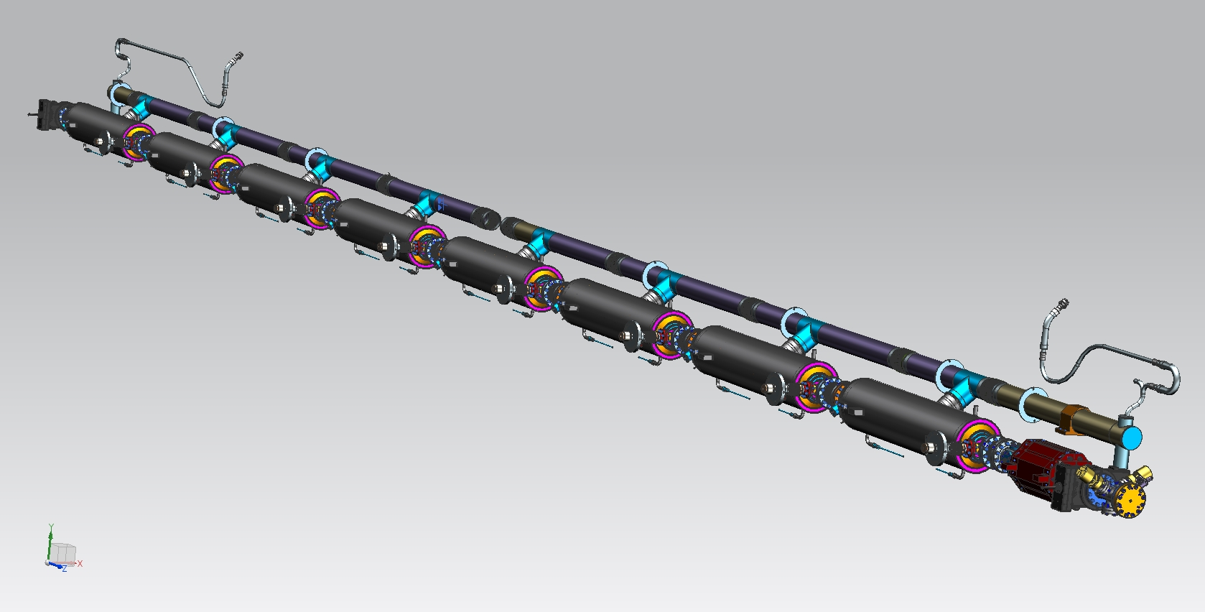

Slide 7
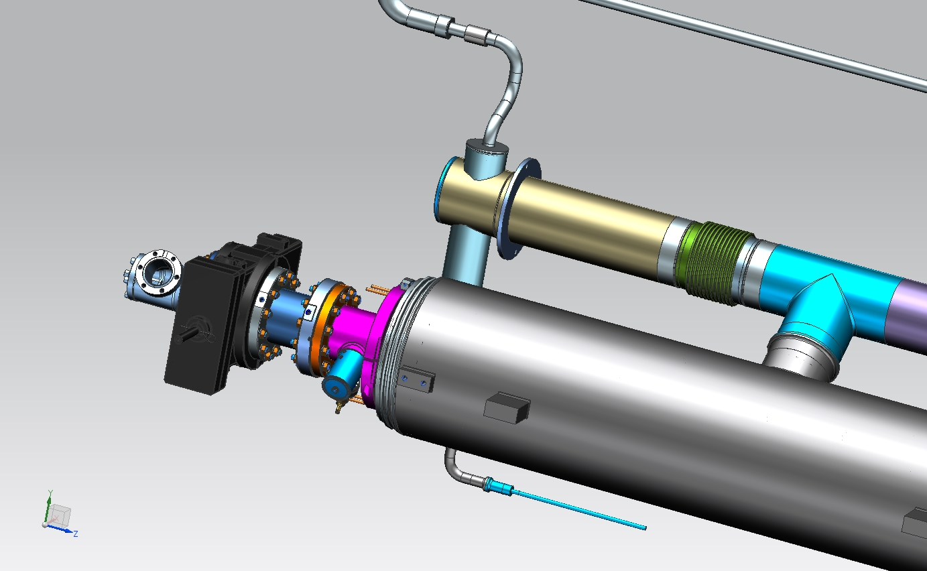

Slide 8
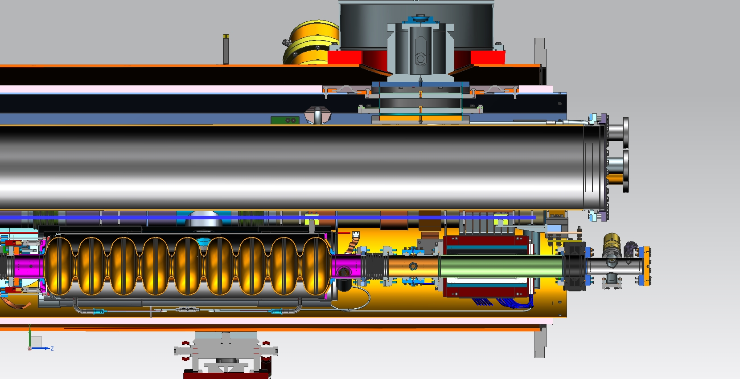

Slide 9
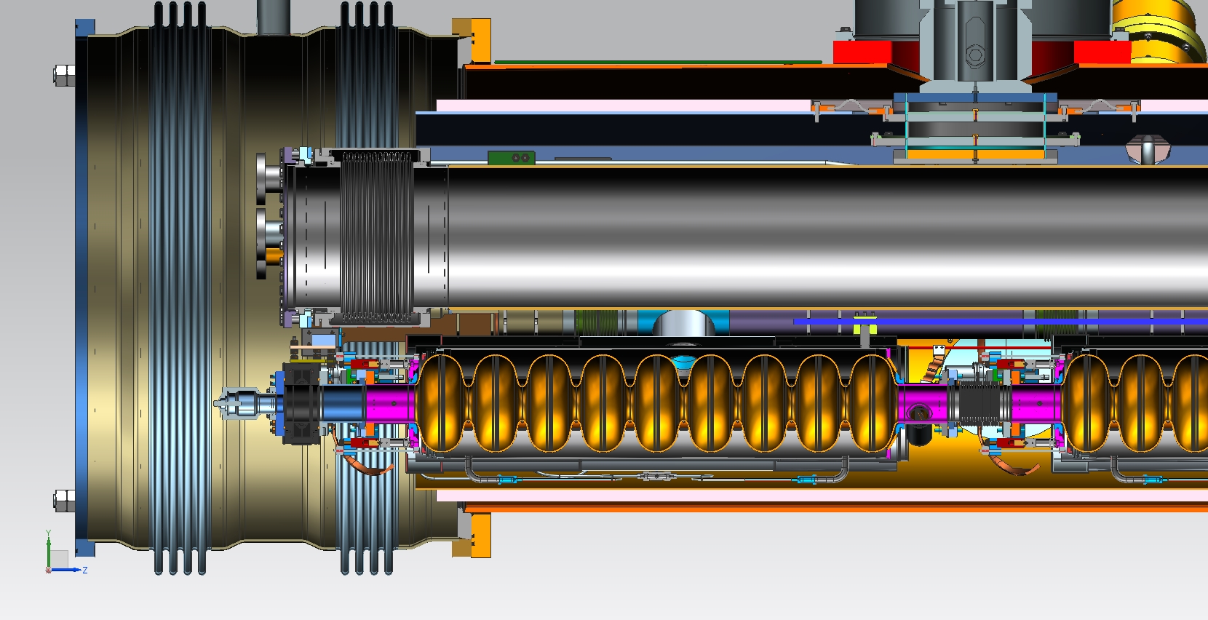

Slide 10
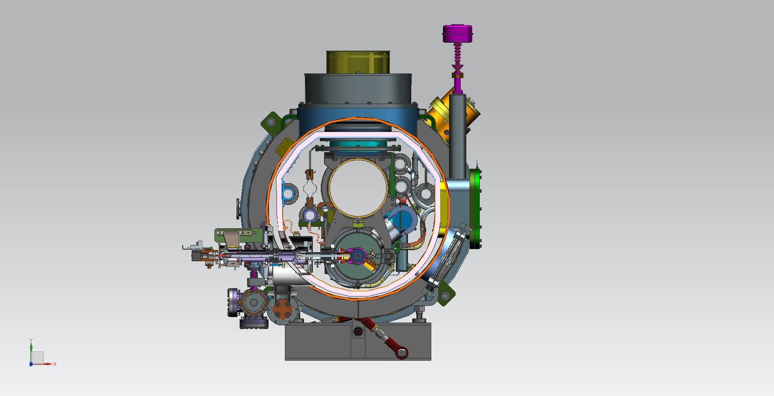

Slide 11
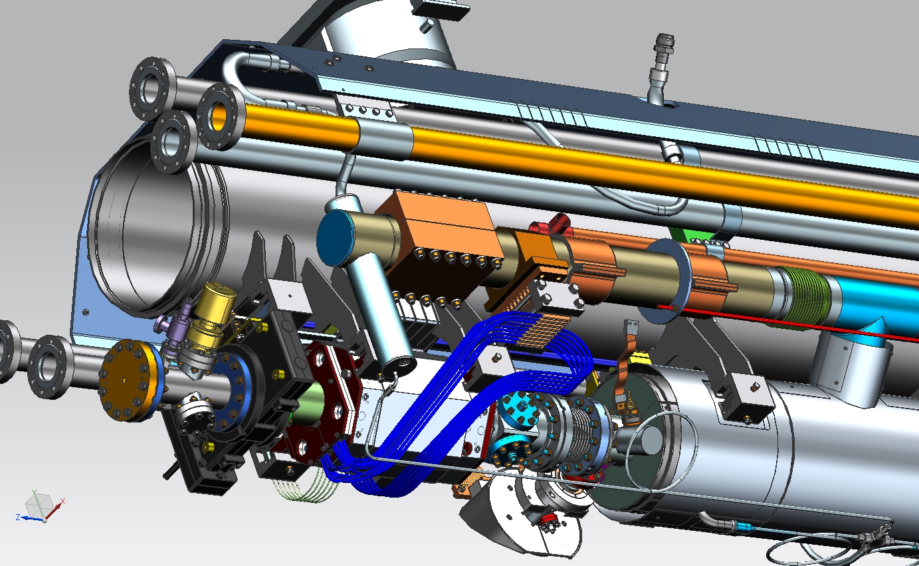

Slide 12
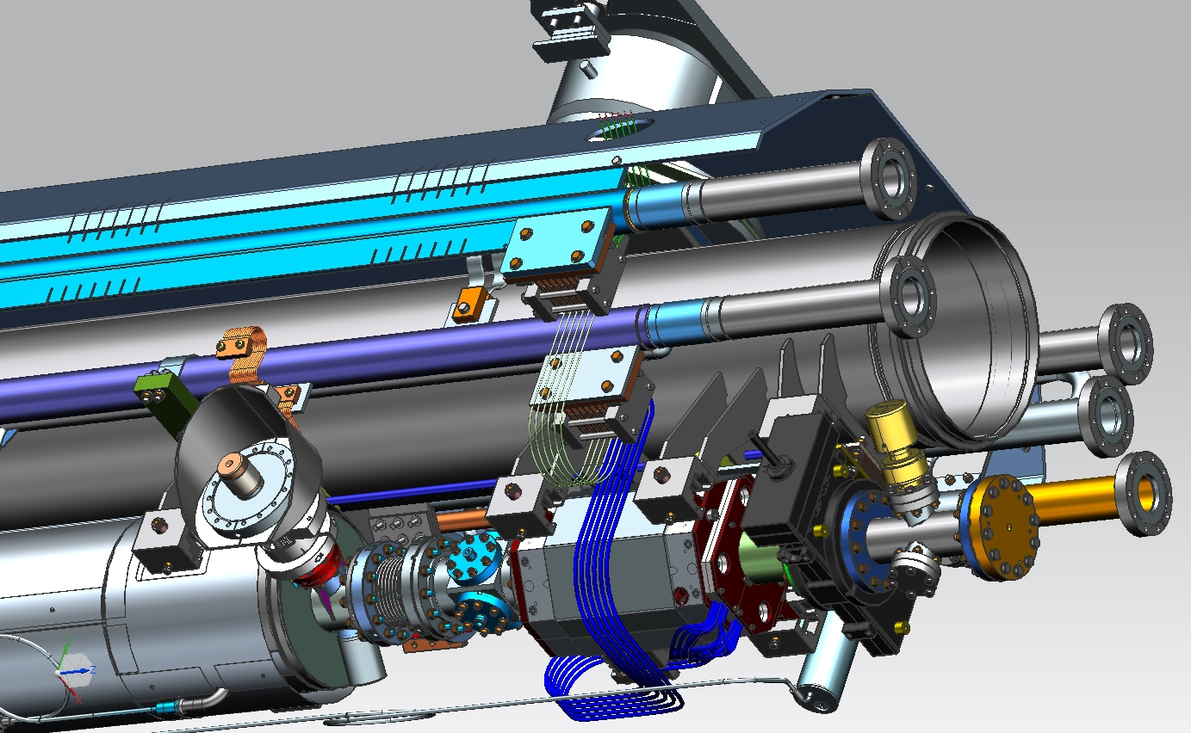

Slide 13
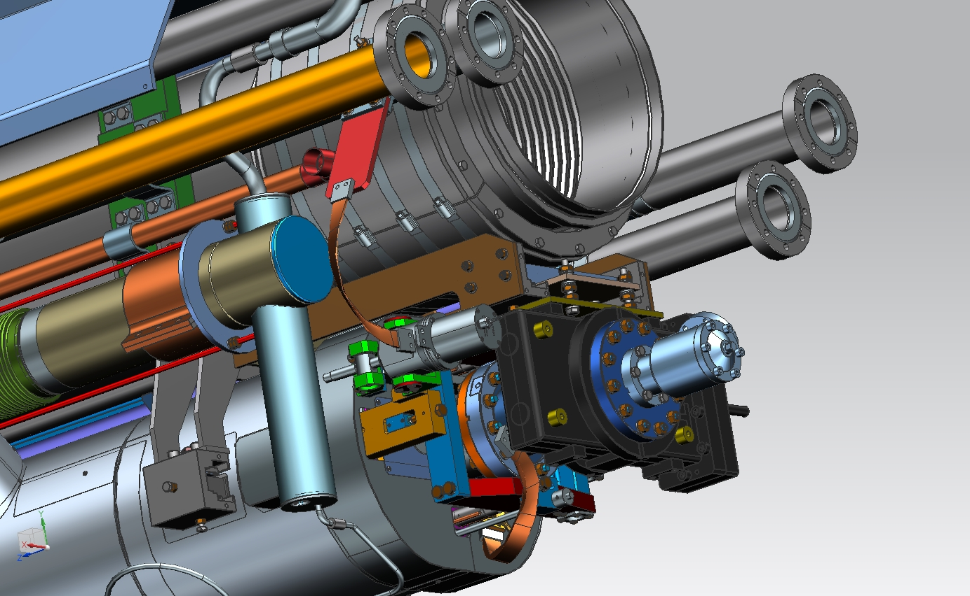

Slide 14
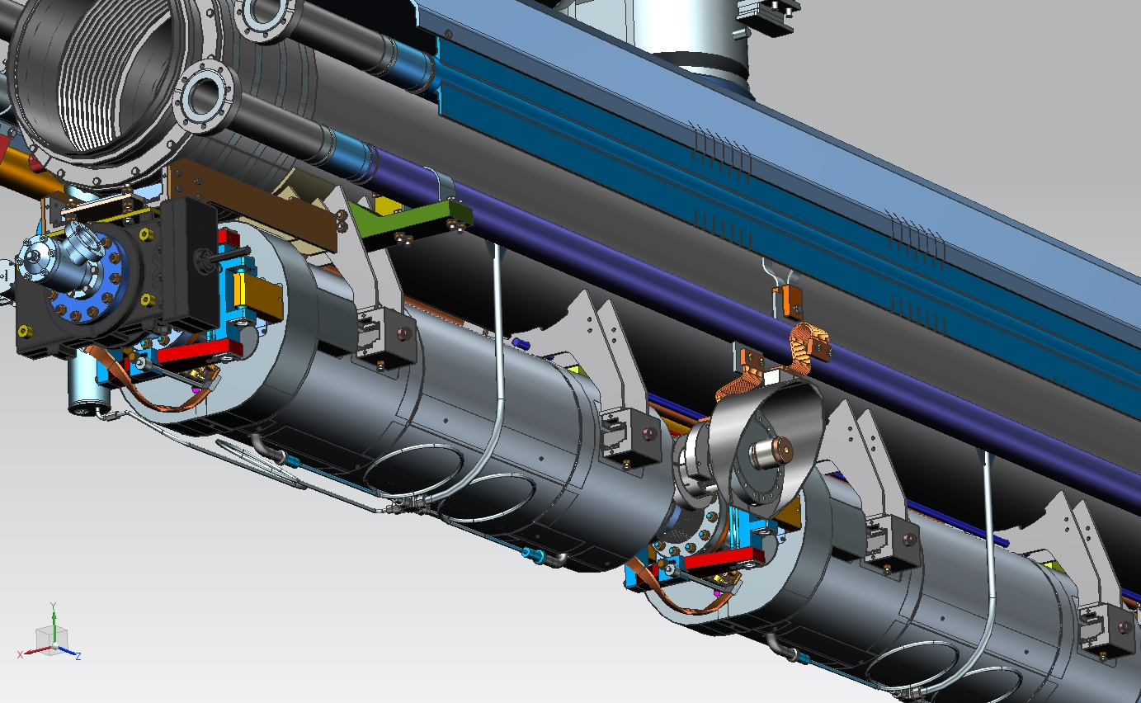

Slide 15
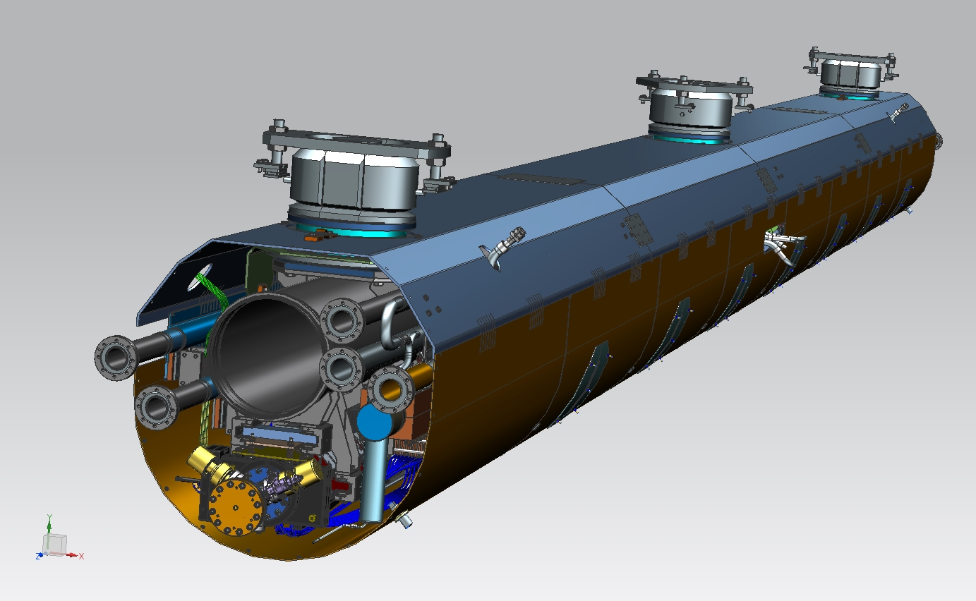

Slide 16
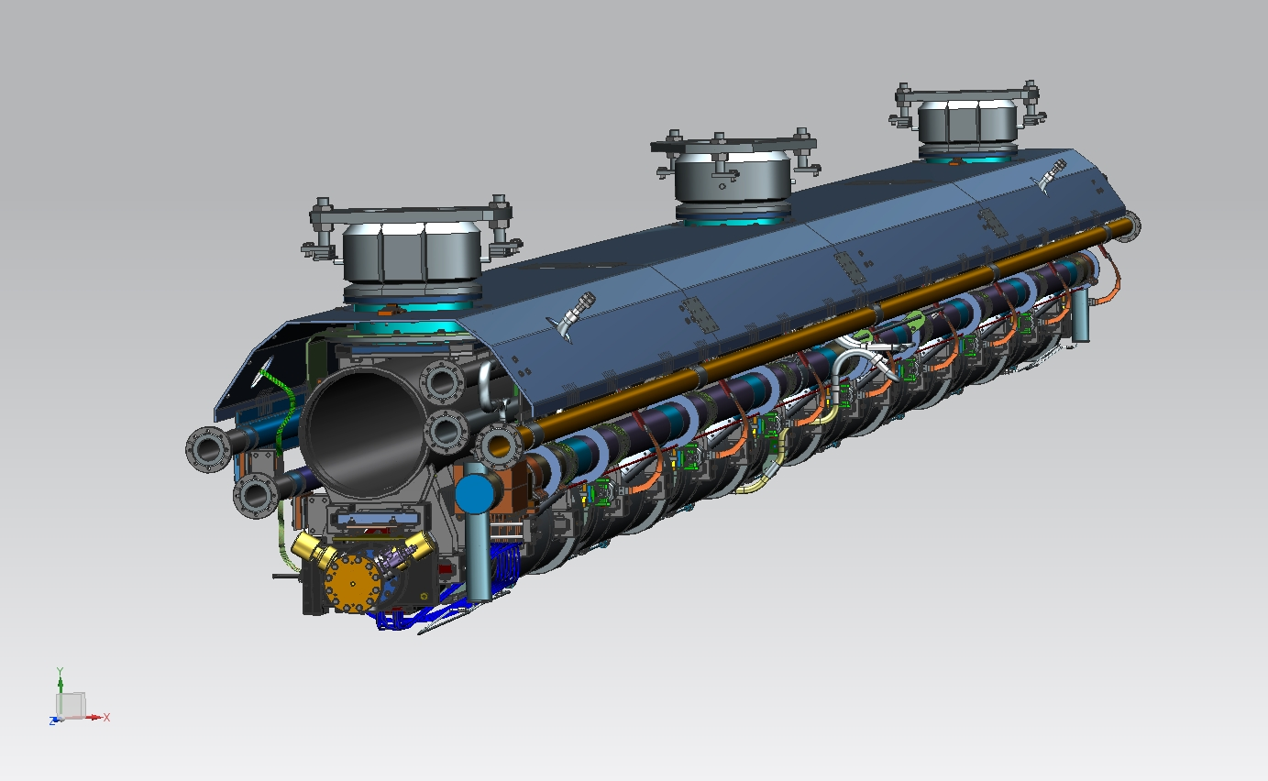

Slide 17
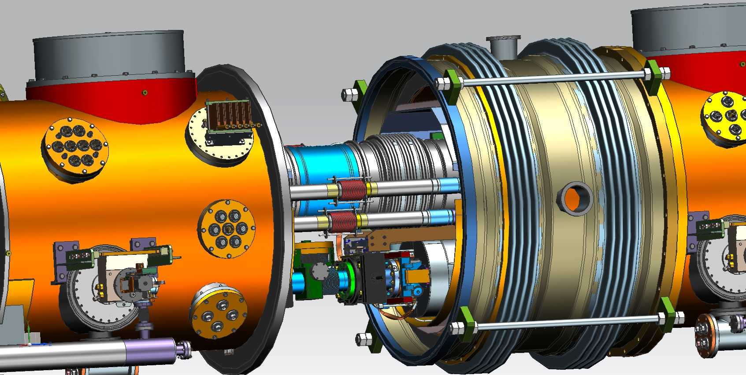

Slide 18
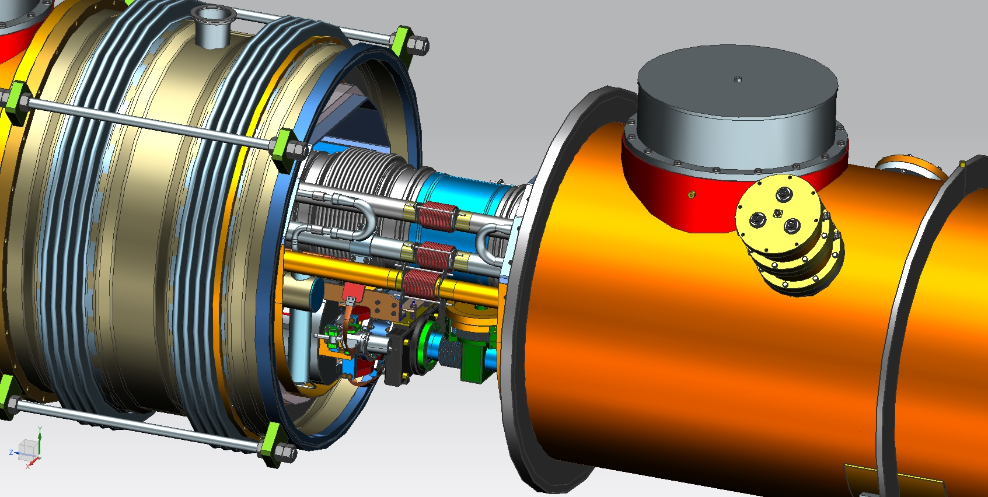

Slide 19
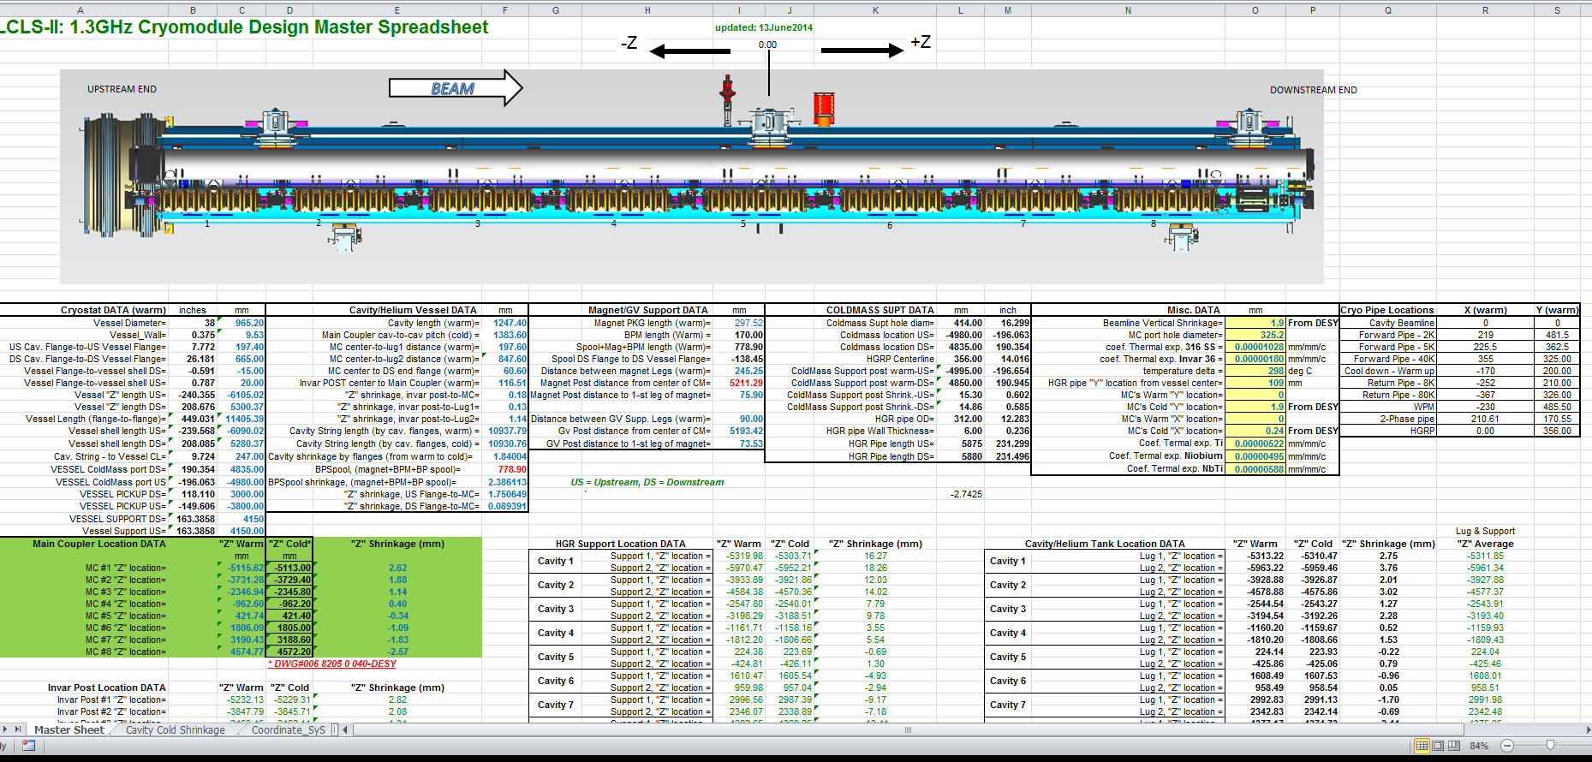
Spreadsheet with cold and warm element positions (consistent with MAD deck)

Slide 20
Alignment
Alignment design and procedures based on
  TESLA Test Facility experience at DESY
  CM1, CM2, and FLASH 3.9 GHz cryomodule experience at Fermilab
  Jlab experience for CEBAF and SNS
  Recent XFEL procedures
An LCLS-II workshop on alignment with SLAC, Jlab and Fermilab participation is planned later in May
Information added to backup slides
  Thermal contraction allowance
  2-phase pipe closure, compensation for pressure loads
  Post-shipment survey mark

Slide 21
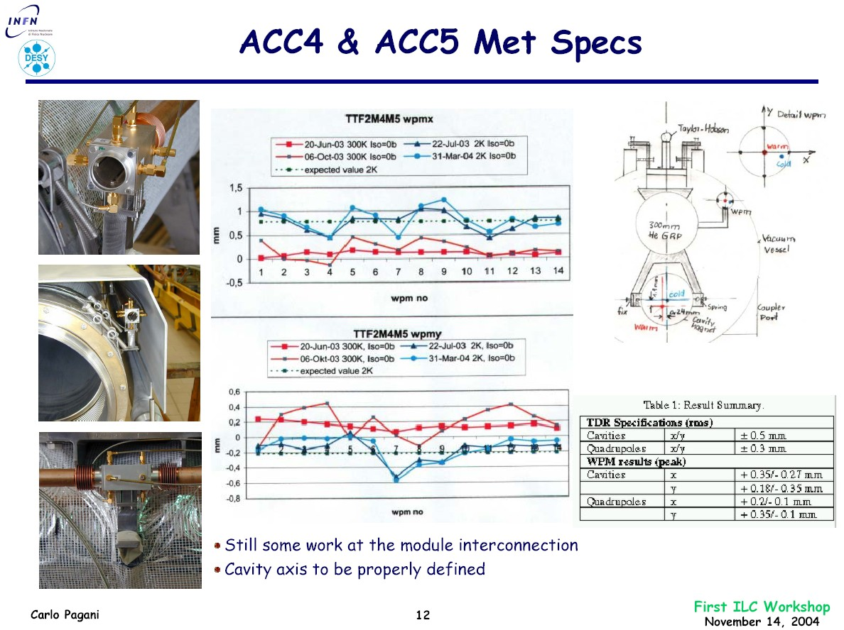
TESLA design alignment verification

Slide 22
y + x on Cavities
0.24mm warm offset on cavities
1.97mm cold contraction.
At cold the distance
to the center is ~245mm
Springs in x
0.24 mm cold contraction to “0”

Slide 23
y + x on Quad/BPM
No springs in x
1.97mm cold shrinking.
At cold the distance
to the center is ~245mm
Same as for cavities
Contractions offset for magnet
No offset for warm vs cold

Slide 24
Reasons of y + x offsets
x on cavities
  The material of the He-vessels and the cold mass is different – Ti and Stainless steel different shrinking factor
  To compensate this the support have in x in direction to the couplers springs.
  The calculate Δ value of the shrinking is ~0.48mm
  To align the cavities with a offset of 0.24mm in warm the cavities will have in cold “0” because the springs are only on one side (coupler direction) installed.
  On the other side are fix screws installed in this case the cavities must move towards to the couplers
x on Quad/BPM
  No offset in x for the Quad/BPM needed because the material of the Dummy vessel and the coldmass identical (both stainless steel)
  No springs installed at both sides on the x supports
y on cavities and Quad/BPM
  The coupler ports in the vacuum vessel are 246mm to the center of the module vacuum vessel
  The module string is in warm align 247mm to the module vacuum vessel center
  In this case the coupler antennas go during the cool down from -1.0mm through 0.0mm to +1.0mm in cold (stress reduction)
  In cold the module string is 245mm to center of module vacuum vessel
  At Desy (Flash and XFEL) the beam lines in the Feed- a. End-boxes are align with 245mm to the center of the box vacuum vessels.
  If I remember right the specification of the NML Feed- a. End-boxes identical with the FLASH boxes?
  If the center of the module vacuum vessels and the Feed- a. End-box vacuum vessels in the same axis the string beam line in the module will in cold also in the axis of the beam line in the Feed- a. End-boxes
  During the beam line connection to the Feed- a. End-boxes you will have a offset of ~2.0mm

Slide 25
Alignment – checking after shipping
XFEL info here from 3 Feb 2015 email from Georg Gassner
For the XFEL production modules
  Measure the posts where the strings are mounted and the end of the strings
  Mount measurement points onto the valve assembly of the strings, which are accessible when the transport caps at the end of the module and the top flanges are removed.
Before the initial production started (>10 years ago)
  DESY measured the position of the cavities directly through ports
  and they had stretched-wires setup to determine the straightness of the strings.
For the new production of the XFEL cryo module in France
  They took the first few modules apart in Hamburg and checked the geometry of the strings.
  What they found was that measuring the position and orientation of the ends of the strings and the posts was sufficient to check for transport related movement as long as it is correctly mounted.
This is also what we did for CM1 and CM2
  Alignment features were installed with epoxy on the Gate Valve body for both sides of cavity string
  We measured the cavity string position on the support posts and at the gate valves relative to the vacuum vessel before and after shipping

