Slide 1

Cryomodule Fiducialization at Jefferson Lab
May 22, 2015
Chris Curtis, Alignment & Metrology Group Leader

Slide 2
Alignment & Metrology Group
Alignment & Metrology group is part of the Engineering Division.
Alignment group is responsible for the fiducialization, positioning and alignment of beam line components in the CEBAF accelerator, Endstations and the FEL.
Group consists of 2 engineers, 2 associate coordinators, and 4 field technicians.
Equipment includes 4 laser trackers, 3 PCMM arms, as well as electronic levels, theodolites and optical tooling transits.
Notes:
Alignment and Metrology Group is part of Eng Div at Jlab. Service group working across the lab.
Other Divisions at the lab include Accelerator, Physics, ESH&Q and Facilities.
SRF are part of Accelerator Division.
Group responsibilities & composition. Cut down significantly since end of 12 GeV upgrade.

Slide 3
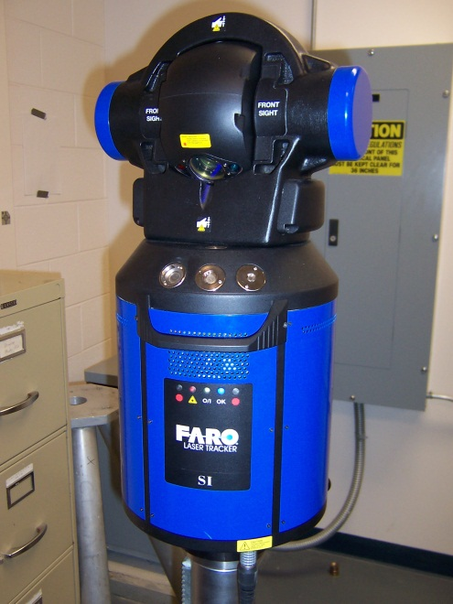
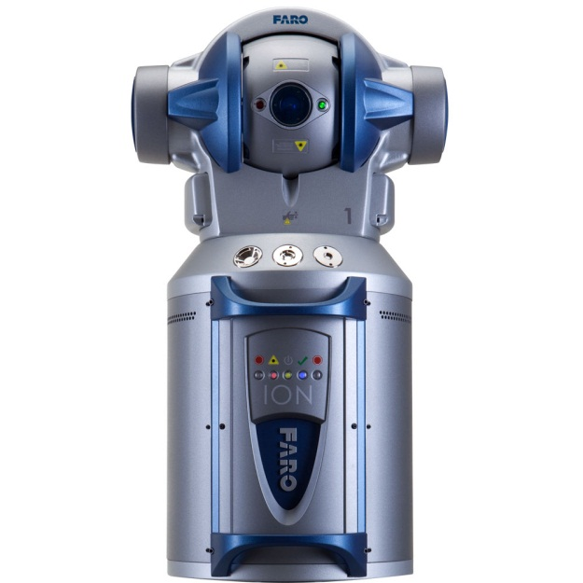
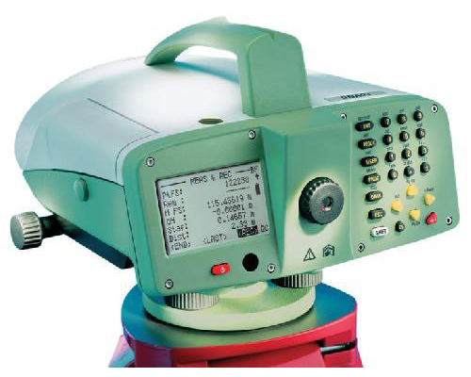
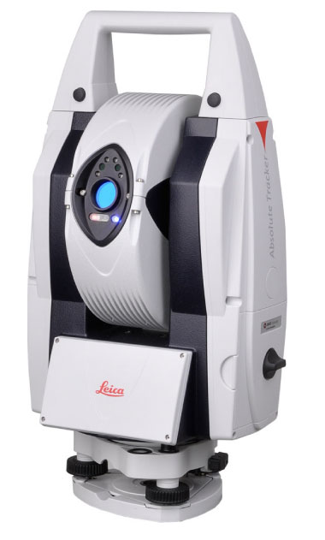
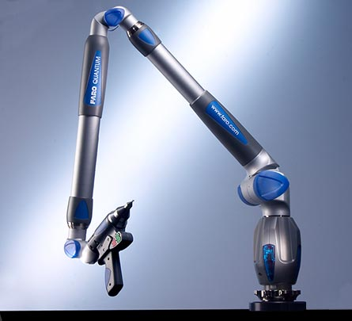
Equipment – new(er)
Faro SI Tracker
Faro X Tracker
Faro Ion Tracker
Leica DNA03 level
Leica AT401 Tracker
Faro Quantum, Platinum & Gold Arms
Notes:
When the accelerator control network was set up ~ 1990 used a monument designed to take a 1.5” sphere.
The idea was, of course, that it would be compatible with a laser tracker target.
It took almost 15 years for us to get our first tracker – Faro SI purchased in 2004.
Since then have added the X (poor reliability), Leica AT401, and recently the Faro Ion.
Been using arms since ~1999. Often referenced to a local coordinate system in order to align more inaccessible components e.g. targets

Slide 4
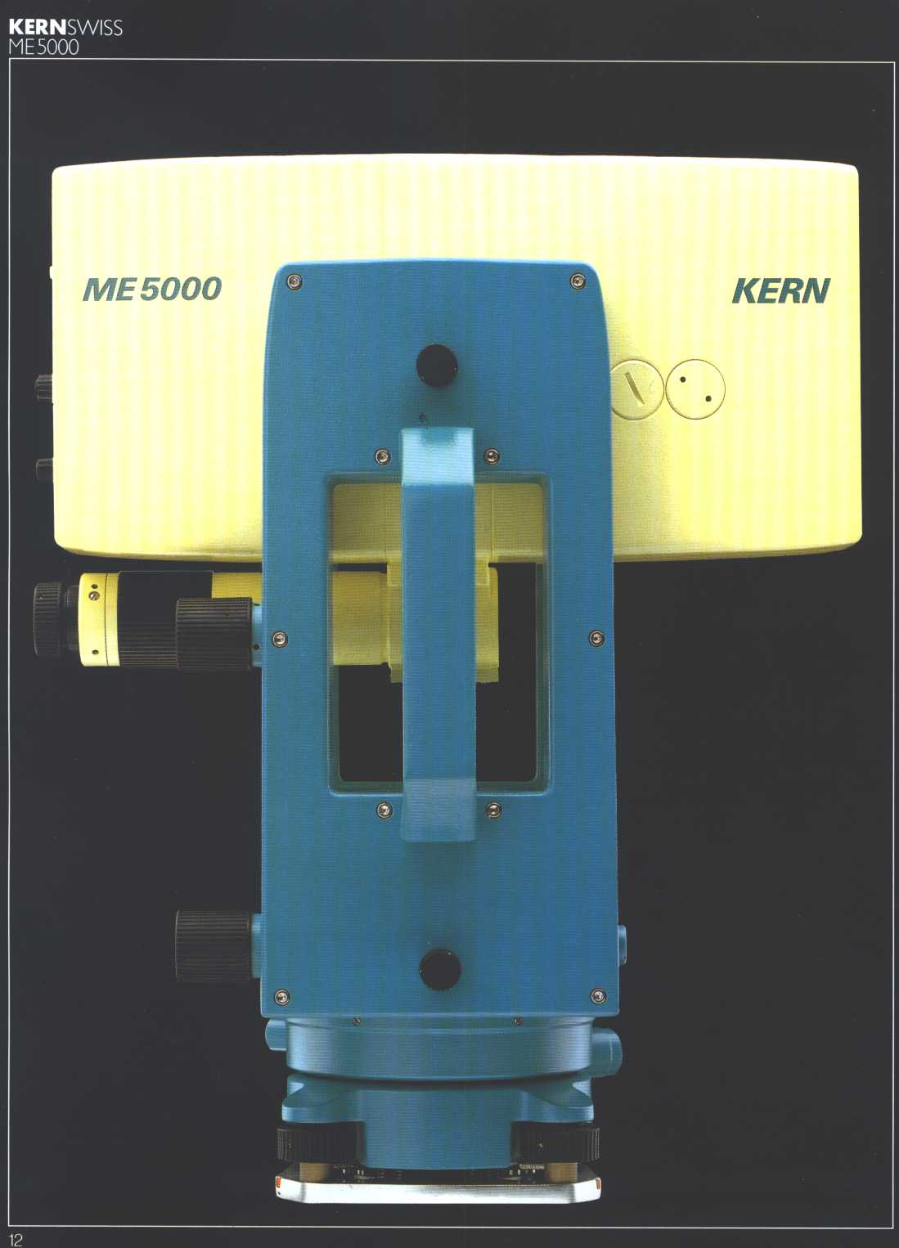
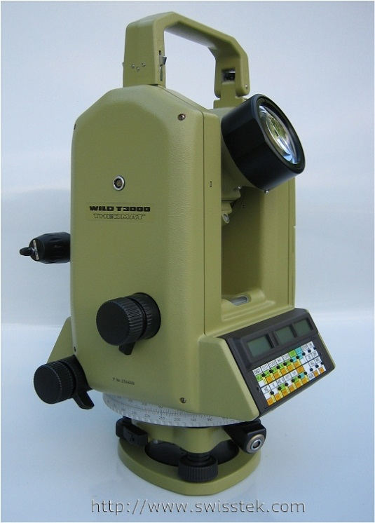
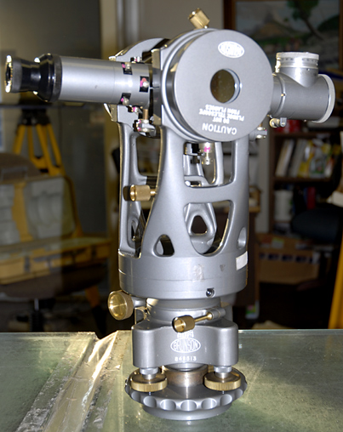
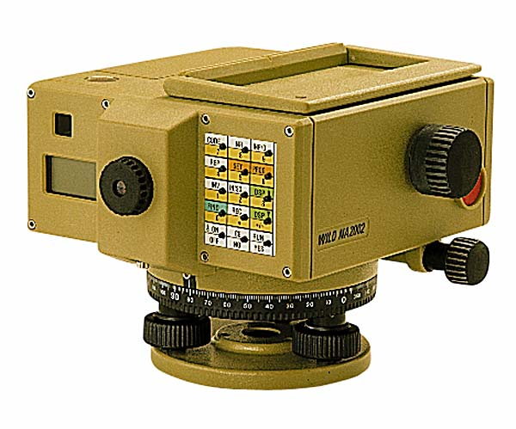
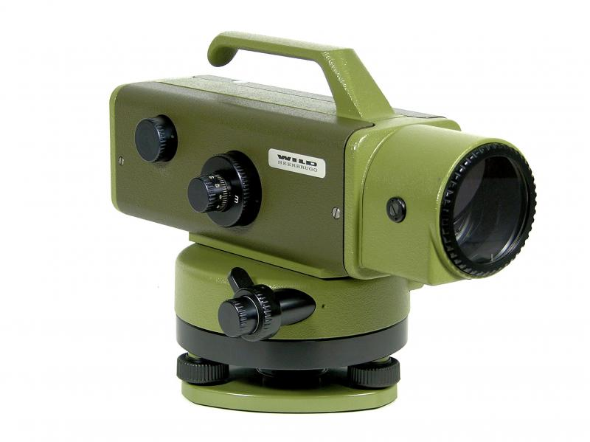
Equipment – old school
Leica T3000 / TC2002
Kern ME5000
Brunson Transits
Leica NA2002 level
Leica N3 level
Notes:
So all of the survey of the original (4-6Gev) CABAF was done with theodolites and YES optical tooling.
Still use the Mekometer ME5000, recently fairly extensively to monitor movements of the main accelerator control network.

Slide 5
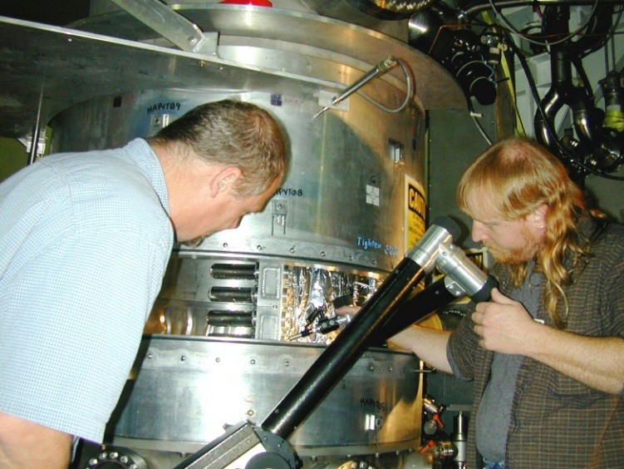
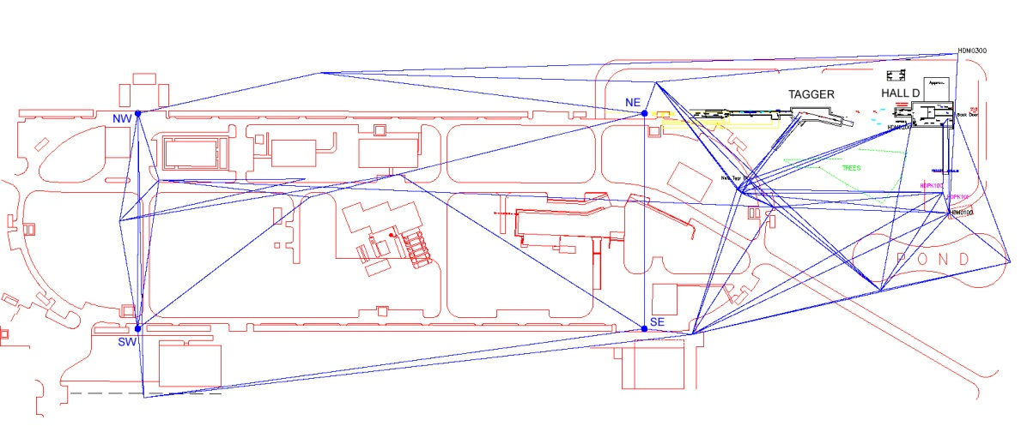
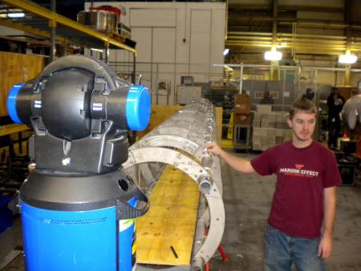
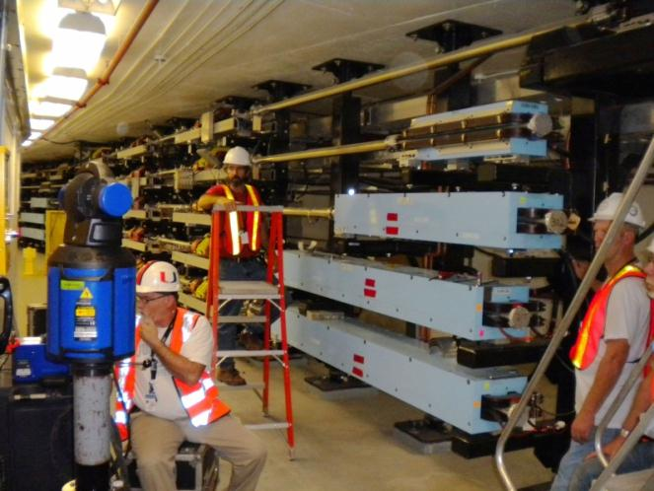
Alignment Across the Lab
Endstation alignment of targets and detectors
Network for new experimental Hall D
CEBAF arc magnet alignment
Calibrations
QC inspections
Notes:
As stated, alignment activities across the lab.
E.g. of local control and arm to align a cryo target in Hall A
QC work of cryomodule spaceframe
Alignment of CEBAF arcs following 12Gev installation
Network for new experimental hall. Hall D; no direct link to CEBAF tunnel, so needed to transfer up penetrations, across surface, down the ramp and into a shielded collimator cave for a 2mm collimator. Customer satisfaction was expressed with: “looks like the alignment was OK”.

Slide 6
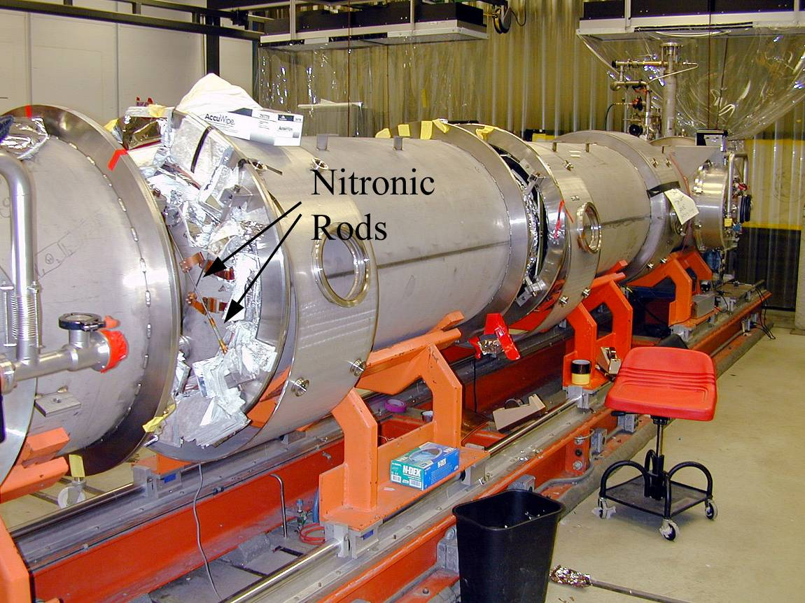
Cryomodule Fiducialization – C20
Original CEBAF cryomodule
Designed to produce 20MV output
No space frame
Vacuum vessel built in segments
Notes:
Originally 40 C20 cryomodules in the main CEBAF accelerator.
No space frame [Listed properties]

Slide 7
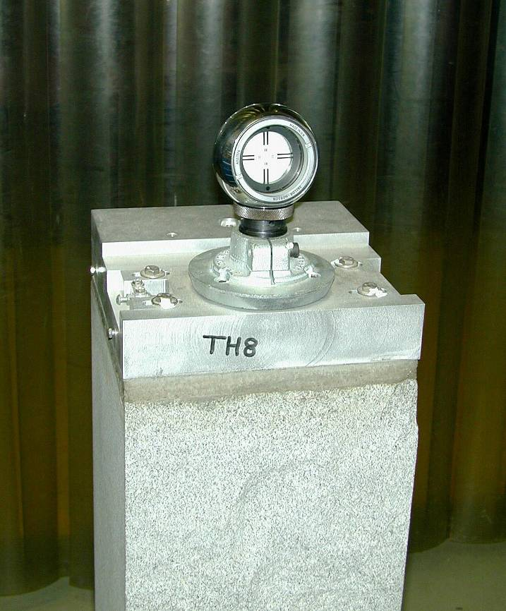
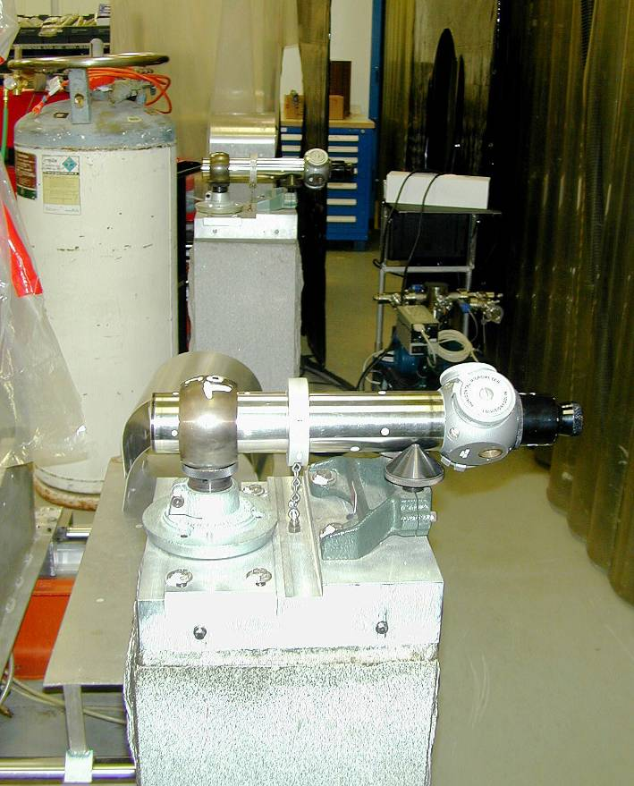
Cryomodule Fiducialization – C20
Notes:
In the assembly area there are 4 granite piers located 2 on each side of the cryomodule
These were aligned w.r.t. the assembly rails, and act as offset references for the cavity center-line

Slide 8
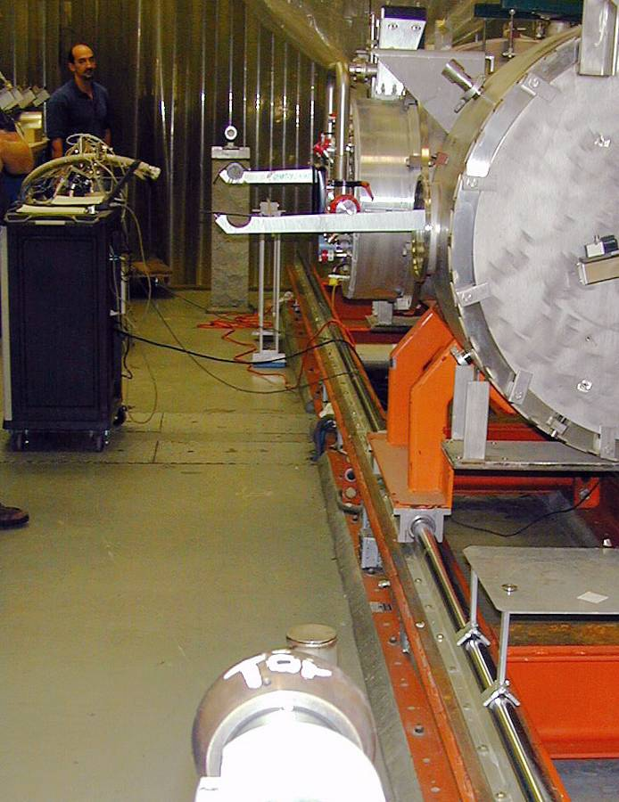
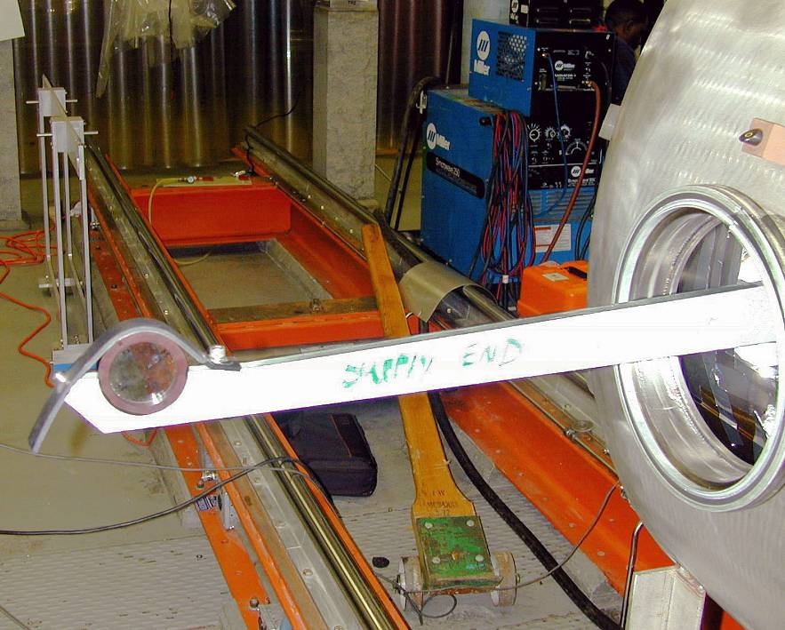
Cryomodule Fiducialization – C20
Notes:
During assembly, target arms are attached to the end flanges of the cavity pairs.
Line scopes and TH spheres on the granite piers provide a reference l.o.s
The cavities are brought into alignment with resect to the l.o.s. using nitronic rods

Slide 9
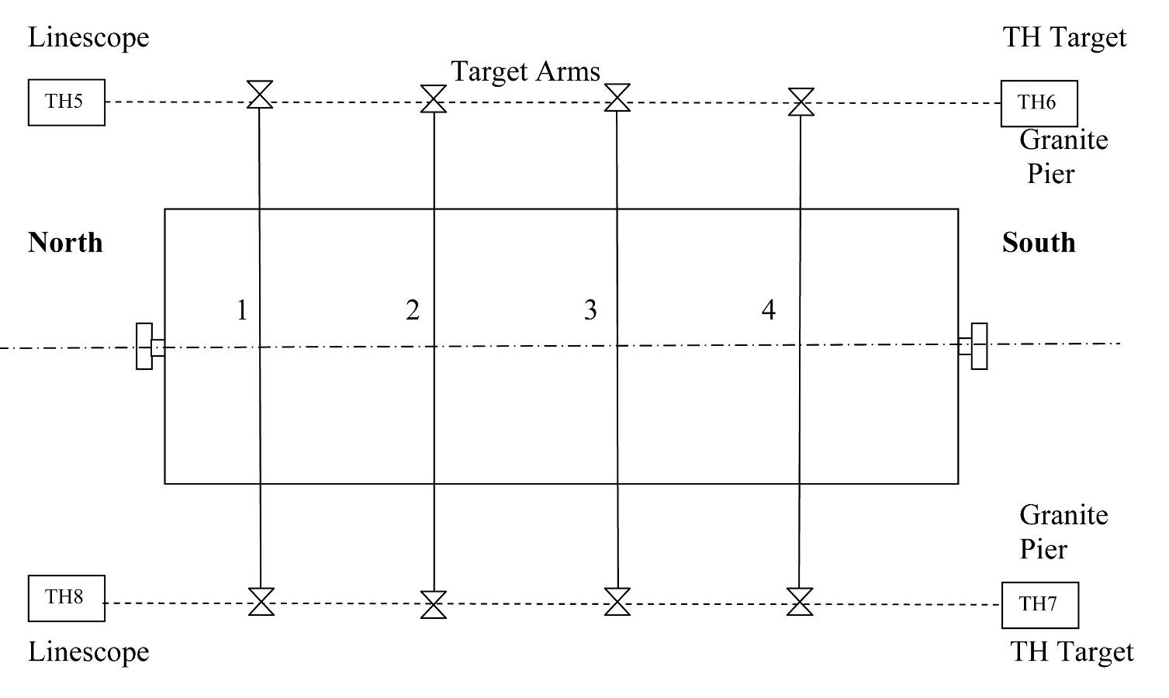
Cryomodule Fiducialization – C20
Notes:
This is what it looks like schematically
For the C20 target arms were visible on both sides giving some redundancy
All of these steps were carried out by SRF techs. as part of the assembly/production process.

Slide 10
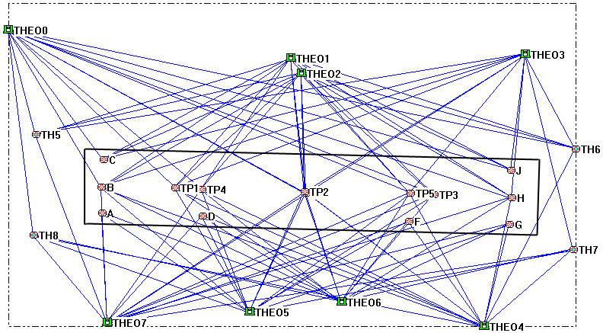
Cryomodule Fiducialization – C20
Notes:
Alignment group then responsible for transferring from the granite piers to fiducials on the vacuum vessel
All four granite piers were surveyed, the line bisecting these defined the cavity center-line.
This shows a typical fiducialization survey using theodolites
Four instruments on each side of the cryomodule with alternating high:low setups
Adjusted using 3D bundle – 3DCD developed at SLAC

Slide 11
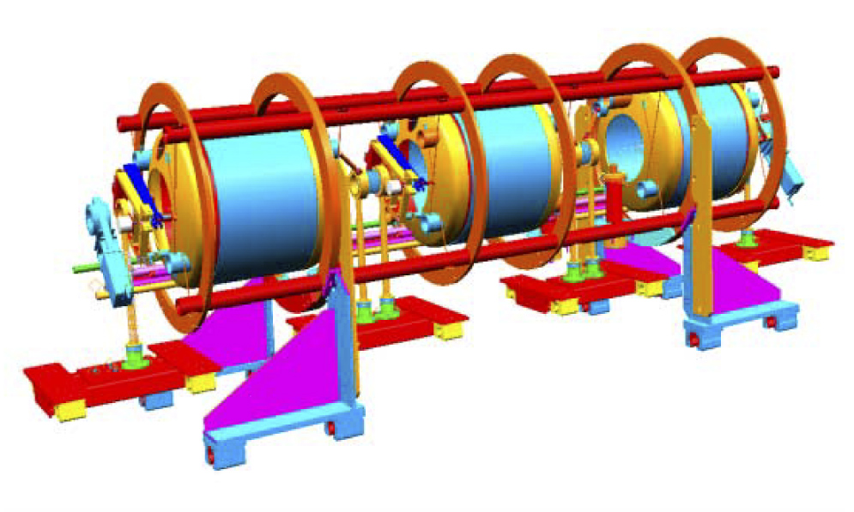
Cryomodule Fiducialization – SNS
Spaceframe Design
Insertion of entire cavity string
Vacuum vessel made as one unit
Transportation stability
Notes:
SNS design used spaceframe [Listed properties]

Slide 12
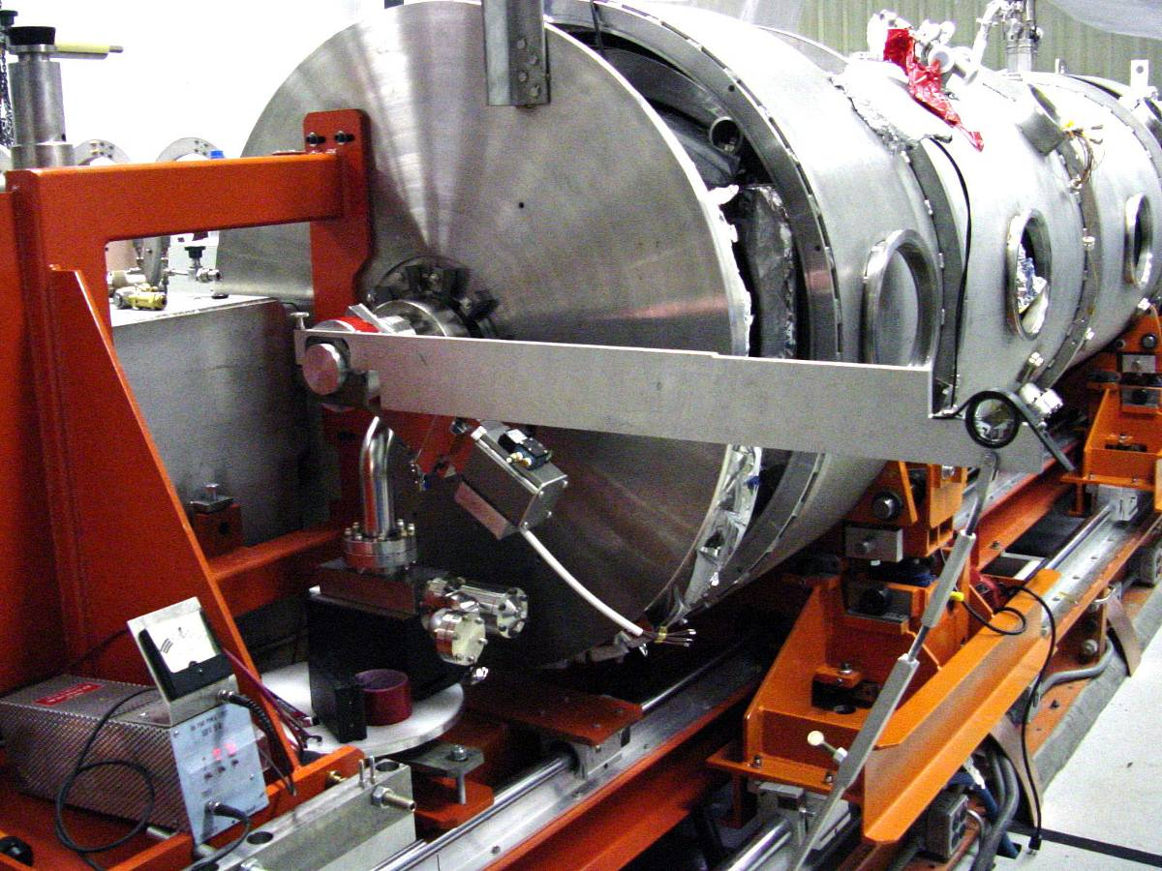
Cryomodule Fiducialization – SNS
Arms inserted from one side only
Notes:
Similar alignment procedure, except that arme no longer passed through both sides.
Meant that accurate levelling the arms was crucial.

Slide 13
Tracker vs. Theodolite
 |  | Tracker |  |  |  | Theod.
 | z | x | y |  | z | x | y
TH1 | 0.018 | 0.014 | 0.017 |  | 0.072 | 0.035 | 0.032
TH2 | 0.015 | 0.011 | 0.010 |  | 0.032 | 0.016 | 0.017
Pt6 | 0.009 | 0.009 | 0.006 |  | 0.026 | 0.020 | 0.012
Pt7 | 0.009 | 0.009 | 0.006 |  | 0.032 | 0.020 | 0.013
Pt8 | 0.010 | 0.009 | 0.007 |  | 0.041 | 0.021 | 0.015
Pt9 | 0.010 | 0.009 | 0.008 |  | 0.047 | 0.022 | 0.016
Pt10 | 0.012 | 0.010 | 0.009 |  | 0.052 | 0.024 | 0.018
Avg. | 0.012 | 0.010 | 0.009 |  | 0.043 | 0.022 | 0.018
Notes:
Same time as we got our first tracker.
Comparison of standard errors between instruments
Improvement in all 3 dimensions, especially Z (axis of cryomodule)

Slide 14
CEBAF 12 GeV Upgrade
New Hall
Upgrade arc magnets
and supplies
Add 5 cryomodules
N. Linac
E.Arc
20 existing cryomodules
CHL upgrade
S. Linac
Add arc
20 existing cryomodules
W.Arc
Add 5 cryomodules
Enhanced capabilities
in existing Halls
Notes:
12 GeV upgrade required 10 new cryomodules each capable of 100MV output.

Slide 15
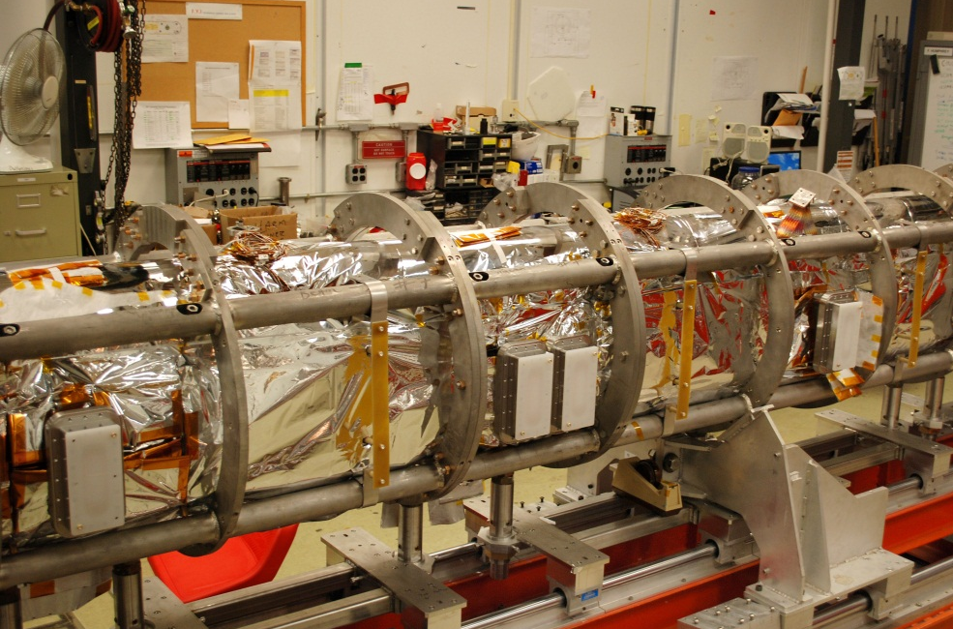
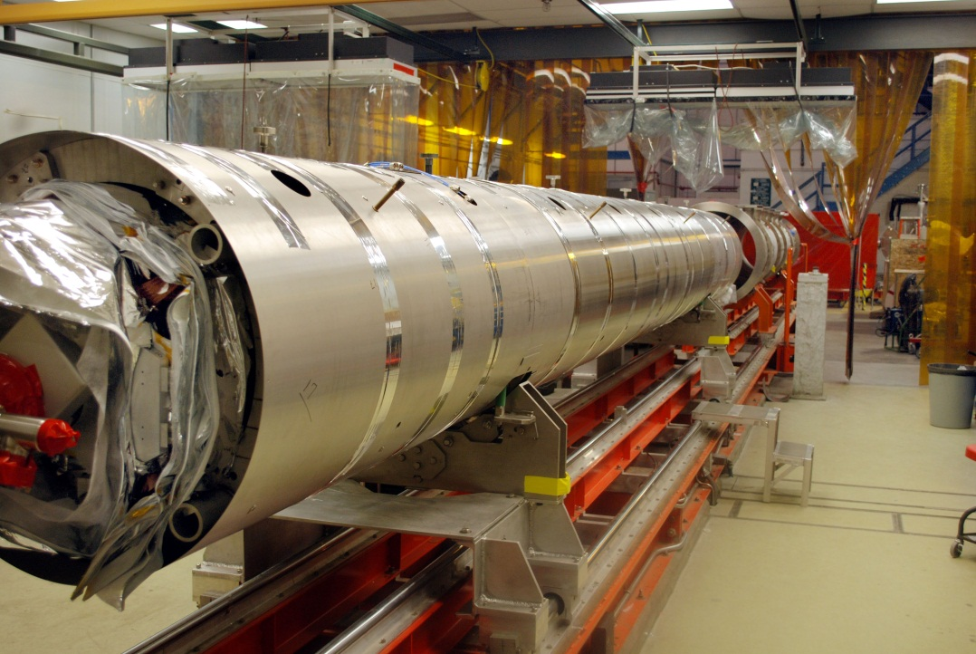
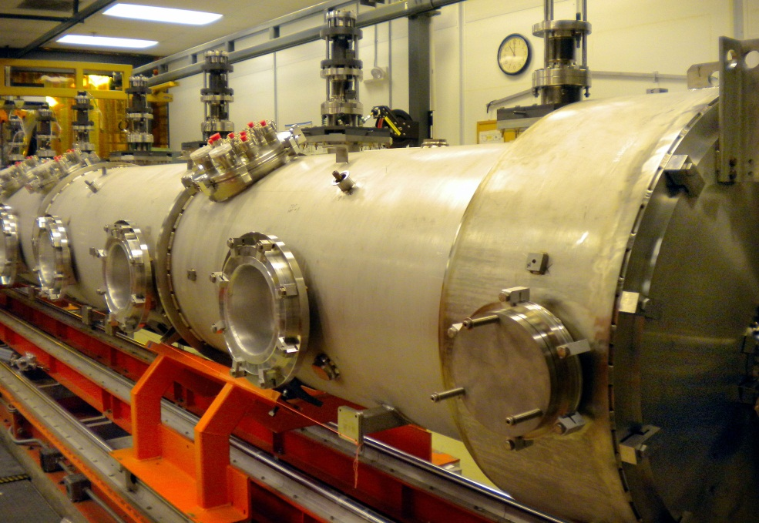
Cryomodule Fiducialization – C100
Pier
Ears
Spaceframe maintained
“Ear” targets on spaceframe
Two stage process
Piers to Ears
Spaceframe rolled into vac vessel
Ears to Vac. Vessel
Ears
Notes:
C100 maintained spaceframe design, allowing vac vessels to be built by offsite vendor
This required cavity string/spaceframe to be rolled out of assembly area then inserted into vac vessel.
Two stage fiducialization process developed with tranfers to “ear” targets on the spaceframe.
i.e. cavities aligned to granite piers as before
Transfer granite piers to the ears
Later transfer ears to fiducials on vac vessel
Did find some issues with the roll out process – roll on some modules were affected

Slide 16
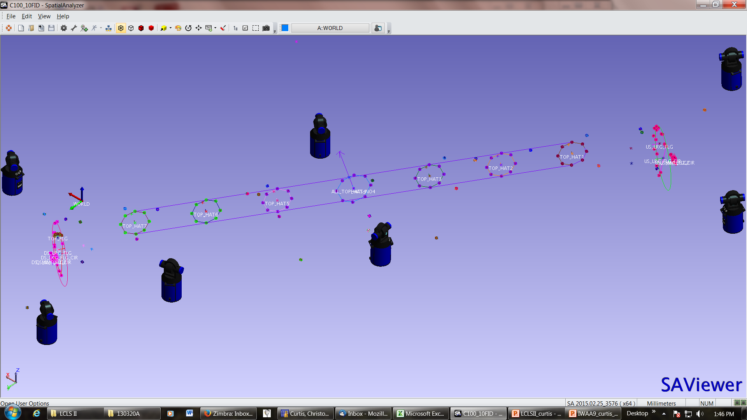
Cryomodule Fiducialization – C100
Ear 5
Ear 6
Ear 7
Ear 1
Ear 8
Ear 2
Ear 3
Ear 4
Notes:
Now using trackers full time
Also started using SA – mostly for convenience of instrument interfaces

Slide 17
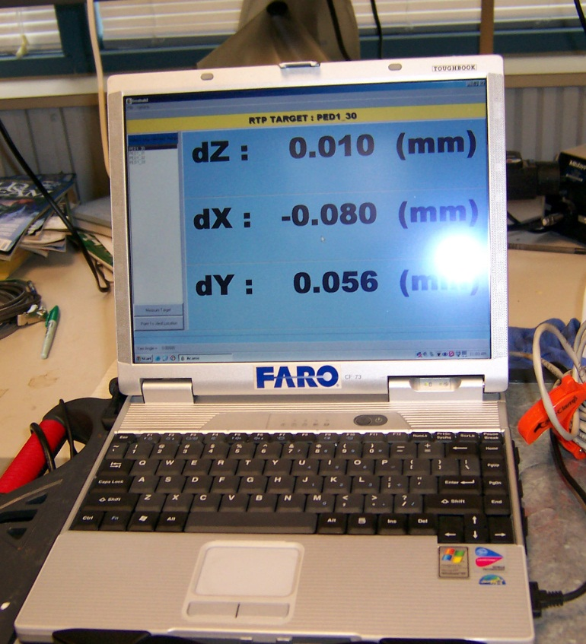
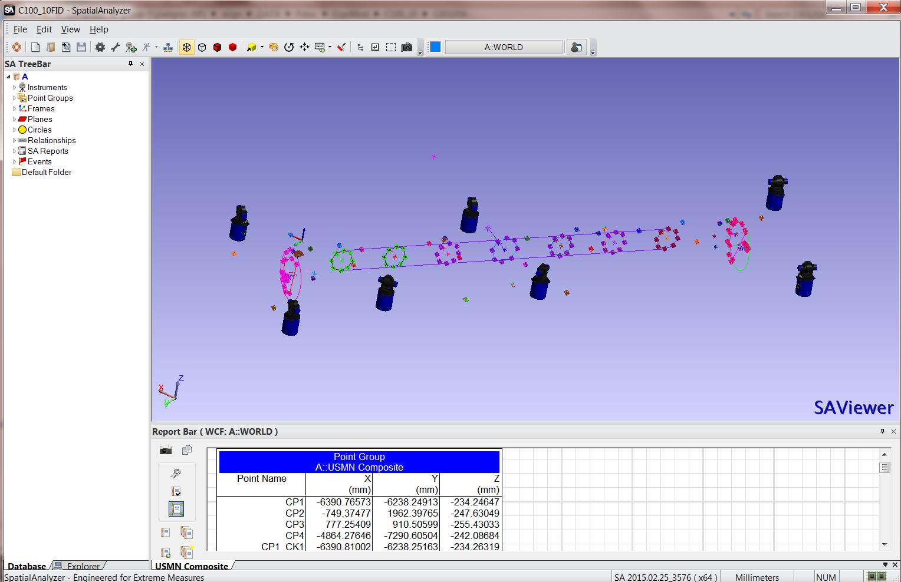
Software
ACAMS
Developed at Jlab
Uses 3DCD bundle developed at SLAC
Used on all C20 / SNS modules
Spatial Analyzer
Developed by NRK
Used on some of the C100 modules
Allows for great flexibility of instruments
Notes:
Ability to use both software packages: ACAMS and SA.

Slide 18
Summary
    Described general alignment process during assembly
    Line scopes used to align cavities to granite piers
    Pier locations used as reference during fiducialization
    Some issues found during assembly:
      control of roll during re-insertion
      need to pay attention to key interfaces (cryo bayonets, RF ports etc.) for tunnel fit-up
    Alignment Group ready to assist wherever needed
Notes:
[As Listed]

