Slide 1
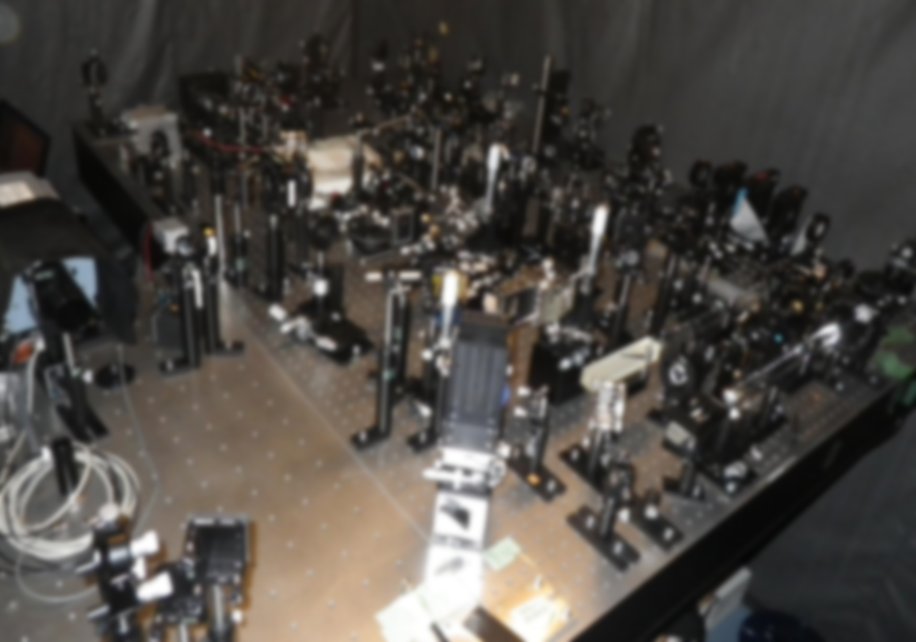
September 11-14, 2018
ULITIMA 2018
Argonne National Laboratory
Single-shot ultrafast imaging using spatiotemporal dispersion of ultrashort pulse
Keiichi Nakagawa
Dept. Bioengineering, Precision Engineering,
The University of Tokyo

Slide 2
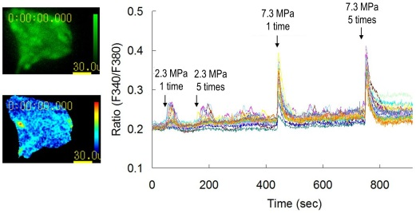
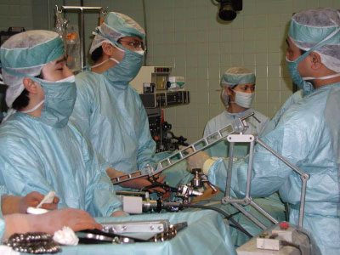
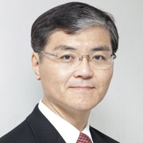
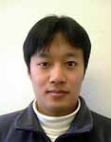
Biomedical Precision Engineering Lab.
[Ca²⁺] increase evoked by acoustic waves
Computer assisted surgery
MDCK cells
I. Sakuma
U. Tokyo
A. Tsukamoto
NDA, Japan

Slide 3
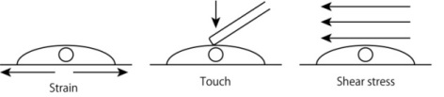
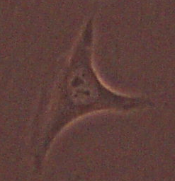
Motivation: acoustic interaction with cells
Stretch
Touch
Shear stress
Acoustic wave
I want to see it!
Cell

Slide 4
I needed…
Sub-nanosecond temporal resolution
  Speed of sound: 1.5 µm/ns
Single-shot capability
  Structure of cell is changed
Good spatial resolution
  To analyze complex events
Low photo-damage of cells
  Intensity is focused both spatially and temporally
Capability for visualizing acoustic waves and cells
  Differential interference contrast (DIC) microscopy
AW
~ 10 ns
~ 10 µm

Slide 5
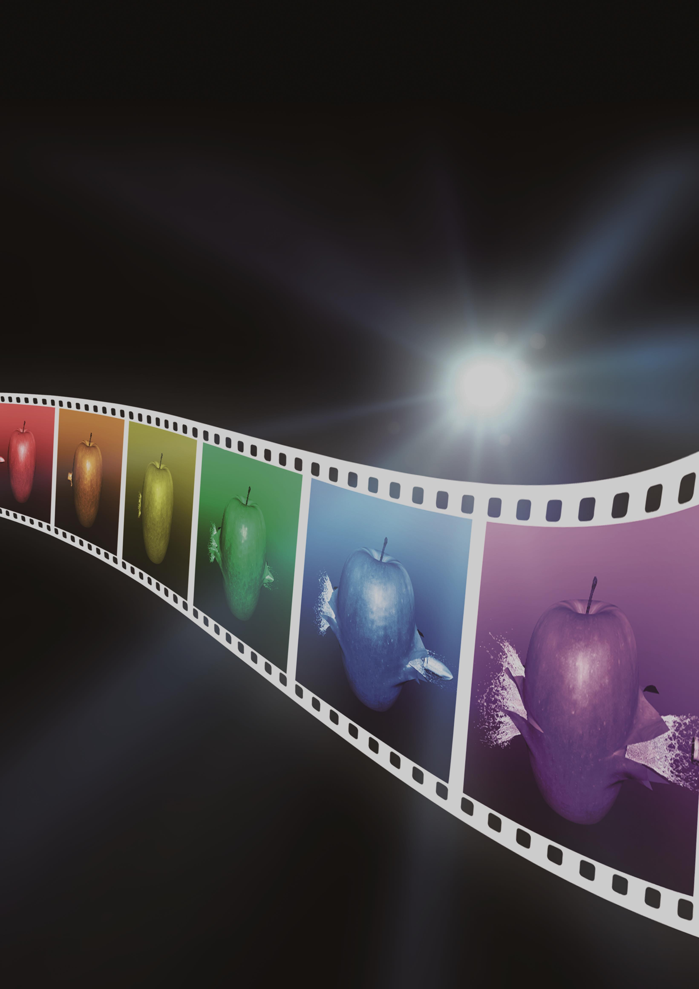
Sequentially Timed All-optical Mapping Photography
(STAMP)
K. Nakagawa et al.
Nature Photonics 8, 695 (2014)
Japanese Patent 6120280,
I. Sakuma, K. Nakagawa, A. Iwasaki, F. Kannari, Y. Oishi, A. Tsukamoto
Filing date: Aug 20, 2013, Issue date: Apr 7, 2017
Notes:
So, here I want to introduce a new type of ultrafast imaging method which we call STAMP that stands for sequentially timed all-optical mapping photography. With this method, we can perform motion-picture femtophotography of ultrafast dynamics.

Slide 6
Principle

Slide 7
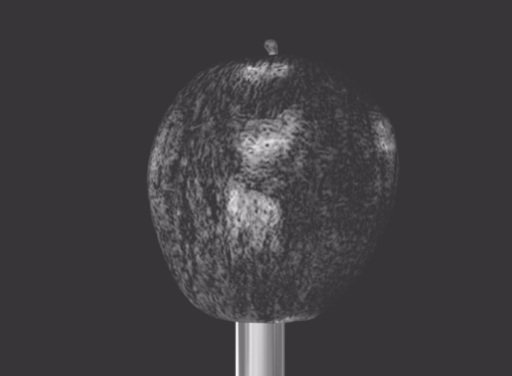
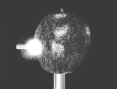
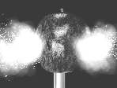
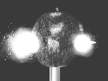
Sequentially Timed All-optical Mapping Photography
Time domain
–
Spectral domain
t₁
t₂
t₃
t₁
t₂
t₃
Spectral domain
–
Spatial domain
s₁
s₂
s₃

Slide 8
Basic configuration of STAMP
Computer
Target
Daughter
pulses
Ultrashort
pulse source
Image sensor
Spatial
mapping device
Temporal
mapping device
Notes:
This is a rough schematic of STAMP. It consists of an ultrashort pulse source, temporal mapping device, spatial mapping device, image sensor, and computer. The ultrashort pulse from the source is temporally stretched and segmented into several daughter pulses by the temporal mapping device. The daughter pulses are incident onto the target as successive flashes for stroboscopic image acquisition. Then, these pulses are separated by the spatial mapping device and incident onto different areas of the image sensor without image deformation.

Slide 9

Operation of STAMP

Slide 10
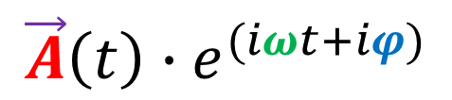
I needed…
Sub-nanosecond temporal resolution
  STAMP achieves sub-nanosecond resolution in videography
Single-shot capability
  Multiple frames can be obtained in a single shot
Good spatial resolution
  ~images quality of conventional microscopes
Low photo-damage of cells
  High-sensitivity imager can be used
Capability for visualizing acoustic waves and cells
Amplitude
Wavelength
Phase
Polarization
Intensity image
STAMP
DIC
$$\vec{A}\left(t\right){∙e}^{(iωt+iφ)}$$

Slide 11
Features of STAMP
High temporal resolution
  STAMP achieves femtosecond resolution in videography
Single-shot capability
  Multiple frames can be obtained in a single shot
Good spatial resolution
  ~images quality of conventional microscopes
Detector
  Cooled CCD, EMCCD, ICCD, high-speed imager, X-ray/IR imager, etc.
Compatible with conventional imaging techniques and instruments
Amplitude
Wavelength
Phase
Polarization
Intensity image
STAMP
DIC, Holography, Polarization imaging, etc.
$$\vec{A}\left(t\right){∙e}^{(iωt+iφ)}$$

Slide 12
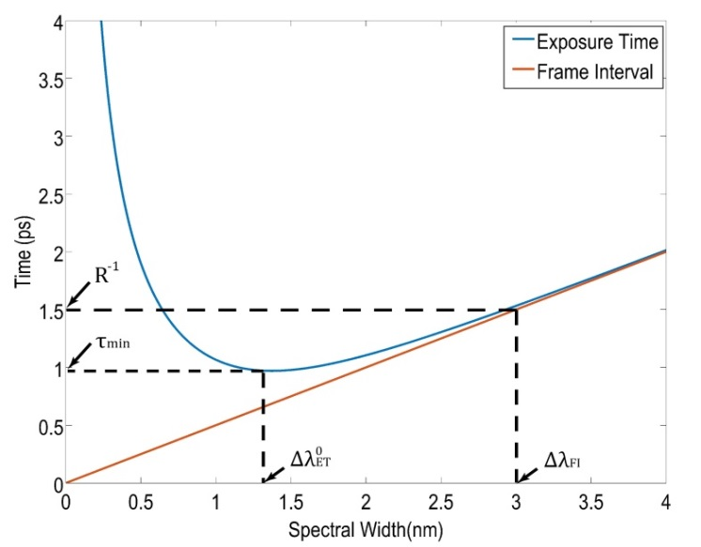
Limitations of STAMP
Requirements for the sample
  Basically, STAMP cannot capture luminous objects
  The object does not have any strong dependence on wavelength
Trade-off between the exposure time and number of frames
Technical limitations
  Bandwidth of light source, configuration of spatial mapping device, etc.
Notes:
To achieve large number of frames, the daughter pulse bandwidth needs to be small, but the exposure time becomes large.

Slide 13
Experimental realization

Slide 14
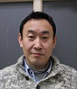



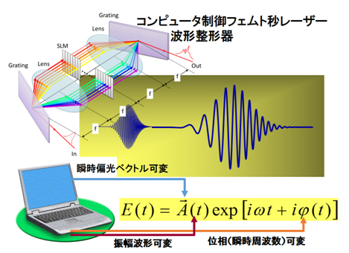
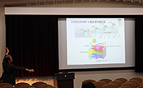
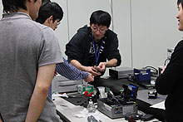
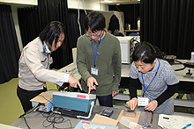
Collaborators
Y. Oishi
Keio Univ.
(KEK, Japan)
A. Iwasaki
U. Tokyo
F. Kannari
Keio Univ.

Slide 15
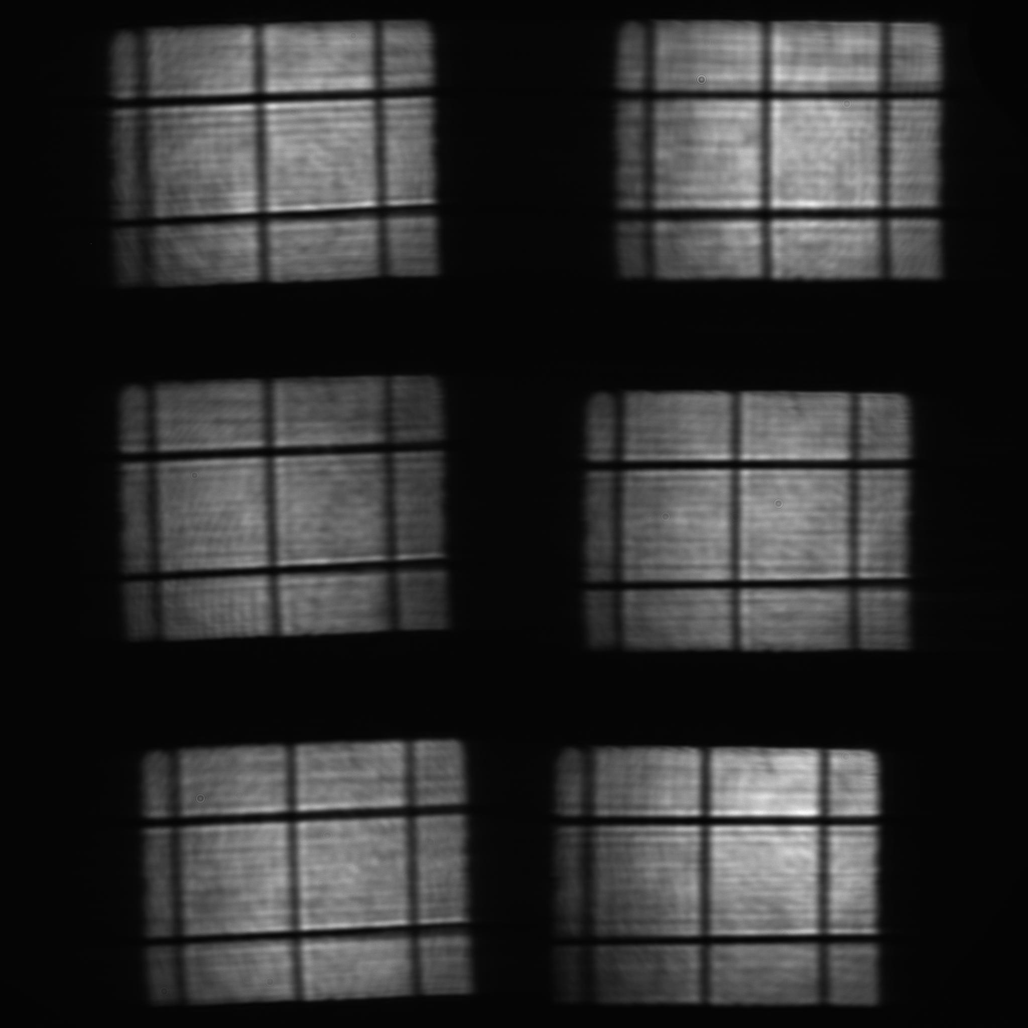
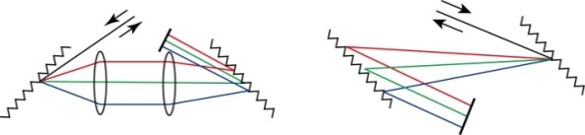

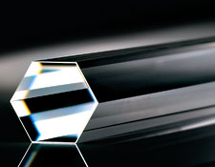


Proof-of-principle experiment
Ti:S laser with CPA
Cooled CCD camera
Pulse duration: 70 fs
Center wavelength: 810 nm
Rep. rate: 1 kHz
Single pulse was generated by an optical chopper and a mechanical shutter
Resolution: 2048×2048
QE: 94% @810 nm
Spectral imaging
with periscope array
Pulse stretcher
Pulse shaper
814-817 nm
811-814 nm
808-811 nm
805-808 nm
802-805 nm
799-802 nm
Lens
Diffraction
grating
Periscope
array
SLM
Cylindrical
mirror
Lens
Grating pair
~ ps
$λ$/2
50 µm
$λ$/2
Diffraction grating
Diffraction
grating
Mirrors
PBS
Glass rods
~ fs
Mirrors
PBS

Slide 16
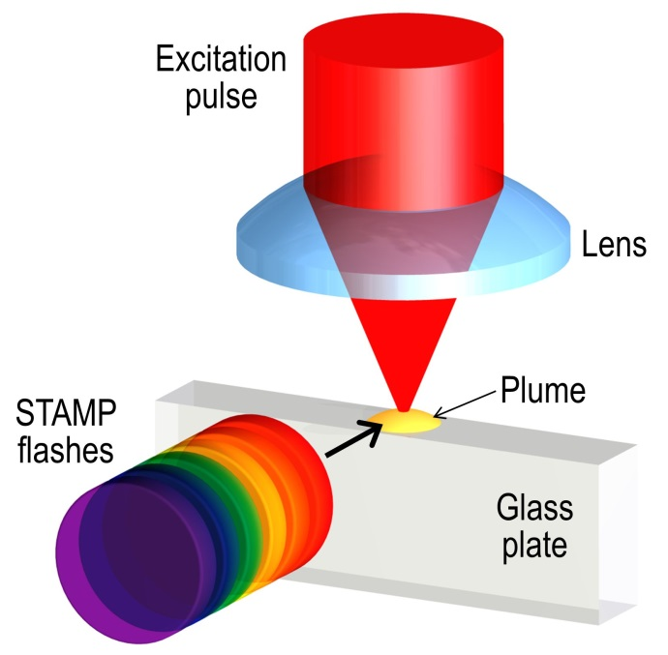
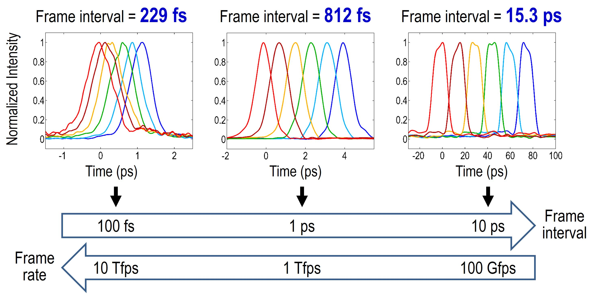
Femtosecond laser ablation
Sample
  Glass (t = 50 µm)
Excitation pulse
  Pulse duration: 70 fs
  Center wavelength: 810 nm
  Pulse energy: 100 µJ
    ～ 10¹⁵ W/cm²
Imaging
  Frame interval: 15.3 ps
    65.4 Gfps
  Exposure time: 13.8 ps
  Shadowgraph imaging

Slide 17
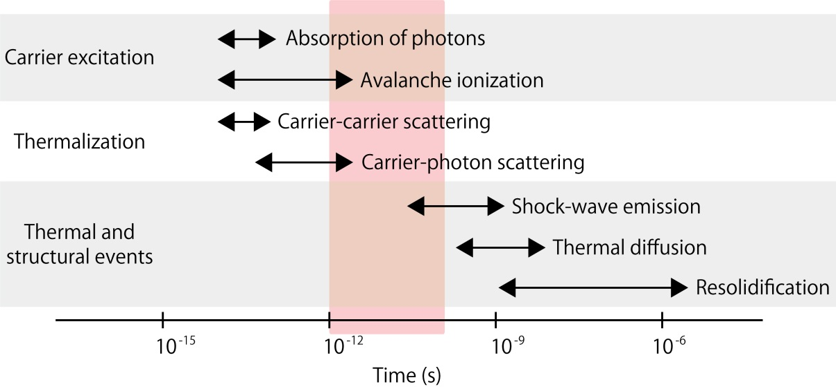
Femtosecond laser ablation
0 ps
15.5 ps
31.0 ps
46.5 ps
61.5 ps
76.5 ps
Air
Glass
20 µm
Air
Glass
Reproduced from R. R. Gattass, E. Mazur, Nature Photon. (2008)

Slide 18
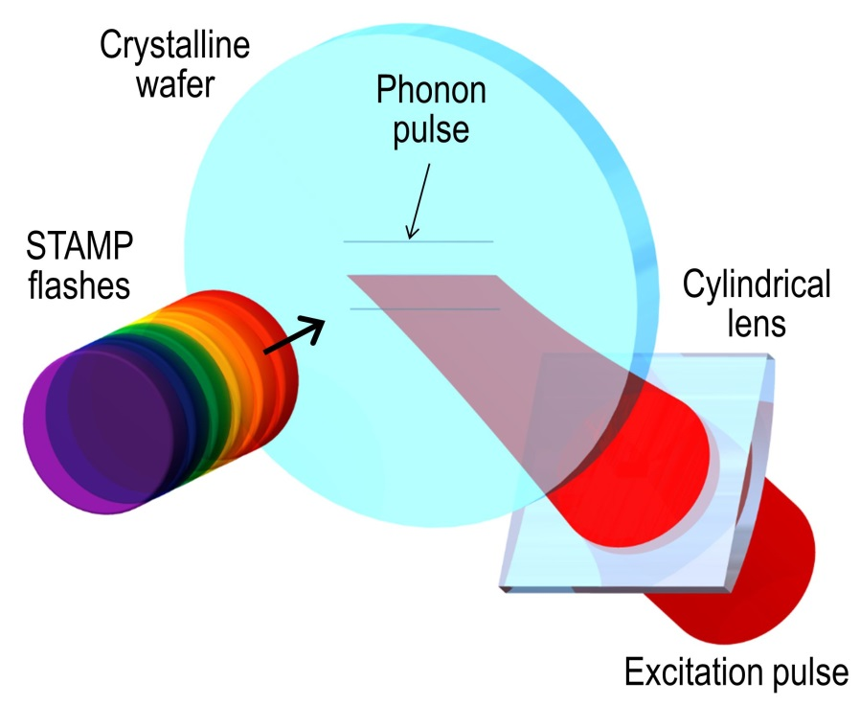
Phonon polariton (THz radiation)
Sample
  LiNbO₃ (t = 500 µm)
Excitation pulse
  Pulse duration: 70 fs
  Center wavelength: 810 nm
  Pulse energy: 40 µJ
Imaging
  Frame interval: 812, 229 fs
    1.23, 4.37 Tfps
  Exposure time: 1020, 733 fs
  Polarization-gating imaging
Notes:
Next, we used STAMP to monitor the phonon-polariton dynamics on femtosecond timescales.
An excitation pulse was cylindrically focused into a lithium niobate wafer.
The dynamics was monitored in a transmission mode.
These are the parameters of an excitation pulse.
Pulse duration was 70 fs, center wavelength was 810 nm, and pulse energy was 40 micro joule.
These are conditions of imaging.
Frame interval were 812 fs and 229 fs, these are equivalent to 1.23 Tfps and 4.37 Tfps, respectively.
Exposure time were 1020 fs and 733 fs, respectively.
For visualizing phonon wave-packet, we used polarization-gating imaging technique..
birefringence

Slide 19
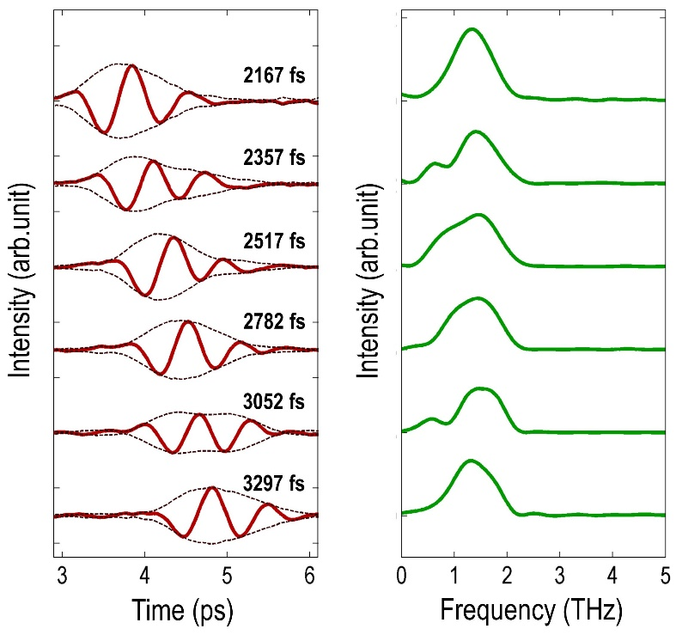






Phonon polariton (THz radiation)
We could observe complex dynamics of phonon wave-packet formation by STAMP.
0 fs
100 µm
190 fs
350 fs
615 fs
885 fs
1130 fs
100 µm
0 fs
780 fs
1590 fs
2400 fs
3255 fs
4035 fs
2167 fs
2357 fs
2517 fs
2782 fs
3052 fs
3297 fs
100 µm
The speed of wave-packet is calculated from the movie to be 4.6×10⁷ m/s
Notes:
Here are the image frames that captured the phonon pulse dynamics with a frame interval of 800 fs, corresponding to a frame rate of 1.2 Tfps. First, we can see a complex electronic response of the crystal and then the formation and upward propagation of a phonon pulse. With a finer frame interval of 230 fs or a frame rate of 4.4 Tfps, we can visualize the detailed dynamics of the electronic response at the phonon pulse generation as well as the phonon pulse propagation. Interestingly, the propagation speed of the phonon pulse is as high as one sixth of the speed of light, but our STAMP can temporally resolve this dynamics clearly. Furthermore, from the images, we can perform both time-domain and frequency-domain analysis to identify the THz spectrum of the phonon pulse.

Slide 20
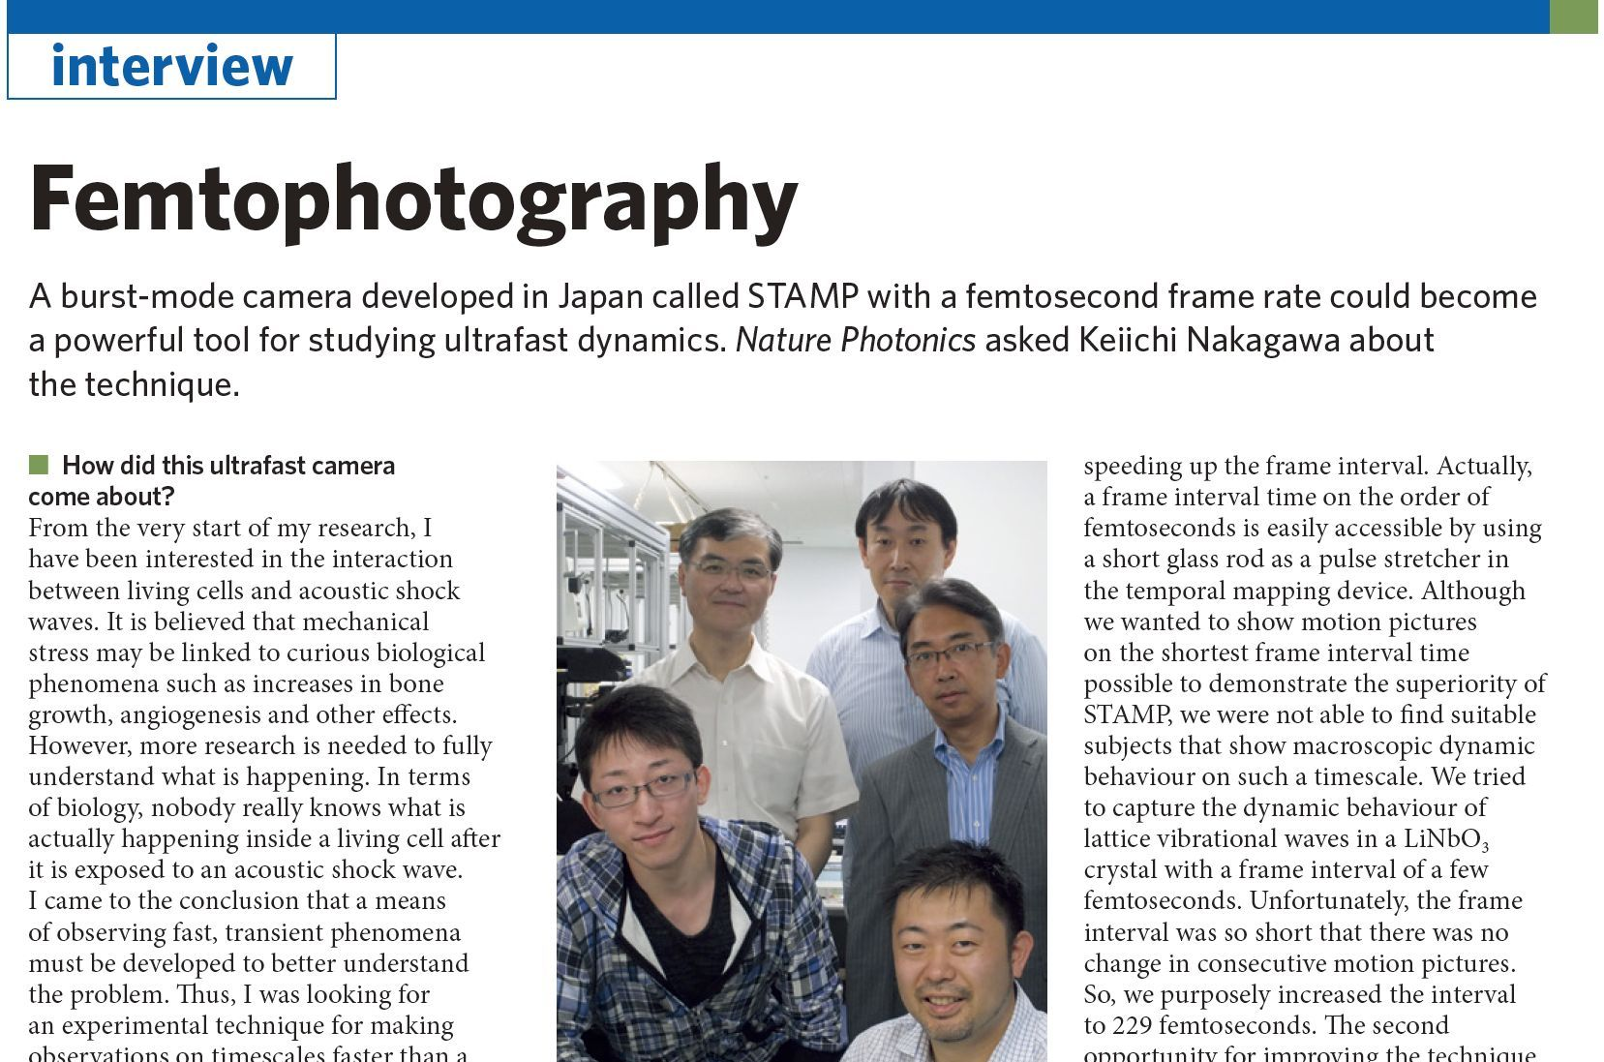
Visualizing acoustic interaction with cells?
Nature Photonics 8, 744 (2014).

Slide 21
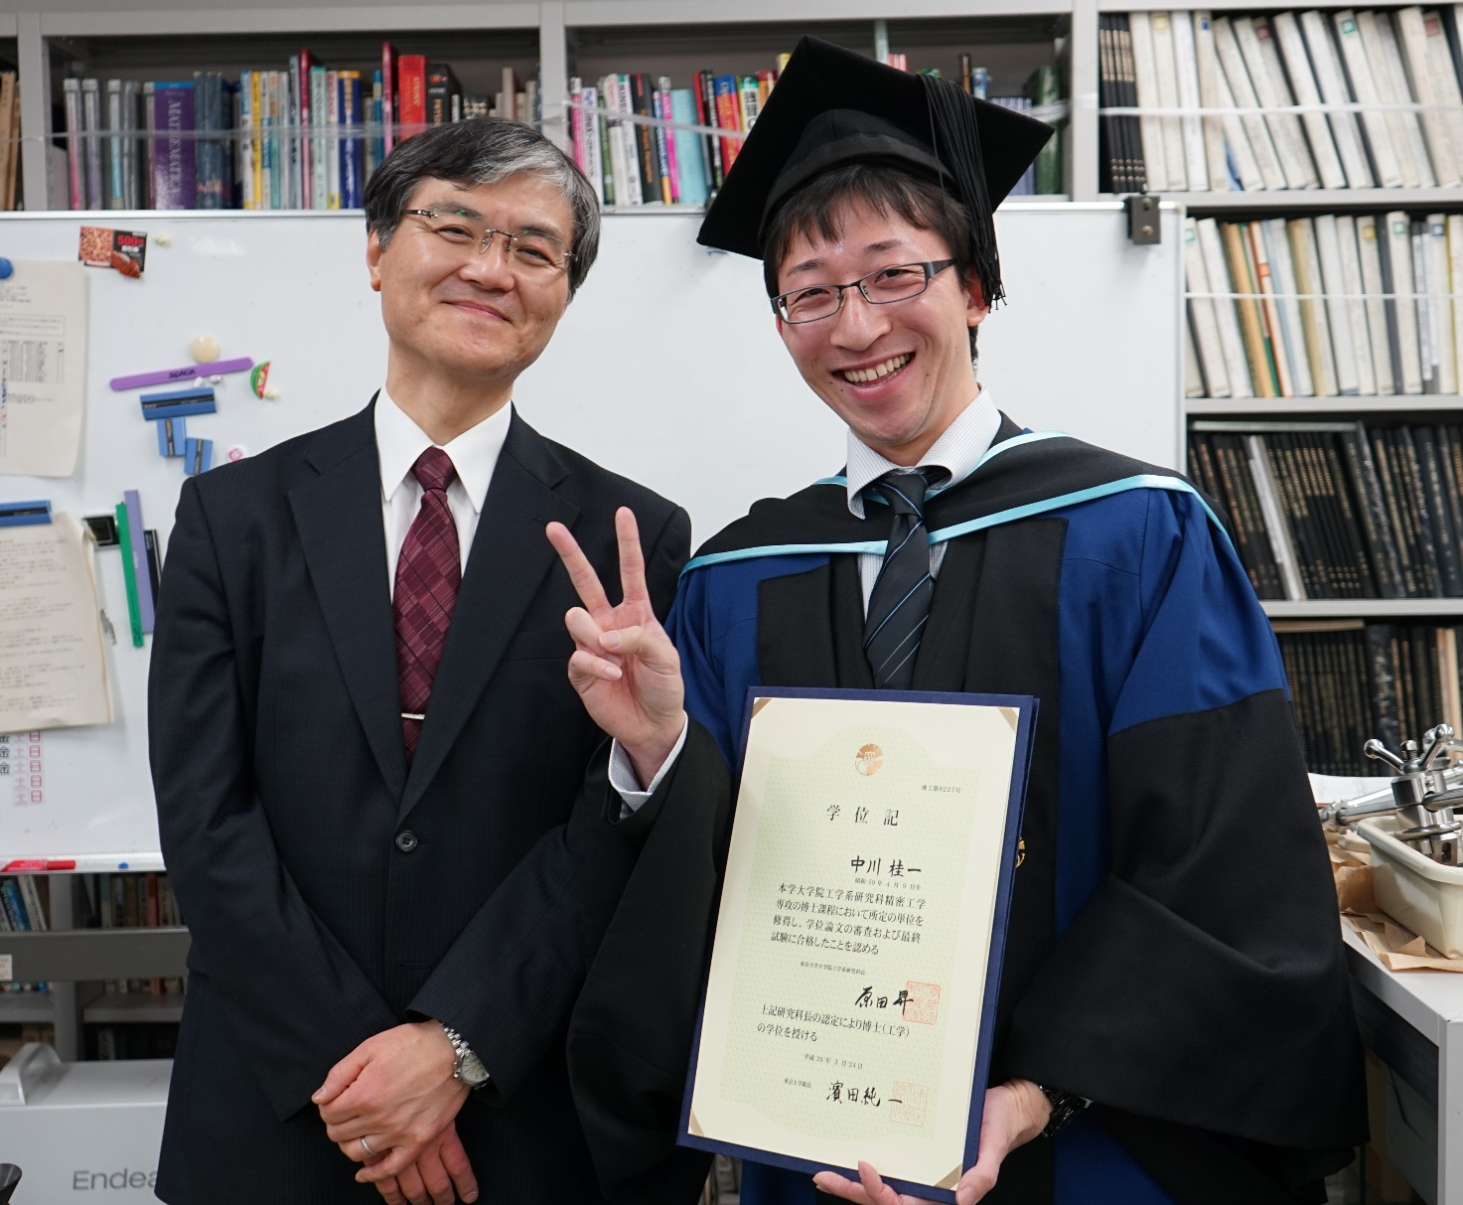
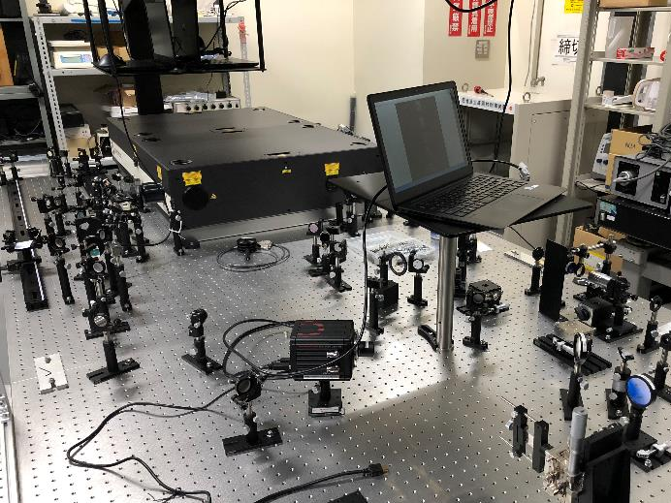
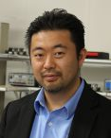

Visualizing acoustic interaction with cells?
I graduated before doing bio-experiment
2014 – 2015
Postdoc
Goda Lab at Tokyo Univ.
- 2016
Postdoc
Nelson Group at MIT
2016 - present
Assistant Prof -> Lecturer of Tokyo Univ.
I have obtained a femtosecond laser this year!
COMING SOON! (hopefully)

Slide 22


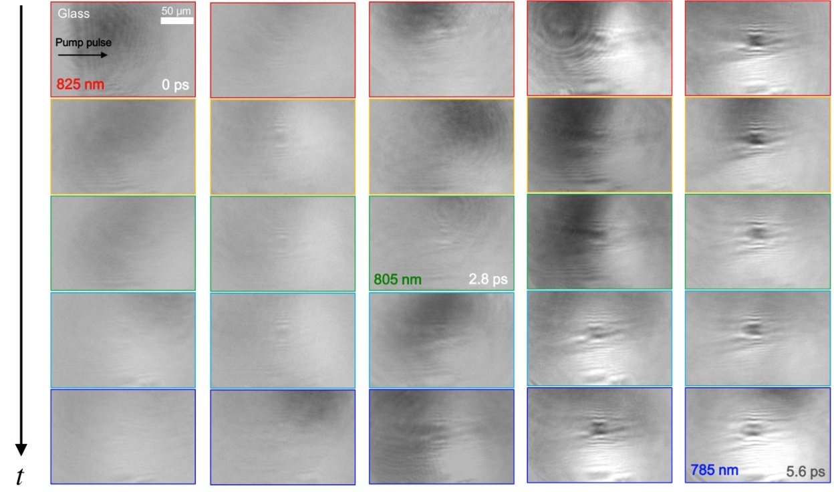
25-frame burst-mode imaging
STAMP utilizing spectral filtering
T. Suzuki
Ph.D. candidate
at Kannari Lab
F. Kannari
0 ps
5.5 ps
fs laser-induced breakdown in glass
Phase transition of Ge₂Sb₂Te₅
T. Suzuki et al., Int. Conf. Ultrafast Phenomena (2016)
T. Suzuki et al., Appl. Phys. Exp. (2017)

Slide 23
Directions

Slide 24

Two directions of STAMP
STAMP
0 ps
15.5 ps
31.0 ps
46.5 ps
61.5 ps
76.5 ps
20 µm
0 fs
190 fs
350 fs
615 fs
885 fs
1130 fs
100 µm
Finding and understanding dynamic behaviors in atomic world
For human
New strategy and method
based on the combination with AI and informatics
For machine

Slide 25
Jump in SMALL WORLD
Time
s
(10⁰)
ms
(10⁻³)
µs
(10⁻⁶)
ns
(10⁻⁹)
ps
(10⁻¹²)
fs
(10⁻¹⁵)
m (10⁰)
mm (10⁻³)
Speed of Light: 0.3×10⁹ m/s
Speed of Sound: ~1×10³ m/s
1 m/s
Space
µm (10⁻⁶)
nm (10⁻⁹)
We need ultrafast imaging in observation of atomic-scale events
pm (10⁻¹²)

Slide 26
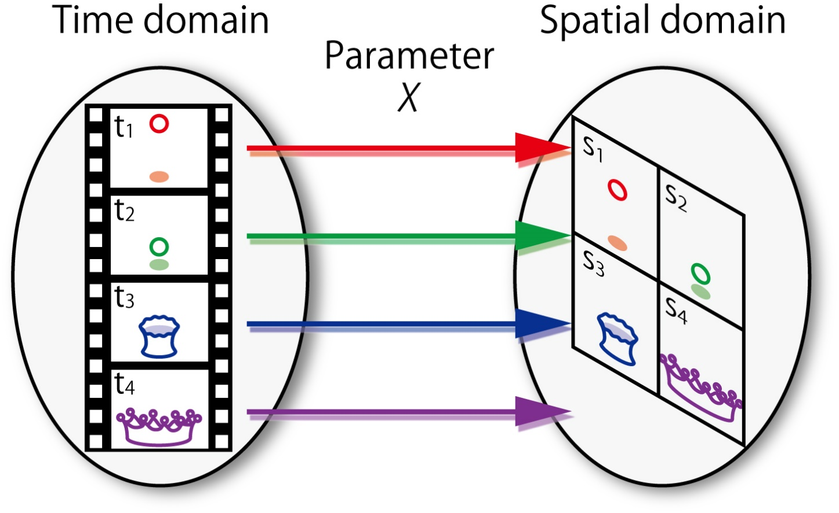
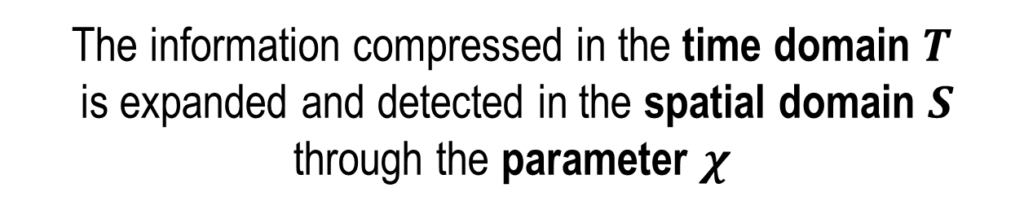
Original concept: spatiotemporal mapping
The information compressed in the time domain $T$
is expanded and detected in the spatial domain $S$
through the parameter $χ$
K. Nakagawa, “Spatiotemporal mapping photography for sub-nanosecond single-shot imaging” Doctoral Dissertation (2014).

Slide 27




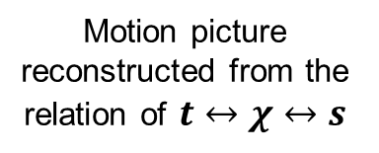





Spatiotemporal Mapping Photography
Detector
Ultrashort pulse of X-ray or electron
Jitter-less
$χ_{1}, s_{1}$
Target
$t_{3}, χ_{3}$
$t_{2}, χ_{2}$
$t_{1}, χ_{1}$
$χ_{2}, s_{2}$
Temporal mapping device
Spatial mapping device
$χ_{3}, s_{3}$
$$t_{3}$$
$$t_{2}$$
$$t_{1}$$
Motion picture reconstructed from the relation of $t↔χ↔s$
Keys to achieve:
  Find a good parameter of 𝝌: wavelength, phase, polarization, incident angle, spatial profile (structured, frequency), etc.
    cf. cranz-schardin camera, single-shot spectroscopy with echelon, FRAME
  Make good use of the properties of pulse sources: XFEL, plasma accelerated electrons, etc.
  Employ computational imaging techniques: compressed sensing, machine learning, etc.
K. Nakagawa, “Spatiotemporal mapping photography for sub-nanosecond single-shot imaging” Doctoral Dissertation (2014).

Slide 28
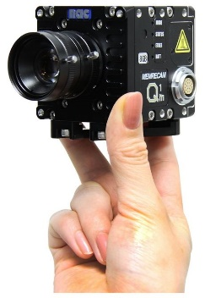


High-speed imaging for machines
Advances in
imager sensor and optics technologies
Advances in
information
science and technology
compact, cost-effective, easy to use
<30 fps
Slow sensing
Limitation in understanding
>1 kfps
Fast data acquisition
Data-driven science

Slide 29
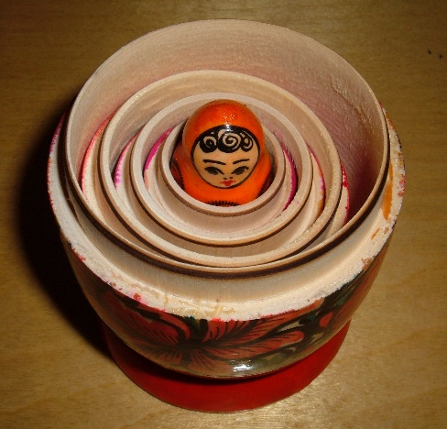
Ultrafast imaging in high-speed imaging
High-speed vision and information science and technology
Ultrafast imaging
Matryoshka doll

Slide 30

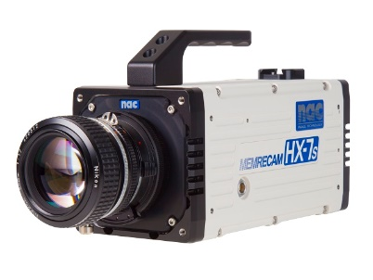

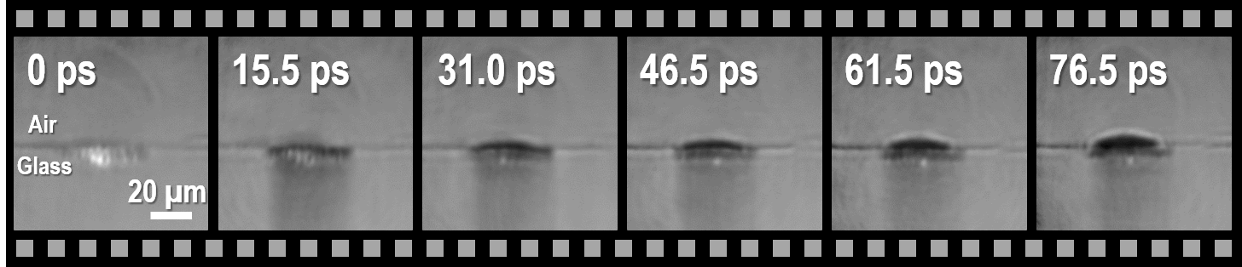

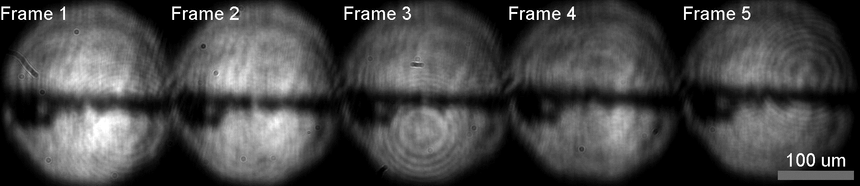
Demonstration: Nesting high-speed videography
1 kHz
Cyber-physical system
Machine learning
Pulse manipulation
Ultrafast monitoring
1 kfps
Real-time feedback
~100 Gfps
Laser processing
Air
Glass

Slide 31
Summary
We have developed STAMP (Sequentially Timed All-optical Mapping Photography) for single-shot sub-nanosecond imaging
We use STAMP to monitor laser ablation, phonon-polariton dynamics, phase transition, and so on.
  Timescale: 100 fs - 100 ps
  Number of frames: 25
We are currently developing an advanced STAMP system for observation of acoustic interaction with cells
Next challenge: videography of ultrafast events in atomic scale
Strategy of high-speed imaging is changing with advances in image sensor, optics, and information technologies

Slide 32

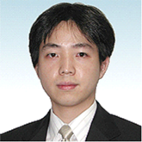


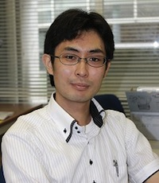








Acknowledgements
Biomedical Precision Engineering Lab., Univ. Tokyo
Kannari Lab., Keio University
A. Iwasaki
R. Horisaki
A. Tsukamoto
T. Ushida
K. Goda
Massachusetts Institute of Technology, Nelson Group
ULITIMA 2018
Committees & Members
Thank you very much!

Slide 33
Thank you for listening
kei@bmpe.t.u-tokyo.ac.jp
https://sites.google.com/site/keinakagawa6
First demonstration of STAMP
  K. Nakagawa, A. Iwasaki, Y. Oishi, R. Horisaki, A. Tsukamoto, A. Nakamura, K. Hirosawa, H. Liao, T. Ushida, K. Goda, F. Kannari and I. Sakuma, “Sequentially timed all-optical mapping photography (STAMP)” Nature Photonics 8, 695–700 (2014).
  Interview "Femtophotography" Nature Photonics 8, 744 (2014).
25-frame STAMP
  T. Suzuki, R. Hida, Y. Yamaguchi, K. Nakagawa, T. Saiki and F. Kannari, “Single-shot 25-frame burst imaging of ultrafast phase transition of Ge₂Sb₂Te₅ with a sub-picosecond resolution” Applied Physics Express 10, 92502 (2017).
For details of STAMP
  K. Nakagawa, “Spatiotemporal mapping photography for sub-nanosecond single-shot imaging” Doctoral Dissertation (2014).

Slide 35
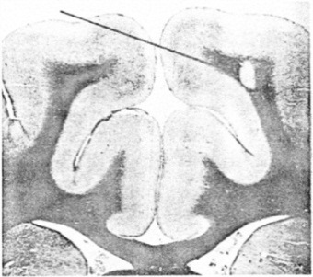
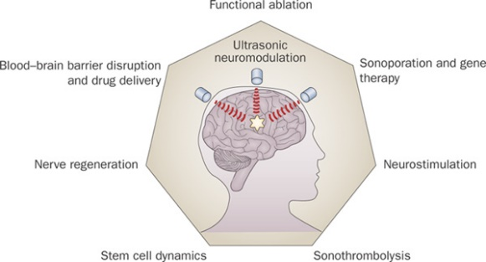
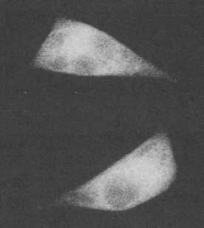
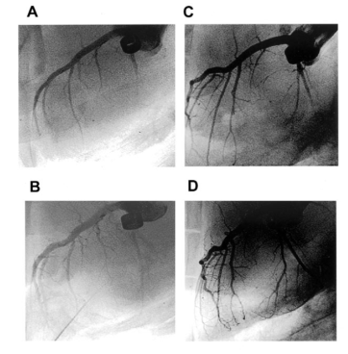
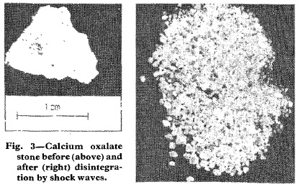
History of therapeutic acoustic waves
1950s
High intensity focused ultrasound for tumor ablation
Late 1980s
Drug and gene delivery by sonoporation
Recent
Ultrasound neuromodulation
Science (1955)
PNAS (1987)
Nat. Rev. Neurol. (2010)
2000s
Angiogenesis by low-intensity shock wave
Early 1980s
Shock wave lithotripsy
Lancet (1980)
Circulation (2004)
Ablate / Break
Control / Regulate
Notes:
Control or regulate the biological function
We want to know how the acoustic waves interact with our body.

Slide 36
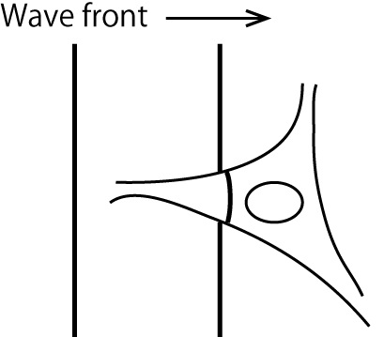
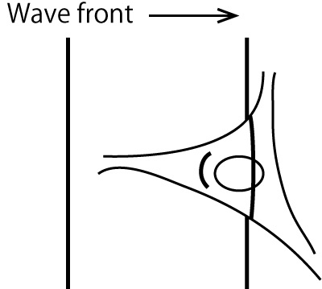
Mechanobiological effects
Stretch
Touch
Shear stress
Reflection by the nucleus
The nucleus is pushed
Effects for the cytoskeleton and membrane
Difference in wavefront
Shear stress is loaded to the membrane
Notes:
Control or regulate the biological function
We want to know how the acoustic waves interact with our body.

Slide 37

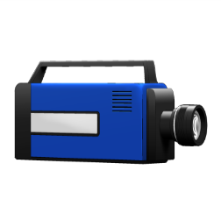
Limitations in resolution
Space
1 m
1 mm
1 μm
1 nm
~100 µm
Diffraction limit
(Physical)
~100 nm
Time
1 s
1 ms
1 μs
1 ns
1 ps
1 fs
~10 ms
Mechanical & Electrical Limits
(Technical)
~1 ns
Notes:
Let’s compare the temporal resolution with the spatial resolution. In spatial domain, the resolution of human eyes is limited to about 100 um. With the help of the microscope, we can see sub-micrometer objects down to about 100 nm, which is fundamentally limited by the diffraction limit.
On the other hand, in temporal domain, the resolution of human eyes is limited to about 10 ms. With the help of the conventional high-speed camera, we can observe fast dynamics down to about 1 ns. This limit comes from technical limitations in mechanical and electrical components of the camera such as mechanical scanning, data readout, and shutters. Here I want to emphasize that these limitations are technical, not fundamental, and therefore, there is room for improvement.

Slide 38




Imaging of laser ablation dynamics with STAMP
Laser ablation in medicine
http://www.allaboutvision.com
http://www.bbc.com/news/health-27595573
© Medtronic
Processing with ns-laser pulse
（nano: 10⁻⁹）
Processing with fs-laser pulse
（femto: 10⁻¹⁵）
B. N. Chickov et. al., Appl. Phys. A (1996).
Notes:
Which do you prefer?

Slide 39
Imaging of laser ablation dynamics with STAMP
Excitation pulse
  Pulse duration: 70 fs
  Wavelength: 810 nm
  Pulse energy: 100 µJ
0 ps
15.5 ps
31.0 ps
46.5 ps
61.5 ps
76.5 ps
Laser
Air
Glass
20 µm
Corresponding to a frame rate of 65.4 Gfps (exposure time = 13.8 ps)
Notes:
In order to show the utility of STAMP, we used it to observe laser ablation dynamics. Here a powerful pulse excites the glass plate while STAMP monitors its ablation process. Here are the STAMP image frames that indicate the generation of free electrons in the glass followed by the generation of a plume that expands away from the ablation point. The exposure time is 13.8 ps and the frame interval is 15.3 ps, which corresponds to a frame rate of 65.4 Gfps.

Slide 40


Imaging of phonon pulse dynamics with STAMP
Atoms
Phonon-polariton: collective lattice vibrational waves excited by electromagnetic waves
Sample
  LiNbO₃ (thickness = 500 µm)
Excitation pulse
  Pulse duration: 70 fs
  Center wavelength: 810 nm
  Pulse energy: 40 µJ
Notes:
The next target was observation of phonon pulse dynamics with STAMP. Phononics has been a hot area of research nowadays as it is important in semiconductor physics and therefore is a good choice as a testbed for testing STAMP’s high-speed imaging capability.
We excited this lithium niobate crystal with a cylindrically focused pulse to produce a phonon pulse via impulsive stimulated Raman scattering while we monitored the light-matter interaction with STAMP.
This vibration is classified as an optical phonon so the velocity of this phonon pulse is much fast.

Slide 41
Imaging of phonon pulse dynamics with STAMP
0 fs
100 µm
190 fs
350 fs
615 fs
885 fs
1130 fs
Frame interval: 800 fs (Corresponding to a frame rate of 1.2 Tfps)
100 µm
0 fs
780 fs
1590 fs
2400 fs
3255 fs
4035 fs
2167 fs
2357 fs
2517 fs
2782 fs
3052 fs
3297 fs
100 µm
Frame interval: 230 fs (Corresponding to a frame rate of 4.4 Tfps)
Notes:
Here are the image frames that captured the phonon pulse dynamics with a frame interval of 800 fs, corresponding to a frame rate of 1.2 Tfps. First, we can see a complex electronic response of the crystal and then the formation and upward propagation of a phonon pulse. With a finer frame interval of 230 fs or a frame rate of 4.4 Tfps, we can visualize the detailed dynamics of the electronic response at the phonon pulse generation as well as the phonon pulse propagation. Interestingly, the propagation speed of the phonon pulse is as high as one sixth of the speed of light, but our STAMP can temporally resolve this dynamics clearly. Furthermore, from the images, we can perform both time-domain and frequency-domain analysis to identify the THz spectrum of the phonon pulse.

Slide 42

高速度イメージングの必要性
Olympics 100m final at London 2012
9.80
9.75
9.79
9.63
http://www.bbc.com/news/science-environment-23462815
100 m / 10 s
= 100 mm / 10 ms ←人間の目（と脳）では分解不可
= 100 µm (髪の毛の太さ) / 10 µs
= 100 pm (原子の大きさ) / 10 ps

Slide 43
細胞レベルの音響作用？
音響波面を観察すれば物理作用が推測できる
細胞核での反射
細胞核への運動量付与
細胞骨格や膜への影響も
細胞内外での波面のずれ
細胞膜へのせん断力

Slide 44

撮影技術と超短パルス
超短パルス
「光」
STAMP
撮影技術
機械・電気デバイス
中川桂一，レーザー研究 (2015)

Slide 45


STAMPの撮影例
0 ps
15.5 ps
31.0 ps
46.5 ps
61.5 ps
76.5 ps
Air
Glass
20 µm
0 fs
100 µm
780 fs
1590 fs
2400 fs
3255 fs
4035 fs
0 fs
100 µm
190 fs
350 fs
615 fs
885 fs
1130 fs

Slide 46



Periscope array
The periscope array spatially separates image-encoded daughter pulses while satisfying the condition for image formation
Notes:
The periscope array is the key component of the STAMP system. The image-encoded daughter pulses are diffracted by the first diffraction grating and then focuses onto the periscope array in which each different spectral component reflects back, but comes out at a different height while traveling the same optical path length regardless of wavelength because of this unique structure. Then, the daughter pulses are recombined at the second diffraction grating, but exit at different heights, keeping the spatial profile in each spectral component intact.

Slide 47



空間写像装置
当研究グループによる新しいスペクトラルイメージングシステム
今回は６分割スライスミラーを利用
スライスミラーは
理化学研究所先端光学素子開発チーム，
東大天文学専攻との共同開発
M. Tamamitsu, Y. Kitagawa, K. Nakagawa et al., Opt. Eng. (2015)

Slide 48
4. Low photo-damage of cells
Photon density
Tissue (mm)
Cell (µm)
Space
Space
Spatially: 10⁶
Time
Time
Temporally: 10³

Slide 49

5. Capability for visualizing AW and cells
Pressure: refractive index
Wavefront
$\frac{∂P}{∂x}：$large
Acoustic wave
Cell
Space
Polarization and Phase
Differential interference contrast is used to detect the wavefront of acoustic waves and the shape of cell with high contrast

