Slide 1
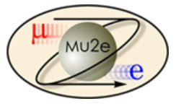
Mu2e Remote Handling Review Baseline Horizontal Design
Mike Campbell
L2 Engineer - Accelerator
L4 Engineer/Designer – Target Remote Handling
3-3-2015

Slide 2
Mu2e RH Review – Baseline Horizontal Design Mike Campbell 3-3-2015
Outline:
Requirements, Assumptions, and Design Constraints
Basic Layout of the RH (Remote Handling) System
Sequence of Operation
Detailed look at the robot design and how it works
Summary

Slide 3
Mu2e RH Review – Baseline Horizontal Design Mike Campbell 3-3-2015
Requirements, Assumptions, and Design Constraints:
RH system to remove the old window and target, dispose them into a storage cask, place new target and window, re-make vacuum seal
RH system to handle the Radiation-Cooled (RC) target
Enter / exit the Target Hall (TH) from a separate RH room on floor rails
Pass through a doorway with a sliding, shielded door between the TH and RH room
Concrete floor (along w/ the embedded floor rails) can/will move over time relative to the location of the work being done
Autonomous or remote control operation
RH system interface with the cask occurs in the TH
Planned usage: Replace window and target once per year
TH has a ceiling hatch to the outside, not intended to access for target exchange
RH system should also be able to remove/dispose/replace 2 additional windows: (A) proton beam exit window, (B) extinction monitor window

Slide 4
Mu2e RH Review – Baseline Horizontal Design Mike Campbell 3-3-2015
How Those Requirements / Assumptions / Design Constraints
Drive the Baseline Horizontal Design:
The target access window is roughly the size and weight of a man-hole cover and must make a high vacuum seal to its’ mounting flange - thus has 36 bolts around its’ perimeter. The best way to put a bolt-driver on this many positions is to use X / Y / Z programmable robotic positioning.
Since the floor is assumed to shift over time, the robot’s move coordinates cannot be preset. The robot must be machine-vision guided, meaning: it must “find” the bolt locations using a video camera and machine-vision software before it can move to the required X / Y / Z coordinates.
The reach distance into the Production Solenoid (PS) to pick / place the target is approx. 12-1/2 ft., but the robot must pass through a much narrower width doorway. Thus the arm that handles the target must have a telescoping reach.

Slide 5
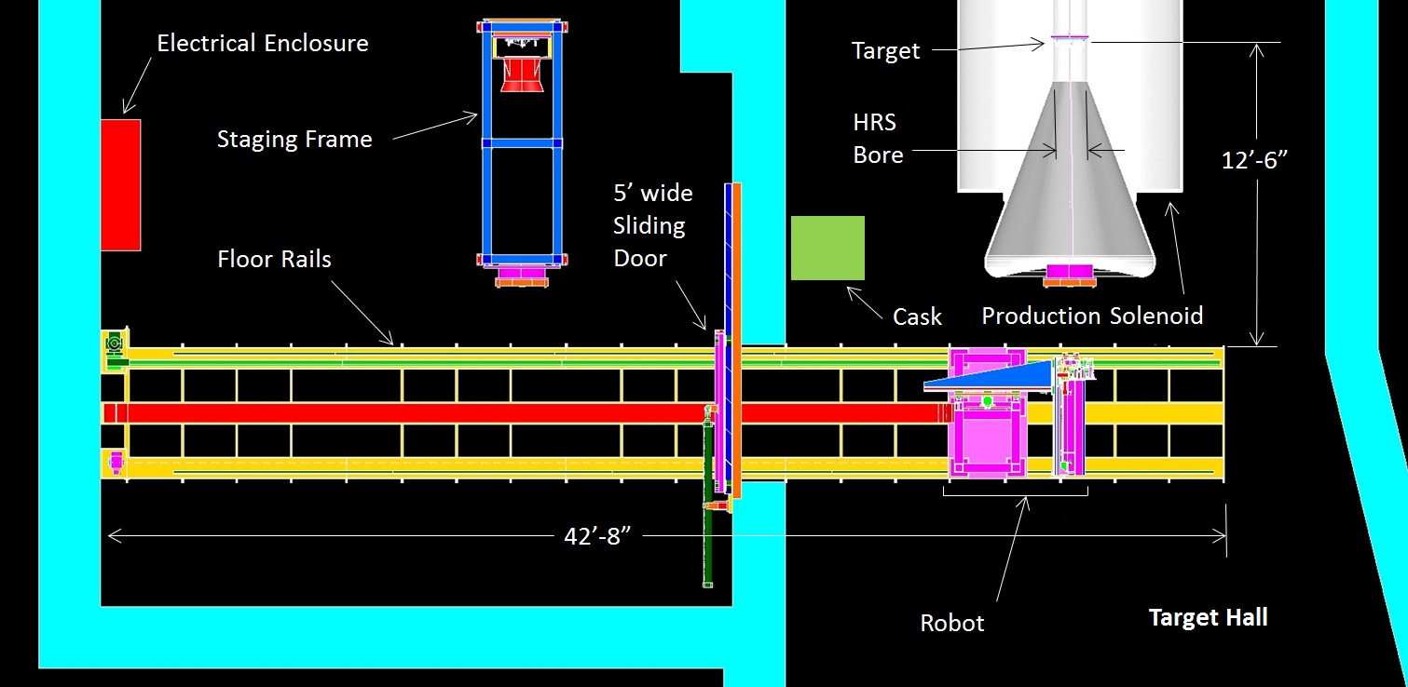
Mu2e RH Review – Baseline Horizontal Design Mike Campbell 3-3-2015
The Baseline Horizontal Design:
The basic layout is shown above.
Note that the robot is autonomous, but does have a control desk in the RH room, plus a possible second control desk at a further remote location. Control desk(s) would include interface to machine control computer, video screen(s) for operators to watch

Slide 6
Mu2e RH Review – Baseline Horizontal Design Mike Campbell 3-3-2015
The Baseline Horizontal Design:
Sequence of Operation . . .
The sliding shield door opens, the robot moves into the TH on its’ floor rails to position behind the PS, and the door closes.

Slide 7
Mu2e RH Review – Baseline Horizontal Design Mike Campbell 3-3-2015
The Baseline Horizontal Design:
Using machine vision and X / Y / Z linear servo / screw-driven motions, the robot moves its’ bolt driver to all bolt locations and removes bolts (retained in holes)
Robot retracts the bolt driver, extends its’ gripper arm, grips, and removes window

Slide 8
Mu2e RH Review – Baseline Horizontal Design Mike Campbell 3-3-2015
The Baseline Horizontal Design:
Robot moves on its’ floor rails to position behind cask, cask door is already open
Robot places window into cask (upper half of chamber), releases it, retracts arm
Robot moves back to position behind PS, uses vision to find the target access hole

Slide 9
Mu2e RH Review – Baseline Horizontal Design Mike Campbell 3-3-2015
The Baseline Horizontal Design:
Robot positions its’ telescoping target handling arm on center with the access hole
Robot extends the arm to reach the target assembly, end of arm tooling grips target
End of arm tooling turns 3 latches to release target from its’ mounting surface

Slide 10
Mu2e RH Review – Baseline Horizontal Design Mike Campbell 3-3-2015
The Baseline Horizontal Design:
Robot retracts its’ telescoping target handling arm to remove target assembly
Robot moves on its’ floor rails to back position behind cask
Robot places target into cask (lower half of chamber), releases it, retracts arm

Slide 11
Mu2e RH Review – Baseline Horizontal Design Mike Campbell 3-3-2015
The Baseline Horizontal Design:
The sliding shield door opens and the robot returns to the RH room, positioning itself behind the staging frame, the sliding shield door then closes
A new target assembly will have been pre-staged in the staging frame as part of the RH task set-up. Using its’ camera and arm, the robot retrieves the new target

Slide 12
Mu2e RH Review – Baseline Horizontal Design Mike Campbell 3-3-2015
The Baseline Horizontal Design:
The sliding shield door opens and the robot returns to the TH, positioning itself again behind the PS, the sliding shield door then closes
Using its’ camera and arm, the robot places the new target, latching it into place on the mounting surface using its’ end of arm tooling

Slide 13
Mu2e RH Review – Baseline Horizontal Design Mike Campbell 3-3-2015
The Baseline Horizontal Design:
Similar to before, the robot returns to the RH room through the doorway, retrieves the new window, then travels back to its’ position behind the PS in the TH
Robot places the new window, then proceeds to tighten the bolts around the perimeter. Any desired star pattern tightening sequence can be programmed

Slide 14
Mu2e RH Review – Baseline Horizontal Design Mike Campbell 3-3-2015
The Baseline Horizontal Design:
The sliding shield door opens, the robot returns to the RH room, and the door closes
The cask is manually pulled back toward the M4 beamline. Once under crane coverage there, the cask front door is placed onto it. The target exchange process is now complete

Slide 15
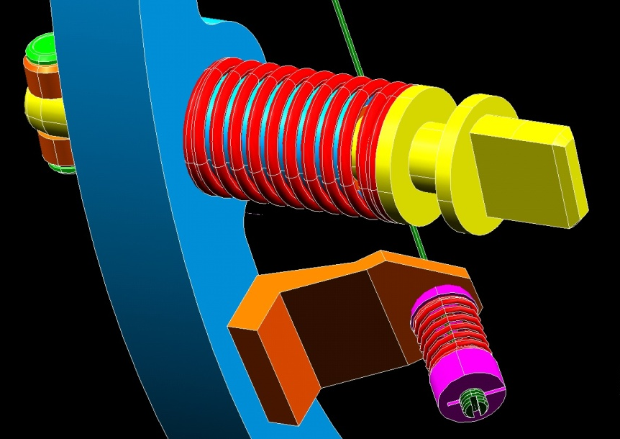
Mu2e RH Review – Baseline Horizontal Design Mike Campbell 3-3-2015
Design Details: The RC Target Assembly and its’ Mount Inside the PS / HRS
4x Grip
Handles
3x Spring
Latches
Spring Latch Detail
Target
3x Mounting
Features Inside
the HRS Bore
Locate, Clamp,
and Latch the
Bicycle Wheel
at the 12, 4,
and 8 o-clock
Positions
Spokes
Outer Ring
(a.k.a. the “Bicycle Wheel”)

Slide 16
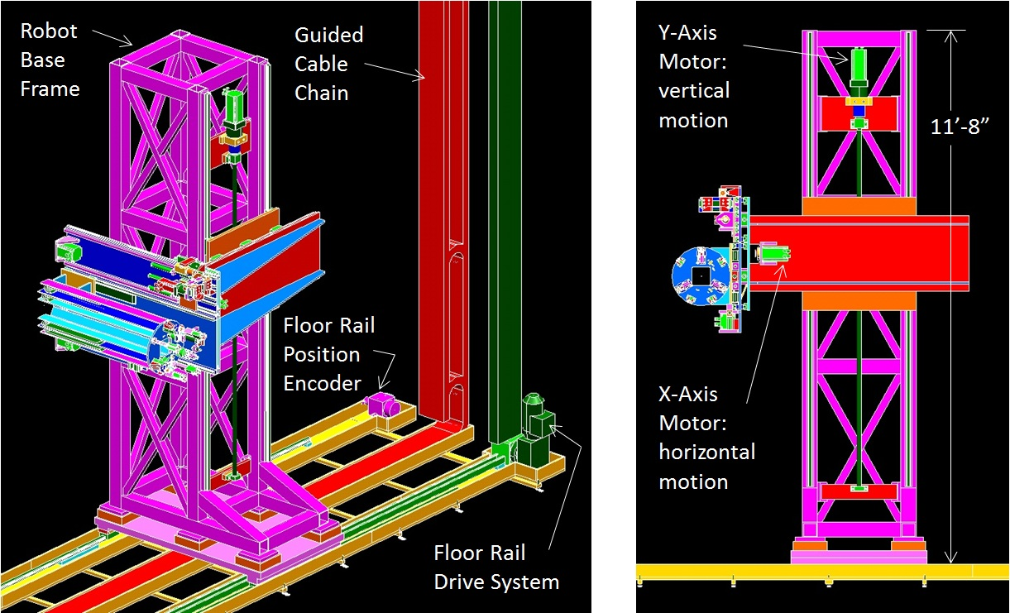
Mu2e RH Review – Baseline Horizontal Design Mike Campbell 3-3-2015
Design Details: The Robot Basic Structure and Its’ X / Y Motion Axes

Slide 17
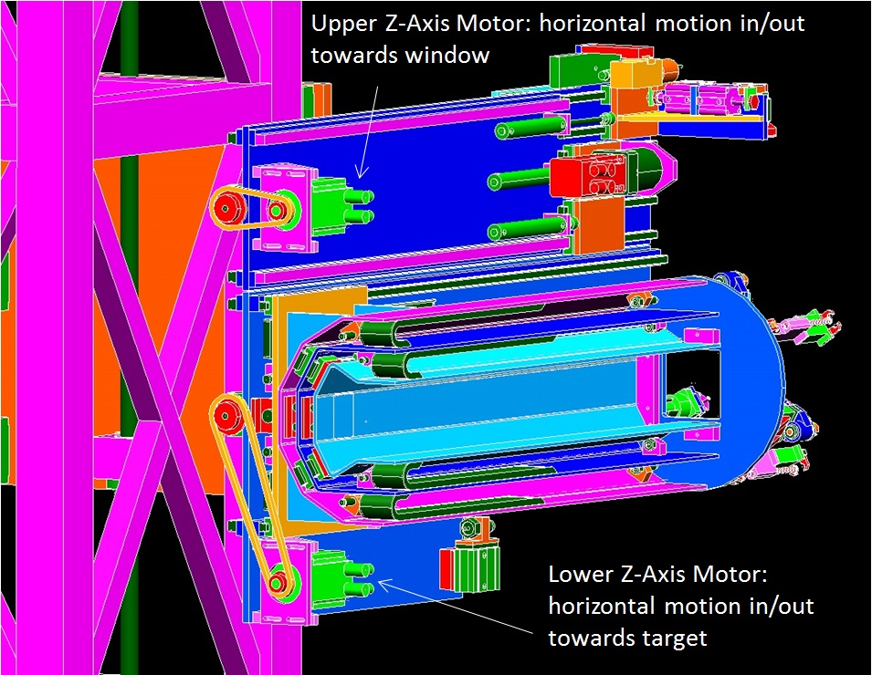
Mu2e RH Review – Baseline Horizontal Design Mike Campbell 3-3-2015
Design Details: The Robot Dual Z Motion Axes

Slide 18
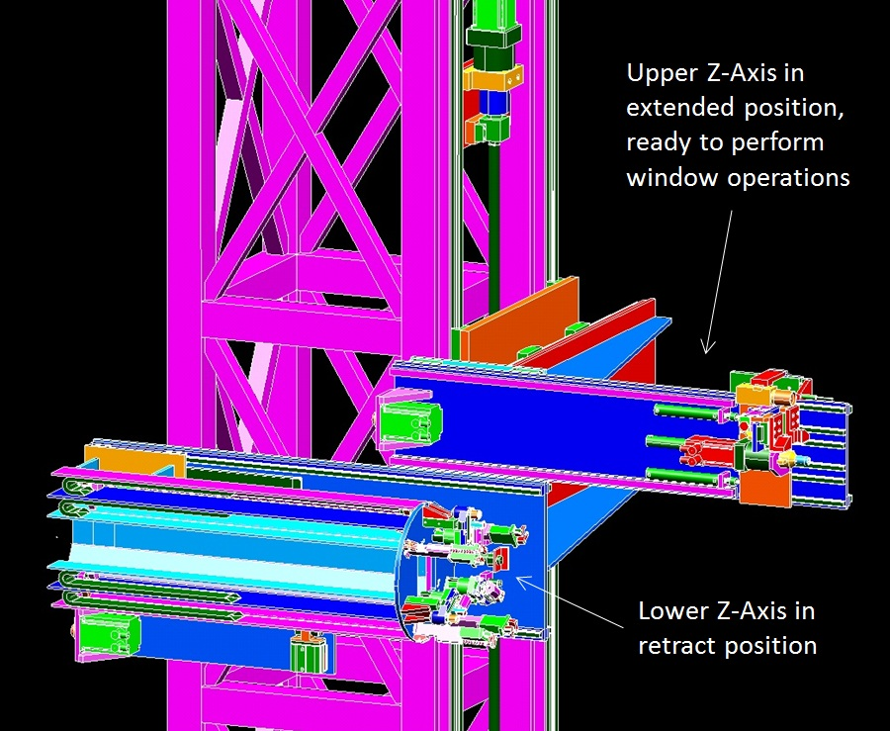
Mu2e RH Review – Baseline Horizontal Design Mike Campbell 3-3-2015
Design Details: Upper Z Axis – Handles the Target Access Window

Slide 19
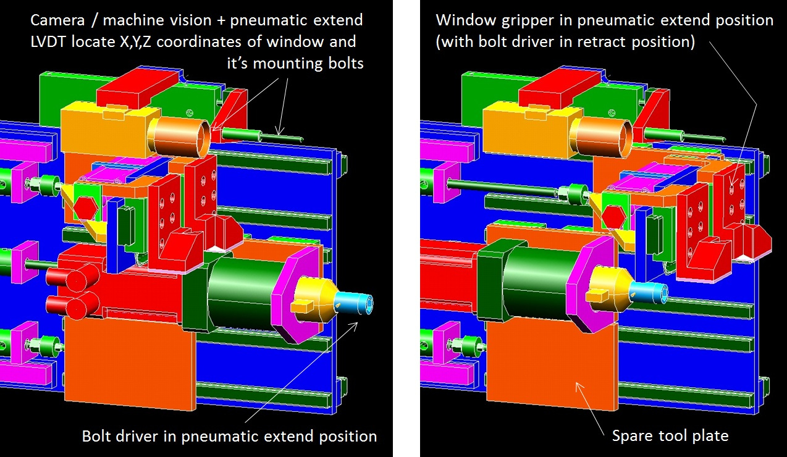
Mu2e RH Review – Baseline Horizontal Design Mike Campbell 3-3-2015
Design Details: Upper Z Axis – Handles the Target Access Window

Slide 20
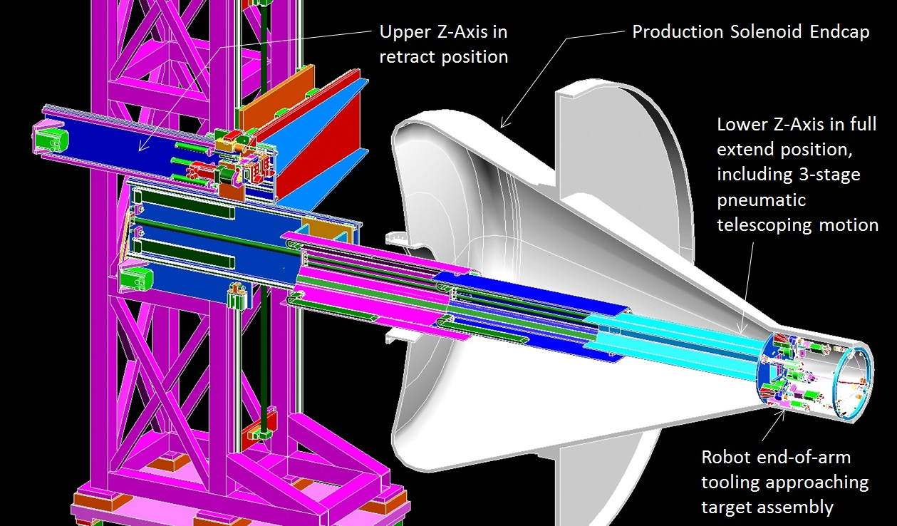
Mu2e RH Review – Baseline Horizontal Design Mike Campbell 3-3-2015
Design Details: Lower Z Axis – Handles the Target Assembly

Slide 21
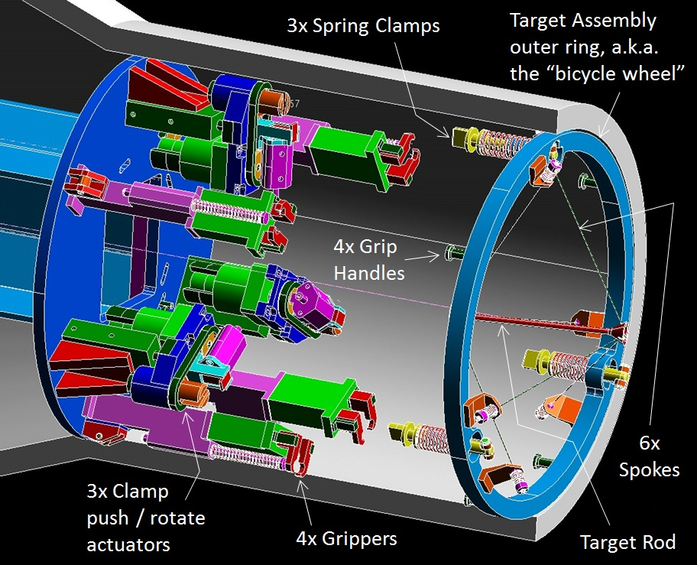
Mu2e RH Review – Baseline Horizontal Design Mike Campbell 3-3-2015
Design Details: Lower Z Axis – Handles the Target Assembly

Slide 22
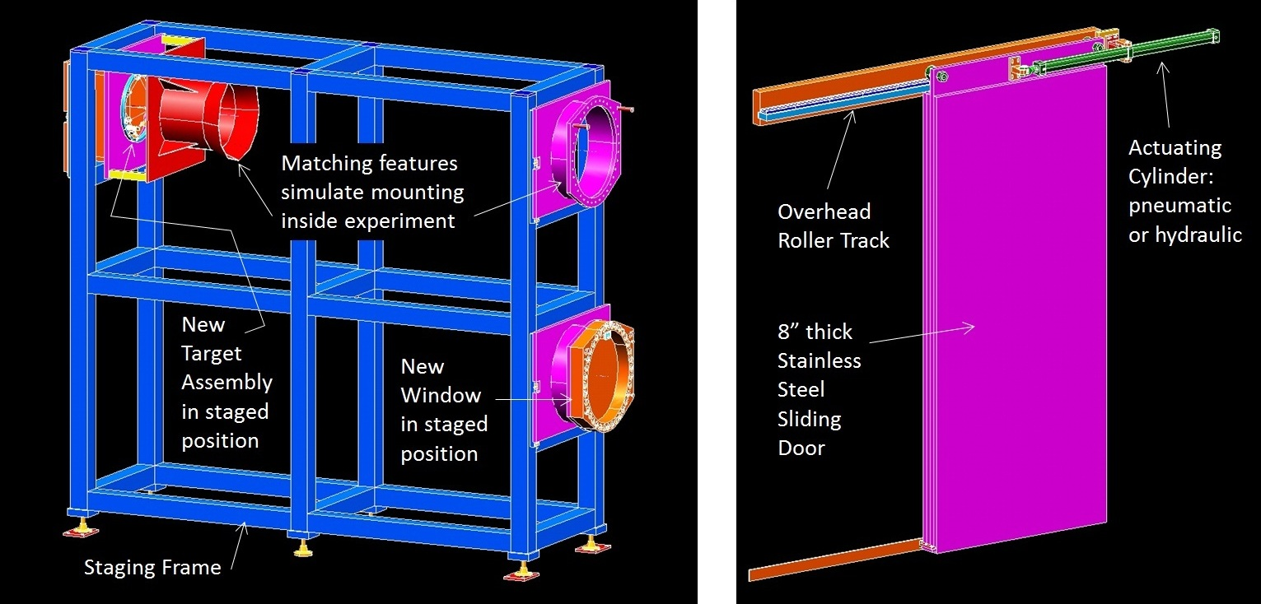
Mu2e RH Review – Baseline Horizontal Design Mike Campbell 3-3-2015
Design Details: Other System Components – Staging Frame and Sliding Door
91”
14’
6’
(doorway = 5’)

Slide 23
Mu2e RH Review – Baseline Horizontal Design Mike Campbell 3-3-2015
Summary:
The horizontal RH scheme utilizes a robotic machine that:
Removes & replaces the RC target and window
Travels between the TH and RH room on floor rails
Contains 5 servo motion axes, the floor rail drive axis, & 20 pneumatic motions
Uses a camera and machine-vision system to “find” its’ move coordinates
Utilizes a 4-stage telescoping arm to cover the 12-1/2’ reach distance to the target

Slide 24
Mu2e RH Review – Baseline Horizontal Design Mike Campbell 3-3-2015
End of Main Presentation
Back-up Slides Following . . .

Slide 25
Mu2e Target Handler Mike Campbell 3-3-2015
Robot Component Selection Details
Stainless steel for both: NSK Ballscrews, THK square-rail linear bearings
SMC Pneumatics – actuators, solenoid valves, other pneumatic system components
Igus cable carrier chains, chainflex cabling
Stainless steel Serapid push/pull chain and AC gearmotor drive for floor rails
Linear pull-wire encoder for floor rails – TR Electronics (optical / absolute), ~2mm resolution, not specifically rad tolerant, will be removed when not in use
Symphotic Tii Megarad-3 camera - good image at 1E5 rad/hr, 3E6 rads total (gamma) > planning to use standard (~ $500) lens and replace as needed > interface to vision-system software via iPORT Analog-Pro frame grabber module
Measurement Specialties LVDT and remote signal conditioner module
Wittenstein rad-hardened brushless servo motors (total dose limit = 1E9 rads) > resolver feedback, also from Wittenstein: planetary gearbox, couplings
Motion controls: National Instruments CompactRIO controller, servo drive modules, other various modules, NI Labview software with NI vision module

Slide 26
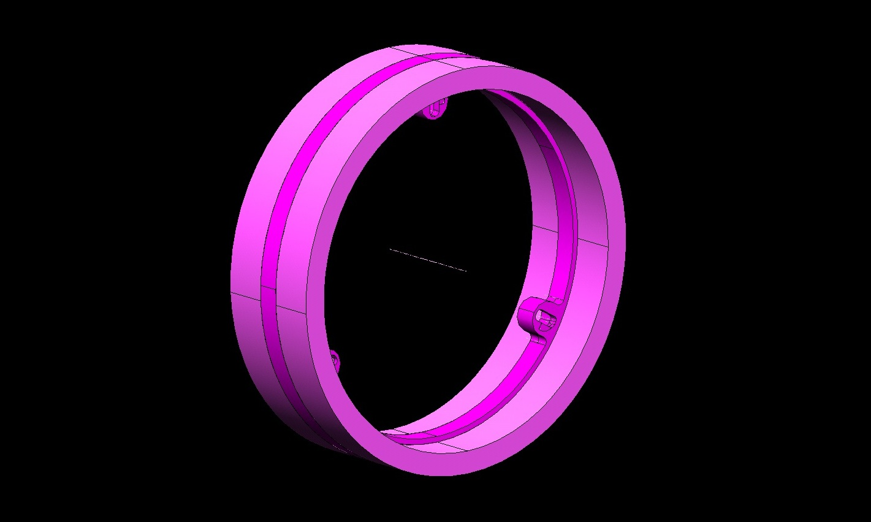
Mu2e Target Handler Mike Campbell 7-22-2013
HRS Bore Tube Detail Showing Target Assembly Mounting Features
2x full OD perimeter welds
Darker color: 1” thick (or more ?) SS plate, ground for flatness,
all machining done prior to welding
Target mounting plate
protrudes ¼” past inside
surface of HRS bore tube
3x areas with mating
features for target
mounting latches
Lighter color: upstream/downstream sections of HRS bore tube (shown shortened)

Slide 27
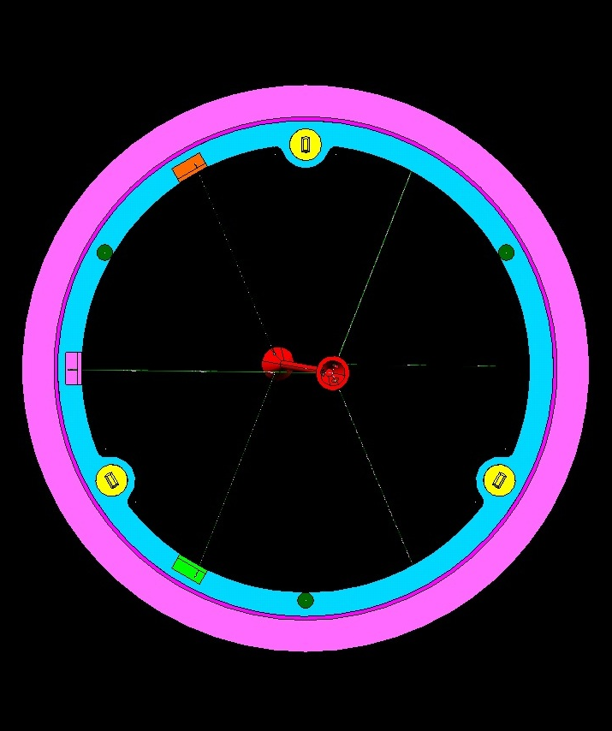
Mu2e Target Handler Mike Campbell 7-22-2013
Target Assembly Shown Mounted in HRS Bore

Slide 28
Mu2e Target Handler Mike Campbell 7-22-2013
Target Latch Mechanism Detail – unlatched (left), latched (right)
5/16” cross-shaft w/ 7/16” OD
bronze sleeve bearings as rollers
1/16” deep recessed areas maintain angular
orientation of guide-pins in latched position
3x 0.500” dia. guide-pins
3x 0.502” slot widths

Slide 29
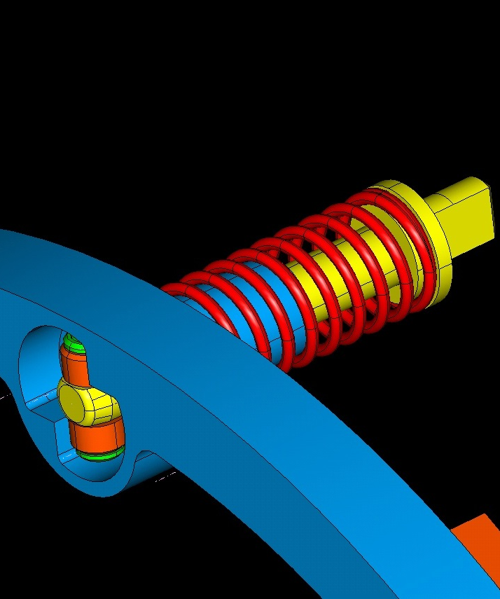
Mu2e Target Handler Mike Campbell 7-22-2013
Target Latch Mechanism Detail – shown retracted in pocket features of bicycle wheel
Latch mechanism retracted into
pocket, slightly (.0125”) below flush
w/ mounting surface of bicycle wheel
Feature to engage w/ target handler robot.
Mechanism to push/retract, & rotate +/- 90 deg

Slide 30
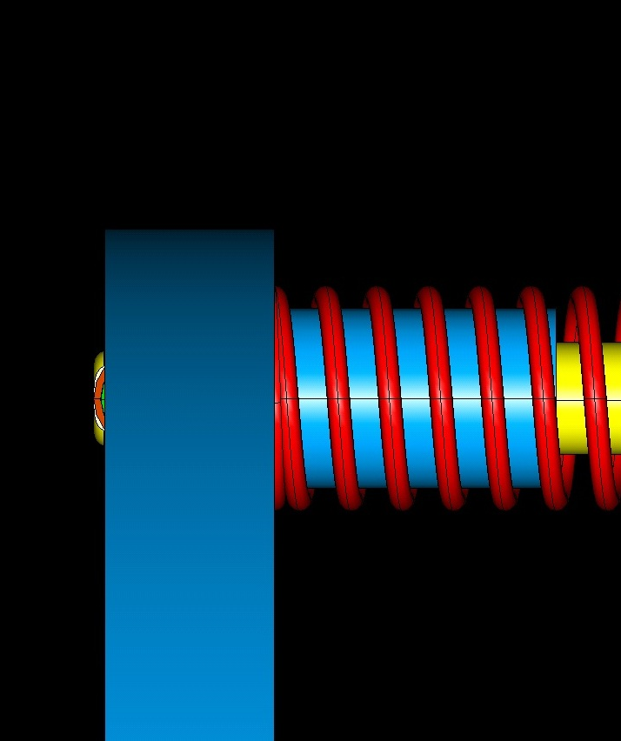
Mu2e Target Handler Mike Campbell 7-22-2013
Target Latch Mechanism Detail – showing push-off feature (1/16” lift cam in pocket)
Helical cam: 1/16” (.0625”)
lift thru 90 deg. rotation of
guide-pins in retract position
.050” separation of bicycle
wheel from HRS mount
Note: bronze bushings
support linear/rotary
motion of guide-pins

Slide 31
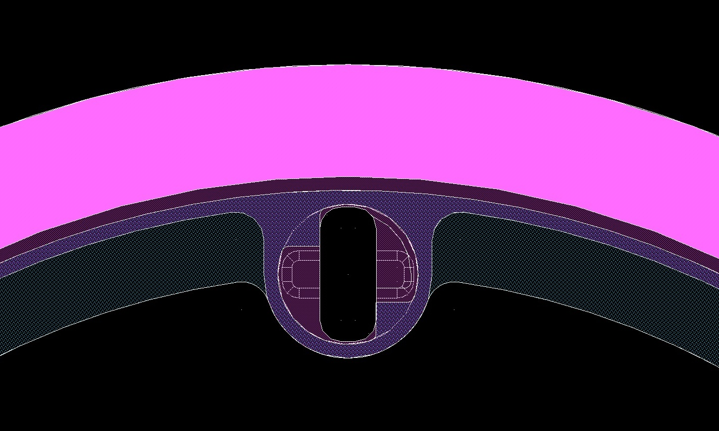
Mu2e Target Handler Mike Campbell 7-22-2013
Target Mounting Detail Showing Thermal Contact Area
Purple area: 1/8” gap
between bicycle wheel
OD and HRS tube ID
Blue area: thermal contact surface – 1/8” wide
full perimeter plus 3 areas surrounding latches
HRS tube
outer radius
Pink area: 1” wall
thickness of HRS tube
Bicycle wheel
outer radius
Inner radius of
target mounting
surface inside
HRS bore
Bicycle wheel
inner radius
Gray area:
bicycle wheel
HRS tube
inner radius

Slide 32
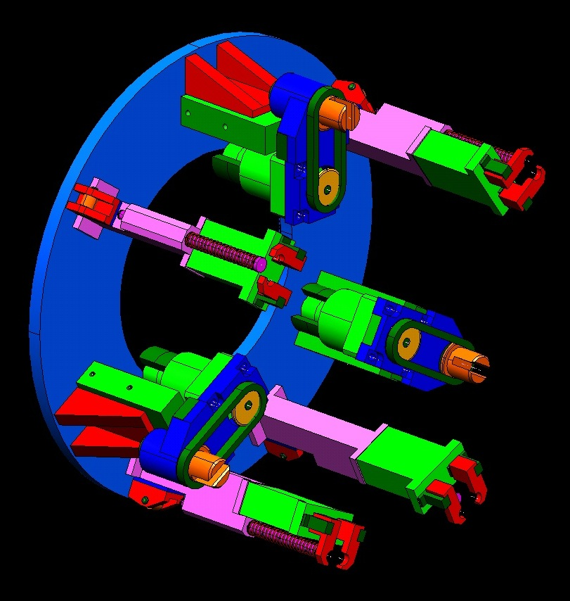
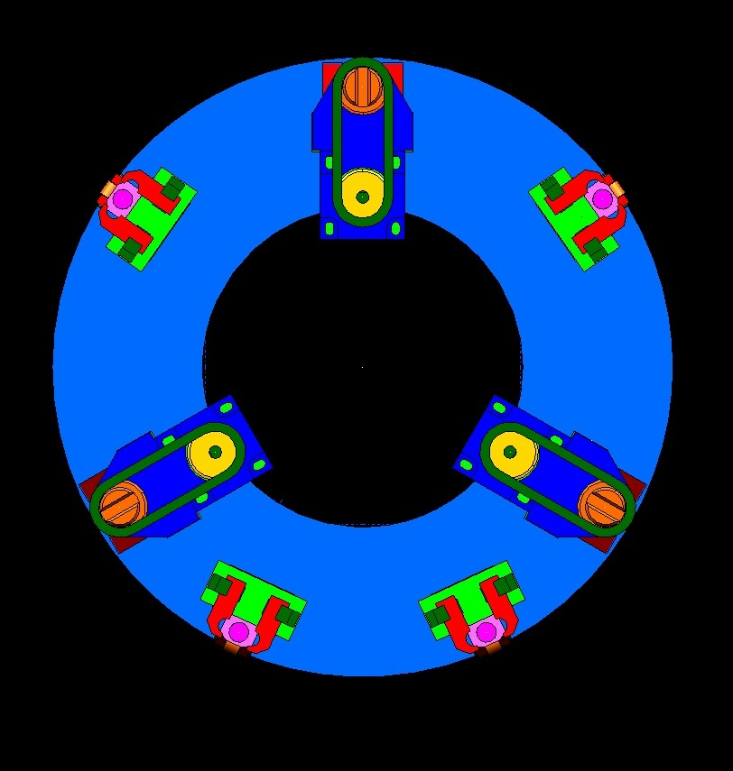
Mu2e Target Handler Mike Campbell 8-12-2013
Target Interface Mechanism Conceptual Design - Overview
Latch Actuator
Gripper
Gripper
Latch Actuator
Latch Actuator
Gripper
Gripper

Slide 33
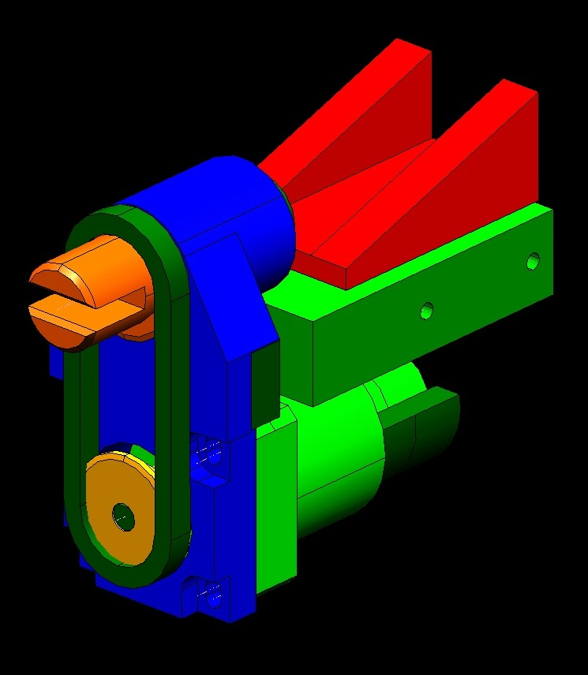
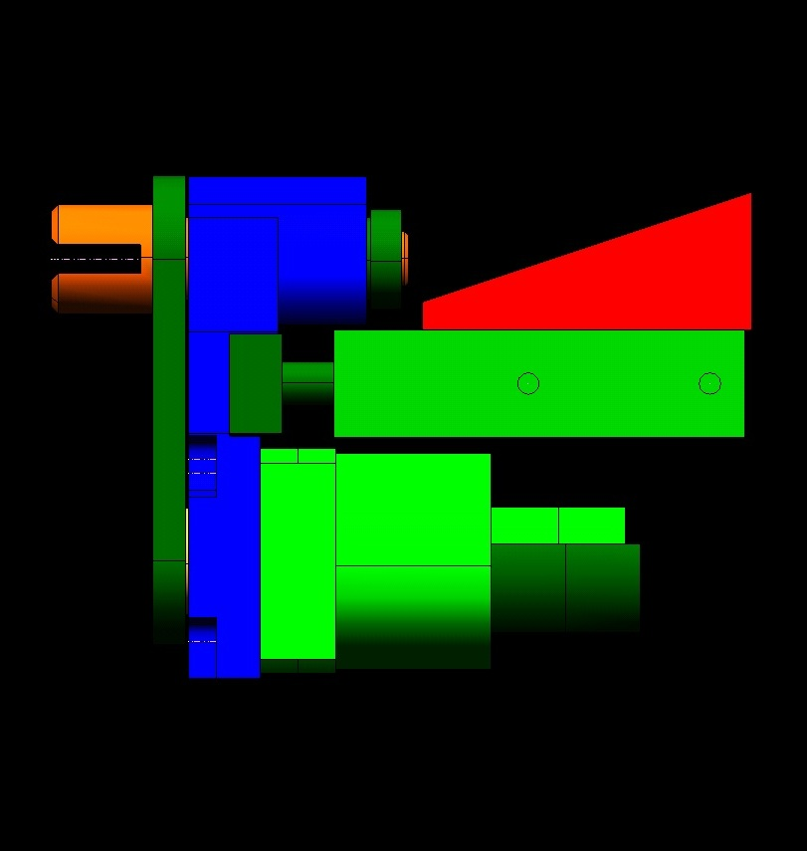
Mu2e Target Handler Mike Campbell 8-12-2013
Target Interface Mechanism Conceptual Design – Latch Actuator Mechanism
Latch actuator tool mounted in ball bearings
Pneumatic linear slide w/ 2x 10mm dia guide shafts - 1” horiz. stroke 90 lbf @ 100 psi (max)
Pneumatic rotary actuator - 90° rot, 44 inlb torque @ 100 psi (max)
Provides ~1000 lb (max) separation force per latch through helical 1/16” lift cam in bicycle wheel
Aluminum blocks
Chain drive

Slide 34
Mu2e Target Handler Mike Campbell 8-12-2013
Target Interface Mechanism Conceptual Design – Gripper Mechanism
Pneumatic gripper – grip force = 12 lb @ 100 psi (max) also spring loaded internally to closed position
Roller assembly supports/guides robot arm inside the HRS bore
Gripper fingers close against each other, Have a clearance fit to grip handles – allows/tolerates some misalignment
Latch actuator tool mounted in ball bearings
Aluminum block
Once target is free from HRS mount, spring plungers push target grip handles to one side of clearance

Slide 35
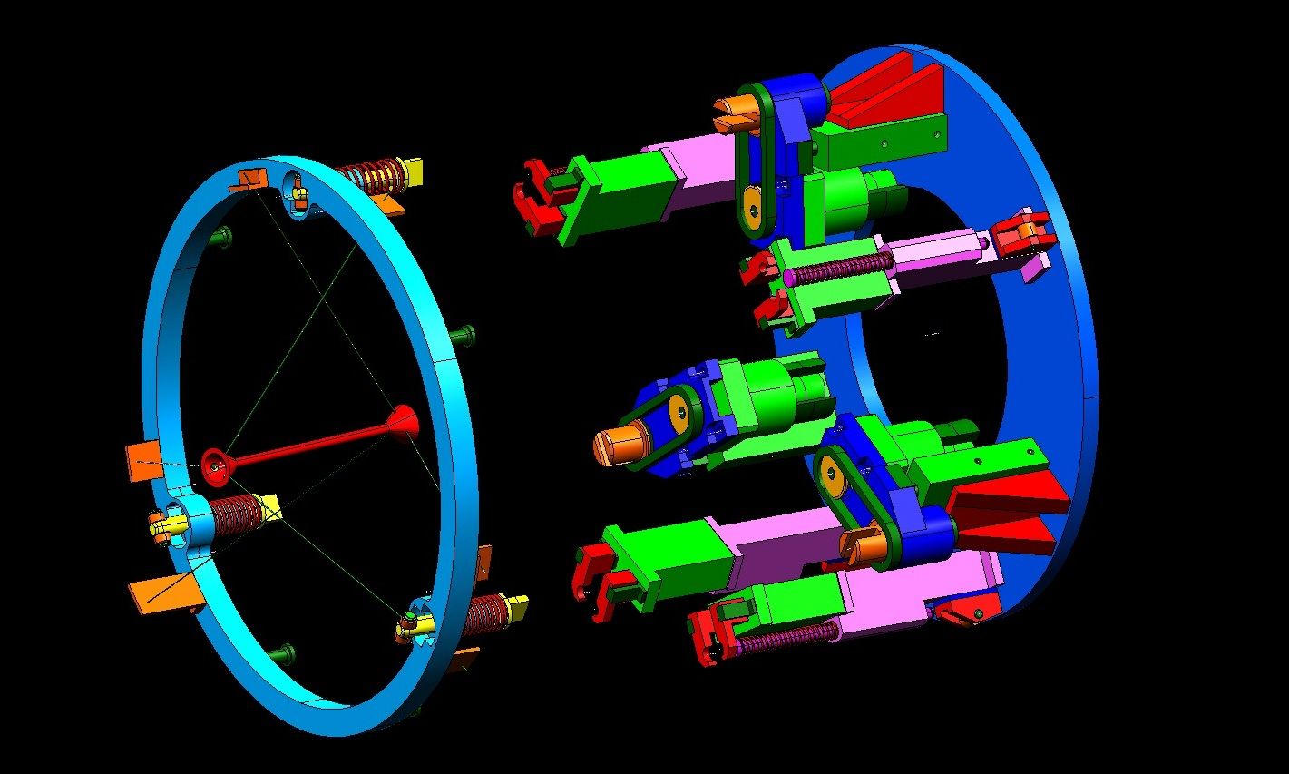
Mu2e Target Handler Mike Campbell 8-12-2013
Target Interface Mechanism Conceptual Design – Just Prior to Engaging Target Assembly
HRS bore
Robot arm
Note 4x rollers around perimeter guide/support end of robot arm as extends into HRS bore

Slide 36
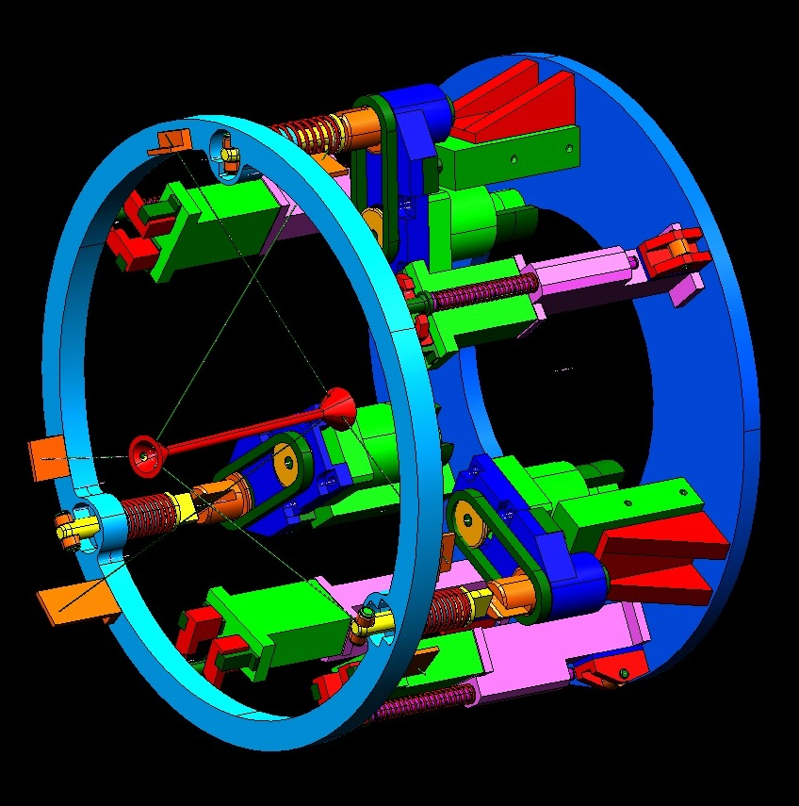
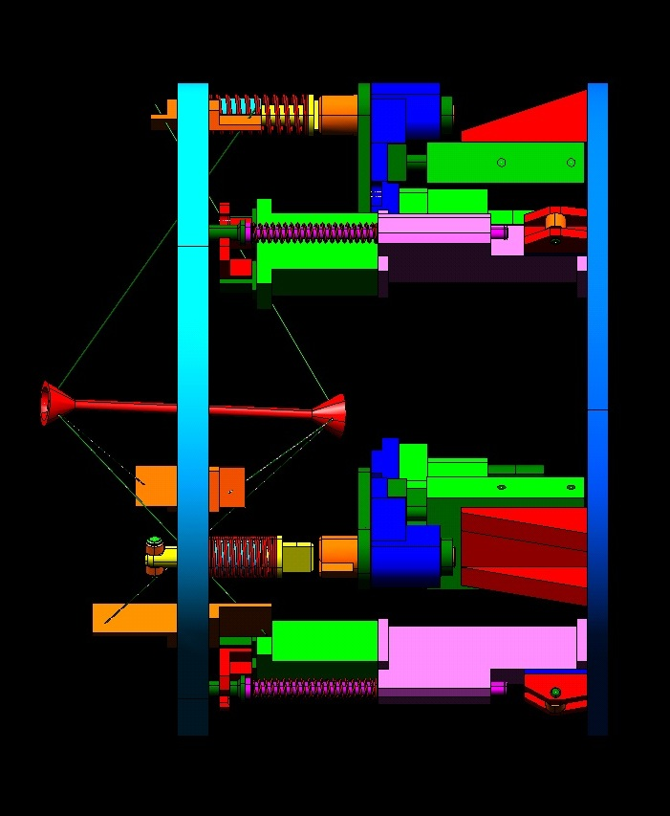
Mu2e Target Handler Mike Campbell 8-12-2013
Target Interface Mechanism Conceptual Design – Engaged with Target Assembly

Slide 37
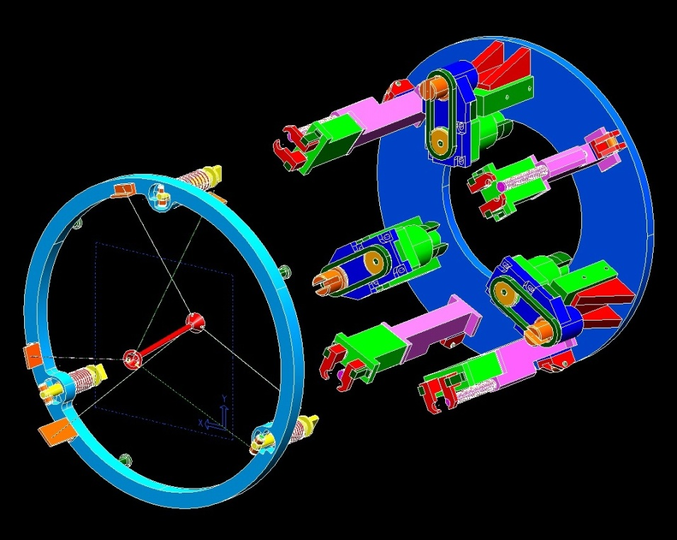
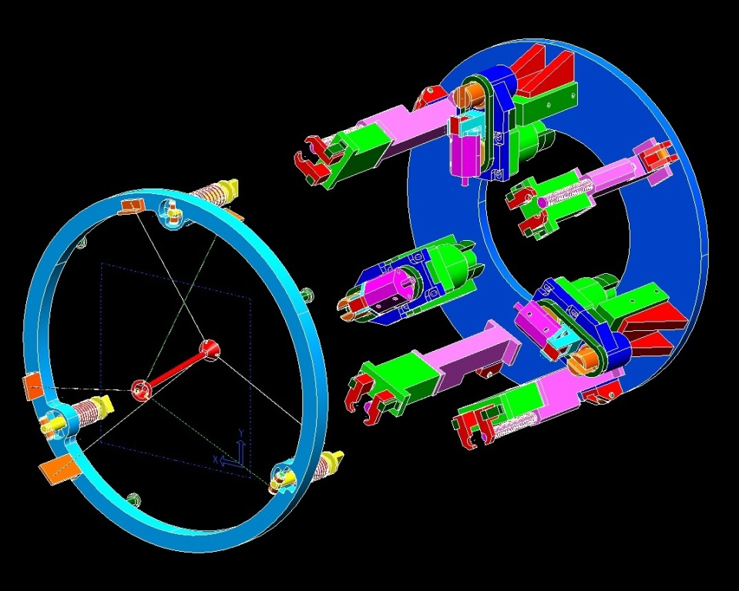
Mu2e Target Handler Mike Campbell 11-04-2013
Bicycle wheel latch mechanism design update
Previous Design
Shows 3 latch actuators that each push
and rotate the latches 90°.
Latest Design
Shows pneumatic cylinders added to
each latch actuator – cylinders extend to
hook the latches, insures they retract.

Slide 38
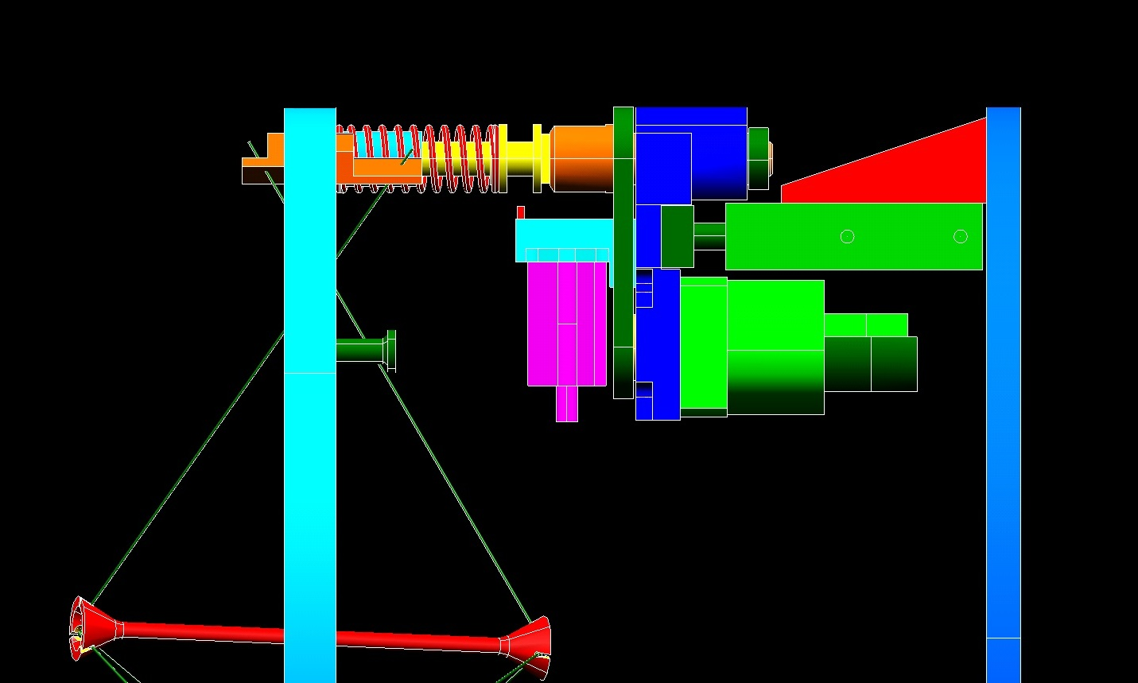
Mu2e Target Handler Mike Campbell 11-04-2013
Bicycle wheel latch mechanism design update
Groove added to latch pins
Finger extends up into groove, hooks latch pin
Latch is thus retracted by the spring pushing it back, also being pulled back by the horizontal pneumatic actuator, also verified w/ sensor
Pneumatic cylinder added

