Slide 1
WLCG Operations Coordination and Commissioning
Maria Girone, CERN IT
On behalf of the Operations Coordination Team
11th March 2013

Slide 2
Outline
Mandate and Scope
Organization
Ongoing activities
Opportunities during LS1
Conclusions

Slide 3
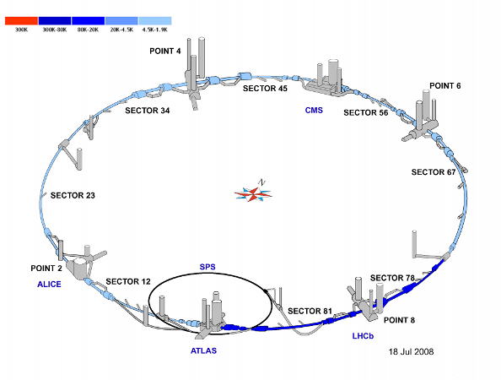
Introduction
The Operations Coordination Team was formed in the middle of 2012 after the Technical Evaluation Groups were finished
It was recognized that there were many deployment and commissioning activities ongoing and needed to be organized

Slide 4
Mandate
WLCG Operations Coordination and Commissioning Team
“This group will be the core operations and deployment coordination team in the future, and will manage ongoing operational issues as well as new deployments. It will replace some of the existing operations/deployment meetings and teams. Intent is to work together with EGI+OSG operations teams.”

Slide 5
Evolution
Even though the WLCG infrastructure has been in constant operations for years, it is also continuously evolving
Infrastructure improvements like CVMFS
Changes in monitoring and availability
Data Management Improvements like FTS3 and the broader deployment of data federations
Security changes like glexec and SHA-2
Transitions of middleware to resource provisioning tools like Open Stack and Agile Infrastructure projects

Slide 6
Organization
Operations Coordination Work Group activities have been kicked-off on 24th September 2012
Large spectrum of activities to be ensured in operations
Internal task forces are the driving force and source of specific and dedicated expertise
Primary communication channel on operational issues to WLCG MB
Regular reports to the monthly GDB
Regular fortnightly meetings established on 1st and 3rd Thursdays as main forum
First Operation Coordination meeting held on 4th October 2012
Minutes and action list

Slide 7
Logistics
Operations Coordination handles the daily operations meetings (now twice weekly)
Operations reports and tickets
Bi-weekly Coordination meetings
Follow task force progress. Report experiment issues
Quarterly Experiment Planning Meetings
Prepares plans and proposes them to the MB
Reviews operational needs from experiments and sites
Creates and dissolves internal ops task forces
E.g. Squid Monitoring task force concluded
Large and diverse group participates in the task forces and the operations. Only works with contributions from many areas

Slide 8
Focusing on LHC
All the grid and Infrastructure projects (OSG, EGI, NorduGrid, etc.) have to expand their focus to continue to be viable
Expand into campus infrastructures, focus on new communities and areas, and focus in new resource providers
Operations Coordination has the ability to focus entirely on the LHC
Form a resource for the LHC experiments in their interactions with the sites, the infrastructure providers, and the projects
Makes Operations Coordination unique

Slide 9
Team Composition
Moving the effort towards the WLCG collaboration
Chairs and task forces leaders from CERN, Tier1 and Tier2
Significant fraction of the coordination effort resides in CERN-IT
Forthnightly Meeting Chairs: M. Girone (CERN), J. Flix (PIC), A. Forti (Manchester)
Secretary: A. Sciabà (CERN)
Experiment representatives: M. Litmaath (ALICE), A. Klimentov (ATLAS), I. Ueda (ATLAS), I. Fisk (CMS), O. Gutsche (CMS), M. Cattaneo (LHCb), S. Roiser (LHCb)
Tier-1 representatives
Site/region representatives: M. Jouvin (GDB chair), J. Flix (PIC), J. Coles (GridPP), I. Collier (GridPP), A. Forti (GridPP), L. Dell'Agnello (CNAF), R. Santana (ROC-LA), M. Barroso (CERN)
Infrastructure projects: T. Ferrari (EGI), R. Quick (OSG), Tim Cartwright (OSG)

Slide 10
Ongoing Activities
CVMFS deployment
gLExec deployment
Tracking tools evolution
perfSONAR deployment
Middleware deployment
FTS 3 integration and deployment
Squid monitoring (concluded)
SHA-2 migration
Xrootd deployment
Scientific Linux 6 migration

Slide 11
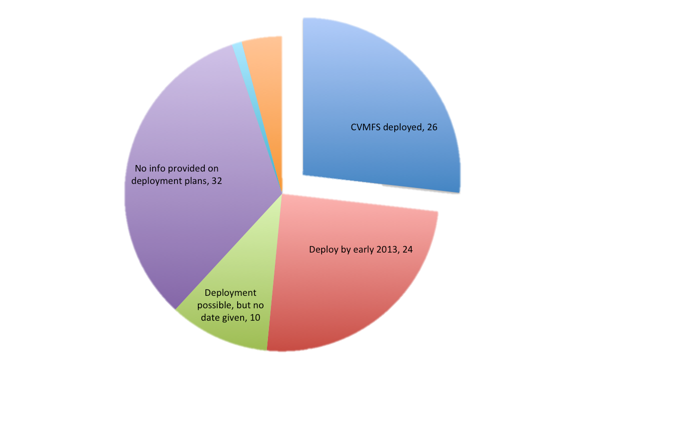
Ongoing Activities
CVMFS
Clear from the progress on tasks that having people to take ownership of the activities is an effective strategy
OSG has a program to support opportunistic Computing through user mounts of CVMFS using Parrot; only works with a healthy and scalable CVMFS system to start
Deployment Status
Dec ’12 (last GDB)

Slide 12
Ongoing Activities
glExec
The long running story that this is mandated, but not installed
The task force is closing out the deployment
Expect to ramp up after winter conferences
Already used in production at several CMS sites (20 EGI sites, 15 OSG sites)
193 CE tested (93 successfully)
milestones to be defined with experiment input
CMS would like to have at least 90% of sites with gLExec enabled by July 1st
LHCb needs testing gLExec support (already in the code)
Will start soon
Integration in PanDA well proceeding

Slide 13
Ongoing Activities
PerfSONAR
Coordinated by the WLCG Ops Task Force
Good representation from USATLAS/USCMS and internet2 (4+ people)
Sites indicated by experiments have been asked to install perfSONAR
And configure through the central mesh configuration
70 sites of 113 have PS installed (100% of OSG sites)
OSG involvement is critical
Liaison with PS developers (ESnet and internet2)
Operational support for deployment in the OSG infrastructure
Development of the perfSONAR Modular Dashboard

Slide 14
Ongoing Activities
Xrootd deployment
To help ATLAS (FAX) and CMS (AAA) collaborations in deploying at sites
Current focus is on systematically monitoring the health of the service at each site
Study the possibility to consolidate tests currently deployed separately by CMS and ATLAS
Deployment of SAM tests, registration of the service in GOCDB
File Access Monitoring is in an advanced state
Monalisa monitoring, Dashboard Transfer monitoring, data popularity monitoring
Discussion ongoing on the approach to follow for the maintenance in operation of the Xrootd UDP collectors
Pool of collectors maintained by a single organization or regional collectors US (OSG) + EU (CERN)

Slide 15
Ongoing Activities
FTS 3
Several new features demonstrated
MySQL backend, new monitoring page, user and SE blacklists, etc.
xrootd 3rd party transfers, explicit file staging (for LHCb)
Central FTS server (Oracle)
Stress tests ongoing and ramping up after winter conferences
Proposal for a deployment schedule will follow (April 2013)

Slide 16
Opportunities during LS1
Cloud infrastructure testing with experiment workflows
Leveraging IT expertise on Agile infrastructure
Agile Infrastructure still under testing but will evolve rapidly into production
Commissioning of the remote Tier0 (Budapest)
SL6 deployment
Task force formed. Target migration date by end 2013
Data placement
optimization of storage resources based on data popularity information
Data access
Transparent access to remote and shared Tier-1 storage, WNs on the OPN
Operations of Common Analysis Framework

Slide 17
Working Together
Operations Coordination is a convenient forum to interact between sites and experiments
EGI will use Operations Coordination for release discussions as well
It would be good to get a closer interaction also with OSG through the Operations Coordination to collaborate
Operations Coordination is also itself a resource
the task force model has proven to itself to be efficient in commissioning and deployment

Slide 18
Conclusions
The Operations Coordination team has taken over the responsibility for WLCG Operations
‘’ Impressive progress in deployment in the first 6 months ‘’ from Feb.2013 GDB minutes
Task forces progressing well. One concluded
Use of common tools and approaches by the LHC experiments is the only way forward towards sustainable operations
Need help from experiments, sites, EGI & OSG
Constructive collaboration spirit, sharing of responsibilities and tasks are key
Push for a stronger active participation of Tier-2 people in the task forces

Slide 19
Twiki and Mailing lists
Up-to-date twiki and action list at
https://twiki.cern.ch/twiki/bin/view/LCG/WLCGOpsCoordination
Mailing lists
WLCG-operations@cern.ch - general communication
WLCG-ops-coord@cern.ch - team member’s communication
WLCG-ops-coord-taskforce@cern.ch - internal task forces communications
WLCG-ops-coord-broadcast@cern.ch - for announcements
contain at least all contacts registered in GOCDB and OIM for the WLCG sites

Slide 20
Backup Slides

Slide 21
Concluded tasks
Squid monitoring
Task force concluded its activity with some agreements
Register all Squid servers in GOCDB/OIM
Propose specific SAM tests based on MRTG monitoring information and possibly on hits to Frontier/CVMFS

