Slide 1
MQXFA1 Structure Status Updates
LARP/HL-LHC Collaboration Meeting
CM-26 at SLAC
May 18-20, 2016
Dan Cheng, E. Anderssen, H. Pan, S. Prestemon
And the rest of the LBNL team

Slide 2
Outline
Updates on the MQXFA Magnet Structures
Status of the assembly and tooling
Action items from the February Workshop
Schedule update
Summary

Slide 3
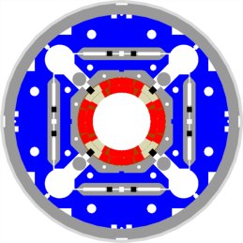
MQXFA Structure Subassembly
Shell-Yoke Structure
Half-length subassemblies
Joined shell-yoke subassembly, full-length
Coilpack
Coil pack subassembly
Load pad stacks
Collar pack subassembly
Collar stacks
Instrumented and GPI wrapped coils
Master Key packages
Load keys, alignment keys, shims
Axial load
Axial rods, [end plates, wire guides]
Splice Connection box
Magnet support ring
Instrumentation connector skirt

Slide 4
MQXFA Structures Updates

Slide 5
Structures Fabrication Status
We experienced significant delays on key structural parts
Initiated yokes order September 2015
Yoke vendor encountered issues with machining tight tolerances, CMM inspections, 1st article turnarounds, several iterations
Loosened a few tolerances (comparable with CERN’s fabrication drawings)
Initiated a backup order for yokes with a 2nd vendor February 2016
Last month the re-tooled efforts of 1st vendor still did not hit tolerances
First yokes and collars are expected to be approved for production soon
Latest set of collars are being inspected this week
F/A yoke is due from 2nd vendor later this week
They invested in in-house inspection capability, so turnarounds could also be expedited
First batch of load pads have been approved and are currently in production
Shells received
Currently being instrumented
Bushings (collars, load pads, yokes) received
Nitronic 50 endplates received
First dummy coils are being delivered this week

Slide 6
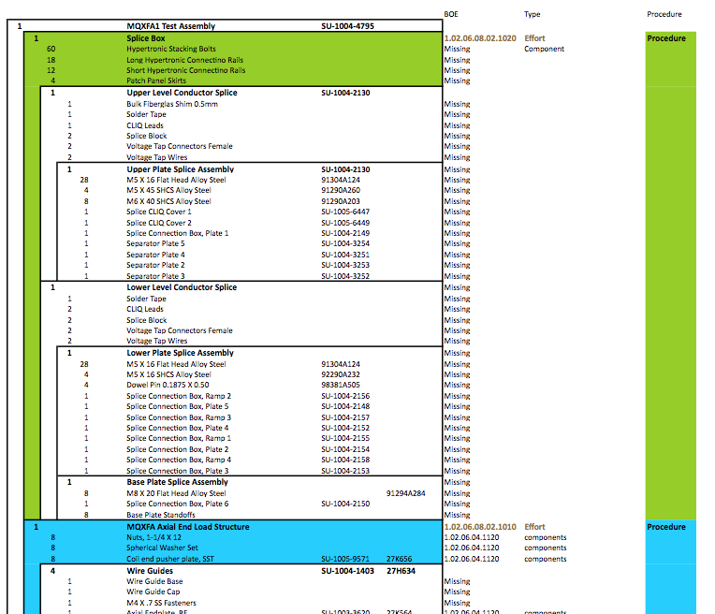
Structures Assembly Update
Assembly Breakdown Structure (ABS) has been developed and will be implemented in the CERN documentation system
Data will be captured on the floor directly into the MTF database
While this magnet will never be installed in the ring, this is a timely opportunity to practice the documentation for the series magnets and work out the bugs
CERN will be at LBNL for training next week

Slide 7
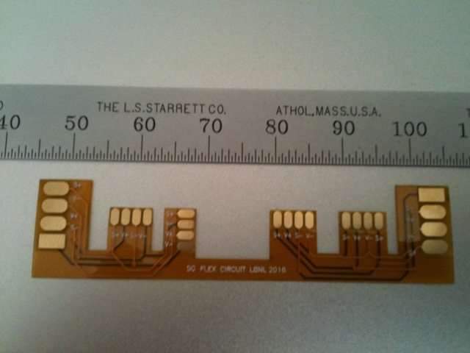
Shell Instrumentation
New strain gauge wiring flex circuit will be tested
Typical wiring employed

Slide 8
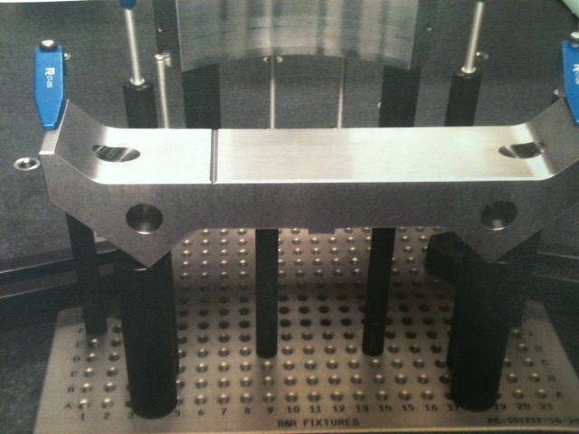
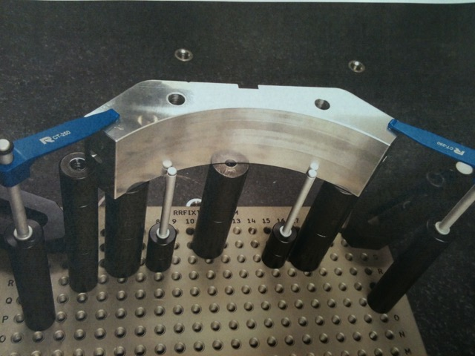
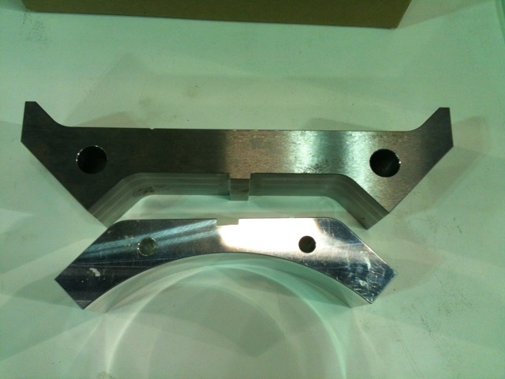
First Articles

Slide 9
MQXFA Structures Tooling Updates

Slide 10
Structures Tooling and Infrastructure Status
We also experienced some delays in tooling design
At the July 2015 review expressed concerns about the amount of work the tooling represented
Designer resources finally stabilized during the first part of 2016, but much work still remained
CERN-style tooling required adaptation for use at LBNL
Short tooling designs had to be scaled up for longer lengths
Also required analysis for seismic events
Tooling is starting to arrive
Coil lifting fixtures
Integration table frame
Coilpack assembly table + side table frames
Procurements have been initiated with almost all tooling

Slide 11
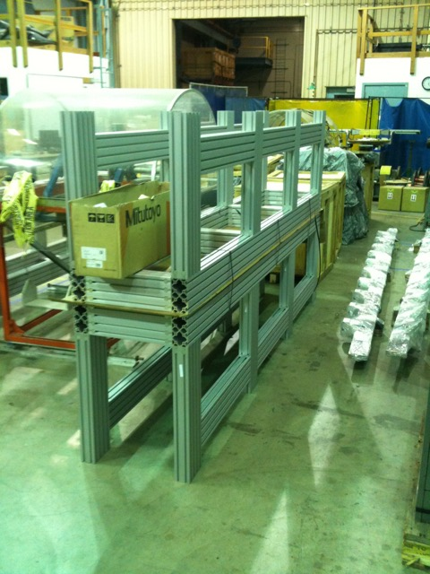
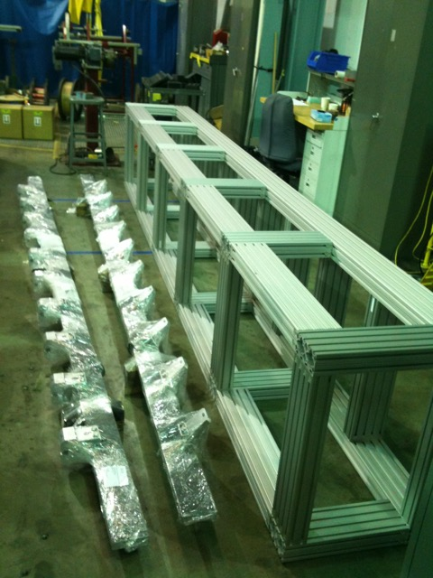
Assembly table frames and coil lifting

Slide 12
Action Items from February Workshop

Slide 13
Action Items from February Workshop
 | Done | Notes
Verify axial preload conditions with SST rods | ☑
Fabricate Nitronic 50 endplates for CERN | ☑ | Not shipped yet
Check coil stress with SST LHe containment | ☑
Check SG versus model during bladder operations | ☐ | In Progress
Perform tolerance analysis on dummy coil case (and full tolerance analysis) Will also investigate impact of azimuthal tolerances | ☐ | Eng. Note in Progress
Update analysis with adjusted modulus | ☑
Evaluate possible use of extruded bladders | ☑
Check rigidity of integration table | ☑
See G. Vallone &
H. Pan talks
See J. C. Perez talk

Slide 14
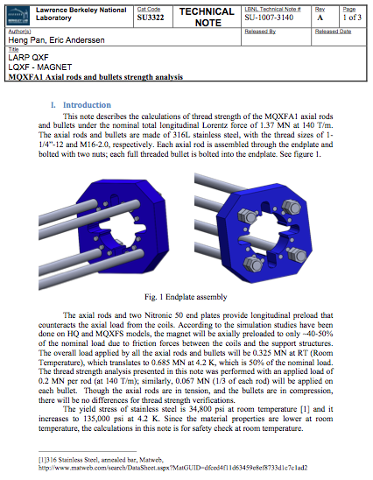
Verification of axial preload using SST Rods
The total axial force of the magnet at 140 T/m is 1.37 MN.
Axial rods and the 12 bullets will be preloaded to half of the rated the load (~0.7 MN) at 140 T/m.
Axial rod thread size: 1-1/4”-12, 316L stainless steel
Bullets thread size: M16-2.0, 316L stainless steel
316L SST | Yield Str. (imperial) | Yield Str. (metric)
Room Temp. | 34,800 psi | 240 MPa
4.2 K | 135,000 psi | 930 MPa

Slide 15
Verification of axial preload using SST Rods
The fundamental criteria is that the bolt or screw will break before the threads strip
The criteria is the area of the screw in shear must be twice the tensile-stress area to attain the full strength of the screw.
 | Rod thread | Bullet
Required engagement length (Le) | 0.9 inch | 10 mm
Tensile area (A_{t}) | 1.073 inch² | 156 mm²
Shear area of external thread (A_{s_ex}) | 2.146 inch² | 312 mm²
Actual Shear area | 3.93 inch² | 3619 mm²
 | Rod thread |  | Bullet
 | RT | 4.2 K | RT | 4.2K
Tensile stress (psi) | 16,900 | 41,900 | 25,000 | 53,900
Safety factor | 1.775 | 3.22 | 1.2 | 2.5
The rods and bullets will not fail!

Slide 16
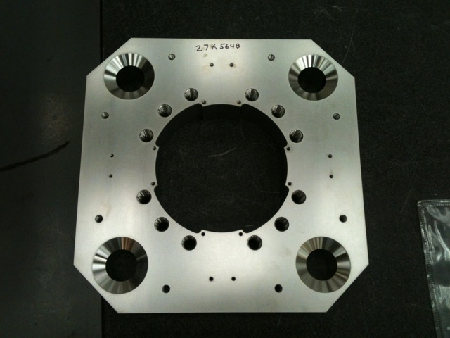
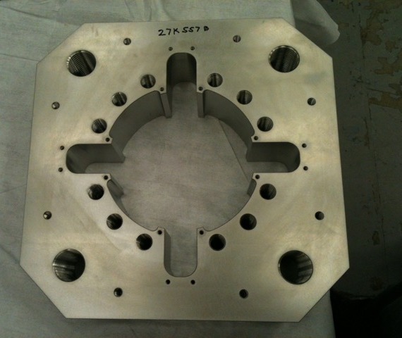
Nitronic 50 Endplates
One of the three sets fabricated will be sent to CERN

Slide 17
MQXFA modeled with the SST LHe Shell
Half-length coil: 2.281 m (return end) using updated coil properties
Octant model
View of the meshed model (colored by different materials)
Solid 186 elements
700 μm Interference applied between the SS shell and Al shell.
All components are in contact using contact elements
Contact174/Target170
Baseline Friction coefficient is 0.2

Slide 18
MQXFA modeled with the SST LHe Shell
Coil azimuthal stress (Layer 1, mid-radius)
A gap opens up between SST and Al shell at cold
Therefore, adding the SST shell does not improve the coil stress uniformity.
With SST shell
Without SST shell
The model of this case employed the lowered coil modulus, 550 μm interference applied.
the coil azimuthal stress variation at 140 T/m is remained as 10 MPa.

Slide 19
Verify SG model during Bladder Operations
Full 2D model was built to check the bladder operations
Some results obtained; work is ongoing.
We expect complete results before loading of first long structure later this year.
B
D
A
C
STEP 1
3500PSI
STEP 2
A
STEP 3
2500PSI
STEP 4
STEP 5
STEP 6
STEP 7
3000PSI
STEP 8
STEP 9
B
D
STEP 10
STEP 11
STEP 12
3500PSI
STEP 13
STEP 14
STEP 15
STEP 16
4000PSI
C
STEP 17
STEP 18
STEP 19
STEP 20
4200PSI
STEP 21

Slide 20
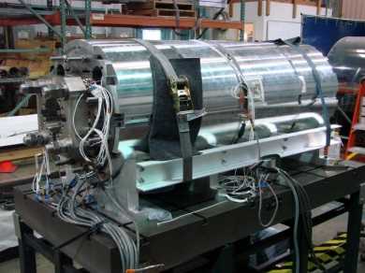
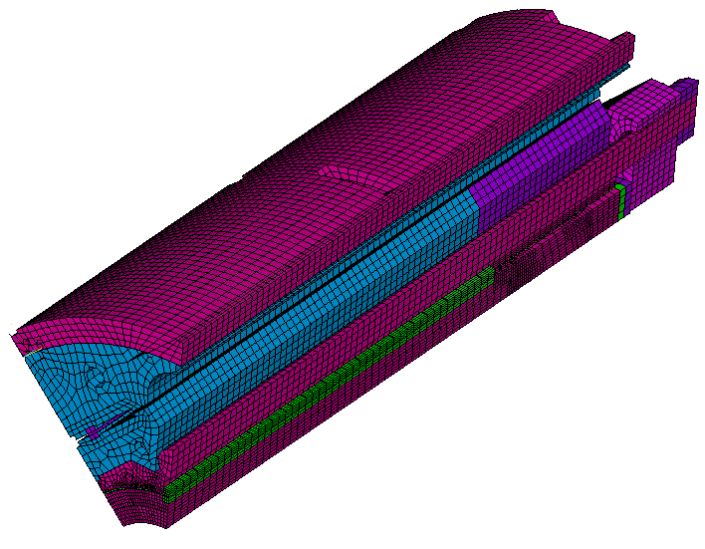
Update on Tolerance Analyses
Actual tolerances of the MQXFSD1
The 3D tolerance model is used for the sanity check.
Aluminum coil
Actual tolerance in dummy coils (profile tolerance)
 | Collar | Pad | Master (pad) | Master (Yoke) | Yoke | Shell
Tolerance (μm) | 20 | 20 | 50 | 50 | 20 | +100

Slide 21
FES vs. Measurement
Actual interference of 550 μm is applied in the model.
Statistical method (RSS---Root-Sum-Square) was used to verify the FEA solution.
The tolerance has similar agreement in shell stress; better agreement in coil stress.
$$∆T=\sqrt{\sum_{k=1}^{n}{T_{k}^{2}}}=127 μm$$
FEA model
FEA model

Slide 22
Impact of azimuthal tolerance
Azimuthal tolerance of each part will cause coil twist.
The physical envelope requirement for the long MQXFA magnet is 1 mrad/5m.
Assume the azimuthal tolerance of each part is 25 μm.
Twist angle of coil is related to the each azimuthal tolerance and distance to the center origin.

Slide 23
Impact of azimuthal tolerance
Assume each azimuthal tolerance is 25 μm, the resultant coil twist angle is (Sensitivity check):
Coil twist angle (mrad) | Collar/Pole key | Pad | Master | Yoke
0.21 | 25 | 0 | 0 | 0
0.19 | 0 | 25 | 0 | 0
0.12 | 0 | 0 | 25 | 0
0.09 | 0 | 0 | 0 | 25
0.61 | 25 | 25 | 25 | 25
If the twist angle of coil is 1 mrad, each corresponding azimuthal tolerance is (Sensitivity check):
 | Collar/Pole key | Pad | Master | Yoke
Max allowable azimuthal tolerance (μm) | 119 | 132 | 212 | 278
This work is on-going

Slide 24
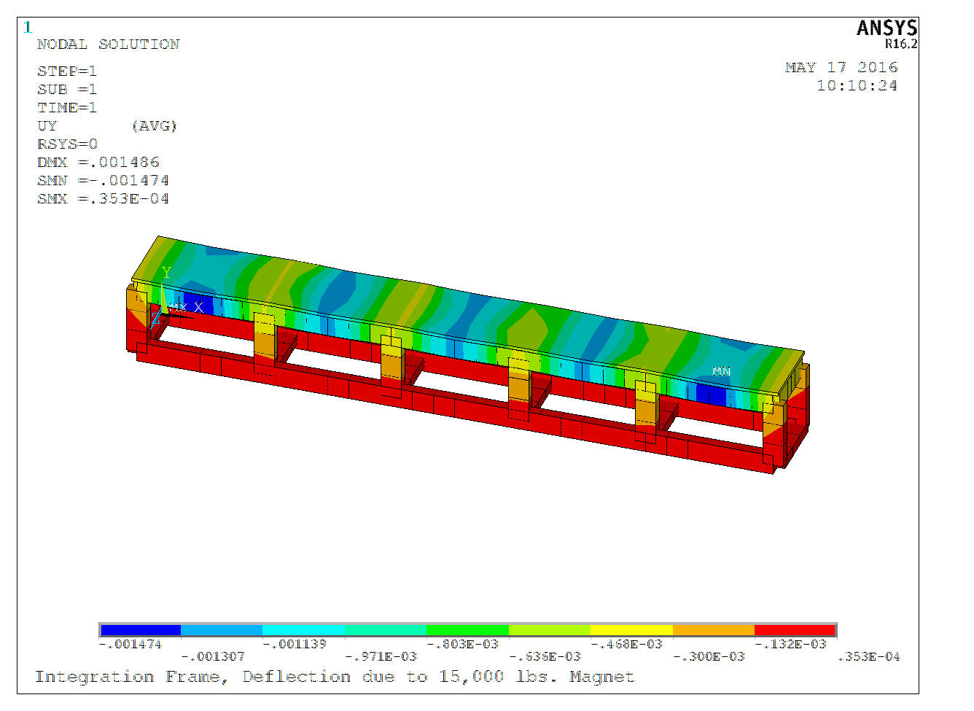
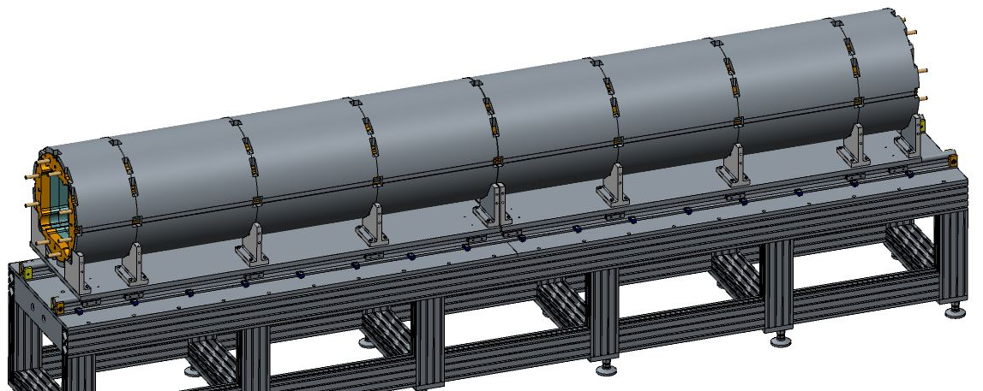
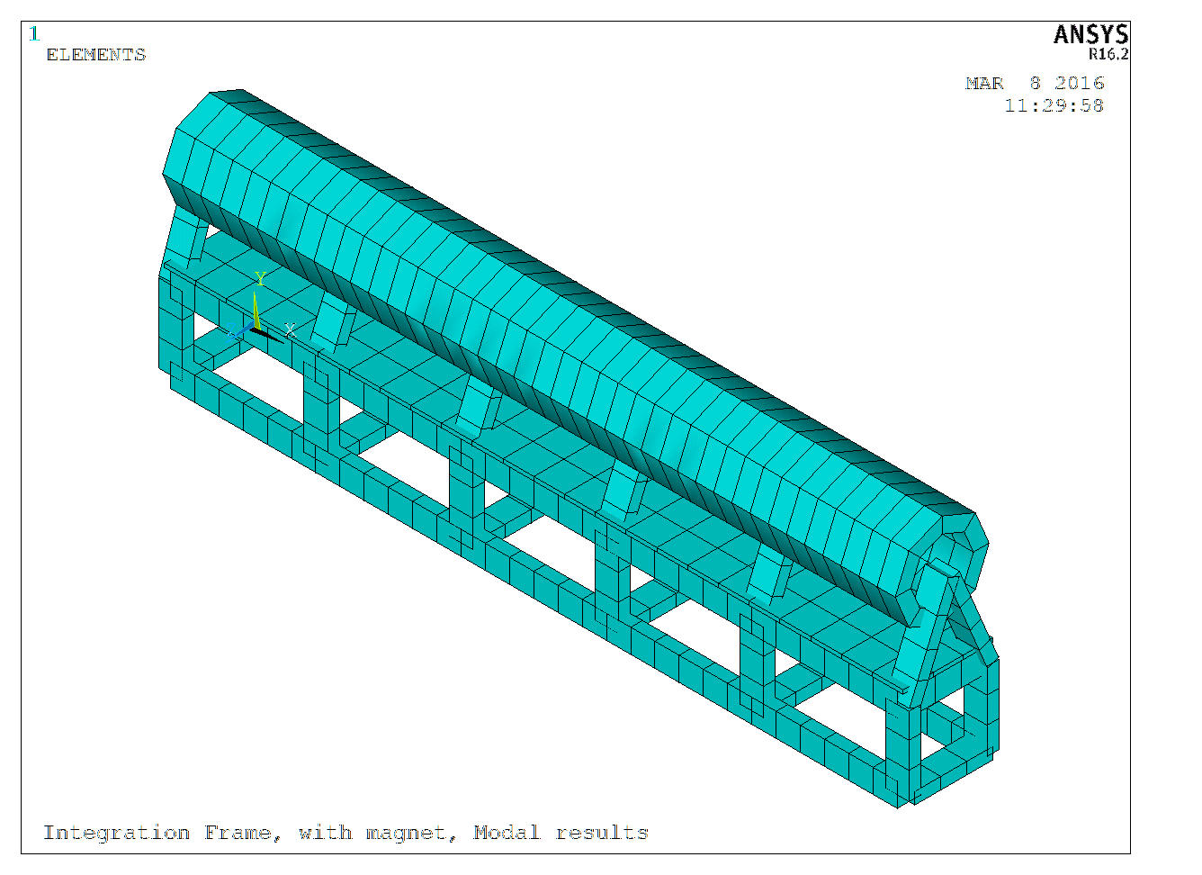
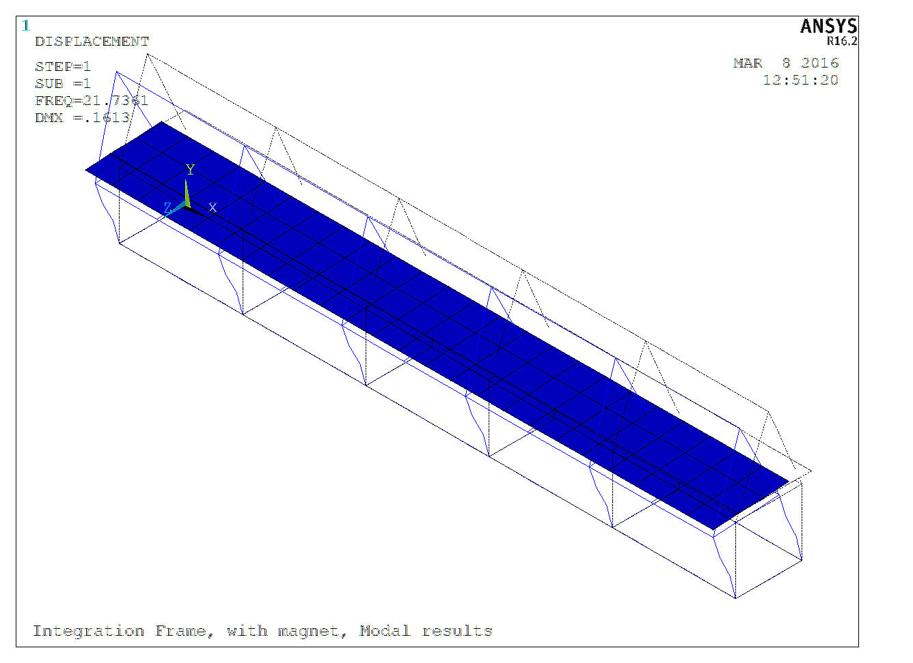
Integration Table Rigidity
Analyzed as part of the seismic restraint
Rigidity of table frame is sufficient
Effect of 15,000 lbs. magnet weight
Max deflection | ~-0.0015”
Lowest freq. modal solution | 22 Hz
Note: Final shell configuration not shown

Slide 25
Status & Schedule updates

Slide 26
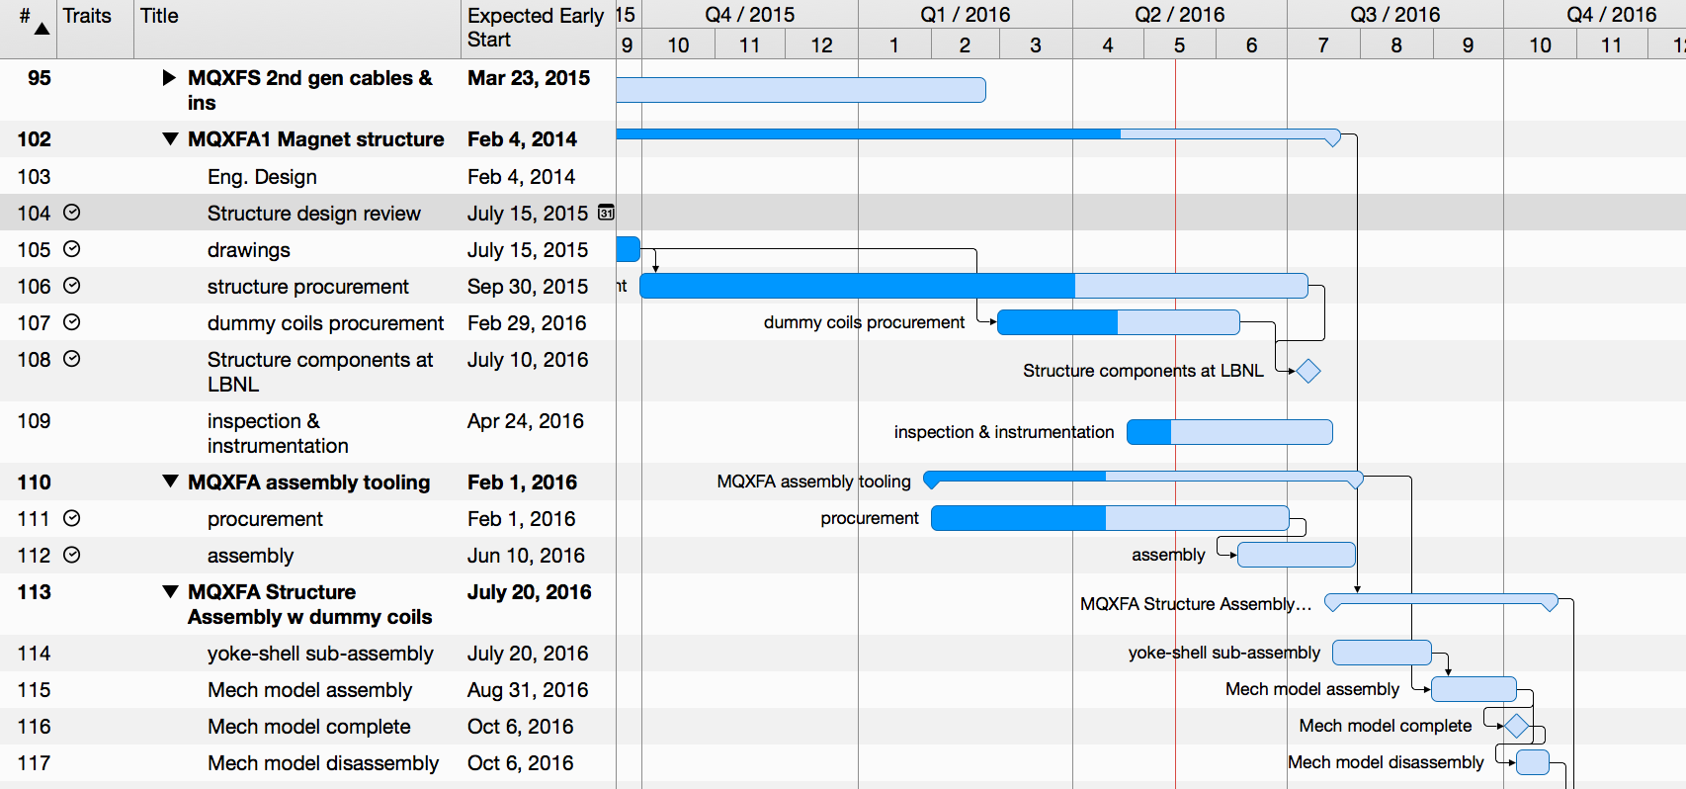
Schedule of Parts & Tooling Procurement
Most structure parts are in procurement process
Majority of components to be delivered late spring
Assembly table components are in the RFQ process
Most detailed designs are complete
Majority of tooling will be delivered late spring

Slide 27
Assembly of MQXFA1
Schedule layout unchanged, but delayed start of assembly by ~2 weeks due to tooling and structure procurement delays results in a projected ~2 week delay of final assembly

Slide 28
MQXFA2 structure
Although the first structure procurements have had issues, we think these are being resolved and will provide lessons-learned for the 2nd structure;
Updating of drawings will occur primarily in summer 2016;
Intend to start 2nd structure procurements later than originally planned, but should not impact final schedule for MQXFA2.
Components and yoke-shell subassembly remains on schedule for completion by end of April 2017

Slide 29
MQXFA2 Assembly and test
Schedule remains unchanged

Slide 30
MQXFS1b Re-loading
Additionally, MQXFS1 magnet is scheduled to arrive at LBNL by the end of this week
Diagnostics (wiring, signals, electrical) will be performed first
After diagnostics checks we expect to increase the preload the first week of June.
See H. Pan talk
For more detailed dates

Slide 31
Summary
Presented the updates to the MQXFA structure fabrication
There were some delays in confirming first articles, but we believe the vendors have the programming dialed in, and production on remaining items can proceed very soon
Presented the updates to the action items in February workshop; most items complete, but a few items are still being worked on; completion this summer
MQXFA1 schedule updates show some resultant delays, though we expect to still maintain the scheduled test target date in early 2017
Schedule for the 2nd structure is not expected to be affected

Slide 32
Thank you for your attention!

Slide 33
Backup slides

Slide 34
Critical stress areas of the threaded joints
The fundamental criteria is that the bolt or screw will break before the threads strip
The criteria is the area of the screw in shear must be twice the tensile-stress area to attain the full strength of the screw.
The following two equations are used to calculated the minimum required tensile area and engagement length based on the above criteria:
Minimum tensile area (Imperial units):
$$A_{t}=\frac{π}{4}∗{(D−\frac{0.9743}{n})}^{2}$$
Minimum engagement length (Imperial units):
$$L_{e}=\frac{2∙A_{t}}{D_{3_max}∙π∙[1/2+0.57735∙n∙\left(D_{2_{min}−}D_{3_max}\right)]}$$
Minimum shear area (Imperial units):
$$A_{s_ex}=π∙n∙L_{e}∙D_{3_max}[\frac{1}{2n}+0.57735(D_{2_min}−D_{3_max})]$$

Slide 35
Results of for the axial rods and bullets
 | Rod thread | Bullet
Required engagement length (Le) | 0.9 inch | 10 mm
Tensile area (A_{t}) | 1.073 inch² | 156 mm²
Shear area of external thread (A_{s_ex}) | 2.146 inch² | 312 mm²
Actual Shear area | 3.93 inch² | 3619 mm²
 | Rod thread |  | Bullet
 | RT | 4.2 K | RT | 4.2K
Tensile stress (psi) | 16,900 | 41,900 | 25,000 | 53,900
Safety factor | 1.775 | 3.22 | 1.2 | 2.5
Each rod has an engagement about 1 inch (25 mm) into the first nut;
Each bullet is fully threaded, and the endplate is 75 mm thick, fully threaded as well.
Given the dimensions of the endplate and bullets, the threads will not fail in the assembly

Slide 36
MQXFA modeled with the SST LHe Shell
Gap between the SS vessel and Al shell
The SST shell will be installed after preloading, gap generated between the SS shell and Al shell due to relatively lower thermal contraction after cool-down.
The gap will be smaller though in the following excitation.

Slide 37
Assembly and prep of short structure with thin laminations
Motivation depends on value added of pursuing thin laminations
Strong interest from CERN
No experience within LARP
Need to evaluate benefits and risks
Should also consider potential value of thicker laminations
Schedule appears reasonable, and includes some float
CERN’s shipment of thin yokes and load pads have arrived at LBNL

Slide 38
MQXFA3 structure adjustments for value engineering
Details of value engineering remain to be identified
Thin laminations is one candidate, but too early to make a decision at this point
Schedule has sufficient time to implement
Need to identify the figures of merit- does the dummy assembly provide sufficient data?

