Slide 1
Science at fermilab (and beyond!)
Dan Hooper – Fermilab
Saturday Morning Physics

Slide 2
What is Physics?
Physics is hard to define. Here are some definitions that I found in online dictionaries:
“The science that deals with matter, energy, motion, and force.”
“A science that deals with matter and energy and their interactions”
“The branch of science concerned with the nature and properties of matter and energy. The subject matter of physics, distinguished from that of chemistry and biology, includes mechanics, heat, light and other radiation, sound, electricity, magnetism, and the structure of atoms.”

Slide 3
What is Physics?
Physics is hard to define. Here are some definitions that I found in online dictionaries:
“The science that deals with matter, energy, motion, and force.”
“A science that deals with matter and energy and their interactions”
“The branch of science concerned with the nature and properties of matter and energy. The subject matter of physics, distinguished from that of chemistry and biology, includes mechanics, heat, light and other radiation, sound, electricity, magnetism, and the structure of atoms.”
In my opinion, these definitions are not “wrong”, but if you think about it closely, they are not very useful.
Everything in the universe is made up of matter and energy.
Everything that happens can be described in terms of motion and interaction
Does this mean that physics is the science of everything?

Slide 4
What is Physics?
Physics is hard to define. Here are some definitions that I found in online dictionaries:
“The science that deals with matter, energy, motion, and force.”
“A science that deals with matter and energy and their interactions”
“The branch of science concerned with the nature and properties of matter and energy. The subject matter of physics, distinguished from that of chemistry and biology, includes mechanics, heat, light and other radiation, sound, electricity, magnetism, and the structure of atoms.”
In my opinion, these definitions are not “wrong”, but if you think about it closely, they are not very useful.
Everything in the universe is made up of matter and energy.
Everything that happens can be described in terms of motion and interaction
Does this mean that physics is the science of everything?
A more useful definition, I would argue, is that physics is the branch of science that strives to address the most fundamental of questions about our universe.

Slide 5
Physics

Slide 6
Physics
Chemistry

Slide 7
Physics
Chemistry
Cellular Biology

Slide 8
Physics
Astronomy
Chemistry
Geoscience
Cellular Biology
Social Sciences
Functional Biology
Psychology
Sociology

Slide 9
What is Physics In Practice?
The physics that you are most likely learn in high school, or in a first year college course, will cover topics such as:
Force and motion (17th century)
Gravity (17th century)
Electromagnetism (18th and 19th centuries)
Thermodynamics (19th century)
Wave phenomena (19th century)
In the twentieth century, physics changed dramatically, with the discovery of Einstein’s theory of relativity and quantum physics.
In practice, all physicists are trained in each of these areas, and we put them to use on a regular basis. But we are not generally studying any of these topics, per se.

Slide 10
Some Areas of Current Investigation in Physics
Particle Physics
What forms can matter and energy take in our universe? How do they fit together into a more complete and predictive theory?
Why do some particles have mass? What causes them to?
What is the “dark matter”?
What is gravity at a quantum level?

Slide 11
Some Areas of Current Investigation in Physics
Condensed Matter Physics (Solid State Physics)
What causes high-temperature superconductivity?
Many aspects of turbulence remain a mystery
Do the equations that we use to describe fluid flow have solutions that apply in all conditions? Or do they break down?

Slide 12
Some Areas of Current Investigation in Physics
Cosmology
How did the Big Bang take place?
Will the universe expand forever, or not?
Are there really three dimensions of space? If so, why?
What is the geometry of the universe?
Why does time flow forward in one direction and backward in another?
What is “dark energy”?
Did the universe undergo a period of ultrafast expansion (inflation)? If so, why and how?

Slide 13
From The Fermilab Website:
“What are we made of? How did the universe begin? What secrets do the smallest, most elemental particles of matter hold, and how can they help us understand the intricacies of space and time?
Since 1967, Fermilab has worked to answer these and other fundamental questions and enhance our understanding of everything we see around us. As the United States' premier particle physics laboratory, we do science that matters. We work on the world's most advanced particle accelerators and dig down to the smallest building blocks of matter. We also probe the farthest reaches of the universe, seeking out the nature of dark matter and dark energy.”

Slide 14
Early Attempts Toward Particle Physics
Many philosophers throughout history have contemplated the nature of matter
Some of the ancient Greeks advocated for:
Everything is made up of a finite number of “atoms” (Democritus, Lucretius, 440 BCE)
Everything is made up of combinations of “elements”, such as air, earth, fire, water (Plato, Aristotle, among others, 360-350 BCE)

Slide 15
Early Attempts Toward Particle Physics
Many philosophers throughout history have contemplated the nature of matter
Some of the ancient Greeks advocated for:
Everything is made up of a finite number of “atoms” (Democritus, Lucretius, 440 BCE)
Everything is made up of combinations of “elements”, such as air, earth, fire, water (Plato, Aristotle, among others, 360-350 BCE)
The work of these ancient philosophers is often presented as constituting the beginning of science.
They were not, however, applying the scientific method in any consistent way.
They were speculating about the same topics we now address scientifically, but were not really doing science.

Slide 16
The Establishment of Chemistry
Throughout the 18th and 19th centuries, a great deal of progress was made in identifying the properties of various chemical elements:
Hydrogen (1766), Oxygen (1773), etc.
In 1808, John Dalton proposed the first modern atomic theory
In 1869, Dmitri Mendeleev published the first modern periodic table (containing 66 elements at the time)
During this period of time, chemistry was established as a science, but there remained little understanding of what “atoms” really were

Slide 17
The Beginning of Particle Physics
Around the beginning of the 20th century, we began to discover the nature of atoms… and the quantum nature of matter

Slide 18
The Beginning of Particle Physics
Around the beginning of the 20th century, we began to discover the nature of atoms… and the quantum nature of matter
The discovery of the electron, cathode ray tube experiment (J.J. Thomson, 1897)

Slide 19
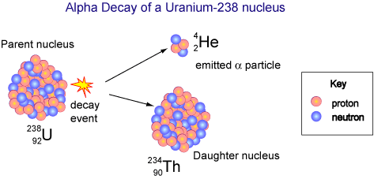
The Beginning of Particle Physics
Around the beginning of the 20th century, we began to discover the nature of atoms… and the quantum nature of matter
The discovery of the electron, cathode ray tube experiment (J.J. Thomson, 1897)
Discovery that radioactivity was caused by decaying atoms (1900, Ernst Rutherford)

Slide 20
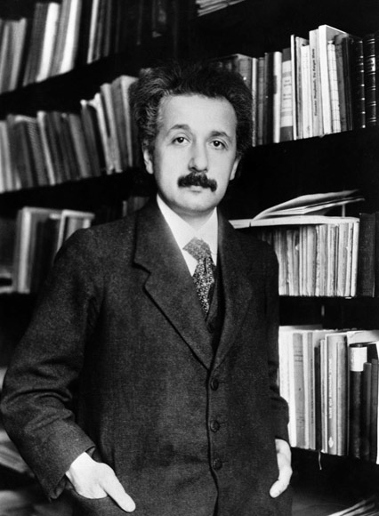
The Beginning of Particle Physics
Around the beginning of the 20th century, we began to discover the nature of atoms… and the quantum nature of matter
The discovery of the electron, cathode ray tube experiment (J.J. Thomson, 1897)
Discovery that radioactivity was caused by decaying atoms (1900, Ernst Rutherford)
Einstein shows that Brownian motion can be explained if gases are made up of atoms – first “proof” of atoms (1905)

Slide 21
The Beginning of Particle Physics
Around the beginning of the 20th century, we began to discover the nature of atoms… and the quantum nature of matter
The discovery of the electron, cathode ray tube experiment (J.J. Thomson, 1897)
Discovery that radioactivity was caused by decaying atoms (1900, Ernst Rutherford)
Einstein shows that Brownian motion can be explained if gases are made up of atoms – first “proof” of atoms (1905)
In the same year, Einstein also showed that the photoelectric effect could be explained if light waves came in discrete pieces, or “quanta” (1905)

Slide 22
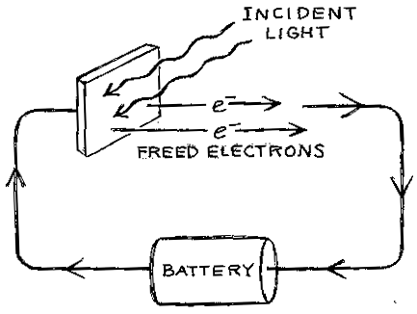
Einstein and the Quantum Mechanics Revolution
Prior to 1905, physicists thought of light as waves of electromagnetic radiation, but in this view, it was was difficult to explain what was known as the photoelectric effect:
Light is directed at a metal plate hooked up to a battery; without any light, no current flows
Once the light hits the plate, it was expected that electrons would be freed from the metal, and electric current would begin to flow around the circuit
When tested, it was found that only high frequency light caused an electric current

Slide 23
Einstein and the Quantum Mechanics Revolution
Prior to 1905, physicists thought of light as waves of electromagnetic radiation, but in this view, it was was difficult to explain what was known as the photoelectric effect:
Light is directed at a metal plate hooked up to a battery; without any light, no current flows
Once the light hits the plate, it was expected that electrons would be freed from the metal, and electric current would begin to flow around the circuit
When tested, it was found that only high frequency light caused an electric current
Einstein proposed that light waves were made up of individual pieces – called “quanta” (now called photons) - each with an amount of energy proportional to their frequency
Low frequency light was made up of low energy photons that could not free electrons from the metal plate, and thus could not generate electric current (no matter how many)
High frequency light, in contrast, was made up of photons with more energy, which could free electrons, creating current
Einstein’s interpretation meant that light was both a wave, and was made up of particles

Slide 24
The Beginning of Particle Physics
Around the beginning of the 20th century, we began to discover the nature of atoms… and the quantum nature of matter
The discovery of the electron, cathode ray tube experiment (J.J. Thomson, 1897)
Discovery that radioactivity was caused by decaying atoms (1900, Ernst Rutherford)
Einstein shows that Brownian motion can be explained if gases are made up of atoms – first “proof” of atoms (1905)
In the same year, Einstein also showed that the photoelectric effect could be explained if light waves came in discrete pieces, or “quanta” (1905)
Measurement of the charge of the electron (Robert Millikan, 1909)

Slide 25
The Beginning of Particle Physics
Around the beginning of the 20th century, we began to discover the nature of atoms… and the quantum nature of matter
The discovery of the electron, cathode ray tube experiment (J.J. Thomson, 1897)
Discovery that radioactivity was caused by decaying atoms (1900, Ernst Rutherford)
Einstein shows that Brownian motion can be explained if gases are made up of atoms – first “proof” of atoms (1905)
In the same year, Einstein also showed that the photoelectric effect could be explained if light waves came in discrete pieces, or “quanta” (1905)
Measurement of the charge of the electron (Robert Millikan, 1909)
Gold foil experiment shows that atoms are made up of a dense and positively charged nucleus, surrounded by a diffuse cloud of electrons (Rutherford, 1911)

Slide 26
The Beginning of Particle Physics
Around the beginning of the 20th century, we began to discover the nature of atoms… and the quantum nature of matter
The discovery of the electron, cathode ray tube experiment (J.J. Thomson, 1897)
Discovery that radioactivity was caused by decaying atoms (1900, Ernst Rutherford)
Einstein shows that Brownian motion can be explained if gases are made up of atoms – first “proof” of atoms (1905)
In the same year, Einstein also showed that the photoelectric effect could be explained if light waves came in discrete pieces, or “quanta” (1905)
Measurement of the charge of the electron (Robert Millikan, 1909)
Gold foil experiment shows that atoms are made up of a dense and positively charged nucleus, surrounded by a diffuse cloud of electrons (Rutherford, 1911)
Niels Bohr uses early concepts of quantum mechanics to explain observed properties of the hydrogen atom – treating electrons as waves! (1913)

Slide 27
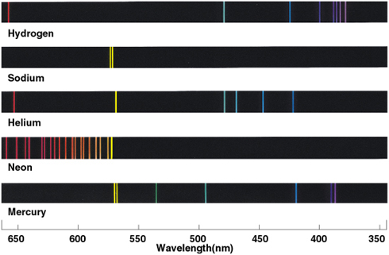
Bohr and the Quantum Mechanics Revolution
During the same period of time, various chemical elements had been observed to radiate light at different, discrete, wavelengths
Heated objects were also observed to radiate a continuous spectrum of light
In both cases, physicists were unable to explain what they were measuring

Slide 28
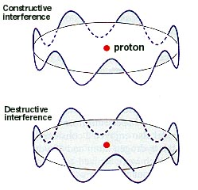
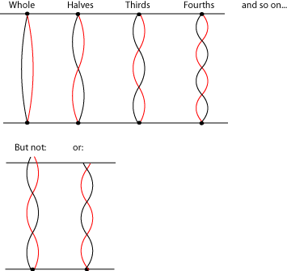
Bohr and the Quantum Mechanics Revolution
Standing waves (those with an integer number of wavelengths around the atom) are the configurations that can exist
This is just like standing wave patterns on a vibrating string

Slide 29
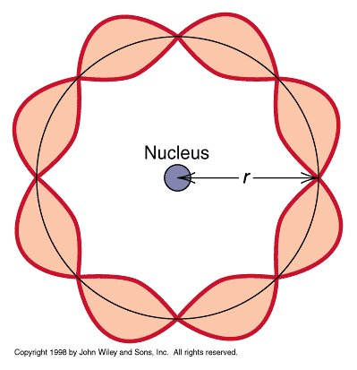

Slide 30
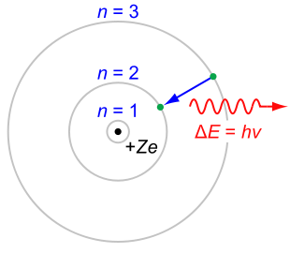

Slide 31
“Quantized” Energy Levels!

Slide 32
Bohr and the Quantum Mechanics Revolution
Light from atoms would be emitted when an electron moved from an energetic standing wave pattern to a lower energy pattern ⇒ discrete groups of spectral lines for each type of atom!
This means that electrons are not only particles, but also waves!

Slide 33
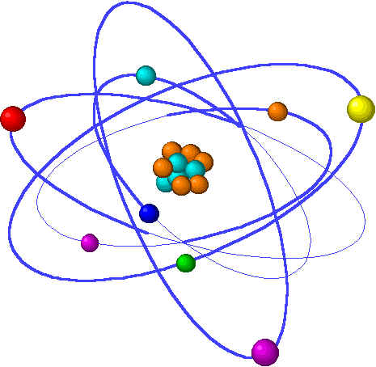
Everything is a Particle and Everything is a Wave
Throughout the twentieth century, experiments have revealed to us over and over again that all matter is made up of discrete pieces (particles) that individually behave like waves
When we talk about the field of “particle physics”, we are talking about the study of these particle-waves that make up everything in our universe
We don’t notice the wave-like nature of matter in the macroscopic world
(A 100 kg person walking at 1 m/s has a wavelength of λ~6x10⁻³⁶ m)
But on atomic and sub-atomic scales, our world is fully particle and fully wave
(An electron moving around at atom has a wavelength of λ~10⁻¹⁰ m, which is about the size of a typical atom)

Slide 34
But What is “Waving”?
Water waves are made up of water molecules; peaks of the waves are where there is the most water
Sound waves are made up of atoms/molecules in high pressure and low pressure patterns
Waves on a string are the motion of atoms/molecules
Question: If photons and electrons (and other quantum particles) are waves, what is waving?

Slide 35
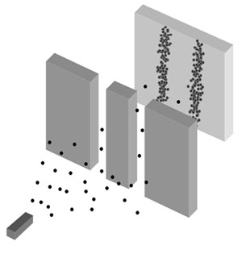
The Double Slit Experiment
If we shoot (non-wavelike) particles through two slits in a barrier, and watch how they accumulate on a far surface, we will find the following:

Slide 36
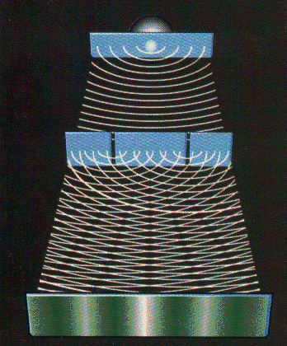
The Double Slit Experiment
If we shoot (non-wavelike) particles through two slits in a barrier, and watch how they accumulate on a far surface, we will find the following:
But if we projected waves through the same apparatus, we will observed an interference pattern:

Slide 37
The Double Slit Experiment
If we shoot (non-wavelike) particles through two slits in a barrier, and watch how they accumulate on a far surface, we will find the following:
But if we projected waves through the same apparatus, we will observed an interference pattern:

Slide 38
The Moral of the Experiment:
Even Individual Particles Behave Like Waves
Unlike waves made of sound, water, sound, or on a string, quantum particle-waves cannot be described as patterns among a large number of molecules
Instead, we have to think of quantum particle-waves are patterns of probability

Slide 39
The Moral of the Experiment:
Even Individual Particles Behave Like Waves
Unlike waves made of sound, water, sound, or on a string, quantum particle-waves cannot be described as patterns among a large number of molecules
Instead, we have to think of quantum particle-waves are patterns of probability
Particles are not, generally speaking, at one place at one time, nor are they moving with a singular velocity, or possess a singular quantity of energy
Events do not even happen at precisely one time
Many kinds of events that are impossible in classical physics are possible in quantum physics
All of these quantities are described probabilistically according to the laws of quantum mechanics

Slide 40
From Quantum Mechanics to Particle Physics
While quantum mechanics was being discovered and understood, the only known particles were the electron (1897), the photon (1905), the proton (1919), and the neutron (1932)
There was nothing known at the time about these particles that gave us any insight into why they existed, or why they have the properties that they do. The equations of quantum mechanics told us how these particles would behave, but we had no larger theory – no big picture – for why our universe is the way it is
(similar to how early chemistry was a taxonomy of unrelated substances, without any larger understanding of their interconnection)

Slide 41
The Data!
A string of new particle discoveries (the most important):
Positron, e⁺ – 1932
Muon, μ± – 1937
Pion, π⁰, π± – 1947
Kaon, K⁰, K± – 1947
Lambda, Λ⁰, Λ± – 1947
Antiproton, p – 1955
Electron anti-neutrino, ν_{e} – 1956
Muon neutrino, ν_{μ} – 1962
Xi, Ξ⁰, Ξ± – 1964
J/Ψ – 1974
Tau,τ± – 1975
Upsilon, ϒ – 1977
Gluon, g – 1979
Z and W bosons, Z⁰, W± – 1983
Top quark, t – 1995 (at Fermilab!)
Tau neutrino, ν_{τ} – 2000
Higgs Boson, h – 2012

Slide 42
The Data!
A string of new particle discoveries (the most important):
Positron, e⁺ – 1932
Muon, μ± – 1937
Pion, π⁰, π± – 1947
Kaon, K⁰, K± – 1947
Lambda, Λ⁰, Λ± – 1947
Antiproton, p – 1955
Electron anti-neutrino, ν_{e} – 1956
Muon neutrino, ν_{μ} – 1962
Xi, Ξ⁰, Ξ± – 1964
J/Ψ – 1974
Tau,τ± – 1975
Upsilon, ϒ – 1977
Gluon, g – 1979
Z and W bosons, Z⁰, W± – 1983
Top quark, t – 1995 (at Fermilab!)
Tau neutrino, ν_{τ} – 2000
Higgs Boson, h – 2012
And not only particle discoveries, but also detailed measurements of their properties:
-mass
-spin
-interactions with other particles
For example, the “magnetic moment” of the electron:
g_{e}=2.00231930436170 ± 0.00000000000152
This is the more precisely measured quantity in the history of humankind!

Slide 44
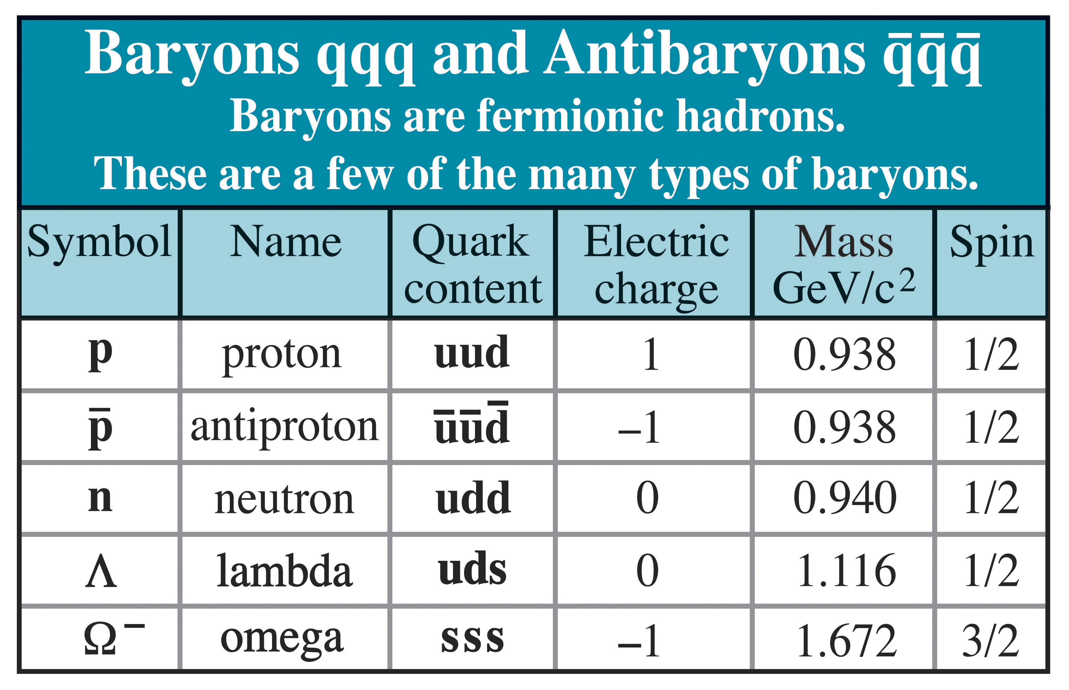
Mesons Baryons

Slide 48
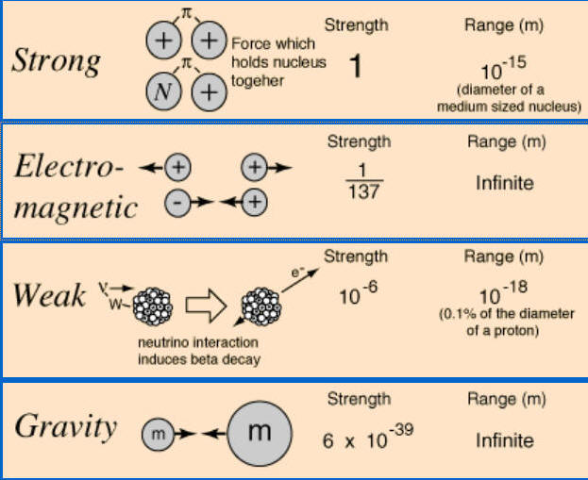

Slide 49
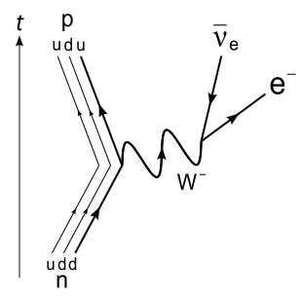
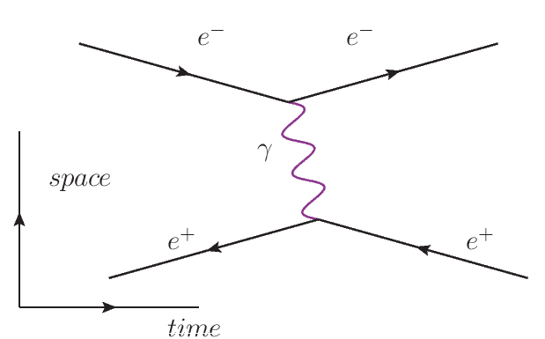
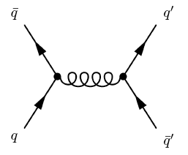
u
d
g

Slide 50
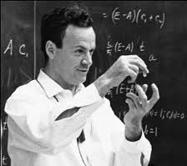
Notes:
Feynman

Slide 52
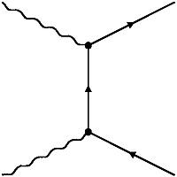
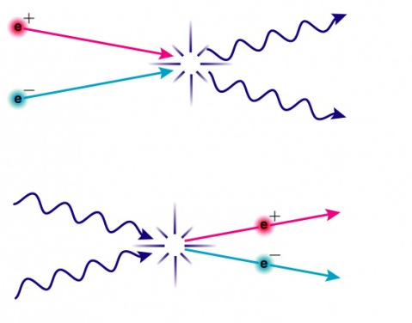

Slide 53
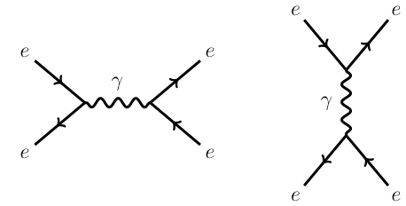

Slide 54
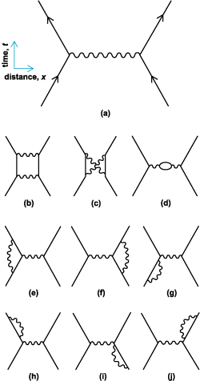

Slide 56
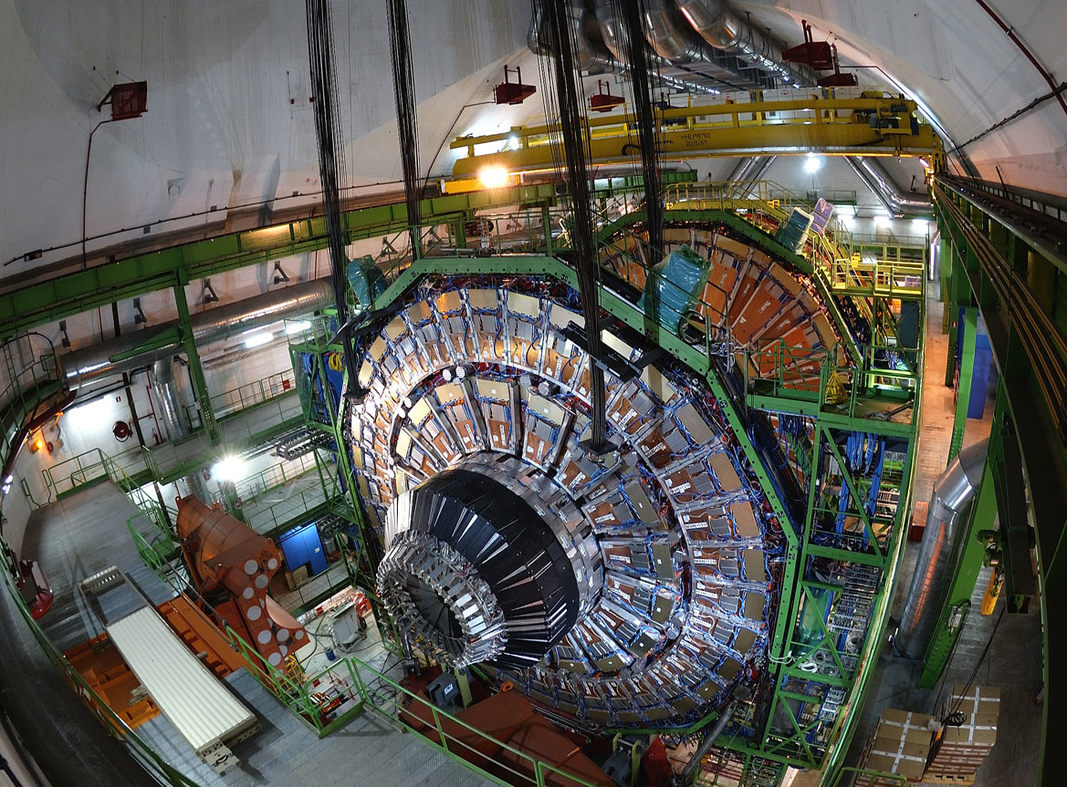
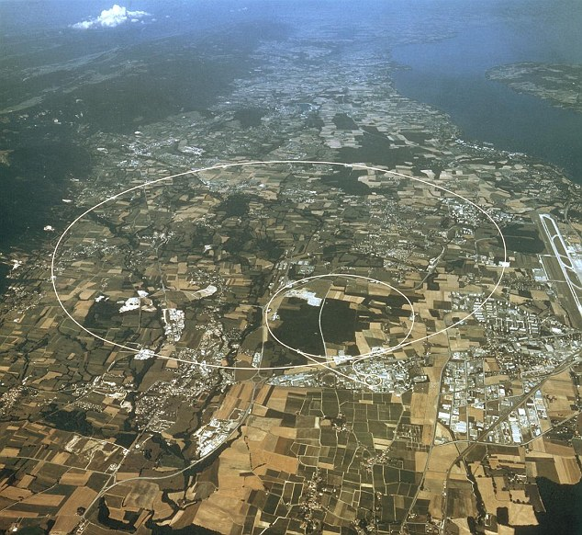
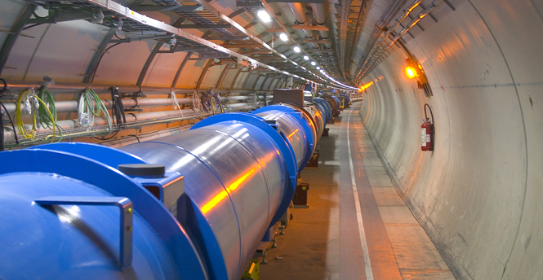

Slide 57
17 mile circumference tunnel, up to 570 feet beneath the city of Geneva and nearby France

Slide 58
Using powerful magnets, beams of protons are accelerated in each direction around the tunnel, until they are traveling at 99.999997% of the speed of light

Slide 59
Using powerful magnets, beams of protons are accelerated in each direction around the tunnel, until they are traveling at 99.999997% of the speed of light
These protons make about 11,000 revolutions around the ring each second

Slide 60
The proton beams are collided head-on into each other inside of enormous detectors, which measure the resulting explosion of particles

Slide 61
The proton beams are collided head-on into each other inside of enormous detectors, which measure the resulting explosion of particles
The LHC produces and observes roughly 100,000,000 collisions per second

Slide 62
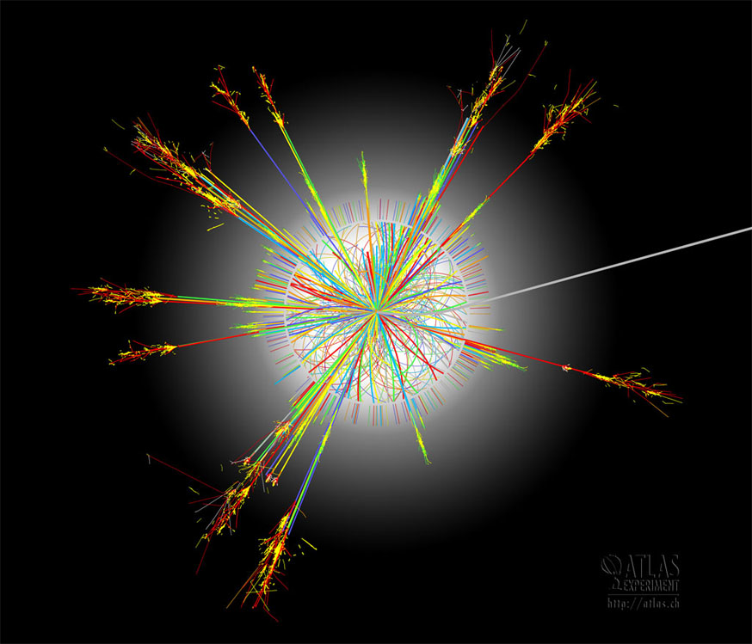

Slide 63
Some of the Ongoing Experiments At Fermilab
The Cryogenic Dark Matter Search (CDMS)
The Dark Energy Survey (DES)
The Deep Underground Neutrino Experiment (DUNE)
The MiniBoonNE and MicroBooNE Neutrino Experiments
The Main Injector Neutrino Oscillation Search (MINOS)
Mu2e (muon to electron conversion experiment)
Muon g-2
NoνA
And many others…

Slide 64
But what is “Science”?

Slide 65
But what is “Science”?

Slide 66
“If we take in our hand any Volume; of Divinity or School Metaphysics, for Instance; let us ask, Does it contain any abstract Reasoning concerning Quantity or Number? No. Does it contain any experimental Reasoning concerning Matter of Fact and Existence? No. Commit it then to the Flames: For it can contain nothing but Sophistry and Illusion.”
-David Hume
(An Enquiry Concerning Human Understanding, 1748)

Slide 67
“Whereof one cannot speak, thereof one must be silent.”
-Ludwig Wittgenstein
(Tractatus Logico-Philosophicus, 1922)

Slide 68
Are There Alternatives to the Scientific Method?

Slide 69
Are There Alternatives to the Scientific Method?
Reliance on tradition or authority
This is something of a straw man opponent to science; few would argue that science conducted sufficiently fairly and carefully will often lead to conclusions that are likely to be false
Many instances of reliance on tradition are actually a weak form of reliance on social science – if many people held position X in the past, then this provides a limited degree of empirical evidence that holding position X is likely to be helpful or advantageous

Slide 70
Are There Alternatives to the Scientific Method?
Reliance on tradition or authority
This is something of a straw man opponent to science; few would argue that science conducted sufficiently fairly and carefully will often lead to conclusions that are likely to be false
Many instances of reliance on tradition are actually a weak form of reliance on social science – if many people held position X in the past, then this provides a limited degree of empirical evidence that holding position X is likely to be helpful or advantageous
Reliance on pure reasoning (mathematics, philosophy)
Many people think of mathematics as a part of science, but it is fundamentally not grounded in empiricism (a central part of the scientific method)
Although philosophers of science hold a range of opinions on this issue, my view is that math helps to illuminate the relationships between ideas and can help to clarify our thinking, but does not itself tell us anything about our world

Slide 71
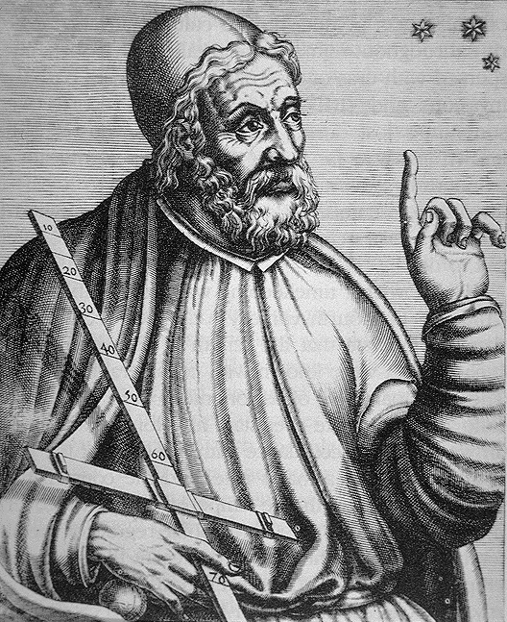
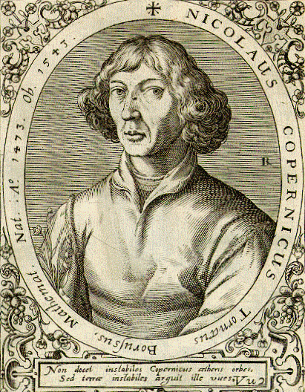
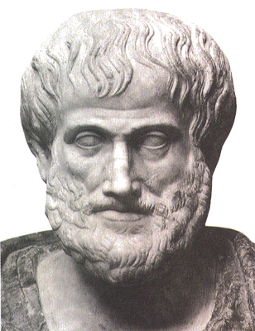
VS
Notes:
Ptolemy, Aristotle

Slide 72
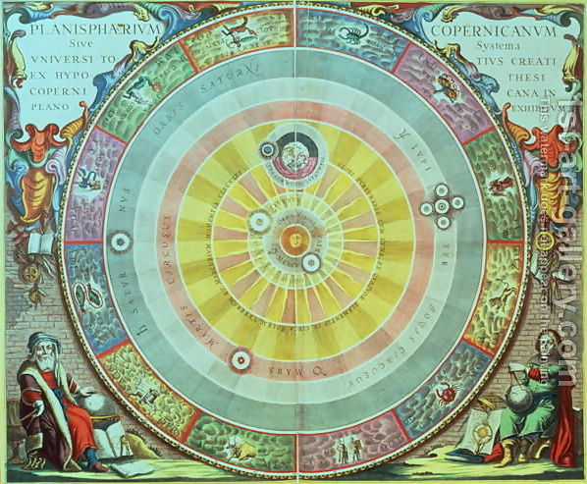
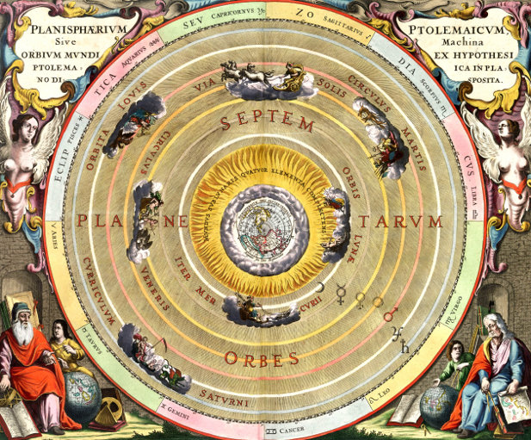
Notes:
Copernican model (geocentric) vs Ptolemaic model (heliocentric)

Slide 73
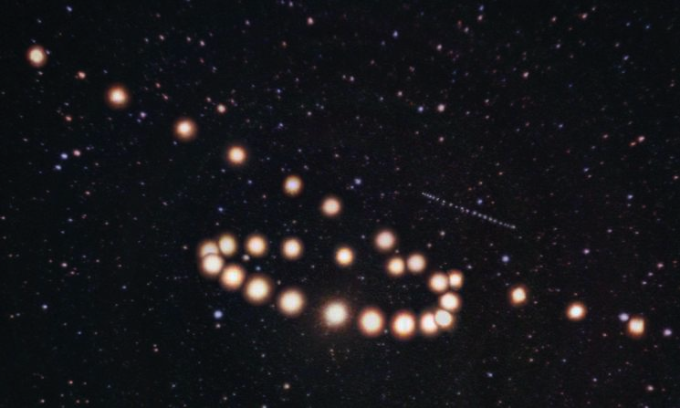
Notes:
Challenge for both models – retrograde motion (Mars, with Uranus in the background)

Slide 74
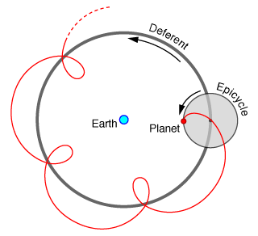
Notes:
Epicycle

Slide 75
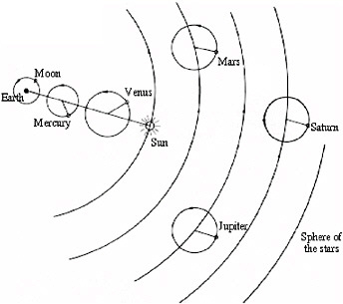
Notes:
Mars, retrograde motion (29 successive nights)
(Uranus is also visible)
Epicycles

Slide 76
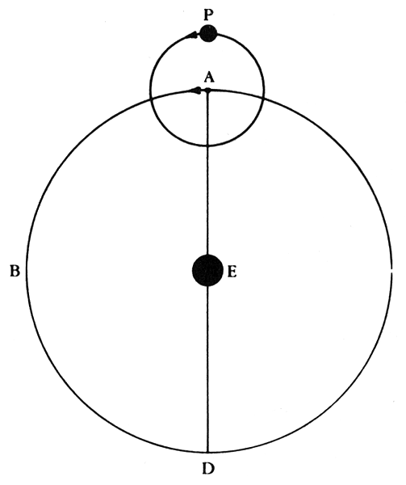
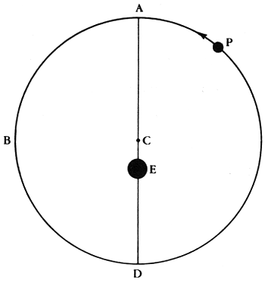
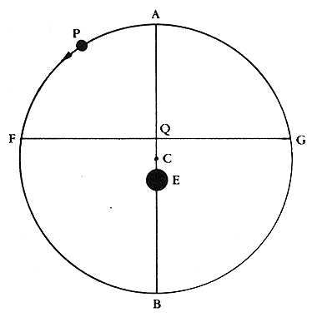
Epicycle Eccentric Equant

Slide 77
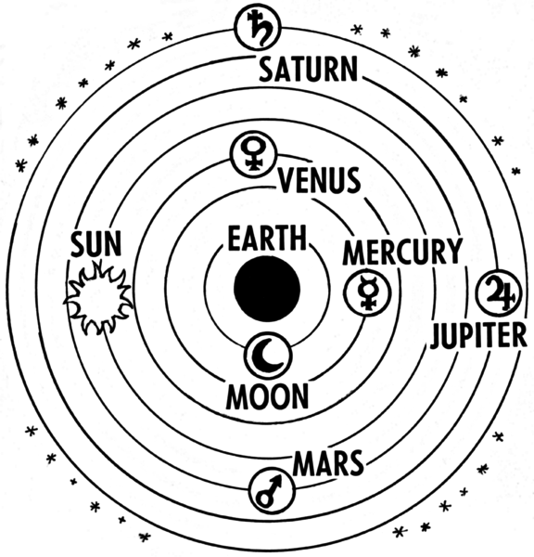

Slide 78
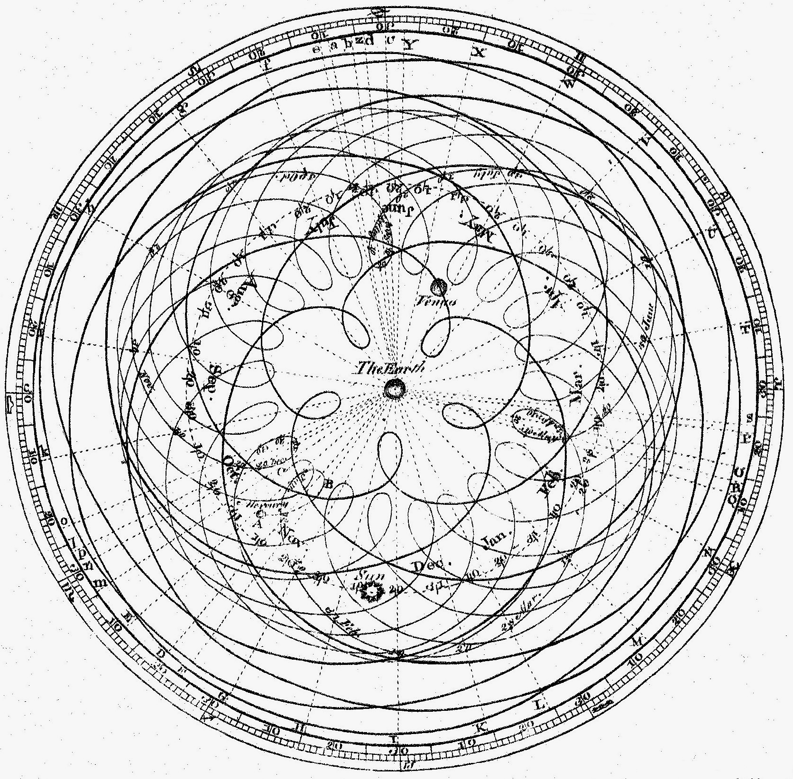

Slide 79
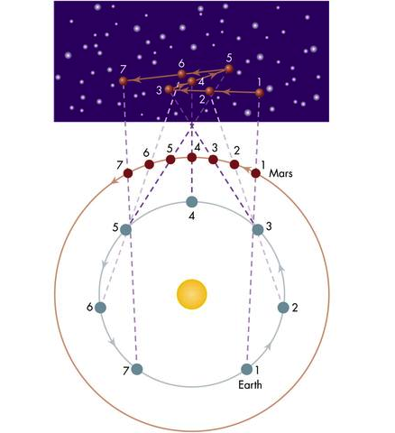
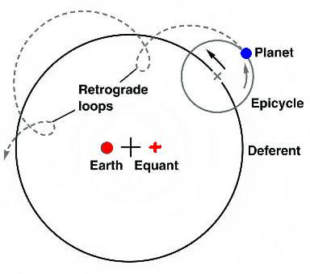
Notes:
Ptolmaic (left) and Copernican (right) explanations for retrograde motion

Slide 80
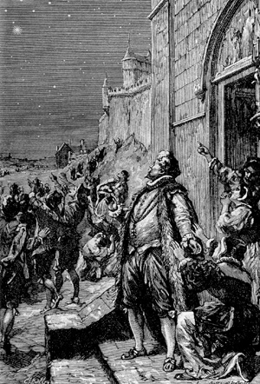
Notes:
Tycho Brahe 1572 Supernova

Slide 81
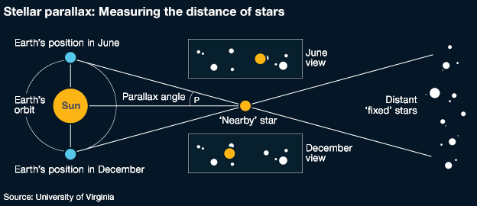

Slide 82
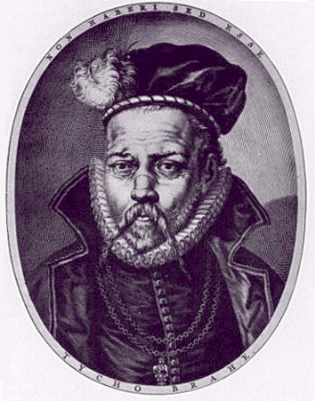
Notes:
Tycho Brahe

Slide 83
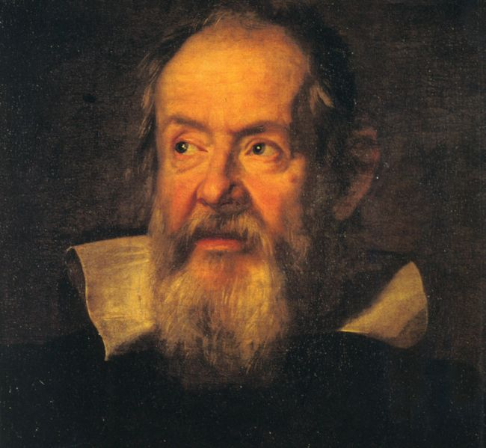
Notes:
Galileo

Slide 84
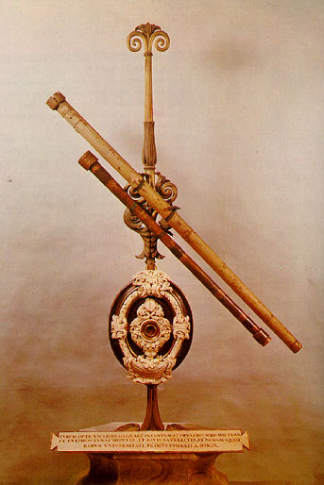
Notes:
Galileo’s telescope

Slide 85
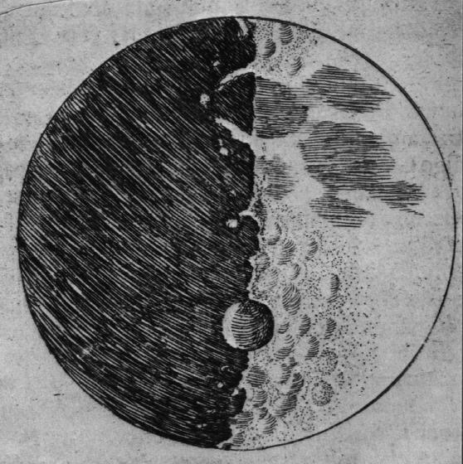
Notes:
Galileo’s sketch of the moon

Slide 86
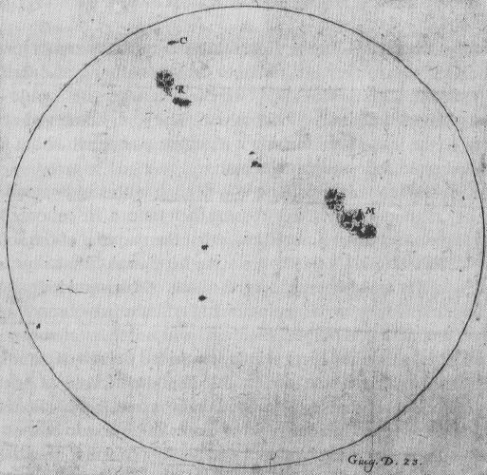
Notes:
Galileo’s sketch of sunspots

Slide 87
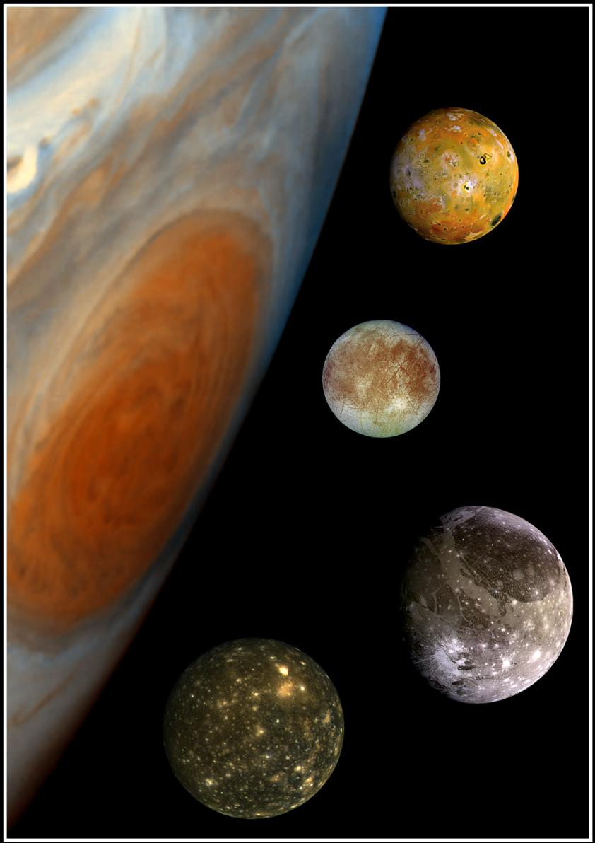
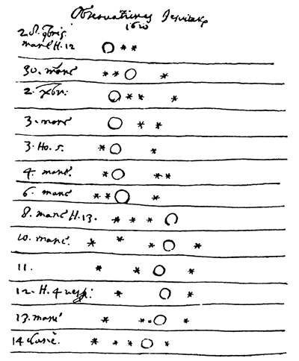
Notes:
Galileo’s notes on Jupiter’s moons

Slide 88
Notes:
Galileo’s observation resolved stars in the Milky Way

Slide 89
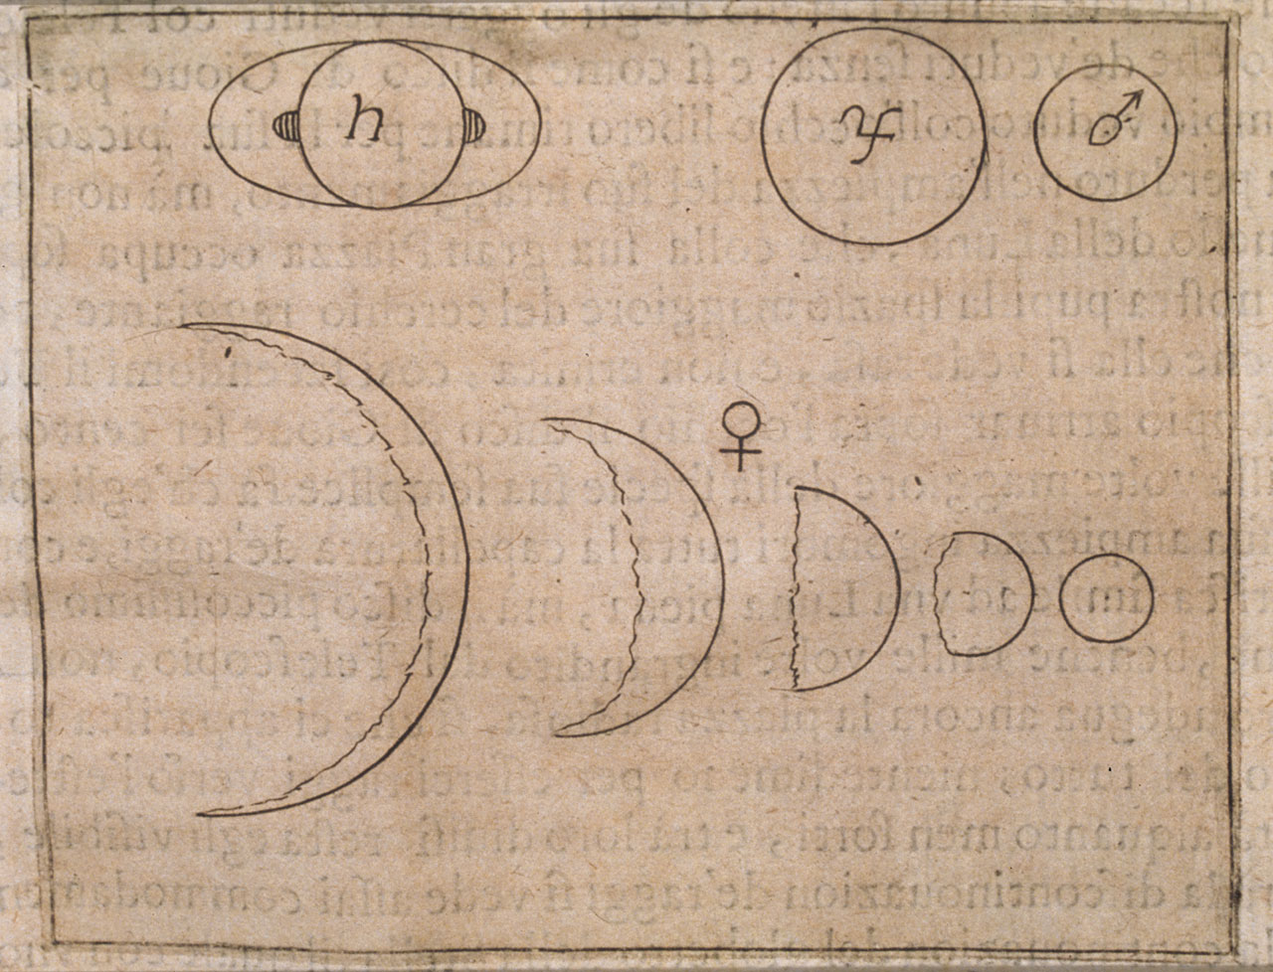
Notes:
Galileo’s observation of phases of venus

Slide 90
Notes:
Galileo’s observation of phases of venus; ptolmaic model (top), copernican model (bottom)

Slide 91
Notes:
Aristotle

Slide 92
Notes:
Isaac Newton

Slide 93
Why Is Science Important?

Slide 94
Why Is Science Important?
32,768
16,384
8,192
4,096
2,048
1,024
512
Galileo, Newton
GDP per capita (1990 equivalent dollars)
0 250 500 750 1000 1250 1500 1750 2000
Year

Slide 95
Why Is Science Important?
Ultimately, all human progress comes from innovation and discovery
Science (broadly defined) represents our best systematized effort to learn about and understand our world, maximizing the rate of innovation and discovery
Successful implementation of the scientific method allows us to better control our world, enabling us to improve our lives
A scientific approach can (and should!) be implemented within every facet of our lives in which we hope to make progress

Slide 97
We’d like to get your feedback and suggestions:
http://TinyURL.com/SMPFeedback17-III

Slide 98
But not all theories yield sensible answers to these kinds of calculations

Slide 100
Summit: 29,028 ft
Sea Level: 0 ft

Slide 101
Summit: 29,028 ft
Summit: 11,328 ft
Base Camp: 0 ft
Sea Level: 0 ft

Slide 102
Summit: 29,028 ft
Summit: 11,328 ft
Base Camp: 0 ft
In order for Quantum Theory to produce the same answers when calculating in different gauges, the photon must be exactly massless
Sea Level: 0 ft

Slide 103
Massive Photon
Mathematical Consistency

Slide 105
Conservation of:
Energy
Momentum
Angular Momentum
Symmetry of:
Time
Space
Rotation

Slide 106
Conservation of:
Energy
Momentum
Angular Momentum
Electric Charge
Symmetry of:
Time
Space
Rotation
Gauge Transformation

Slide 107
SU(3)xSU(2)xU(1)

Slide 108
Why Is Science Important?

