Slide 1
Site Network Support for Others WAN needs?
Phil DeMar
Summer 2013 ESCC meeting
July 16, 2013

Slide 2
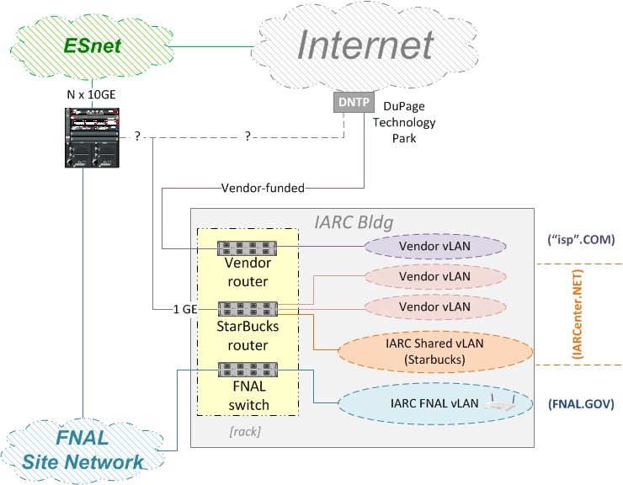
Wide-Area Networking for IARC (FNAL)
Would like to leverage our ESnet bandwidth
But AUP aspects are ‘unclear’

Slide 3
Discussion Area(s)?
Do you have WAN network support issues for “others” inside your site?
Local DOE office
Project collaborators on-site
Co-located private industry
Local service provider(s)
What else?
If so, do you have a commodity internet connection to dump them off on? (OK, maybe not the local DOE office…)
If not, would something via ESnet be helpful, if do-able?

