Slide 1
Time Calibration System for RF Cavity Breakdown Measurements
Juan Takase
Northwestern University
SIST INTERN Fermi National Lab
08/04/2015

Slide 2
Overview
Background of Experiment
Current need and system for calibration
Design

Slide 3
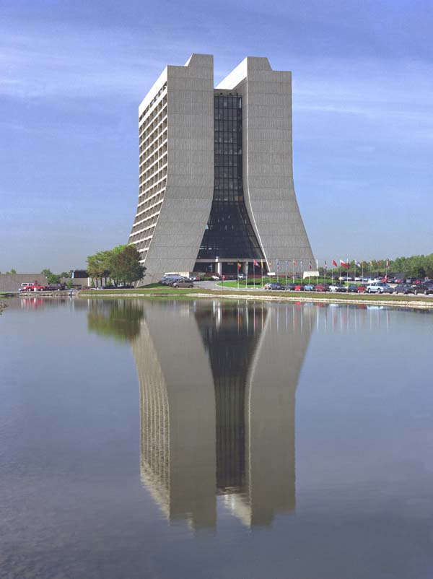
BACKGROUND
https://www.fnal.gov/pub/presspass/vismedia/gallery/buildings.html

Slide 4
RF Cavity
Induced electromagnetic field accelerates a charged particle as it goes through
http://www.linearcollider.org/ILC/GDE/Director%27s-Corner/2010/17-June-2010---Superconducting-RF-cavity-industrialisation

Slide 5
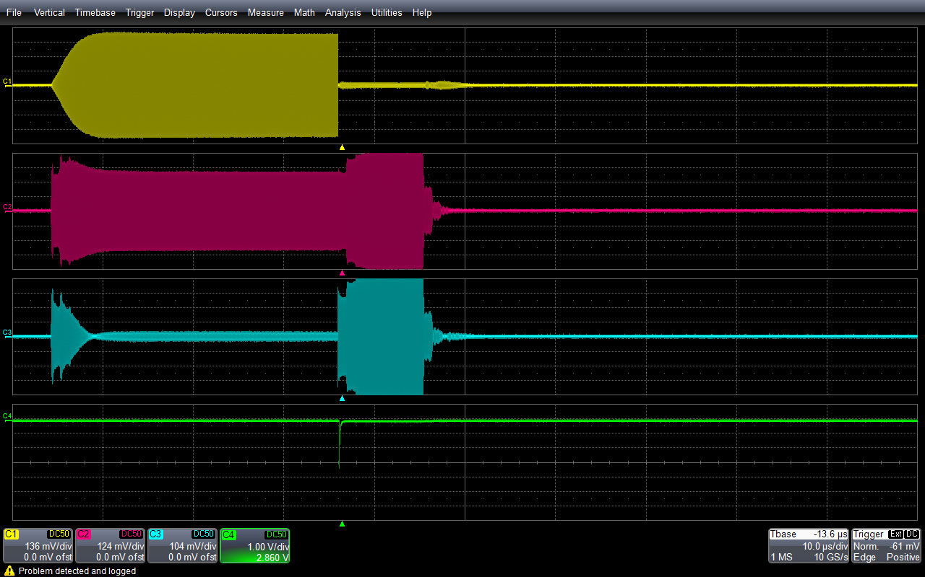
Breakdown
During a break down, electrons from one side of the cavity go through the space between the cavity walls to the other side.
Releases a flash of light
RF electric signal
RF power feed signal
RF power reflected signal
Breakdown light signal

Slide 6
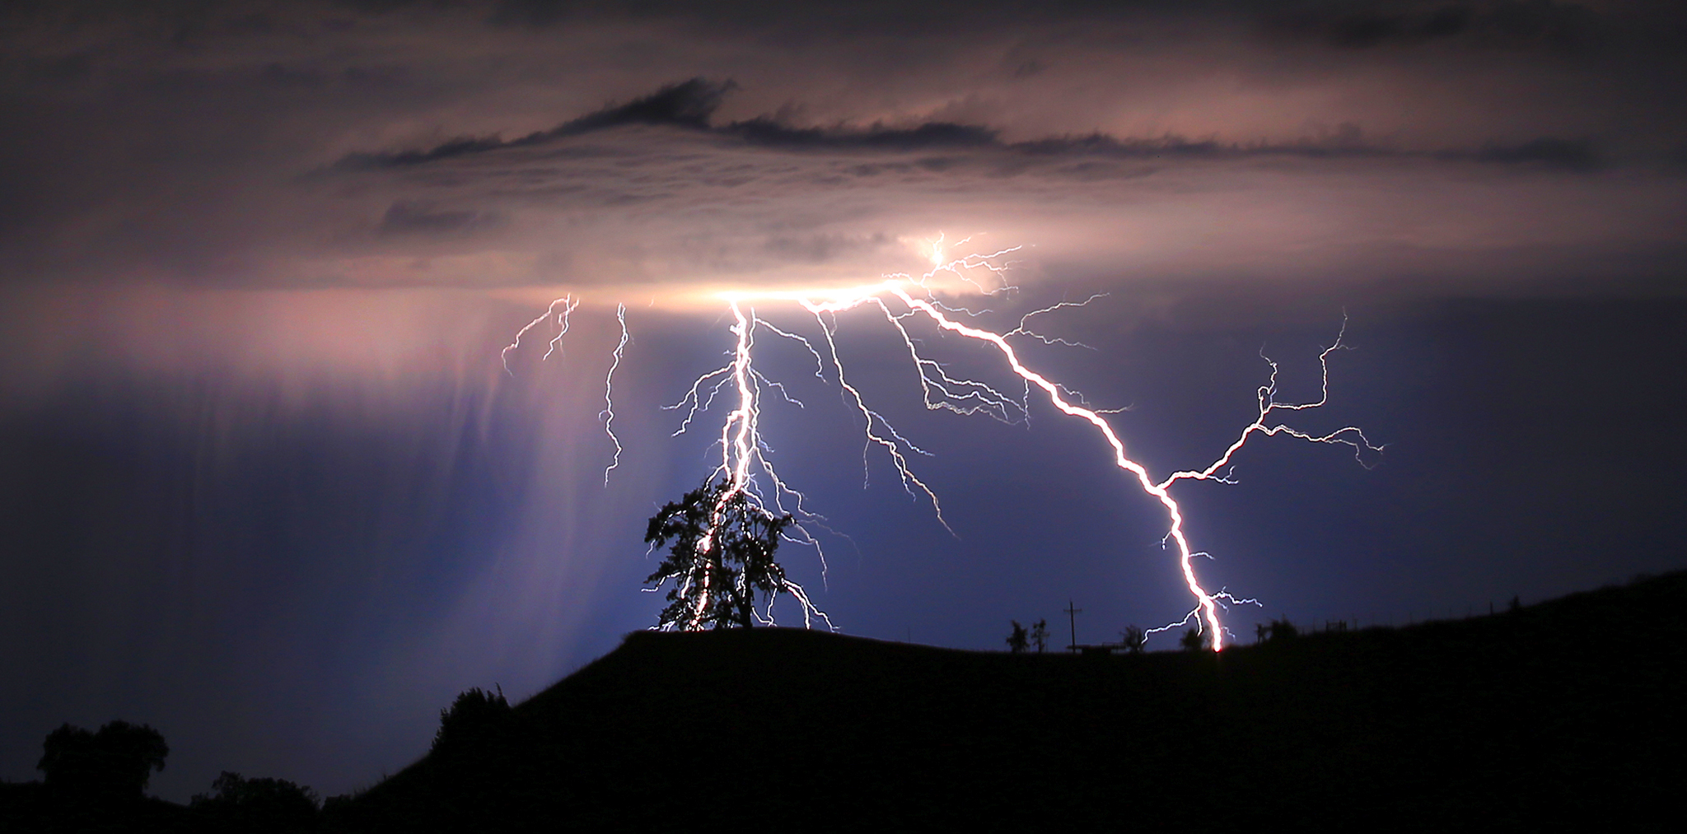
Lightning
http://blogs.ft.com/photo-diary/tag/lightning/

Slide 7
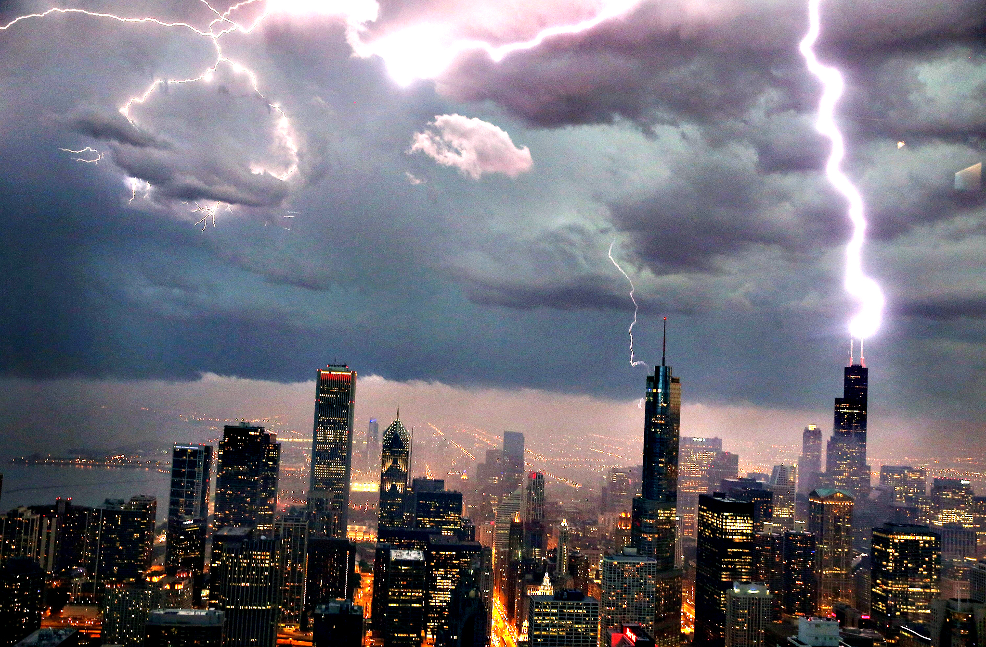
http://blogs.ft.com/photo-diary/tag/lightning/

Slide 8
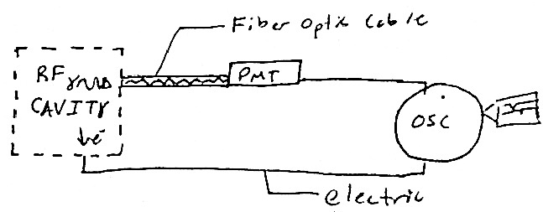
Measurements
Due to the different paths the data must take during measurements. The data arrive at the oscilloscope slight offset.
This can make it difficult to analyze the physics because precise correspondence is necessary.

Slide 9
CURRENT NEED
A time calibration system to resolve the cable arrival time delays
Generation of a signal into both optical and electrical tracks
Analyzing the difference in arrival time to resolve the arrival delay during experimental measurements.

Slide 10
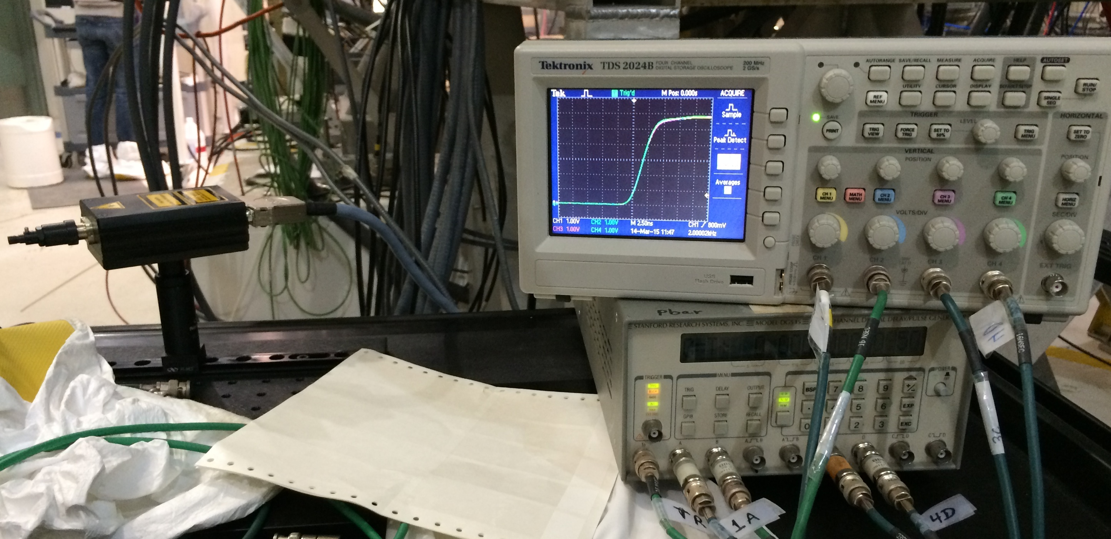
Current Method
Current timing calibration
Laser head
Digital Oscilloscope
(for coarse calibration)
4-channel
function generator

Slide 11
Delay Exists
Coarse alignment is possible
Precise alignment is difficult to do consistently
Only one pair of channels can be calibrated at a time
Electrical Signal
Voltage (V)
Optical Signal
Time (s)
(20 ns/division)

Slide 12
Project
Design a system to take calibration measurements more quickly than the current method.
Resolve this arrival time delay precisely and consistently by calculating the difference in arrival times.

Slide 13
DESIGN

Slide 14
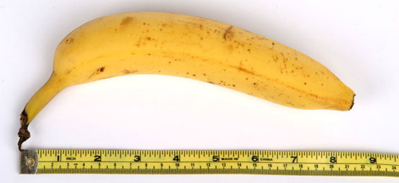
Hardware
Multiple tracks can be calibrated at once.
Cylindrical shape reduces asymmetrical noise
15 cm
20 cm

Slide 15
Inside look of design

Slide 16
Program
Inputs data of varying styles easily.
Outputs of relative delays for easy interpretation.
The user is not required to “go into the code”
Software of choice: Matlab
Allows for a variety of loading options
Allow for graphical displays
Allows the use of programmable dialog boxes for data and parameter inputs

Slide 17
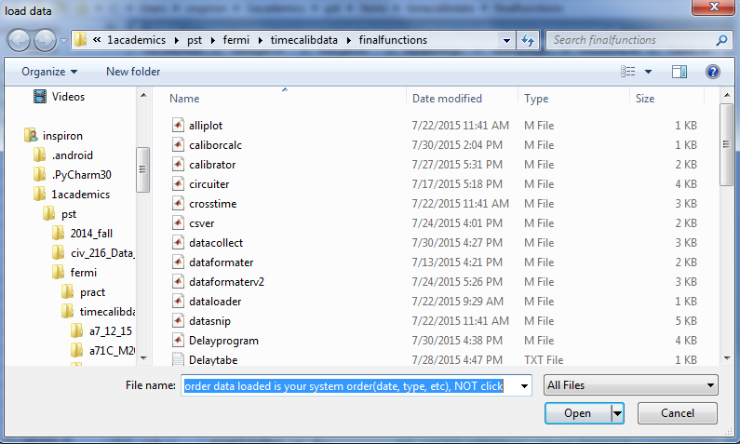
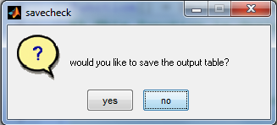
Data Input

Slide 18
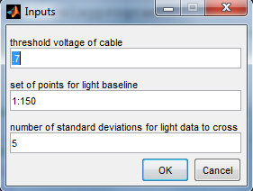

Slide 19
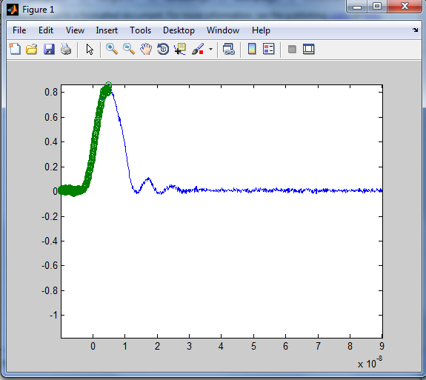
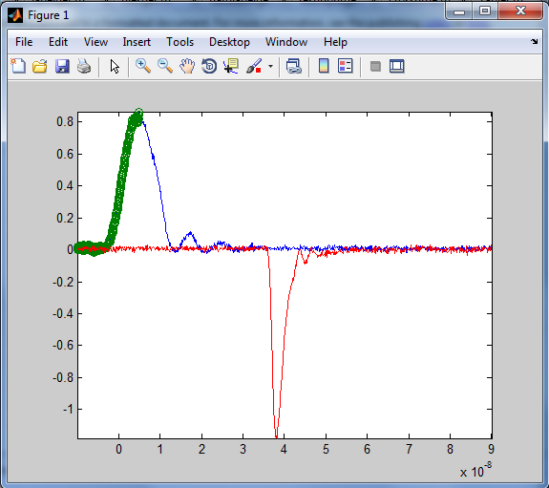
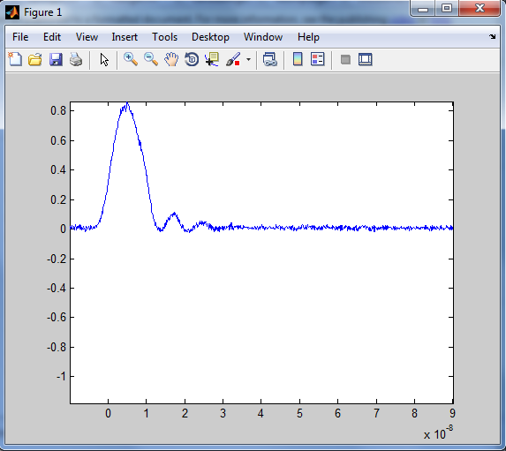
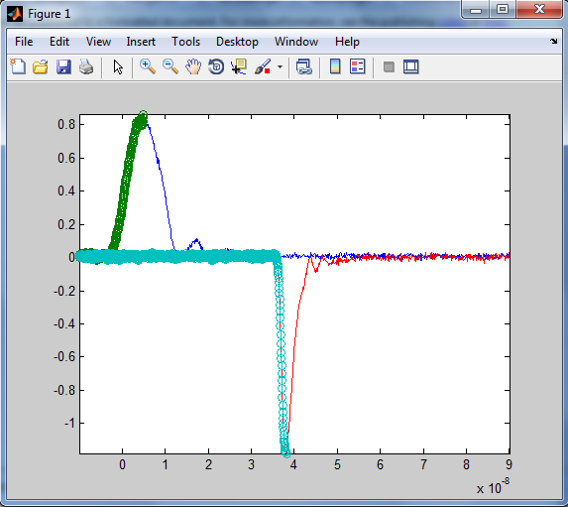

Slide 20
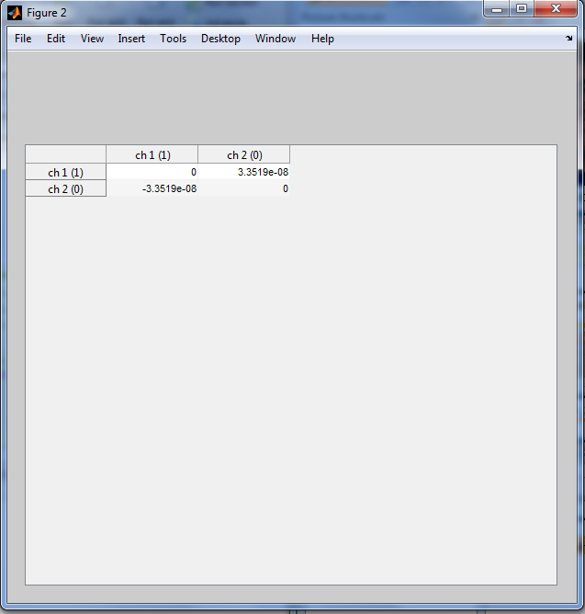
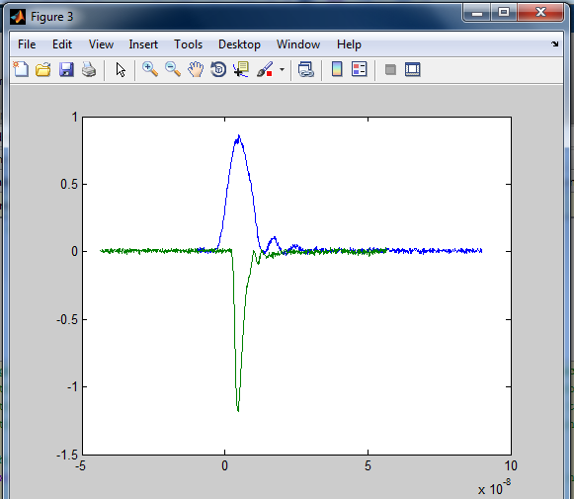
Delay Table

Slide 22
Sources of Error
Threshold voltage deviation
Time cross deviation
Alleviated with precise inspection of LED
1ns deviation
Time cross calculation uses the average
Caused by noise near the crossing point.
Temperature
LED has a lower threshold with rising temperature.
Cables of large length undergo thermal expansion, which affect measurements

Slide 23
Conclusion and Futurework
Present
We were able to develop a design proposal for a measurement device to collect multiple tracks of calibration data at once
Developed a program to analyze multiple data types returning a table of delays that is easy to read.
Future
Build device
More efficient program (style/language)

Slide 24
Thanks
Supervisor Katsuya Yonehara, and the rest of the group
Mentor Mayling L Wong-Squires
SIST Committee
Fermi National Lab
Jackie Chan

Slide 25
Questions?

Slide 26
Why Jackie Chan?

Slide 27
References (pictures mainly)
RF Cavity:
http://newsline.linearcollider.org/images/2010/20100617_dc_1.jpg
Lightning
http://blogs.r.ftdata.co.uk/photo-diary/files/2013/07/Lightning.jpg

