Slide 1
Future Circular Collider— 100 km Circumference at 50 TeV
Javier Diaz
SIST
4 August 2015

Slide 2
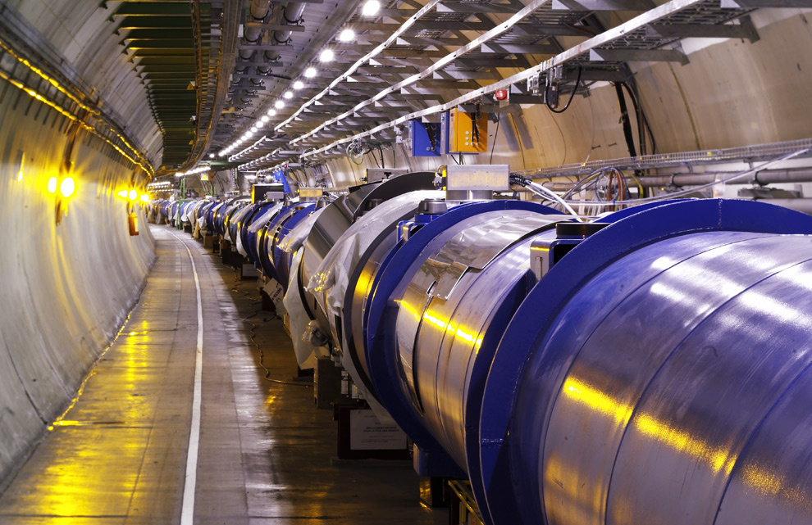
Motivation
In 2012 the LHC discover the Higgs with 7 TeV collision energy
Run 2 of the LHC will be at 13 Tev collision energy
http://www.extremetech.com/extreme/176969-searching-for-supersymmetry-work-begins-on-large-hadron-colliders-60-mile-long-successor

Slide 3
Basic LHC Design
LHC
FCC
Tevatron

Slide 4
Basic LHC Design
Circumference=27km
8 straight sections
Each straight section = 528m
Arc fill factor = 0.84
http://www.symmetrymagazine.org/breaking/2008/08/25/free-online-full-documentation-for-the-large-hadron-collider

Slide 5
FODO Cell
Dipoles bend the beam
Quadrupoles focus the beam
Sextupoles give the chromaticity of the machine
Packing Fraction=length of magnets/length of cell
http://lhc-closer.es/taking_a_closer_look_at_lhc/0.lhc_layout
Javier Diaz | Future Circular Collider— 100 km Circumference at 50 TeV

Slide 6
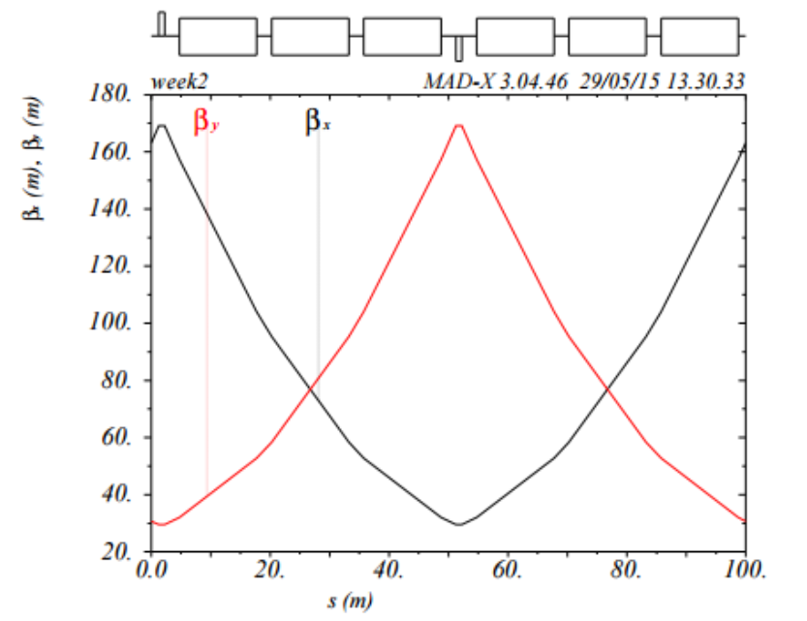
Optics Functions - Beta
$β_{Max}=L\left(\frac{1+sin⁡(\frac{∆φ_{c}}{2})}{sin⁡(∆φ_{c})}\right)$
$∆φ_{c}=\frac{π}{2}=\int{\frac{ds}{β(s)}}$
$∆φ_{c}$ is determined by the strength of the Quad

Slide 7
Optics Functions - Dispersion
Comes from off energy particles being bent a different amount by the dipoles

Slide 8
Dispersion Suppressor
Made of 2 FODO cells with dipoles that are ½ strength

Slide 9
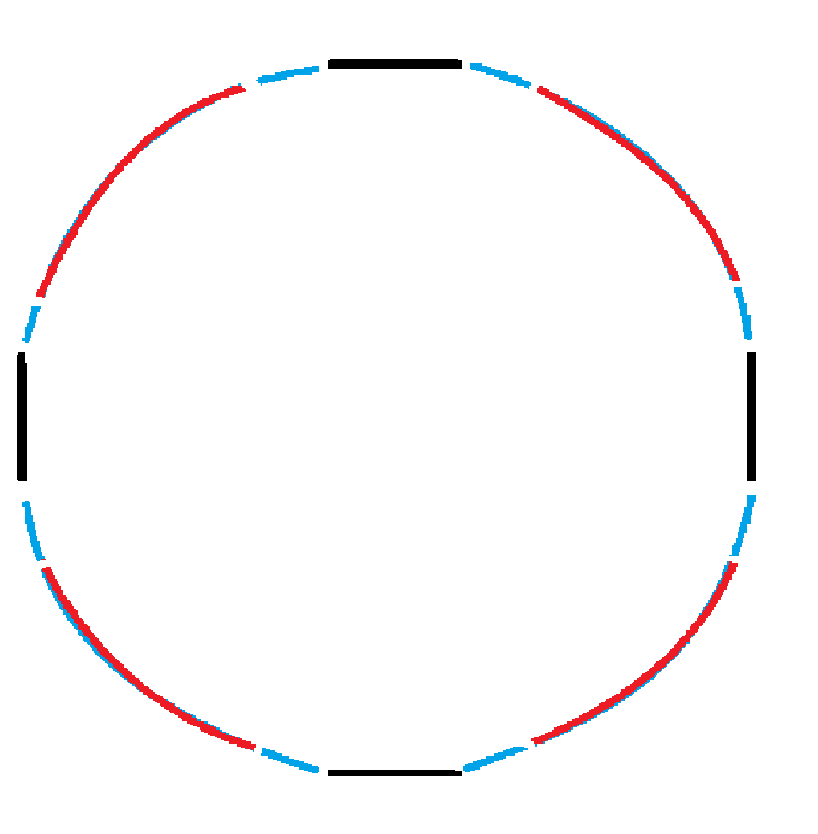
Ring Designs
Racetrack
4 straight sections

Slide 10
Ring Parameters
arc fill factor = 0.84 (DS are considered part of straights)
Packing fraction = 0.86
Half aperture = 0.02 m (same as SSC)
Phase advance per cell = $π/2$
Chromaticity = 1
RF frequency = 400MHz , Voltage = 100MV

Slide 11
Ring Parameters
Variables
Cell length ( 200-260 m)
Quad length (≤ 5 m)
Dipole length (5-15 m)
Goal
Keep dipole field under 15 T
Keep quad field at aperture under 8 T

Slide 12
MADX
Build a FODO cell, DS, or ring
Define a beam
Calculates and plots optics functions
MATCH command finds the strengths of the magnets to get $∆φ_{c}=\frac{π}{2}$and dq1=1
Quad coefficient is reduced by 5% to avoid integer tunes
TRACK particles around the ring

Slide 13
Reducing the Number of Variables – Quad Length
Quad length ≤ 5 m
Quad field at aperture ≤ 8 T
$Quad Field=\frac{Const.}{Quad Len}$
Set Quad field= 8T, and solved for Quad Len
$Min Quad Len=−0.0166×\left(Cell Len\right)+8.$696

Slide 14
Dipole Field
Number of dipoles / cell
$\text{numbdip} \text{=2*}\text{floor}\left(\frac{\text{lencell}\text{∗}\text{maxpack}\text{−2∗}\text{quad}}{2∗dip}\right)$
Number of cells/ arc
$numbcell=floor\left(\frac{1}{numb str}\left(\frac{100000∗arcfill}{lencell}−4∗numb str\right)\right)$
Bend angle / dipole
$bend=\frac{2π}{numb dip ∗numb str (numb cell+2)}$
Dipole Field
$dip field=\frac{\left(Bρ\right)∗bend}{dip}$

Slide 15
Minimizing Dipole Field
Using a C++ program to scan over cell length and dipole length
It writes the matching cells to an output file
Does this for both rings
Number of Solutions
Max Field (T) | 4 straights | racetrack
15.2 | 0 | 0
15.3 | 0 | 4
15.4 | 0 | 4453
15.5 | 12 | 22991
15.6 | 3108 | 50244

Slide 16
Number of solutions
Why is there more solutions for the racetrack?
Combine Equations for bend, numb cell, numb dip, and dipole field
$Dipole Field=\frac{2π∗\left(Bρ\right)}{dip∗numb dip (K−2∗numb str)}$
$K=\frac{100000∗arc fill}{len cell}$

Slide 17
Dipole Field – Racetrack
Combining the 5 equations and keeping the integer constraints
Pixels are to small to see a trend
Notes:
Delta x = 0.1 (0-401)
Delta y = 0.01 (0-1001)

Slide 18
Dipole Field – 4 Straight Sections
Notes:
Delta x = 0.1 (0-401)
Delta y = 0.01 (0-1001)

Slide 19
Dipole Length = 5.0 Cross Section
Consider the racetrack
Field is inversely proportional to packing fraction

Slide 20
Dipole Length = 5.0 Cross Section
Long periodicity comes from packing fraction and number of dipoles / cell

Slide 21
Dipole Length = 5.0 Cross Section
Long periodicity comes from packing fraction and number of dipoles / cell
Short periodicity comes from the number of cell/arc

Slide 22
Magnetic Fields – Racetrack
Compare both extremes and middle of dipole lengths
Chose the shortest, the closest to 10m, and the longest dipole length with Dipole Field ≤ 15.5T

Slide 23
Other Variables – Racetrack
$β_{max}=L\left(\frac{1+\sin\left(\frac{∆φ_{c}}{2}\right)}{\sin\left(∆φ_{c}\right)}\right)$

Slide 24
Other Variables – Damping Time (mode 1)
$τ=\frac{2 E_{0}T_{0}}{U_{0}}$
Time per revolution=$T_{0}∝Length of Ring$
Energy lost per turn=$U_{0}∝I_{2}∝Dipole Field$
$τ∝\frac{Lenght of Ring}{Dipole field}$

Slide 25
Picking a FODO Cell Design
Racetrack
Dipole Field ≤15.3T | Dipole (length)
Cell Length= 259.2 m | 6.69
 | 8.92
 | 9.72
 | 13.38
4 Straight Section
Dipole Field ≤15.5T | Dipole (length)
Cell Length= 259.1 m | 5.53
 | 8.23
 | 10.7
 | 11.89
Cell Length = 259.2 m | 5.35
 | 6.69
 | 8.23
 | 8.92
 | 9.73
 | 10.7
 | 11.89
 | 13.38

Slide 26
Conclusions
A cell Length of 259.2m minimizes the dipole field for both rings
Multiple dipole lengths work as long as packing fraction is maximized
Points to consider
Beam dynamics: instabilities, beam-beam effects, …
Complete straight section design with Interaction Regions
Different dispersion suppressors
Notes:
Add an outline of talk
Add acknowledgments/thanks
-define/describe madx
-slide 17 typo
-T_o and U_0 define them
-time (20 min)
-describe the problem that I actually worked on
-describe what were my biggest problems (how long madx took)
-how you had to build the ring…
-describe better what I actually did for the plots of variables vs cell length
-mention that they were found using MADX and then compare with theory
-take out the slide that I can’t explain (eq emitt, IBS growth,…)
-add citations
-add comparison of size between 100 km and LHC

