Slide 1
Moving Forward with Design & Simulation: FY15 plans; prospects for the future
Slides extracted from MAP weekly meeting: Oct 24, 2014
by Robert D. Ryne
Lawrence Berkeley National Laboratory

Slide 2
Post P5
P5 recommendations (May 2014):
Reassess MAP as project with dedicated DOE funding
Incorporate into the General Accelerator R&D (GARD) (~ 90 M$) the MAP activities that are of importance to Accelerator R&D
HEPAP Accelerator R&D Panel (http://www.usparticlephysics.org/p5/ards)
The P5 report has highlighted the importance of accelerator based experiments for the future of particle physics and this places renewed emphasis on accelerator R&D efforts in support of medium- and long-term HEP projects. In light of this, we are requesting that HEPAP set up a subpanel to examine the research in the current HEP accelerator R&D program and to identify the most promising research areas to support the advancement of high energy and particle physics.
Final recommendations: March 2015
Resources: from FY 16 = Oct 2015
Seminar
D.Hartill
Dec 5

Slide 3
White Papers to the AR&D Panel
Session about MAP GARD proposals
on Sunday 7
All public submissions are posted at (http://www.usparticlephysics.org/node/1059/webform-results/public)
4 MAP related white papers
accessible from a link at map.fnal.gov (http://map.fnal.gov/documents/white-papers-accelerator-RnD-panel-2014.shtml)
Muon Accelerator R&D Issues, by MAP mgt
The Case for Muon-based Neutrino Beams, by P. Huber, A. Bross, and M. Palmer
Normal-Conducting RF Cavity R&D at the
MuCool Test Area, by D. Bowring,
K. Yonehara, Y. Torun
Fundamental Aspects of Muon Beams,
by J.-P. Delahaye and R.D. Ryne
Submitted for GARD funding
Submitted for GARD funding

Slide 4
Fundamental Aspects of Muon Beams
Refocus on
High Intensity Muon Sources
High Brightness Muon Sources
Fast Muon Acceleration
Muon Storage and Collider Rings
Roughly parallels the Area Systems of our IBS effort, but with different emphasis:
Not oriented toward selecting initial baseline design of a future facility
Oriented toward determining the limits of the most promising concepts identified by MAP
Reduced scope
session after coffee
1rst session pm
2nd session pm

Slide 5
Instead of facility designs, aiming to answer questions such as
What are the intensity limits of muon beam generation?
What are the emittance limits of muon beam cooling?
What are the fundamental limits for rapid acceleration of muons?
What are the fundamental limits of precision neutrino beams generated from stored muons?

Slide 6
Approach to FY15
We don't know yet if Fundamental Aspects of Muon Beams will/won't be approved in FY16 GARD
FY15 considered as a transition year to:
finish key D&S activities begun in MAP, including initial studies of the most important concepts
document our results in publications
establish lasting record of our designs
Preserve the knowledge and work already done
Facilitate revival when the physics will call for it:
neutrinos factory (?) post LBNF
muon collider in the multi-TeV range (?) for new physics beyond standard model
make transition away from facility design and toward fundamental aspects of muon beams assuming future GARD support and funding

Slide 7
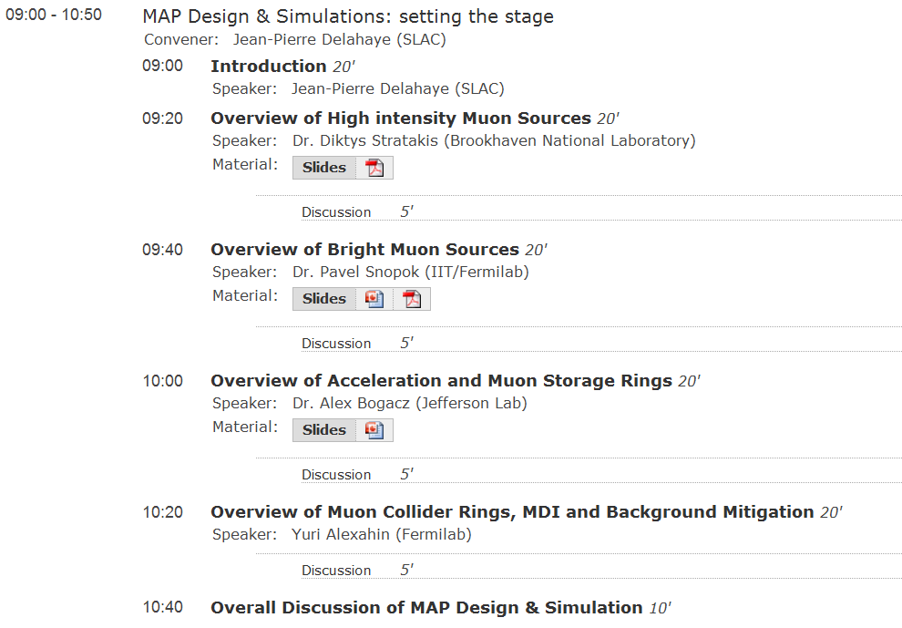

Slide 8
Basic Documentation in Fermipoint
Central reference point to all MAP documentation, organized by topical areas
Constructed by Maura Barone
http://web.fnal.gov/project/map/AreaSystems/ (area in preparation)
Read: Public
no login required
however, access to files stored in the IBS
Configuration repository will require login
Write:
FNAL Services Account required
Fermipoint MAP Group membership required
Note: Fermipoint is a Fermilab customization of Sharepoint 2013.
The system is expected to be operational for several years to come.

Slide 9
Fermipoint
For each Area:
IBS Documents
Links to files in Redmine-SVN
IDS-NF Documents
Links to files …
Technical Notes
Links to notes in MAP-docDB
Articles
Links to published articles (Journal or Proceedings)
Presentations
Files stored locally in Fermipoint

Slide 10
Special issue of JINST on MAP & MICE
Dedicated discussion
Dec 7 am
Along w/ pubs in the usual places (PRST-AB, NIM, conferences) there are plans for a special issue of JINST on MAP & MICE
Publications in this issue from MAP personnel are very strongly encouraged!

Slide 11
Summary
FY2015 a close-out year and (hopefully) a transition year
close-out: document what we have learned, finish initial designs of most promising concepts
transition: away from facility design, toward funda- mental aspects (limits to intensity, brightness,...)
Documentation: Critical for leaving a lasting record that will facilitate revival of muon concepts when the Physics calls for it
Fermipoint
JINST special issue

