Slide 1
Mu2e Ron Ray Mu2e Project Manager Fermilab Institutional Review June 6-9, 2011

Slide 2
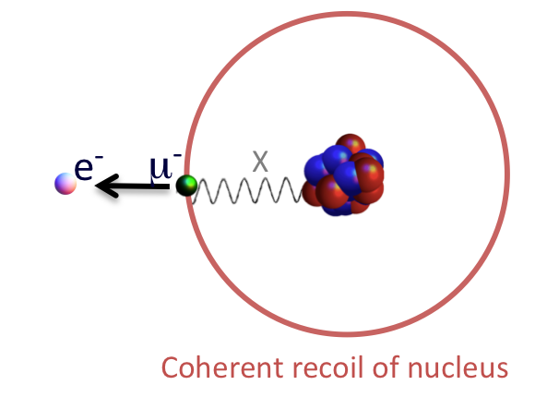
One Page Physics Summary
μ⁻ to e⁻ conversion – μ⁻ converts to an e⁻ in the field of a nucleus
No emission of neutrinos
Nucleus remains intact – coherent
Signal is a monoenergetic 105 MeV e⁻
Goal is to search for μ⁻ to e⁻ conversion with a sensitivity of < 6 x 10⁻¹⁷ (90% C.L.):
Observation is unambiguous evidence of physics beyond the SM
Provides information about flavor structure of new physics that is not easily accessible at the LHC.
A null result at the proposed sensitivity will severely constrain new physics models.
CLFV is predicted at observable rates in most new physics models.
Mu2e can probe mass scales up to 10⁴ TeV, far beyond the reach of the LHC.

Slide 3
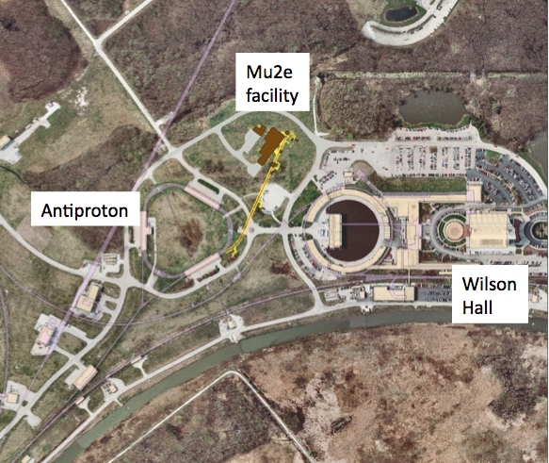
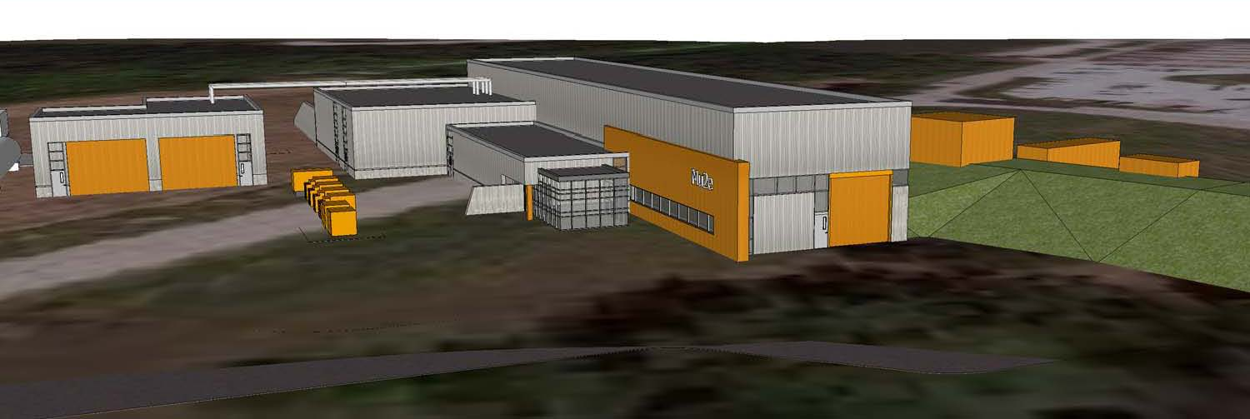
Scope of Mu2e Project
Design, construct, and install the Mu2e detector, modify and upgrade the accelerator complex to provide 8 GeV protons with the appropriate intensity and time structure, build a new beamline and a new detector hall.

Slide 4
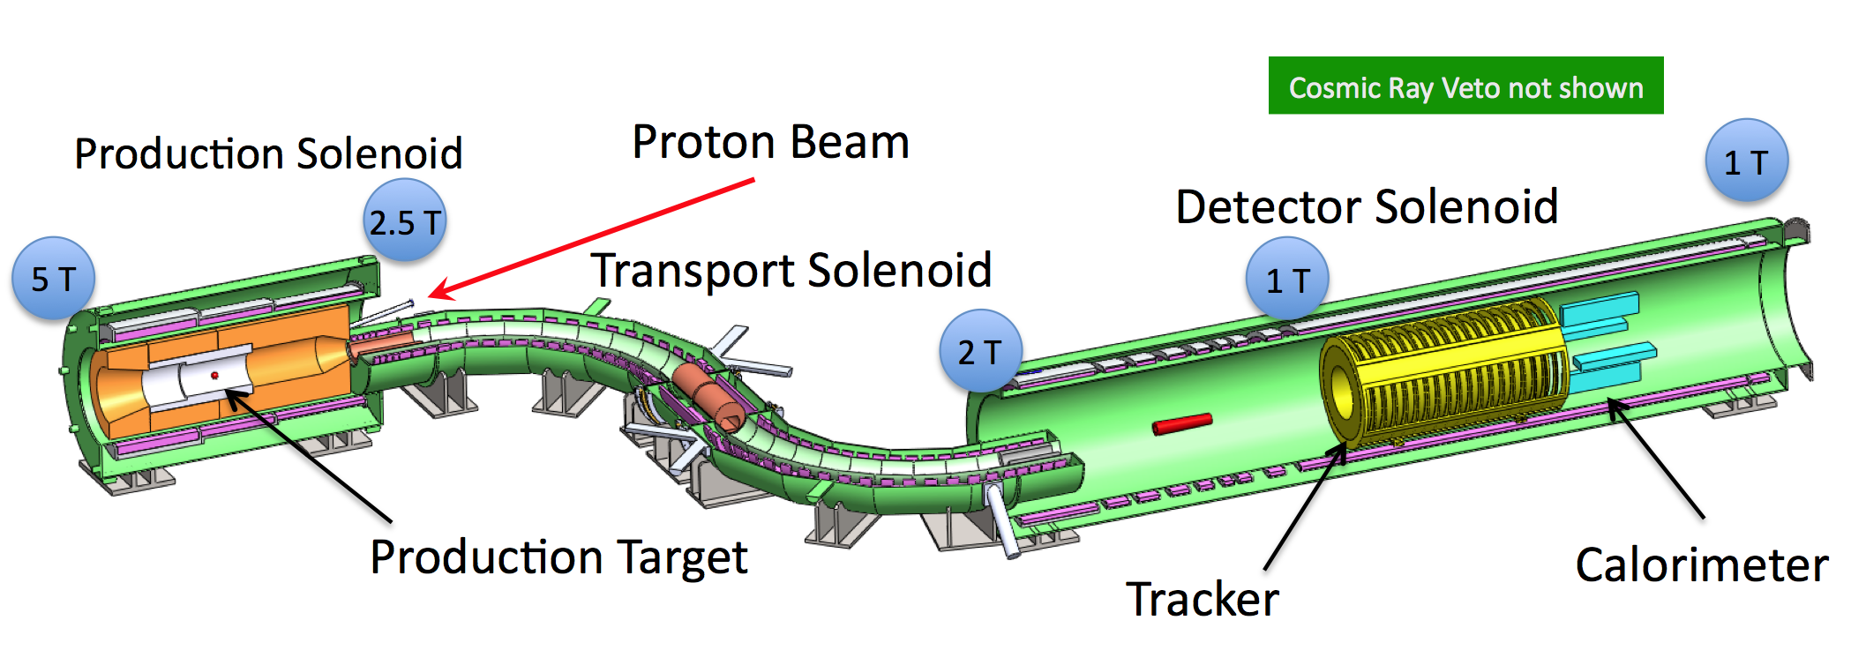
Mu2e Detector
Proton beam hits production target in Production Solenoid.
Pions captured and accelerated towards Transport Solenoid by graded field.
Pions decay to muons.
Muons captured in stopping target.
Conversion electron trajectory measured in tracker, validated in calorimeter.
Cosmic Ray Veto surrounds Detector Solenoid.
Transport solenoid performs sign and momentum selection.
Eliminates high energy negative particles, positive particles and line-of-site neutrals.

Slide 5
Project Status
Received CD-0 in November 2009
In the past year we have
Completed draft CDR > 550 pages of detailed conceptual design across the project
Conducted a number of internal design reviews
Independent Design Review of Project held last month
Chaired by Jim Yeck. 29 reviewers in 8 subgroups from inside and outside Fermilab
Lots of comments and recommendations but conclusion was that the overall design was at the CD-1 level.
Need for more scientific effort on simulations and more engineering support from Fermilab cited as important issues.
Compiled a > 3000 line RLS. Still lots of work to do to get it ready for CD-1.

Slide 6
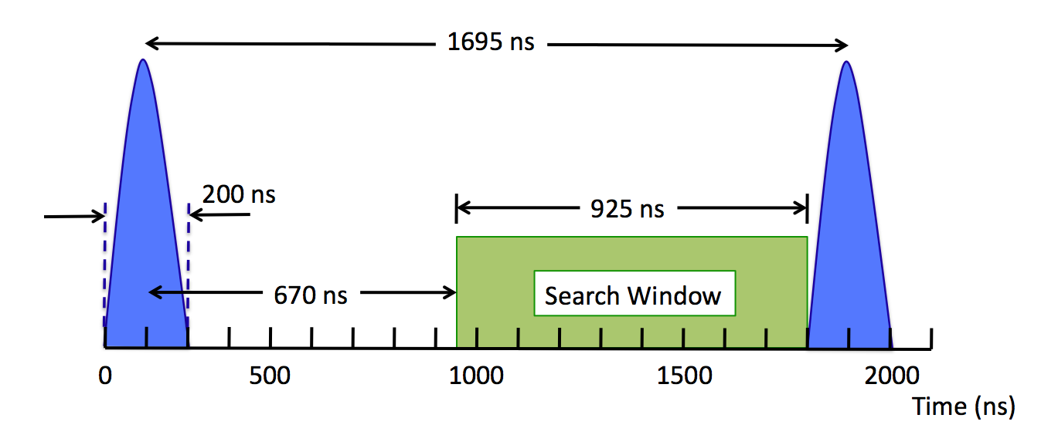
Maximizing the productivity of the existing facility. The Mu2e accelerator scheme.
Mu2e requires a very specific beam structure
We can accomplish this with changes and upgrades to the existing Fermilab accelerator plant.
In particular, the pbar source is ideally suited to our needs
We require proton pulses separated by 1-2 muon lifetimes
Revolution time in Fermilab pbar source is 1.7 μs. Perfect!
Don’t want proton beam between pulses

Slide 7
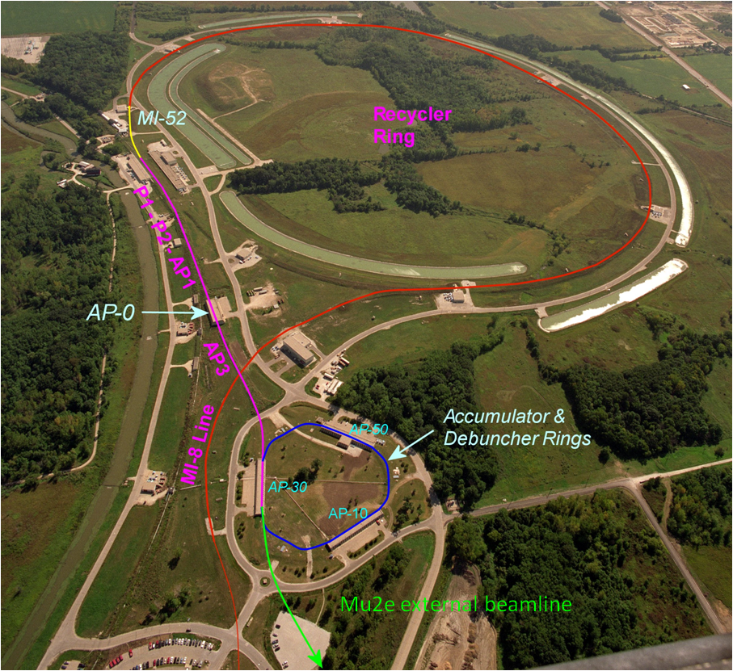
Accelerator Scheme
Deliver 25 kW pulsed proton beam to Mu2e detector with no impact on NOvA
Transfer beam from Booster to Mu2e detector using the existing Recycler Ring as a transfer line.
Interleave batches with NOνA batches in the Recycler Ring.
New transfer line from RR to P1.
Protons are stacked and re-bunched in Accumulator Ring
2 new RF systems
Protons transferred one bunch at a time to Debuncher Ring. Slow extracted.
New RF system
RF knockout extraction system – first application at Fermilab

Slide 8
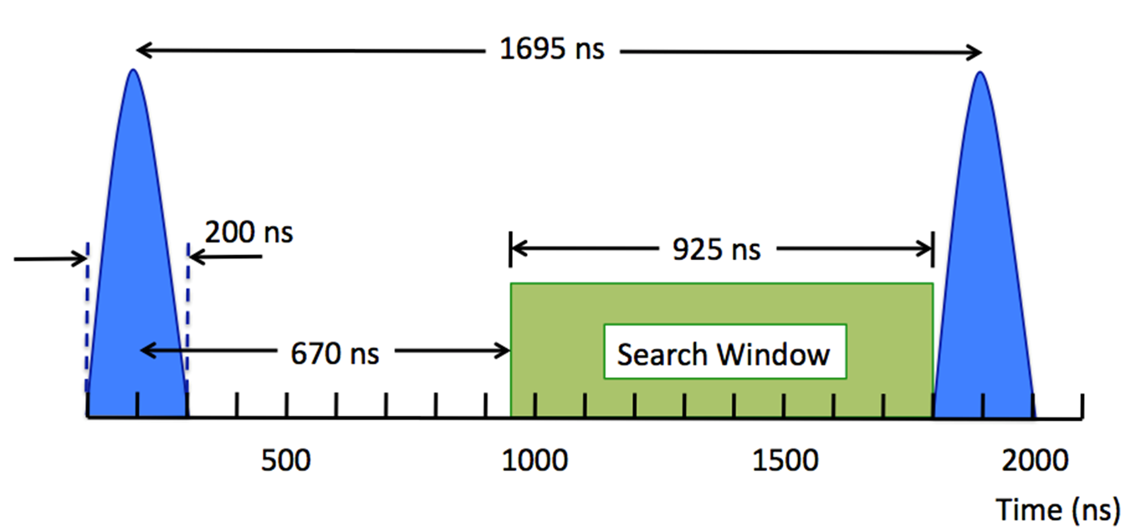
Extinction
The most important backgrounds to the Mu2e experiment are prompt with respect to the incident proton
For this reason, out of time protons must be suppressed at a level of 10⁻¹⁰ relative to in time protons.
This high level of extinction is achieved in two stages
In the Debuncher ring, prior to extraction – Goal 10⁻⁵
In the proton transport beam line – Goal > 10⁻⁷

Slide 9
Internal Extinction
Several mechanisms could cause out-of-time beam through tail formation.
This migration can be ameliorated by momentum collimation in the high dispersion regions of the Debuncher.
We are currently addressing the tail formation in the Debuncher through a combination of direct calculation as well as 3D simulations using Synergia.
The fact that 10⁻⁷ extinction has been achieved in the J-PARC ring gives us confidence that extinction that our required level of extinction can be reached.

Slide 10
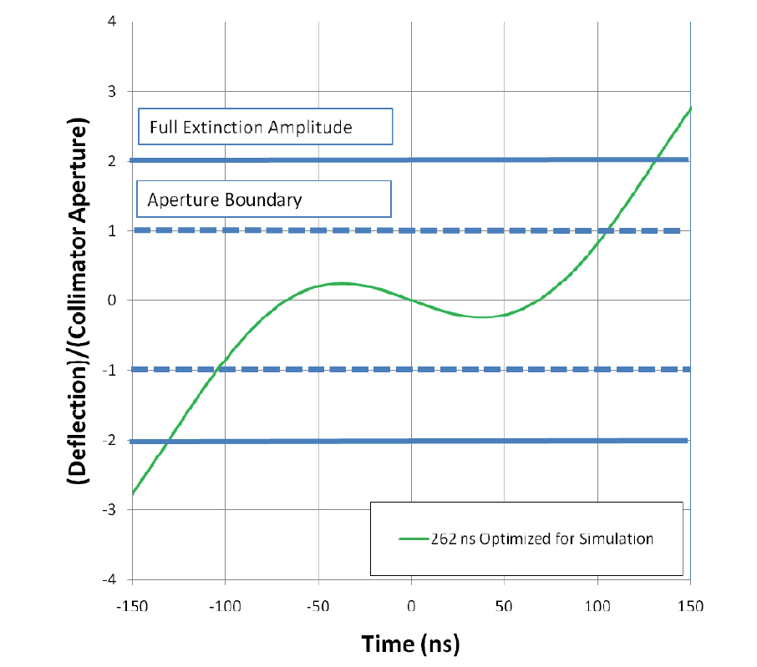
Beamline Extinction
Beam line extinction is based on deflecting magnets and a collimation system, such that only in time protons are transported to the production target. A pair of resonant dipoles are used to achieve the desired deflection.
The lower frequency magnet sweeps the out of time beam out of the transmission channel, the higher frequency magnet limits the slewing in the transmission window, increasing the effective transmission window.
A simulation of the beam line and collimation found that with 210M particles incident on the first collimator, 27 hit the target, or < 110⁻⁷.

Slide 11
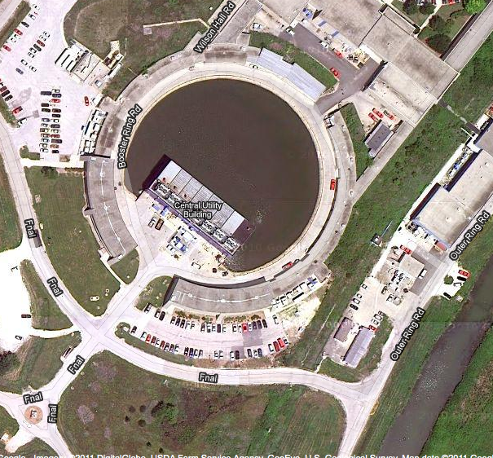
Future Facility Upgrades: The Booster
In order to use remaining Booster cycles all Booster components must operate at 15 Hz.
In NOvA era, 15 Hz operation is necessary to run Mu2e, g-2 or MicroBooNe.
Improves reliability for NOvA as well.
15 Hz operation is not part of any project, but is part of continuing Proton Improvement Plan.
Lab funds targeted for Booster upgrade beginning in FY12

Slide 12
Solenoids
Solenoids are the schedule driver for the project
Led by Fermilab Technical Division
Mike Lamm – L2 Manager
Significant engineering resources from TD and PPD
Significant simulation effort, on and off-Project, from Fermilab, BU, Muons Inc.
Conceptual design completed and documented over the past year.
Includes value engineering to reduce the cost and complexity
Shorter Production Solenoid
Simpler cooling scheme
Relaxed uniformity specification in Detector Solenoid
Simplified coil design in PS and DS
RFI sent to industry for budgetary quotes.
Lots of interest. No surprises.

Slide 13
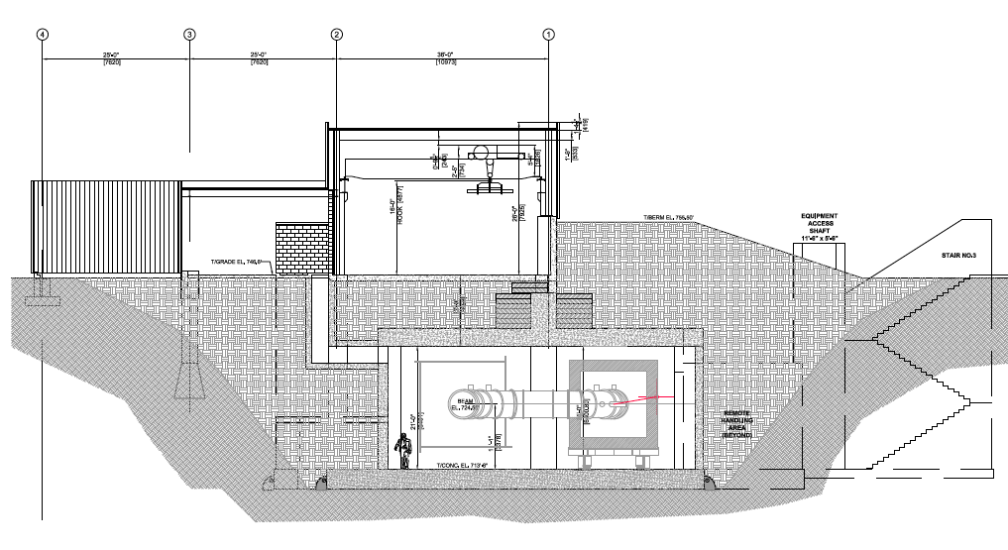
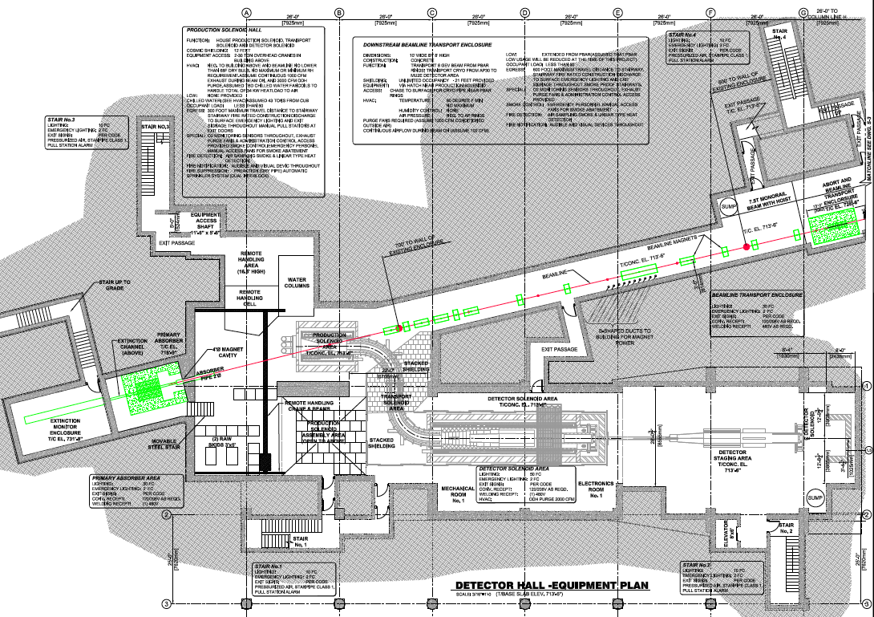
Conventional Construction
Design and construction of detector hall led by FESS engineers and designers
Tom Lackowski – L2 Manager
Layout has evolved over the last year as the result of extensive discussions with stakeholders.
Architectural design consistent with Fermilab standards developed since last year.

Slide 14
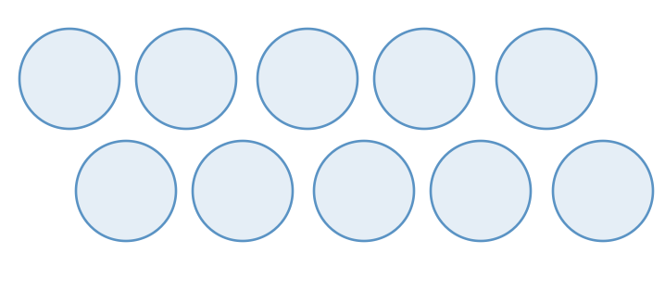
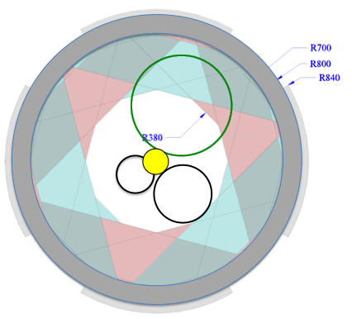
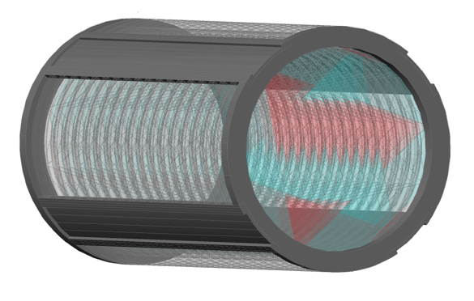
Tracker
Led by Fermilab Particle Physics Division with significant Collaboration support
Aseet Mukherjee – L2 Manager
Engineering resources from PPD, LBNL
Rice, Houston, Duke also playing major roles.
Essential simulations to develop requirements and demonstrate tracker performance performed by off-project scientific resources from LBNL and Fermilab.
Complete conceptual design of low mass transverse straw tube tracker (T-Tracker)including mechanical support, cooling and electronics has emerged in the past year.

Slide 15
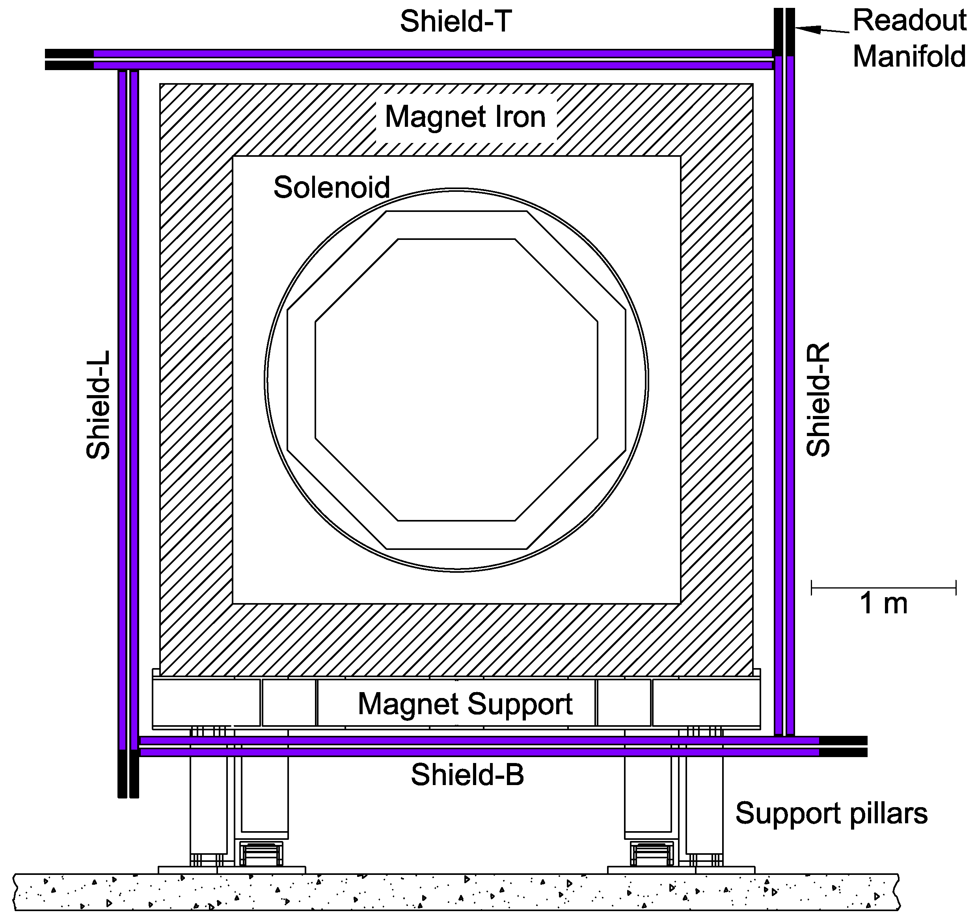
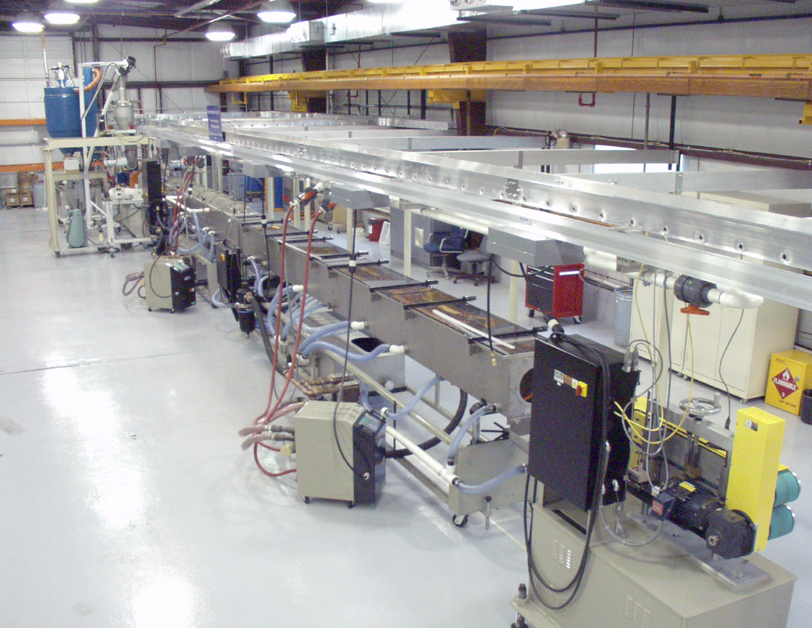
Cosmic Ray Veto
Veto cosmic rays that have been shown in other experiments to generate potential backgrounds.
Led by University of Virginia with support from Fermilab and Brookhaven.
On and off-project scientific effort on simulations from BU, Berkeley, Virginia, BNL and Fermilab.
Relies on extruded scintillator from the FNAL-NICADD extrusion facility.
Ongoing R&D effort for Mu2e to optimize light output and understand neutron ID.

Slide 16
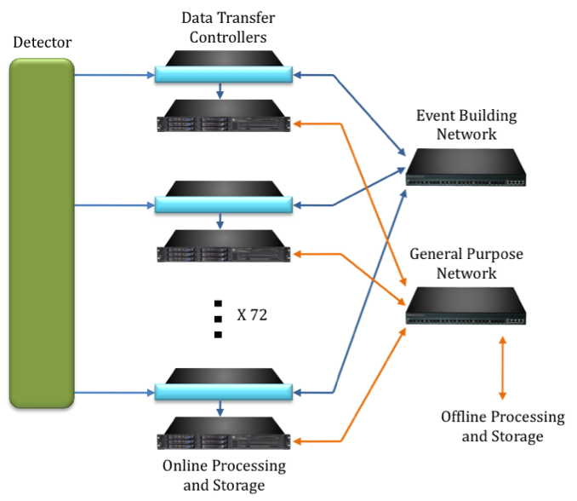
DAQ
Led by Fermilab Computing Division
Mark Bowden – L2 manager
Engineering and programming resources provided by CD. Potential interest from Caltech. Collaborators will eventually get involved in writing analysis software that will be used for online processing.
Over the past year we have developed a conceptual design for a streaming DAQ that transmits zero suppressed data off the detectors and filters in software.
Primarily off-the-shelf components. One custom part
Data Transfer Controller

Slide 17
Computing
High statistics simulation runs are important for many aspects of the Mu2e design.
Swimming large samples of particles through the solenoids to identify potential traps for low energy particles that could arrive late and create background.
Large statistics samples of tracks in the straw tubes in the presence of accidentals to look for reconstruction errors that might appear as background.
Study how to identify these events with the calorimeter.
Over the past year we have made virtually all of our software grid-compliant
GEANT 4
G4Beamline
MARS
FastSim
Running hundreds of jobs in parallel has now become routine.

Slide 18
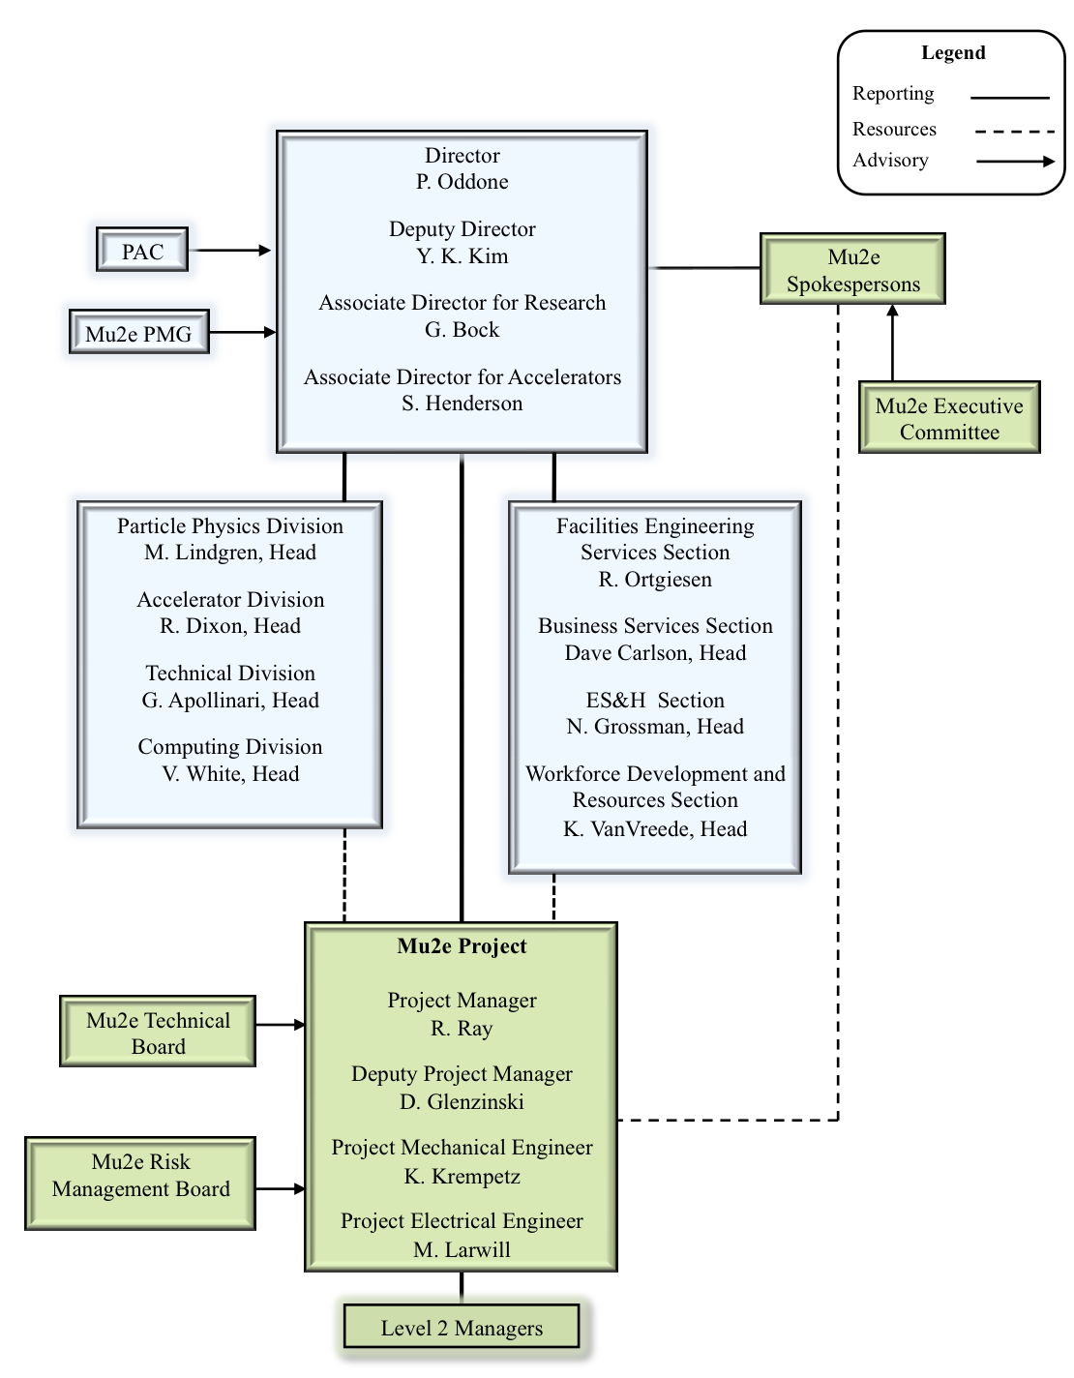
Project Management

Slide 19
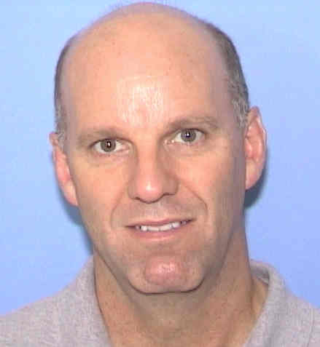
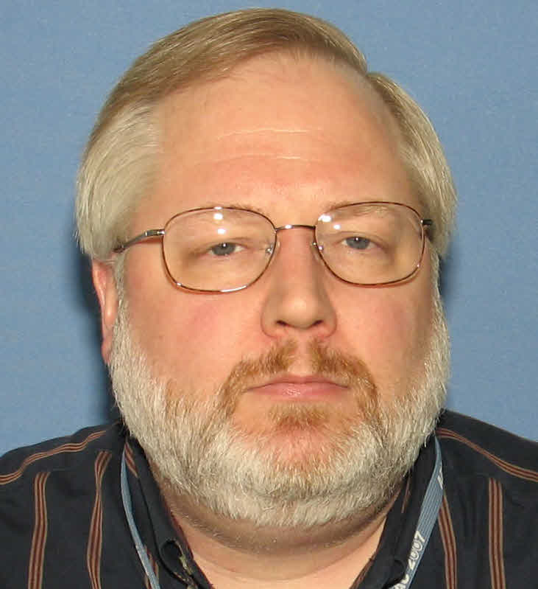
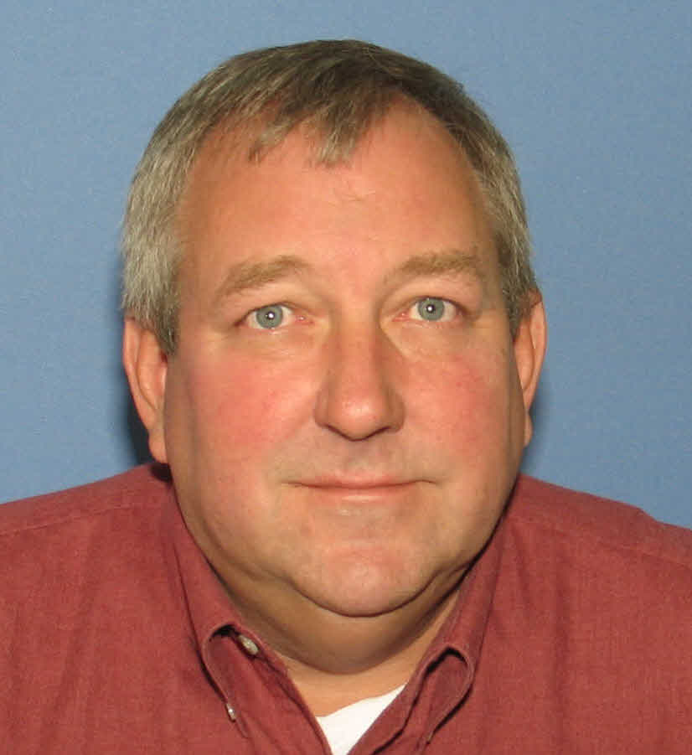
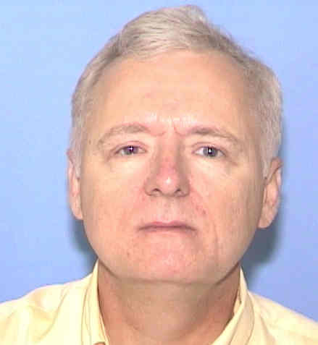
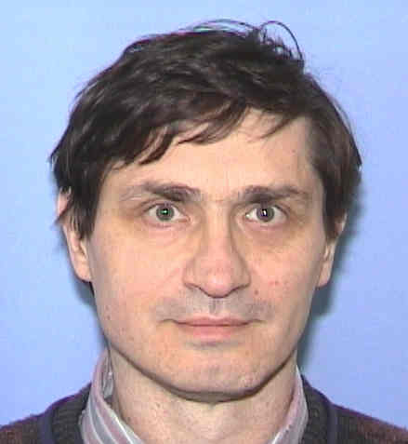
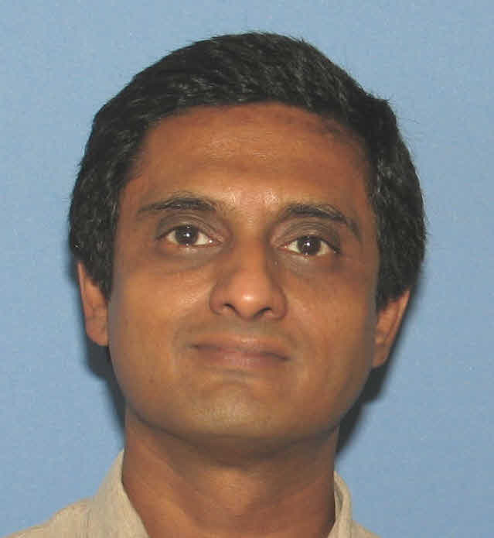
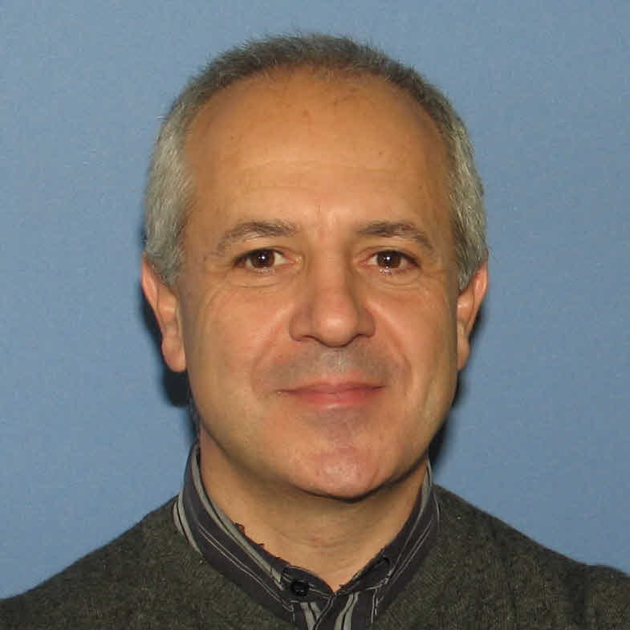
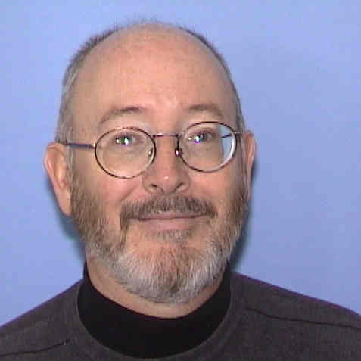
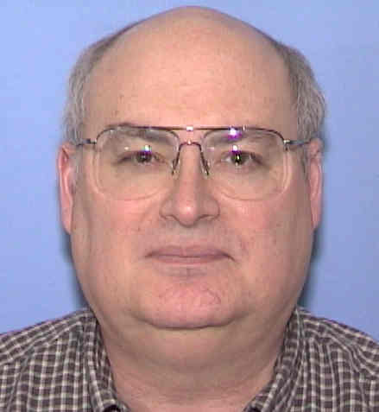
L2 Managers
1
Project Management
R. Ray
FNAL
2
Accelerator
S. Werkema
FNAL
3
Conventional Construction
T. Lackowski FNAL
4
Solenoids
M. Lamm
FNAL
5
Muon Channel
S. Feher
FNAL
6
Tracker
A. Mukherjee
FNAL
7
Calorimeter
S. Miscetti
Frascati
8
Cosmic Ray Veto
C. Dukes
UVa.
9
Trigger and DAQ
M. Bowden
FNAL

Slide 20
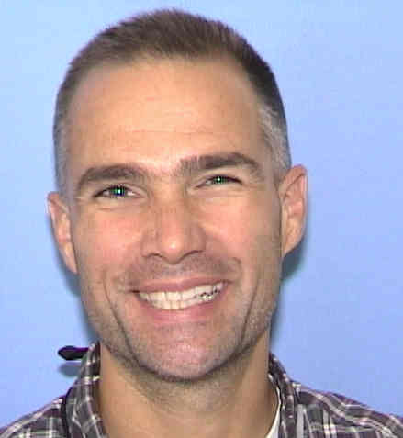
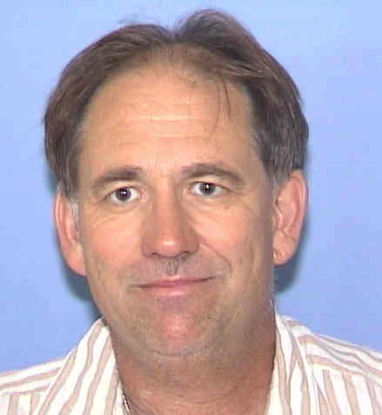
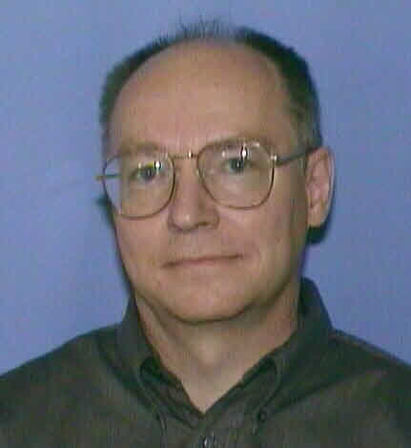
Project Office
Ron Ray PM
Doug Glenzinski Deputy PM
Kurt Krempetz Project Mechanical Engineer
Marcus Larwill Project Electrical Engineer
David Leeb Lead Project Controls
Mike Smith Budget
Dale Knapp Budget
Nathan Duff ES&H
Teri Dykhuis NEPA
Cindy Kennedy Admin support
Ron Evans Procurement Contact
Andrew Norman DocDb support
Mike Dinnon Risk Management
Jamie Blowers Configuration Management

Slide 21
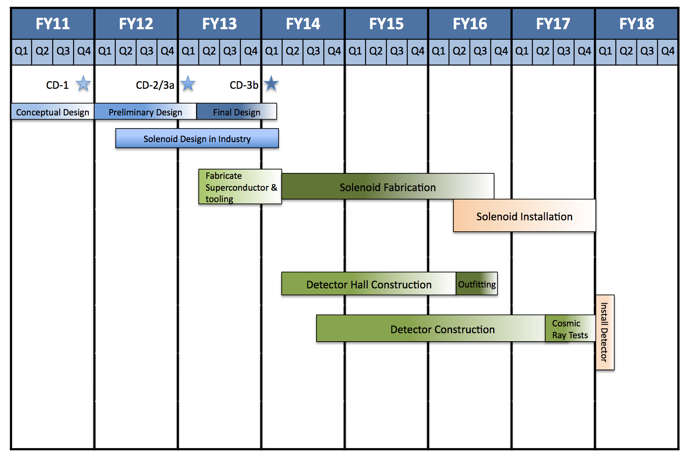
Block Schedule

Slide 22
Transition to Intensity Frontier
A transition to the Intensity frontier is underway and Mu2e is playing an important role in that transition.
Transition of facilities
PBAR source will be converted to a high intensity, high power (25 kW) facility to service Mu2e.
Associated with high intensity are high radiation levels. We are working with the lab to develop new technologies (eBerms) and improve our simulation capabilities (MARS)
Transition of people
Many people playing key roles on Mu2e are from the energy frontier
Glenzinski – FNAL/CDF
Mukherjee – FNAL/CDF
Rusu – FNAL/CDF
Interest from many others…
Corcoran – Rice/D0
Group – UVA/FNAL/CDF
Feher – FNAL/LHC

Slide 23
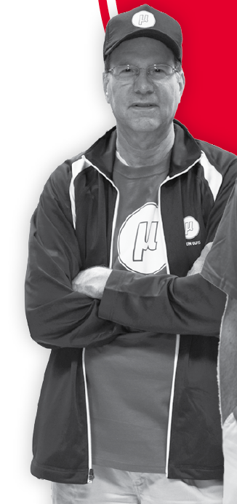
Support of Collaborators
New UVA/FNAL joint faculty/staff position – Craig Group.
3 International Fellows from INFN in residence for 2 years.
Support for CERN scientist to spend a year at Fermilab working on the solenoids
Support for Russian and Italian colleagues to spend time at the lab over the summer.
From Symmetry Magazine article on Mu2e

Slide 24
Collaboration Growth
In the past year Houston, Duke and Caltech have joined and have all quickly found ways to make important contributions to the Project.
Houston – Tracker electronics
Duke – Tracker gas manifolds and X-ray source to validate wire positions.
Caltech – Calorimeter crystals
Udine joined very recently and is interested in SiPMs
Significantly increased KA11 support for Mu2e over the past year has made it possible for the new US institutions to contribute and has provided funding for several new RA hires at collaborating institutions.

Slide 25
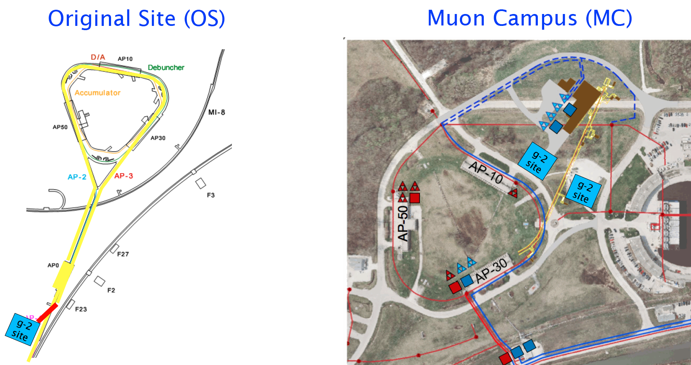
Mu2e and g-2
g-2 recently received Stage I approval from Fermilab
g-2 will also use the pbar rings, though in a different way than we do
Dedicated running time required for each experiment.
g-2 still evaluating site alternatives
Schedule and funding still highly uncertain
Can’t make a firm plan until g-2 is better specified.

Slide 26
Coordination with g-2
Most delicate part of Mu2e / g-2 coordination is to ensure that changes in the Debuncher remain mutually compatible.
g-2 wants the biggest aperture possible.
Aperture itself not such a concern for Mu2e, but larger apertures can quickly drive up the cost of new Debuncher RF system required for Mu2e.
Other potential aperture restrictions include Accumulator-Debuncher kicker, sextupoles, extraction septum and Lambertson.
Have to be designed to preserve aperture or to move out during a changeover.
If the “Muon Campus” site is chosen by g-2, both projects would use part of the Mu2e external beamline, requiring further coordination.
Based on everything we know the facility can accommodate both experiments during a common time frame, toggling from one to the other once or twice a year.

Slide 27
Summary
Mu2e has made significant progress in the past year on almost every front.
Expect CD-1 this year
Must finish RLS and complete some simulations.
New groups have joined and have made an immediate impact on the Project.
Significant KA11support has made this possible.
Still have a significant need for scientific support for simulations. This need will increase over the next year.
Off-project scientific effort critical here.
Need more AD engineering support from Fermilab.
Addition of g-2 makes this a harder problem.
Projects are not easy. Mu2e will succeed because of the strong, coherent and sustained support we are receiving from the Lab, the DOE and the Collaboration.

Slide 28
Backup Slides

Slide 29
Solenoid Fields
Production Solenoid
Uniform negative gradient
Mirror effect to capture more pions
Accelerate muons into Transport Solenoid
Detector Solenoid
Gradient upstream
~Doubles acceptance
Background rejection
Uniform downstream in detector region
Falls off at the end to reduce backsplash
Transport Solenoid
Negative gradient in straight sections to eliminate trapped/late arriving particles.

Slide 30
In Ring Extinction
There should be essentially no out of time beam when the single bunch is initially transferred to the Debuncher
Any out of time beam will develop during the slow extraction
Beam-gas
Space charge
RF noise
This will tend to migrate to the separatrix
Animations by Mike Syphers

Slide 31
In Ring Extinction (cont’d)
The addition of momentum collimation in the Debuncher should reduce out of time beam significantly
Goal: 10⁻⁵

Slide 32
Sources of Tails
Several mechanisms that could lead to out-of-time beam through tail formation
Space Charge - Causes bunch growth over the course of a spill.
RF Phase Noise - Phase noise near synchrotron oscillation harmonics can lead to growth. Modeling will allow us to set limits on noise spectrum of RF system.
Intra-beam Scattering - Small energy transfer events can lead to the formation of longitudinal tails.
Beam-Gas Interactions - Energy loss through proton interactions with residual gas particles leads to longitudinal bunch growth.

Slide 33
Tail Formation Modeling
We are currently addressing the tail formation in the Debuncher through a combination of direct calculation as well as 3D simulations using Synergia
Although we have not reached a conclusion yet, the fact that the J-Parc ring has achieved 10⁻⁷ extinction in their ring gives us confidence that extinction that our required level of extinction can be reached.

Slide 34
Beam Line Extinction
General Considerations
Out of time beam may have very different transverse distribution than in time beam.
Beam line must have well defined admittance aperture which is matched to admittance of collimation channel.
Define extinction window as the time outside of which 100% of the beam will impact the extinction collimator.
Optimization Considerations
Maximize transmission efficiency of nominal bunch
Minimize cost/complexity of magnets and power supply

Slide 35
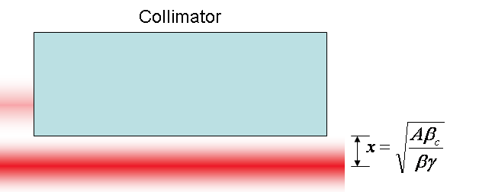
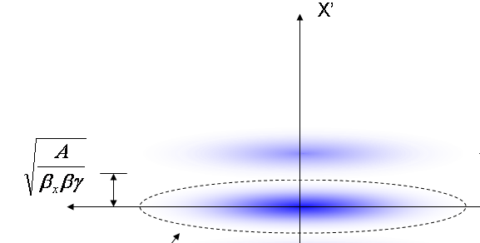
Generic Extinction Analysis*
At collimator:
Beam fully extinguished when deflection equals twice full admittance (A) amplitude
At kicker:
Angle to extinguish beam
*FNAL-BEAM-DOC-2925

Slide 36
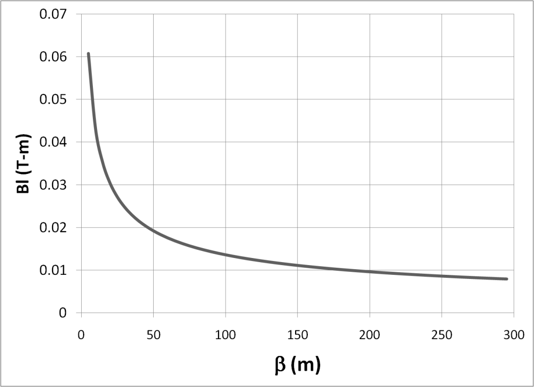
Magnet Optimization
Bend strength to extinguish:
Stored Energy:
⇒Large β_{x}, long weak magnets
- Assume β_{x}=250m, L=6m
- Factor of 4 better than β_{x}=50m, L=2m

Slide 37
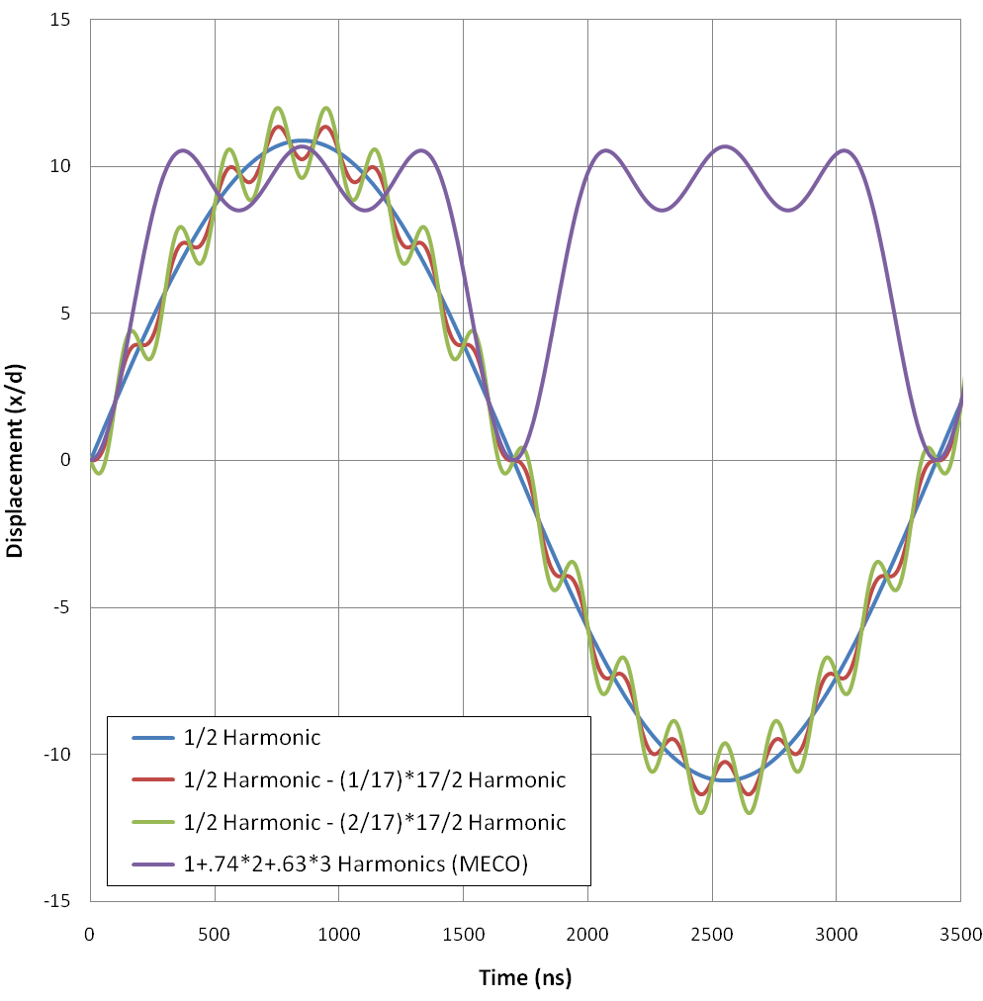
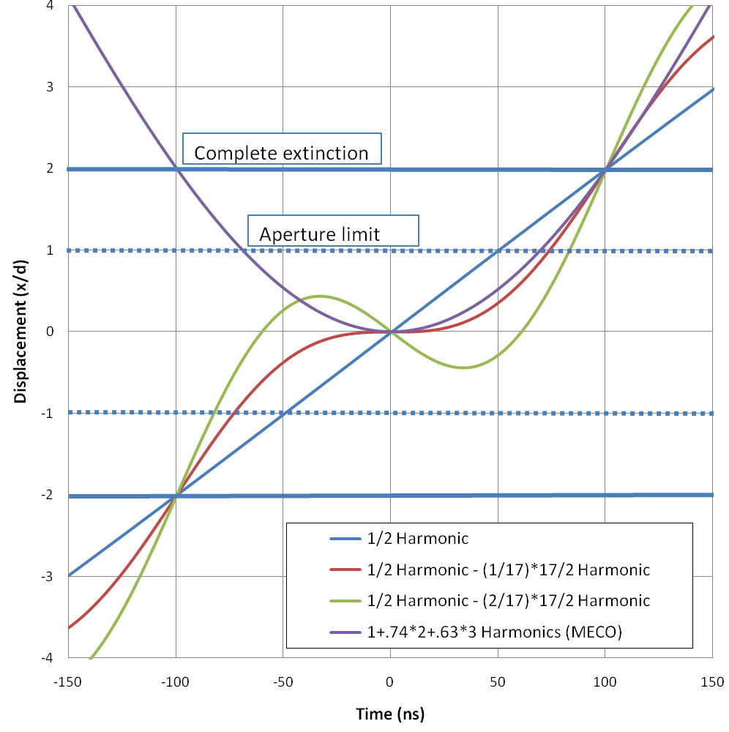
Waveform Analysis*
a)
b)
*Mu2e-DOC-552

Slide 38
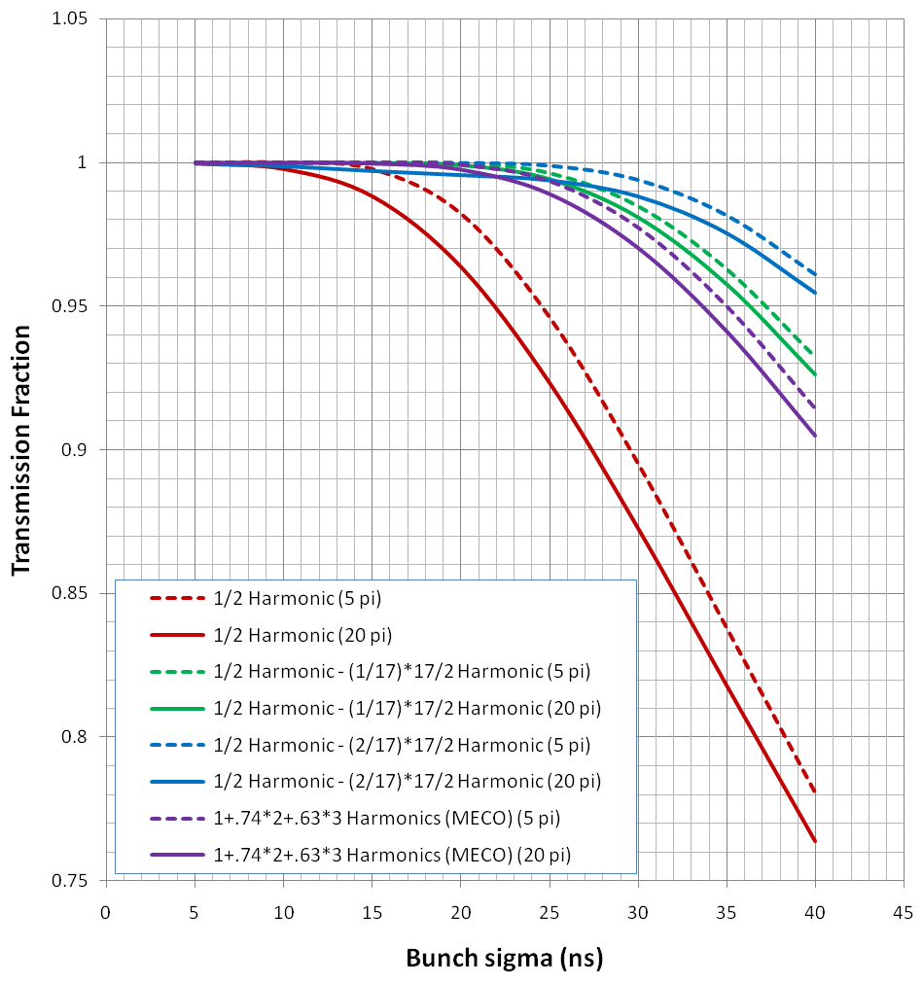
Transmission Results
Beam transmission efficiency is shown as a function of (Gaussian) bunch length for the various waveforms considered
Solid and dashed lines represent 20 and 5 π-mm-mr emittances, respectively

Slide 39
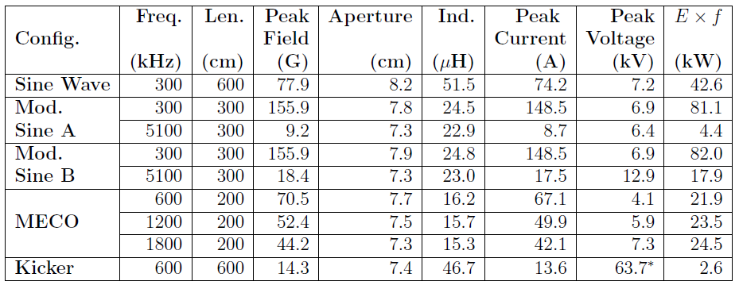
Base Line Magnet Choice
Magnet specification
Assume equal length per harmonic (6m total)
Gap in non-bend plane 1.2 cm (waist for 50π-mm-mr admittance)
Electrical parameters assume ideal magnets (μ>>μ₀)
Power = (Exf)x(2π/Q)
Pursuing Mod. Sine A as most promising, although modifying for realistic beam distribution

Slide 40
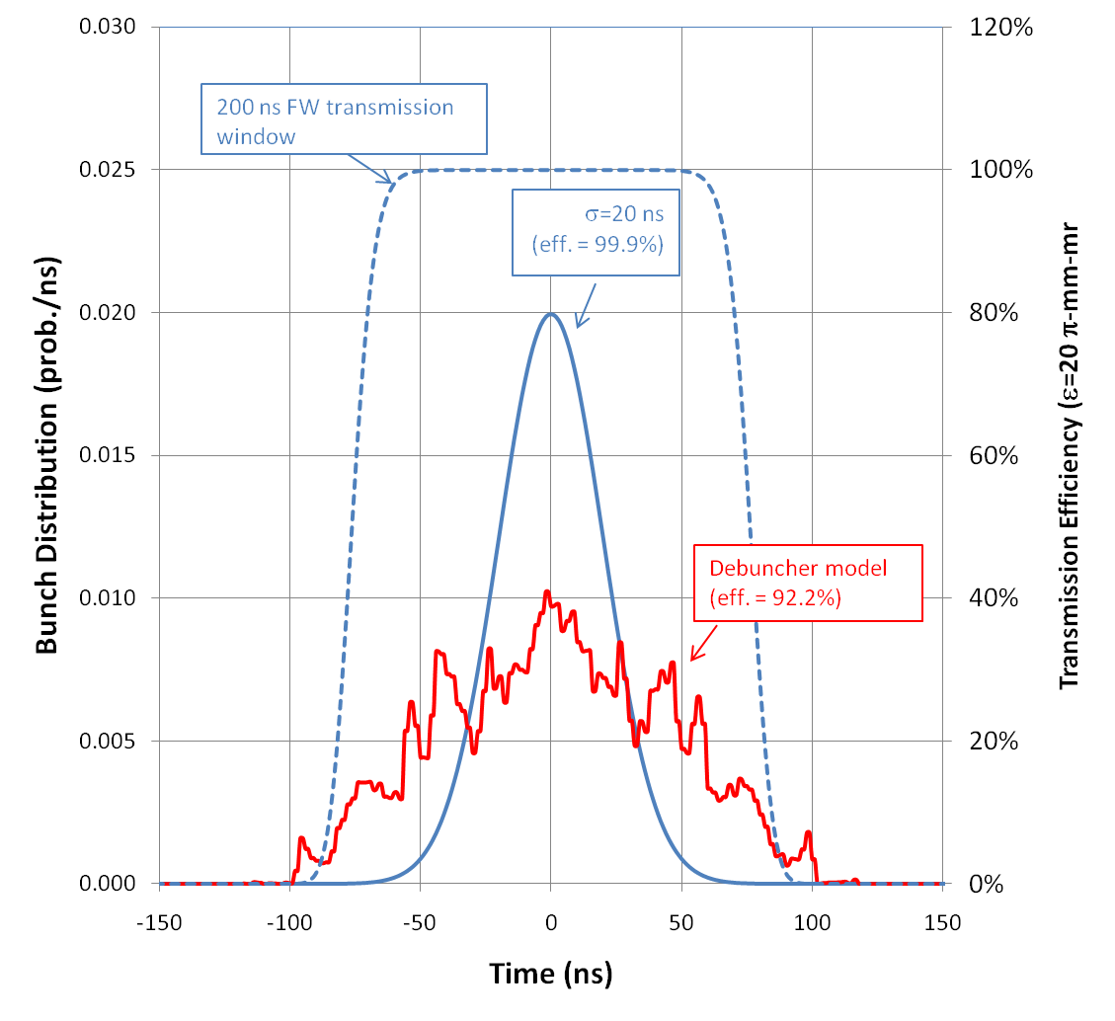
Optimization of Parameters
A more accurate model of the Debuncher produced wider distributions than were originally planned for, and the dipole parameters were subsequently reoptimized:
Solution: must go to a wider transmission window (lower harmonics)
Can also increase amplitude of high frequency component to increase efficiency

Slide 41
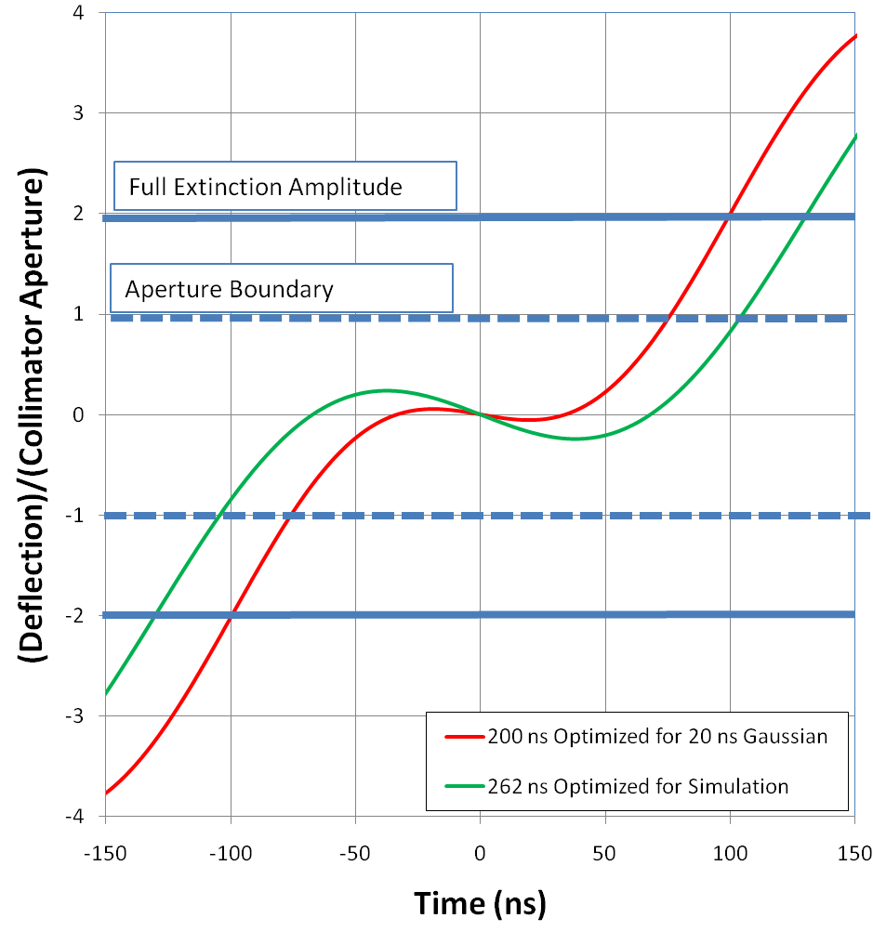
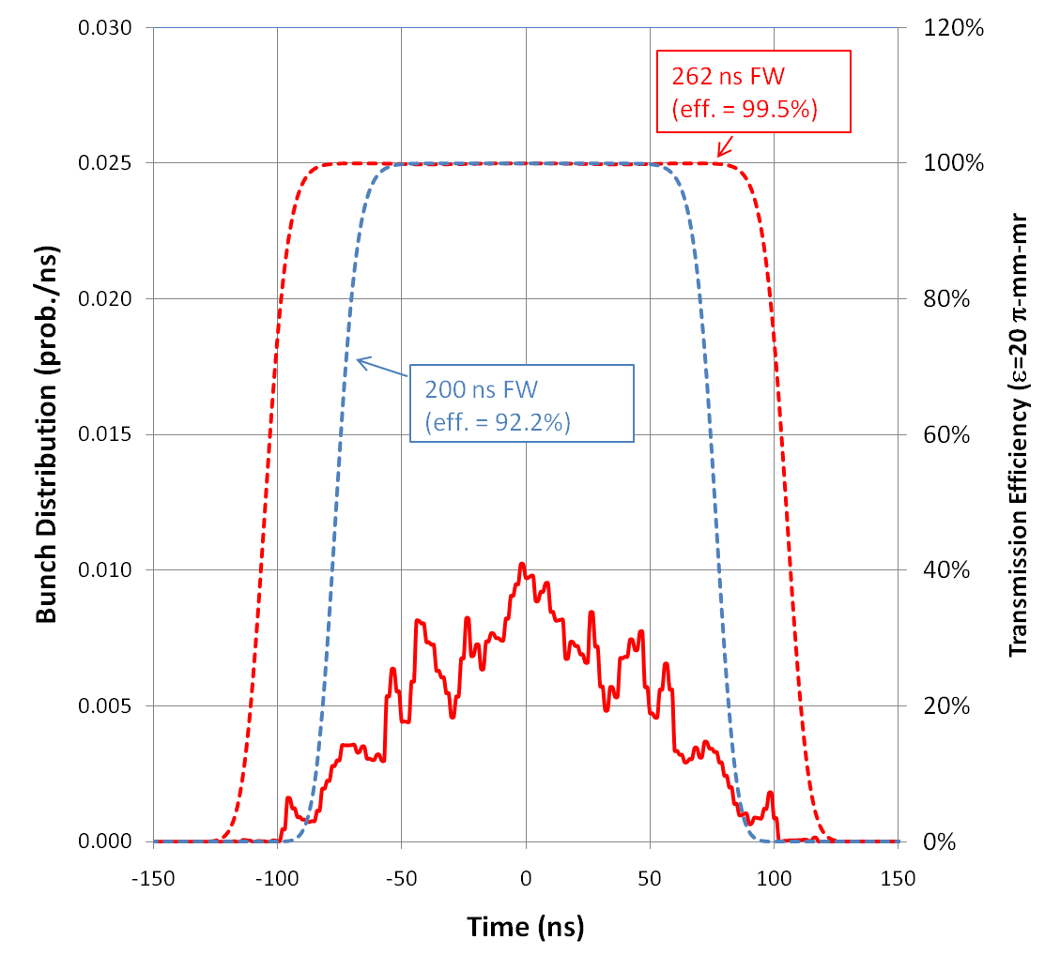
Optimized Base Line
120 G peak @ 300 kHz
15 G peak @ 3.8 MHz
Transmission efficiency: 99.5% for modeled bunch distribution

