Slide 1
Jayakar Thangaraj Fermilab Accelerator Advisory Committee November 7-9, 2011
PROTOPLASMA: Proton-driven wakefield experiment at Fermilab

Slide 2
Plasmas : a role in future accelerators ?
Linear colliders are in the TeV era.
Increasing cost of next generation accelerators
Conventional RF technology (~ 100 MV/m). Plasmas can support large electric fields (> GV/m).
Can we use plasmas to make accelerators compact?

Slide 3
Physical mechanism
Space charge of the drive beam sets up a plasma wave
Drive beam could be (a) Laser beam (b) Electron beam

Slide 4
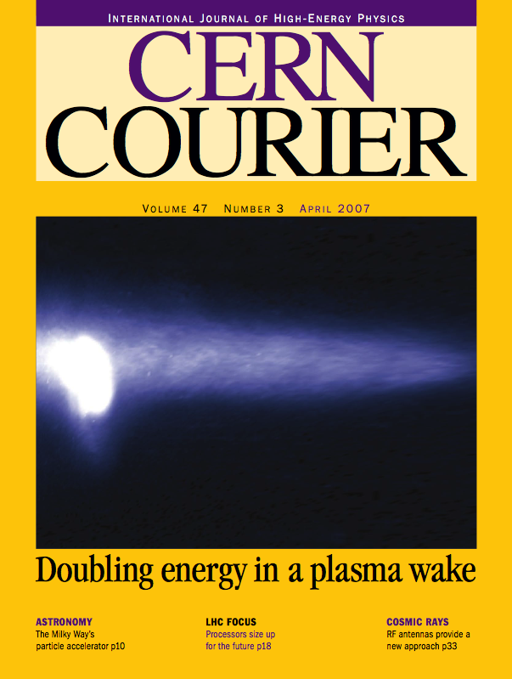
Electron and Laser driven acceleration
(1 GeV in 3.3 cm)
Laser-driven and electron beam-driven
acceleration have shown great progress
(new facilities such as FACET, BELLA )
Question: Can we use these schemes
for a multi-TeV collider?
Challenge: We will need many stages
(42 GeV in 85 cm)
Possible solution : Use a proton beam to drive plasma
Nature v 445 (2007) I.Blumenfeld et al.,
A.Caldwell et. al Nature 2009, C. Joshi

Slide 5
Why use a proton beam?
Plasma act as an energy transformer.
“Conventional” accelerators produce TeV proton beam. kJ’s of energy.
Key Idea
Use an existing high energy proton beam to drive a plasma wake and accelerate an electron beam
Opportunity
We could accelerate electrons to TeV in a single stage. This will be a new research frontier.
Fermilab would be well-suited for such R&D. CERN has also proposed an experiment in their facility.

Slide 6
Challenges on using a proton beam as a driver
Key challenge
Proton bunches are the order of 10s of cm NOT sub-mm.
Compressing high energy proton beam is expensive
Solution
Use “self-modulation” of a long proton bunch in a plasma to generate short bunches
N.Kumar, A. Pukhov, K. Lotov PRL 2010

Slide 7
People involved in Protoplasma
Fermilab:
Tevatron: D. Still, J. Annala , A. Valishev
Main Injector: I. Kourbanis, D. Morris, T. Johnson
APC : V. Shiltsev, P. Spentzouris
External Beamline: A. Soha, T. Kobilarcik, R. Coleman
U
W. Mori, C. Joshi, W. An

Slide 8
Our goal and current status
Our goal : To demonstrate 1 GeV electron acceleration in 3 m
Simulation status
We are currently exploring various beam and plasma parameters to look for self modulation within 3 m.
Current simulation effort is pursued by W. An under
W. Mori at UCLA (Some discussions: Spentzouris talk)
Experimental design status
We are considering the Tevatron option (120 GeV) or the external beam line option (120 GeV).
A lower energy option (8 GeV) is being pursued as well.

Slide 9
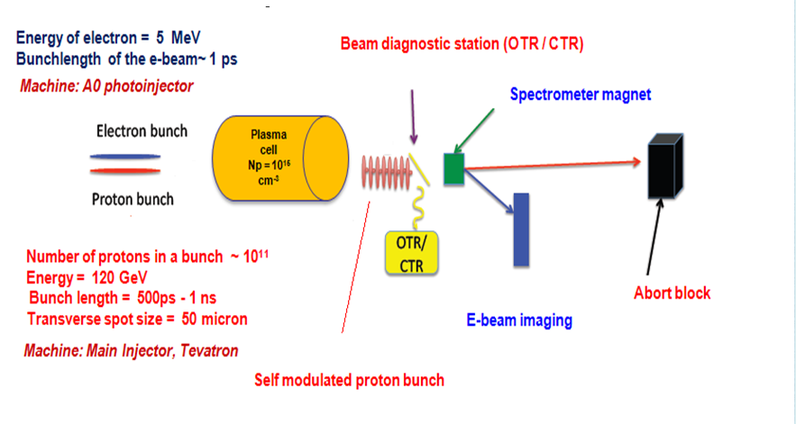
Experimental schematic

Slide 10
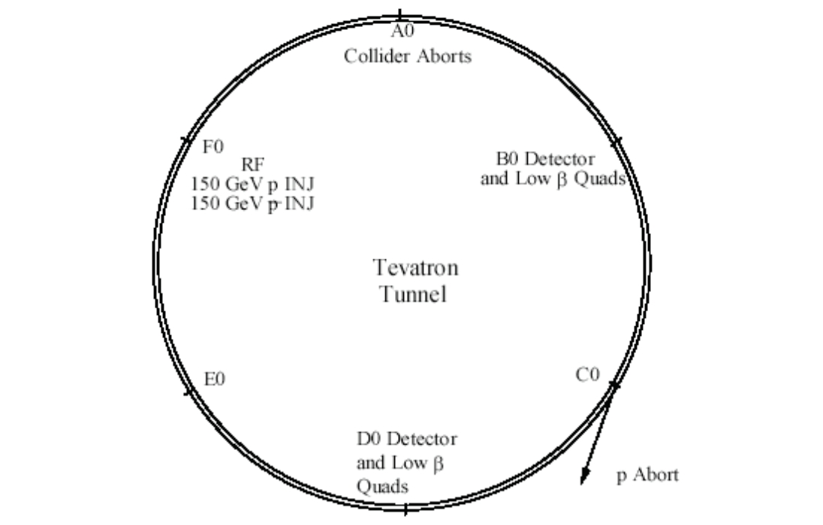
The Tevatron option
Inject 120 GeV protons at 1e11 protons per bunch from MI
to Tevatron
Beam is single pass from F11 to
B17
Beam will interact with plasma located in the CDF collision hall.
There will be detector and beam dump at ~B17
F0 to A49
CDF collision Hall
Portion of B section

Slide 11
If Tevatron (120 GeV)…
Cryogenics
Refrigerator work 40 weeks (~ $ 500 K)
We have to run F, A, B sector cryogenically
Half the current running cost of TeV: $ 4 million/yr
People 2 post-docs
Safety $30 K
Plasma cell $500K
Mechanical and Electrical
48 weeks 10 hours a day 5-6 man crew
< $500K (certify TeV)
Power supply (assuming no change the ring , HOPS)
No significant cost M&S ($100 K)
6 people (3 techs and 3 engineers) 2-4 weeks
Cost of moving CDF Detector
Possible sharing with kaon experiment (60 GeV)

Slide 12
If External Beamline (120 GeV) …
Time to install ~ 6 months – 1 year long
Available space is about 200 m long
Magnets ~ $4 million
Power supply ~ $2 million
Cables, dipoles, engineering FTE ~ $400 K
Plasma cell ~ $500 K

Slide 13
Plan
 | 2011 | 2012 | 2013 | 2014 | 2015 | 2016 | 2017
Approval
Experiment design Simulations Plasma cell R&D
Beamline restructuring
Measurements of proton beam modulation
Seeding
Electron injection
First demonstration of proton wakefield acceleration

Slide 14
In summary for the protoplasma experiment:
Next steps, continue exploring the parameter space through simulation.
Continue search for experimental location: TeV or the external beamline or 8 GeV option
Our near term experimental goal is to demonstrate self-modulation of the proton bunch
Enable US leadership on proton-driven wakefield class of experiments
Fermilab (proton expertise) and UCLA ( plasma R&D leaders) have already started to work on optimal beam/plasma parameters design.

