Slide 1
Fermilab Users’ Meeting June 1-2, 2011
Higgs Searches at the Tevatron
Avto Kharchilava
The State University of New York at Buffalo
(for the CDF and DØ Collaborations)

Slide 2
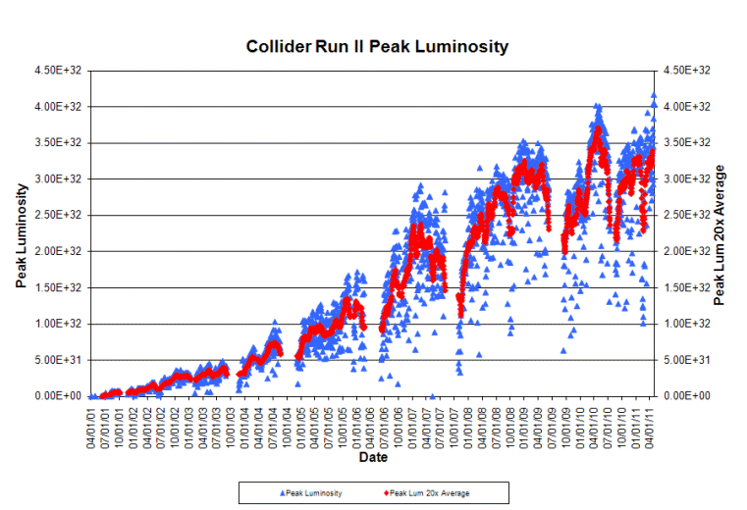
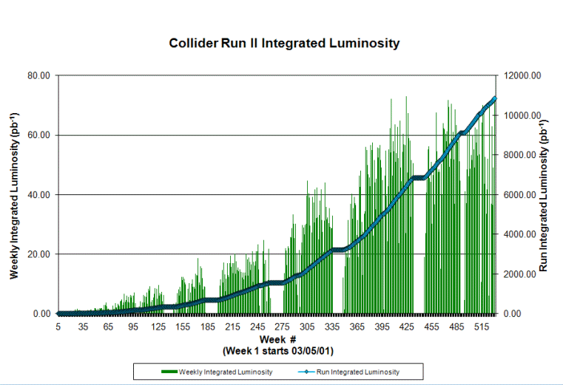
Thanks to the Tevatron !
Peak luminosity of
~4.3×10³² cm⁻²s⁻¹
Delivered integrated luminosity ~11 fb⁻¹
Expect ~12 fb⁻¹ by the end of 2011
Integrated luminosity of ~11 fb⁻¹ so far
CDF/DØ operate at ~90% efficiency
Following results are based on 5 – 8 fb⁻¹ of data

Slide 3
Outline
Introduction
Tevatron, CDF, DØ
The SM Higgs
WH → ℓνbb
ZH →ℓℓ/ννbb
H → ττjj, H → γγ, ttH
H → WW* → ℓ⁺ℓ⁻νν/jj
BSM Higgs
bh/bbh(→bb)
Summary

Slide 4
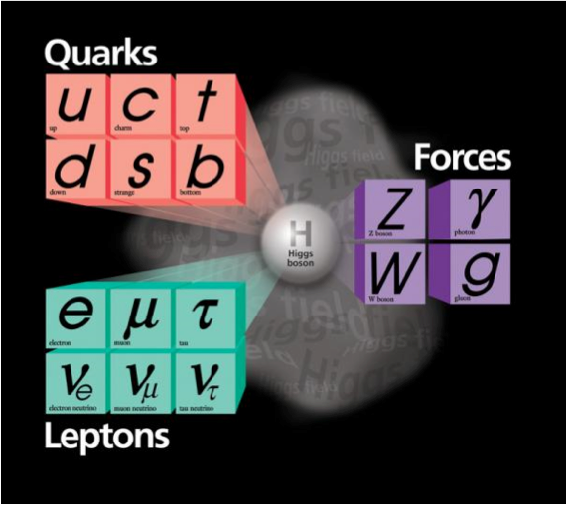
Higgs Mechanism in the Standard Model (1)
The SM – Quantum Field Theory
Mathematical description of all interactions, involving weak, electromagnetic, strong forces, through closely related symmetry principles: gauge symmetries
Problem: gauge invariance only possible for massless gauge bosons
Massive gauge bosons (W, Z) → violation of gauge invariance
Solution: postulate presence of a Higgs field that breaks the gauge symmetry:

Slide 5
Higgs Mechanism in the Standard Model (2)
As a result of the EW symmetry breaking
W and Z acquire masses, photon remains massless
Bonus: fermion masses are generated if Higgs field couples to them
Bonus: can prevent violation of unitarity in WW scattering
Prediction: an excitation of this field will be a neutral, massive scalar particle
the Higgs boson
Need to find it !
Otherwise the SM is incomplete
Electroweak symmetry breaking mechanism introduced in mid 60-ties by:

Slide 6
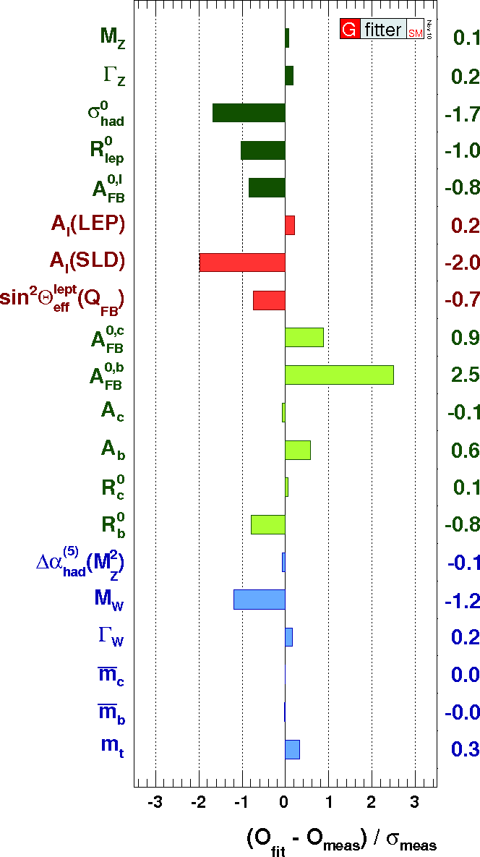
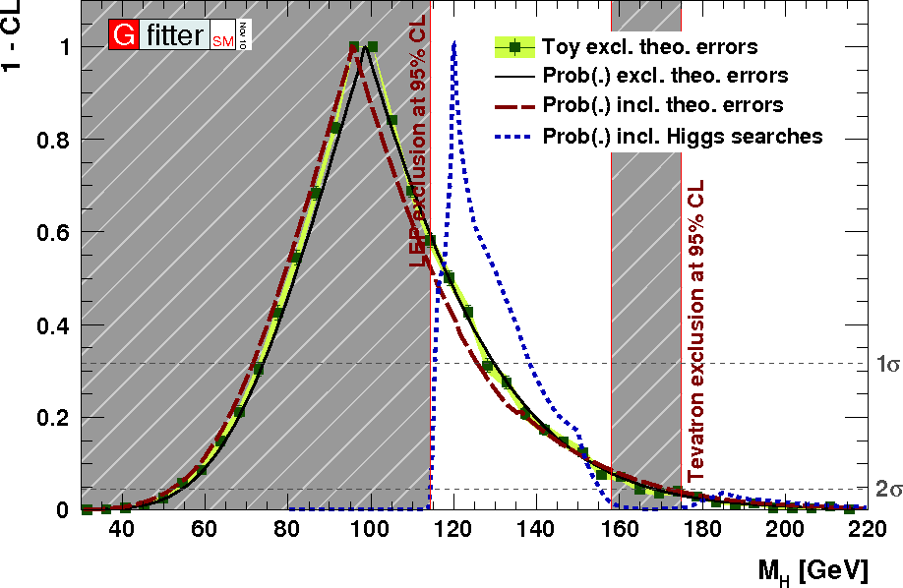
Constraints on the SM Higgs Boson Mass
Indirect constraints from global fits to data
Include results from direct searches at LEP and Tevatron
Central value for the Higgs mass:
➔ Mass range favorable to Tevatron’s reach

Slide 7
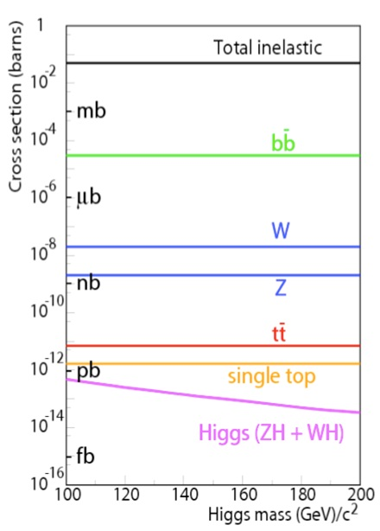
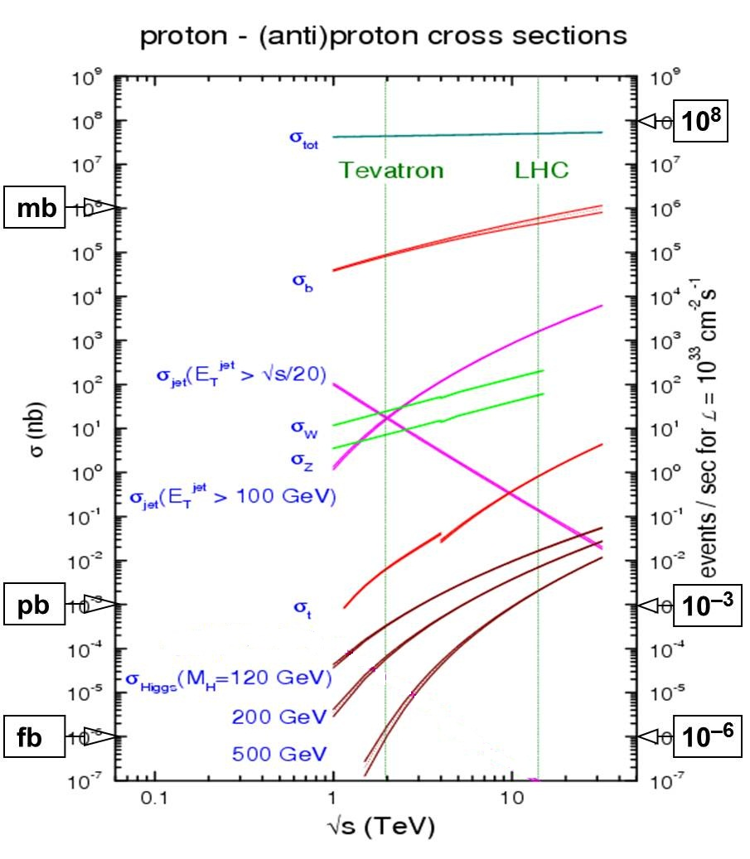
Production Cross Section and Event Rate
Tevatron vs LHC

Slide 8
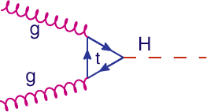
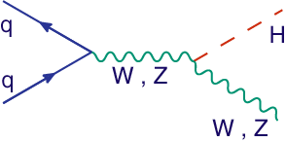
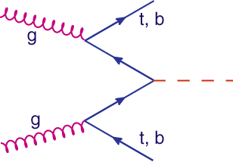
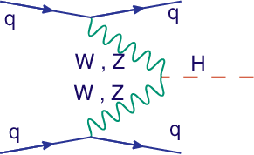
Higgs Boson Production at Hadron Colliders
gg fusion
Dominates at hadron machines
Usefulness depends on the Higgs decay mode
In association with W, Z
Important at the Tevatron: one or two high-p_{T} leptons helps in trigger
ttH and bbH associated production
High-p_{T} lepton, top reconstruction, b-tag
Low rate at the Tevatron
Vector Boson Fusion
Low rate at Tevatron, important at LHC
Two high-p_{T} forward jets help to “tag” event

Slide 9
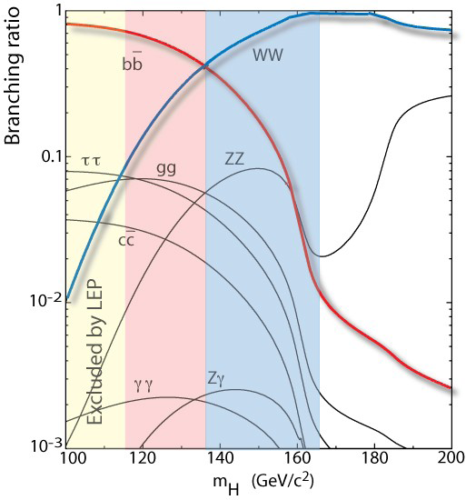
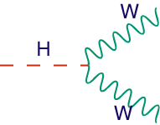
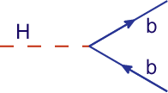
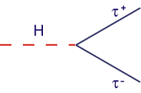
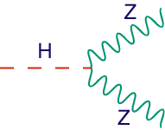
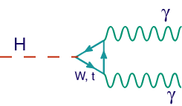
The Standard Model Higgs Boson Decays
Tevatron can explore nearly all decay modes, and in favorable mass region

Slide 10
Higgs Search Strategy
Consider all possible production mechanisms and decay modes
Maximize signal acceptance
Employ multivariate analysis techniques
Neural Network, Decision Tree, Matrix Element
Improve on simulations of signal and background processes
Use the latest available theory predictions
Devise data driven techniques for the background estimation
Combine individual analysis results to maximize sensitivity
About 130 (!) mutually exclusive final states analyzed by DØ and CDF Collaborations have been recently combined by the Tevatron Electroweak working group
Details of individual analyses are available at:
http://www-d0.fnal.gov/Run2Physics/WWW/results/higgs.htm
http://www-cdf.fnal.gov/physics/new/hdg/hdg.html

Slide 11
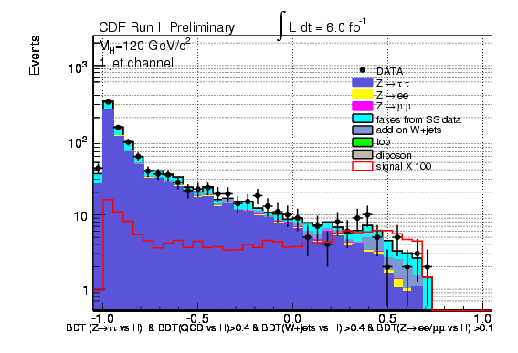
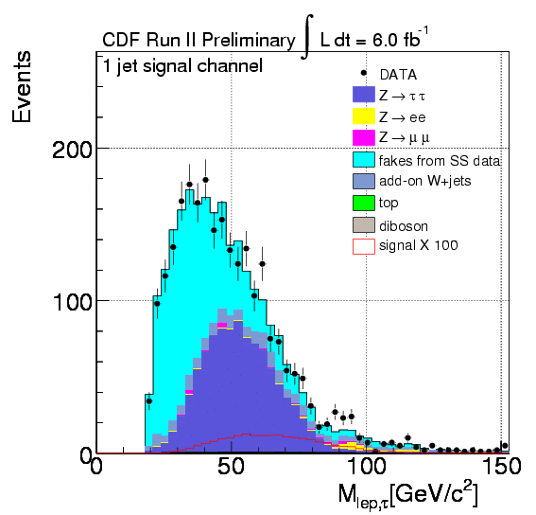
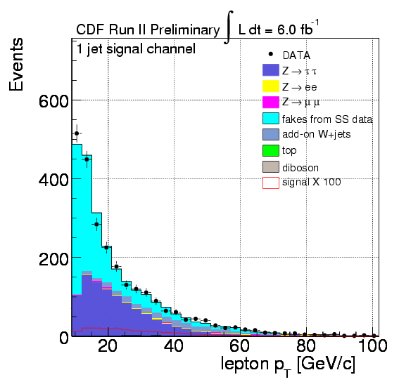
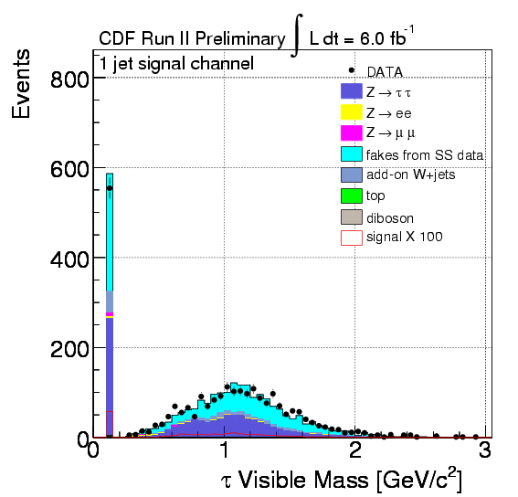
Example: Final States with τ leptons
Maximize sensitivity – examine various properties of event
No single variable can efficiently separate signal from the bkgd.
Feed them into a Boosted Decision Tree
Use the BDT output to set the limit or discover Higgs

Slide 12
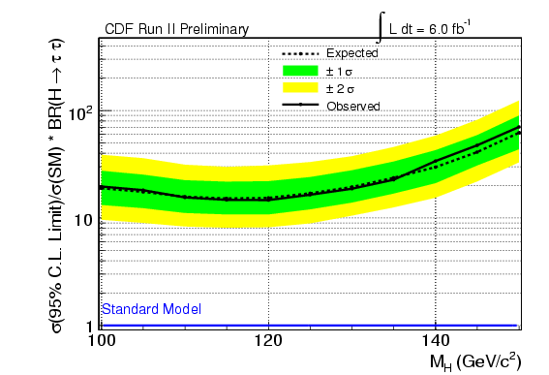
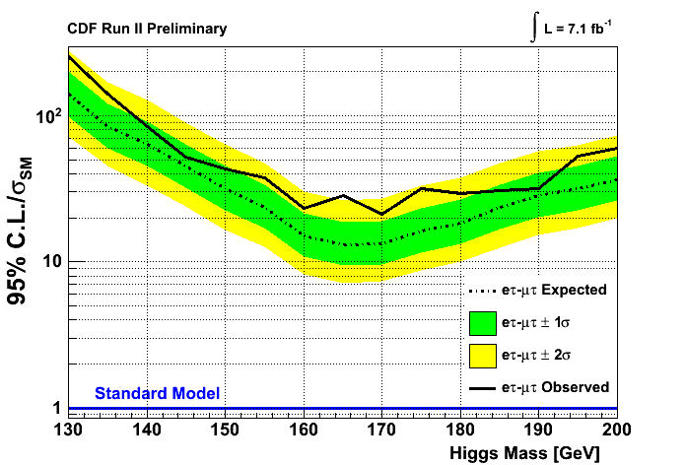
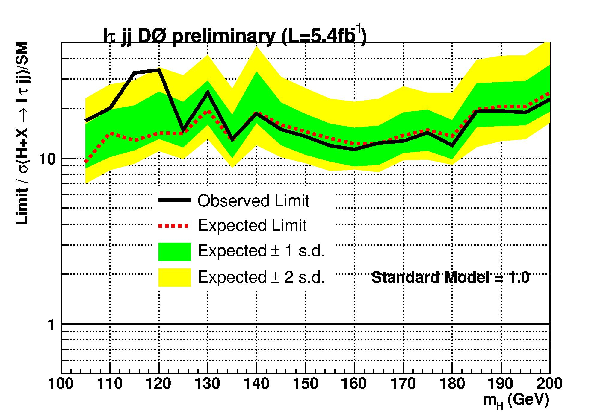
Limits: Final States with τ leptons
Use decision tree outputs to set the limits

Slide 13
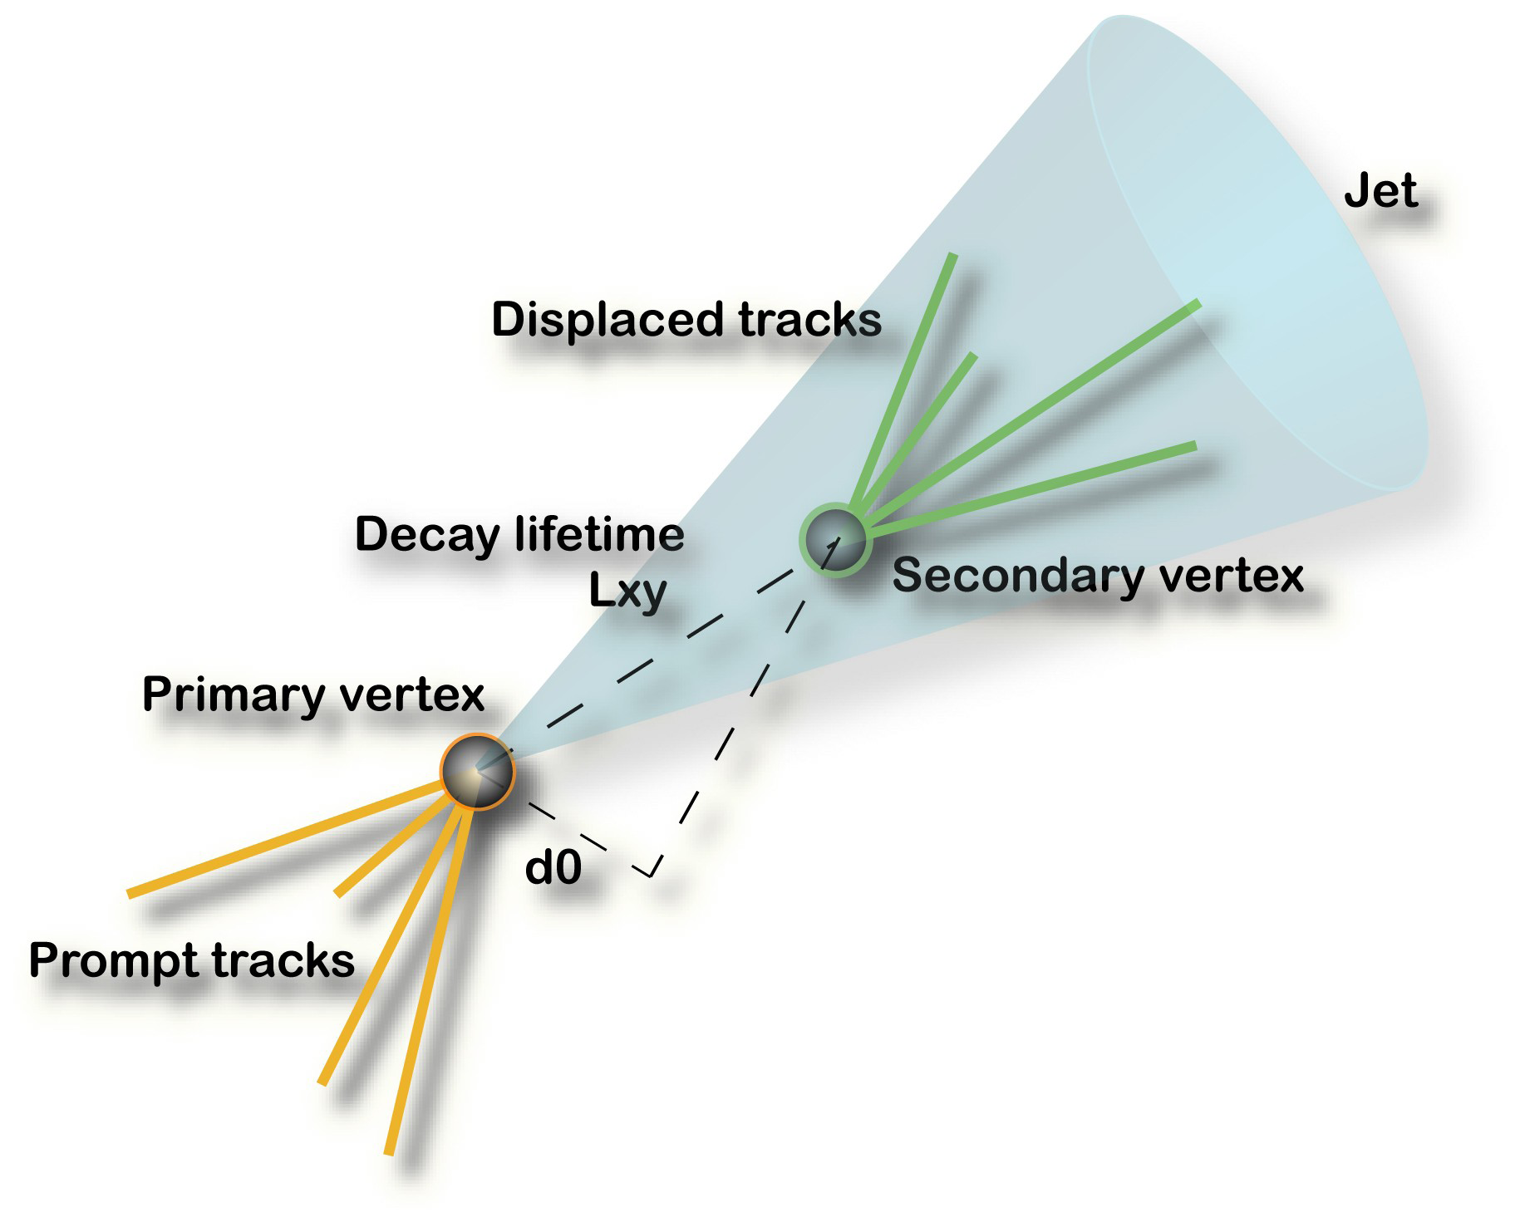
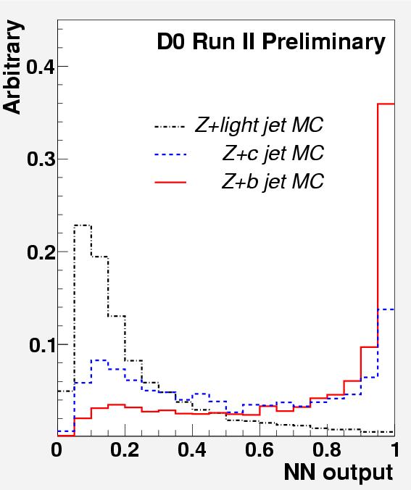
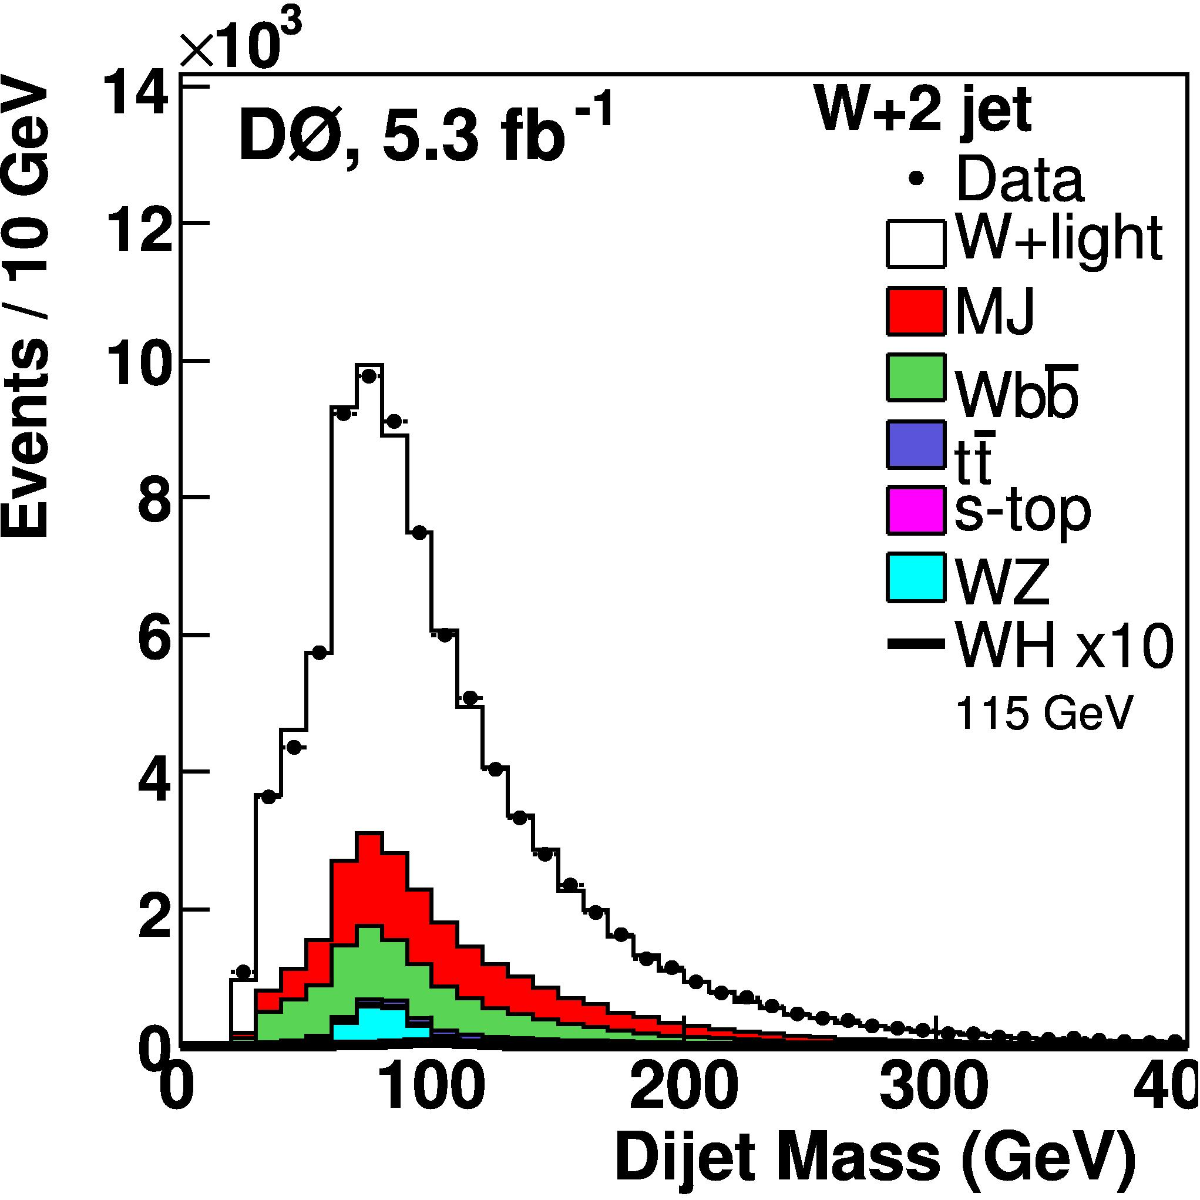
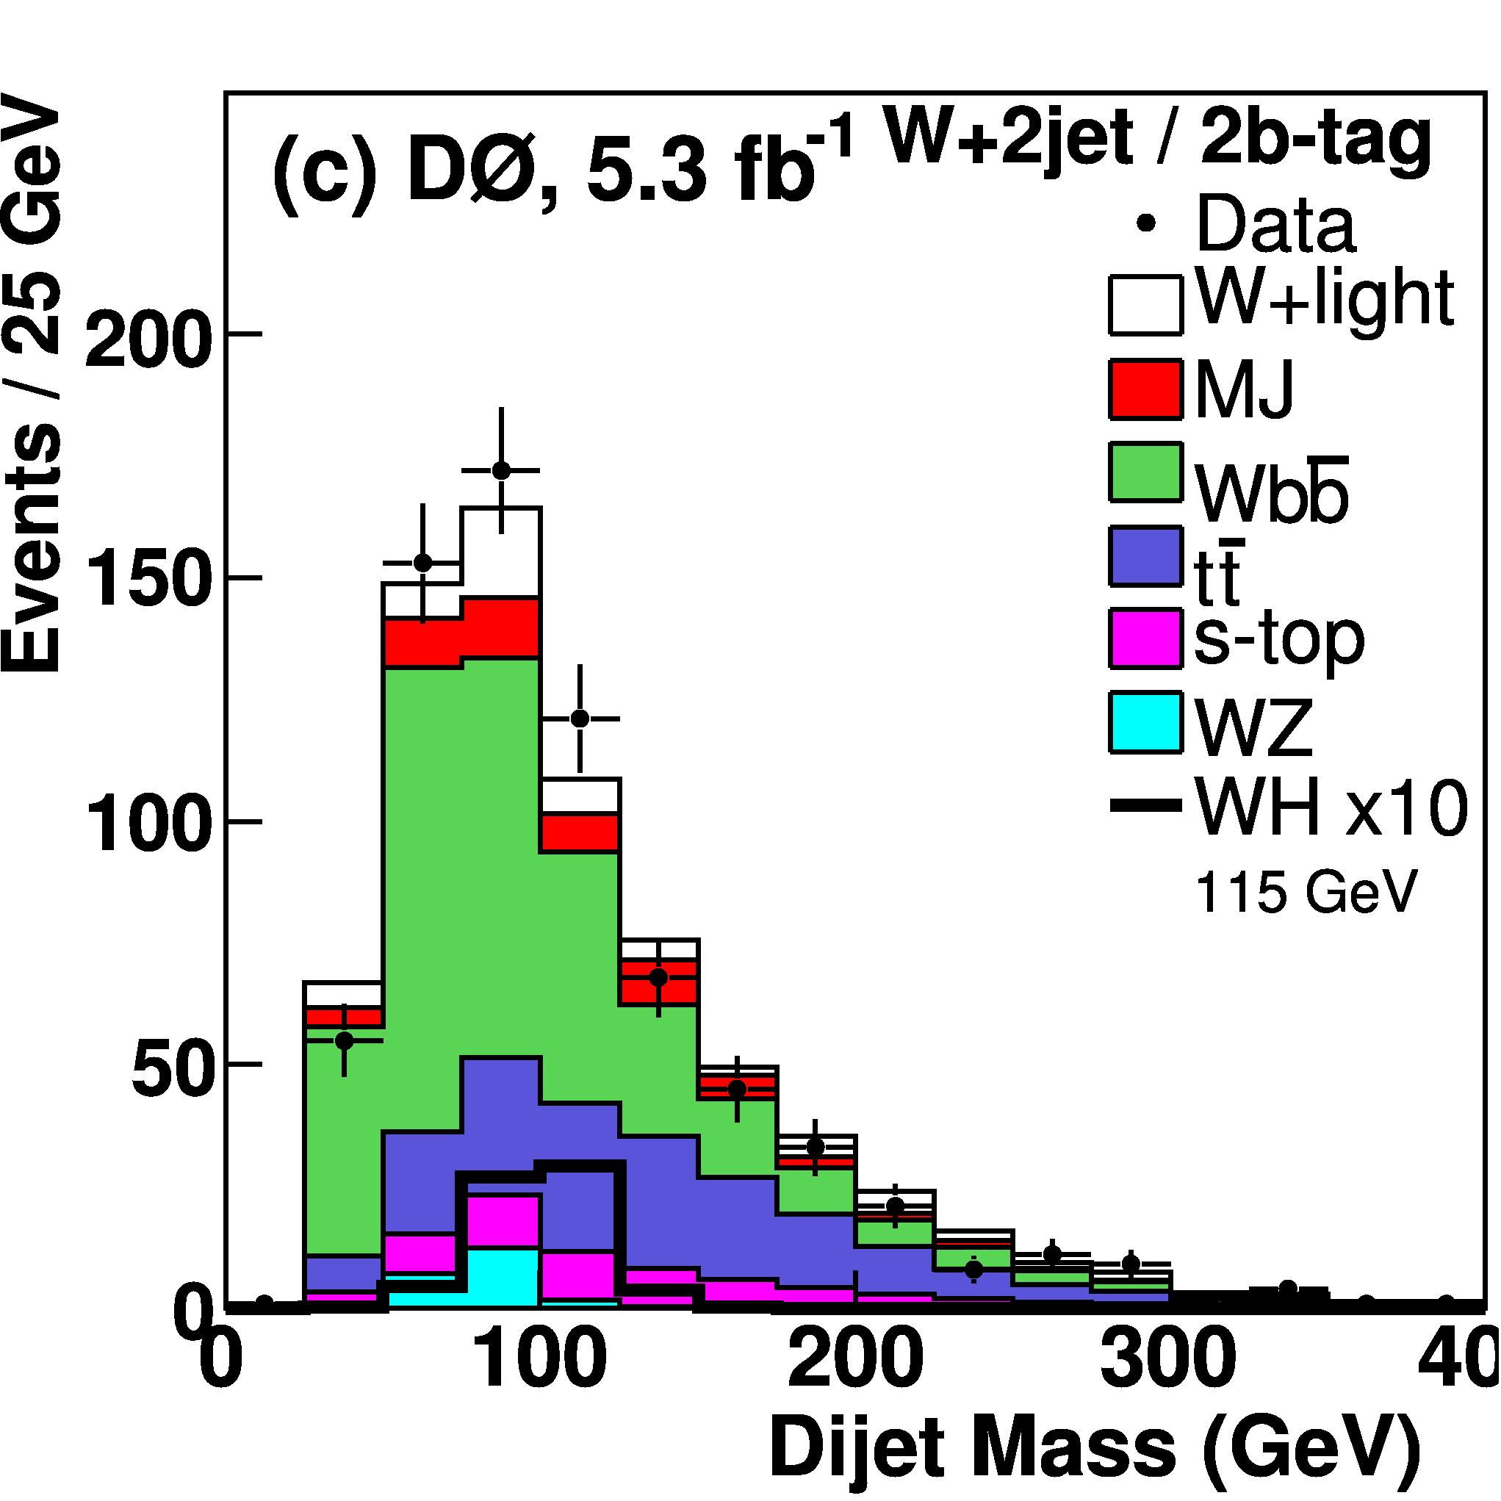
Object Selection: b-jet Tagging
Neural Network event classifier
Track impact parameter, jet “lifetime”, decay vertex mass, etc.
 | Efficiency
b-jets | 50%-70%
light jets | 0.5%-4.5%
S/B: 1/3500
S/B: 1/100

Slide 14
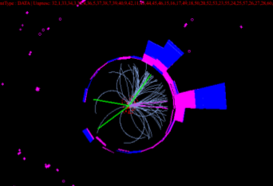
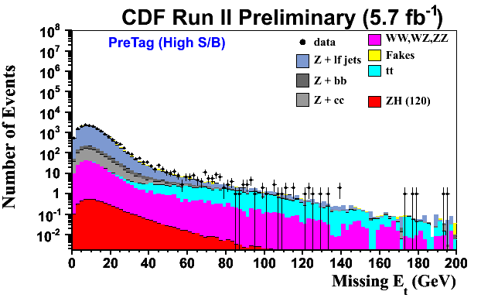
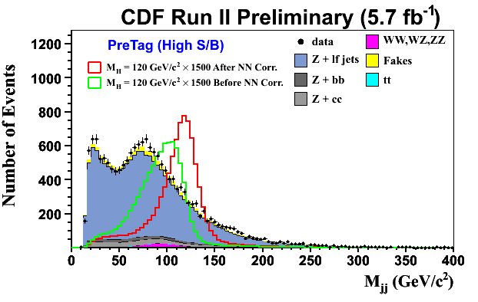
ZH → ℓ⁺ℓ⁻bb Channel: Improving Mass Resolution
Clean signature
Two high p_{T} leptons plus b jets
Missing E_{T} is mainly due to instrumental effects/mis-measured jets
Can constrain event kinematics in transverse plane to improve on jet energy measurement
CDF Run 229879 Event 3787664

Slide 15
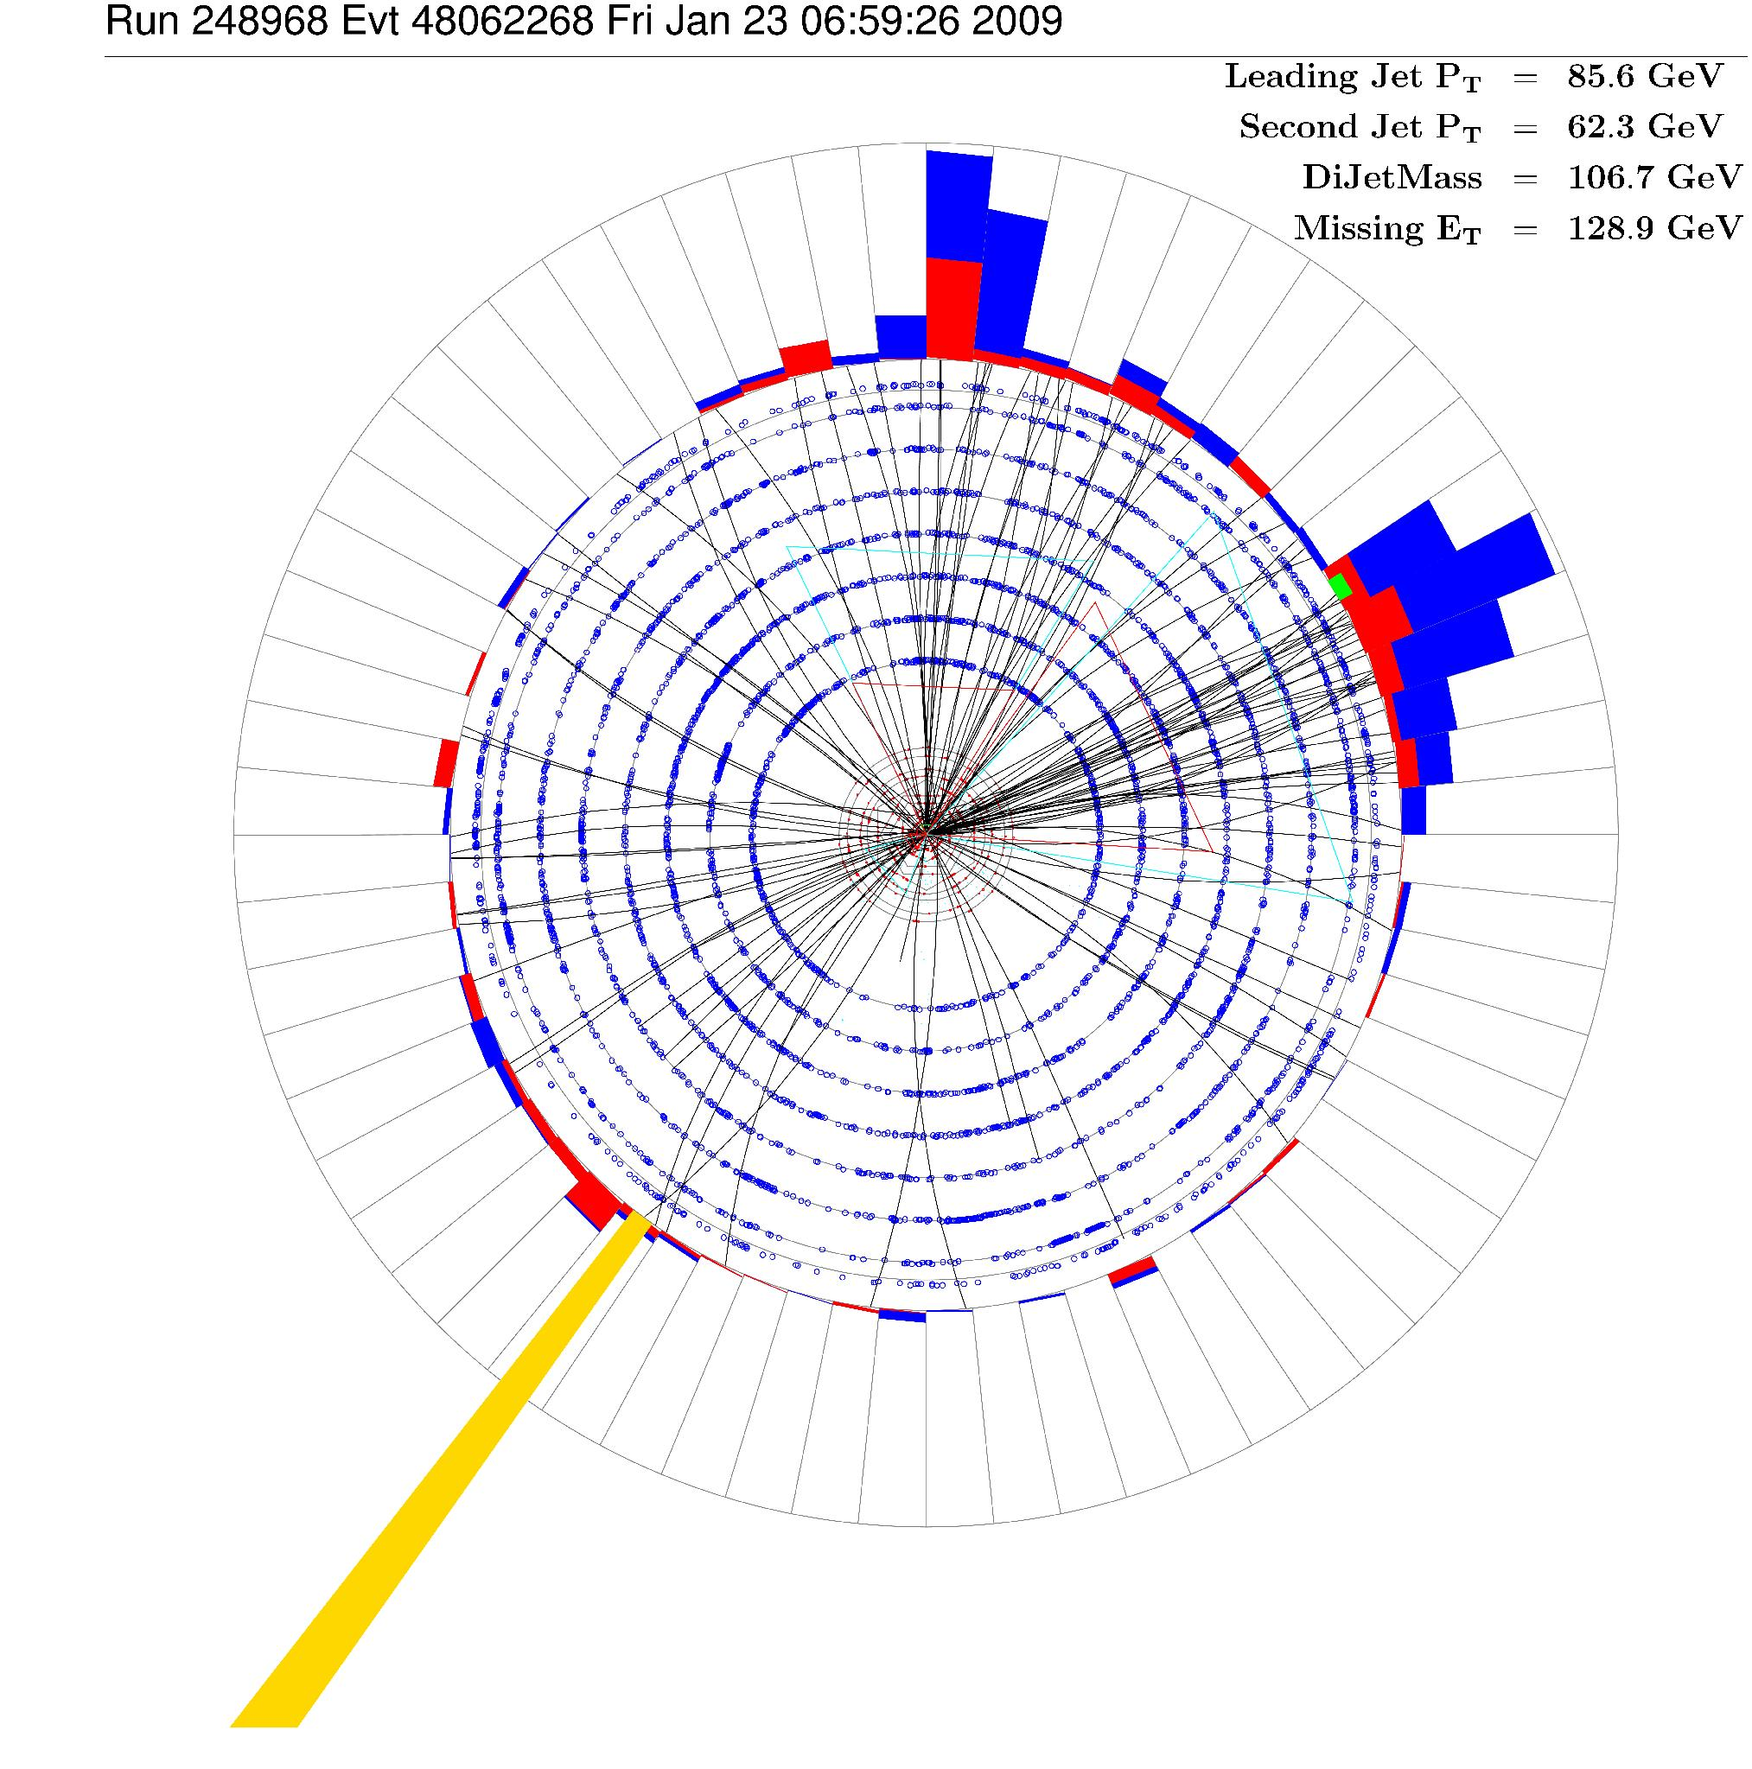
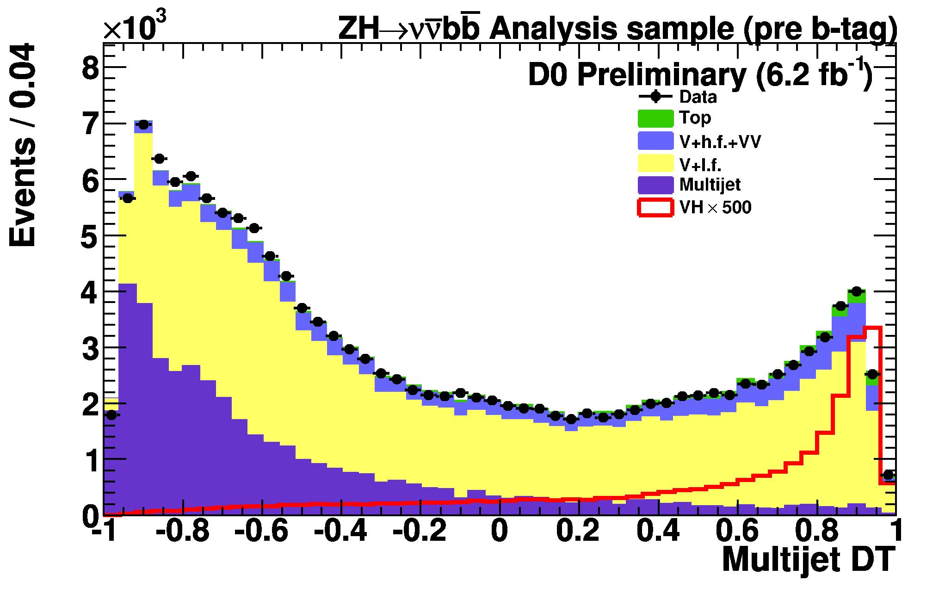
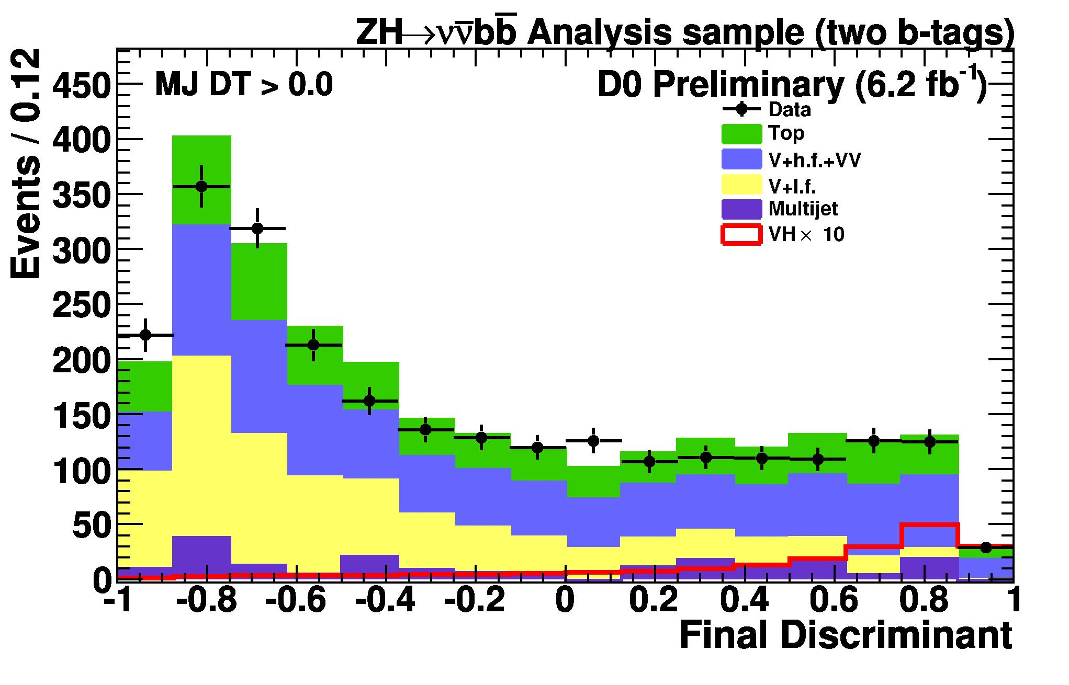
ZH → ννbb Channel
ZH→ννbb, WH→ℓνbb (ℓ not detected)
Signature: Missing E_{T} and b jets
Bkgd: instrumental/QCD multi-jet, W/Z+(b-)jets, top, di-boson
QCD bkgd. determined from data
Use missing p_{T} built from tracks to define control regions
Jet
Jet
E_{T}
p_{T}^{TRK}

Slide 16
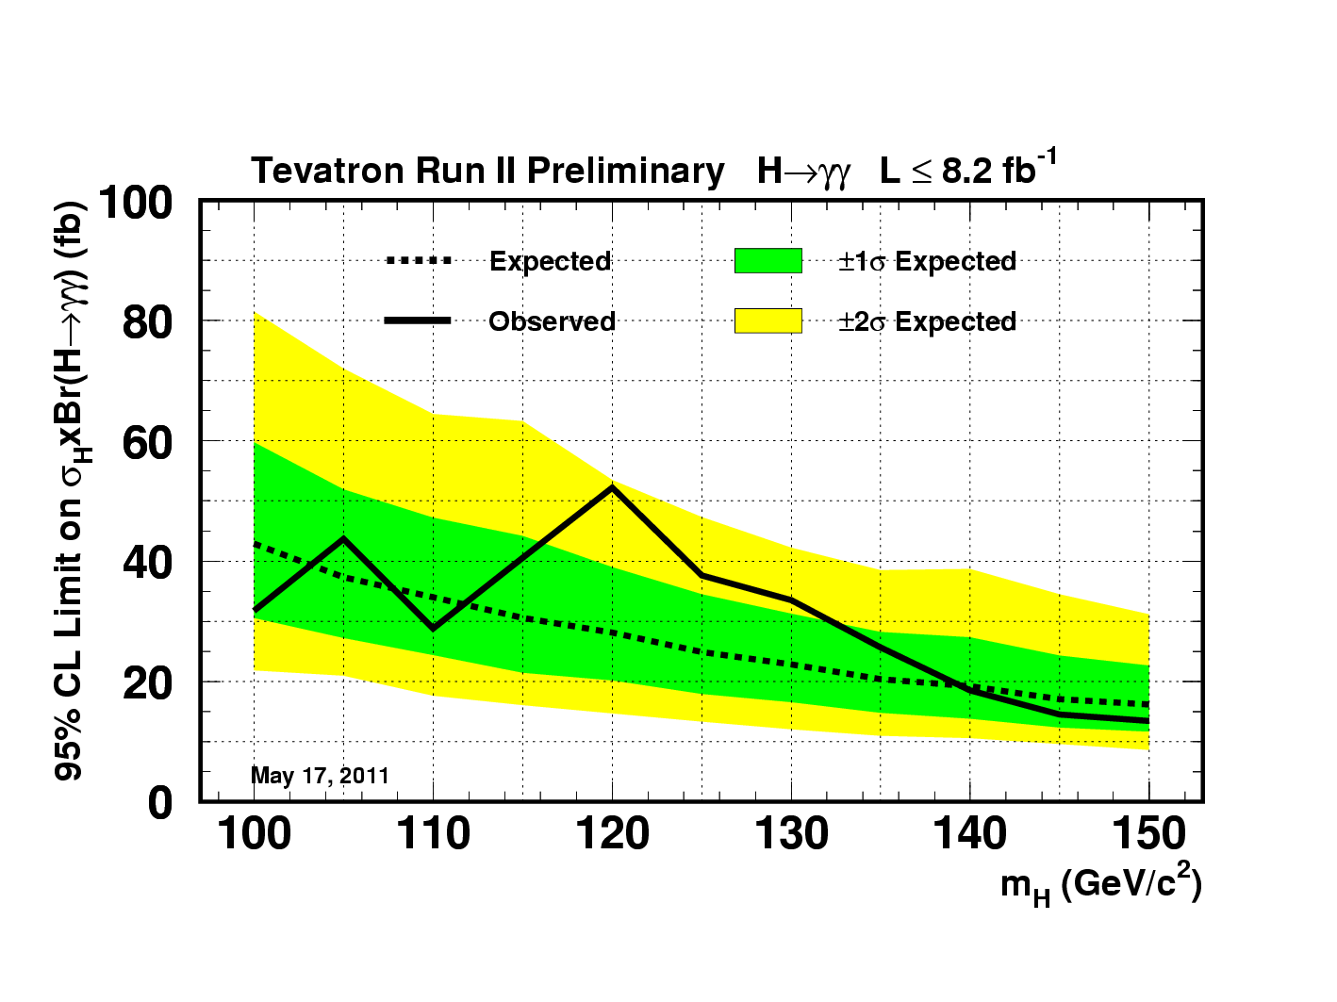
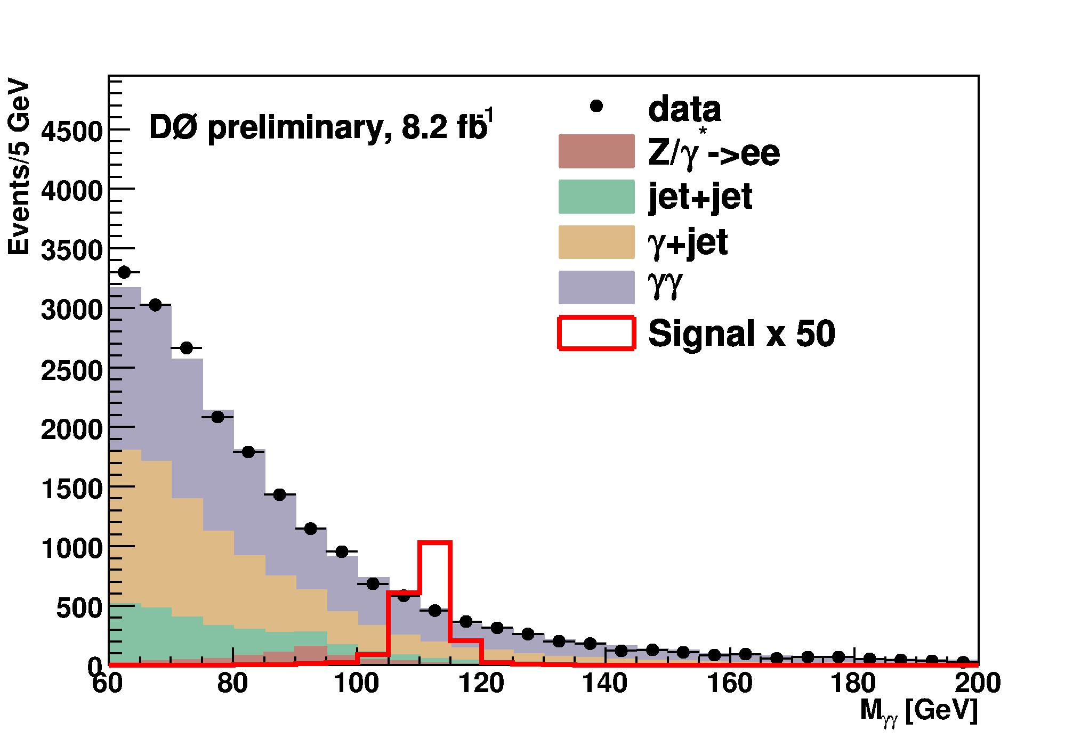
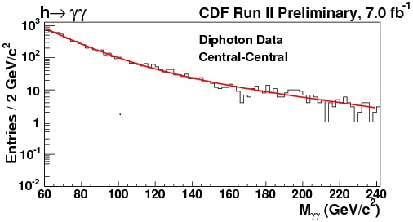
H → γγ
Neural Network based photon identification
Look for excess in di-photon mass spectrum
Limits at m_{H} = 115 GeV
Observed: 12×σ_{SM}
Expected: 9.2×σ_{SM}
Result is re-interpreted to set stringent limit on fermiophobic Higgs

Slide 17
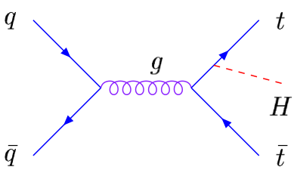
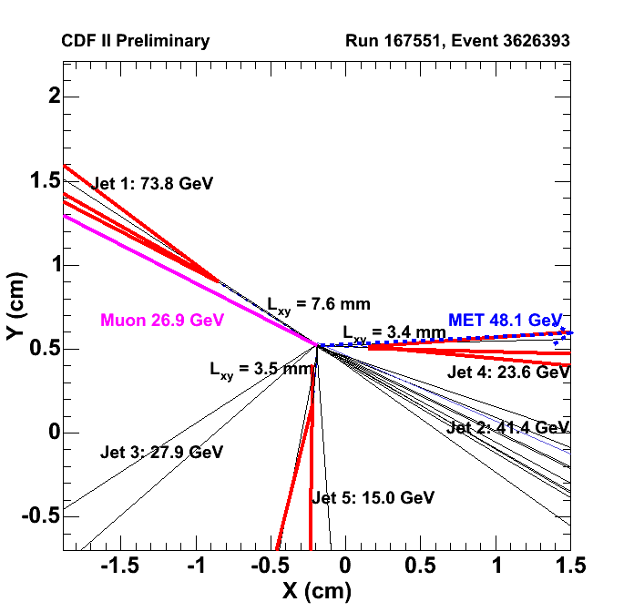
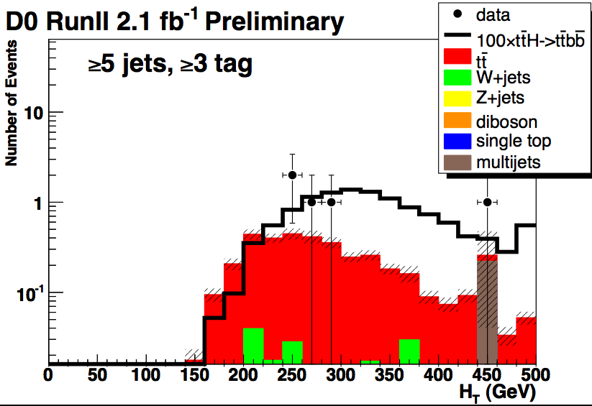
A Word of Encouragement for LHC
ttH → ℓνbbbbqq
1 lepton + MET + ≥5 jets
Treat number of b-tags separately
Employ jets scalar sum (H_{T}) discriminant to extract signal
CDF
Limits at m_{H} = 115 GeV
Observ.: 64×σ_{SM}, Expect.: 45×σ_{SM}

Slide 18
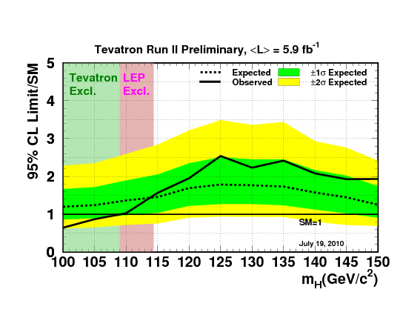
DØ and CDF Combine Limits: Low Mass Region
Exclude m_{H} < 109 GeV
Limits at m_{H} = 115 GeV
Observed: 1.56×σ_{SM}
Expected: 1.45×σ_{SM}
*Does not include the latest results

Slide 19
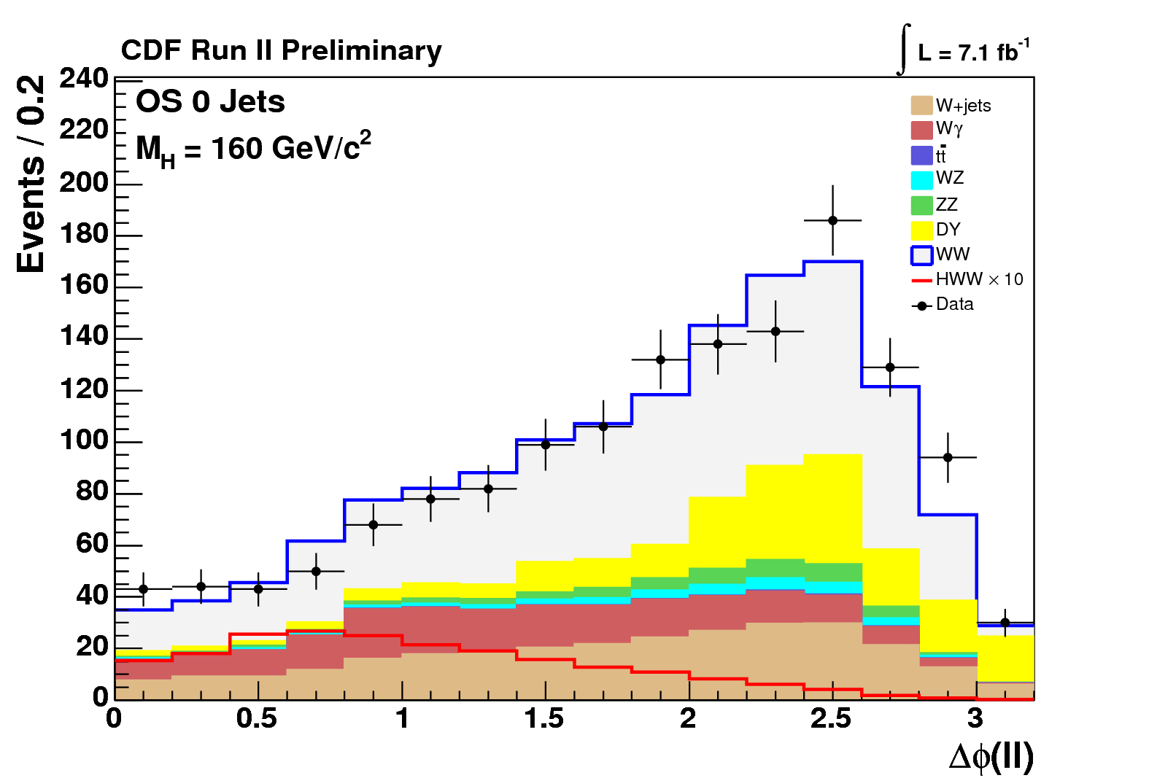
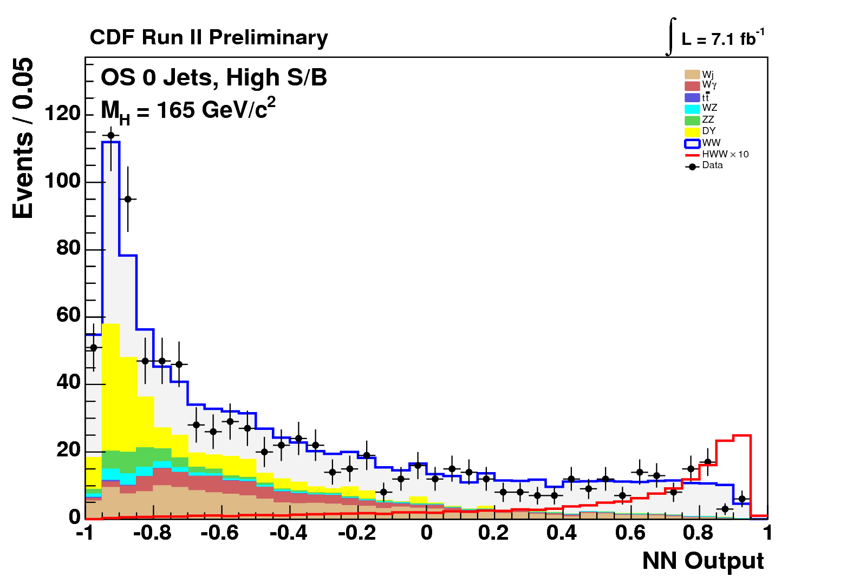
H → WW* → ℓνℓν Channel
Analyze all production mechanisms, subdivide into jet multiplicity bins
Higgs mass reconstruction not possible due to two neutrinos
Employ spin correlations to suppress the background
Leptons from Higgs tend to be collinear
ν
W⁺
e⁺
ν
W⁻
e⁻

Slide 20
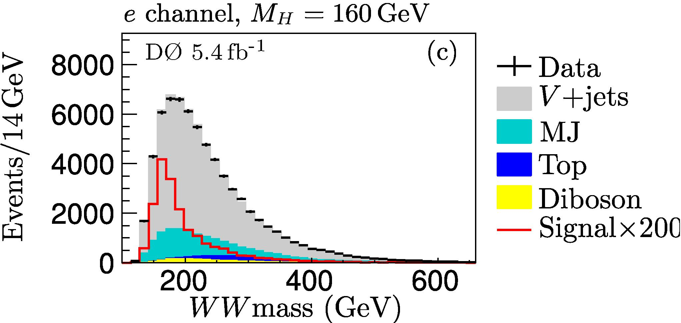
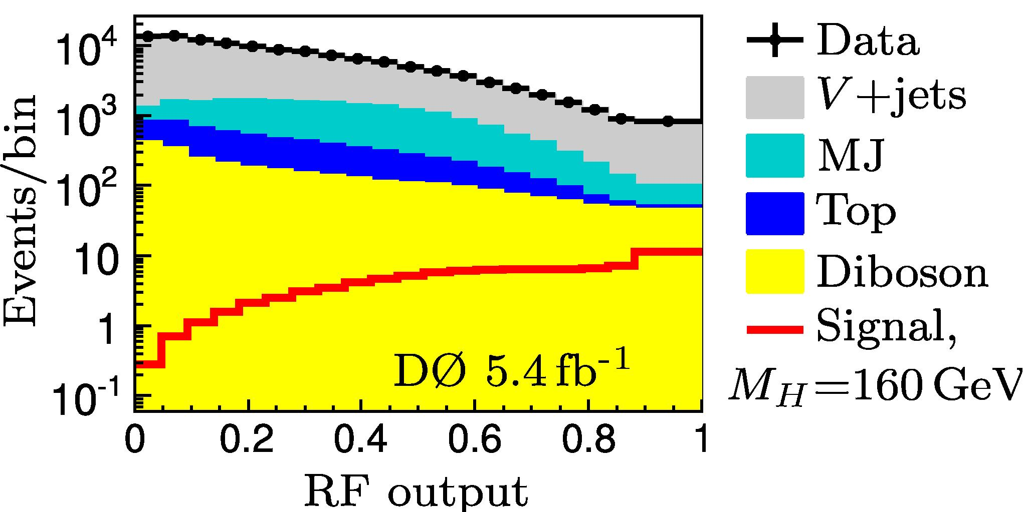
H → WW* → ℓνqq’ Channel
Larger branching fraction. Receives contributions from
WH → ℓνbb/qq, H → ZZ → ℓ(ℓ)qq, H → WW → τνqq’
Larger background compared to pure leptonic mode
Neutrino momentum in W → ℓν decay inferred from missing E_{T}
Limits at m_{H} = 160 GeV
Observed: 3.9×σ_{SM}
Expected: 5.0×σ_{SM}

Slide 21
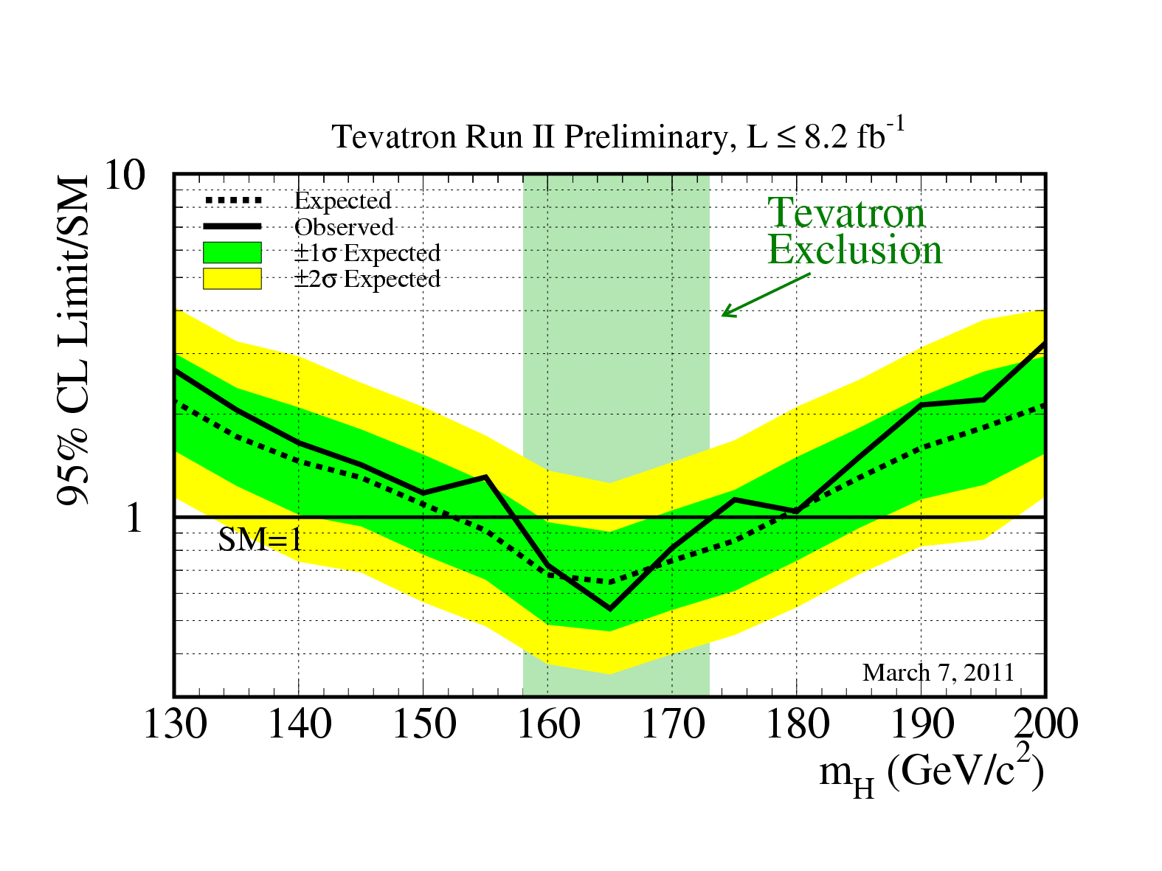
Combined Limits: High Mass Region
Exclude 158 GeV < m_{H} < 173 GeV

Slide 22
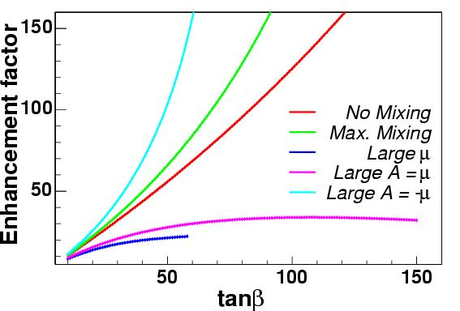
Searches for SUSY Higgs Bosons
In MSSM have two Higgs doublet fields
H_{u} (H_{d}) couple to up- (down-) type fermions
The ratio of their vacuum expectation values: tanβ = <H_{u}>/<H_{d}>
5 Higgs particles after EWSB
h, H, A, H⁺, H⁻
At large tanβ, coupling to down-type quarks, i.e. b’s, is enhanced wrt SM
At tree level the production cross section rise as tanβ²
Modified by other SUSY parameters:
Δ_{b} – function of X_{t}=A_{t}-μcotβ, μ, M_{g}, M_{q}, etc.

Slide 23
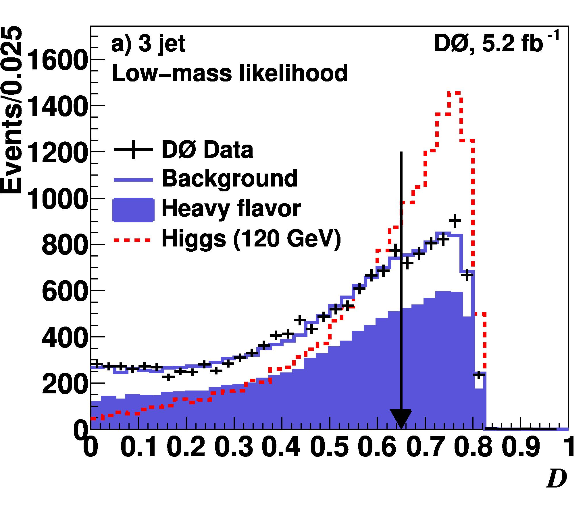
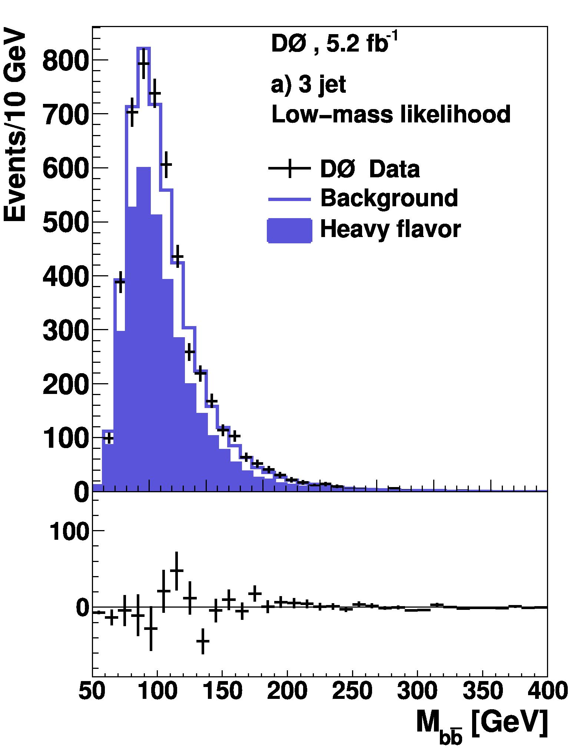
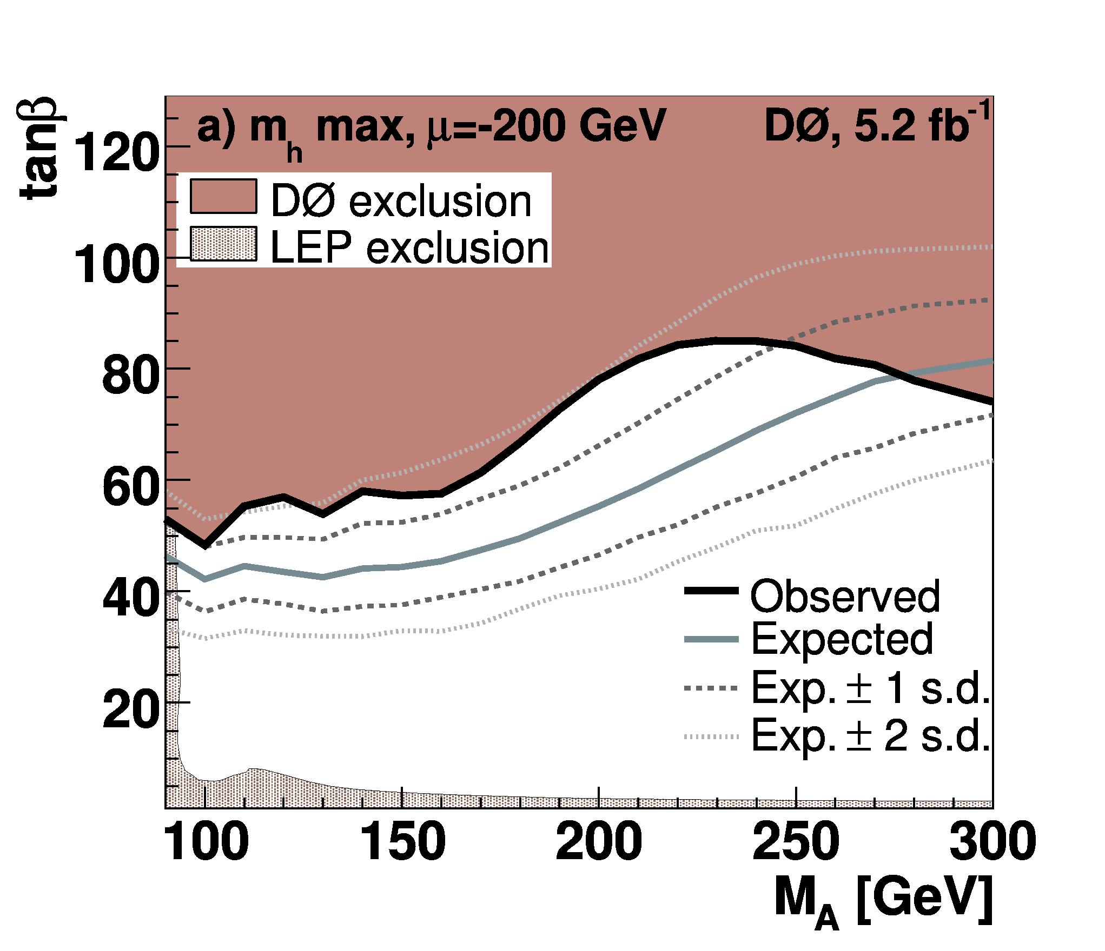
MSSM Higgs: Associated Production with b quarks
bh/bbh(→bb) → ≥3 jets in final states
Require ≥ 3 b-tagged jets
Bkgd. evaluated from MC and data
Build a likelihood discriminant based on signal/bkgd. event kinematics

Slide 24
Summary
Tevatron, CDF and DØ are performing very well
Many improvements to the analysis techniques have been made recently
Higgs searches at the Tevatron has entered an exciting phase
The SM Higgs of 158 GeV < m_{H} < 173 GeV mass is excluded
Significantly impacts the global fit of various model parameters
Complements LHC’s reach in a very interesting mass region

Slide 25
A Final Word
First “Higgs events observed” in CMS and ATLAS
Kibble Guralnik Hagen Englert Brout
Let’s have all these gentlemen at CDF and DØ before the Tevatron shutdown
25
Notes:
25
25

Slide 26
Backups

Slide 27
Summary
Tevatron, CDF and DØ are performing very well
Many improvements to the analysis techniques have been made recently
Higgs searches at the Tevatron has entered an exciting phase
The SM Higgs of 158 GeV < m_{H} < 173 GeV mass is excluded
Significantly impacts the global fit of various model parameters
Complements LHC’s reach in a very interesting mass region

Slide 28
Recent Improvements
Better trigger algorithms
b-tagging: ~60% efficiency at ~1% mis-tagging rate
Di-jet mass resolution (CDF)
Combine calorimeter and tracking information
NN based jet energy corrections
Recover the acceptance losses
Precise measurements of the bkgd. and reference (low x-section) processes
W/Z+jets, W/Z+b-jets, ZZ→ℓℓ/ννℓℓ, single top, WW/WZ→ℓν+jets
Tuning of the corresponding MC event generators
Extensive use of multivariate analysis techniques (NN, ME, DT, …)

Slide 29
Data make us smarter

Slide 30
The upgraded DØ detector in Run II
Upgraded
Muon system, cal. electronics
DAQ, (track) trigger system
Displaced-vtx trigger
New (tracking in B-field)
Silicon detector
Fiber tracker
Tracker
Solenoid Magnet
Have layer 0 at r ~ 1.7 cm installed since summer 2006
protons
antiprotons
3 Layer Muon
System
Electronics
Preshowers

