Slide 1
Introduction of MICE 201 MHz RF Cavity
Derun Li
Lawrence Berkeley National Laboratory
MICE RF Workshop
Fermilab, June 2, 2014

Slide 2
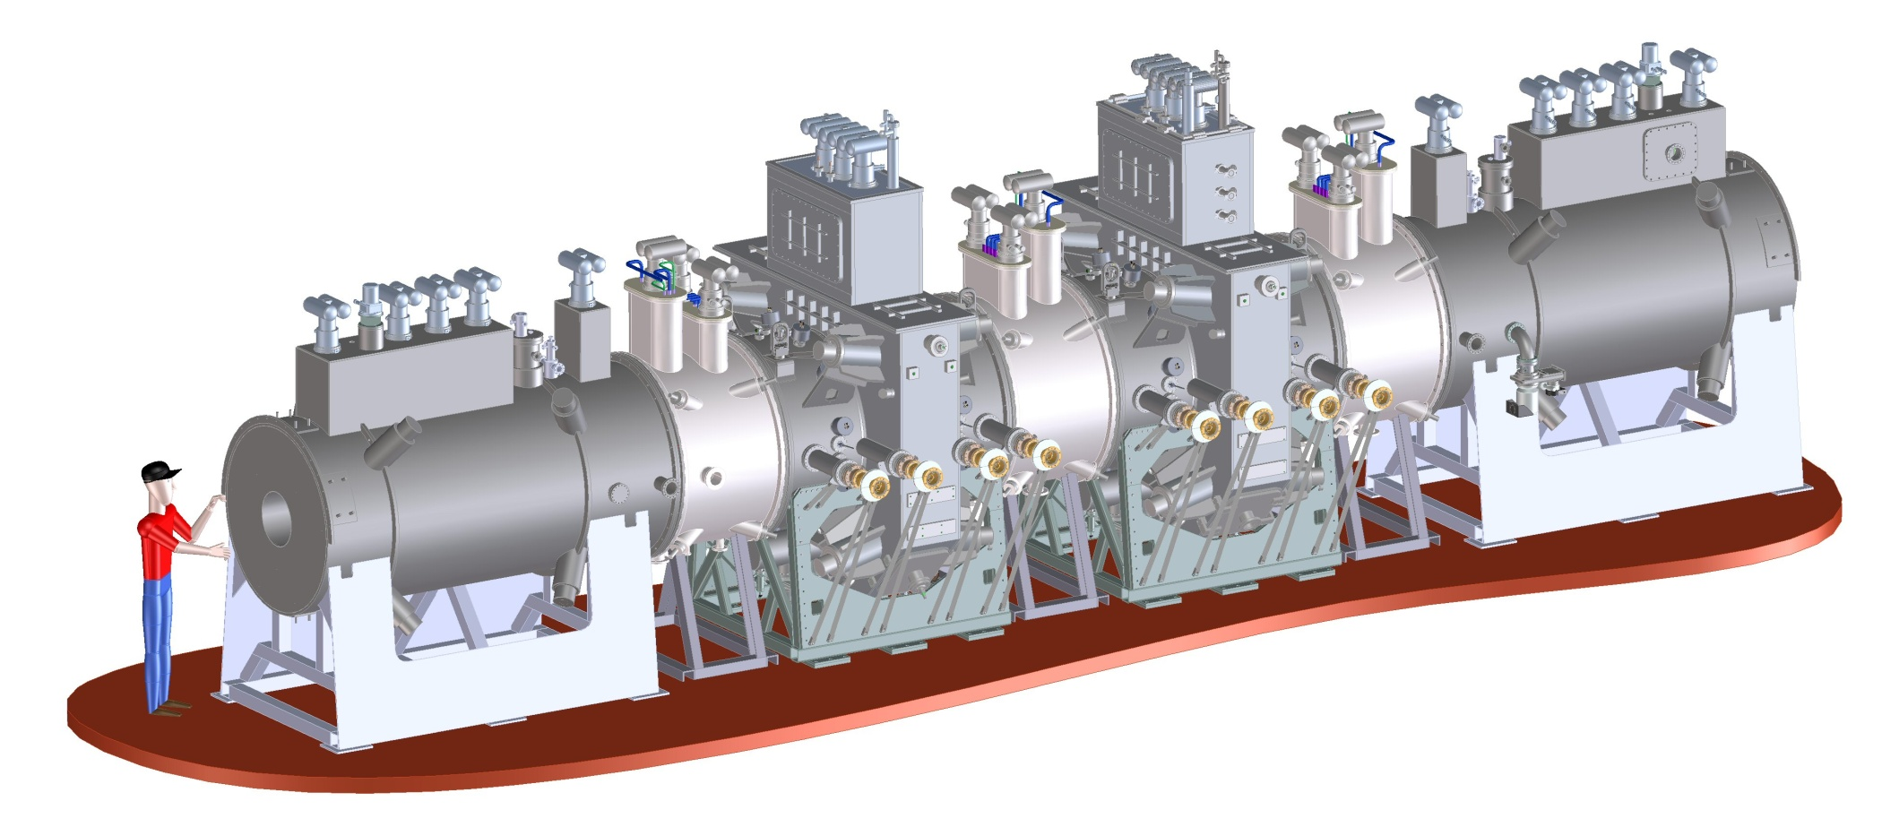
MICE
Our responsibilities in MICE cooling channel:
2 RFCC modules (eight 201-MHz cavities) (Step-6)
2 spectrometer solenoids (delivered)
RFCC
SS
RFCC
SS
International MICE experiment at RAL
Demonstration of muon ionization cooling

Slide 3
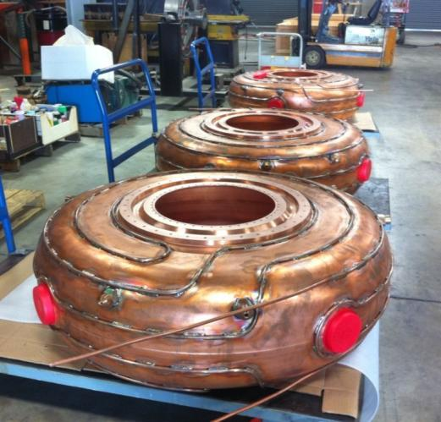
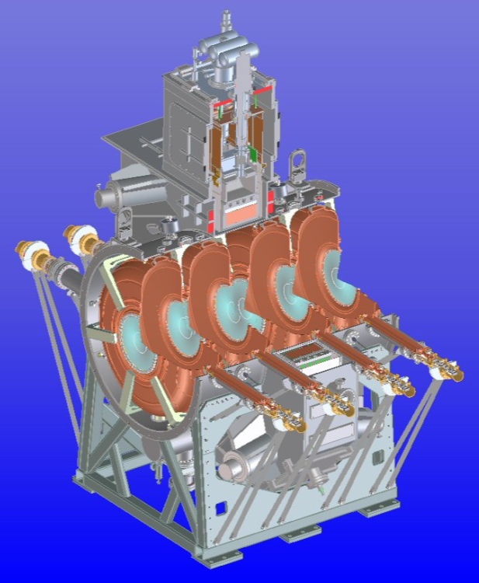
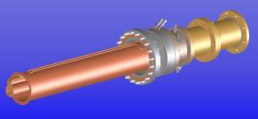
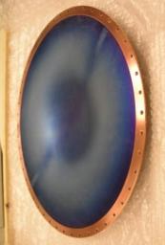
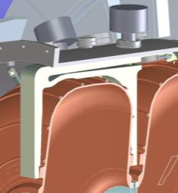
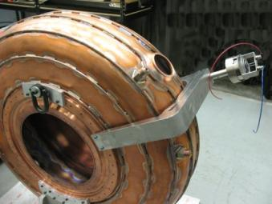
The RFCC Module
Design and fabrication progress
Cavity fabrication
Sectional view
of RFCC module
Coupler
Beryllium window
tuner

Slide 4
RF Design of the Cavity
The cavity design parameters
Frequency: 201.25 MHz
β = 0.87
Shunt impedance (VT²/P): ~ 22 MΩ/m
Quality factor (Q₀): ~ 53,500
Be window diameter and thickness: 42-cm and 0.38-mm
Nominal parameters for MICE and cooling channels in a neutrino factory
8 MV/m (~16 MV/m) peak accelerating field
Peak input RF power: 1 MW (~4.6 MW) per cavity
Average power dissipation per cavity: 1 kW (~8.4 kW)
Average power dissipation per Be window: 12 watts (~100 watts)

Slide 5
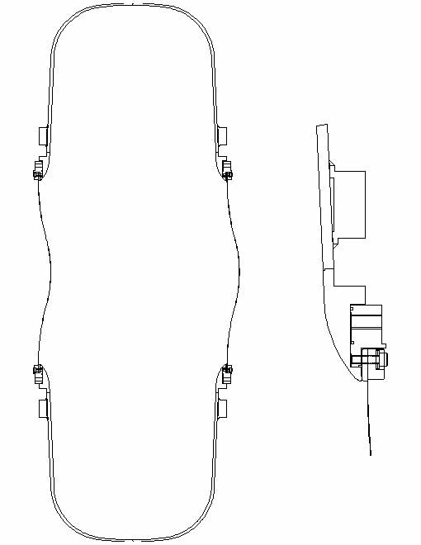
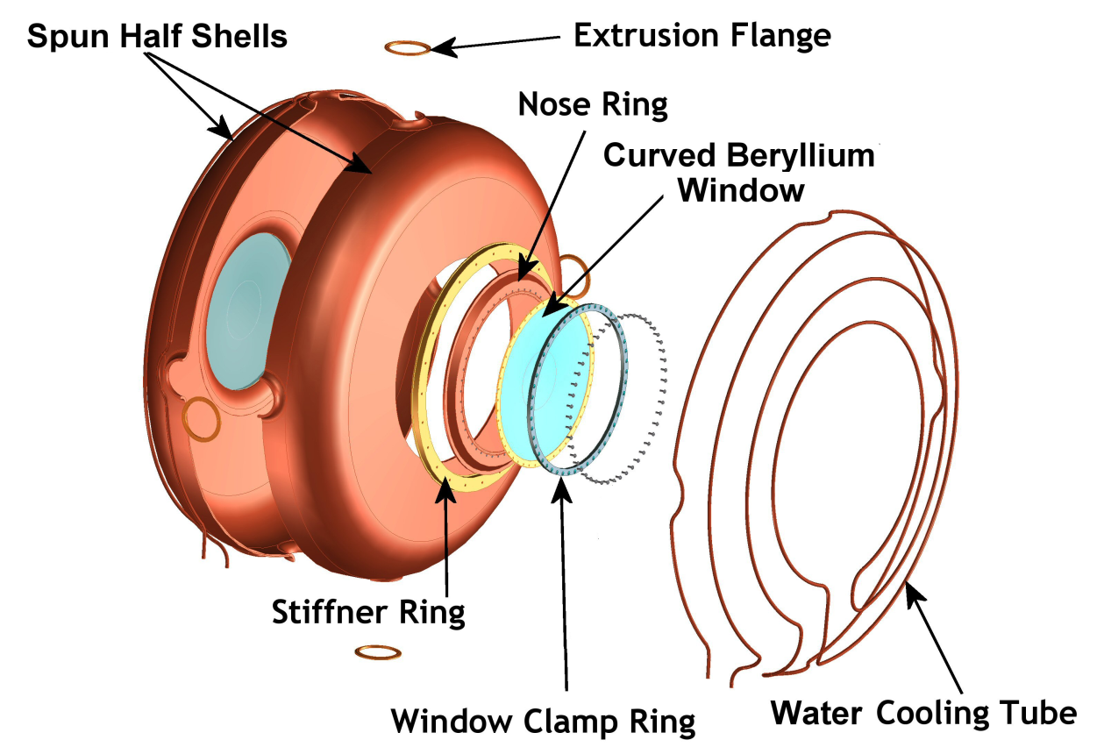
MICE RF Cavity
Cavity has been tested successfully at MTA

Slide 6
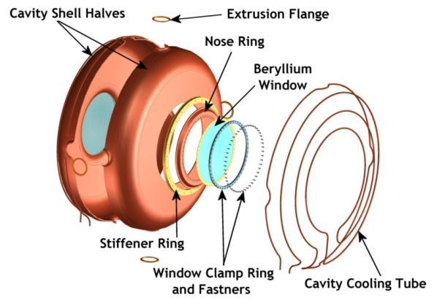
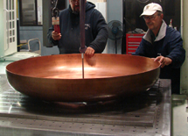
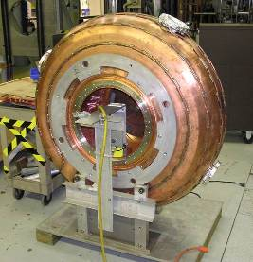
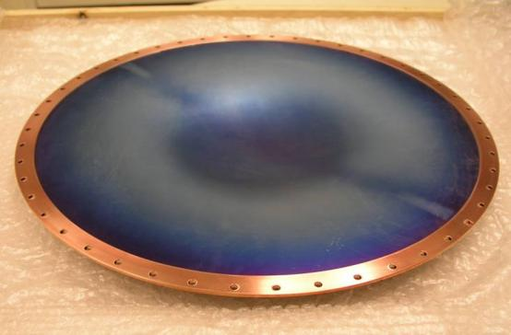
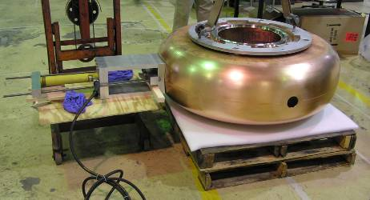
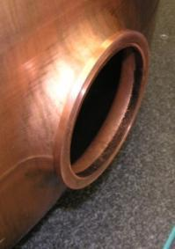
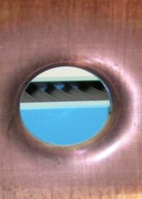
Fabrication Development of Cavity
Cavity fabrication technique development, in collaboration with JLab; First prototype cavity has been high power tested at MTA, Fermilab
42-cm

Slide 7
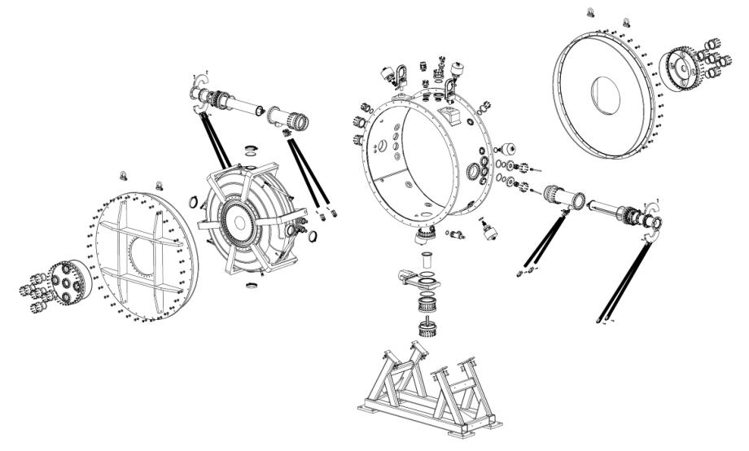
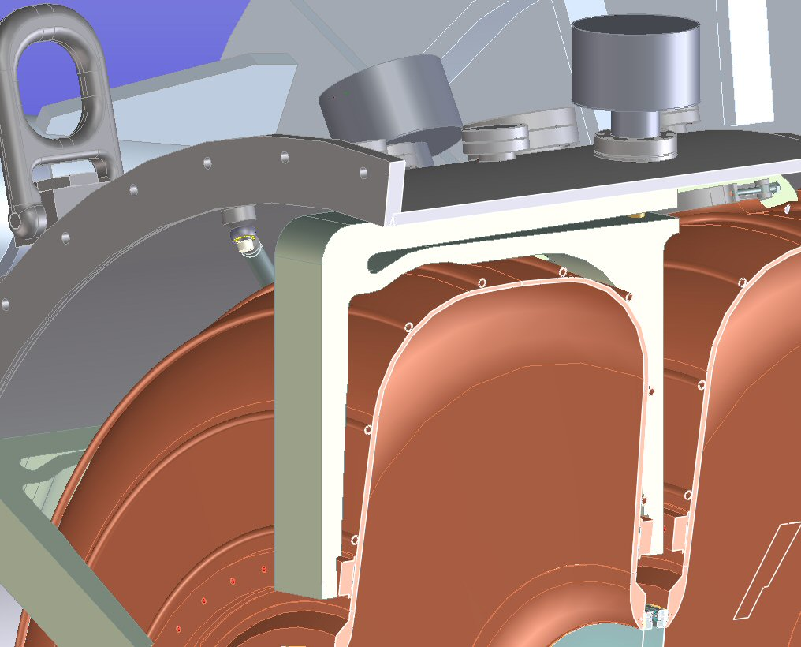
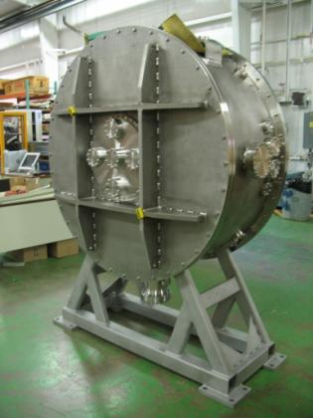
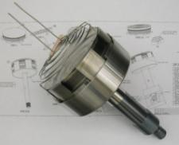
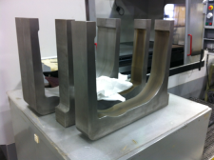
Single Cavity Vessel
Same features RFCC module would have
MuCool CC coil
Tuners &Tuning mechanism
The vessel is made by Keller Technology, and is currently at Fermilab.

Slide 8
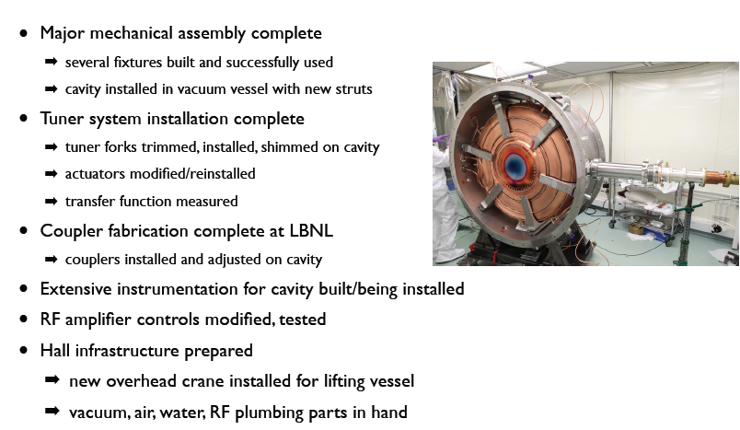
Single Cavity Vessel (cont’d)

Slide 9
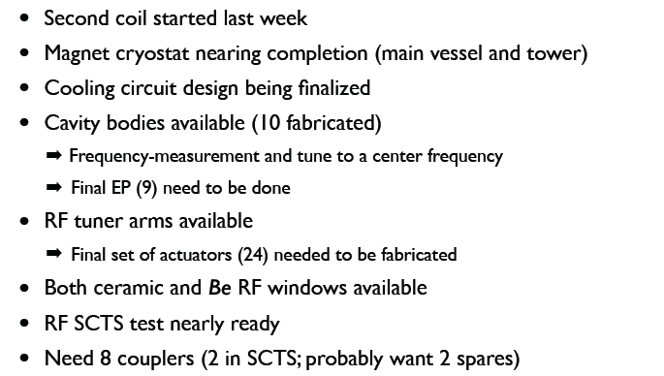
First RFCC Module - Status

