Slide 1
The Fermilab Accelerator Complex: In and Beyond the Oddone Era
Steve Holmes
Pier Oddone Symposium
June 13, 2013

Slide 2
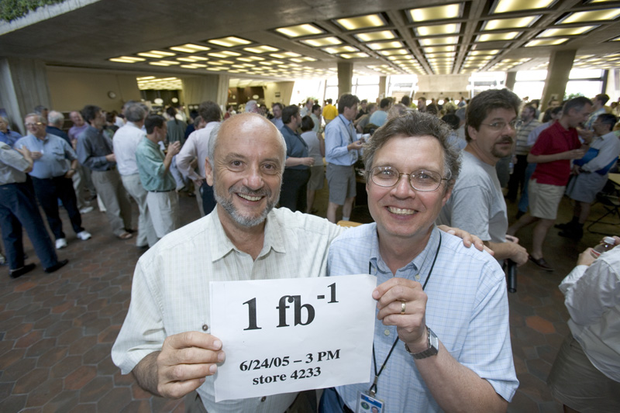
Day -7
Numbers
1
1E32
6E20
0.1E20

Slide 3
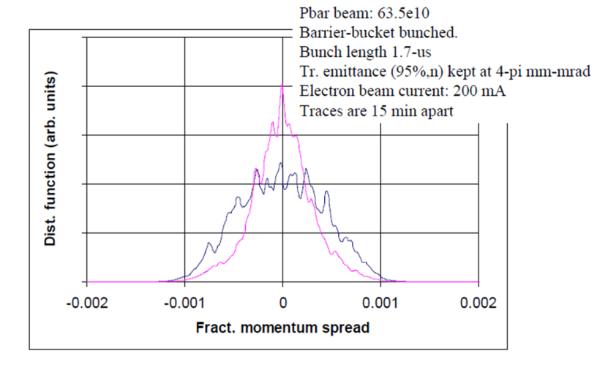
The Oddone Years
Run II
Electron cooling (day 15)
12 fb-1
LHC
LARP, “consolidation”
NuMI
400 kW
MiniBoone
Left-overs
ILC → Project X
SRF, staging
NFMCC + MCTF → MAP
MICE, MTA
Strategies (for uncertain times)…

Slide 4
Day -45
EPP (2010)
“Most critical need: establish world class expertise in SC RF technology in the US: human and physical resources”
RF module assembly and testing
Industrialization
ILC CDR effort
Looks good! Press for early decision
LHC discovery: GO
2005
2006
2007
2008
2009
This induces other
program choices
Not affordable
Nothing yet
Much longer R&D needed

Slide 5
THE PLAN (Evolves)
Steering Group/P5/Plan for Discovery (2007-8)
Established PX/ILC technological synergy, with PX as preferred option if ILC significantly delayed
Linked High Power Proton Source and Long Baseline Neutrino Experiment (LBNE)
(Fermilab) Plan for Discovery (2011)
Update to Fermilab Steering Group Report:
Recognized low probability of ILC in the US Fermilab;
Established LBNE/PX/NF/MC as the on-site accelerator path.
Project X: “You buy it, you name it”

Slide 6
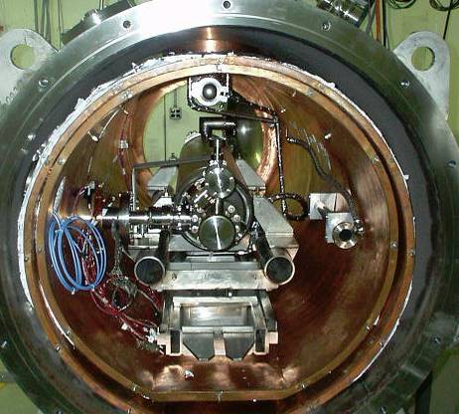
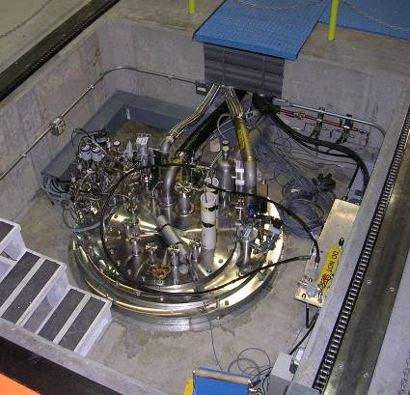
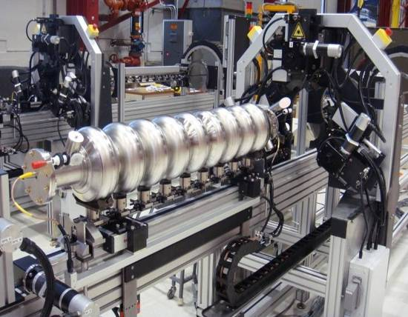
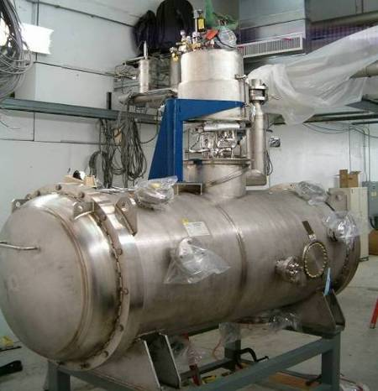
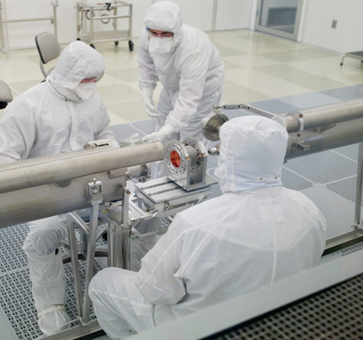
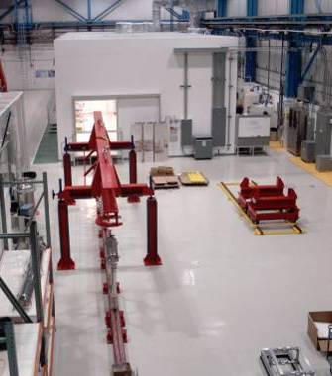
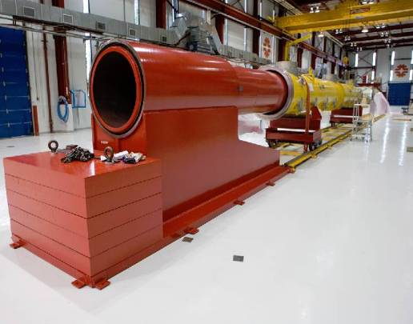
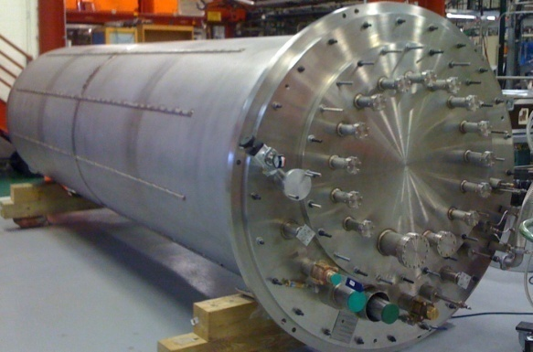
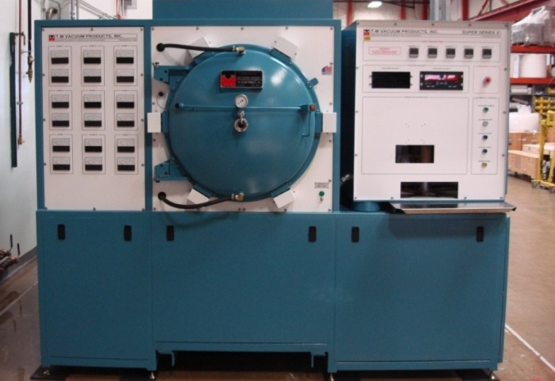
SRF infrastructure at Fermilab

Slide 7
Fermilab Accelerator Strategy (Today)
NuMI (120 GeV):
350 kW
Booster (8GeV): 35 kW
NuMI/LBNE (120 GeV)
700 kW
Booster (8GeV): 80 kW
Project-X:
>2MW @ 120 GeV
3MW @ 3 GeV
1 MW @ 1 GeV
150 kW @ 8 GeV
Neutrino Factory
To build upon our existing strengths to establish a world-leading program at the Intensity Frontier, enabled by a world-class facility
…and use this program to provide a cornerstone for an Energy Frontier facility beyond LHC
LHC
Tevatron
LHC Upgrades in
luminosity and energy
Lepton Colliders
Technology Development and Fundamental Accelerator Science
…while relying on a strong program of technology development and fundamental accelerator science.

Slide 8
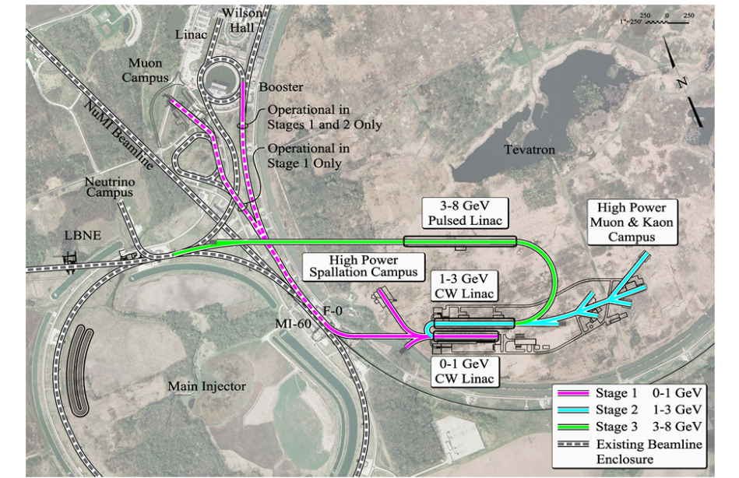
Day 2905
Numbers
12 fb-1
4E32 cm-2sec-1
20E20 protons to MiniBoone
16E20 protons to NuMI
Future: Accelerator Based Particle Physics (in the US)
NuMI/LBNE/BNB
Muon Campus
ORKA
Project X
Superconducting rf
Superconducting magnets
IARC
ASTA/IOTA
νSTORM/Neutrino Factory/Muon Collider

