Slide 1
Measuring Light Guide Performance in Liquid Argon
Jarrett Moon
Massachusetts Institute of Technology
FNAL New Perspectives – 6/9/15

Slide 2
Outline
Liquid argon scintillation
Measuring attenuation
Attenuation results
Using air to predict argon behavior
Adding Xenon
Conclusions

Slide 3
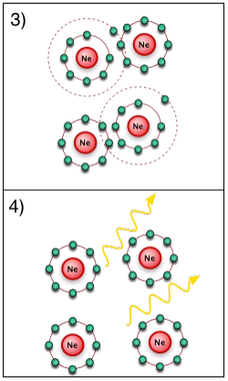
Liquid Argon Scintillation
Scintillation light is produced in LAr via the following reaction
Ionized Argon atoms can form metastable molecules which then decay producing 128 nm light
There is a fast (7 ns) and slow (1.6μs) component

Slide 4
Outline
Liquid argon scintillation
Measuring attenuation
Attenuation results
Using air to predict argon behavior
Adding Xenon
Conclusions

Slide 5
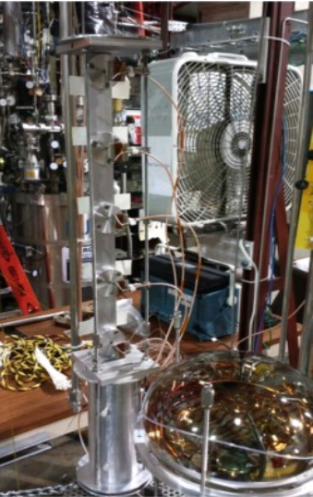
“Tall Bo” Dewar
Measurements were done at the FNAL proton assembly building in a high purity dewar dubbed “Tall Bo”
This setup allowed us to carefully measure and minimize contaminants

Slide 6
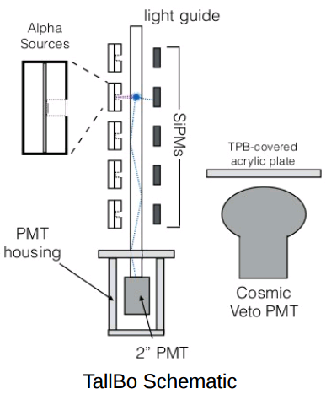
Measuring the Attenuation
We want to measure light output as a function of flash distance
Flashes generated via scintillation produced by 5 Po-210 sources spaced along the bar
5 adjacent SiPMs act as triggers
A PMT reads out the light output
Another PMT is used for cosmic Veto

Slide 7
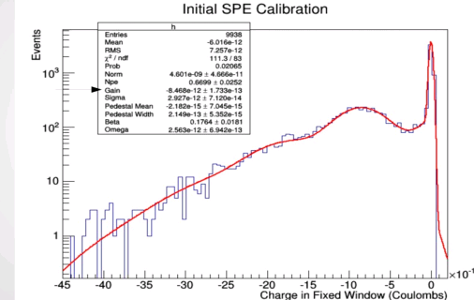
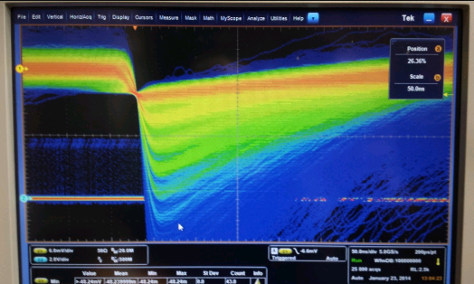
System Calibration
A UV LED was used to calibrate the PMT
The LED was pulsed at low voltage to primarily produce single photoelectron events
Fitting to this PMT data allows us to extract the calibration constants
The SiPMs are easy to calibrate by eye

Slide 8
Outline
Liquid argon scintillation
Measuring attenuation
Attenuation results
Using air to predict argon behavior
Adding Xenon
Conclusions

Slide 9
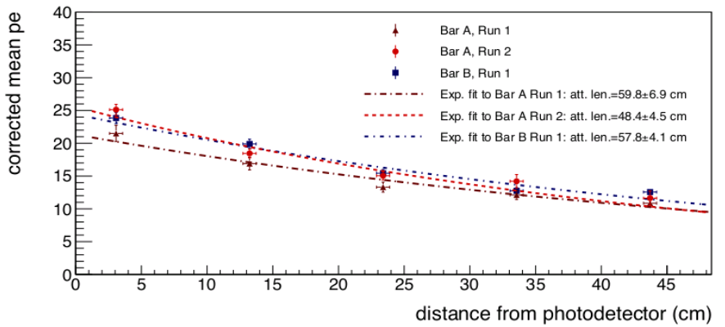
Attenuation Results
We observed an attenuation length of ~50 cm which is a significant improvement over previous light guides

Slide 10
Outline
Liquid argon scintillation
Measuring attenuation
Attenuation results
Using air to predict argon behavior
Adding Xenon
Conclusions

Slide 11
Connecting Air and Argon Results
Testing these bars in liquid argon is time consuming, expensive, and relatively problem prone
Can we create a model which links performance in air to the performance in argon?

Slide 12
Connecting Air and Argon Results
Try a 3 parameter model
Internal reflection which depends on the refractive index of the medium (air vs argon)
Photon loss per reflection
Coating thickness gradient
Simultaneously fit the air data from a bar’s forward and backward runs to extract parameters
Use light loss per bounce to deduce an attenuation curve for liquid argon

Slide 13
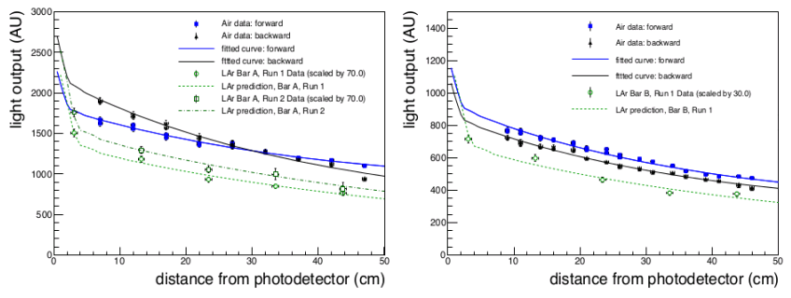
Model Results
The model correctly “post-dicts” the argon attenuation curve we already measured

Slide 14
Outline
Liquid argon scintillation
Measuring attenuation
Attenuation results
Using air to predict argon behavior
Adding Xenon
Conclusions

Slide 15
Adding Xenon
One promising avenue for improvement we plan to pursue this summer is doping the argon with ppm Xenon
Xenon has several key benefits
Its presence shifts the Argon late light to earlier times
It reemits the Argon light at a higher wavelength, which will improve the efficiency of our wavelength shifting coat

Slide 16
Outline
Liquid argon scintillation
Measuring attenuation
Attenuation results
Using air to predict argon behavior
Adding Xenon
Conclusions

Slide 17
Conclusions
Our measurements in air and liquid argon are both great improvements over prior light guides
We can now reliably and consistently produce meter scale guides
R&D is ongoing. We hope to push the attenuation of our guides higher, possibly to several meters

Slide 18
Thank You! Questions?

