Slide 1
Short-Baseline Experiments
Jonathan Link
Center for Neutrino Physics
Virginia Tech
ICFA Neutrino Panel Mini-Workshop
1/30/14

Slide 2
What this Talk Will Not Be…
There was a nice discussion of the current state of short-baseline oscillation data by Pedro Machado at the ICFS European Meeting…
…so I will give only a bare bones summation.
For these of you who were not at the European Meeting, I suspect that you have seen a similar presentation before. I have given similar talks here on there separate occasions:
“Report on the SNAC Workshop,” Pre-High Intensity Workshop, Fermilab (10/24/11)
“Particle Physics Data on Light Sterile Neutrinos,” Future Short Baseline Neutrino Experiments – Needs and Options, Fermilab (3/21/12)
“Report from Recent Studies of Sterile Neutrinos and Short-Baseline Oscillations,” Next Generation Nucleon Decay and Neutrino Detectors, Fermilab (10/4/12)

Slide 3
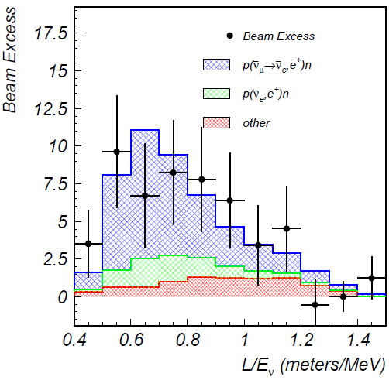
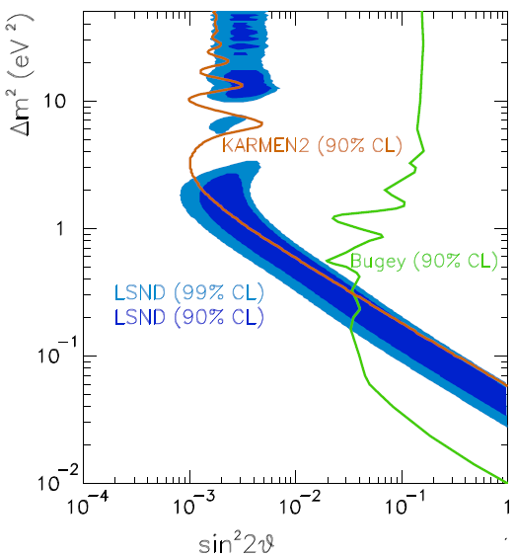
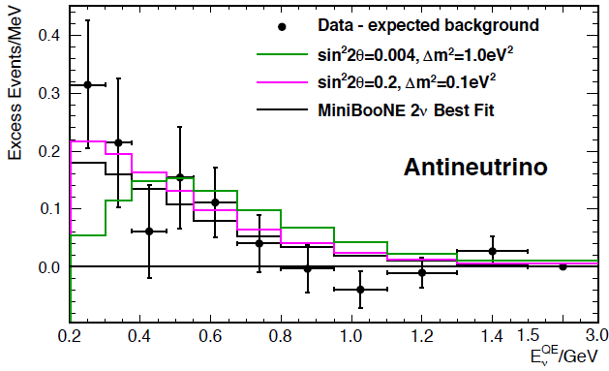
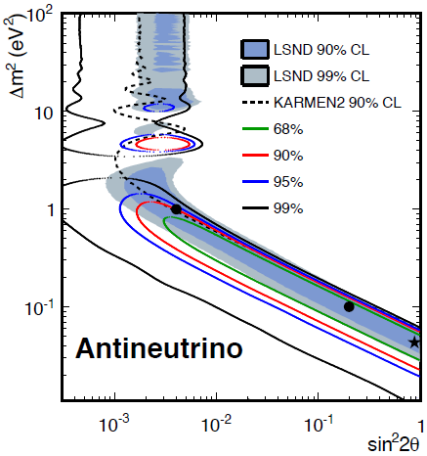
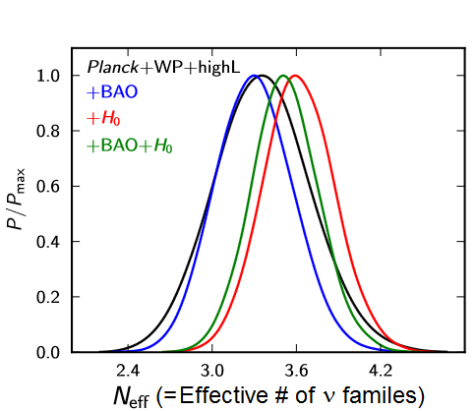
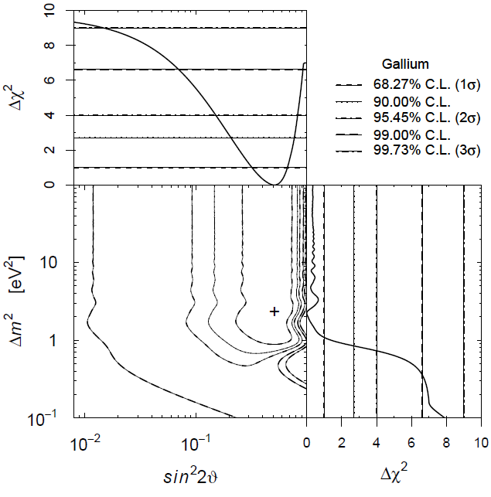
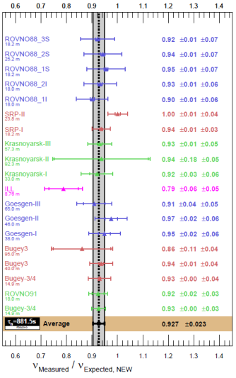
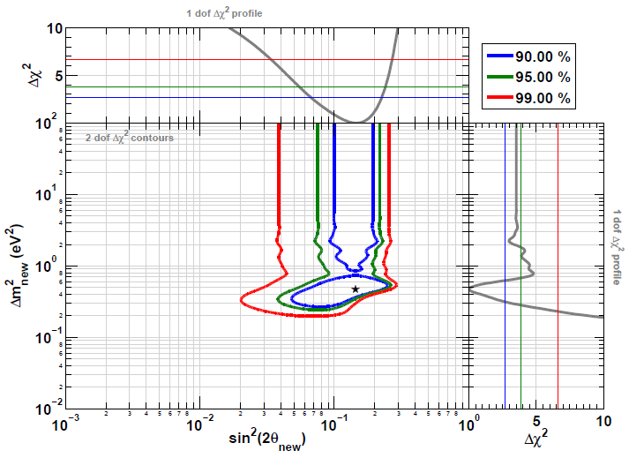
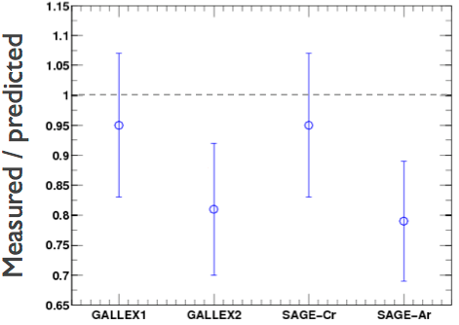
The Evidence for Sterile Neutrinos
LSND (${\overline{ν}}_{μ}→{\overline{ν}}_{e}$)
MiniBooNE (${\overline{ν}}_{μ}→{\overline{ν}}_{e}$)
Cosmology
Ade et al, arXiv:1303.5076 [astro-ph.CO] (2013)
Event Excess:
32.2 ± 9.4 ± 2.3
Event Excess: 78.4 ± 28.5
Aguilar-Arevalo et al., Phys.Rev.D64, 112007 (2001)
Aguilar-Arevalo et al., Phys.Rev.Lett. 110, 161801 (2013)
Gallium Anomaly ($ν_{e} Disappearance$)
Reactor Anomaly (${\overline{ν}}_{e}$ Disappearance)
Giunti and Laveder, Phys.Rev.C83, 065504(2011)
Mention et al., Phys.Rev.D83 073006 (2011)

Slide 4
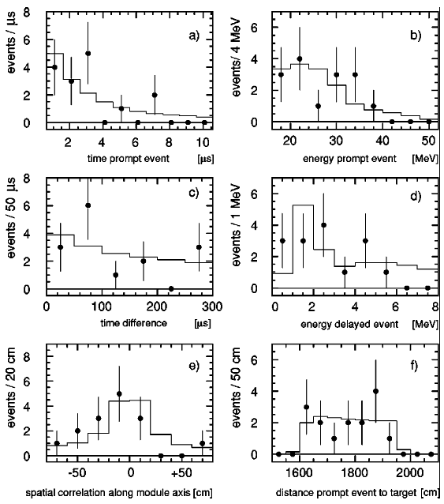
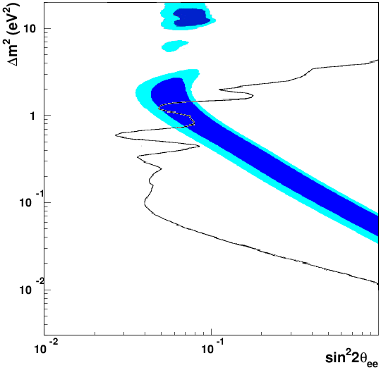
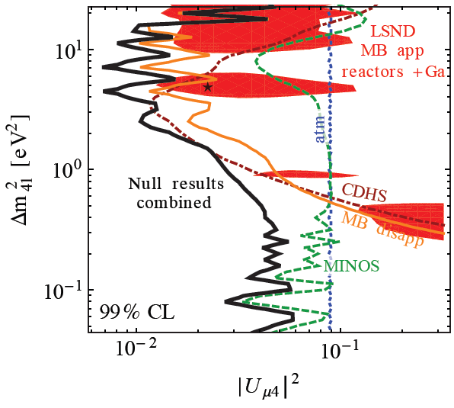
Evidence Against the ~1 eV² Sterile Neutrino
KARMEN (${\overline{ν}}_{μ}→{\overline{ν}}_{e}$)
Bugey Reactor (${\overline{ν}}_{e}$ Disappearance)
KARMEN (90% CL)
Effective
${\overline{ν}}_{μ}→{\overline{ν}}_{e}$ under
certain assumptions
No ${\overline{ν}}_{e}$ Excess
Armbruster et al., Phys.Rev.D65 112001 (2002)
Achkar et al., Nucl.Phys.B434, 503 (1995)
ν_{μ} Disappearance
(where is it?)
For $ν_{μ}→ν_{e}$ to happen there must be both $ν_{e}$ and $ν_{μ}$ disappearance
Kopp et al., JHEP 1305, 050 (2013)

Slide 5
What this Talk Will Be…
From the meeting description:
ICFA has established a Neutrino Panel to promote international cooperation in the development of the accelerator-based neutrino-oscillation program and to promote international collaboration in the development of a neutrino factory as a future intense source of neutrinos for particle physics experiments.
In this context, the Panel, which has a three year mandate, is holding an initial meeting to collect input from the neutrino community in the Americas in order to review the near term prospects of the global accelerator-based neutrino oscillation program (4-7 year time scale), opportunities for future discovery (7-25 year time scale), and the program of measurements and R&D needed to support this program.
The meeting will use as input reports from the recent regional planning processes and focus on the following questions:
Do the conclusions from the various regional studies agree about the accelerator-based-neutrino physics priorities? To what extent are the envisioned future regional accelerator-based neutrino programs in competition and/or complementary with each other?
For each of the programs, what level of inter-regional collaboration is needed for their success, and what are the obstacles that must be overcome to achieve the desired level of collaboration?
How might the ICFA neutrino panel help the community achieve the level of inter-regional collaboration and cooperation desired for the optimization
…this talk will focus on the accelerator-based program.

Slide 6
There is a Vibrant Non-Accelerator Program …that I don’t intend on discussing beyond this slide
It includes:
Reactors – Prospect (US), Stereo (EU), Soliδ (EU), DANNS (Russia)…
Radioactive Source – SOX (⁵¹Cr & ¹⁴⁴Ce-¹⁴⁴Pr), CeLAND (¹⁴⁴Ce-¹⁴⁴Pr)
Atmospheric Neutrinos – IceCUBE (through matter effects)
This quote from a letter to P5 captures the relationship between the accelerator and non-accelerator short-baseline programs:
“Source and reactor experiments will provide timely and cost-effective probes of specific anomalies in the neutrino sector with exceptional discovery potential, while ultimately accelerator-based experiments will be required to fully cover the allowed phase space, and provide a definitive resolution of the sterile neutrino hypothesis. Further, should sterile neutrinos be discovered, accelerator-based experiments will be essential to fully study the sterile sector.”
Signed by nearly 300 members of the neutrino community

Slide 7
Note on Sensitivities
I won’t be showing any sensitivity plots.
They all purport to cover LSND (or some other more relevant anomaly) with significance from 90% CL to 10 σ.
Instead, I will attempt to provide information that you can be used to assess the various proposals chances of achieving their sensitivity claims.
If you really want to see them the collaboration’s self-reported sensitivity plots are included in extra slides at the end of this talk.

Slide 8
Accelerator Technologies and the Projects that Love Them
Pion decay-in-flight
Booster Neutrino Beam (BNB)
MicroBooNE, MiniBooNE+, LAr1, ICARUS at FNAL
NUMI
Minos+
Pion decay-at-rest – OscSNS
Cyclotron Produced Isotopes – IsoDAR
Muon Storage Ring – nuSTORM

Slide 9
Comments on the Booster Neutrino Beam
The Booster Neutrino Beam is the beam that we have…
…but it’s not necessarily the beam we need.
The ν_{e} appearance signal is susceptible to misID
Beam intrinsic backgrounds larger than anticipated signal
Neutrino flux is not understood from first principles
Wrong sign contamination is large, especially in $\overline{ν}$ mode
Near/Far comparisons are not straight-forward cancelations
(Remember, the short-baseline oscillation effect is 35 times smaller than the expected long baseline ν_{e} appearance effect.)
Still, since the beam exists, experiments can be staged there quickly and for relatively less money.
These advantages can not be ignored, but be warned.
Notes:
New detector technologies like LAr and boosted scintillation in MiniBooNE hope to improve the situation, but that is yet to be demonstrated
This is irreducible and the rate is inferred from poorly understood hadron production dynamics in the primary target
Even the primary muon neutrino flux rests on uncertain extrapolations
This is mostly a complication if you are concerned about CP violating effects.
With near and far detectors sampling very different solid angles any cancelation of systematic errors is contingent on your understanding of the primary hadro-production.
As LBNE will also use a superbeam, you may worry that this analysis applies there as well, but…

Slide 10
Pion Decay-in-Flight: Very Near Term Program
The MicroBooNE Experiment is a single 34 ton LAr detector located in the BNB at a baseline of 470 m. It will attempt to understand the MiniBooNE Low-energy excess through a detailed reconstruction of the event vertex.
MINOS+ will improve upon the MINOS total NC disappearance analysis.
Experiments MINOS+ and MicroBooNE are approved and will run over the next several years.
MiniBooNE+ is a proposal to add scintillator to MiniBooNE and thereby improve CC and NC separation with neutron tagging. The oscillation part of this program is narrowly focused on determining the nature of the MiniBooNE low-energy excess.
I don’t expect any of these experiments to provide a definitive resolution of the LSND effect.

Slide 11
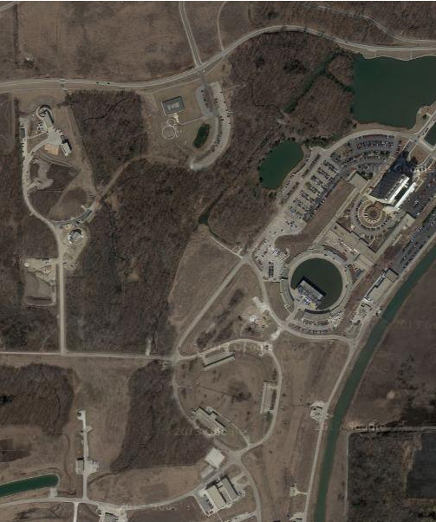
Pion Decay-in-Flight: LAr1
LAr1 is a proposal to add additional LAr detectors in the BNB, starting with a ~40 ton near detector, at 100 m baseline, and later adding a kton-scale detector at 700 m.
As with MicroBooNE, LArTPC pattern recognition is expected to significantly reduce misID backgrounds.
Additional near detector provides an inclusive measure of beam and misID backgrounds, but the cancelation is not perfect.
Additional far detector extends range in L/E and boosts statistics.
LAr1 (700m)
MicroBooNE (470m)
Oscillation Channels & Detection Mechanism
$ν_{μ}→ν_{e} \&$ ${\overline{ν}}_{μ}→{\overline{ν}}_{e}$ $ν_{e}$ CC
$ν_{μ}$ & ${\overline{ν}}_{μ}$ disappearance $ν_{μ}$ CC
Booster
Neutrino
Beam
LAr1-ND (100m)

Slide 12
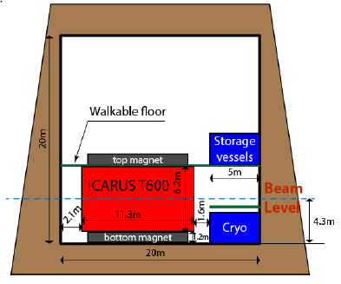
Pion Decay-in-Flight: ICARUS at FNAL
ICARUS at FNAL is a proposal to bring the ICARUS T600 and T150 to Fermilab and install them in the Booster Neutrino Beam as near (150 m) and far (700 m) detectors.
As with MicroBooNE this proposal is motivated in part as LBNE R&D.
Perhaps the most interesting aspect of the proposal is that the T600 volume would be magnetized (1 T), making this the largest test of magnetized LAr.
Additionally:
Significantly increases the active LAr volume
Provides three baselines for LAr in BNB
Magnetic field provides wrong sign rejection,
especially useful in $\overline{ν}$ mode
Oscillation Channels & Detection Mechanism
$ν_{μ}→ν_{e} \&$ ${\overline{ν}}_{μ}→{\overline{ν}}_{e}$ $ν_{e}$ CC
$ν_{μ}$ & ${\overline{ν}}_{μ}$ disappearance $ν_{μ}$ CC

Slide 13
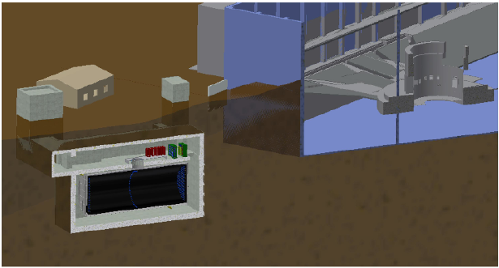
Pion Decay-at-Rest: OscSNS
OscSNS is direct test of LSND using the Spallation Neutron Source as a pion decay-at-rest source.
LSND is the most significant evidence for sterile neutrinos
Neither the beam nor the detector is particularly innovative, but they have the opportunity to fix certain weaknesses of LSND:
Detector located upstream of the target
Possible use of Gd to tag neutrons
Covers a wider range in L/E
Oscillation Channels & Detection Mechanism
${\overline{ν}}_{μ}→{\overline{ν}}_{e}$ Inverse β-decay
$ν_{μ}→ν_{e}$ $ν_{e}$+¹²C→e⁻ (12.5 MeV) +¹²N
$ν_{e}$ disappearance $ν_{e}$+¹²C→e⁻ +¹²N
Golden Mode
60 m
SNS Target
OscSNS Detector

Slide 14
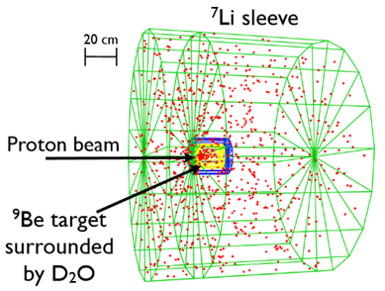
Cyclotron Produced Isotopes: IsoDAR
The IsoDAR proposal uses an intense beam of 60 MeV protons to produce ⁸Li. The ⁸Li decays producing ${\overline{ν}}_{e}$with a β-spectrum.
Neutrinos are detected via inverse β-decay. KamLAND and Watchman are two possible host detectors.
Oscillations observed through a disappearance channel.
The IsoDAR proton beam (or $H_{2}^{+}$beam) comes from a high powered cyclotron, which is an R&D step towards the long-baseline Daedelus proposal.
Oscillation Channels & Detection Mechanism
${\overline{ν}}_{e}$ disappearance Inverse β-decay
Golden Mode

Slide 15
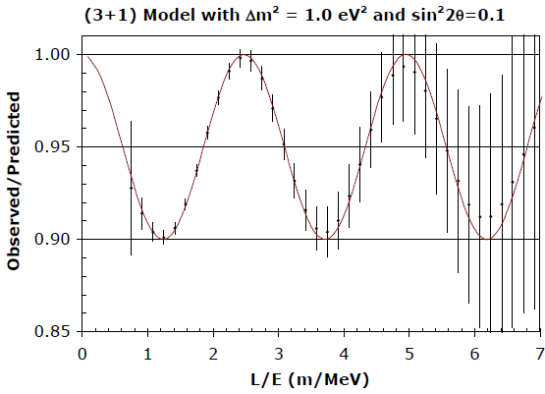
Note on ν_{e} Disappearance Experiments
To paraphrase Duke Ellington,
“It don’t mean a thing if it ain’t got that ring”
As with all reactor and source experiments, the existence of sterile neutrinos can only be convincingly established through oscillometry.
IsoDAR+KamLAND with 5 years of data

Slide 16
Muon Storage Ring: nuSTORM
nuSTORM is a low-energy muon storage ring that produces pure and well-characterized beams of $ν_{μ}$ and ${\overline{ν}}_{e}$, or ${\overline{ν}}_{μ}$ and $ν_{e}$ depending on which sign muons are stored.
In the golden mode $ν_{μ}$ appearance channel, one need only to identify the sign of the outgoing muon to establish oscillations. So a simple magnetized iron detector is envisioned. The magnetized T600 would also be a good detector.
The nuSTORM ring is the next step in neutrino factory R&D and an amazing
facility for a whole host of neutrino scattering experiments
Oscillation Channels & Detection Mechanism
$ν_{e}→ν_{μ} \&$ ${\overline{ν}}_{e}→{\overline{ν}}_{μ}$ $ν_{μ}$CC
$ν_{μ}→ν_{e} \&$ ${\overline{ν}}_{μ}→{\overline{ν}}_{e}$ $ν_{e}$ CC
$ν_{μ}$, ${\overline{ν}}_{μ}$, $ν_{e} \& {\overline{ν}}_{e}$ disappearance $ν_{μ}$ CC
Golden Mode

Slide 17
Comparison of the Proposals
Beam Intrinsic S/N
Primary Oscillation
Channel
Oscillation Channels
Located at Fermilab
Innovative Beam
Golden Mode
Innovative Detector
*
LAr1 |  |  | 4 |  | ? | $ν$: 1.5 $\overline{ν}$: 2.0 | ✓
ICARUS at FNAL |  |  | 4 |  | ✓ | $ν$: 1.5 $\overline{ν}$: 2.0 | ✓
OscSNS |  | ✓ | 3 |  |  | 0.2 | 
IsoDAR |  | ✓ | 1 | ✓ | ? | NA | 
nuSTORM |  | ✓ | 8 | ✓ |  | <0.1 | ✓
*
✓
* From the latest MiniBooNE oscillation paper (Phys. Rev. Lett 110, 161801)

Slide 18
Final Comments
It is widely known that the search for sterile neutrinos is not worth a few $100 million. (Conventional wisdom if you will)
To better understand this point of view I’ve been asking myself:
Why do we do the experiments that we do?

Slide 19
Why We Do the Experiments that We Do
One of the primary motivations in our field is the search for new physics.
The search for new particles in the LHC
Deviations from theory in muon g-2 and $K→πν\overline{ν}$
The search for flavor violating of the muon
Neutrinoless double β-decay
Dark matter searches
Dark energy surveys
And the search for light sterile neutrinos
But we’re not looking for new physics everywhere. We conduct searches in areas motivated by theoretical models and/or experimental anomalies.
Do we place higher priority on theoretical or experimental motivation? Should we?
Our search is also limited by our capabilities. We search only where we are able. (Otherwise our highest priority would be to search at the Planck scale.)
Notes:
For example, the search for new particles at the LHC and flavor violating muon decays are motivated by Super Symmetry, while muon q-2 and sterile neutrino searches are motivated primarily by anomalies observed in earlier experiments.

Slide 20
Why We Do the Experiments that We Do
We are more likely to do experiments that offer a greater value.
The LHC is a very expensive project, but it also covers a vast array new physics searches and standard model measurements.
Low cost sterile experiments using reactors and radioactive sources with discovery potential, but limited coverage are moving ahead.
Yet, there are single purpose searches in the few $100 million range that are moving ahead (μ2e for example).
The question of the ~1 eV sterile neutrino has been hanging over the field for more than 15 years. Its resolution has been hampered by low-balled experiments and inaction.
Many of the proposals I have shown today requires innovative technologies (i.e. muon storage rings, low-cost cyclotrons, magnetized LAr) that may enable important experiments in the future.
It is time we do the right experiments to resolve this question.
Notes:
For example, the search for new particles at the LHC and flavor violating muon decays are motivated by Super Symmetry, while muon q-2 and sterile neutrino searches are motivated primarily by anomalies observed in earlier experiments.

Slide 21
Slides with collaboration self-reported sensitivities follow…

Slide 22
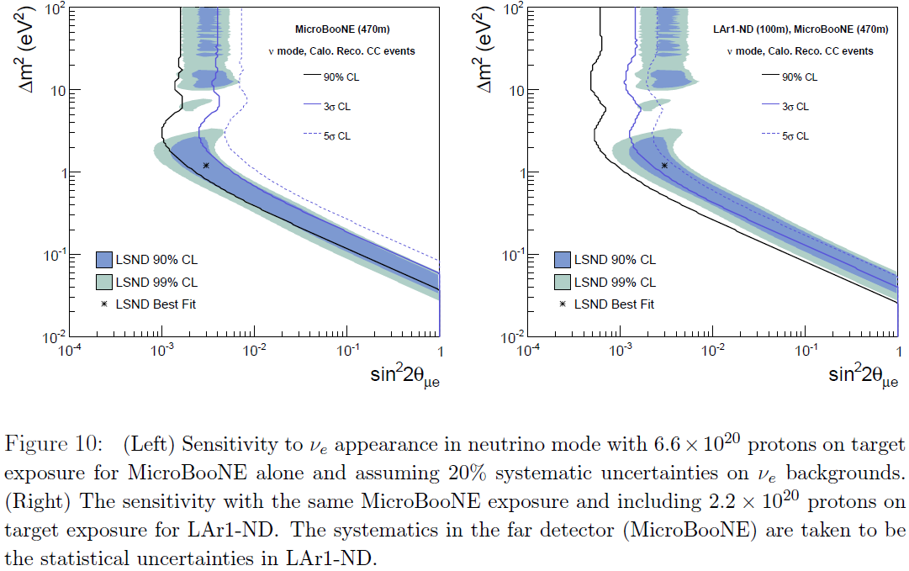
MircoBooNE & LAr1 Self-Reported Sensitivity

Slide 23
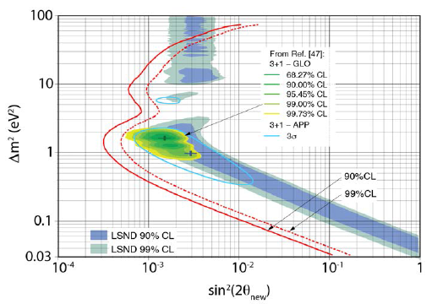
ICARUS at FNAL Self-Reported Sensitivity

Slide 24
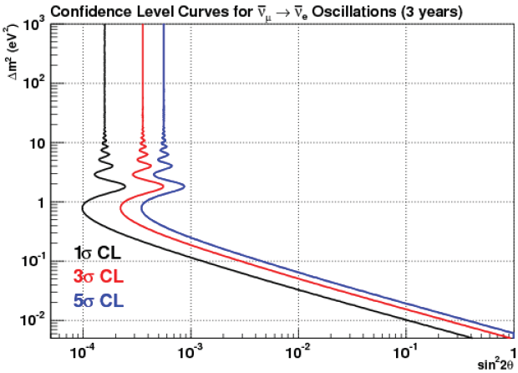
OscSNS Self-Reported Sensitivity

Slide 25
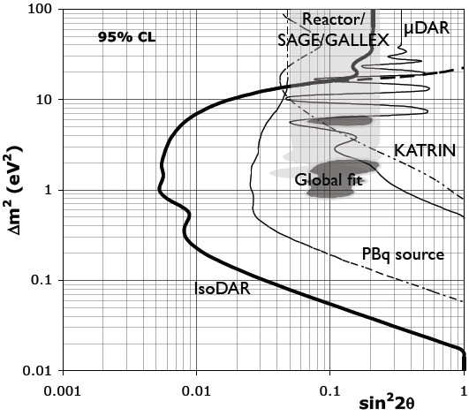
IsoDAR Self-Reported Sensitivity

Slide 26
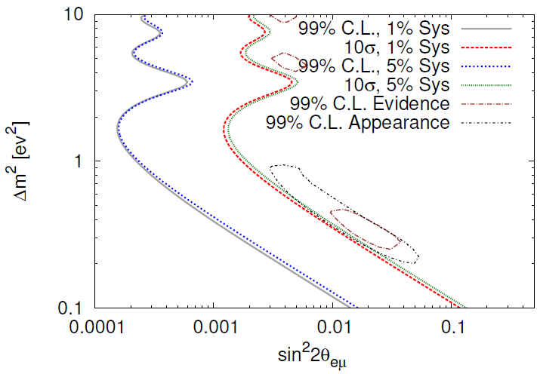
nuSTORM Self-Reported Sensitivity
Assumes 10²¹ POT

