Slide 1
Fabrication and test results of the HD3 magnet
M. Marchevsky, S. Caspi, D. W. Cheng, D. R. Dietderich, H. Felice, P. Ferracin*, A. Godeke, A. R. Hafalia, J. Joseph, J. Lizarazo, M. Turqueti, P. K. Roy, X. Wang, A. Salehi¹, T. Salmi, G. Sabbi and S. Prestemon
Lawrence Berkeley National Laboratory
*CERN

Slide 2
Outline
Brief history of HD2 / HD3 development and previous tests
HD3b training history, quench locations and quench propagation
New instrumentation: quench antenna and acoustic sensors
Examples of quench localization and analysis
Conclusions

Slide 3
HD2 / HD3 magnet overview
Racetrack coils with flared ends for beam path
HD2a-c: 36 mm aperture, stainless bore tube
HD2d,e and HD3a,b: 43 mm aperture, no bore tube
Large cable (51 strand, 22 mm x 1.4 mm)
Optimized for field quality
Parameter | Unit | HD2 (4.3 K) | HD3 (4.4 K)
Short sample current I_{ss} | kA | 18.1 | 18.67
Bore field at 4.4 K | T | 15.6 | 15.37
Peak field at 4.4 K | T | 16.5 | 16.26
Axial force Fz at I_{ss} per quadrant | kN | 138 | 168
Nonlinear stored energy at I_{ss} | kJ/m | 910 | 856

Slide 4
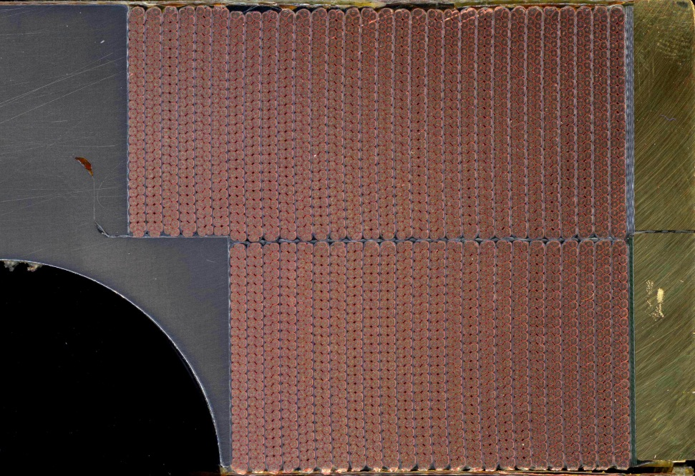
HD2 hard-way bend
Quench locations
All quenches in HD2d,e occurred in the pole turn of the inner layer, in the straight section, within ~100 mm before the hard-way bend
displacement
Potential cause for the long training
High probability of insulation damage

Slide 5
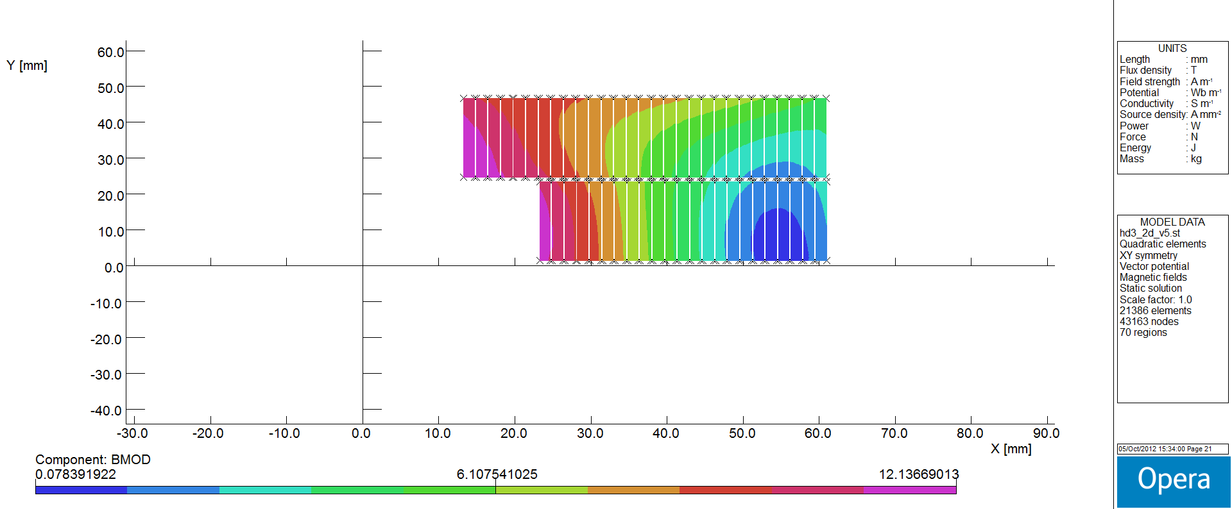
Changes in HD3 compared to HD2
Bend radius increased from 349 mm to 873 mm, or 2.5x the original HD2 hard-way bend radius
The inter-layer insulation was increased (from 0.25 mm to 0.75 mm)
One turn per layer was removed for HD3 coils (23 turns in layer 1 and 29 turns in layer 2)
~ 5% higher field
I = 13.6 kA
The superconducting margin is lowest in the outer layer pole turn

Slide 6
HD3a test
A# | Quench current (A) | Coil | Section | Segment | location
1 | 8997 | 3 | STRAIGHT | A54 | Between A5 and A4
3 | 9753 | 3 | Straight | A54 | ~ 5 cm from A4
5 | 10033 | 3 | RE | A76 | ~ 10 cm from A7
6 | 10689 | 1 | RE | A56 | Close to A6
7 | 10680 | 1 | RE | A67 | Close to A6
8 | 11626 | 1 | Straight | A78 | Between A7 and A8, closer to A8
9 | 11877 | 3 | RE | a65 | Between A6 and A5
10 | 12082 | 3 | STRAIGHT | A54; A65 | At A5
11 | 12103 | 3 | STRAIGHT | A23; A78 | At A8
12 | 11973 | 3 | STRAIGHT | A32; A78 | Between A7 and A8, closer to A8
14 | 13192 | 3 | Straight | A87; A98; A32 | At A8
All quenches were in the inner layer, mainly in Coil 3
Quench locations were equally distributed along the pole turn, no obvious localization of quenches at the hard-way bend lines
Test was interrupted due to an incident – short between the current leads

Slide 7
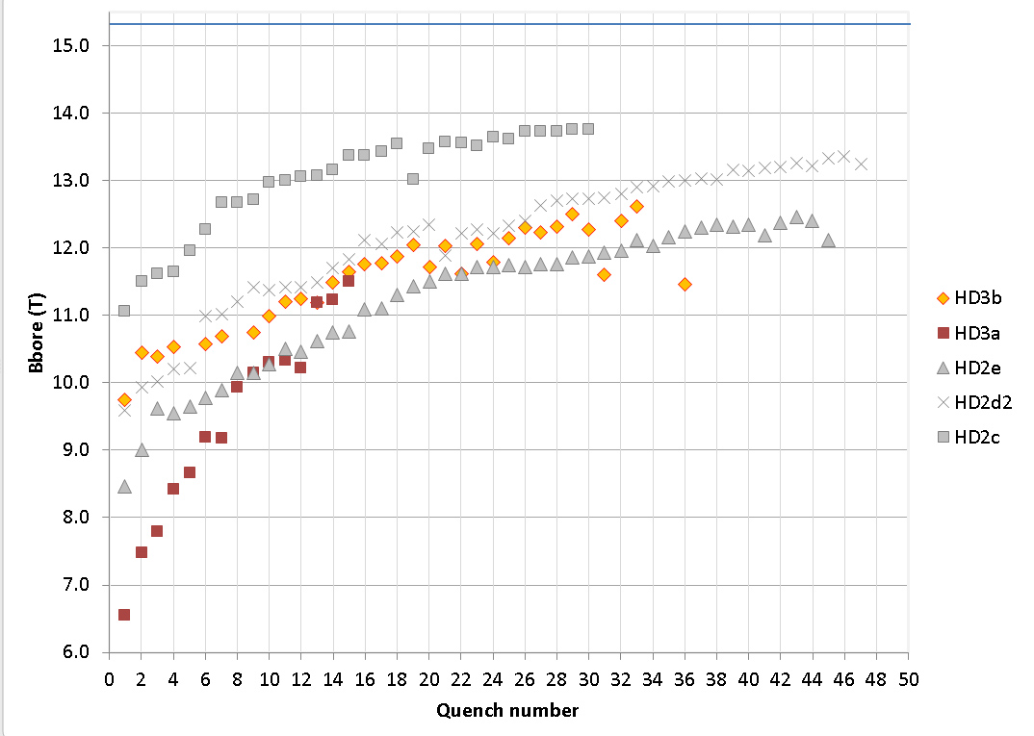
HD3b training plot (bore field)
HD3b short sample limit
Removal of the bore tube
Increased pre-stress
HD2 achieved 13.8 T bore field (87% of I_{ss} at 4.5 K) in HD2c (2008)
HD3b so far achieved 12.6 T bore field (80.5 % of of I_{ss} at 4.5 K)

Slide 8
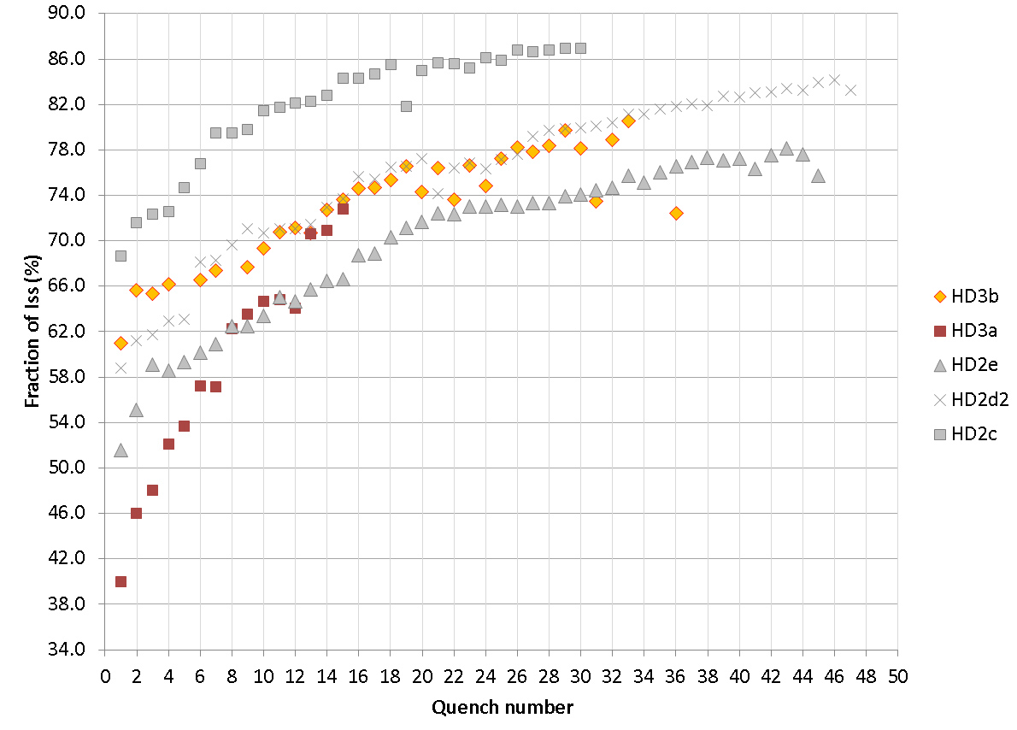
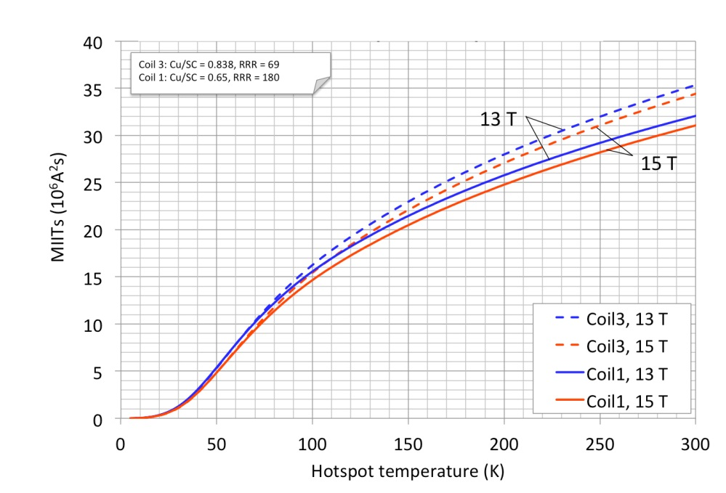
Training plot (I_{ss})
The highest current quench A35 (15039 A) was ~ 28.6 MIITs.
15039 A
~ 200-220 K
T. Salmi, H. Felice
Training to be continued…

Slide 9
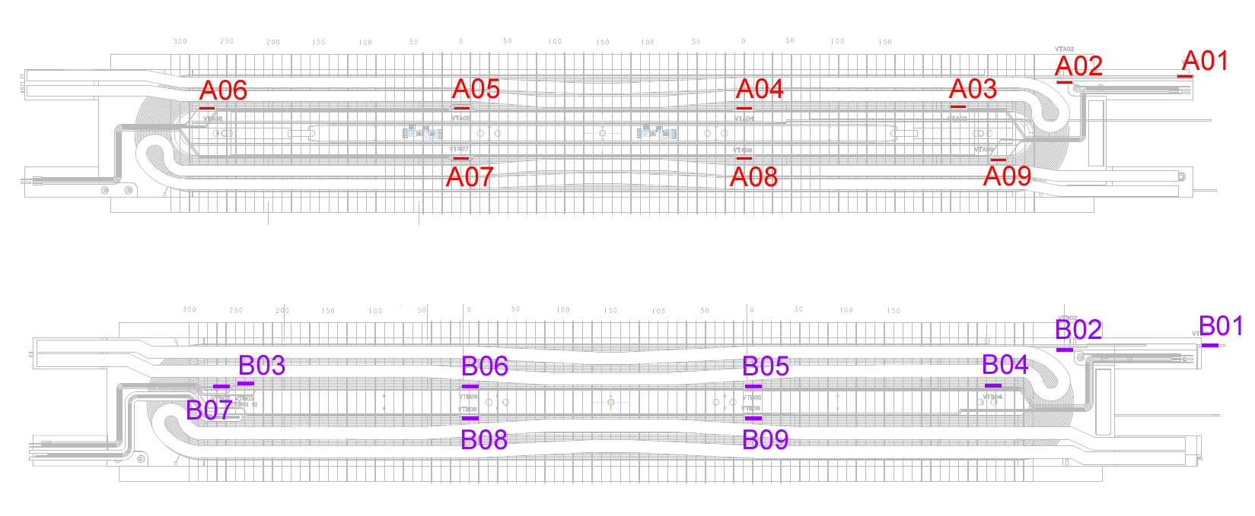
HD3b quench locations
33 quenches in Coil 3, inner layer
3 quenches in Coil 1, inner layer
1 simultaneous quench in Coils 1 and 3 (A35)
Coil 3
Coil 1
No quenches in the outer layer
Some clustering of the quench locations is seen around Vtaps A7, A4 of Coil 3

Slide 10
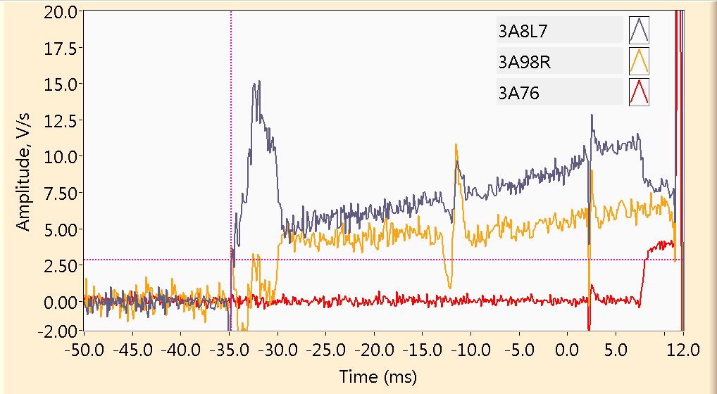
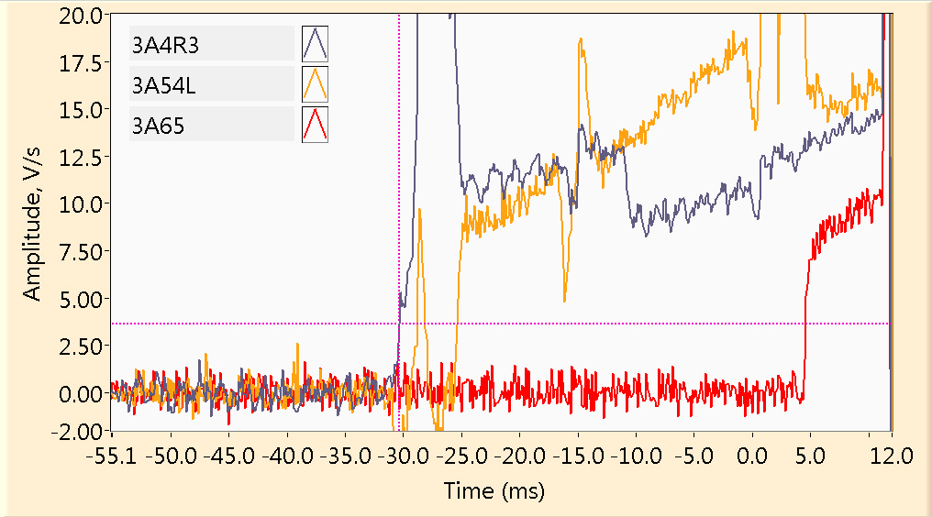
Quench propagation velocity
A03
12196 A
A29
14540 A
3A87: -34.9 ms
3A98: -30.4 ms
3A76: +7.7 ms
Quench is ~ 3 cm from the A8 Vtap in the A87 segment
3A43: -30.4 ms
3A54: -25.3 ms
3A65: +4.5 ms
Quench is ~ 5 cm from the A4 Vtap in the A43 segment
L_{A87}= 30 cm; dt = (4.5 + 42.6) = 47.1 ms => V = 6.3 m/s
L_{A54}= 30 cm; dt = (25.3 + 4.5) = 29.8 ms => V = 10.1 m/s
A29
A03

Slide 11
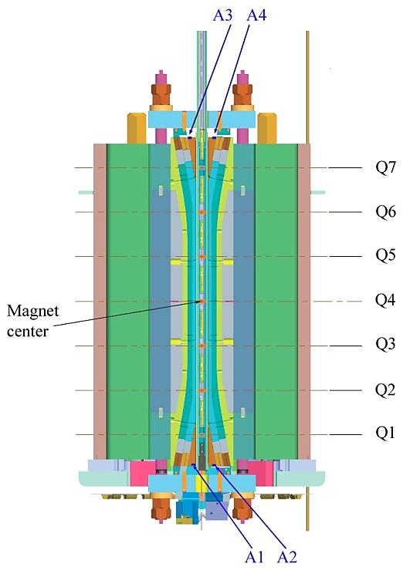
New instrumentation for the HD3b test
We are using new instrumentation to better localize magnet quench locations and study its training behavior:
Inductive quench antenna (sensors Q1-Q7 in the bore, in the anti-cryostat tube)
Acoustic emission sensors (A1-A4, at the coil wedges
C1
C3

Slide 12
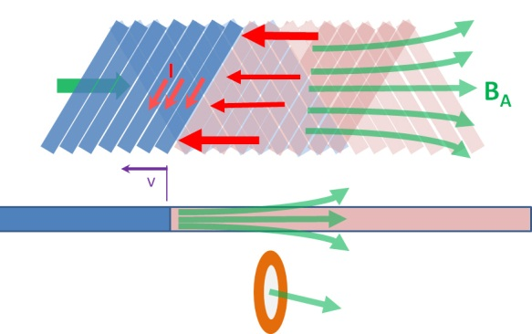
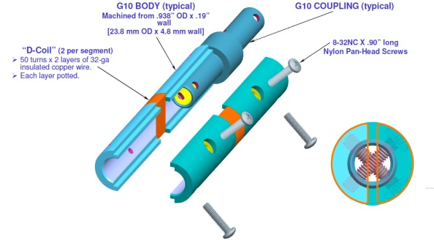
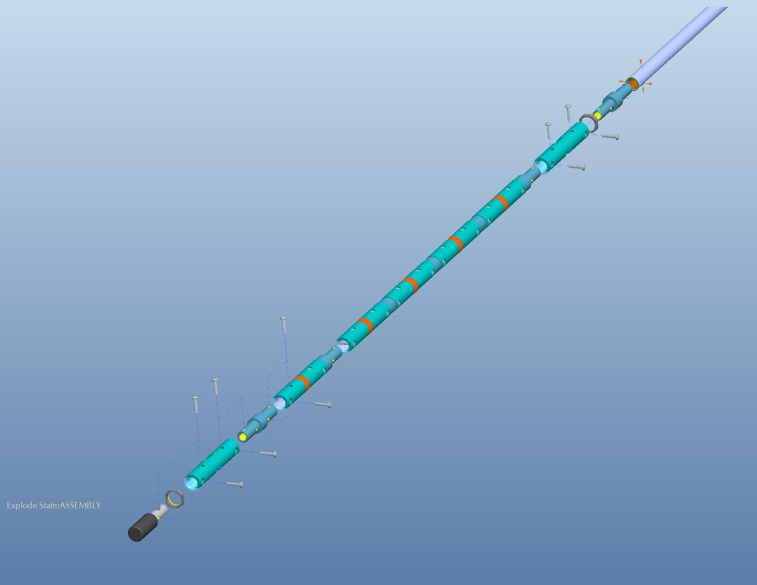
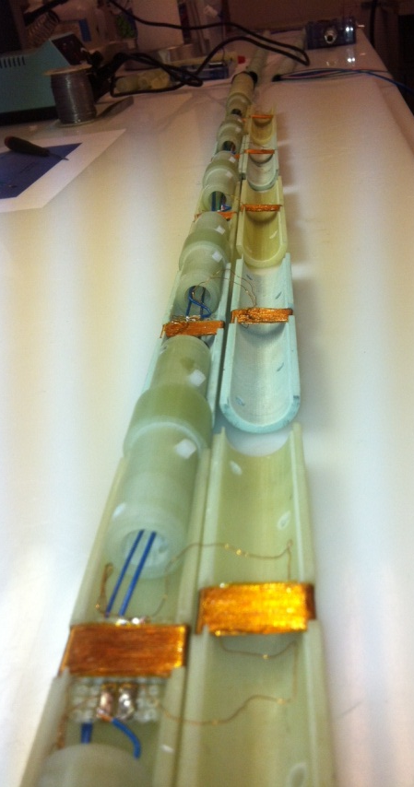
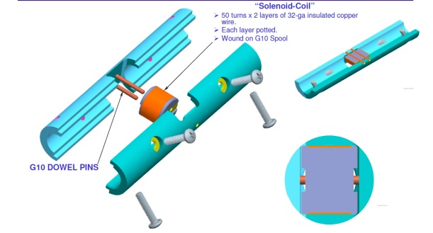
Quench Antenna
Normal zone boundary in a Rutherford cable locally generates the magnetic field component B_{a} along the cable axis. We have developed a novel inductive quench antenna that utilizes this effect for localization of the quench origin and propagation.
The axial field it not shielded efficiently by the anti-cryostat walls. Therefore, our antenna is expected to have a higher sensitivity compared to the traditional ones that sense variations of the transverse field multi-poles.
B
a
WARM-FINGER BORE GUIDE
TYPE “B”
SENSORS
B
SHAFT ADAPTER
a
Longitudinal field sensors (“A”) for the magnet straight section
BOTTOM END
CAP
B
TYPE “A” SENSORS
a
WARM-FINGER
BORE GUIDE
Transverse field sensors (“B”) for the magnet ends
Parts design: R. Hafalia

Slide 13
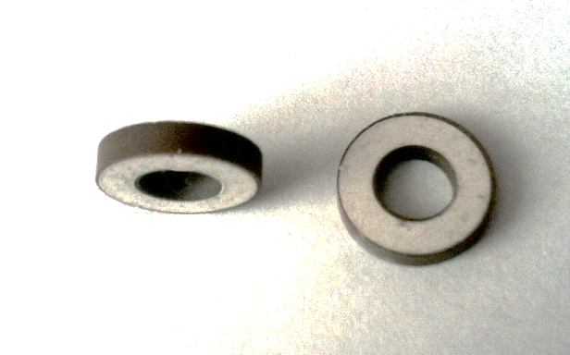
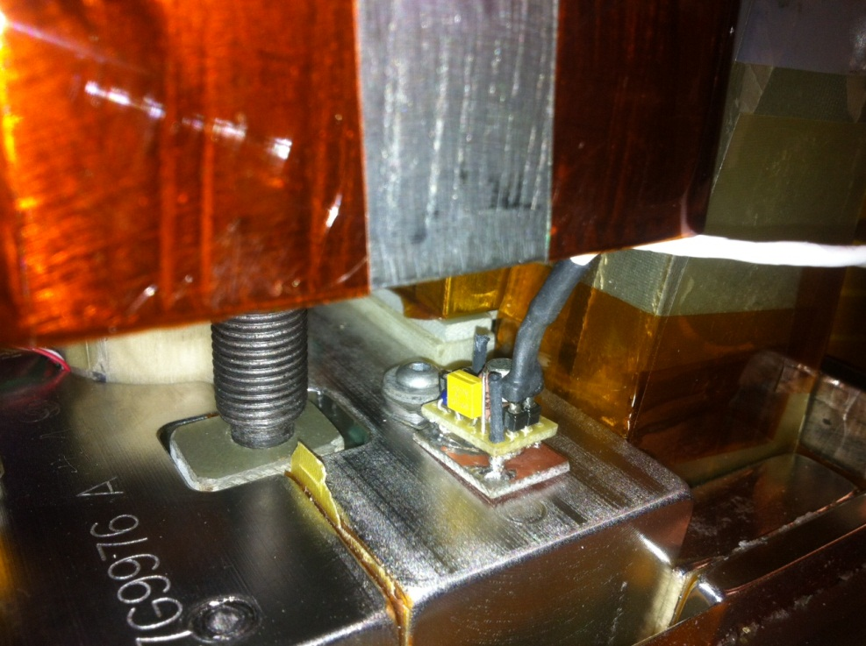
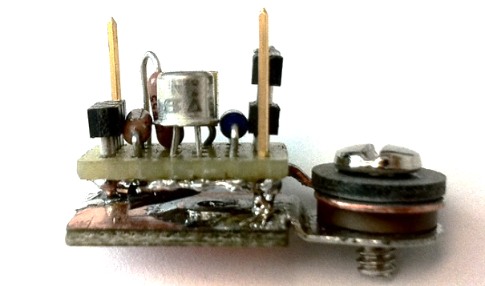
Acoustic sensors
D
.
D
20 mm
Piezoelectric ceramics washer, polarized across thickness
f_{r} = (154 ± 4) kHz
GaAs MOSFET-based amplifier
Bandwidth of 0-100 kHz
300 - 1.9 K operation temperature range
Coil wedges
Acoustic sensor
Four sensors were installed, one per each wedge
Acoustic signals were simultaneously acquired with Yokogawa DAC (1 MHz and 10 kHz acquisition rate), as well as with MVMS system (200 kHz)
Non-invasive/portable system, easily adaptable to different magnets

Slide 14
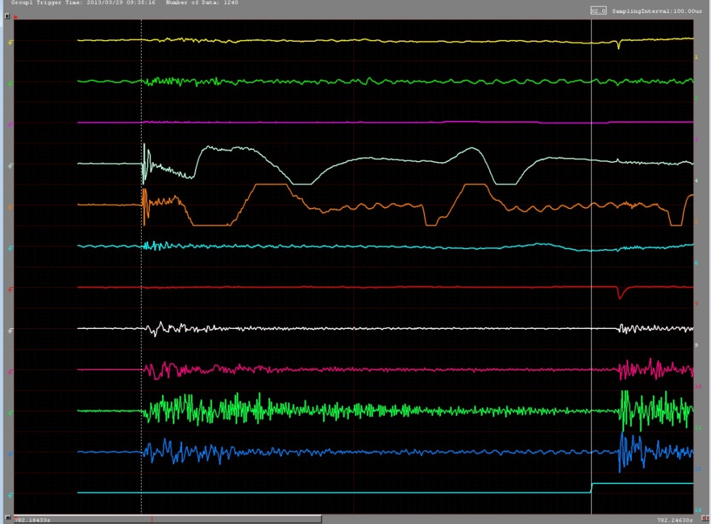
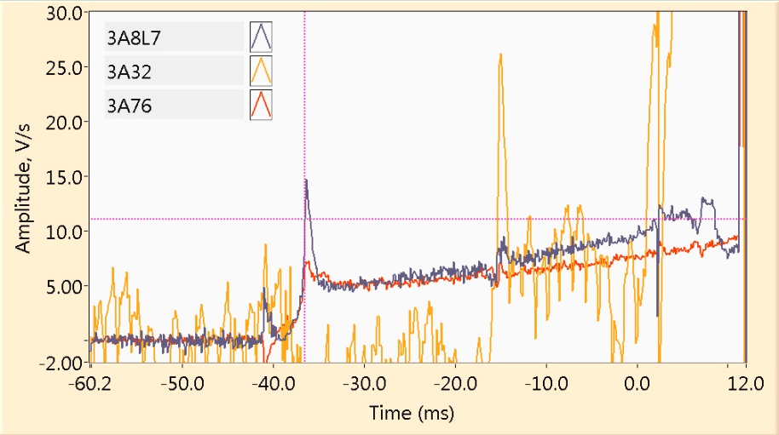
Quench A7 example
A7
12426 A
Q1
Q2
Q3
Q4
Q5
Q6
Q7
A1
A2
QD
A3
A4
“Calibration quench”: it has started at the Vtap A7, 15 mm from the magnet center towards the RE.
Trig
40.05 ms
QD
30 cm
Quench at A7
RE
(top)
LE
(bottom)
1
2
15 cm

Slide 15
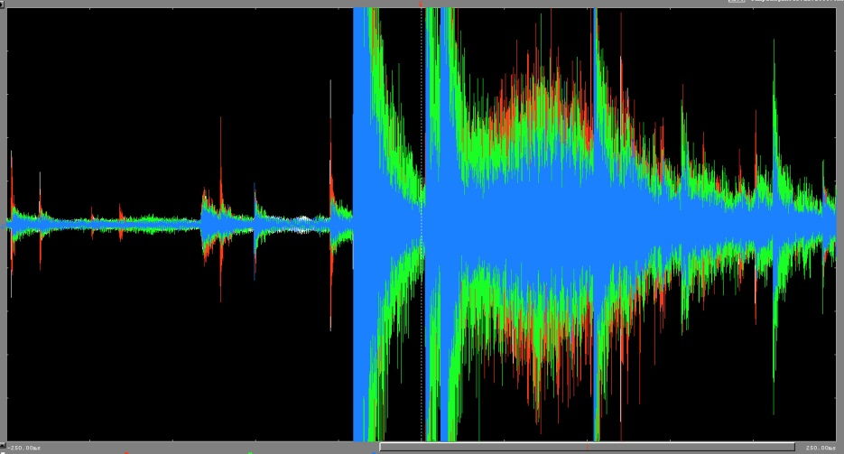
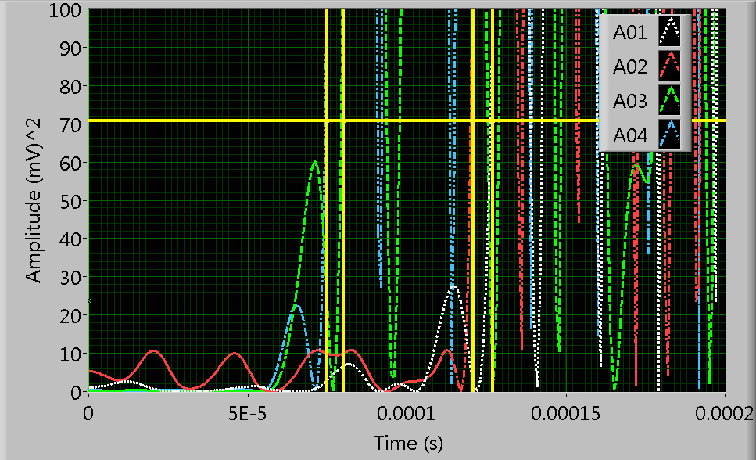
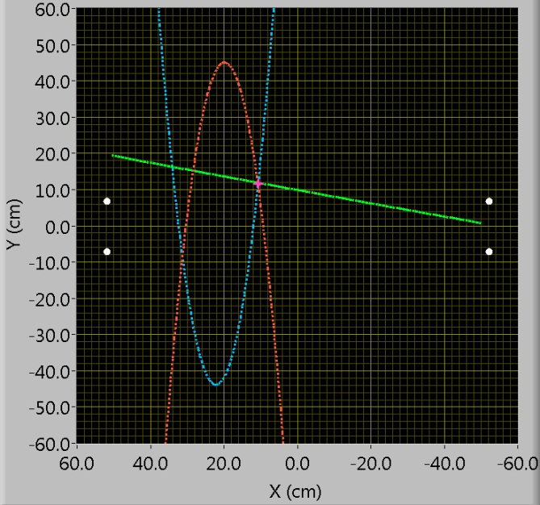
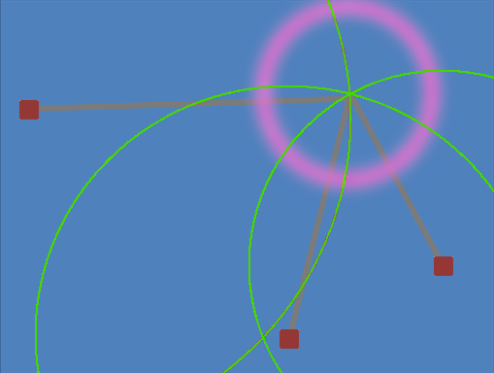
Acoustic localization of the quench A7
t₁ | 0.075 ms
t₂ | 0.08 ms
t₃ | 0.121 ms
t₄ | 0.127 ms
Quench
propagation
QD
40 ms
Sensor 1
(x₀,y₀)
(x₀-x₁)²+(y₀-y₁)²=R₁²
A4
COIL 3
A2
(x₀-x₂)²+(y₀-y₂)²=R₂²
R₁
(x₀-x₃)²+(y₀-y₃)²=R₃²
R₂
A3
COIL 1
A1
R₃
|R₁-R₂|=$V_{s}$Δt₁₂
RE
(top)
LE
(bottom)
|R₁-R₃|=$V_{s}$Δt₁₃
Sensor 2
Sensor 3
v_{s}= 4.3 km/s

Slide 16
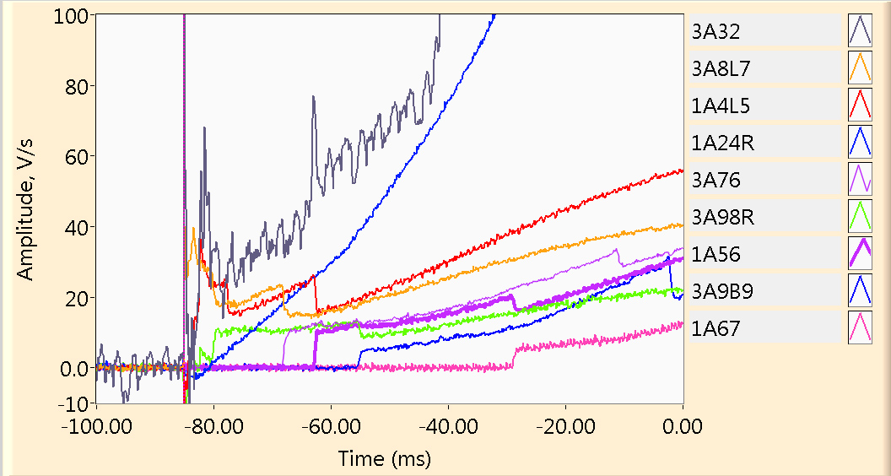
A35 quench (15039 A)
Quench begins ~ 5.5 cm from the Vtap A08 in the 3A87 segment and propagates at ~12 m/s linearly around the pole and across into the multi-turn.
At the same time, Coil 1 starts quenching in the 1A45 segment and quench propagates to the neighboring segments.
Coil 3: 3B89 (-2.3) ← 3A9B9 (-55.3) ← 3A98 (-80.4) ← 3A87(-85.0) → 3A76 (-68.4) → 3A65 (-11.0) → 3A54 (+5.7) 3A32 (-81.0) ↵
Coil 1: 1A24 (-82.7) ← 1A45 (-84.2) → 1A56 (-62.8) → 1A67 (-28.9)

Slide 17
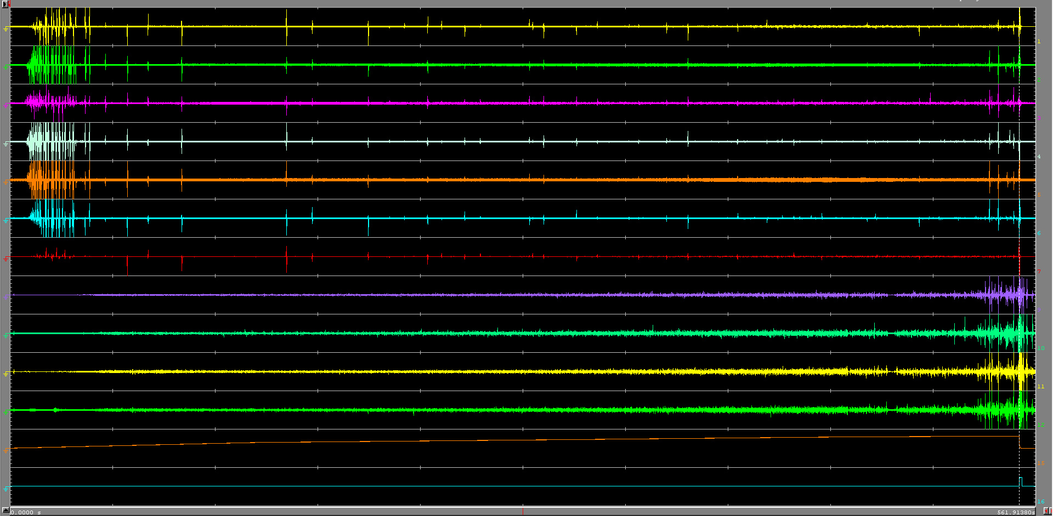
Quench A35 – full record
Q1
Q2
Q3
Q4
Q5
Q6
Q7
A1
A2
A3
A4
Imag
Trg
0
561.9 s
Flux jumps (2-4 kA)
Acoustic background level is increasing with current
Many large acoustic and several magnetic events are observed ~10 s prior to the quench
10x slowed sown sound ->

Slide 18
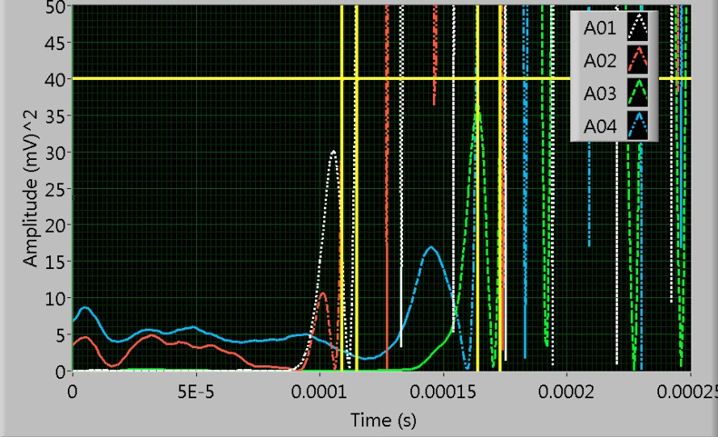
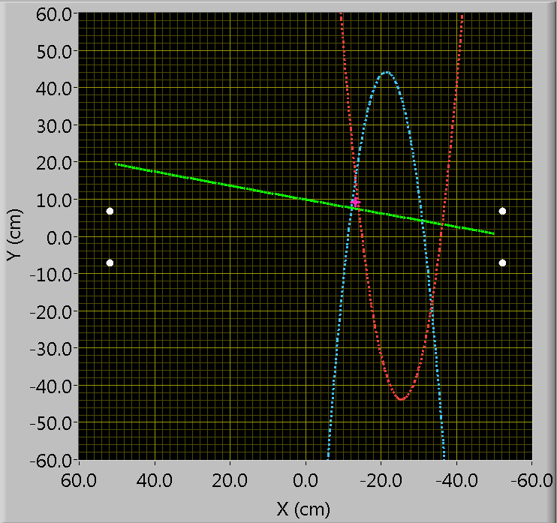
Localization A35
COIL 3
A4
A2
A3
A1
RE
(top)
COIL 1
LE
(bottom)
Quench is localized with a few cm accuracy using the fast (1 MHz) acoustic detection system

Slide 19
Conclusions
HD3 be is currently being tested at LBNL and so far has reached bore field of 12.6 T (80.5 % of I_{ss})
Extended training is seen; quench locations are distributed evenly along the pole turn of the inner layer (mostly in Coil 3)
Quench propagation velocity is measured (~ 6 m/s at 12.2 kA -> 12 m/s at 15 kA)
New axial field quench antenna is able to localize quench locations from inside the warm bore with good accuracy
Acoustic localization of quenches using is demonstrated; further analysis of magnet acoustic emissions and their correlations with magnetic instabilities and training process is underway
Test will be continued for another 1-1.5 weeks (MM, ramp rate, quench heater studies, etc…)

