Slide 1
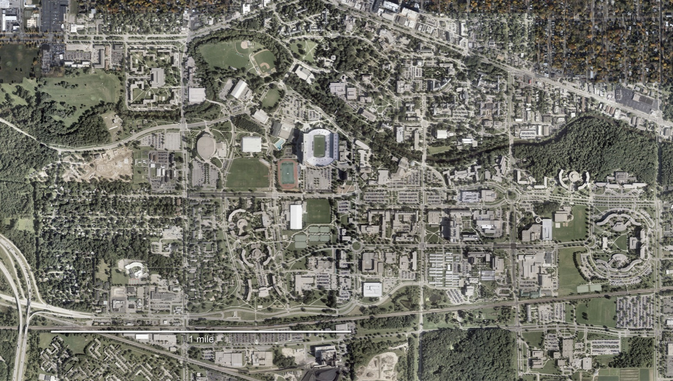
Welcome to Michigan State University
Founded 1855
12,000 employees
(5,300 academic)
50,000 students
(11,000 graduate students)
5,200-acre campus
(538 buildings)
$2.3 billion/year total
revenues
$1.2 billion civil
construction in past decade
1 Mile

Slide 2
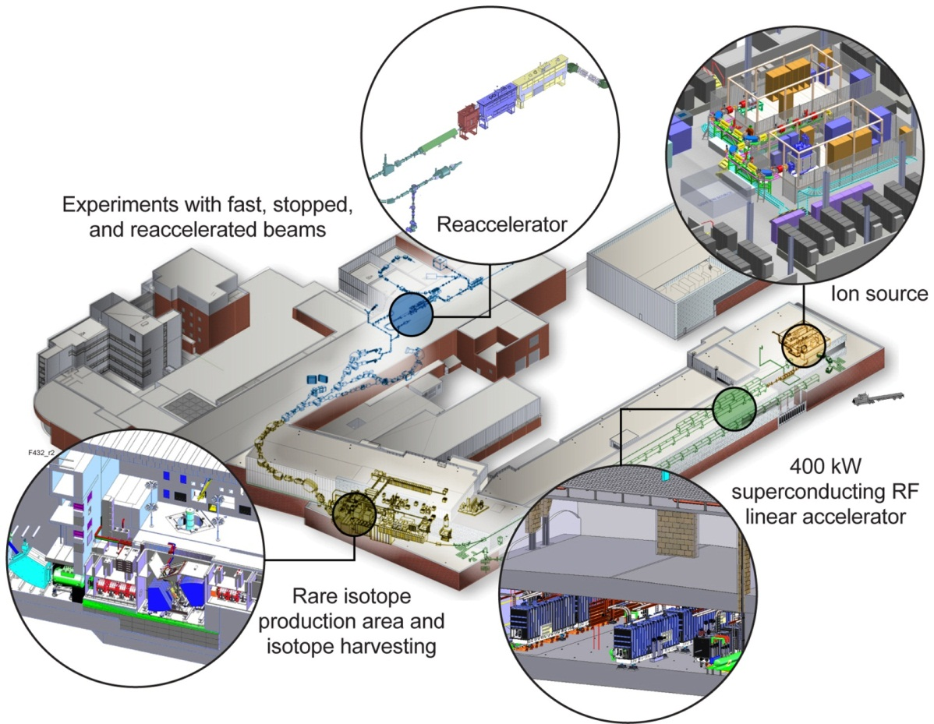
MSU – Home to Facility for Rare Isotope Beams A Future DOE-SC Scientific User Facility for Nuclear Physics
Funded by DOE–SC Office of Nuclear Physics with contributions and cost share from Michigan State University and State of Michigan
Serving over 1,400 users
Key feature is 400 kW beam power for all ions (5x10¹³ ²³⁸U/s)
Separation of isotopes in-flight
Fast development time for any isotope
Suited for all elements and short half-lives
Fast, stopped, and reaccelerated beams

Slide 3
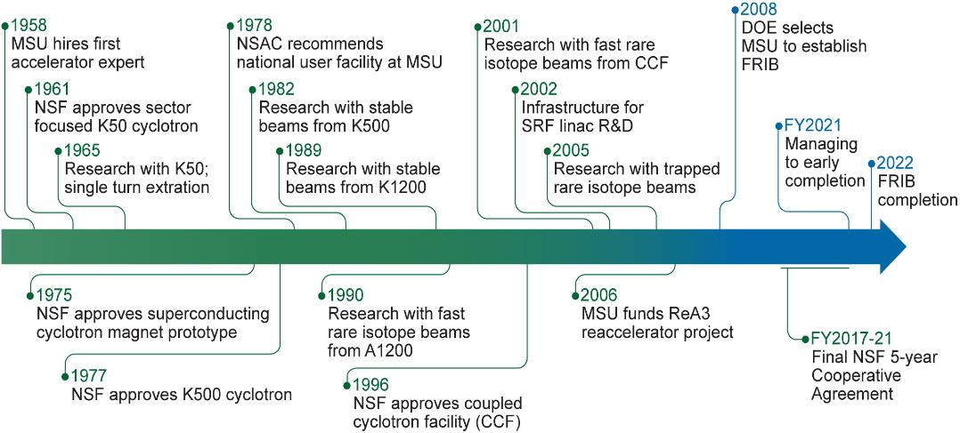
60 Years of Reinvention: From Cyclotrons to Linear Accelerators

Slide 4
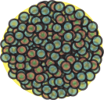
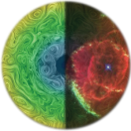
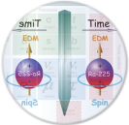
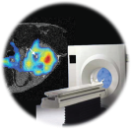
FRIB Affords Discovery Opportunities
Properties of nuclei
Develop a predictive model of nuclei and their interactions
Many-body quantum problem: intellectual overlap to mesoscopic science, quantum dots, atomic clusters, etc.
Astrophysical processes
Explore origin of the elements in the cosmos
Model explosive environments: novae, supernovae, X-ray bursts …
Determine properties of neutron stars
Tests of fundamental symmetries
Complementary tests for physics beyond the Standard Model
Societal applications and benefits
New tools for bio-medicine, energy, material sciences
National security
Notes:
UNEDF: Unified Nuclear Energy Density Functional
SciDAC: Scientific Discovery through Advanced Computing
SC proton-therapy cyclotrons (ACCEL/VARIAN): PSI - Switzerland, St. Petersburg - Russia, RPTC Munich - Germany, Scripps - San Diego, Riyadh - Saudi Arabia

Slide 5
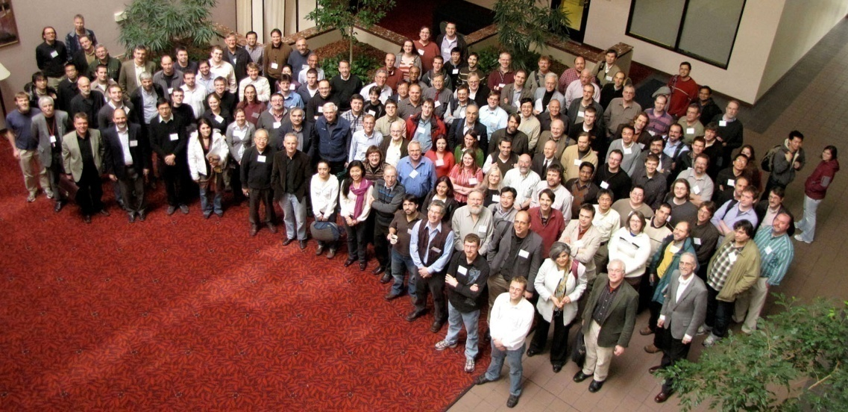
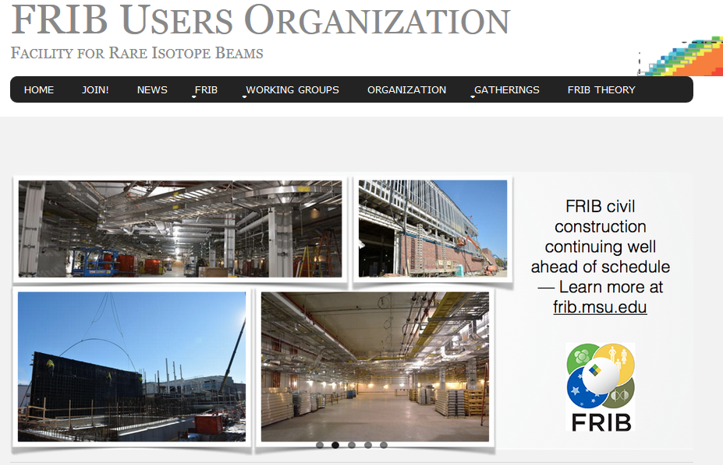
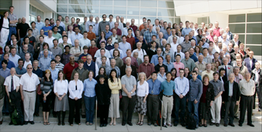
1,400 Users Will Make Discoveries
Users organized as part of independent FRIB Users Organization (FRIBUO)
Chartered organization with an elected executive committee
1,400 members (109 U.S. colleges and universities, 12 national laboratories, 51 countries) as of December 2016
19 working groups on instruments
User needs and high user satisfaction are important to NSCL and FRIB
Monthly phone conferences with NSCL Operations Subcommittee of FRIB Users Organization
CCF availability > 90%, highly successful current GRETINA campaign, user feedback
Annual low-energy nuclear science community meetings (since 2011)
At Notre Dame August 2016: “FRIB remains our top priority. The community eagerly anticipates the completion and the forefront science this facility will enable. The user community strongly endorses the energy upgrade of ReA3 to ReA6 prior to FRIB as it offers tremendous opportunities for forefront science already at NSCL.”
Notes:
Updated 12/1/2016 - WW

Slide 6
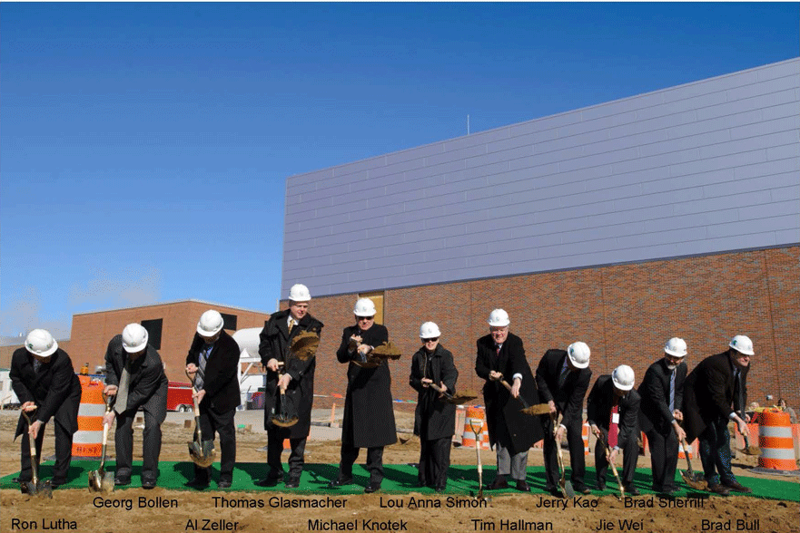
FRIB Civil Construction March 17, 2014 Ground Breaking

Slide 7
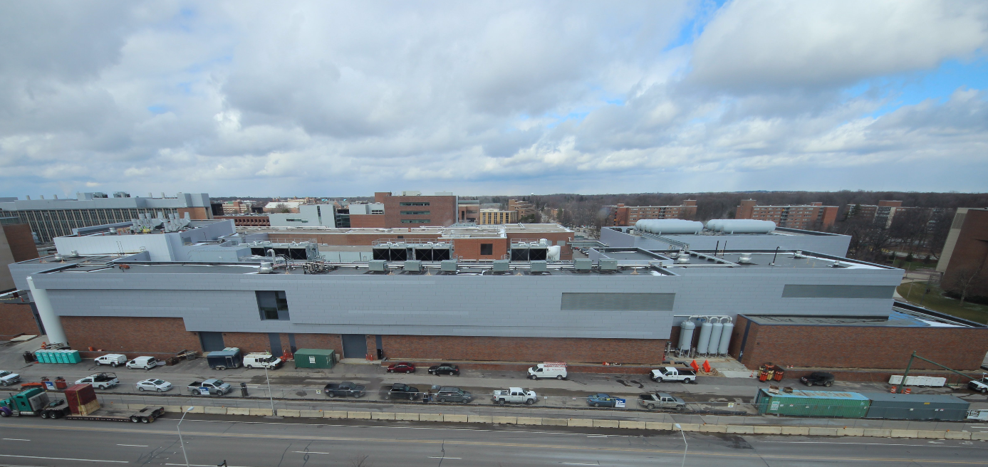
36 Month: Beneficial Occupancy March 2017

Slide 8
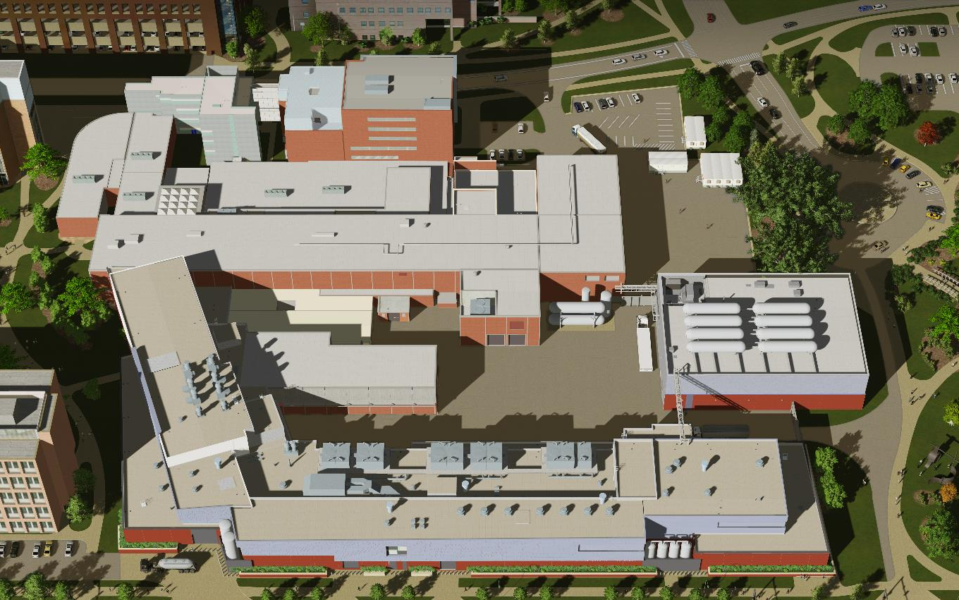
Facility for Rare Isotope Beams in 2021

Slide 9
We are Honored to Host You
I wish you a successful conference
with many new ideas, new collaborations forming and old relationships being strengthened
to create new insights and knowledge

