Slide 1
Cryogenics Breakout Session
David Montanari
LBNC Review
21-24 June 2017

Slide 2
Topics
WA105 1x1x3 Lessons learned.
Cryogenics Planning for ProtoDUNEs.
Cool-down requirements for ProtoDUNEs.
Progress on LBNF Mezzanine.
Feedback from ProtoDUNE-SP Instrumentation review (Apr 2017).
Notes:
READ.

Slide 3
WA 105 1x1x3 Lessons Learned
Cool down:
Provide escape path for the GAr generated when flowing LAr through warm pipe in the cool down manifold. ✓
Condenser heat exchanger:
Provide LN2 phase separator on LN2 feed line to condenser. ✓
Excessive cryostat heat leak:
Trying to evaluate the contribution of the roof versus the sides/bottom to understand how the feedthroughs affect the heat leak. ✓
Use secondary barrier to contain potential LAr spills but also stop convective currents within the insulation. ✓
Use potential other barriers to stop convective currents within the insulation (e.g. tapes over the gaps between insulation panels filled with glass wool). ✓
Evaluating the addition of radiation shields in the spare cryostat feedthroughs and manholes to reduce the radiative heat leak. Good from cryo point of view, but may negatively affect purity.

Slide 4
Engineering Parameters (from Detector Requirements)
Same as presented in Mar 2017
Mode | Parameter | Value | Notes
1 | GAr purge flow rate | 88 m³/hr | From 1.2 m/hr
2 | Maximum cool-down rate TPC | 40 K/hr 10 K/m | T sensors to be defined and placed by Internal Cryogenics/Detector
2 | Maximum Delta T between any two points in the detector | 50 K | T sensors to be defined and placed by Internal Cryogenics/Detector
3 | LAr filling flow rate (*) | 18 l/min | Assuming 2 trucks/day (**)
4 | Cryostat static heat leak | 3.0 kW | GAr boil-off (18 g/s)
4 | Other heat loads (estimate) | 5.0 kW | Total estimate is ~ 8 kW
4 | LAr circulation (5 days turnover) | 72 l/min (19 gpm) | Nominal value (1 pump)
2, 3, 4 | Condenser size | 16 kW
* Value might be limited by the pressure inside the LAr storage dewar.
** Market survey in place to confirm price and availability of 2 trucks/day of LAr.
Note: Noise, micro phonics and vibrations inside the LAr volume will be studied with an external pump configuration.

Slide 5
ProtoDUNEs Cryogenics Status
Proximity/External Cryogenics:
Contract awarded. ✓
Design about to start. ✓
Estimated start of installation in EHN1: Nov 2017.
Estimated completion of installation in EHN1: Feb 2018.
Internal Cryogenics:
Design completed. ✓
Fabrication in progress. ✓
Supports to be delivered earlier to be welded to the tanks prior to washing them.
Estimated start of installation in EHN1: Aug 2017.
Estimated duration of installation: 3 weeks.
Inline safety valves (Protego):
NP-04 Installed. ✓
NP-02 being repaired (following mishandling after installation).
Platforms/Cable Trays/Cabling/Warm Piping:
Estimated installation: Jun 2017-Feb 2018.
Not started yet.

Slide 6
ProtoDUNEs Cool down
CFD Simulations of the cool down process.
Two hand calcs to verify the CFDs.
Good agreement with the methodology.
CFD Simulations assume a higher cooling power and higher GAr flow rates than currently available.
Solution is to use all available cooling power and increase duration of cool down phase to whatever is needed (currently 2-3 weeks).
Details on DocDB-886.

Slide 7
LBNF Mezzanine
We continue the conceptual design adding details:
Structure to support the majority of the equipment.
Legs and feet to support heavy components (vessels, valves).
We have estimated the mezzanine loads (and location), based on the current design.
A design of the mezzanine structure is in progress (CERN).
Working with DUNE Far Detector and Systems Engineering to identify location of all feedthroughs through the roof of the cryostat (See contribution “DUNE Detector, Cryogenics, Cryostat Interfaces” in LBNF/DUNE Interfaces breakout session).
Animation showing the current design is available on the Indico page.

Slide 8
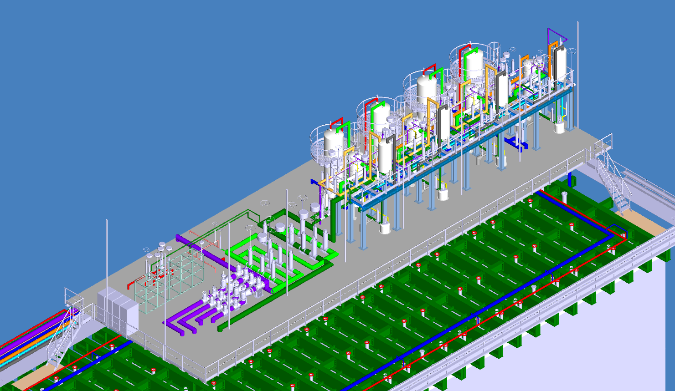
LBNF Mezzanine – Iso
35 m
12 m

Slide 9
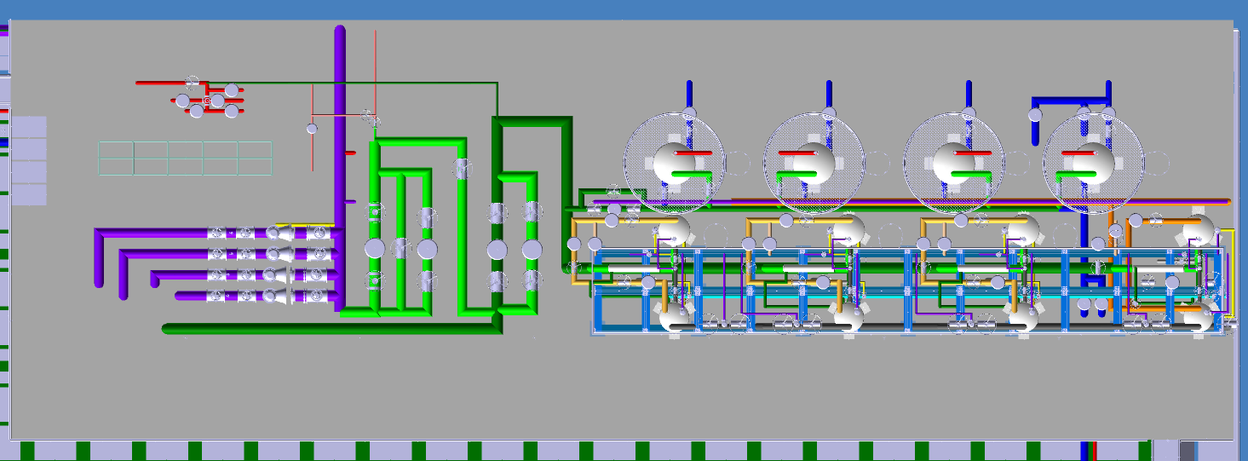
LBNF Mezzanine – Top

Slide 10
LBNF Mezzanine – Side

Slide 11
LBNF Mezzanine – Side

Slide 12
Thanks

