Slide 1
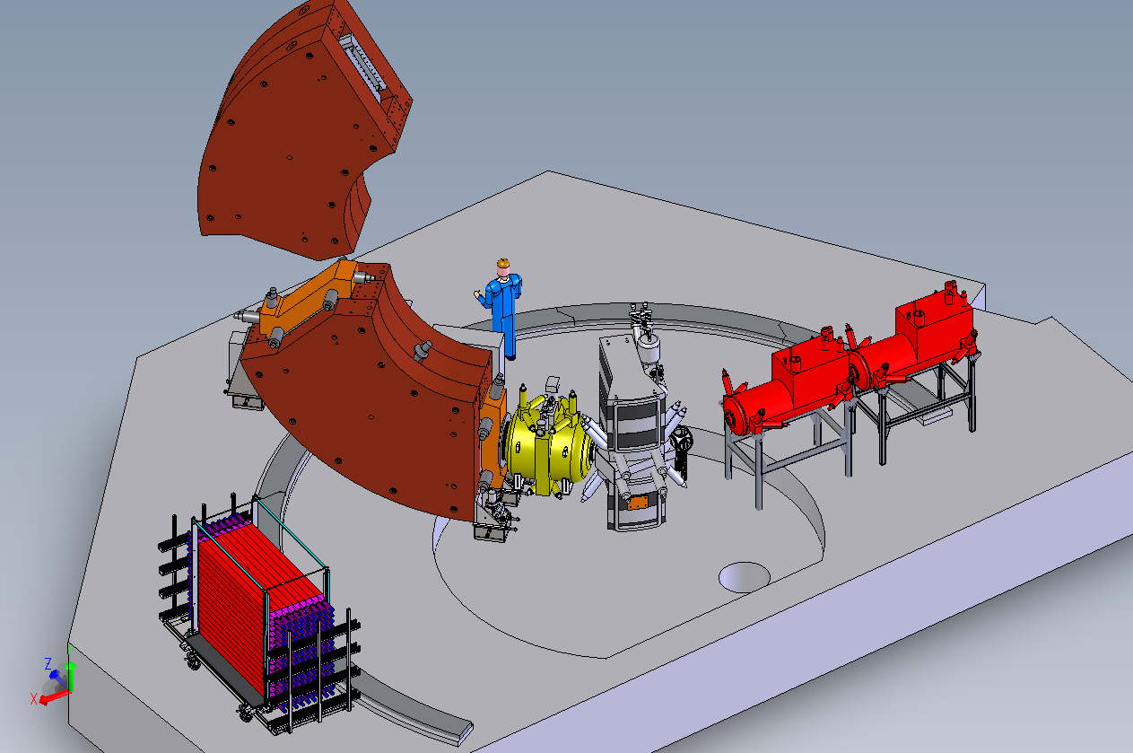
Fast Neutron Detection with the S800 Working Group
Workshop goal: Solicit proposal ideas for a MoNA-LISA/S800 campaign.
Physics ideas discussed:
Improved Transfer Reactions with the Sweeper/MoNA-LISA/S800 Setup
Study of ³⁷Mg
Prefragmentation Reaction Studies
Question of Isomers in Invariant Mass Measurements
Testing Ab-Initio Predictions
Neutron-Proton Pairing and Pairing in Weakly Bound Systems with Direct Reactions
Status of the Instrument: The instruments to be used are all fully functional experimental devices. The proposal is to move the Sweeper dipole magnet in front of the S800 spectrograph, including the MoNA-LISA detector setup.
Timeline: Have proposals submitted for the PAC 42 (May 2018?).
Needs: Community support to work with MoNA-Collaboration to expand the range of physics utilizing the MoNA-LISA and Sweeper at the S800.

