Slide 1
Cosmology
Fermilab Saturday Morning Physics
Chris Stoughton

Slide 2
Wonder
For it is through wondering that human-beings both now and at first began to philosophize, wondering first about the strange things close at hand, and then little by little in this way devotedly exerting themselves and coming to impasses about greater things, such as about the attributes of the moon and things pertaining to the sun and the stars and the coming-into-being of the whole.
(Aristotle, Metaphysics, I.2, 982b11-17)
Notes:
The Metaphysics is among the greatest philosophical works. It is a reconciliation of “common sense” observations with Plato’s theory of Forms. What is existence? What kinds of things exist? How can things by CHANGE and PERSIST? How can we understand what is going on?
Studied under Plato as a teenager, 350 BC

Slide 3
Physical Sciences
Each physical science has axioms
Geometry: points and lines behave in a certain way.
You can ask why but the geometry itself can not answer that question.
You can change the axioms, but then you are working on a different kind of geometry.
Notes:
Euclid’s textbook “The Elements” lists axioms:
CONSTRUCTION
Straight line between two points
Extend a finite straight line
Circle defined by center and radius
All right angles are equal
Parallel postulate
COMMON NOTIONS
Transitive property of equality
Equals added to equals are equal
Equals subtracted from equals are equal
Reflexive property of equality
The whole is greater than the parts

Slide 4
Limits of Physical Science
Godel’s Incompleteness Theorem: for any consistent, effectively generated formal theory that proves certain basic arithmetic truths, there is an arithmetical statement that is true, but not provable in the theory.
Wolpert’s knowledge limit: the universe lies beyond the grasp of any intellect, no matter how powerful, that could exist within the universe.
Notes:
Kurt Godel 1906-1978; pal of Einstein
Wolpert (current) – the best we can get is a “theory of almost everything”

Slide 5
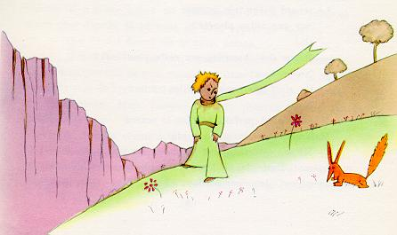
"One sees clearly only
with the heart.
What is essential is
invisible to the eye."
"It is the time you have lost
for your rose
that makes your rose
so important."

Slide 6
Process of Science
Observation
Model
Interpretation
Notes:
Put this diagram on the board
Illustrate this with Olber’s paradox

Slide 7
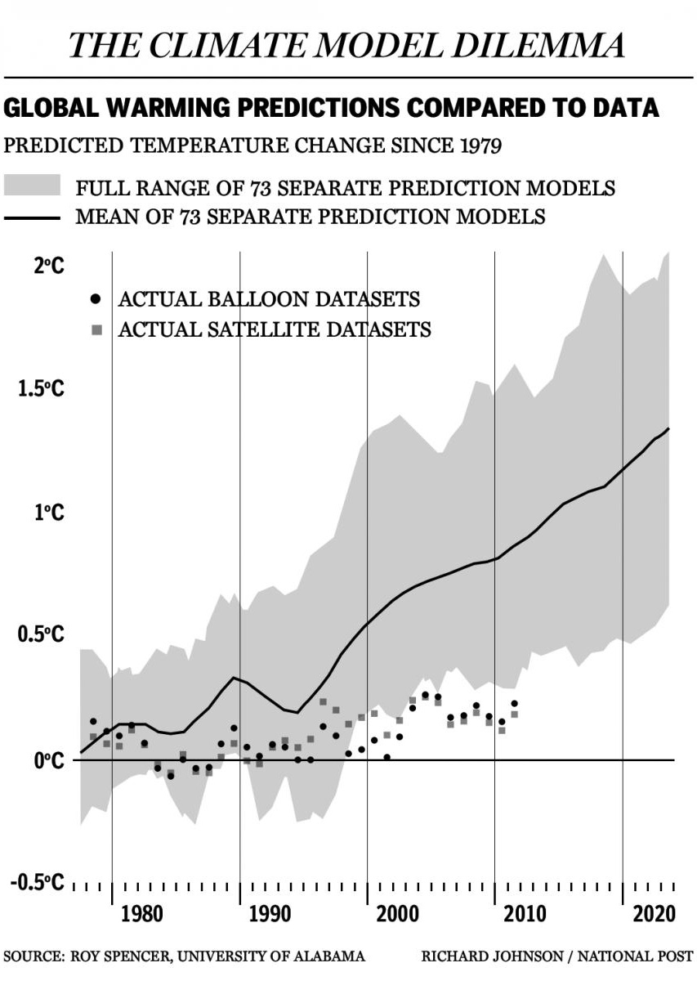

Slide 8
A Model of the Universe
Here is how a finite, static, Newtonian
Universe behaves

Slide 9
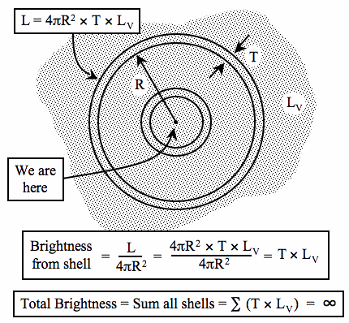

Slide 10
Axioms of Physical Cosmology
The Universe Exists.
It makes sense. Patterns → laws.
Physical laws are the same everywhere, at all times
We can discover these laws. (They are intelligible.)
Notes:
Existence – down the hall in the philosophy and English departments they might have issues with this!
Patterns and laws in orbits of planets: Bode and Kepler

Slide 11
Tools we will use
Scale: very small to very large, in terms of
size [meters]
energy [Joules] OR [mass*velocity^2].
Blackbody Radiation. (First puzzle solved by quantum mechanics!)
Basics of Nuclear Physics
Doppler shift. Observed wavelength depends on velocity between observer and source

Slide 12
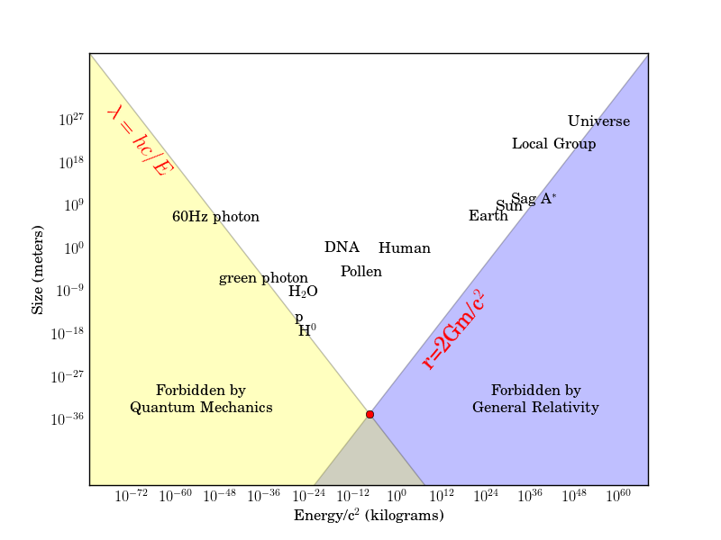
Scale: Size vs. Energy

Slide 13
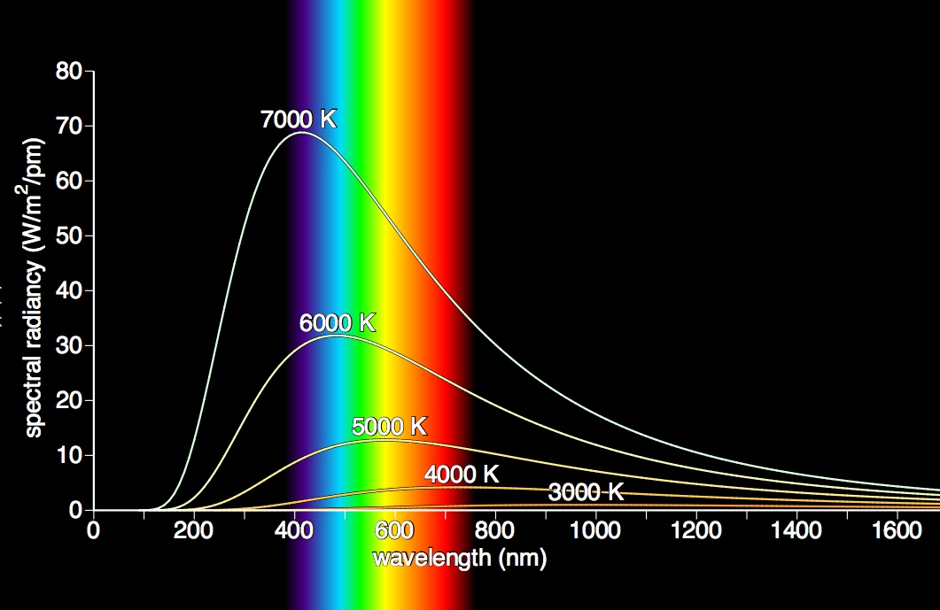
Blackbody Radiation
Notes:
Blue and red joke

Slide 14
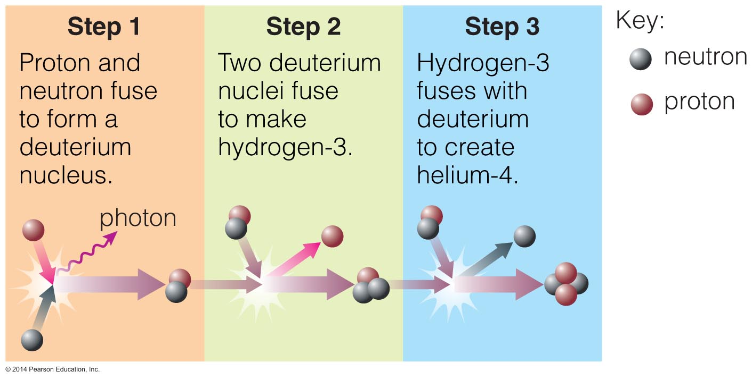
Nuclear Physics

Slide 15
Doppler Shift
Notes:
Radar guns
Measure speed and direction of blood flow (ultrasound)
Siren changes tone as vehicle passes
Velocity dispersion of gas molecules
Recessional velocity of star’s surface
Orbital velocity
Extra solar planets

Slide 16
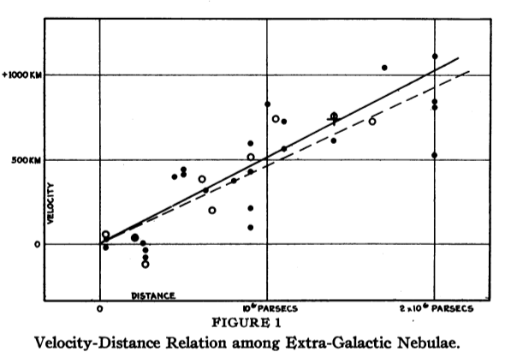
A Surprising Observation…
Other galaxies move AWAY from us
The further away they are, the
faster they are moving away!
Notes:
The Universe is “obviously” static. We deal with “wandering” in our Solar System (planets).
Einstein’s general relativity has a term – Lambda – which implies a “changing” universe, which he thought was obviously wrong, so we set that term to zero. (“My biggest blunder.”)
Always entertaining new ideas, how did he miss that one?
Hubble published in 1929; data collected and know for a couple of years before that.

Slide 17
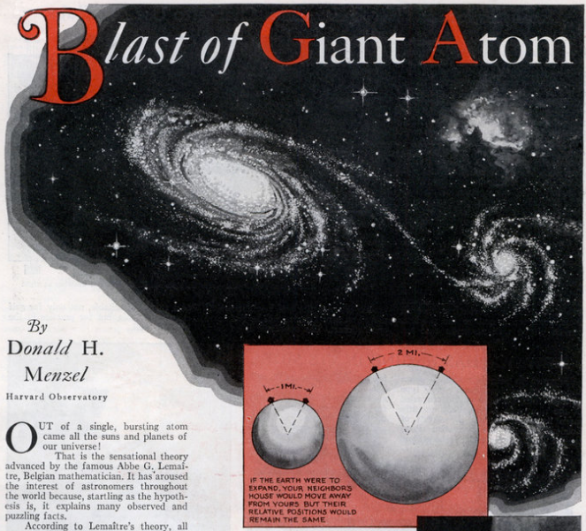
… leads to a new Model
Article in
“Modern Mechanix”
December, 1932.
Fr. George LeMaitre

Slide 18
Hubble to de Sitter:
Mr. Humason and I are both deeply sensible of your gracious appreciation of the papers on velocities and distances of nebulae. We use the term ‘apparent’ velocities to emphasize the empirical features of the correlation. The interpretation, we feel, should be left to you and the very few others who are competent to discuss the matter with authority.
Notes:
Emphasize the “interpretation” caveat on the diagram
“Hubbles Law” formulated as an EMPIRICAL relation between V and D.

Slide 19
What observations does this predict?
There should be nothing older than
the age of the Universe ~ 1/H
Uh oh! Rocks dated to be
4 Billion years old.
The Universe (cooled off now) should
still “glow” with black body radiation,
peaking at microwave frequencies.
Very faint, so let’s build an antenna
to look for this!
Notes:
Work out 1/H for H=500 km/sec/Mpar
1 par = distance corresponding to parallax of one arcsecond”
= 206e3 AU
= 3.26 ly
= 31e15 m
T = (1e6*31e15m)/(5e5 m/sec)
= 6.2e16 sec * (1 year/pi 1e7 sec)
= 2e9 years

Slide 20
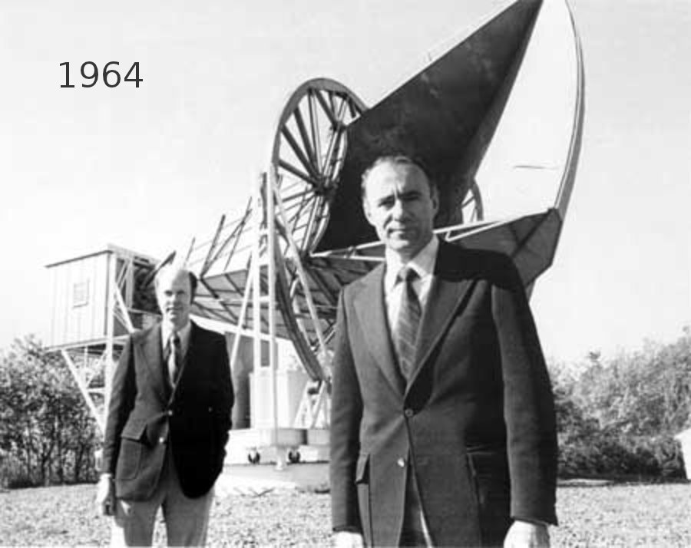
Notes:
Had Arno Penzias and Robert Wilson known in 1964 of the prediction of Alpher and Herman sixteen years earlier, the two Bell scientists would have been spared a year’s work trying to uncover the source of the noise in their horn antenna. Had [Robert] Dicke been aware of the prediction, he could have begun work on his own antenna years earlier without having to wait for Jim Peebles to do the theoretical calculations from scratch.
John C. Mather, John Boslough, The Very First Light, New York: Basic Books, 1996, pp. 49-50.
For decades, there was a “consensus view” that a steady state theory was true. Einstein was “more comfortable philosophically” with it.
It “predicted” (actually post-dicted” the wavelength shift/distance relationship. A big supporter of the “big bang” theory, George Gamow,
Was kind of outspoken.

Slide 21
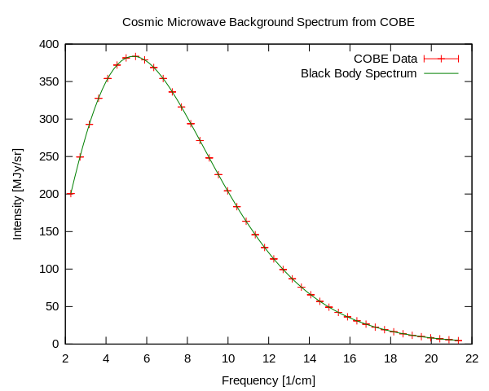
Notes:
COBE was launched using its own rocket on 18 November 1989.
The first results were received after nine minutes of observations: COBE had registered a perfect blackbody spectrum.
When the curve was later shown at a meeting of the American Astronomical Society in January 1990, the results received a standing ovation.

Slide 22
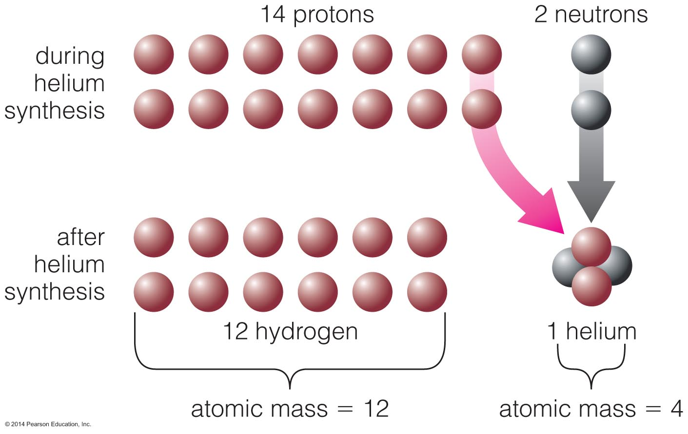
Bonus way to falsify the theory
Big Bang Nucleosynthesis model prediction: 75% H, 25% He (by mass). This matches observations.
Notes:
Gamow, Alpher and Herman proposed the hot Big Bang as a means to produce all of the elements in the 1940s. The key paper is the “Alpher-Bethe-Gamow” paper. (Get it?)
There was, however, a rumor that later, when the alpha, beta, gamma theory went temporarily on the rocks, Dr. Bethe seriously considered changing his name to Zacharias.
The close fit of the calculated curve and the observed abundances is shown in Fig. 15, which represents the results of later calculations carried out on the electronic computer of the National Bureau of Standards by Ralph Alpher and R. C. Herman (who stubbornly refuses to change his name to Delter.)

Slide 23
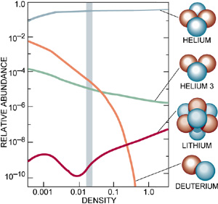
Notes:
One problem is that the overall DENSITY was too low. In the 1970’s this is resolved by postulatin the existence of dark matter. This is shown on the horizontal axis, and at the indicated density all FOUR abundances match up – over many orders of magnitude.
The fact the Helium is nowhere seen to have an abundance below 23% (mass) is very strong evidence that the Universe went through an early hot phase.

Slide 24
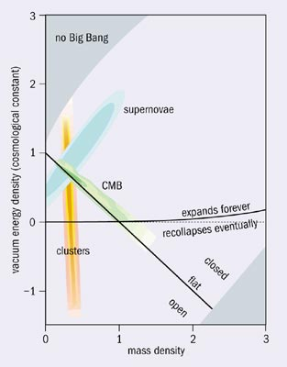
Notes:
Two of the parameters from the standard model.
The fact that different ways to measure give the same answer is amazing!
Draw on the board a fit to N points and a parabola…why not cubic?

Slide 25
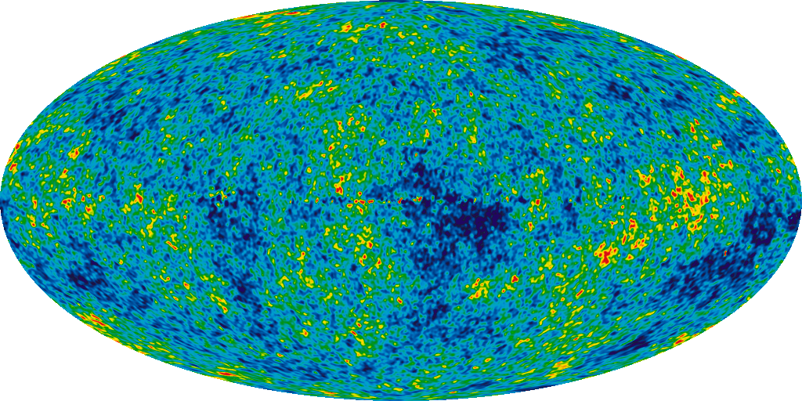
WMAP temperatures
Temperature variation of +/- 200 micro Kelvin
Notes:
The Wilkinson Microwave Anisotropy Probe launced in 2001, with a 12-year mission.
December 20, 2012 the nine-year data sample gave an age to the universe of 13.74 +/- 0.11 Billion Years.
After removing 3 milli Kevin dipole due to motion of ~ 300 km/Sec
Changed the hubble constant from “between 50 and 100” to “70.4 +/- 1.4’

Slide 26
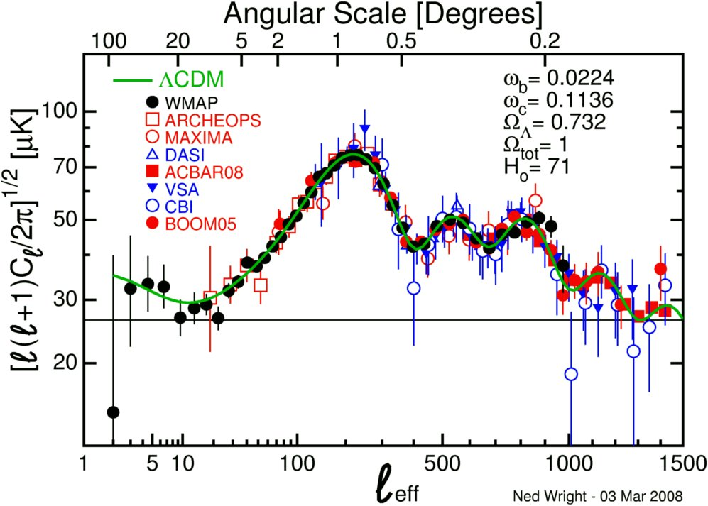
Notes:
Describe this plot and refer to the map on the previous picture.

Slide 27
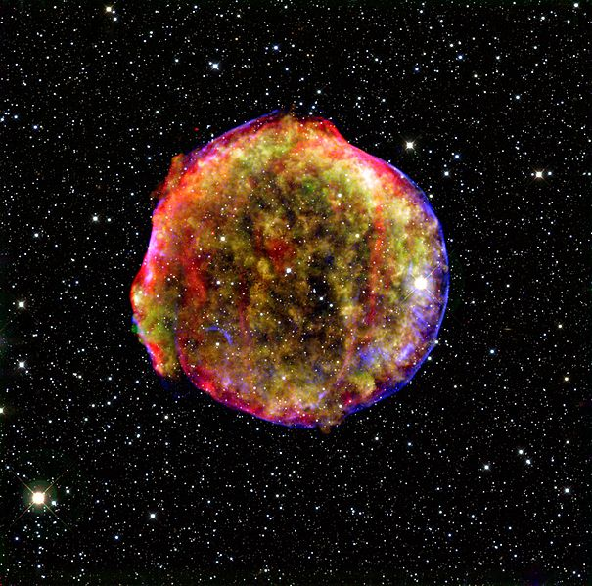
Notes:
This is a combined X-ray and infrare image of a supernove – ‘Tycho’s nova’ of 1572. This is the remnant of a Type Ia supernova.

Slide 28
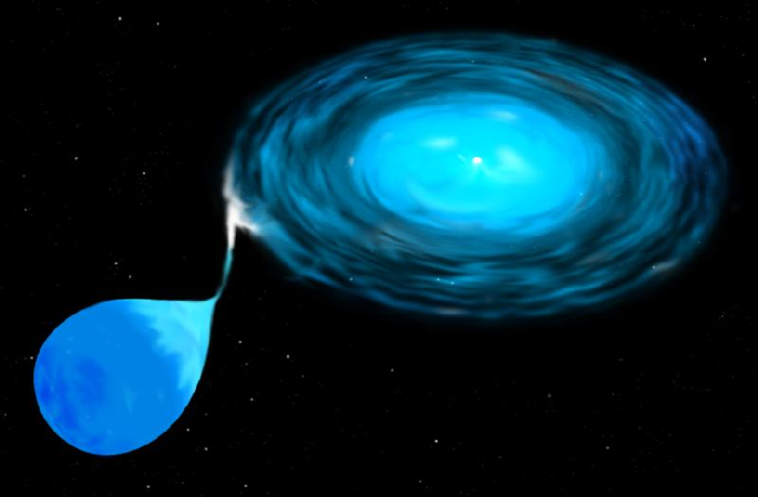
Notes:
The “small” star is not quite big enough to explode. The giant star next to it slowly feeds mass, until it gets just big enough to explode.
The key thing here is that all type Ia supernovae explode at the same mass, and hence with the same power – they are calibrated “standard candles” than can be seen very far away.

Slide 29
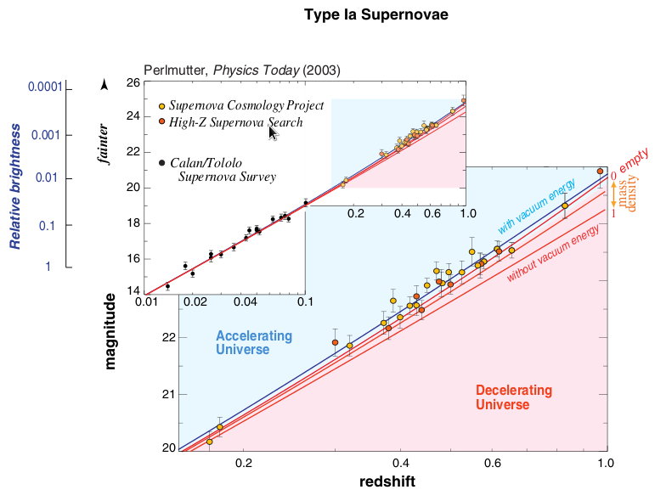
Notes:
The apparent brightness tells us how far away they are.
The redshift tells you the velocity.
So we get a Hubble diagram – but going much farther away!

Slide 30
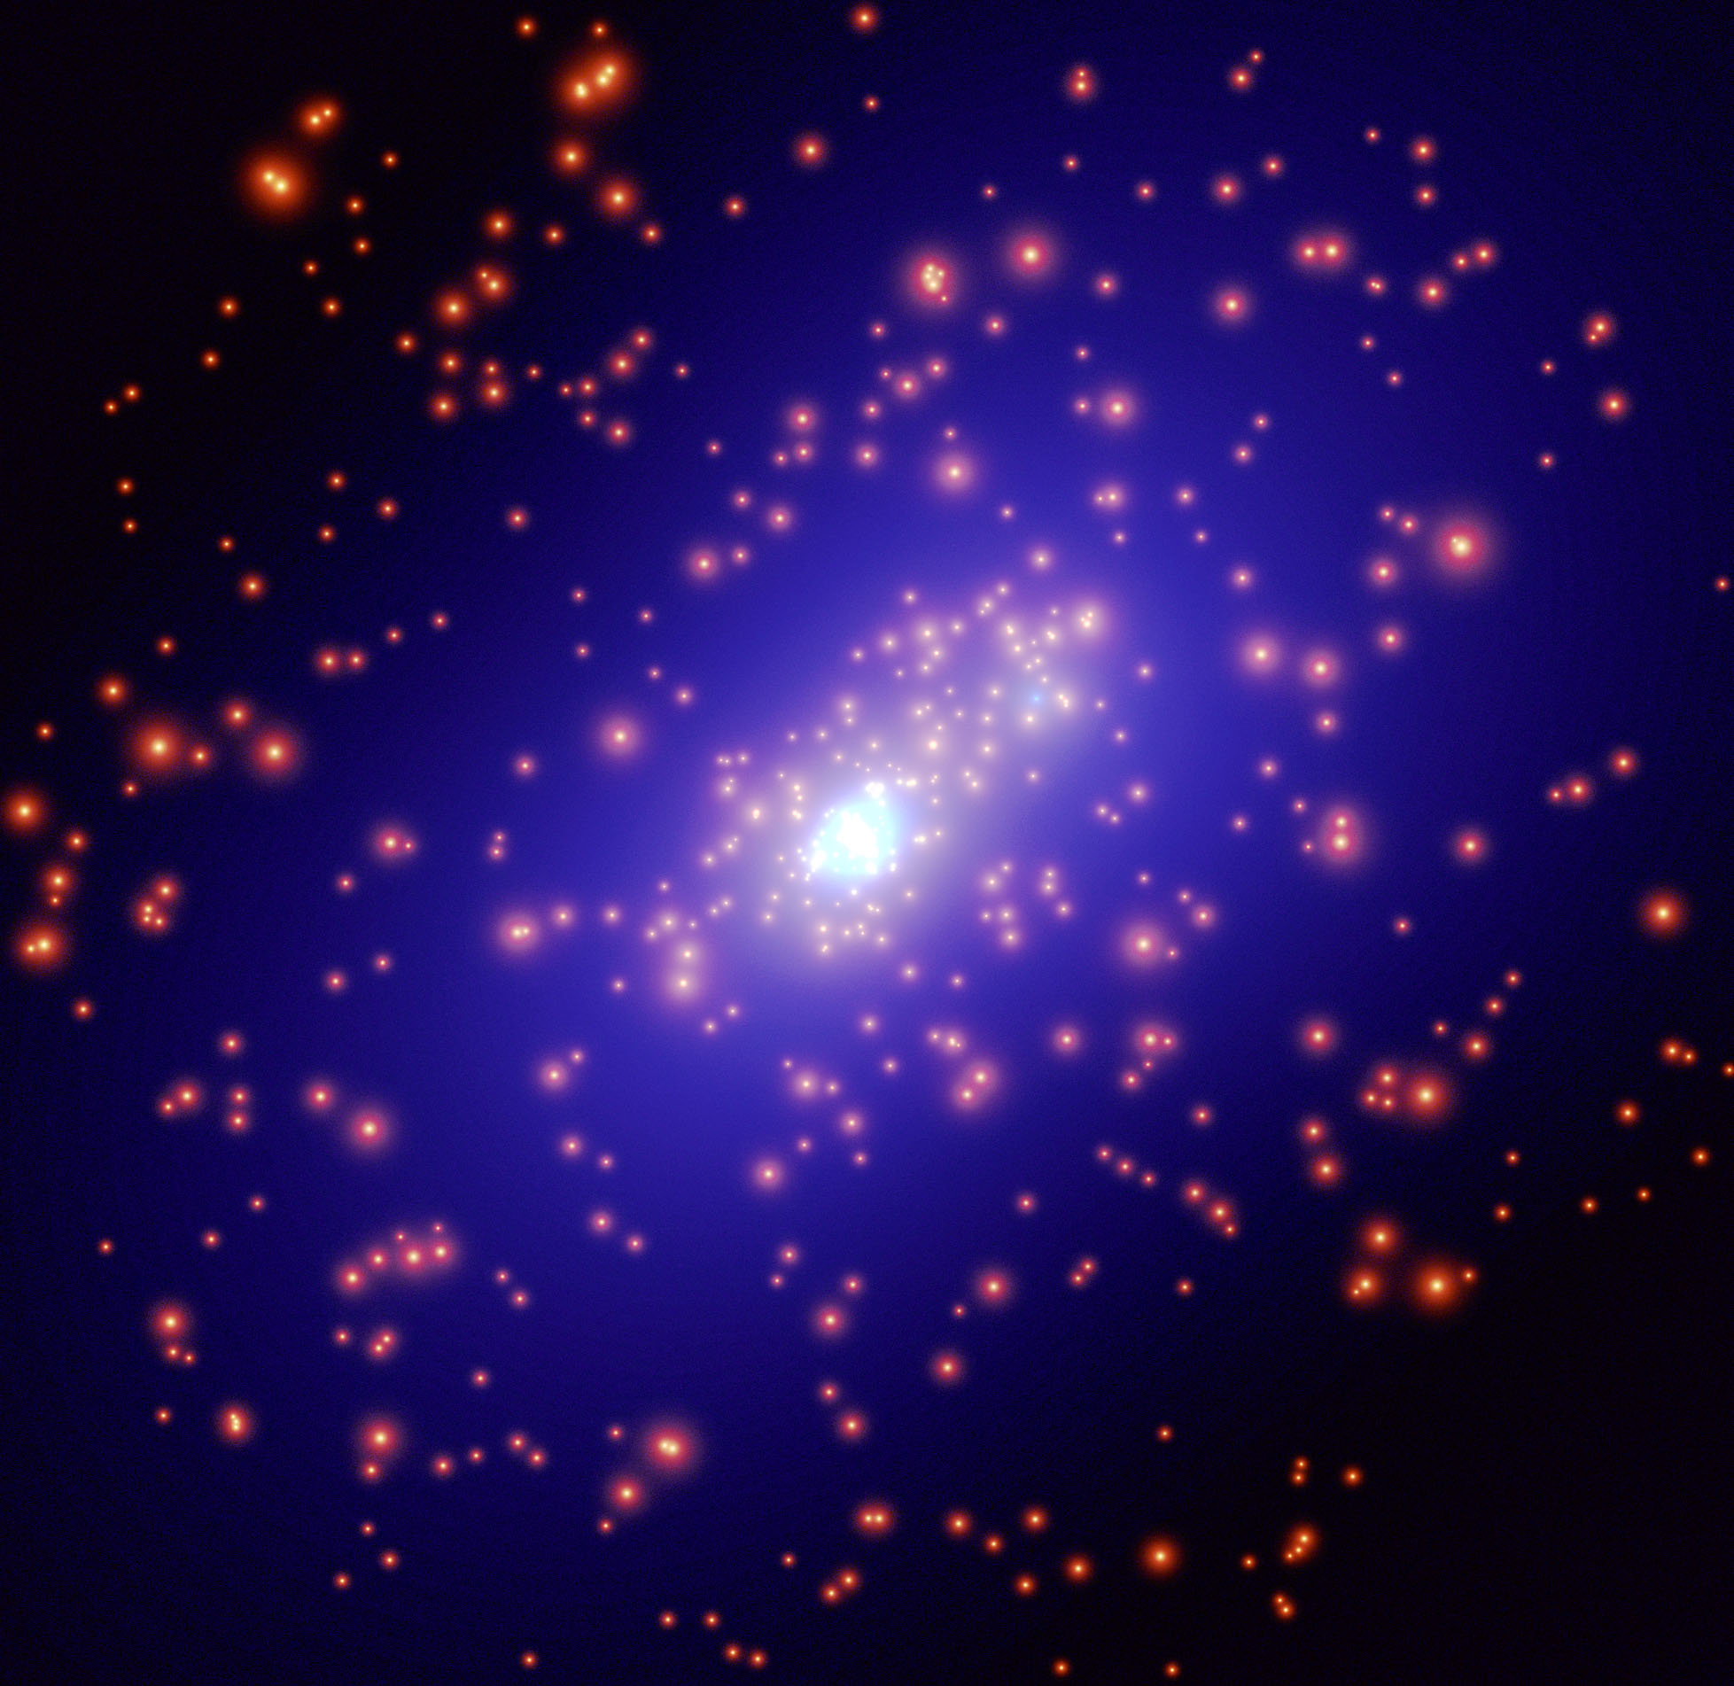
Galaxy Cluster Cosmology
Notes:
Cluster of galaxies Cl0024+1654, with visible galaxies in red and the inferred distribution of dark matter in blue. Jean-Paul Kneib and collaborators used the Hubble Space Telescope to map more than 7000 galaxies in the background of this cluster. The shapes of these background galaxies are slightly distorted by the gravitational field of the mass in the cluster, a phenomenon known as "weak gravitational lensing." A computer model was used to determine the distribution of dark matter required to produce the observed distortions. From the European Space Agency.

Slide 31
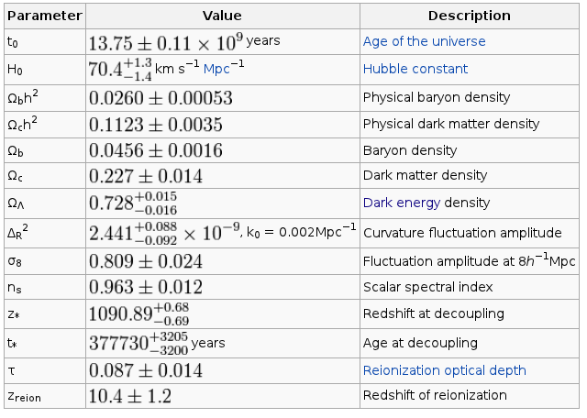

Slide 32
End of First Half
Up next:
What are we going to
do about the Universe?

Slide 33
Questions Raised
FLATNESS – if density is near 1 now, it must have started really close to 1.
HORIZON – how does the “left side” know what the “right side” is like; why are they the same temperature?

Slide 34
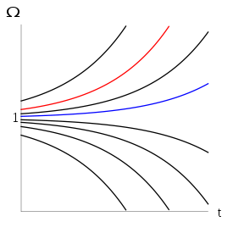
The Flatness and Horizon Problems

Slide 35
Cosmic Inflation
In a brief period of time; 10^-32 seconds
Volume of Universe increases 10^26 times
Drives the density of the universe to 1
Moves “connected” regions far away from us.
Accounts for what we see.
Not the only game in town, but the most popular.
Relies on “beauty contest” criteria

Slide 36
BICEP2
News Flash
Announcement on March 17, 2014

Slide 37
Background
In the 1970’s, some questions were raised about
Big Bang cosmology: the horizon problem,
the flatness problem, and the magnetic-monopole
problem.
Inflation proposed to solve this problem by
Alan Guth (1980) and Andrei Linde (1986) and
many others.

Slide 38
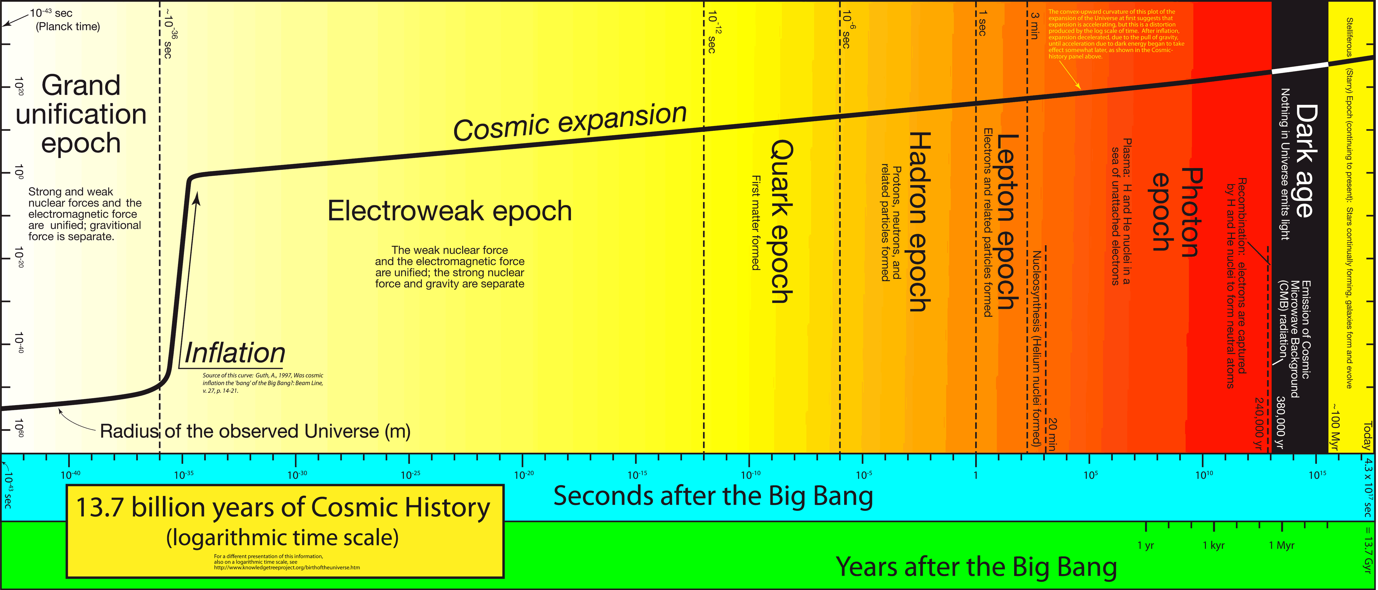
The “epoch” of inflation is from 10E-36 to 10E-32 seconds.
The size of the universe increased by 1E26
The post-dictions of Inflation solve the three problems and
predicts patterns of polarization.

Slide 39
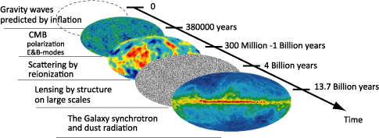

Slide 40
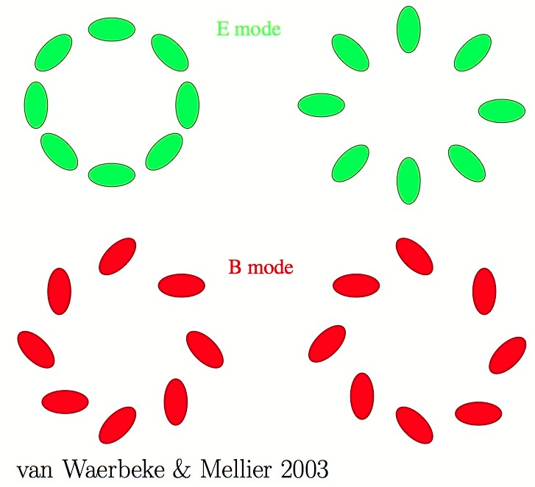

Slide 41
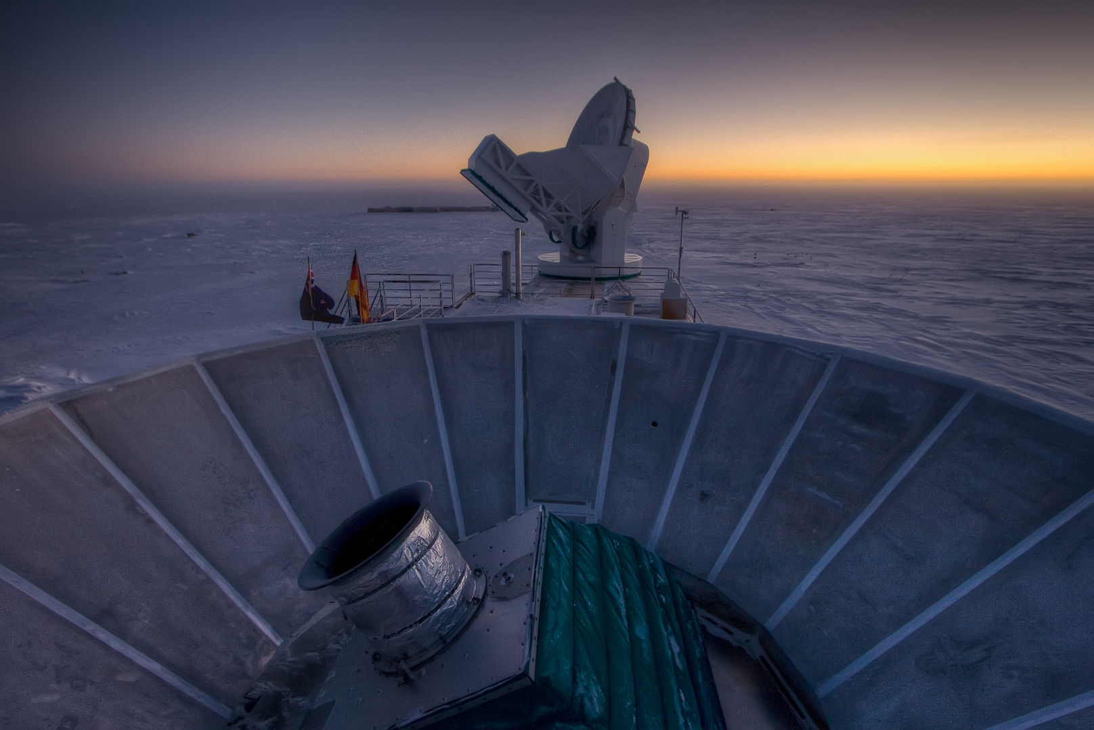
Sunset at the South Pole, with BICEP2 (in the foreground) and the South Pole Telescope in the
background. Image: Steffen Richter (Harvard University)

Slide 42
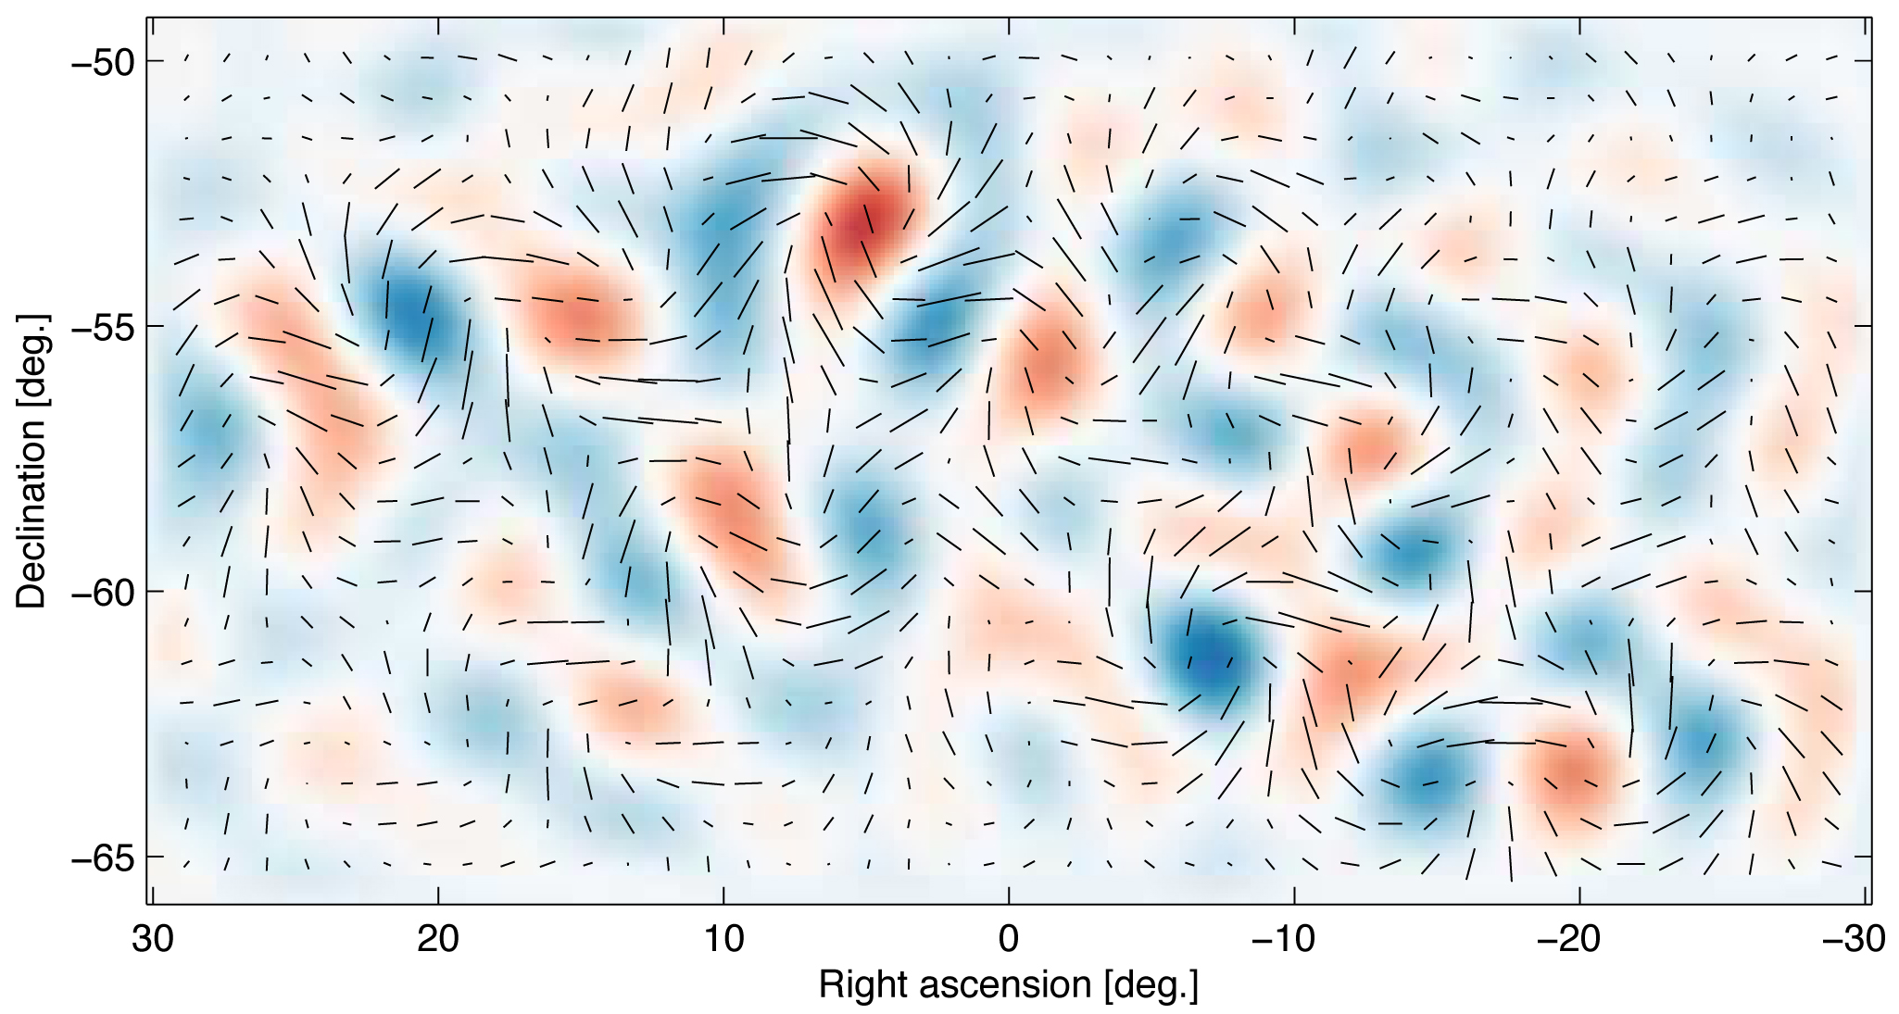
Primordial gravitational waves may have been detected in this swirly pattern of light from the early universe. Image: BICEP2 Collaboration

Slide 43
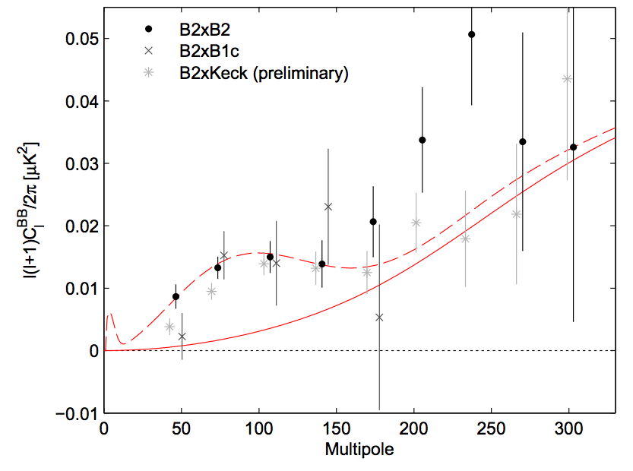

Slide 44
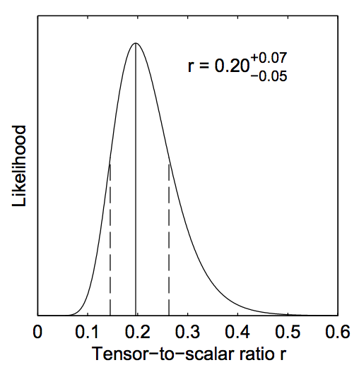
r measures “how much”
primordial gravitational
wave contribute to the
observation. The B-Modes (tensor) are due to gravitational waves. In this one place on the sky, they measured the ratio of B-modes to E-modes (Tensor to Scalar).

Slide 46
That is the Universe What are we going to do about it?
Increase Precision on the measurements
Does the % dark energy change with time?
Direct Detection of Dark Matter
Distinguish from modified gravity
Gravitational Waves
Direct detection
From near and far
Planck Scale – smallest space and time

Slide 47
Dark Energy Survey
Notes:
The Dark Energy Camera features 62 charge-coupled devices (CCDs), which record a total of 570 megapixels per snapshot.

Slide 48
Large Synoptic Survey Telescope (2014 construction start)
WIDE: A large aperture, wide field survey telescope and 3200 Megapixel camera to image faint astronomical objects across the sky.
FAST: LSST will rapidly scan the sky, charting objects that change or move: from exploding supernovae to potentially hazardous near-Earth asteroids.
DEEP: LSST’s images will trace billions of remote galaxies, providing multiple probes of the mysterious dark matter and dark energy.

Slide 50
MS-DESI
Mid-scale Dark Energy Spectroscopic Instrument
Parameter measurements are hundreds of times more precise
Project to design this instrument is approved
Taking data in 2018+

Slide 51
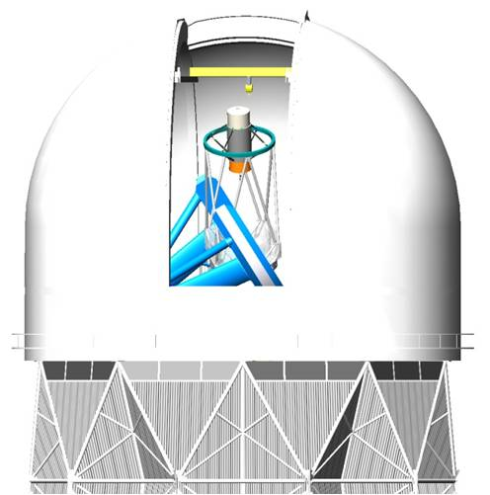

Slide 52
CMBPOL
Measurement of the polarization of the Cosmic Microwave Background (CMB) has the potential to provide one of the few quantitative observable consequences of the inflationary epoch. A community-wide study of the theory, analysis, instrumentation and technology is being supported by a NASA Mission Concept Study grant.
To be installed on existing “South Pole Telescope”

Slide 53
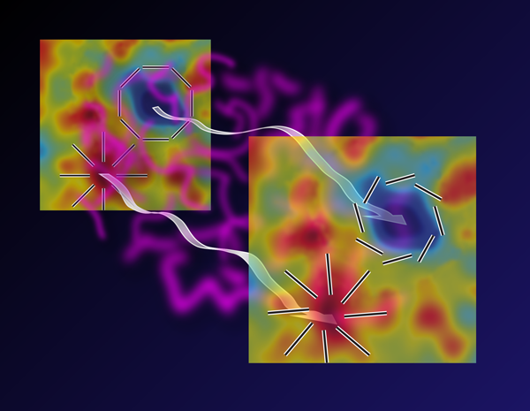
Notes:
When the cosmic microwave background (CMB) originated 13.7 billion years ago (represented by the map on the left), it was polarized with radial and tangential patterns around hot (red) and cold (blue) regions, respectively. This E-mode polarization has been previously observed in CMB measurements. However, gravitational lensing from intervening matter (purple) causes a slight twist in the primeval pattern (shown in the map on the right). This B-mode polarization has been detected for the first time by the SPT Collaboration.

Slide 54
Direct Detection of Dark Matter

Slide 55
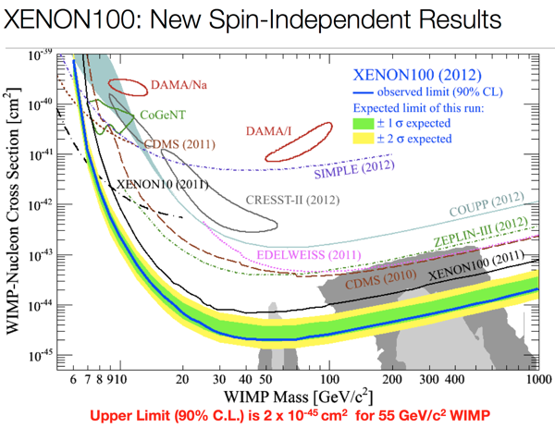

Slide 56
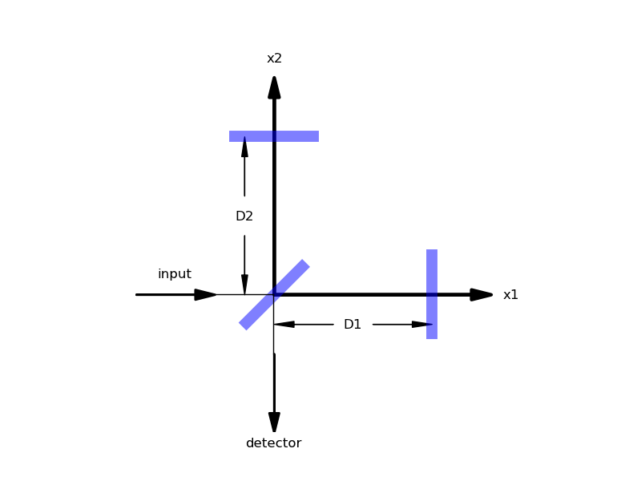
Interferometers
Notes:
Gravitational Wave Detector
Holometer

Slide 57
The Next Big Thing

Slide 58
Across the Earth, right now, millions of people are looking up into the night sky. No one owns the stars or the planets or the Milky Way. No one owns the Moon. We all see the same sky, and the sky belongs to all mankind; it is our inheritance from the Creation of the Universe.
I believe this is a part of basic human rights — the right to wonder. It is also the most revolutionary of human rights, because it is the right to question and discover. It is the right to lift our souls and hopes into the sky, and to receive in return a sense of connection among human beings that transcends all boundaries and that, one day, may bring us peace.
-- Nicholas B. Suntzeff
Notes:
http://giving.tamu.edu/faculty/archives/SuntzeffCosmology.aspx

