Slide 1
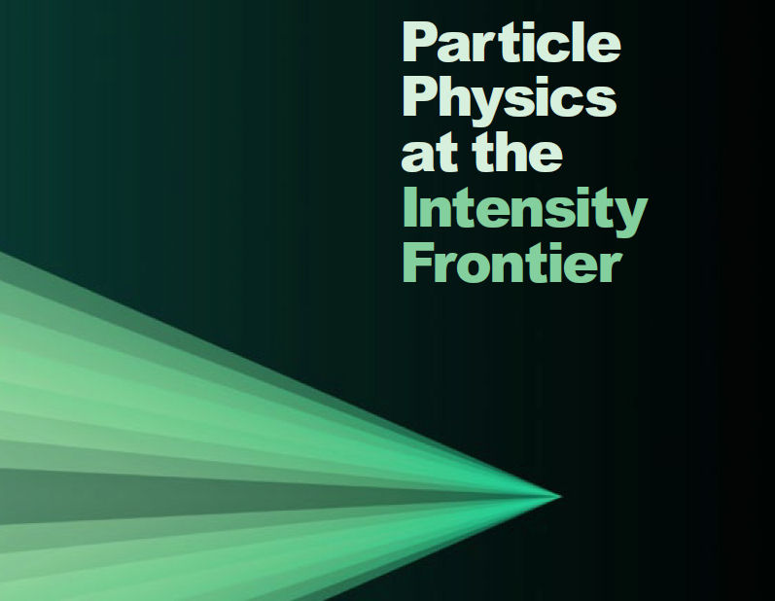
Neutrinos from Stored Muons: νSTORM
A new paradigm for neutrino physics & a path to the future?

Slide 2
Motivation
The idea of using a muon storage ring to produce neutrino beams for experiments is not new
1 GeV – Neuffer in 1980
nuSTORM can:
Address the large δm² ν oscillation regime
Provide beam for precision ν interaction physics
Provide an accelerator technology test bed
potential for intense low E muon beam
Muon Collider → Energy Frontier
Provides a μ decay ring R&D (instrumentation) & technology demonstration platform
Provides a ν Detector Test Facility

Slide 3
μ-based ν beams
Flavor content fully known
“Near Absolute” Flux Determination is possible in a storage ring
Beam current, beam divergence monitor, μ_{p} spectrometer
Overall, there is tremendous control of systematic uncertainties with a well designed system

Slide 4
nuSTORM
100 kW Target Station
Assume 60-120 GeV protons (Fermilab PIP)
Graphite target
Optimization on-going
Horn collection after target
π collection/transport channel π injected into decay ring
Decay ring
Large aperture FODO
Instrumentation: BCTs, mag-Spec in arc, polarimeter

Slide 5
π Transport Line

Slide 6
FODO Decay ring
Alex Bogacz JLAB
Ao Liu Fermilab
3.8 GeV/c ± 10% momentum acceptance, circumference = 350 m

Slide 7
μs at end of first straight

Slide 8
Looking to the Energy Frontier
Only 40% of πs decay in straight
Need π absorber

Slide 9
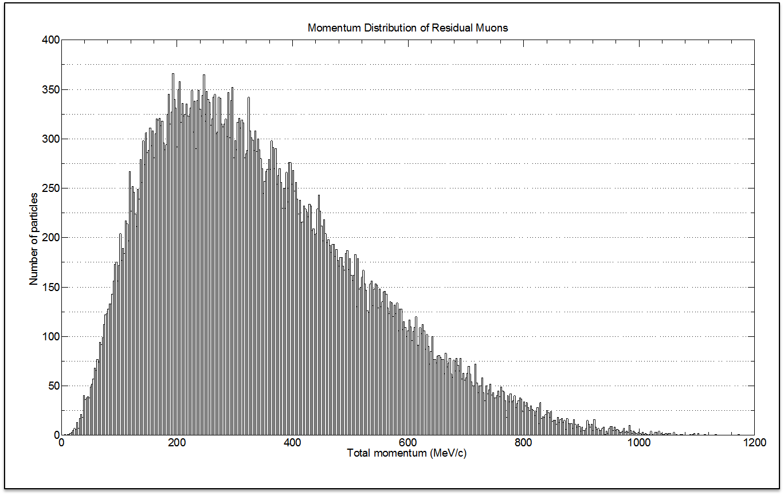
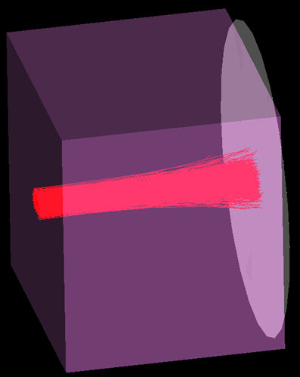
Low Energy μ beam
At end of straight we
have a lot of πs, but
also a lot of μs with
4.5 < P(GeV/c) < 5.5
After 3.48m Fe, we have ≈ 10¹⁰ μ/pulse in 100 < P(MeV/c) < 300

Slide 10
The Physics Reach
SBL oscillation appearance channel
ν_{e} → ν_{μ}
NF “Golden” channel

Slide 11
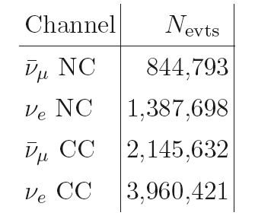
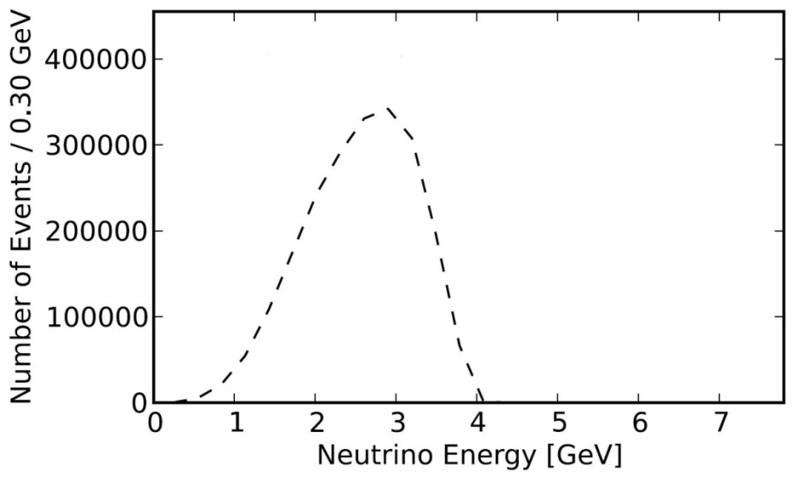
E_{ν} spectra (μ⁺ stored)
Chris Tunnell
Oxford
Event rates/100T
at ND hall 50m
from straight with
μ⁺ stored
ν_{e}
N_{μ} = (POT) X (π/POT) X ε_{collection} X ε_{inj} X (μ/π) X A_{dynamic} X Ω
10²¹ POT in 5 years of running @ 60 GeV in Fermilab PIP era
0.1 π/POT (FODO)
ε_{collection} = 0.8
ε_{inj} = 0.8
μ/π = 0.08 (γct X μ capture in π → μ decay) [π decay in straight]
A_{dynamic} = 0.75 (FODO)
Ω = Straight/circumference ratio (0.43) (FODO)
This yields ≈ 1.7 X 10¹⁸ useful μ decays
ν_{μ}-bar

Slide 12
Experimental Layout
Appearance
Channel:
ν_{e} → ν_{μ}
Golden Channel
Must reject the
“wrong” sign μ with
great efficiency
150
~ 2000 m
Why ν_{μ} → ν_{e}
Appearance Ch.
“not” possible

Slide 13
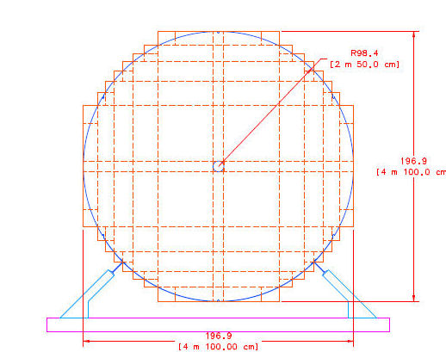
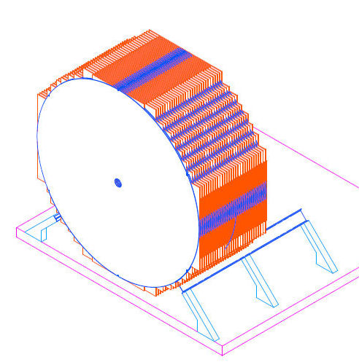
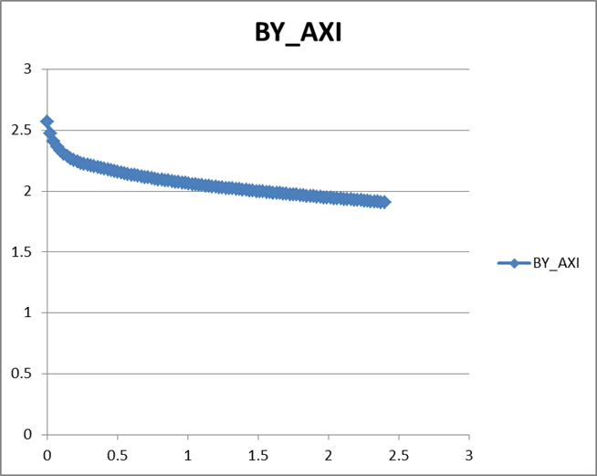
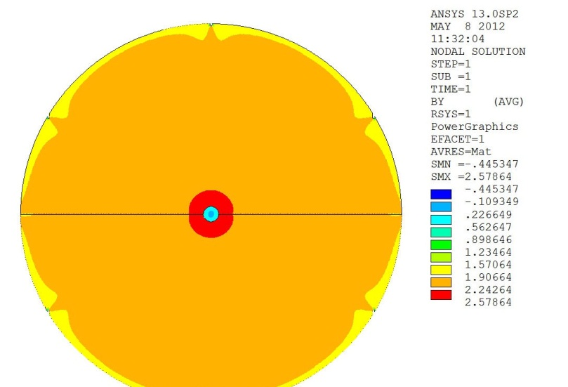
Baseline Detector Super B Iron Neutrino Detector: SuperBIND
Magnetized Iron
1.3 kT
Following MINOS ND ME design
1-2 cm Fe plate
6 m diameter
Utilize superconducting transmission line for excitation
Developed 10 years ago for VLHC
Extruded scintillator +SiPM
X&Y readout between plates
20 cm hole
For 6-8 turns
of STL

Slide 14
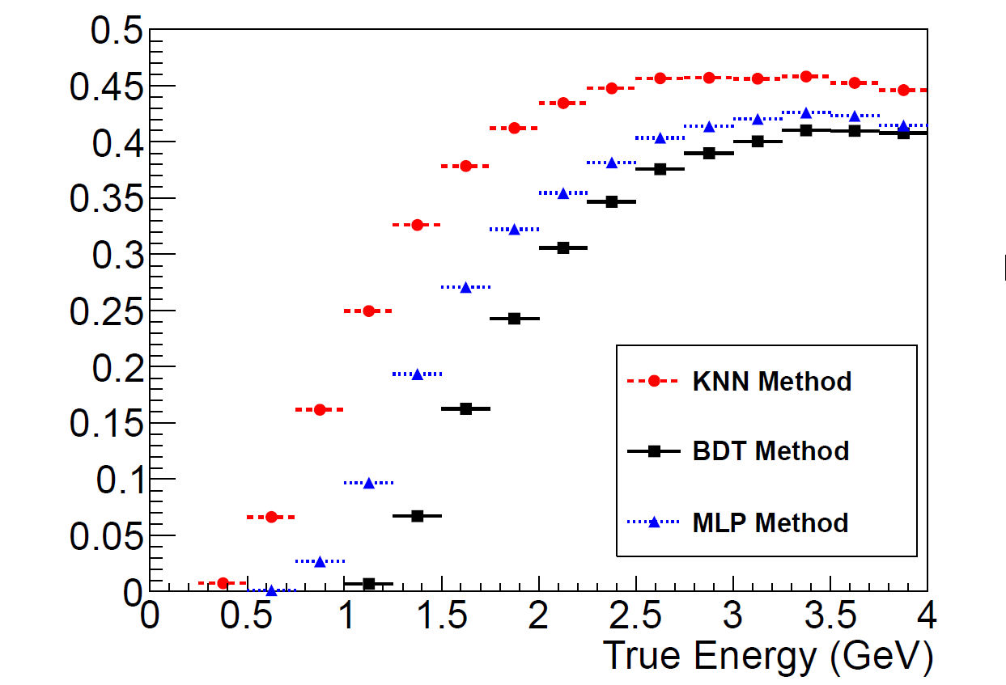
Multivariate Analysis CC-NC discrimination
Ryan Bayes
Steve Bramsiepe
Glasgow
2 cm plates
Updated reconstruction
Tested 3 multi-variate methods
KNN
BDT
MLP
Goal to reduce threshold & increase eff.
BDT Best
Lower Bkgs.
Clearly, raising our peak E_{ν} by .5 to 1 GeV would help

Slide 15
ν_{e} → ν_{μ} appearance CPT invariant channel to LSND/MiniBooNE
2 cm plate

Slide 16
ν_{e} → ν_{μ} appearance
Preliminary
3+1
Assumption

Slide 17
Project Considerations

Slide 18
Siting
≈ 2000 m

Slide 19
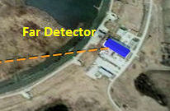
Far Detector Hall and Detector(s)

Slide 20
Moving Forward

Slide 21
Important steps to move forward
Two workshops are planned
CERN: March 26-27
Virginia Tech: April 12-13
Aim:
Consolidate technical options
Define work-packages
Identify possible collaborative topics
Production of Full Proposal to Fermilab (June 2013 PAC & Snowmass)

Slide 22
nuSTORM: Conclusions
The Physics case:
Initial simulation work indicates we can confirm/exclude at 10σ (CPT invariant channel) the LSND/MiniBooNE result
ν_{μ} and (ν_{e} ) disappearance experiments delivering at the <1% level look to be doable
Simulation work on these channels has not yet started
ν interaction physics studies with near detector(s) offer a unique opportunity & can be extended to cover 0.2<GeV< E_{ν}< 4 GeV
Provides valuable data for LBL experiments: ν_{e} & ν_{e}-bar x-sections
Could be “transformational” w/r to ν interaction physics
For this physics, nuSTORM should really be thought of as a facility: A ν “light-source” is a good analogy
nuSTORM provides the beam & users will bring their detector to the near hall

Slide 23
Conclusions II
The Facility:
Presents very manageable extrapolations from existing technology
But can explore new ideas regarding beam optics and instrumentation
Offers opportunities for extensions
Add RF for bunching/acceleration/phase space manipulation
Provide μ source for 6D cooling experiment with intense pulsed beam
Move P_{μ} to 5 Gev/c & set stage for future phase of LBL program?

Slide 24
Back Ups for Q&A

Slide 25
The “Collaboration”
P. Kyberd,¹ D.R. Smith,¹ L. Coney,² S. Pascoli,³ C. Ankenbrandt,⁴ D. Adey⁴, S.J. Brice,⁴ A.D. Bross,⁴ H. Cease,⁴ J. Kopp,⁴ N. Mokhov,⁴ J. Morfin,⁴ D. Neufer,⁴ M. Popovic,⁴ P. Rubinov,⁴ S. Striganov,⁴ A. Blondel,⁵ A. Bravar,⁵ F. Dufour⁵, Y. Karadhzov⁵, A. Korzenev⁵,E. Noah,⁵ M. Ravonel⁵, M. Rayner⁵, R. Asfandiyarov⁵, A. Haesler⁵, C. Martin⁵, E. Scantamburlo⁵, F. Cadoux⁵, R. Bayes,⁶ F.J.P. Soler,⁶ D. Colling⁷, A. Dobbs,⁷ J. Dobson⁷, P. Dornan⁷, K. Long,⁷ J. Pasternak,⁷ E. Santos,⁷ J.K. Sedgbeer⁷, M.O. Wascko,⁷ Y. Uchida⁷, S.K. Agarwalla,⁸ S.A. Bogacz,⁹ Y. Mori,¹⁰ J.B. Lagrange,¹⁰ A. de Gouvêa,¹¹ Y. Kuno,¹² A. Sato,¹² V. Blackmore,¹³ J. Cobb,¹³ C. D. Tunnell,¹³ A. Webber¹³, J.M. Link,¹⁴ P. Huber,¹⁴ and W. Winter¹⁵, K.T. McDonald¹⁶, R. Edgecock¹⁷, W. Murray¹⁷, S. Ricciardi¹⁷, C. Rogers¹⁷, C. Booth¹⁸, M. Dracos¹⁹, N. Vassilopoulos¹⁹, J.J. Back²⁰, S.B. Boyd²⁰, P.F. Harrison²⁰
¹Brunel University, ²University of California, Riverside,
³Institute for Particle Physics Phenomenology, Durham University
⁴Fermi National Accelerator Laboratory, ⁵University of Geneva
⁶University of Glasgow, ⁷Imperial College London, ⁸Instituto de Fisica Corpuscular, CSIC and Universidad de Valencia, ⁹Thomas Jefferson National Accelerator Facility, ¹⁰Kyoto University,
¹¹Northwestern University, ¹²Osaka University, ¹³Oxford University, Subdepartment of Particle Physics, ¹⁴Center for Neutrino Physics, Virginia Polytechnic Institute and State University
¹⁵Institut für theoretische Physik und Astrophysik, Universität Würzburg
¹⁶Princeton University, ¹⁷STFC Rutherford Appleton Laboratory, ¹⁸University of Sheffield,
¹⁹IPHC, Universit´e de Strasbourg, ²⁰University of Warwick
LOI submitted to Fermilab PAC, June 2012 (P=1028)
nuSTORM: input to the update of the European Strategy for Particle Physics, July 2012

Slide 26
Physics

Slide 27
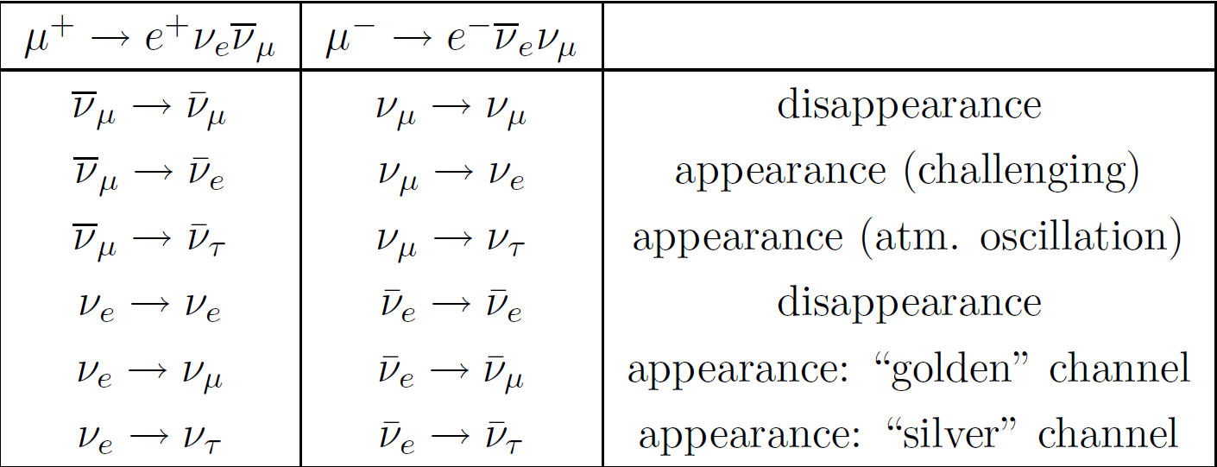
ν physics with a μ storage ring
For the past decade+, the focus has been on ν oscillation physics
12 channels accessible
if E_{ν} is above the τ threshold

Slide 28
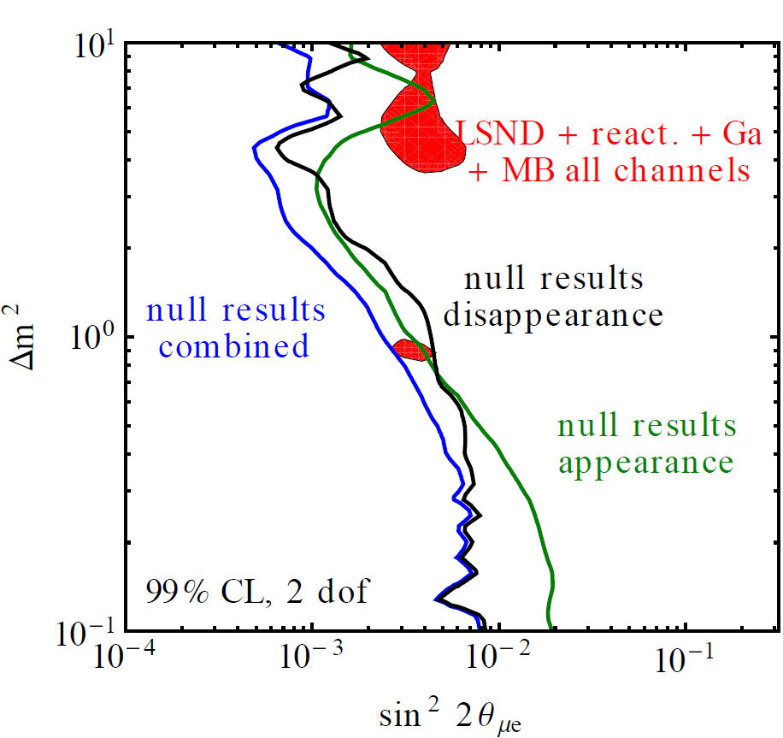
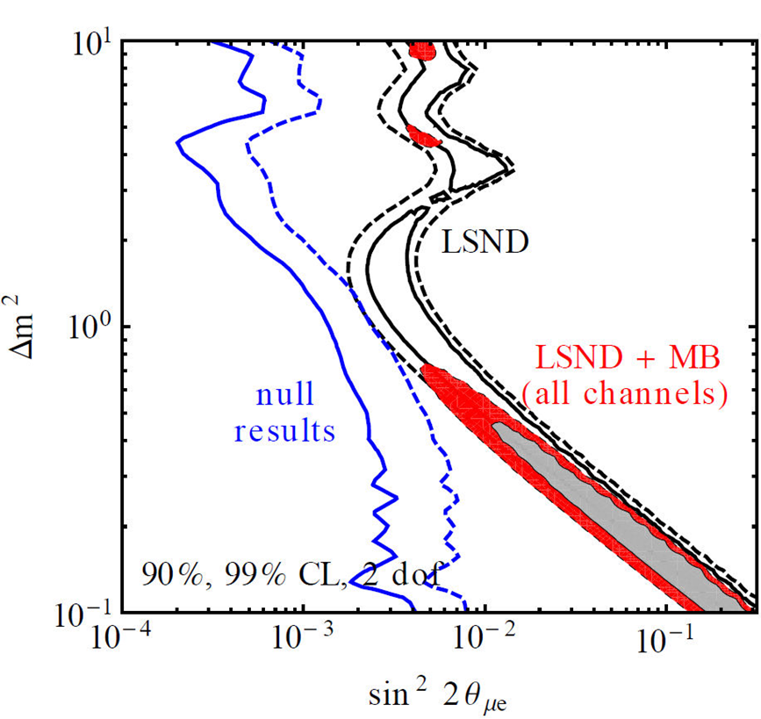
Short-baseline ν oscillation studies
Sterile neutrinos arise naturally in many extensions of the Standard Model.
GUT models
Seesaw mechanism for ν mass
“Dark” sector
Usually heavy, but light not ruled out.
Experimental hints
LSND
MiniBooNE
GA
Reactor “anomaly”
3+1
Kopp, Machado, Maltoni & Schwetz (work in progress) & arXiv:1103.4570".

Slide 29
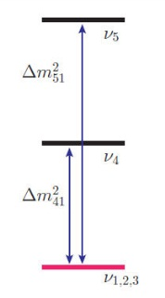
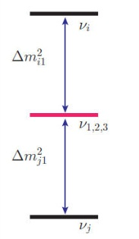
3 + 2 Models
3+2
Models with 2 sterile neutrinos provide better fits to the data
1+3+1
arXiv:1204.5379v1
arXiv:1103.4570
Kopp, Maltoni & Schwetz

Slide 30
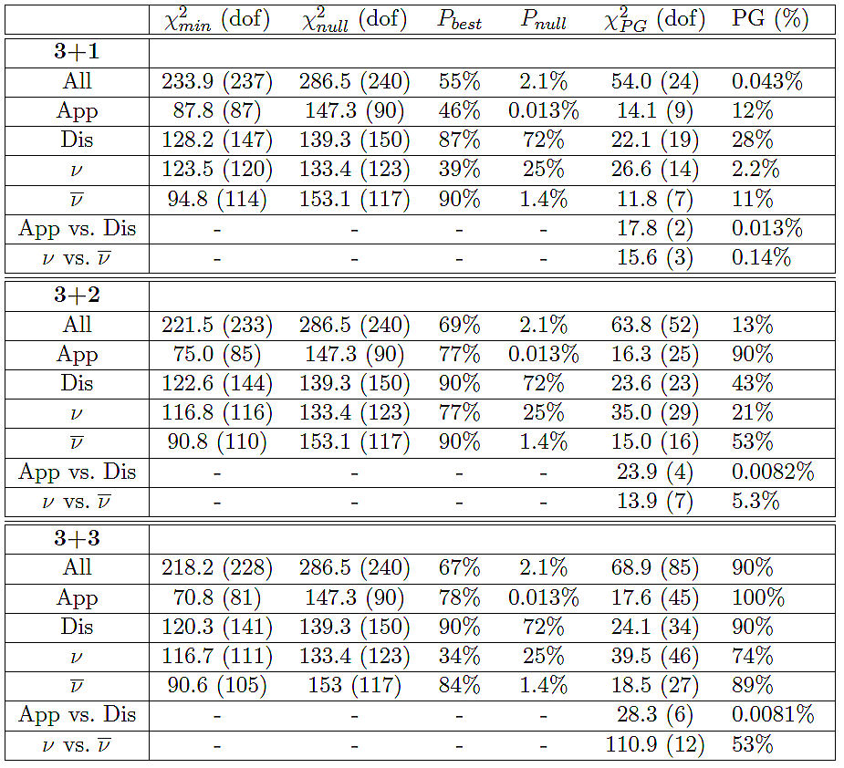
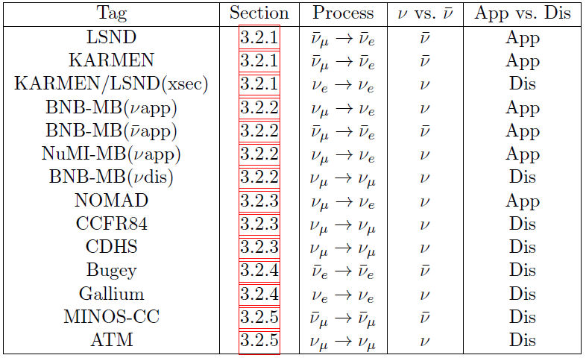
3 + 3 Model
A 3+3 model has recently been shown to better fit all available data
J.M. Conrad, C.M. Ignarra, G. Karagiorgi, M.H. Shaevitz, J. Spitz (arXiv:1207.4765v1)

Slide 31
Raw Event Rates
3+1
Assumption
Appearance channels

Slide 32
“Golden Channel” Robustness
Bkg uncertainty:
10% → 20%

Slide 33
Required μ charge mis-ID rate needed for given sensitivity

Slide 34
Background rates
On-going work
to understand

Slide 35
S:B for Appearance Channel Past and Future(?)
Experiment | S:B
LSND | 2:1
MiniBooNE | 1:1 → 1:2
ICARUS/NESSiE | ≈1.5:1 / 1:4
LAr-LAr | 1:4
K⁺ DAR | ≈4:1
LSND Reloaded | 5:1
oscSNS | 3:1
nuSTORM | 11:1
Note: There are a number of experiments with megaCi to petaCi sources next to large detectors that have an exquisite signature of steriles (# evts/unit length displays oscillatory behavior in large detector) and have large effective S:B
SNO+Cr, Ce-Land, LENS, Borexino, Daya Bay
IsoDAR
A number of very-short baseline reactor experiments

Slide 36
NF Upgrade path
2020 – T2K, NOνA and Daya Bay
LBNE – 1300 km, 34 kt
0.7MW, 2 × 10⁸ s (10 yrs)
LBNO – 2300 km, 100 kt
0.8MW, 1 × 10⁸ s (10 yrs)
T2HK – 295 km, 560 kt
0.7MW, 1.2×10⁸ s (10 yrs)
0.025 IDS-NF
700kW (5 yrs)
no cooling
2 × 10⁸ s running time
10 kt detector
Still Very Expensive
LBNE (10kt, surface)
P. Coloma, P.Huber, J. Kopp, W. Winter, in preparation

Slide 37
5 GeV, Low-luminosity NF
E. Christensen, P. Coloma, and P. Huber arXiv:1301.7727

Slide 38
ν Interaction Physics

Slide 39
E_{ν} spectra (μ⁺ stored)
Integrated over the 150 m straight at a position 50m from the end of the straight with 3m diameter detector
NOTE: The transport line and ring could be re-tuned for 2 GeV/c μ and move these spectra lower by » a factor of two with some drop in μ production efficiency

Slide 40
ν Cross-section measurements
The next generation of LB experiments face some significant challenges
CP asymmetry decreases with increasing sin²2θ₁₃
Well…. I should say that the CP asymmetry IS small
Flux and cross-sections must be known to much better than 5%
Gaining a better understanding of x-sections may be crucial to these future experiments
The energy range of interest is roughly 1-3 GeV
μ storage rings provide the only way to get large sample of ν_{e} and ν_{μ} interactions (both neutrino and anti-neutrino) in a single experiment and:
With μ decay ring instrumentation we anticipate getting the flux uncertainty below 1% and
With a well designed suite of near detectors, x-sections can be measured to the few % level or less.
Great deal of ND work for LBNE, LBNO & IDS-NF
Reach an overall systematic uncertainly that is very difficult (impossible?) in conventional ν beams

Slide 41
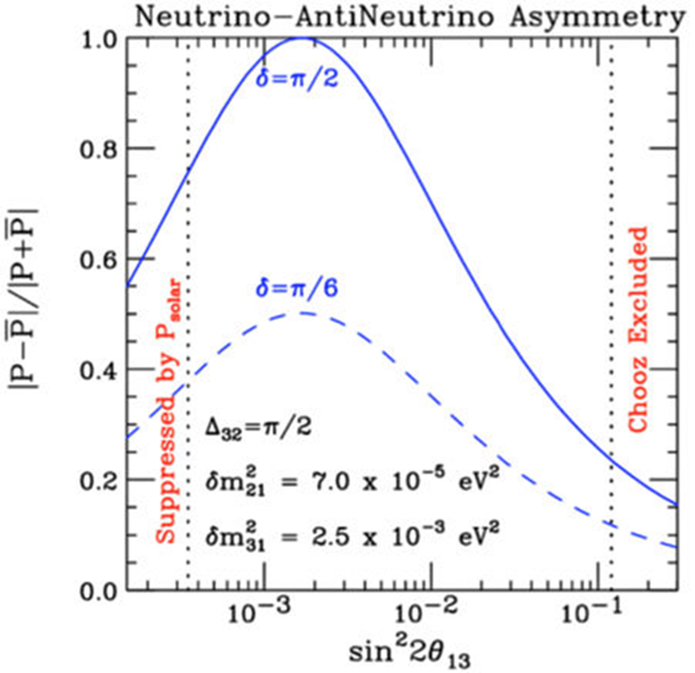
ν Cross-section measurements
Cross-section measurements
μ storage ring presents only way to measure ν_{μ} & ν_{e} & ( ) x-sections in same experiment
Supports future long-baseline experiments
Important to note that with θ₁₃ large, the asymmetry you’re trying to measure is small, so:
Need to know underlying ν/νbar flux & σ more precisely
Bkg content & uncertainties start to become more important

Slide 42
ν Interaction Physics A partial sampling
ν_{e} and ν_{e}-bar x-section measurements
π⁰ production in ν interactions
Coherent and quasi-exclusive single π⁰ production
Charged π & K production
Coherent and quasi-exclusive single π⁺ production
Multi-nucleon final states
ν-e scattering
ν-Nucleon neutral current scattering
Measurement of NC to CC ratio
Charged and neutral current processes
Measurement of ν_{e} induced resonance production
Nuclear effects
Semi-exclusive & exclusive processes
Measurement of K_{s}⁰, Λ & Λ-bar production
New physics & exotic processes
Test of ν_{μ} - ν_{e} universality
Heavy ν
eV-scale pseudo-scalar penetrating particles
Over 60 topics (thesis)
accessible at nuSTORM

Slide 43
Cost based on LBNE costs Fully loaded and escalated
Sub System | Cost M$¹
Primary Beam Line | 39
Target Station | 56
Transport Line | 14
Decay Ring | 82
Near Hall | 29²
Far Detector | 25³
Sub Total | 245
Project Office | 37⁴
Total | 282
¹No allowances made for reuse of existing equipment
²Near Hall sized for multiple experiments & ND for SBL oscillation physics
³Far Detector cost based on MINOS as-built + full burdening + escalation & no
allowance for existing FD Hall
⁴Assumes LBNE estimate of ≈ 15% (including contingency)

Slide 44
Detector Considerations

Slide 45
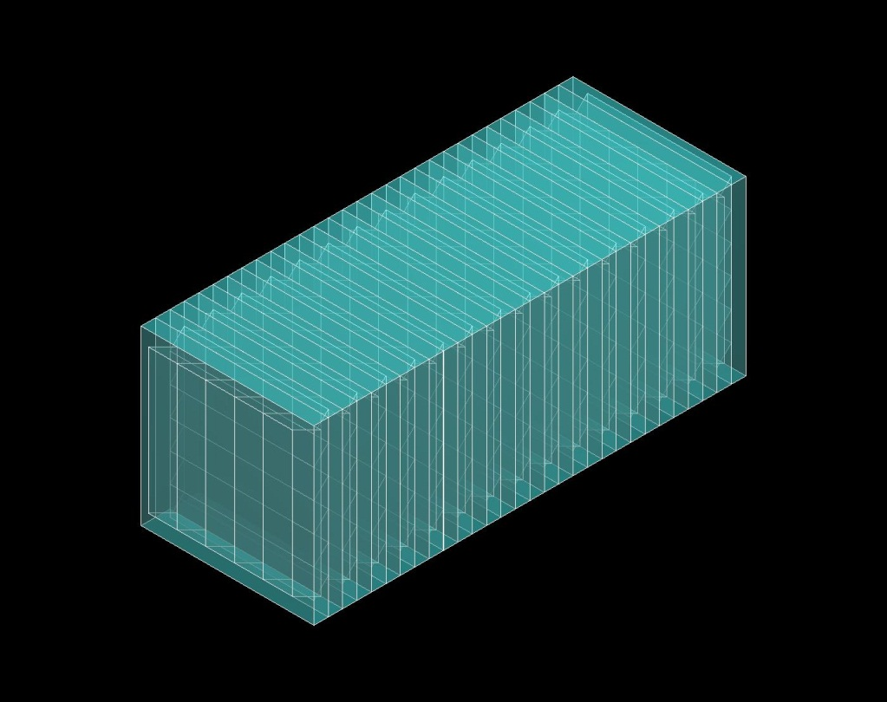
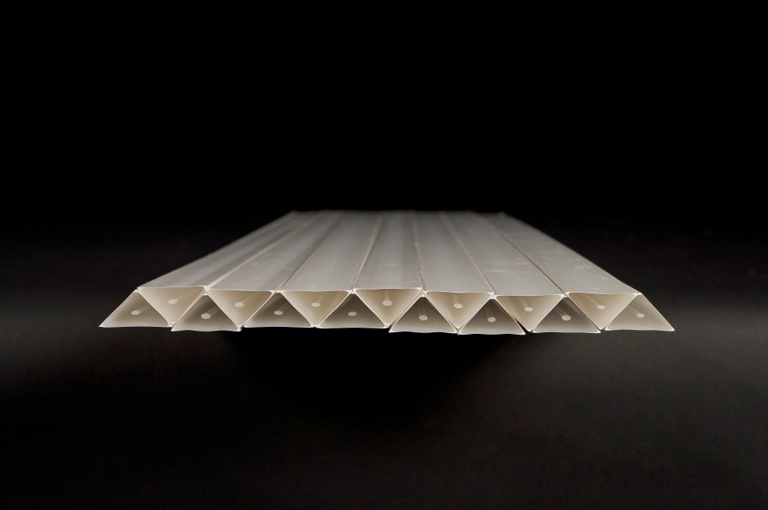
Fine-Resolution Totally Active Segmented Detector (IDS-NF)
Simulation of a Totally Active Scintillating Detector (TASD) using Noνa and Minerνa concepts with Geant4
3333 Modules (X and Y plane)
Each plane contains 1000 slabs
Total: 6.7M channels
150 m
15 m
15 m
1.5 cm
15 m
3 cm
35 kT Total Mass
Momenta between 100 MeV/c to 15 GeV/c
Magnetic field considered: 0.5 T
Reconstructed position resolution ~ 4.5 mm
B = 0.5T

Slide 46
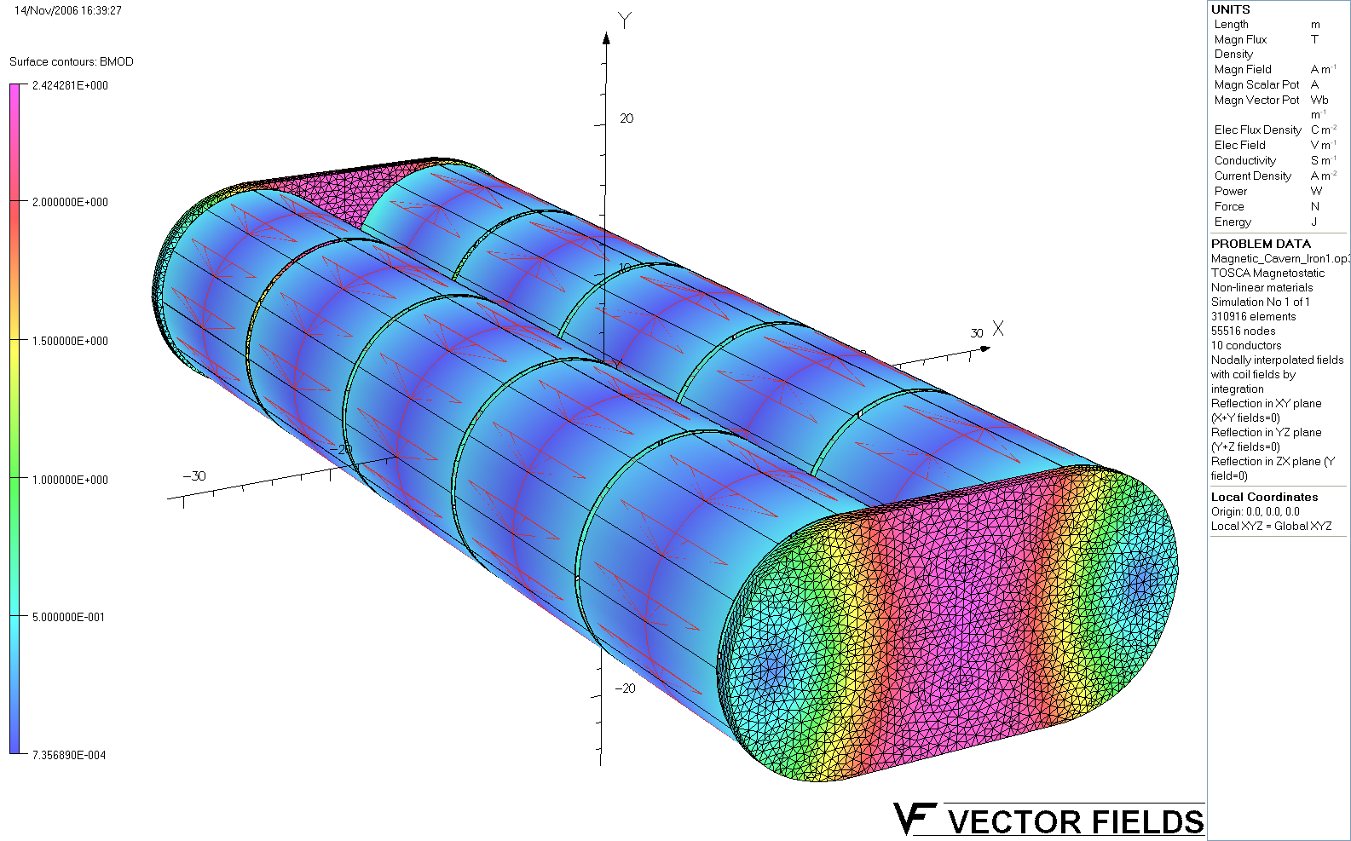
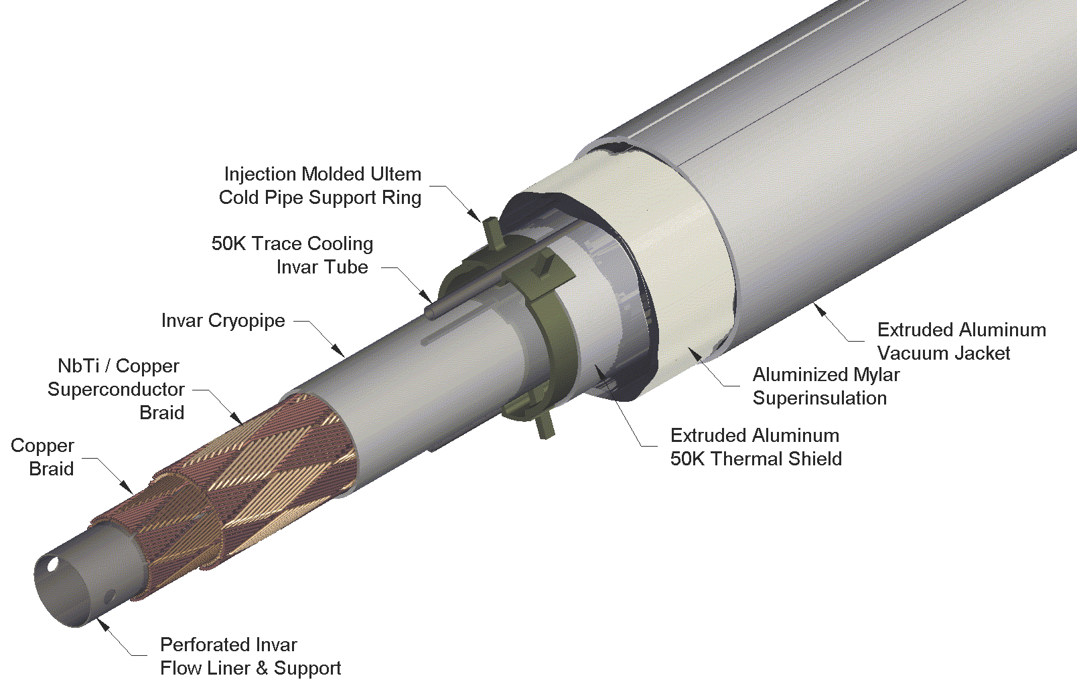
Magnet- Concept for IDS-NF
VLHC SC Transmission Line
Technically proven
Affordable
1 m iron wall thickness.
~2.4 T peak field in the iron.
Good field uniformity
R&D to support concept
Has not been funded

Slide 47
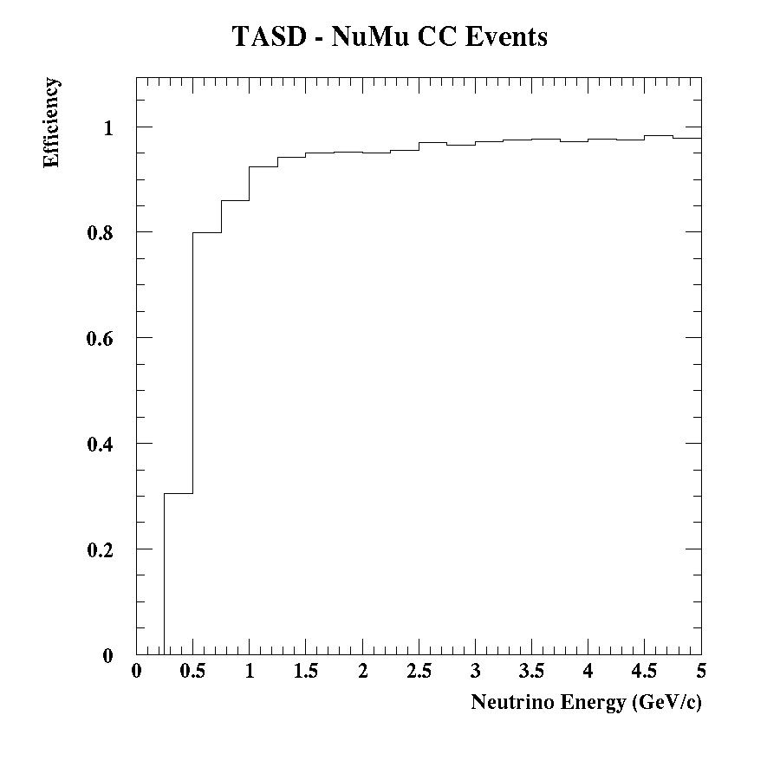
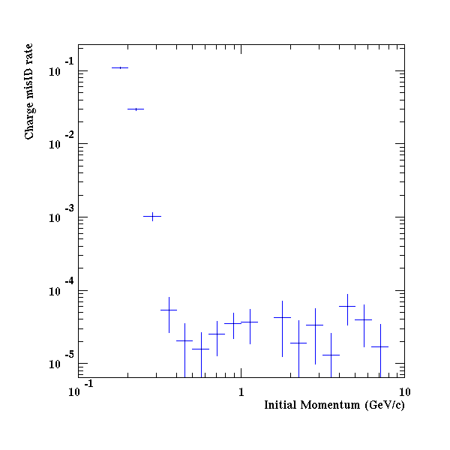
TASD Performance
ν Event Reconstruction ε
Muon charge mis-ID rate
Excellent σ_{E}

Slide 48
Facility

Slide 49
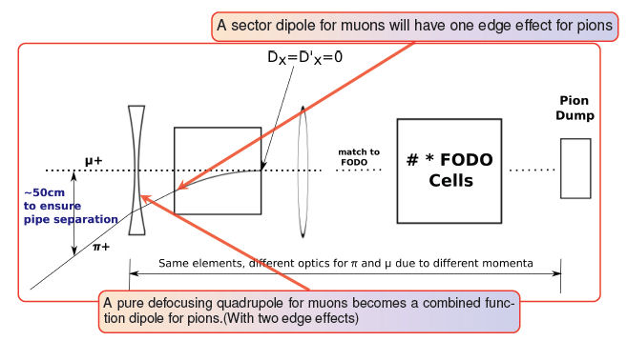
Injection
Ao Liu
Fermilab
π’s are on an injection orbit
separated by chicane
μ’s are in ring circulating orbit
lower p = 3.8 GeV/c

Slide 50
MI-40 Beam Absorber

Slide 51
Costing

Slide 52
Cost based on LBNE costs Fully loaded and escalated
Sub System | Cost M$¹
Primary Beam Line | 39
Target Station | 56
Transport Line | 14
Decay Ring | 82
Near Hall | 29²
Far Detector | 19³
Sub Total | 239
Project Office | 36⁴
Total | 275
¹No allowances made for reuse of existing equipment
²Near Hall sized for multiple experiments & ND for SBL oscillation physics
³Far Detector cost based on MINOS as-built + full burdening + escalation & no
allowance for existing FD Hall
⁴Assumes LBNE estimate of ≈ 15% (including contingency)

Slide 53
Ongoing & future work
Facility
Targeting, capture/transport & Injection
Need to complete detailed design and simulation
Decay Ring optimization
Continued study of both FODO & RFFAG decay rings
Decay Ring Instrumentation
Define and simulate performance of BCT, polarimeter, Magnetic-spectrometer, etc.
Produce full G4Beamline simulation of all of the above to define ν flux (Fermilab PhD student - thesis)
And verify the precision to which it can be determined.

Slide 54
Ongoing & future work II
Detector simulation
For oscillation studies, continue MC study of backgrounds & systematics
Start study of disappearance channels
Look in detail at all sources of backgrounds: CR, atmospheric ν, etc.
First pass done & with timing to remove CR, small compared to charge mis-ID
Will lead to detector (FAR) optimization
Move to Multivariate techniques. [Begun]
For cross-section (& general ν interaction physics) measurements need detector baseline design
Learn much from work for LBNE & IDS-NF (both detector & physics)
Increased emphasis on ν_{e} interactions, however

