Slide 1
201 MHz Cavity alignment
Cavity fiducilized 18 targets welded to outside
All flanges and ports were measured with respect to fiducials
Have plan to measure cavity inside of vacuum vessel
Meaure cavity fit to cylinder
Locate ports for RF couplers
Rotate cavity to align ports with vacuum vessel flanges
Reference cavity wrt fidcuials
After transport and installation of windows reference these to the other fidciuals

Slide 2
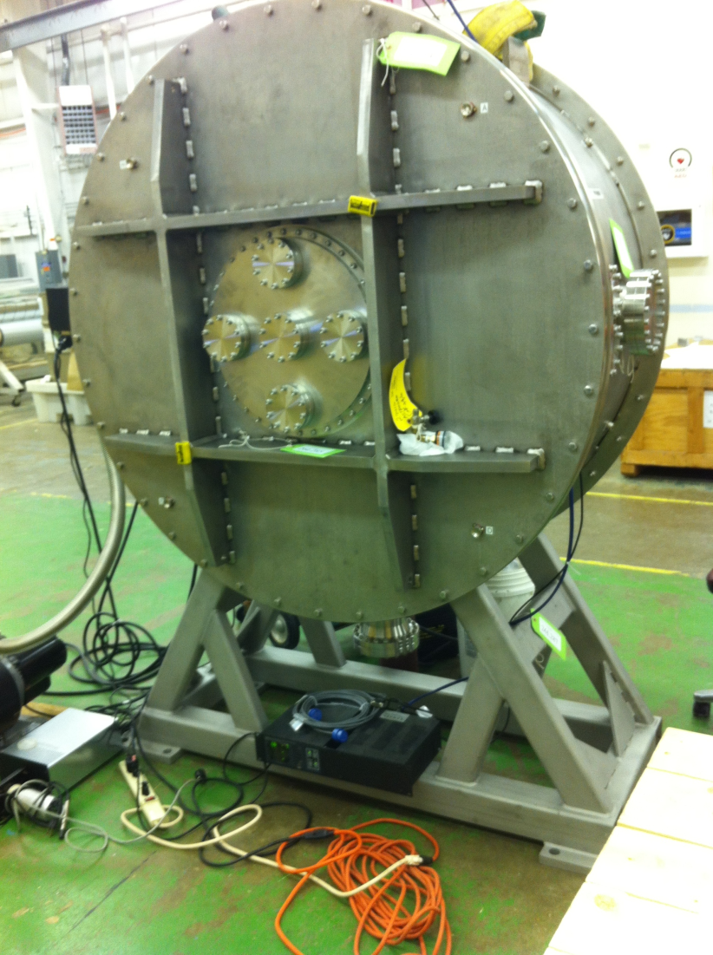
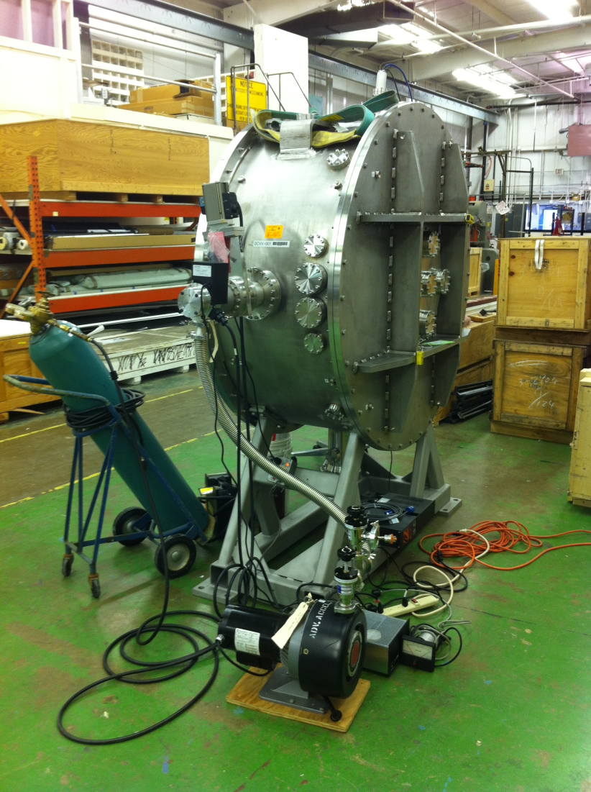
Vacuum Vessel with fiducials

Slide 3
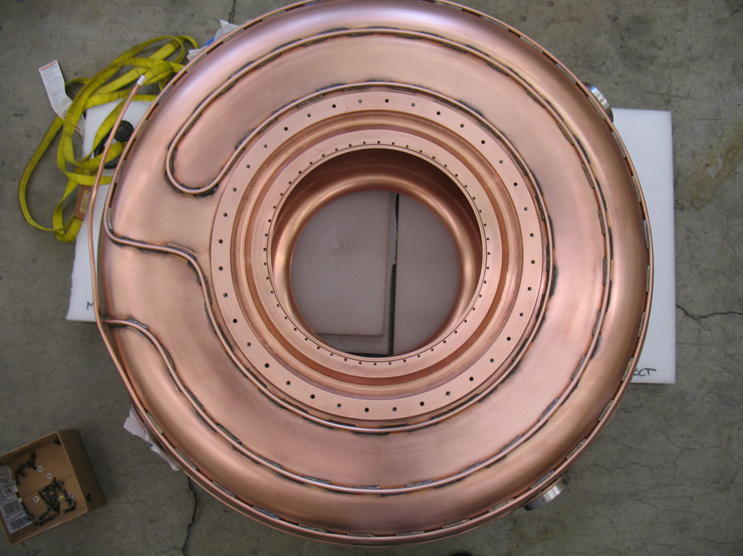
201 MHz cavity

Slide 4
Safety issues
JHA for installation of cavity inside of vacuum vessel
Mechanical review of fixtures needed for installation
Pressure vessel review of vacuum vessel
JHA for installation in MTA
RF review of installation in MTA
Inform radiation safety of new object in MTA hall

