Slide 1
MICE Magnets
Steve Virostek
Engineering Division
Accelerator & Fusion Research Division
Lawrence Berkeley National Laboratory
Muon Accelerator Program Review-Fermilab
August 24, 2010
1

Slide 2
Outline
Introduction
Spectrometer Solenoids
Overview
Current status
Plan to complete
Coupling Coils
Overview
Recent progress
Completion schedule
Summary

Slide 3
Introduction
The full MICE cooling channel will incorporate 7 superconducting magnet modules comprised of a total of 18 solenoid coils
LBNL is responsible for the two 5-coil Spectrometer Solenoids and the two single-coil Coupling Coils
The Spectrometer Solenoids were designed and are being built by a vendor local to LBNL (Wang NMR)
The Coupling Coils were designed by the Institute for Cryogenics and Superconductivity Technology in Harbin, China (a MICE collaborator) and are being built by a company in Beijing (the QiHuan Company)
August 24-26, 2010
MICE Magnets - Virostek
3

Slide 4
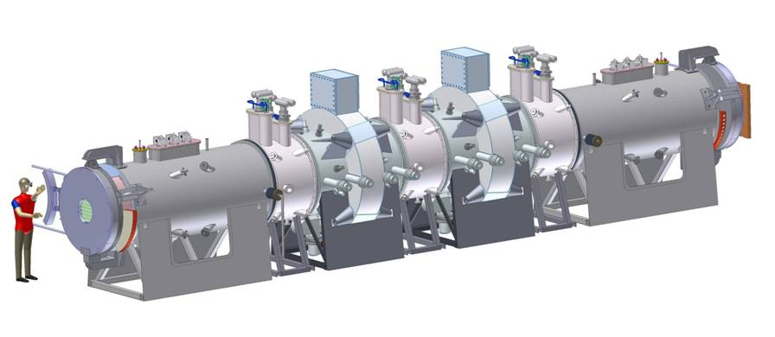
Spectrometer Solenoids in MICE
Spectrometer Solenoid
Spectrometer Solenoid

Slide 5
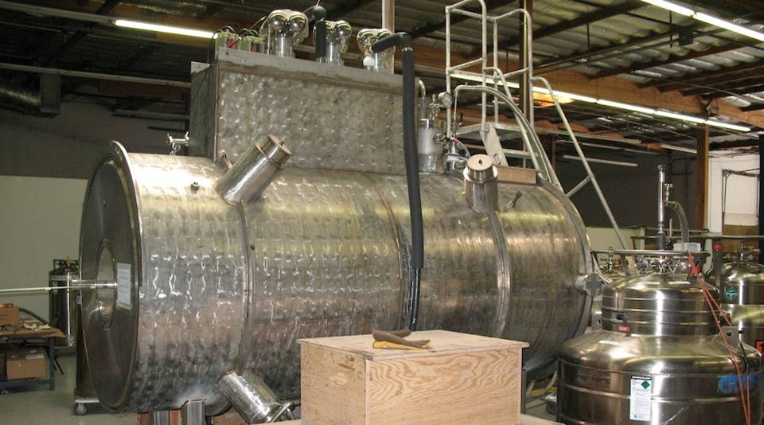
Spectrometer Solenoid Overview
Each magnet has five coils wound on a common Al mandrel
The radiation shield and cold mass are cooled by a series of two-stage cryocoolers
A recondensation circuit maintains LHe in the cold mass

Slide 6
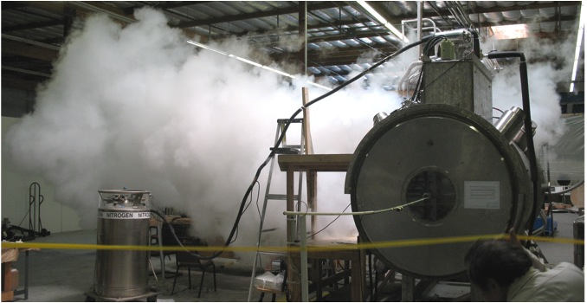
Spectrometer Solenoid Overview
Each magnet has five coils wound on a common Al mandrel
The radiation shield and cold mass are cooled by a series of two-stage cryocoolers
A recondensation circuit maintains LHe in the cold mass

Slide 7
Spectrometer Solenoid Overview
Each magnet has five coils wound on a common Al mandrel
The radiation shield and cold mass are cooled by a series of two-stage cryocoolers
A recondensation circuit maintains LHe in the cold mass
Magnet history:
Both magnets were previously fully assembled and tested
The training goal is to reach 275 amps in all five coils
Magnet #1 trained to 196 amps before disassembly to modify the recondensing circuit, which was prone to blockage
Magnet #2 was assembled with a modified condensing circuit and several other design enhancements
The second magnet trained to 238 amps when an HTS lead burned out due to inadequate cooling of the upper lead ends

Slide 8
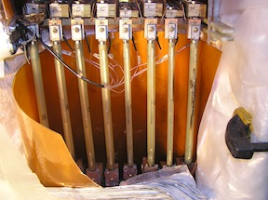
Spectrometer Solenoid Overview
Each magnet has five coils wound on a common Al mandrel
The radiation shield and cold mass are cooled by a series of two-stage cryocoolers
A recondensation circuit maintains LHe in the cold mass
Magnet history:
Both magnets were previously fully assembled and tested
The training goal is to reach 275 amps in all five coils
Magnet #1 trained to 196 amps before disassembly to modify the recondensing circuit, which was prone to blockage
Magnet #2 was assembled with a modified condensing circuit and several other design enhancements
The second magnet trained to 238 amps when an HTS lead burned out due to inadequate cooling of the upper lead ends

Slide 9
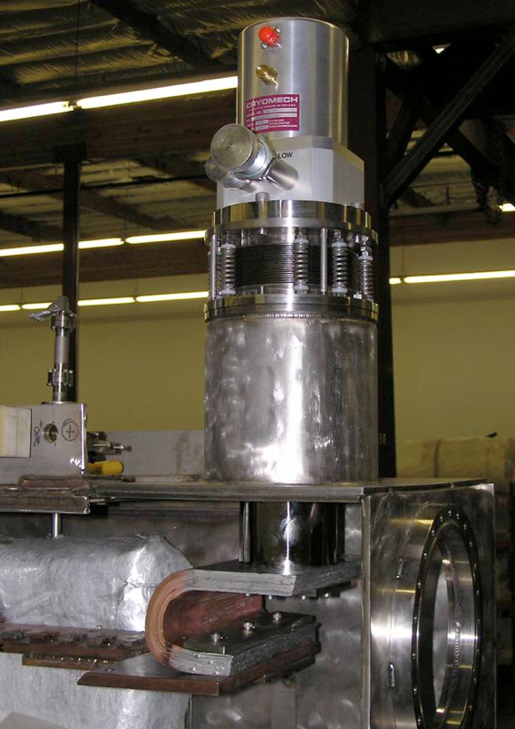
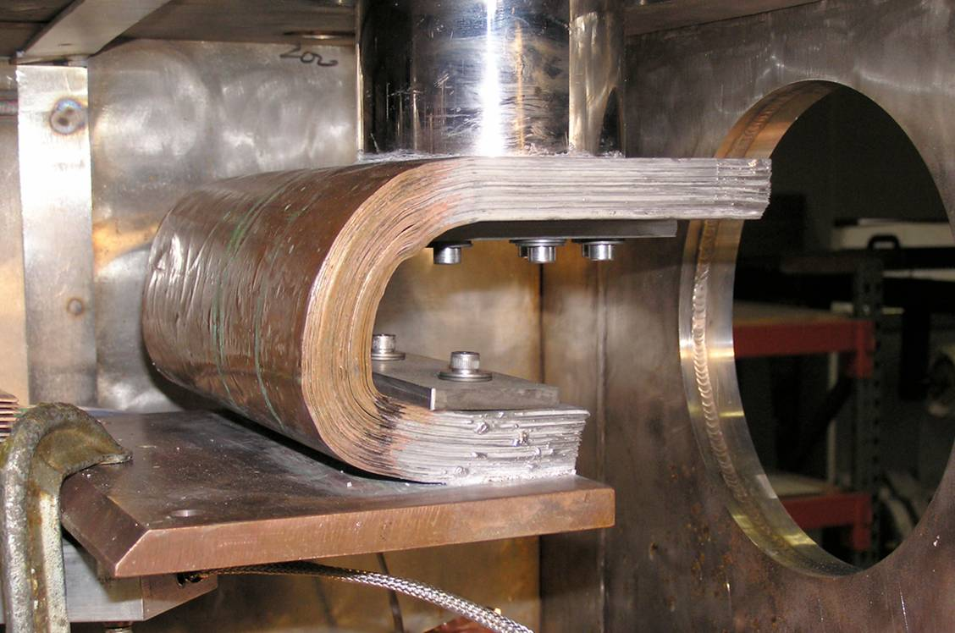
Added Single Stage Cryocooler
August 24-26, 2010
MICE Magnets - Virostek
9

Slide 10
Current Spectrometer Solenoid Status
Magnet history (cont’d):
Two review committees have been assembled to assess the design and assembly of the Spectrometer Solenoid magnets
An 11/09 MICE project committee developed recommendations before Magnet #2 was prepared for a 2nd round of testing
Per the committee’s recommendation, a single-stage cooler was added to increase the shield and HTS lead cooling
With the HTS lead issue solved, Magnet #2 trained to 258 amps when a coil lead was found to contain an open circuit
Also, the three 2-stage coolers + the 1-stage cooler could not maintain a closed LHe system (per boil-off measurements)
Magnet #2 has been disassembled and the cold mass opened
The failed lead was just inside the cold mass feedthrough

Slide 11
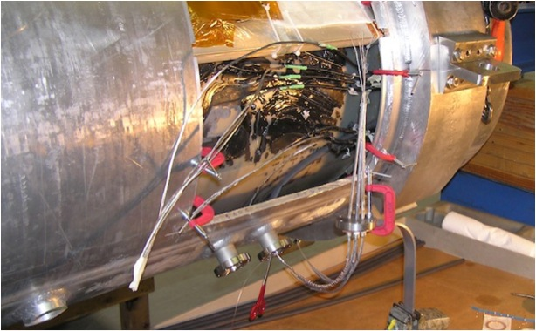
Preliminary Repair of Leads
August 24-26, 2010
MICE Magnets - Virostek
11

Slide 12
Preliminary Assessment & Plan
A 2nd committee of 3 FNAL magnet experts was assembled to review and assess the lead failure and the helium boil-off issue
LBNL is developing a plan to respond to the committee’s recommendations before incorporating any design changes
The initial steps in the process are shown below:
A complete set of the latest as-built drawings (including future changes) is being compiled to facilitate engineering calculations
All heat loads are being reassessed to ensure that the LHe in the cold mass can be maintained with the selected number of cryocoolers
All EM calculations will be redone for both test and operational conditions
The instrumentation plan will be reviewed and changes implemented to allow confirmation of the thermal and EM calculations during testing
Further analysis will demonstrate that the mechanical support of the magnet, leads, piping and other internal components are adequate

Slide 13
Design Modification Plan
In parallel to the analysis effort, a modification and assembly plan is being developed and will likely include the following:
reduction of heat leaks to the cold mass
the addition of more cryo cooling power
modification of the cold leads near the feedthroughs to prevent burn-out
The preliminary plan (pending results of analyses) is shown below and on the next slide:
LBNL/MICE personnel will be present to document/oversee all aspects of magnet reassembly
Improved vacuum pumping and instrumentation will be implemented to ensure there is adequate insulation of the cold mass
All 4K components will be covered with actively cooled shield where possible – the effects of partially covered areas will be analyzed

Slide 14
Design Modification Plan (cont’d)
The total cooling power will be increased by using five 2-stage pulsed tube coolers and one single-stage cooler (preliminary)
The thermal/mechanical stabilities of the cold leads will be improved by adding extra copper/superconductor near the cold mass feedthroughs
The heat loads from the following will be decreased as possible: shield pass through holes for the cold mass supports, intermediate cold mass support heat intercepts, and shielding of the warm end of the supports
Detailed inspection of MLI during assembly will be part of the QA plan
The individual leads will be wrapped with super insulation
Possible thermal acoustic oscillations in vent lines will be addressed
The vent line heat loads will be evaluated and reduced where possible
Sensor wires to be optimized to reduce the heat loads as needed
A fast DAQ system will continuously monitor the voltage tap signals
August 24-26, 2010
MICE Magnets - Virostek
14

Slide 15
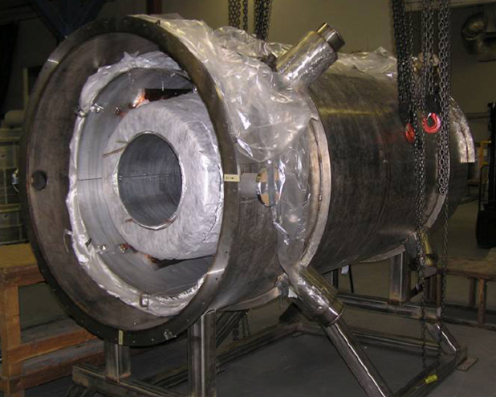
Assembly of Spectrometer Solenoid

Slide 16
Schedule
Task Description Date
Complete EM, thermal and mechanical analyses mid-Sept.
Complete the design modification plan early-Oct.
Presentation to review committee(s) end-Oct.
The nominal reassembly time for the magnets is expected to be approximately four months
Actual assembly time will depend on the degree of modification required
The second magnet will follow the first by 2 to 3 months

Slide 17
Manpower
Thermal calculations
Soren Prestemon (LBNL Engineering Division – Cryogenic Engineer)
EM analysis
GianLuca Sabbi, Diego Arbelaez (LBNL Supercon Group)
Mechanical analysis
Steve Virostek (LBNL Engineering Division – Mechanical Engineer)
Drawings
Steve Virostek, Allan DeMello (LBNL Mechanical Engineers), Wang NMR
Instrumentation plan
Soren Prestemon, Mike Green (LBNL Cryogenic Engineers), Wang NMR
Fabrication oversight
Nanyang Li (LBNL Engineering Division – Production Engineer)
Management & manpower
Steve Gourlay (LBNL AFRD Division Director)
Ross Schlueter (LBNL Mechanical Engineering Department Head)

Slide 18
Coupling Coils in MICE
Coupling Coils

Slide 19
Coupling Coil Overview
The Coupling Coils are single coils wound on a forged aluminum mandrel
Cooling of the radiation shield and cold mass is provided by a series of two-stage cryocoolers
Liquid helium is maintained in aluminum tubes welded to the cold mass by means of a recondensation circuit
The coils are designed so as to allow integration with the vacuum vessel for the RF/Coupling Coil (RFCC) Module
The full MICE cooling channel will contain two of these modules
A third coil (MuCool) is being built for the MTA Facility at FNAL
The RFCC vacuum vessel will contain a set of four 201 MHz, normal conducting copper cavities (5 complete, 5 under way)

Slide 20
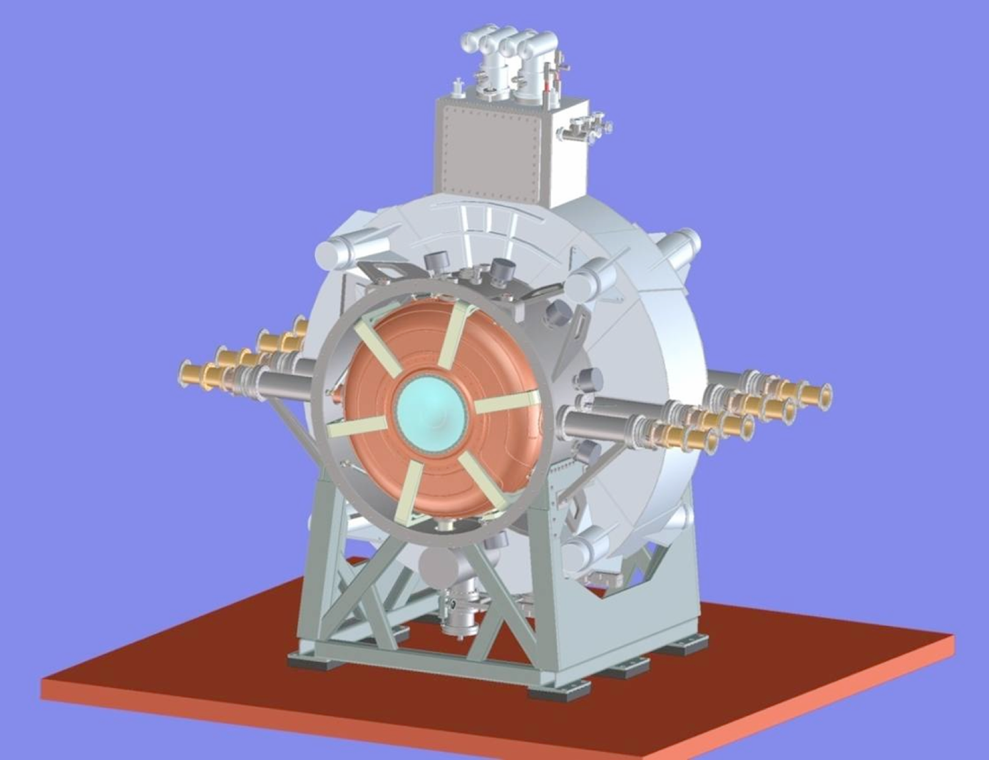
RFCC Module CAD Model
Coupling Coil
RF Cavities
August 24-26, 2010
MICE Magnets - Virostek
20

Slide 21
Coupling Coil Status
The coupling coils are being designed and built through a collaboration with the Institute of Cryogenics and Superconductivity Technology (ICST) in Harbin, China
The cold-mass design is complete; a fabrication contract was awarded to the QiHuan Company in Beijing in March 2010
The cryostat design will be complete in September 2010
A collaboration between LBNL and the Shanghai Institute of Applied Physics will allow the cryostat design to be completed
The first magnet coil winding is approximately 40% complete
To test the cold-mass before magnet assembly, the cryogenic test system at ICST must be ready by late November 2010
The first cold-mass test will be conducted at ICST in Dec. ‘10
August 24-26, 2010
MICE Magnets - Virostek
21

Slide 22
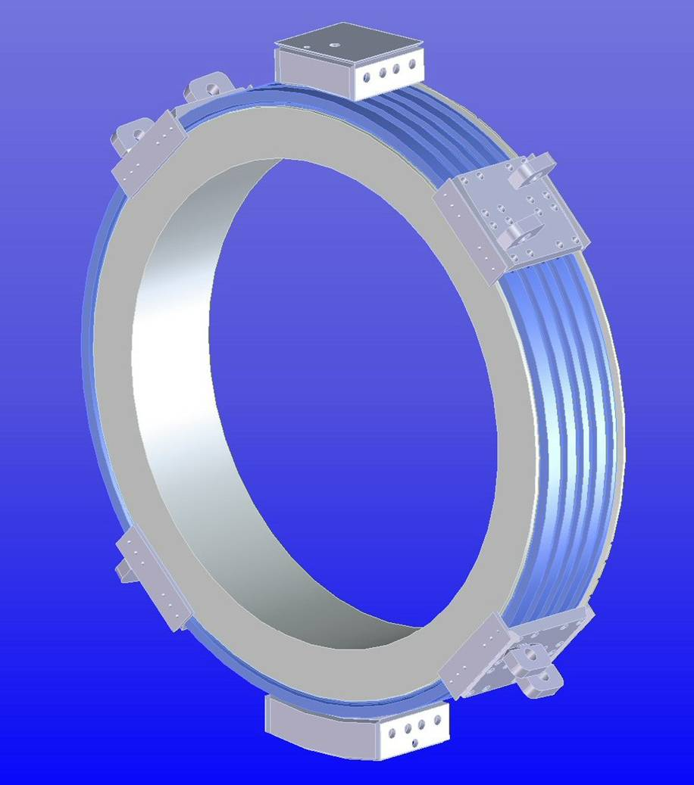
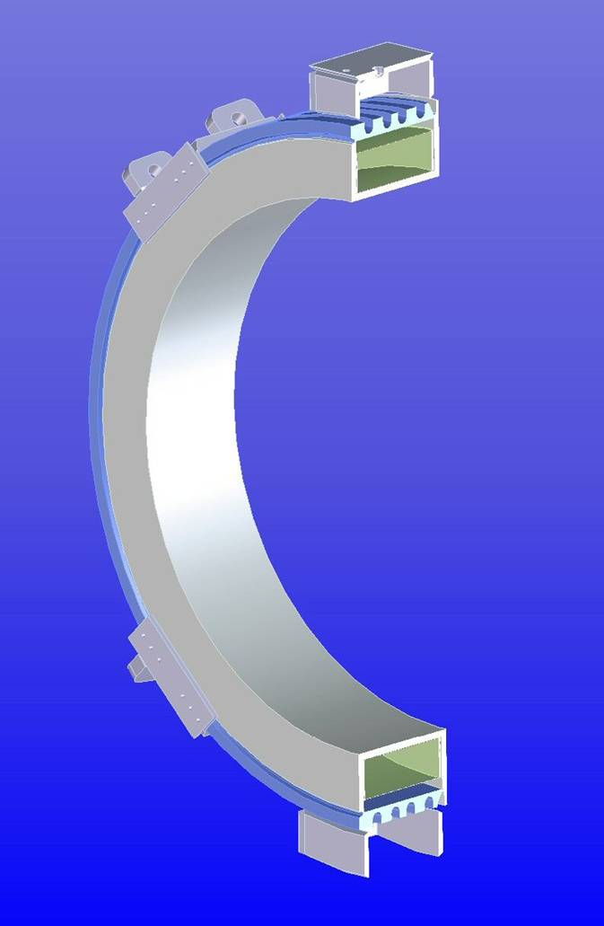
Cold Mass CAD Model
August 24-26, 2010
MICE Magnets - Virostek
22

Slide 23
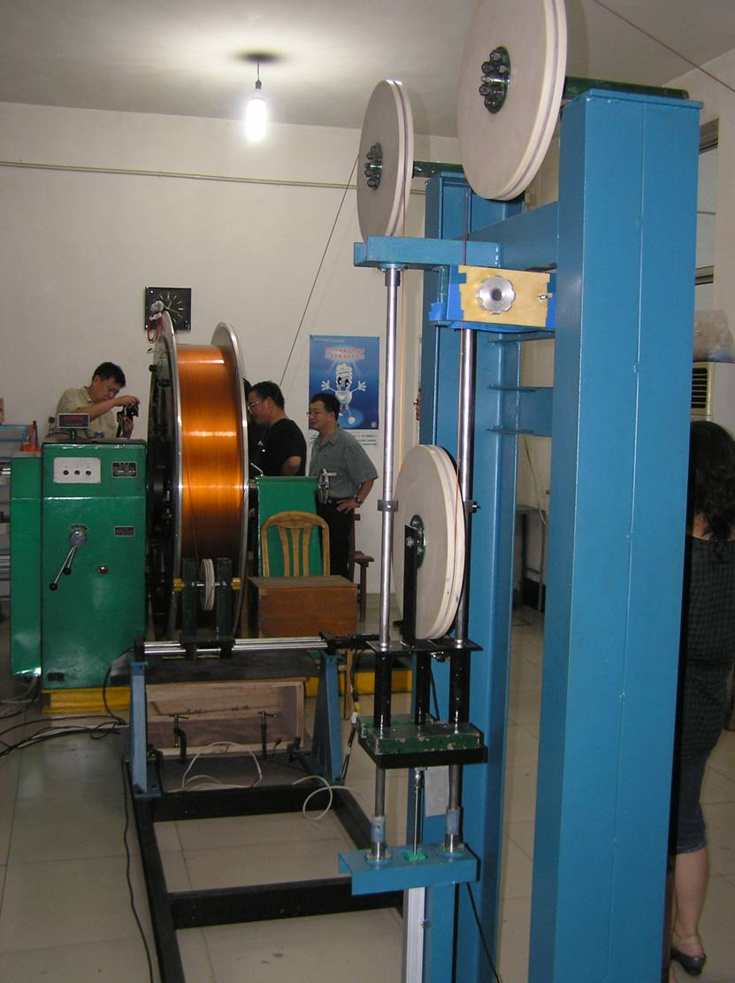
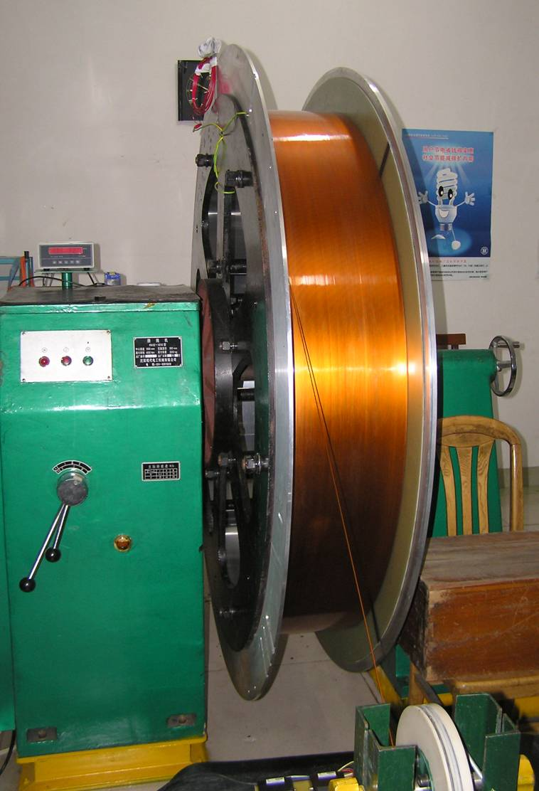
First Magnet Coil Winding
August 24-26, 2010
MICE Magnets - Virostek
23

Slide 24
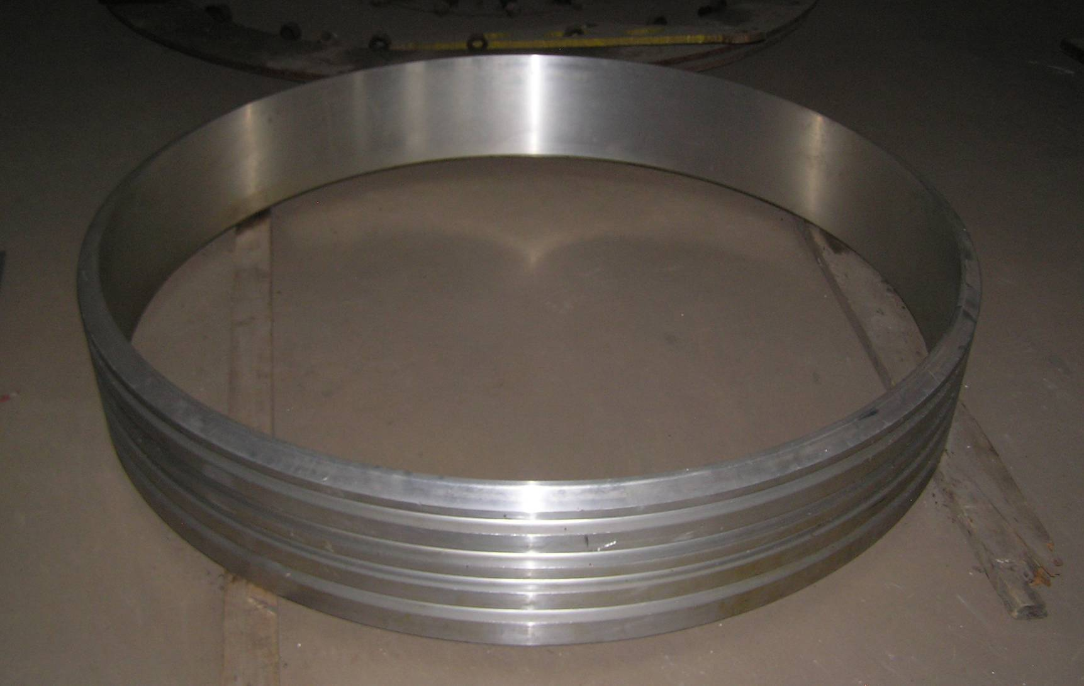
Completed Cold Mass Cover
August 24-26, 2010
MICE Magnets - Virostek
24

Slide 25
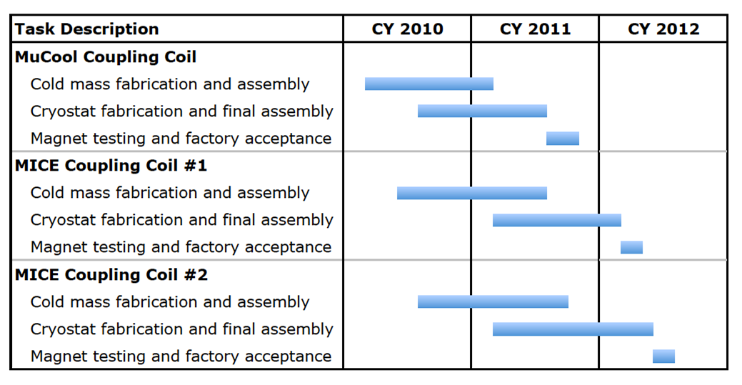
Schedule to Complete
August 24-26, 2010
MICE Magnets - Virostek
25

Slide 26
Project Manpower
Project management at ICST
Fengyu Xu (ICST Project Engineer/Electrical Engineer)
Engineering design at SINAP
Wang Li (SINAP Cryogenic Engineer, formerly ICST Deputy Director)
Prof. Lixin Yin and Yun Cao (SINAP Mechanical Engineers)
Design review scheduled at SINAP for September 13th
Drawing verification at LBNL
Allan DeMello (LBNL Engineering Division – Mechanical Engineer)
Sisi Shan (LBNL Engineering Student Intern)
Fabrication oversight
Fengyu Xu of ICST will spend a large portion of his time at the fabricator
The following MICE collaborators will participate in rotating visits to the QiHuan Company during fabrication (~once per month):
Steve Virostek, Derun Li, Allan DeMello, Nanyang Li (LBNL)
Wang Li (SINAP)
Consultants: M. Green (LBNL), K. Hosoyama (KEK), H. Chen, C. Yi (IHEP)
Periodic visits by other MICE collaborators
August 24-26, 2010
MICE Magnets - Virostek
26

Slide 27
MICE Magnet Summary
Spectrometer Solenoids
Recent testing/training of the magnets has uncovered some deficiencies in the design
Work is under way to develop plans to modify the design and reassemble the magnets
The 1st reassembled magnet is to be tested early 2011
Coupling Coils
The design of the magnet cold mass is complete and fabrication is under way in China
Final cryostat design will be reviewed next month
The 1st magnet is expected to be ready in late 2011
August 24-26, 2010
MICE Magnets - Virostek
27

