Slide 1
Cisco 40GE/100GE Strategy and Direction
Chris Hocker
Consulting Systems Engineer
chocker@cisco.com

Slide 2
Discussion Items
40GE/100GE Platform Investments
Transport (DWDM and Routers)
15454 MSTP Transponder/Muxponder
CRS, ASR9K
IP over DWDM
Data Center - N2K, N3K, N5500, N6K, N7000/N7700
Campus - Cat6K
CPAK Optics
Breakout Interfaces

Slide 3
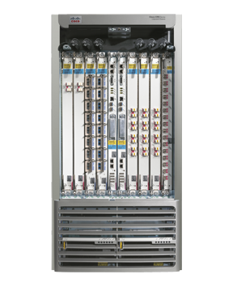
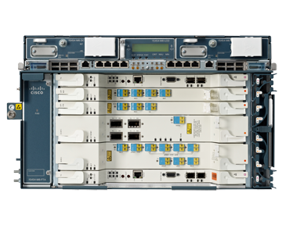
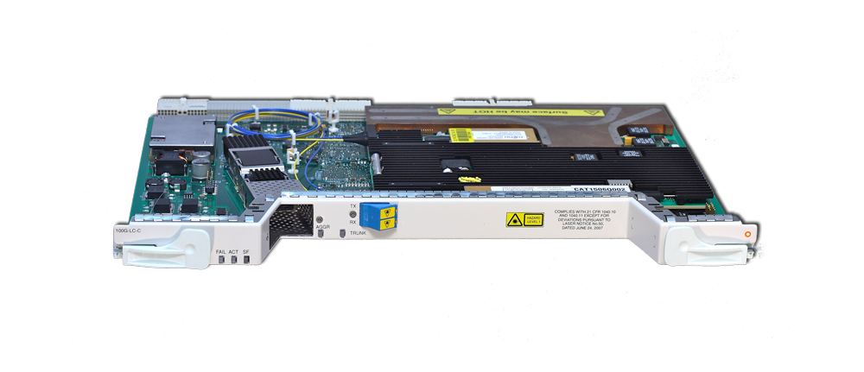
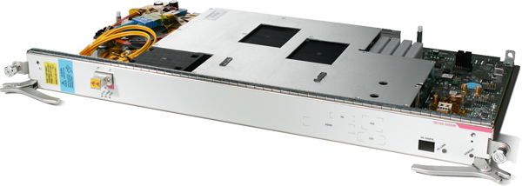
Cisco 100G Coherent DWDM Module
animated
Cisco
100G Coherent
DWDM Module
ONS 15454
100G Transponder / Trunk
CRS-3
100G IP-over-DWDM PLIM

Slide 4
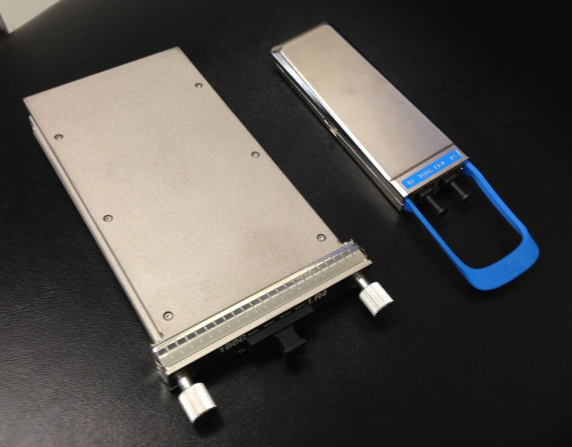
Optics – What Is CPAK?
New Cisco 100G transceiver form-factor using Silicon Photonics technology
IEEE standards compliant
High density
Low power consumption
Significantly smaller than current 100G CFPs
100G CPAKs available in 2013 timeframe:
Cisco 100G CPAK Transceiver
SR10 CPAK | LR4 CPAK
100m (OM3) or 150m (OM4) MMF ribbon cable MPO-24 connector Can also run as 10X10G SR or 2X40G SR4 | 10km SMF duplex cable SC connector

Slide 5
Nexus 7700 F3 40G and 100G Modules
2HCY13
24-port 40G QSFP+ module / 12-port 100G CPAK module
Based on F3 ASIC technology
Wire-rate L2/L3 IPv4/IPv6
960G / 1.2T per slot
1.4 / 1.8 Bpps/slot
~6µsec latency cross-fabric
Buffering:
6MB VOQ per 40G port
12MB VOQ per 100G port
User-configurable buffer sharing
Breakout cable support
Multi-protocol – Classic Ethernet, FabricPath, DCB/FCoE
MPLS, OTV, LISP, GRE, VXLAN
64K FIB TCAM/64K adjacency table
64K MAC address table
Nexus 2000 (FEX) support
F3 100G N77-F312CK-26
*Not all listed features committed for FCS of F3.

Slide 6
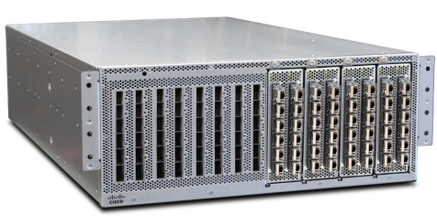
Nexus 6004
N6K-C6004-96Q
Expansion Modules
Fixed ports
4 RU
12 x 40 Gig
Per “module”
N6K-C6004-M12Q
Notes:
Q stands for QSFP
T stands for 10GbaseT
P stands for SFP+

Slide 7
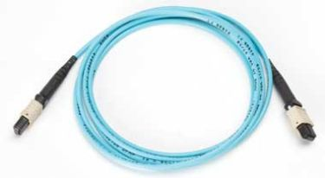
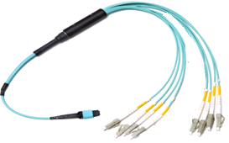
Multimode Fiber Cabling Options for 40GBASE-SR4
40G-SR4
40G-SR4
MPO-12 ←→ MPO-12
Could also be used with
Existing cabling infrastructure (*)
10G-SR
40G-SR4
10G-SR
10G-SR
10G-SR
MPO-12 ←→ LC Breakout

