Slide 1
China Connection
Ted Liu
12th Argonne-UChicago-Fermilab collaboration meeting
Dec. 7th, 2012, Univ. of Chicago

Slide 2
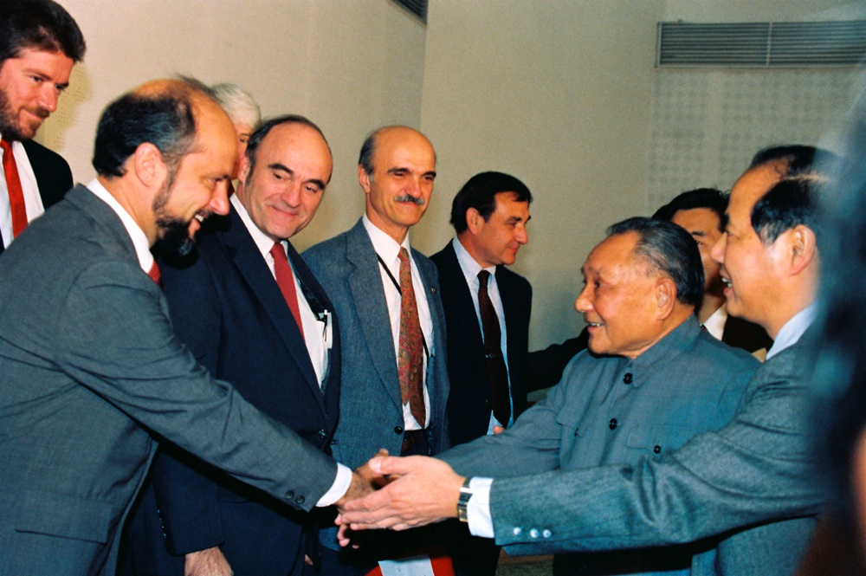
An old photo from early 80s

Slide 3
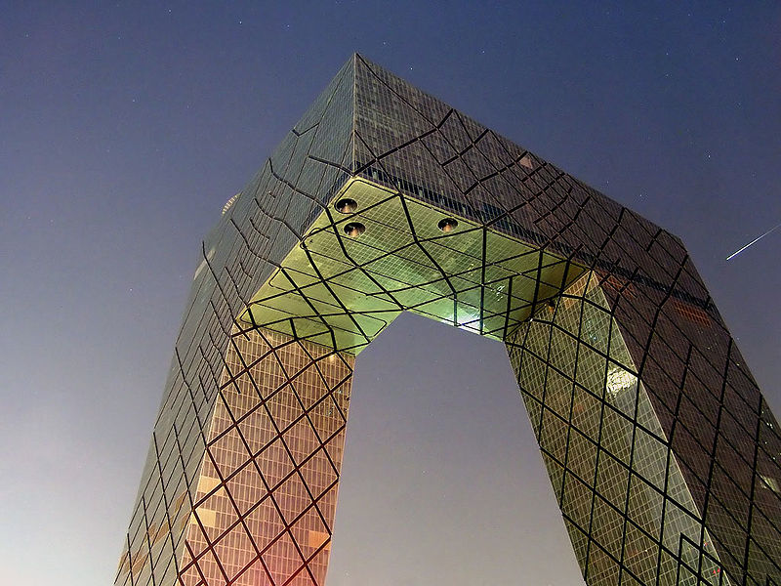
The art of Making the connection
In order not to lock in structural differentials the connection
was scheduled in the early morning when the steel
in the two towers cooled to the same temperature...
Photo
from
2007
visit
China Central
Television
(CCTV)
headquarters

Slide 4
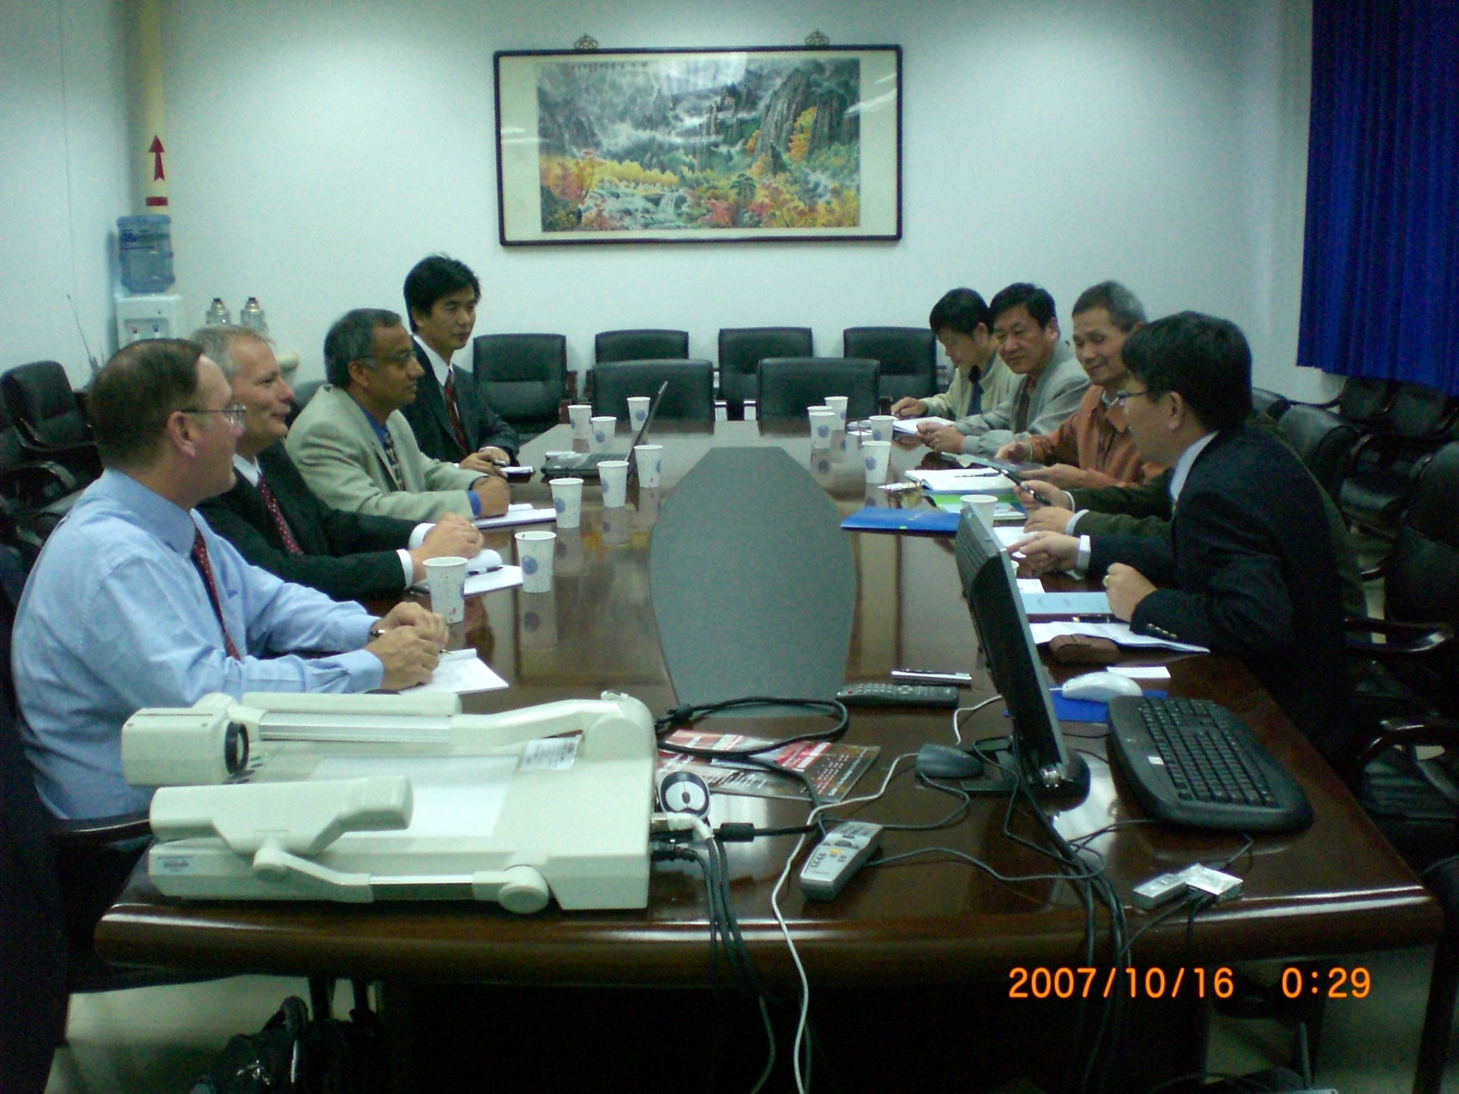

Slide 5
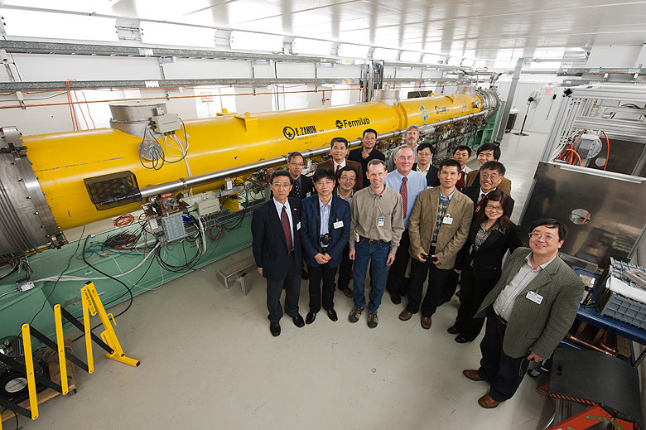

Slide 6
US-China: Collaboration on Accelerator R&D
Fermilab has MOU with both IHEP and Peking University on R&D on Superconduting RF technology.
collaborating on superconducting RF cavity design, manufacture, surface treatment and test equipments.
FNAL and IHEP have been exploring synergy in high intensity proton accelerator programs such as Project X and CSNS/ADS (Accelerator Driven subcritical System) between US and China….

Slide 7
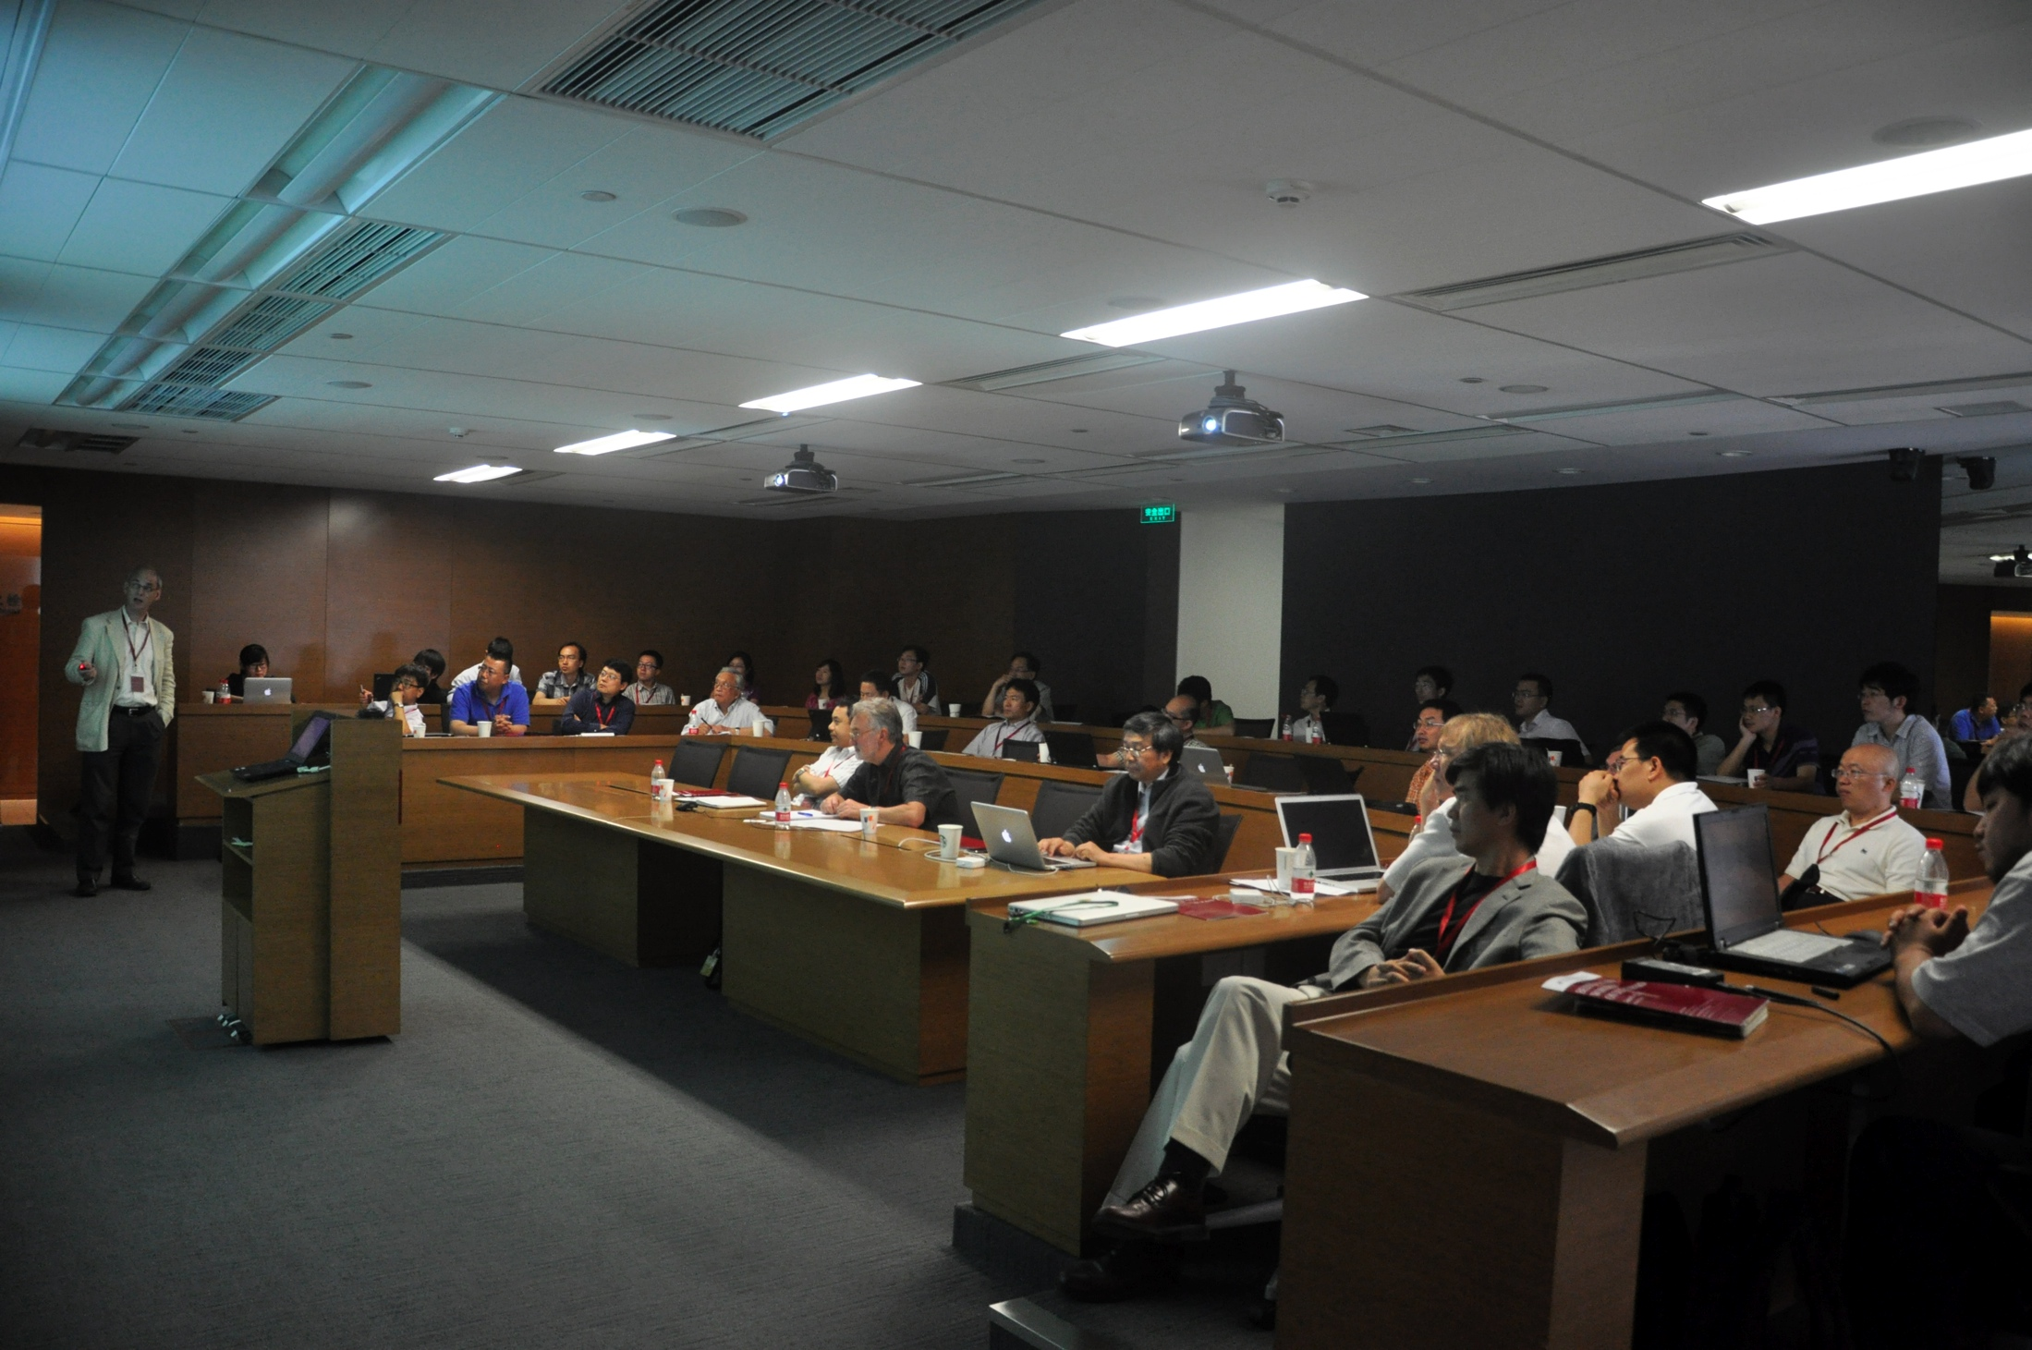
Beijing-Chicago Workshop on Detector R&D, June 2012
(UC-ANL-FNAL with IHEP-Peking-Tsinghua)
https://twindico.hep.anl.gov/indico/conferenceDisplay.py?confId=1023

Slide 8
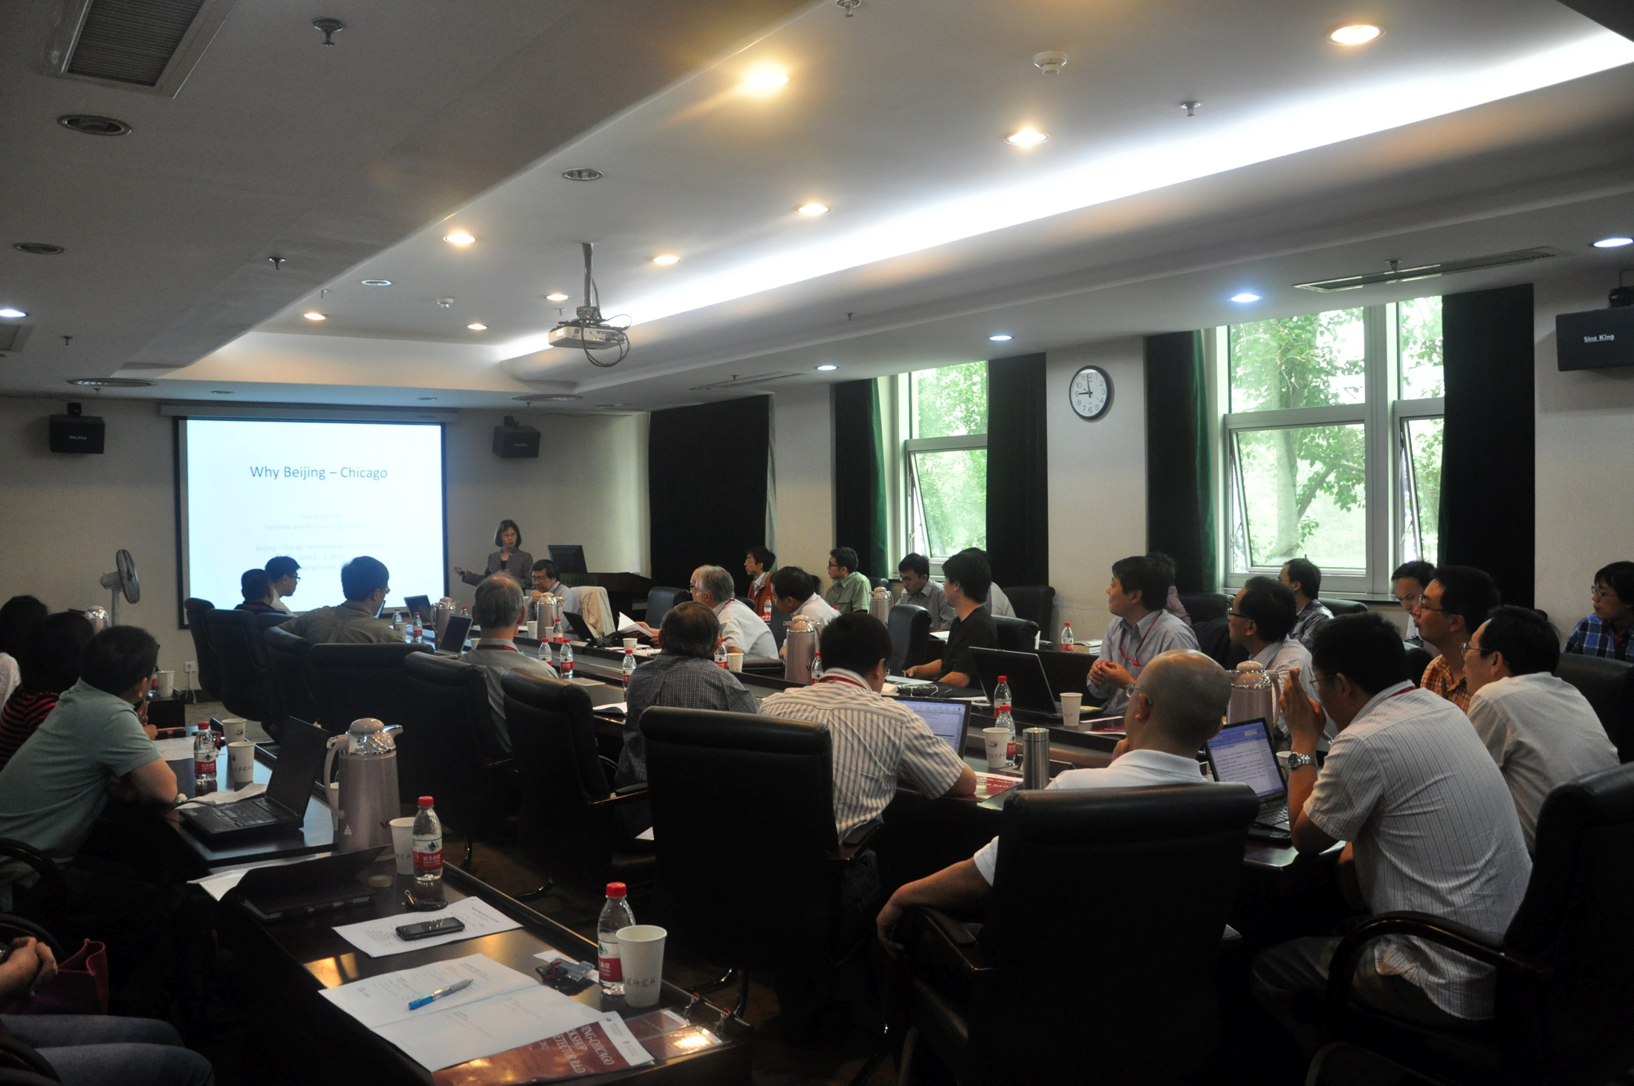

Slide 9
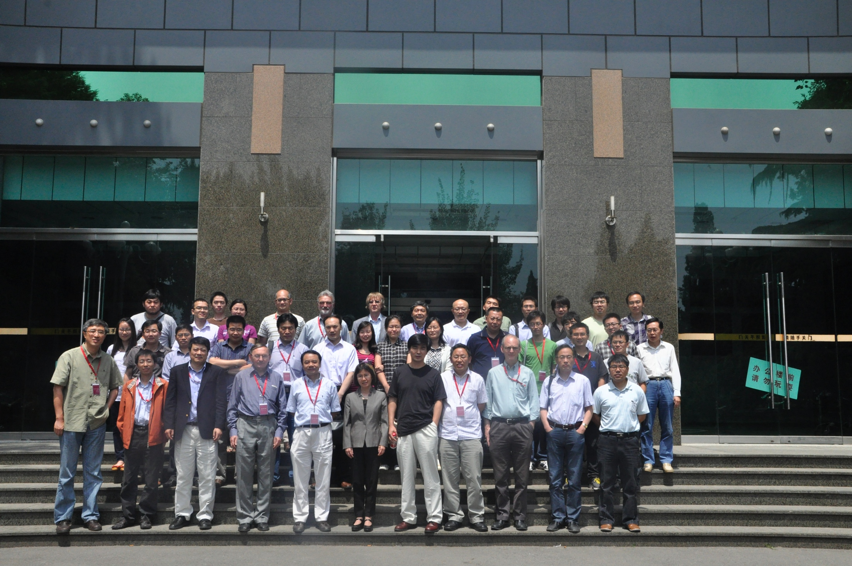
A successful (first) workshop organized by Univ. of Chicago
to explore new ideas on detector R&D and Instrumentation
between IHEP and ANL, UChicago and Fermilab.
Next workshop: June 2013

