Slide 1
QXF 2D Magnetic Analysis & Coil Cross-Section
F. Borgnolutti
04/09/2012

Slide 2
Outline
Cross-section presented at Frascati in Oct. 2012
Updated Yoke design
Updated cable dimensions (Cable 1042Z-13)
Re-optimized cross-section based on the new cable design
Field harmonics and transfer function
Tuning of the magnetic field to take into account coil deformation
Magnetic field sensitivity to components tolerances
Summary and plans

Slide 3
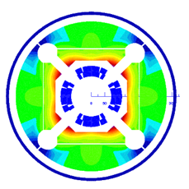
Cross-section presented at Frascati
150 mm aperture diameter
140 T/m nominal gradient
Insulation:
Total mid-plane Insulation thickness: Baseline 0.500 mm (2*250 µm)
Inter-layer insulation thickness: 0.500 mm
Coil cross-section:
The coil cross-section is optimized at room temperature/coil aligned on their OD
Conductor specifications:
RRP
Conductor specifications @4.2K 2650 A/mm2 @ 12T 1400 A/mm @ 15 T
Jc curve available on the plone:
https://plone.uslarp.org/MagnetRD/DesignStudies/QX-CD/ShortSample/
Reference design as presented at the Frascati meeting

Slide 4
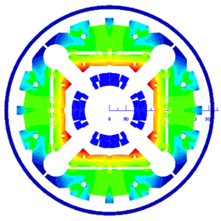
Updated Yoke design
Holes for tie rods
Updated yoke design:
Bladder location
Loading keys
Alignment key
Slot for bus bars
Notch
Former yoke design
New design:
Can still evolve, it is not the final design
Yoke design provided by M. Juchno

Slide 5
Updated Yoke design
“Frascati” coil cross-section in the new yoke:
Rref=2/3 of the aperture
 | With old yoke | With new yoke | With new yoke + more current
b₆ | 0.26 | 0.11 | 0.03
b₁₀ | 0.22 | 0.21 | 0.21
b₁₄ | 0.33 | 0.33 | 0.33
b₁₈ | -0.47 | -0.48 | -0.48
G (T/m) | 140.0 | 138.4 (-1.1 %) | 140
I (kA) | 17.32 | 17.32 | 17.55
The updated yoke cross-section has little impact on the harmonics
Need to increase the current to compensate for yoke material removal (+1.1 %)

Slide 6
Updated cable dimension
Reacted Bare Cable (4.5 % and 2 % thickness and width growth assumed from un-reacted cable)
 |  | Frascati cable (v1) | New version (v2)
Width (mm) | mm | 18.638 | 18.300
Thickness in | mm | 1.462 | 1.454
Thickness out | mm | 1.673 | 1.660
Keystone angle | deg | 0.650 | 0.644
Cable 1042Z-13
Dimensional changes
-0.338 mm
-0.008 mm
-0.013 mm
-0.006 mm
Insulation thickness | mm | 0.150 | 0.125
-0.025 mm
Insulated & Reacted Cable
 |  | Frascati cable (v1) | New version (v2)
Width (mm) | mm | 18.938 | 18.550
Thickness in | mm | 1.762 | 1.704
Thickness out | mm | 1.973 | 1.910
-0.388 mm
-0.058 mm
-0.063 mm
→ The cross-sectional area of the new cable is ̴̴5% smaller than for the one used at Frascati

Slide 7
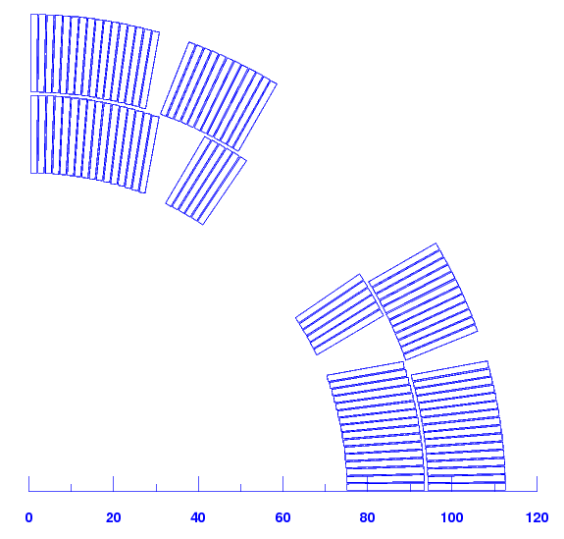
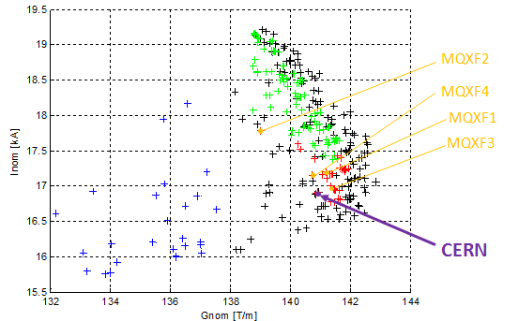
Updated cable dimension
2
4
1
3
Reference design
The chosen coil design layout is “optimum”
How much turns could we add in each block if we want to match the dimension of the “Frascati” cross-section with the new cable?:
Block 1: 16 turns → 0.5 cable
Block 2: 6 turns → 0.2 cable
Block 3: 16 turns → 0.5 cable
Block 4: 12 turns → 0.4 cable
1.6 cable in total (looking at the thickness)

Slide 8
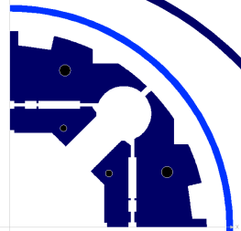
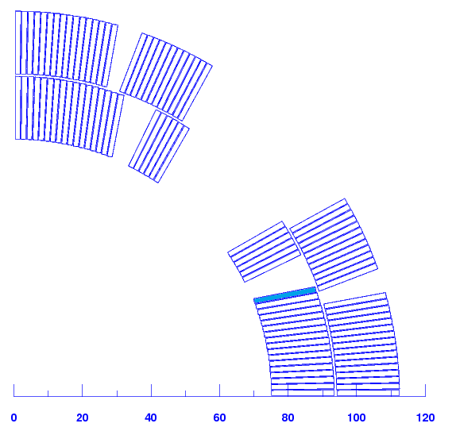
Re-optimized cross-section
“Frascati” coil layout with the new cable dimension
Additional turn
Rref=2/3 of the aperture
 | Changing the cable dimension only | Re-optimized cross-section (one turn added)
b₆ | 21.2 | 0.07
b₁₀ | 1.72 | 0.06
b₁₄ | 0.26 | 0.02
b₁₈ | -0.54 | -44
G (T/m) | 140 | 140
I (kA) | 17.32 | 17.00
Field quality is achieved
The current is smaller

Slide 9
Re-optimized cross-section
“Frascati” cross-section: 50 turns
Updated coil cross-section with
new cable dimension: 51 turns
6
12
Additional turn
6
12
16
16
17
16
Easier to protect (quench)

Slide 10
Re-optimized cross-section
V1: “Frascati” x-section + new yoke
V2: Updated x-section with new cable and new yoke
 | Units | V1 | V2
Operational Temp. | K | 1.9
Short sample gradient | T/m | 172 | 174
Short sample current | kA | 21.5 | 21.1
Peak field at Iss | T | 15.0 | 15.1
Nominal Gradient | T/m | 140 | 140
Nominal Current | kA | 17.55 | 17.00
Fraction of Iss | % | 81.6 | 80.6
Peak Field @ In | T | 12.19 | 12.15
Stored energy @ In | MJ/m | 1.33 | 1.310
Diff. inductance @ In | mH/m | 8.26 | 8.67
Nb turn/coil | - | 50 | 51
V1
V2

Slide 11
Magnetic field and transfer function
Updated x-section with new cable
Maximum of b₆ of about 4.5 unit reached at I ≈ 0.4 In
9 % reduction on the TF at nominal current

Slide 12
Tuning of the magnetic field
Coil cross-sections are optimized at room temperature (does not take into account for coil deformation)
Estimated variation of the field components due to coil deformation
(see M. Juchno’s presentation)
Most of the coil deformation is provided during cool-down
Harmonic | Value (unit)
b₆ | +0.97
b₁₀ | -0.03
b₁₄ | +0.04
Need a cross-section that generate b₆ ≈ -1 unit at room temperature
Impact of coil deformation on b₁₀ and b₁₄ is negligible

Slide 13
Tuning of the magnetic field
A b₆ of -1 unit can be easily generated without dramatically changing other harmonic components by moving the upper block of the outer layer by ~380 um
Harmonic order | Generated by coil deformation | Generated by the coil at room temperature
b₆ | +0.97 | -1.05
b₁₀ | -0.03 | 0.26
B₁₄ | +0.04 | 0.019
B₁₈ | - | -0.442
+380 um

Slide 14
Magnetic field compensation
Maximum of b₆ of reduced from 4.5 unit to 3.5 unit reached at I ≈ 0.4 In

Slide 15
Field sensitivity to components tolerances
Cable insulation is thicker on the thick edge
Method
Pole piece with defect
Nominal pole dimension
Cable insulation is thinner on the thin edge
Example of method applied to a defect on the pole piece
Realistic model
Matlab model is used (analytical equations)
The yoke is not considered

Slide 16
Field sensitivity to components tolerances
Defects with following Gaussian distribution with σ = 25 um , values >25 um are discarded
New tool to estimate field error due to parts/fabrication defects.

Slide 17
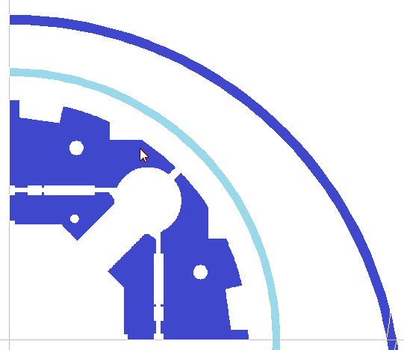
Summary and Plans
Two cross-sections have been studied:
“Big” cable with 150 um thick insulation
“Small” cable with 125 um → one additional turn + less current
Compensation of b₆ to take into account for coil deformation at cold:
It easy to compensate one unit of b₆
Do we want to implement now a correction of b₆ of 1 unit to compensate for cool down effect?
Magnetic shimming?

