Slide 1
Proposed Dates: 30/8 – 4/9 2020

Slide 2
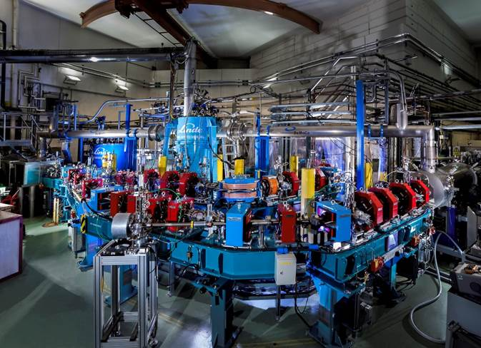
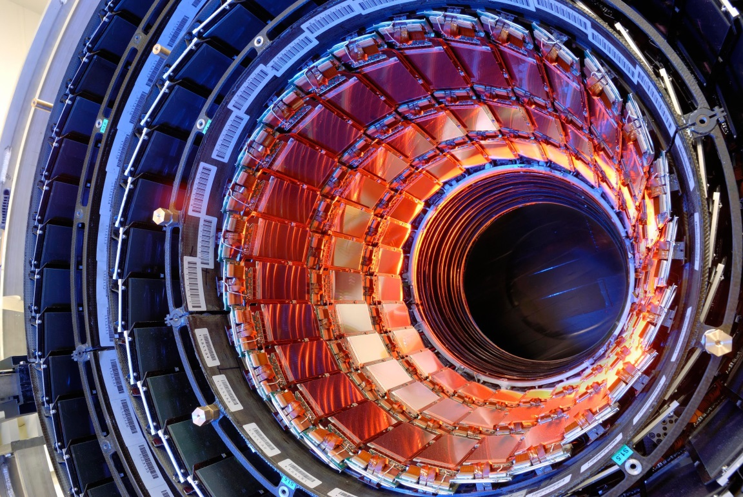
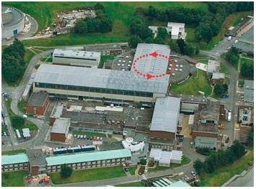
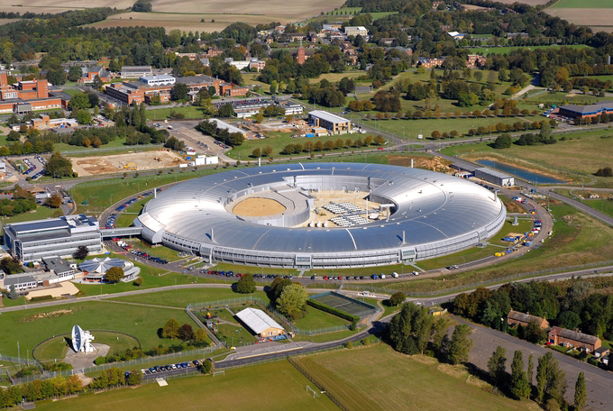
Major Scientific Nation
Major Collaborator with CERN
National Accelerator Facilities
National Accelerator Institutes
Why the UK?

Slide 3
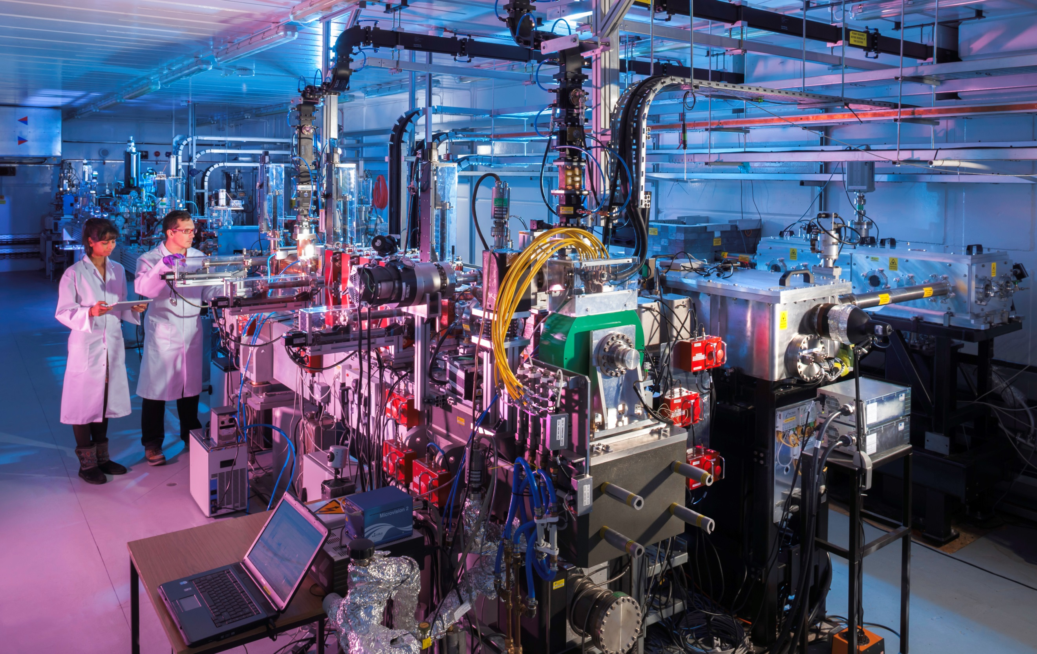
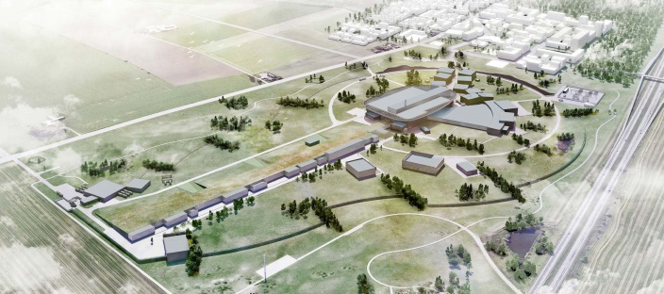
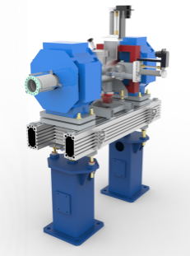
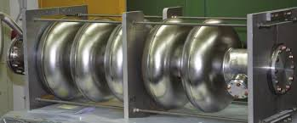
Daresbury Laboratory (Near Liverpool)

Slide 4
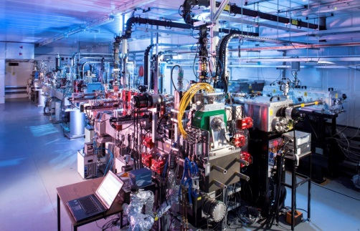
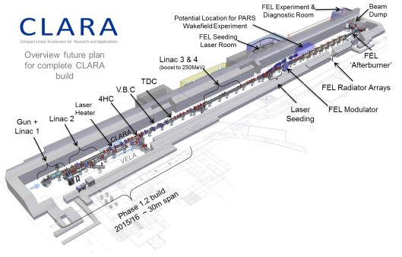
Cockcroft Institute
John Adams Institute
Strathclyde
Lancaster
Daresbury Laboratory
Liverpool
Manchester
Rutherford Appleton
Laboratory
VELA
Imperial College
Oxford
Royal Holloway
VELA
UK Accelerator Institutes & National Labs

Slide 5
Extensive resources available across the UK Accelerator Institutes and STFC.
UK Accelerator Resources
Notes:
Leading figures in the field
2 Institute Directors & 1 Laboratory Head
7 Internationally renowned universities/labs
Experienced conference organizers
Strong administrative support (Lab & Uni.)

Slide 6
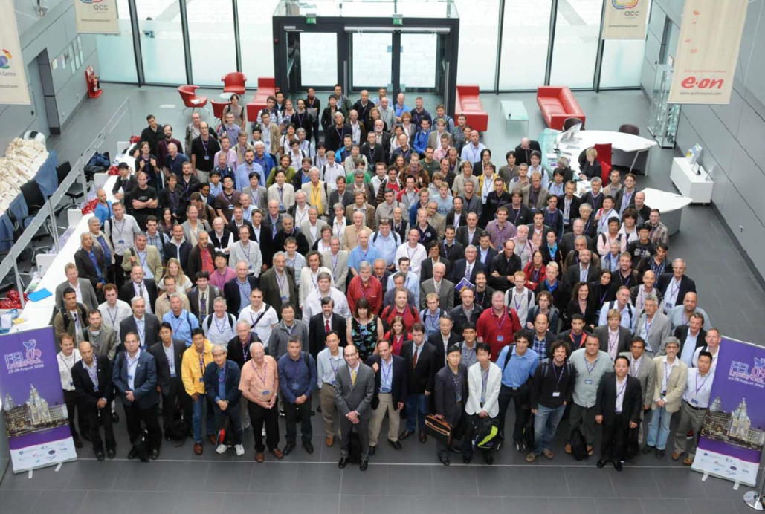
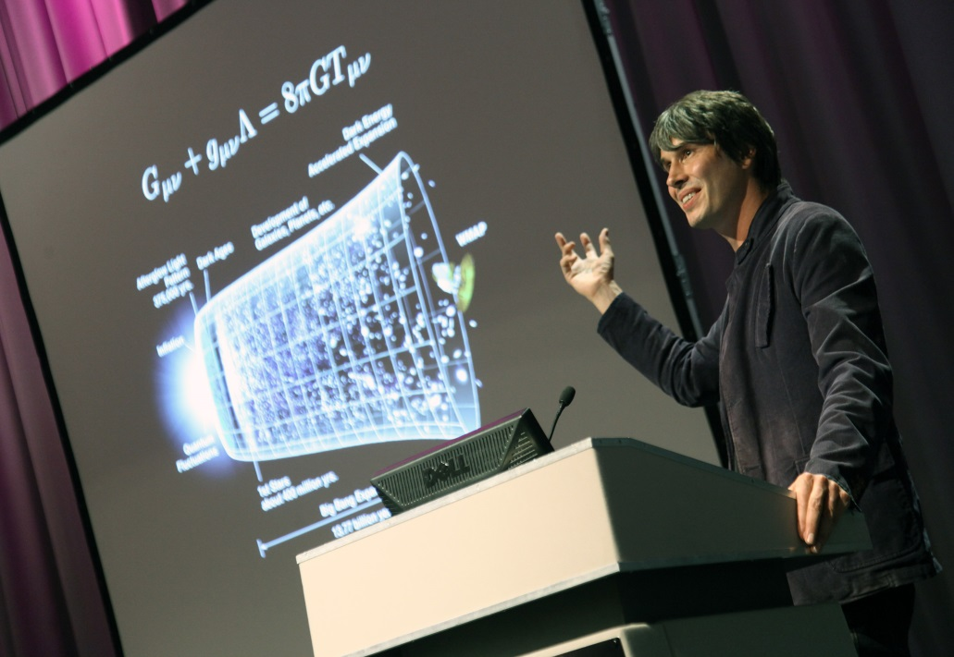
Symposium on Lasers and Accelerators for Science and Society 2015
ACC Liverpool, 250 delegates
International Conference on Accelerator Optimization 2015
Seville, 200 delegates
International Linear Collider Workshop 2015
Whistler, BC., 300 delegates
International Symposium on Lepton-Photon Interactions 2013
San Francisco, 700 delegates
Annual Joint HiLumi-LHC-LARP 2013
Cockcroft Institute, 180 delegates
International Conference on Cyclotrons and their Applications (CYCLOTRONS 13) 2013
Vancouver, 200 delegates
Free Electron Laser (FEL) Conference 2009
ACC Liverpool, 300 delegates
10th European Particle Accelerator Conference 2006
Edinburgh, 1000 delegates
Heavy involvement in organisation of every IPAC conference
Experience in Organising Large Events
Notes:
in summary…………..
Pass to Kerrin

Slide 7
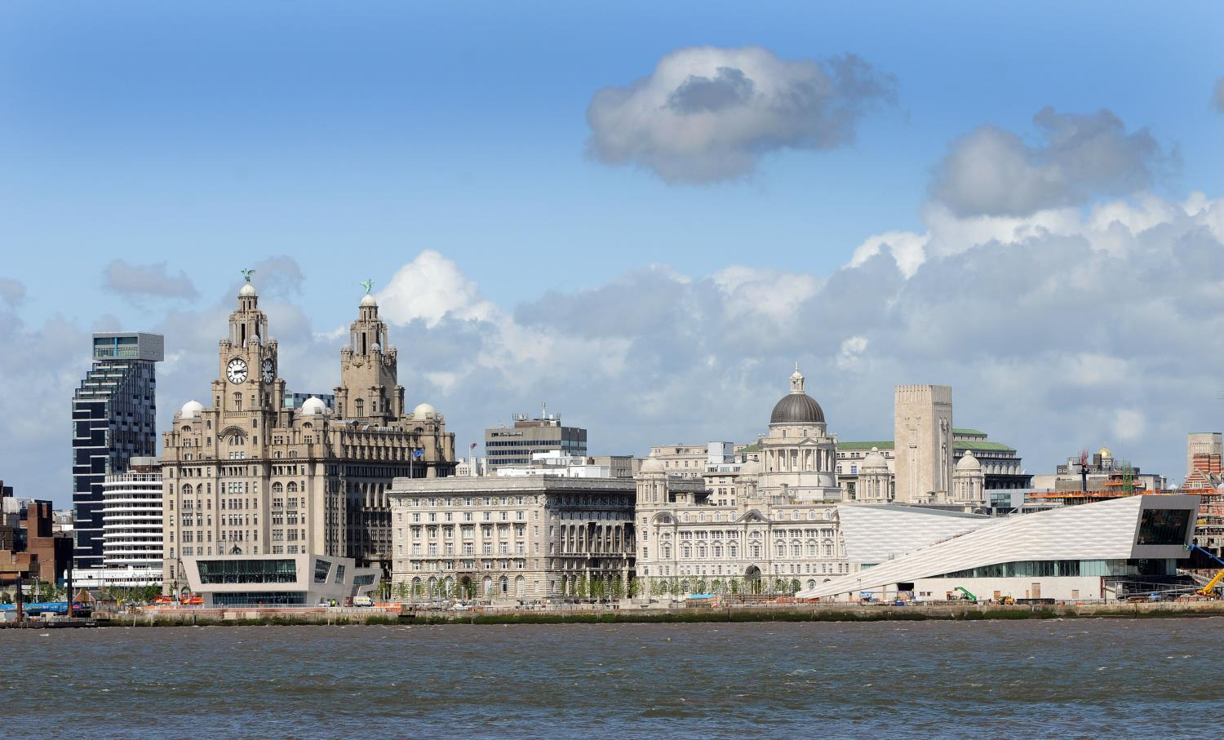
Liverpool
European Capital of Culture

Slide 8
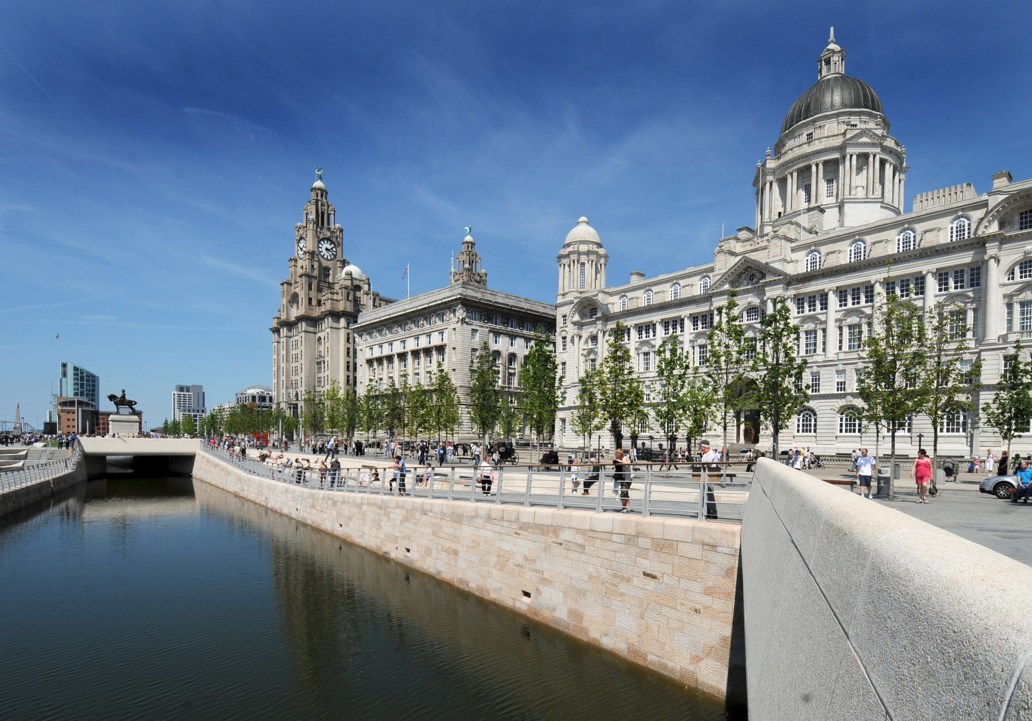
UNESCO World Heritage Site

Slide 9
Team Liverpool
Professional Conference Organiser to provide event integration
Team Liverpool

Slide 10
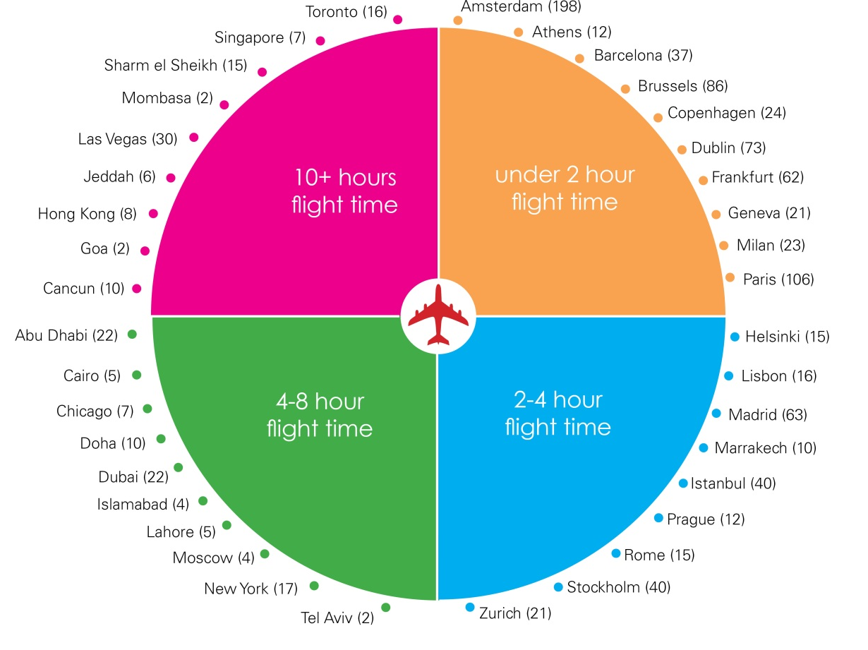
LINAC 2020 – Connected to the World

Slide 11
2 Airports
within 45 minutes
77
airlines
226
destinations worldwide
217,145
flights per year
LINAC 2020 – Connected to the World
Notes:
Two airports within 45 minutes of Liverpool city centre: Liverpool John Lennon Airport and Manchester Airport. Easy transfer from both
Just two hours from London
Walkable city once here

Slide 12
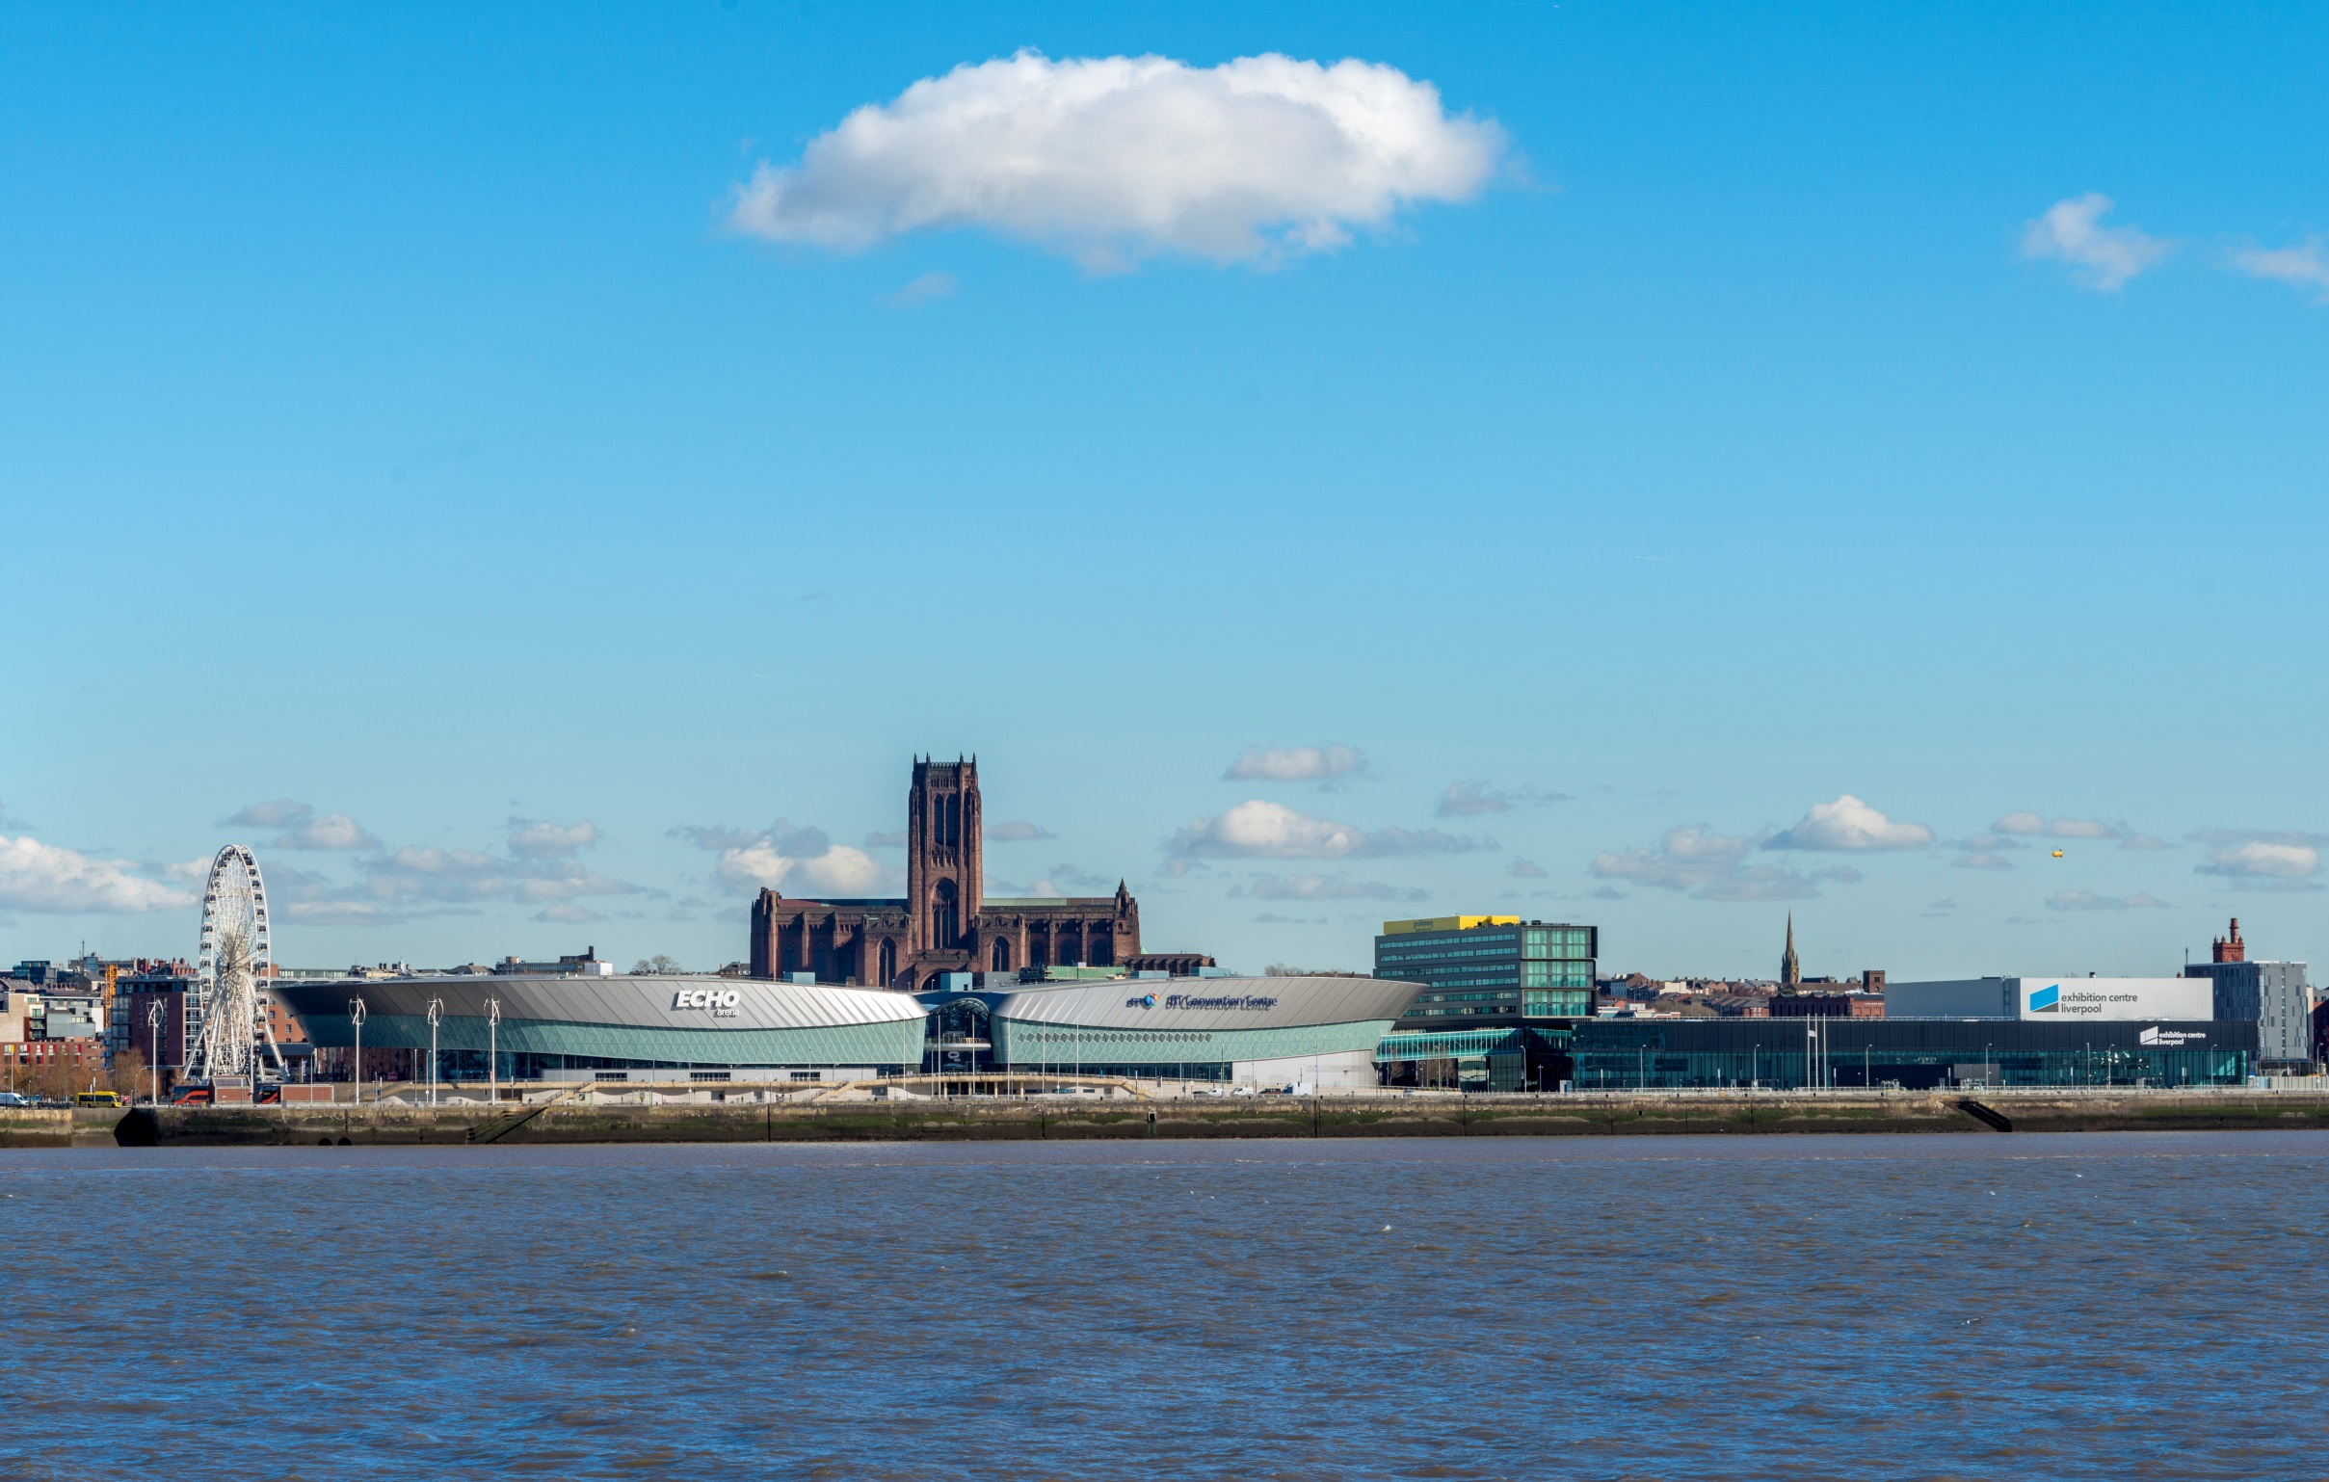
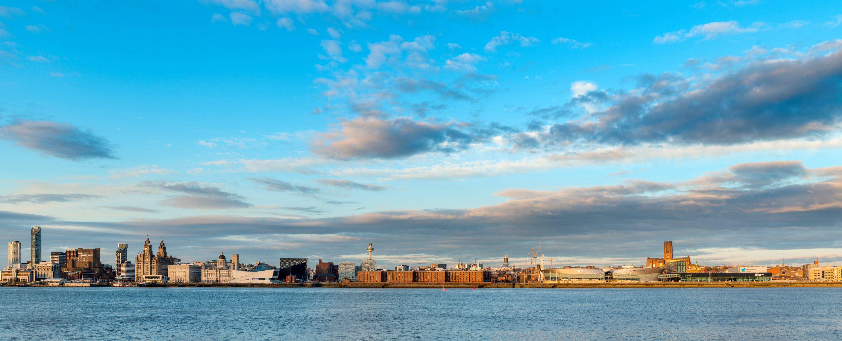
On the Waterfront
Notes:
City centre venue on a waterfront Location

Slide 13
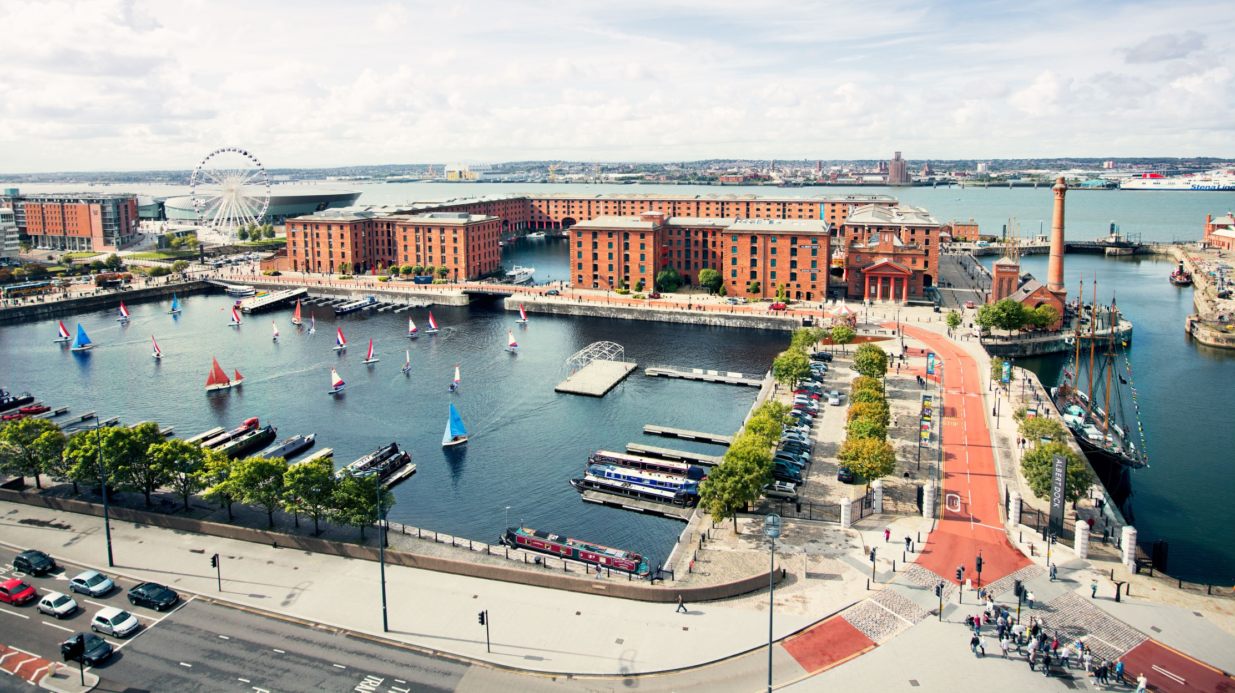
Modern, Historic, Vibrant, Friendly, Exciting, Cultural, Sporting and Musical
Liverpool is all these and more
Compact & Walkable
Compact

Slide 14
Prices range from £70 - £180/night for bed and breakfast
Accommodation

Slide 15
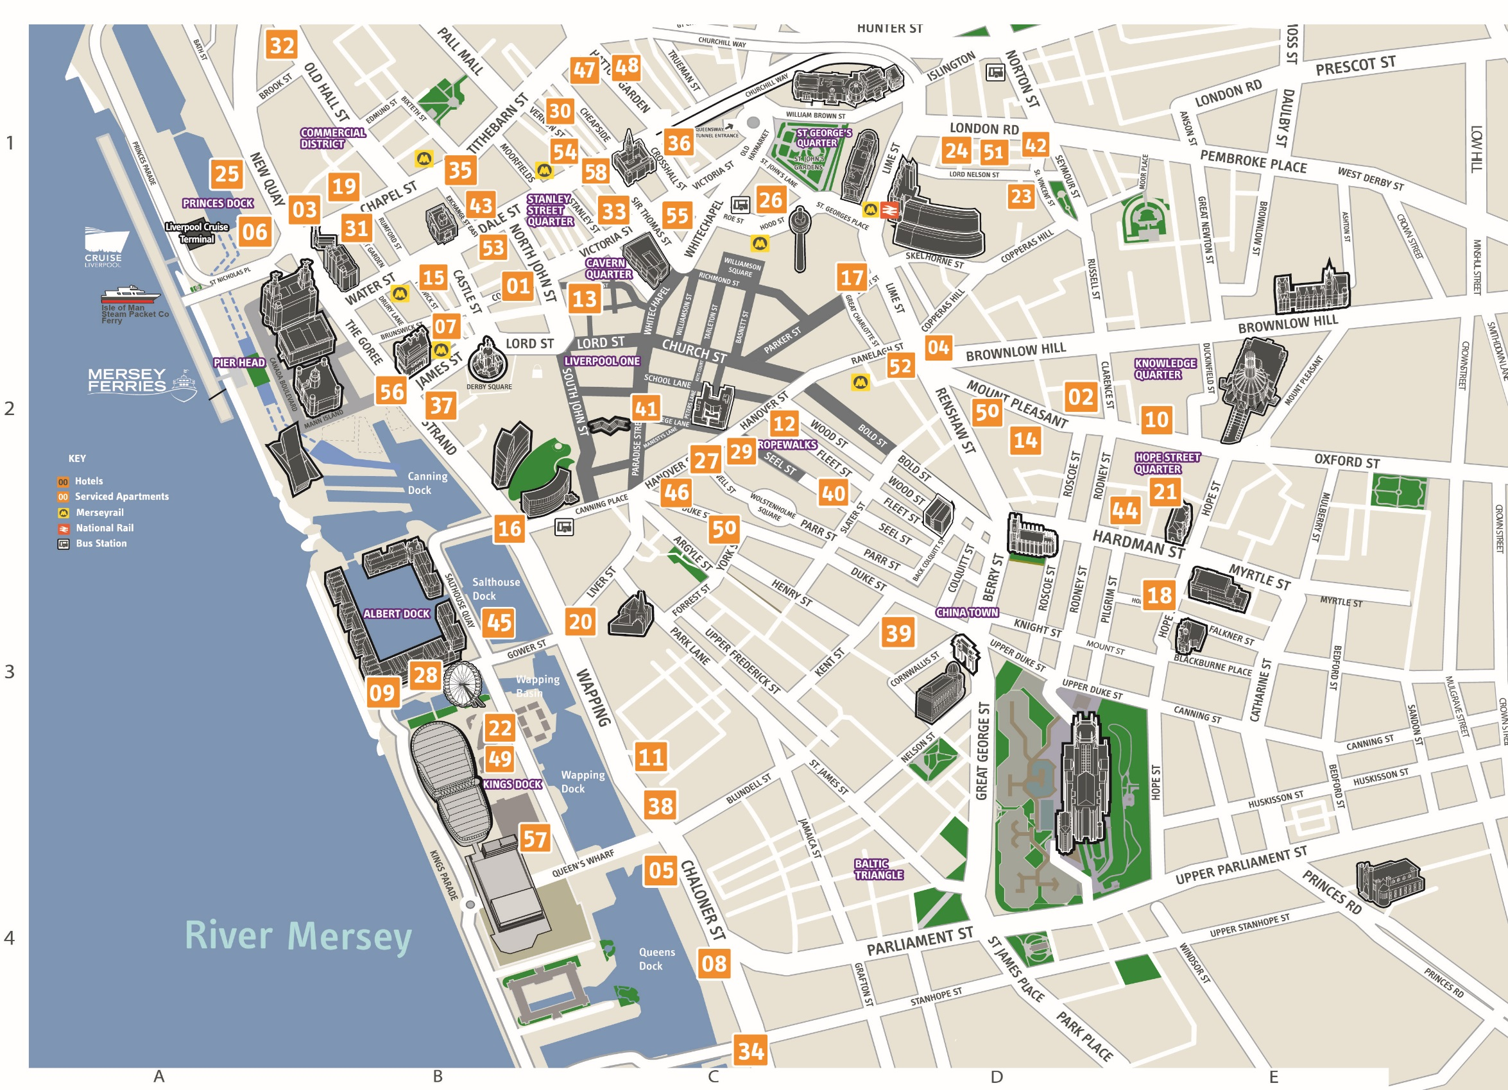
City Centre 6,138
City Region 8,046
Onsite
972 rooms
10 minute walk
1,902 rooms
20 minute walk
3,848 rooms
Accommodation
ESPE Evening

Slide 16
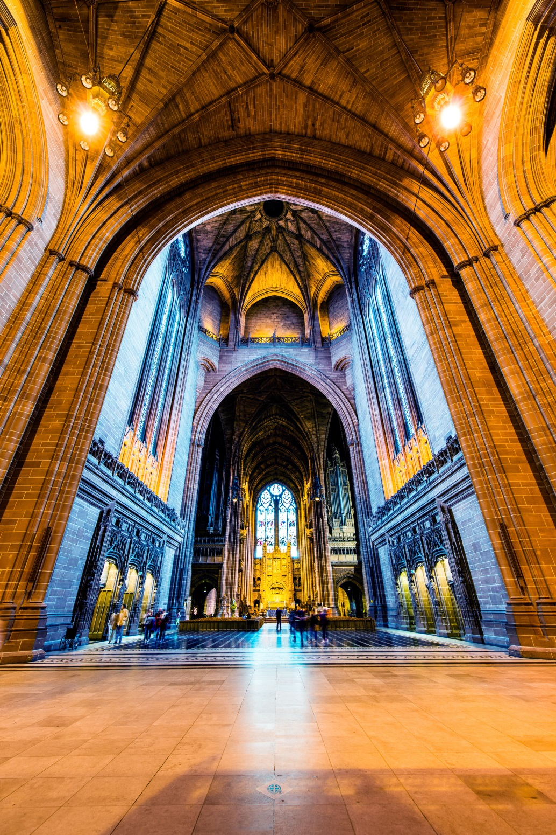
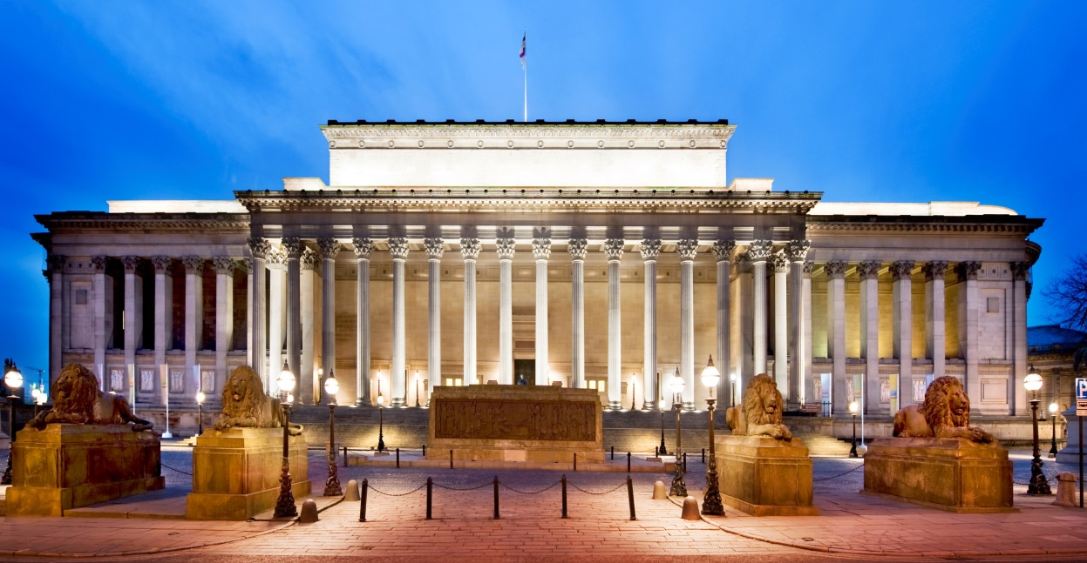
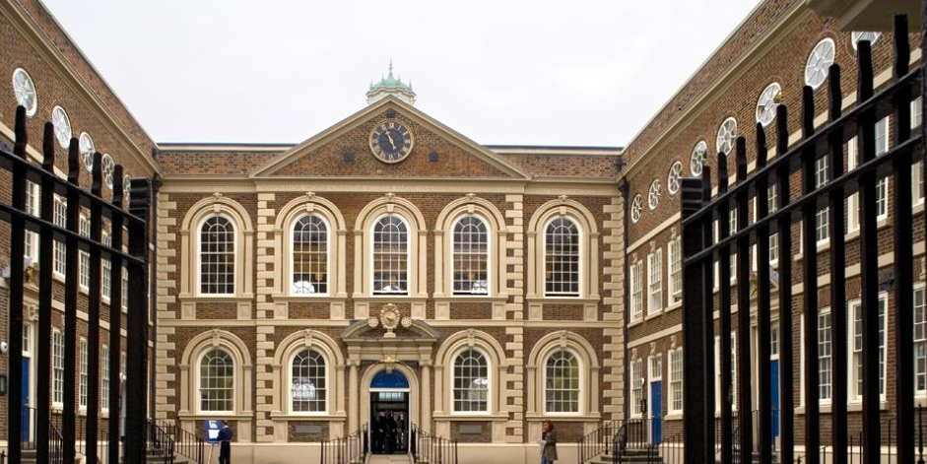
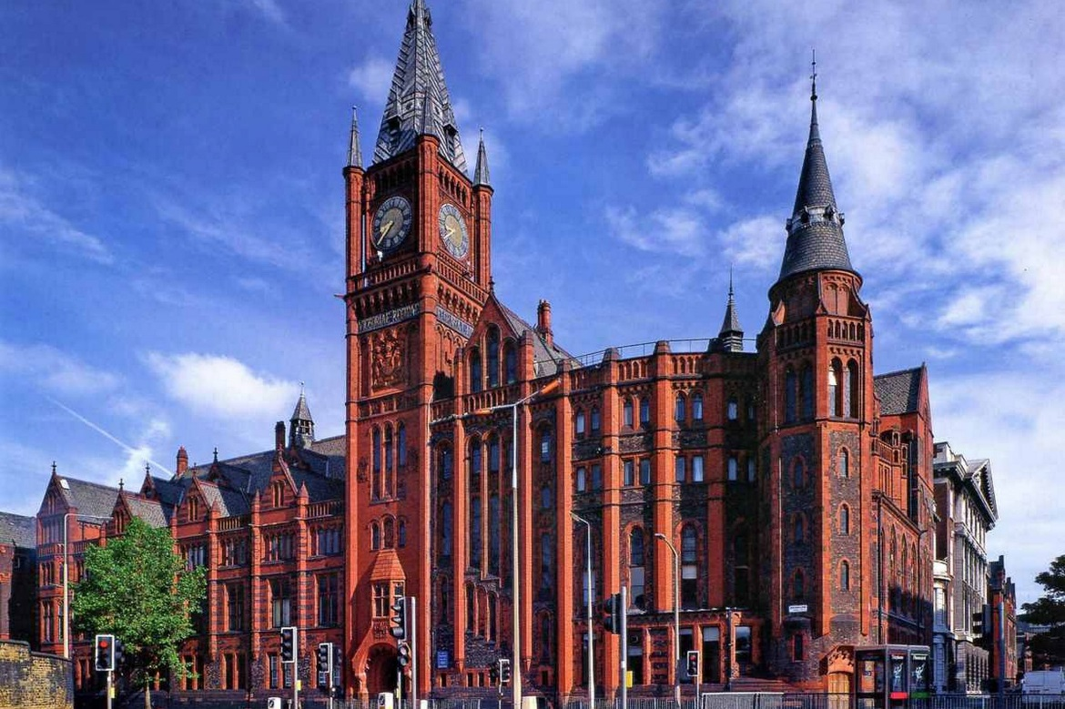
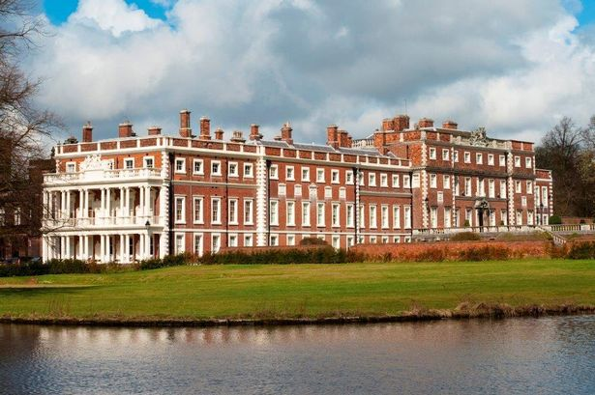
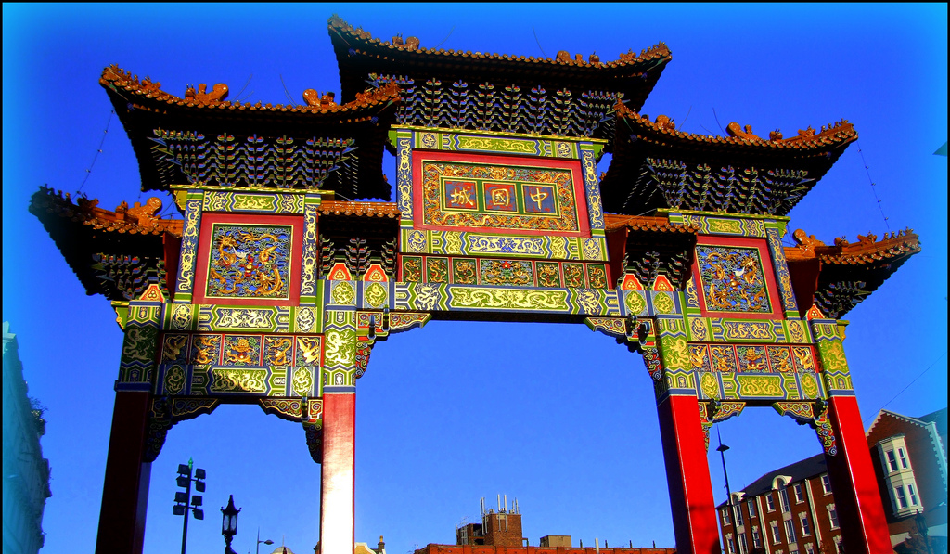
More listed buildings than any UK city outside of London
Notes:
Liverpool Cathedral - largest in the UK, 5 largest in the world (also a stunning Dinner venue (max 1000)
St Georges Hall – Historic Law court – now a council opened venue for dinners (max 500)
Old Chinese community in Europe

Slide 17
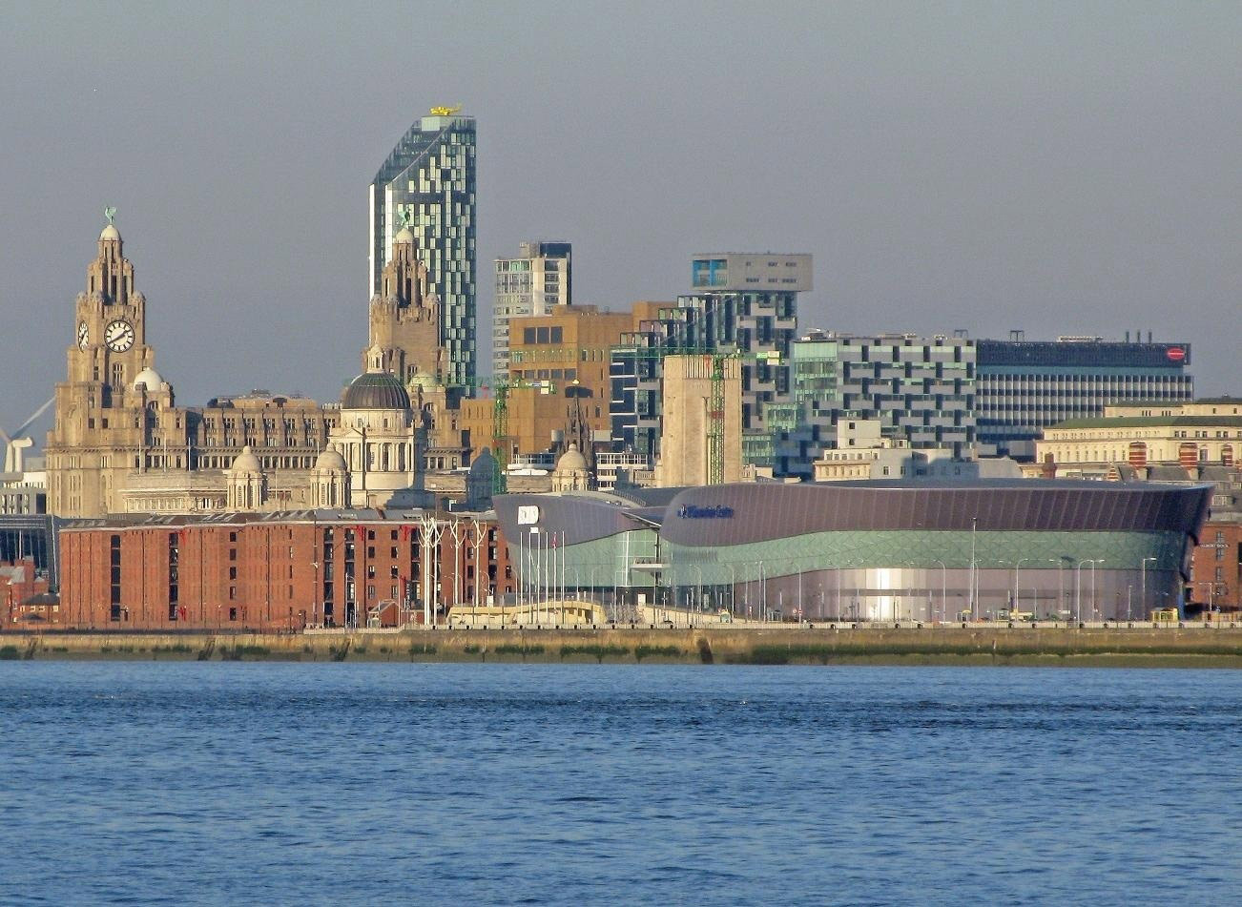
ACC Liverpool – Conference Venue

Slide 18
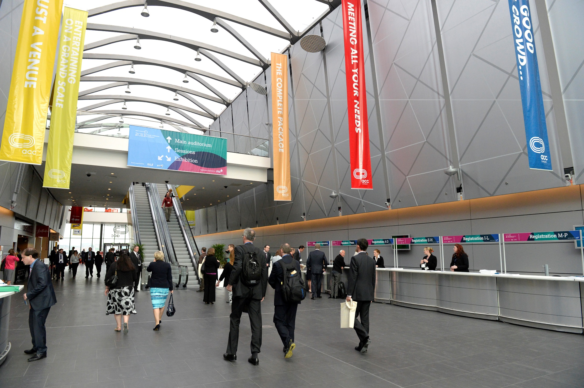
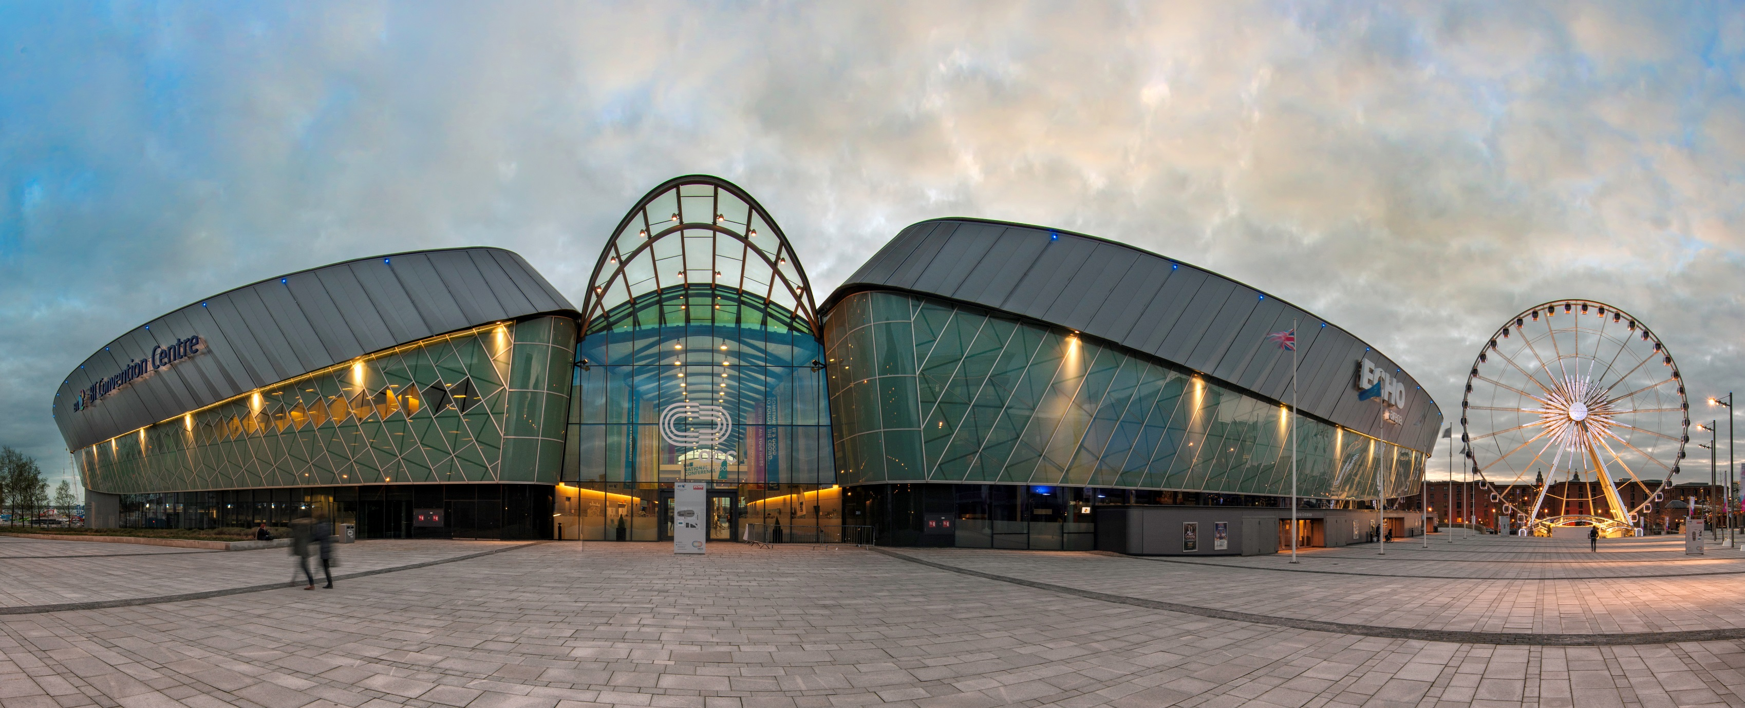
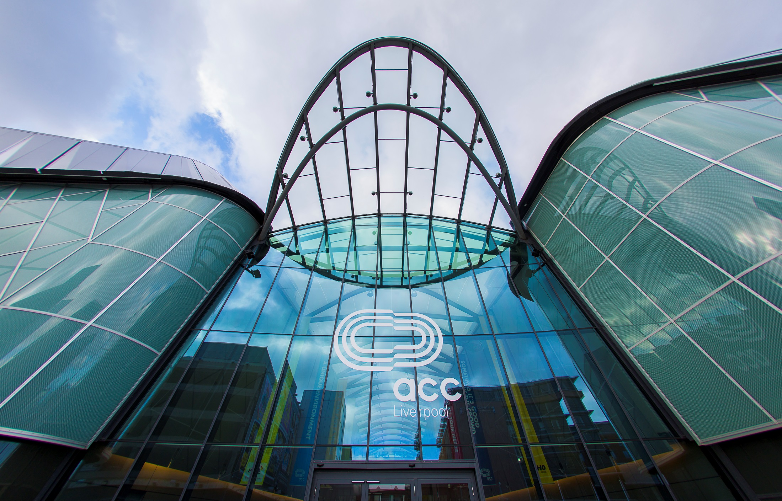
Registration Area

Slide 19
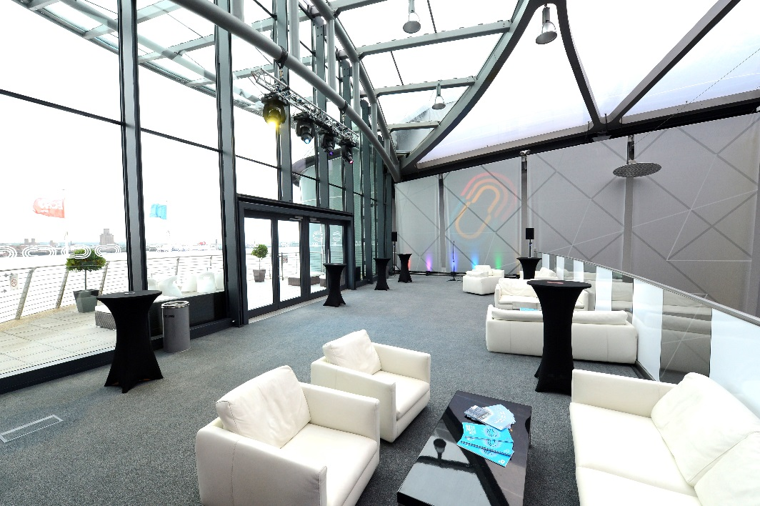
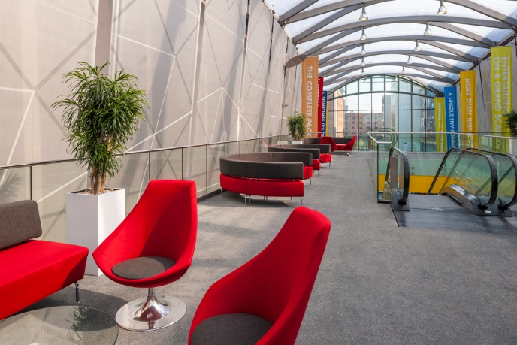
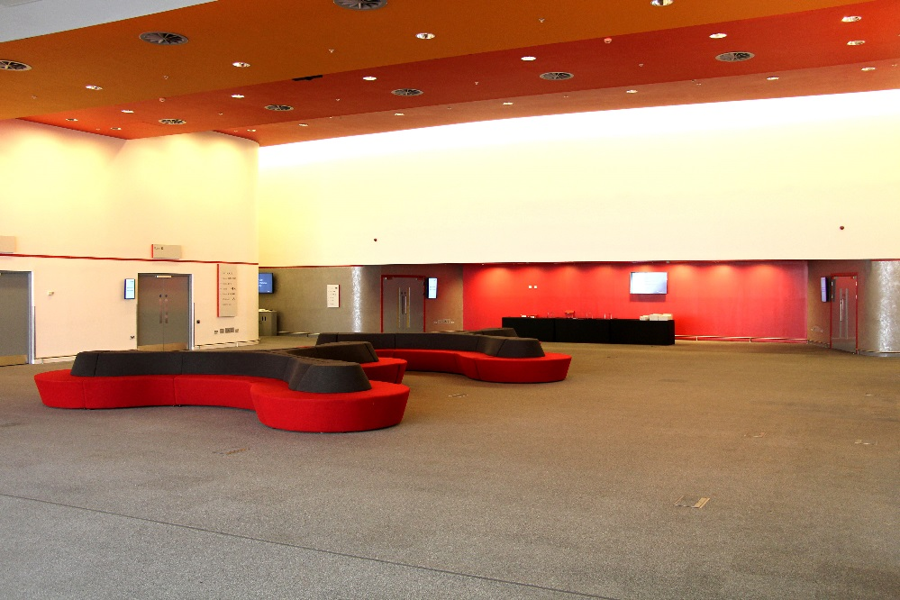
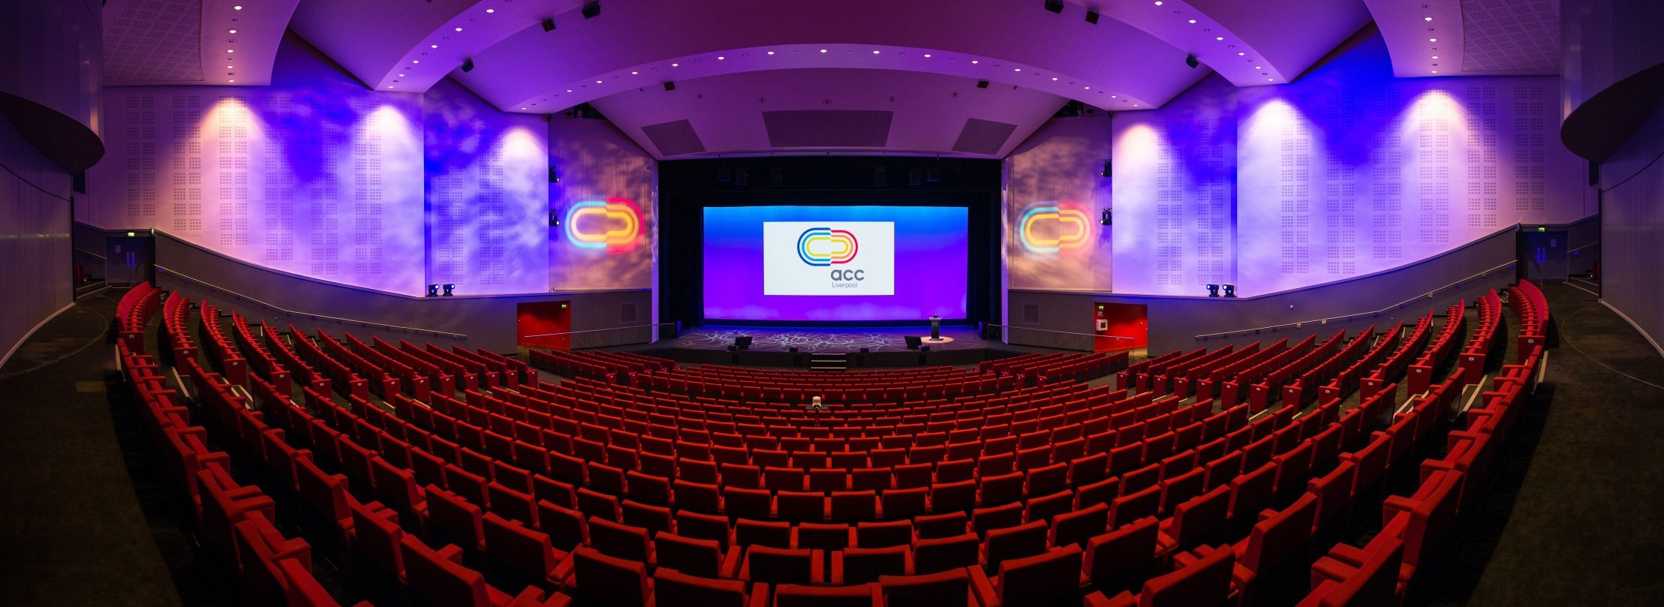
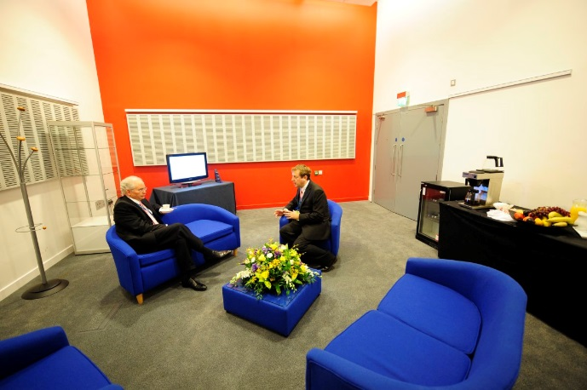
3, 11, Balcony and Foyer
Exhibition, Posters and Catering
1A
Main Plenary
332m²
26m²
5, 6, 8, 9
Offices
500+ delegates
25m²
670m²
26m²
25m²
463m²
137m²
Venue Layout

Slide 20
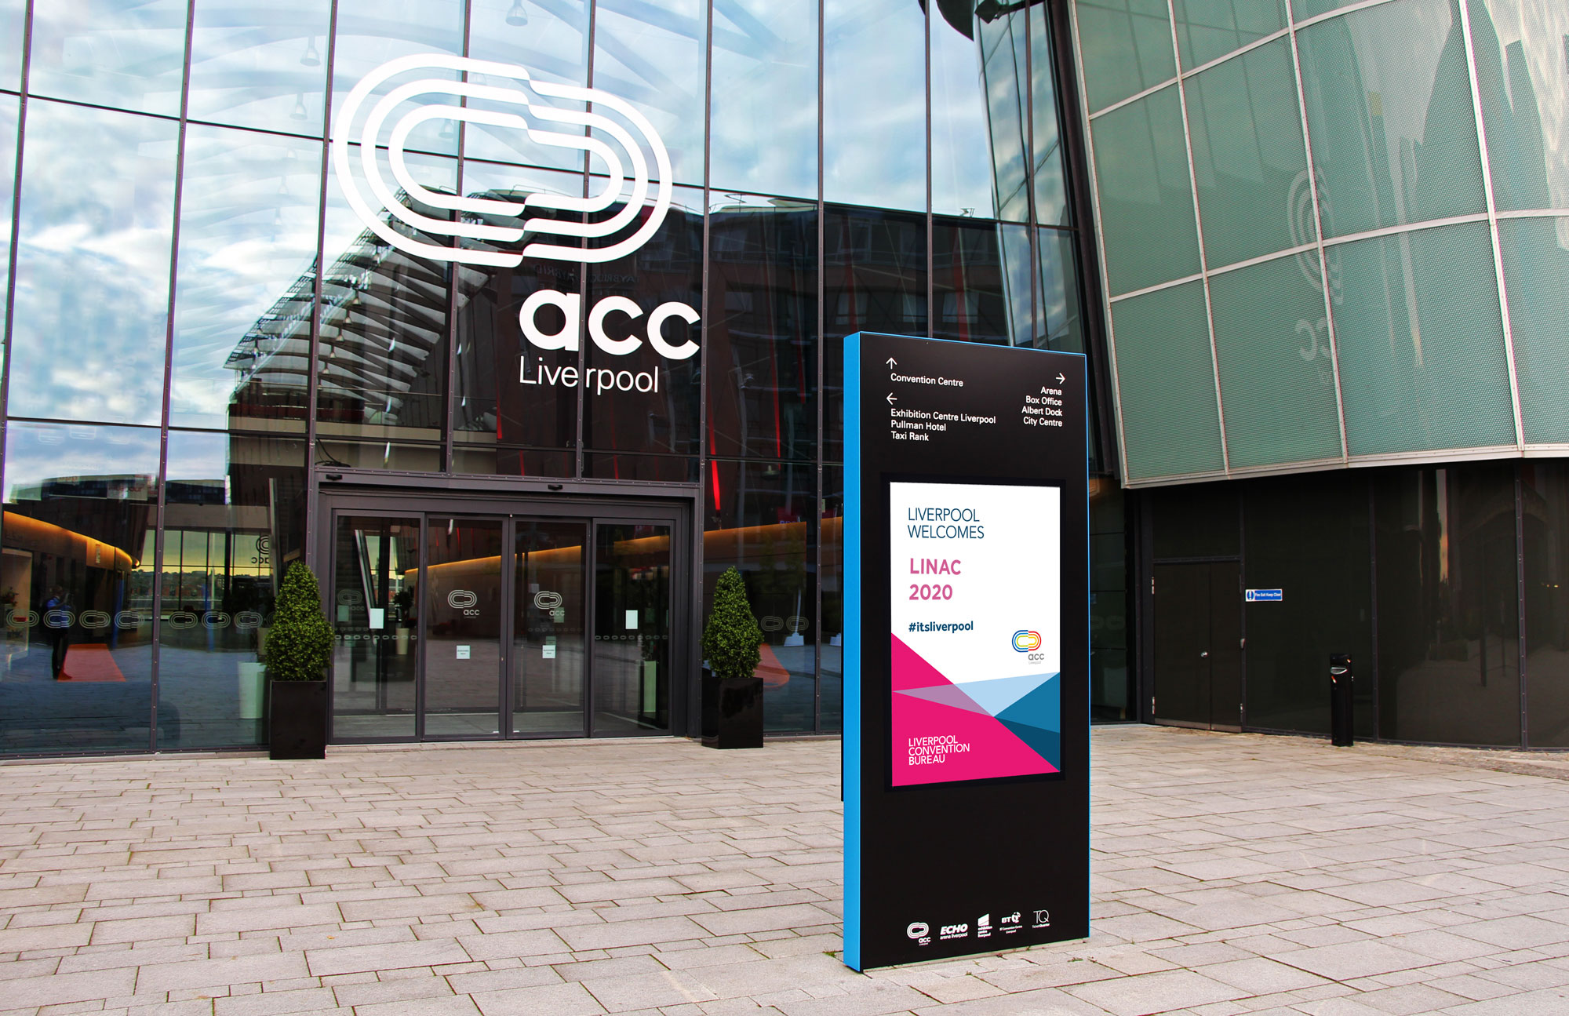
Inclusive AV packages
Free Wifi
Carpeted exhibition space
Conference Furniture
Registration Desks
Stewarding and security
Traffic marshalling
Cleaning provision
Digital signage
Delegate discount card
Inclusive Items

Slide 21
Best UK Conference Centre

Slide 22
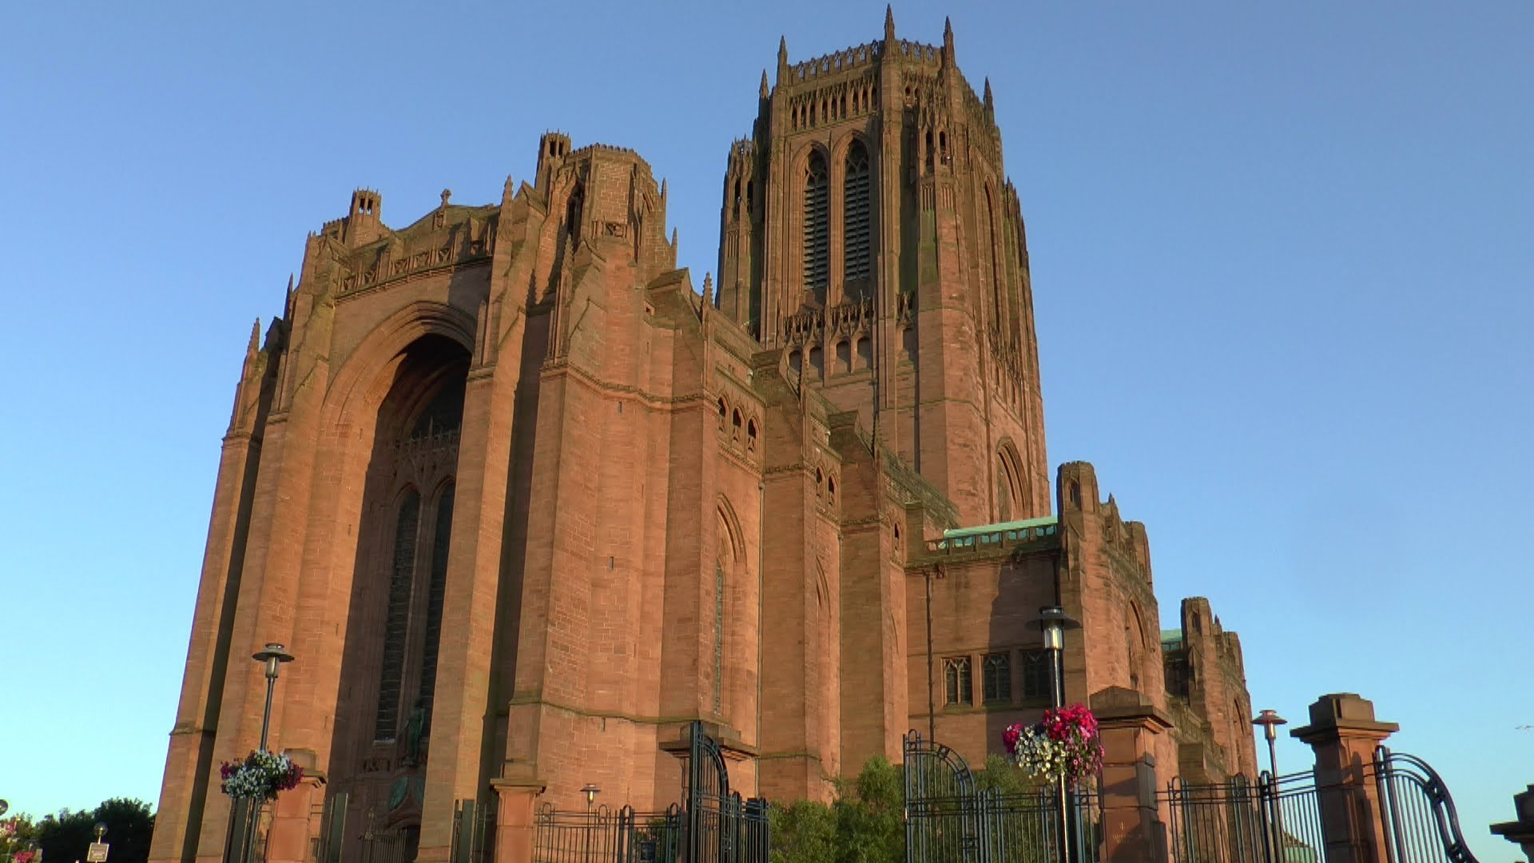
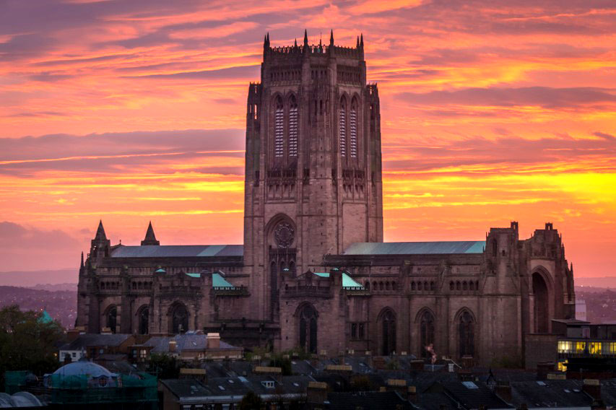
Chairman’s Reception – Liverpool Cathedral
Monday Evening (70 people)

Slide 23
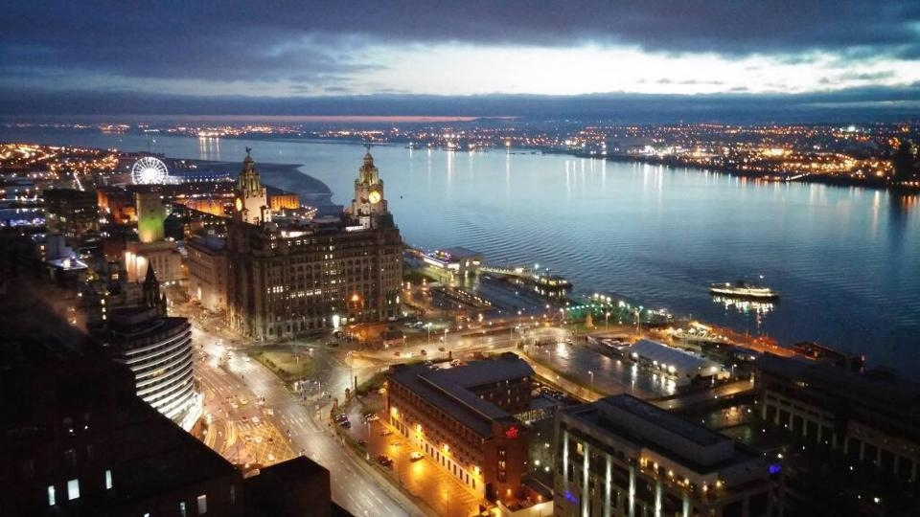
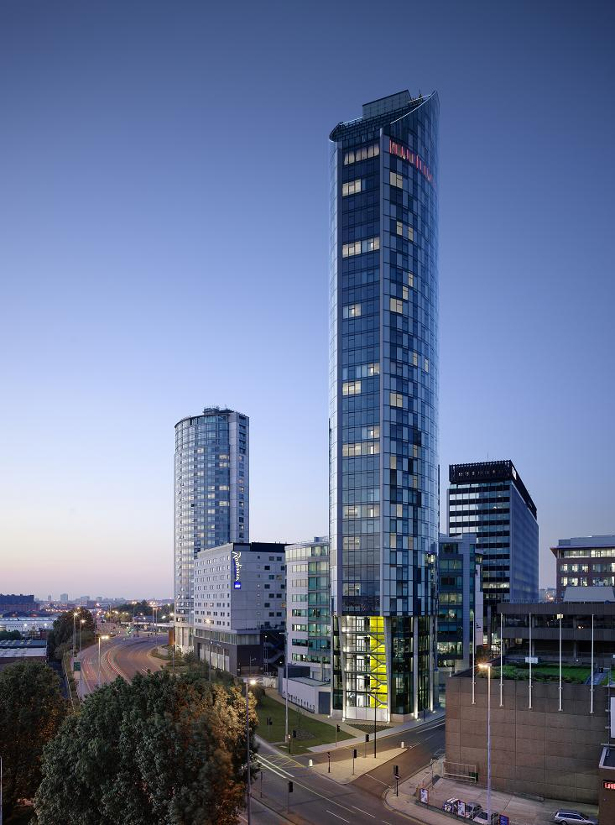
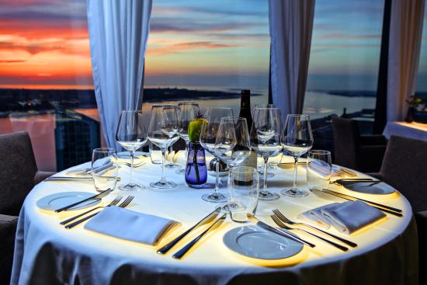
IOC Committee Dinner – Panoramic 34
Tuesday Evening (30 people)

Slide 24
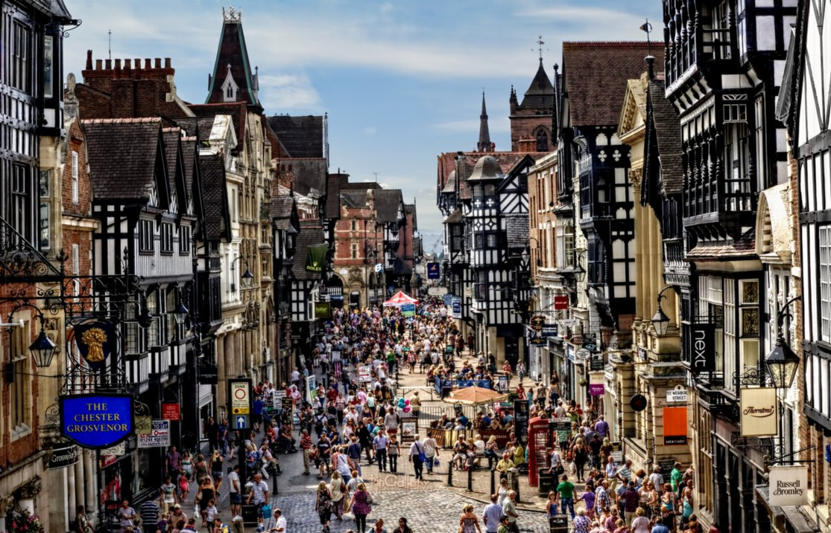
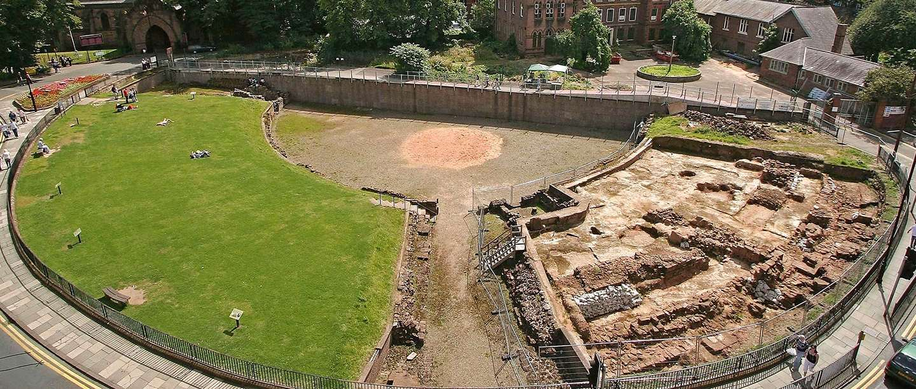
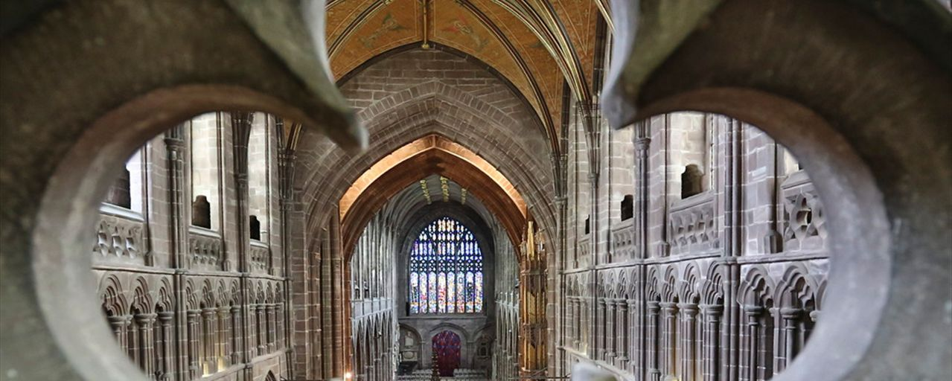
Excursion Option 1 – Chester
Wednesday Afternoon

Slide 25
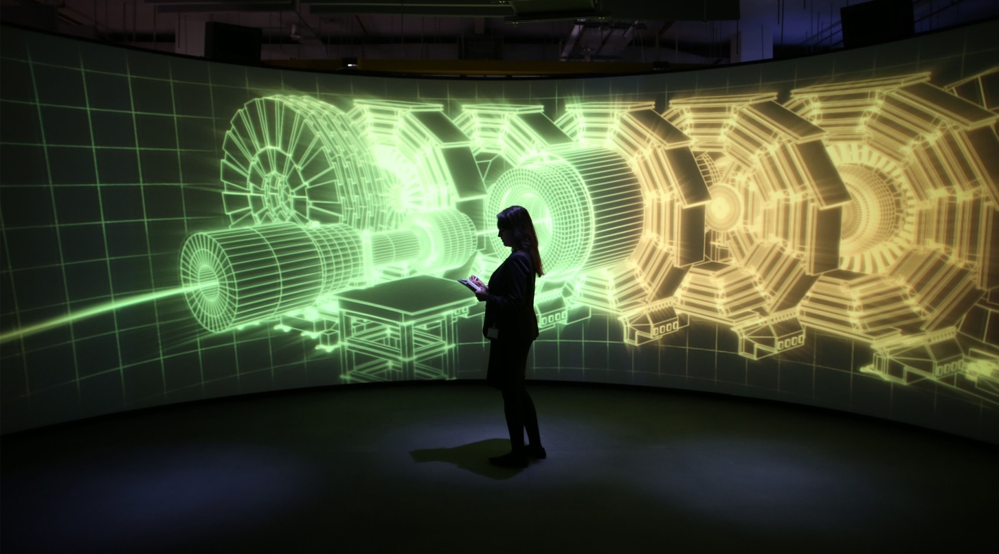
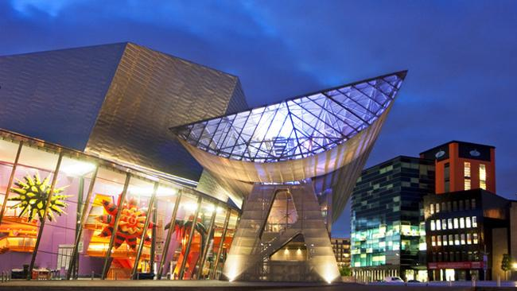
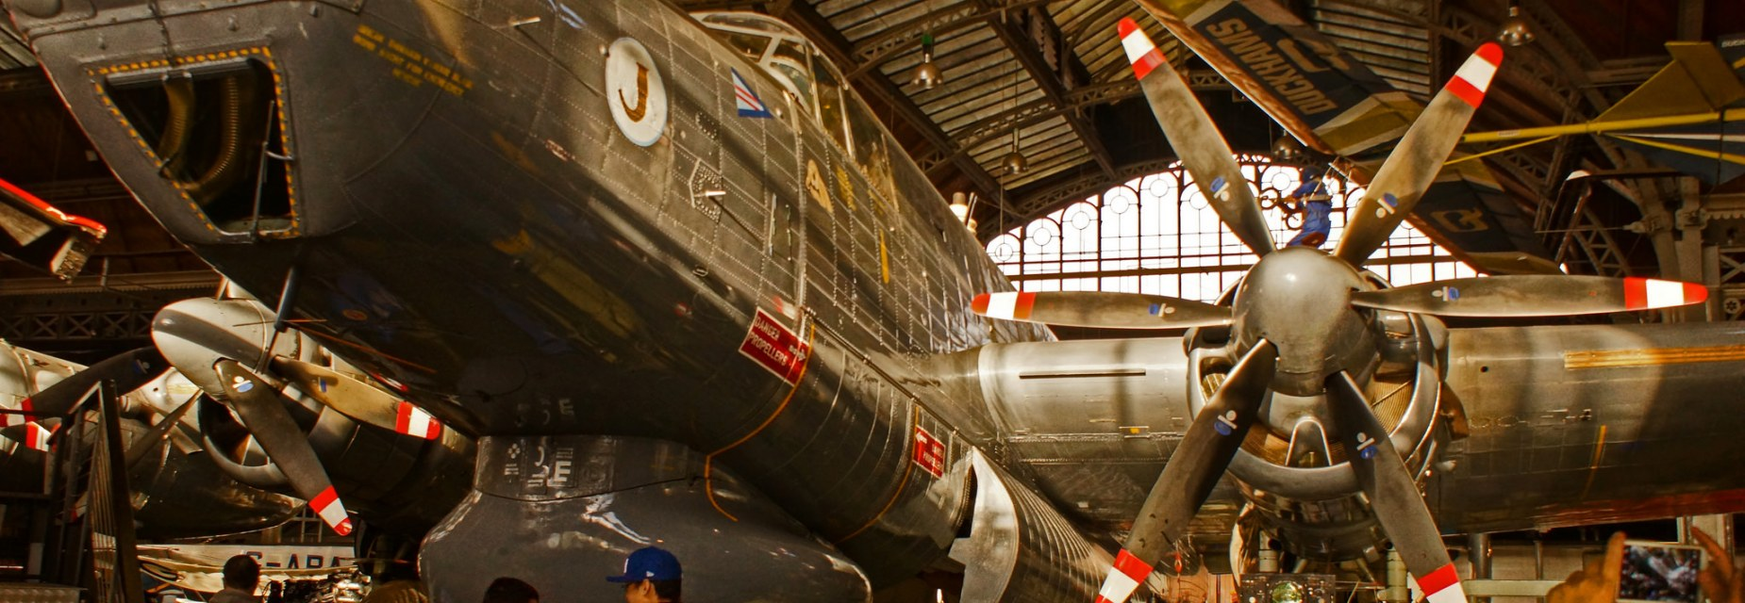
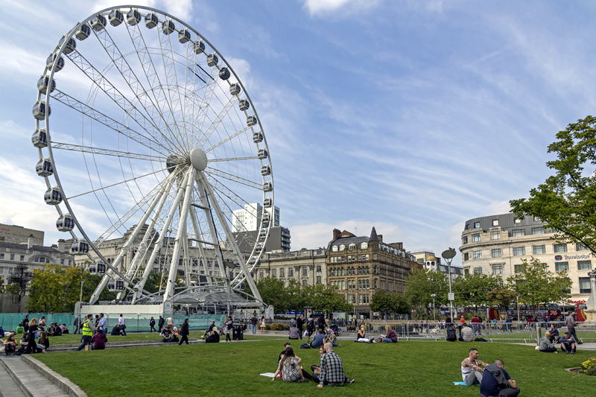
Excursion Option 2 – Manchester
Wednesday Afternoon

Slide 26
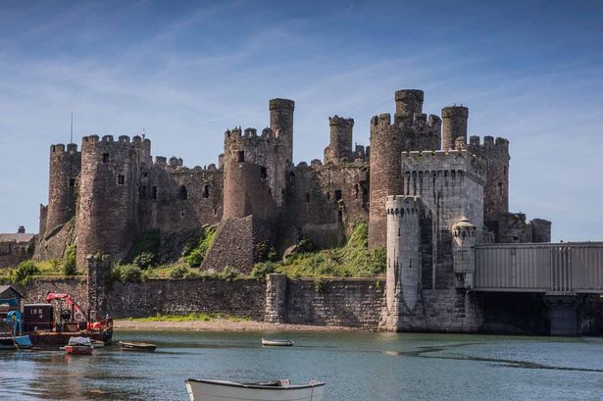
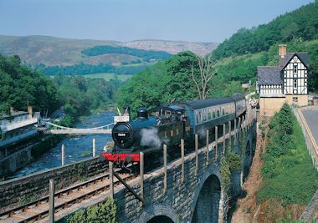
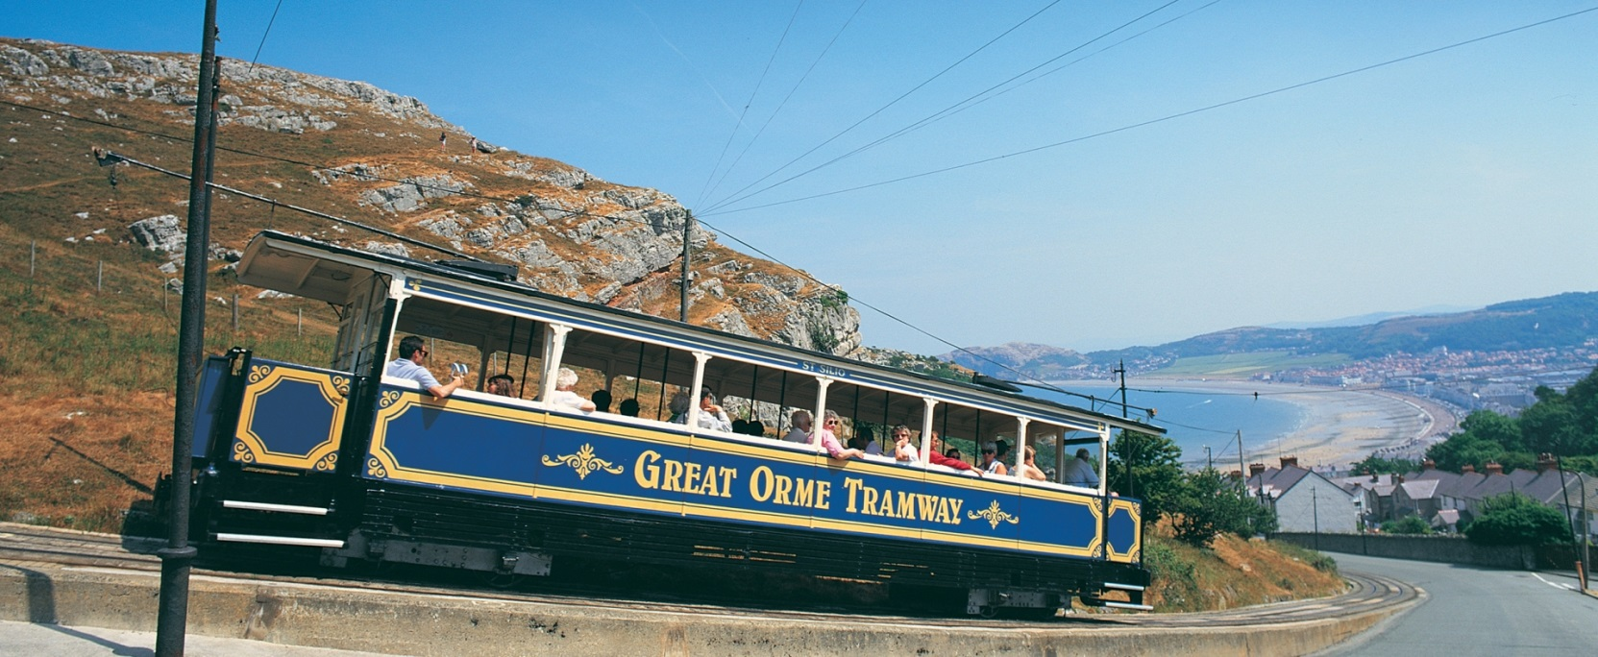
Excursion Option 3 – North Wales
Wednesday Afternoon

Slide 27
Excursion Option 4 – Hiking (Moel Famau)
Wednesday Afternoon

Slide 28
Conference Dinner – St George’s Hall
Thursday Evening (350 people)

Slide 29
ALICE
CLARA
Only 35 min drive from ACC Liverpool.
We have ALICE, a 35 MeV energy recovery prototype and EMMA the world’s only NS-FFAG.
We have a 6 MeV industry focussed accelerator VELA.
Currently constructing CLARA a 250 MeV FEL test accelerator – expect to be complete by 2020.
Expect to test all of the high-beta SRF cavities for ESS from 2015-2021 at Daresbury.
CLARA
Free Electron Laser Test Facility
Europe’s only SRF ERL
UK FEL Test Facility
EMMA
World’s only NS-FFAG
ESS
VELA
Unique access LINAC
ESS
Tour of Daresbury Laboratory
Friday Afternoon

Slide 30
Delegate Downtime

Slide 31
Assumptions:
220 paying early registration (£510, 592€, $663)
80 paying late registration (£560, 650€, $728)
30 industry participants (registration paid in exhibitor fee)
20 students paying reduced registration fee (£220 cf £510)
350 minimum number of delegates anticipated.
Conference Budget 1/3

Slide 32
EXPENDITURE |  | Cost (£) | Number | Servings
 | Item Including Fixed and Variable Costs |  |  |  | Total (£) | Total (€) | Total ($)
Venue
1 | Venue Hire | 115,000 |  |  | 115,000 | 133,400 | 149,500
2 | Audio visual (WiFI and Media Services) | 4,500 |  |  | 4,500 | 5,220 | 5,850
3 | Equipment, Presentation and Décor | 2,500 |  |  | 2,500 | 2,900 | 3,250
4 | Exhibition Stands | 13,200 |  |  | 13,200 | 15,312 | 17,160
Catering |  |  |  |  |  | 0 | 0
5 | Lunches | 20 | 350 | 3 | 21,000 | 24,360 | 27,300
6 | Refreshments | 4 | 350 | 10 | 14,000 | 16,240 | 18,200
Conference |  |  |  |  |  | 0 | 0
7 | PCO |  |  |  | 5,000 | 5,800 | 6,500
8 | Conference bags | 15 | 350 |  | 5,250 | 6,090 | 6,825
9 | Conference booklets | 7 | 350 |  | 2,450 | 2,842 | 3,185
10 | Conference gifts | 4 | 350 |  | 1,400 | 1,624 | 1,820
11 | Proceeding staff expenses (Locals + Jacow) |  |  |  | 9,000 | 10,440 | 11,700
12 | Student support | 800 | 20 |  | 16,000 | 18,560 | 20,800
13 | Student awards |  |  |  | 1,400 | 1,624 | 1,820
Events |  |  |  |  |  | 0 | 0
14 | Conference Reception | 18 | 350 |  | 6,300 | 7,308 | 8,190
15 | Chairman's Reception | 40 | 70 |  | 2,800 | 3,248 | 3,640
16 | IOC Dinner | 60 | 30 |  | 1,800 | 2,088 | 2,340
17 | Afternoon Excursion (Event, Transport and Dinner) | 50 | 350 |  | 17,500 | 20,300 | 22,750
18 | Excursion packed lunches | 13 | 350 |  | 4,550 | 5,278 | 5,915
19 | Conference Banquet | 70 | 350 |  | 24,500 | 28,420 | 31,850
20 | Banquet Entertainment |  |  |  | 1,500 | 1,740 | 1,950
21 | Transport (Daresbury Tour) |  |  |  | 1,000 | 1,160 | 1,300
 | TOTAL |  |  |  | 270,650 | 313,954 | 351,845
Conference Budget 2/3

Slide 33
EXPENDITURE |  |  |  |  | Total (£) | Total (€) | Total ($)
 | TOTAL |  |  |  | 270,650 | 313,954 | 351,845
INCOME
1 | Registration (Early) | 510 | 220 |  | 112,200 | 130,152 | 145,860
2 | Registration (Late) | 560 | 80 |  | 44,800 | 51,968 | 58,240
3 | Registration (Students) | 220 | 20 |  | 4,400 | 5,104 | 5,720
4 | Resistration (Exhibitors) | 0 | 30 |  | 0 | 0 | 0
5 | Exhibitors | 3000 | 30 |  | 90,000 | 104,400 | 117,000
6 | Sponsorship |  |  |  | 20,000 | 23,200 | 26,000
 | TOTAL |  | 350 |  | 271,400 | 314,824 | 352,820
Registration Comparison
 |  | Early |  |  | Late |  |  | Participants
 |  | € | $ | £ | € | $ | £
Linac14 | Geneva | 620 | 780 | 510 | 700 | 880 | 575 | 480
Linac16 | East Lansing | 608 | 680 | 521 | 698 | 780 | 598 | 403
Linac20 | Liverpool | 592 | 663 | 510 | 650 | 728 | 560 | 350
Conference Budget 3/3

Slide 34
6,208 CITY CENTRE BEDROOMS
ACCELERATOR
EXCELLENCE
EXCITING & VIBRANT
Why Choose Liverpool?

Slide 35
We look forward to hosting,
for the very first time in the UK,
The 30th LINAC Conference in 2020.

Slide 36
Liverpool video

