Slide 1
Accelerator Complex in the Near Term: PIP and NOvA
Bob Zwaska
Fermilab AAC Meeting
November 7, 2011

Slide 2
Introduction
Present and near-future experiments at Fermilab require unprecedented levels of proton production from the Fermilab Complex
Protons are the raw material to make neutrinos, muons, and other rare particles
NOvA requires a proton exposure 3-6x that of MINOS
Several experiments are to run concurrent with NOvA
Fermilab has several programs to address desired increases in proton production
Outline
Present Fermilab Accelerator Complex
Provides protons neutrino production (and other fixed-target applications)
340 kW @ 120 GeV, additional ~ 10 kW @ 8 GeV
Programs to improve proton beam power
Proton Improvement Plan ⇒ in progress (new this year)
NOvA Upgrades (ANU) ⇒ in progress (underway, part of NOvA project)

Slide 3
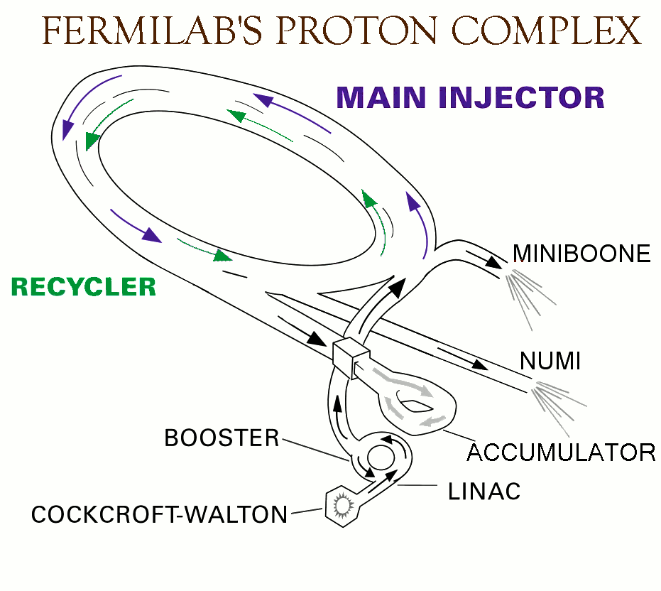

Slide 4
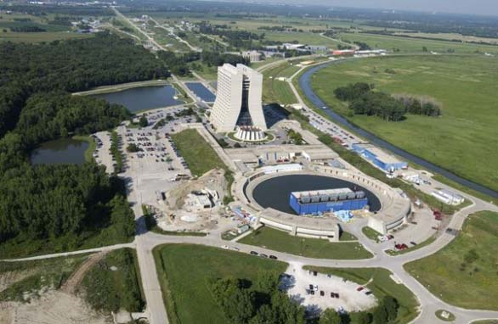
Present Proton Production
Linac produces 400 MeV H⁻
Bunched at 200 MHz
35 mA for up to 40 us at up to 15 Hz
Booster produces 8 GeV protons (MiniBooNE, etc.)
Bunched at 53 MHz
Up to 5e12 (typically 4.3e12) in 1.5 us
Operates up to ~ 7 Hz (40 kW)
Main Injector produces 120 GeV protons (NuMI)
Bunched at 53 MHz
Up to 4e13 (typically 3.7e13) in 9.7 us
Operates as quickly as 2.07 s (350 kW)
Almost all is for neutrino production, but ~ 20% was for antiprotons until recently

Slide 5
Limits to Proton Throughput
Linac/Booster (Proton Source)
Losses in the Booster accelerator limit power
Not initially intended as high duty factor machines
Proton Improvement plan is to more than double throughput (goal of 2.25e17/hr, or 90 KW)
Main Injector
Losses and cycle time limit power
More modern machine – designed for high duty factor
NOvA accelerator upgrades will reduce the cycle time, pushing MI power to near 700 kW
Target Stations
Generally, the target stations to produce beams can limit how many protons can be delivered to them
Issues become significant in the 10s of kW and severe in the 100s of kW – MW will be above and beyond
Power delivered to NuMI is presently limited by the state of the target and target spares

Slide 6
Booster - Historical Performance
Proton Improvement Examples:
Booster Collimators FY04
Booster Low Level/Damping FY04
New Booster Injection Line FY FY06
Removal of L13 Extraction Region FY07
Linac Quad PS FY07
Linac Low Energy Low Level FY08
New Ramped Correctors FY09
Annual E19

Slide 7
PIP – Proton Improvement Plan
A recognition that, until Project-X is operational, the entire domestic accelerator-based high-energy physics program is powered by the 40+ year old Proton Source
The Proton Source suffers age-related issues of reliability and availability of spare components, yet proton demands continue to increase
Experiments that have received Fermilab PAC approval or are in the DOE CD-process expect a factor of two increase of the current proton delivery rate within the coming decade

Slide 8
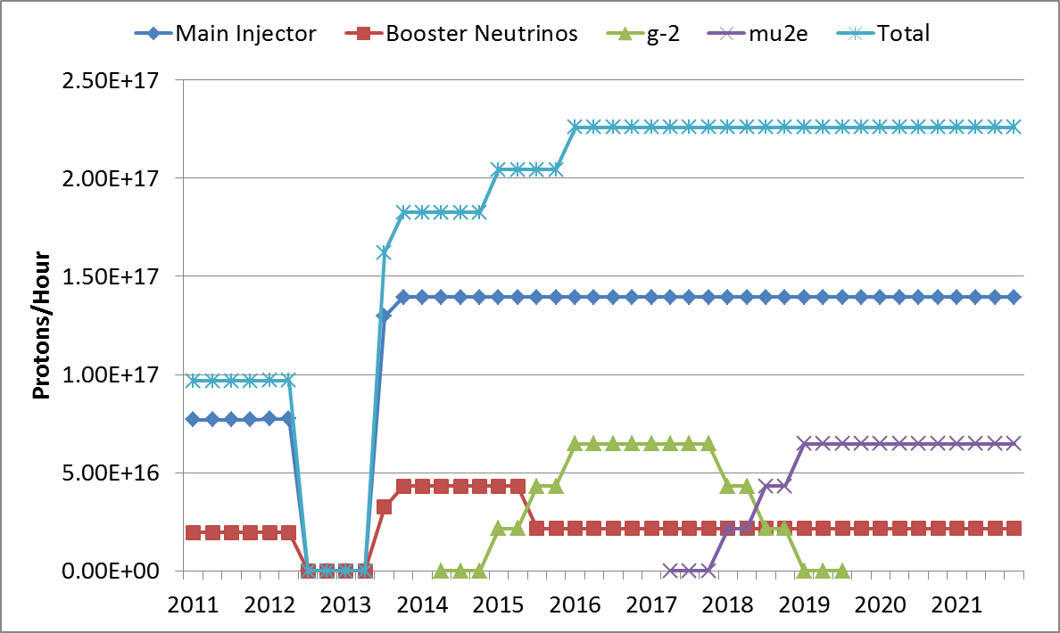
Proton Source Throughput Goals
NOvA Shutdown
120 GeV ν
LBNE
g-2
Mu2e
8 GeV ν

Slide 9
Goals for the Proton Improvement Plan
The Proton Improvement Plan should enable Linac/Booster operation capable of
Delivering 2.25E17 protons/hour (at 15 Hz) in 2016
while
Maintaining Linac/Booster availability > 85%, and
Maintaining residual activation at acceptable levels
and also ensuring a useful operating life of the proton source through 2025.
The scope of the Proton Improvement Plan includes
Upgrading (or replacing) components to increase the Booster repetition rate
Replacing components that have (or will have) poor reliability
Replacing components that are (or will soon become) obsolete
Studying beam dynamics to diagnose performance limitations
Implementing operational changes to reduce beam loss
Several important activities are well underway

Slide 10
Proton Improvement Plan Major Items
The Cockcroft-Walton system
Drift Tube Linac RF Power Systems
Booster RF Solid State Program
Booster RF Cavities, Tuners, Anode Supplies, and Bias Supplies
Beam Instrumentation and Controls
Linac and Booster Conventional Systems
Vacuum system upgrades
Booster Gradient Magnet Spares
Loss control
Plan to spend about $40M M&S over 5 years

Slide 11
Proton Improvement Plan Bill Pellico Bob Zwaska, Deputy Elmie Peoples-Evans, Project Controls Mary Convery, Installation Coordinator Valeri Lebedev, Free Agent
Booster Keith Gollwitzer
Linac Fernanda G. Garcia
RFQ Injector C. Y. Tan
200 MHz Accelerating System Fernanda G. Garcia
HLRF ???
Linac Modulator Trevor Butler
7835 Procurement Fernanda G. Garcia
Instrumentation Craig Drennan
Utilities Patrick Karns
Power Distribution Steve Hayes
Booster RF John Reid
Anode PS Rene Padilla
Bias Supplies Pat Sheahan
New Tuners Matt Slabaugh Ralph Pasquinelli
New Cavities Valeri Lebedev
Cavity Test Stand Pat Sheahan John Reid
Cavity 20 Matt Slabaugh John Reid
Accelerator Physics Bob Zwaska
Booster Cogging Kiyomi Seiya
Booster Instabilities & Feedback Bob Zwaska
Injection Painting Valeri Lebedev
Radiation Shielding Peter Kasper
Alignment & Aperture Kiyomi Seiya
Booster Notcher Bruce Hanna
Power Distribution Steve Hayes
95LCW System Maurice Ball
Vacuum Systems Dave Augustine
Solid State Upgrade John Reid
Modulators Rene Padilla
Driver Amplifiers Tom Kubicki
Cavity & Tuner Refurb. Matt Slabaugh Mary Convery
Controls Upgrade Mike Kucera
Cooling System David Hixson
400 MeV Optics Matching & Collimation Valeri Lebedev
Linac Notch Creation Dave Johnson
Linac Lattice , Orbits and Collimation Hyung Jin Kim
Accelerator Physics Valeri Lebedev
Vacuum Systems Dave Augustine
Power Amplifiers Steve Kotz
Installation Rene Padilla Steve Kotz
Instrumentation Craig Drennan
Dampers Nathan Eddy
Controls Craig Drennan
Utilities Todd Sullivan
Booster Collimation Valeri Lebedev
BPM Upgrade Nathan Eddy

Slide 12
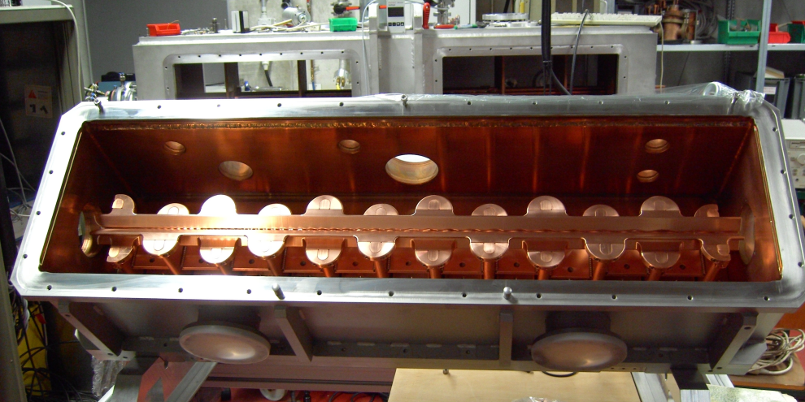
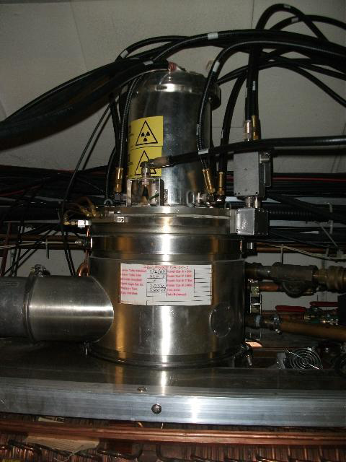
PIP
Plan is underway, though just organized formally in the last year
Advanced items
Source/RFQ replacement
Solid State RF upgrade
Utilities work
Aging water, electrical, vacuum systems
Items in planning
Linac RF replacement
Booster cavity rework
Loss reduction and control
Numerous small items
Installation of all work to be complete by 2016, gains realized along the way as commissioning occurs

Slide 13
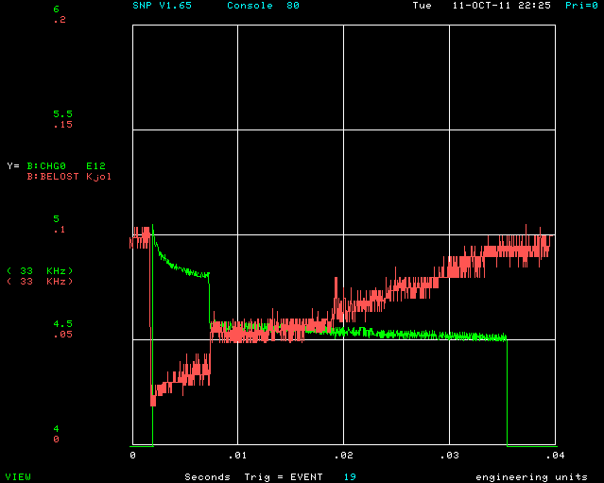
Booster Losses
Losses at injection
Poorly captured beam
Notch creation
Gap for extraction
Created with a kicker
Lost in gradient magnet
Slow losses at high-energy
Optics issues
RF variation
Transition
Occasionally significant, but can usually be tuned away

Slide 14
Path to Higher Proton Throughput
Loss reduction
Lower linac emittance
RFQ & linac lattice improvements
Apertures & alignment
Comprehensive survey of apertures
Alignment where necessary (including within girders)
Opening apertures where possible
Optics adjustment
Comprehensive survey of lattice and coupling
Control of tunes and chromaticity
Automated orbit and optics smoothing
RF improvements
Increased voltage from amplifiers
Cavity modification/replacements
Instabilities
Dampers
Injection painting
Orbit Control
Magnetic Cogging
Prerequisite for other work
Loss Control
Rework of notching in Booster
Perform earlier in cycle
New notch kickers and absorber
Exploration of full or partial notching in Linac
Collimation system
Run beam near primary scatterer
Optimize primary scatter thickness
Operate as true, two-stage system
Adjust radiation shielding where advantageous

Slide 15
PIP Status & concerns
With the new FY, there has been an infusion of labor and M&S
The effect has been real, and progress on the solid-state upgrade is proceeding better than ever
However, the labor increase was less than promised, so we are already falling behind where we would like to be
Consistent labor effort is an issue
People are moving around – (can be seen on SS effort)
Starts and Stops to work
Inefficient and difficult to manage
Domino affect on production effort
Knowledgeable People
Key people are not easily replaceable
Skilled help is tough to get when needed
Has been more difficult to get people involved where real design work is needed

Slide 16
NOvA History
2nd generation neutrino mixing experiment
Main goal is to see ν_{e} appearance in a ν_{μ} beam
14 kton active detector in Ash River MN
14 mrad off axis to get a monoenergetic ν_{μ} beam
Critical Decision Schedule:
CD-1 May 11 2007 (Rev. Apr 4-6 2006)
CD-2 Sep 15 2008 (Rev. Oct 22-25 2007)
CD-3a Oct 24 2008 (Rev. Oct 22-25 2007)
CD-3b Oct 29 2009 (Rev. July 21-23 2009)
CD-4 Nov 2014
Accelerator added to project in Dec 2006
Project was shut down in FY2008 Omnibus bill (Dec 2007)
Started again in Feb 2009, though informally in summer 2008

Slide 17
ANU: Recycler as an 8 GeV Proton Pre-injector
Recycler had been an antiproton storage ring in MI tunnel
Use the Recycler to accumulate protons from the Booster while MI is running
Time needed to inject multiple Booster batches
Save 0.8 s for 12 Booster batches injected
Recycler momentum aperture is large enough to allow slip-stacking operation in Recycler, for up to 12 Booster batches
4.9×10¹³ ppp at 120 GeV every 1.333 s ⇒ 700 kW
New Kicker and Collimator system to control losses
Kickers force stray beam in injection and extraction gaps to the abort
Collimators collect beam that is not captured and spirals inward

Slide 18
Near Term Plan
FY12: Preparation and Installation
Deliverables:
Ready for installation: hardware prepared
About 55 FTEs for FY12
Drawn from more than 100 people
FY13: Finish Installation
Deliverables:
Accelerator capable of delivering 700 kW on target
ANU subproject complete
Note: operational commissioning not included in project
6 month linear ramp to 700 kW on target

Slide 19
FY12-13: Installation Shutdown
11 Month installation shutdown, 1 Mar 2012 - 1 Feb 2013
Fabrication of components: magnets, kickers, RF
Remove pbar devices:
Stochastic and electron cooling
Broad band barrier RF
Injection and extraction lines
Install new transfer lines (from MI-8 to RR, RR to MI)
Install new RF (3 in RR, 2 in MI)
Install new Instrumentation (BPM cables and electronics)

Slide 20
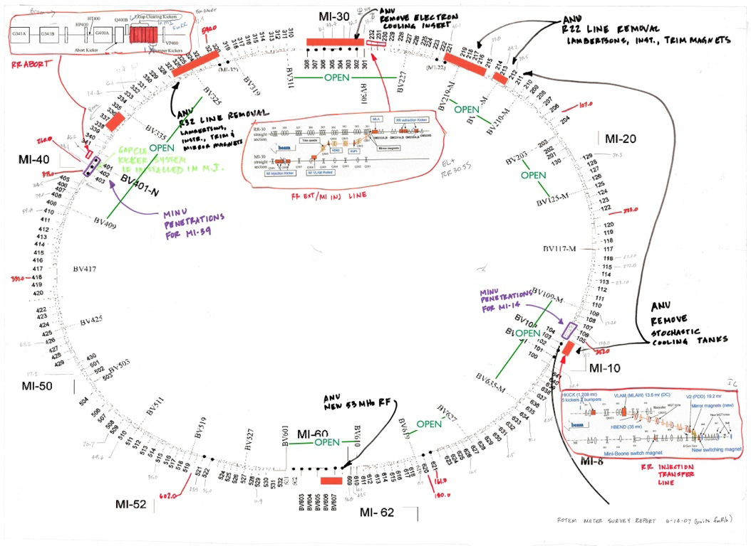
Map of Work

Slide 21
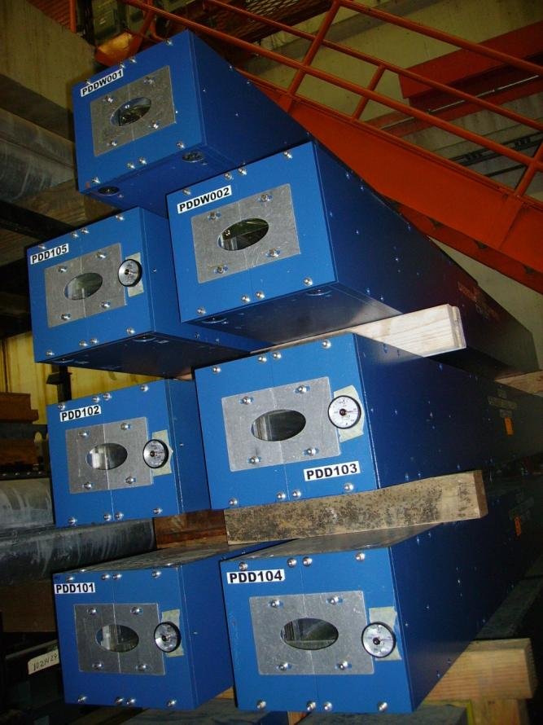
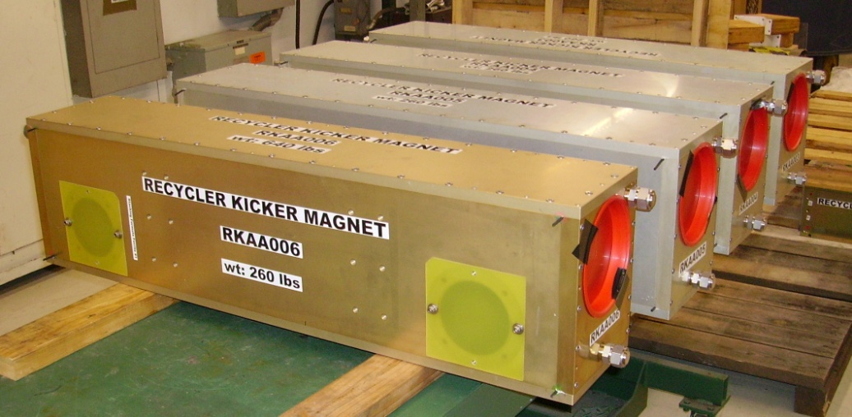
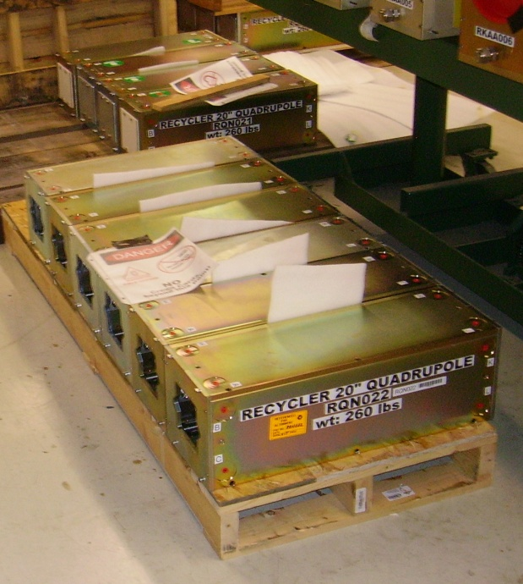
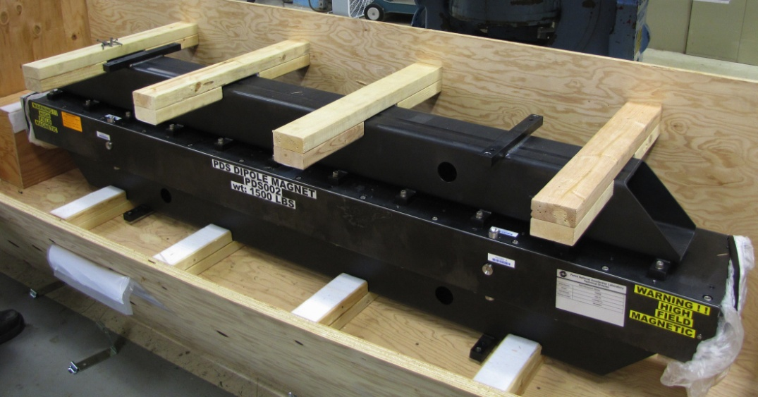
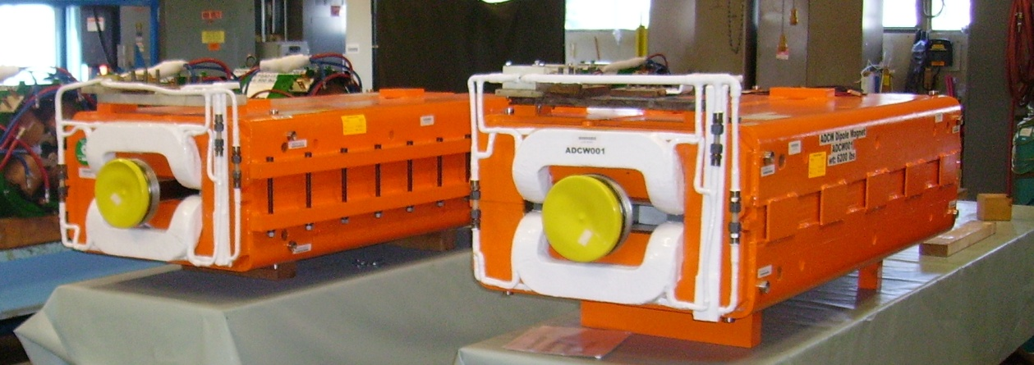
Magnets

Slide 22
NuMI Upgrades
Target Replacement
New design for 700 kW
External to horn
Target Hall Re-arrangement
Higher Energy
Various shielding and magnet reconfigurations

Slide 23
MINOS / NOVA / LBNE Targets
 | NUMI / MINOS | NUMI / NOVA | LBNE / DUSEL
Distance to far detector | 735 km | 810 km | 1300 km
Desired n energy | 1 to 15 GeV | 2 GeV | 0.8 & 2.7 GeV
Detector Off-beam-axis angle | 0 | 14 mrad | 0
Design beam power | 400 kW | 700 kW | 700 kW initial
Energy per proton | 120 GeV | 120 GeV | 120 GeV
Number of horns | 2 | 2 | 2
Target length | 0.95 m | 1.2 m | 1 m
Distance between target downstream end and horn | 1.6 m to -0.6 m (Variable) | 0.2 m (Not in horn) | -0.95 m (In horn)
Protons/spill | 4.4 E13 max. | 4.9 E13 | 4.9 E13
Repetition rate | 2.2 sec | 1.33 sec | 1.33 sec

Slide 24
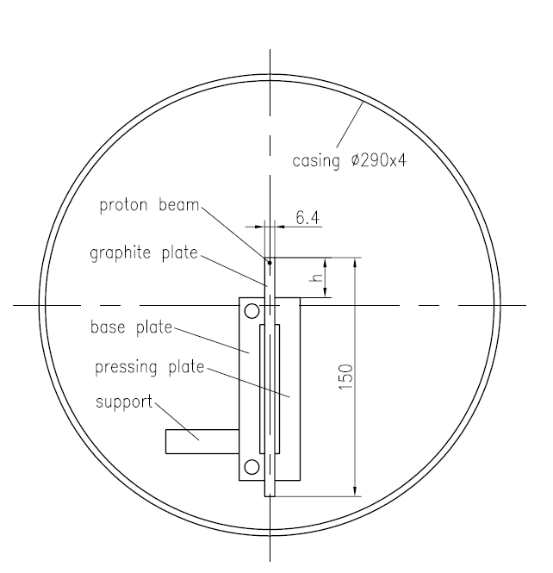
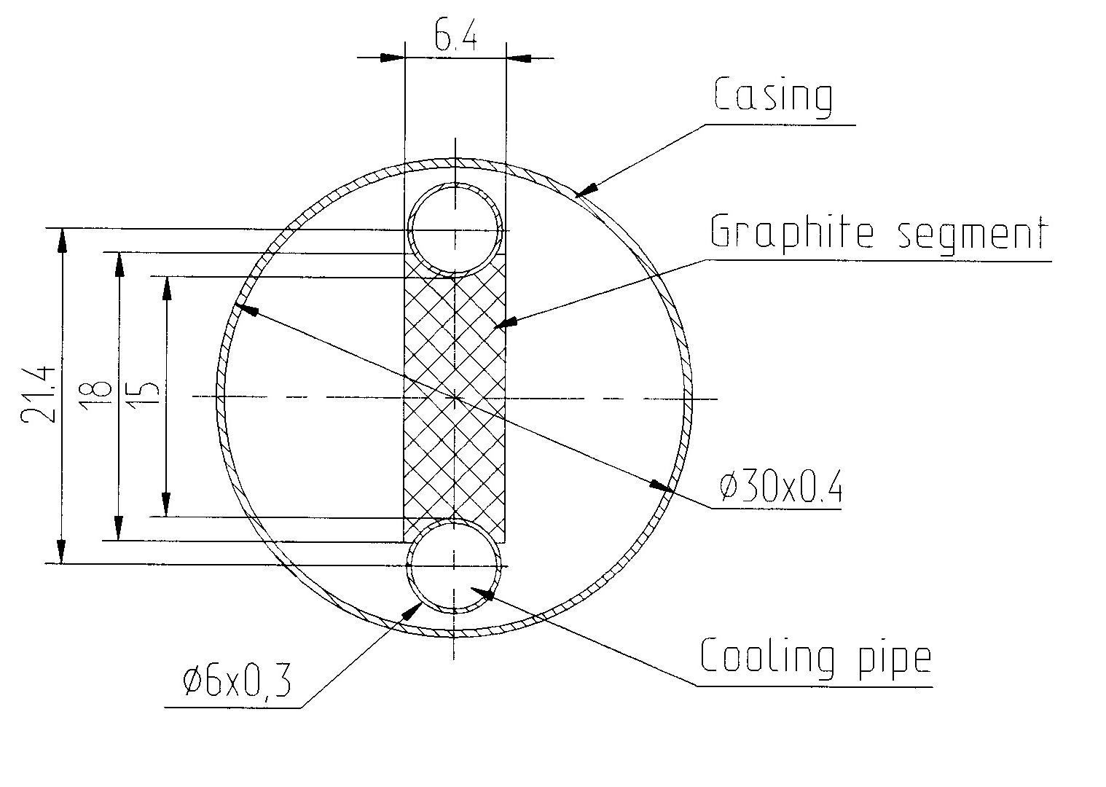
MINOS & NOvA Target Comparisons
MINOS beam spot size of 1.1 mm RMS is increasing to 1.3 mm for NOVA,
increasing 6.4 mm target width to ~ 7.4 mm
- reduces the neutrino flux ~ 1%, but eases alignment tolerance.
NOvA target cooling simplified by being out of horn
Pions come
out 3 sides
instead of 2
Spacing between fins
0.5 mm / 24 mm versus 0.2 mm / 20 mm
Cooling Channel
7.4
Proton Beam
Base Plate
Proton
Beam
All units mm
Pressing Plate

Slide 25
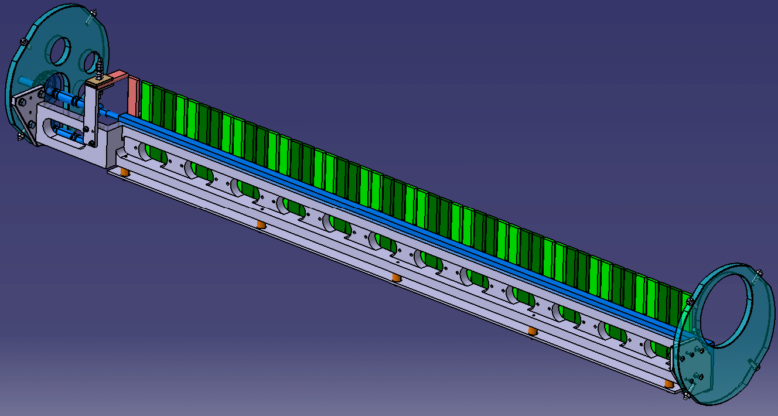
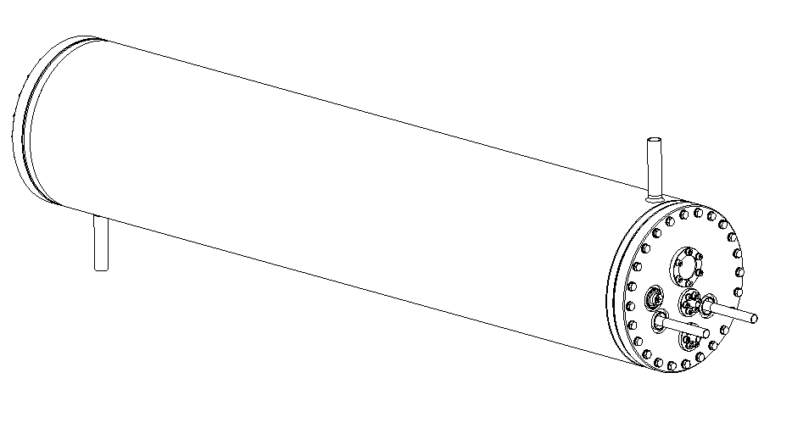
NOVA Target
IHEP Design
Budal Monitors
(for Alignment)
Water Cooled
Clamping Plates
Nominal max. beam power 700 kW

Slide 26
Experience with MINOS targets
 | Max. Proton/pulse | Max. Beam Power | Integrated Protons on Target
Target Design specification | 4.0e13 p.p.p. at 120 GeV | 400 kW | 3.7 e20 p.o.t. or 1yr minimum lifetime
NT-01 | 3.0 e13 | 270 kW | 1.6 e20
NT-02 | 4.0 e13 | 340 kW | 6.1 e20
NT-03 | 4.4 e13 | 375 kW | 3.1 e20
NT-04 | 4.3 e13 | 375 kW | 0.2 e20
NT-05 | 4.0 e13 | 337 kW | 1.3 e20
NT-06 | 3.5 e13 | 305 kW | 0.2 e20
NT-01 rerun | 2.6 e13 | 228 kW | 0.2 e20
NT-02 rerun | 3.8 e13 | 330 kW | 0.4 e20
NT-07 | 3.6e13 | 340 kW | 0.5e20+

Slide 27
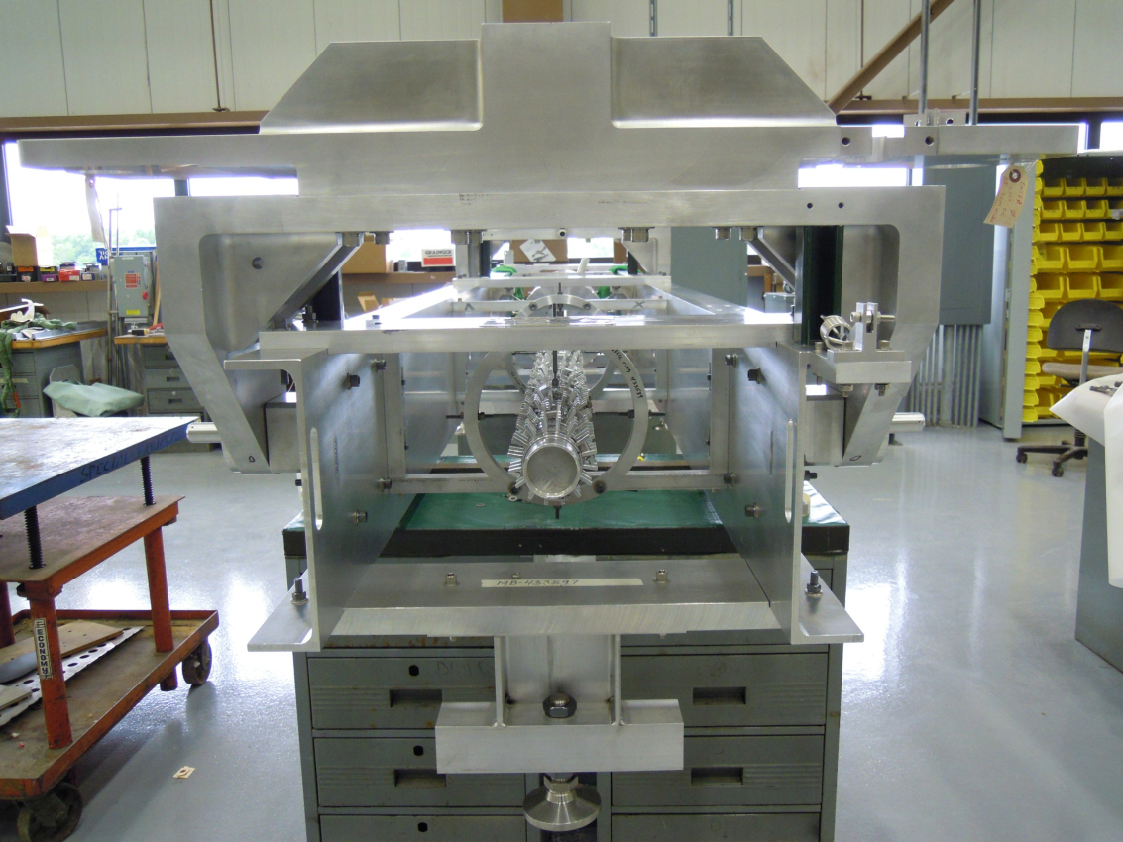
Target Planning
Proceeding with two vendors:
1st target in production @ RAL
Two more to be made at IHEP
In-house expertise needs to be developed for this and other projects

Slide 28
Summary
Fermilab accelerators have vastly improved performance over the last decade
Prompted by MiniBooNE and MINOS experiments
Performance must be enhanced by another factor of ~ 2 over the next several years
PIP for Linac & Booster produces ~ 90 kW @ 8 GeV
Complete by 2016
NOvA for MI / RR produces ~ 700 kW @ 120 GeV
Consuming 50 kW of the 8 GeV beam
Complete by 2013
Both projects are underway, but present significant demands on lab resources for the next few years
Present experiments account for all proton availability through the next decade (LBNE for another decade)

Slide 29
References
PIP (Proton Improvement Plan)
A Plan for Delivery of 8-GeV Protons through 2025, Beams-doc-3781, http://beamdocs.fnal.gov/ADpublic/DocDB/ShowDocument?docid=3781
Proton Source Task Force Report, Beams-doc-3660, http://beamdocs.fnal.gov/ADpublic/DocDB/ShowDocument?docid=3660
Proton Source December 2010 Workshop, http://beamdocs.fnal.gov/ADpublic/DocDB/DisplayMeeting?conferenceid=114
NOvA Accelerator Upgrades
NOvA Technical Design Report, Chapter 8, http://www-nova.fnal.gov/nova_cd2_review/tdr_oct_23/tdr.htm

Slide 30
Accelerator Complex in the Near Term: PIP and NOvA
Bob Zwaska
Fermilab AAC Meeting
November 7, 2011

Slide 31
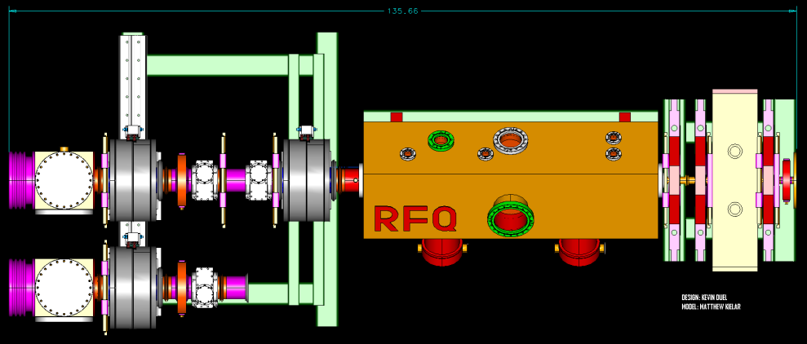
Current Proton Source PIP Work Underway
Pre-Acc and Linac
Booster
Cockcroft Walton Replacement
Started FY09 using operating funds
Completion set date June FY12
Linac Dump Repair
Linac Optics
High Power RF 201.25 MHz Drive System
Buildup of 7835 Power Tube Inventory
Solid State RF Power Drivers
First solid state system installed FY04
Solid state project tasks started FY06
4 of 19 solid state stations now installed
Collimator System Review
Cogging System Upgrade
Booster Orbit/Aperture Work
Fast Kicker (Built – Testing)
Booster Gradient Magnet
Build Spare Inventory
Prepare Required Hardware
Notes:
CHANGES

