Slide 1
Theory of Relativity (with other stories: black holes, faster-than-light travel, etc)

Slide 2
Part I. Setting The Stage

Slide 3
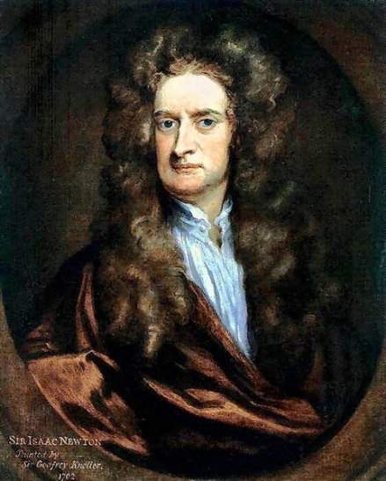
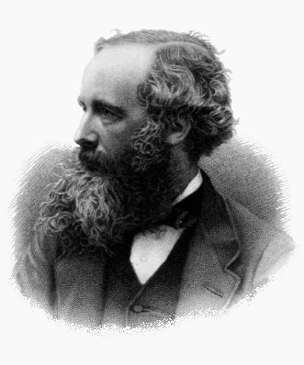
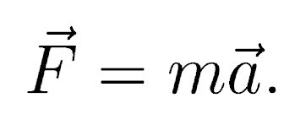
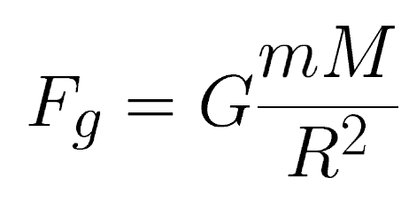
The Year Is 1887…
Isaac Newton
(1642-1727)
James Maxwell
(1831-1879)

Slide 4
Speed of Light
In Maxwell's theory the speed of light is the same in all reference frames, i.e. it is invariant, rather than relative. However, the principle of Galilean invariance states that the speed of anything, including light, is a relative quantity.
The notion of light propagating all by itself, rather than in some medium (like sound waves in the air, ocean waves on the surface of the ocean etc) was also unusual to scientists, and thus disturbing.

Slide 5
Stopover: Galilean Relativity
A physical quality is said to be:
invariant, if different observers would obtain the same result from a measurement of this quantity. Example: the mass of an object.
relative, if different observers would obtain different result from a measurement of this quantity. Example: the speed of an object.

Slide 6
Luminiferous Ether
A resolution was quickly discovered: light was propagating not by itself, but in a special medium called luminiferous ether.
The luminiferous ether had no other reason for its existence than to provide the expected medium for the propagation of light.
Ether was massless and invisible. It could not be directly detected in the lab, but one could detect the motion of Earth through ether.

Slide 7
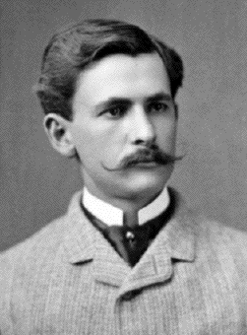
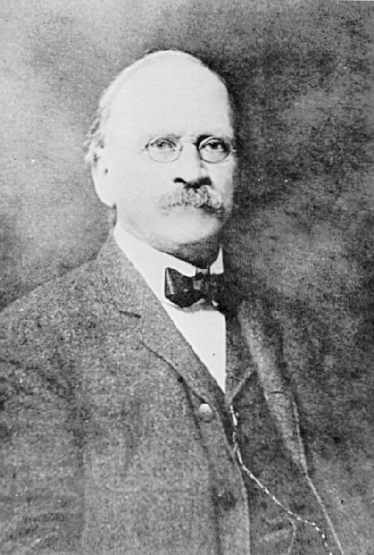
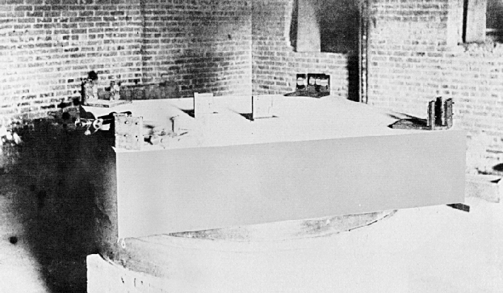
Michelson-Morley experiment
In 1887, two American physicists, Albert Michelson and Edward Morley set out to measure the motion of Earth with respect to the ether.

Slide 8
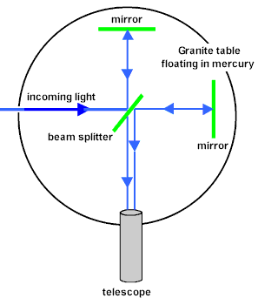
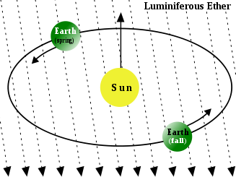
Michelson-Morley experiment
Earth must move differently through the ether throughout the course of a year

Slide 9
Michelson-Morley experiment
The result of their experiment was negative. They found that the speed of light along the Earth orbital direction was the same as the speed of light perpendicular to the Earth orbital direction, in a clear contradiction to the principle of Galilean invariance. The ether was gone!
Michelson still got his Nobel prize, though – he also was the first chair of the Physics Dept. at UChicago.

Slide 10
Aftermath of M-M Experiment
After the Michelson-Morley experiment, scientists
were left with two equally unpleasant alternatives:
either Maxwell’s equations were incorrect (but they explained all the electromagnetic phenomena so well!...)
or Galilean principle was wrong/incomplete (yet Newtonian mechanics works so well everywhere, from orbits of planets to the everyday experience on Earth!...)

Slide 11
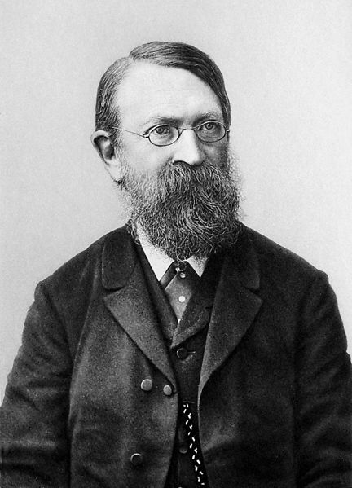
Ernst Mach (1838-1916)
Both explanations were unsatisfactory. Austrian physicist and philosopher Ernst Mach offered a different explanation:
The Michelson-Morley experiment was designed to detect ether. No ether was detected, therefore, there was no ether at all.
This explanation fully follow the rules of science. However, it was difficult to accept since there was no alternative theory (and since Mach was a weirdo)!

Slide 12
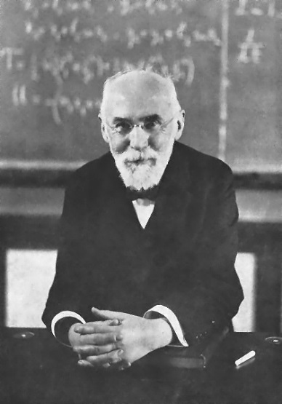
Hendrik Lorentz (1823-1928)
Lorentz discovered a coordinate transformation, i.e. a way of relating two different reference frames, which kept the speed of light, and thus Maxwell’s equations invariant. This transformation has been called Lorentz transformation ever since.
Maxwell’s equations are invariant under the Lorentz transformation.
Newton’s equations are invariant under the Galilean transformation.

Slide 13
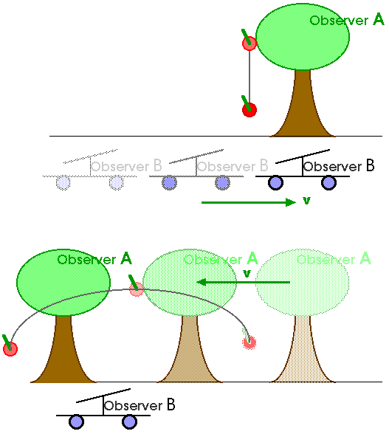
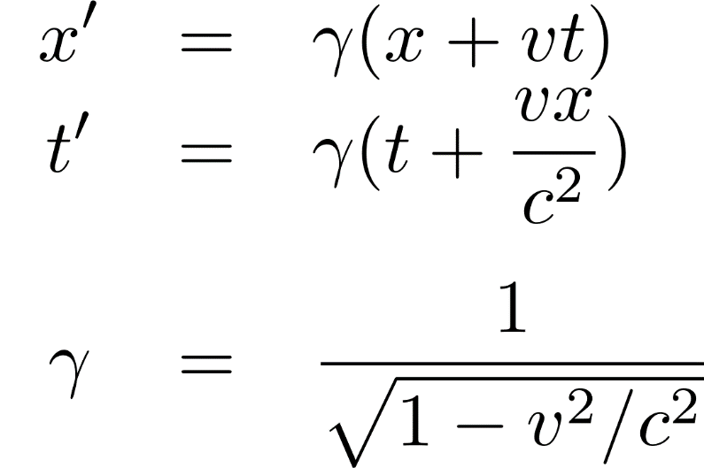
Stopover: Coordinate Transformations
Galilean transformation:
Lorentz transformation:

Slide 14
Lorentz Transformation
For speeds much less than the speed of light, both transformations are identical.
However, for speeds close to the speed of light, Lorentz transformation predicted weird things: lengths should contract and time intervals should increase (time dilation). This seemed so radical, that few people were ready to accept this.
Then there came a patent examiner from Bern...

Slide 15
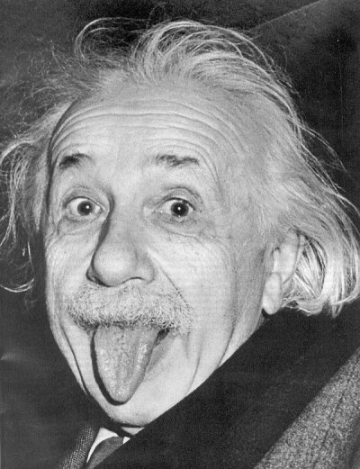
Albert Einstein (1879 – 1955)
Began his career as a patent clerk in 1902.
In 1905 developed Special Theory of Relativity.
In 1908 became Assistant Professor at Bern.
In 1915 developed General Theory of Relativity.
In 1921 got Nobel Prize.

Slide 16
Part II. Special Relativity

Slide 17
Relativity Principle
Einstein realized, that these weird things like length contraction and time dilation were not absolute, but
relative. In other words, they only appeared (at least up to a point).
Einstein based his theory on the relativity principle:
The laws of nature are the same in all inertial
frames of reference.

Slide 18
Special Relativity
Einstein also believed in Maxwell’s equations, and since Maxwell’s equations require that the speed of light is the same in all reference frames, he simply stated that:
The speed of light in the vacuum is the same in all inertial frames of reference.
Thus, he accepted Lorentz transformation and “discarded” Galilean transformation. In doing so, he created the Special Theory of Relativity, or SR.

Slide 19
Question
The textbook I use at UChicago says:
“Einstein had the audacity and courage to abandon Galilean relativity completely, and with it Newtonian mechanics...”
True
False

Slide 20
Physics Theories
Special Relativity extends Newtonian Mechanics to close-to-c speeds, but it does not contradicts it – on the opposite, it includes all of Newtonian Mechanics in its entirety.
Special Relativity
Newtonian Mechanics
Electromagnetism

Slide 21
γ Factor
Both, the length contraction, and the time dilation, are described by one quantity, called the boost factor, or simply factor, because it is traditionally denoted by a Greek letter .
If an object is moving with respect to a specific reference frame, it appears that all lengths along the direction of motion are contracted times, and all clocks on this object are slowed down times.

Slide 22
γ Factor
If the speed of an object is much smaller than the
speed of light, the factor is almost exactly 1, and Newtonian mechanics with Galilean relativity rules.
When the speed of an object approaches the speed of light, the factor becomes very large, and then deviations from the Galilean relativity become large too.

Slide 23
γ Factor
1.15
1.34
1.51
1.67
1.81
0.9 2.3
0.99 7.1
0.999 22.4
0.9999 70.7

Slide 24
Proper Length and Proper Time
Since the time and the length appear differently to different observers, i.e. they become relative, it is important to have some invariant quantities as well.
Proper time is the time that is measured in the reference frame that is at rest with respect to an object.
Proper length is the length that is measured in the reference frame that is at rest with respect to an object.

Slide 25
Proper Length and Proper Time
Thus, if you want to measure a proper length of an object, or a proper time interval between two events, you need to be in the reference frame that is at rest with respect to this object or events.
Proper time interval is always the smallest as measured by various observers.
Proper length is always the largest.

Slide 26
Time Dilation Is Real –
Atmospheric Muons
The Earth is bombarded by energetic particles from space – cosmic rays. The most energetic of them would heat a teaspoon of water by 8ºC.
Fortunately, we are protected from them by the atmosphere.

Slide 27
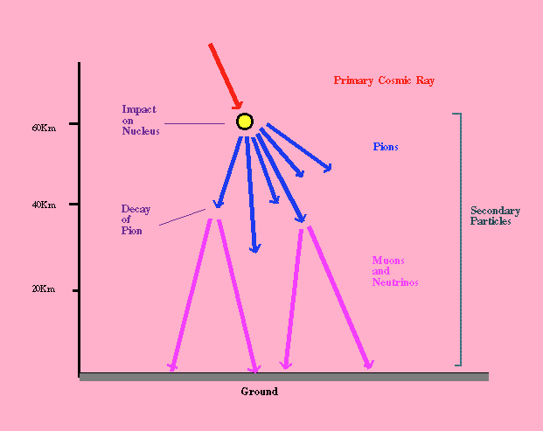
Proper Time Is Real –
Atmospheric Muons

Slide 28
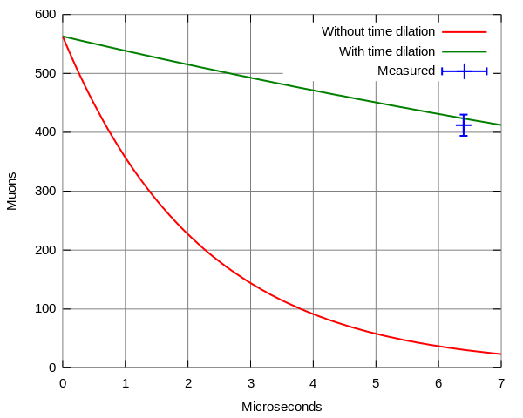
Proper Time Is Real –
Atmospheric Muons
Muons decay very quickly – they live only for 2 micro-seconds.
2μs x 300,000 km/s
= 0.6km = 600m

Slide 29
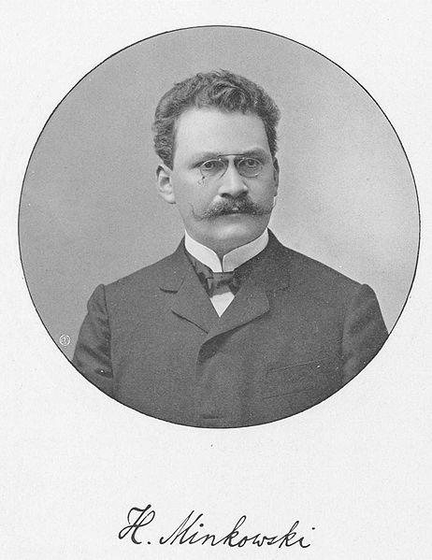
Space-Time
Since both, space distances, and time intervals, become relative, and the property of simultaneity is lost, we should not separate space and time any more, but talk about space-time.
Usually, space-time of SR is also called Minkowski space-time, due to Hermann Minkowski (we will meet other space-times later).

Slide 30
Space-Time
Me going to the left (and up in time)
Time
Me standing (still going up in time)
Me going to the right (and up in time)
Space

Slide 31
Space-Time Diagrams
From now on we will measure distance in light-years (light-second, light-hours, etc). One light-year is the distance light travels in one year.
1 light-second = c*1 second = 300,000 km
1 light-hour = c*1 hour = 10⁹ km
1 light-year = c*1 year = 10¹³ km
A key advantage of such units – light now travels at 45 degrees.

Slide 32
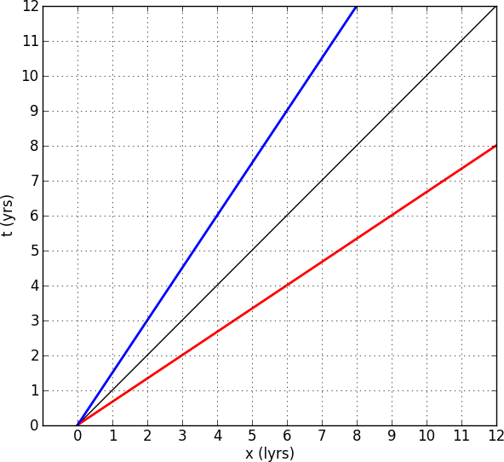
Space-Time Diagrams
Material objects travel only along time-like world lines.
Light (and other massless particles) travel along light-like world lines.
Light-like
Time-like
Space-like

Slide 33
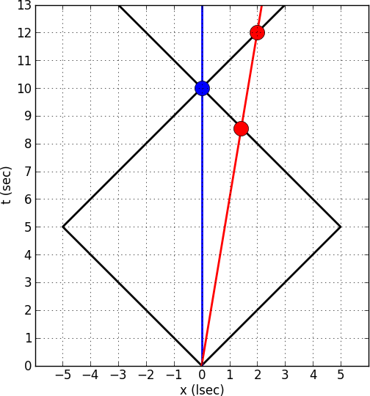
Why Special Relativity Is
Called “Relativity”
Blue sees two events as simultaneous.
Red sees them as happening at different times.
Not surprising, Red travels towards one of them.

Slide 34
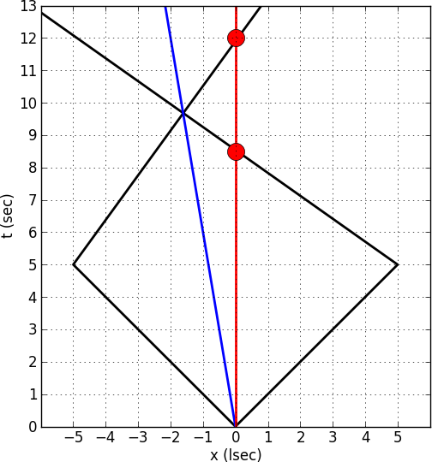
Why Special Relativity Is
Called “Relativity”
Red reference frame.
Is there anything wrong in this picture?

Slide 35
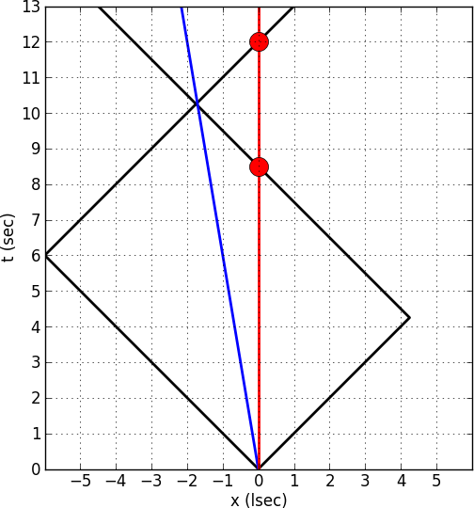
Why Special Relativity Is
Called “Relativity”
Red reference frame.
Red sees the two events as not simultaneous!

Slide 36
Why Special Relativity Is
Called “Relativity”
In Special Relativity not all observers agree on whether a pair of events are simultaneous or not.
Different observers may see two causally-disconnected events as happening in a different order.
Causally connected events always happen in the same order.

Slide 37
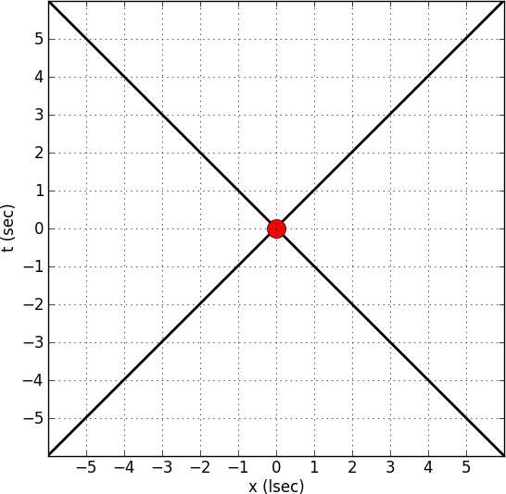
Future And Past Light Cones
Future light cone: all the events you can influence.
Past light cone: all the events that could have influenced you.
Future light cone
Past light cone

Slide 38
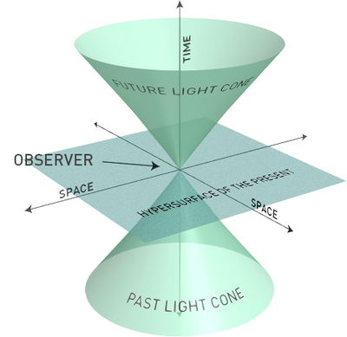
Why Cones?
Future light cone: all the events you can influence.
Past light cone: all the events that could have influenced you.

Slide 39
Question
How to observe a galaxy 10 billion years ago?
Find a galaxy 10 billion light years away.
Jump in a time machine and go 10 billion years back.
Travel to a parallel universe where time flows slower.
This is absolutely impossible.

Slide 40
Twin Paradox
Andy and Betty are twins. Betty rides in a spaceship at 2/3 the speed of light to Alpha Centauri and back. Andy stays on Earth and waits for her return. Who will be older when they meet?
What if some time after Betty had left, Andy jumps into a spaceship and flies after her even faster, and eventually catches up with her. Who will be older when they meet?

Slide 41
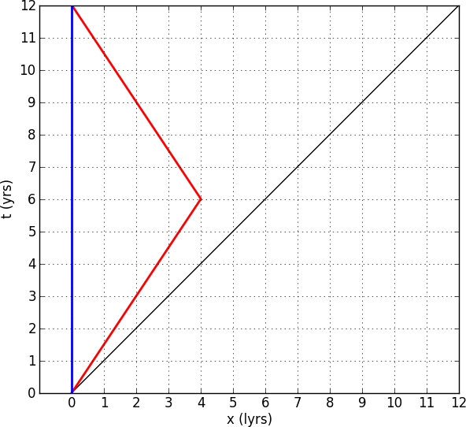
It takes Betty 12 Earth years to get back, hence Andy will be 12 years older. What about Betty?
Betty will be younger.
Betty will be older.
Betty will be the same age as Andy.

Slide 42
It takes Betty 12 Earth years to get back, hence Andy will be 12 years older. What about Betty?
Betty will be younger.
Betty will be older.
Betty will be the same age as Andy.
Leg #1: her proper time
Leg #2: the same
Conclusion:
Betty will be only 9 yrs older!

Slide 43
The Paradox of the Twin Paradox
The actual paradox of the twin paradox is that motion is relative:
In Andy’s reference frame, Andy is at rest and Betty is moving.
In Betty’s reference frame, Andy is moving and Betty is at rest.
Hence, there cannot be any difference between them!!!

Slide 44
The Paradox of the Twin Paradox
What is going on?
Einstein’s theory is wrong, there is no relativity.
Nick’s calculation is wrong.
Andy and Betty are not twins.
Even if they are twins, they are not equal in some other respect.
Women live longer, they must be aging slower.

Slide 45
Twin Paradox Resolved
Betty is not an inertial observer. In SR (as we have just saw) time really flows slower in non-inertial reference frames.
Time is relative!!!

Slide 46
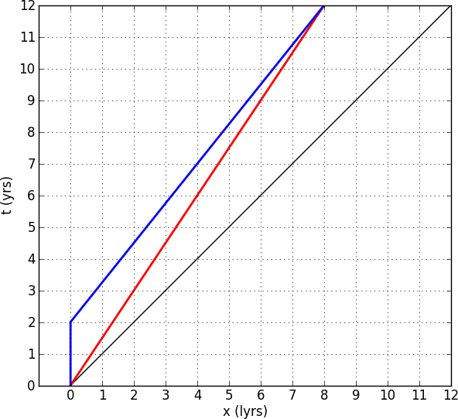
Twin Paradox II
How about this story?
Andy is younger
Betty is younger
They are of the same age
Andy
Betty

Slide 47
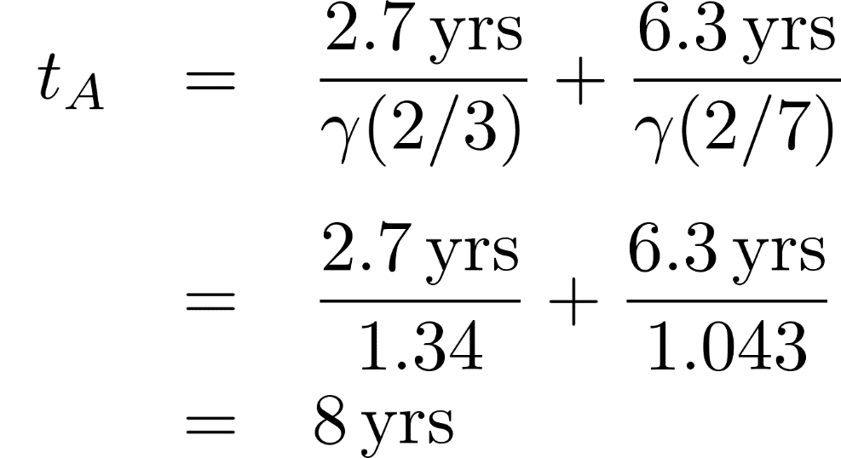
Twin Paradox II
Betty:
Andy:
How about this story?
Andy is younger
Betty is younger
They are of the same age
Andy
Betty

Slide 48
Relativistic Velocities
According to Galilean transformation, if a ball is thrown inside a moving train, an observer on the ground would measure its speed as
What if and ?
Uncle Albert gets very unhappy…

Slide 49
Relativistic Velocities
The Lorentz transformation has a special formula for adding relativistic speeds. If you add two speeds that are less than c, you always get a speed that is less than c.

Slide 50
Rest energy
One of the biggest differences between Newtonian Mechanics and SR is the existence of rest energy.
Einstein found that the energy of a moving particle in SR is
Newtonian kinetic energy
Extra term

Slide 51
Rest Energy
He called that extra term the “rest energy”.
Wrong forms (try it and ruin my day).

Slide 52
Rest Energy
The rest energy is enormous compared to other types of energy. The rest energy of an average person, if fully used, is enough to satisfy the energy needs of the whole country for 10 days*.
* That’s why in “Star Trek” they use matter-antimatter reactors.

Slide 53
Rest Energy
Total energy .
Thus, in order to accelerate an object to, say, 0.9c ( ), we need to spend 130% of its rest energy!
To get a 1 ton spaceship to that speed will take all the energy the US consumes in ½ year.
Another ½ year will take the ship to 0.96c.
Another ½ year will take the ship to 0.98c.
Another ½ year will take the ship to 0.987c.

Slide 54
Interstellar Travel
Ok, let’s imagine we finally found someone up there. How do we go visit? (Or, we reached the stage of colonial expansion, if it happens.)
Special Relativity (SR) limits the speed of any interstellar travel to below the speed of light (300,000 km/s).
Interstellar distances are humongous:
Proxima Centari: 4.22 lyr.
Center of the Galaxy: 27,700 lyr.
Notes:
Uph – “(astronomical) units per hour”, not a real unit.

Slide 55
Center of the Galaxy
To reach the center of the Milky Way in 10 years, one has to travel on average at 0.999,999,935c.
To send a 1,000 ton spaceship with such a speed requires all the energy the Sun emits in 1 second.
Theoretically, this seems possible. But what’s the point? – travelers will incur a 55,000 year time difference!
Notes:
Explain that on the ship only 20 years will pass, but on the Earth 54,000 years will pass, so it makes no sense to travel at all.

Slide 56
One Way Ticket
Essentially, any interstellar travel beyond the very vicinity of the Sun is a one-way ticket – there is no sense in coming back.
If we don’t care about coming back, how far can we go? That depends on how fast we accelerate.
A convenient acceleration is 1 g (would feel like the gravity on Earth).

Slide 57
One-gee All The Way...
Edge of the Solar system 30AU 11 days
Nearest star 4.22 lyr 2.3 yrs
Center of the Galaxy 27,700 lyr 10.6 yrs
Andromeda galaxy 2.5M lyr 15 yrs
Cosmic horizon 50,000M lyr 25 yrs

Slide 58
Part III. General Relativity

Slide 59
Special Relativity And Gravity
Special relativity included Newton’s laws as a special case of low speeds. However, the Newton’s law of gravity is not included in SR, in particular, according to the Newton’s law, the gravitational force propagates with the infinite speed.
Also, the distance is not absolute but relative. Which distance to use in computing the gravity force?

Slide 60
Physics Theories
General Relativity
Special Relativity
Newtonian Mechanics
Electromagnetism
Newtonian Gravity
General Relativity

Slide 61
Questions, questions...
On the orbit around the Earth, astronauts in the Space Shuttle feel no gravity: they float around, move objects many times their own mass with one finger, etc. Does it mean that there is no gravity in the outer space?
Yes
No

Slide 62
Questions, questions...
When the Space Shuttle lifts up, astronauts often feel several “gee”, i.e. gravity several times larger than the gravity at the surface of the Earth. Does it mean that the gravity is stronger inside the Space Shuttle than outside it?
Yes
No

Slide 63
Space Shuttle
We can get a clue to the “weightlessness” of the astronauts if we consider an object, thrown inside the Space Shuttle (an astronaut himself will also suffice). An object will fly in a straight line with constant speed (until it hits a wall or someone’s head). Thus, the Space Shuttle orbiting the Earth is an inertial frame of reference! (Yes, even if the Shuttle itself does not go in a straight line - this is a clue to General Relativity!)

Slide 64
Questions, questions...
What is so special about the Shuttle orbiting the Earth?
It moves really fast.
It is made in the US.
It freely falls in the Earth gravity field.
It has a special shield, protecting it from the Earth gravity.

Slide 65
Equivalence Principle
If a freely falling object is an inertial frame of reference, then an object that does not fall freely is not in the inertial (i.e. in the accelerated) frame of reference.
Hence, gravitational and inertial forces produce effects that are indistinguishable. This is called the weak equivalence principle. It states that all objects will move in the gravity field the same way as in the accelerated frame of reference.

Slide 66
Equivalence Principle
The gravity force that pulls us downward is equivalent to upward acceleration (several “gee”s of astronauts).
Einstein went one step further, and formulated the strong equivalence principle:
All physical laws are precisely the same in all inertial and freely falling reference frames, there is no experiment that can distinguish them.

Slide 67
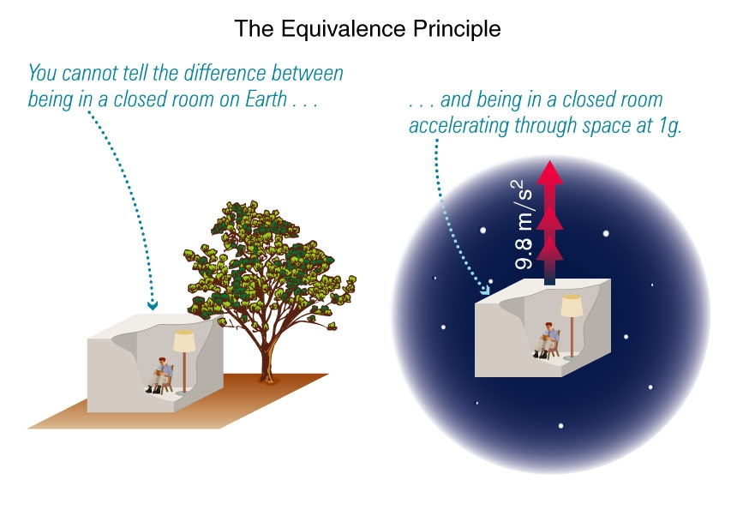
Equivalence Principle
If

Slide 68
Ramifications
Light is also curved by the gravitational force, even if according to the Newton’s law, the force of gravity acting on light (massless photon) is zero.
Light, emitted toward the source of gravity, will experience Doppler effect (Ever got a speeding ticket? – then you know what it is).
All physical processes should run slower in the presence of gravity.

Slide 69
Geometry
In the presence of gravity, an inertial observer is not necessarily moving in a straight line (orbiting Space Shuttle). Thus, gravity makes straight lines curved, in other words, it changes the geometry of space, or, more precisely (the SR is still valid!), the geometry of space-time.
Thus, the GR is a theory of a curved (i.e. non-flat) space-time.

Slide 70
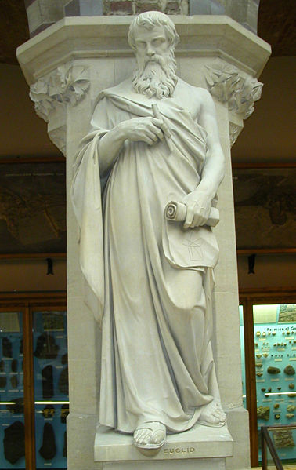
Euclidean Geometry
Euclid (c 300 BC)
Euclid’s book “Elements” served as a main geometry textbook until 20th century.
Almost nothing is known about his personal life.
Euclidean geometry is based on five axioms (postulates).

Slide 71
Euclidean Geometry
It is possible to draw a straight line from any given point to any other point.
A straight line of finite length can be extended indefinitely, still in a straight line.
A circle can be described with any point as its center and any distance as its radius.
All right angles are equal.
Given a line and a point not on the line, only one line can be drawn through that point that will be parallel to the first line.

Slide 72
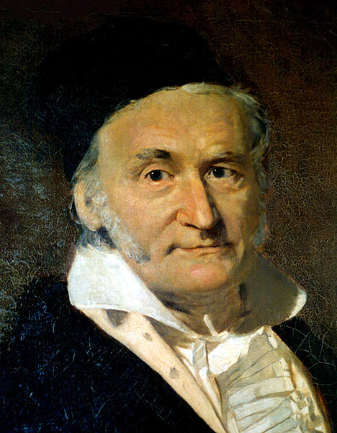
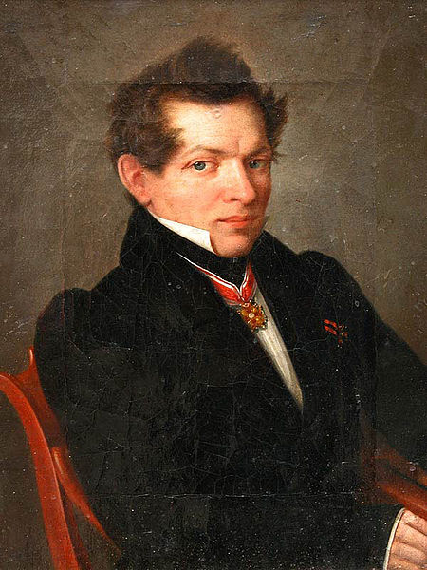
Euclidean Geometry
Gauss (1777-1855)
For centuries, mathematicians tried to prove the fifth postulate. Finally, Carl Friedrich Gauss (German) and Nickolay Lobachevsky (Russian) showed that by changing the fifth postulate, one can create new, non-Euclidean geometries.
Lobachevsky
(1792-1856)

Slide 73
Non-euclidean Geometry
Lobachevsky discovered the geometry of space with negative curvature (hyperbolic geometry):
5. Given a line and a point not on the line, arbitrary many lines can be drawn through that point that will be parallel to the first line.
Gauss discovered the geometry of space with positive curvature (spherical geometry):
5. Given a line and a point not on the line, no lines can be drawn through that point that will be parallel to the first line.

Slide 74
Non-euclidean Geometry
Sum of angles of a triangle is
greater than 180º in spherical geometry.
equal to 180º in flat geometry.
less than 180º in hyperbolic geometry.
Circumference of a sphere with radius is
less than in spherical geometry.
equal to in flat geometry.
greater than in hyperbolic geometry.

Slide 75
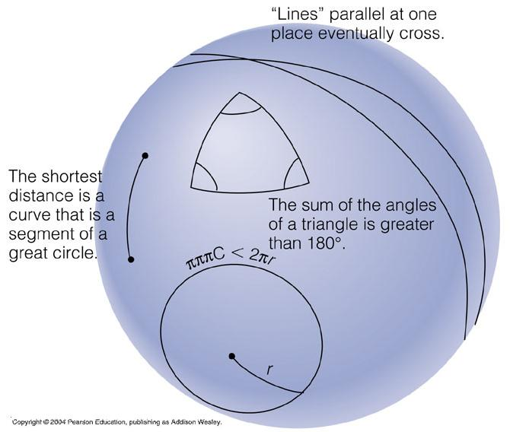
Spherical Geometry

Slide 76
Hyperbolic Geometry

Slide 77
Geometry of Space-Time
Now we know, that
in flat space, the shortest distance between two points is a straight line.
in curved space, the shortest distance between two points is not necessarily a straight line.
in flat (i.e. Minkowski) space-time inertial observers move between two events along straight lines in such a way as to maximize their proper time.

Slide 78
Geometry of Space-Time
Thus, we can conclude, that in curved space-time inertial observers move between two events not necessarily along straight lines, but in such a way as to maximize their proper time.
This type of world line is called a geodesic.

Slide 79
Geometry of Space-Time

Slide 80
Einstein Equations: Physics
Equations of GR relate the curvature of space-time (its geometry), and its contents (matter + energy).
Symbolically, they are
Which side is the cause?
A: geometry
B: matter + energy
Geometry = Matter + Energy

Slide 81
The Year Is 1887…
Isaac Newton
(1642-1727)
James Maxwell
(1831-1879)

Slide 82
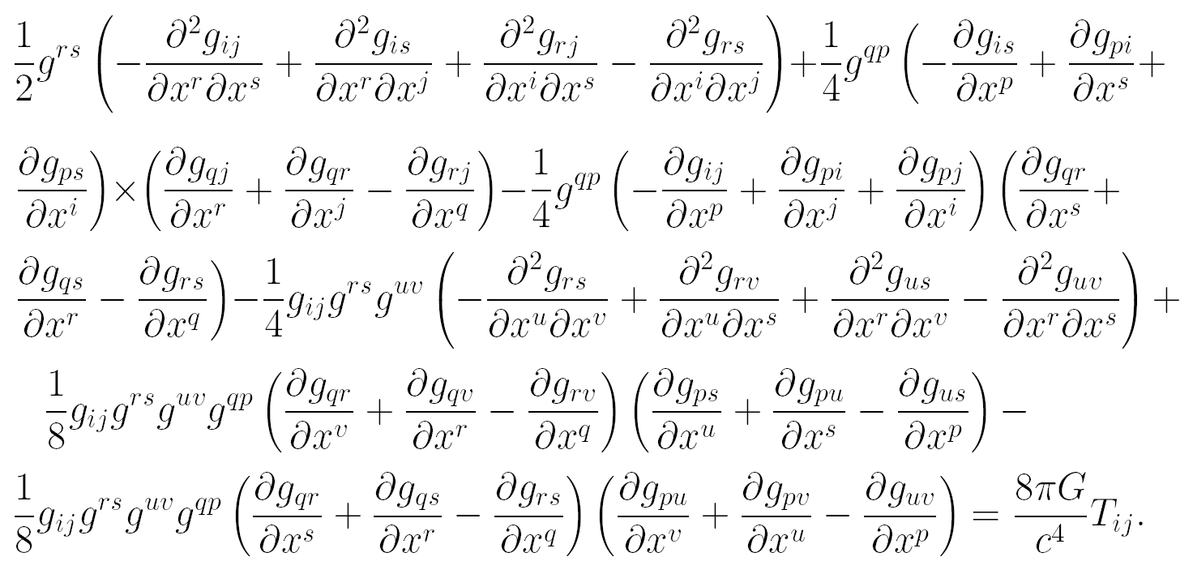
Einstein Equations: Math

Slide 83
Dynamical Space
In GR space becomes a dynamical quantity. Space can be curved, perturbed, deformed in arbitrary way, and these deformations can change with time.
Distortions of space can move – those are called gravitational waves.
Space can reconnect with itself – wormholes.
Space can flow into a point of infinite density – singularity – making a black hole.

Slide 84
Testing GR
Any physical theory must be constantly tested, and GR is no exception.
All tests of GR can be separated into two types: a weak field limit, i.e. testing GR when deviations from Newton’s gravity are weak, and a strong field limit, when deviations from the Newton’s law are large.
Weak field limit test are numerous (but they are less valuable, because there are alternative theories of gravity).

Slide 85
Weak Field Tests
Precession of planetary orbits.
Anomalous precession of Mercury explained by Einstein in 1916.
Bending of light by the Sun’s gravity field.
Measured by Eddington in 1919.
Time delay due to the Earth gravity.
Need to account in time-keeping since ~1960.
Delay due to Saturn measured by Cassini probe to 0.002% in 2003.

Slide 86
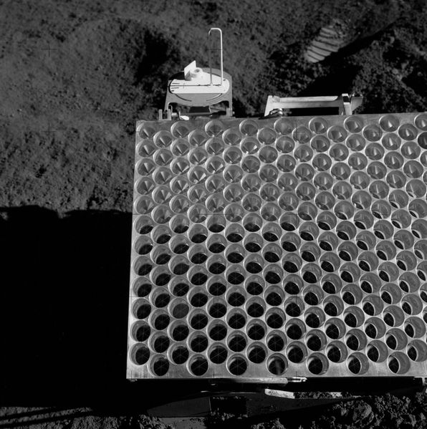
Weak Field Tests
Gravitational redshift.
Pound–Rebka experiment at Harvard in 1959.
Routine correction for modern GPS systems.
“Frame dragging”.
Gravity Probe B (2005) – to 15%
LARES satellite (2012) – to 1%.
Lunar Laser Ranging Experiment
Measures everything.

Slide 87
Strong Field Tests
Strong field limit tests are much more difficult to perform, but only they can convincingly confirm (or reject!) GR:
Gravitational radiation from a binary pulsar.
First discovered in 1974 by Joseph Taylor and Russel Hulse (Nobel prize in 1993).
Existence of black holes.

Slide 88
Part IV. Black Holes

Slide 89
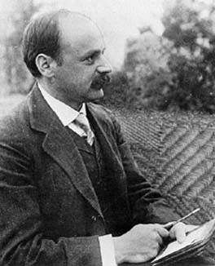
Black Holes
Einstein published his paper on GR in Nov 1915.
Karl Schwarzschild (1873-1916), German physicist turned soldier, found black holes mathematically in 1916.
Schwarzschild died on the Russian front in May 1916 from disease.
We did not kill him!!!

Slide 90
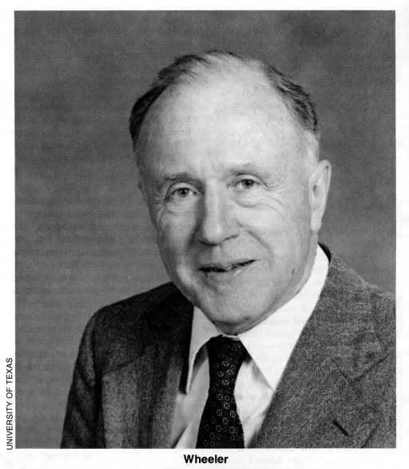
Black Holes
The term itself coined by John Wheeler (1911 – 2008) in 1967.
There are many ways to think about black holes. The best one is a “river of space” analogy.

Slide 91
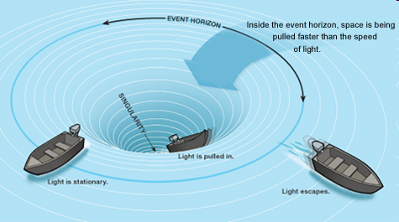
River Model of Black Holes
Boat swimming against the river current can move around in slow places, but falls down the waterfall.

Slide 92
River Model of Black Holes
In GR one cannot move faster than the speed of light relative to space.
Radius where space flows in at c is called the horizon (a point of no return) or Schwarzschild radius.
Speed of light

Slide 93
Flowing Space
If the space flows into a black hole, wouldn’t it all disappear eventually? No – there are no laws for the “conservation of space”. Space can be destroyed and created.
The universe expands because the space between galaxies expands – there is “more” space today than we had yesterday. That’s ok – the mess in my kid’s room does the same….

Slide 94
Schwarzschild radius
The Schwarzschild radius (the “radius” of the horizon), is proportional to the mass of the black hole.
If the Sun became a black hole (in reality it will not), its Schwarzschild radius will be just 3 km (1.8 miles) – just 3 times the size of the Tevatron ring.

Slide 95
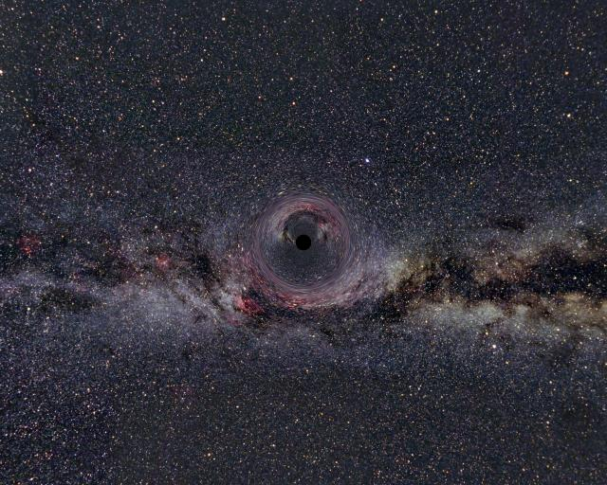
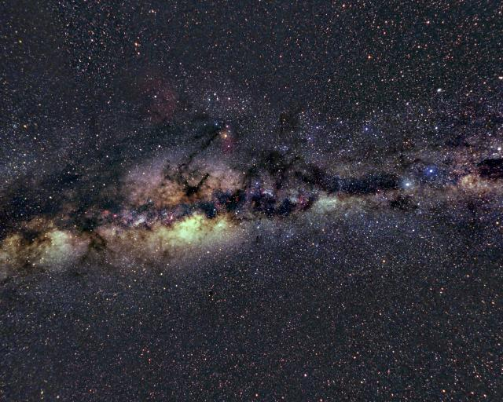
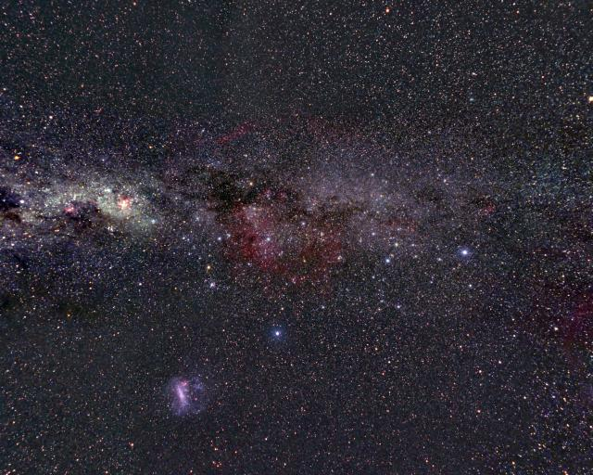
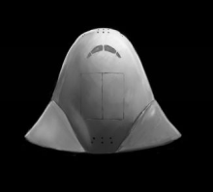
Falling into a Black Hole: 100 R_{s}

Slide 96
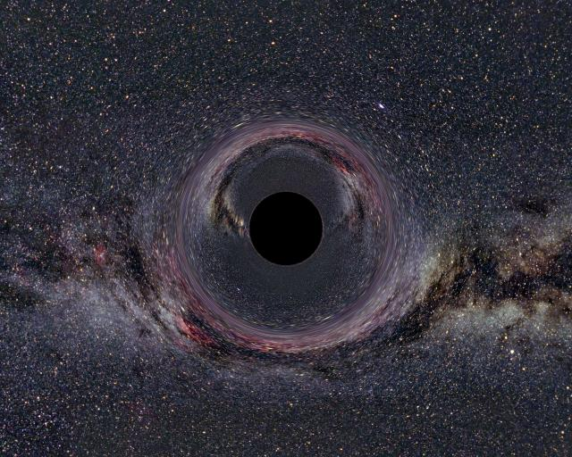
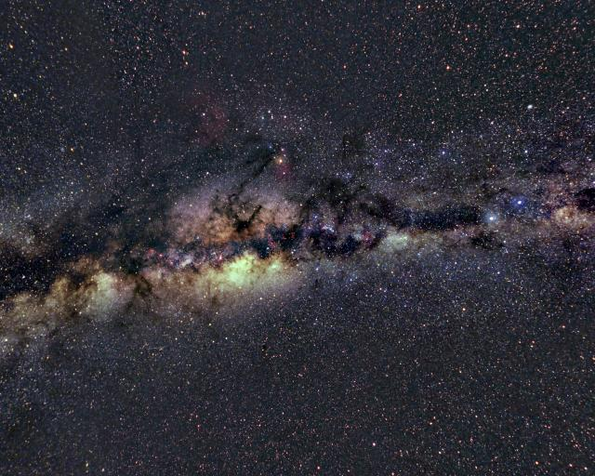
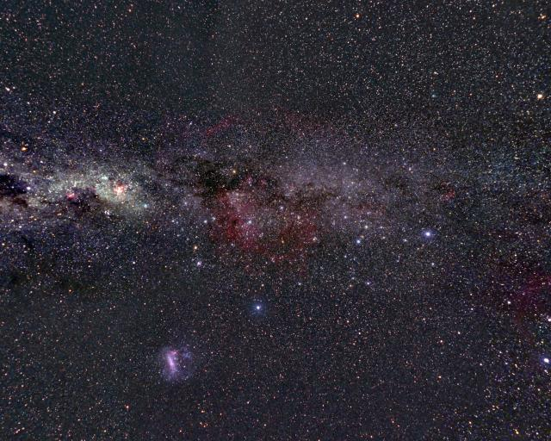
Falling into a Black Hole: 20 R_{s}

Slide 97
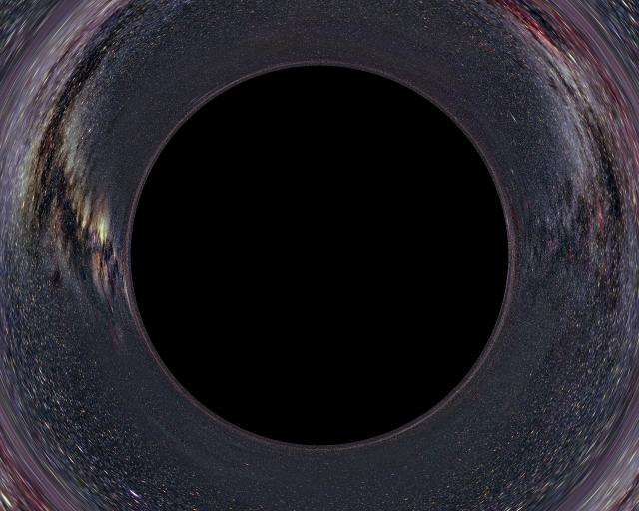
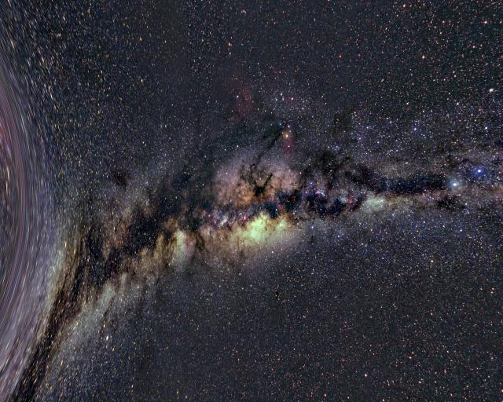
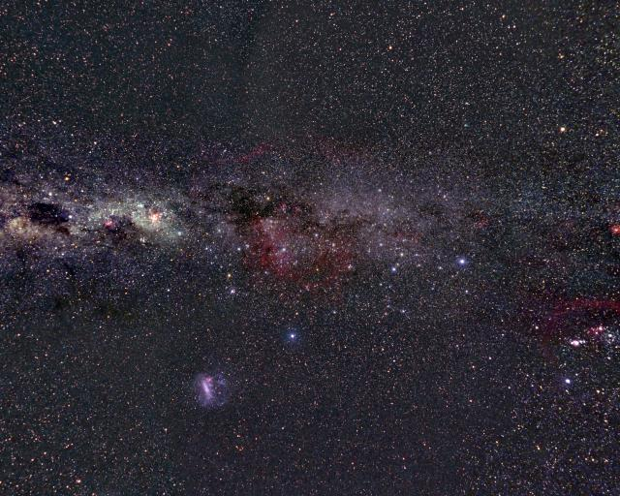
Falling into a Black Hole: 4.5 R_{s}

Slide 98
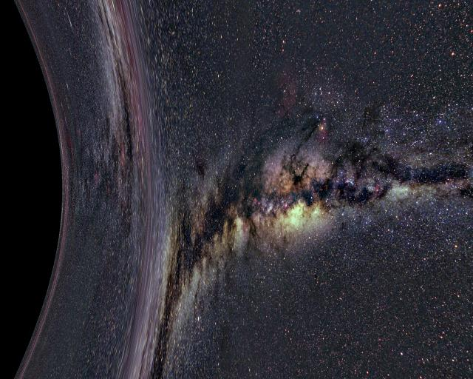
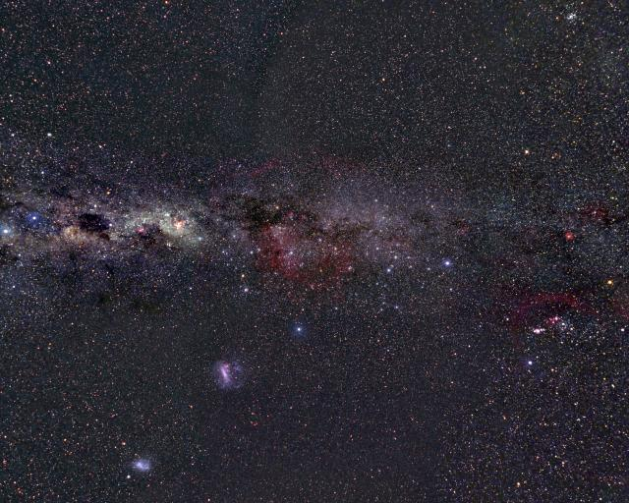
Falling into a Black Hole: 2.5 R_{s}

Slide 99
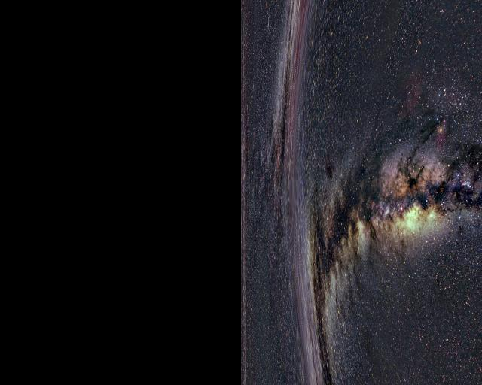
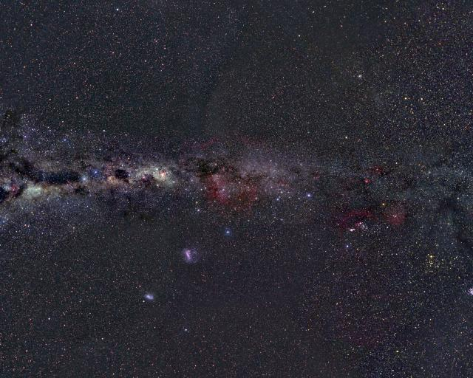
Falling into a Black Hole: 1.5 R_{s}

Slide 100
Falling into a Black Hole: 1.2 R_{s}

Slide 101
Falling into a Black Hole: 1.05 R_{s}

Slide 102
Falling into a Black Hole: 1.005 R_{s}

Slide 103
Falling into a Black Hole: Movie

Slide 104
Epilogue: Alcubierre Warp Drive
In 1994 Miguel Alcubierre discovered a “warp drive” space-time.
His space-time allows travel with arbitrary speed (relative to the rest of the Galaxy) with no time delay.
It is unclear whether this practical at all.
Notes:
If you don’t this: there is a metric that describes a region of flat space travelling with the arbitrary speed v(t) wrt the Minkowsky space at infinity, with no time delays incurred and no speed of light limit. Remind them that in GR it is forbidden only to move faster than c relative to the space around you, and here the spaceship does not move relative to the space around it, it is a region of space that moves. It is directly anlogous to accelerated expansion of the universe – the region of space before the spaceship contracts faster than c, and the region of space behind it expands faster than c.
This is a valid metric, hence a valid solution of Einstein equations if the appropriate energy-momentum tensor is specified. That metric would require negative energy density, but that is not forbidden by laws of physics (Casimir effect, for example). Of course, the practically o this is unknown. Also, Albert claimed that such a ship could never start (there would be a singularity at the point when v(t) goes from 0 to the infinitesimally positive value, but it does not seem reasonable to me, I can make v(t) = exp(-1/t) to have all derivatives continuous at t=0.

