Slide 1
Simulation study of helical cooling channel
K. Yonehara
APC

Slide 2
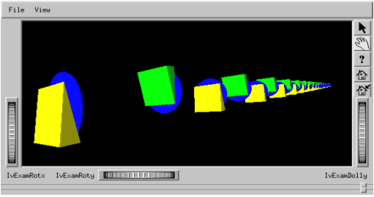
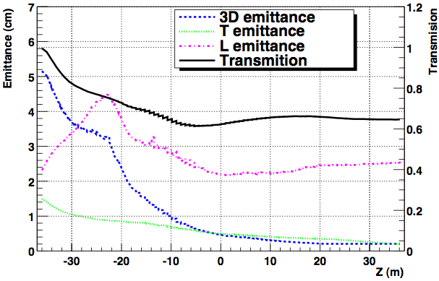
Review HCC design effort
< 2000: Y. Derbenev proposed a novel cooling channel based on helical dipole magnet
V. Balbekov et al. worked on a helical cooling channel
Use very low helix pitch (κ = p_{φ}/pz ~ 0.2)
Use a wedge absorber
Use a periodic magnet structure (Rotation dipole+solenoid)
P.Lebrun et al., NFMCC-DOC-193-v1
Yellow+Green: Wedge absorber
Blue: RF cavity

Slide 3
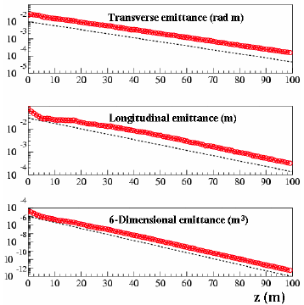
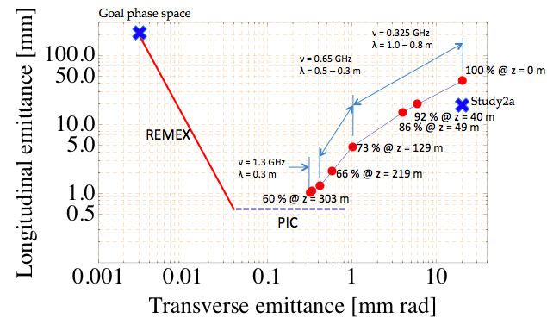
Review HCC design effort (cont’d)
2003: Y. Derbenev and R.P. Johnson developed a continuous helical cooling channel
Combine a continuous helical dipole+quad components with a solenoid magnet with a continuous high pressure gas filled RF cavity
Gas can work on a cooling absorber as well as the dark current buffer
2005: First cooling demo simulation
Tested HCC theory
2009: First end-to-end cooling demo simulation
K. Yonehara et al., Proceedings of PAC’05, TPPP052 & IPAC’10, MOPD076

Slide 4
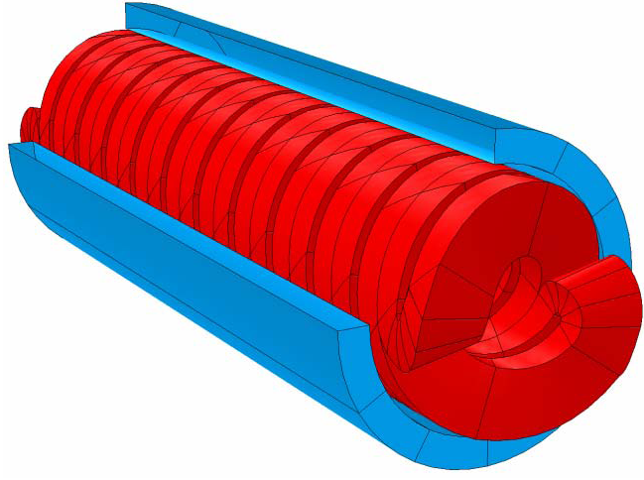
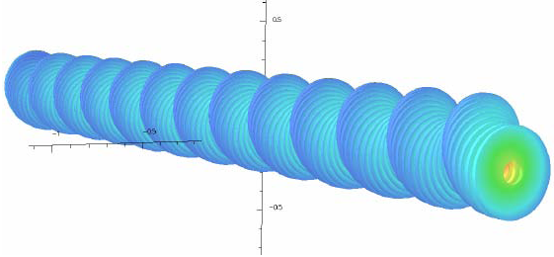
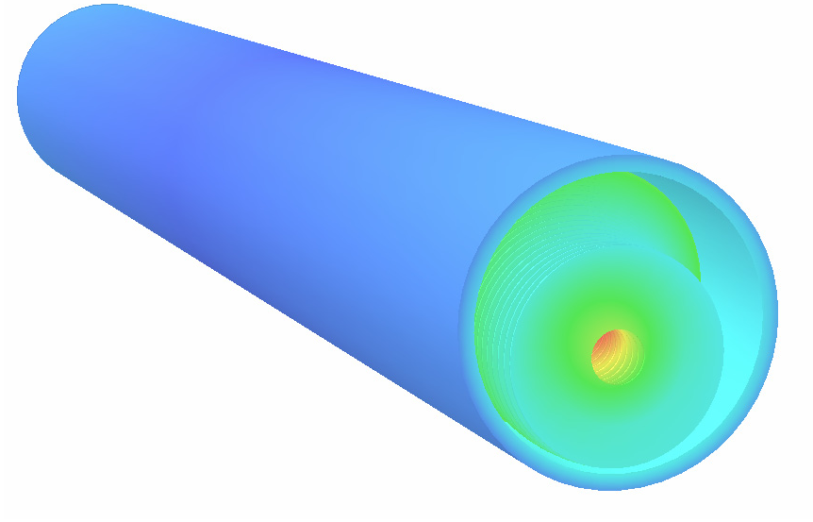
Review HCC design effort (cont’d)
2006: V. Kashikhin invented a helical solenoid magnet
2008: M. Popovic and M. Neubauer invented a dielectric loaded RF cavity
V. Kashikhin et al., Proceedings of EPAC’08, WEPD015
Siberian snake type helical magnet
Helical solenoid magnet

Slide 5
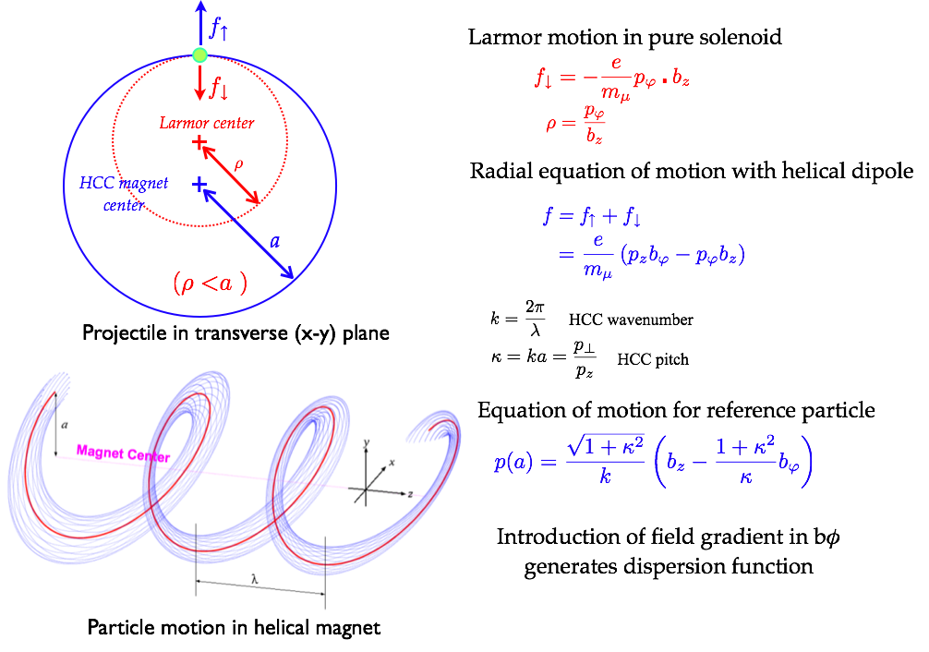
Beam dynamics in Helical Cooling Channel (HCC)
No periodic structure ⇒ Large beam phase space

Slide 6
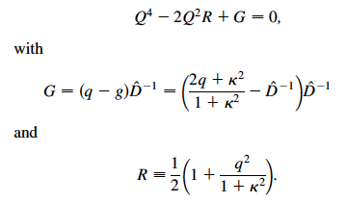
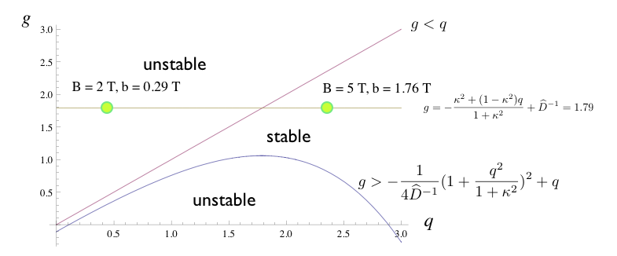
Stability condition
Beam dynamics is pretty simple in a local helical coordinate system
with
Stability condition is
It represented by g (field index) and
q (= k_{c}/k-1)
and

Slide 7
Tune dispersion
Taylor expansion of dispersion function
μ beam in GH₂
D’ is tuned from dp/ds
Energy loss term
Dispersion = 0.28 m
(proper dE/ds dx)
Dispersion = 0.13 m
(Close to isochronous condition)
Dispersion = 0.35 m
(path length is overestimated)
Long path
at hi p
Short path
at lo p
Tune dispersion to obtain the best cooling performance
Add higher magnet component (e.g. sextupole)
Take higher momentum particle (costly)

Slide 8
V. Balbekov revisited HCC
K. Yonehara, V. Balbekov, Proceedings of EPAC’08, THPC110
HCC has been simulated with totally independent simulation code by V. Balbekov
The simulation results are reproduced in two different simulation codes
He also pointed out that there is strong frequency dependence on the longitudinal
acceptance
The admittance of HCC is given in PRSTAB paper

Slide 9
Invariant phase space in helical channel
Please find definition of variables
in Y. Derbenev and R.P. Johnson, PRSTAB 8, 041002, 2005
Action variable in transverse phase space
Action variable in longitudinal phase space
Following emittance plot is estimated by using above invariance
However, difference between ECALC9F and this evaluation is within 5 %

Slide 10
Define geometry in HS magnet
HS coil
Offset from HCC center:
R_{rf pos}: Offset of RF cavity
R_{coil pos}: Offset of HS coil center
Other constant geometry:
HS coil I.R.= 650 mm (due to 200 MHz RF)
HS coil O.R. = 700 mm
R_{ref}: Radius of reference orbit = 160 mm
Helical pitch = 1.0 (45 degrees)
Helical period = 1 m
Reference orbit
HCC center
RF cavity

Slide 11
Cooling simulation in HS channel
 | R_{rf pos} | R_{coil pos} | Transmission
Blue | 160 mm | 495 mm | 80
Orange | 160 mm | 565 mm | 75
Red | 160 mm | 475 mm | 82
Need to optimize parameters
Need to shrink RF cavity to be half radius

Slide 12
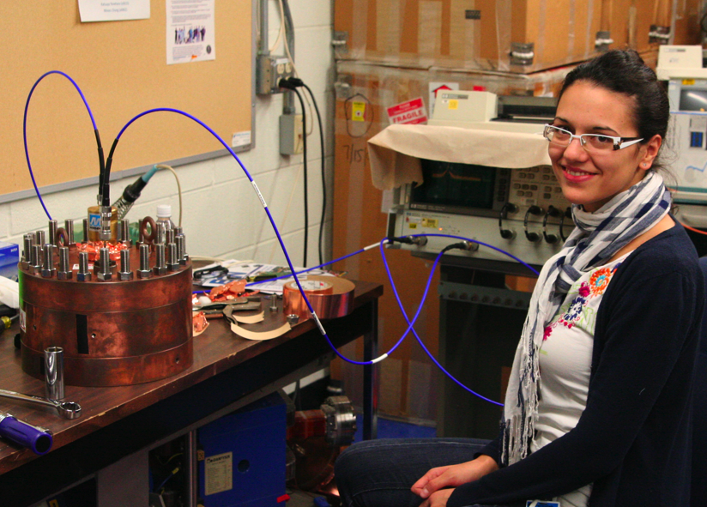
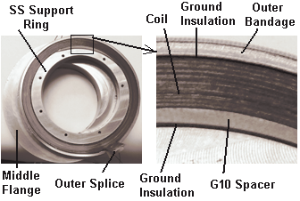
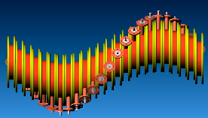
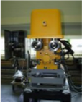
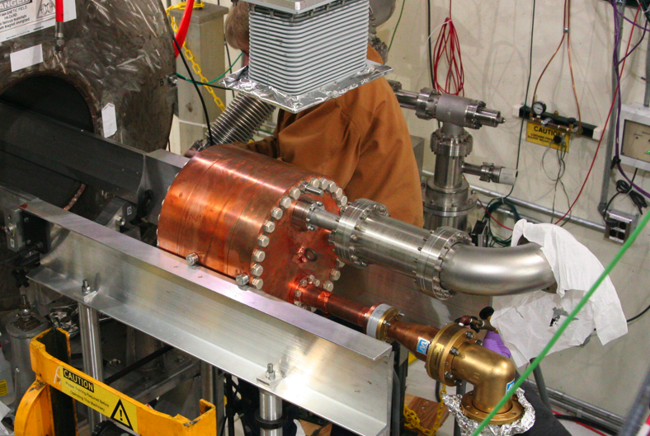
Technological challenging of HCC
Study dielectric loaded RF cavity
Helical solenoid technology
HPRF cavity
High cooling power
LN2 regulator
Real pillbox 805 MHz HP cavity
Helical solenoid coil
CAD drawing of helical cooling channel
K. Yonehara et al., Proceedings of IPAC’10, MOPD076

Slide 13
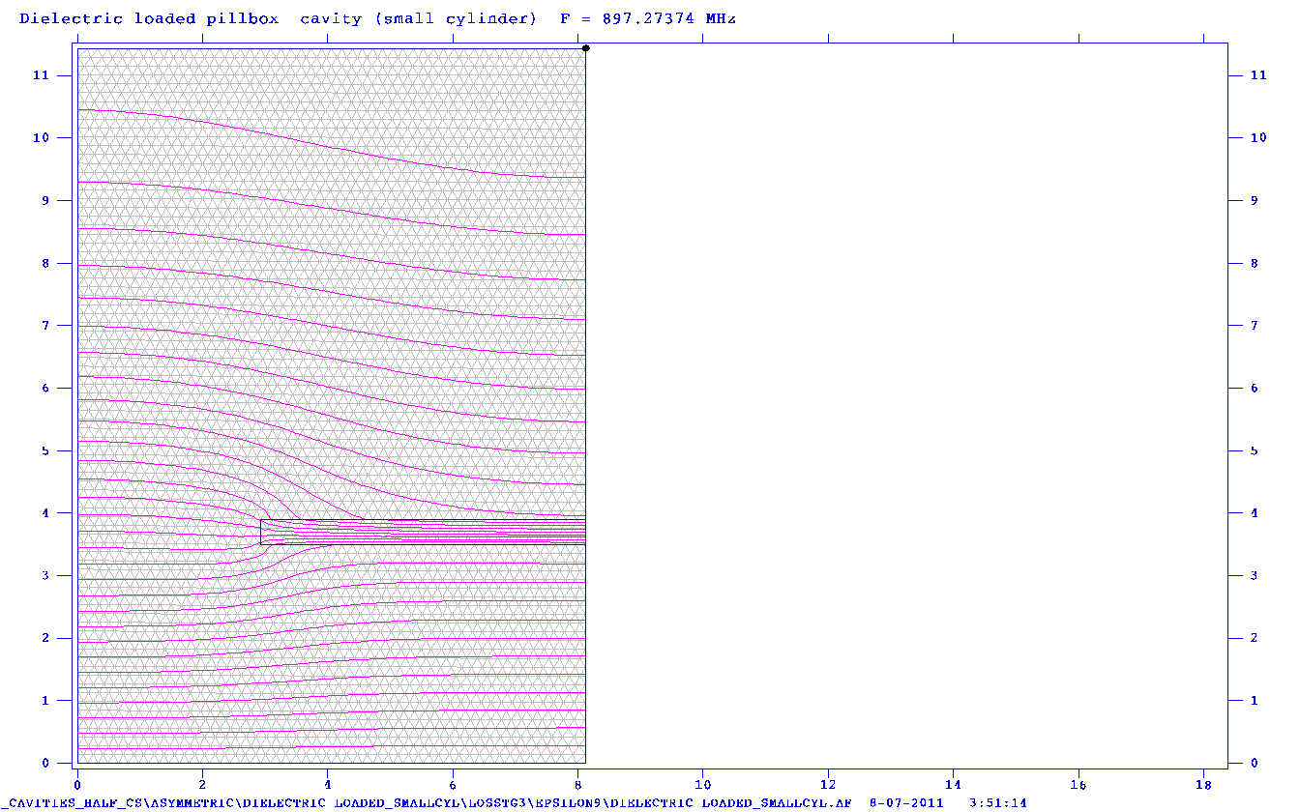
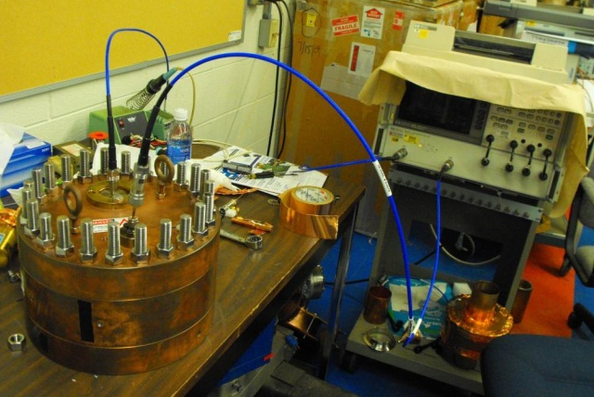
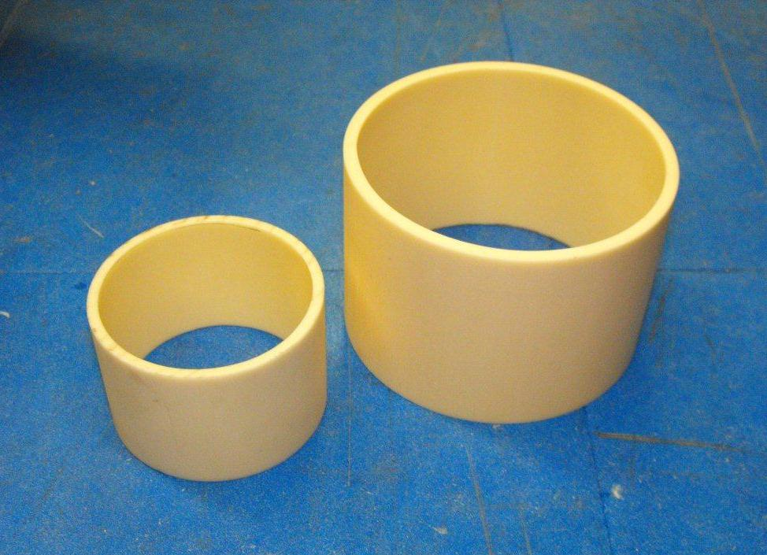
Dielectric loaded HPRF cavity test
Goal: Measure dielectric constant and loss tangent in room & cryogenic temperature
Study breakdown with dielectric material in HPRF cavity
Make a compact HPRF cavity to incorporate into a compact magnetic structure
Dielectric rings
SF simulation
Al₂O₃ 99.5%
Al₂O₃ ring
Rin=5.325cm
Rin=3.5cm
L
=
7.75
cm
E field direction
L
=
5.2
cm
Empty cavity:
f = 1003.87 MHz
Q = 22772.3
Experimental results:
SMALL CYLINDER
BIG CYLINDER
f = 897.96 (±0.97) MHz
Q = 11823.1 (±1037.1)
ε = 8.925 (±0.125)
tgδ = 7.28E-5 (±4.92E-5)
f = 814.30 (±0.81) MHz
Q = 9415.89 (±828.6)
ε = 9.595 (±0.134)
tgδ = 8.17E-5 (±5.52E-5)
J. Cenni, MAP Friday meeting, https://indico.fnal.gov/conferenceDisplay.py?confId=4661

Slide 14
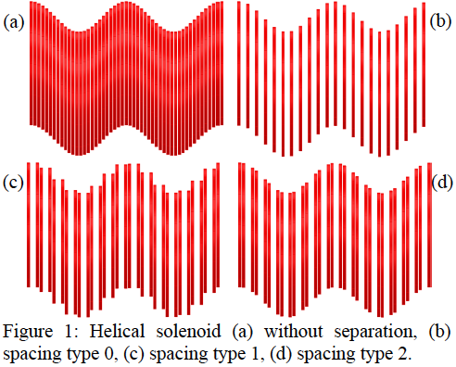
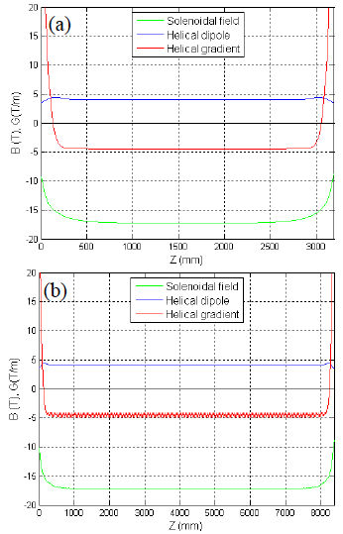
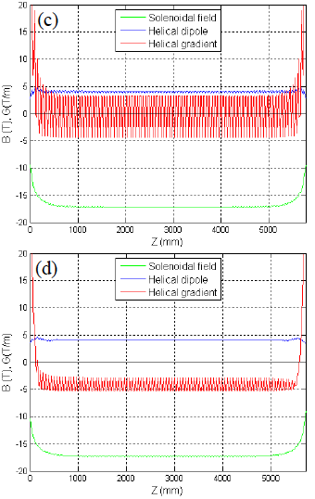
HS magnet in final cooling section
M. Lopes et al., Proceedings of PAC’11, TUP172
A large ripple is induced in configuration (c)
We need a cooling simulation with them for further investigations

Slide 15
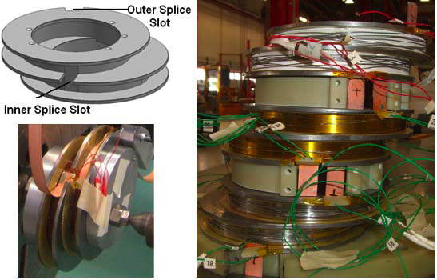
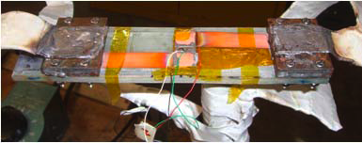
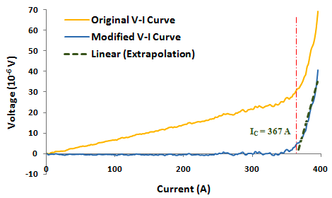
Development of HS magnet technology
Joint of HTS for double pancake coil
Wind helical solenoid coil
M. Yu et al., FNAL TD-11-001
Critical current at joint part

Slide 16
Force flow LN2 cooling system
LN2 inlet (66 K)
LN2 chiller
& circulator
Cryo RF
system
LN2 outlet (70 K)
m: LiN2 flow rate m³/s
c: Specific heat 2019 J/K/kg
ΔT: Temperature difference
(TLN₂ from 66.4 to 77 K)
ρ: Density 853 kg/m³
m ~ 3 Litters/s @ΔT = 4K
Cooling power = 4 kW
Cooling efficiency of chiller: ~10 %

Slide 17
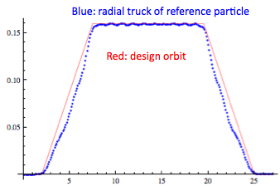
Study matching section
Baseline design of matching section (transport beam from coaxial straight to helical structure) has been made
Change HS coil center position adiabatically
Tune longitudinal beta oscillation by changing the length of section and the current density of HS coil
Almost 100 % transmission
Longitudinal phase space grows
This can be fixed by putting RF cavity in the section
Or tune phase slip factor
Include pressure window effect in future study

Slide 18
Working group
For homogeneous absorber filled HCC
Original inventors & analytic investigation
Yaroslav Derbenev, Rolland Johnson
Simulation tool developer
Tom Roberts, Rick Fernow
HCC simulation developer
Alex Bogacz, Kevin Beard, Katsuya Yonehara
Kevin Paul, Cary Yoshikawa, Valeri Balbekov, Dave Neuffer
Design/Test HCC beam elements
RF: Mike Neubauer, Gennady Romanov, Milorad Popovic, Alvin Tollestrup,
Al Moretti, Moses Chung, Ben Freemire, Mukti Jana, Leo Jenner,
Maria Leonova, Tom Schwarz
Magnet: Gene Flanagan, Steve Kahn, Vladimir Kashikhin, Mauricio Lopes,
Miao Yu, John Tompkins, Sasha Zlobin, Vadim Kashikhin

Slide 19
Summary
HCC theory was verified in numerical simulation
Present efforts for designing/making real HCC
HS magnet: Has been demonstrated
Promising technology
Need additional effort to design final cooling section
e.g. B_{solenoid} = 14.1 T, B_{dipole} = 4.3 T at final segment in latest
simulation
HPRF cavity: Has been demonstrated with intense beam
Looks promising technology
RF power can be an issue (cryogenic operation?)
Cryogenic & infrastructure: have not been discussed
Integration: Has been discussed
Need further efforts

Slide 20
Next task in HCC simulation effort
Take into account RF power dissipation in HPRF cavity
Demonstrate cooling simulation with last two HCC configurations
Space charge in dense hydrogen gas?
 | Z | ±Δr | ±Δp/p | b | b’ | bz | ν | κ | λ | ε_{t} | ε_{T} | ε_{L} | ε_{6D}
unit | m | cm | % | T | T/m | T | GHz |  | m |  | mm rad | mm | mm³
 | Channel length | Full Width | Full width | @ ref | @ ref | @ ref | RF |  |  | transmision
1 | 0 | 15 | 22 | 1.3 | -0.5 | -4.2 | 0.325 | 1.0 | 1.0 |  | 20.4 | 42.8 | 12900
2 | 40 | 8 | 10 | 1.3 | -0.5 | -4.2 | 0.325 | 1.0 | 1.0 | 0.92 | 5.97 | 19.7 | 415.9
3 | 49 | 7 | 10 | 1.4 | -0.6 | -4.8 | 0.325 | 1.0 | 0.9 | 0.86 | 4.01 | 15.0 | 10.8
4 | 129 | 3 | 2.5 | 1.7 | -0.8 | -5.2 | 0.325 | 1.0 | 0.8 | 0.73 | 1.02 | 4.8 | 2.0
5 | 219 | 1.7 | 1.8 | 2.6 | -2.0 | -8.5 | 0.65 | 1.0 | 0.5 | 0.66 | 0.58 | 2.1 | 3.2
6 | 243 | 1.6 | 1.3 | 3.2 | -3.1 | -9.8 | 0.65 | 1.0 | 0.4 | 0.64 | 0.42 | 1.3 | 0.14
7 | 273 | 1.3 | 1.3 | 4.3 | -5.6 | -14.1 | 0.65 | 1.0 | 0.3 | 0.62 | 0.32 | 1.0 | 0.08
8 | 303 | 1.2 | 1.1 | 4.3 | -5.6 | -14.1 | 1.3 | 1.0 | 0.3 | 0.60 | 0.34 | 1.1 | 0.07

