Slide 1
Beam energy and beam energy spread calibration
in muon storage rings
Apologies if this seems to be very old (but very good!) stuff.
R. Raja and A. Tollestrup,
Calibrating the energy of a 50x50 GeV collider using the muon spin precession
Phys. Rev. D 58 (1998) 13 005,
AB, in: beam energy calibration
in Prospective Study of Muon Storage Rings at CERN, CERN 98-02, p. 51-54.
AB , NIM A 451 (2000) 131}137 Muon polarisation in the neutrino factory
M. Apollonio, AB et al, OSCILLATION PHYSICS WITH A NEUTRINO FACTORY
arXiv:hep-ph/0210192 v1 13 Oct 2002
MUON POLARIMETER IN A NEUTRINO FACTORY DECAY RING
M. Apollonio, D. J. Kelliher, ASTeC, A. B, IPAC2010, Kyoto
(Used also in the IDS-NF report)
and…. Patrick Janot, 14 Nov 2012 at HF2012
Alain Blondel Higgs Factory Muon Collider mini Workshop. Fermilab 13-Nov-2012

Slide 2
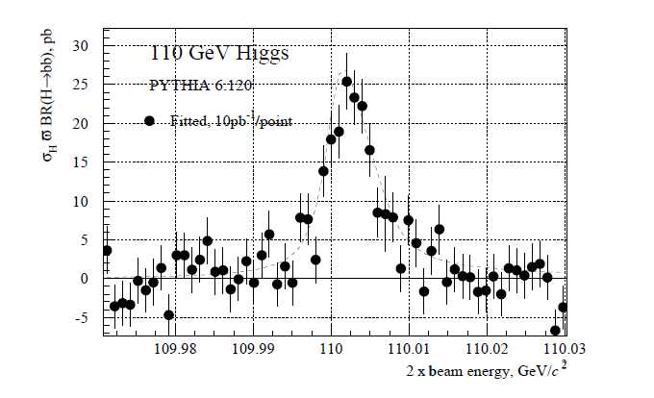
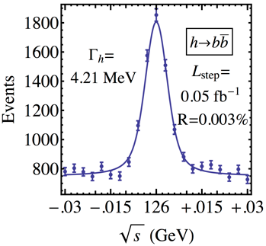
Imagine scanning the Higgs resonance with the s-channel μ⁺ μ⁻ →H(125) reaction
W. Murray CERN YR 1999-02
T.Han Z.Liu,
“Direct Measurement of the Higgs
Width at a Muon Collider”,
arXiv:1210.7803 (2012)

Slide 4
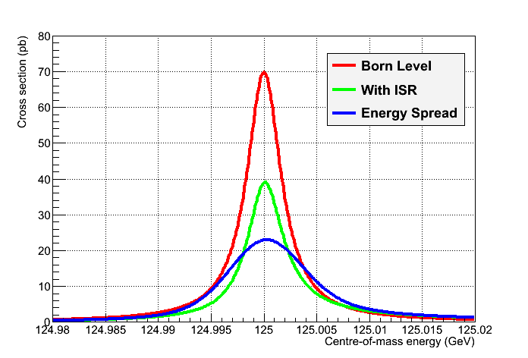
What is seen is a convolution of
Higgs line shape,
+initial state radiation,
+beam energy variation
+beam energy spread
Janot
1. E_{cm} reproducibility has to be better than +-5 MeV
1’. E_{cm} measurement has to be better than 1 MeV per shot
2. Energy spread (and effect of initial state radiation)
has to be unfolded from the observed line shape

Slide 5
Solution is well known:
measure energy and energy spread by spin precession of muons in the storage ring.
1. Muons are born polarized in pion decay. The captured ensemble of muons
will have some remaining polarization (typically 10-20%)
2. Muons do not depolarize in the cooling or acceleration processes because
-- stochastic effects are small
-- spin tune is large.

Slide 6
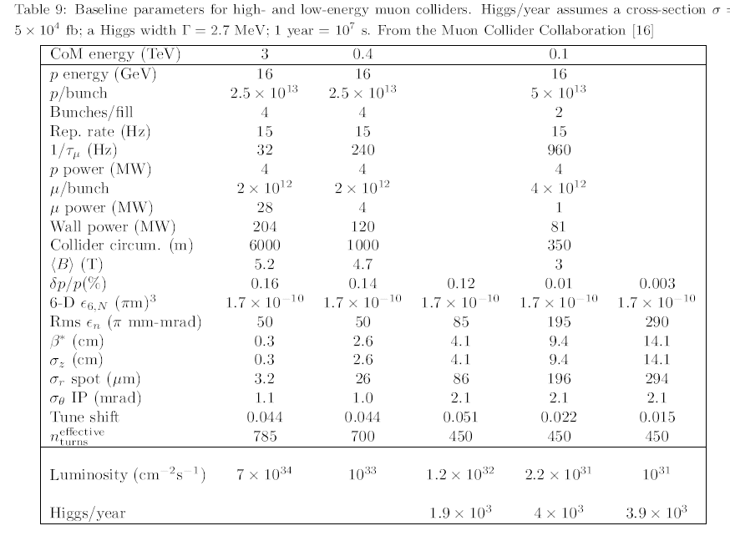
The numbers then (1999)

Slide 7
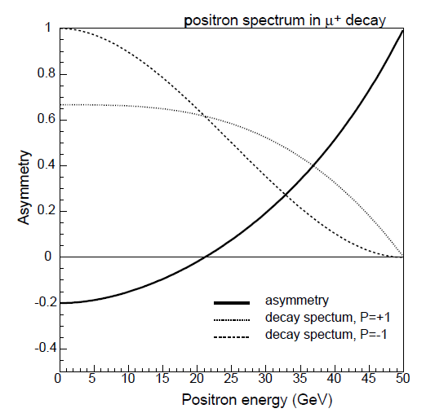
Energy spectrum of electrons from
muon decay depends on the muon polarization →
Technique: record the number of electrons with energies
between e.g. [10,20% ] and [60,80%] of the muon beam:
There are MANY electrons on each turn of the muon beam
emitted on a sample segment dL of the ring of circumference L
N_e ≅ N_muons x dL/L x 1/Nturns e^{-n/Nturns} = 10¹³ x 5/350 x 1/450 (= 3 10⁸ ) e^{-n/450} at turn n
or a total of 1.4 10¹¹ per fill.
Of which 10% are in each of the two bins considerered – → 10¹⁰ electrons/fill to work with !
(I had taken a factor >10 safety factor in the error estimates that follow)

Slide 8
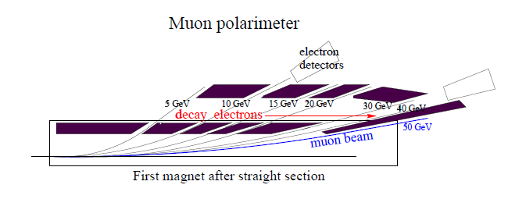
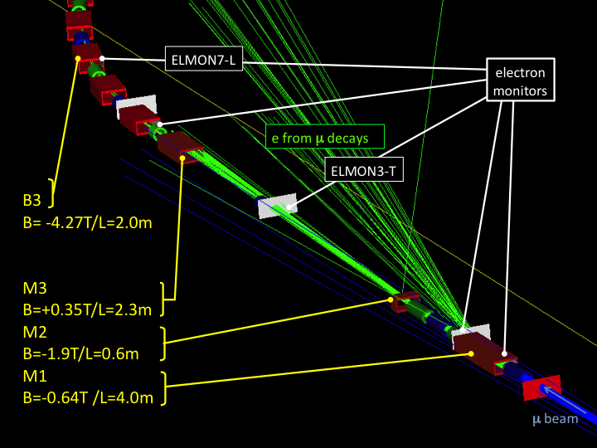
Example of a polarimeter (magnet is open on one side– or ‘electron gaps’ are foreseen) (AB)
calculations of acceptance/statistics « by hand » and a fortran code simulating errors +minuit fit
Electrons originate from a
straight section before the
the bending magnet where
the polarimeter is located.
The acceptance calculation is
more reliable if the
straight section is short
Detectors= gas CKOV+ calorimeter
Another possibility on the same principle
[Marco Apollonio]
This one was actually fully simulated,
for the neutrino factory
with the consequence that only
‘small’ statistics were accumulated.
NB: This one took the design of the
storagering ‘as is’.
I think the measurement is
so important that it deserves inclusion
in Storage Ring desing from the start as in above.

Slide 9
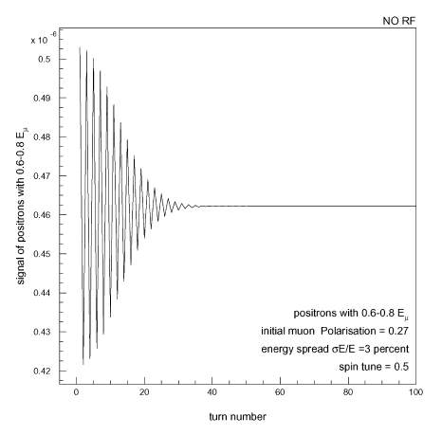
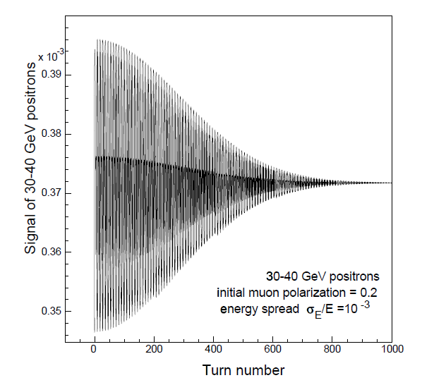
we dont have to make this Gaussian assumption, just do the Fourrier analysis.
frequency → energy
decrease→ energy spread
E_beam =50 GeV
NB: in a muon collider operating at 15Hz, there is always enough turns!

Slide 10
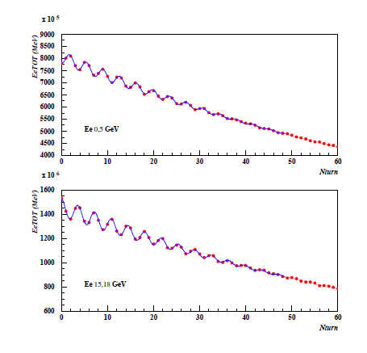
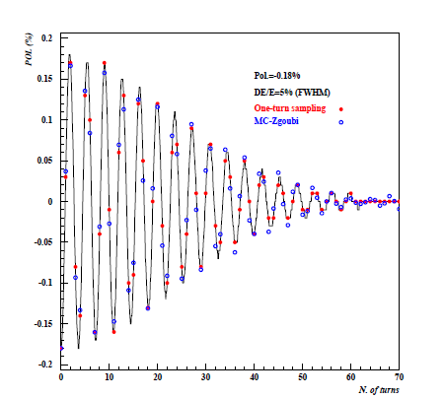
M. Apollonio, real simulation (NB simulated one of100 bunches of muons for 1 fill out of 50/s).
Statistical errors are higher by corresponding factors)
In real life there are 10¹³ muons decaying per second and the only challenge in the
estimate of errors is to understand the number of decay electrons that make it
to the polarimeter. (typically 10⁹-10¹¹ per second, statistics is never a problem). Because
the absolute value of the polarization is not relevant, and only frequencies are involved
the systematic errors are very small (~5-100 keV) on both the beam energy
and energy spread.

Slide 11
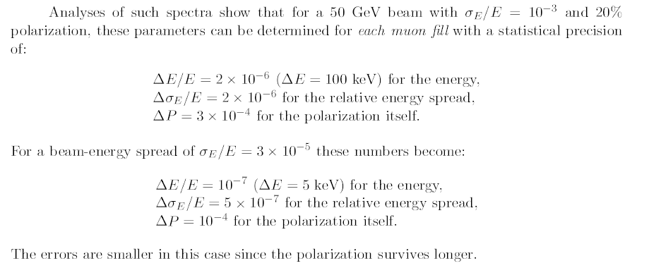
1%!
this technique is really easy and very powerful – a paradise!
The level of polarization has a relative systematic error of the order of 10% due to the exact
simulation of the acceptance.
ΔΕ/E and Δσ_{E}/E are based on frequency measurement and are free from these systematics.

Slide 12
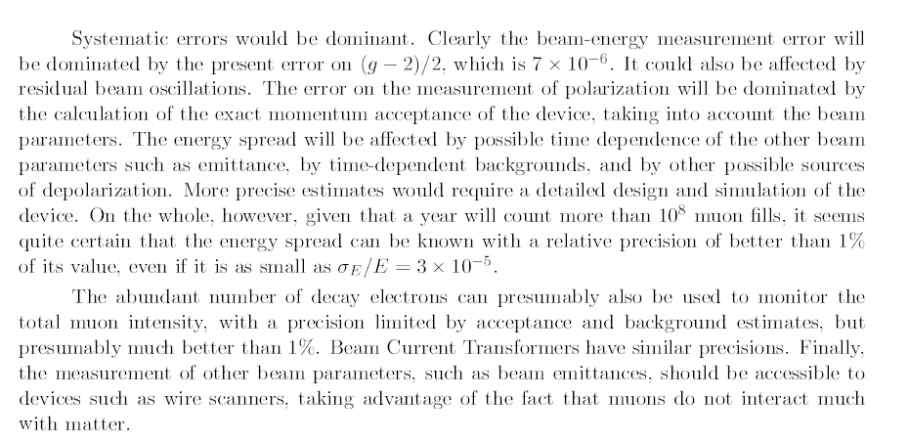
Systematics
g-2/2 (muon) = 11659208.9± 5.4±3.3 (±7.10⁻⁸) has improved…
m_muon = 105.6583715±0.0000035 (±3.10⁻⁸)
Can think of beam beam depolarization – should be small.
Can check by comparing result for interacting vs non-interacting beams.

Slide 13
Conclusions and a question.
It should be relatively easy to measure the energy and energy spread of each fill
with the advertised precision.
The Higgs boson width and other parameters can safely be extracted
from the measurement of cross-section as function of energy
the {energy and energy spread} related errors will be good enough.
The main issues are
1. (of course) feasibility of small energy spread
2. (of course) luminosity
3. Reproducibility within 1 Higgs width (5 MeV) of the energy of the 62.75 GeV/c beams
that are injected in the storage ring.
If the beam is off by δE ~ 5MeV~710⁻⁵ E_{beam} there will be ~no Higgs produced.
Is the RF Voltage in the muon accelerator stable enough?

