Slide 1
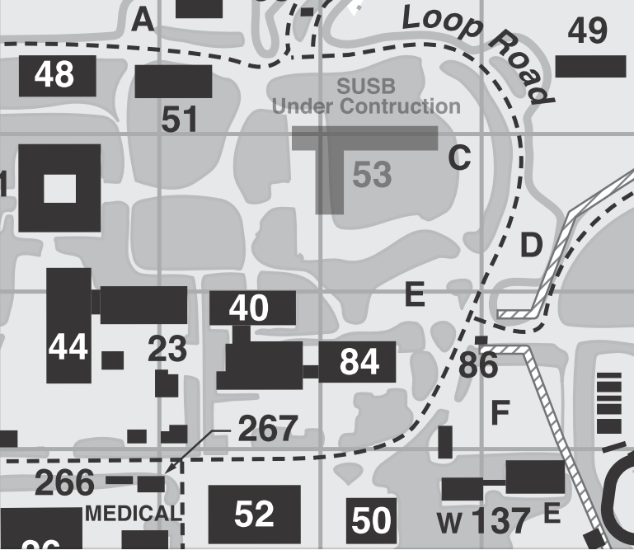
EC & IB Lunches & Reception
Wednesday: 3rd floor, this building (Kavli, #51)
Thursday: 3rd floor, this building
Friday: ROB (Bldg.48), A/B Conference Room
Saturday: 2nd floor, this building
Sunday (Institutional Board): 2nd floor, this building
Pre-Ordered Lunches: Pick up in lobby
Reception: Bldg. 52 Lobby
Starbucks

Slide 2
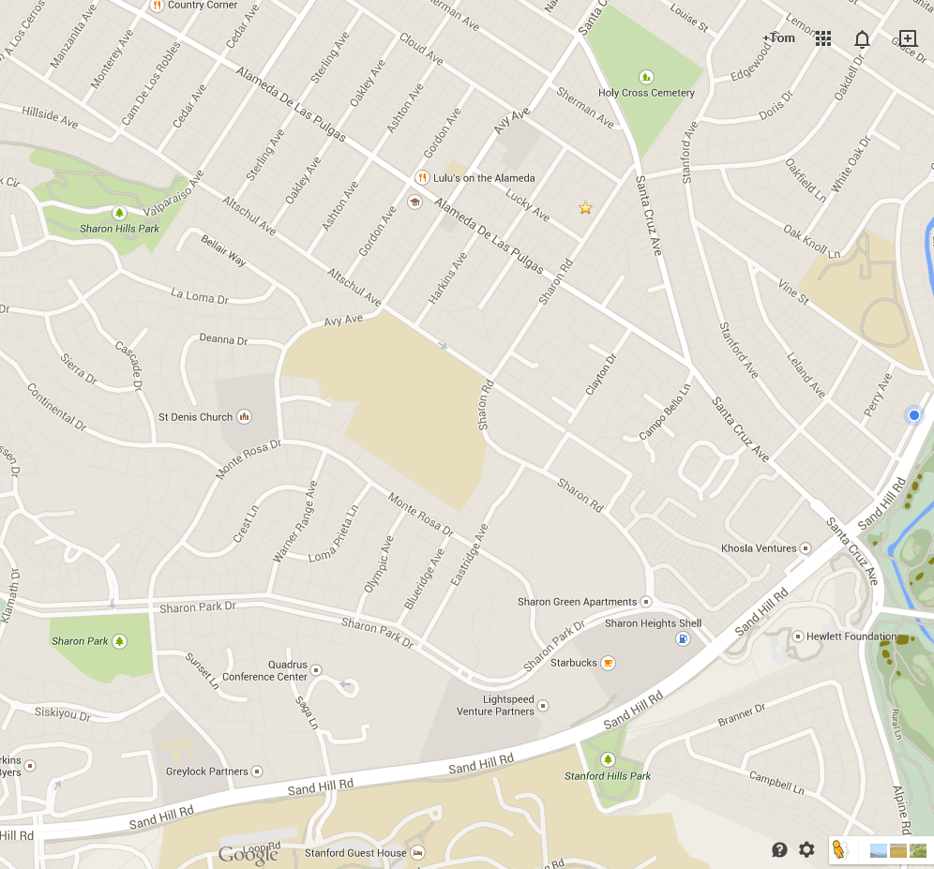
Nearby Lunch Options
Country Corner
(Deli Sandwiches)
Dutch Goose (beer, burgers)
Luttiken’s (Deli Sandwiches)
Lulu’s (Mexican)
Avanti (Pizza)
Starbucks
Quadrus (sit down)
Eric’s Gourmet
(Deli Sandwiches)
Safeway(PreparedSandwiches)
Starbucks
Starbucks

Slide 3
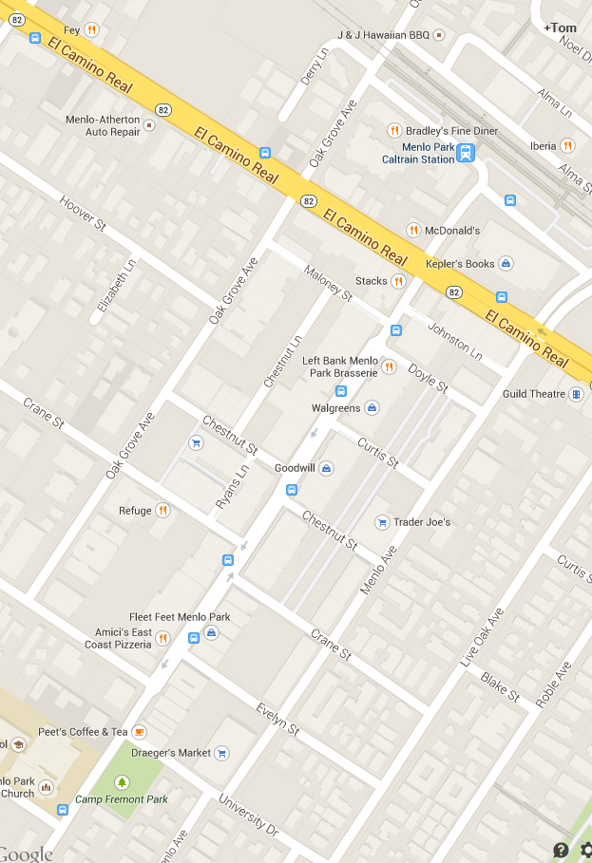
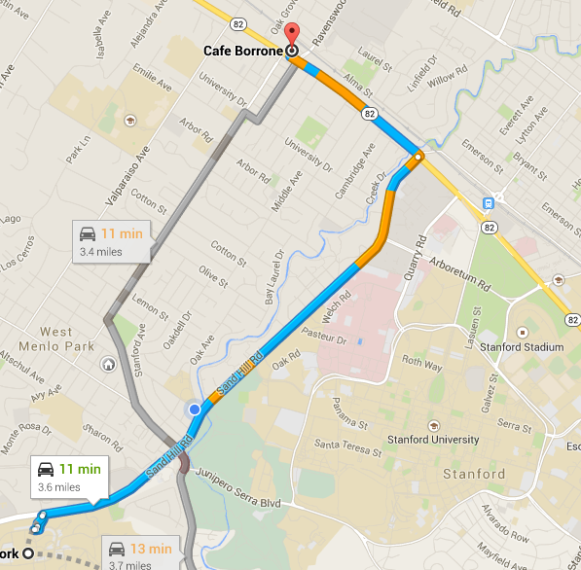
Dinner Options: Menlo Park & SSC
Menlo Park
Santa Cruz from University Avenue to El Camino & along El Camino
Saturday Banquet: Fey Restaurant, 1368 El Camino
Stanford Shopping Center

Slide 4
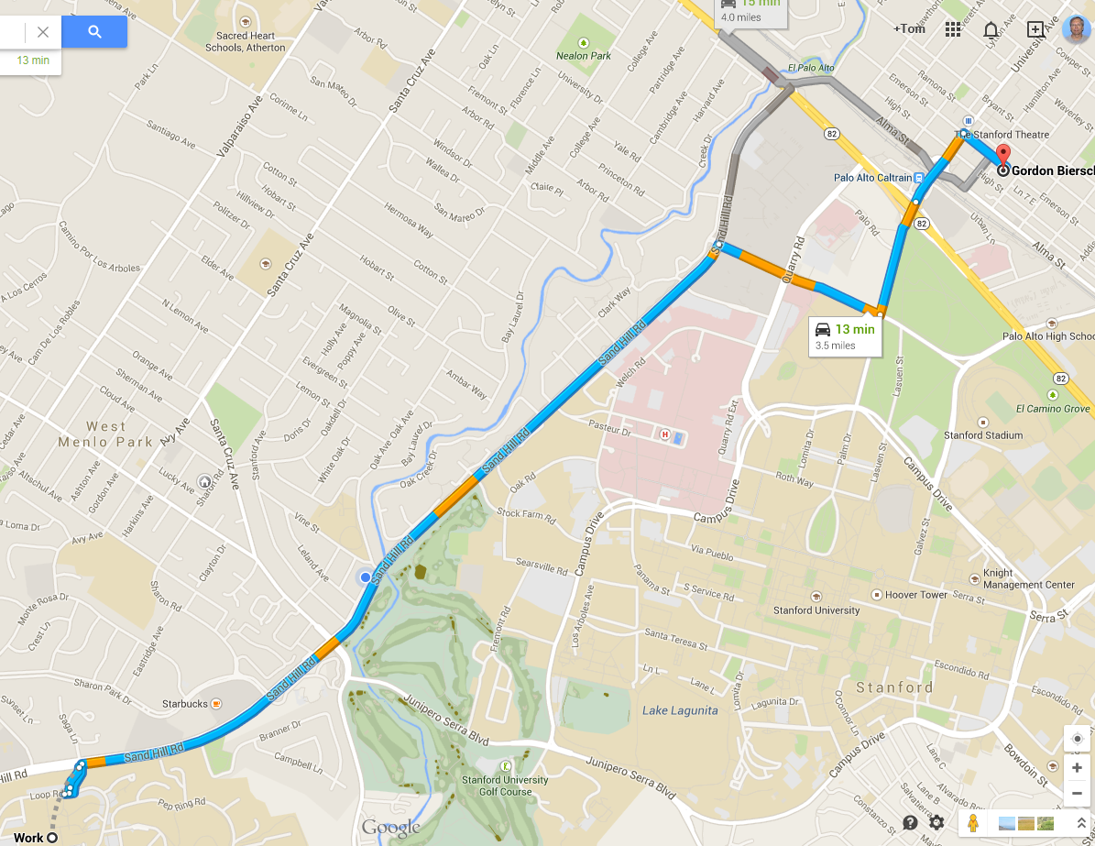
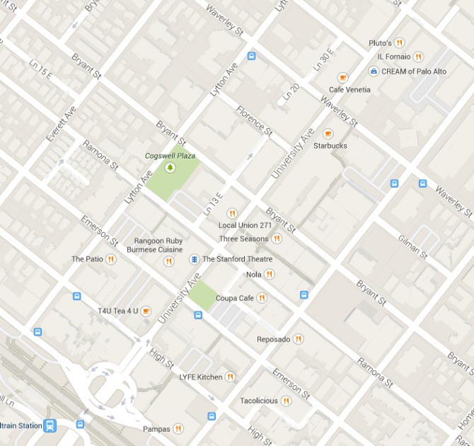
Dinner Options: Palo Alto
University Avenue & Cross streets between Hamilton & Lytton

