Slide 1
Mobility in the Enterprise SLAC Spring, 2014

Slide 2
BYOD Mobile Environment
Citrix XenMobile MDM
Self-serve enrollment for IOS, Android (limited)
Exchange ActiveSync access for mobile devices
Enterprise app store with PNNL developed apps and user picked
File Sync MobilEcho/ActivEcho (SharePoint and File Shares)
Provide WiFi profile to mobile network
Provide VPN profile

Slide 3
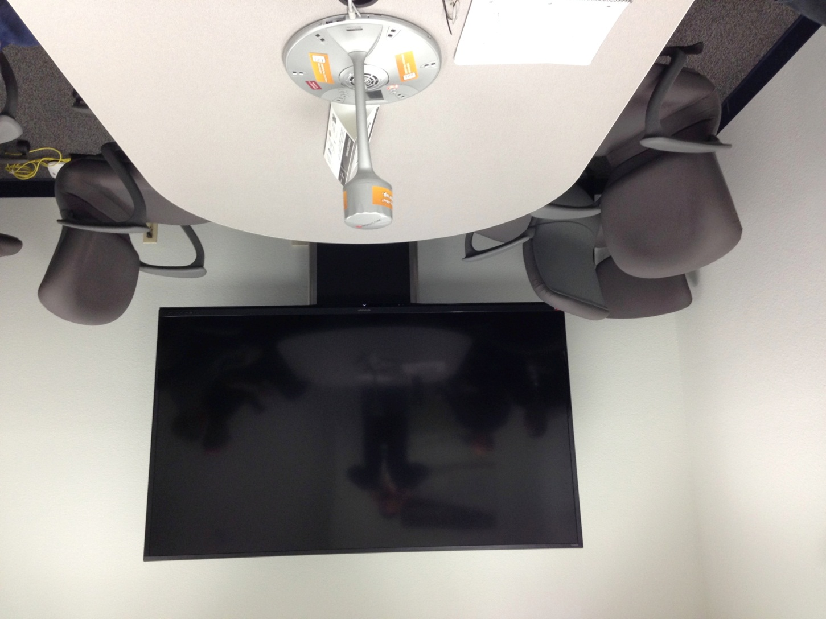
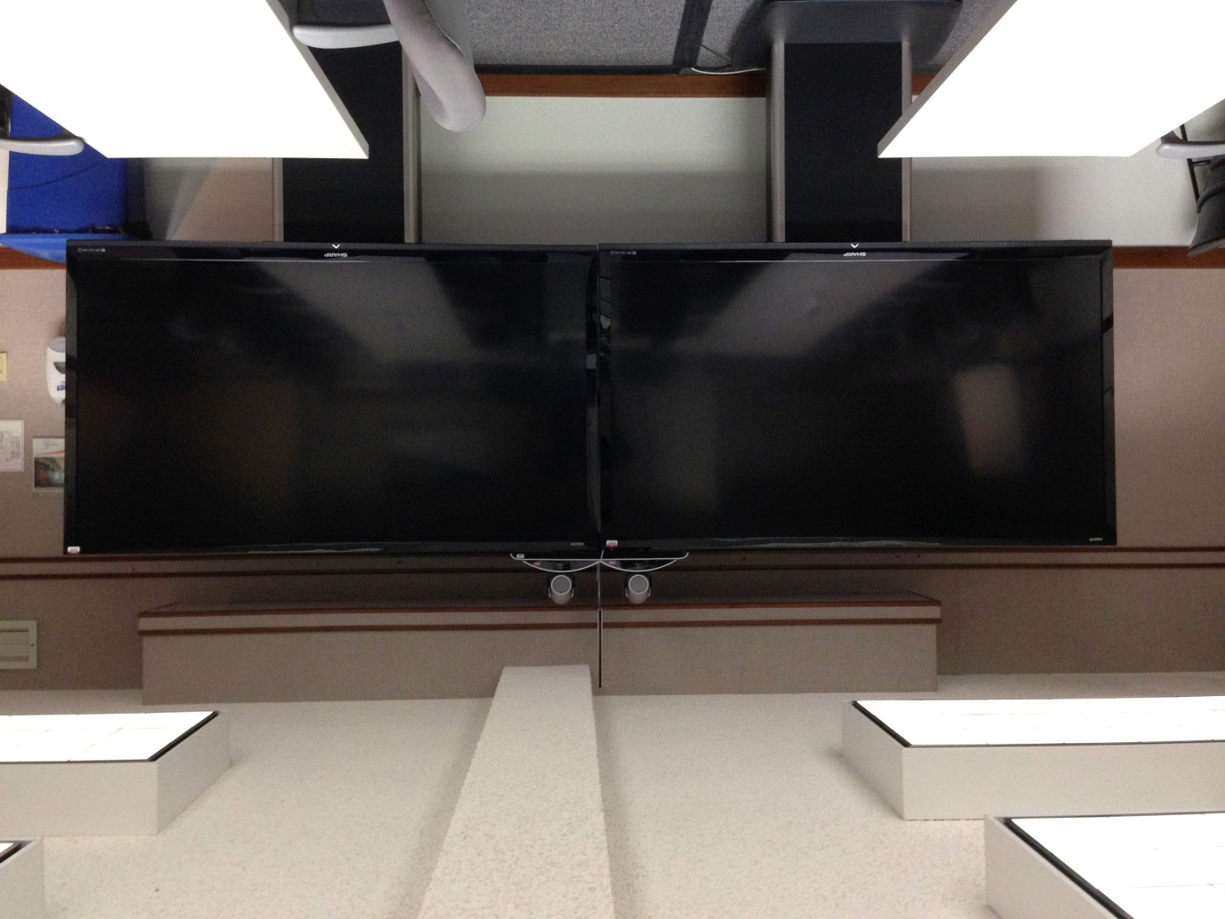
UC Environment
Lync 2013
Exchange 2010
Polycom RMX MCU
Polycom RPAD Video Gateway
Polycom CX5000 Round Table
Polycom HDX 8000 stations

Slide 4
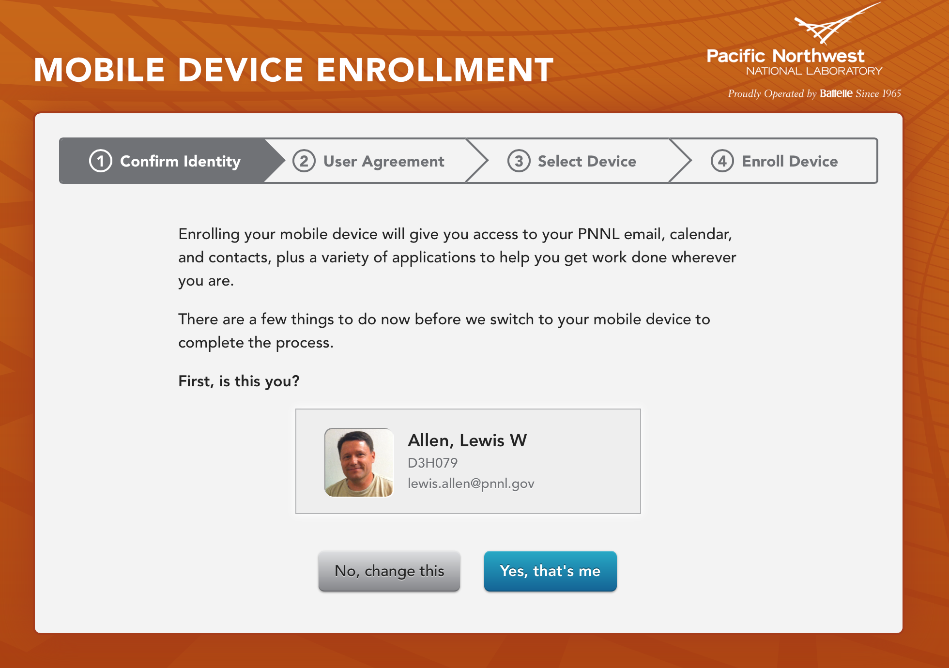
BYOD mobile enrollment

Slide 5
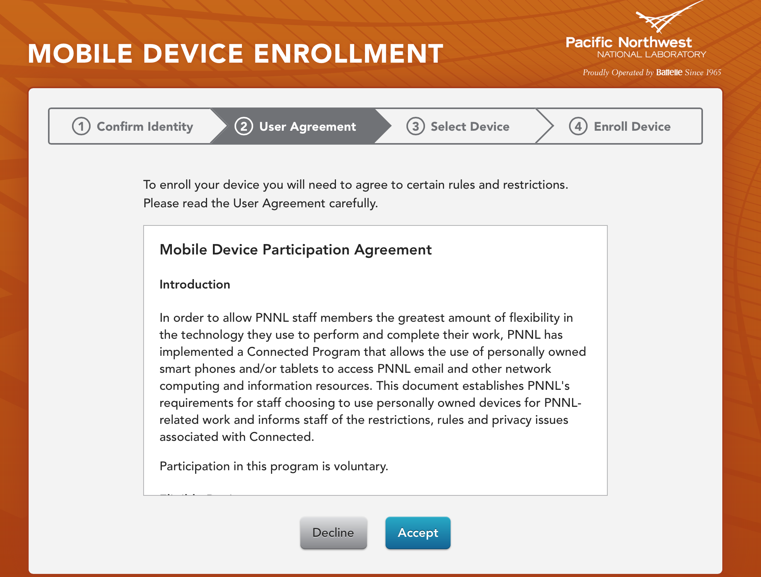
BYOD mobile enrollment

Slide 6
BYOD mobile enrollment

Slide 7
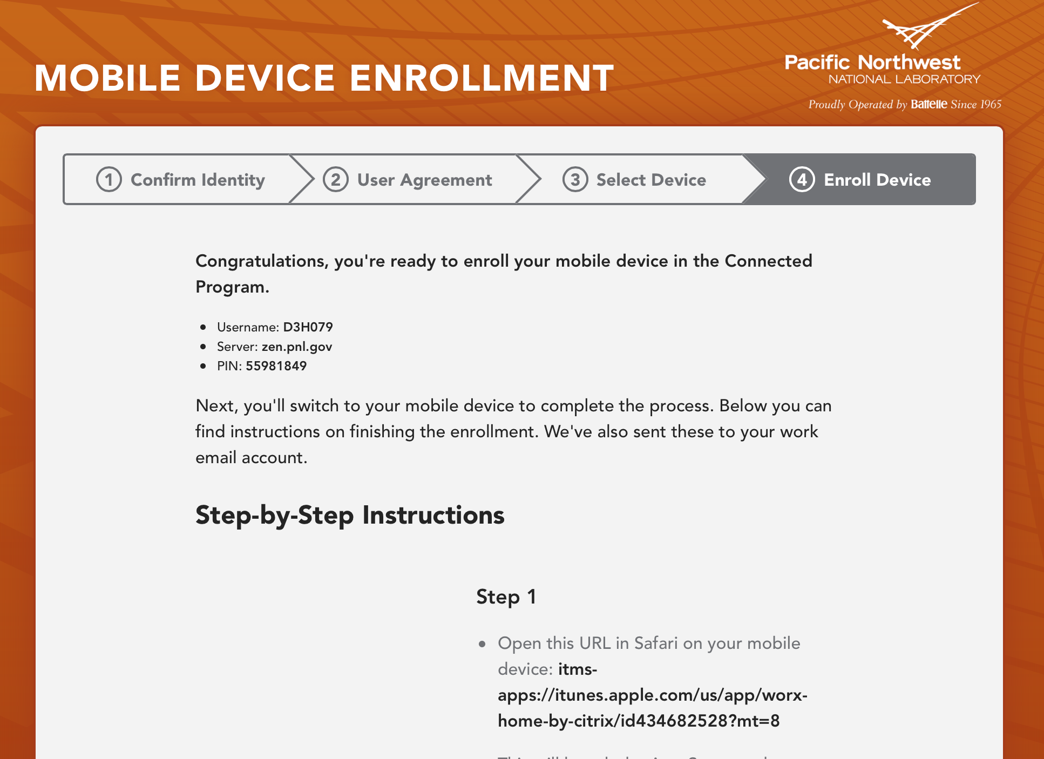
BYOD mobile enrollment

Slide 8
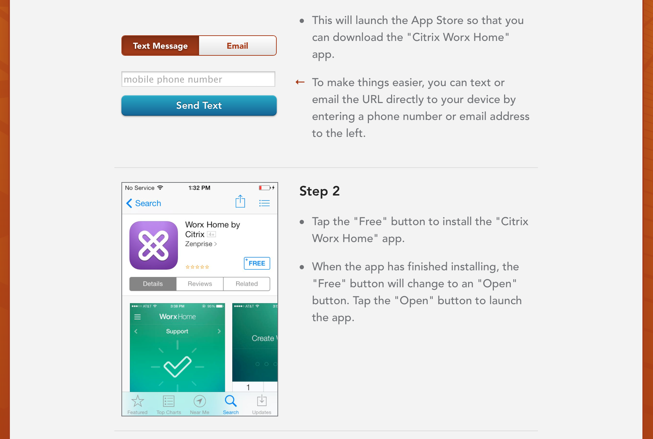
BYOD mobile enrollment

Slide 9
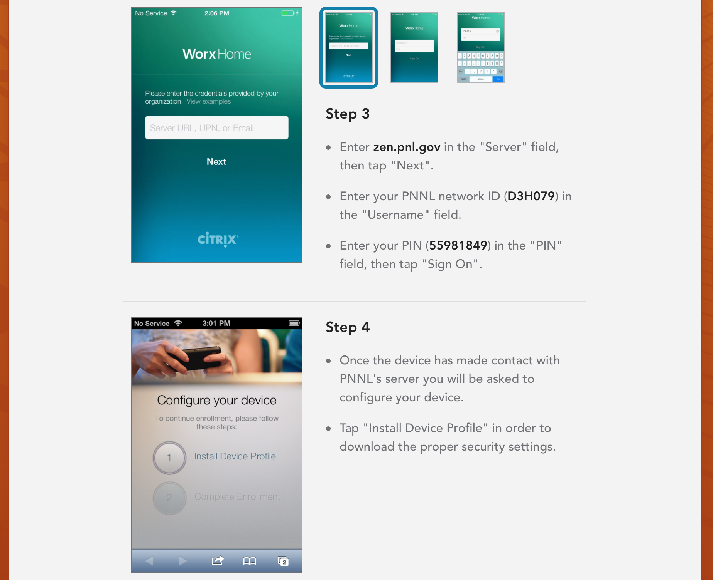
BYOD mobile enrollment

Slide 10
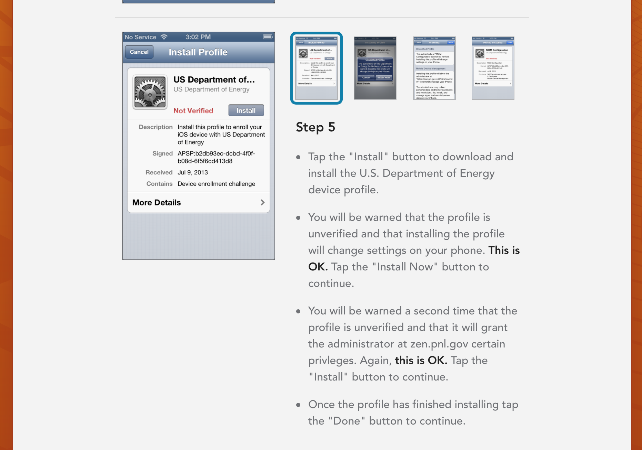
BYOD mobile enrollment

Slide 11
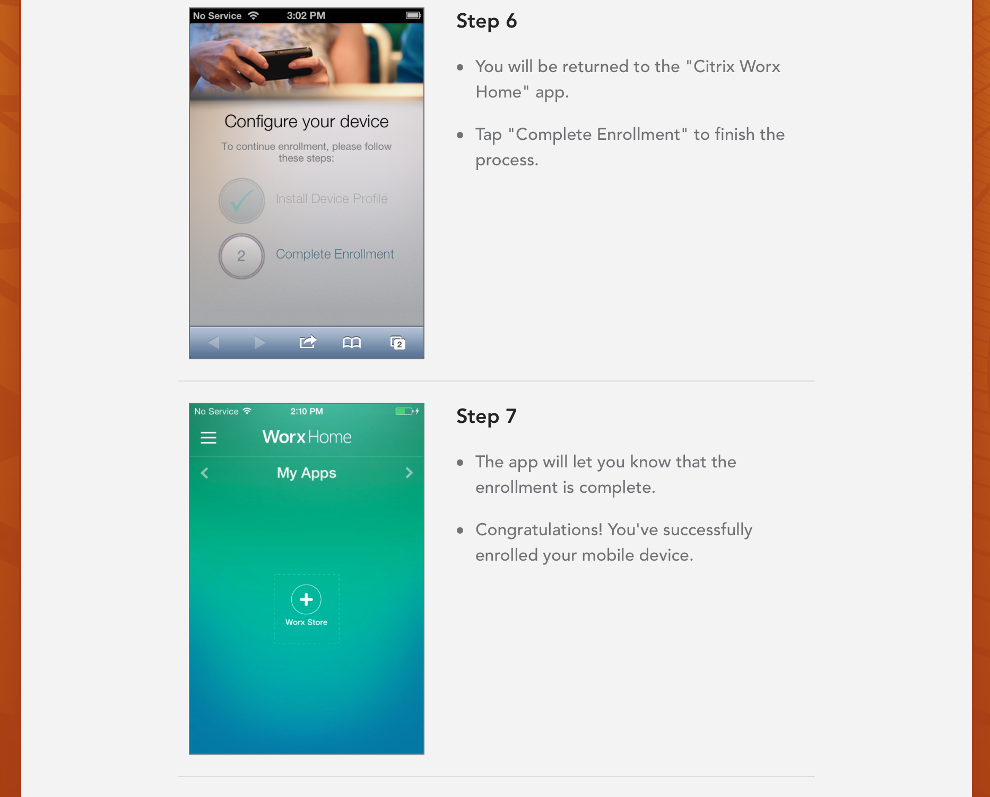
BYOD mobile enrollment

Slide 12
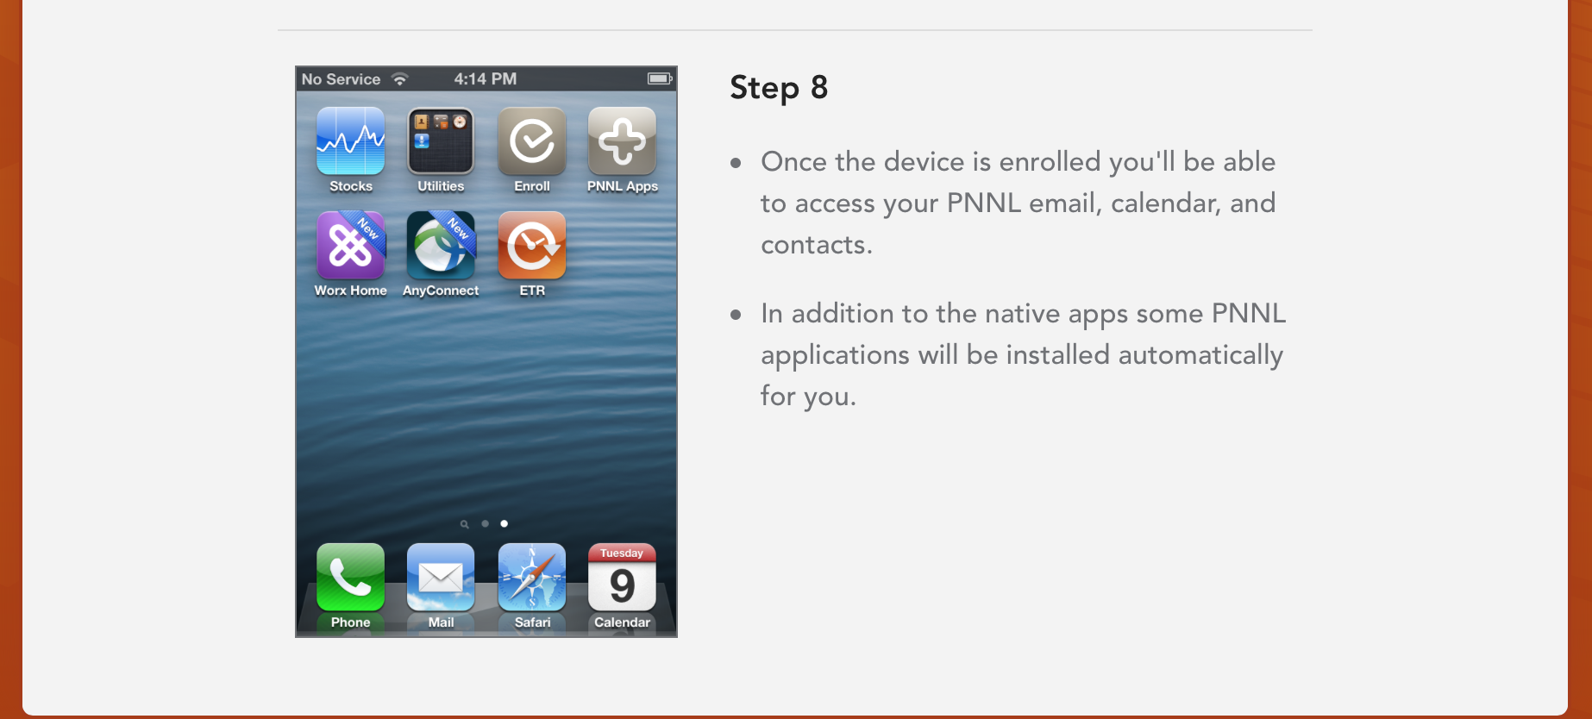
BYOD mobile enrollment

Slide 13
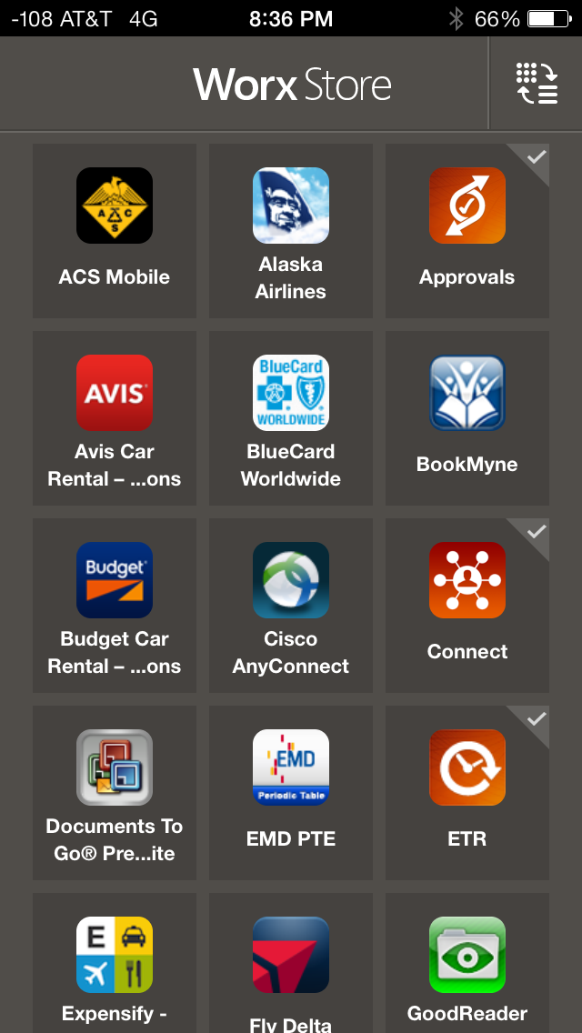
PNNL App Store
PNNL App Store
Approvals
Connected
ETR (Electronic Time Reporting)
MyOps (location aware)
Other / Self Nominated Apps
Travel apps
Cisco AnyConnect
Lync 2013

Slide 14
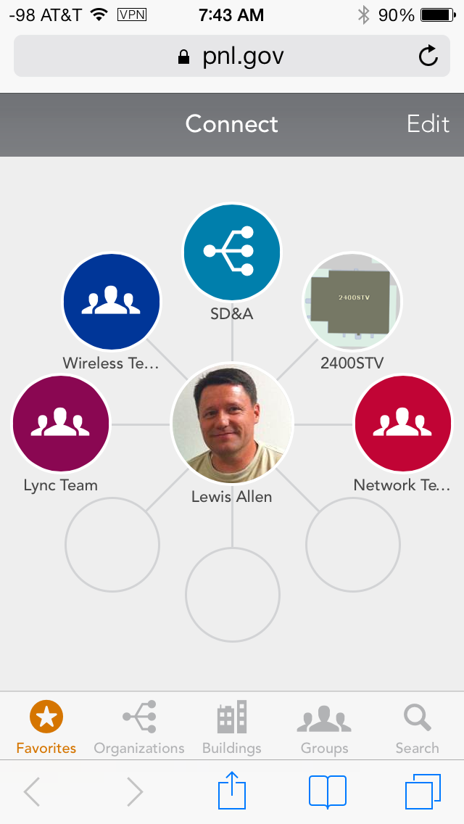
Connected App
Connected App
Self Defined Groups
Org Chart
Building maps
Conference rooms locations
Contacts with Lync presence

Slide 15
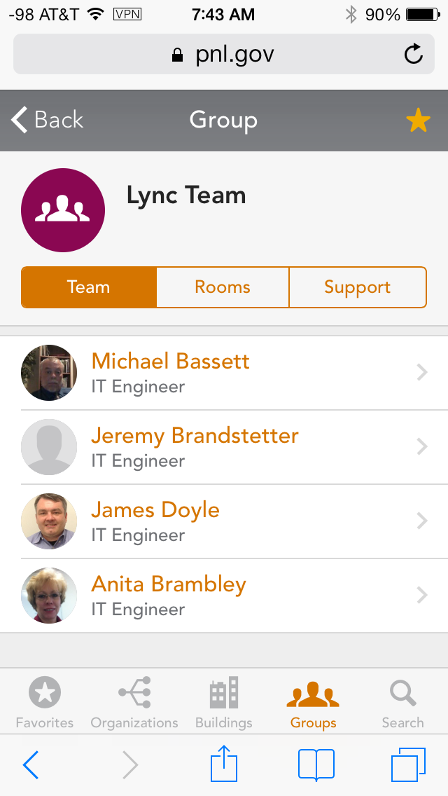
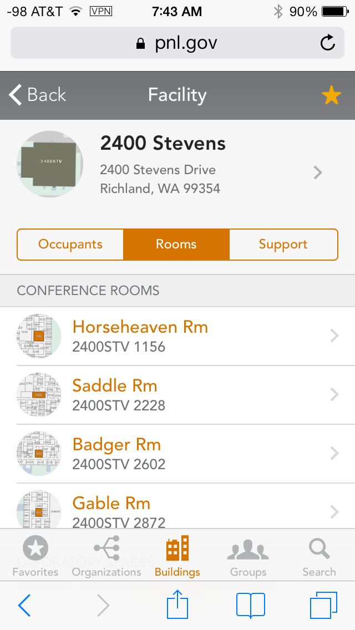
Connected App

Slide 16
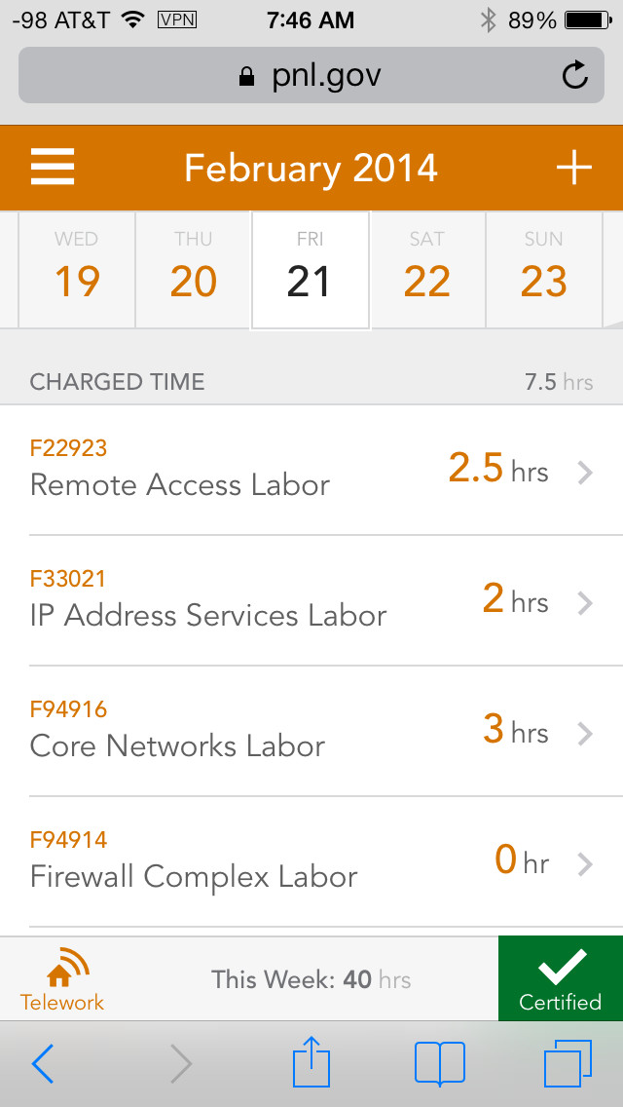
Electronic Time Reporting App
Electronic Time App
Enter time accrual
Certify at the end of week
Chargeable hour reports

Slide 17
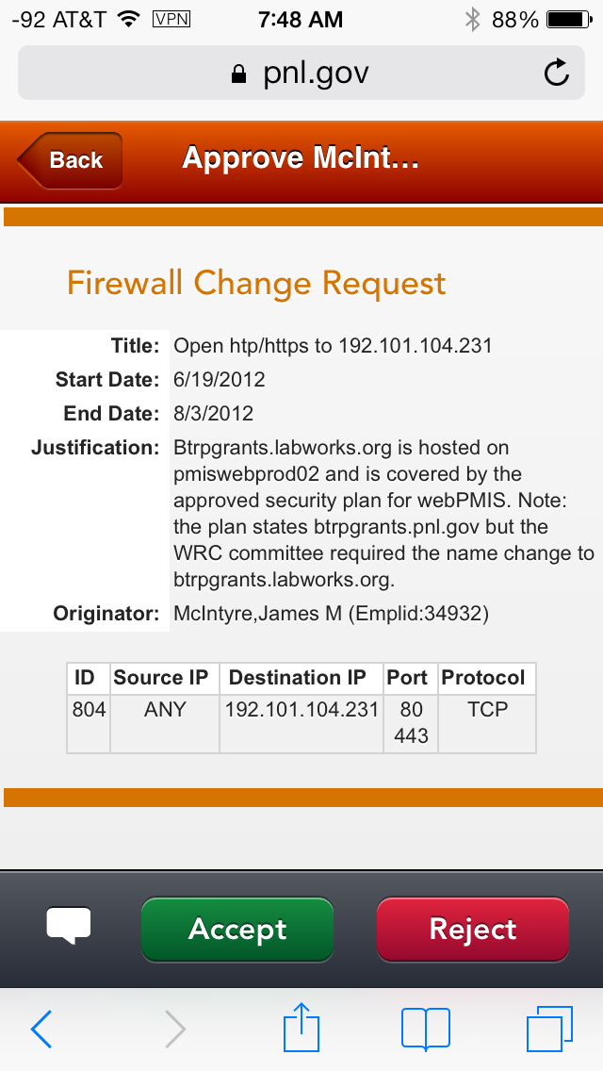
Approvals App
Approvals App
Status of approvals
Allow to approve/reject

Slide 18
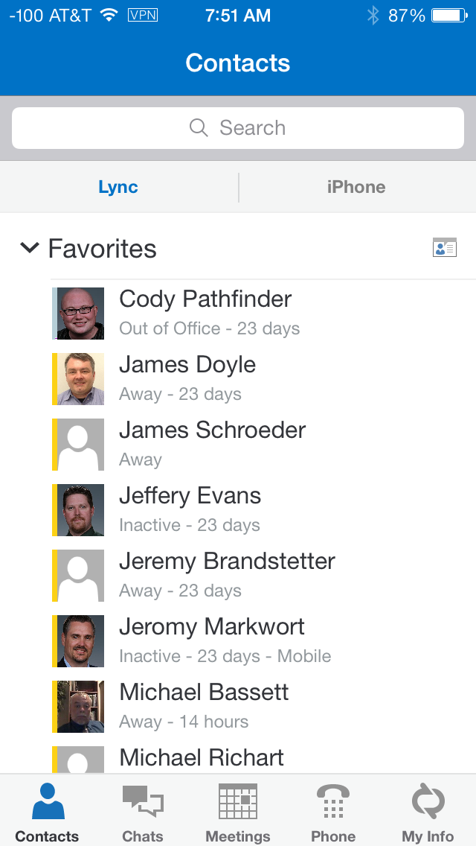
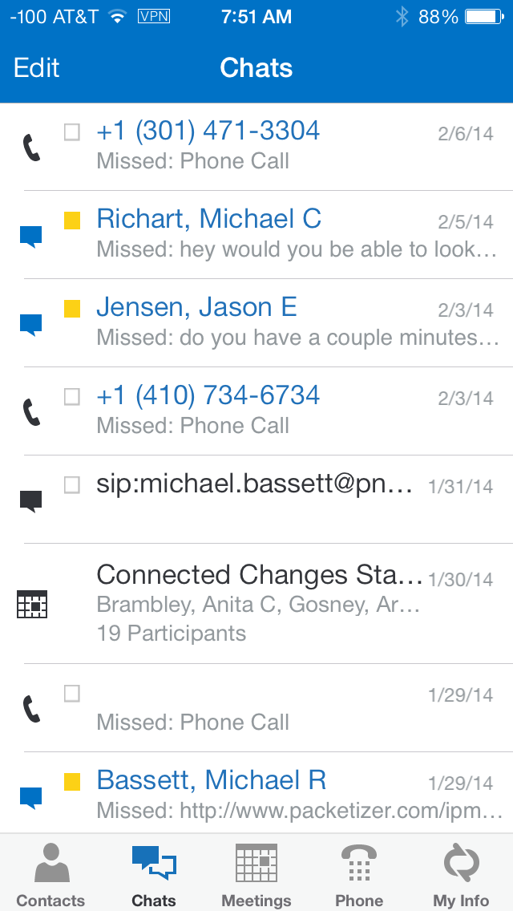
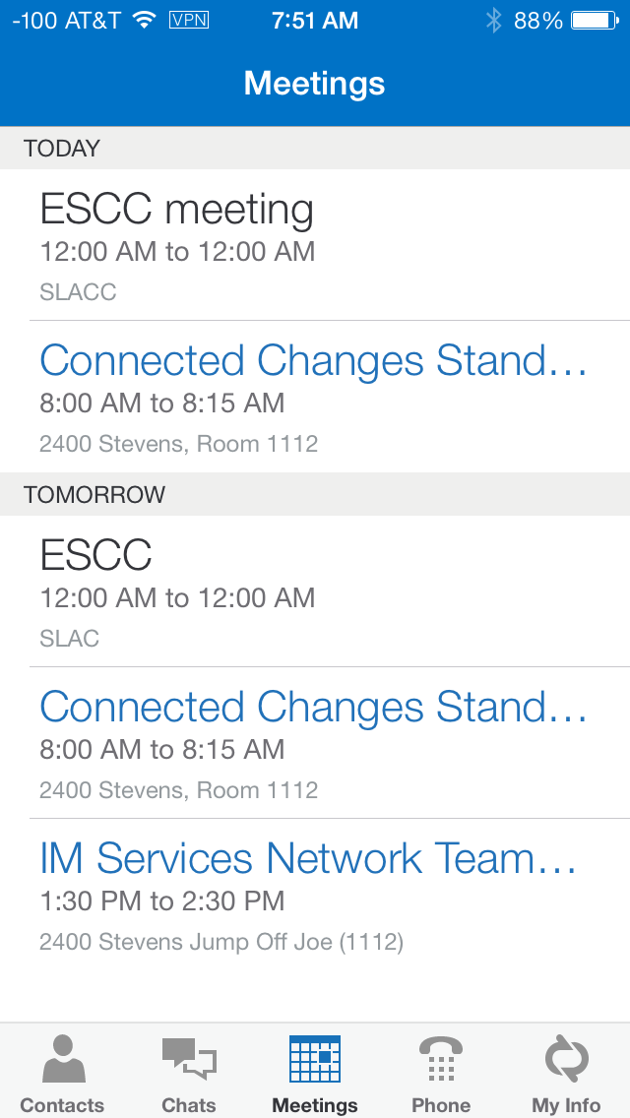
Lync Mobile App

Slide 19
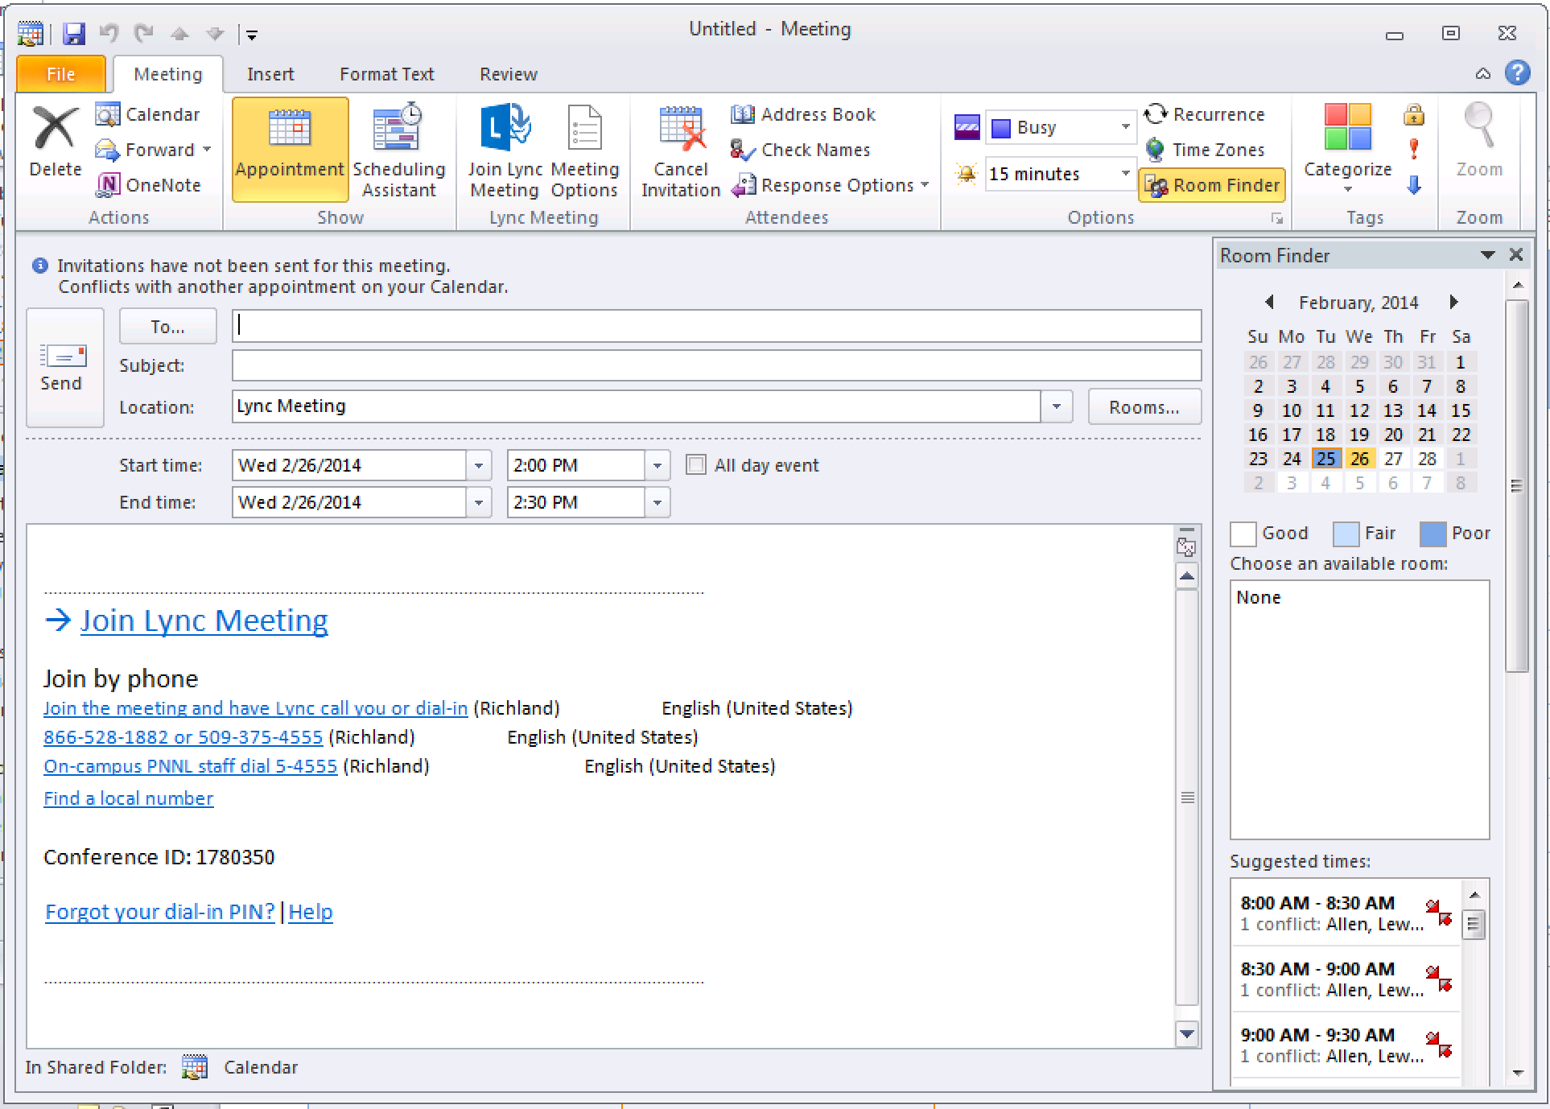
Scheduling Online Meeting
Online Meeting
Scheduled through outlook
Conference info for joining meeting.
Web Client
Installs Plug-in
Audio/Video
Content Sharing

Slide 20
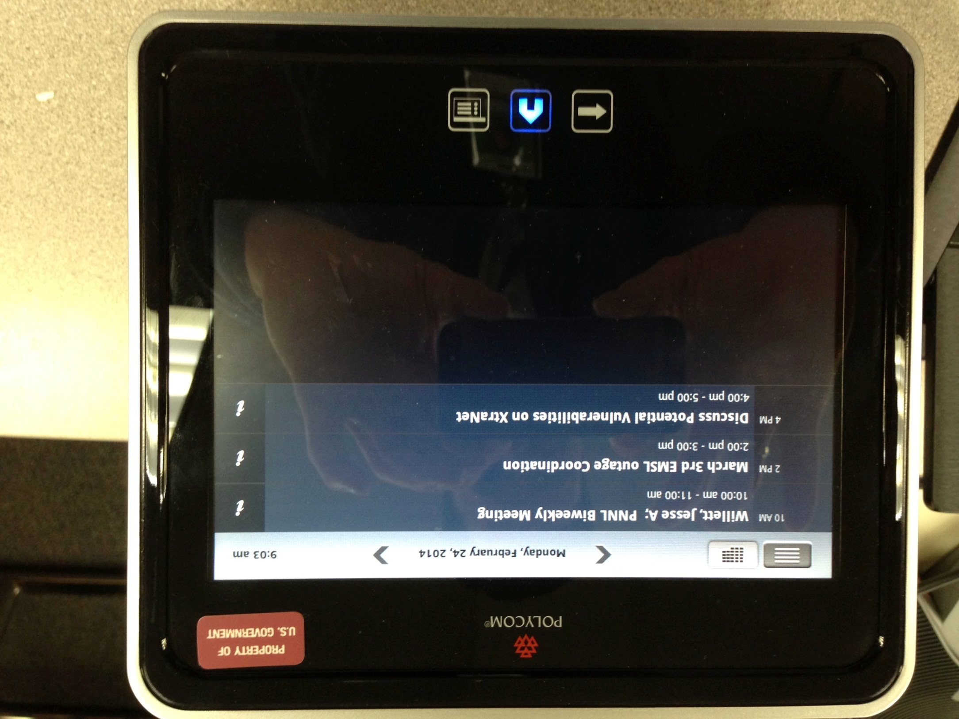
Joining Online Meeting
Polycom Touch
Calendar lists meeting for day
Tap on link to join meeting
Round Table Room
Plug into laptop
Just a USB camera, mic
Join meeting

Slide 21
Progress Towards Initiatives
BYOD mobile enrollment
~1683 devices enrolled
~1283 staff
Lync 2013 upgrade
Completed February
Lync Enterprise Voice
~100 users
Exchange 2010 upgrade
Completed January
Collaboration rooms 35 complete

Slide 22
Lessons Learned
Deployment was done Bldg at a time within several months
Migrating Lync 2010 to Lync 2013
3 voice systems - Audio Codes GW’s (Aastra, Cisco, and Lync)
Migrating to new AD forest PNL -> PNNL
Migrating email systems Exchange 2007 to Exchange 2010
Privacy concerns - (what can you see on my personal device).

